Slide 1
synergies and scientific cases

Slide 2
synergies and scientific cases
¹⁴N(α,γ)¹⁸F
¹⁵N(α,γ)¹⁹F

Slide 3
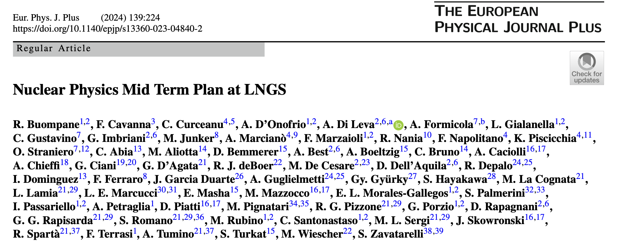
Mid Term Plan Paper for LNGS
TOPICS:
Fundamental Symmetries
Direct measurements for nuclear astrophysics
Applied nuclear physics
Workshop performed at LNGS the 11th of October 2022

Slide 4
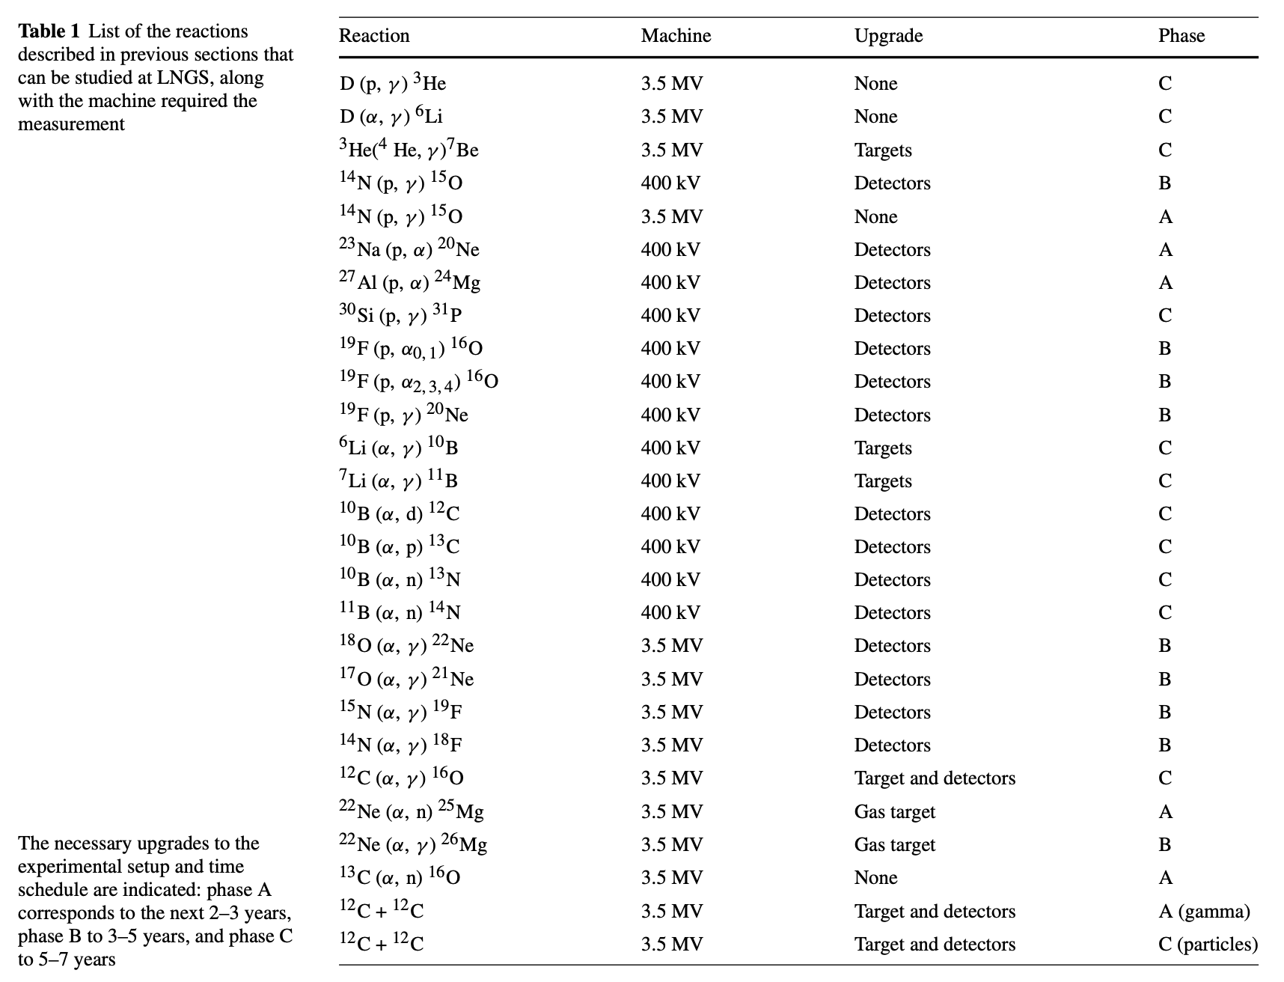
Direct measurements for nuclear astrophysics

Slide 5
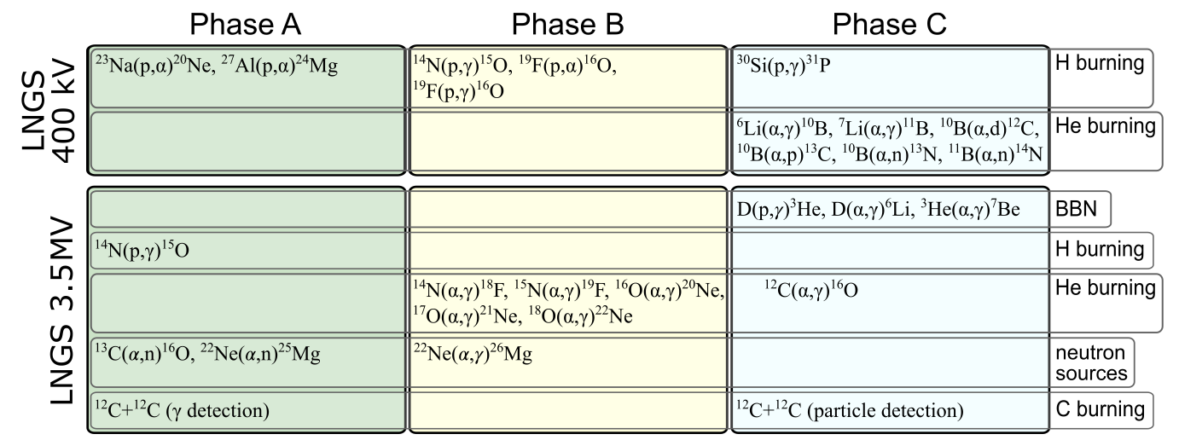
Direct measurements for nuclear astrophysics

Slide 6
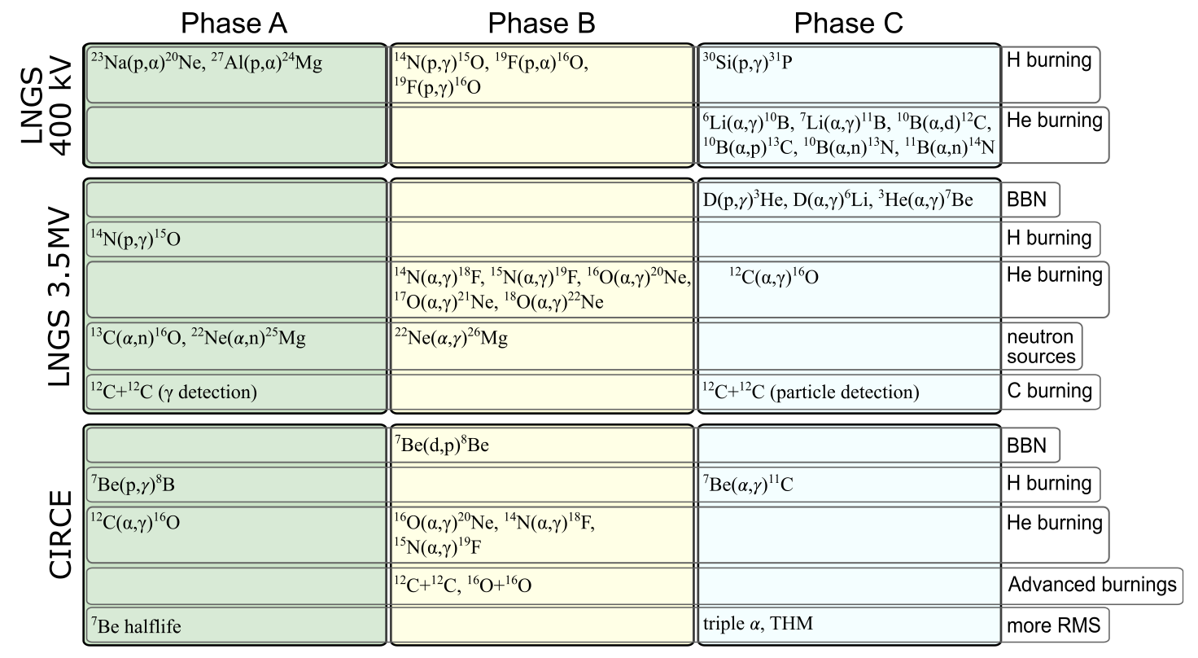
Direct measurements for nuclear astrophysics @ LNGS
Those are also under study at the Felsenkeller facility (see Eliana Masha talk)

Slide 7
Alpha induced reactions on nitrogen isotopes
Those reactions are important for the production of ¹⁹F and ²²Ne
Key for chemical evolution
Fluorine can be produced/destroyed in several stellar scenarios
    Type II Supernova
    Asymptotic Giant Branch
    Wolf-Rayet
    White Dwarf Merger
¹⁴N(α,γ)¹⁸F(β⁺ν)¹⁸O(p,α)¹⁵N(α,γ)¹⁹F
¹⁴N(α,γ)¹⁸F(β⁺ν)¹⁸O(α,γ)²²Ne

Slide 8
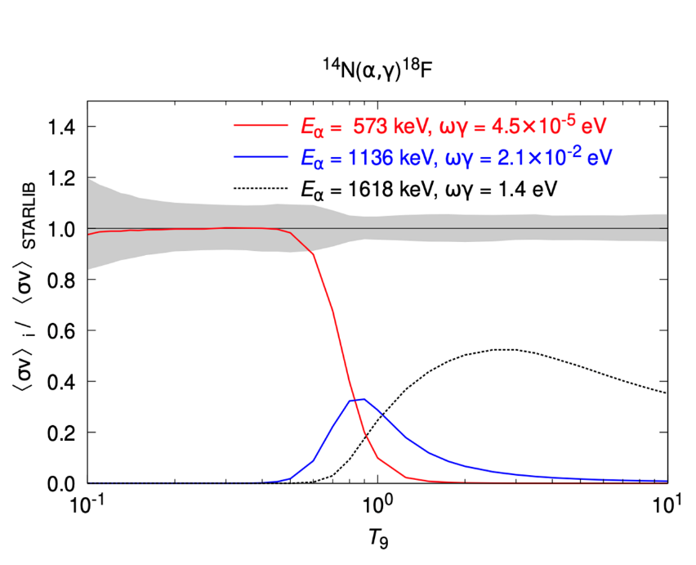
¹⁴N(α,γ)¹⁸F

Slide 9
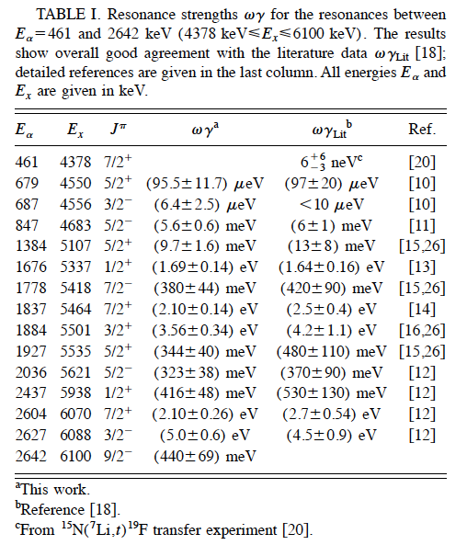
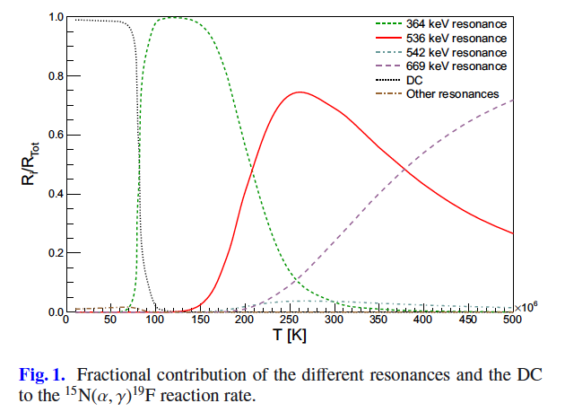
¹⁵N(α,γ)¹⁹F
Many resonant states in the ¹⁹F compound nucleus
At astrophysical relevant energies three of them are dominant
Other resonances can be also studied at IBF
The lowest resonant only measured with indirect methods
«A revision of this reaction rate therefore looks mandatory for minimizing the uncertainty on the 19F nucleosynthesis related to this nuclear process.»
Cristallo et al., A&A 570, A46 (2014)

Slide 10
¹⁵N(α,γ)¹⁹F
Many resonant states in the ¹⁹F compound nucleus
At astrophysical relevant energies three of them are dominant
The lower resonant only measured with indirect methods
«A revision of this reaction rate therefore looks mandatory for minimizing the uncertainty on the 19F nucleosynthesis related to this nuclear process.»
Cristallo et al., A&A 570, A46 (2014)
For some resonances, the E_{R} values are debated in literature requiring further experimental efforts

Slide 11
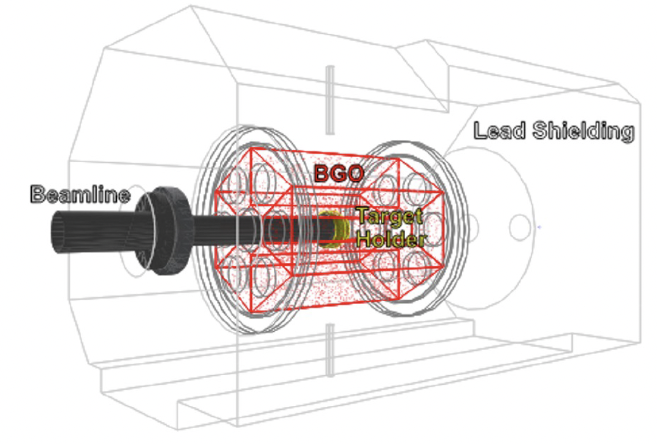
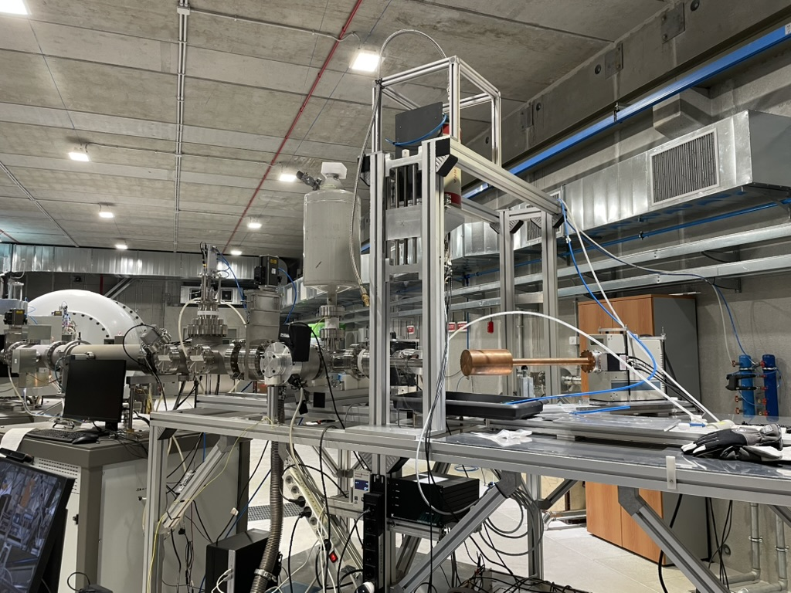
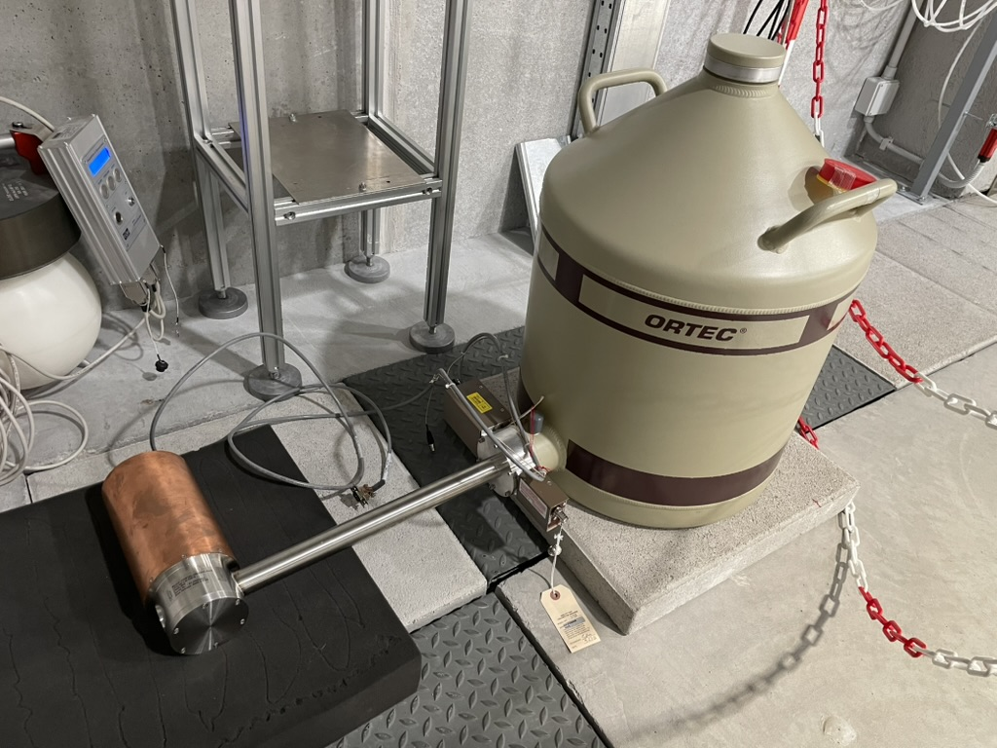
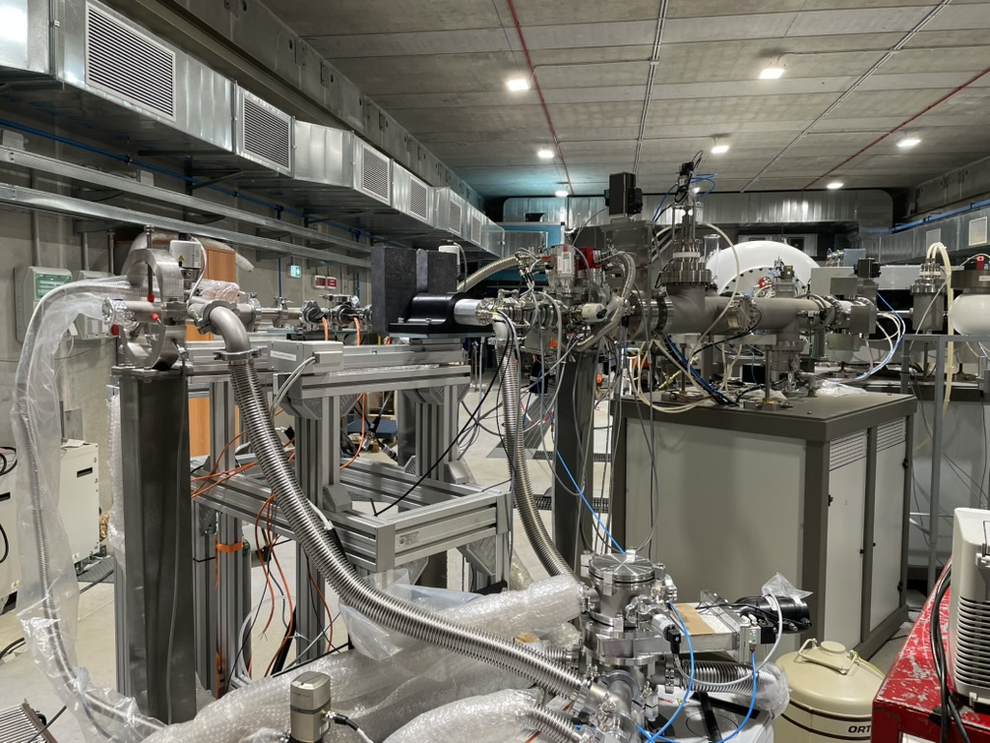
Available setups
Both reactions can be studied via solid and gas targets setup based on previous LUNA studies to understand better the systematics due to the targets
Direct capture can be investigated at the IBF in a wide energy range
Synergies with other techniques (recoil separator and indirect methods) and other underground facilities (i.e. recent study at the Felsenkeller facility) can be planned

Slide 12
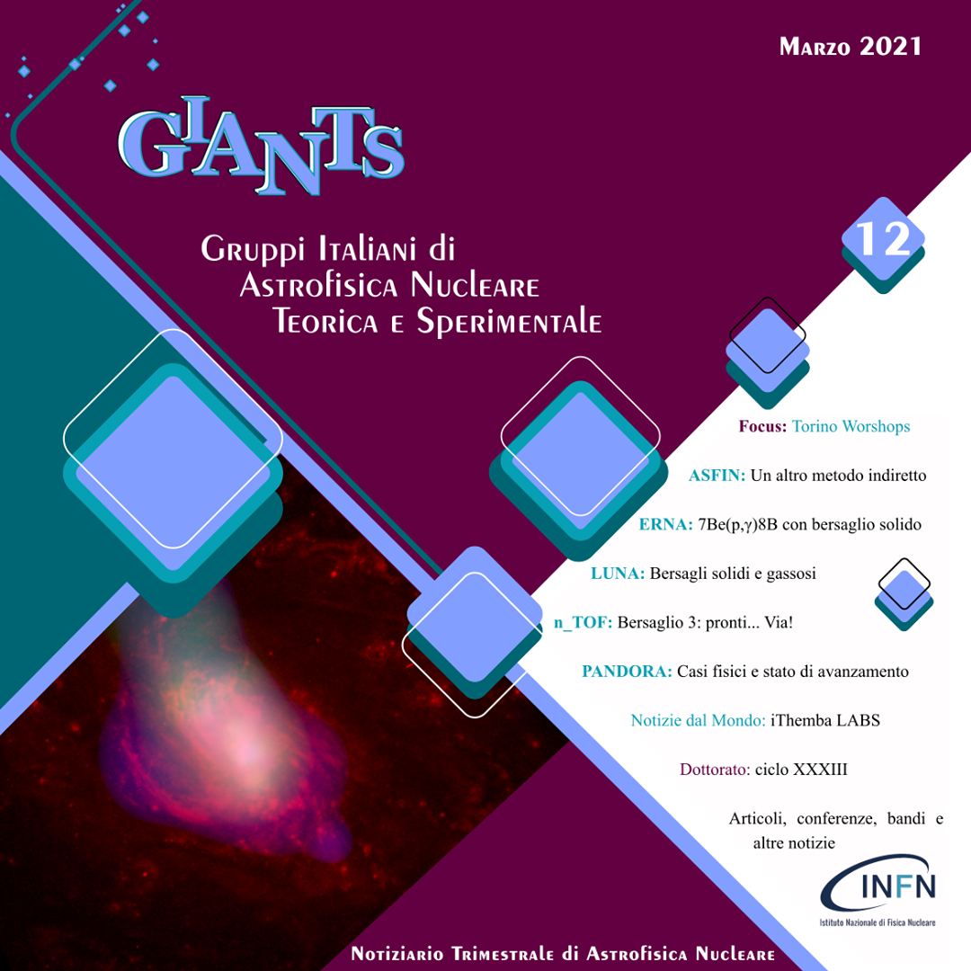



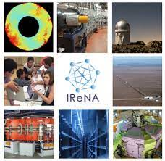

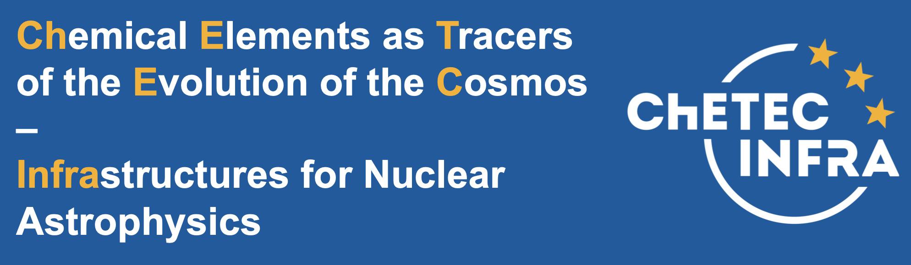
Synergies and Networks

