Slide 1
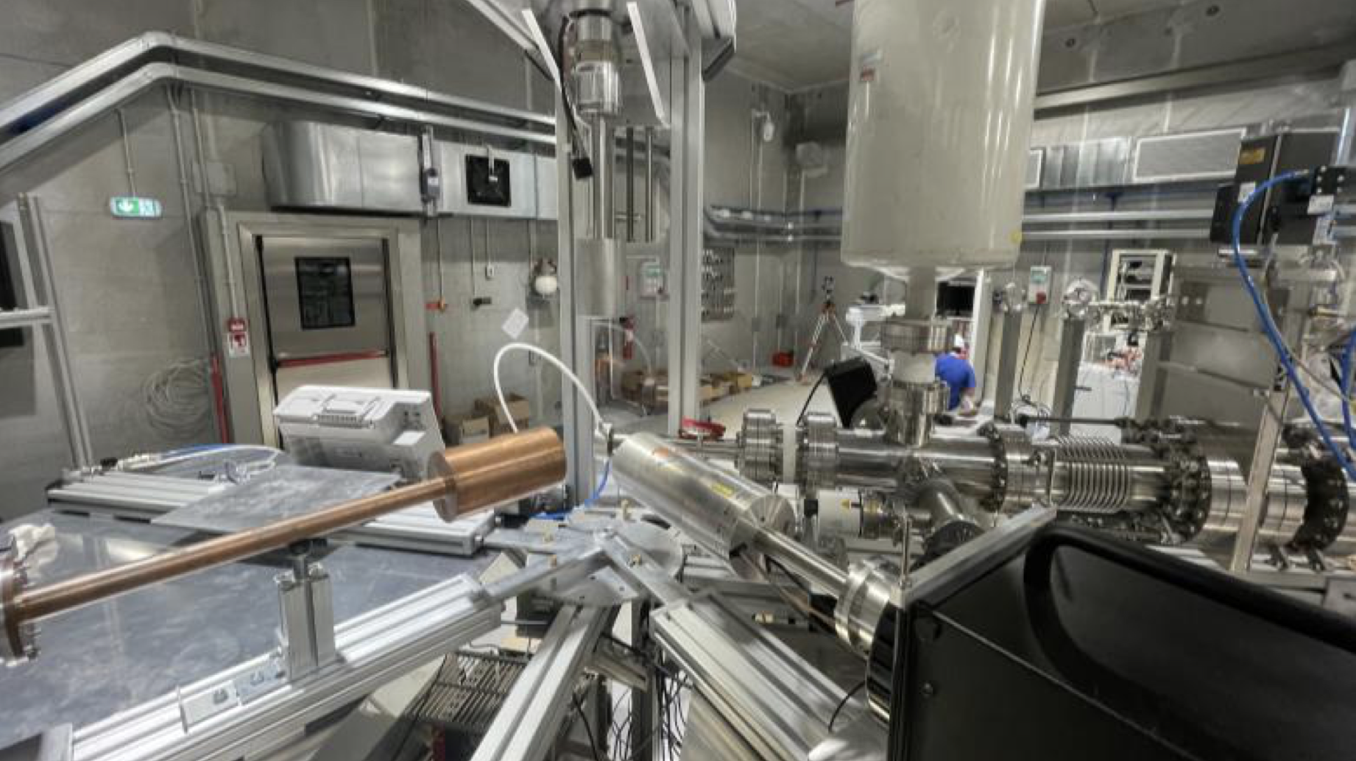


Detectors for Nuclear Astrophysics in the LUNA collaboration
G.F. Ciani on behalf of LUNA collaboration INFN Bari
Perspectives at the Bellotti IBF 8-10 October 2025 Laboratori Nazionali del Gran Sasso

Slide 2

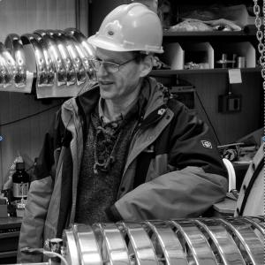


TYPICAL EXPERIMENTAL SETUP IN NUCLEAR ASTROPHYSICS
REACTION PRODUCTS
Accelerator
α, p, n, γ
HIGH DENSITY
AND STABILITY TARGET
Intense current beams
High performance detector: - low intrinsic background
High efficiency
High energy resolution
MY TURN!!!

Slide 3



Over 30 year of Nuclear Astrophysics at LUNA (LNGS, INFN) and beyond
LUNA program @ IBF facility 2023-2027
solar fusion reactions
³He(³He,2p)⁴He ²H(p,γ)³He ³He(α,γ)⁷Be
electron screening and stopping power
²H(³He,p)⁴He ³He(²H,p)⁴He
CNO, Ne-Na and Mg-Al cycles
¹⁴N(p,γ)¹⁵O ¹⁵N(p,γ)¹⁶O ²²Ne(p,γ)²³Na ²²Ne(α,γ)²⁶Mg
²³Na(p,γ)²⁴Mg ²⁵Mg(p,γ)²⁶Al ¹²C(p,γ)¹³N ¹³C(p,γ)¹⁴N
²¹Ne(p,γ)²²Na ²⁰Ne(p,γ)²¹Na ²³Na(p,α)²⁰Ne
Explosive hydrogen burning in novae and AGB stars
¹⁷O(p,γ)¹⁸F ¹⁷O(p,α)¹⁴N ¹⁸O(p,γ)¹⁹F ¹⁸O(p,α)¹⁵N
Big Bang nucleosynthesis
²H(α,γ)⁶Li ²H(p,γ)³He ⁶Li(p,γ)⁷Be ⁶Li(p,α)³He
neutron capture nucleosynthesis
¹³C(α,n)¹⁶O
CNO Cycle ¹⁴N(p,γ)¹⁵O
Carbon Burning
12C+12C reactions
Neutron capture nucleosynthesis ²²Ne(α,n)²⁵Mg ²²Ne(α, γ)²⁶Mg

Slide 4
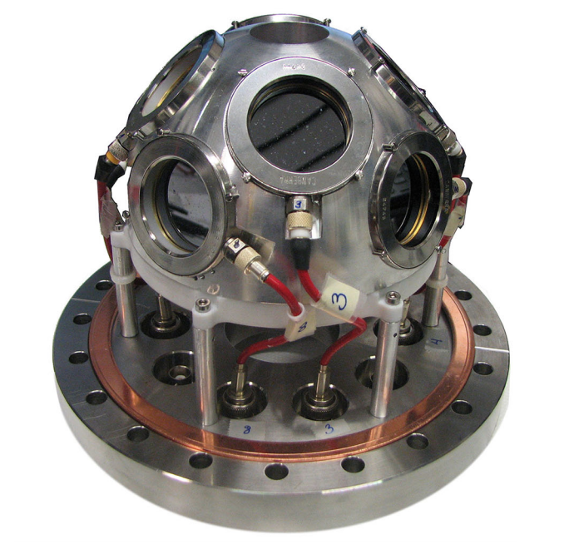
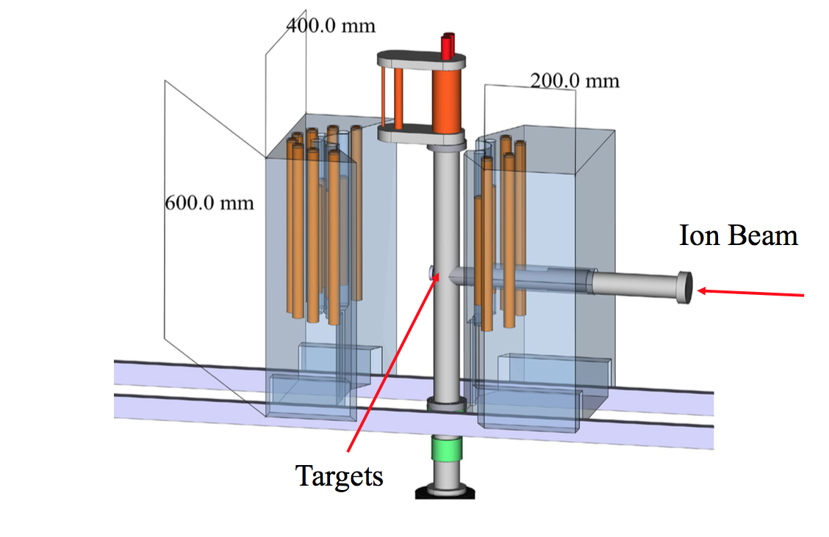
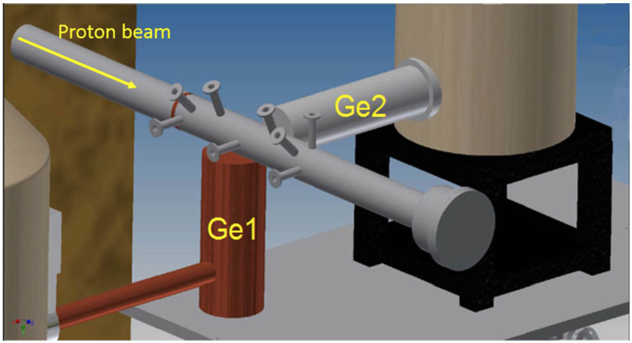

DETECTOR USED AT LUNA FOR..
γ-rays
HPGe, BGO, NaI
Charged particles
Silicon detector array
Neutrons
He3 counters and scintillators
Main features:
- As high as possible efficiency, validated with Monte Carlo
Good characterization in terms of energy calibration and resolution
Intrinsic background minimized or under control

Slide 5
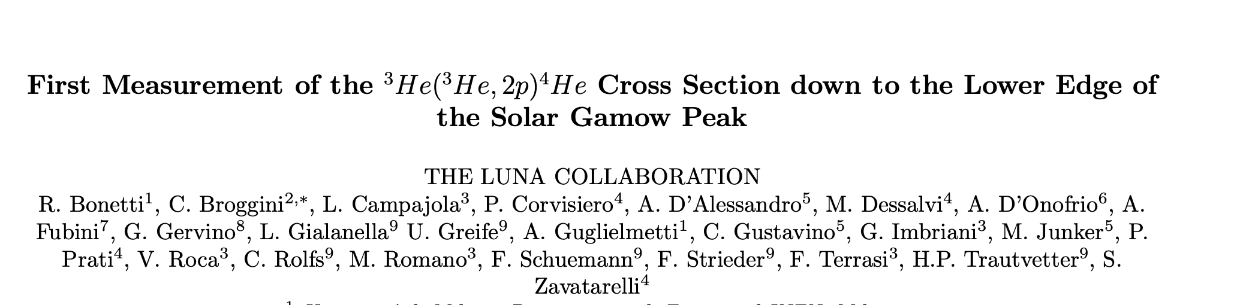
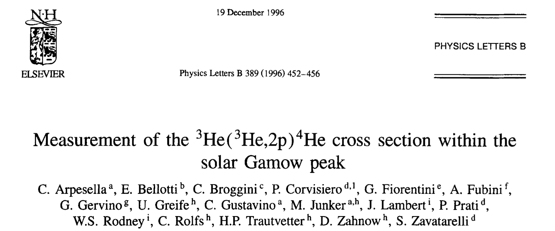
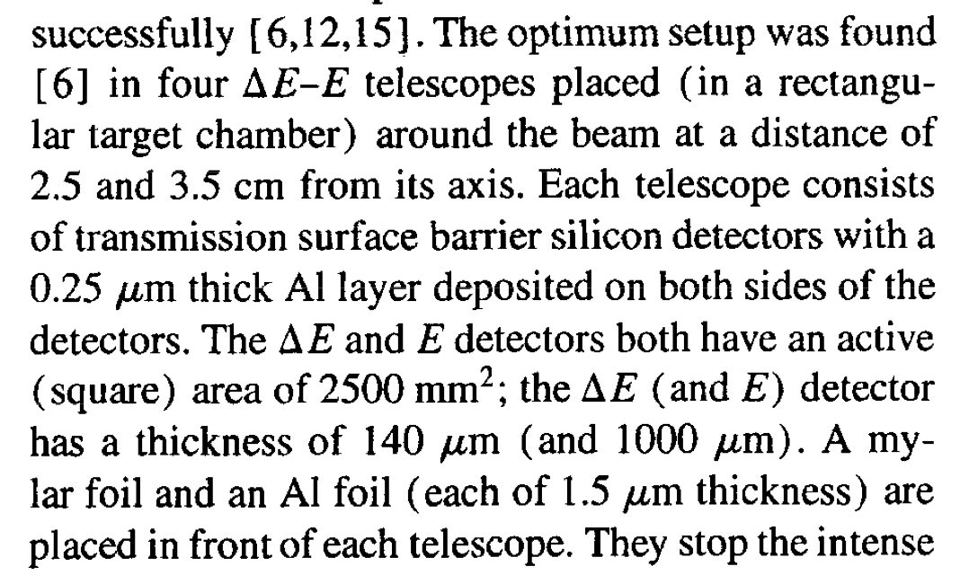
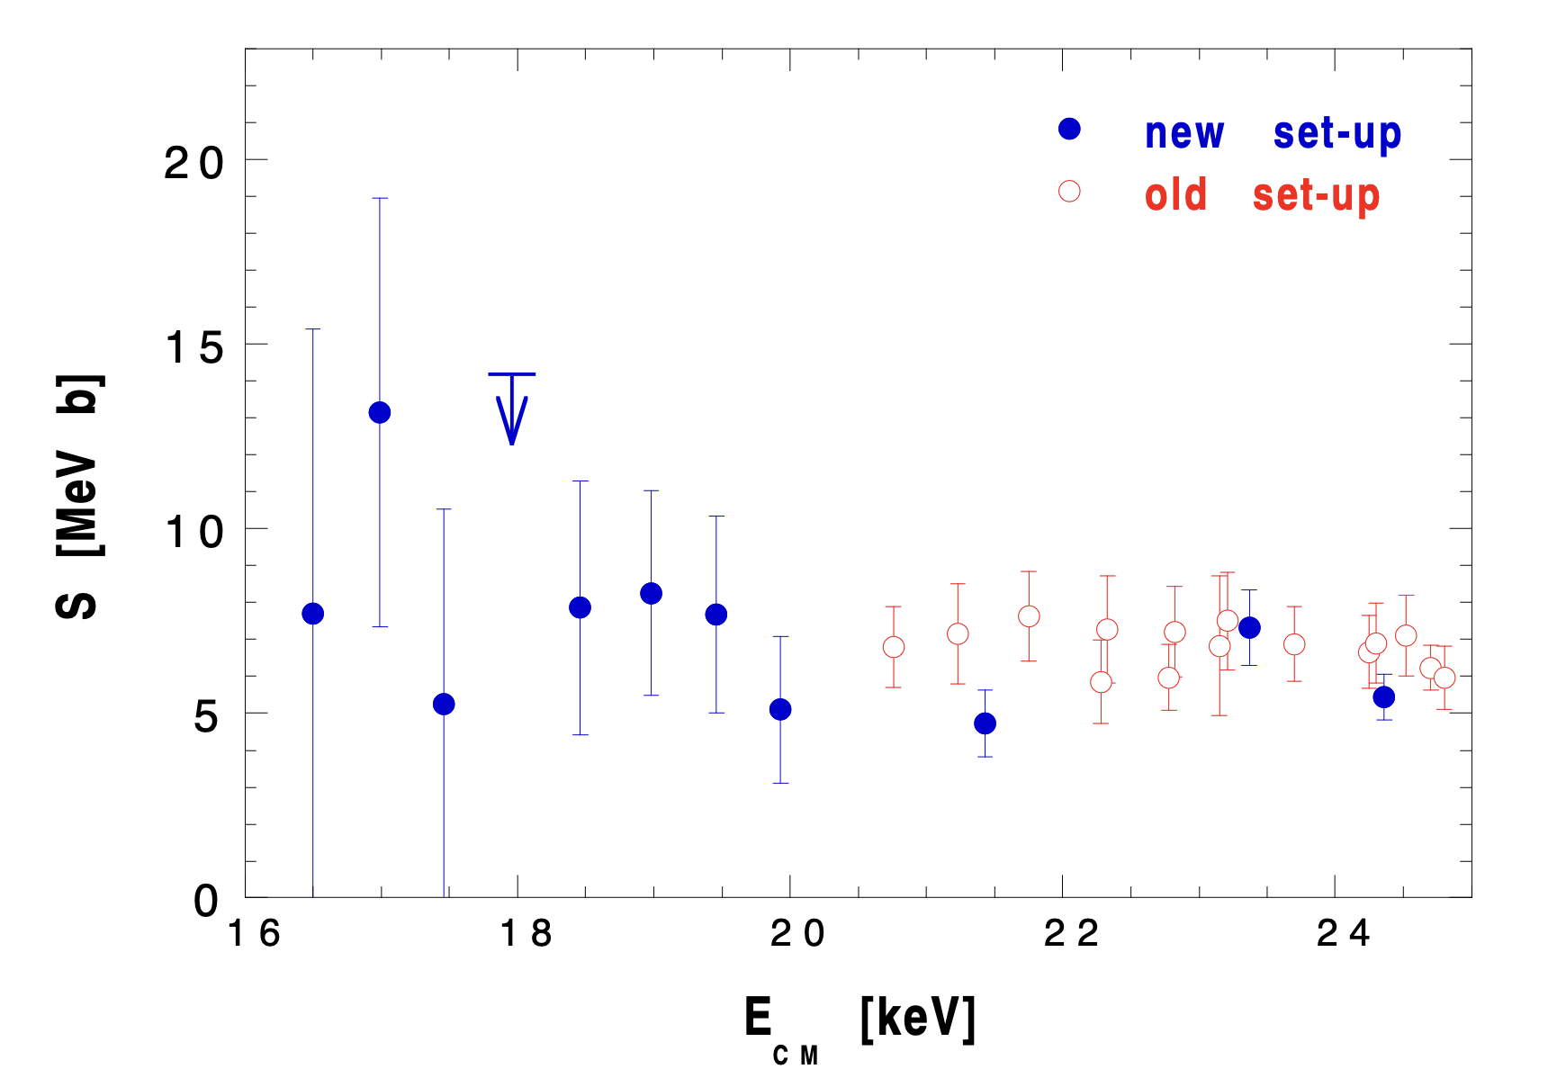
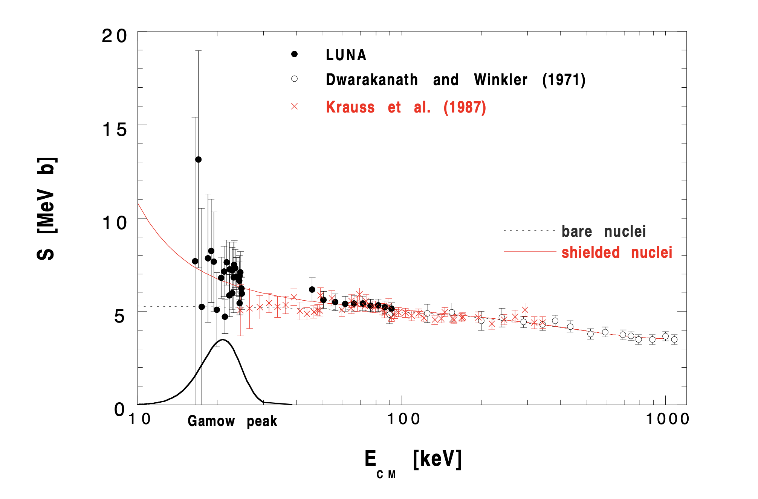
CHARGED PARTICLE DETECTORS
«In order to suppress the background we had to use a new detector set-up, which consists of eight thick (1 mm) silicon detectors of 5x5 cm² area placed around the beam. They form a 12 cm long parallelepiped in the target chamber, at 5.3 cm from its entrance»
Phys. Rev. Lett. 82, 5205 – Published 28 June, 1999

Slide 6
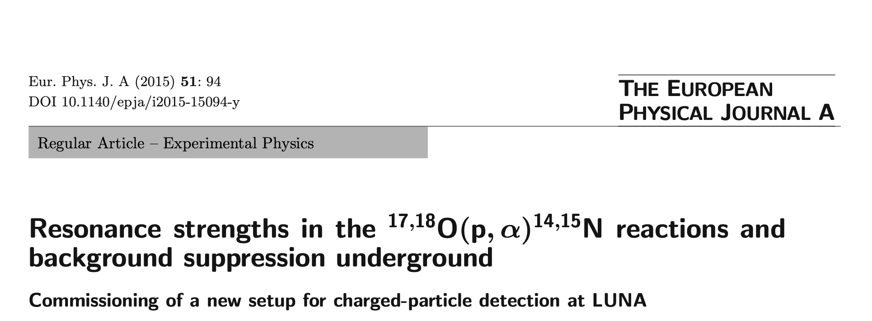
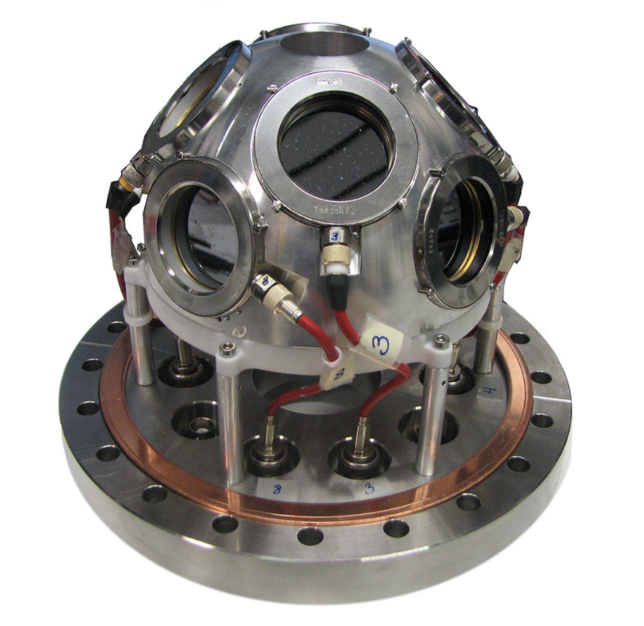
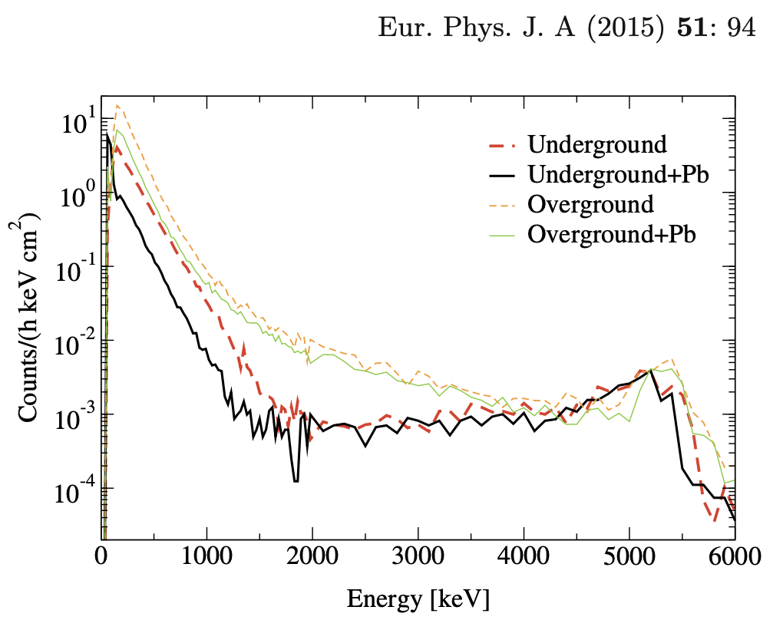
CHARGED PARTICLE DETECTORS
Implanted Planar Silicon detectors (PIPS, active area 9 cm² each; 5 with 300 μm +3 with 700μm thickness;
Arranged in two rows, at 135.0° and 102.5°.
In order to protect the detectors from the large flux
of elastically scattered protons, aluminised Mylar foils of about 2 μm thickness were mounted on the
inner copper dome
Efficiency of about 10% (simulation validated with α source)

Slide 7
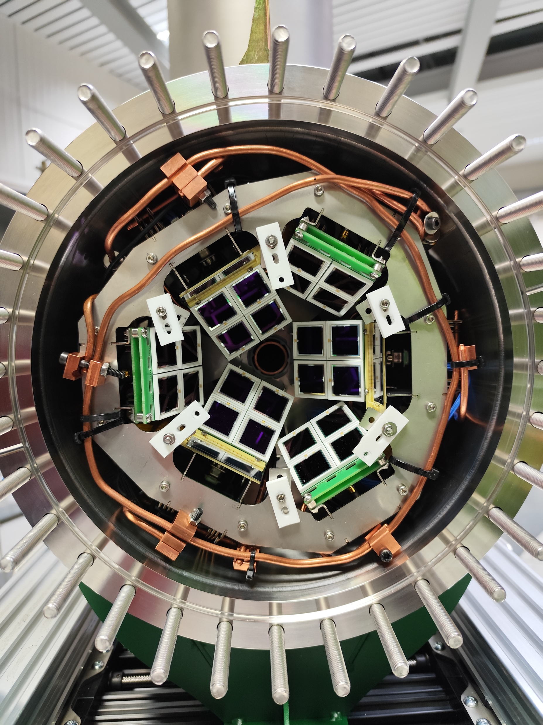
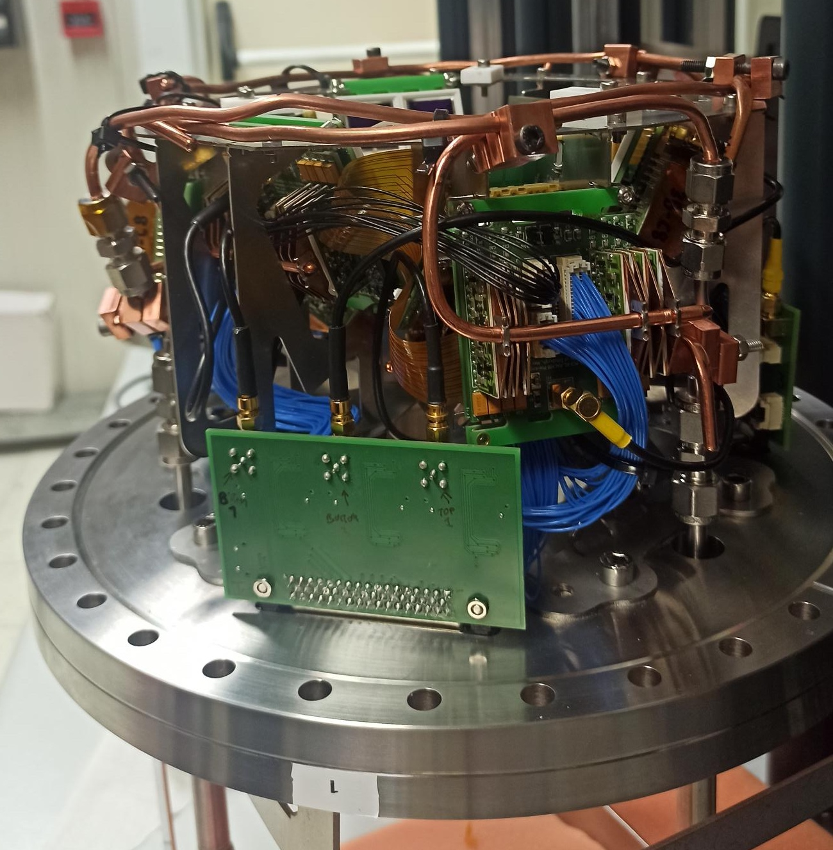
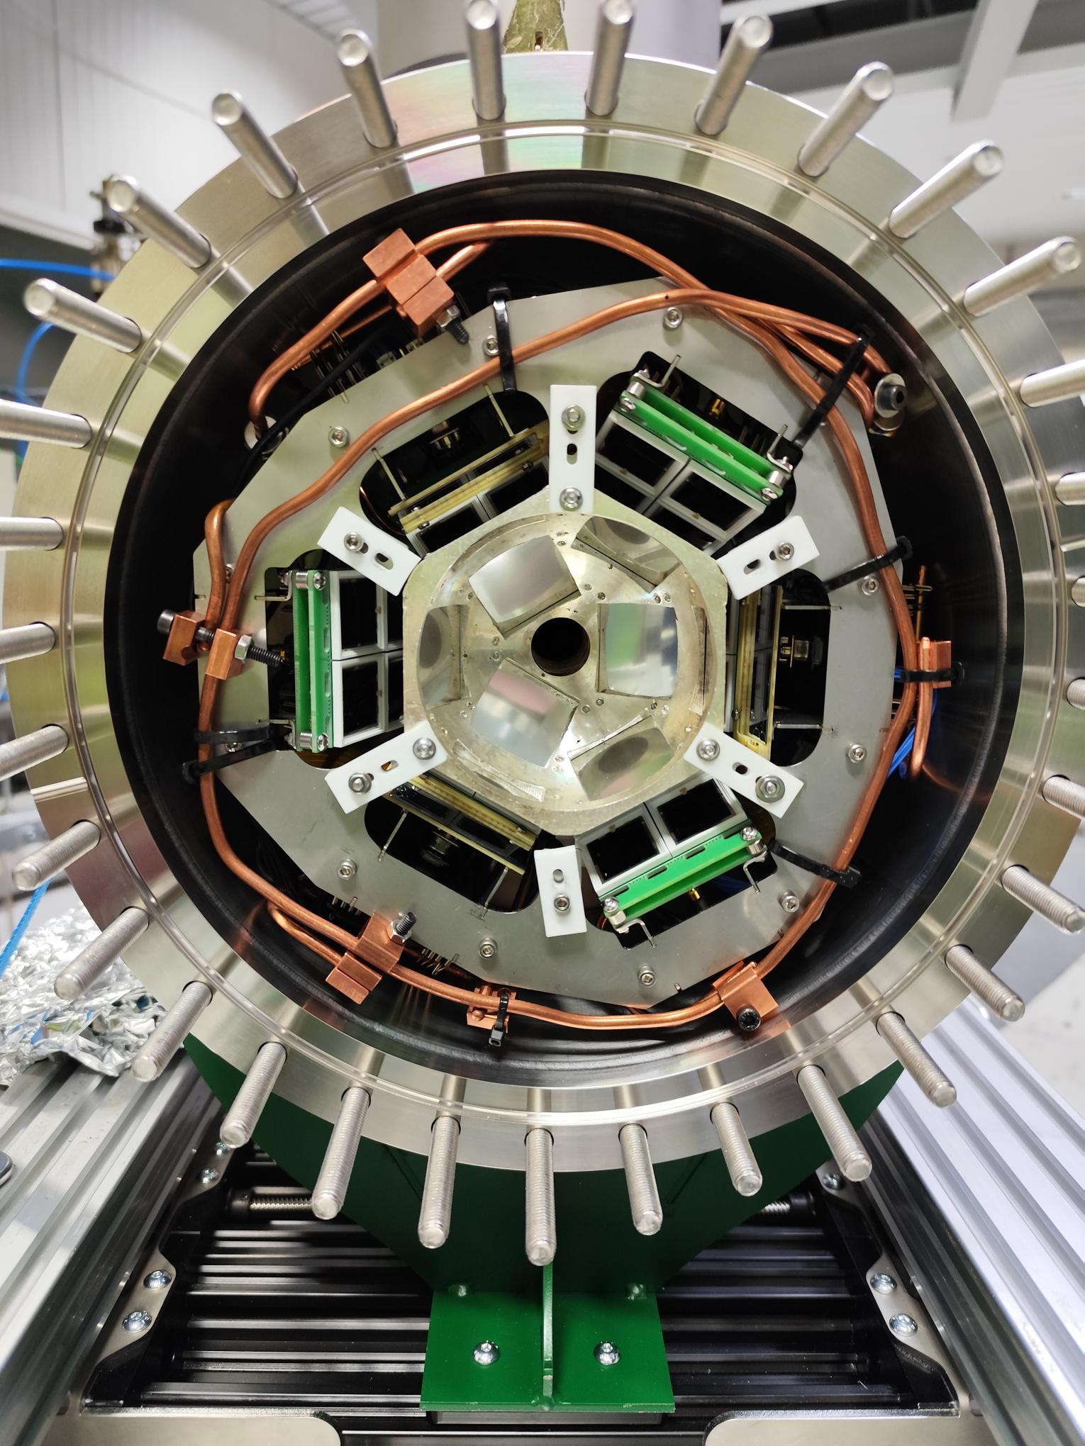
A NEW CHARGED PARTICLE DETECTOR (2025)
A new beamline dedicated to the detection of charged-particles has been installed at LUNA400@LNGS, supported by ELDAR (burning questions on the origin of the Elements in the Lives and Deaths of stARs) UKRI-ERC StG with an in kind contribution
24 HAMAMATSU
PHOTODIODES
Larger number of channels with respect to the previous setup
Higher sensibility to angular distribution
Temperatures of detectors around 42°C thanks to preamplifiers’ cooling system and dome being kept at liquid nitrogen temperature.
Reading of both sides of Silicon will reduce the background
≃15% geometric efficiency from Geant4 simulation
Energy resolution: 16-20 keV @
SILVER DOME WITH ALUMINIZED MYLAR FOILS TO STOP SCATTERED BEAM PROTONS
3 MSPADs (nTDs,
4 channels each)
Credits: C.Bruno & Lucia Barbieri

Slide 8
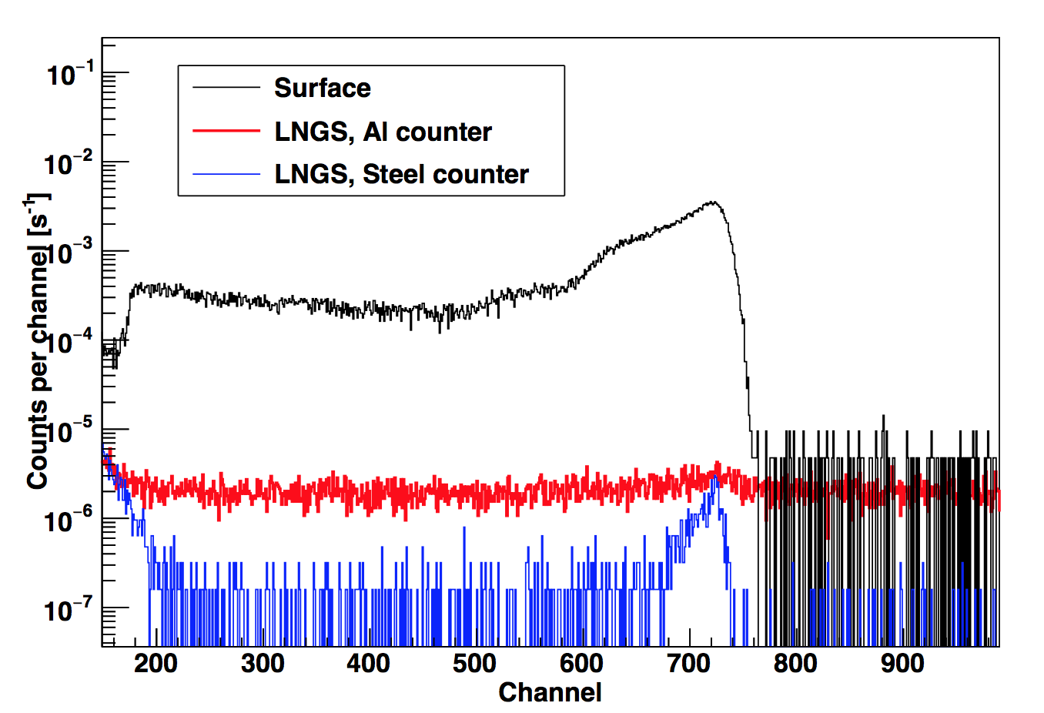
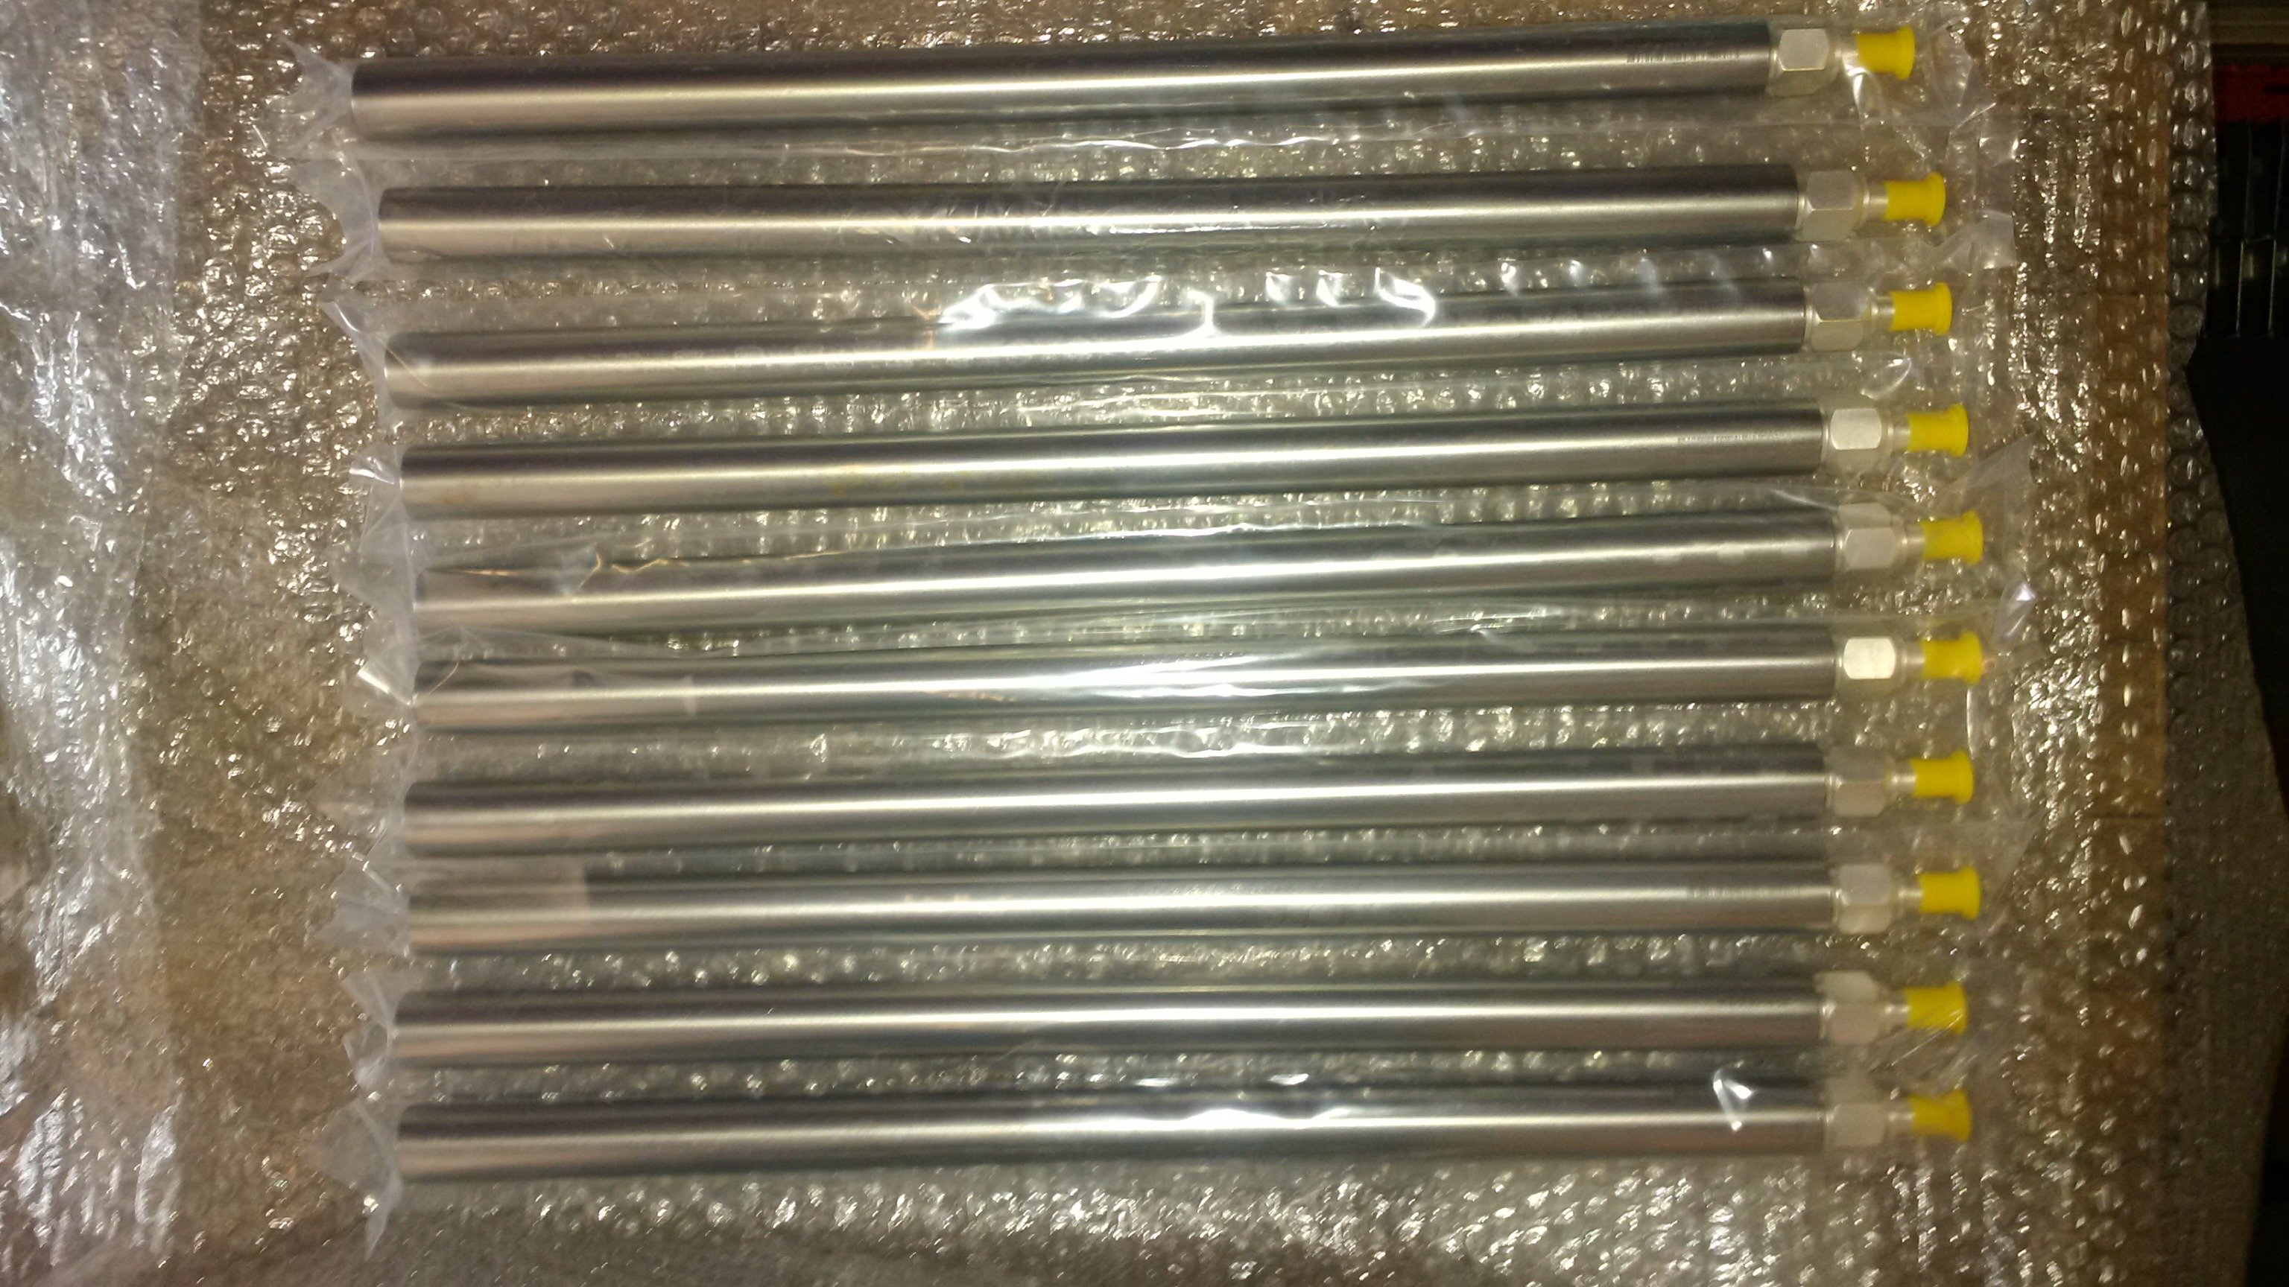
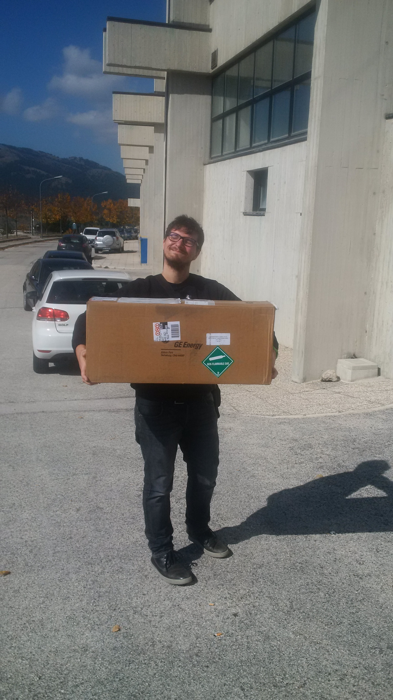
NEUTRON DETECTION
4th October 2017
10 atm pressurised ³He counters with a stainless steel case
Intrinsic efficiency for slow neutrons > 90%
Low intrinsic background (α particles source of intrinsic background from U and Th impurities in the counters’ case)

Slide 9
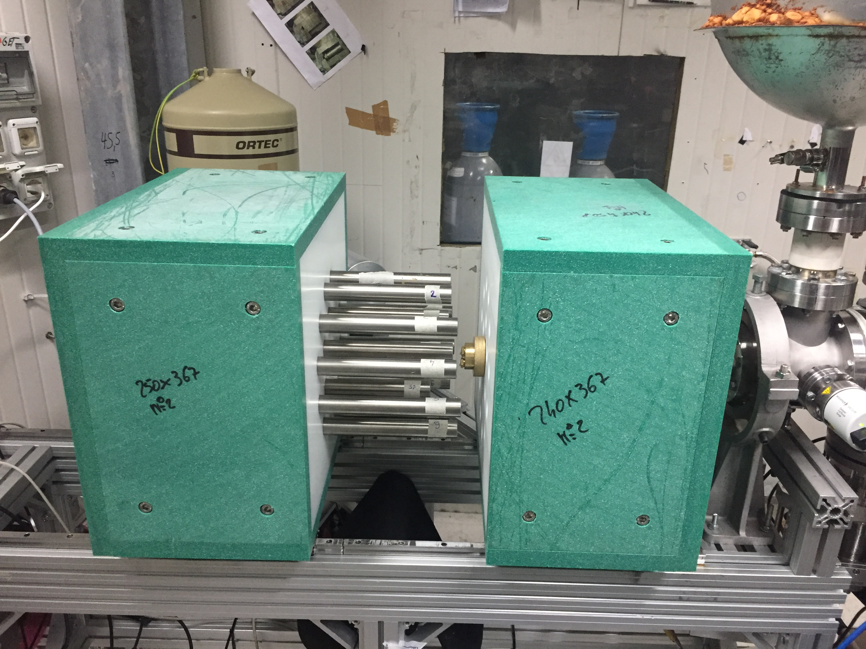
Array of 18 ³He counters
arranged in 2 rings (r₁ = 6 cm, r₂=11 cm)
6 inner counters L=25 cm
12 outer counters L= 40 cm
Polyethilene as moderator (<E_{n}>=2.5 MeV)
External shielding of BPE (1 inch)
Background (n+α):3.3 counts/h in the ROI Efficiency Curve: simulated and validated with ⁵¹V(p,n)⁵¹Cr reaction at ATOMKI
Good point: PE cheap and easy to machine: the moderator and the setup can be easily optimised for specific occasions and for other measurements
Weak point: cannot measure the neutron energy because of moderation

Slide 10
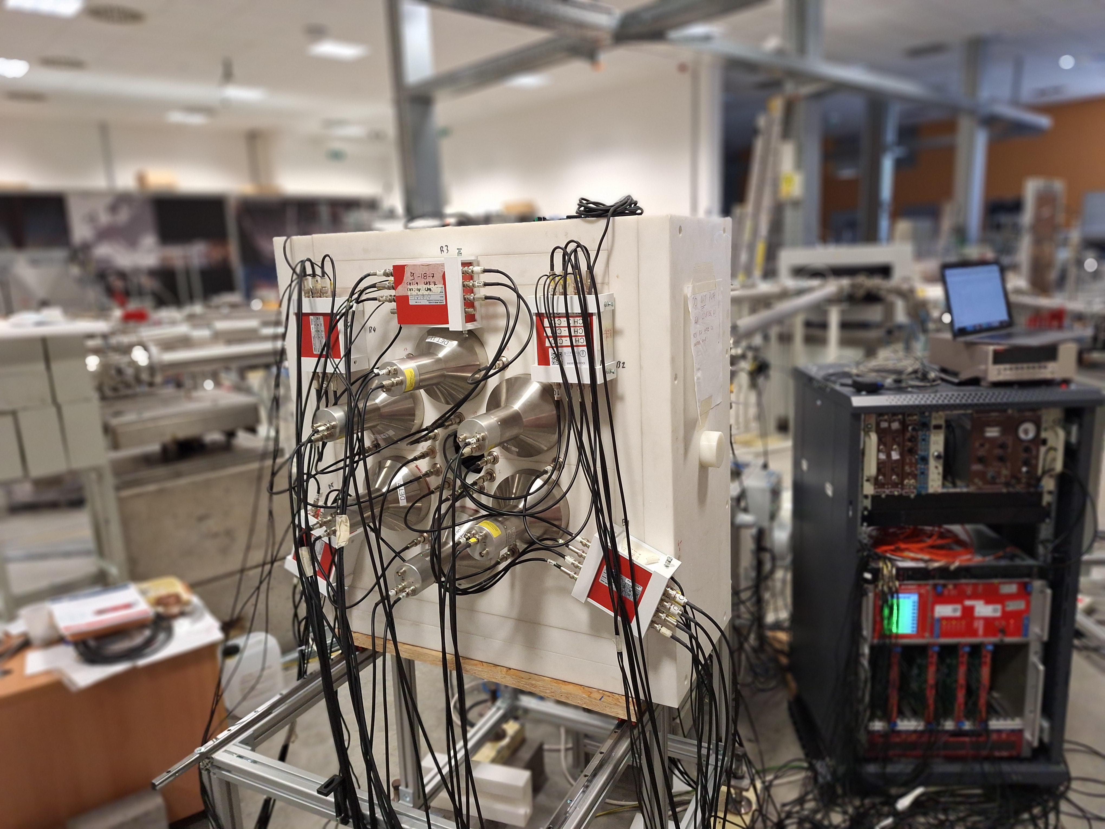
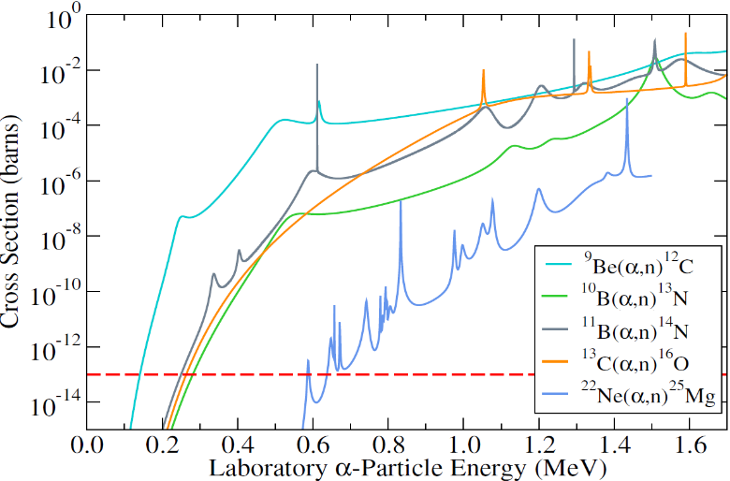
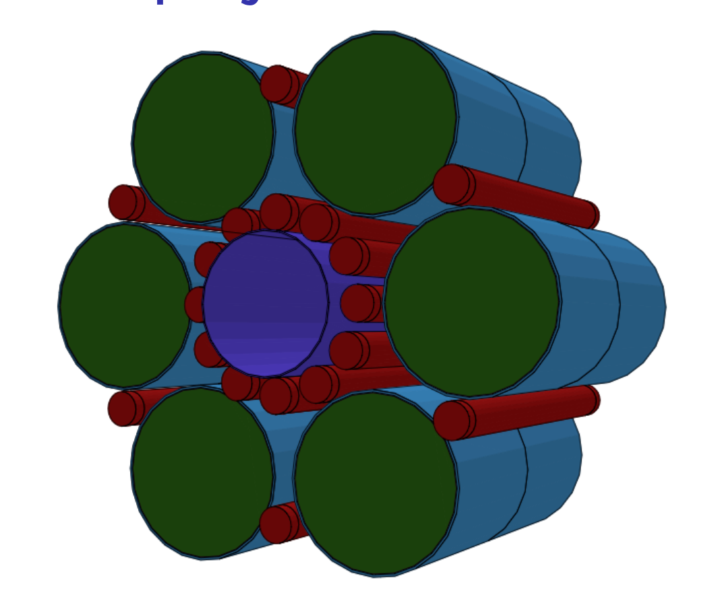
FAST NEUTRON DETECTORS
Credits of the plot: JINA-CEE
DETECTION «STRATEGY»
Hybrid detector array: 18 ³He counters combined with 12 liquid scintillator EJ-309 in the SHADES experiment for the measurement of the ²²Ne(a,n)²⁵Mg reaction.
The EJ-309 provides energy, timing, and tagging information for the neutron, and the counters provide a measure of the number of neutrons thermalised in the system.
BIB REDUCTION APPROACH
Lowest detectable neutron energy in scintillator is 163 keV Characterization of a prototype indicates a coincidence time of 3-7 μs providing a suppression factor of 48% from background neutrons entering the counters
Use anticoincidence to select neutrons of the reaction from BIB
Notes:
The EJ-309 provides energy,
timing, and tagging information for the neutron, and the counters provide a measure of the
number of neutrons thermalised in the system

Slide 11
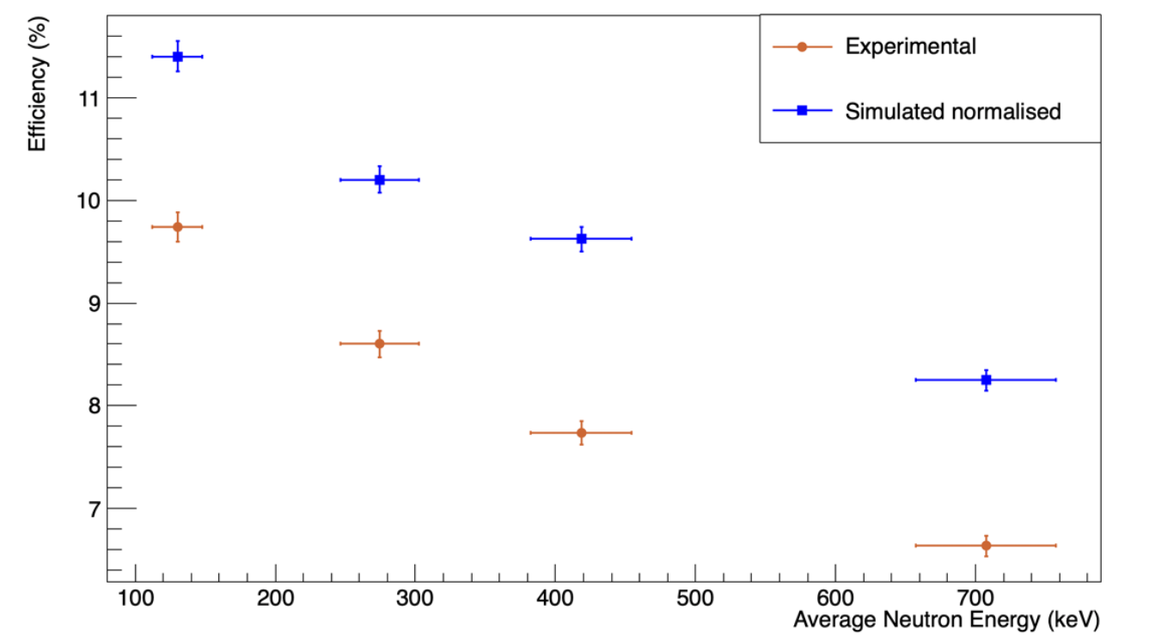
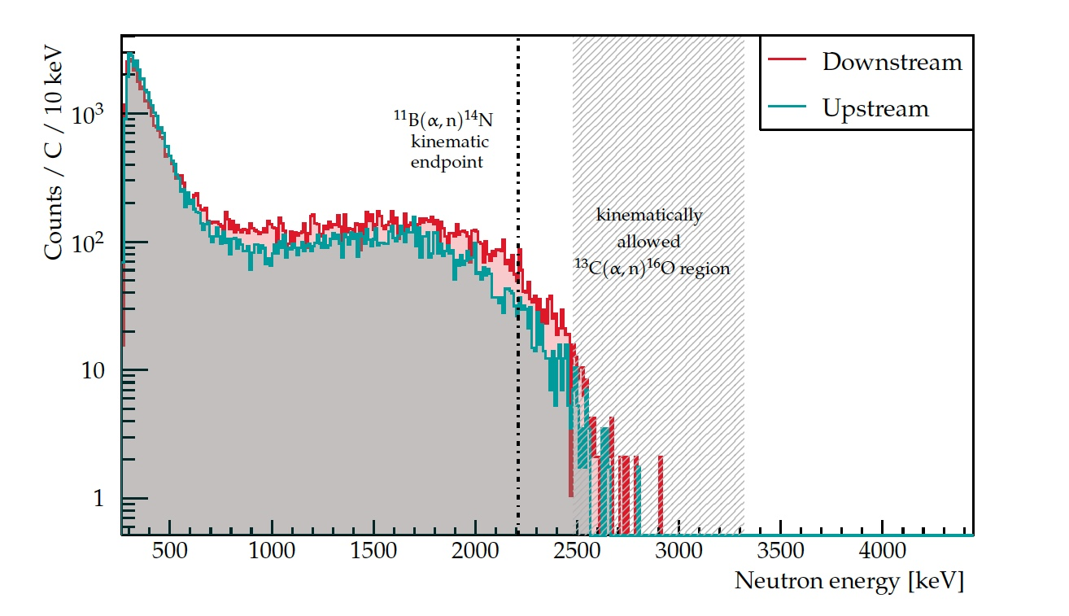
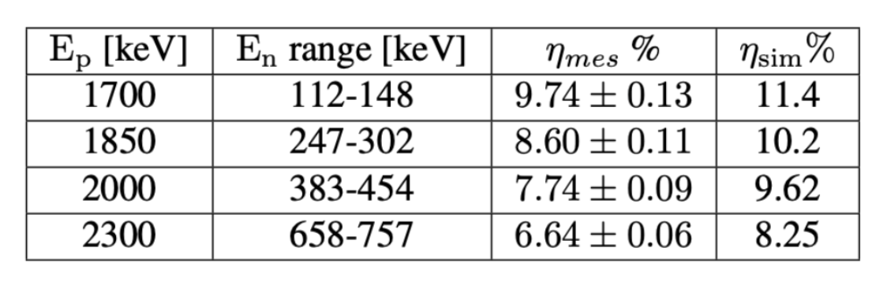
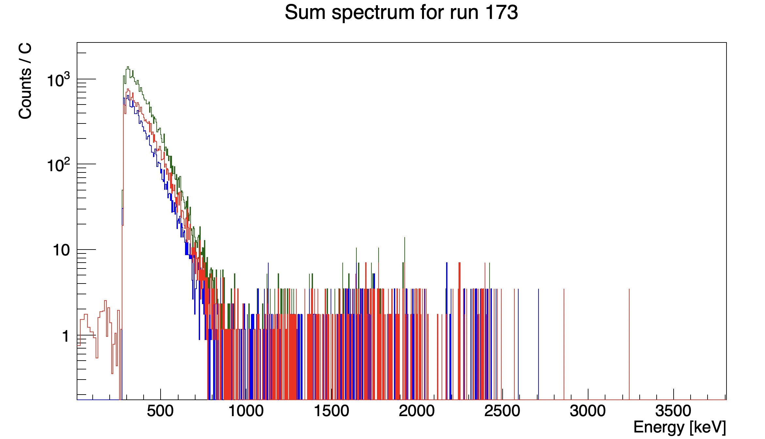
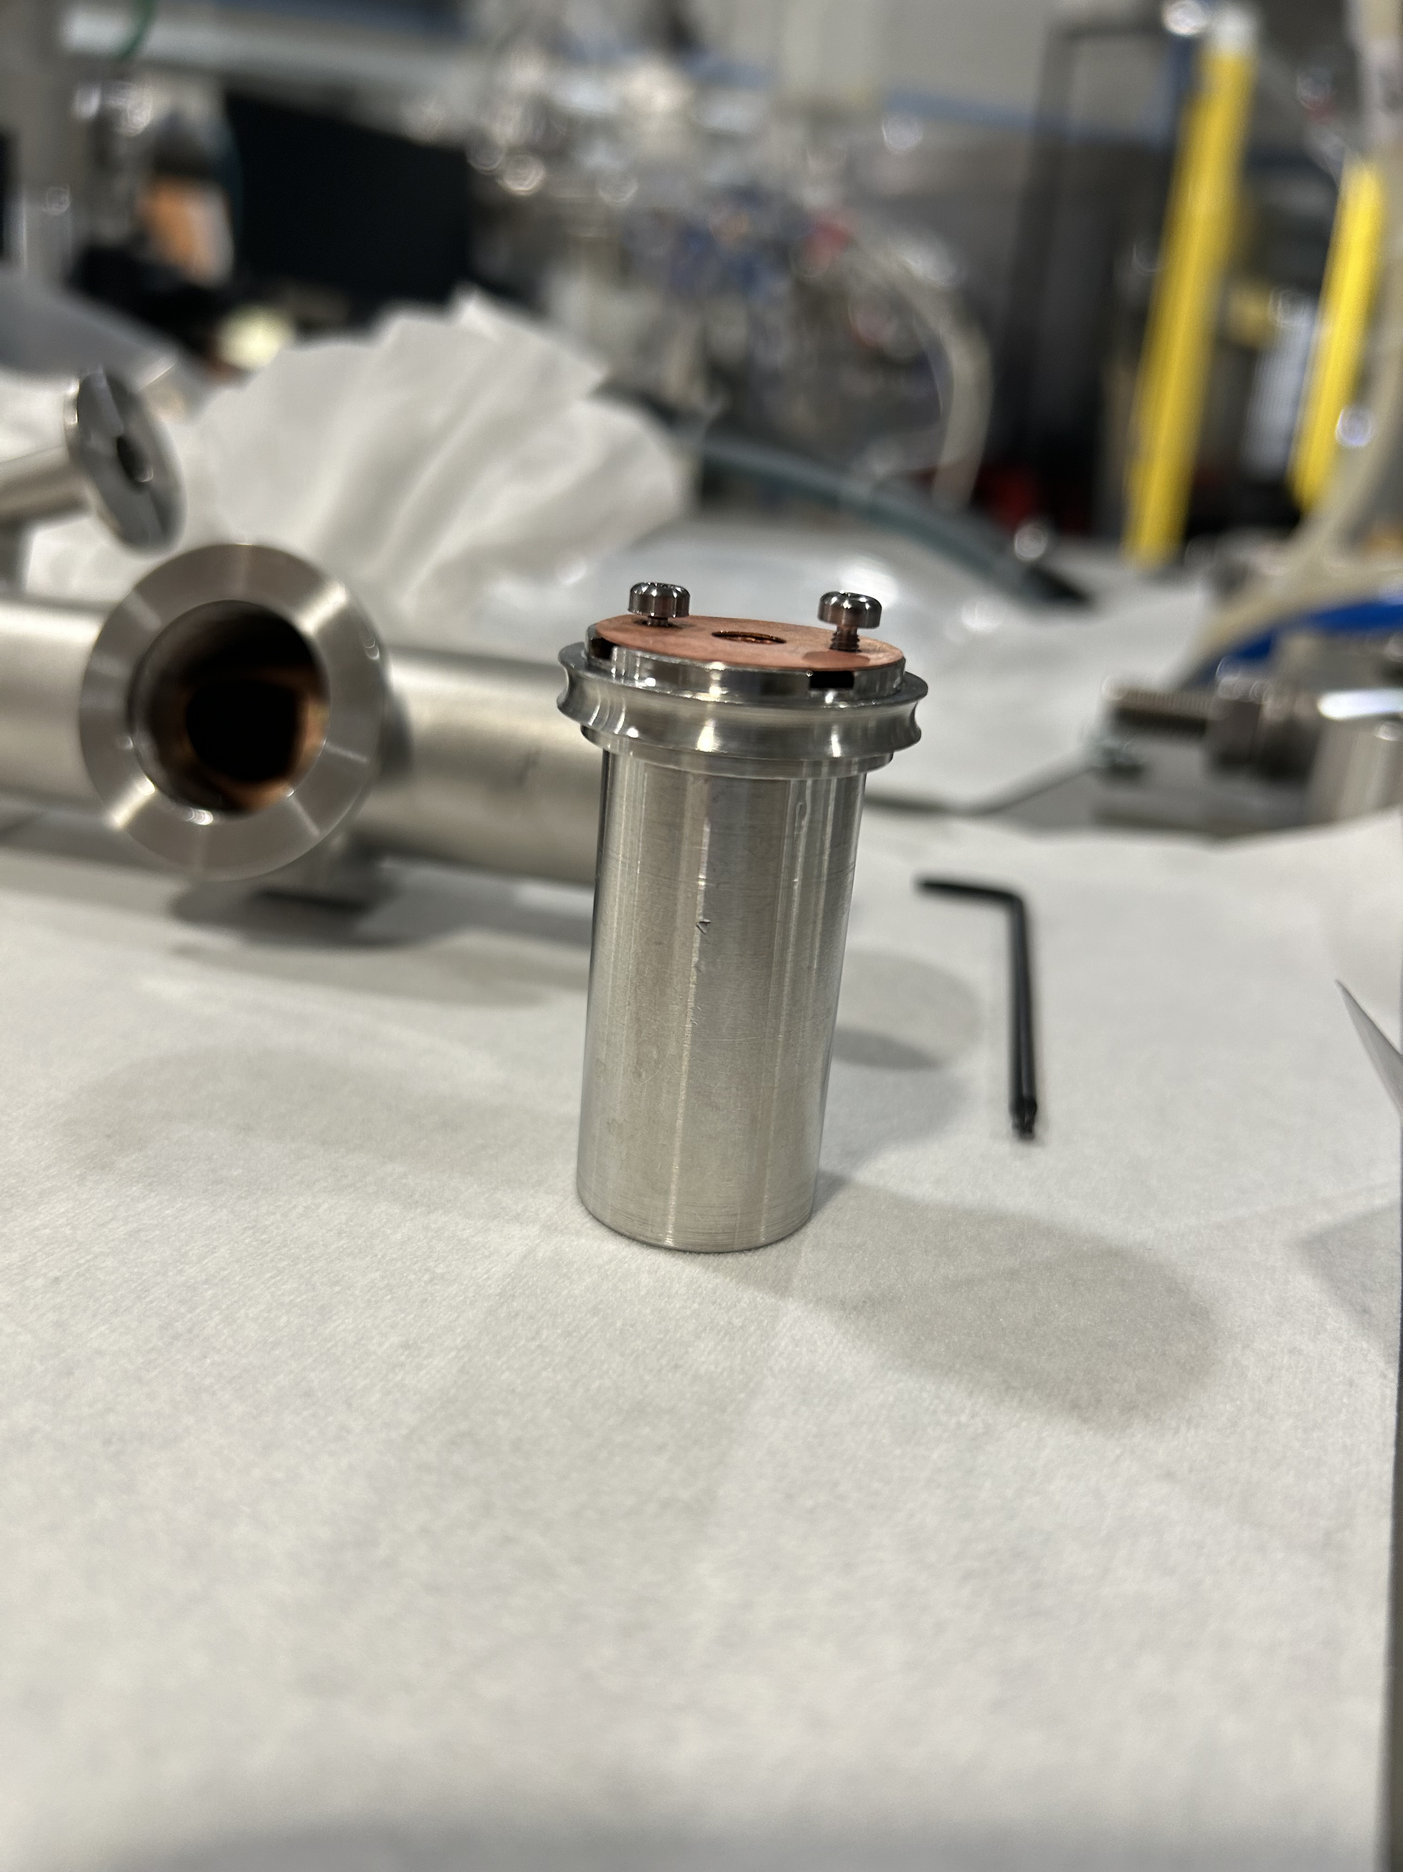

FAST NEUTRON DETECTORS: characterization
Low Beam induced background after
OFHC collimator + nitric acid bath
PRELIMINARY
Deviation from experimental data by approximately 15%, likely due to inaccuracies in the thermal scattering cross sections used in Geant4
Credits: A. Best & D. Mercogliano

Slide 12
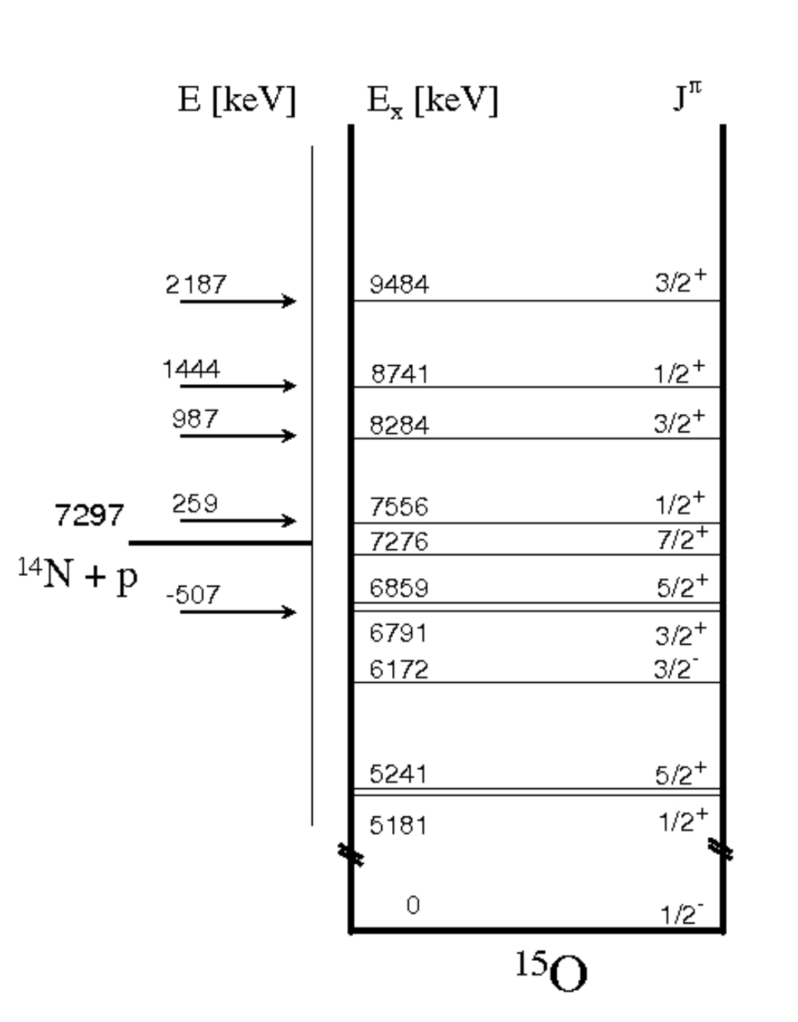
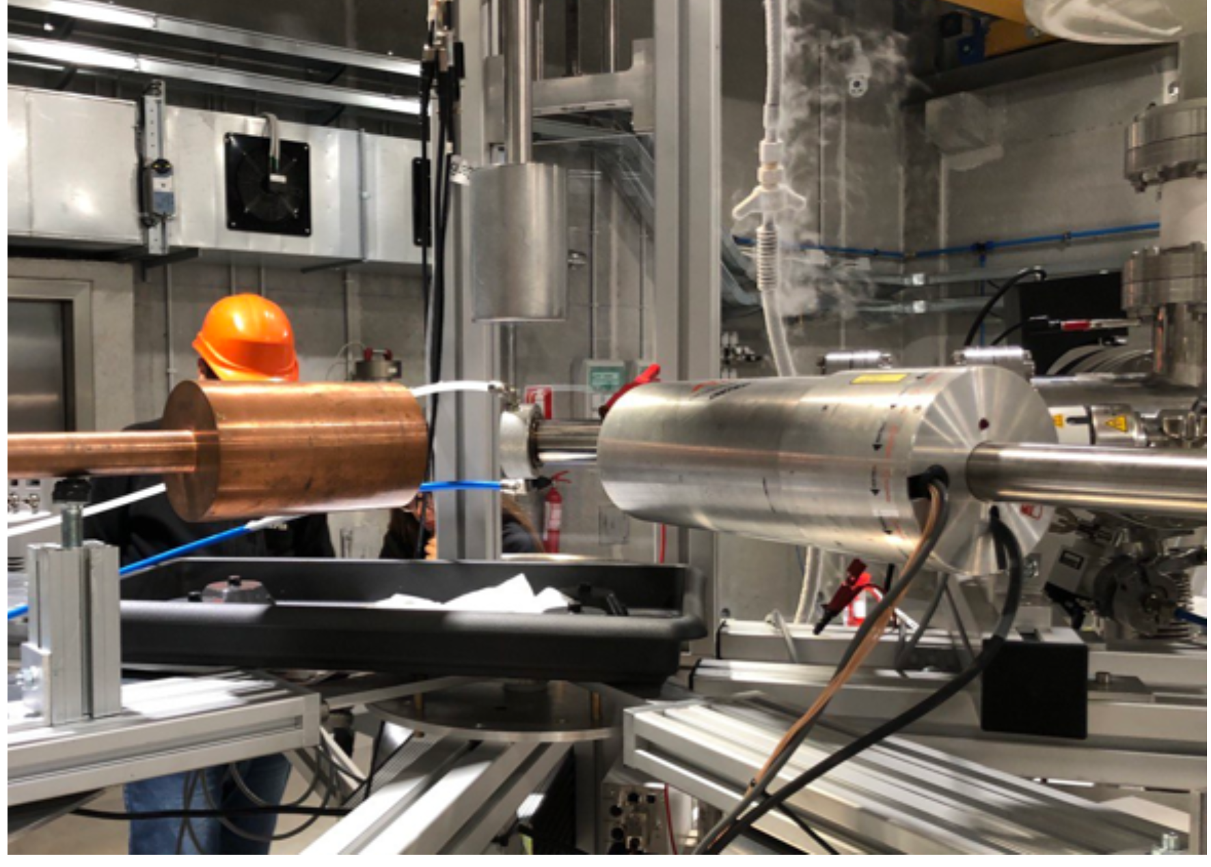
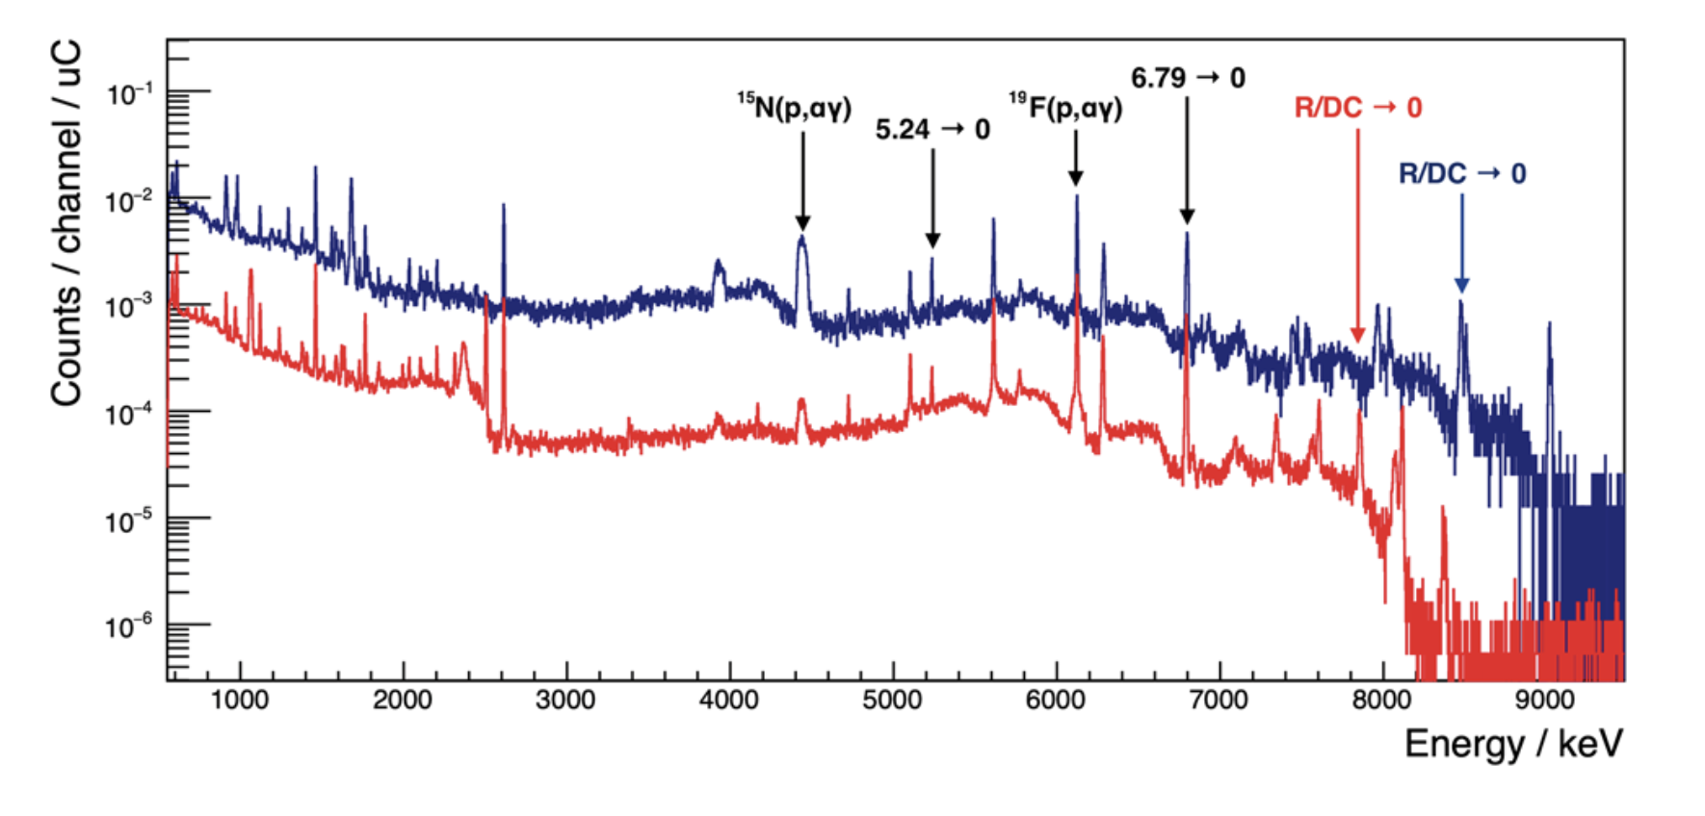
HIGH RESOLUTION γ−rays PARTICLES DETECTORS
Complex cascades request high resolution to distinguish all the γ-rays emitted.
A recent example is the measurement of the ¹⁴N(p,γ)¹⁵O reaction at IBF
Array of HPGe detectors available also for angular distribution measurements.
Coupled wit Cryocooler to avoid operation of refilling and favor long measurements
 | Relative efficiency | FWHM at 1.33 MeV
HPGeBochum Camberra | 120% | ~2 keV
HPGe Genova Ametek | 120% | ~2 keV
HPGeDresda Camberra | 60% | ~2 keV
605 keV
1260 keV

Slide 13
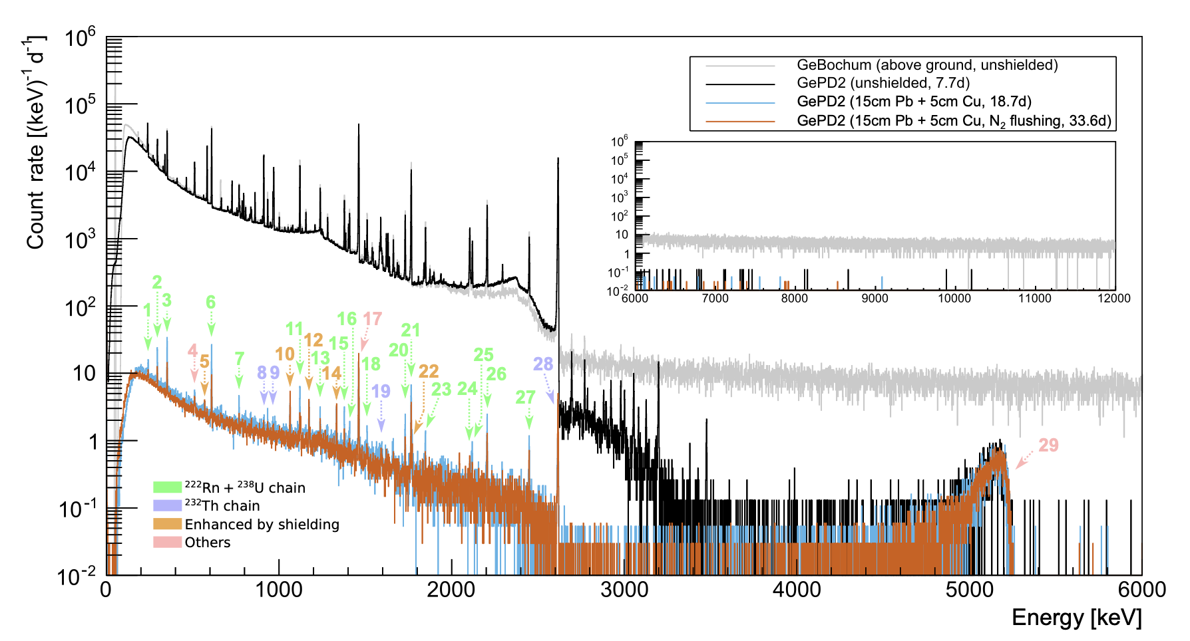
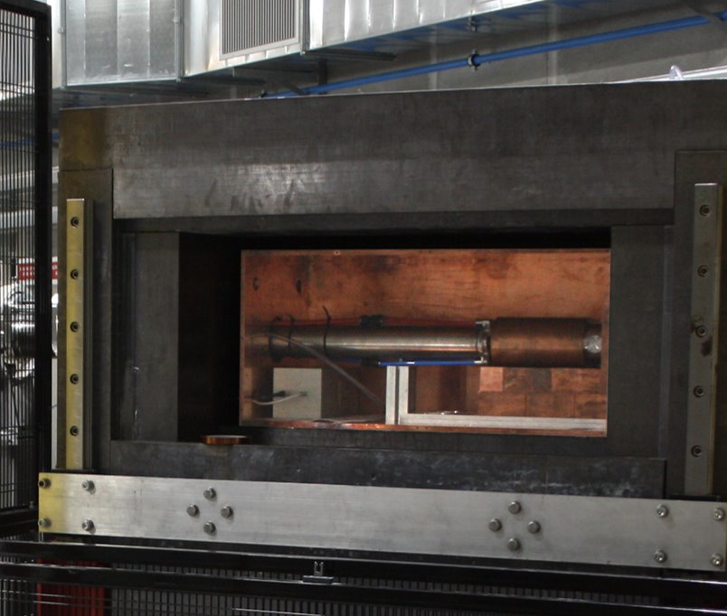
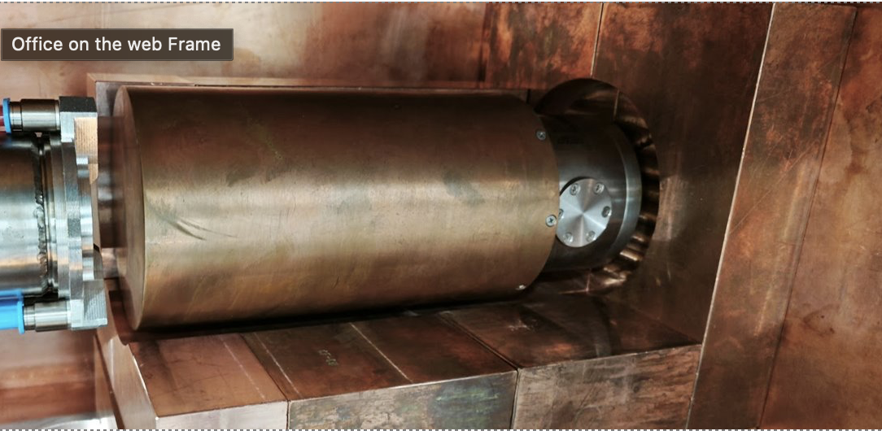
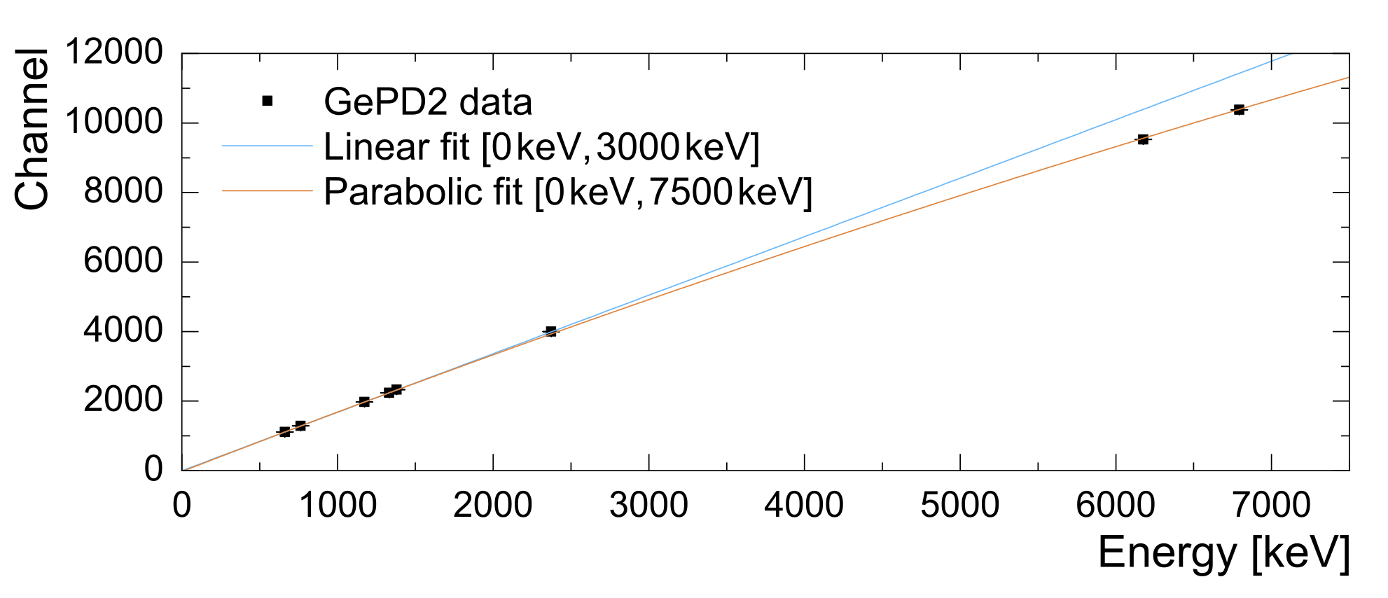
HIGH RESOLUTION γ−rays PARTICLES DETECTORS
Proton and alpha channels of the 12C+12C reaction emit γ-rays at 440 keV and 1634 keV, respectively. These signatures can be hampered by natural background.
 | Relative efficiency | FWHM at 1.33 MeV
HPGe Pd 2 Ametek | 157% | 2.1 keV
30 l dewar for measurements longer thatn 10 days
 | Background rate [200-2700 keV]
unshielded | 6 034 800 (900) cpd
Lead+Cu | 4176(15) cpd
Lead+Cu+ N2 flushing | 3416(10) cpd

Slide 14
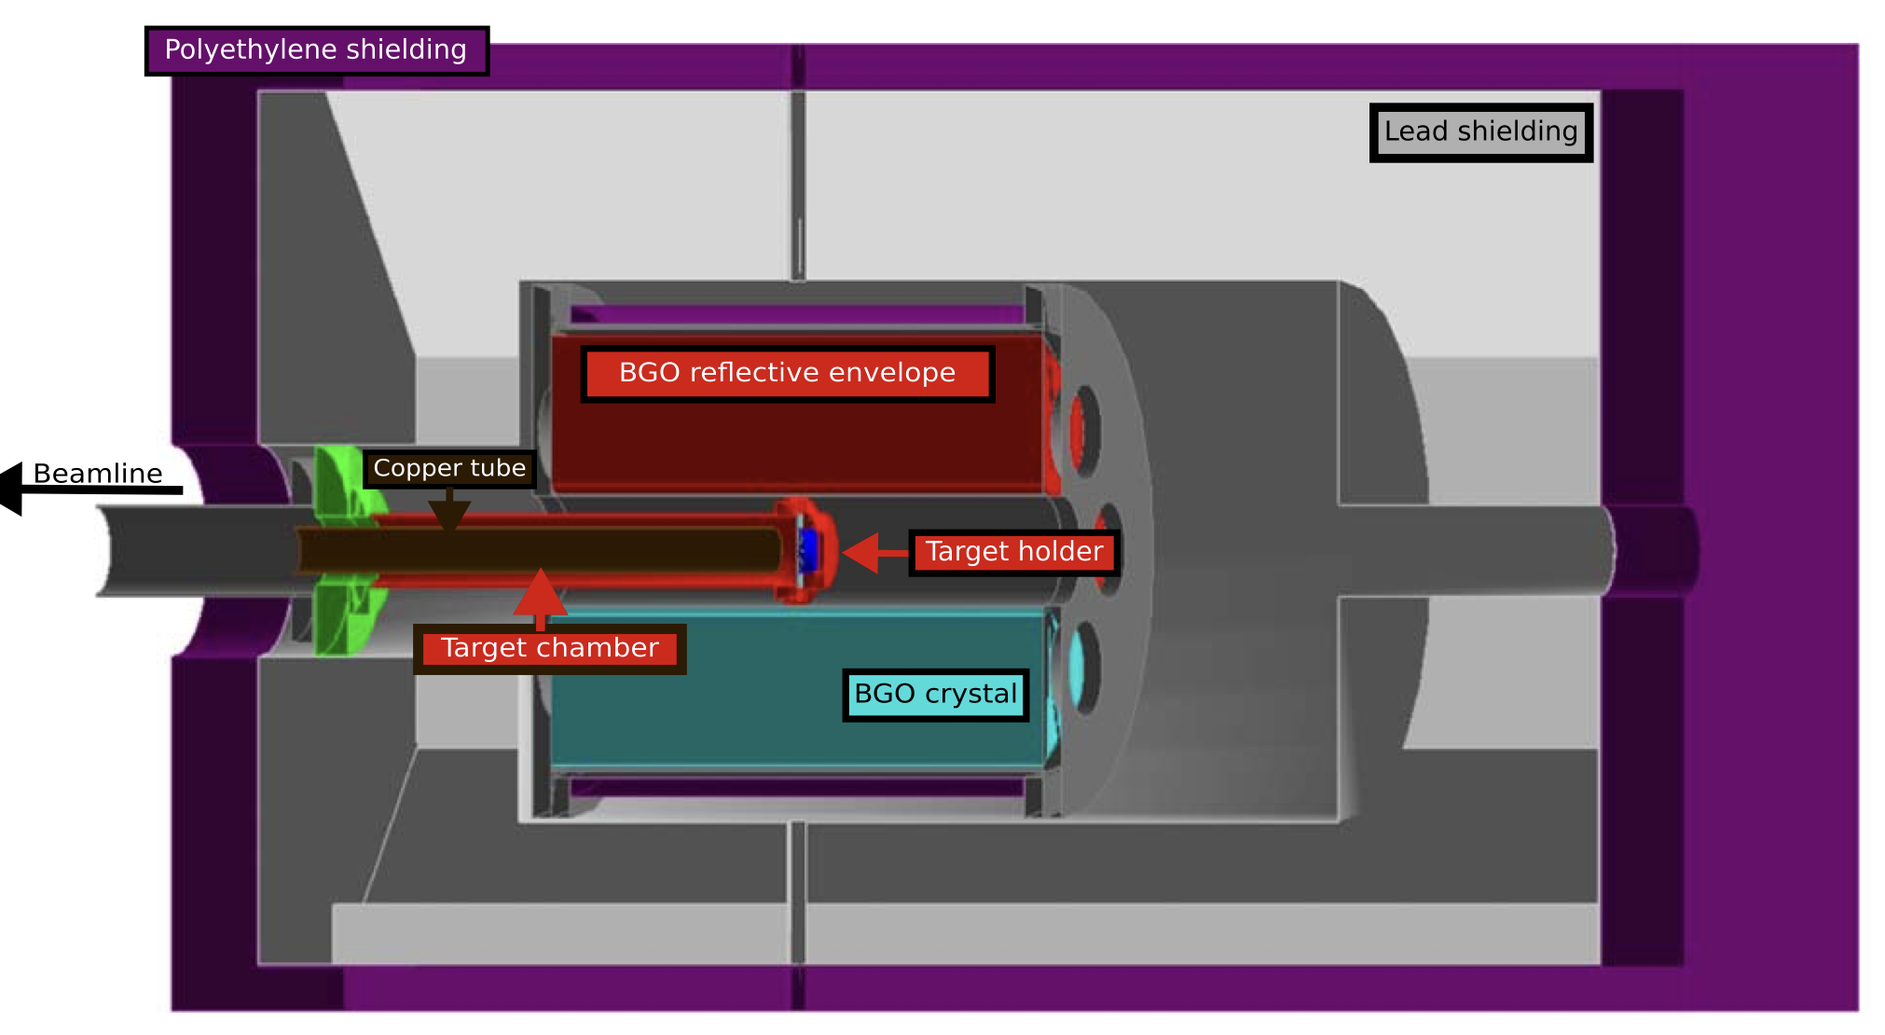
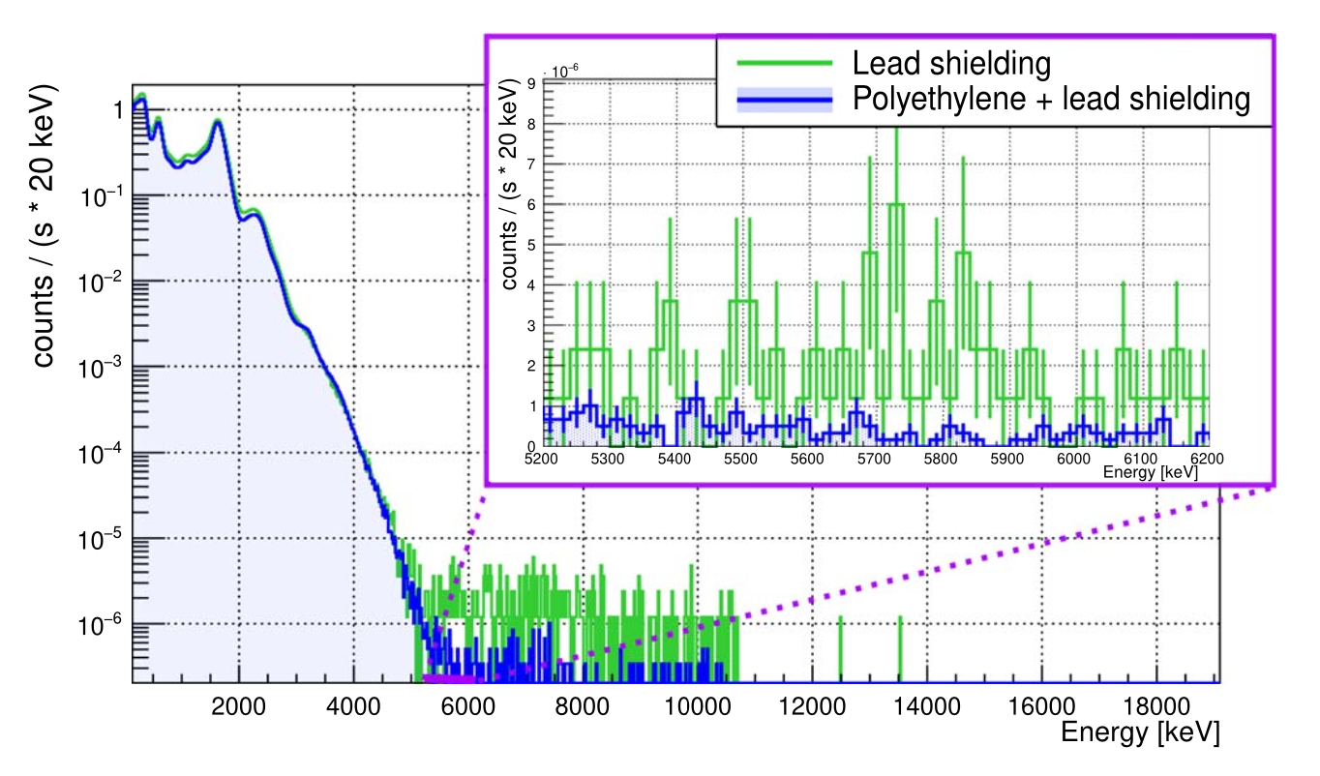
HIGH EFFICIENCY γ−rays PARTICLES DETECTORS
Bismuth Germanate Oxide detector
Optimal solution for reactions with high Q-value
6 optically independent segments, each of them read out by one photomultiplier tube (Total Absorbtion Spectroscopy).
For each signal in each cystal, energy and timestamp are saved
Proper shielding and proper coupling with target holder for maximization of background reduction and efficiency
steel chamber
Brass holder + steel chamber
Al holder+ Al chamber

Slide 15
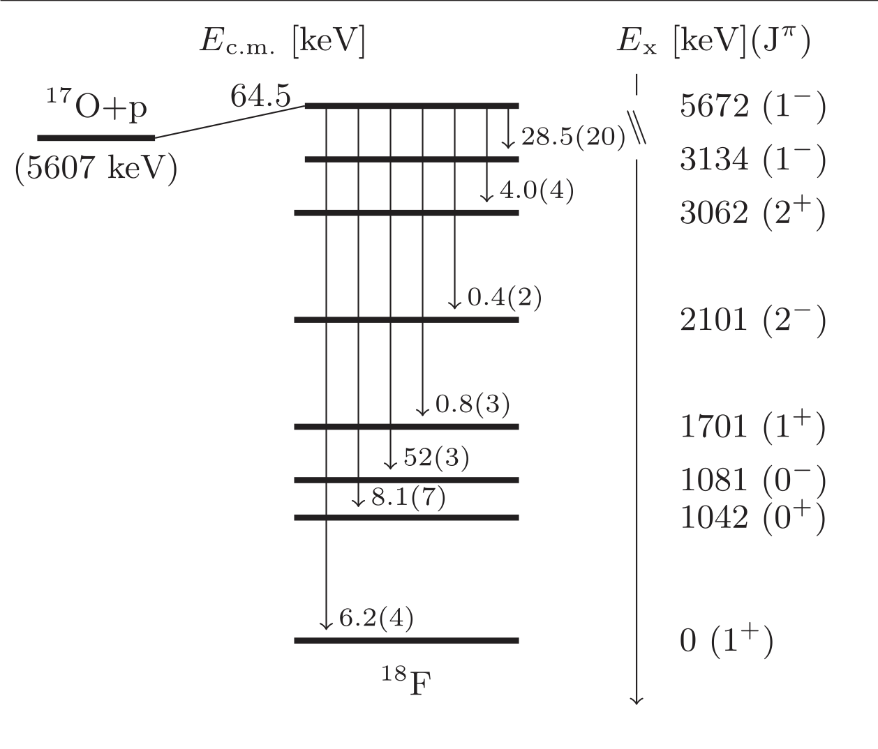
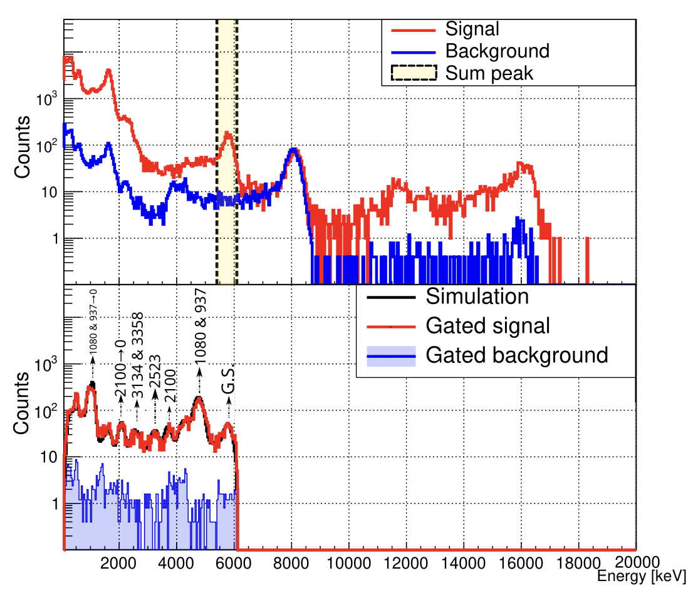

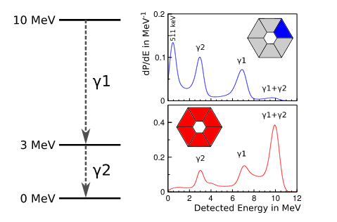
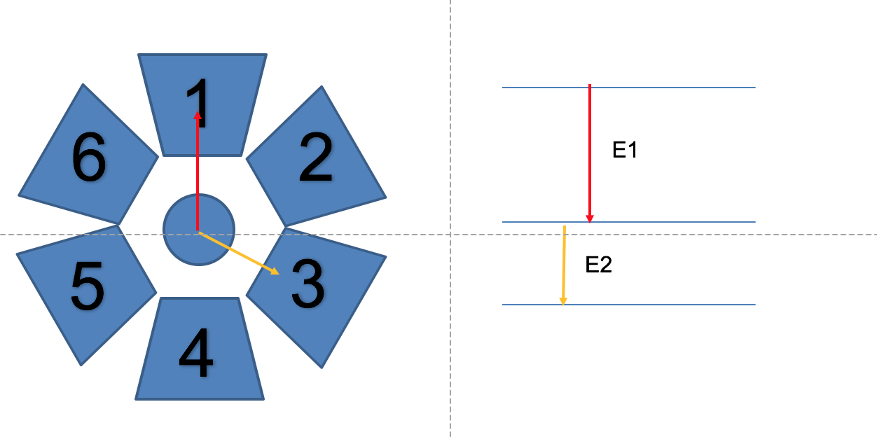

Coincidence analysis with the BGO setup
Add-Back:By adding the energy of «coincident» events (Δt<35 μs) in the individual crystals, a total energy (sum, or add-back) spectrum can be obtained, while the energy deposition in the individual crystals allows to infer information on the individual γ-rays emitted in the cascades
5.67
Q = 5.6 MeV
5.56 MeV
¹⁷O+p
Q = 5.5 MeV
D+p
γ3
1.08
0 MeV
In spectrum 1 → 1 event of E1
In spectrum 3 → 1 event of E2
In the post processing sum spectrum → 1 event of E1+E2 (Q+E_{p,cm} )

Slide 16
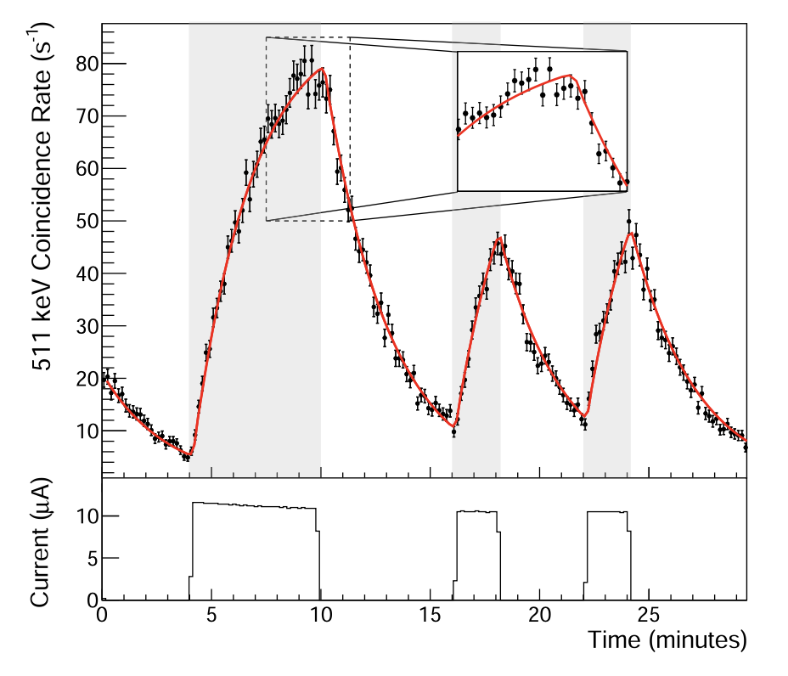
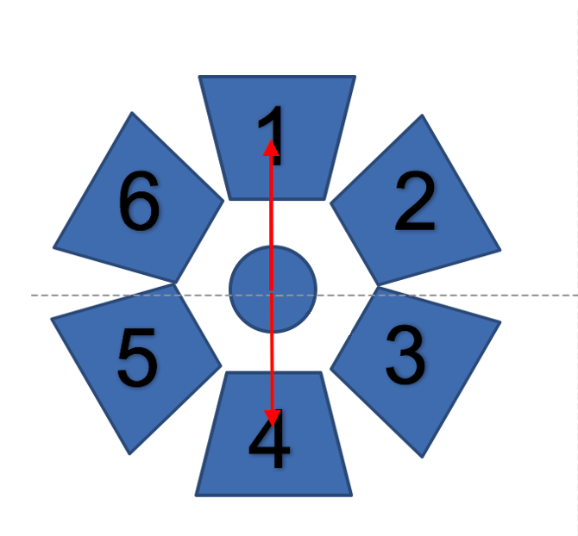
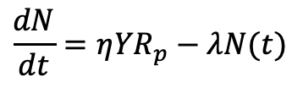
Coincidence analysis with the BGO setup
β+ reaction products decay by emission of e⁺ particles,
annihilate with an e⁻.
The 511 keV γ-rays created in e⁺e− annihilation are emitted in opposite directions from the point of annihilation.
Because of the BGO segmentation and 4π geometry, this translates to a coincident detection
of two 511 keV signals in opposite crystals
Counting the number of nuclei produced in the reaction by detecting the 511 keV γ-rays created in the e⁺e⁻ annihilation following their decay is a form of
activation method
$$\frac{dN}{dt}=η{YR}_{p}−λN(t)$$

Slide 17
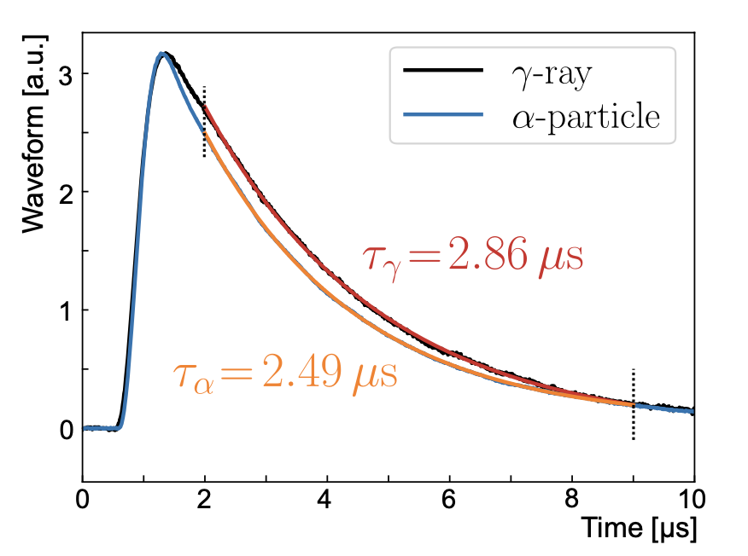
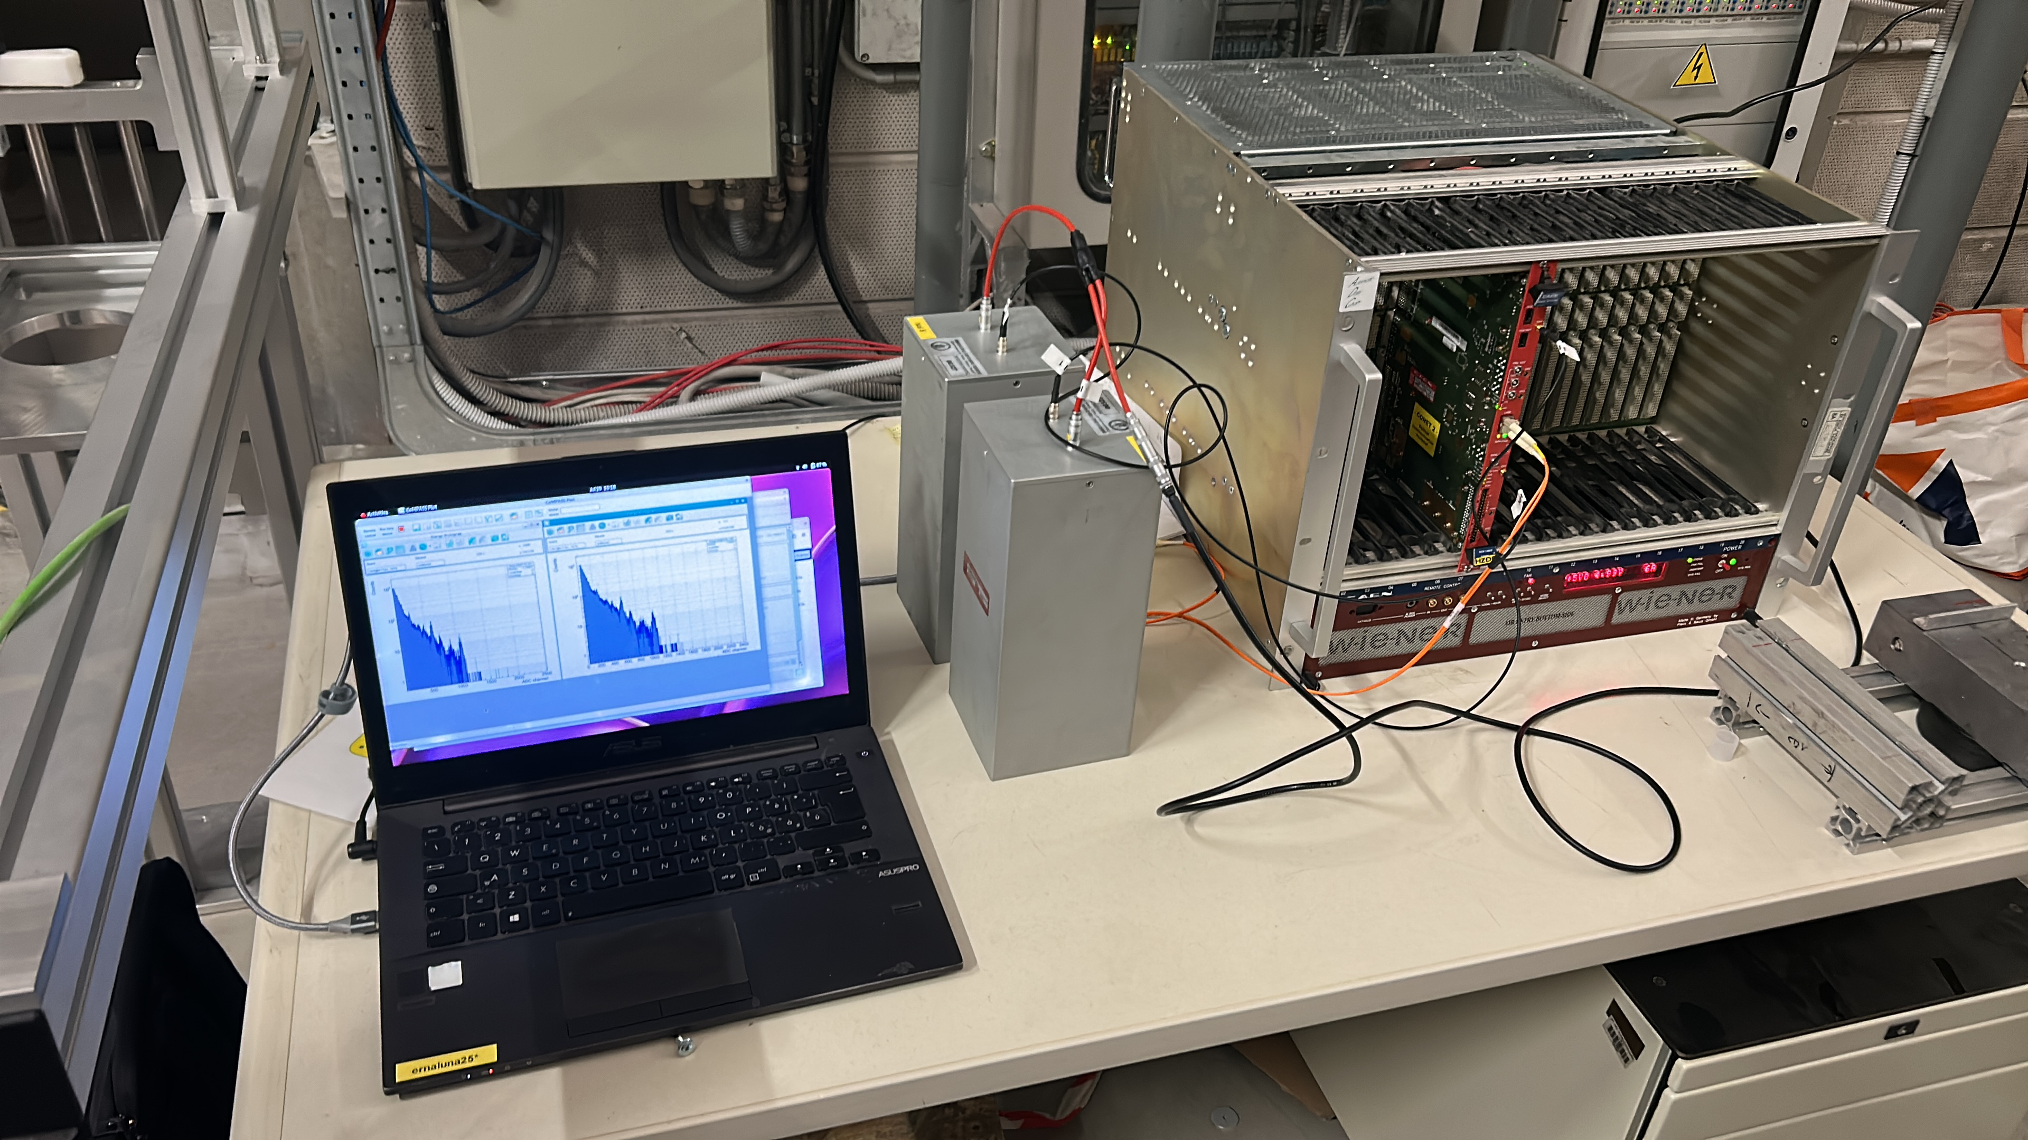
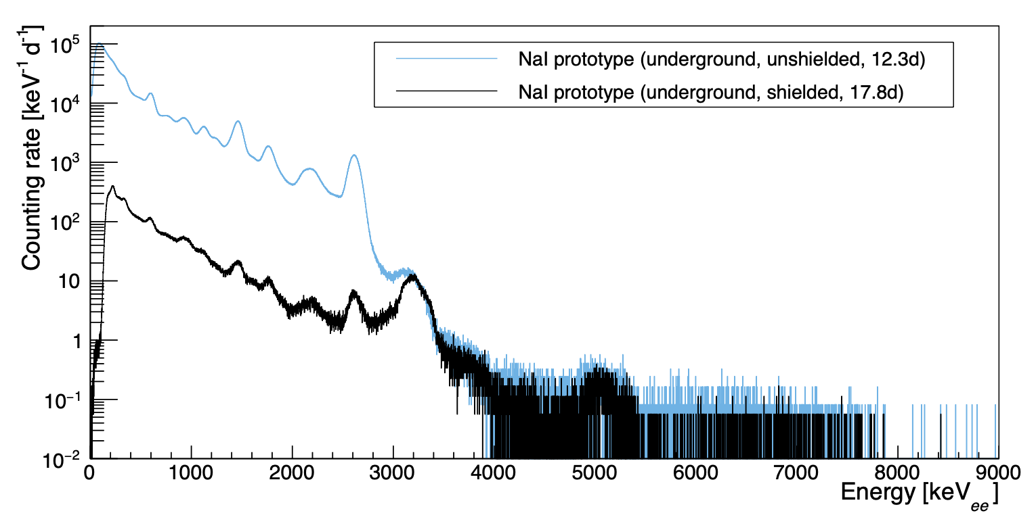
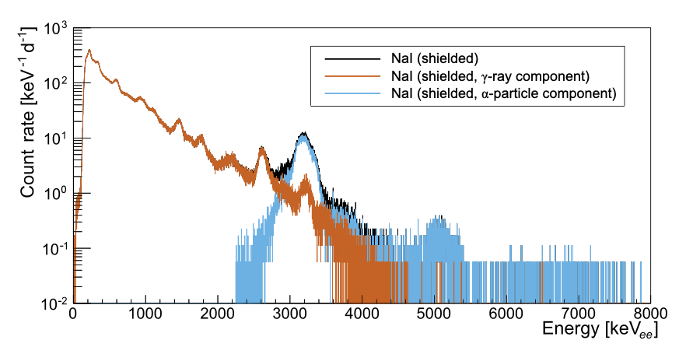
γ−rays PARTICLES DETECTORS
High efficiency detectors
NaI detectors: 109x109x254 mm each, coupled to a SiPM

Slide 18
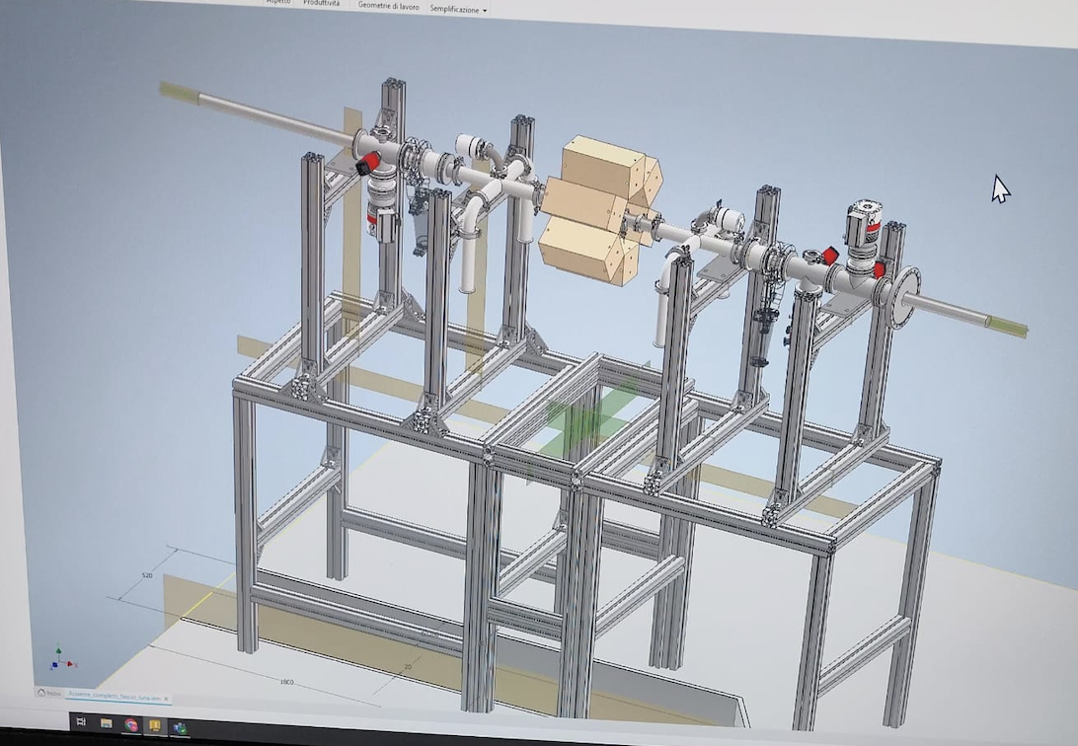
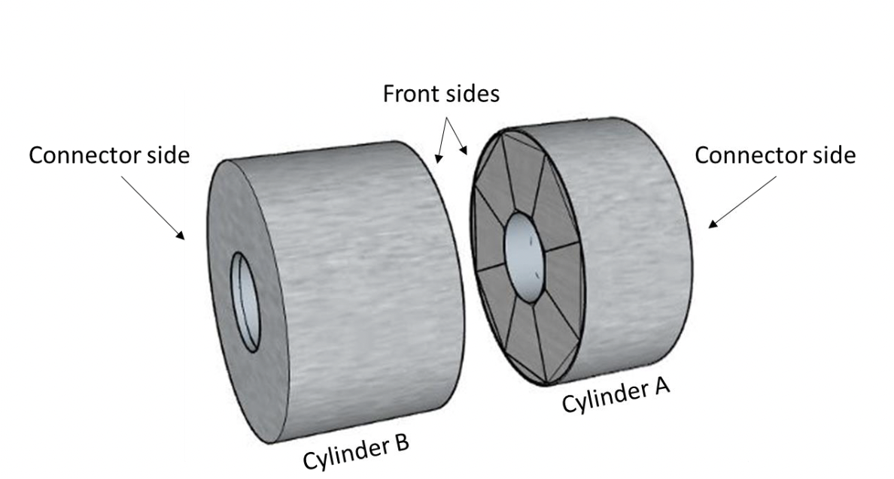
NaI APPLICATION
Detectors for Compton Veto
NaI(Tl) detector as a veto detector within the upcoming campaign. When γ-rays stemming from these contaminations within the NaI(Tl) detector deposit energy in GePD2, their associated α and β particles
from the respective decay are expected to also induce
a signal in the NaI(Tl) detector and are therefore
automatically vetoed out
Array of 6 NaI for the measurement of the ²²Ne(a,γ)²⁶Mg reaction in the framework of the Easy experiment starting from next year

Slide 19


SIMLUNA mainly developed by Z. Elekes (ATOMKI)
Geant4-based simulation code including different setup used by LUNA collaboration

Slide 20

LunaDAQ mainly developed by J. Skowroński and A. Compagnucci
This system integrates real-time data collection, analysis, and FAIR-compliant metadata management in a user-friendly web interface
Key Capabilities
Real-time Data Acquisition from multiple detector channels
Interactive Visualization of spectra and waveforms
FAIR Metadata Management for experimental runs
Secure User Authentication with role-based access
Dockerized Analysis Pipeline with XDAQ integration

Slide 21
RECENT PAPERS ON DETECTORS (AND MORE WILL COME!!)
«Resonance strengths in the ^{17,18}O(p,α)^{14,15}N reactions and background suppression underground» Bruno et al Eur. Phys. J. A (2015) 51: 94
«Characterization of the LUNA neutron detector array for the measurement of the ¹³C(α,n)¹⁶O reaction», Csedreki et al Nuclear Inst. and Methods in Physics Research, A 994 (2021) 165081
«A prototype neutron-detector array for future deep- underground s-process studies», Chillery et al J. Phys. G: Nucl. Part. Phys. 52 075202 (2025)
«Advances in radiative capture studies at LUNA with a segmented BGO detector» Skowronski Et Al J. Phys. G: Nucl. Part. Phys. 50 045201 (2023)
«Detectors and Shieldings: Past and Future at LUNA», Ananna Et Al Universe 2024, 10(5), 228
«Detector characterization for a new 12C+12C reaction study at LUNA», Gesuè et al, J. Phys. G: Nucl. Part. Phys. 105296 (2025)
«Towards a comprehensive study of the ¹⁴N(p,γ)¹⁵O astrophysical key reaction: Description of the experimental technique including novel target preparation», Compagnucci et al Eur. Phys. J. A (2025) 61:191

Slide 22
WHAT’S NEXT?
Thanks to the long and wide experience acquired with detectors, LUNA collaboration is ready to effort new challenges in Nuclear Astrophysics (and maybe more?!?!)
Combine gamma detector and charged particle detector for the 12C+12C reaction and further reduce the background
Double the number of channels of the BGO detector

Slide 23






THANK YOU FOR THE ATTENTION

