Slide 1



TARGET DEVELOPMENTS
AT LUNA
Denise Piatti¹ and Matteo Campostrini²
1 = University and INFN of Padua, via Marzolo 8 35136 Italy
2 = INFN - Laboratori Nazionali di Legnaro, viale dell’Università 2 35020 Italy

Slide 2
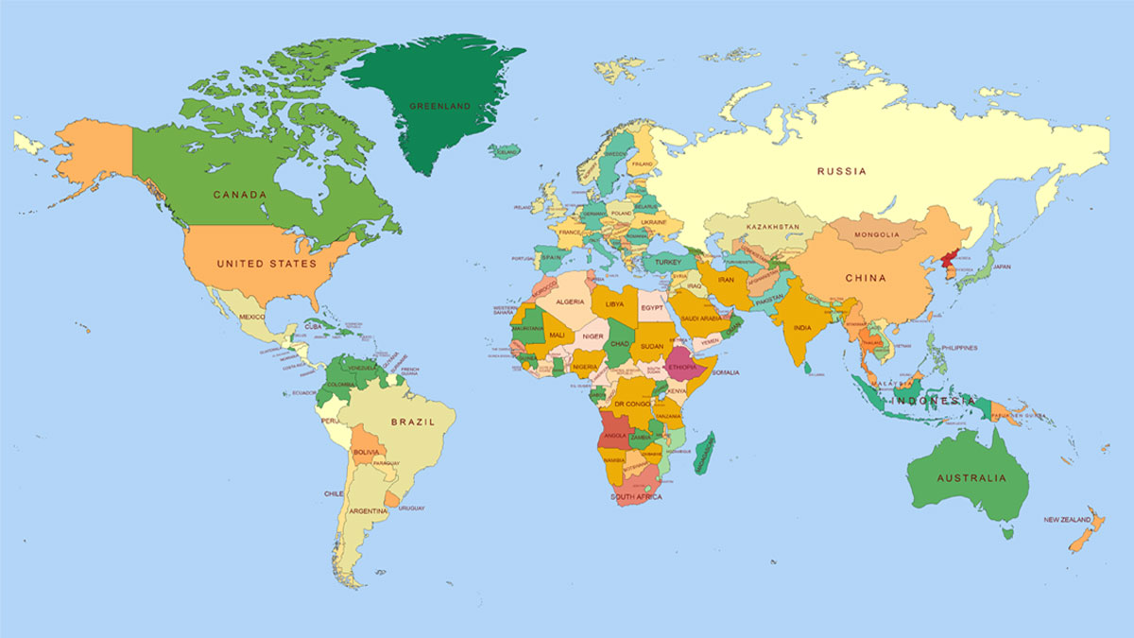
Where and how are they produce?
Speaking of LUNA
Felsenkeller
45 m underground (shallow)
5 MV: H⁺, He⁺, C⁺, C⁺⁺
I_{max} = 30e𝜇A
Since 2019
JUNA
2400 m underground
400 kV: H⁺, He⁺, He⁺⁺
I_{max} = 1200 e𝜇A
Since 2021
CASPAR
1290 m underground
1 MV: H⁺, He⁺
I_{max} = 250 𝜇A
Since 2017
Bellotti IBF
1400 m underground
3.5 MV: H⁺, He⁺, C⁺, C⁺⁺
I_{max} = 1000 e𝜇A
Since 2023
LUNA
1400 m underground
50 kV: H⁺, He⁺
400 kV: H⁺, He⁺
I_{max} = 100 -1000 e𝜇A
Since 1991/2003
Perspective at the Bellotti IBF workshop, LNGS (Italy), October 8th - 10th 2025

Slide 3
A successful 35 years long story…
Reaction | Accelerator | Astrophysical Motivation/Scenario
D(α,γ)⁶Li; ³He(α,γ)⁷Be; D(p,γ)³He | LUNA400kV | Big Bang Nucleosynthesis (BBN), Lithium problem(s)
3He+3He; D(p,γ)3He | LUNA50kV | pp-chain and Solar neutrinos
6Li(p,γ)7Be | LUNA400kV | Stars, cosmic-ray spallation and BBN; Resonance NOT confirmed
12,13C(p,γ)13,14N | LUNA400kV | CNO cycle kick off reactions; only few, poorly constrained data
14,15N(p,γ)15,16O | LUNA400kV | CNO cycle bottleneck;
17,18O(p,α)14,15N | LUNA400kV | CNO cycle; crucial for oxygen isotopic abundance in AGB stars
16,17,18O(p,γ)17,18,19F | LUNA400kV | CNO cycle and CNO leak
20,21,22Ne(p,γ)21,22,23Na | LUNA400kV | NeNa cycle; affecting abundances up to P
23Na(p,γ)24Mg | LUNA400kV | NeNa-MgAl cycle link
25Mg(p,γ)26Al | LUNA400kV | MgAl cycle; poorly constrained resonances dominate the rate
13C(α,n)16O, 22Ne(α,γ)26Mg | LUNA400kV | s-process crucial for production of isotopes heavier than iron
Perspective at the Bellotti IBF workshop, LNGS (Italy), October 8th - 10th 2025

Slide 4
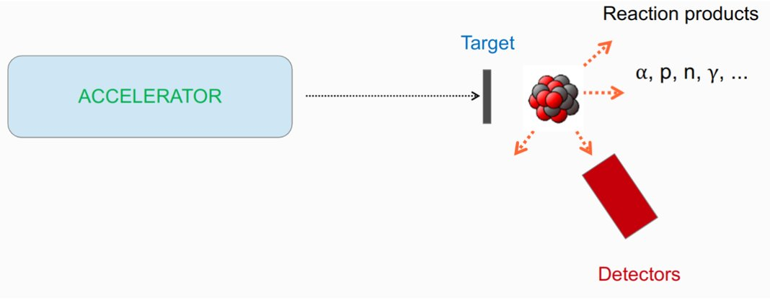
Where and how are they produce?
… but also painful…
LUNA performs direct measurement for which some ingredients are required:
High efficiency and resolution
Low intrinsic background
Versatile geometry
…
High density
Favorable stoichiometry
High stability under irradiation
Wide thickness range
High purity
Not fragile, easy to handle
Enriched on demand
Cheap
…
High stability and intensity beam
Low beam spread
Perspective at the Bellotti IBF workshop, LNGS (Italy), October 8th - 10th 2025

Slide 5


Where and how are they produce?
… indeed
The perfect target is a unicorn!
PERFECT
TARGET
Perspective at the Bellotti IBF workshop, LNGS (Italy), October 8th - 10th 2025

Slide 6
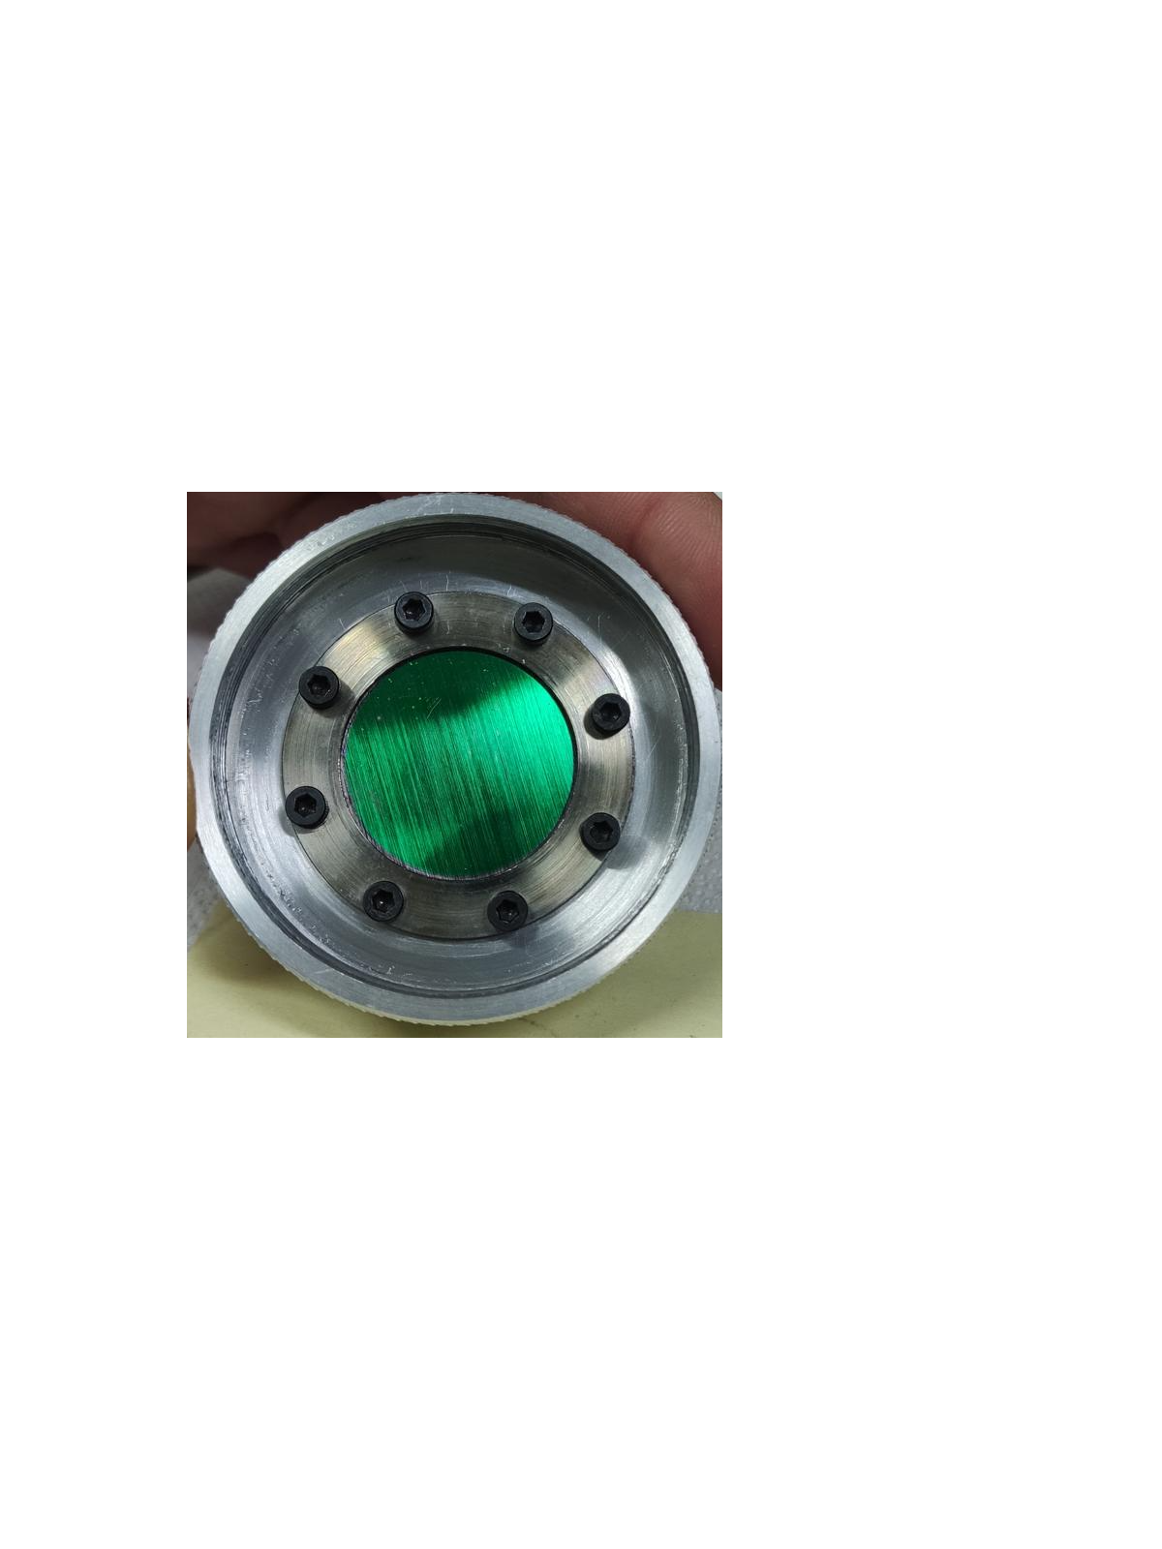
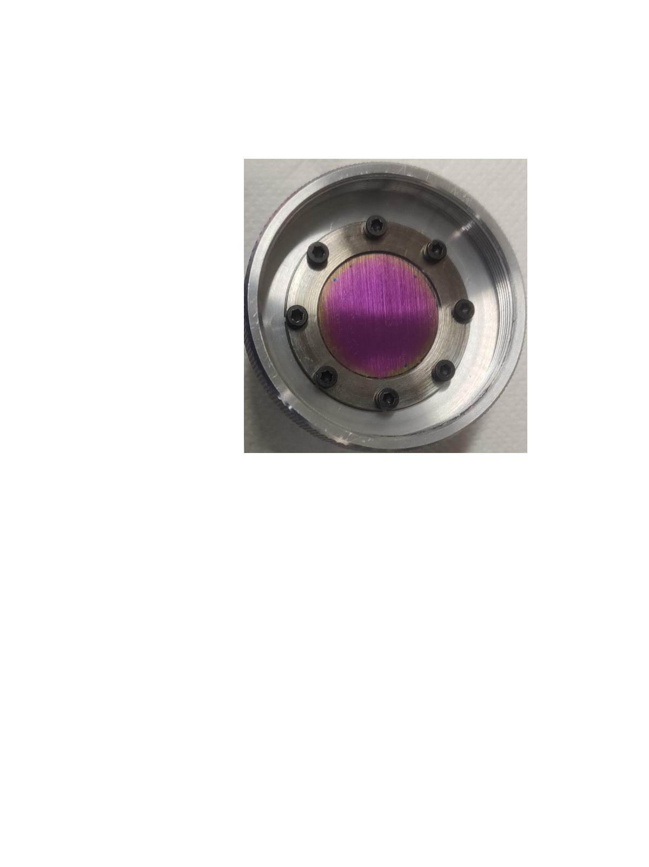
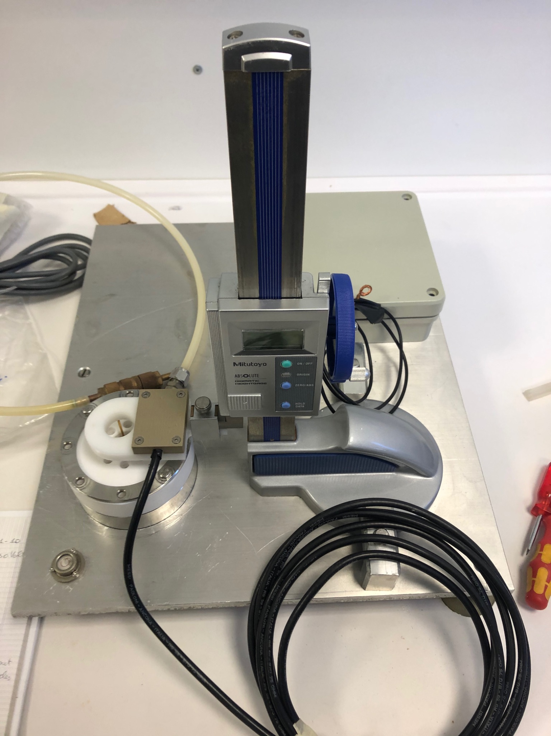
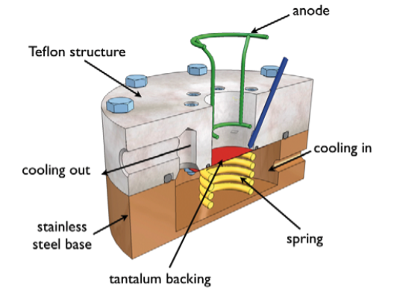
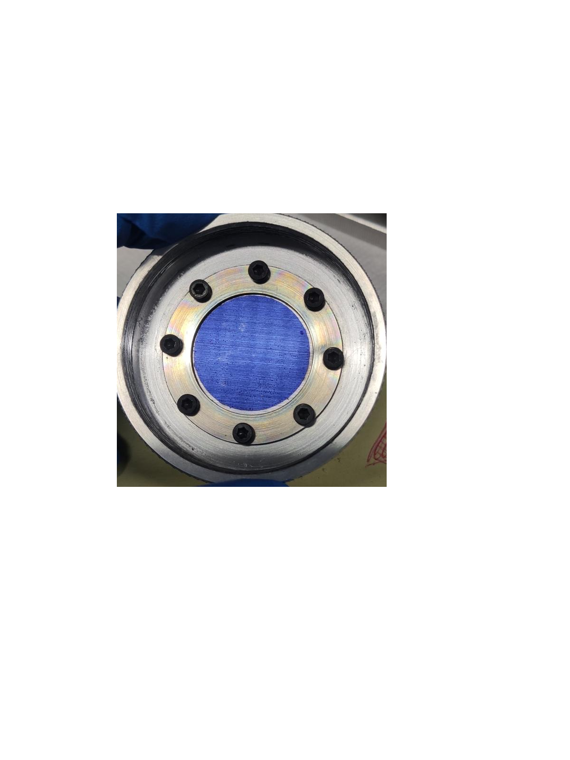
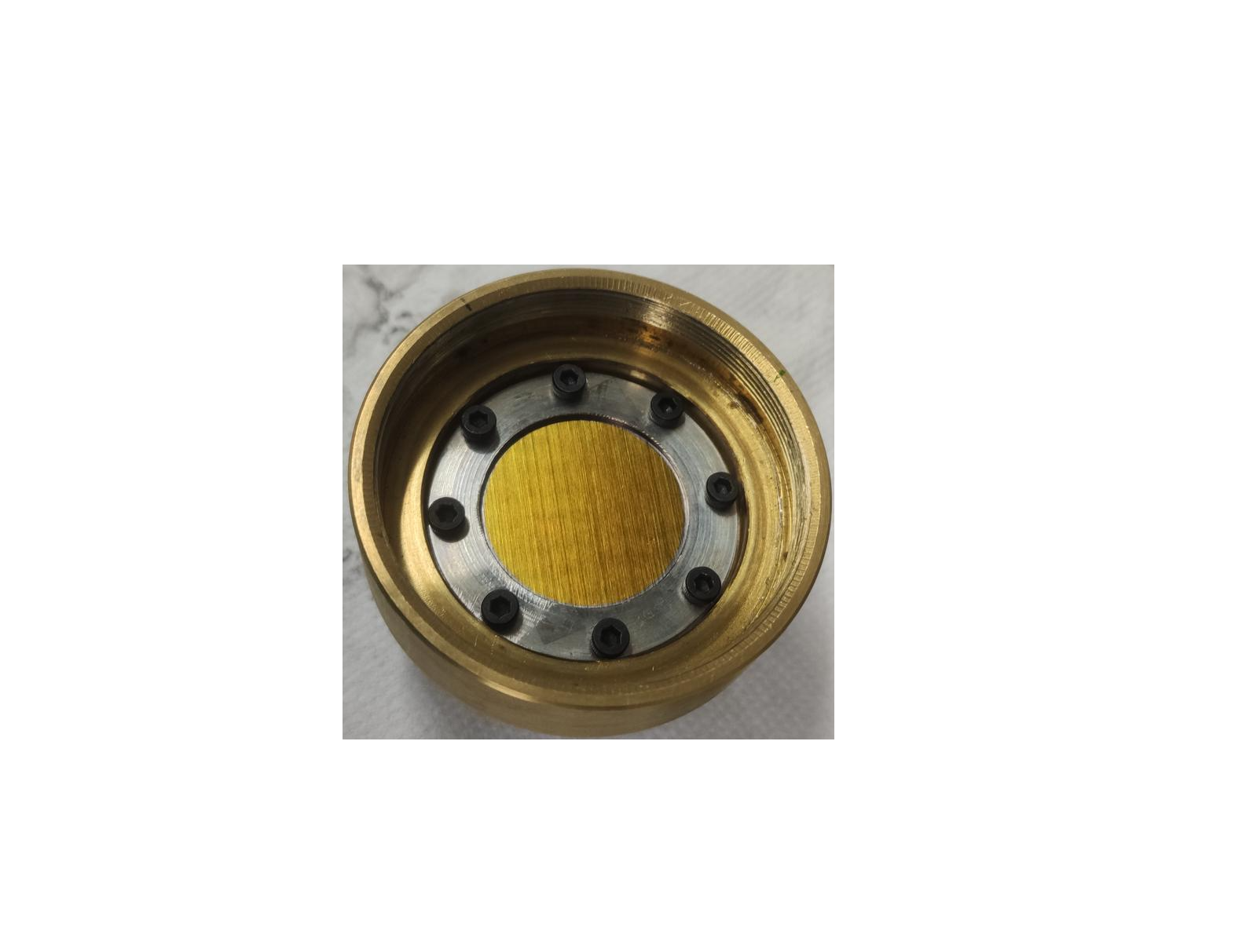
Where and how are they produce?
LUNA Solid Targets - Oxygen Targets
The (recent) aim: the first direct determination of the 64.5 keV resonance of the ¹⁷O(p,𝛾)¹⁸F reaction
Technique: anodic oxidation of Ta in enriched (at 90% level in ¹⁷O) water solution which acts as the electrolyte
pot for
enriched water
Perspective at the Bellotti IBF workshop, LNGS (Italy), October 8th - 10th 2025

Slide 7
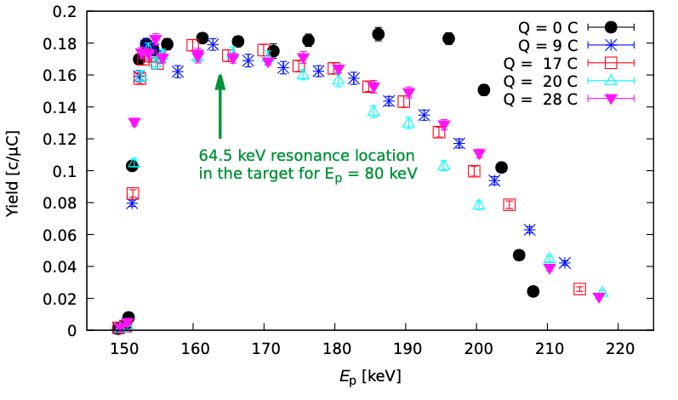
Where and how are they produce?
LUNA Solid Targets - Oxygen Targets
The (recent) aim: the first direct determination of the 64.5 keV resonance of the ¹⁷O(p,𝛾)¹⁸F reaction
Technique: anodic oxidation of Ta in enriched (at 90% level in ¹⁷O) water solution which acts as a electrolyte
Target features [Gesué, R.M. et al., PRL 133 (2024), Caciolli, A. et al, EPJ A 48 (2012) and references therein]:
easy and fast to produce (1h per target on average)
uniform
well known target stoichiometry, Ta₂O₅
well known target stability (10-20% degradation with Qtot = 25-30 C)
well known voltage-thickness relation in the range 50 - 400 nm
target areal density of 10¹⁷-10¹⁸ atoms/cm²
online characterization via NRRA doping the solution with ¹⁸O
if handled with care no contaminants introduced in the production
SO FAR IT SEEMS VERY CLOSE TO THE UNICORN!!!!
BUT….
Perspective at the Bellotti IBF workshop, LNGS (Italy), October 8th - 10th 2025

Slide 8



Where and how are they produce?
LUNA Solid Targets - Oxygen Targets
SO FAR IT SEEMS VERY CLOSE TO THE UNICORN!!!!
BUT
Ta backing is a sponge for contaminants (bulk and surface) [Campostrini, M. et al., EPJ ST 233 (2024)]:
Superficial Fluorine can be reduced by 3 orders of magnitude via acid bath
Boron contamination is reduced by 2 orders of magnitude via acid bath
Deuterium, however, could be reduced by a factor of 4 applying a Mo coating to the Ta but this was not useful for the ¹⁷O(p,𝛾)¹⁸F investigation
AND GUESS WHAT…
Good electrical
and thermal conductivity
high Z
and of course suitable for anodic oxidation
Low H permeability [Katsuka H., J. Phys. Chem. Solids 43 (1982)]
Perspective at the Bellotti IBF workshop, LNGS (Italy), October 8th - 10th 2025

Slide 9

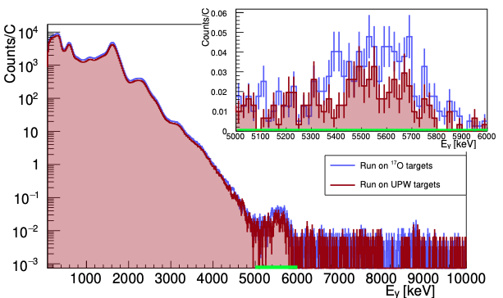
Where and how are they produce?
LUNA Solid Targets - Oxygen Targets
SO FAR IT SEEMS VERY CLOSE TO THE UNICORN!!!!
BUT
Ta backing is a sponge for contaminants (bulk and surface) [Campostrini, M. et al., EPJ ST 233 (2024)]:
Superficial Fluorine can be reduced by 3 orders of magnitude via acid bath
Boron contamination is reduced by 2 orders of magnitude via acid bath
Deuterium, however, could be reduced by a factor of 4 applying a Mo coating to the Ta but this was not useful for the ¹⁷O(p,𝛾)¹⁸F investigation
AND GUESS WHAT…
At this point you can only be smart [Gesué, R.M. et al., PRL 133 (2024)]
ROI
Perspective at the Bellotti IBF workshop, LNGS (Italy), October 8th - 10th 2025

Slide 10
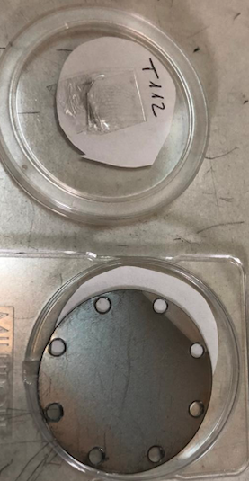
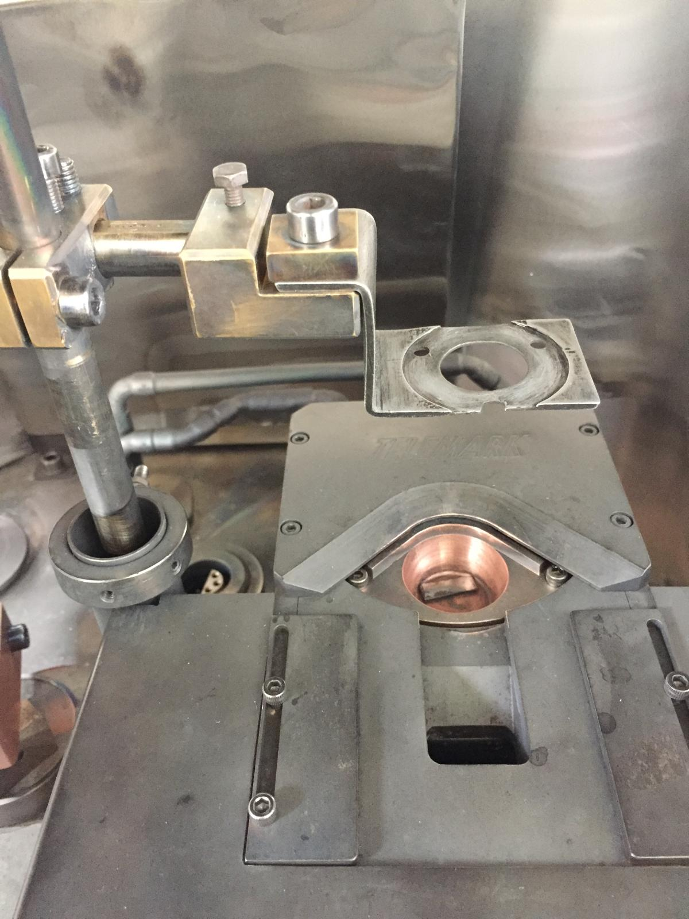
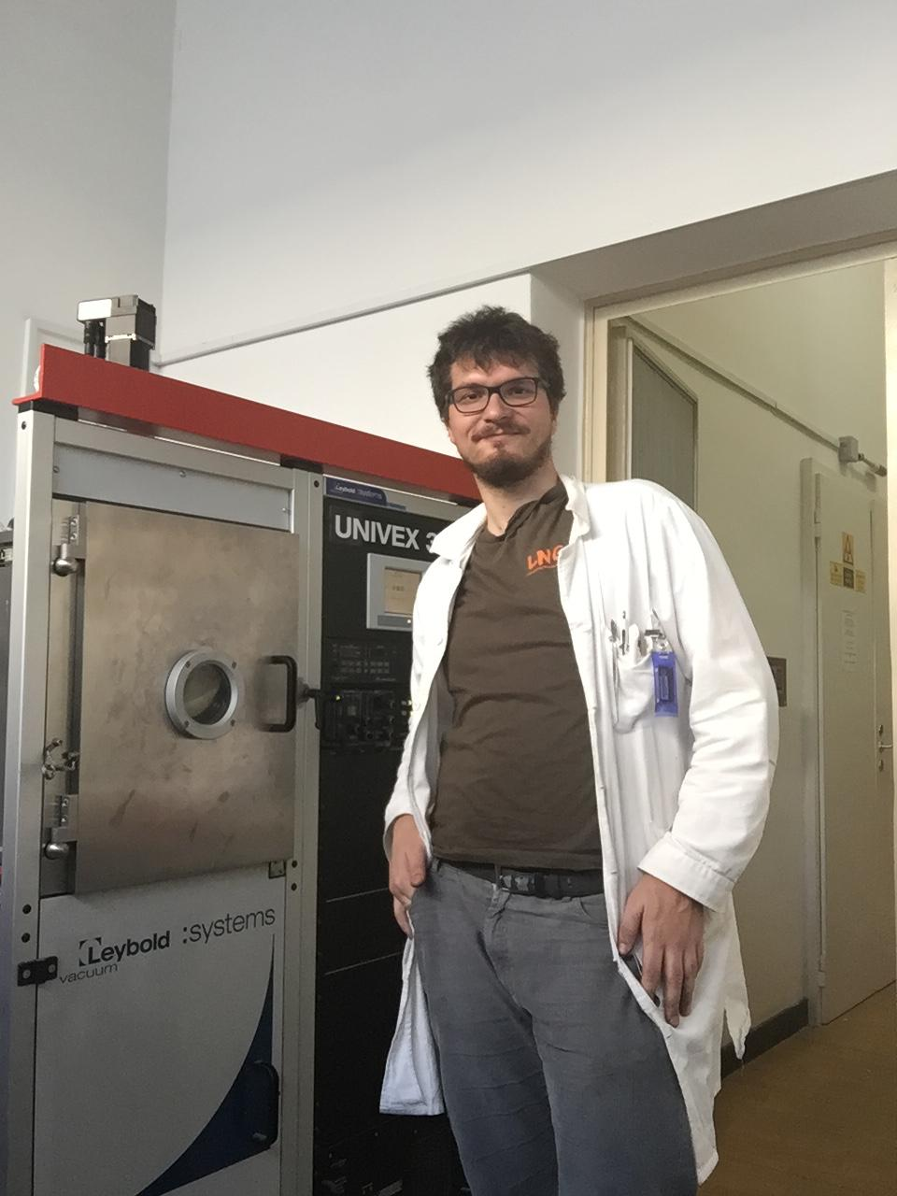
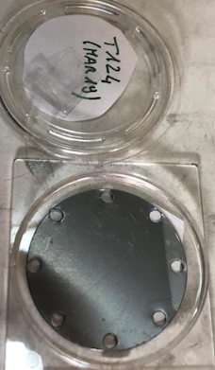
Where and how are they produce?
LUNA Solid Targets - Carbon Targets
The aim: the measurement of the ¹³C(𝛼,n)¹⁶O reaction cross section.
Technique: Evaporation (PROUDLY) performed at ATOMKI, using a Leybold UNIVEX 350 vacuum evaporator, 99% enriched ¹³C powder and Ta as backing
Adjustable arm
Ta holder
Cu melting pot
Perspective at the Bellotti IBF workshop, LNGS (Italy), October 8th - 10th 2025

Slide 11
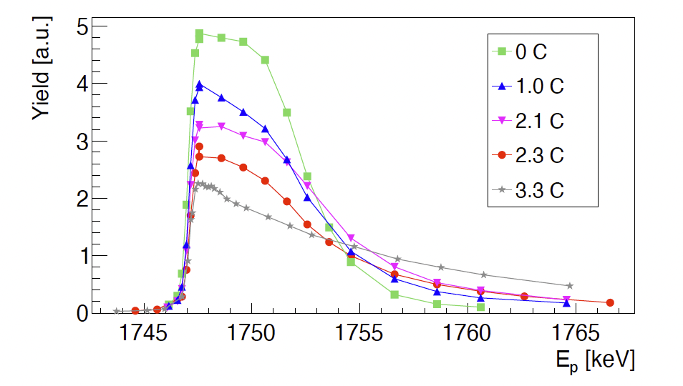
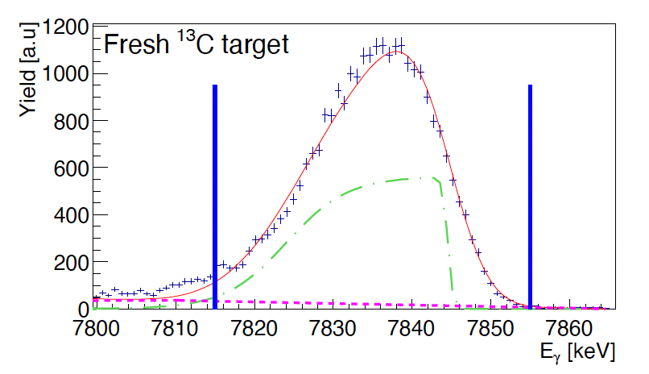
Where and how are they produce?
LUNA Solid Targets - Carbon Targets
The aim: the measurement of the ¹³C(𝛼,n)¹⁶O and ^{12,13}C(p,𝛾)^{13,14}N reaction cross sections.
Technique: Evaporation (PROUDLY) performed at ATOMK, using a Leybold UNIVEX 350 vacuum evaporator, 99% enriched ¹³C powder and Ta as backing
Target Features [Ciani, G.F. et al, PRL 127 (2021) and Ciani, G.F. et al., EPJ A 56 (2020)]:
powder stable with time
uniform
high stability under proton irradiation
target stability under 𝛼 irradiation was poor -> setup designed to change target often
Online monitoring such as NRRA not available -> Peak shape analysis
Made in ATOMKI offline
Perspective at the Bellotti IBF workshop, LNGS (Italy), October 8th - 10th 2025

Slide 12
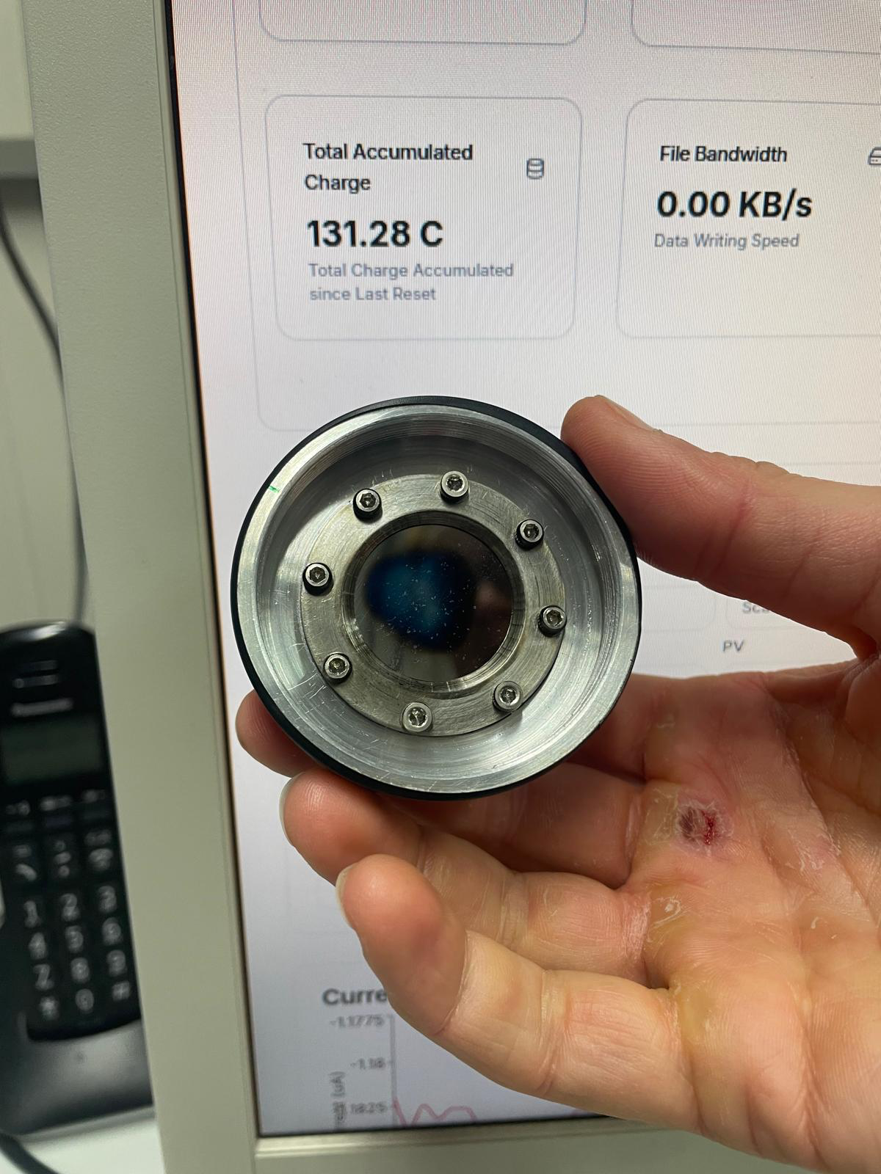
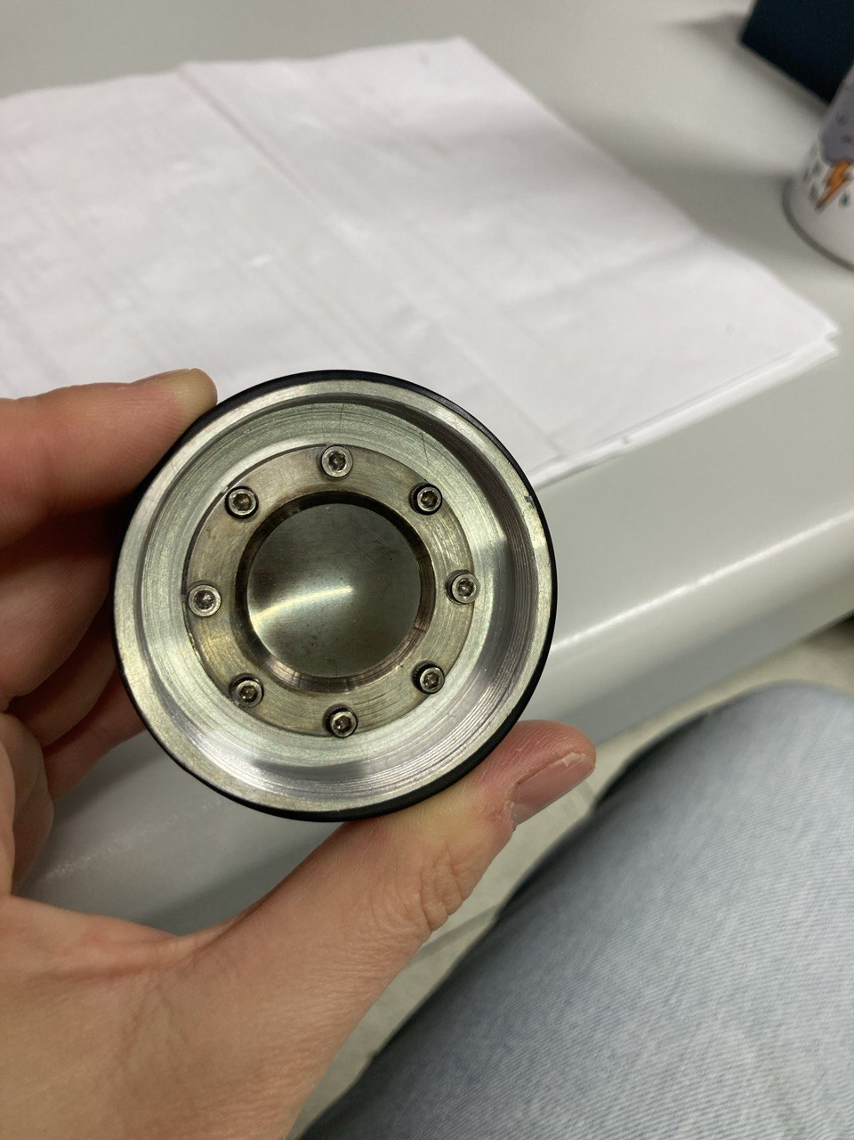
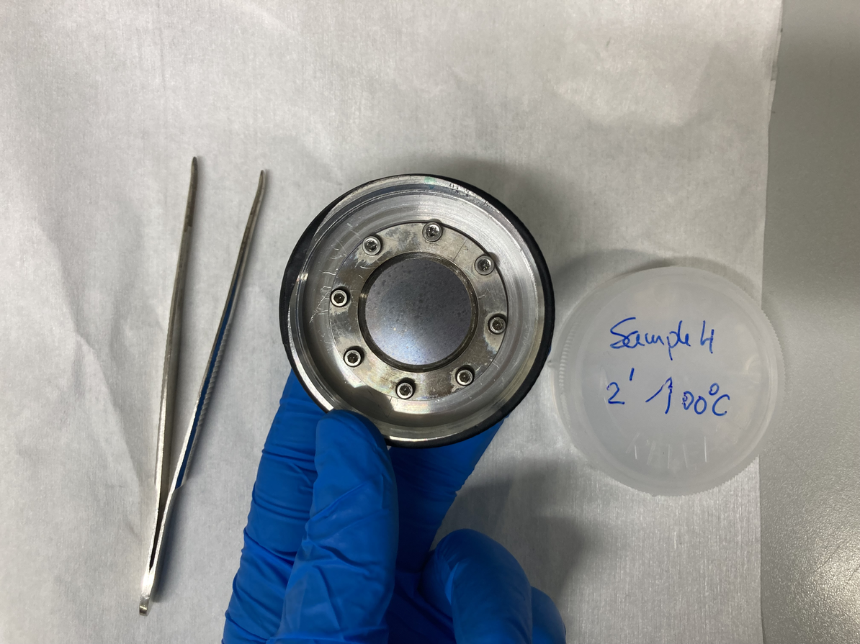
Where and how are they produce?
LUNA Solid Targets - Fluorine Targets
The aim: the measurement of the ¹⁹F(p,𝛾)²⁰Ne reaction cross section
Technique:
Evaporation starting from CaF₂ powder, performed in ATOMKI (favorable stoichiometry but bad stability)
Implantation on Ta and Fe, performed at University NOVA in Lisbon, with 10¹⁵-10¹⁷ atoms/cm²
Fluorination, performed by external company, Ta was dipped in gaseous F₂ at 500 mbar for 2’ and at 100°
2
2
3
Perspective at the Bellotti IBF workshop, LNGS (Italy), October 8th - 10th 2025

Slide 13
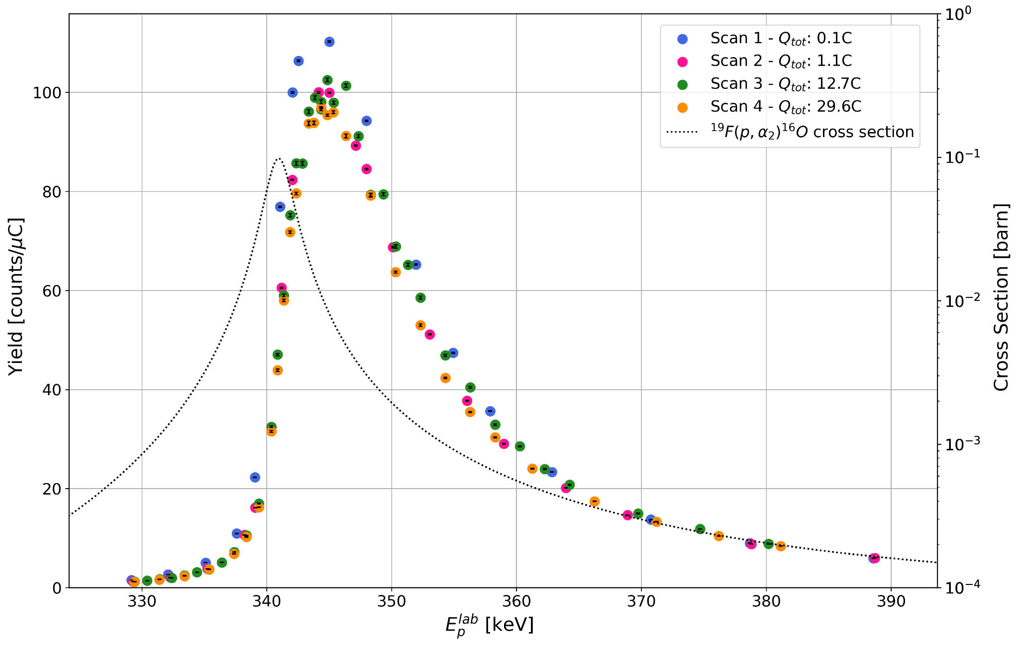
Where and how are they produce?
LUNA Solid Targets - Fluorine Targets
The aim: the measurement of the ¹⁹F(p,𝛾)²⁰Ne reaction cross section
Technique:
Evaporation starting from CaF₂ powder, performed in ATOMKI (favorable stoichiometry but bad stability)
Implantation on Ta and Fe, performed at University Nova in Lisbon, with 10¹⁵-10¹⁷ atoms/cm² and HZDR in Dresden
Fluorination, performed by external company, Ta was dipped in gaseous F₂ at 500 mbar for 2’ and at 100°
Target features:
both target types thin as desired
and stable up to high accumulated charge
stoichiometry under investigation
Boron content similar in both Fe and Ta
3
A paper is in preparation!
Perspective at the Bellotti IBF workshop, LNGS (Italy), October 8th - 10th 2025

Slide 14
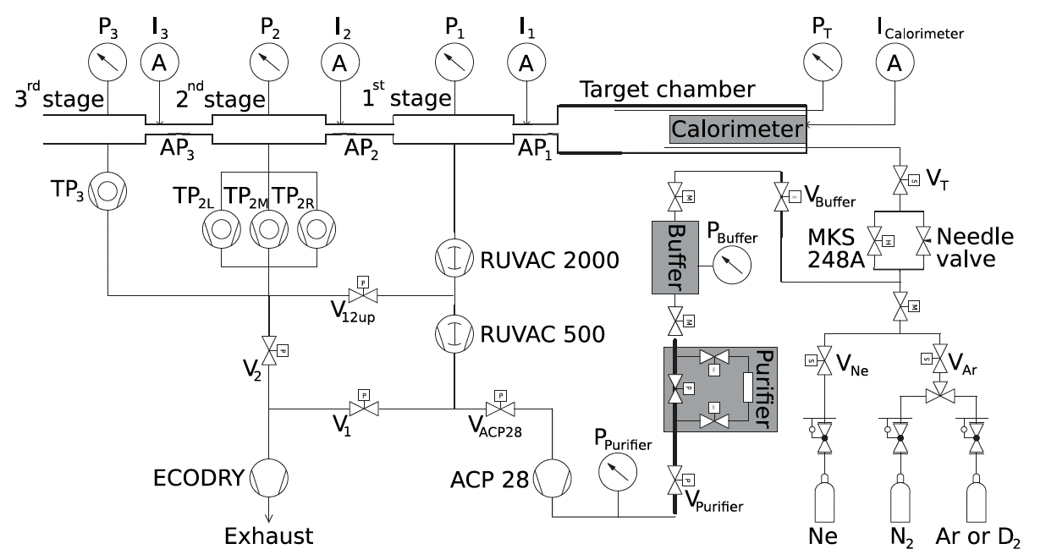
Where and how are they produce?
LUNA Targets - Gas target
Three differential pumping stages windowless gas target
Pressure in the chamber 0.3 - 2 mbar and kept constant within 0.5%
Target density of 10¹⁵ atom/cm²
High stability under irradiation
Recirculation mode for expensive gas
Calorimeter for current reading
High precision obtained for the p+D measurement
High purity BUT contaminants along beamline and at the beam stop must be annoying (B, C, N and F)
Ultrasonic bath to reduce contaminants level and runs w. noble gas to subtract it
[Ferraro F., et al., EPJ A 54 (2018); Mossa V., et al., EPJ A 56 (2020) and reference therein]
Perspective at the Bellotti IBF workshop, LNGS (Italy), October 8th - 10th 2025

Slide 15
Speaking of Perspectives

Slide 16
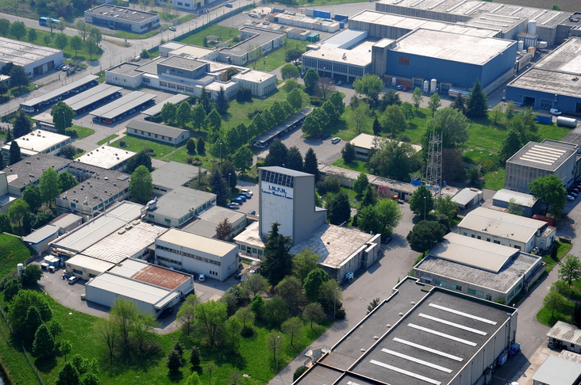
NATIONAL LABORATORIES OF LEGNARO (LNL)
Other Laboratories involved in targets production:
LNL (Padua-Italy)
LNGS (L’Aquila-Italy)
ATOMKI (Debrecen-Hungary)
University NOVA (Lisbon-Portugal)
HZDR (Dresden-Germany)
Edinburgh University (UK)
Notre Dame (USA)
……
CN facility
AN2000 facility
Laboratory of Materials Physics for Nuclear Physics

Slide 17
Legnaro WG activities
INFN CSN3 nuclear physics
Solid targets development and characterization
LNL Group:
Valentino Rigato (DT)
Carlo Roncolato (PT)
Matteo Campostrini (IIIT-TD)
INFN CSN5 interdisciplinary physics
Functional coatings with nanostructured multilayers
Sigle ion irradiation for quantum technologies
Ion-matter interaction and beam induced damage
Research Fields:
Surface engineering and materials synthesis
Characterizations (IBA, morphological Compositional and structural analysis)
High Vacuum deposition systems design and development
Ion beam irradiation
Detector testing
INFN Technological Transfer
Large area irradiations, accelerated tests for satellite components
Nanostructured coatings Mechanical reinforcement coatings
Legnaro laboratory activities and user's support
LNL Target service (technical support and IBA characterization)
SPES (target analysis, beam diagnostics, coatings…) Accelerator Division (Beam characterization, coating for RF accelerator windows)
……..

Slide 18
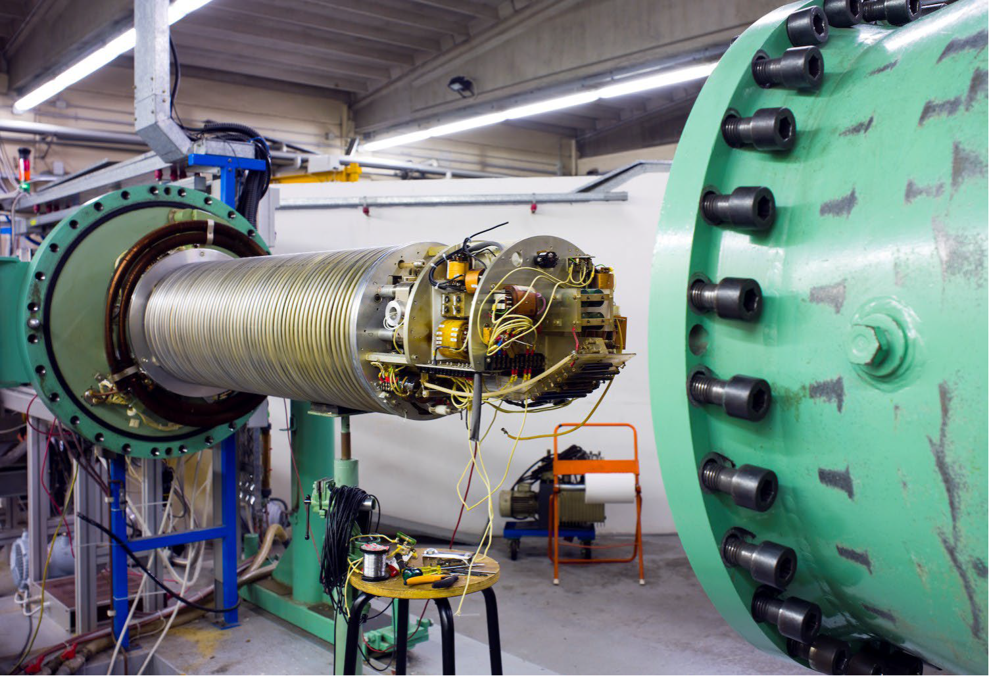
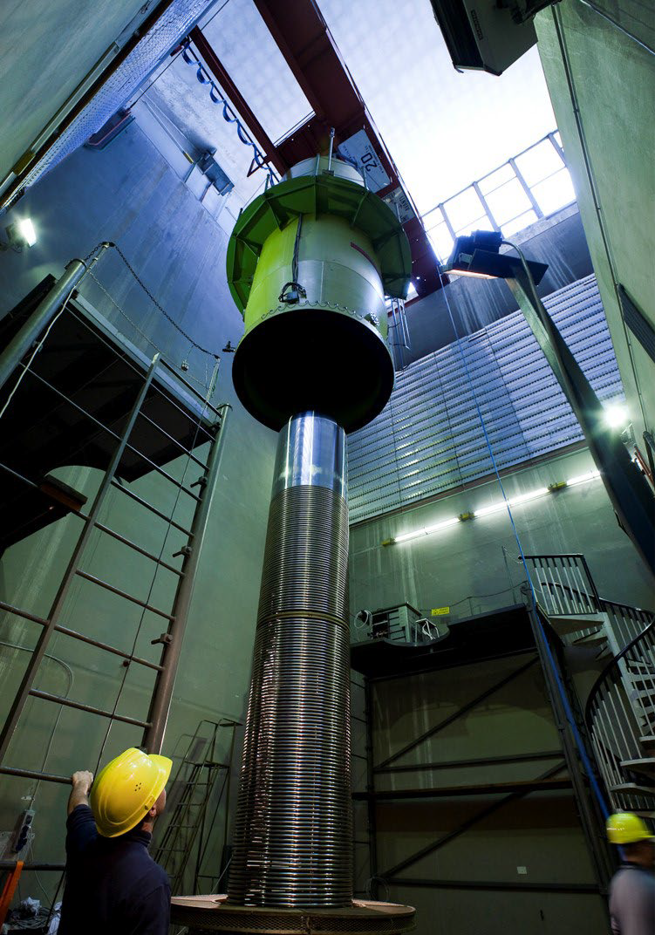
LNL ion beam facilities
AN2000
CN
Available beams:
1H+ 0.8÷5.5 MeV
2H+ 0.8÷5.5 MeV
3He+ 0.8÷5.5 MeV
4He+ 0.8÷5.5 MeV
Pulsed beam
Main activities:
IBA (EBS,NRA and PIXE)
ASIF (large area irradiation HE-facility)
Available beams:
1H+ 0.2÷2.0 MeV
3He+ 0.2÷2.0 MeV
4He+ 0.2÷2.0 MeV
1H+ and 4He+ µ-probe 2-5 µm spot size
Main activities:
IBA (EBS, NRA)
ASIDI (Single ion irradiation)
ASIF (large area irradiation LE-facility)
Detector testing
Quantum technology

Slide 19
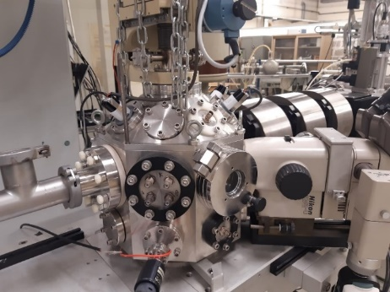
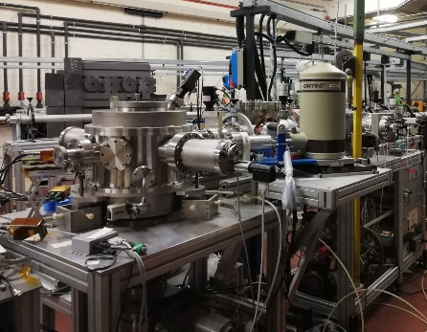
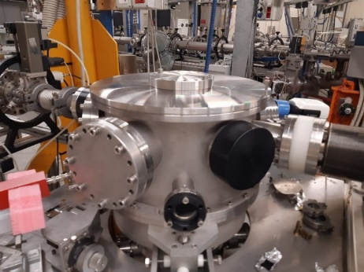
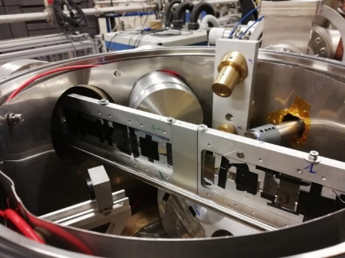
LNL ion beam facilities
AN2000
CN
µ-probe scattering chamber
(2-5 µm spot size)
Total IBA scattering chamber
(1-25 mm²
spot size)
IBA scattering chamber
(1-25 mm²
spot size)

Slide 20
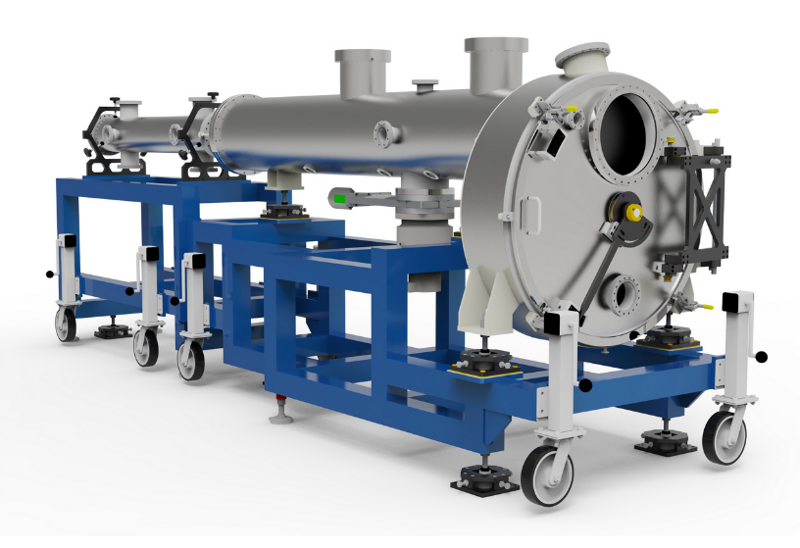
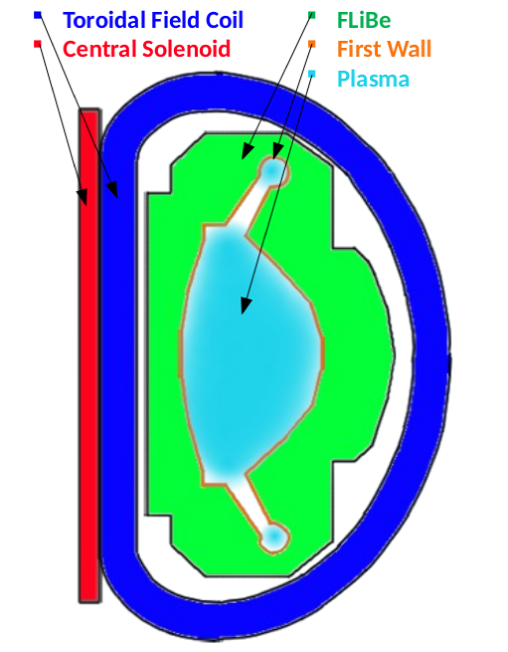
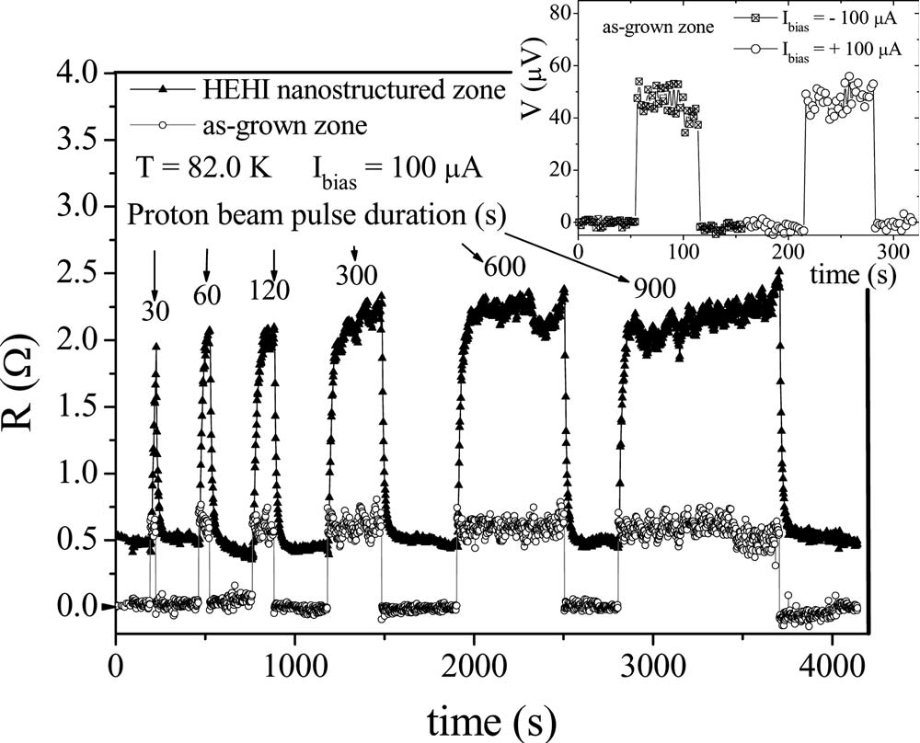


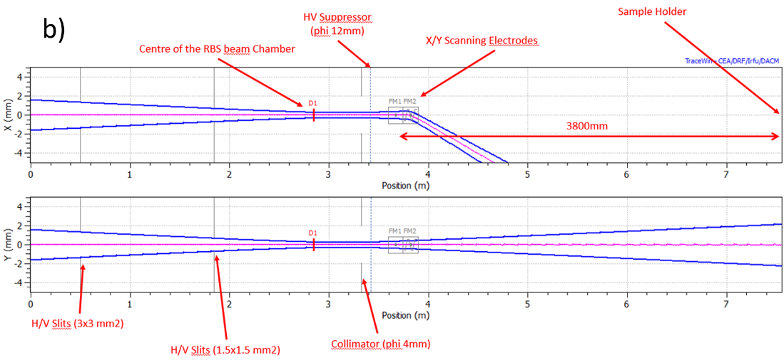
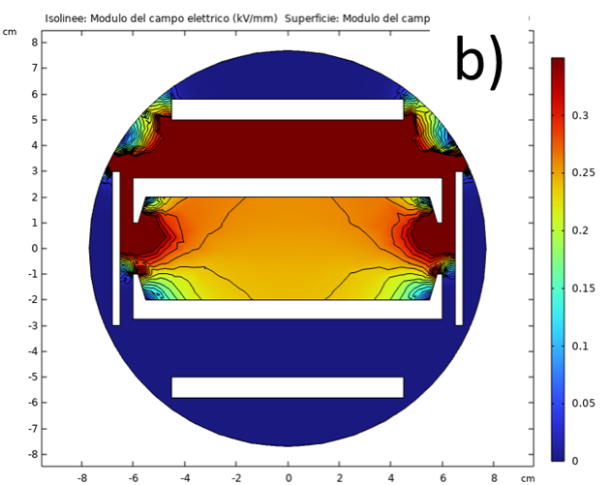
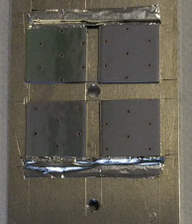
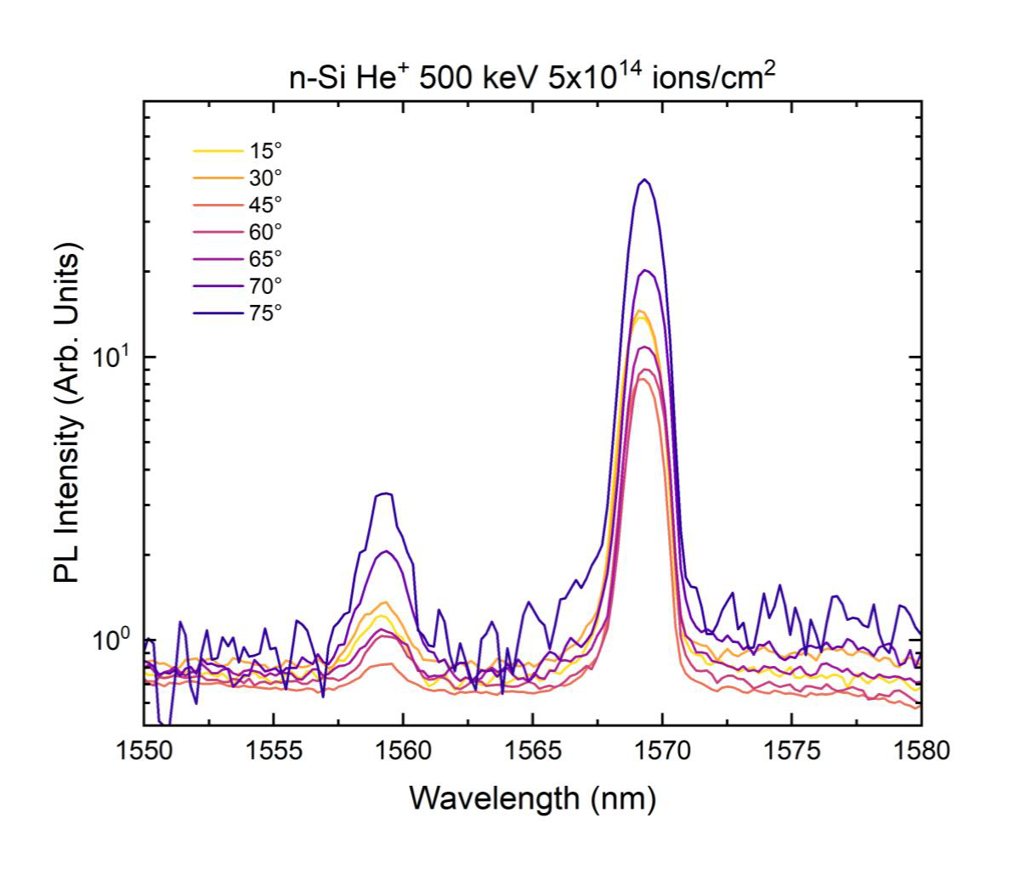
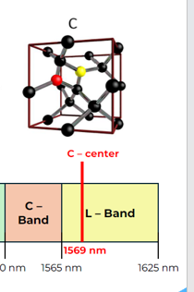
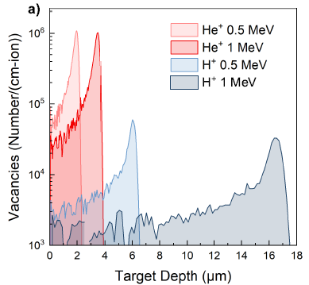
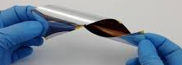



Irradiation Activities…
Large area ion beam irradiations
Large area ASIF irradiation facility (ASI Supported Irradiation Facilities )
Monochromatic Beams: 1H+, 4He+
Energy: 0.2÷5.5 MeV
Spatial uniformity: target ≤ ±1%
XY beam scanning (up to 20cmx20cm)
High temperature Superconductive materials (REBCO), compact fusion reactor
https://doi.org/10.1063/1.2982370
satellite optical components
Single Photon Emitters production for Quantum Technology
Beam dynamics design
Ion-matter interaction
Photo luminescence emission

Slide 21
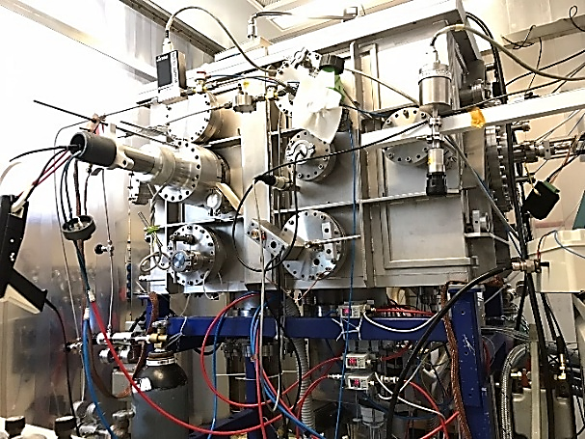
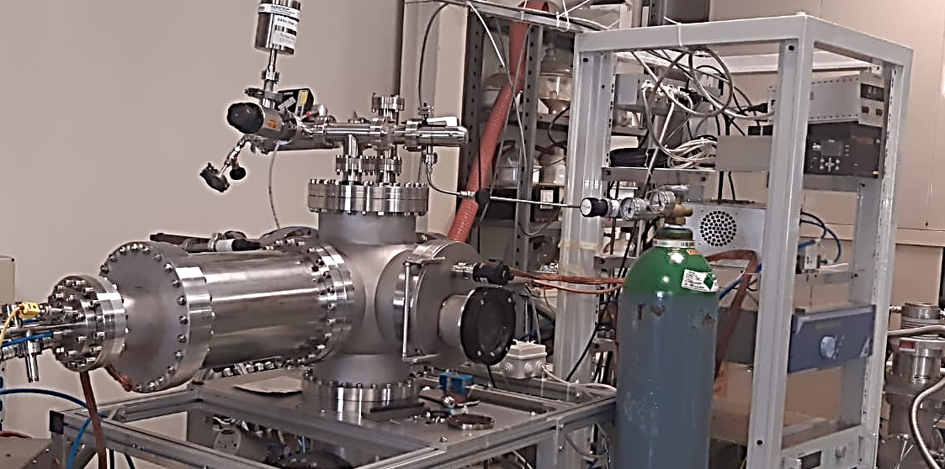
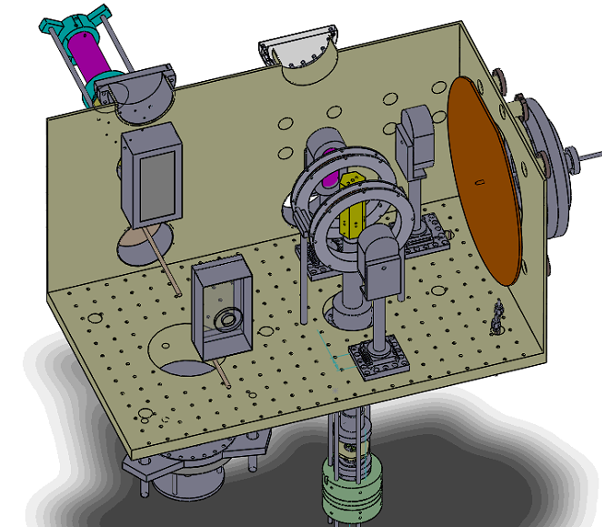
Laboratory of Materials Physics for Nuclear Physics
Characterization techniques:
Optical microscope
SEM (Scanning electron microscope)
EDS (Energy-dispersive X-ray spectroscopy)
AFM (Atomic force microscope)
Avaible in other collaborators laboratory:
XRD (X-ray Diffraction)
Raman
TEM (transmission electron microscope)
STEM (scanning TEM)
FIB (focused ion beam)
…
Pure metal and compounds materials synthesis
Sputtering systems
Characteristics:
3 sputtering source (50mmx140mm)
2 sputtering source (150mmx230mm)
Active gettering system
Optical emission plasma diagnostics for reactive processes
Different power supply technologies (HiPIMS, DC, pulsed-DC, RF)
2 different sample holder
Materials: Pure materials (Ta, Ti, Zr, Cr, Cu, Nb…)
Compounds:
Oxides (natural O, ¹⁶O and ¹⁷O)
Nitrides (natural N, ¹⁴N, ¹⁵N)
Hydrides (natural H, Deuterium)
Alkali materials (Na, Mg,…)
Materials:
NaNbO₃, Mg₂Si
Characteristics:
Heated sample holder (up to 600 °C)

Slide 22
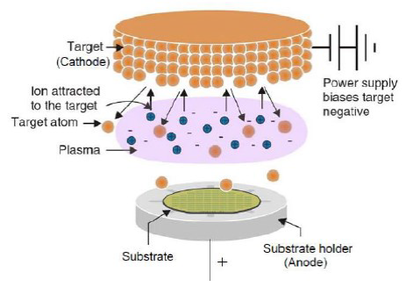
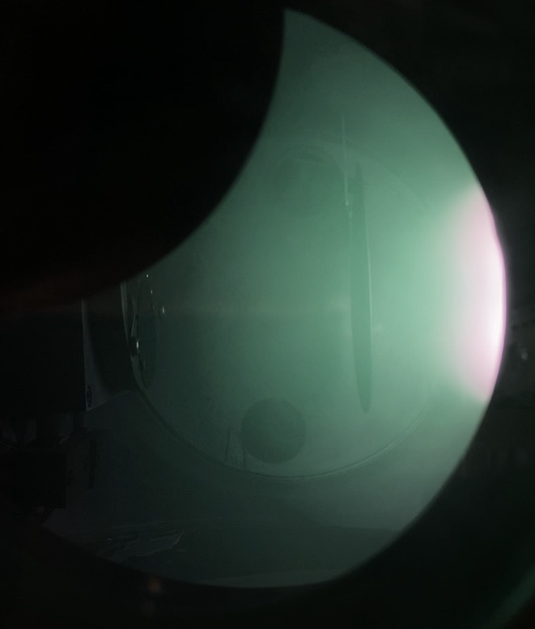
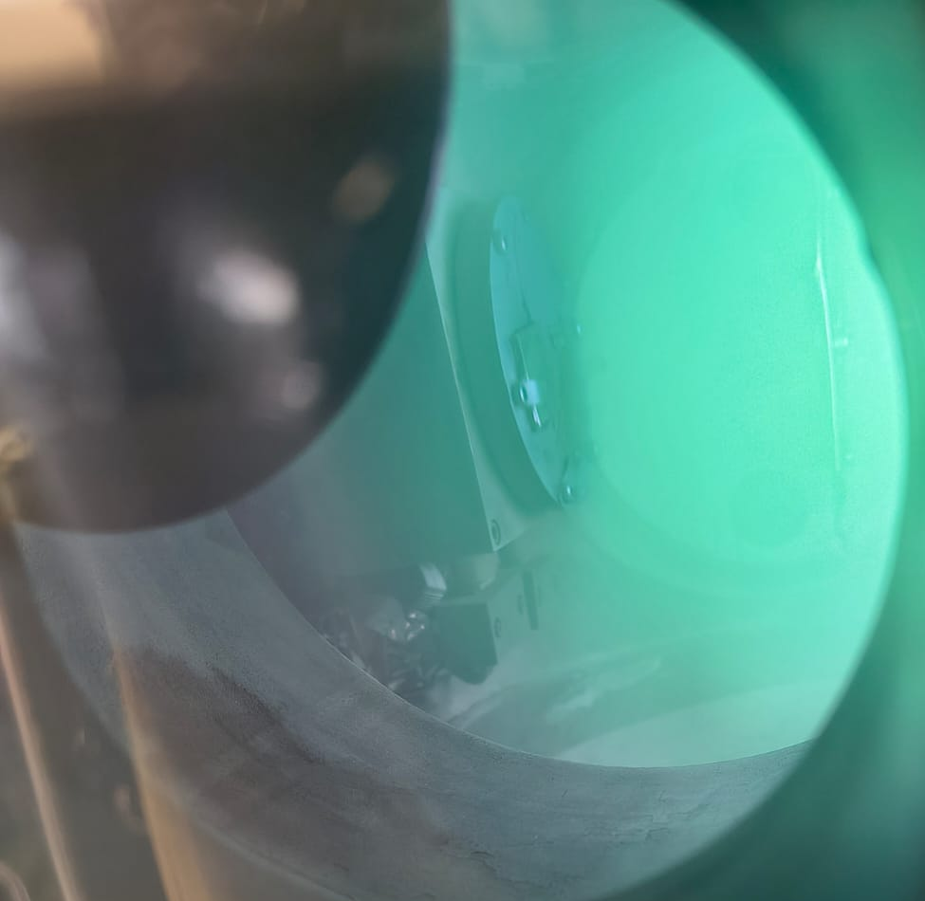
Laboratory of Materials Physics for Nuclear Physics
Magnetron sputtering PVD deposition process
DOI: 10.13140/RG.2.1.3855.5605
Magnesium Silicide (Mg₂Si) deposition (Argon plasma process gas)

Slide 23
Laboratory of Materials Physics for Nuclear Physics
Magnetron sputtering PVD deposition process
Process control and system improvements
High quality coatings
Ion bombardment assisted film growth
Low Oxygen contamination
Active gettering system
Synthesis of compound targets using REACTIVE magnetron sputtering technology
Nitrides, Oxides and Hydrides with natural and isotopically enriched gas
DOI: 10.13140/RG.2.1.3855.5605
Magnesium Silicide (Mg₂Si) deposition (Argon plasma process gas)
Optical emission spectroscopy (UV-VIS) and Time resolved OES
Plasma study and monitoring

Slide 24
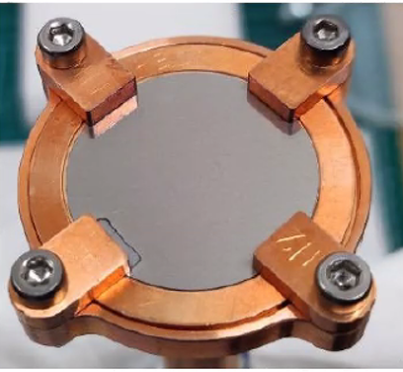
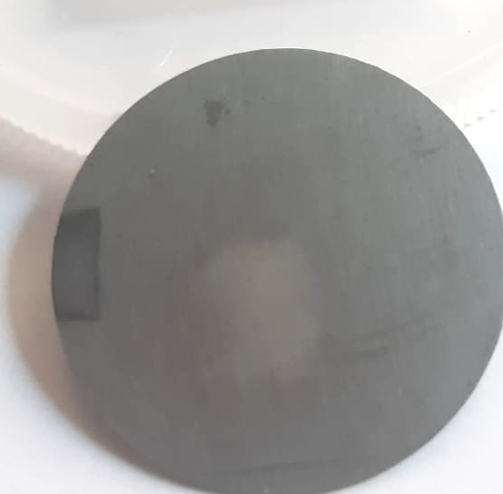
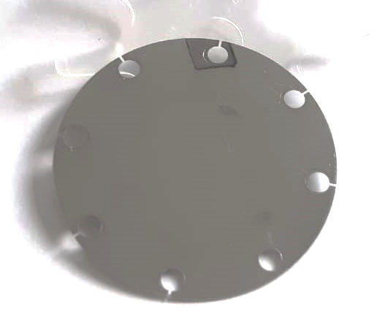
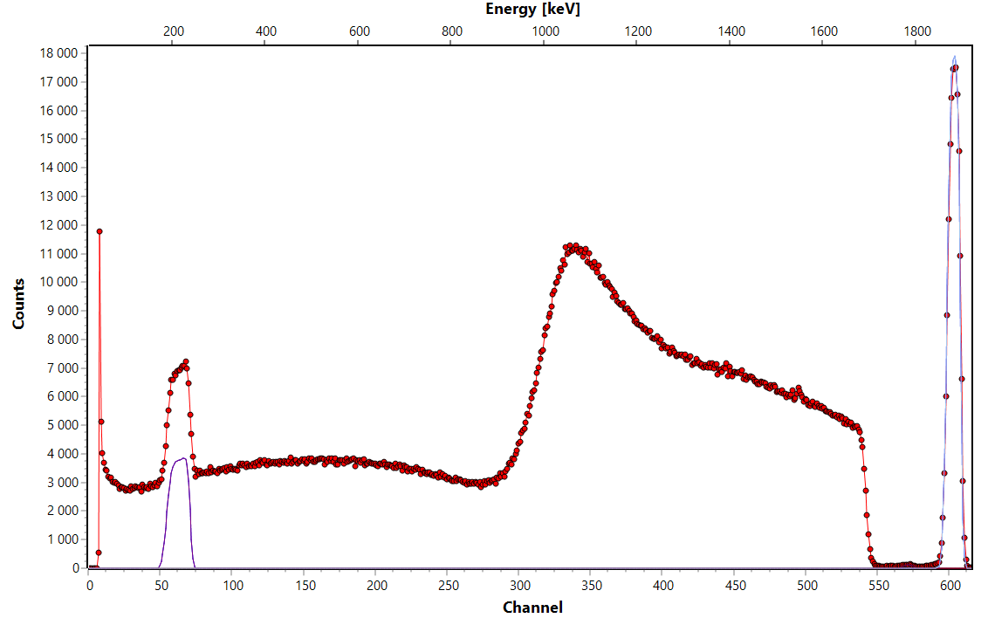
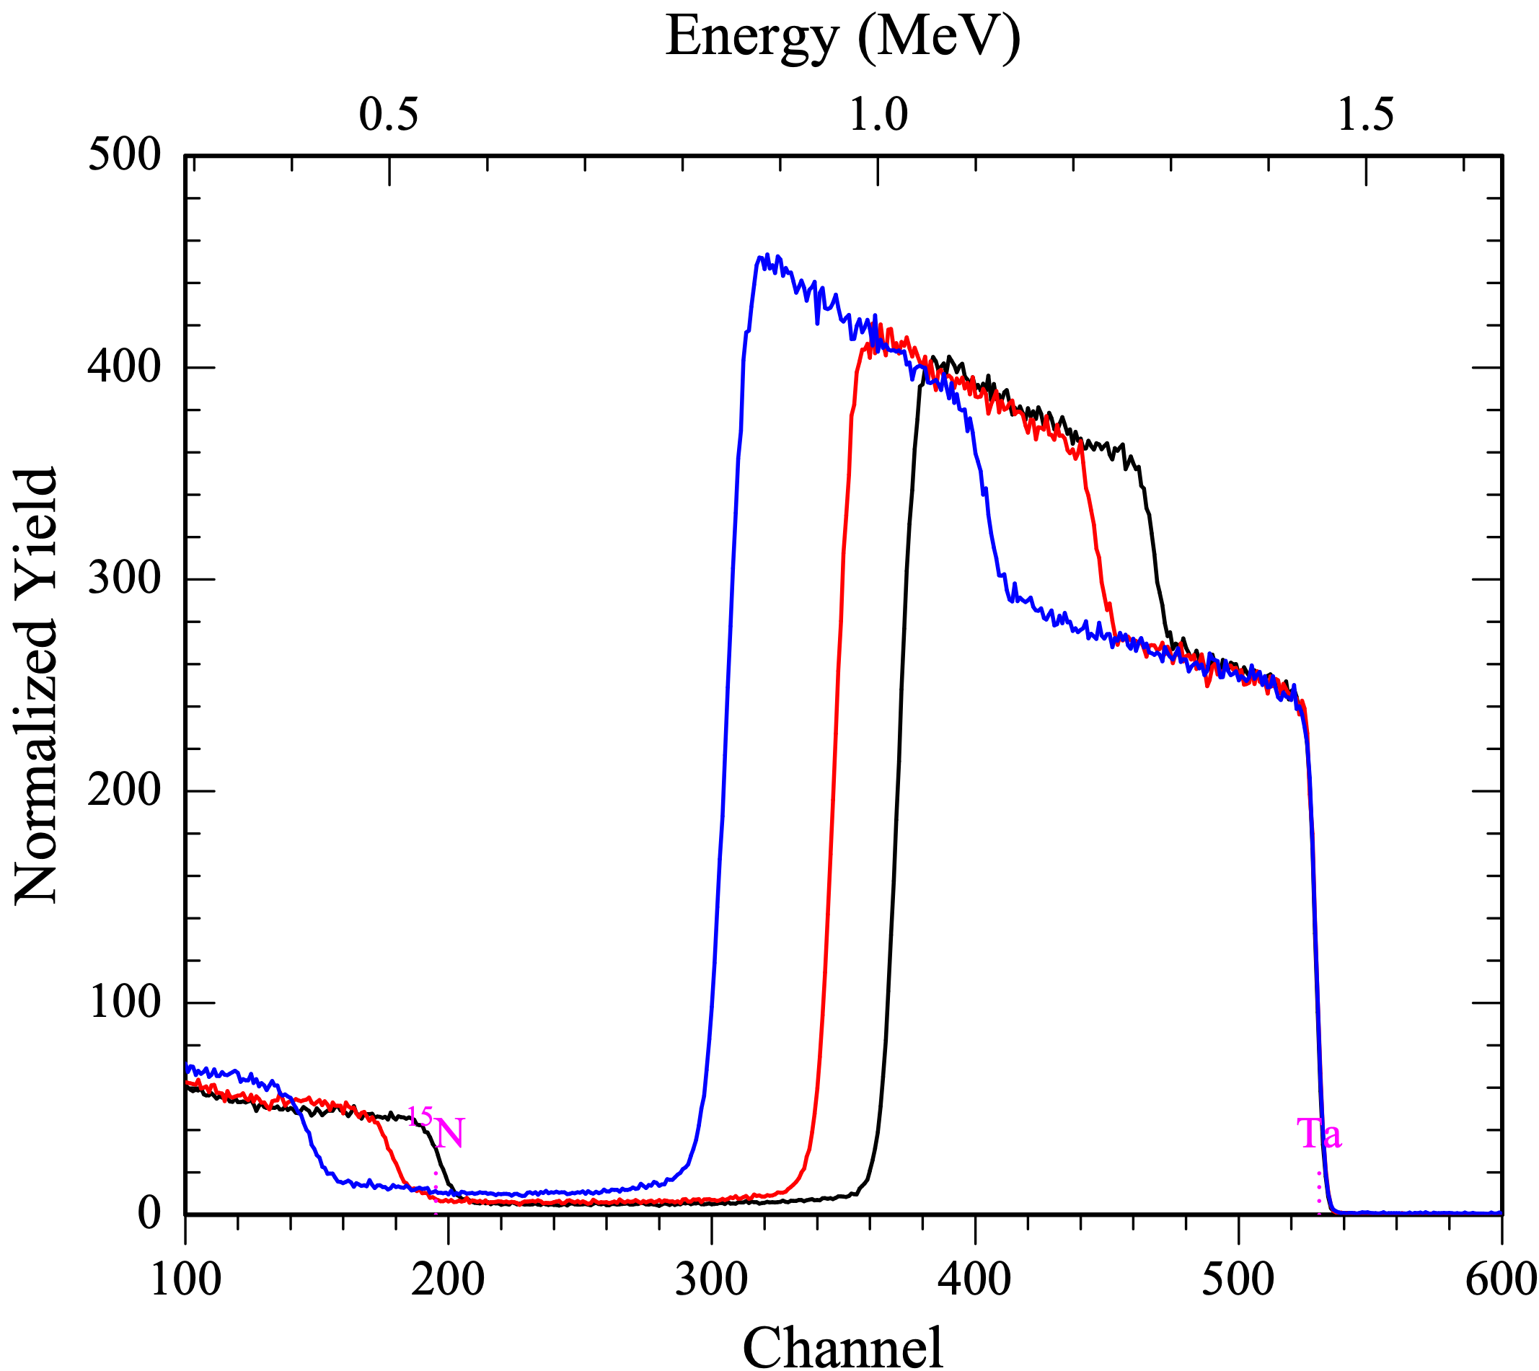
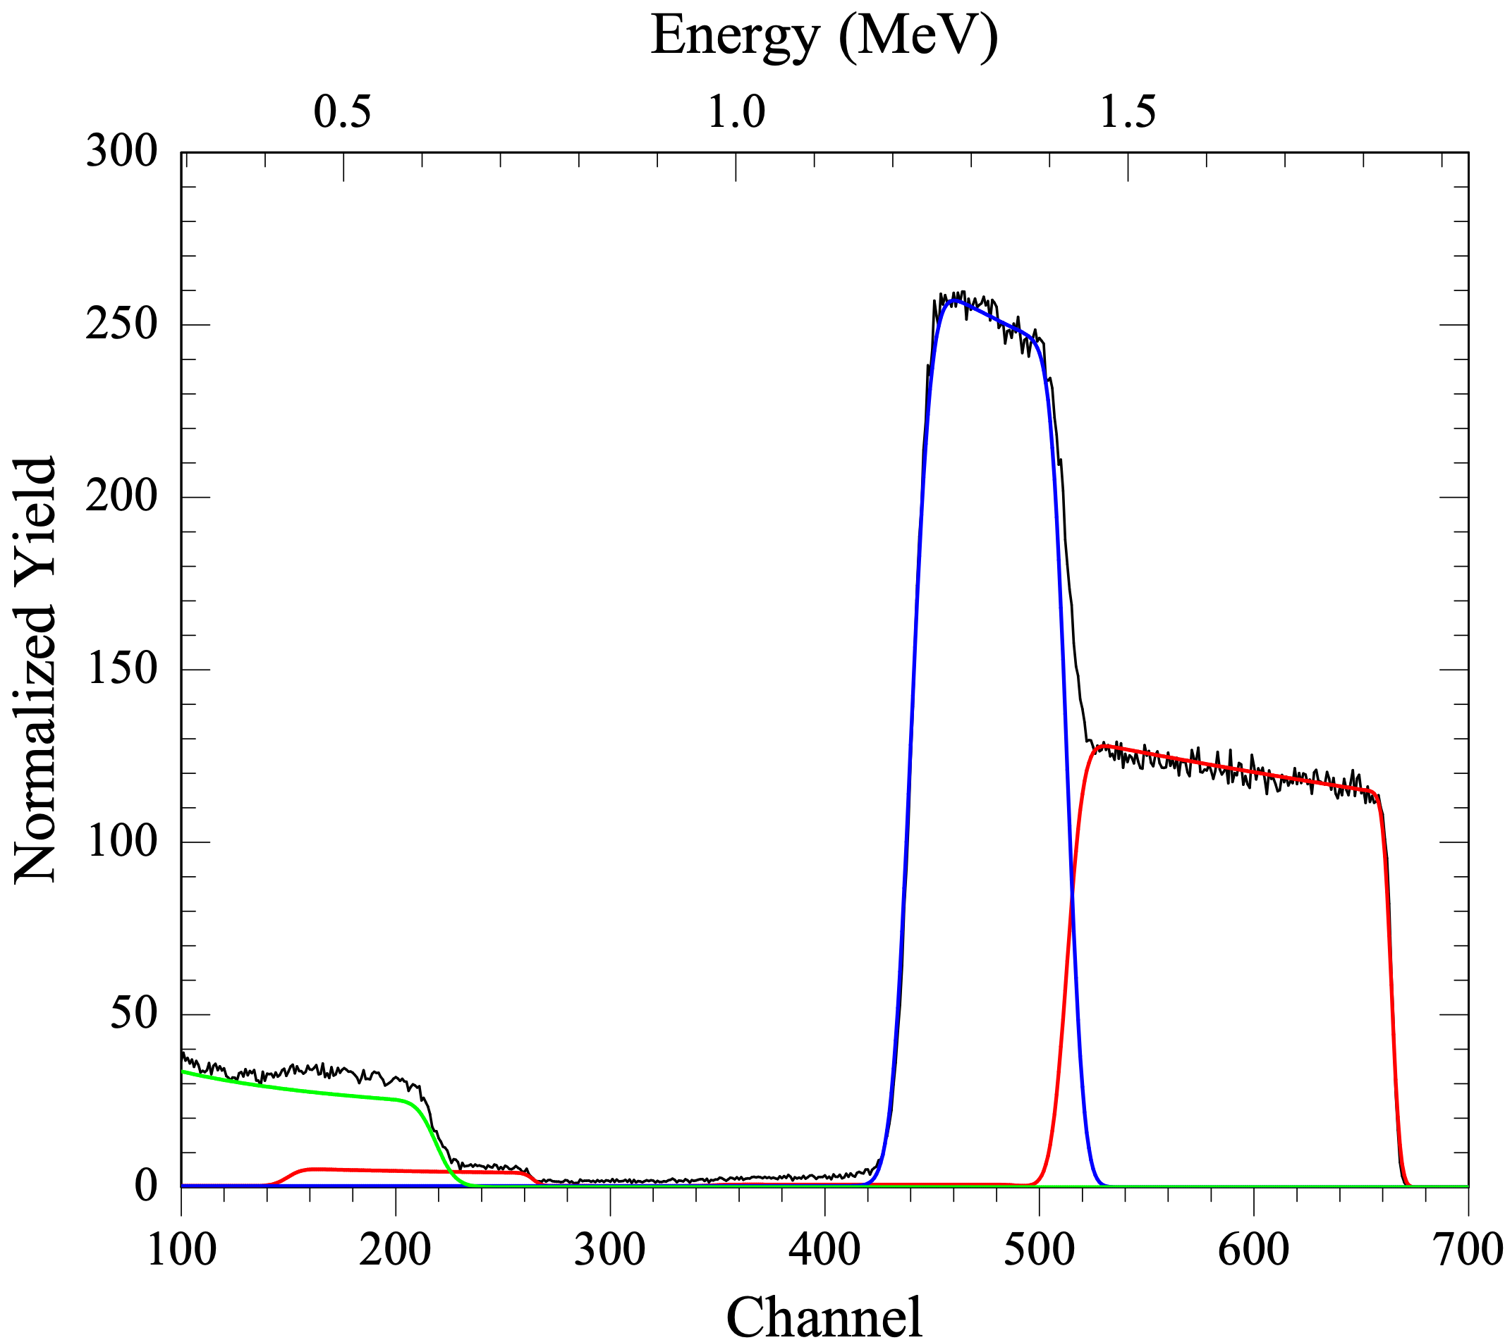

Laboratory of Materials Physics for Nuclear Physics
Hydrides targets
ZrD₂
Nitrides targets
Ta¹⁵N
Oxides targets
Ta₂^{nat}O₅
EBS (p,p) 2MeV, AN2000
NRA
D(³He, p)⁴He
1MeV ³He AN2000
EBS (α,α) 1.6MeV, AN2000
EBS (α,α) 2MeV, AN2000

Slide 25


LNL is involved in LUNA experiments
Targets production, characterization and experimental supports
SoCIAL
SOlar Composition Investigated At Luna
14N(p,γ)15O
First experiment at Bellotti facility
14N(p,γ)15O
23Na(p,α)20Ne
ELDAR
Elements in the Lives
and Deaths of stARs
CaBS
Carbon Burning in Stars
12C+12C
24Mg(p,γ)25Al
experiments at LUNA400
experiments at BELLOTTI ion beam facility

Slide 26

14N(p, γ)15O experiments
14N(p, γ)15O target production and characterization (first IBF experiment)
Fluorine contaminant reduction
Oxygen contaminant reduction
RBS characterization
High endurance target
Acid cleaning procedure
19F(p,αγ)16O @ LNGS facility

Slide 27


14N(p, γ)15O experiments
14N(p, γ)15O target production and characterization (first IBF experiment)
Fluorine contaminant reduction
Oxygen contaminant reduction
RBS characterization
High endurance target
Acid cleaning procedure
19F(p,αγ)16O @ LNGS facility

Slide 28


14N(p, γ)15O experiments
14N(p, γ)15O target production and characterization (first IBF experiment)
Fluorine contaminant reduction
Oxygen contaminant reduction
RBS characterization
High endurance target
14N isotopically enriched (99.99% )
Acid cleaning procedure
TiN
Ta¹⁴N
19F(p,αγ)16O @ LNGS facility

Slide 29



14N(p, γ)15O experiments
14N(p, γ)15O target production and characterization (first IBF experiment)
Fluorine contaminant reduction
Oxygen contaminant reduction
RBS characterization
High endurance target
DOI: 10.1140/epja/s10050-025-01658-7
DOI: 10.1140/epja/s10050-025-01561-1
DOI: 10.1140/epjs/s11734-024-01349-2
14N isotopically enriched (99.99% )
Acid cleaning procedure
TiN
Ta¹⁴N
EBS (α,α) stoichiometry measurement TaN compound
NRA Oxygen No detectable
16O(d,p₀)17O
EBS (α,α) measurement stoichiometry TiN compound
19F(p,αγ)16O @ LNGS facility

Slide 30


12C + 12C experiment
Target design and production
High lifetime:
Max ¹²C implantation power: 400 W
Expected lifetime: 50-100 C
Characterization pre/post irradiation with IBA (AN2000, CN), SEM – EDS, AFM, RAMAN
Purity : semiconductor grade
Structure: selected fine grain size

Slide 31




12C + 12C experiment
Target design and production
Thich Ta-PVD coating:
prevent BIB for eventual target failure
High lifetime:
Max ¹²C implantation power: 400 W
Expected lifetime: 50-100 C
Characterization pre/post irradiation with IBA (AN2000, CN), SEM – EDS, AFM, RAMAN
Purity : semiconductor grade
Structure: selected fine grain size
3.9 µm
Graphite 1-3mm
Tantalum coating
>3µm
Cu backing
∼1-3mm

Slide 32




12C + 12C experiment
Target testing and analysis
Sintered Graphite
NOT IRRADIATED
No evidence of damage after 7.5C of 2.9MeV of ¹²C⁺ beam
Other Carbon
12C IRRADIATED
Graphite irradiated target
Strong damage after 0.6C of 2.9MeV of ¹²C⁺ beam
Preliminary irradiation test performed at Felsenkeller HZDR (2024) E. Masha (HZDR) unpublished data LUNA test performed at IBF 2025 F. Ferraro (LNGS) unpublished data

Slide 33


12C + 12C experiment
Target testing and analysis
RAMAN spectroscopy proves amorphization of graphite surface IBA analysis shows no contamination on irradiated regions
Sintered Graphite
NOT IRRADIATED
No evidence of damage after 7.5C of 2.9MeV of ¹²C⁺ beam
(RAMAN analysis F. Pezzoli (Bicocca University)
Other Carbon
12C IRRADIATED
Graphite irradiated target
Strong damage after 0.6C of 2.9MeV of ¹²C⁺ beam
Preliminary irradiation test performed at Felsenkeller HZDR (2024) E. Masha (HZDR) unpublished data LUNA test performed at IBF 2025 F. Ferraro (LNGS) unpublished data

Slide 34




23Na(p,α)20Ne experiment
First test of NaNbO₃ Sputtered Target endurance tests ²³Na(p,γ)²⁴Mg, BGO detector
NO degradation up to 35C
23Na(p,γ)24Mg, BGO detector
L. Barbieri and C. Bruno (PI)
The target was:
stable in air
good adhesion
good uniformity
RBS confirm a good stoichiometry
SEM and EDS shows nanometrically crystal enriched in Na
RBS spectrum NaNbO₃ /SI Eα=1.6MeV
Θ_{EBS}=160°

Slide 35


23Na(p,α)20Ne experiment
ELDAR experiment setup for ²³Na(p,α)²⁰Ne analysis (PI C. Bruno)

Slide 36


23Na(p,α)20Ne experiment
ELDAR experiment setup for ²³Na(p,α)²⁰Ne analysis (PI C. Bruno)
The measurement cannot be performed due to the BIB caused by ¹¹B and ⁶Li contamination
23Na ROI
6Li(p, α)3He
6Li(p, 3He)α
23Na(p,α)20Ne ROI
L. Barbieri and C. Bruno

Slide 37








23Na(p,α)20Ne experiment
B reduction using PVD Ta thick coating
Li reduction in Vapour phase
SETUP for NRA @ AN2000
thickness > 2.5μm (E_{pmax}=400keV)
J.Liu et al. NIMB190(2002)107

Slide 38



23Na(p,α)20Ne experiment
Boron and Lithium contamination reduction: results
NRA ⁷Li(p,α)⁴He
Ep=1250keV, ~26µm Mylar
Θ_{NRA}=150° ; sample tilt=0°
NRA ¹¹B(p,α)⁸Be[2α]
Ep=680keV, ~13µm Mylar
Θ_{NRA}=150° ; sample tilt=70°
=Blue color
18O(p,α)15N
Ta(after laser cut)
Ta(acid etched LNL)
Ta(PVD-LNL)
Lithium content reduction ∼ 80% ∼2 ppm of ⁶Li
Boron content reduction ∼ 90%
∼2-3 ppm of ¹¹B

Slide 39



LUNA Collaboration
D. Basak, T. Chillery, R. Gesue'*, M. Junker, F. Ferraro | INFN LNGS *and GSSI, Italy
R. Biasissi, C. Broggini, A. Caciolli, R. Menegazzo, D. Piatti, J. Skowronski | Università di Padova and INFN Padova, Italy
A. Formicola, C. Gustavino, M. Vagnoni* | INFN Roma 1 *and Università degli Studi della Campania, Italy
D. Bemmerer, A. Boeltzig, E. Masha | HZDR Dresden, Germany
L. Csedreki, Z. Elekes, Zs. Fülöp, Gy. Gyürky, T. Szücs | MTA-ATOMKI Debrecen, Hungary
M. Lugaro | Konkoly Observatory and ELTE University Budapest, Hungary
U. Battino, O. Straniero | INAF Osservatorio Astronomico di Collurania, Teramo, Italy
P. Corvisiero, P. Prati, M. Rossi, S. Zavatarelli | Università di Genova and INFN Genova, Italy
R. Depalo, A. Guglielmetti | Università di Milano and INFN Milano, Italy
A. Best, D. Dell'Aquila, A. Di Leva, D. Mercogliano, G. Imbriani, D. Rapagnani | Università di Napoli and INFN Napoli, Italy
F. Cavanna, P. Colombetti, G. Gervino | Università di Torino and INFN Torino, Italy
M. Aliotta, L. Barbieri, R. Bonnell, C. Bruno, A. Compagnucci, L. Dalla Vedova, T. Davinson, J. Marsh, D. Robb | University of Edinburgh, United Kingdom
G. Ciani | Università di Bari and INFN Bari, Italy
M. Campostrini, V. Rigato | INFN LNL, Italy

Slide 40

Thank you for your attention

