Slide 1
1
Absolute Calibration of GNSS Timing Receiver Chain
A Global Navigation Satellite Systems (GNSS) receiver chain consists of an antenna, RF cable, and receiver. Absolute calibration of a GNSS receiver chain is necessary for GNSS time scales monitoring.
This calibration allows for the computation of [GNSS_time − UTC(k)] and monitoring of GNSS timing broadcast messages.
CNES absolute calibration:
The Centre National d’Etudes Spatiales (CNES) has developed absolute calibration methods for the antenna, cable, and receiver, to give an uncertainty budget.
1

Slide 2
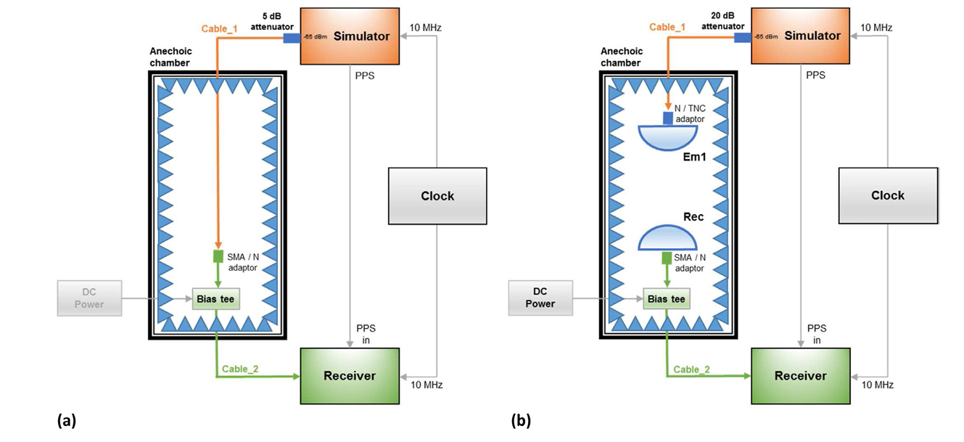
1
CNES absolute calibration
Antenna delay calibration
2

Slide 3
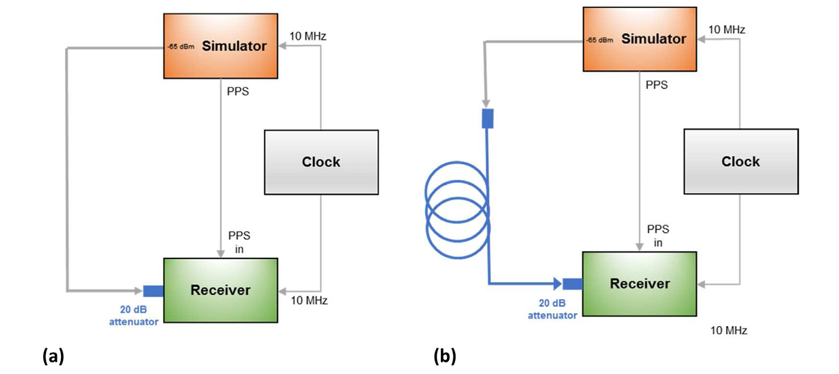
1
CNES absolute calibration
RF cable delay calibration
3

Slide 4
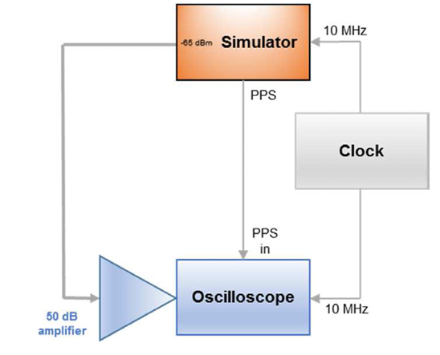
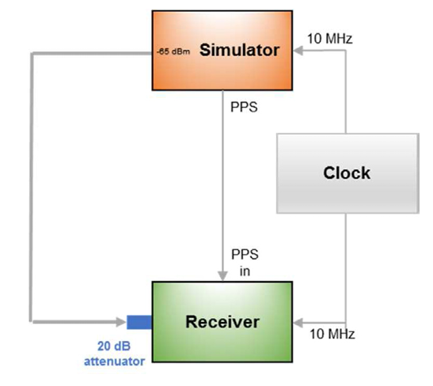
1
CNES absolute calibration
Receiver delay (RxD) calibration
4

Slide 5
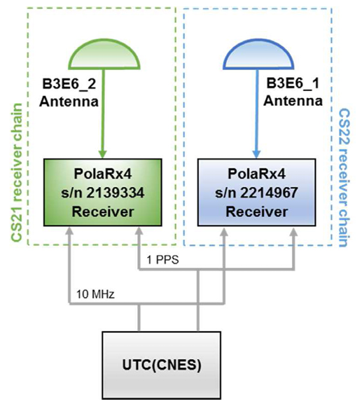
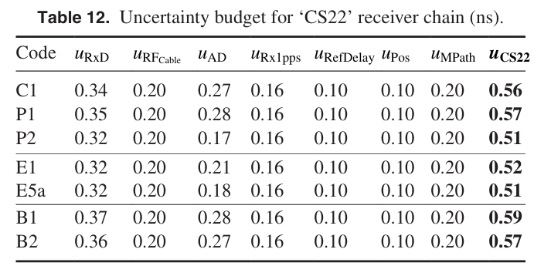
Common-clock validation setup
1
5

Slide 6
Uncertainty budget for ‘CS22’ receiver chain (ns)
1
Use ionosphere-free linear combination:
RAWDIF is the raw CGGTTS data with standard deviation $u_{\text{RAWDIF}}$
6

Slide 7
Uncertainty budget for ‘CS22’ receiver chain (ns)
1
7

Slide 8
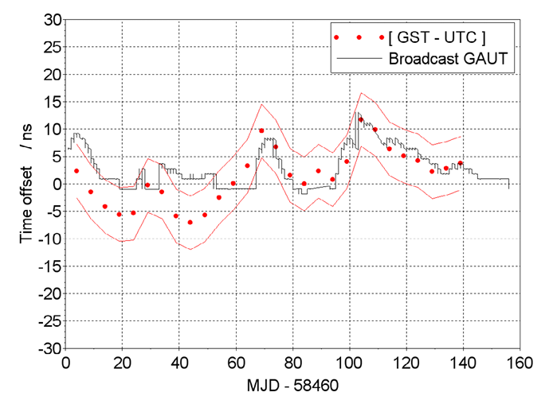
1
UTC − GNSS_Time
[GST −UTC] =[UTC(CNES)−UTC]−[UTC(CNES)−GST].
Associated to the Galileo to UTC coefficients (GAUT) broadcast messages:
This equation includes the calibrated BIPM link on one hand (4.7 ns), and the absolute calibration of the CS22 receiver chain on the other (1.0 ns).
8

Slide 9
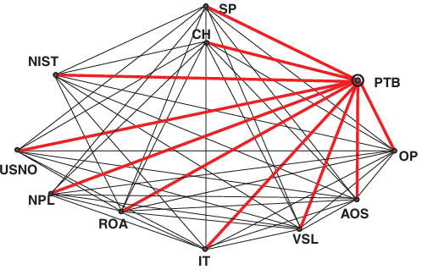
2
Two-Way Satellite Time and Frequency Transfer (TWSTFT) and UTC Computation
Two-Way Satellite Time and Frequency Transfer (TWSTFT) is a key technique for generating UTC.
Currently, over 12 timing laboratories worldwide use TWSTFT for UTC generation. TWSTFT has small calibration uncertainty and long-term link stability.
9

Slide 10
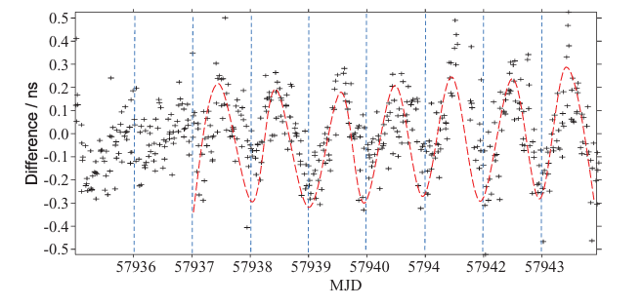
Diurnal Variations in TWSTFT
2
Diurnal variation: peak-to-peak amplitudes reaching 2.0 ns.
Origin of the diurnal variation is not yet conclusively understood, and efforts are ongoing to mitigate its impact.
10

Slide 11
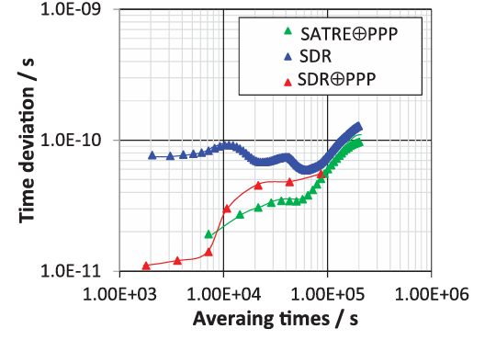
Use of GPSPPP in UTC Computation
2
Since 2010, the BIPM has used the combination of SAtellite Time and Ranging Equipment (SATRE) TWSTFT results and GPS carrier-phase precise point positioning (GPSPPP).
This combination eliminates the diurnal variations as GPSPPP results are almost free from diurnals.
11

Slide 12
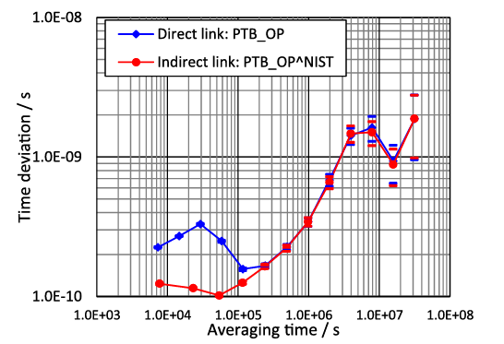
SDR TWSTFT Indirect Links
2
Using indirect Software-defined radio (SDR) TWSTFT links is a pure TWSTFT solution, independent of GPS results.
This improves the robustness of UTC computation, providing a more resilient approach to time transfer.
12

Slide 13
3
Cosmic time synchronizer (CTS) for wireless and precise time synchronization
The output signals from the detectors are given to the Time to Digital Converter (TDC) as the stop signals. Signals from the Oven-Controlled Crystal Oscillator (OCXO) are given to the TDC as the start signals so that the time difference can be measured.
13
Notes:
EAS: Extended air shower

Slide 14
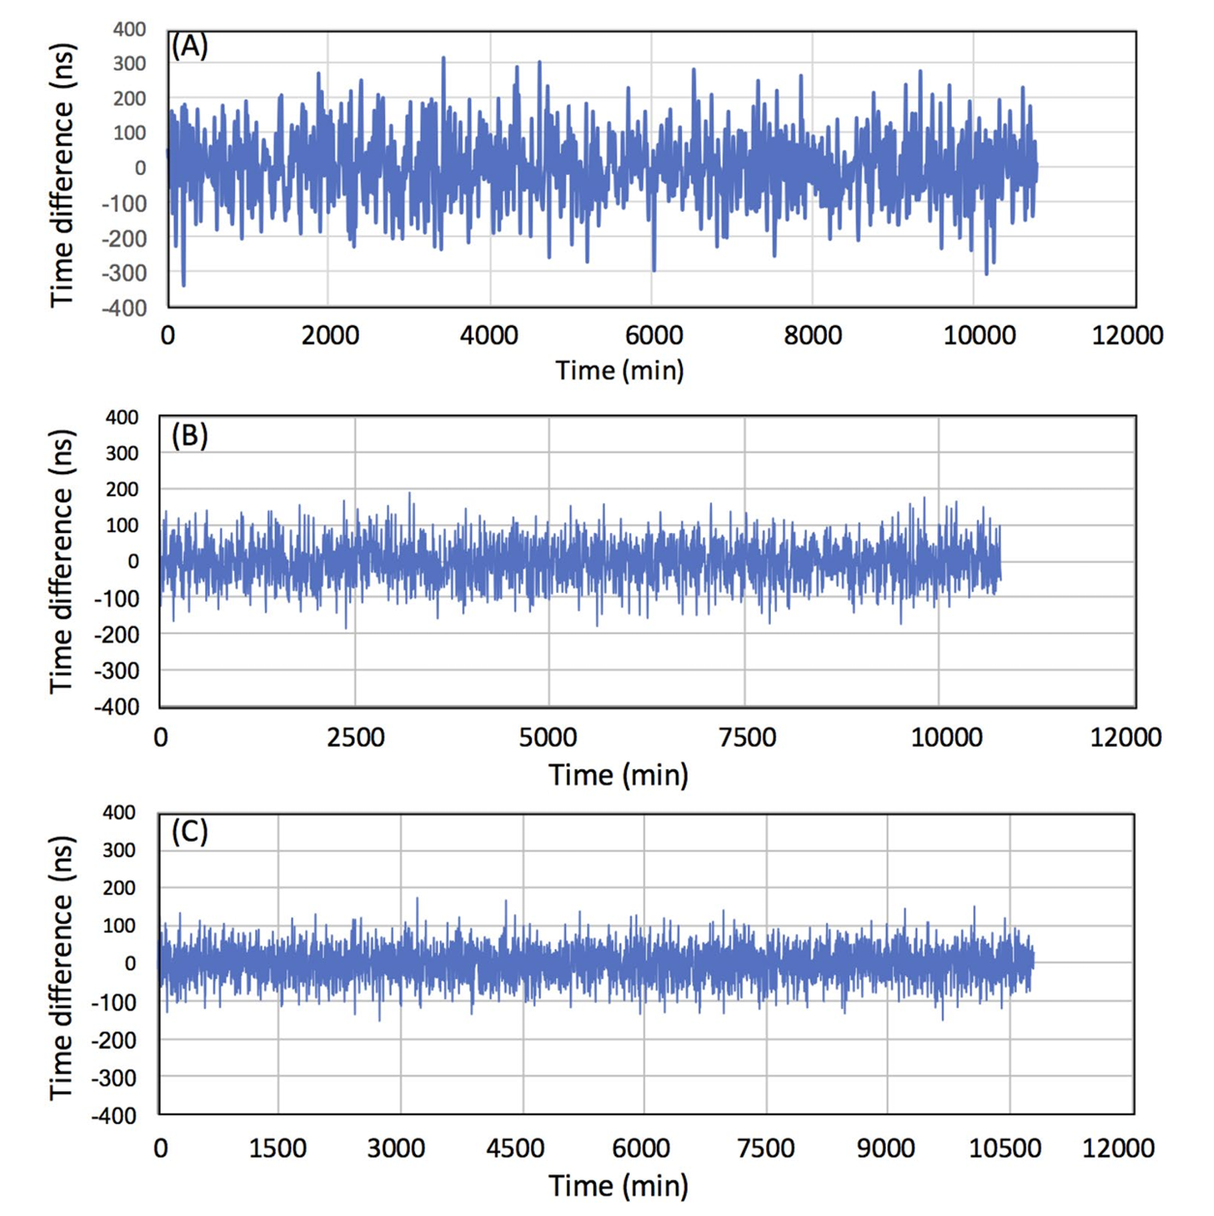
3
Cosmic time synchronizer (CTS) for wireless and precise time synchronization
14

Slide 15
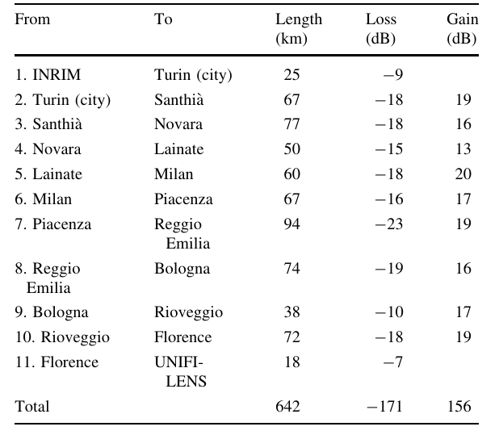
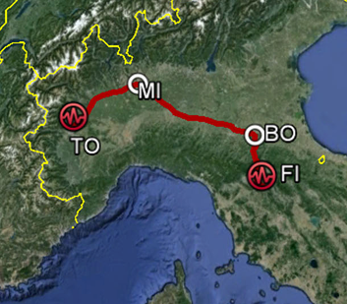
4
High-accuracy coherent optical frequency transfer
The ultimate link performance has been evaluated by doubling the link to 1,284 km, demonstrating a new characterization technique based on the double round trip on a single fiber.
15

Slide 16
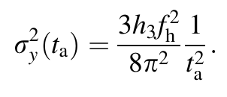
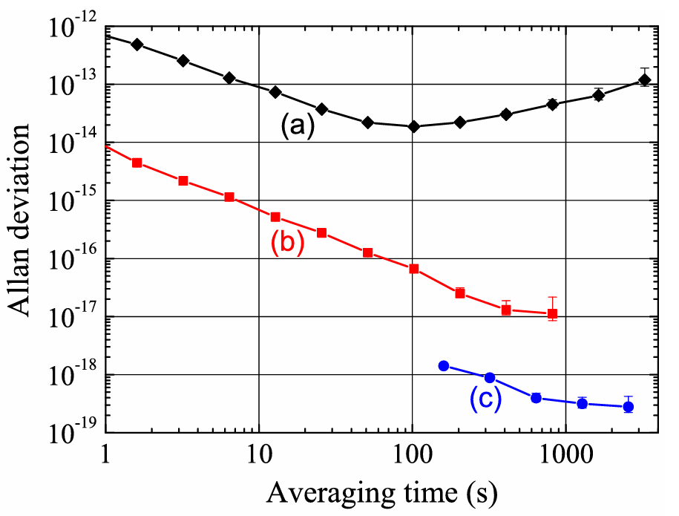
4
High-accuracy coherent optical frequency transfer
A frequency instability of ${3×10}^{−19}$(in terms of Allan deviation) at 1,000 s.
16

