Slide 1
Crosstalk Analysis in ASAP110LF Chip
F. Shojaei & L. Ratti
ASPIDES meeting
March 14, 2025

Slide 2
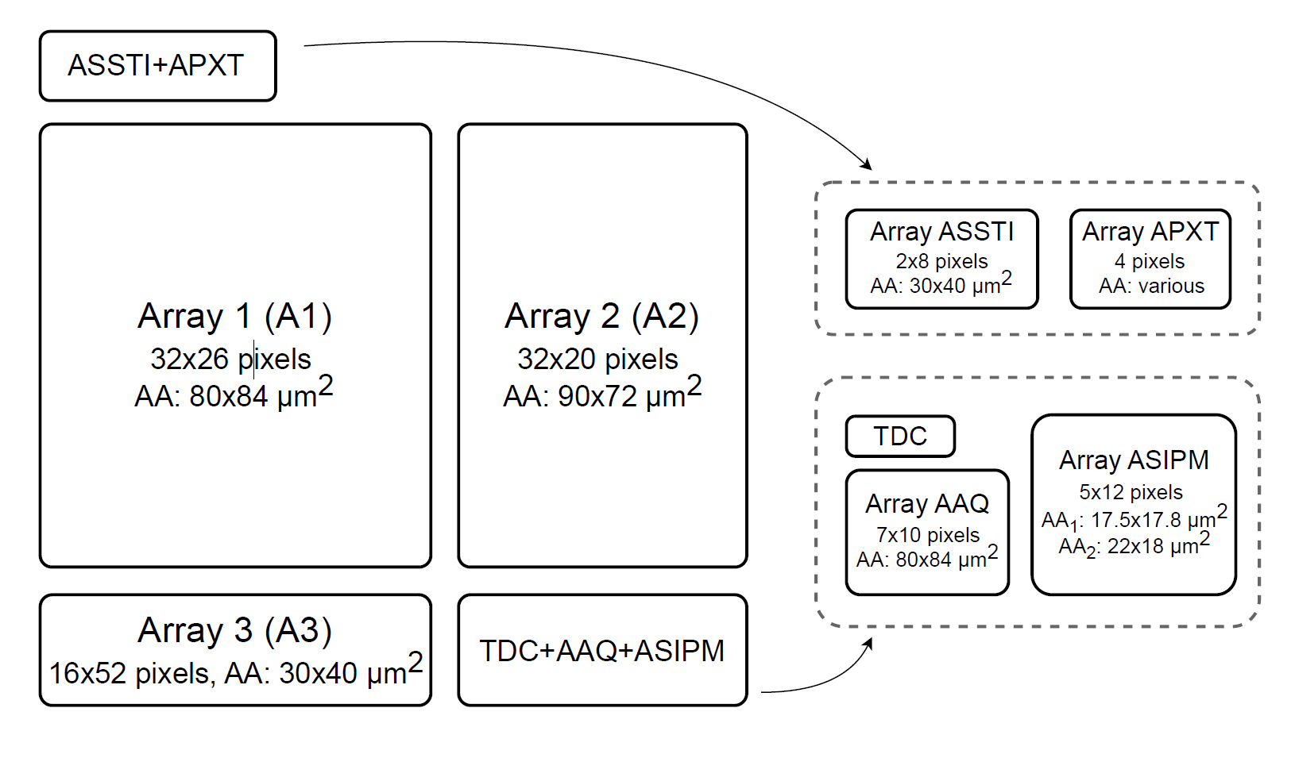
Crosstalk Probability Estimation & Measurement Approach in Array A1 & A3
A pair of adjacent pixels in the same row are selected.
The DCR of each pixel in a pair is measured while the other is off.
In these DCR measurements, each pixel was enabled for 5 us for 10000 times, and the number of 1s in the output memory is counted.
Key point: Consider pixels that have 10 times DCR higher than the other in a pair as emitter and so the other as detector.
Counts for emitter = N_{E} , Counts for detector = N_{D} , Total counts = N in this case 10000.
Then both pixels are enabled, and the number of simultaneous avalanches is counted. Coincidence counts = N_{EΛD}.
$p_{E}= \frac{N_{E}}{N}$, $p_{D}= \frac{N_{D}}{N}$, $p_{EΛD}= \frac{N_{EΛD}}{N}$.
$p_{EΛD}− p_{E}p_{D}=$(1- $p_{D}$) $p_{E}p_{xD}+(1−p_{E}$) $p_{D}$ $p_{xE}$
$p_{xD}=\frac{p_{EΛD}− p_{E}p_{D}}{\text{(1-} p_{D}\text{)} p_{E}}$
1-bit output memory per pixel
There is an overlap among pixels during measurements. For example, measurements were taken for pixels 0, 1, and then for 1, 2, and so on.
0
1
2
≈ 0

Slide 3
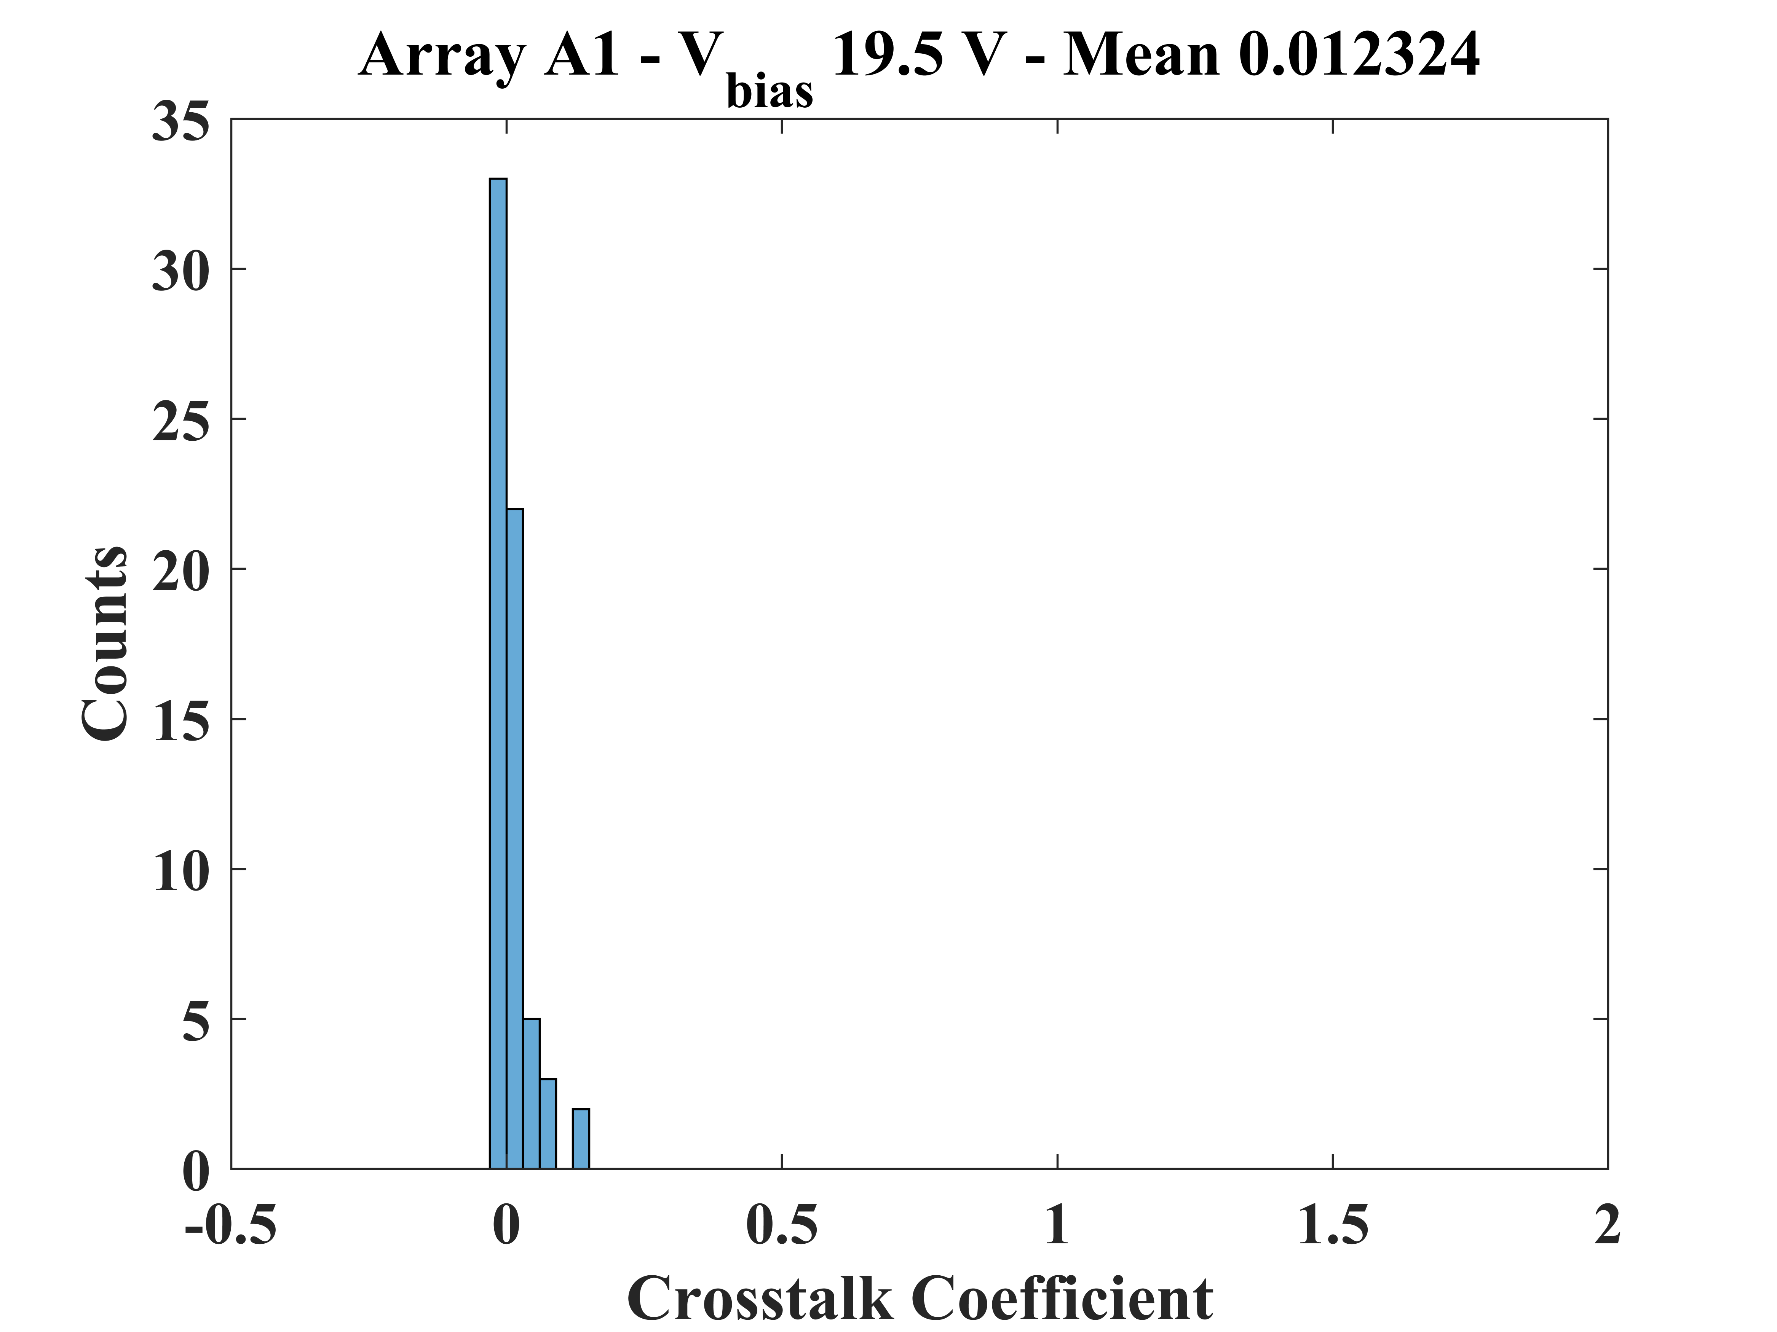
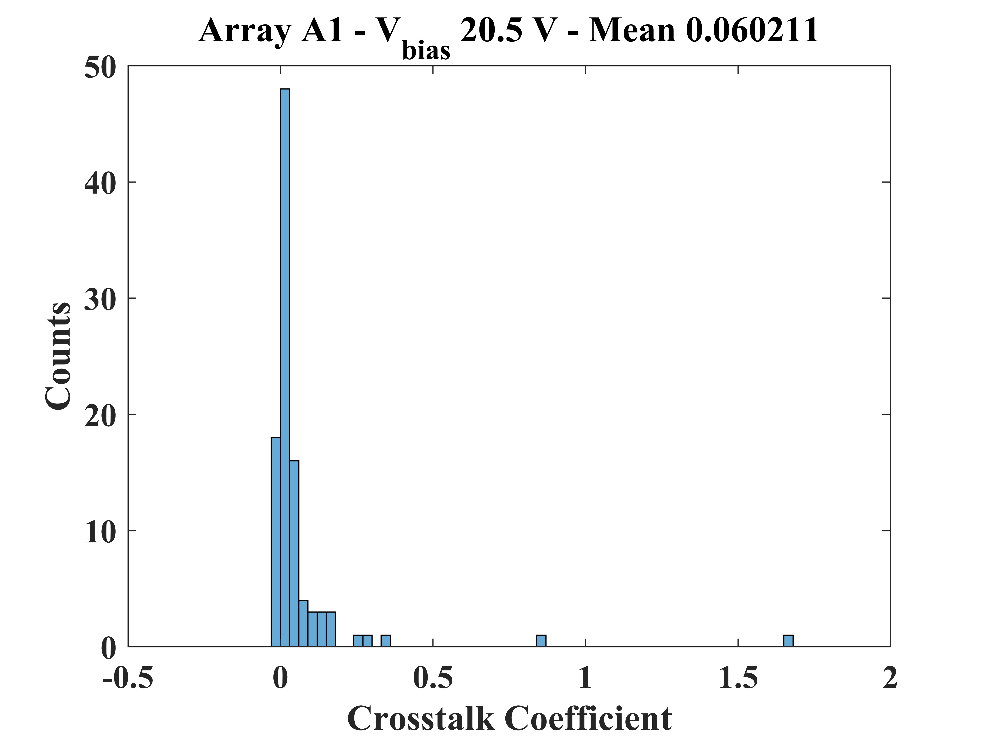
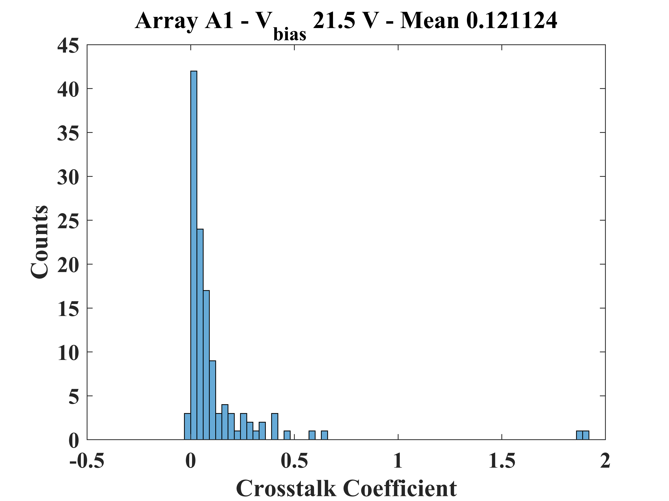
Measurement Results in Array A1
V_{ex}= 1V
V_{ex}= 2V
V_{ex}= 3V

Slide 4
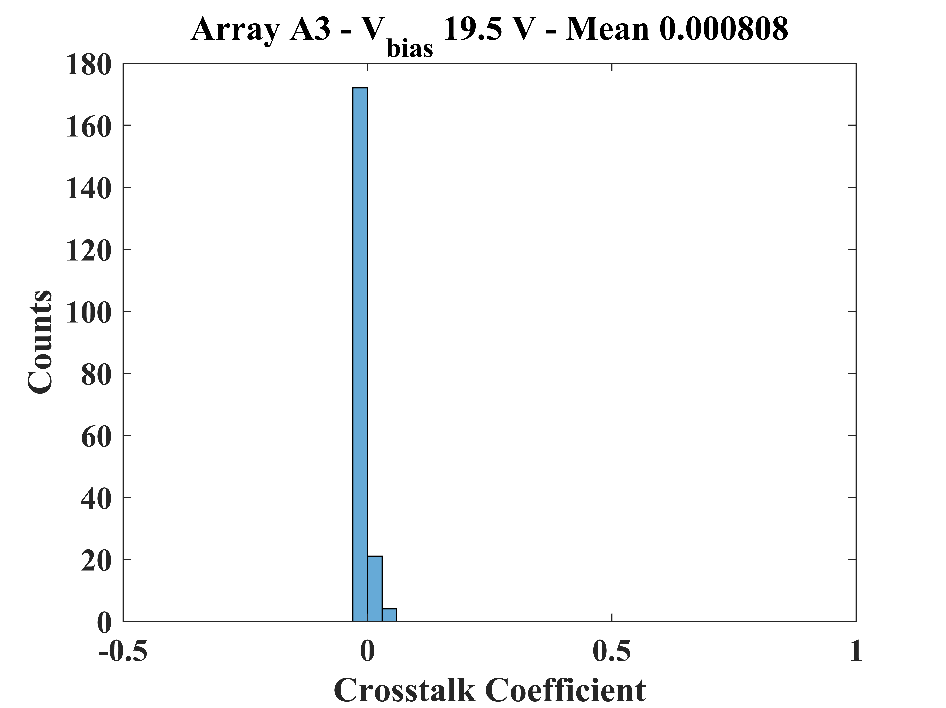
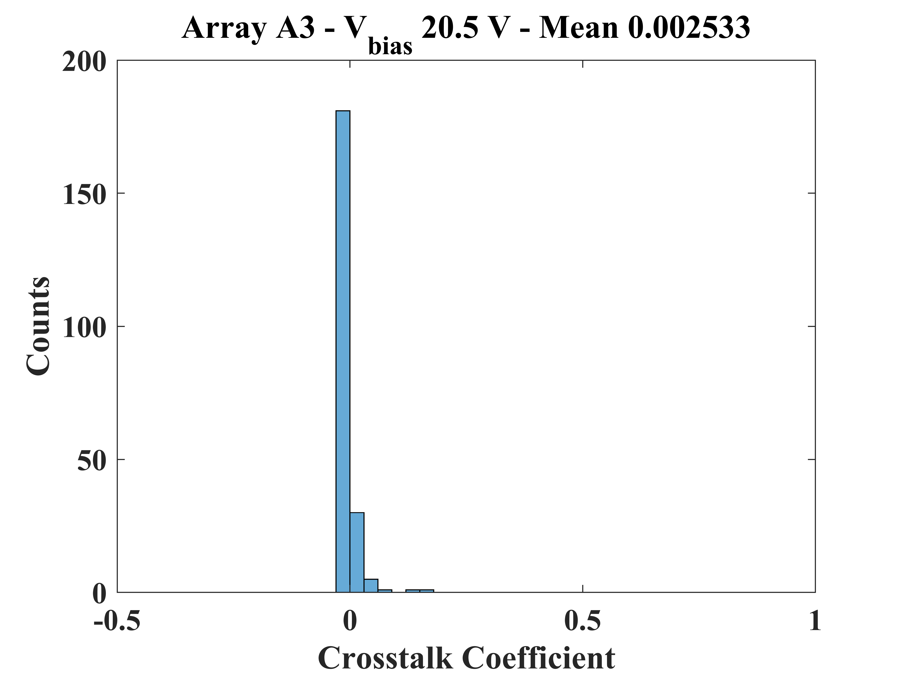
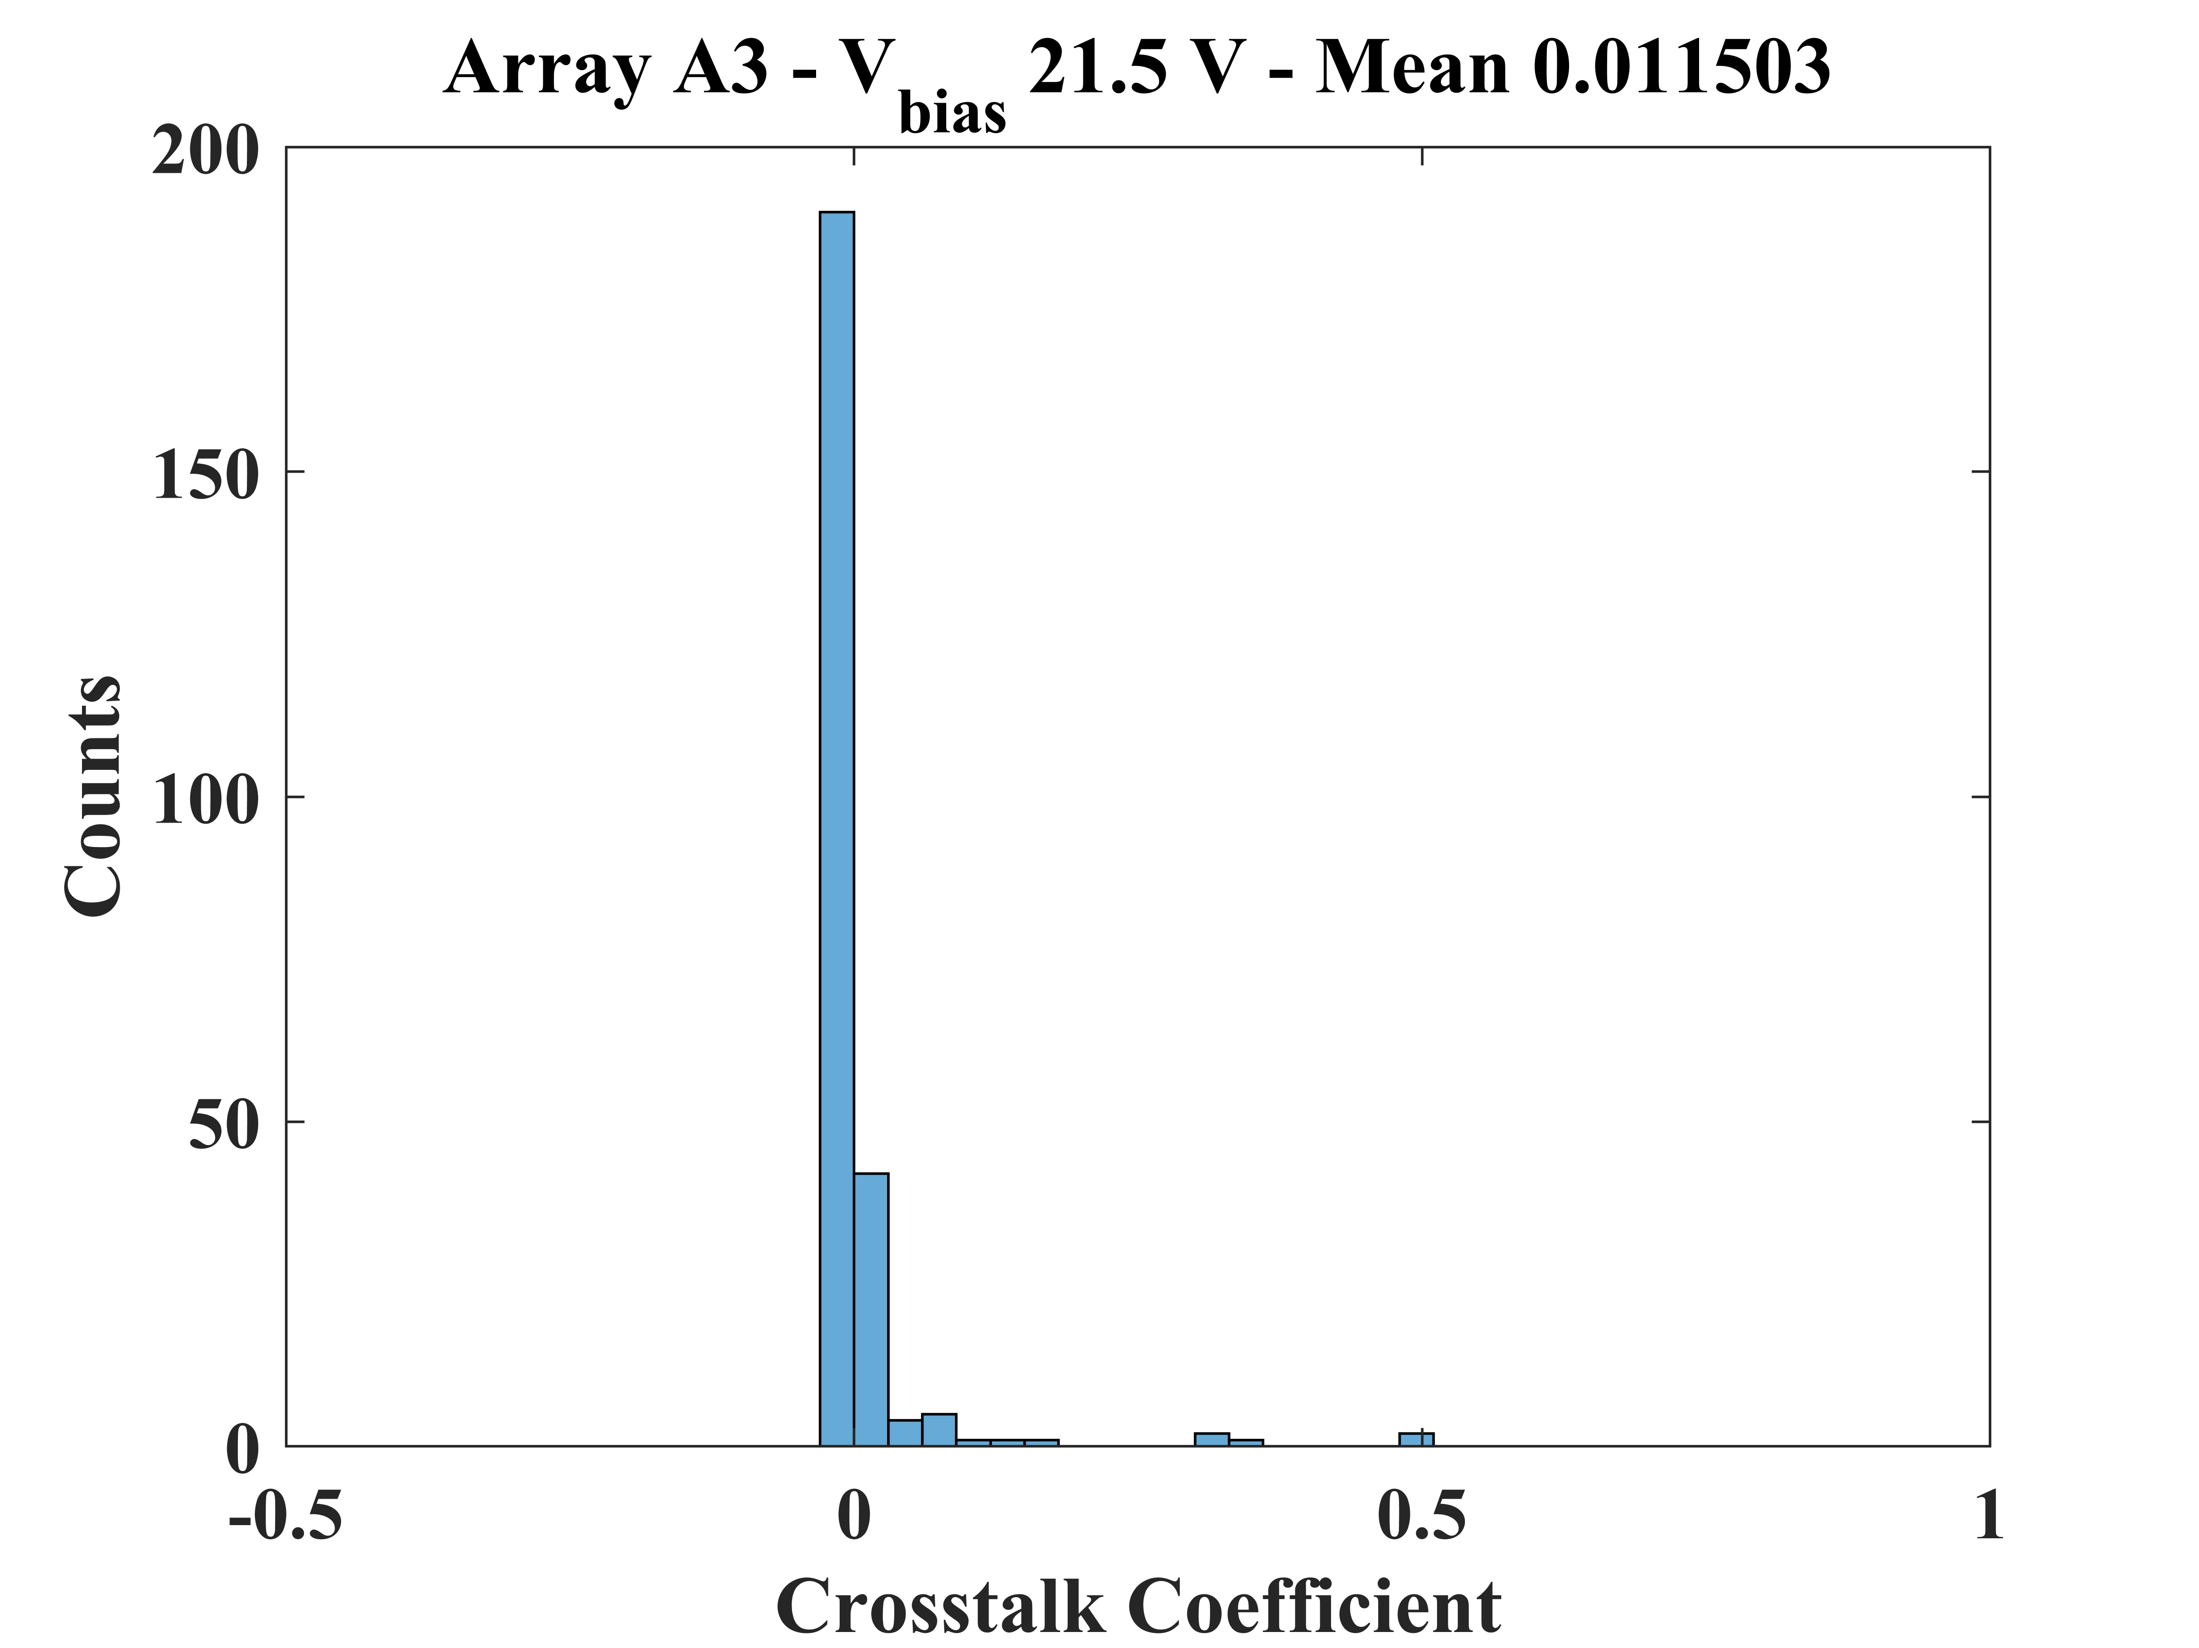
Measurement Results in Array A3
V_{ex}= 1V
V_{ex}= 2V
V_{ex}= 3V

Slide 5
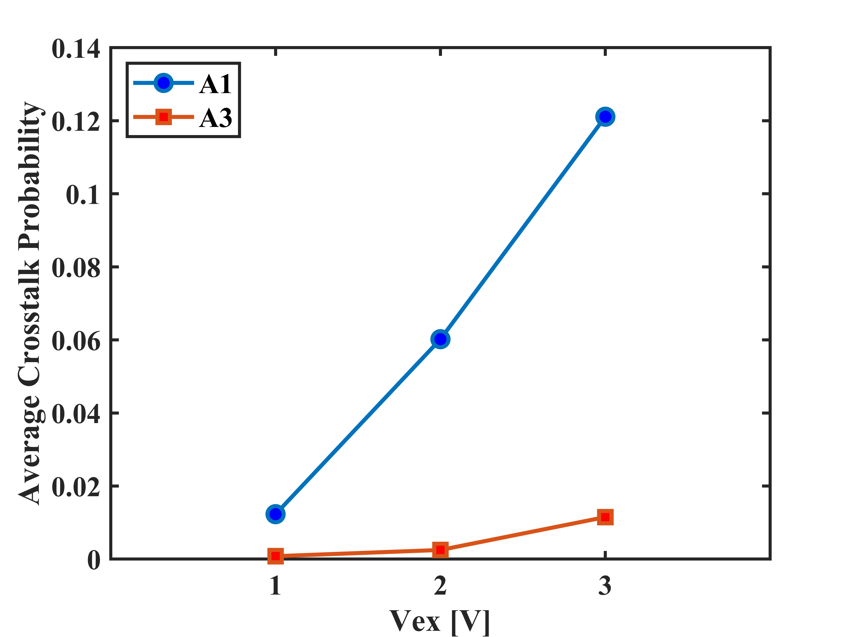
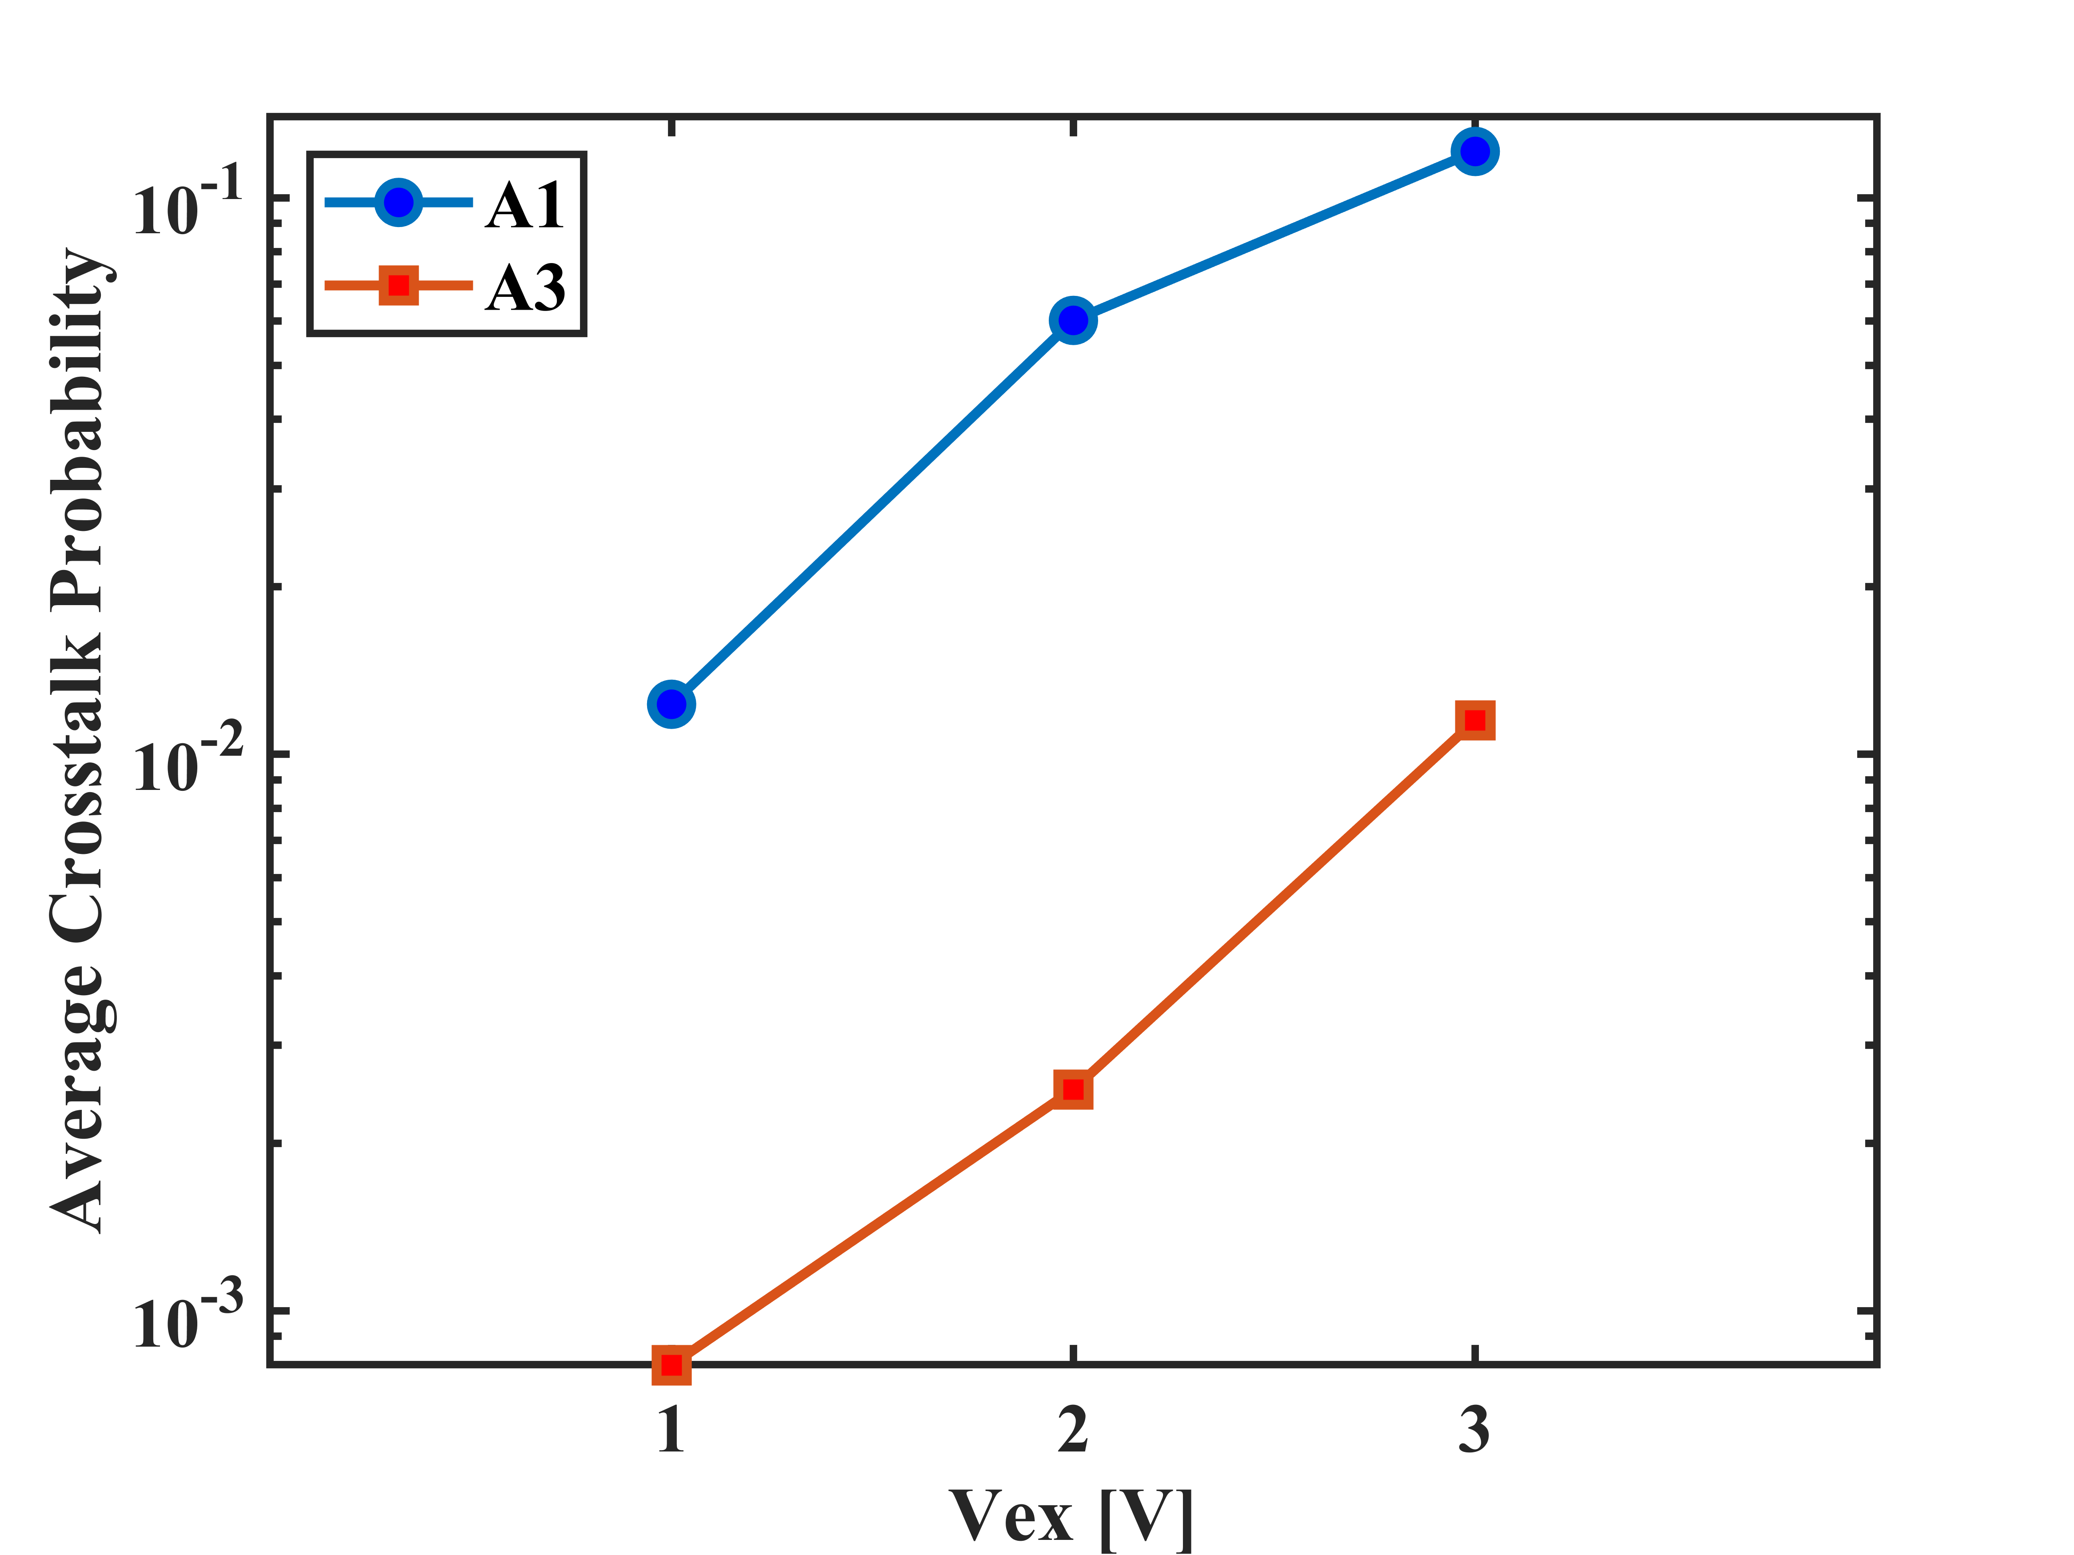
Comparison between A1 & A3

Slide 6
Crosstalk Probability Estimation & Measurement Approach in Array A2
10-bit output counter per pixel
A pair of adjacent pixels in the same row are selected. In this case, there is no overlap among pixels.
Again, DCR of each pixel is measured while the other is off for 10 ms. Pixel with DCR 10 times higher than the other is considered as emitter (N_{E}, N_{D}).
Measure the DCR of the detector while the emitter is on (N*_{D}).
Crosstalk coefficient = $\frac{N_{D}^{∗}−N_{D}}{N_{E}}$

Slide 7
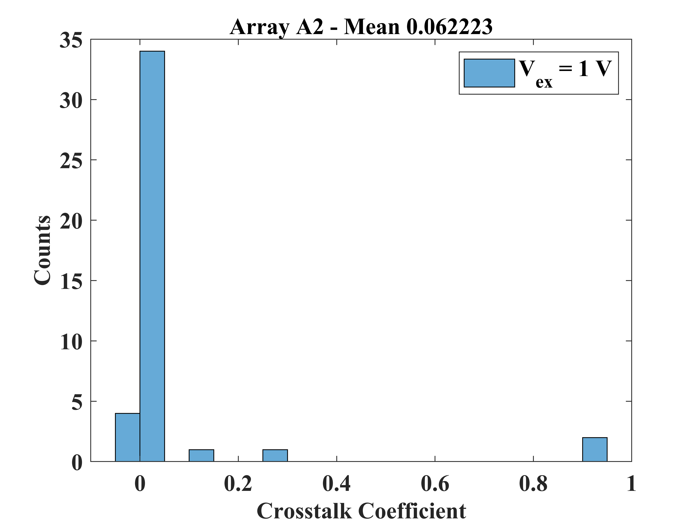
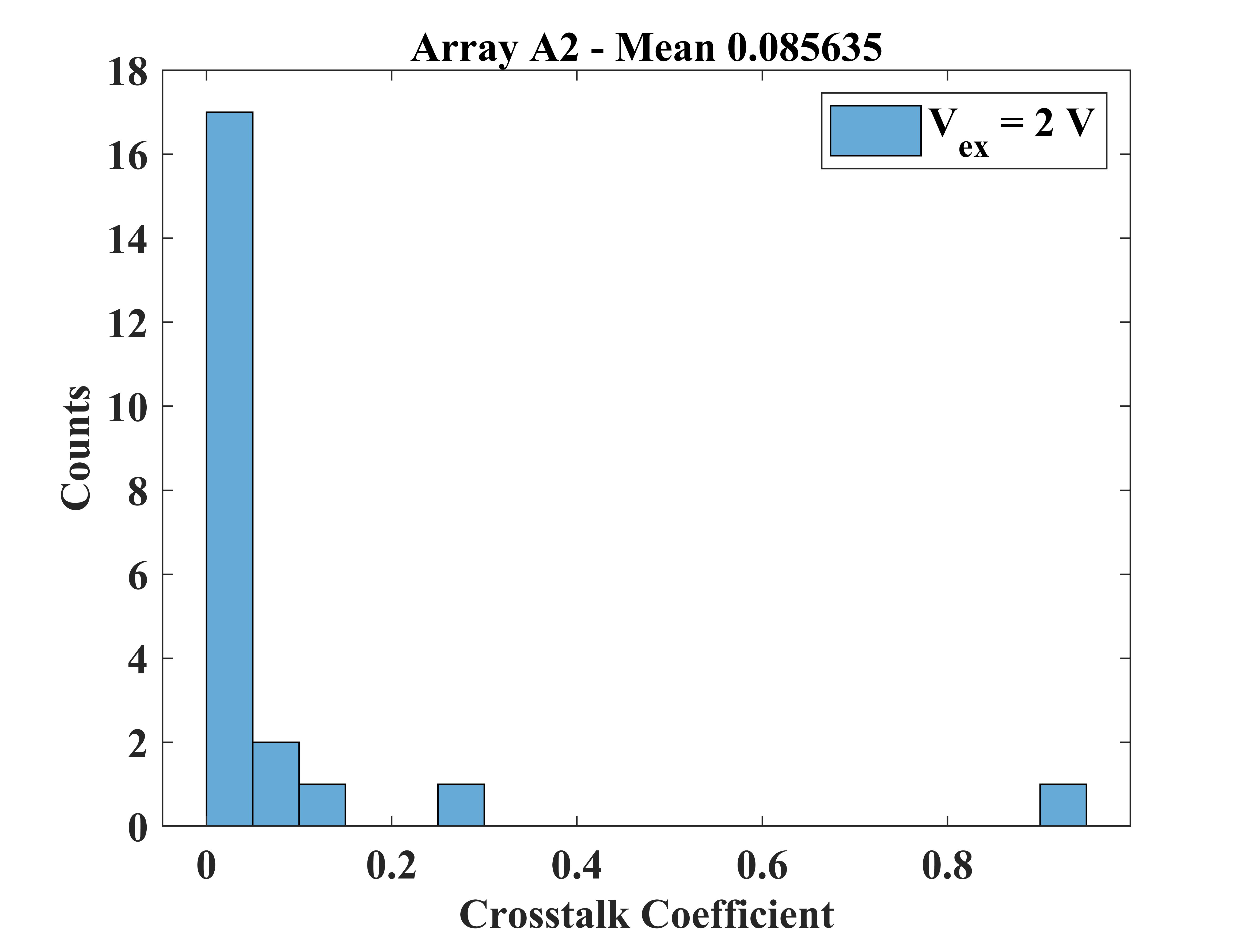
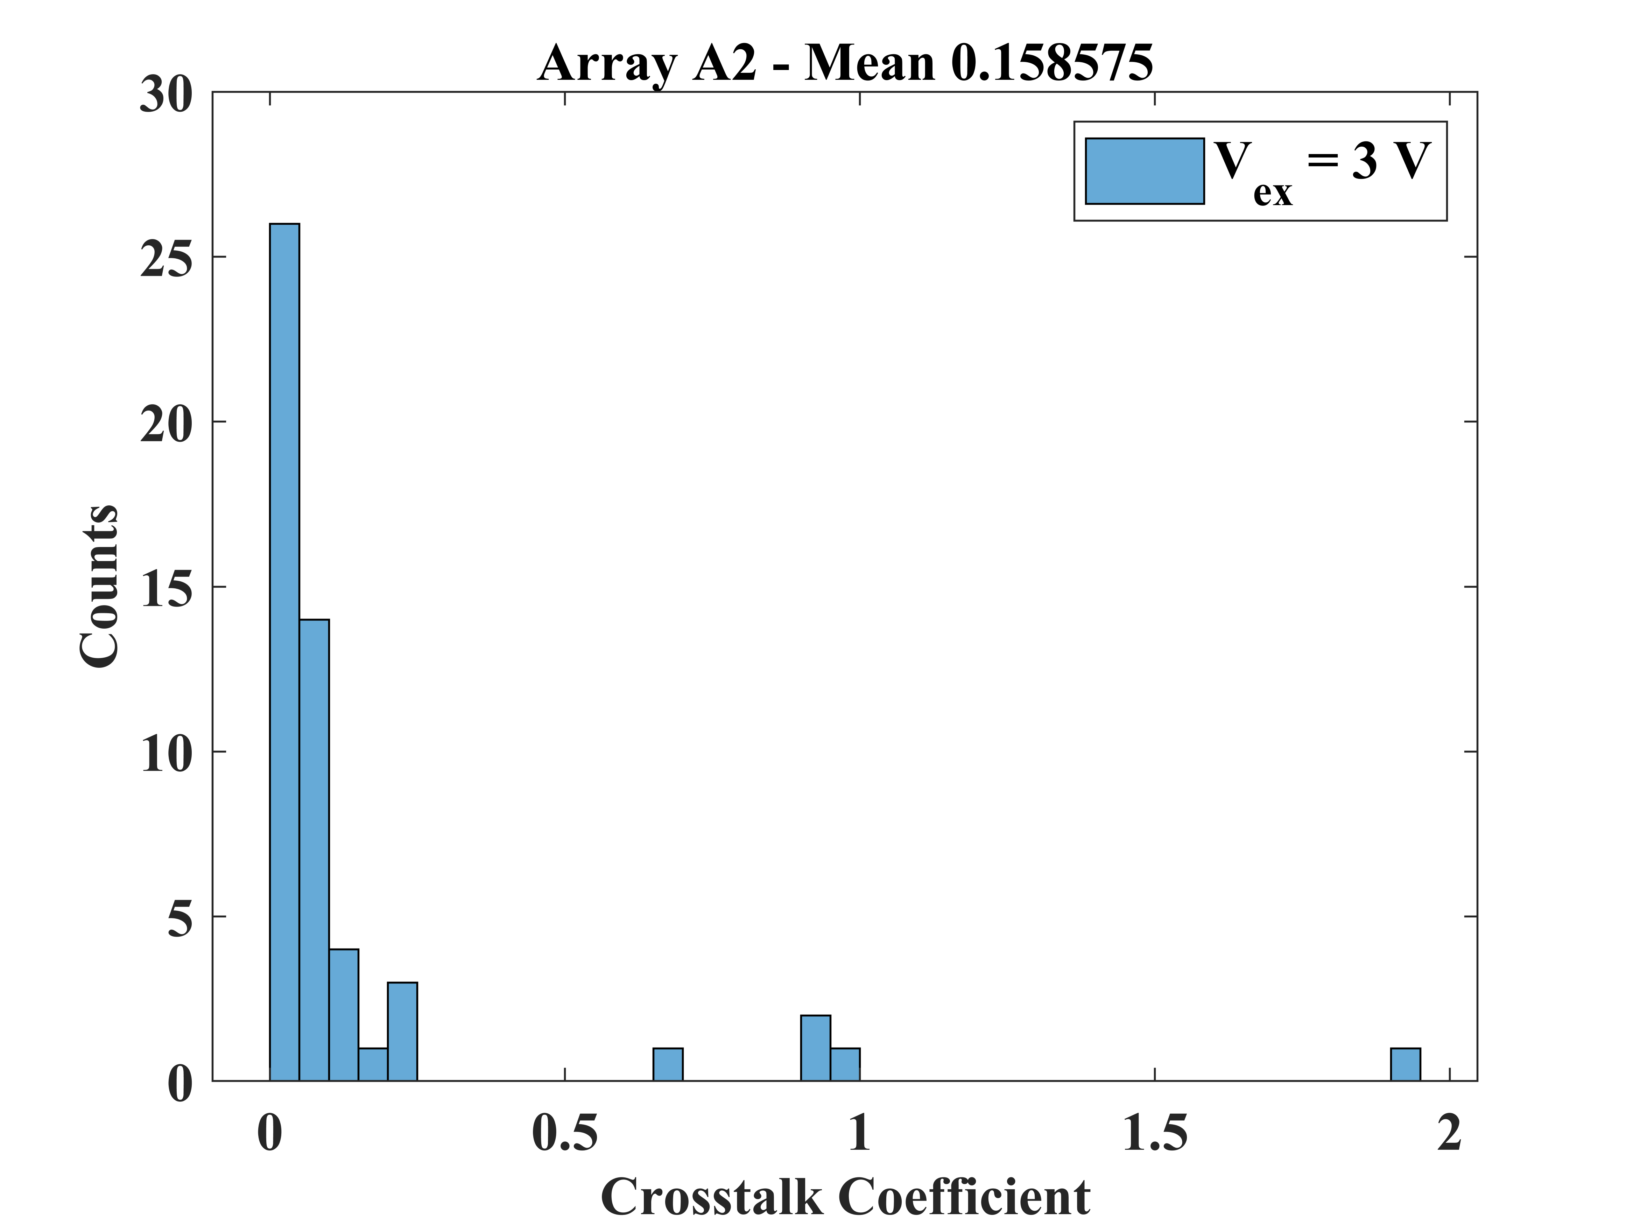
Measurement Results in Array A2

Slide 8
Thank You

