Slide 1
Detection of Light-Mass and Ultralight Dark Matter Particles with the TESSERACT Experiment
TESSERACT
Dan McKinsey - LBNL and UC Berkeley
20th Patras Workshop on Axions, WIMPs, and WISPs
Sept. 25, 2025

Slide 2
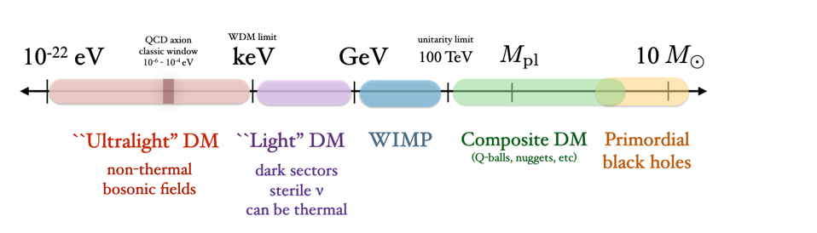
TESSERACT - A New Experiment to Detect Light and Ultralight Dark Matter
We don’t know the dark matter particle mass; many possibilities exist
TESSERACT is sensitive to bosonic dark matter absorption in the meV to keV mass range (“ultralight DM”), and to Electronic Recoil (ER) and Nuclear Recoil (NR) scattering in the keV to GeV mass range (”Light DM”)
Courtesy T. Lin

Slide 3
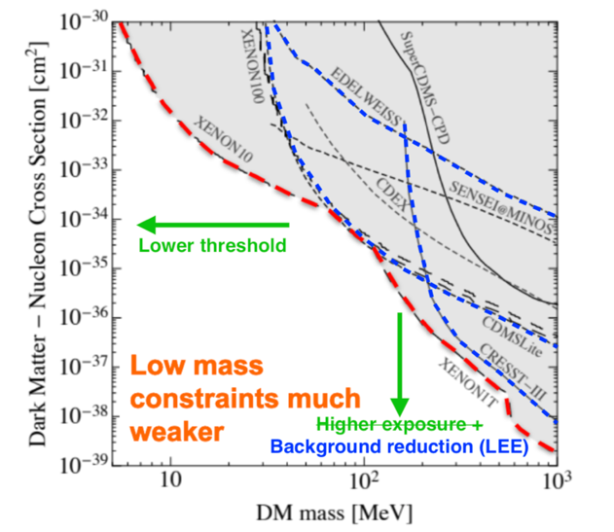
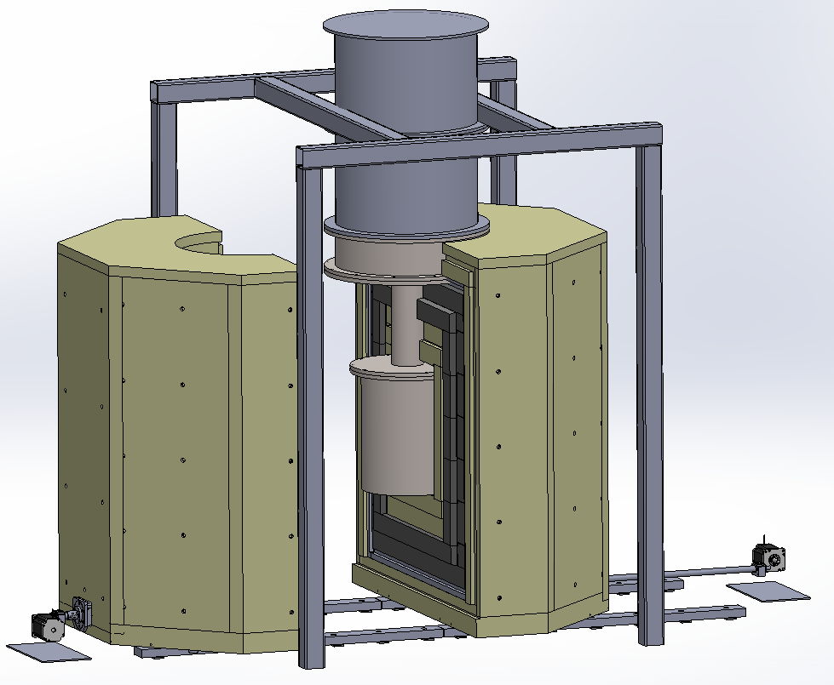

Dark Matter Nuclear Recoils: Future Directions
DM
Exposure: Rate scales inversely with dark matter mass
Compare ton scale LXe with gram scale low mass DM experiments

Slide 4
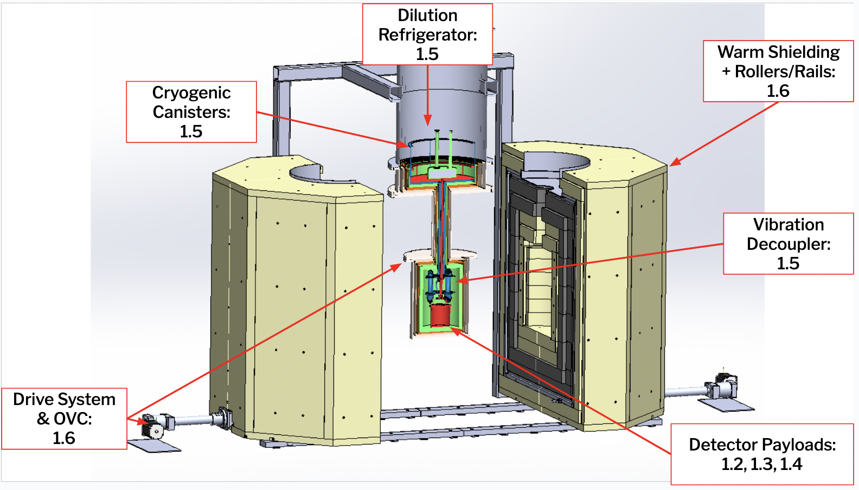
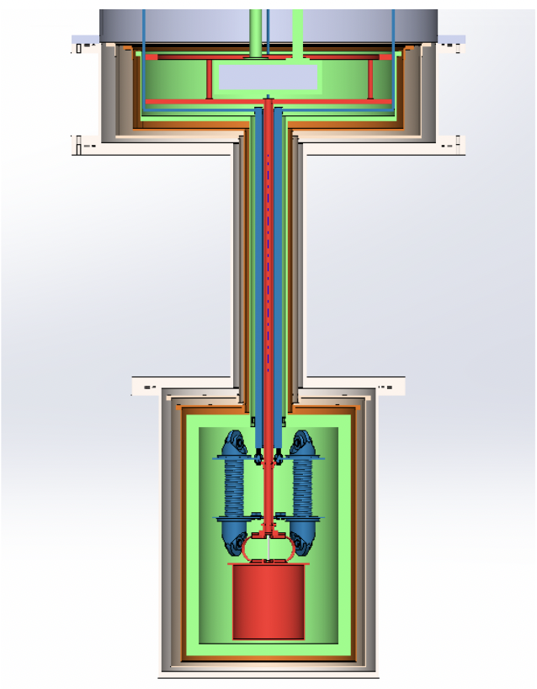
TESSERACT Overview
TESSERACT is designed for flexibility and straightforward detector replacement, with a common infrastructure of shielding, cryostat, vibrational decoupler, cold electronics, and DAQ.

Slide 5
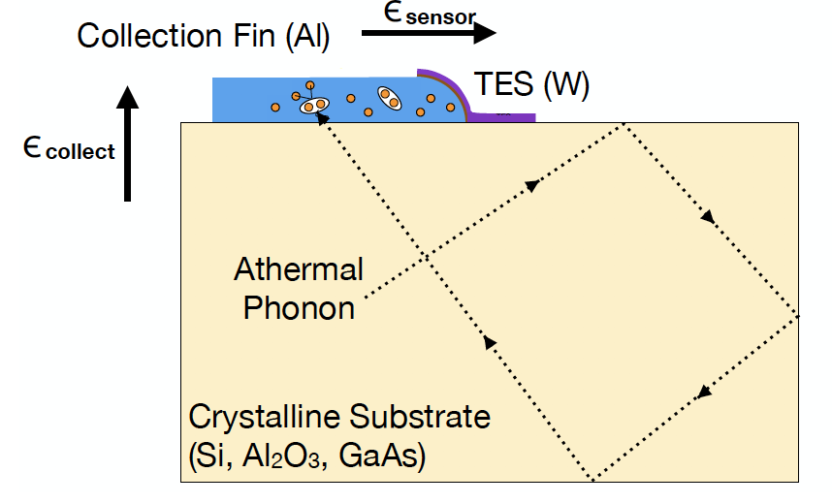
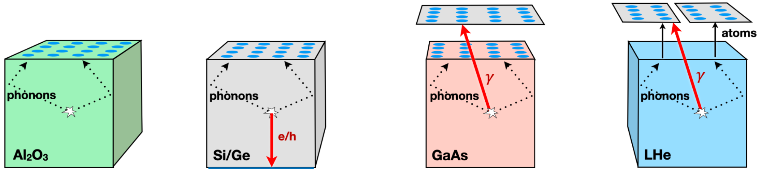
TESSERACT Overview
TESSERACT has existing detectors with world-leading energy resolution that can provide interesting science as soon as they can get underground in a low-background, cryogenic setup.
The Si/Ge, GaAs, and LHe technologies all benefit from multiple signal types and requiring coincidence across readout pixels, allowing strong reduction of instrumental and radioactive backgrounds. Al2O3 benefits from dark matter-lattice coupling, enhancing its sensitivity at especially low dark matter masses.

Slide 6
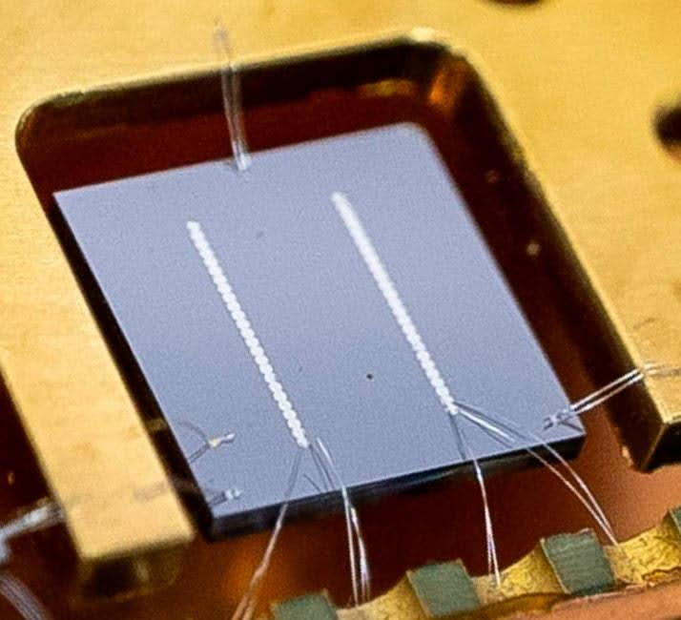
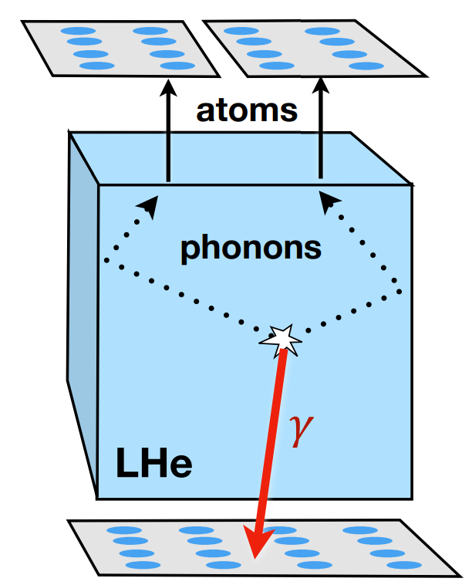

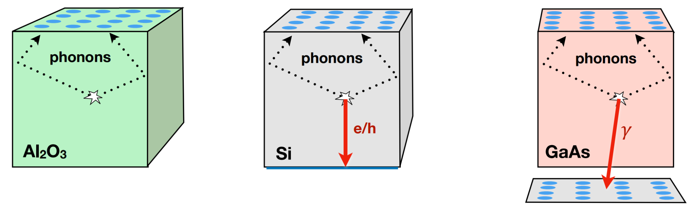
TESSERACT Overview
Three ingredients will make TESSERACT successful:
  World-leading, background-reduced sensors
  Optimized, complementary dark matter targets/modules
  Long-term, low-background, underground searches
Ge/Si

Slide 7


Collaborating Institutions
TESSERACT includes over 60 scientists, researchers, engineers, project managers, postdocs, and graduate students, from 12 institutions in the US, France, and Switzerland.

Slide 8
TESSERACT project
Science goal: Direct detection of particle-like sub-GeV dark matter
  Sensitive to a wide variety of dark matter interaction modes: DM-electron scattering, DM-nuclear scattering, and DM absorption
Technology and Strategy:
  Athermal phonon readout with Transition Edge Sensors for fast signals, decreased noise
  Shared engineering on shielding design, cryostat, vibrational isolation, electromagnetic interference, TES readout electronics, data storage and processing.
  Multiple targets. Sapphire and Gallium arsenide (SPICE), Superfluid helium (HeRALD), plus French technologies based on Ge and Si.
  Strong emphasis on detector coincidence and discrimination techniques to reduce backgrounds
  One detector type operated at a time, to avoid extra backgrounds
  Two identical setups of the shielding, cryostat, and electronics for operational flexibility and the ability to let one detector type run to collect more exposure, while still testing other detectors.
  Shared analysis tools and a single, cohesive analysis team across detector technologies
Schedule:
  Project planning stage: FY2020-FY2025 (completed)
  Project phase: FY2025-FY2028 (current)
  Operations phase: FY2029-FY2031

Slide 9
TESSERACT Overview
TESSERACT has existing detectors with world-leading energy resolution that can provide interesting science as soon as they can get underground in a low-background, cryogenic setup.
TESSERACT has chosen an underground site: The Laboratoire Souterraine de Modane (LSM), located under the Alps at the French/Italian border. CNRS/IN2P3 has also committed laboratory space for both setups at LSM.
The CNRS IN2P3 is allocating equipment, postdocs/theses, and permanent staff working on the project
Switzerland (SNF) is supporting TESSERACT research.
May 9, 2024: DOE announces TESSERACT to be the first new small project in DM physics.
In June 2025 TESSERACT held a Director’s Review (PD-1/3a).
In July 2025 we held a DOE gateway review, shepherding TESSERACT into the Project phase, with approval to start purchasing major equipment.

Slide 10
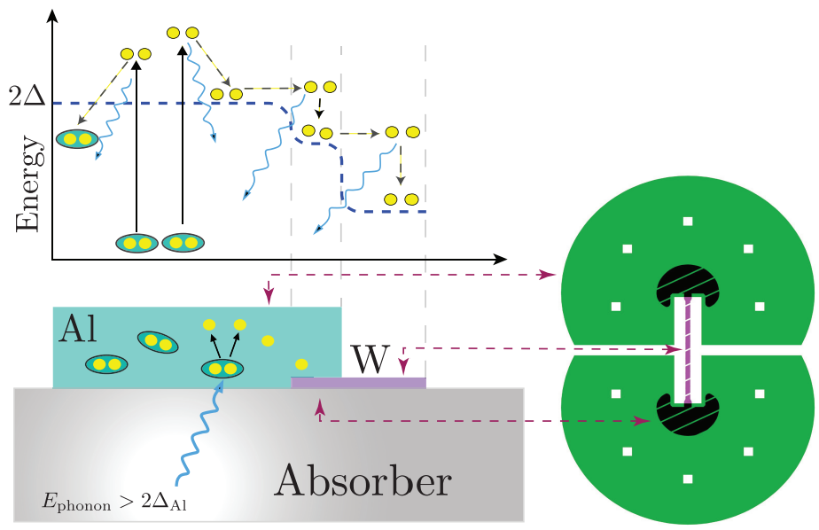
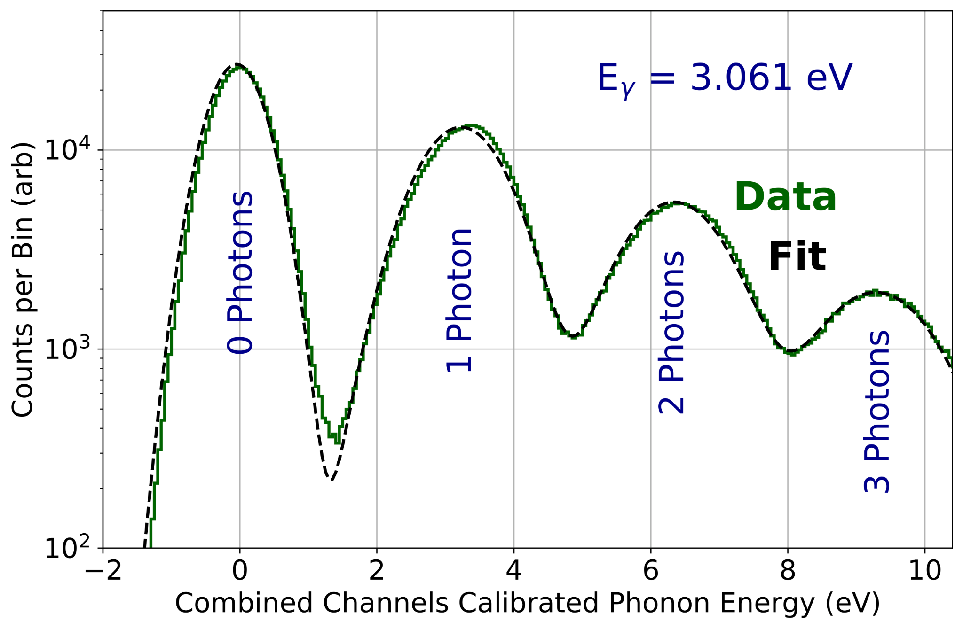
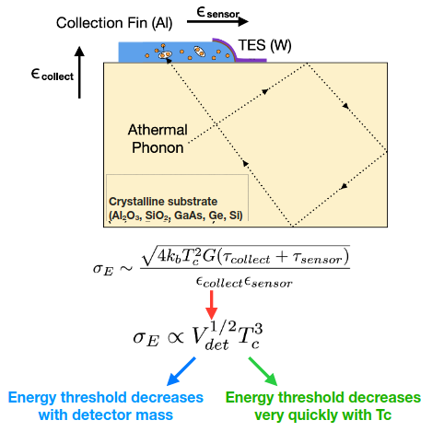
TESSERACT Sensors
W Transition-edge-sensors
DM scatters in absorber, producing athermal phonons
Athermal phonon break cooper pairs in large area Al
Broken cooper pairs thermalize in W (biased in superconducting transition)
Optimized for resolution: 361.5 ± .4 meV from photon source
Energy threshold decreases very quickly with T_{C}
Energy threshold decreases with TES mass

Slide 11
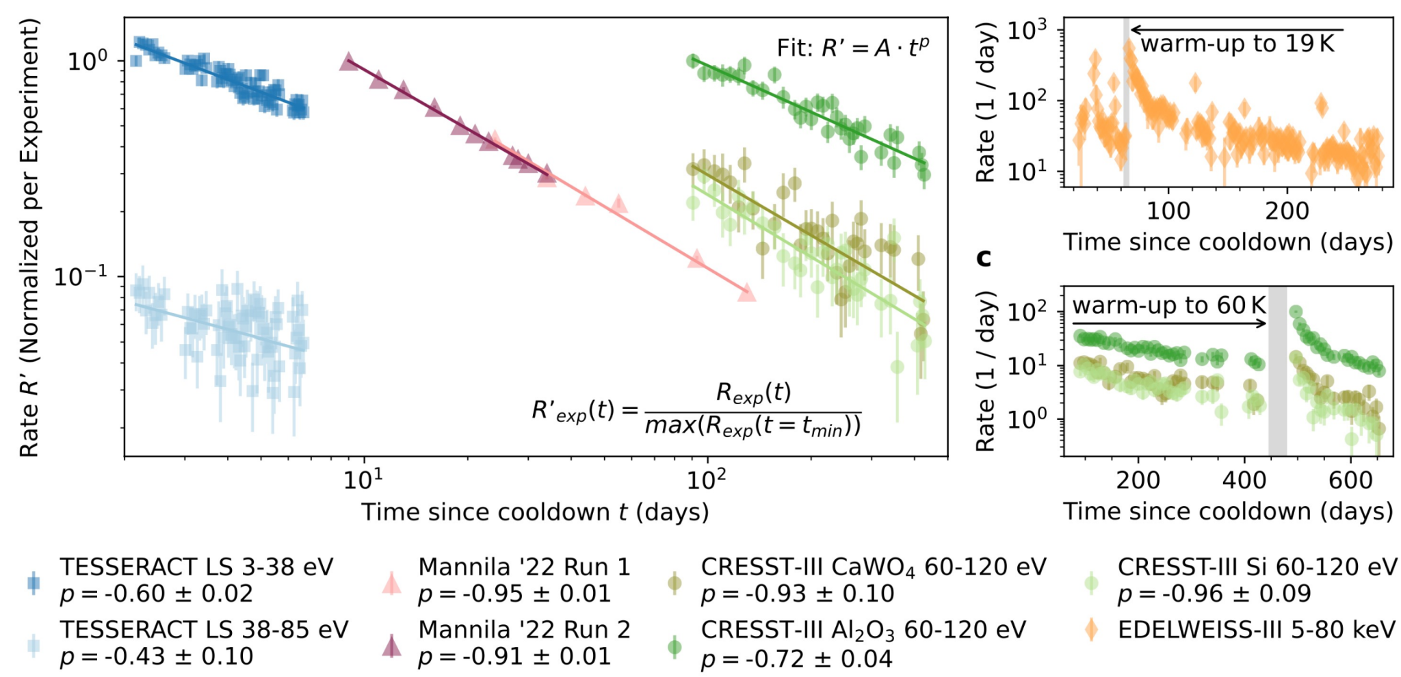
Instrumental Backgrounds
arXiv: 2503.08859
Low-temperature detectors see an excess of backgrounds at low energies (LEE)
What do we know?
    It’s not DM: rate is time-dependent
What impact does this have on our science goals?
  Above threshold: LEE is a background, limiting DM searches at lower cross-sections
  Sub-threshold: LEE adds extra noise. Limiting DM searches at lower masses

Slide 12
Instrumental Backgrounds
Extensive R&D toward mitigating LEE from 3 sources:
  1) Mounting Scheme (stress)
    Hang by wire-bonds > Gluing
  2) Al/W Films
    Require coincidence between 2 independent sensor films
  3) Substrate volume
    Active area of research
    Rate ~ substrate volume
Al/W Films
Substrate/Absorber
Mounting

Slide 13
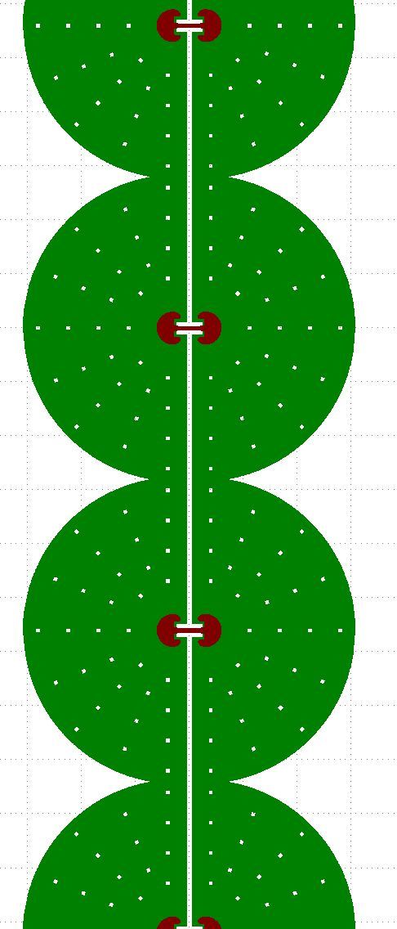

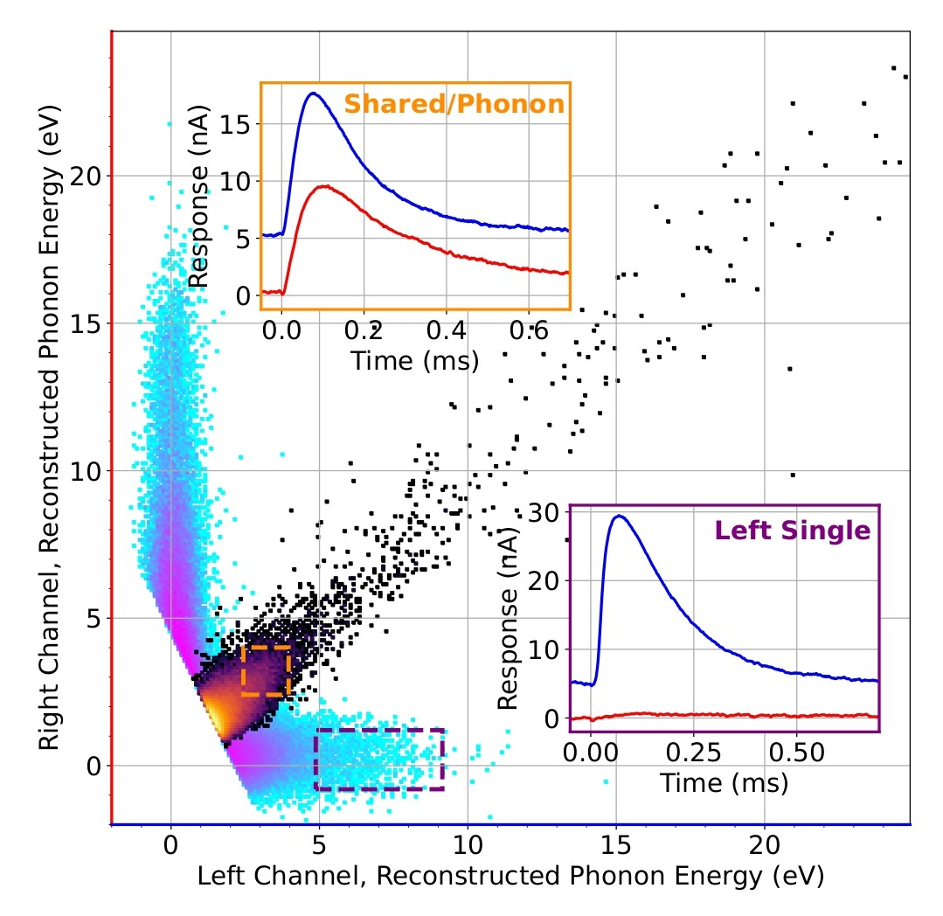
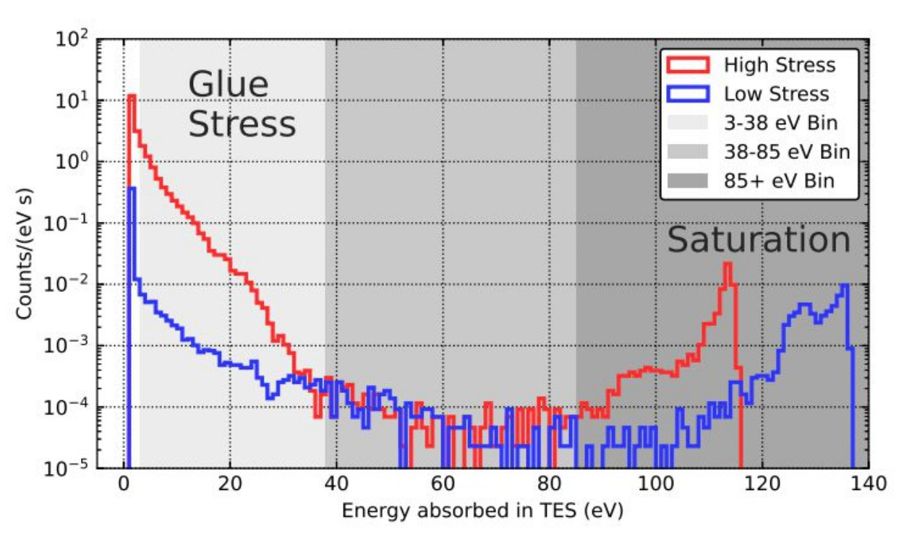
LEE Discrimination and Mitigation
LEE Discrimination: selection of events shared between 2 channels:
LEE mitigation : Si substrate suspended with Al wires
⇒ suppress a stress induced LEE source from the holder
Si substrate
arXiv:2503.03683v2

Slide 14
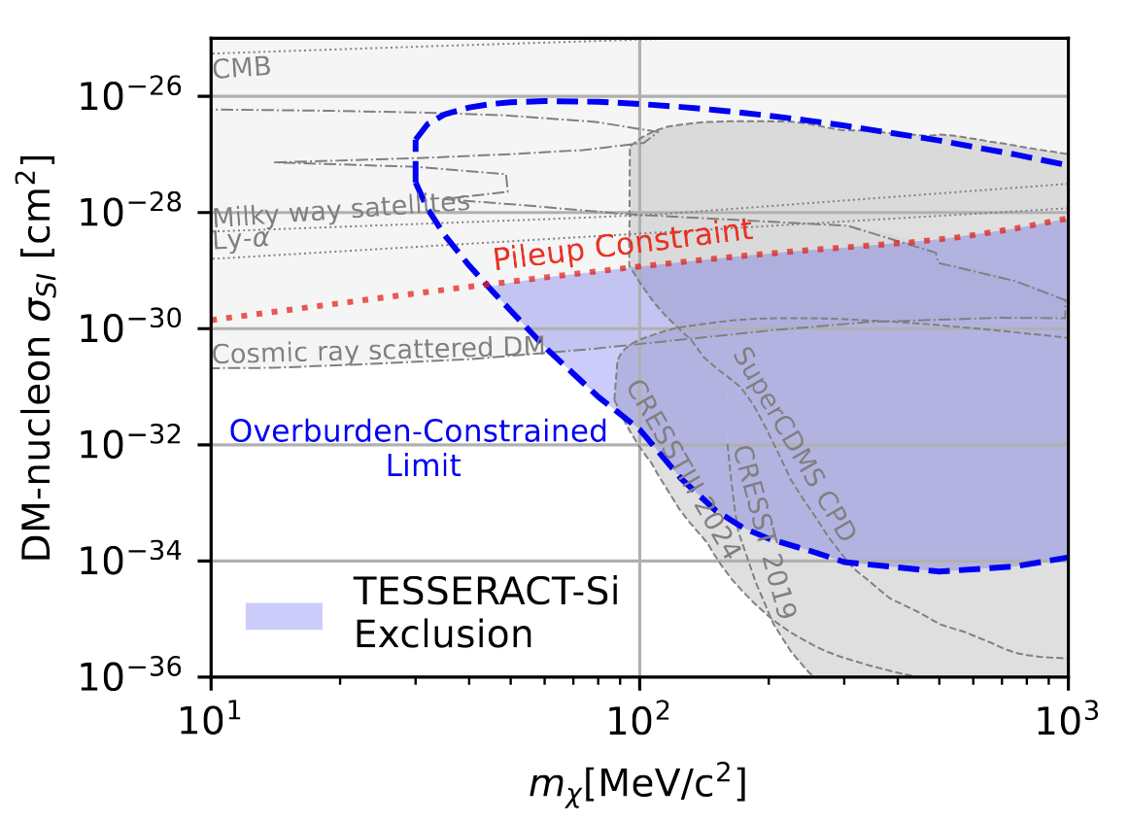
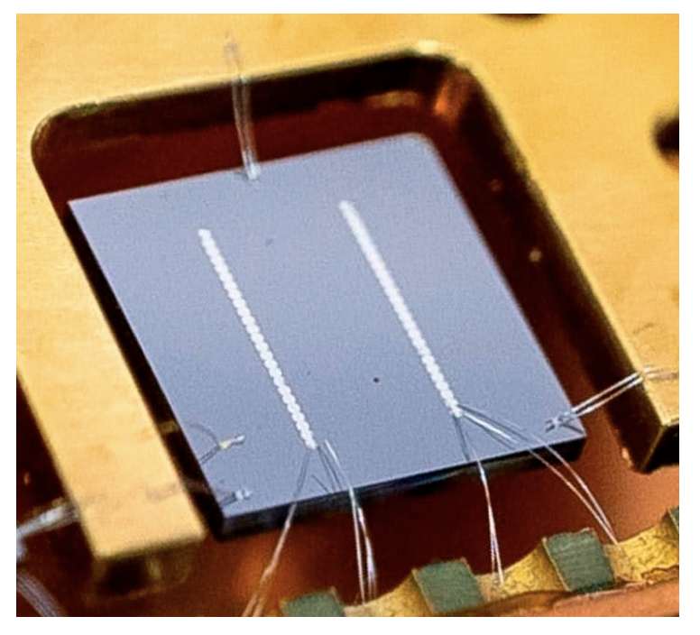
TESSERACT Has Already Produced New DM Science
TESSERACT Collaboration, https://arxiv.org/pdf/2503.03683
Now accepted to Physical Review Letters
Because TESSERACT energy thresholds are especially low, even very small detectors operated at the surface can probe new dark matter parameter space.
Here is a new TESSERACT result, using a 0.23 g silicon detector, like we would use for one of the readout pixels for HeRALD.
361.5 ± .4 meV photon resolution

Slide 15
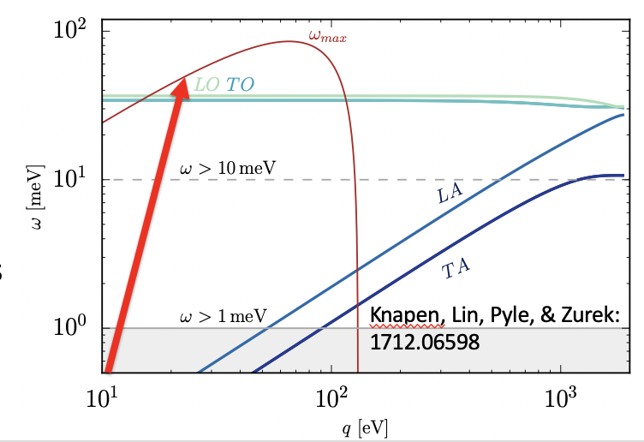
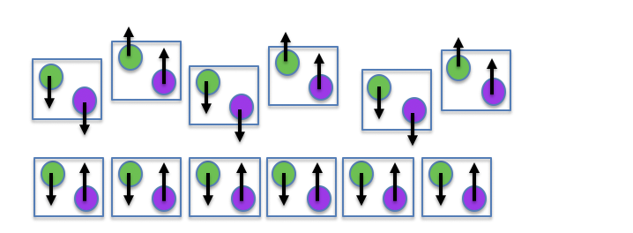
Sapphire Target
Coherent excitations:
Vibrational energy scale in crystals is O(100 meV)
For dark matter masses < 100 MeV, we can’t use the simplifying approximation that the nucleus is free.
DM scatters coherently with the entire crystal, producing a single phonon.
The kinematics of optical phonon production are favorable; due to their gapped nature, all of the kinetic energy of the DM can potentially be used for phonon creation.
Optical phonons modulate the electric dipole in polar crystals, so they have strong couplings to IR photons, and thus by extension, all DM models that interact through a kinematically mixed dark photon.
1 detection channel: Phonons (sensors on sapphire)
Polar crystal => phonon modes couple to dark photon
Status: First sensors have been fabricated!

Slide 16
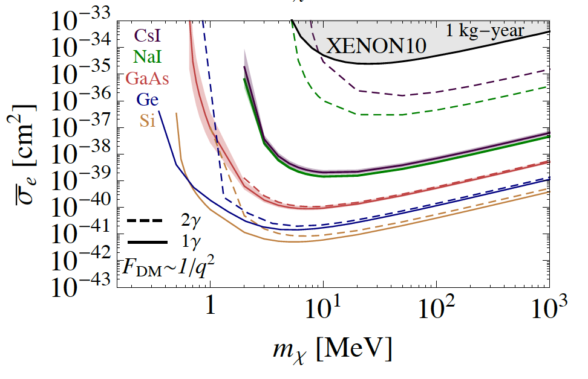
Gallium Arsenide Target
Low bandgaps:
Just as with optical phonons, the gapped nature of an electronic excitations in semiconductors allows them to maximally extract kinetic energy when scattering with or absorbing DM.
Due to a strong rate dependence upon energy, low bandgap semiconductors like Ge, Si (SENSEI and SuperCDMS HV), and GaAs (SPICE) are the preferred target candidates.
With GaAs one can collect both photons and phonons!
Can allow background rejection through phonon/photon ratio
Status: First sensors have been fabricated!
S. Derenzo et al, 1607.01009

Slide 17
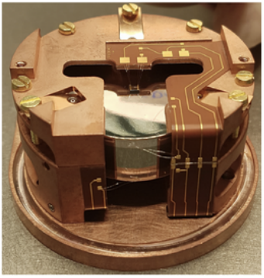
Si/Ge Target
Based on EDELWEISS and Ricochet expertise
Ionization signal
Heat signal
Charge/Phonon sensors
E_{ion}
E_{heat}
E_{Luke}
h⁺
prompt phonons
ΔV
time
time
e⁻
E_{heat} = E_{recoil} + E_{luke}
= E_{recoil} + E_{ion} ΔV/ε_{eh}
e⁻
Charge/Phonon sensors
Two channels : heat and ionization
Luke boost ⇒ additional phonons proportional to ΔV
Two working modes : Low Voltage (LV) and High Voltage (HV)

Slide 18
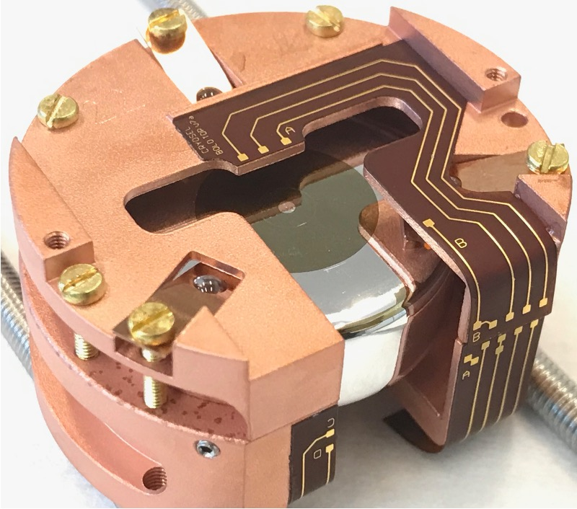
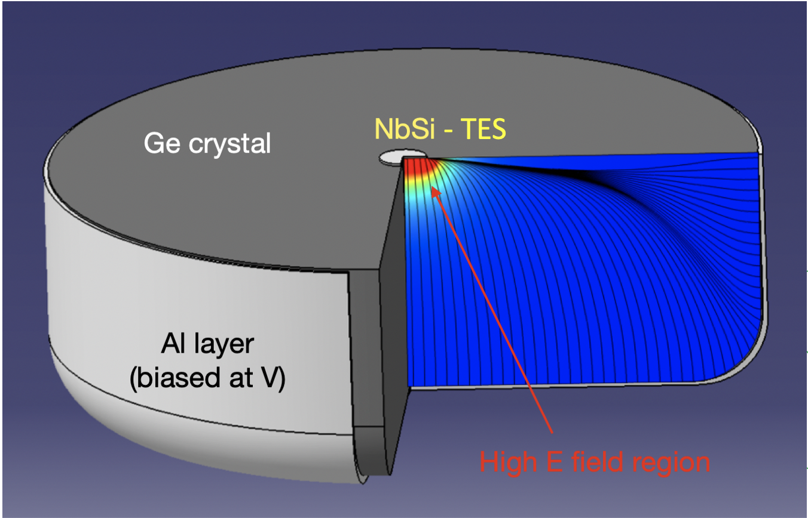
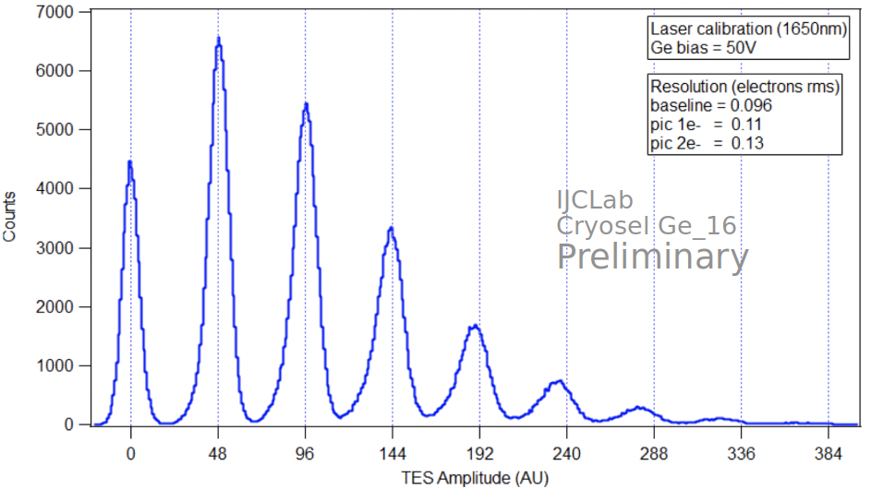
Si/Ge Target
High-Voltage approach for optimal ERDM sensitivity
E_{heat} = E_{recoil} + E_{ion} ΔV/ε_{eh}
E_{heat}≃ E_{ion} ΔV/ε_{eh} (HV)
First observation of a single-electron sensitivity in a massive (40g) Ge cryogenic detector !
Low-imp. TES and SQUID readout : 0.1 electron/hole (RMS)
For TESSERACT :
High control of IR backgrounds and charge leakage
LEE discrimination down to single e/h pair
Exquisite sensitivities to ERDM with LEE discrimination

Slide 19
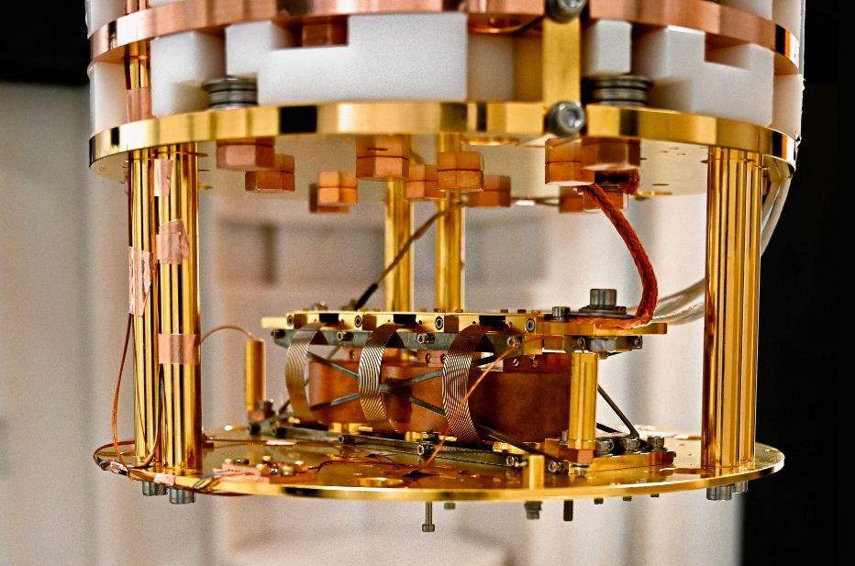
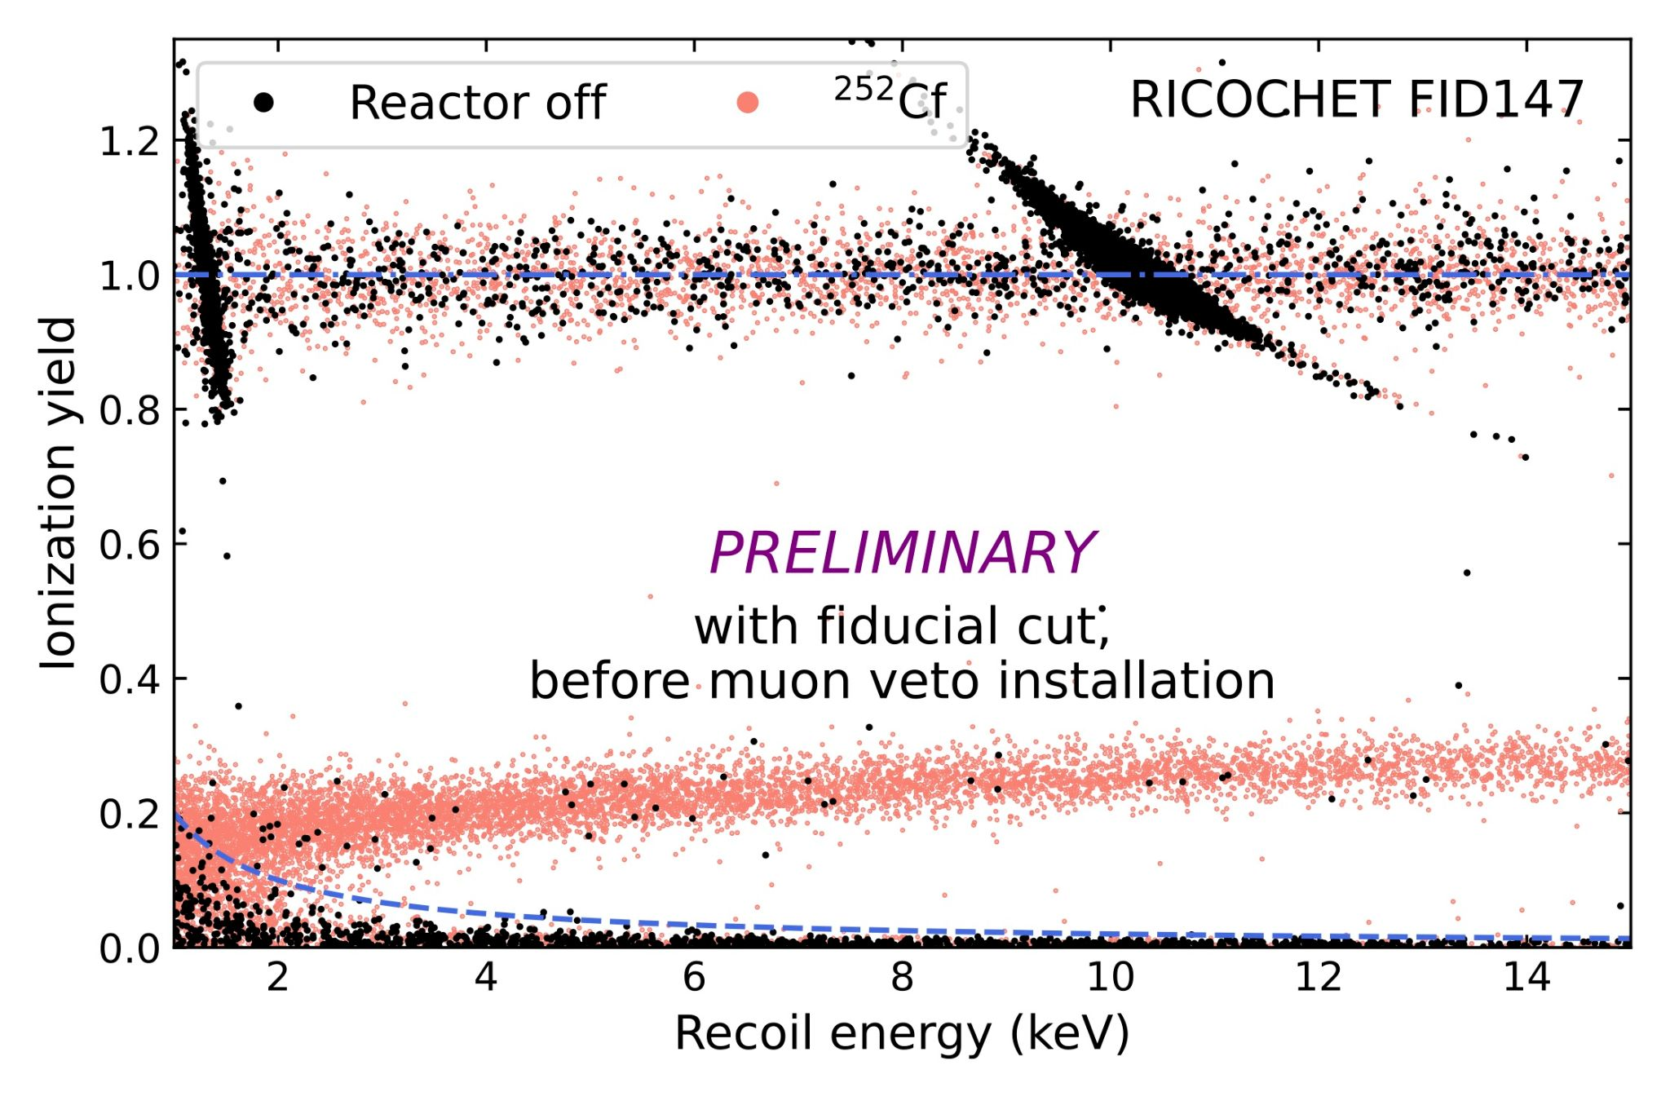
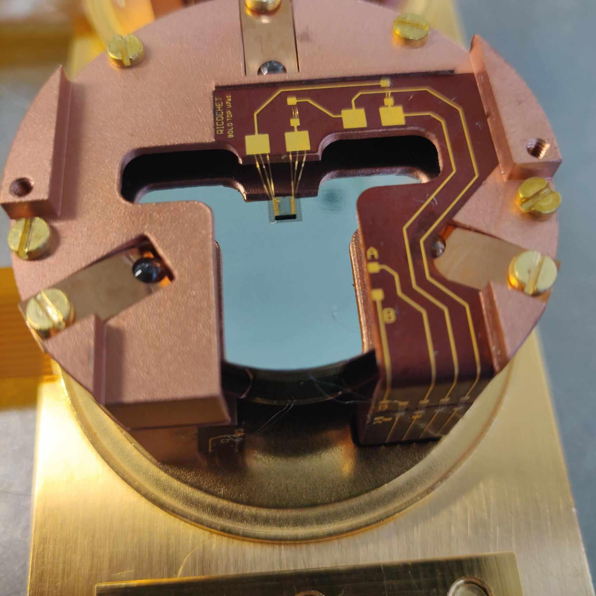
Si/Ge Target
Low-Voltage approach for optimal NRDM sensitivity
Calibration peaks
Heat sensor (NTD-Ge)
Ricochet data
RED167
= E_{ion}/E_{Recoil}
Electronic recoils
Ricochet Mini-Cryocube
Ge crystal
Electrodes
Double readout heat/ionization ⇒ particle identification
LEE are non ionizing ⇒ improving the charge resolution is of major importance
Nuclear recoils
LEE (heat only)

Slide 20
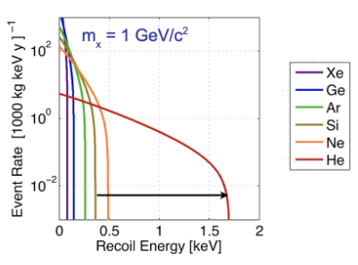
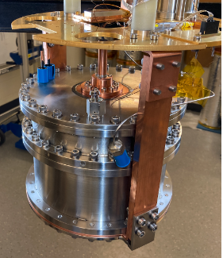
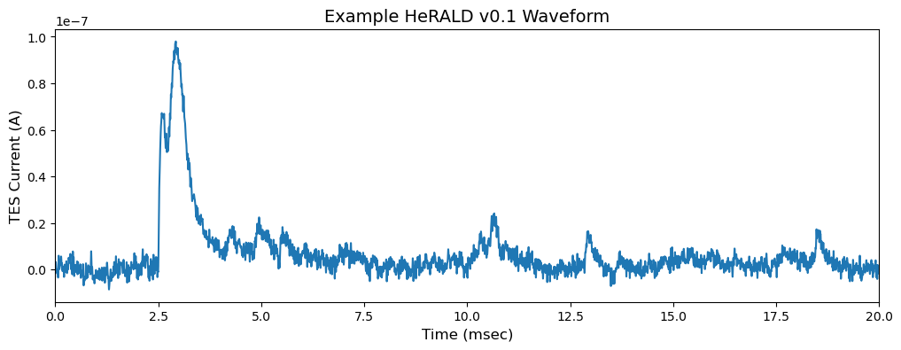
Superfluid Helium Target (HeRALD)
Target : Liquid He
Light material ⇒ better kinematic matching with LDM
Extremely radiopure
No internal stress nor dislocation (LEE source ?)
Superfluid ⇒ no vibrational coupling with the environment (another LEE source ?)
Several signal channels :
    quasiparticles (phonon/roton
    singlet ⇒ short lived, decay to emit a 15.5 eV photon
    triplet ⇒ long lived, ballistic
Singlet
Evaporation
Triplets
R. Anthony-Petersen et al., arXiv:2307.11877

Slide 21
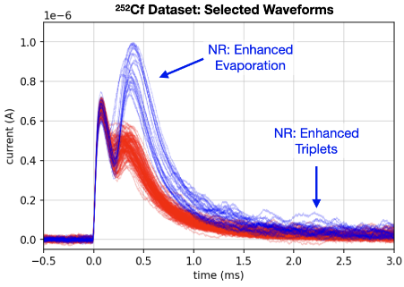
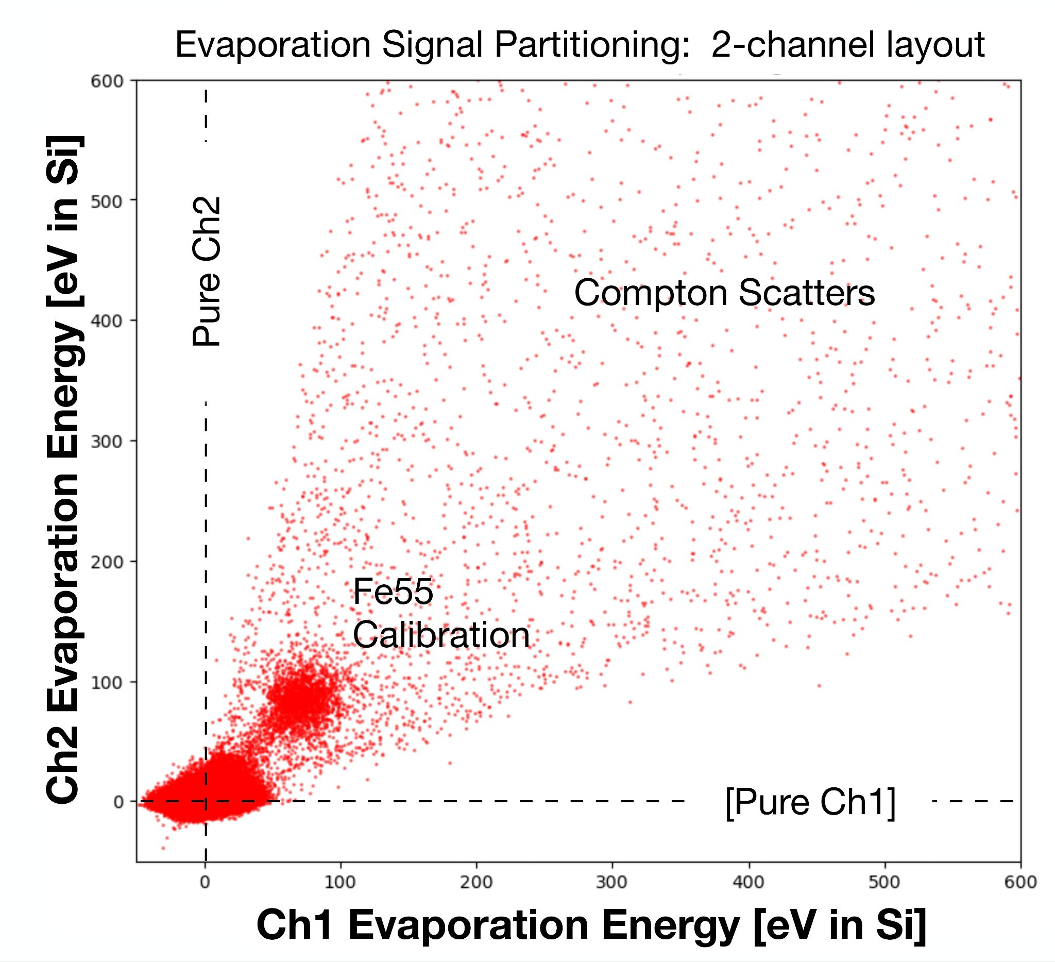
Superfluid Helium Target (HeRALD)
Particle identification thanks to pulse shape discrimination
LEE mitigation strategy:
Several channels above the vacuum
  Events in calorimeters (LEE) ⇒ single channel
  Events in ⁴He ⇒ multiple channels
Prompt Scintillation
ER

Slide 22
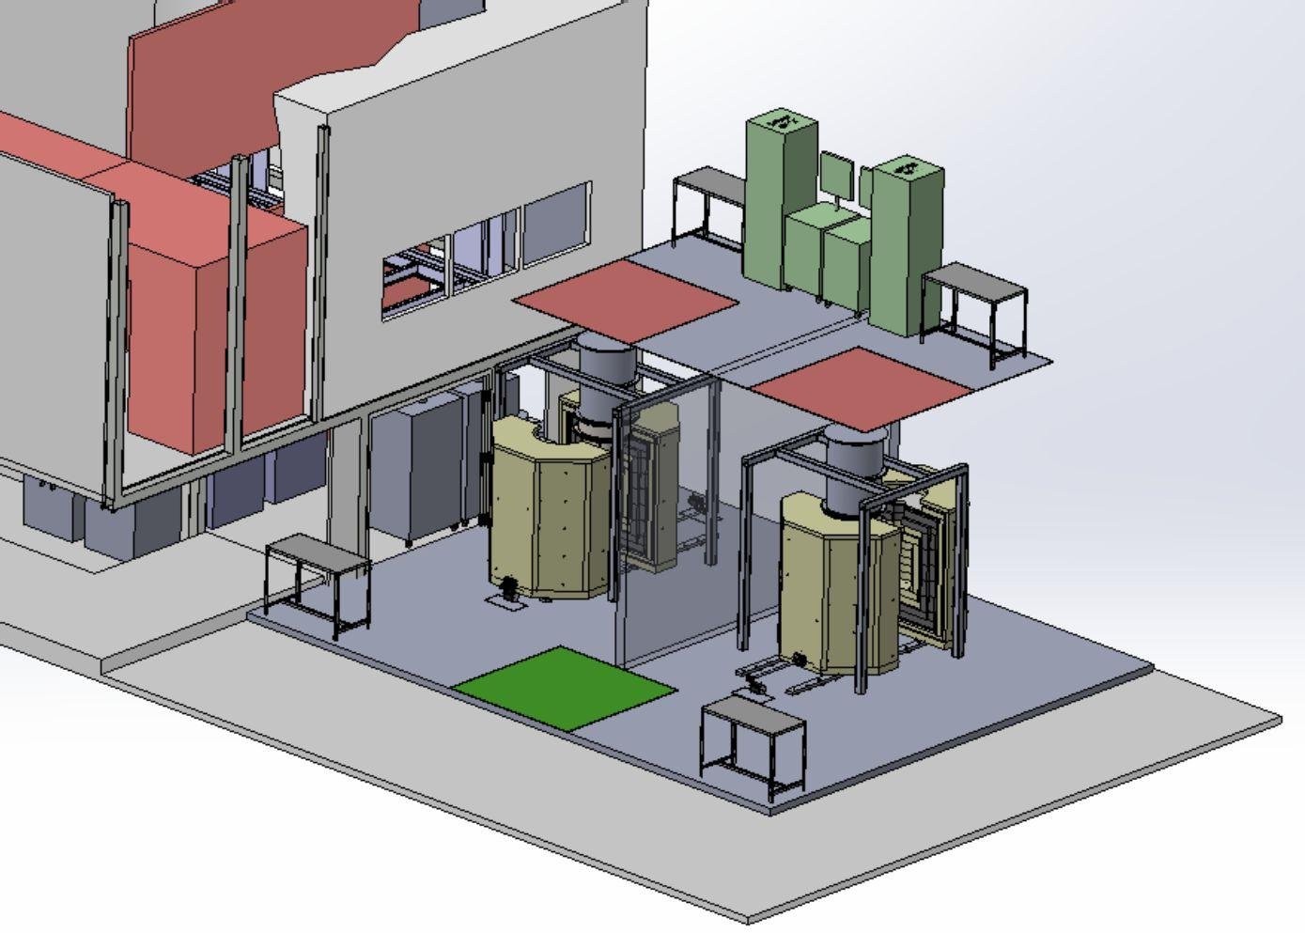
Moving Underground
First DM search was background-limited by LEE
  This won’t be the case for targets with discrimination power
TESSERACT will be moving into Modane underground lab starting in 2028
  Target: few-DRU backgrounds
  2 dilution fridges
    2 DM searches can occur simultaneously
Preliminary
Detectors R&D - Fabrication - Testing - Optimization - Surface Science
1st science data taking at LSM
cryostat & shielding design
cryostats commissioning @ LPSC
commissioning @ LSM
2025
2026
2027
2028
2029

Slide 23
Summary
TESSERACT has state-of-the-art technology for detection of sub-eV events.
A strong TESSERACT team has been built, including institutions in the US (DOE-supported), France (IN2P3-supported), and Switzerland (SNF-supported).
Following reviews in summer 2025, TESSERACT has moved to the Project phase.
Multiple target materials allow for exploration of different types of interactions and dark matter particle masses.
Multiple signal channels and coincidence-based background rejection will lead to improved dark matter sensitivity.
World-leading energy resolution leads to exploration of new dark matter parameter space at low particle masses. Even small gram-scale detectors can have a big science impact!
TESSERACT is not trying to improve upon the state-of-the-art in radioactive backgrounds
R&D focus is shifting toward development of our targets
  Superfluid He, Al₂O₃, GaAs, Si/Ge
  Sensor R&D will continue
Moving to Modane in 2028 for low-background searches

Slide 24
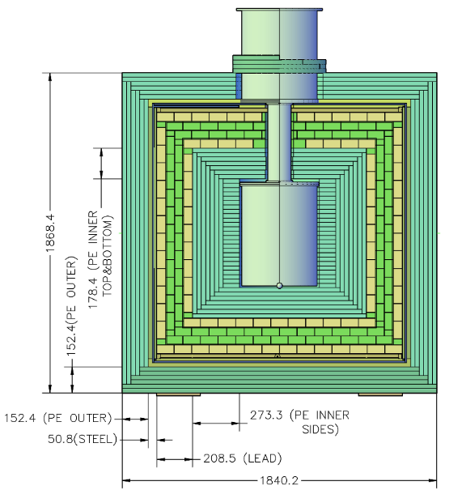
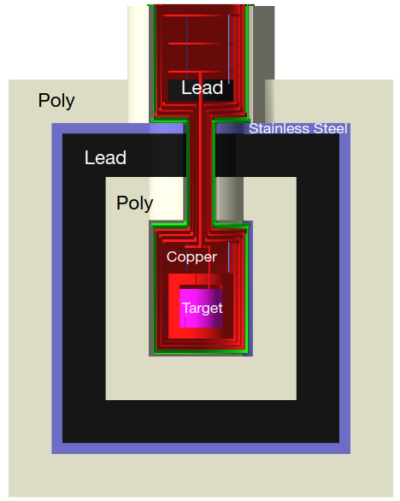
Shielding Scheme

