Slide 1

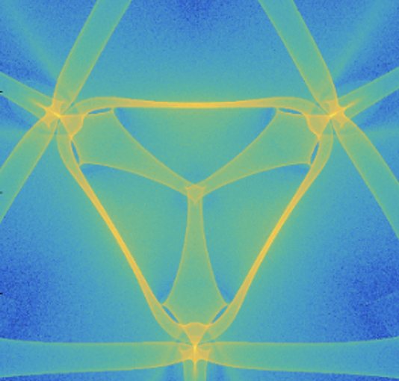
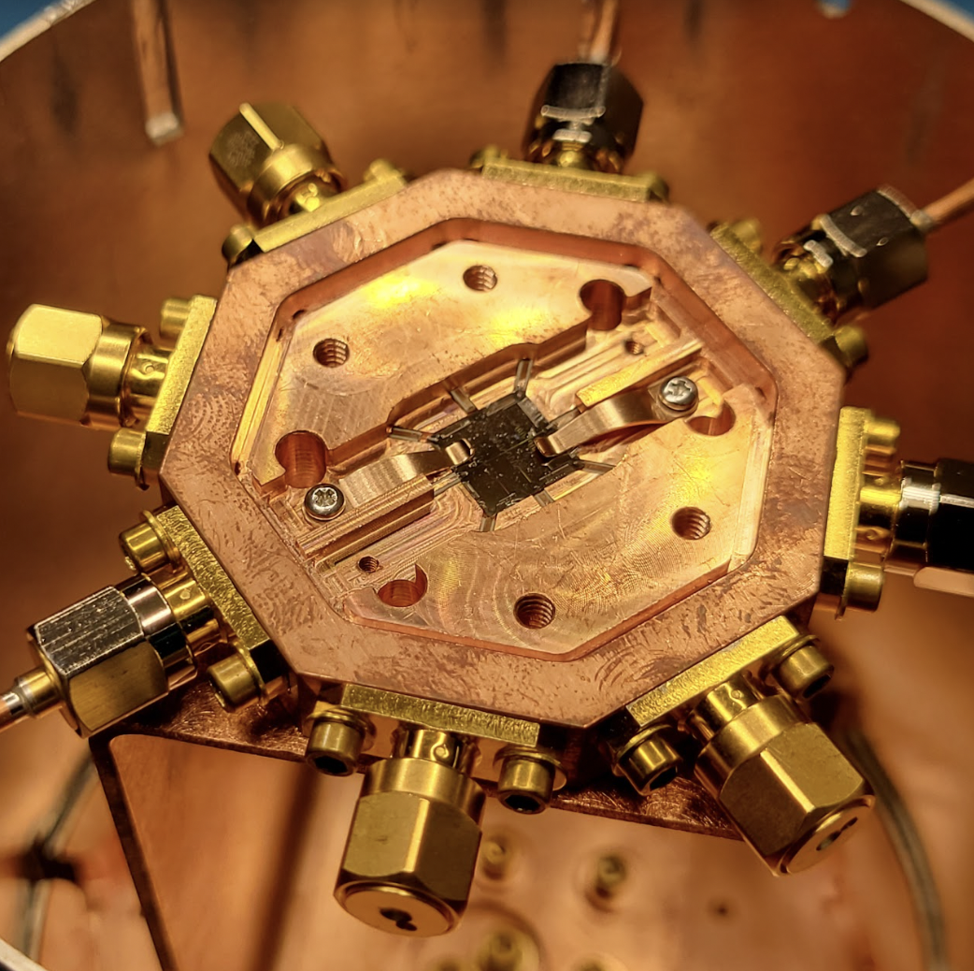
Phonon mediated Quantum sensors for
Dark Matter
Rakshya Khatiwada
Illinois Institute of Technology & Fermilab
09/22/2025
Tenerife, Spain
View of North Atlantic Coastline from Roque de Taborno

Slide 2
Quantum Technology
(for this talk)
Superconducting Qubit and its variants
2

Slide 3
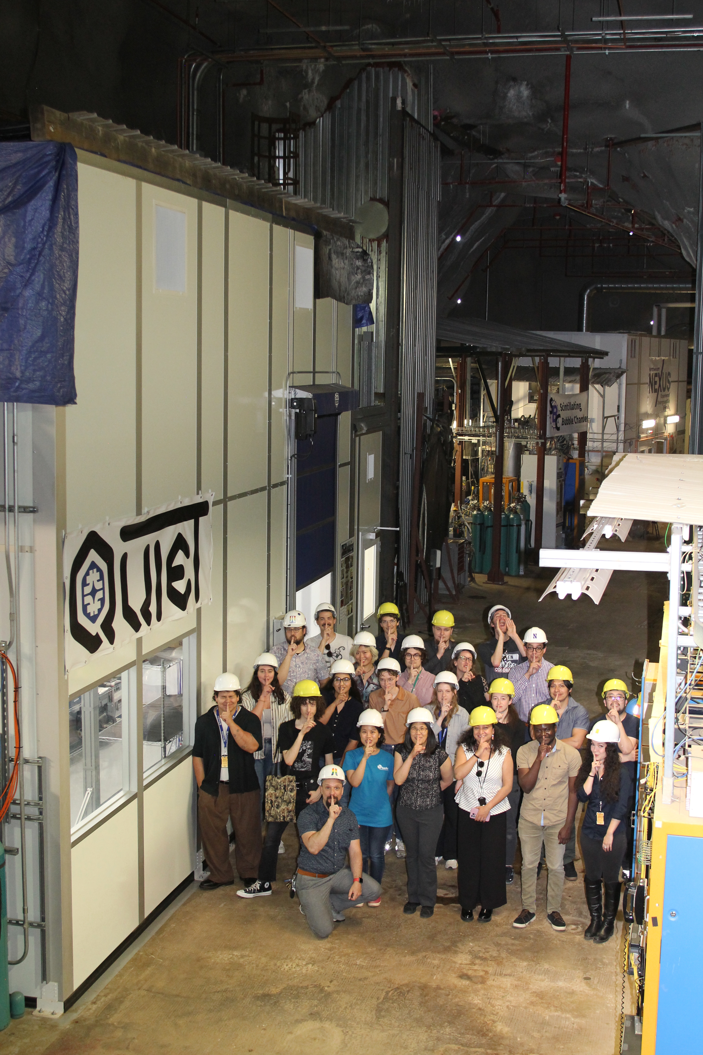
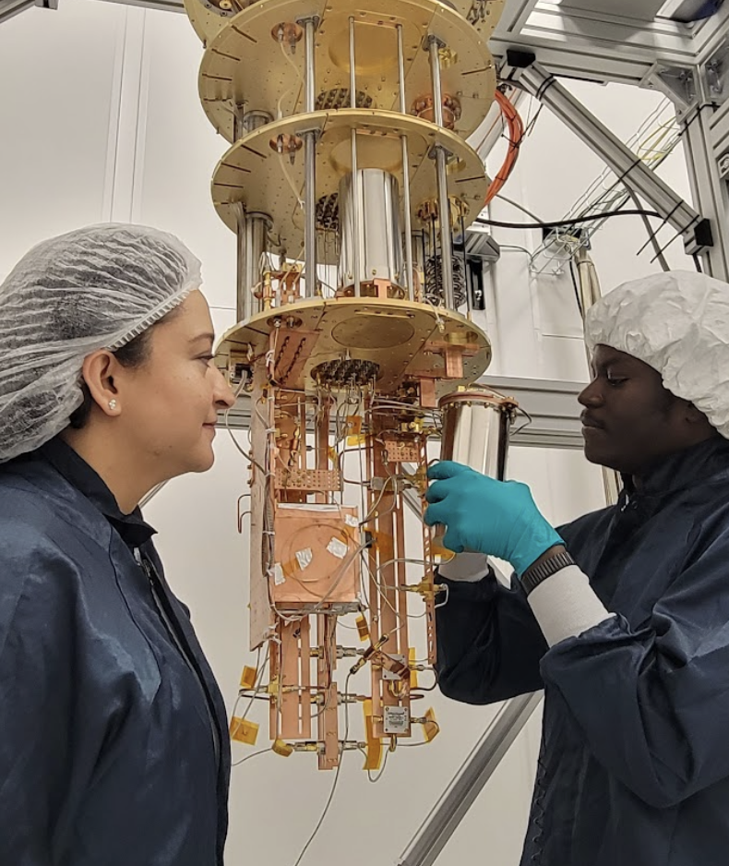
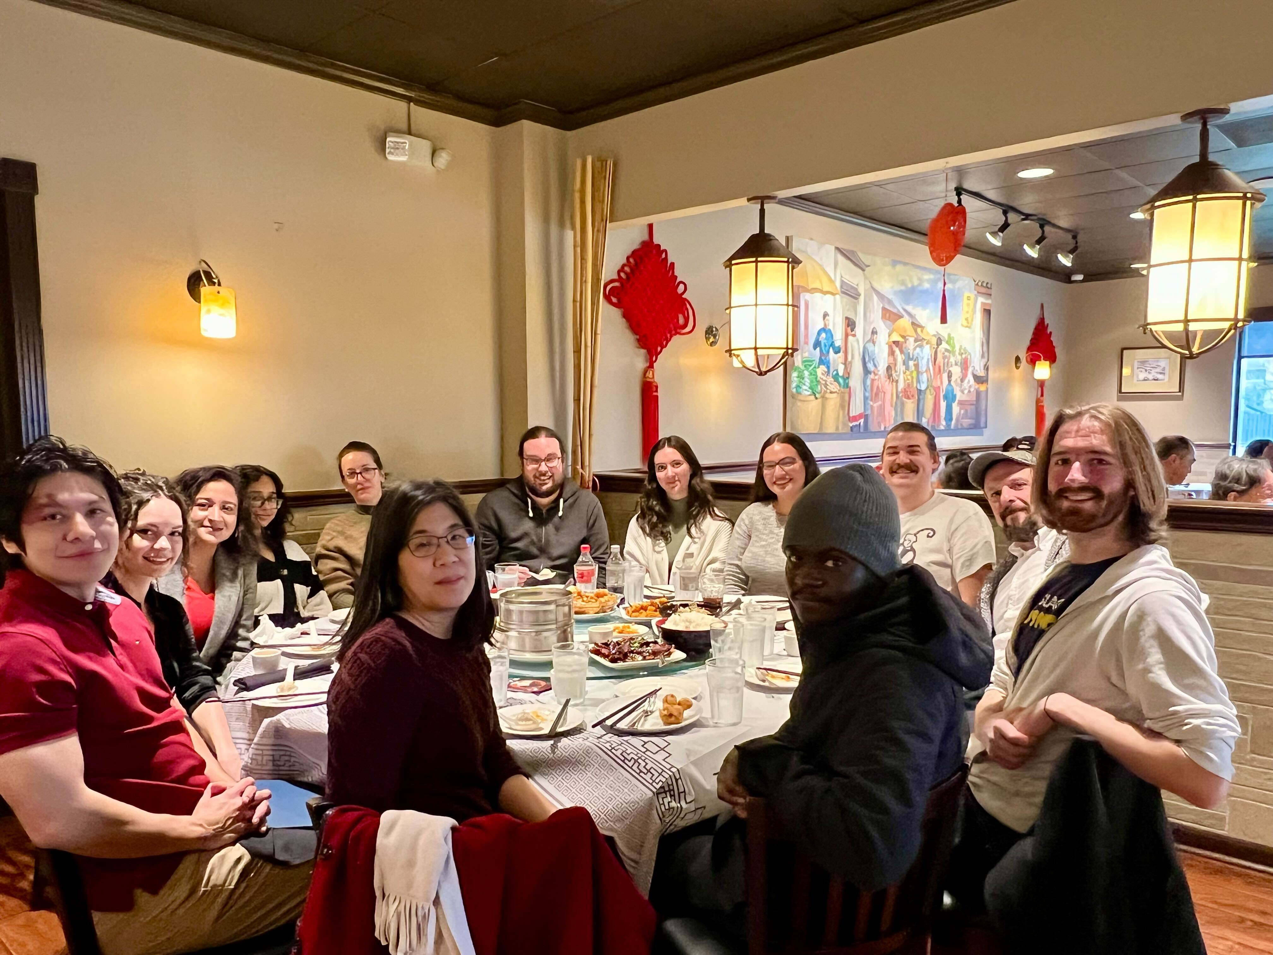
CosmiQ group
Started in 2020
IIT/Northwestern students/postdocs and Fermilab postdocs along with PIs
Above-ground and underground (low background) labs.
CosmiQ group FNAL/IIT/NW
LOUD facility FNAL
QUIET facility FNAL
3

Slide 4
Ideal Quantum Detector for Dark Matter
Low energy threshold
Quantum non demolition measurement
No background coupling
Couples to only DM interaction mode
High precision
Fast response time
Scalable
Hard to get all of these in one detector!
4

Slide 5
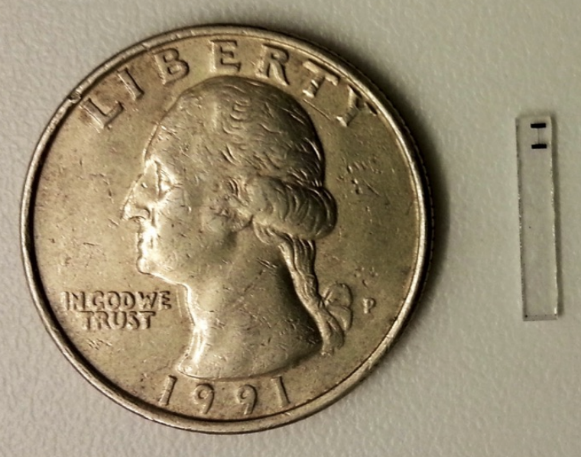
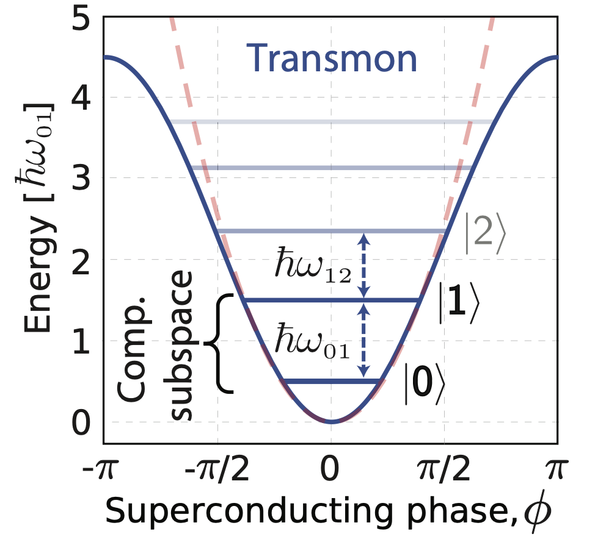
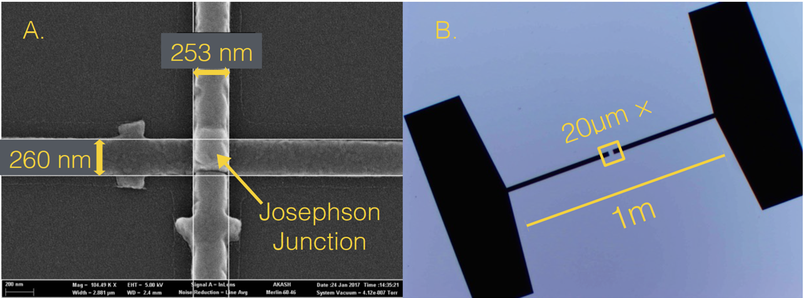
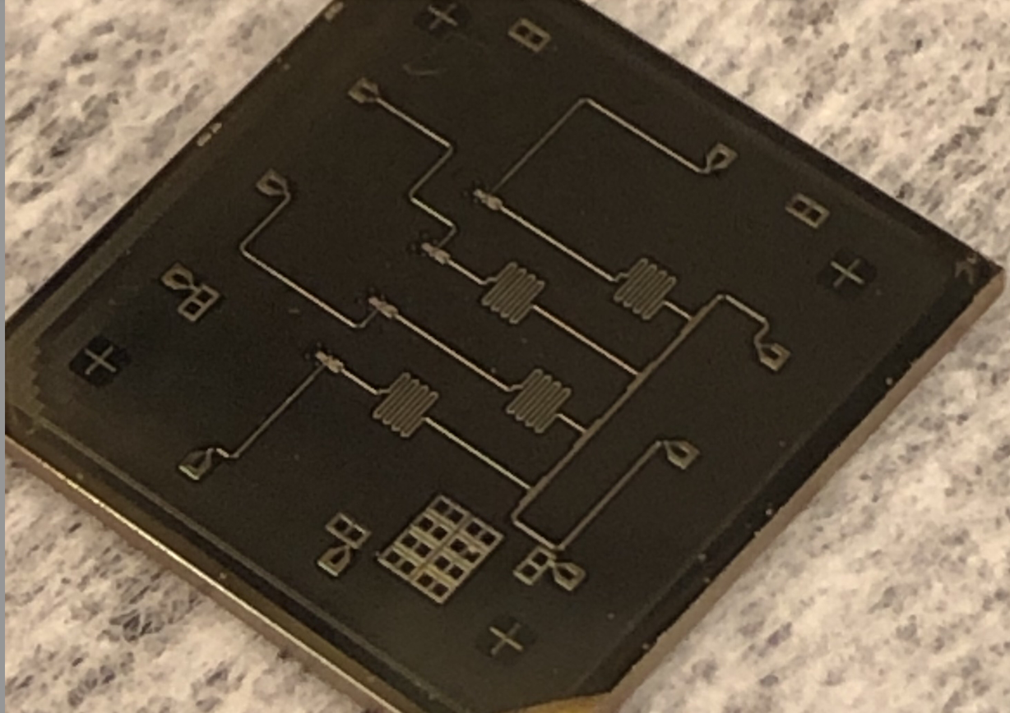
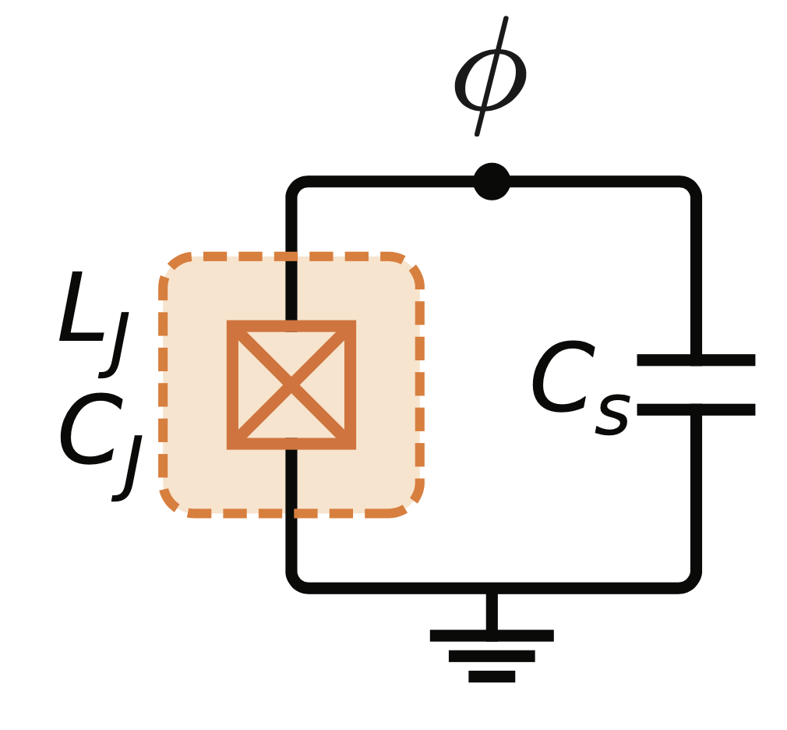
Superconducting Qubits
Quadratic energy potential of a QHO reshaped by Josephson Inductance to a sinusoidal potential
Josephson Junction
Phase difference Φ
between the two
superconducting
(Cooper pair) wave functions
qubit on a Sapphire substrate
Qubit
JJ: Non-linear
dissipation less
Inductor
Readout
Resonator
4-Qubit device fab by Sara Sussman
Size: 1cm X 1 cm
qubit schematic
Qubits (artificial atoms) with customized energy levels.

Slide 6
How can we detect particles with qubits?
Insulator (Al₂O₃)
Superconductor
(Al, Nb, Ta)
Qubit
dummy
Qubit
Readout
Resonator
Josephson
Junction (JJ)
4-Qubit device fab by Sara Sussman
Substrate (Silicon or Sapphire)
Size: 1cm X 1 cm
JJ: nm
What kind of energy sensitivity can we get with Qubits?

Slide 7
How can we detect particles with qubits?
Insulator (Al₂O₃)
Superconductor
(Al, Nb, Ta)
Cooper pair
(paired
electrons)
Cooper pair breaking energy
(2Δ bandgap)
in the superconductor
governs energy scale!
(Al: 0.3 meV , Nb: 3 meV and Ta: 1.5 meV)
Josephson
Junction (JJ)
Substrate (Silicon or Sapphire)
What kind of energy sensitivity can we get with Qubits?

Slide 8
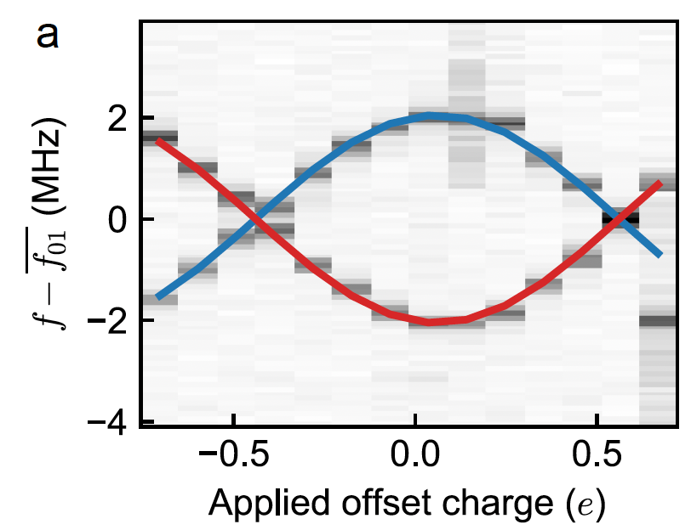
How can we detect particles with qubits?
Insulator (Al₂O₃)
Superconductor
(Al, Nb, Ta)
Broken
Cooper
Pair
(quasi-
particles)
Quasiparticles can tunnel through JJ
Individual tunneling event can be seen in
qubit readout
odd
Josephson
Junction (JJ)
Qubit Even and
Odd Parity
bands
e-
Substrate (Silicon or Sapphire)
even
What kind of energy sensitivity can we get with Qubits?

Slide 9
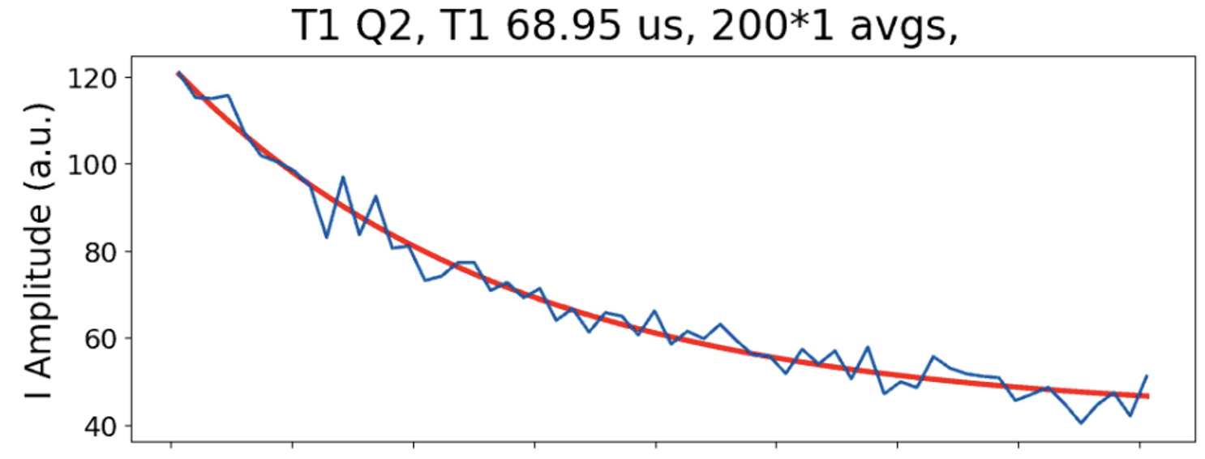
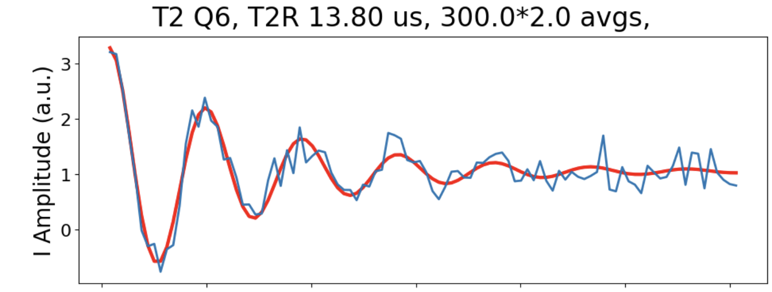
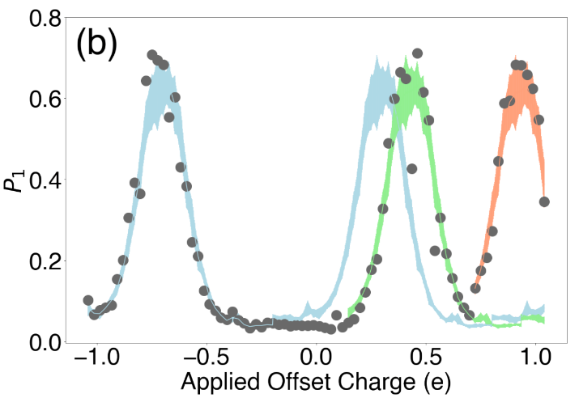
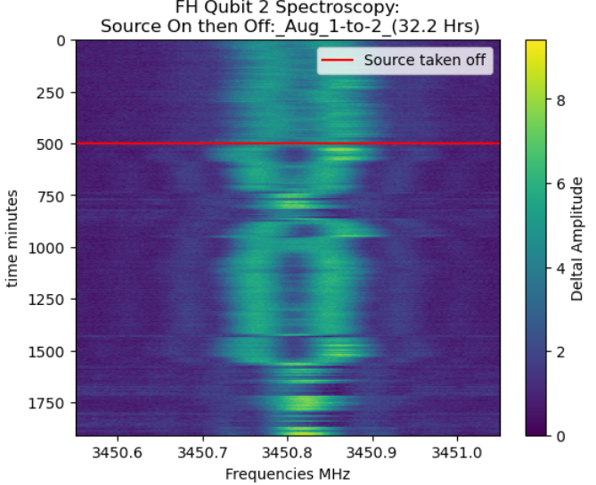
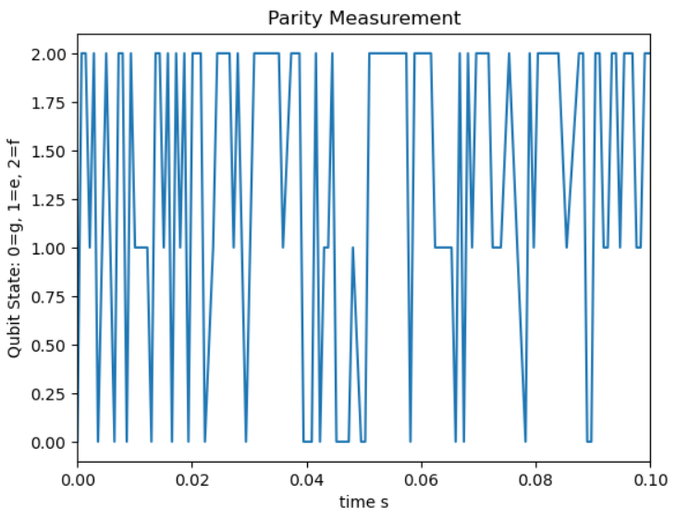
There are many types of Qubit Readout!
1) Qubit Lifetime, T₁
2) Qubit decoherence, T₂ (Ramsey)
3) Ramsey Tomography
NEXUS
3) Charge Parity
4) Spectroscopy
Kester Anyang, IIT
Cs-137 source
(Gamma: 661 keV)
f->h transition
Data Analysis in
progress
f state
Increased
parity switching
rate (higher qp
tunneling)
e state
g state

Slide 10
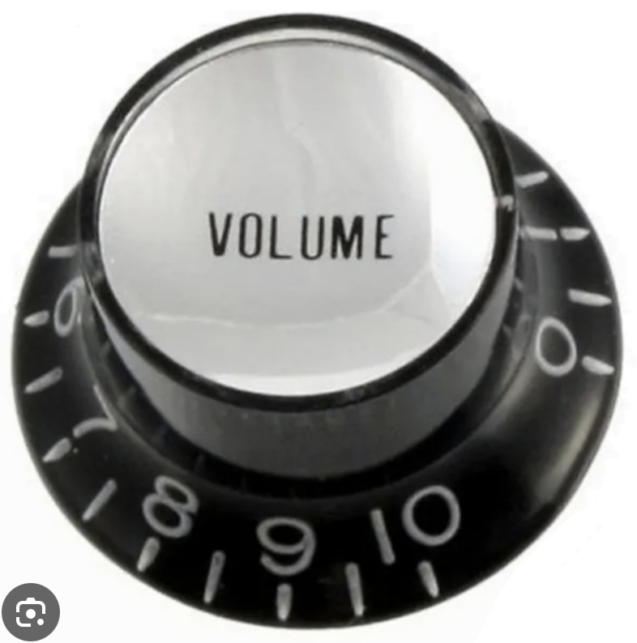
There are many types of Qubit Readout!
1) Qubit Lifetime, T₁
2) Qubit decoherence, T₂ (Ramsey)
3) Ramsey Tomography
Which one of these gives the best sensitivity to sub-eV energy?
Current resolution and threshold not enough.
Need background reduction to achieve better
sensitivity and resolution
READOUT
3) Charge Parity
4) Spectroscopy
f state
e state
g state

Slide 11
Excess quasiparticles in Superconductor
Insulator (Al₂O₃)
Superconductor
(Al, Nb, Ta)
Higher density of excess quasiparticles seen
in superconductor
What causes excess quasiparticles?
It impacts coherence times and sensitivity
Big fraction comes from pair breaking radiation
Broken
Cooper
Pair
(quasi-
Particles)
N_{qp}~5*10⁻¹⁰ normalized to Cooper pair density in best case
Josephson
Junction (JJ)
Substrate (Silicon or Sapphire)
What kind of energy sensitivity can we get with Qubits?

Slide 12
How do we couple DM particles to the qubits?

Slide 13
Through phonons
DM
DM
Phonons (crystal
lattice vibrations)
10 - 100 meV
Substrate (Sapphire)
What kind of energy sensitivity can we get with Qubits?

Slide 14
Through phonons: down-conversion
DM
DM
down-converted phonons
Phonons (crystal
lattice vibrations)
10 - 100 meV
Substrate (Sapphire)
What kind of energy sensitivity can we get with Qubits?

Slide 15
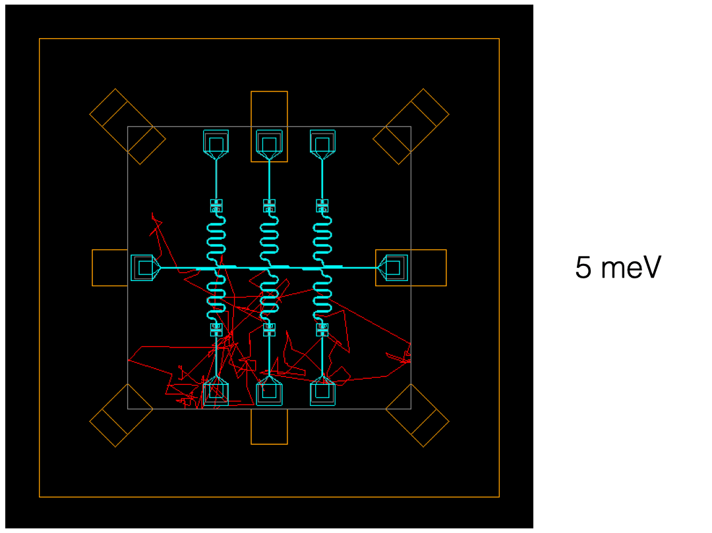
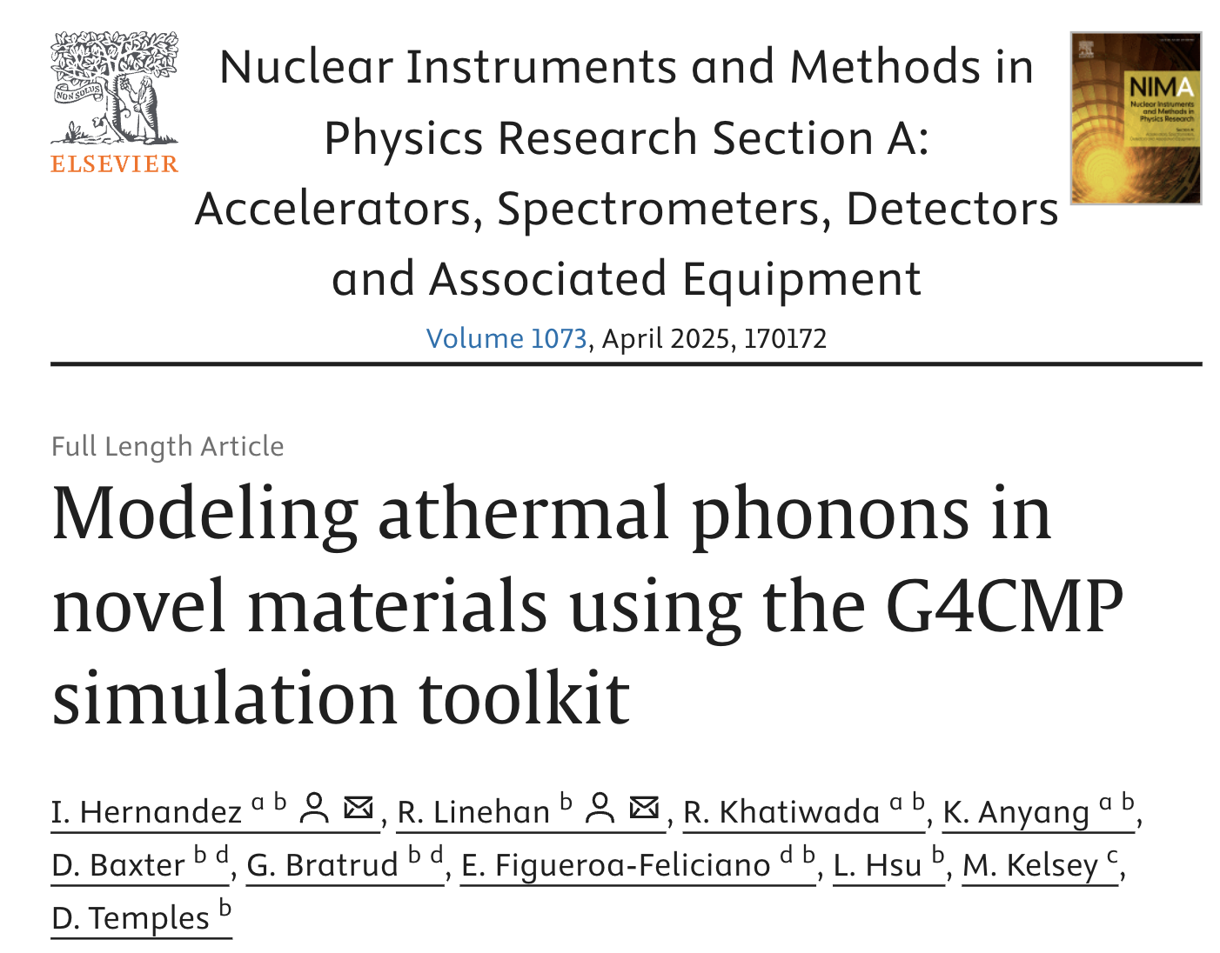
Through phonons: simulation (G4CMP)
DM
DM
Phonons (crystal
lattice vibrations)
10 - 100 meV
Phonon Caustic
in Sapphire (G4CMP)
phonon simulation in a 6-qubit silicon chip using G4CMP
Substrate (Sapphire)
Israel Hernandez, IIT
Ziyu Cai, IIT
CaWO₄, LiF, GaAs, Al₂O₃, CaF₂ + Superconductors: Al, Ta, Nb
QSC
What kind of energy sensitivity can we get with Qubits?

Slide 16
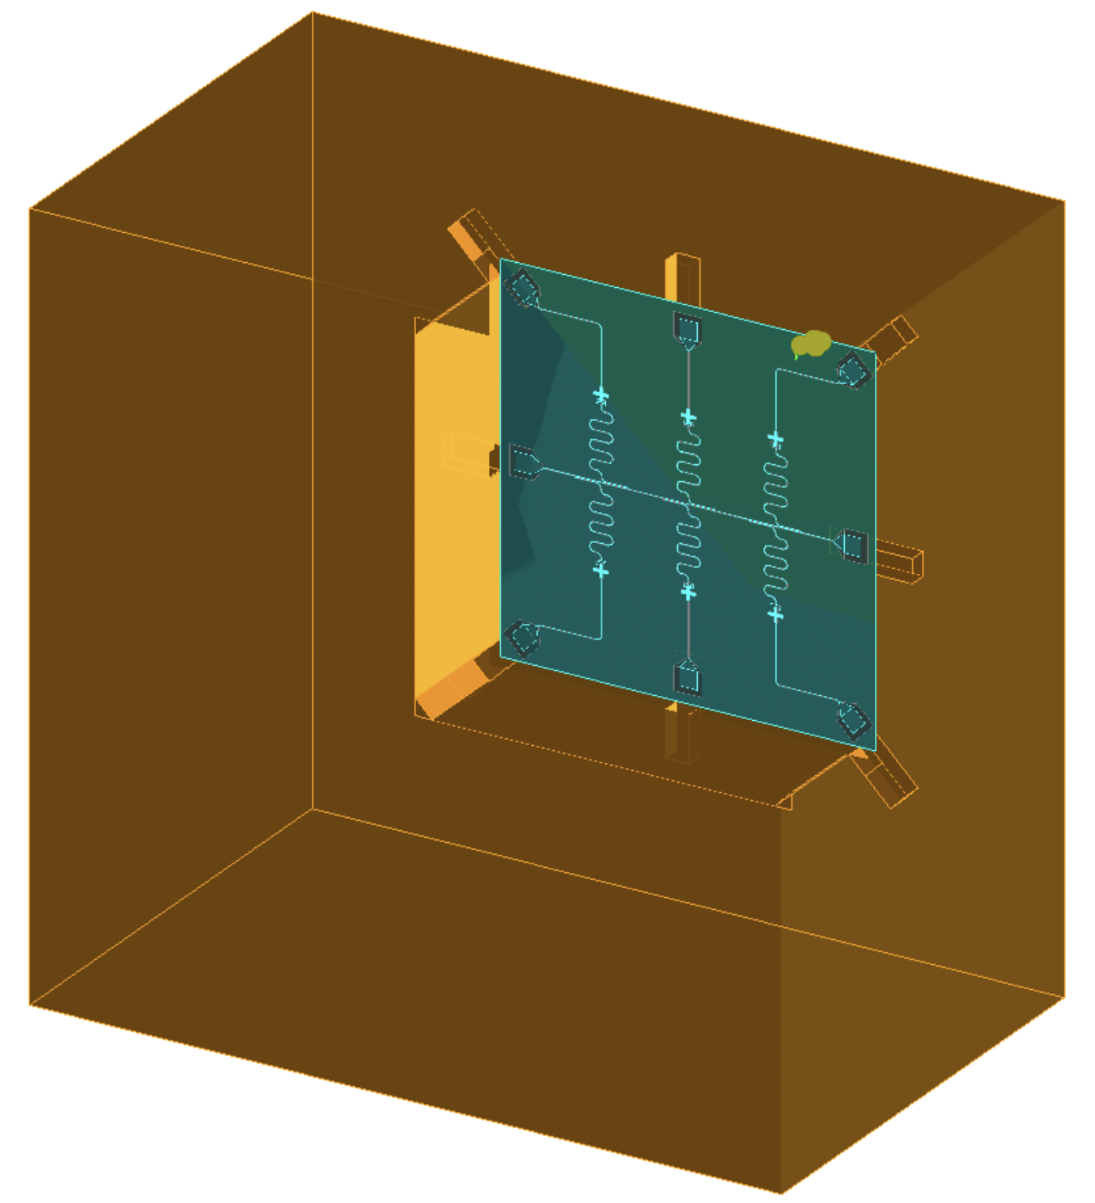
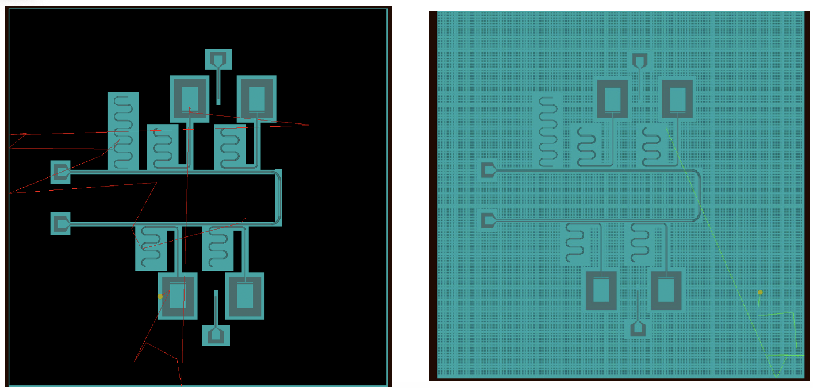
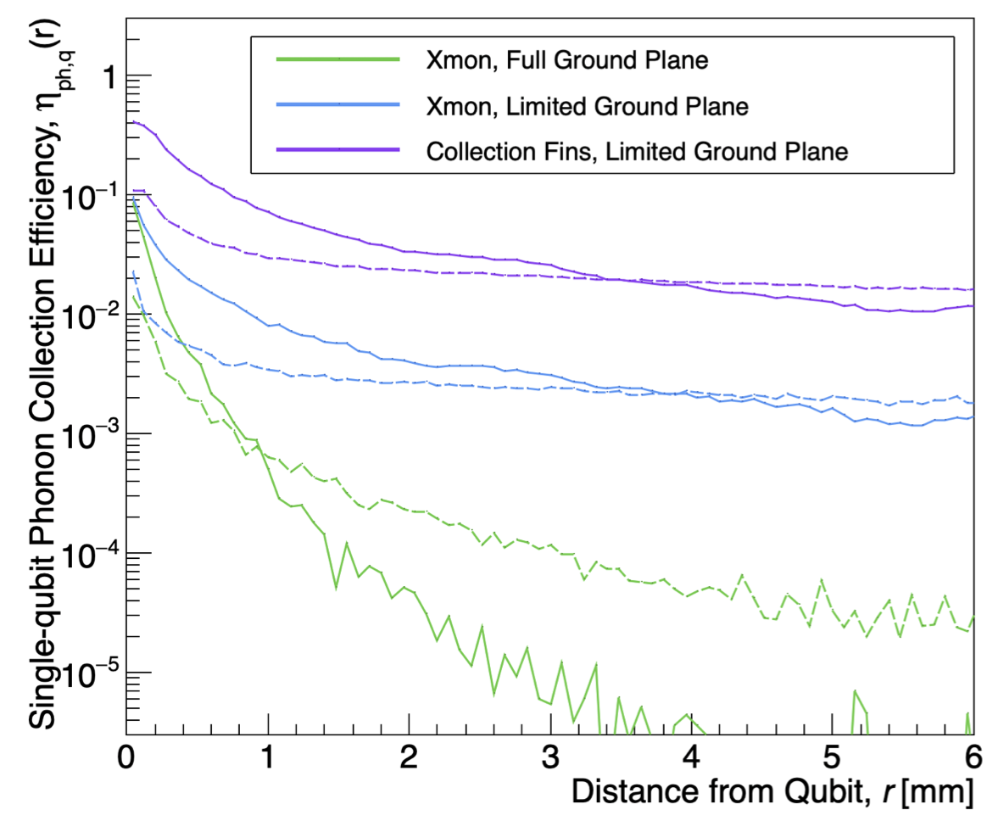
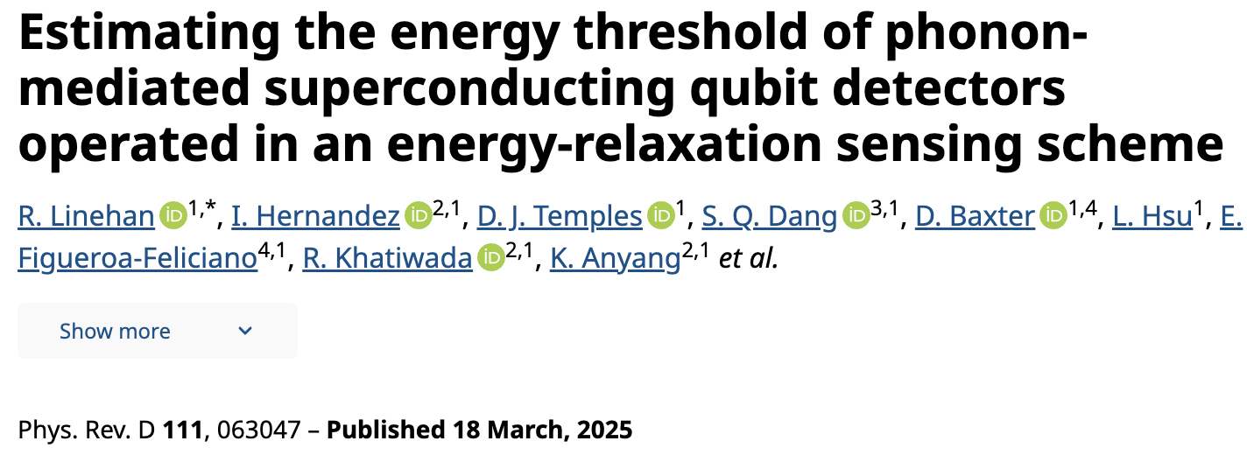
Through phonons: Device response simulation
Israel Hernandez
IIT
QUBIT
DESIGN
Limited Ground Plane
Meshed Ground Plane
Qubit Device
Rendering with
G4CMP
High phonon
collection efficiency
necessary
With T₁ relaxation scheme and Si substrate,
Estimated E_{th} ~ 0.44 eV and resolution 88 meV
Expected to push this threshold lower with
Charge parity readout and Sapphire

Slide 17
Through phonons: Gap Engineering
GAP
ENG.
DM
DM
Instead of Al, use AlMn, Hf
Phonons (crystal
lattice vibrations)
Low bandgap materials to amplify the
quasiparticle signal.
10 - 100 meV
Substrate (Silicon or Sapphire)
Northwestern U.
What kind of energy sensitivity can we get with Qubits?

Slide 18
Through phonons: Microphysical processes
DM
DM
How does Energy transfer from Particle to Qubit?
Phonon production and down-conversion
Phonon-superconductor interface
Phonon-quasiparticle dynamics
Quasiparticle diffusion in the superconductor
Quasiparticle recombination
Phonons (crystal
lattice vibrations)
10 - 100 meV
Micro.
processes
Ryan Linehan, FNAL
Israel Hernandez, IIT
Substrate (Silicon or Sapphire)
QSC
What kind of energy sensitivity can we get with Qubits?

Slide 19
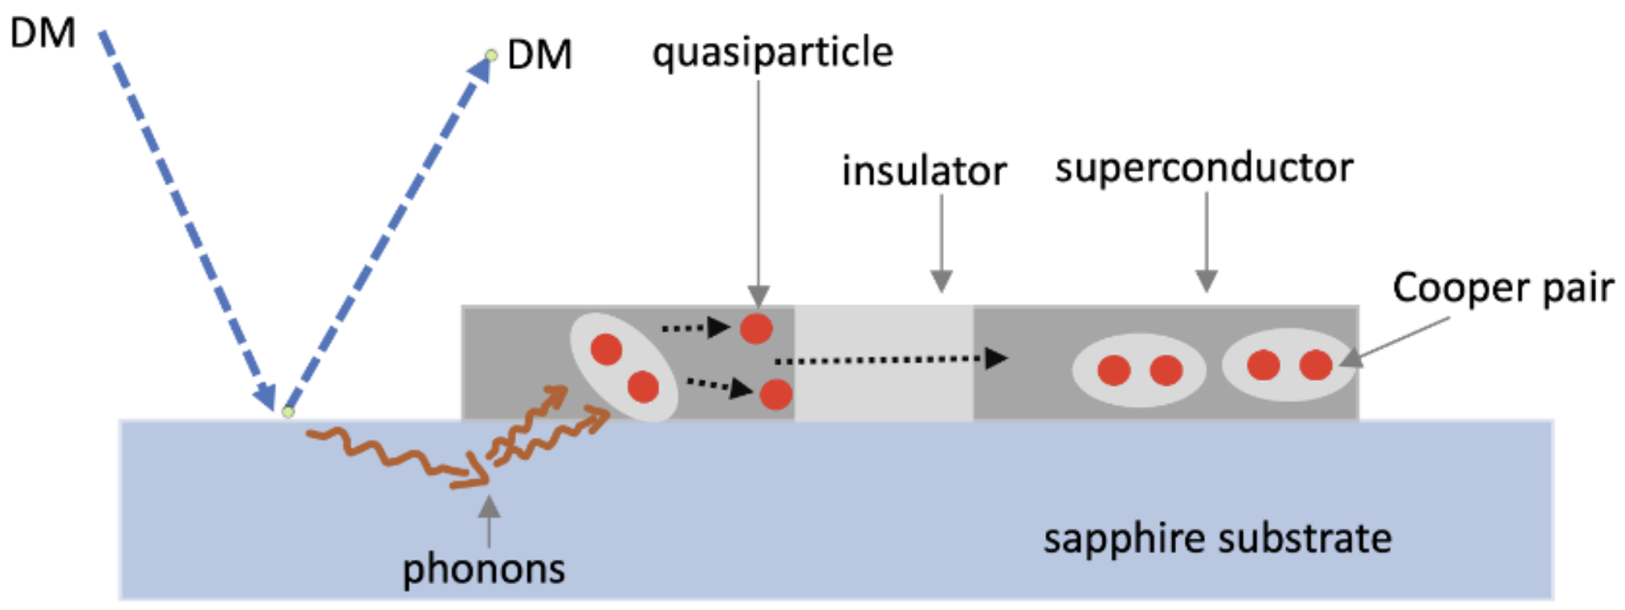
Possible Dark Matter detector
(Complete Picture)
Qubit readout
Particle like DM can
excite phonons
in qubit substrates
E_{DM} < MeV
E_{phonon} ~ 40 to 100 meV
QuantiSED 2.0
Khatiwada
~2 eV Photon source + 4 qubit transmon data taking in October
What kind of energy sensitivity can we get with Qubits?

Slide 20
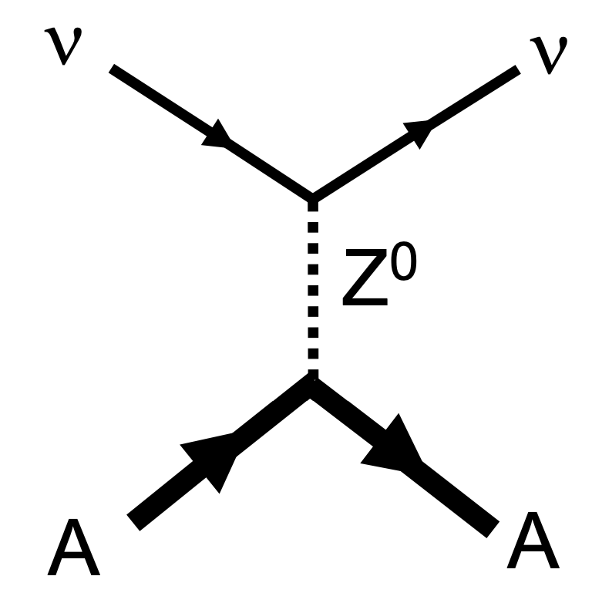
Also a Neutrino detector?
Coherent neutrino-nuclear scattering
CeνNS
Qubit readout
Neutrino
Neutrino
Reduced Environmental contribution
to quasiparticles → better readout
and high sensitivity
Nucleus
Littlejohn + Khatiwada
IIT, U Chicago, FNAL, NU, UCSD
DARPA (QuSen)
What kind of energy sensitivity can we get with Qubits?

Slide 21
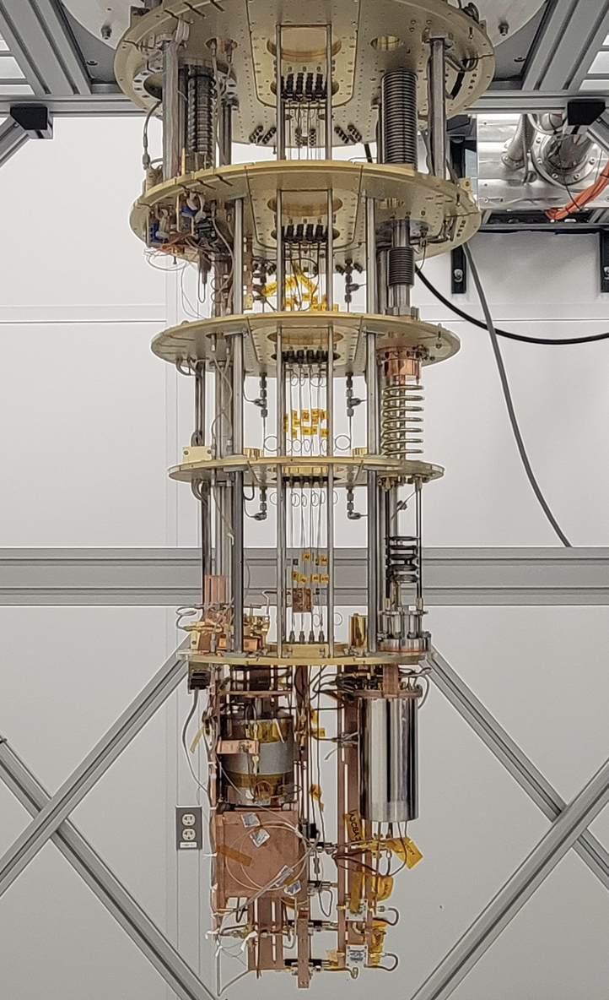
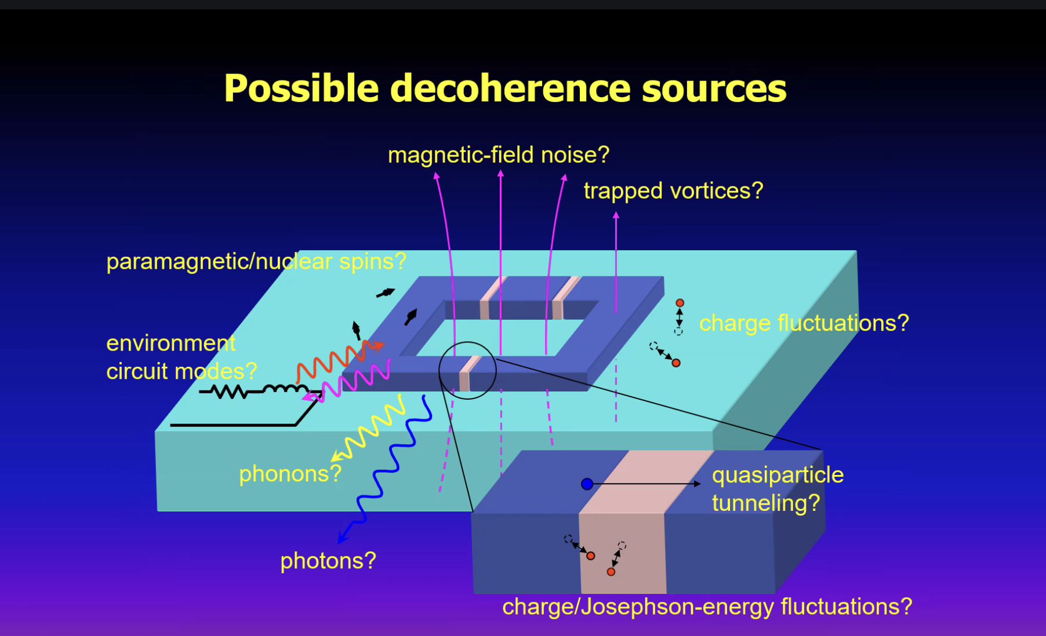
Qubit Environment
(Environmental Engineering necessary)
Cryogenic and
Microwave
Engineering
+
Quantum Science
+
Material Science
+
AMO
Fermilab CosmiQ
dilution refrigerator
Schematic from Yasunobu Nakamura’s Talk
University of Tokyo, RIKEN

Slide 22
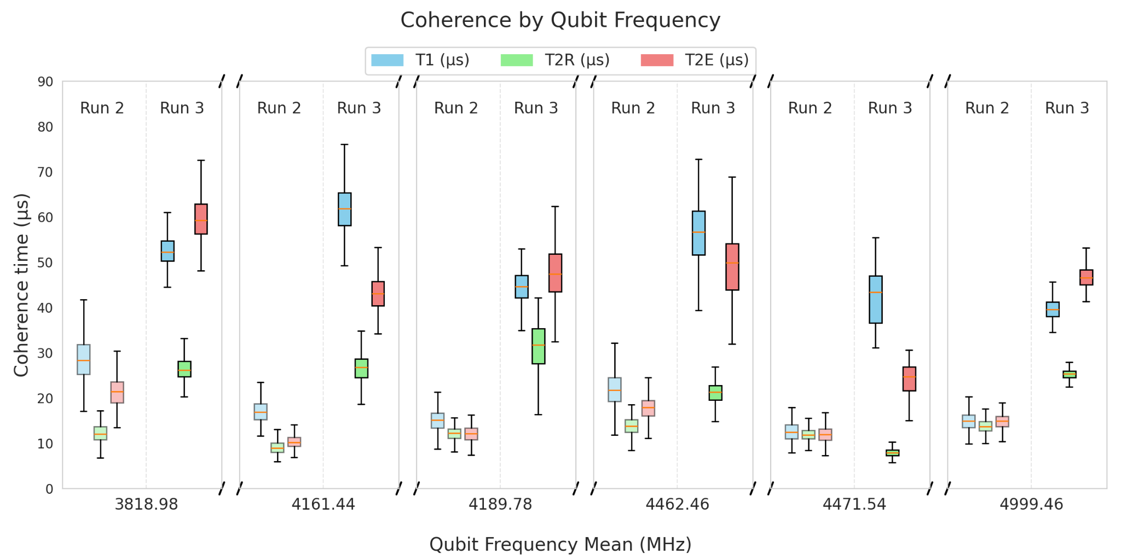
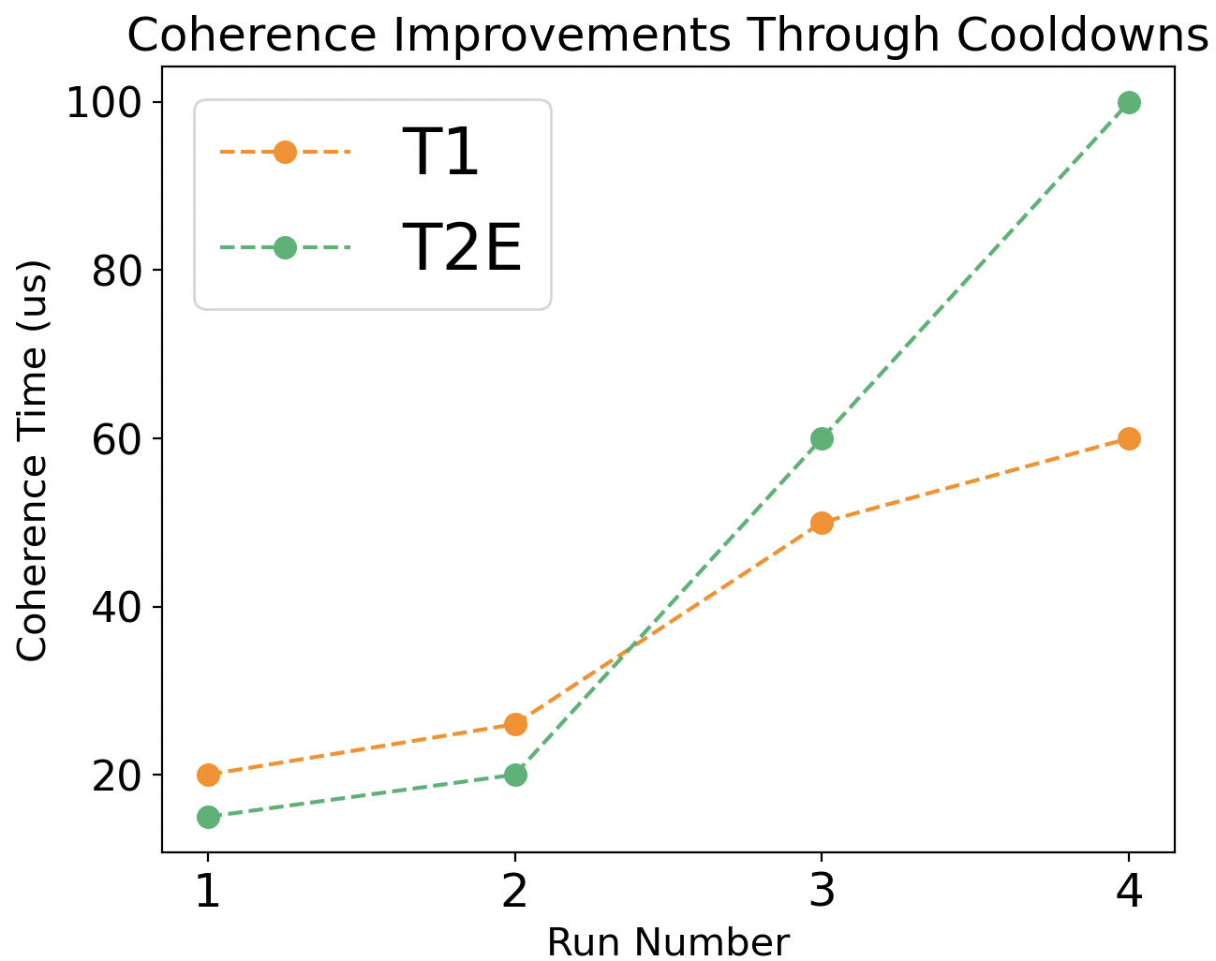
Qubit Environment Engineering
Qubit Coherence as a function of shielding, filtering and thermalization improvements over 3 runs
IIT, NU, FNAL
Run 4
ENV.

Slide 23
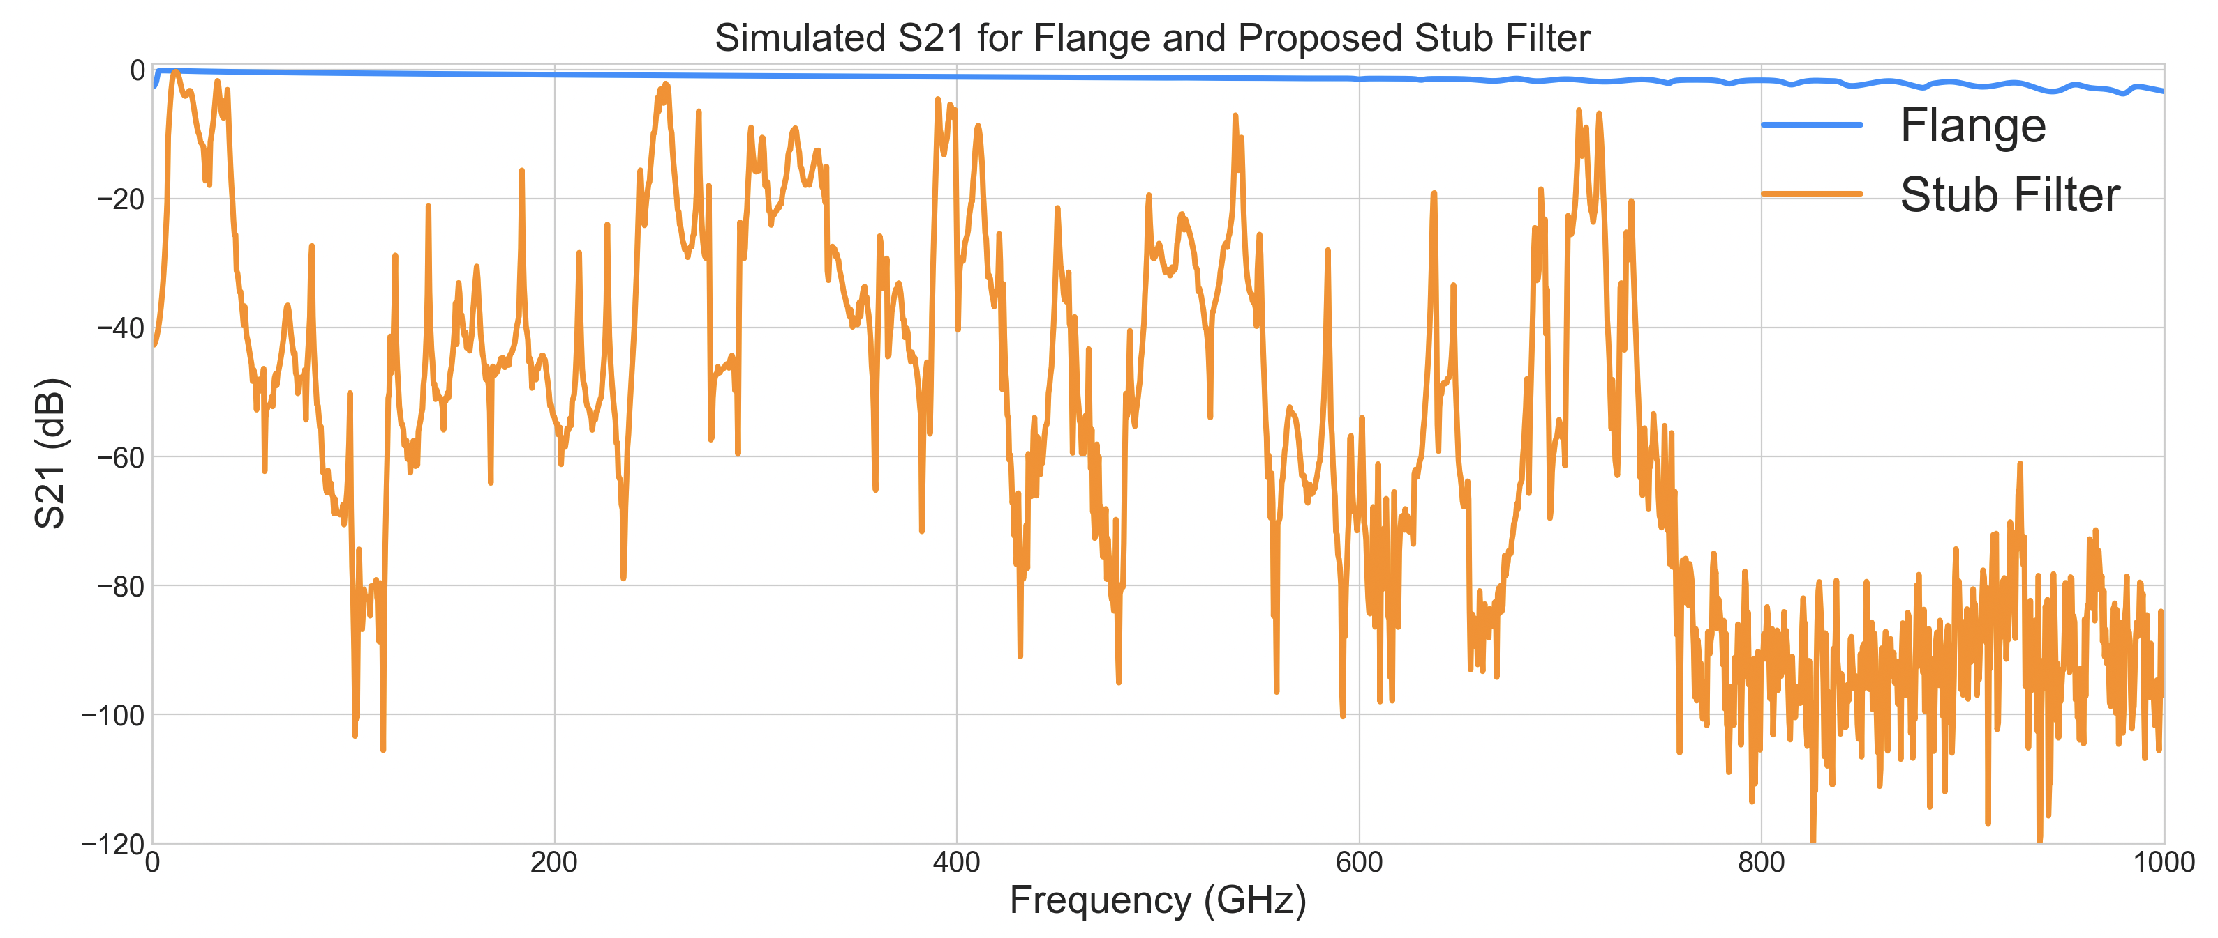
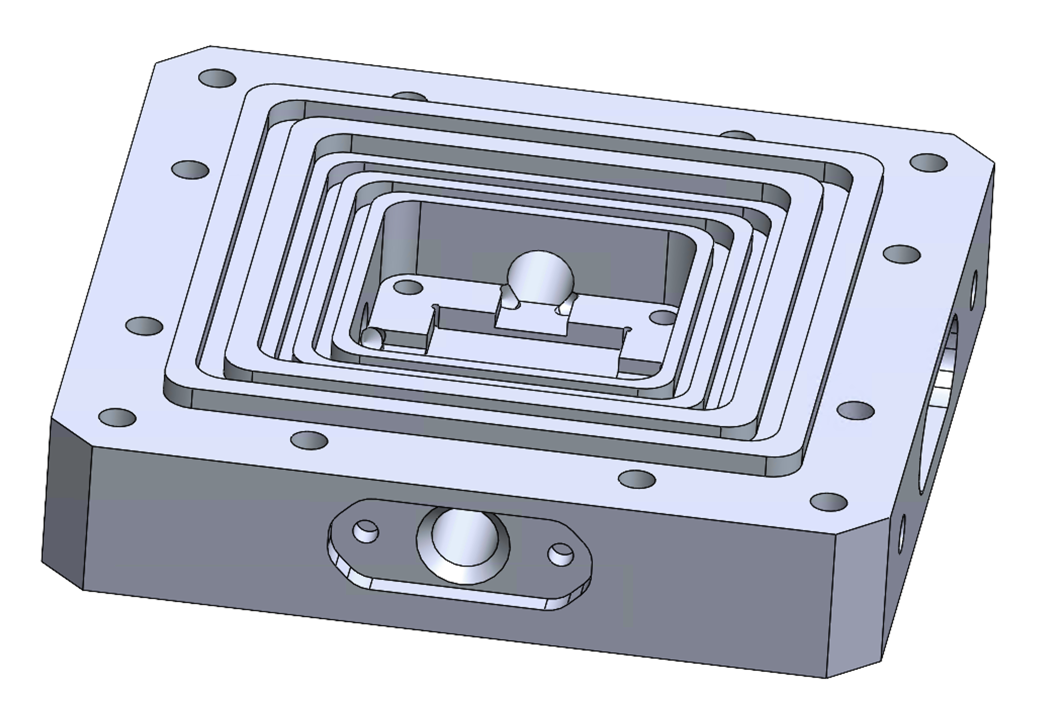
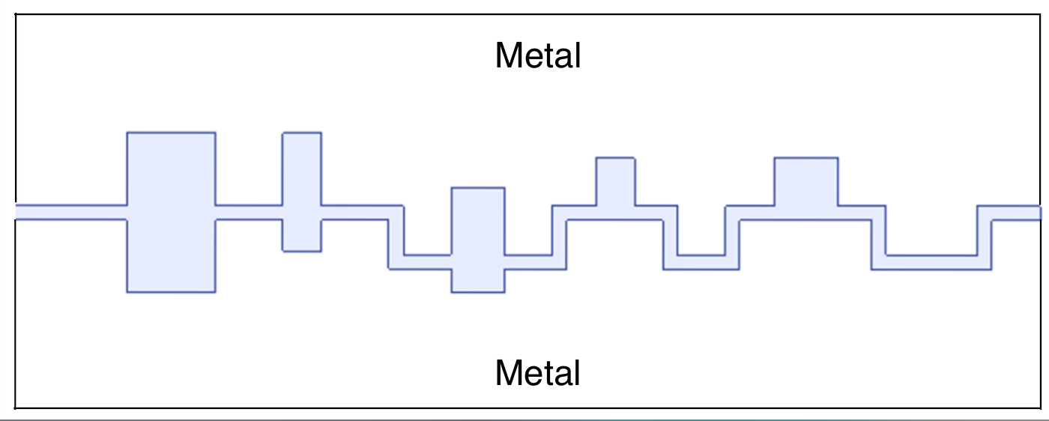
Photon Background reduction: Stub filter design
HFSS simulation of radiation attenuation by stub filter
Based on Berkeley group’s design
Daniel Molenaar, IIT
Broadband background radiation
Suppression filter
Qubit enclosure
5-stub filter
top flange
Top flange
IR radiation can pass through < 1 mm cracks!
Box mode and low frequency (4-8 GHz)
radiation can induce qubit decay/Purcell effect
IR absorptive shield (Stycast+Carbon)
bottom flange
bottom flange

Slide 24
Dilemma of designing qubits:
Qubits good for sensing also couple to background easily
24

Slide 25
Can we use higher qubit energy levels to sense the background ?
25

Slide 26
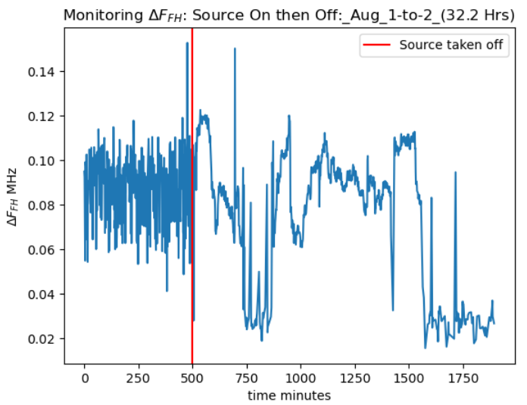
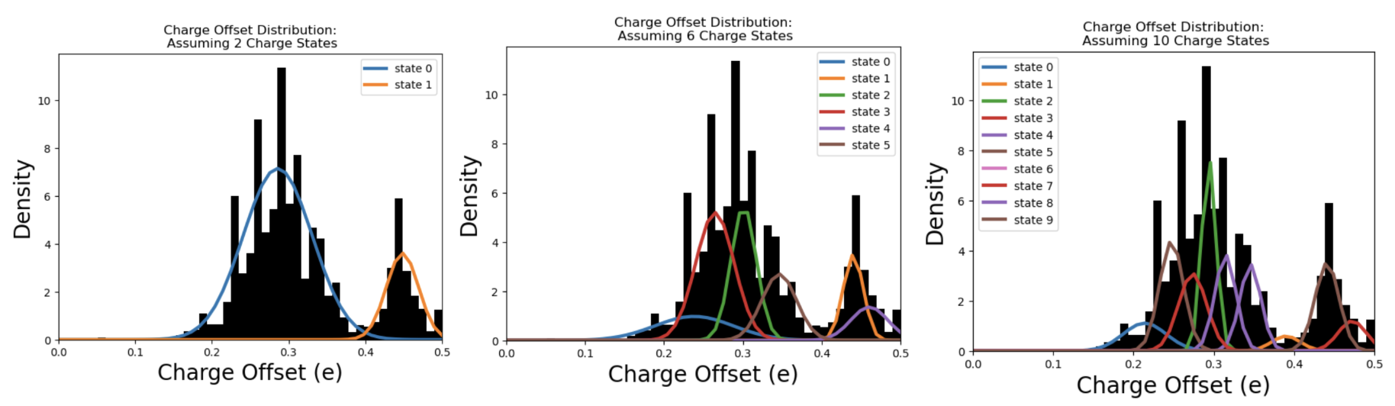
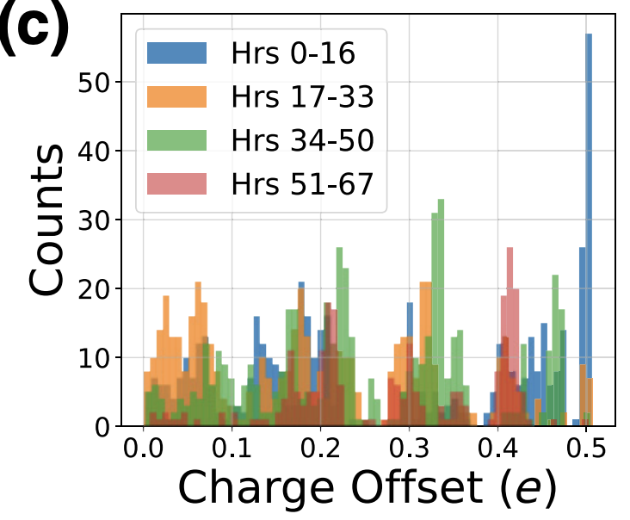
Qudit f->h Spectroscopy for background sensing
Kester Anyang, IIT
Cs-137 source on a Al₂O₃-Ta
(𝜸: 661 keV), f->h transition
47 hours of source on + off data
Need higher statistics to resolve quantized charge states
Need to understand Sapphire-Tantalum interface physics
This was not visible
in g → e T₁ measurement
Source On
Fitting of observed qubit Offset charge
x
https://journals.aps.org/prxquantum/pdf/10.1103/PRXQuantum.3.030307
26

Slide 27
Understanding the qubit device
What’s Next?
Address most consequential issues:
Background reduction
Qubit Readout Optimization
Phonon Collection Efficiency
Substrate-superconductor microphysics
Prototype demonstration
Looooooooong way to go!
Possibly will need Machine Learning to tag DM events
high certainty on results unlikely without ML.
27

Slide 28



Acknowledgement
This material is based upon work supported by the U.S. Department of Energy, Office of Science, National Quantum Information Science Research Centers, Quantum Science Center.
DOE-OHEP-QuantiSED
This manuscript has been authored by Fermi Research Alliance, LLC under Contract No. DE-AC02-07CH11359 with the U.S. Department of Energy, Office of Science, Office of High Energy Physics.

Slide 29
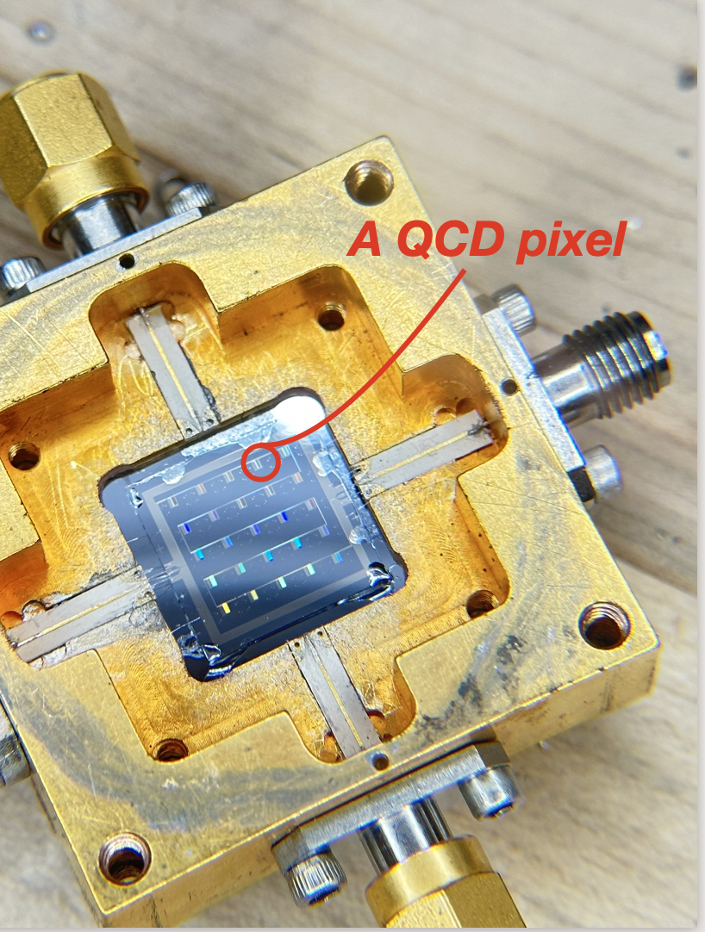
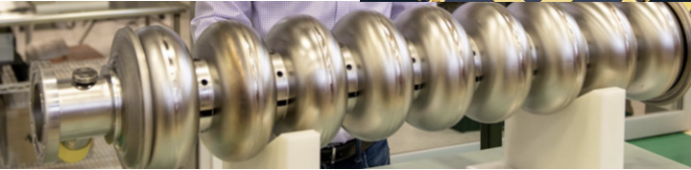
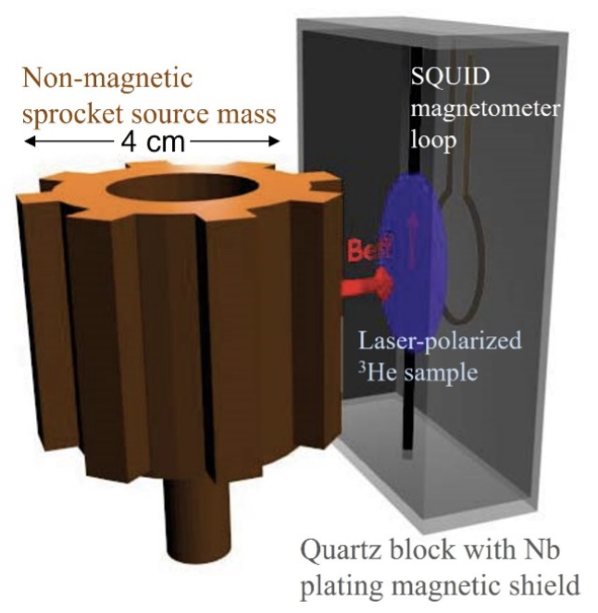
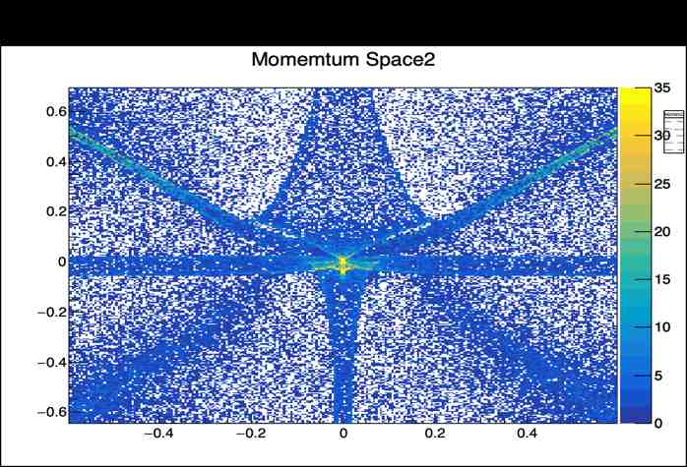
Quantum and Superconducting sensors
Quantum Sensor : Any new quantum device or technique that has the potential to achieve greater reach towards beyond-the-standard-model physics than that achievable through conventional techniques traditionally used in HEP. → Not just superposition and entanglement based. (source BRN)
Coordinating Panel for Advanced Detectors (CPAD)
QCD
array
Pairbreaking sensors:
MKIDs, TESes, SNSPDs, QCDs, SC Qubits and variants etc.
Coherent wave sensors:
JPA, TWPA, KIPA, Squeezed state receivers, microwave to optical transducers, SRF cavities, cavities, etc.
AMO (interferometry, NMR, Optomechanical) clocks sensors:
Neutral atoms, trapped ions, magnetometers, spin precession, optomechanical devices, entangled probes etc.
Novel materials & Theory:
Quantum and metamaterials, Low bandgap materials (Dirac, Weyl, Sapphire), High T_{c} materials, spin liquids, NV centers etc. New theories/ideas that can be tested with detectors, specific technology model building etc.
SRF cavities
Phonon in Sapphire
Spin ensemble
/NMR

Slide 30
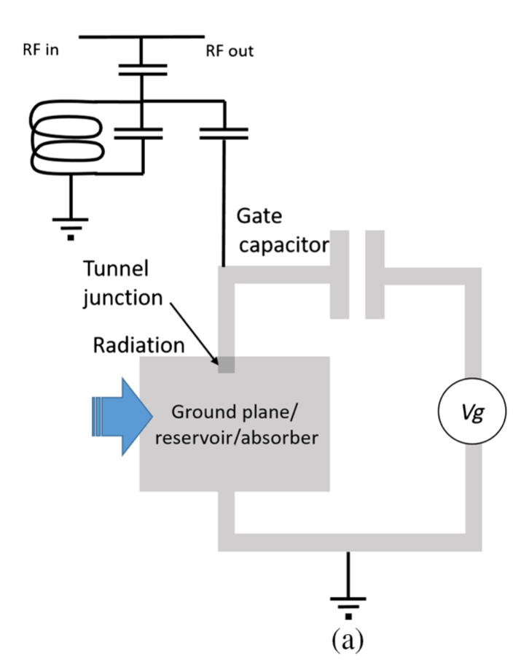
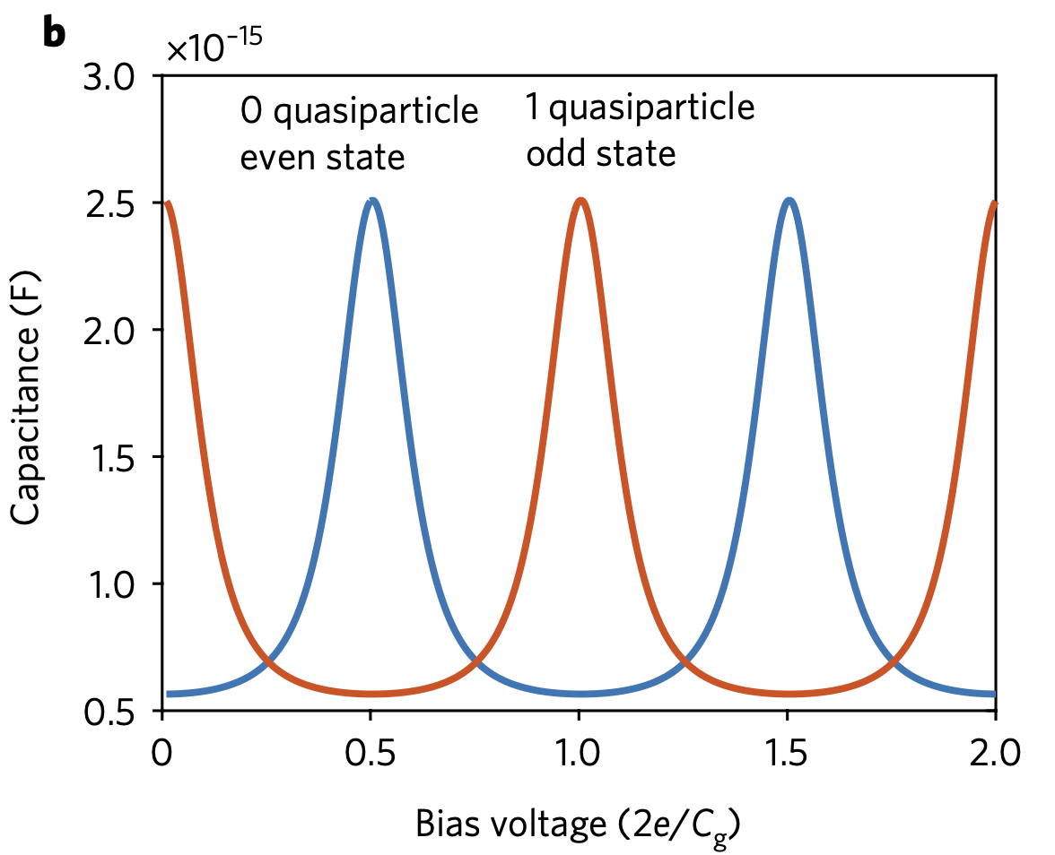
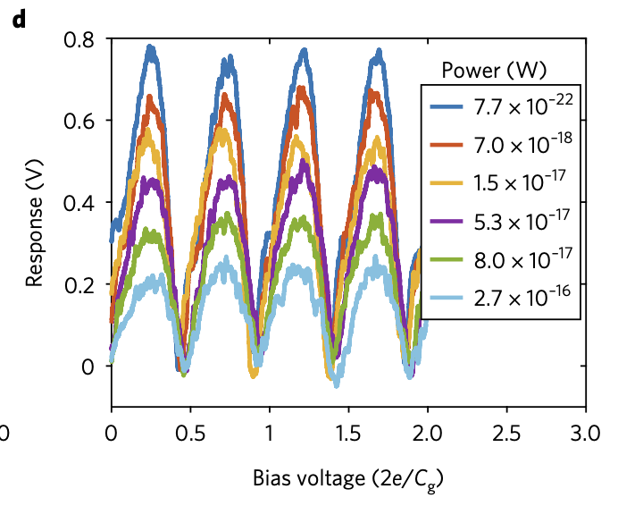
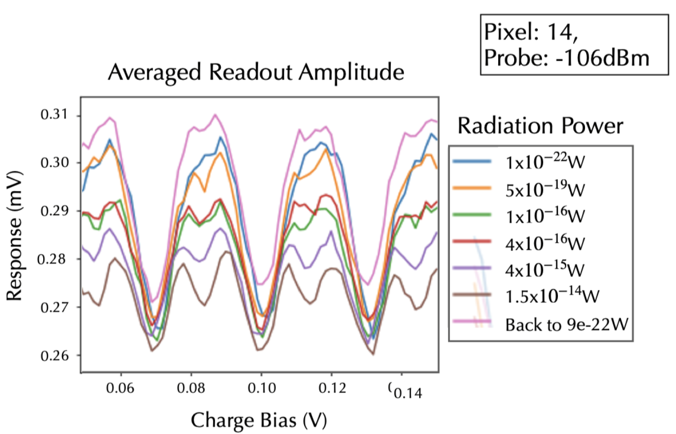
Quantum Capacitance Detectors
(amplitude of quantum capacitance
As a function of illumination)
capacitively
coupled feedline
Island
Measured amplitude as a
Function of illumination

Slide 31
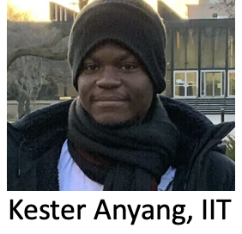
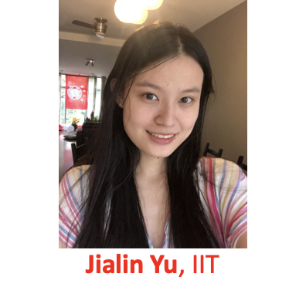
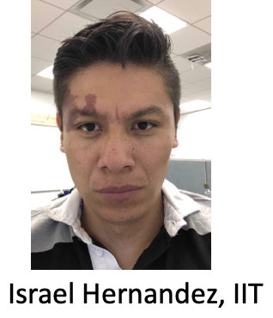
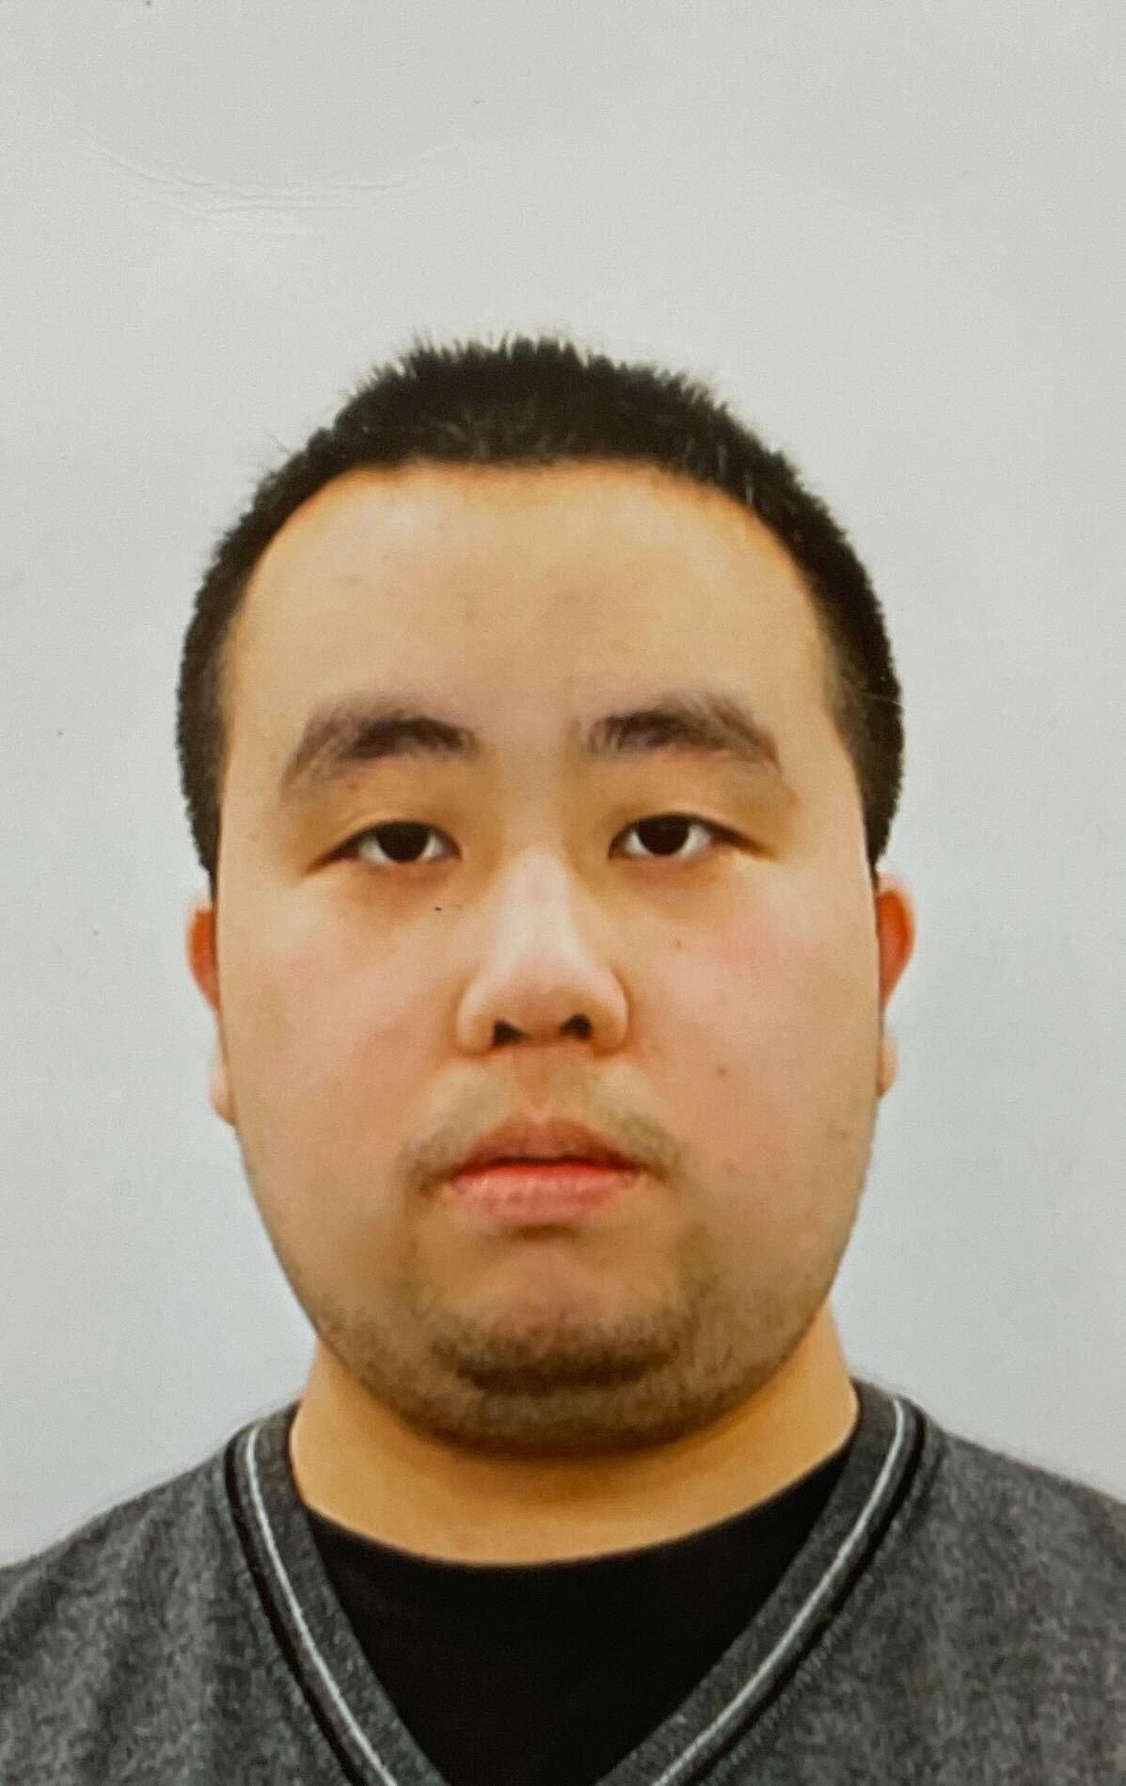
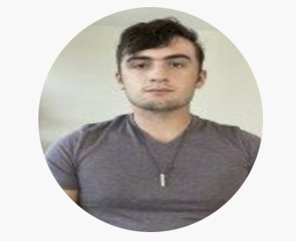
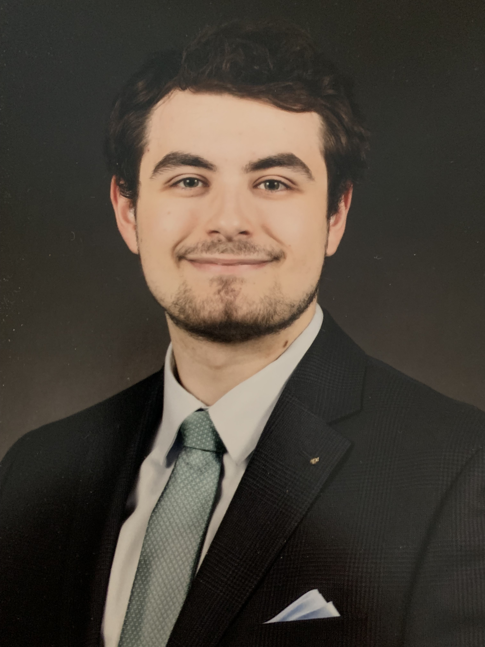
Summary
Khatiwada Group
Fermilab Postdocs
Ryan Linehan
Sara Sussman
Dylan Temples
Northwestern Students
Arianna H Colon Cesani
Grace Bratrud
UT Arlington
Olivia Seidel
Building Quantum Sensing program at FNAL/IIT
Aboveground and Underground facilities at FNAL provide complimentary platform for radiation/background studies in superconducting devices
Particle simulation tools (G4CMP) to understand energy dissipation in qubits and novel materials
Hope to gain knowledge on device sensitivity and ways to optimize them further for Dark Matter searches
Da
Daniel Molenaar
Ziyu Cai
Noah Beaman
Undergraduate

Slide 32
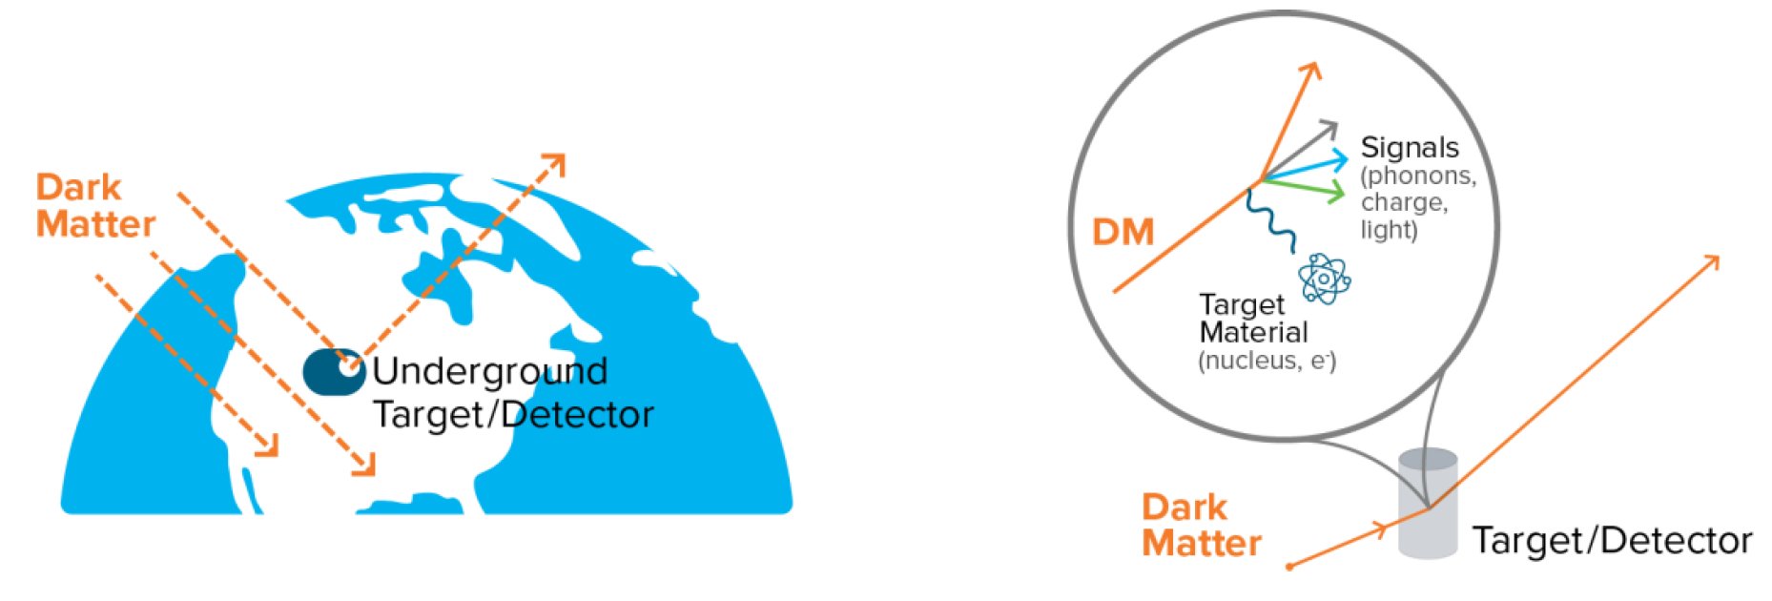
Particle like Dark Matter Search overview
Underground to avoid background like cosmic muon
Processes:
--DM Scattering off of nuclei
--DM Scattering off of electrons
*Fraction of DM Energy transferred to the
target material (nuclear, electron recoil)
--Absorption of DM
DM Energy absorbed by the target material
Eg: Super-CDMS-SNOLAB, LZ (LUX-ZEPLIN)
https://www.osti.gov/servlets/purl/1659757

Slide 33


Slide 34





Interesting findings from Quantum Community

Slide 35


T₂ Ramsey
Ramsey and Spectroscopy in Qudit

Slide 36
Interesting findings from Quantum Community
Cosmic muon and terrestrial gamma impacts
Qubits -> correlated error in quantum computers
unexplained background (excess quasiparticles) observed in superconducting devices
Can we use low background setup to study this?

Slide 37
Quantum Capacitance Detectors for Ultralight Dark Matter
QuantiSED
far infrared spectroscopic missions (space telescope) Caltech/JPL
NEP < 10⁻²⁰ W/Sqrt Hz at 1.5 THz – most sensitive far IR detector!
Applications for > 100 GHz
QCD
array
Photon
Photon
https://journals.aps.org/prl/abstract/10.1103/PhysRevLett.128.131801
Jialin Yu, IIT GS
Collaboration: Fermilab
Caltech/JPL, Wisconsin Madison
M. D. Shaw, J. Bueno, P. K. Day, C. M. Bradford, and P. M. Echternach, Phys. Rev. B 79, 144511 2009.

Slide 38



Impact of cosmic and terrestrial radiation on quantum computers
High energy radiation: source of quasiparticle in qubits
Study context: Quantum Error Correction
Why should we care?
Building superconducting devices (qubit)
based experiment for DM
Need to decrease dark rate of available SPD
Hasn’t been studied in detail before
100 keV to MeV
event rate:
1/7.6 s &
1/38 s
muon or 𝛄 absorption
Direct measurement on google processor
Non localized impact of radiation in qubit
(quasiparticle absorb qubit energy and cause
excited state to decay)
Suppressed T₁ throughout the device
Mitigation: shielding, underground operation
quasiparticle and phonon traps being studied
phonon reservoir Si substrate
Phonons break cooper pair
quasiparticle tunnel to the junctions
qubit decoherence
https://arxiv.org/abs/2104.05219
𝛕 = 25 ms

Slide 39







Qubit based wave-like Dark Matter search
Qubit detector
Cavity
Harmonic
Oscillator
qubit
mixed state
g ~ d.E:
Δ: ω_{q}-ω_{c}
g²/Δ: Stark shift
two level system
excellent
photon
detector
readout
cavity
qubit
𝝲
Temperature
10 mK
Qubit array
photons
𝝲

Slide 40
Qubit based photon counter
Non absorptive
photon counting
readout
cavity
Cavity
qubit
mixed state
g ~ d.E:
Δ: ω_{q}-ω_{c}
g²/Δ: Stark shift
𝝲
qubit
nonlinear oscillator
two level system
𝝲
Photon shifts qubit transition
Excite qubit at shifted frequency
Measure flipped qubit by monitoring
cavity line shift
counts photons!
Akash Dixit
U Chicago

Slide 41


Near and long-term Dark Matter search
Need low energy threshold systems < 1 eV !
Source: Basic Research Needs (BRN)

Slide 42


Slide 43


Slide 44


Slide 45


Slide 46


Slide 47


Slide 48


Slide 49

Signal and noise rate
DFSZ, 0.45 GeV/cc, B=14T, C=1/2, Q=5x10⁴@1GHz, V=13𝜆³, crit.coup
N QND measurements dark rate =
(10⁻²)^{N} ∆f
Assumes axion detection bandwidth
∆f ~ MHz
Sensitivity limited only by signal photon shot noise.
Aaron Chou

Slide 50


Slide 51

MEMS mirror allows for desired operating specifications:
~1.5” x 1.5” scanning area
<100μm spot size
~10μm position resolution
O(100)Hz scanning speed
O(μs) pulse width
>10mK operating temperature
Focusing optics
MEMS mirror
Stationary mirror

Slide 52
Nature of Dark Matter
Fermions: 1 DM particle per mode volume (𝝺_{deBroglie})³
For mass < 70 eV, Pauli exclusion principle causes dark matter clumps to swell up to be larger than the size of the smallest dwarf galaxies. (Randall, Scholtz, Unwin 2017)
Wave like DM
Particle like DM

Slide 53


Axion production
Global symmetry broken at scale f_{a}
-- axion produced through misalignment
mechanism
-- during QCD phase transition, trough
tilted by Λ_{QCD}⁴
PE ~Λ_{QCD}⁴ released, makes up dark matter
-- oscillation of the QCD θ angle about
its minimum--vacuum energy to axions
QCD axion mass m_{a}~Λ_{QCD}²/f_{a}
~ (200 MeV)²/f_{a}
--- f_{a} unknown
GHz frequencies at f_{a}~ 10¹³ GeV scale
PE ~Λ_{QCD}⁴
Fig 1:J. Ellis et al; arxiv:1201.6045v1
Notes:
----- Meeting Notes (3/1/18 20:12) -----
Misalignment: at QCD phase transition (100 MeV) non-perturbative effects generate a mass and the axion field relaxes to its minimum (PQ mechanism)
----- Meeting Notes (3/10/18 13:19) -----
Lambda QCD?

Slide 54

Axion searches overview
Graham, et. al (2016)
Notes:
----- Meeting Notes (3/8/18 16:28) -----
--10-12 eV QCD axion limit from fa exceeding Planck scale
--Hot dark matter limit comes from processes involving quarks and gluons that give rise to axion during QCD color confinement. Pion + Pion -> Pion + Axion
--Yellow: possible theoretical models based on Electromagnetic and Color Anomaly E/N ratio
--
--Telescope: If axions are present in galaxies then their decay photons would appear as spectral lines
----- Meeting Notes (3/10/18 14:42) -----
Massive stars: Photon+He4=He4+A
----- Meeting Notes (3/10/18 15:52) -----
Brokeheaven and University of Florida haloscope with just HFETs

Slide 55
Axion searches overview contd.
Analytic and lattice
predictions of the
axion mass, given it
makes 100%
Dark matter
ADMX G2 Range
Adapted from G.R, J. Phys. G (2017)
Notes:
----- Meeting Notes (3/8/18 16:28) -----
Don't follow a single procedure or model
Calculate parameter like Topological susceptibility related to mass of the axion.

Slide 56



Quantum amplifiers
Josephson Parametric
Amplifier
Why quantum amps.?
Intrinsically low noise (superconducting technology)
low resistance elements
low thermal dissipation
Add very low added noise during
amplification
=> Tunable in frequency
Only limited by Quantum Noise
JPA
dc SQUID
Energy transfer from pump to
two normal modes of swing
ω_{idler}
ω_{pump}
JPA
⍵ modulated
through non-linear
Inductor L_{J}
ω_{pump}
ω_{signal}
ω_{signal}
Notes:
----- Meeting Notes (1/11/19 14:59) -----
Measurement of extremely small signals in precision measurement experiments requires very low noise amplifiers. Generally these noise levels are achieved by SQUID amplifiers that add very low noise to the system while amplifying the small signal. I will discuss two main technologies called the Microstrip SQUID Amplifiers (MSA)s and Josephson Parametric Amplifiers (JPA)s which are used broadly in radio frequency based experiments.

Slide 57
What’s causing these dark counts?
Microfractures due to GE Varnish and mounting
glue on Si substrate causing phonon bursts breaking
cooper pair -> qp poisioning
Eliminated cosmic muon and radioactive background
from suspects since qp poisoning suppressed over
longer ~ a week cooldown period
Used similar device to charge parity device like QCD

Slide 58

What is a qubit?
two level system
Josephson
Junction
E_{J} ≫ E_{C}
E_{c}= e²/2C charging energy
E_{J} = I_{c}Φ₀/2π Josephson energy
where Φ₀ = h/2e magnetic flux quantum
Non-linear
dissipation less
circuit element
resonator
Quadratic energy potential of QHO
reshaped by Josephson Inductance
to sinusoidal potential
Josephson
junction
Qubit and resonator
circuit on a Si
substrate
--Superconducting Transmon and its variants can be utilized for Dark Matter detection through several mechanisms of coupling
App. Phys. Rev., 6, 2, 10.1063 (2019).

Slide 59
One of the largest CPAD RDCs
We base collaboration and R&D ideas from Basic Research Needs (BRN) and particularly, QIS for HEP workshop, 2023.
Pairbreaking sensors:
MKIDs, TESes, SNSPDs, QCDs, SC Qubits and variants etc.
Coherent wave sensors:
JPA, TWPA, KIPA, Squeezed state receivers, microwave to optical transducers, SRF cavities, rf quantum upconverters, mechanical tuning of cavities, etc.
AMO (interferometry, NMR, Optomechanical) clocks sensors:
Neutral atoms, trapped ions, magnetometers, spin precession, optomechanical devices, optical-RF-magnetic levitation, cantilevers etc. entangled probes that beat SQL with optical readout etc.
Novel materials & Theory:
Quantum and metamaterials, Low bandgap materials (Dirac, Weyl, Sapphire), High T_{c} materials, spin liquids, NV centers etc. New theories/ideas that can be tested with detectors, specific technology model building etc.

Slide 60


Sapphire Phonon modes
Sinead Griffin, Simon Knapen, Tongyan Lin, and Kathryn M. Zurek, Phys. Rev. D 98, 115034 – Published 27 December 2018

Slide 61






Fermilab Quantum Network (FQNET)
Picosecond level entanglement distribution and clock synchronization EEE JQE 59,1-7 (2023)
doi: 10.1109/JQE.2023.3240756
QuantiSED
Collaboration: FNAL, Argonne, Caltech, Northwestern University.
Illinois Express Quantum Network (IEQNET)
Hosts photonics and optical fiber based local quantum teleportation nodes, between Chicagoland institutions
→ High fidelity quantum teleportation was
achieved between multiple nodes (50 km
apart) at Argonne and Fermilab (2022)
using entangled photons
Picosecond level entanglement distribution and clock synchronization between two nodes.
Step forward in building Quantum networking over metropolitan distances
Towards a metropolitan scale quantum network
High-fidelity quantum teleportation
PRX QUANTUM 1, 020317 (2020)
Quick-Quantum Network (QICK-QN): https://arxiv.org/abs/2304.01190
Teleportation of entanglement: entanglement swapping

Slide 62
Fermilab Quantum Network (FQNET)
Picosecond level entanglement distribution and clock synchronization EEE JQE 59,1-7 (2023)
doi: 10.1109/JQE.2023.3240756
QuantiSED
Collaboration: FNAL, Argonne, Caltech, Northwestern University.
Illinois Express Quantum Network (IEQNET)
Hosts photonics and optical fiber based local quantum teleportation nodes, between Chicagoland institutions
→ High fidelity quantum teleportation was
achieved between multiple nodes (50 km
apart) at Argonne and Fermilab (2022)
using entangled photons
Picosecond level entanglement distribution and clock synchronization between two nodes.
Step forward in building Quantum networking over metropolitan distances
Towards a metropolitan scale quantum network
High-fidelity quantum teleportation
PRX QUANTUM 1, 020317 (2020)
Quick-Quantum Network (QICK-QN): https://arxiv.org/abs/2304.01190
Teleportation of entanglement: entanglement swapping

Slide 63


Dark Matter Detector R&D
QuantiSED
Quantum Capacitance Detector (QCD)
far infrared spectroscopic
missions (space telescope)
Caltech/JPL
Photon => superconducting
absorber => broken Cooper
pairs => tunnel into a small
capacitive island => causes
non-equilibrium quasiparticle
population to increase
NEP < 10⁻²⁰ W/Sqrt Hz
at 1.5 THz – most sensitive far IR detector!
Broadband Axion Antenna (BREAD)
and Superconducting Nanowire
Single Photon Detector for Dark Matter
SNSPD R&D for axion detection experiments Appl. Phys. Lett. 122, 243506 (2023)
Island
Towards a metropolitan scale quantum network
Photon
Photon
BREAD concept
SNSPD
Caltech, JPL, FNAL etc.
Quantum
Capacitance
Time (s)
JPL, FNAL, IIT, Wisconsin

Slide 64


Quantum Instrumentation Control Kit (QICK)
Primary support through QSC
Broadly used: >30 labs in the US and abroad
> 20 science talks in APS March meeting!
AMD-RFSoC ZCU111 +QICK custom RF/DC amplifiers, bias
16 DAC outputs from DC to 10GHz all digital mixers.
  This is critical need for quantum. => Better experiments.
  Minimizes calibrations.
16 ADC inputs from DC to near 10GHz without analog mixers.
  Input noise 120K (i.e. 1.2dB)
8 x 20-bit DAC outputs for bias (BW of 10 or 100Hz) ultra low noise, ±10V outputs.
<200ns latency for error correction (fastest in the market).
Optimal filtering, no dead-time 3ns pulses.
100 pico-second pulses for QN.
Accurate timing readout 2ps resolution.
RF multiplexing of 10K detectors per board.
AMD-RFSoC ZCU216
QICK custom RF/DC amplifiers, bias under design
(1.3.3.02)

Slide 65

Excess quasiparticle density

Slide 66


