Slide 1
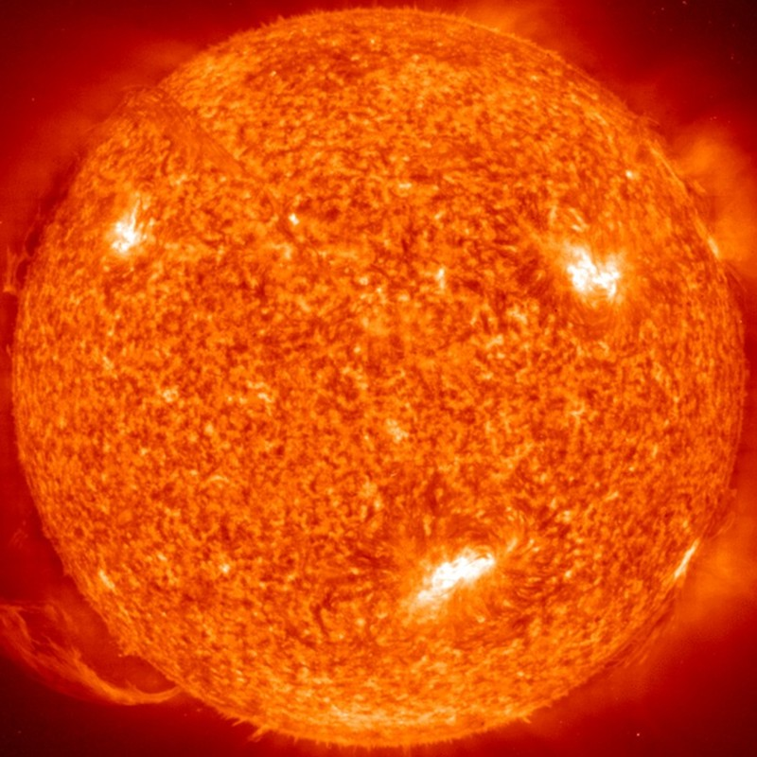
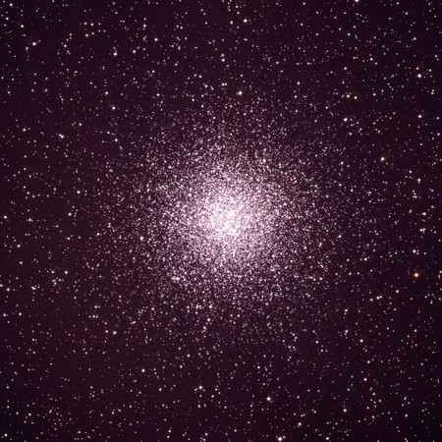
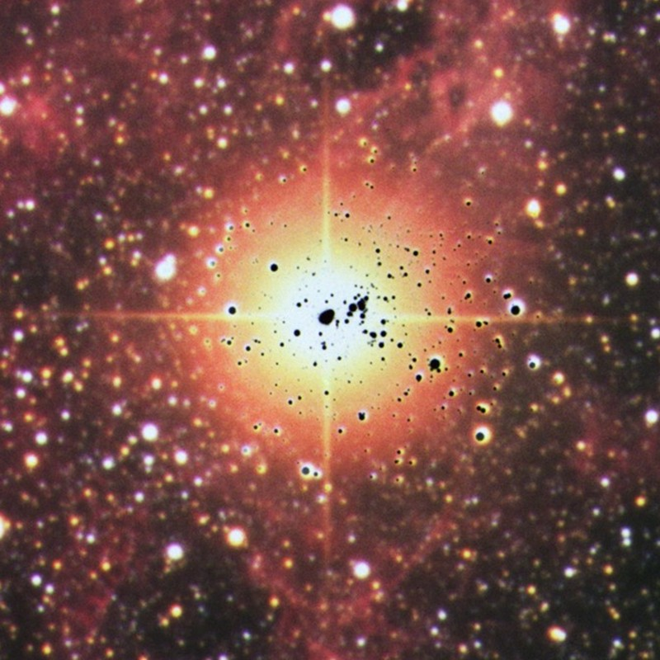
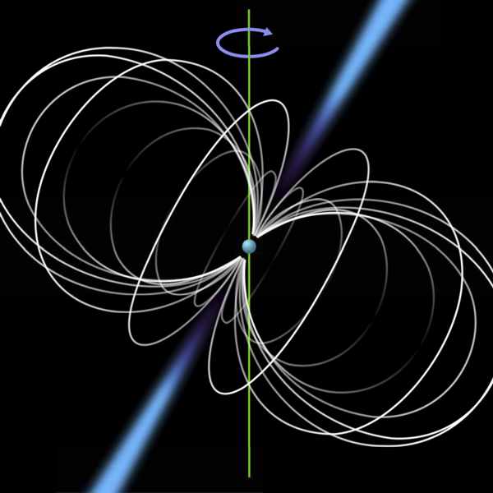
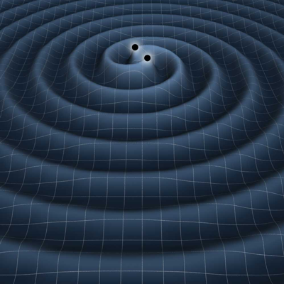
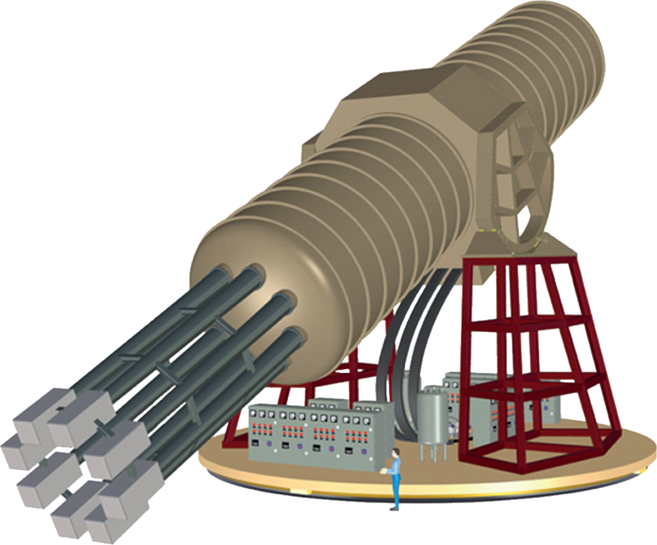




Looking at Stars
Aiming for Axions
20th Patras Workshop on Axions, WIMPs and WISPs
La Laguna, Tenerife, 22 September 2025
Solar Axions
Globular Clusters
Supernova 1987A
Neutron Stars
Gravitational Waves
Georg G. Raffelt, Max-Planck-Institut für Physik, Garching

Slide 2
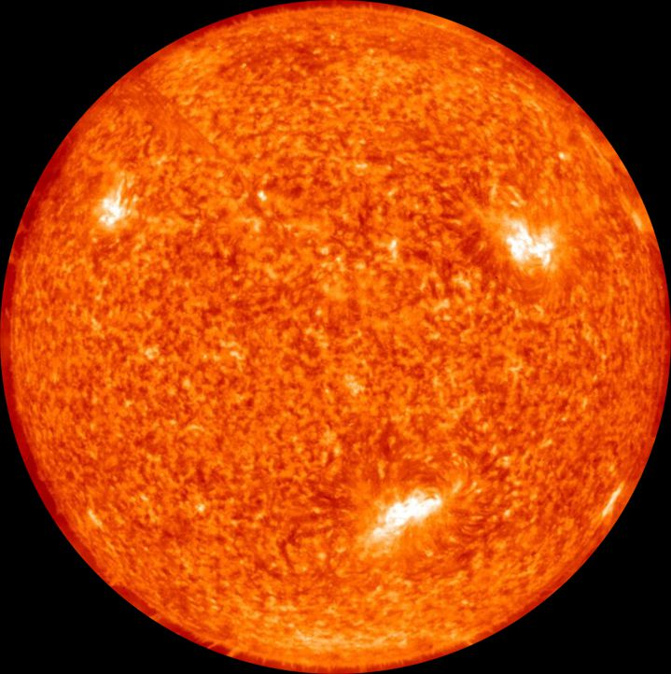

Particles and Stars
Low-mass particles are
produced in stellar interiors
• Detection opportunity
(Sun or Supernovae)
• Backreaction on stellar
properties
→ Neutrinos
→ Axions & friends

Slide 3

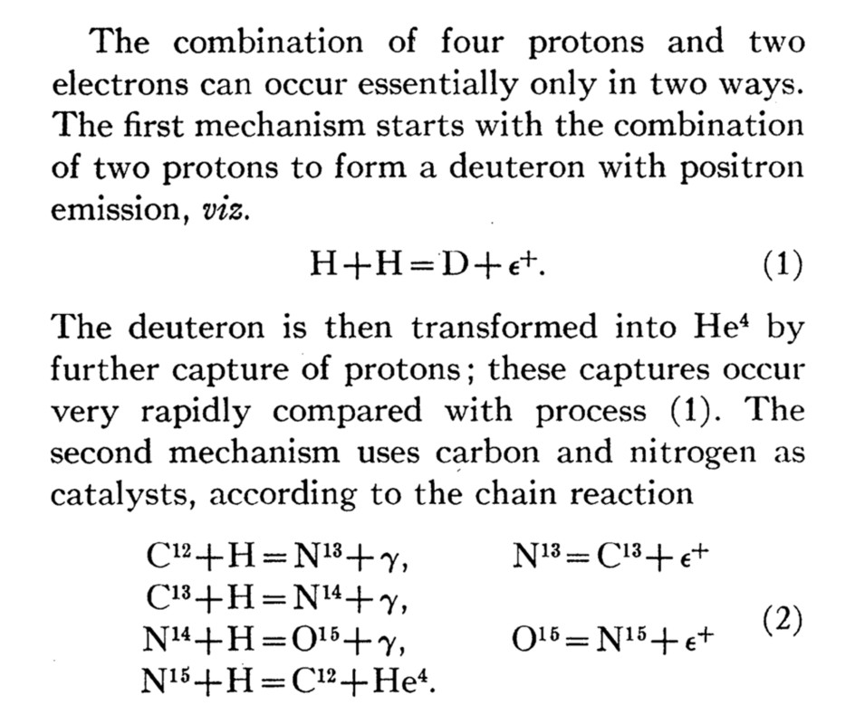
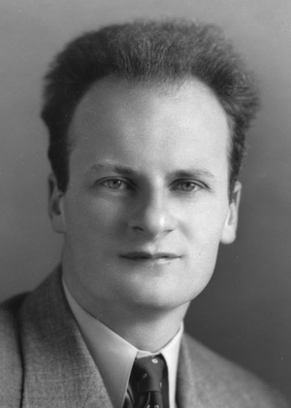
Bethe’s Classic Paper on Nuclear Reactions in Stars
Hans Bethe
1906–2005
• First mention of neutrino
emission from stars
• Neutrino losses discussed,
although overestimated

Slide 4
Some Early Papers on Stellar Particle Physics
Neutrinos (since 1960s)
• Bernstein, Ruderman & Feinberg:
Electromagnetic properties of the neutrino, Phys. Rev. 132 (1963) 1227
• Gribov & Pontecorvo:
Neutrino astronomy and lepton charge, PLB 28 (1969) 493
• Cowsik:
Limits on the radiative decay of neutrinos, PRL 39 (1978) 511
• Falk & Schramm:
Limits from supernovae on neutrino radiative lifetimes, PLB 79 (1978) 511
Flavor oscillations!
Axions
Axions & light Higgs (ca 1978)
• Vysotsky, Zeldovich, Khlopov & Chechetkin:
Some astrophysical limitations on the axion mass,
Pisma Zh. Eksp. Teor. Fiz. 27 (1978) 533 [JETP Lett. 27 (1978) 502]
• Dicus, Kolb, Teplitz & Wagoner:
Astrophysical bounds on the masses of axions and Higgs particles, PRD 18 (1978) 1829
• K. O. Mikaelian: Astrophysical implications of new light Higgs bosons, PRD 18 (1978) 3605
• K. Sato: Astrophysical constraints on the axion mass and the number of quark flavors,
Prog. Theor. Phys. 60 (1978) 1942

Slide 5
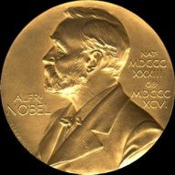

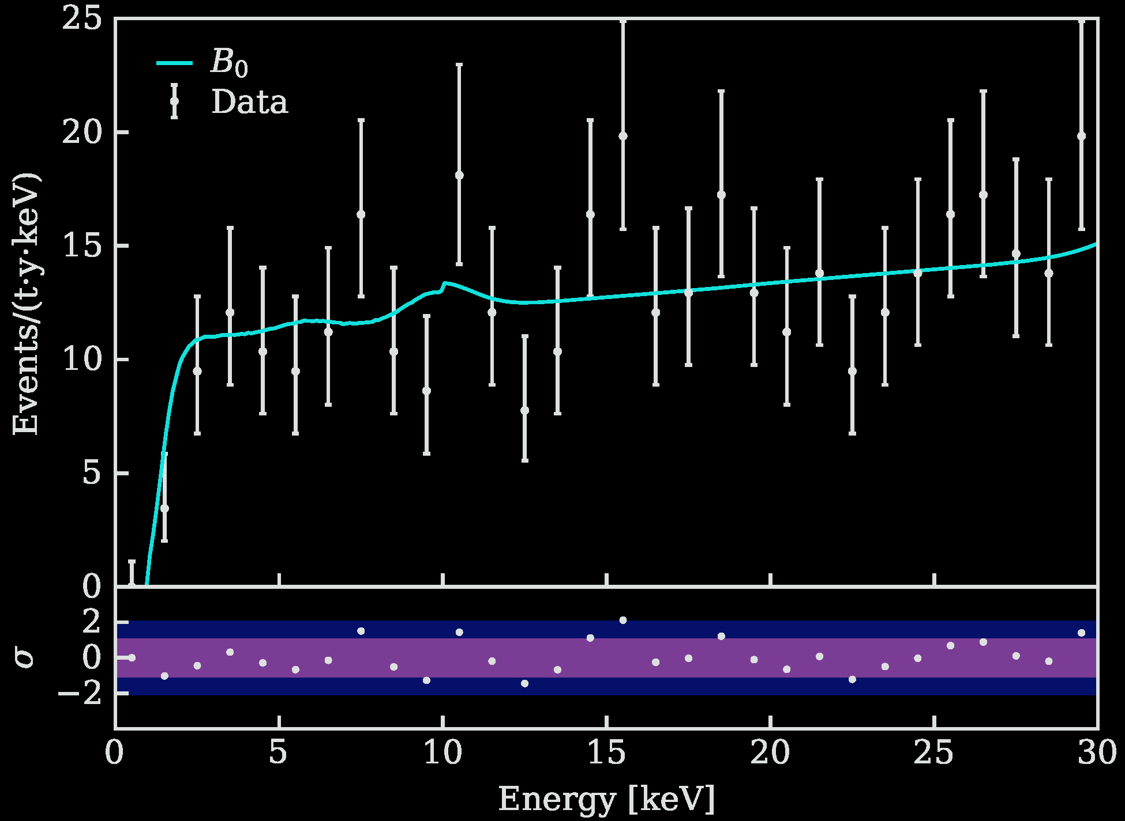
Particles from the Sun
2002 Solar Neutrinos (R.Davis, M.Koshiba)
2015 Solar Nu Oscillations (A.McDonald)
Search for solar axions
with CAST and future IAXO
No excess in XENONnT
arXiv:2207.11330
Bounds on axions,
dark photons, neutrino
dipole moments

Slide 6
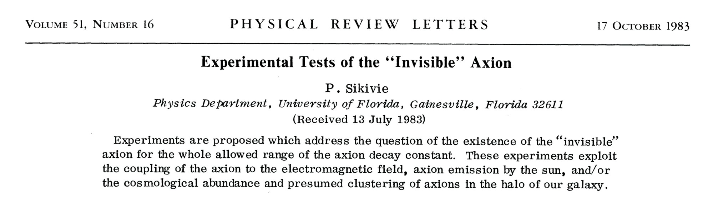

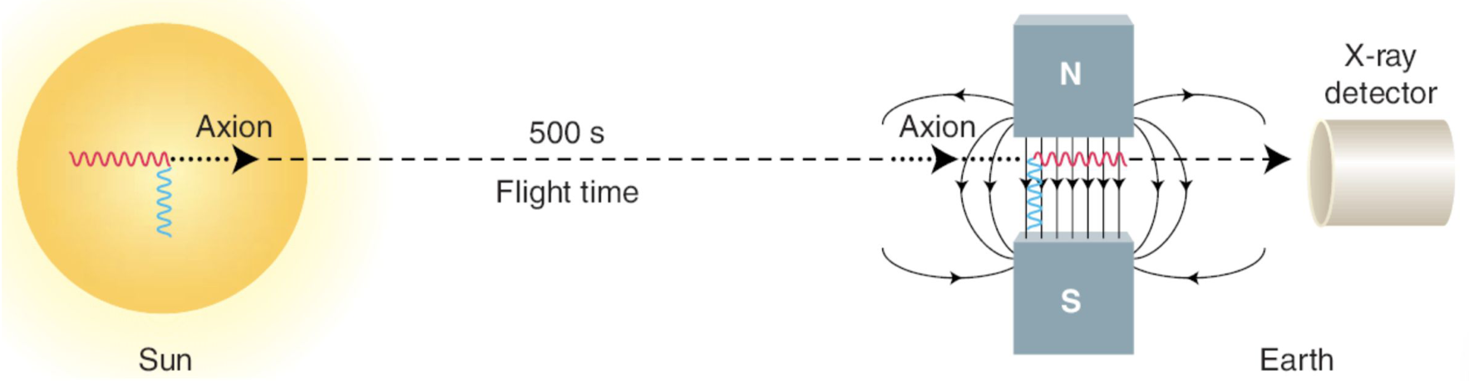
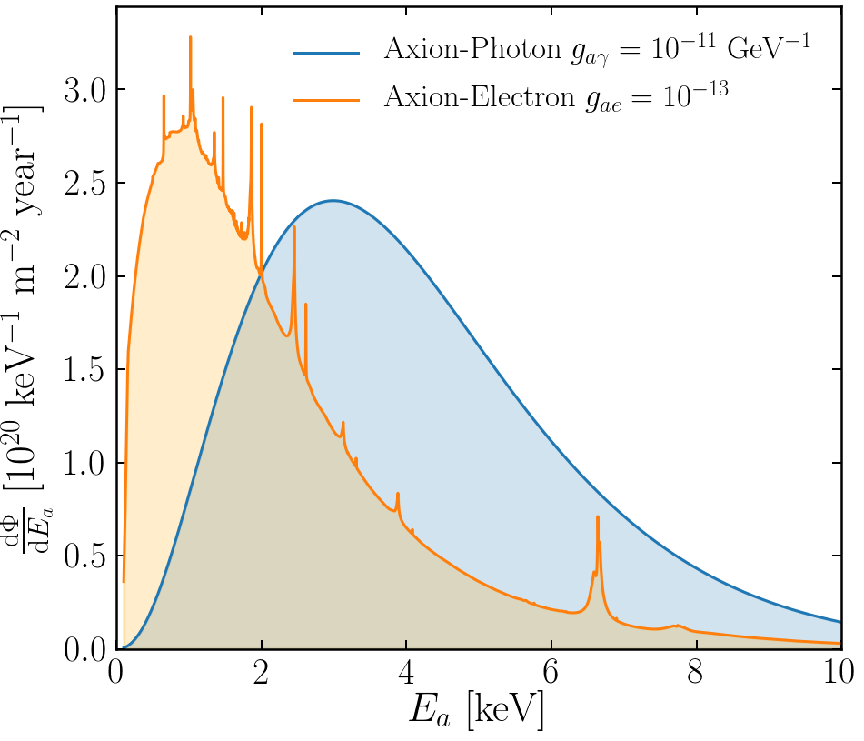
Experimental Tests of Invisible Axions
● Large coherence length overcomes
small coupling
● Axion-photon conversion in B-field similar to
neutrino flavor oscillation, PRD 37 (1988) 1237
● Can be enhanced with gas filling
van Bibber+ PRD 39 (1989) 2089
Primakoff
https://cajohare.github.io/IAXOmass/

Slide 7
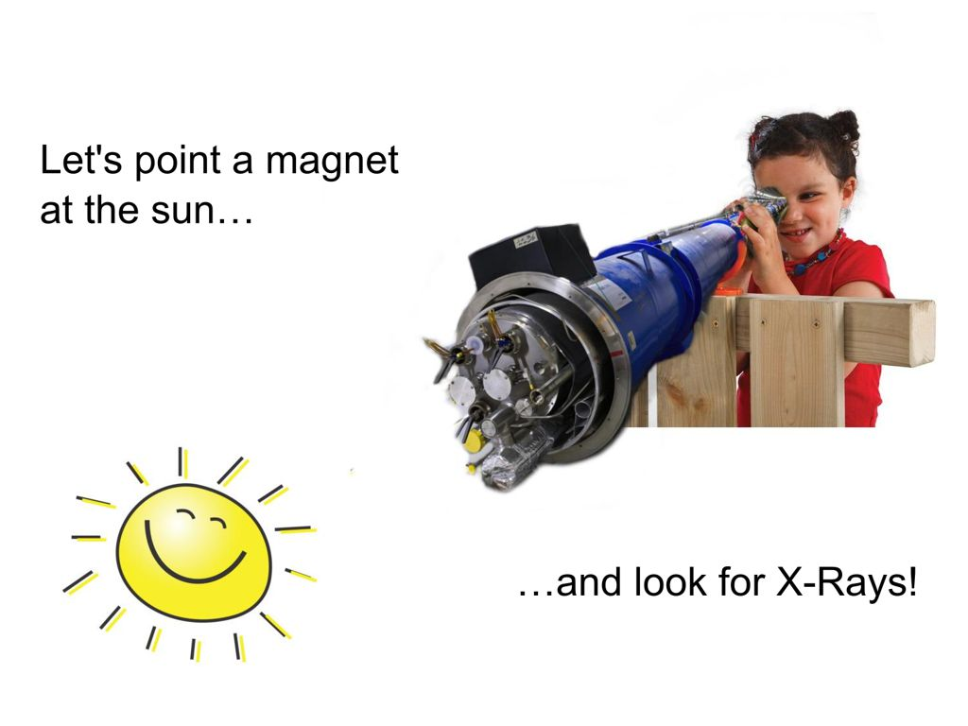
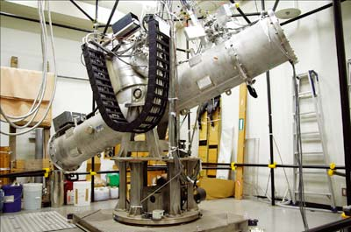
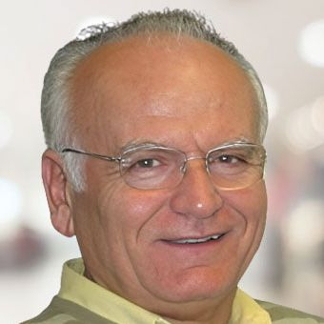
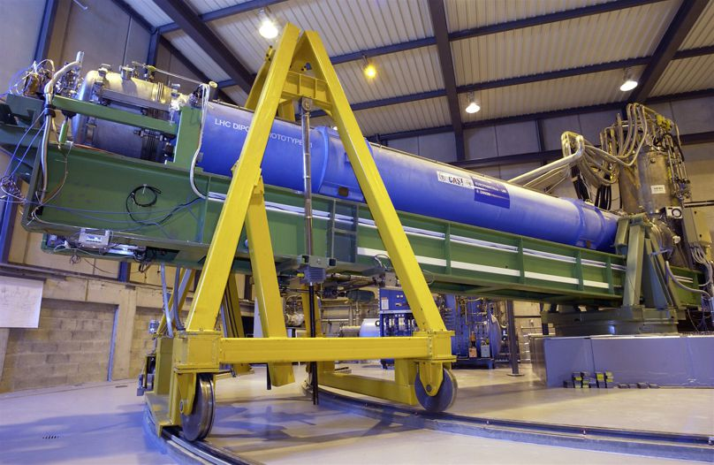
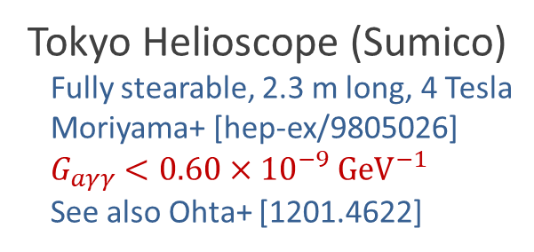
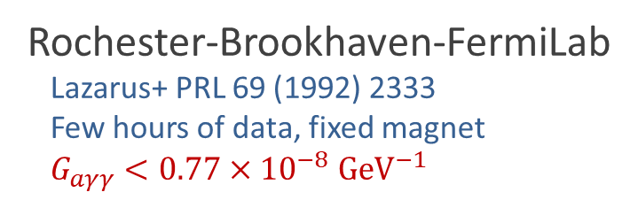
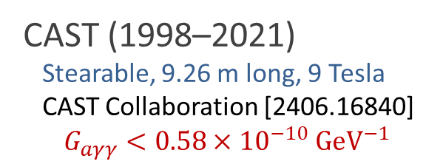
Pointing a Magnet to the Sun
Rochester-Brookhaven-FermiLab
Lazarus+ PRL 69 (1992) 2333
Few hours of data, fixed magnet
$G_{aγγ}<0.77×{10}^{−8} GeV^{−1}$
© Sebastian Baum
Tokyo Helioscope (Sumico)
Fully stearable, 2.3 m long, 4 Tesla
Moriyama+ [hep-ex/9805026]
$G_{aγγ}<0.60×{10}^{−9} GeV^{−1}$
See also Ohta+ [1201.4622]
CAST (1998–2021)
Stearable, 9.26 m long, 9 Tesla
CAST Collaboration [2406.16840]
$$G_{aγγ}<0.58×{10}^{−10} GeV^{−1}$$
Konstantin
Zioutas
CAST Movie on YouTube
https://youtu.be/XY2lFDXz8aQ

Slide 8
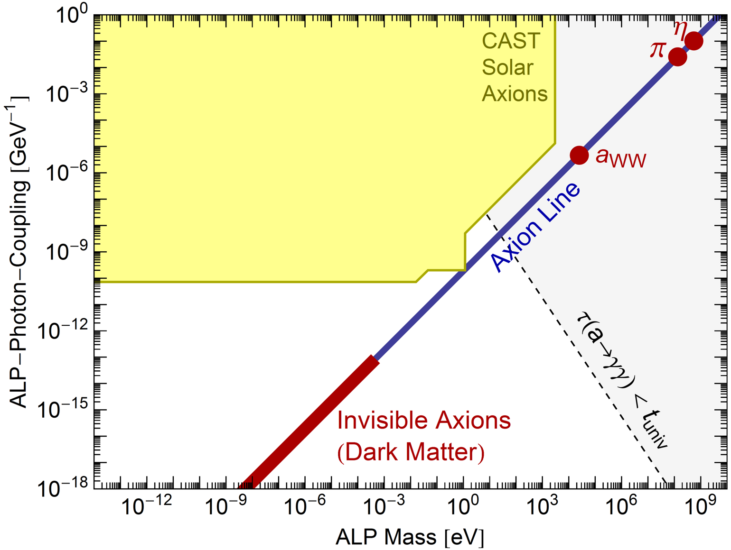
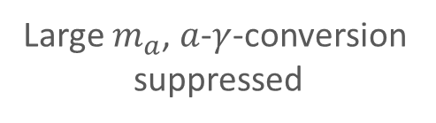
Parameter Space for Axion-Like Particles (ALPs)
CAST exclusion range
End of solar
spectrum
Large $m_{a}$, $a$-$γ$-conversion
suppressed
$a$-$γ$-oscillations enhanced
with He filling ($m_{γ}∼m_{a}$)
Maximal mixing
(“coherent”, small $m_{a}$)
Re-alignment axions
(Dark Matter)

Slide 9
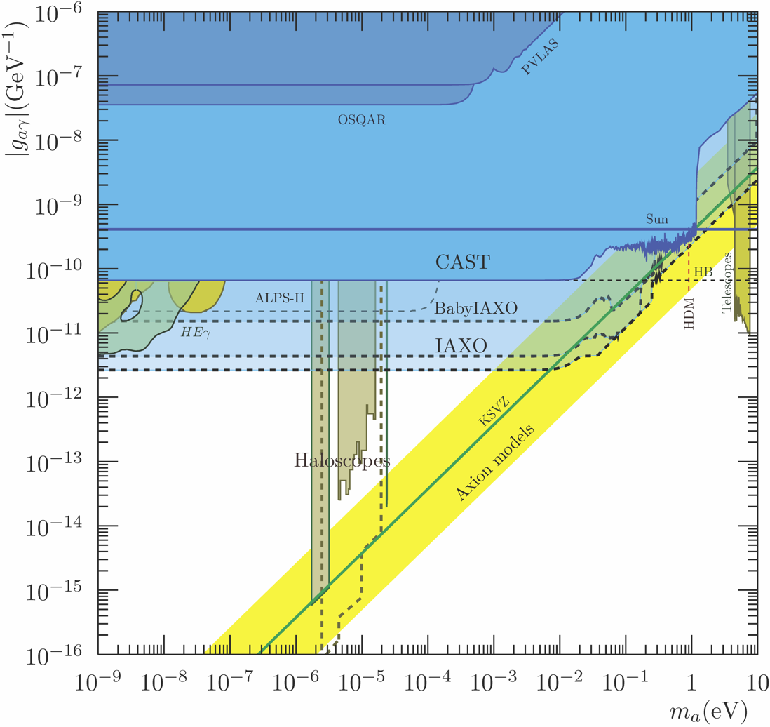

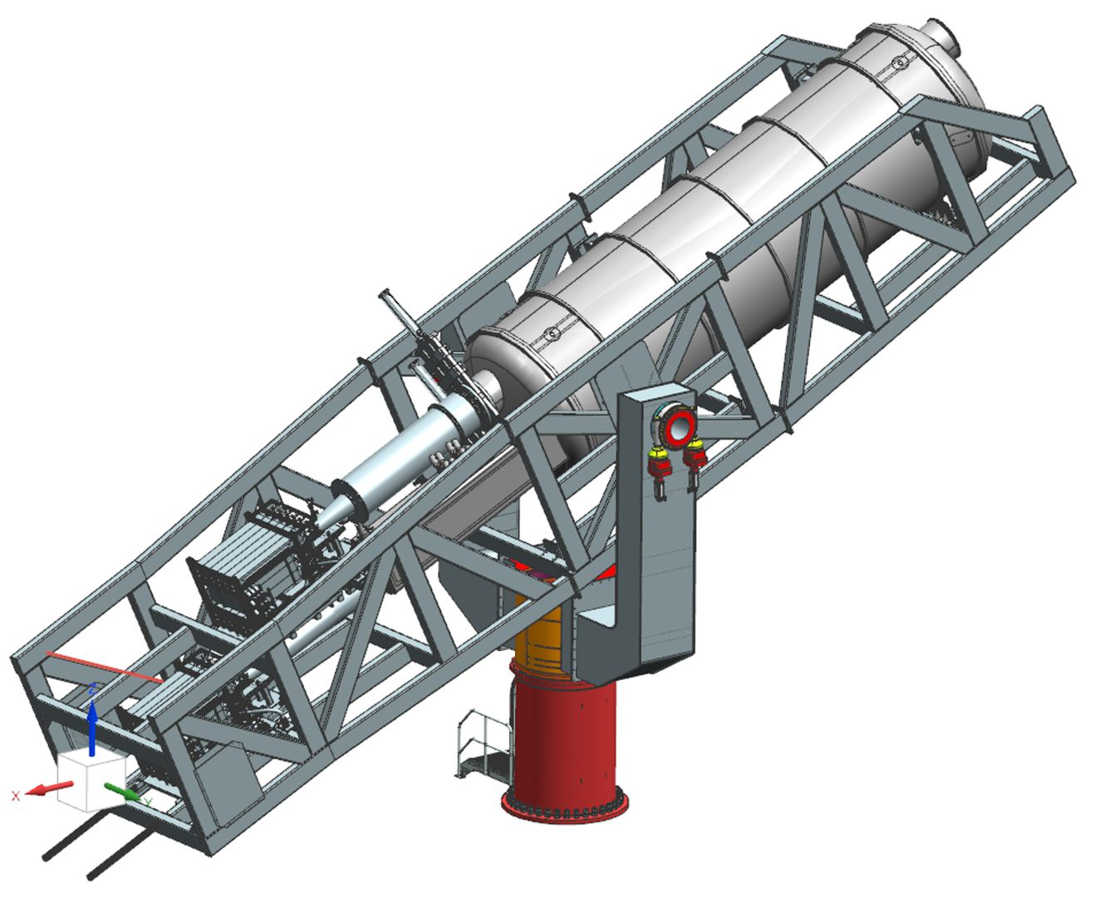
(Baby) IAXO Sensitivity Forecast
Discovery potential
for QCD axions
Physics potential of the International Axion Observatory (IAXO)
JCAP 1906 (2019) 047, arXiv:1904.09155

Slide 10
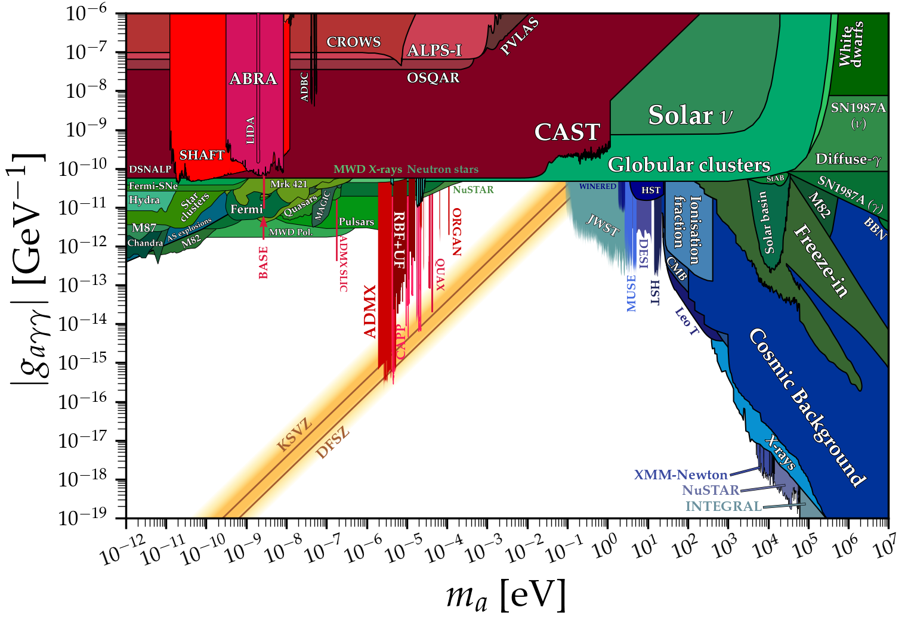
Grand Unified ALP Scape
SN87A
TRGB
Ciaran O'Hare @ Github

Slide 11
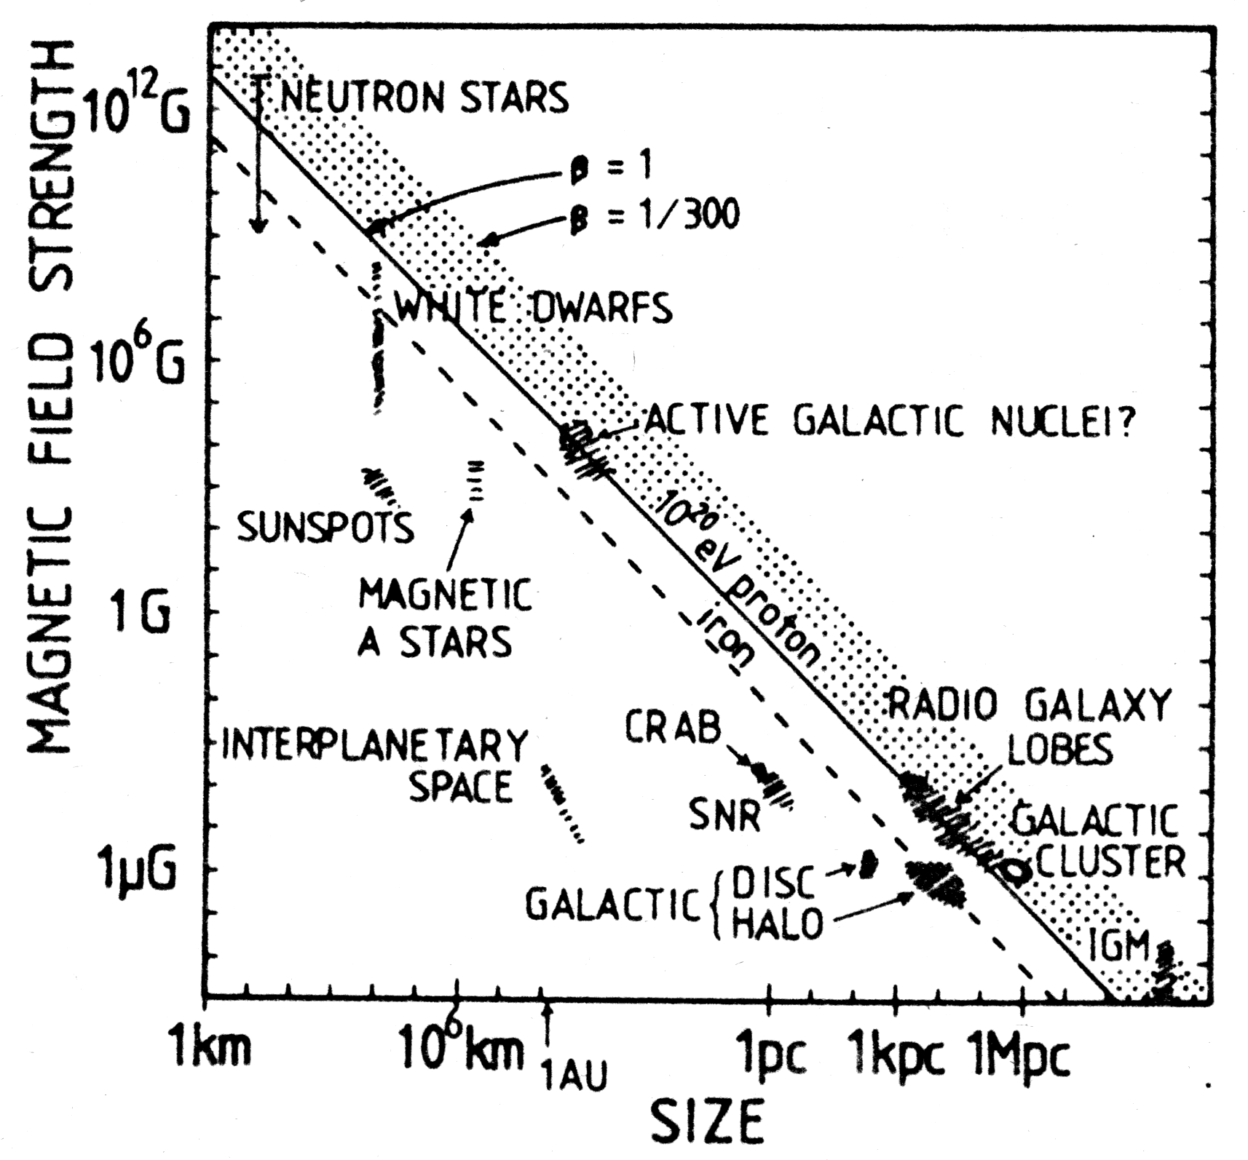
Hillas Plot
A. M. Hillas
Ann. Rev. Astron. Astrophys.
22, 425 (1984)
Size and B field strength
of possible sites for
particle acceleration.
Objects below the
line cannot accelerate
protons to 10²⁰ eV
ALP-γ conversion
$$\frac{g_{aγ}}{{10}^{12}GeV}BL∼1$$

Slide 12
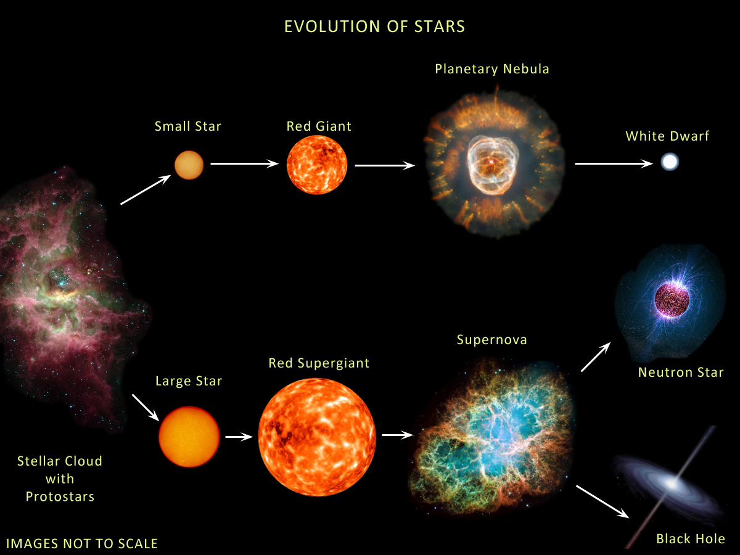





Evolution of Stars
Compact
Remnants:
$$M≲8 M_{⊙}$$
$1 M_{⊙}=2×{10}^{30}$kg
$$M∼0.6 M_{⊙}$$
R $∼$5000 km
$M$ = 1–2$M_{⊙}$
R $∼$12 km
$$M≳8 M_{⊙}$$
few-tens $M_{⊙}$
few km
BR ≈ 25% (?)
http://earthspacecircle.blogspot.com/2013/07/stellar-evolution.html

Slide 13
Evolution of Stars
Particles from the Sun:
• Direct search
• Back-reaction on Sun
• Number counts in globular clusters
• Brightness of tip of red-giant branch (TRGB)
• White dwarf luminosity function
• Period decrease of variable WDs
• WD Initial-final mass function
• EoS w/ axions
DM axion conversion in
pulsar magnetosphere
• Nus from SN 1987A & future SN
• Explosion energy
• Radiation from all past SNe
• Cooling speed
• EoS w/ axions
Superradiance
Core-collapse supernova

Slide 14
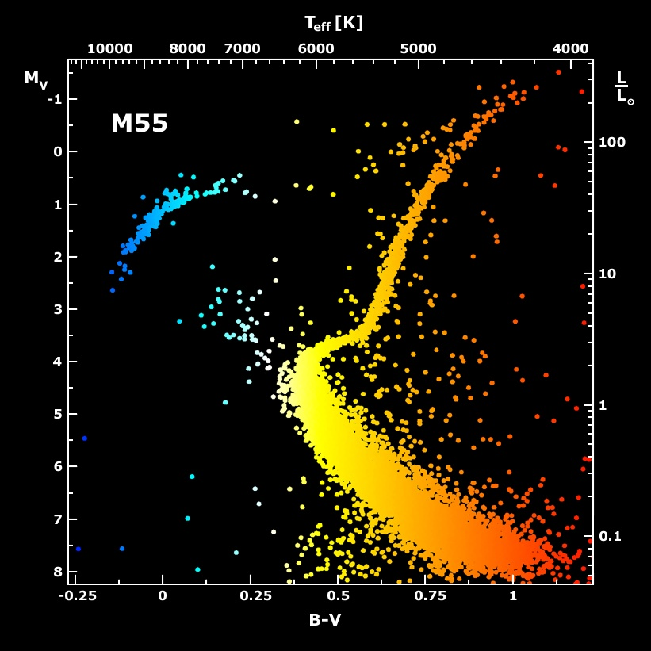
Galactic Globular Cluster M55

Slide 15
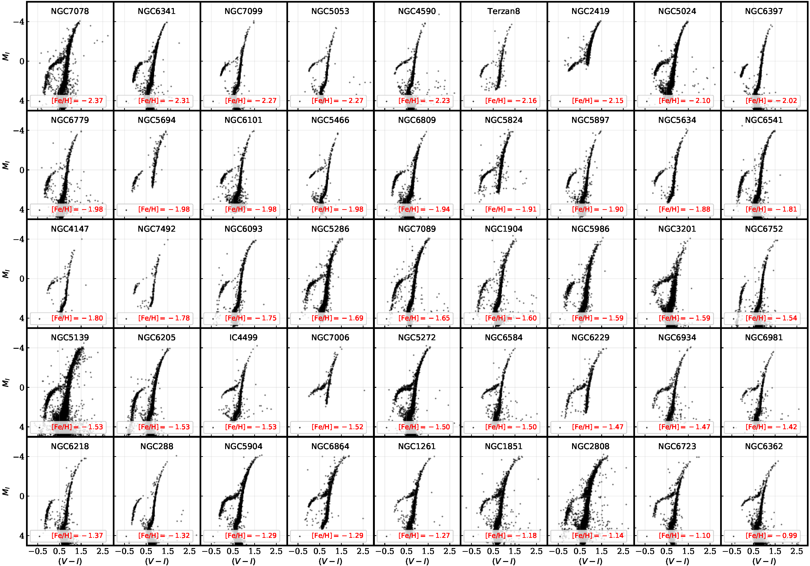
TRGB in 46 Globular Clusters [Cerny+ 2012.09701]

Slide 16
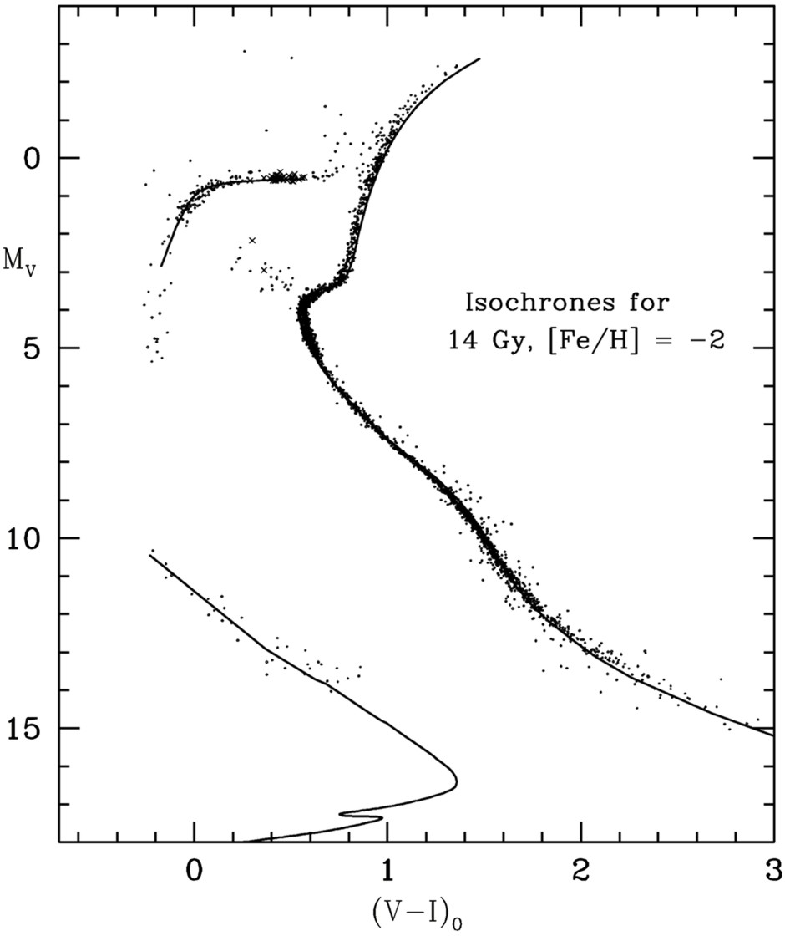
Color-Magnitude Diagram for Globular Clusters
Hot, blue
cold, red
Color-magnitude diagram synthesized from several low-metallicity globular
clusters and compared with theoretical isochrones (W.Harris, 2000)

Slide 17
Color-Magnitude Diagram for Globular Clusters
H
H
He
C O
He
Asymptotic Giant
Red Giant
H
H
He
C O
White
Dwarfs
Horizontal Branch
Main-Sequence
Hot, blue
cold, red
Color-magnitude diagram synthesized from several low-metallicity globular
clusters and compared with theoretical isochrones (W.Harris, 2000)

Slide 18
Color-Magnitude Diagram for Globular Clusters
H
Particle emission
delays He ignition, i.e.
core mass increased
H
He
C O
He
Asymptotic Giant
Red Giant
H
H
He
C O
White
Dwarfs
Horizontal Branch
Main-Sequence
Hot, blue
cold, red
Color-magnitude diagram synthesized from several low-metallicity globular
clusters and compared with theoretical isochrones (W.Harris, 2000)

Slide 19

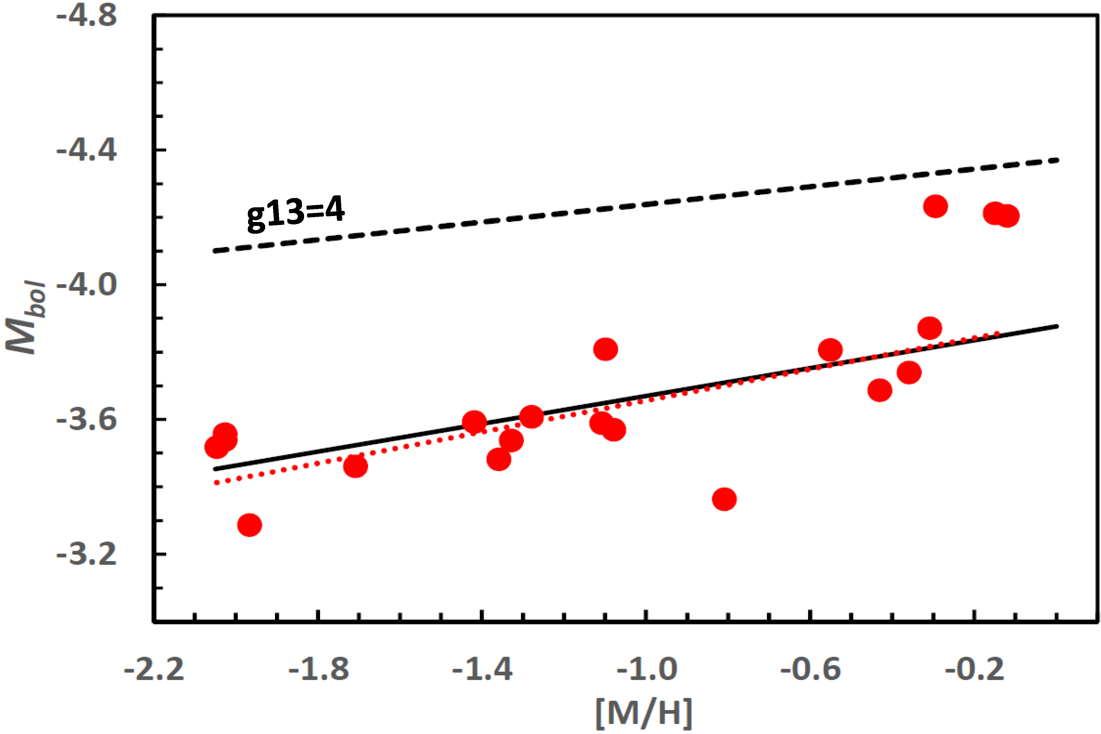
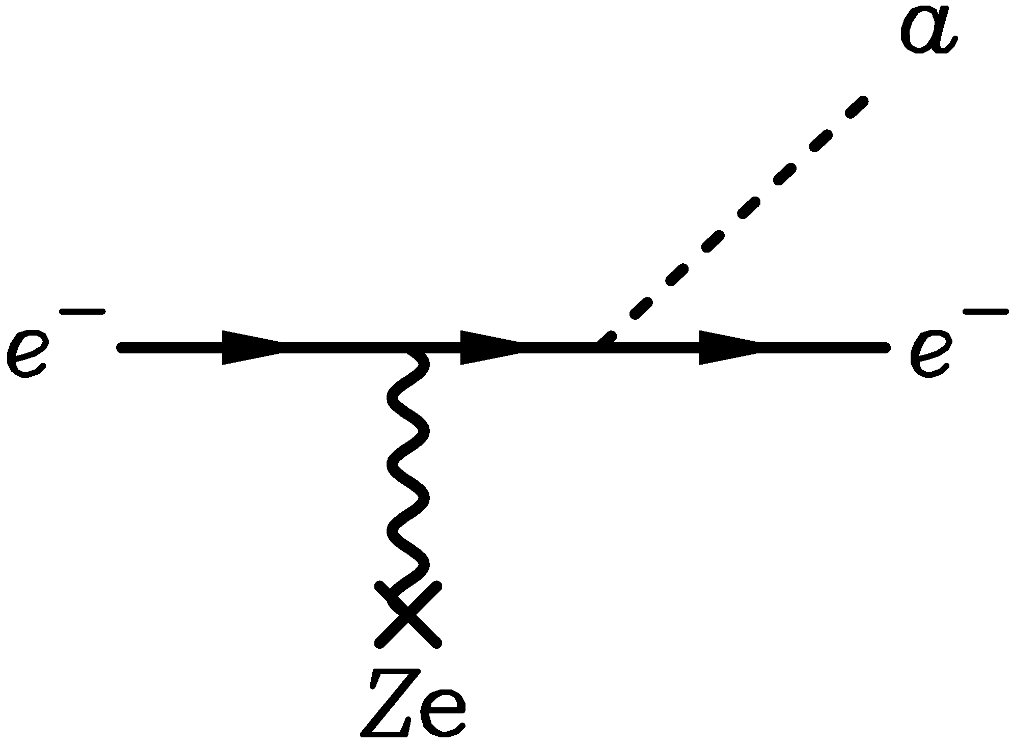
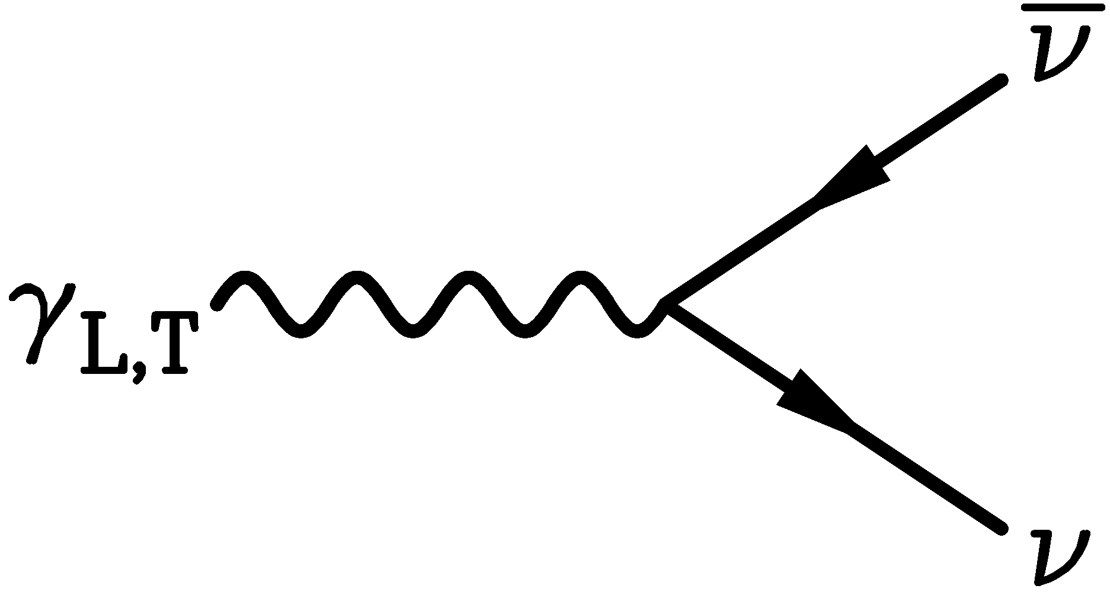
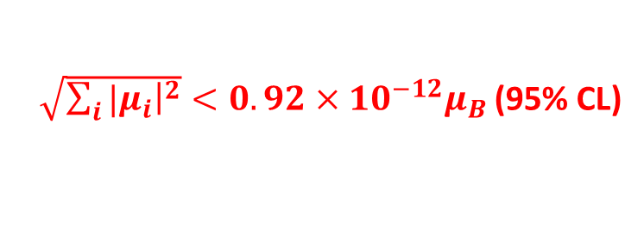
New TRGB Calibration from 21 Globular Clusters
Straniero+ arXiv:2010.03833 and https://www.ggi.infn.it/talkfiles/slides/slides6554.pdf
Emission of axions & friends
with direct electron coupling
$$g_{ae}$$
Theoretical Prediction
TRGB in 21 GCs
$g_{ae}<0.96×{10}^{−13}$ (95% CL)
Bremsstrahlung emission by
degenerate electrons
Metallicity [M/H]
Bound for neutrino dipole moments
Plasmon decay
$\sqrt{\sum_{i}{{|μ}_{i}{\left.​\right|}^{2}}}<0.92×{10}^{−12}μ_{B}$ (95% CL)

Slide 20
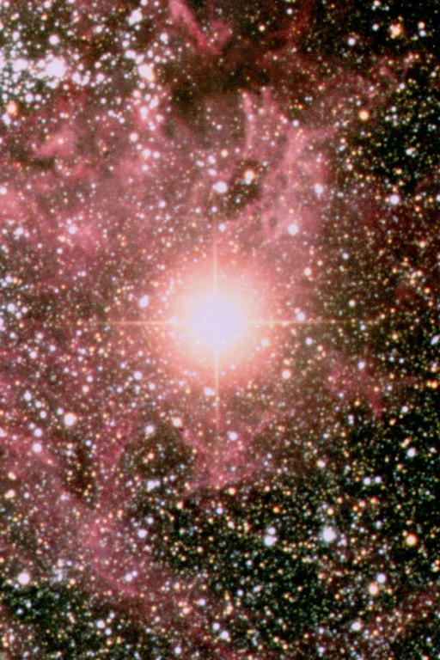
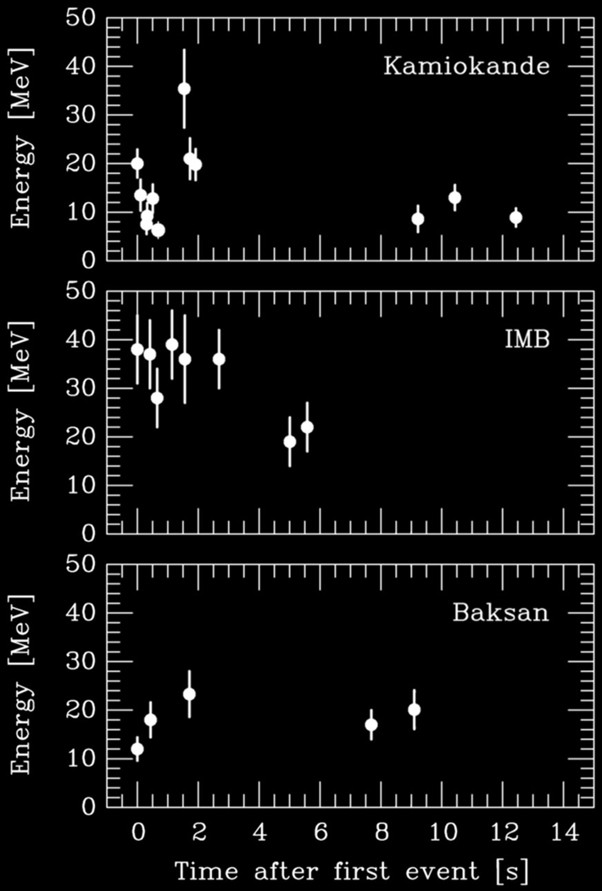
Supernova 1987A
Supernova 1987A
23 February 1987

Slide 21
Stellar Collapse and Explosion
Progenitor Star
Iron Core − “White Dwarf”
Collapsed Core
Shells not to scale
Mass ≈ 1.5 M⊙
Nuclear density (3×10¹⁴ g cm⁻³)
Hydrogen
Helium
Carbon
Neon
Oxygen
Silicon
Iron
Bounce
Shock
$$ν \overline{ν}$$
6×10⁸ km
6000 km
60 km
Gravitational binding energy
E_{b} ≈ 3 × 10⁵³ erg ≈ 15% M_{SUN} c²
This shows up as
99% Neutrinos
1% Kinetic energy of explosion
0.01% Photons, outshine host galaxy

Slide 22
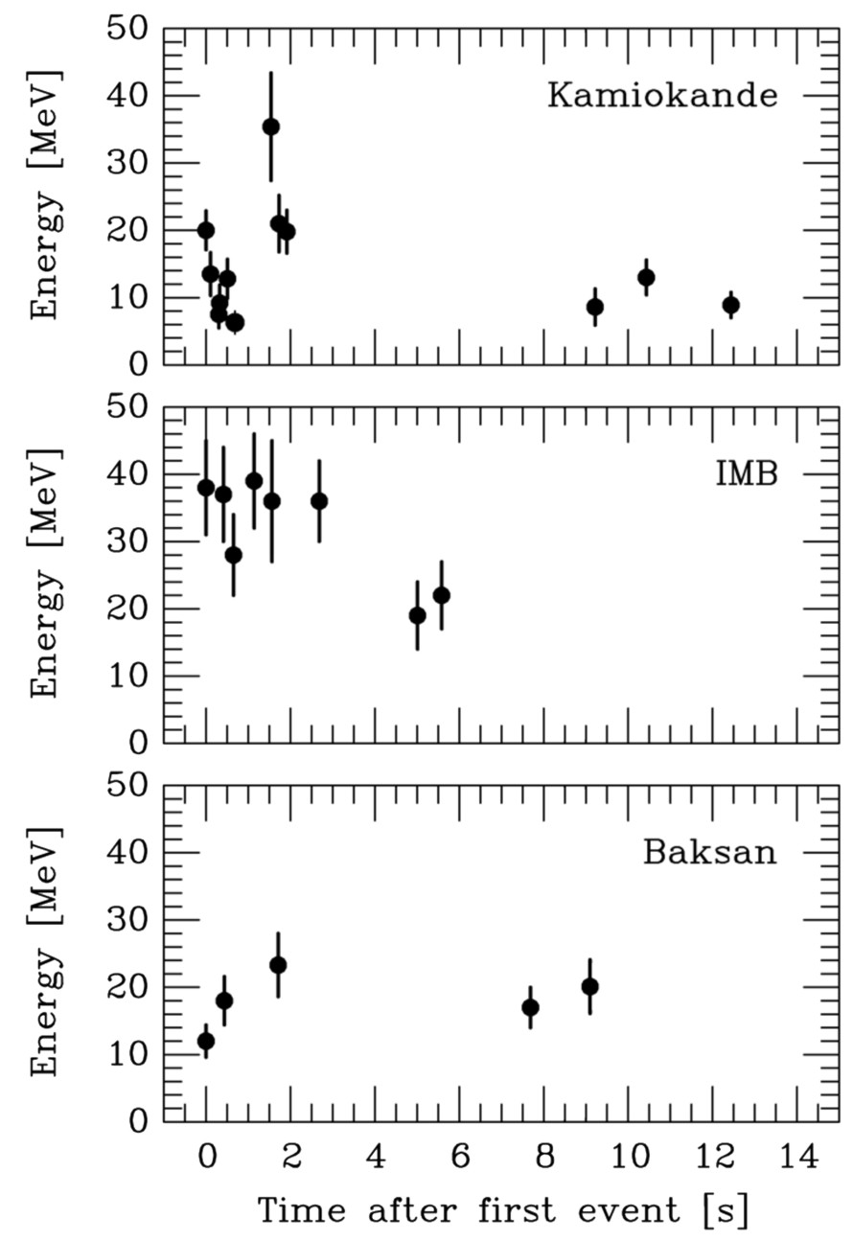
Supernova 1987A Energy-Loss Argument
SN 1987A neutrino signal
Neutrino
sphere
Volume emission
of new particles
Neutrino
diffusion
Emission of very weakly interacting
particles would “steal” energy from the
neutrino burst and shorten it.
(Early neutrino burst powered by accretion,
not sensitive to volume energy loss.)
Late-time signal most sensitive observable

Slide 23

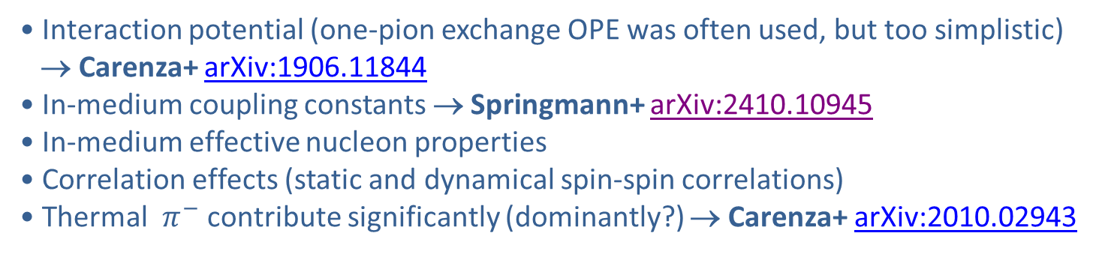
Axion Emission from a Nuclear Medium
Axion-nucleon interaction: $ℒ_{int}=\frac{C_{N}}{2f_{a}} {\overline{Ψ}}_{N}γ_{μ}γ_{5}Ψ_{N}∂^{μ}a=\frac{C_{N}}{2f_{a}}J_{μ}^{A}∂_{a}^{μ}$
a
N
N
+ ...
Axial-vector interaction implies
dominance of spin-dependent process
V
N
N
Nucleon-Nucleon
Bremsstrahlung
• Interaction potential (one-pion exchange OPE was often used, but too simplistic)
→ Carenza+ arXiv:1906.11844
• In-medium coupling constants → Springmann+ arXiv:2410.10945
• In-medium effective nucleon properties
• Correlation effects (static and dynamical spin-spin correlations)
• Thermal $π^{−}$ contribute significantly (dominantly?) → Carenza+ arXiv:2010.02943
$$π^{−}$$
a
p
n
Axion emission is a complicated nuclear physics problem, for several issues see
Fiorillo, Gil Muyor, Janka, Raffelt & Vitagliano, arXiv:2509.13322

Slide 24
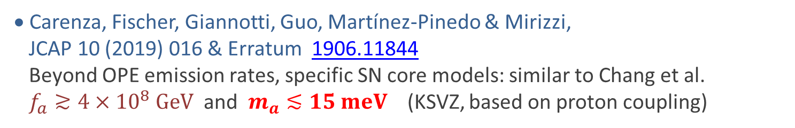
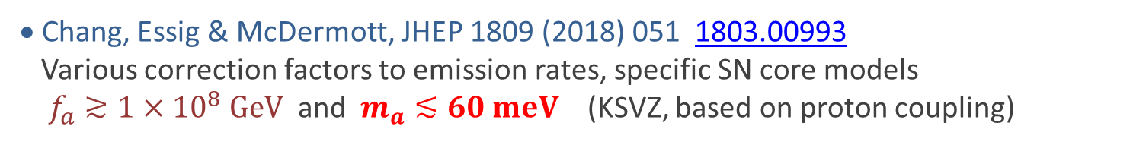
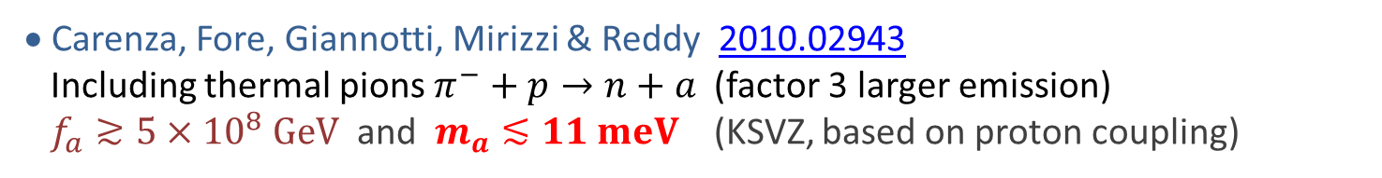
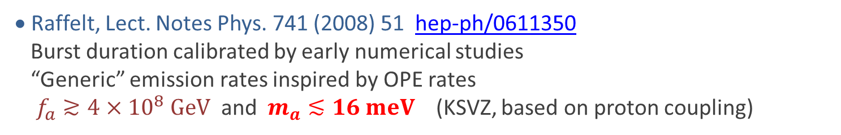
SN 1987A Axion Limits from Burst Duration
• Raffelt, Lect. Notes Phys. 741 (2008) 51 hep-ph/0611350
Burst duration calibrated by early numerical studies
“Generic” emission rates inspired by OPE rates
$f_{a}≳4×{10}^{8} GeV$ and $m_{a}≲16 meV$ (KSVZ, based on proton coupling)
• Chang, Essig & McDermott, JHEP 1809 (2018) 051 1803.00993
Various correction factors to emission rates, specific SN core models
$f_{a}≳1×{10}^{8} GeV$ and $m_{a}≲60 meV$ (KSVZ, based on proton coupling)
• Carenza, Fischer, Giannotti, Guo, Martínez-Pinedo & Mirizzi,
JCAP 10 (2019) 016 & Erratum 1906.11844
Beyond OPE emission rates, specific SN core models: similar to Chang et al.
$f_{a}≳4×{10}^{8} GeV$ and $m_{a}≲15 meV$ (KSVZ, based on proton coupling)
• Carenza, Fore, Giannotti, Mirizzi & Reddy 2010.02943
Including thermal pions $π^{−}+p→n+a$ (factor 3 larger emission)
$f_{a}≳5×{10}^{8} GeV$ and $m_{a}≲11 meV$ (KSVZ, based on proton coupling)
• Bar, Blum & D'Amico, Is there a supernova bound on axions? 1907.05020
Alternative picture of SN explosion (thermonuclear event)
Observed signal not PNS cooling. SN1987A neutron star (or pulsar) not yet found.
(but see “NS 1987A in SN 1987A”, Page et al. arXiv:2004.06078)

Slide 25
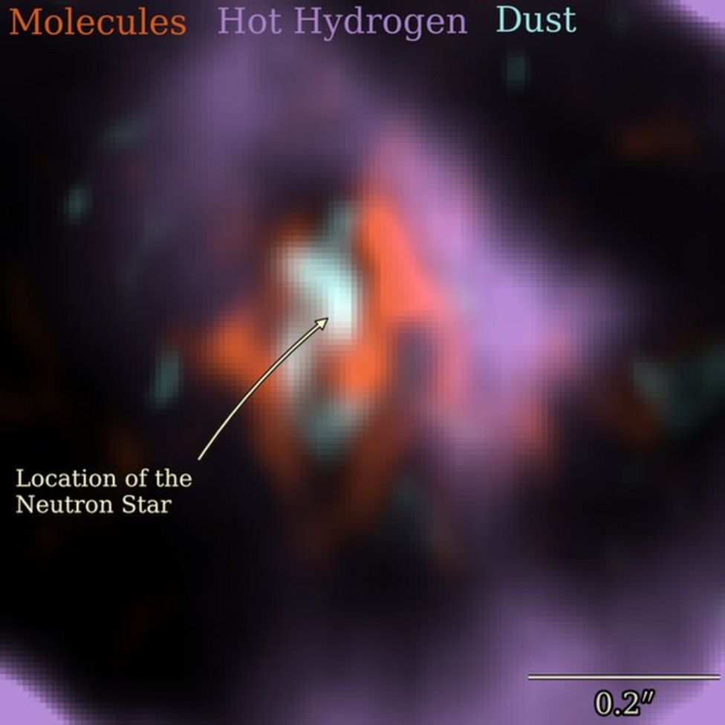
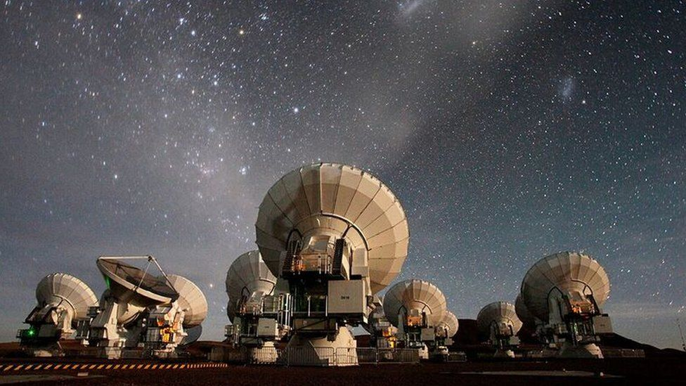
Where is the Neutron Star of SN 1987A?
No pulsar or neutron star has been seen until now (38 years later)
• Infra-red excess observed by ALMA: In “the blob” strong indication for NS
Expected position, remnant hidden by dust [Cigan+ arXiv:1910.02960]
• Most plausible model: Thermally cooling non-pulsar NS [Page+ arXiv:2004.06078]
https://www.bbc.com/news/science-environment-50473482
Atacama Large Millimeter/Submillimeter Array (ALMA) at ESO in Chile
1.5×10¹² km

Slide 26
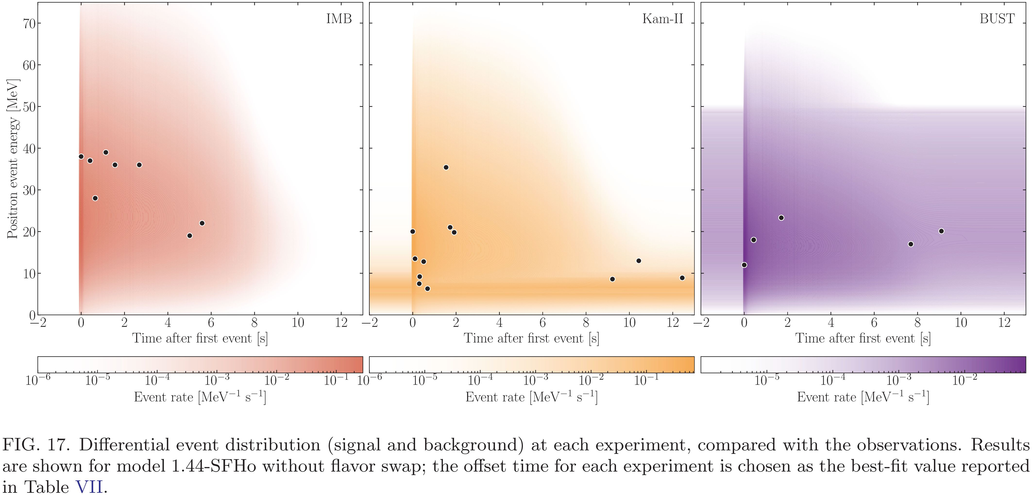
SN 1987A Signal Duration Too Long?
Fiorillo+ arXiv:2308.01403
Expected Signal & BKG
Expected Signal & BKG
Expected Signal & BKG
Mysterious late events
● In a suite of Garching models (no axions), expected signal always too short
(PNS convection and reduced opacities by correlations!)
● Deserves dedicated study

Slide 27
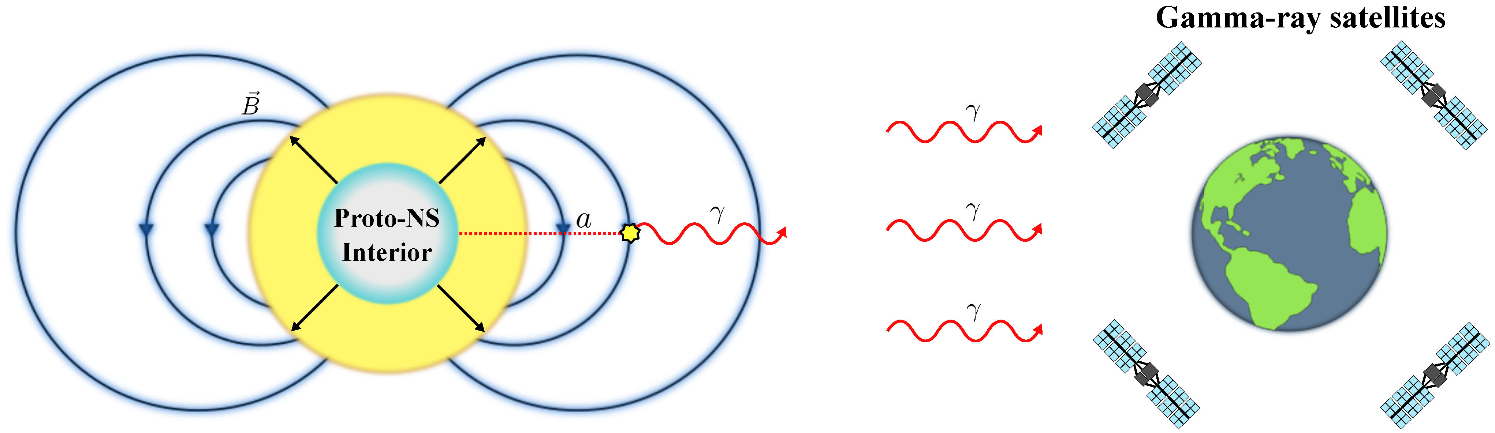
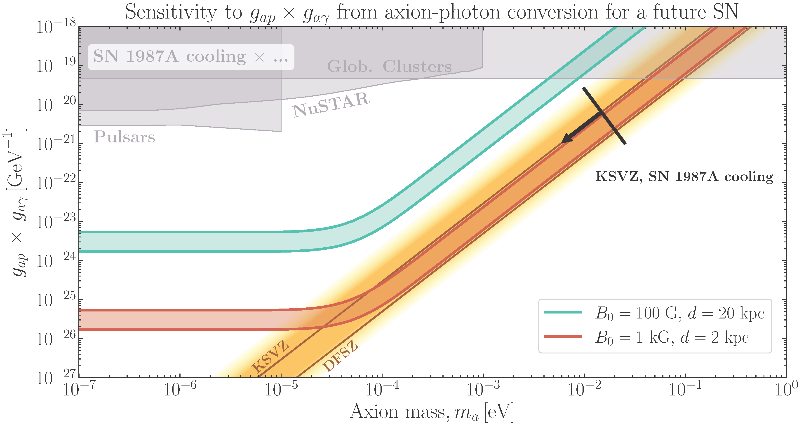
Detecting Axions with Next Galactic Supernova?
4 Fermi-LAT
like satellites
(proposed
GALAXIS)
Axion-photon
conversion in B field
of progenitor
Manzari+ arXiv:2405.19393
This figure:
Fiorillo, Gil Muyor,
Janka, Raffelt & Vitagliano
arXiv:2509.13322
For optimistic SN assumptions (distance, B field) QCD axion parameters reachable

Slide 28
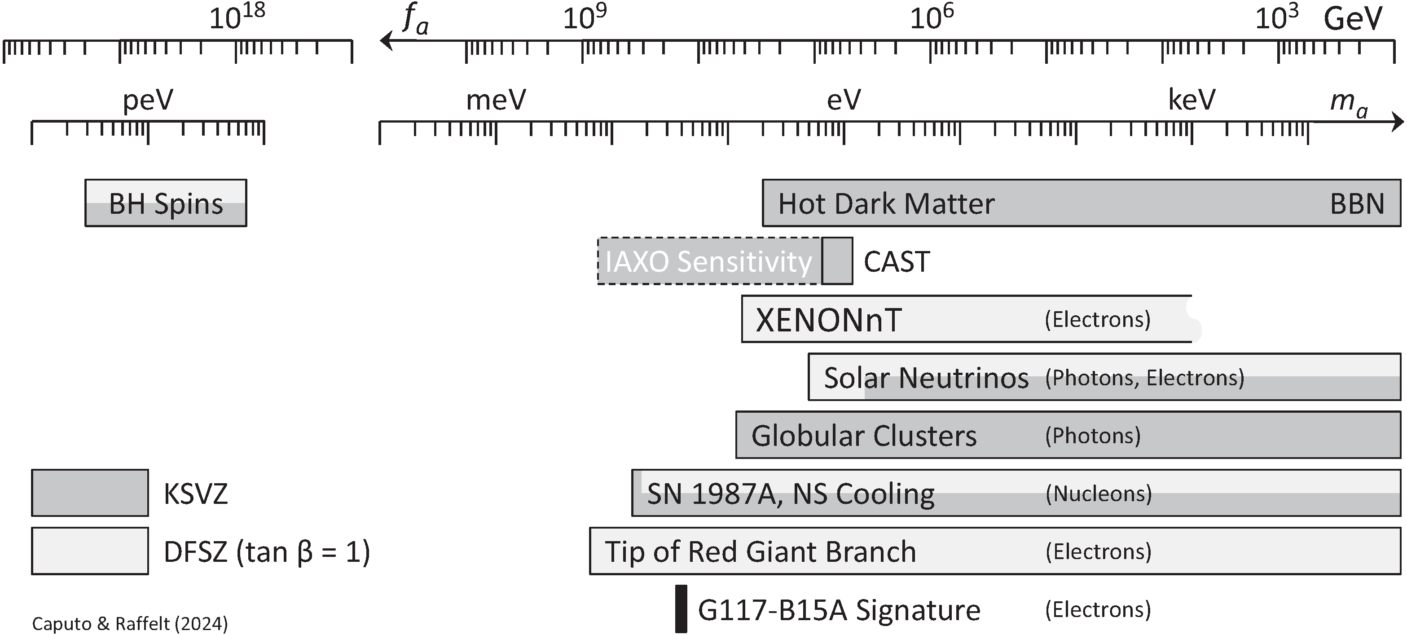
Astrophysical Axion Bounds
The 2024 Edition, Caputo & Raffelt, arXiv:2401.13728, 24 Jan 2024
See also Carenza, Giannotti, Isern, Mirizzi & Straniero, arXiv:2411.02492
GW231123
• Many improvements over the years, but overall picture the same
• Specific QCD axion signatures cannot come from cooling effects
• Best stellar detection opportunity probably (Baby)IAXO

Slide 29
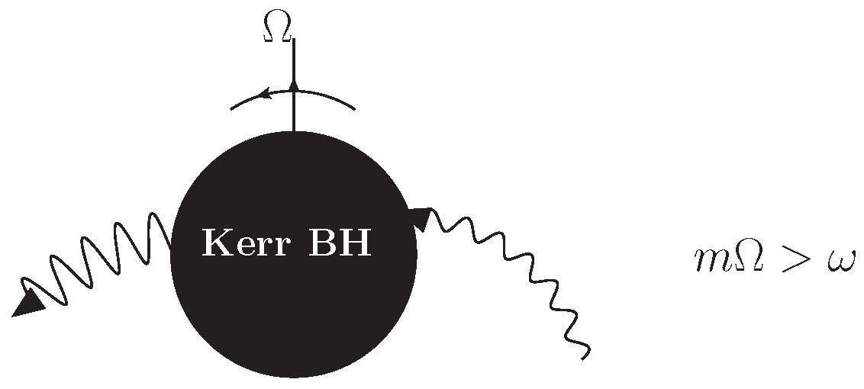

Superradiance
Extraction of rotational energy
from spinning object by
low-frequency modes $ω<Ω$
of an external bosonic field
• Bosons with mass get
gravitationally bound
• Superradiant run-away mode
$φ=Y_{lm}\left(θ,φ\right)ψ_{lmn}\left(r\right)e^{Γt}$
• “Bosonic atom”
• Transitions → Gravitational waves
Superradiance: New Frontiers in Black Hole Physics (2020 edition)
R. Brito, V. Cardoso & P. Pani, 1501.06570v8 (8 Jan 2021)
Adapted from Jamie McDonald

Slide 30

BH Spins from Binary Merger GW231123
LIGO-Virgo-KAGRA observed GWs from BH-BH merger GW231123
${137}_{−17}^{+22}M_{⊙}$ and ${103}_{−52}^{+20}M_{⊙}$ with large spins
New superradiance bounds
on scalar boson masses
Caputo, Franciolini & Witte
arXiv:2507.21788 (29 July 2025)
Aswathi, East, Siemonsen, Sun & Jones
arXiv:2507.20979 (28 July 2025)

Slide 31

Dark Matter Axion-Photon Conversion in
Neutron Star Magnetospheres
Dark matter axions
$m_{a}∼μeV$, $v_{a}∼{10}^{−3}c$
Pshirkov & Popov 2007
arXiv:0711.1264
Many papers recently
Very narrow
radio line
Axion mass and plasma frequency
Degenerate near NS surface
→ Resonant conversion

Slide 32


Searching for Axions with Radio Telescopes
PSR J2144−3933
MeerKAT
Battye+ 2303.11792
Galactic Center Pulsars
Breakthrough Listen
Foster+ 2202.08274
$$m_{a}/μeV$$
CAST
SKA forecast
Galactic Center Magnetar
SKA forecast
CAPP
ADMX

Slide 33



Axion Clouds around Neutron Stars
Polar cap cascades
D.Noordhuis, A.Prabhu, S.J.Witte, A.Y.Chen, F.Cruz & C.Weniger, arXiv:2209.09917
D.Noordhuis, A.Prabhu, C.Weniger & S.J.Witte, arXiv:2307.11811
• E-field extracts charges
• QED cascade
• Shuts off E-field
• Cascade stops
...
• Periodic E modulation
• Periodic E.B
• Sources ALPs

Slide 34

Thanks

Slide 35

Astrophysical Axion Bounds and Opportunities
m_{Planck}
f_{a}
10¹⁸
10¹⁵
10¹²
10⁹
10⁶
GeV
peV
neV
μeV
meV
eV
m_{a}
Super
Radiance
Opportunities for detection
Astrophysical Bounds
(Energy loss of stars)
Next SN
Black
Hole
IAXO Solar
Axion Telescope
Axion conversion in neutron star magnetospheres

Slide 36
• Best bet for systematic axion search with stars
Globular clusters should be more systematically studied
• Best bounds on electron and photon coupling
• Cooling hints inconsistent
• SN1987A bounds unchanged, many refinements
• Next SN: Putting these on firm basis
• GALAXIS or IAXO detection opportunity
• Radio detection from pulsars
(DM conversion, polar-cap production)
• Superradiance limits from BH spins (very small masses)
• GW signals can still show up

Slide 37
Thanks
Solar Axions
Globular Clusters
Supernova 1987A
Neutron Stars
Gravitational Waves
Thanks!

Slide 38
Thanks

Slide 39
End
Bonus
Topics

Slide 40

Globular Cluster Stars
Luminosity (compared with Sun)
Surface Temperature (Kelvin)
https://www.eso.org/public/images/eso0728c/

Slide 41



Hubble Tension
See also Riess+
arXiv:2112.04510
Freedman ApJ 919 (2021) 16 [2106.15656]
Di Valentino+ arXiv:2103.01183

Slide 42


Tip of the Red-Giant Branch in the Galaxy NGC 4258
I-Band Brightness (HST)
Color (HST Filters)
NGC 4258 hosts a water megamaser
→ Quasi-geometric distance determination
Among the best absolute TRGB calibrations
One rung in cosmic distance ladder

Slide 43
Color-Magnitude Diagram for Globular Clusters
H
H
He
C O
He
Asymptotic Giant
Red Giant
H
Particle emission reduces
helium burning lifetime,
i.e. number of HB stars
H
He
C O
White
Dwarfs
Horizontal Branch
Main-Sequence
Hot, blue
cold, red
Color-magnitude diagram synthesized from several low-metallicity globular
clusters and compared with theoretical isochrones (W.Harris, 2000)

Slide 44

Helium Burning Lifetime: R-Method
Number ratio (“R”) of HB/RGB fixes He-burning lifetime
(if RGB not affected by new energy loss)
Straniero, Ayala, Giannotti, Mirizzi & Domínguez,
doi:10.3204/DESY-PROC-2015-02/straniero_oscar

Slide 45



ALP Limits from Globular Clusters
Helium abundance and energy loss rate
from modern number counts HB/RGB
in 39 globular clusters R = 1.39 ± 0.03
$$R_{th}=1.48+6.26\left(Y−0.255\right)−0.41g_{10}^{2}$$
$g_{aγ}<0.66×{10}^{−10}GeV^{−1}$ (95% CL)
Same as CAST limit within 2 digits ☺
Small “cooling hint” almost certainly
systematics (as usual in astrophysics)
eg nuclear reaction rates
Need more systematic exploration of
systematics!
Ayala, Dominguez, Giannotti, Mirizzi & Straniero, arXiv:1406.6053
doi:10.3204/DESY-PROC-2015-02/straniero_oscar
Update including ALP masses: Lucente, Straniero, Carenza, Giannotti & Mirizzi, arXiv:2203.01336

Slide 46

HB vs. AGB Clump on Luminosity Function
Notes:
46

Slide 47


AGB/HB Counts in 48 Globular Clusters
R₂ = N_{AGB}/N_{HB} = 0.117 ± 0.005
The treatment of mixing in core helium burning models
II. Constraints from cluster star counts
Constantino, Campbell, Lattanzio & van Duijneveldt,
arXiv:1512.04845

Slide 48



Predicting the Axion-Modified Ratios
M.J. Dolan, F.J. Hiskens & R.R. Volkas, arXiv:2207.03102
$$g_{aγ}<0.66×{10}^{−10}GeV^{−1}$$
$$g_{aγ}<0.47×{10}^{−10}GeV^{−1}$$
“Cooling hint”
HB/RGB
AGB/HB
Probably one should analyze GCs for all observables simultaneously
using modern high-statistics (GAIA) data

Slide 49
White Dwarfs
Luminosity (compared with Sun)
Surface Temperature (Kelvin)
https://www.eso.org/public/images/eso0728c/

Slide 50


White Dwarfs
20 km
200 km
6000 km
C/O core
He
H
if present
= DA WDs
Heat
Reservoir
Photon
emission
Energy flux control
Cooling much slower for
DA type (with H layer)
$R ≃6000 km$ (Size of the Earth)
$T_{eff}≃10,000$–$30,000K$ (Sun 6000 K)
$L ≃{10}^{−4}\text{–}{10}^{−1}L_{⊙}$
$$M ≃0.5\text{–}0.8M_{⊙}$$
$ρ ≃{10}^{6}g/cm^{3}$ (very degenerate)

Slide 51

Axion Bounds from WD Luminosity Function
Limits on axion-electron coupling and mass limit in DFSZ model:
$g_{ae}≲3×{10}^{−13}$ $m_{a}\cos^{2}{β}≲10 meV$
Miller Bertolami, Melendez, Althaus & Isern, arXiv:1406.7712, 1410.1677
For extensions and review see: Isern, arXiv:2002.08069

Slide 52

Pulsating Stars
https://www.eso.org/public/images/eso0728c/
https://scienceatyourdoorstep.com/2021/01/04/what-are-variable-stars/

Slide 53




Non-Radial g-Modes
• Long period waves
(100 – 1000 s)
• Gravity is the restoring force
From a talk by J. Isern
• Period decreases as
the star cools
• Characteristic rate ${10}^{−15} s/s$
• Measures cooling speed
of a single star
$$\frac{d\log{Π}}{dt}∝−\frac{d\log{T}}{dt}$$

Slide 54




Pulsating White Dwarf G117–B15A
Kepler+ ApJ 254 (1982) 676
Kepler+ ApJ 906 (2021) 7
$$D=57.5±0.1 pc$$
$$T=12,400 K$$
$$M=0.69 M_{⊙}$$
Period 215.2 s
“Most stable optical clock”, slipped by 26 s (of 215.2 s period) in 45 years
$${\dot{P}}/P=\left(5.12±0.82\right)×{10}^{−15} s/s$$

Slide 55





G117–B15A Period Decrease: Hint for Axion Cooling?
Kepler+ ApJ 906 (2021) 7
Emission of axions & friends
with direct electron coupling
$$g_{ae}$$
Bremsstrahlung emission by
degenerate electrons
Case of DFSZ Axion
$$g_{ae}= 0.28×{10}^{−13} \frac{m_{a}\cos^{2}{β}}{meV}$$
Nominal cooling signal
$$g_{ae}=\left(5.7±0.6\right)×{10}^{−13}$$
$${\dot{P}}/P=\left(5.12±0.82\right)×{10}^{−15} s/s$$

Slide 56





White-Dwarf Bounds on Axion-Electron Coupling
0
1
2
3
4
5
6
7
$$\frac{g_{ae}}{{10}^{−13}}$$
NGC 4258
TRGB,
“Cooling hints” in strong
tension with TRGB limits
Probably issue of systematics
TRGB,
21 GCs
WDLF
$$\dot{Π}$$
L 19-2
$$\dot{Π}$$
PG1351+489
$$\dot{Π}$$
R548
$$\dot{Π}$$
G117-B15A
White Dwarfs as Physics Laboratories: Lights and Shadows, arXiv:2202.02052
J. Isern, S. Torres & A. Rebassa-Mansergas
Stellar Evolution Confronts Axion Models, arXiv:2109.10368
L. Di Luzio, M. Fedele, M. Giannotti, F. Mescia & E. Nardi

Slide 57

Neutron Star Cooling

Slide 58

Neutron Star Cooling
Potekhin & Chabrier: Magnetic neutron star cooling and microphysics [1711.07662]

Slide 59



Cooling Simulations of Five Neutron Stars
Cooling of J1605 with KSVZ axions,
BSk22 EOS, SBF-0-0 superfluidity
model, $M_{NS} = 1.0 M_{⊙}$
Upper Limit on the QCD Axion Mass from Isolated Neutron Star Cooling
Buschmann, Dessert, Foster, Long & Safdi, 2111.09892

Slide 60


Neutron-Star Cooling Bounds
Caputo & Raffelt, arXiv:2401.13728
DFSZ Axions
$$ℒ_{af}=C_{f} {\overline{Ψ}}_{f}γ^{μ}γ_{5}Ψ_{f}\frac{∂_{μ}a}{2f_{a}}$$
$$C_{n}=−0.160±0.025+0.414\cos^{2}{β}$$
$$C_{p}=−0.182±0.025−0.435\cos^{2}{β}$$
$$C_{e}=\frac{1}{3}\cos^{2}{β}$$
Upper Limit on the QCD Axion Mass
from Isolated Neutron Star Cooling
Buschmann, Dessert, Foster, Long & Safdi, arXiv:2111.09892

Slide 61

Superradiance
Superradiance: New Frontiers in Black Hole Physics (2020 edition)
R. Brito, V. Cardoso & P. Pani, 1501.06570v8 (8 Jan 2021)

Slide 62



Rotational Superradiance
0711.4416
Gravitational Collapse: The Role of General Relativity
Riv. Nuovo Cim., Num. Spez. 1 (1969) 257
Reprinted in Gen. Rel. Grav. 34 (2002) 1141
Roger Penrose
Generation of Waves by a Rotating Body
JETP Lett. 14 (1971) 180
Amplification of Cylindrical Electromagnetic Waves Reflected
from a Rotating Body
Zh. Eksp. Teor. Fiz. 62 (1972) 2076
Yakov B. Zeldovich

Slide 63


Superradiance
Extraction of rotational energy
from spinning object by
low-frequency modes $ω<Ω$
of an external bosonic field
• Bosons with mass get
gravitationally bound
• Superradiant run-away mode
$φ=Y_{lm}\left(θ,φ\right)ψ_{lmn}\left(r\right)e^{Γt}$
• “Bosonic atom”
• Transitions → Gravitational waves
Superradiance: New Frontiers in Black Hole Physics (2020 edition)
R. Brito, V. Cardoso & P. Pani, 1501.06570v8 (8 Jan 2021)
Adapted from Jamie McDonald

Slide 64



Signatures
• Constraints on light particles from BH spin
Exploring the string axiverse with precision black hole physics
Arvanitaki & Dubovsky, 1004.3558
Discovering the QCD axion with black holes and gravitational
waves, Arvanitaki, Baryakhtar & Huang, 1411.2263
• Gravitational waves from “atomic transitions”
• Effects on binaries
Probing Ultralight Bosons with Binary Black Holes
Baumann, Chia & Porto, 1804.03208
Adapted from Jamie McDonald

Slide 65

Impact on Black Hole Spins
Discovering the QCD axion with black holes and gravitational waves
Arvanitaki, Baryakhtar & Huang, 1411.2263

Slide 66


Constraints from Black Hole Spins
Arvanitaki, Baryakhtar & Huang, 1411.2263

Slide 67

Gravitational Wave Signals
Arvanitaki, Baryakhtar, Dimopoulos, Dubovsky & Lasenby, arXiv:1604.03958
Masha Baryakhtar, Talk at Invisibles 2016, https://indico.cern.ch/event/464402/

Slide 68


LIGO Limits
Superradiance limits from LIGO O2 all-sky search for periodic GWs
See also:
Search for ultralight bosons in Cygnus X-1 with Advanced LIGO, arXiv:1909.11267

Slide 69

Superradiance in Neutron Stars
• Crucial issue is absorption of bosons within neutron star
• Not enough absorption for axions in nuclear matter?
Superradiance in rotating stars and pulsar-timing constraints on dark photons
V.Cardoso, P.Pani & T.-T.Yu, 1704.06151
Axion superradiance in rotating neutron stars
F.V.Day & J.I.McDonald, 1904.08341
Superradiance in stars: non-equilibrium approach to damping of fields in stellar media
F.Chadha-Day, B.Garbrecht & J.I.McDonald, 2207.07662

Slide 70

Peccei-Quinn Scale vs. Axion Mass
Ciaran O'Hare @ Github

Slide 71
Axions and Stellar Structure
Coupled systems are coupled:
Stars destabilize axions, axions destabilize stars
Neutron Star
White Darf
Scalar Field
Axion condensation
(aka axion sourcing,
bubble formation)
Adapted from Andi Weiler

Slide 72

Axion Potential in Vacuum
Non-perturbative effects
generate $Λ_{QCD}$
$$\frac{g_{s}^{2}}{32π^{2}}\frac{φ}{f_{a}} G\tilde{G}$$
UV
$$V\left(φ\right)=−m_{π}^{2}f_{π}^{2}\sqrt{1−\frac{4m_{u}m_{d}}{{\left(m_{u}+m_{d}\right)}^{2}}\sin^{2}\left(\frac{φ}{2f_{a}}\right)}$$
$$≃−\frac{m_{π}^{2}f_{π}^{2}}{4}\left[\cos\left(\frac{φ}{f_{a}}\right)−1\right]$$
IR
$2πf_{a}$ periodic potential
}
$$m_{a}^{2}f_{a}^{2}$$
Adapted from Weiler & Springmann

Slide 73
Axion Potential in Dense Medium
Nuclear chiral perturbation theory with QCD axion
$$ℒ_{chiral}=Tr\left[U M_{q}e^{{iφ}/{f_{a}}}+h.c. \right] \overline{N}N+…$$
Leads to non-derivative nucleon couplings
$$ℒ ⊃−\left[m_{N}+σ_{πN}\left(\cos{\frac{φ}{f_{a}}}−1\right)\right]\overline{N}N$$
$$σ_{πN}≃50 MeV$$
For nonvanishing nucleon density $n_{N}=〈\overline{N}N〉$ an axion potential
$$V\left(φ\right)=−\frac{m_{π}^{2}f_{π}^{2}}{4}\left(1−\frac{{4σ}_{πN}n_{N}}{m_{π}^{2}f_{π}^{2}}\right)\left(\cos{\frac{φ}{f_{a}}}−1\right)$$
}
$𝒪\left(1\right)$ at nuclear density
Hook & Huang 1708.08464, Balkin+ 2105.13354
Adapted from Weiler & Springmann

Slide 74


Light QCD Axions at Finite Density
$$V\left(φ\right)=−\frac{m_{π}^{2}f_{π}^{2}}{4}\left(ε−\frac{{4σ}_{πN}n_{N}}{m_{π}^{2}f_{π}^{2}}\right)\left(\cos{\frac{φ}{f_{a}}}−1\right)$$
Axions with smaller mass
$$n<n_{c}=ε \frac{m_{π}^{2}f_{π}^{2}}{{4σ}_{πN}}$$
}
$${\left(2.1 fm\right)}^{−3}$$
New minima appear at large density
$$n>n_{c}=ε \frac{m_{π}^{2}f_{π}^{2}}{{4σ}_{πN}}$$
Hook & Huang 1708.08464, Balkin+ 2105.13354
$$−πf_{a}$$
$$+πf_{a}$$
Adapted from Weiler & Springmann

Slide 75

Axion Profile of a Neutron Star
Nucleon mass shifted
$$m_{N}→m_{N}−σ_{πN}$$
Hook & Huang 1708.08464
Balkin+ 2105.13354
Adapted from Weiler & Springmann

Slide 76


Binary Neutron Star Merger GW 170817
First Constraints on Nuclear Coupling of Axionlike Particles from the Binary Neutron Star Gravitational Wave Event GW 170817
J.Zhang+, 2105.13963
LIGO & Virgo, 1710.05832

Slide 77

Changed Equation of State (EoS)
Energy/nucleon
Pressure
$$m_{N}$$
$$m_{N}−σ_{πN}$$
Adapted from Weiler & Springmann

Slide 78

White-Dwarf Mass-Radius Relation
$$ε={10}^{−11}$$
$$λ_{φ}≫R_{WD}$$
R. Balkin, J. Serra, K. Springmann, S. Stelzl & A. Weiler, 2211.02661

Slide 79

Axion Bounds from Stellar Structure
Not dense enough
Not
large
enough
R. Balkin, J. Serra, K. Springmann, S. Stelzl & A. Weiler, 2211.02661

Slide 80

Peccei-Quinn Scale vs. Axion Mass
Ciaran O'Hare @ Github

