Slide 1


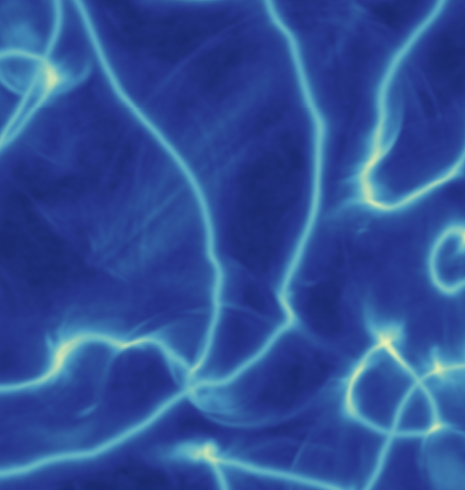
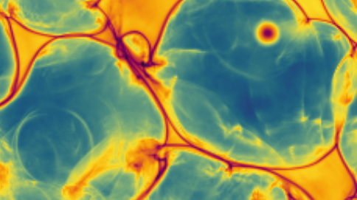
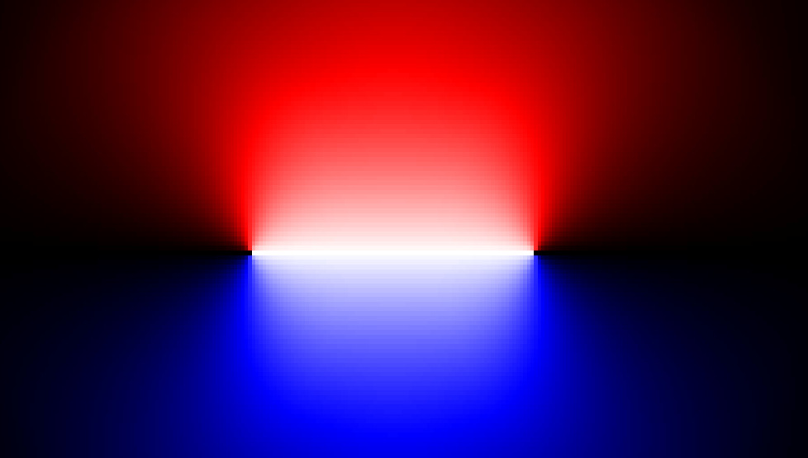
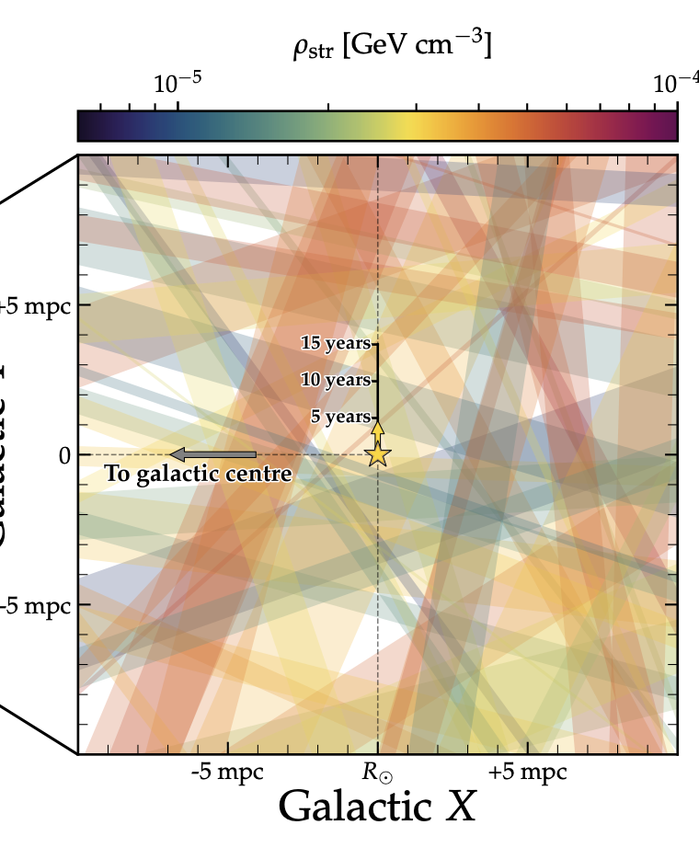
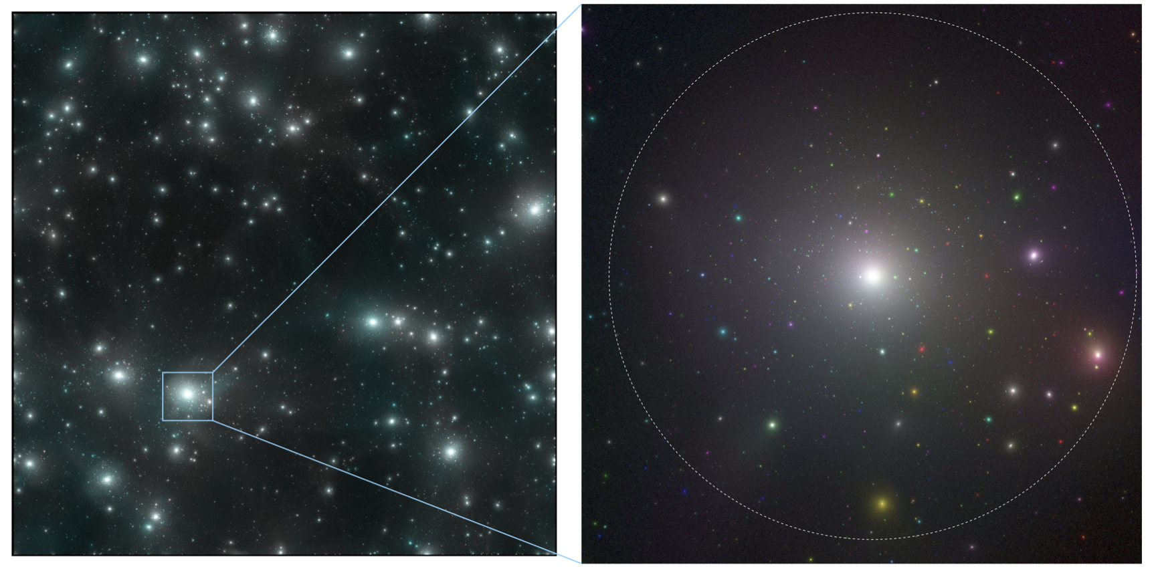
Axion
stringS
  Javier Redondo
  23 September 2025,
  20thPatras Workshop
  La Laguna Tenerife
&
Mini
clusterS

Slide 2
- postiflation (no inflation, Isocurvature?
- predicting axion DM mass, strategies, problems, outcomes
  Axions come from loop explosions
  Moore Effective theory (
- effective theory does not quite work (loops) ... (it does for motion, but spectrum ... NO!)
- miniclusters, smoking gun (core?)
- cores, axitons?
- streams and signal
- jaxions code/ AMR

Slide 3



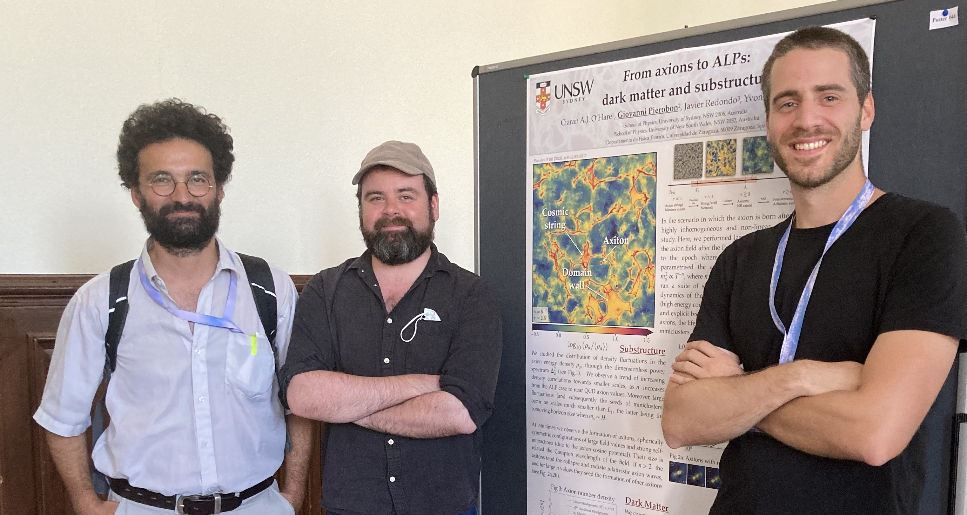

based on :
Many in preparations ...
2401.17253 [hep-ph] Spectrum of global string networks and the axion dark matter mass
2311.17367 [hep-ph] Axion Minicluster Streams in the Solar Neighborhood
2307.09941 [hep-ph] Miniclusters from axion string simulations
2212.00560 [hep-ph] Axion minivoids and implications for direct detection
2204.13187 [hep-ph] Structure of axion miniclusters
2112.05117 [hep-ph] Simulations of axionlike particles in the postinflationary scenario
1911.09417 [astro-ph.CO] First Simulations of Axion Minicluster Halos
1809.09241 [astro-ph.CO] Early Seeds of Axion Miniclusters
in collaboration with :
Alejandro Vaquero, Mathieu Kaltschmidt, Ivan Rybak (Zaragoza U), Kenichi Saikawa (Kanazawa U.)
Giovanni Pierobon, YYY Wong (South Wales U) Ciaran O'Hare (Sidney U)
Kierthika Chathirathas, Thomas Schwetz (IAP, Karlsruhe),
Guy Moore (Darmstadt U.), Benedikt Eggemeier, Bodo Schwabe, David Ellis, Jens Niemeyer (Göttingen U) Klaus Dolag (Munich Obs.)
David Marsh (KCLondon)
Notes:
It is interesting to note that the required PQ symmetries can be very esily embedded in extensions of the SM and they appear generically in string theory.
Perhaps the axion is even a requirement of QG as a theory with different "choices" of non-dynamical theta could lead to de-Sitter vacua, which are strictly inconsistent.
Unfortunately, the accesible LE phenomenology is largely insensitive to the concrete theory as the EFT is mostly determined from the U(1) symmetry. This implies that axions (as well as other similar particles) have a concrete set of possible interations with SM, which we can use to test the Dm hypothesis.
Among those, the most relevant turns out to be the coupling to photons.

Slide 6
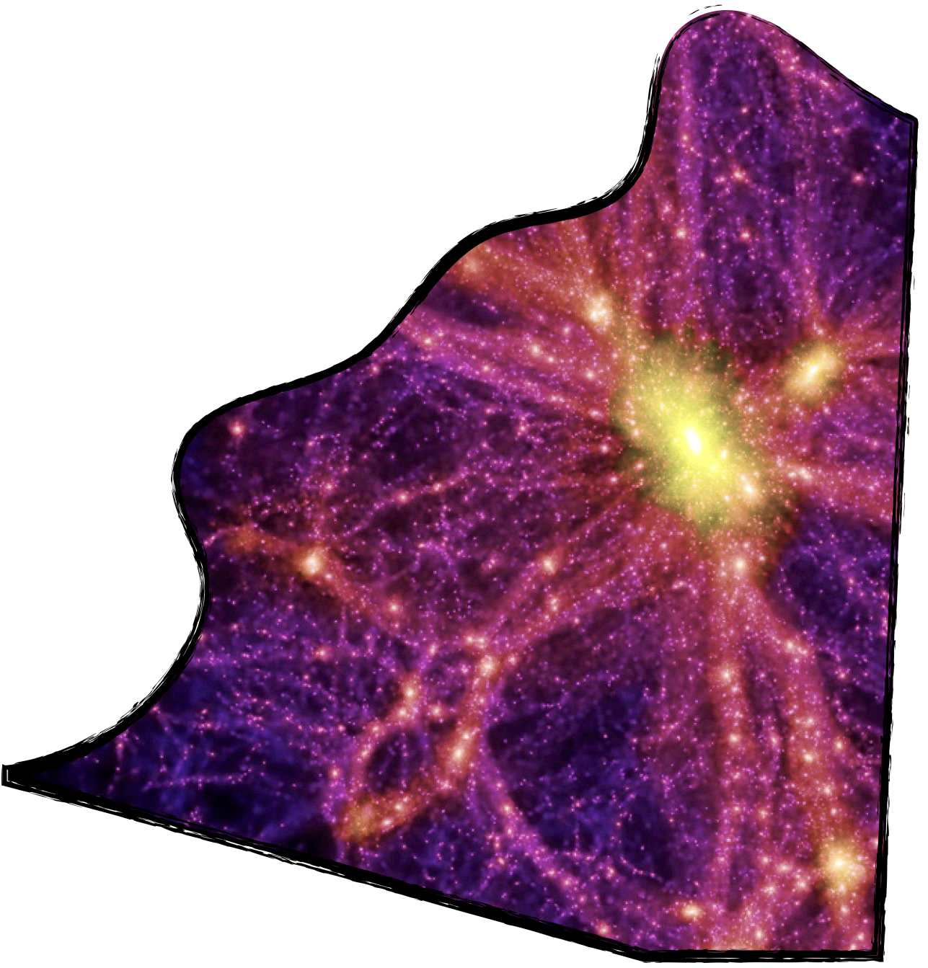
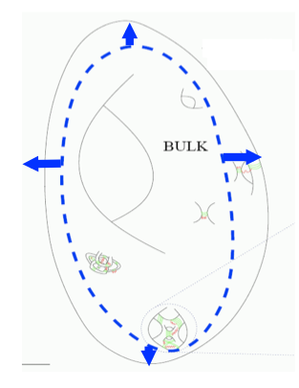
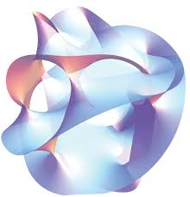
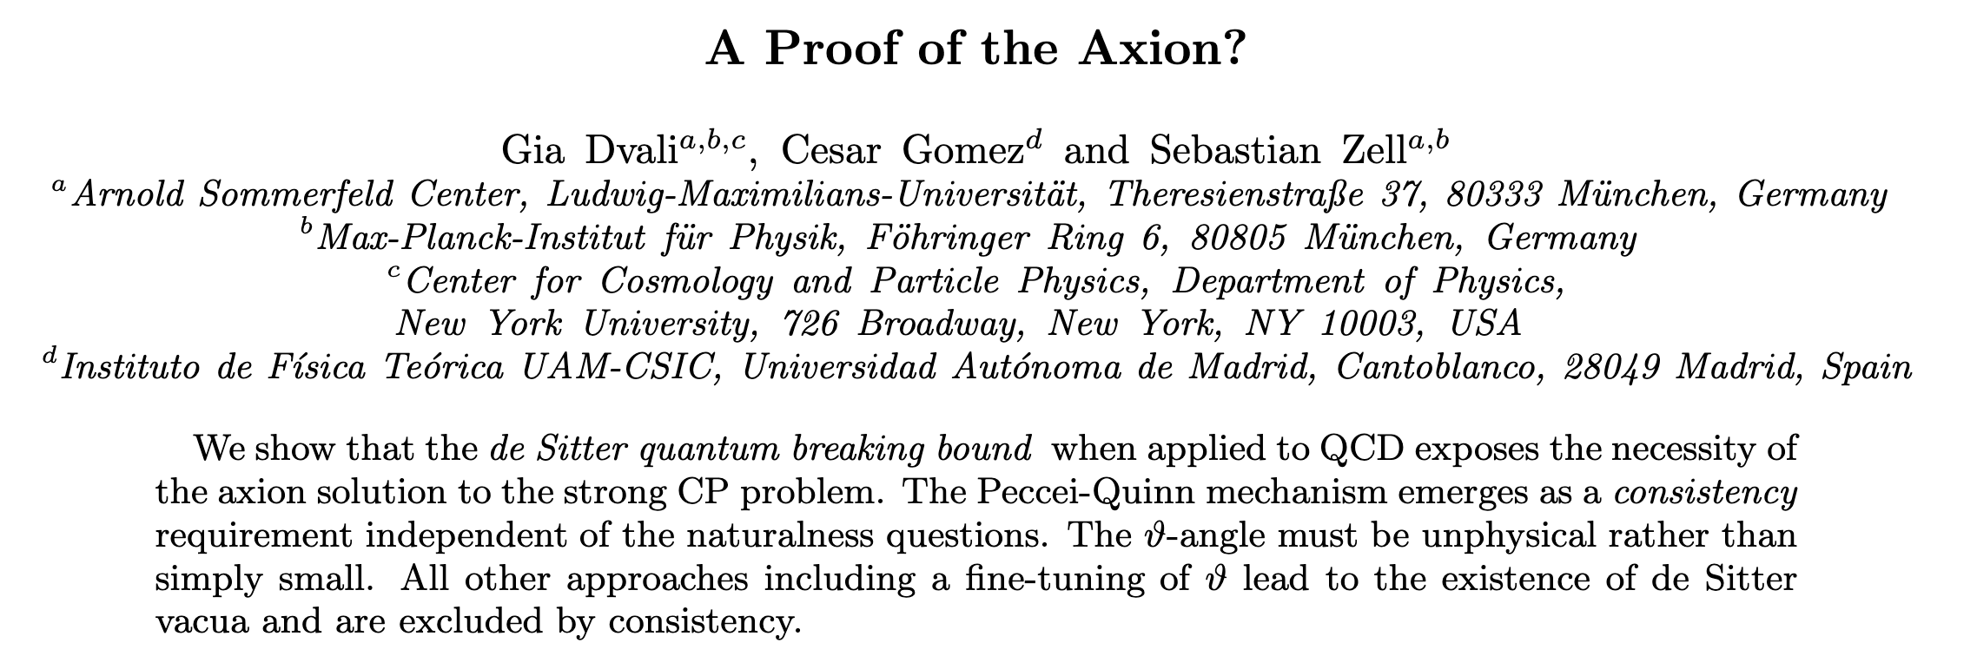
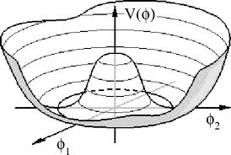
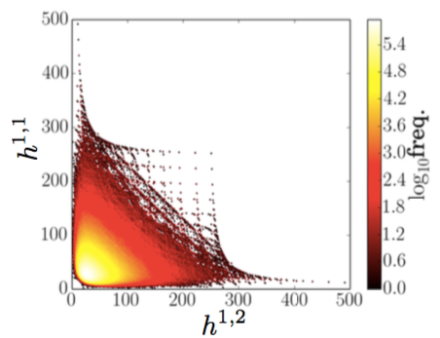
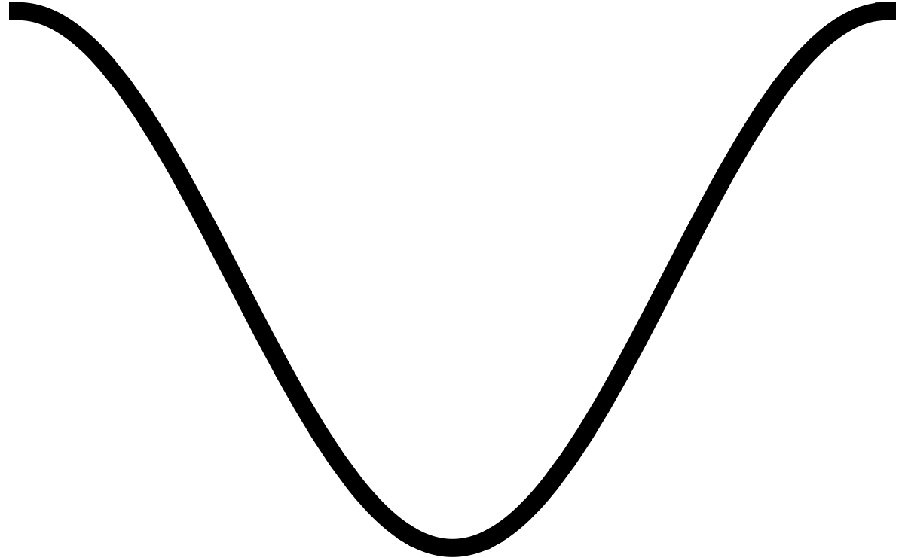





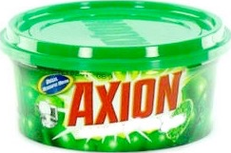


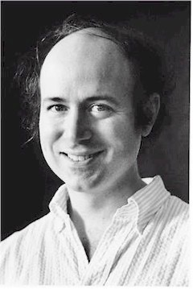



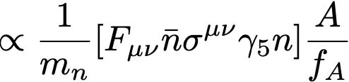
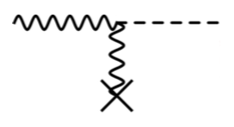
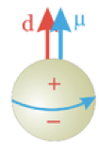
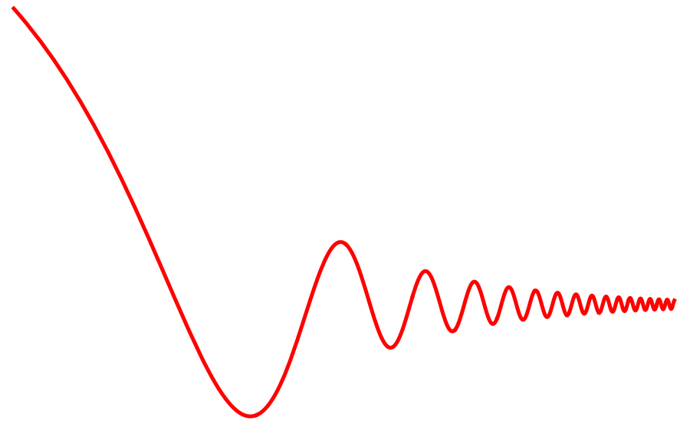

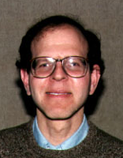


Motivation: axions and axion-like particles beyond the SM
- Axions and "axion-like" particles are generic in BSM + compatible with SUSY, GUTs and String Theories
pseudo Goldstone Bosons
stringy axions
- The QCD axion might be a requirement of quantum gravity
- Im parts of moduli fields (control sizes)
- Global symmetry spontaneously broken
QCD vacuum energy
- O(100) candidates in typical compactifications
- masses from non-perturbative effects
Examples: QCD mesons, ..., QCD axion, Majoron, R-axion, Familon ...
COLD DARK MATTER
- Axion couplings with SM particles are also generic (shift-symmetry determines leading interactions)
CP Neutron electric dipole
3 - Relic oscillations of the axion-field ...
photon coupling
electron coupling
nucleon coupling
generated by QCD!
X
J. Preskill
M. Wise
F. Wilczek
W. Fischler
M. Dine
P. Sikivie
Notes:
It is interesting to note that the required PQ symmetries can be very esily embedded in extensions of the SM and they appear generically in string theory.
Perhaps the axion is even a requirement of QG as a theory with different "choices" of non-dynamical theta could lead to de-Sitter vacua, which are strictly inconsistent.
Unfortunately, the accesible LE phenomenology is largely insensitive to the concrete theory as the EFT is mostly determined from the U(1) symmetry. This implies that axions (as well as other similar particles) have a concrete set of possible interations with SM, which we can use to test the Dm hypothesis.
Among those, the most relevant turns out to be the coupling to photons.

Slide 7
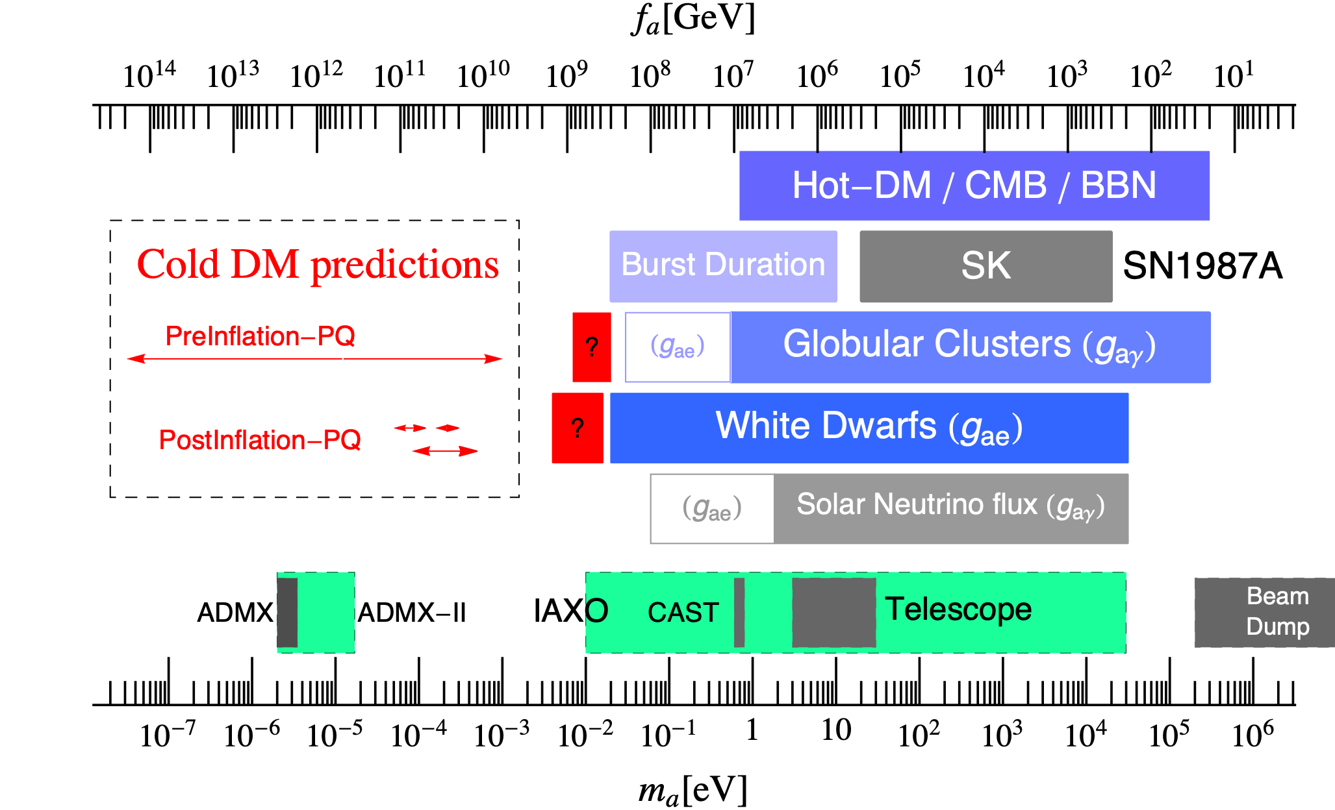




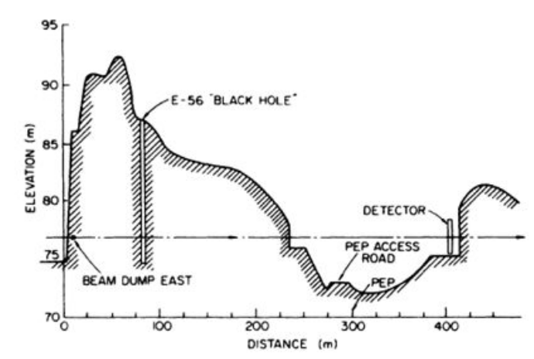

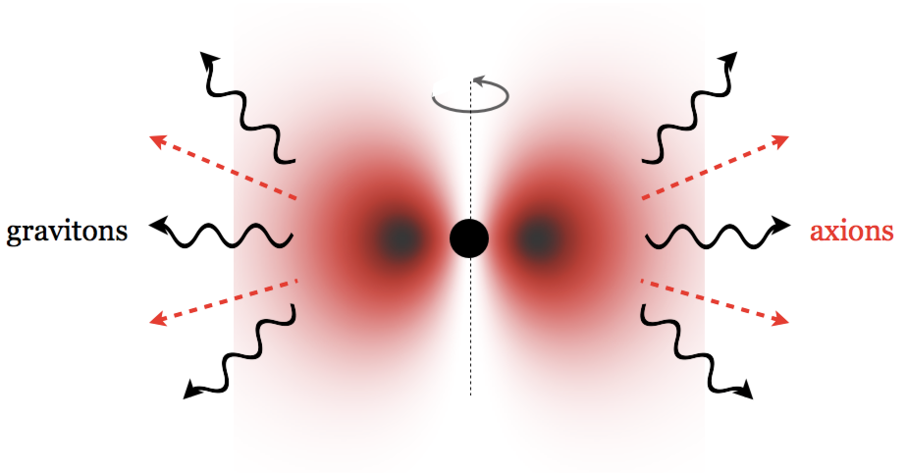
QCD axion ~ One parameter theory: decay constant fA
Less interacting
More interacting
DM
viable
EXCLUDED
Astrophysics
EXCLUDED BHSR
Reactors
Had. dec
beam dumps
Black hole spin radiated
Stellar evolution accelerated*
Notes:
The following graph summarises the status of the knowledge about the axion decay constant, which controls the size of interactions of axions.
Small fa means less suppressed interactions and mass, so much that axions could be effectively radiated from stars altering its evolution.
This is genrally regarded as contrary to observations, except in some interesting borderline situations, so most of the parameter space is excluded although the boundary at meV masses could be preferred.
At the low-masses axions are ultra weakly interacting and very difficult to detect, but they might be prone to gravity effects like the superradiance of black-hole angular momentum if the Schwarzschild radius would coincide with the axion mass. Since BHs with spin are measured, some region of parameter space is disfavoured. This leaves a huge parameter space where axions can be DM.

Slide 8
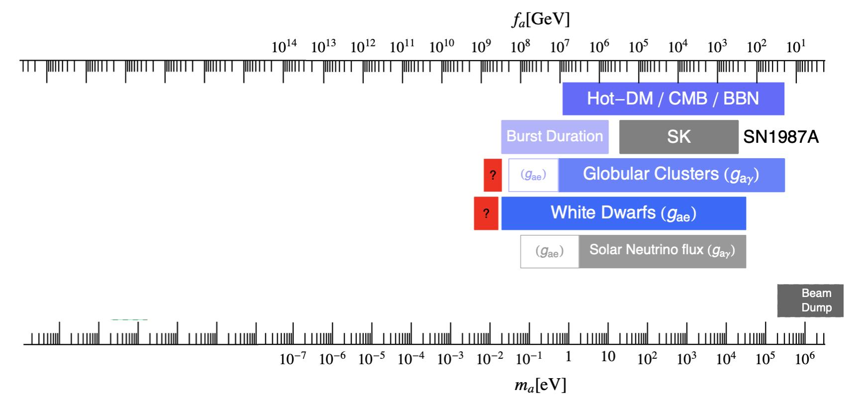
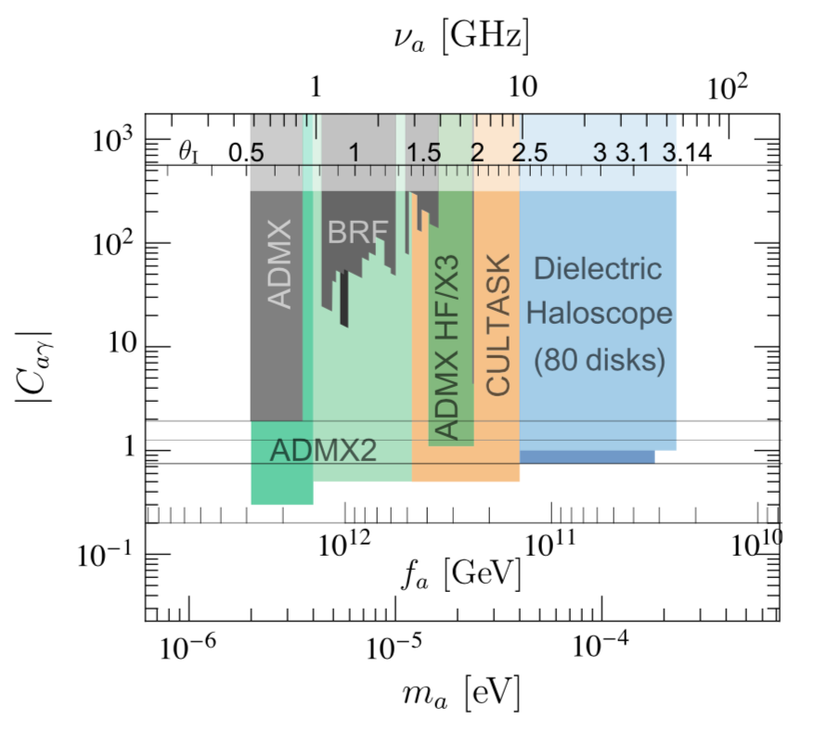
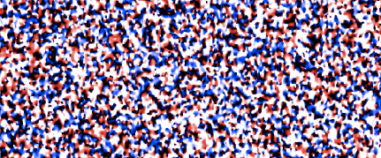





The axion DM mass: two predictions
Less interacting
More interacting
EXCLUDED
Astrophysics
POST-Inflation Scenario
- Axion Initial conditions @ phase transition
- All values of theta -> mass prediction -> Inmediate discovery!
- Inflation BEFORE or NO inflation
- Cosmic strings, walls carry huge energy
- String radiation is uncertain!
- Miniclusters
Excluded (too much DM)
ok
sub
EXCLUDED BHSR
Reactors
Had. dec
PRE-Inflation Scenario
- INFLATION blows one homogeneous patch to our Universe size
- 1 IC for the whole Universe
- Maximum uncertainty, slooooow scaaaaan
- isocurvature and adiabatic (small) fluctuations ...
- Miniclusters???
Anthropic region
Notes:
In this range axions are very light and weakly interacting. The few of them produced thermally are hot DM or radiation but negligible.
The realignment mechanism is non-thermal and produces CDM, with potentially sufficient abundance in all the remaining WIndow.
There is some gain in discussing this further.
Since axions are produced non-thermally, their initial conditions play an important role.
If cosmic inflation happens when the axion is a good degree of freedom, a small causal region where the axion VEV had time to become homogeneous grows to the size of our observable Universe.
By anthropic arguments we can conclude that the IC was such that the DM abundance allowed observers like us in the Universe.
In this case, essentially the allowed range is viable.
On the other hand, if the axion appears as an effective dof after a phase transition AFTER inflation, its IC have to be different in causally disconnected patches of the Universe and the uncertainty over initial conditions is averaged out.
In this case there should be possible to make a prediction of the axion mass that gives the relic density -> this will be extremely important for the detection of axion DM.

Slide 9
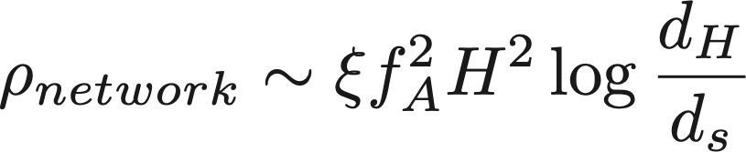
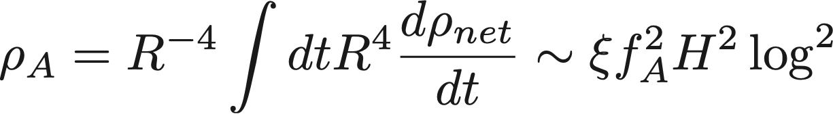
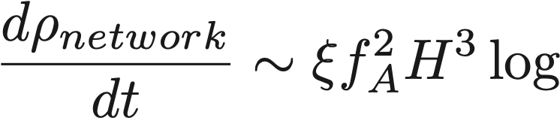
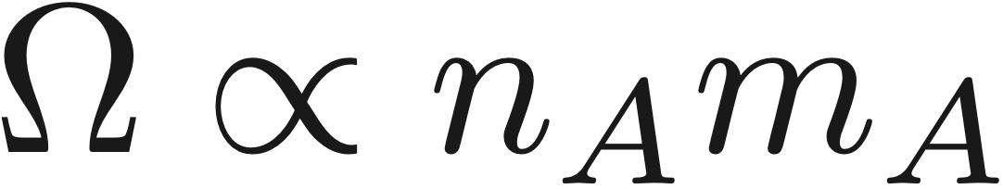
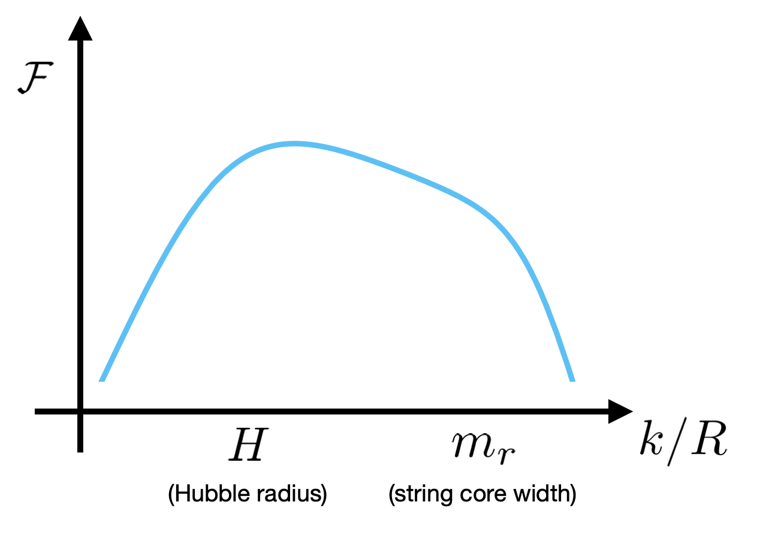
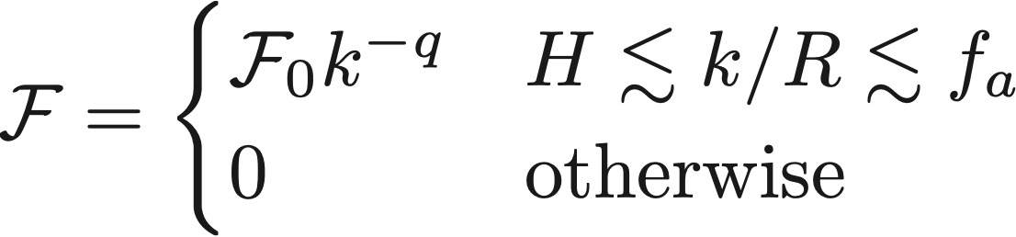

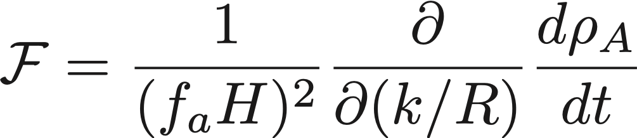
Axions from strings
- String network energy, axion radiation rate, log-enhanced radiated axion density
- BUT DM yield depends on axion NUMBER not energy (energy redshifts into mass)
300 axions of E~m
3 axions of E~m
100 times less DM
300 axions of E~H
3 axions of E~fA
same total E
- Energy dependence of production rate:
Notes:
In the post-inflation scenario, cosmic strings form when the axion is an angular field.
A huge energy is stored in the string gradients that can potentially produce more axions, complicating the estimation of the DM mass.
This can be in pcinciple estimated with numerical simulations although a huge dynamical range is required.
After having almost exhausted the HCP capabilities, we want to develop AMR to improve the dynamical range and pinpoint the axion mass.

Slide 10
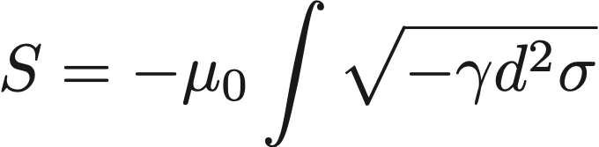
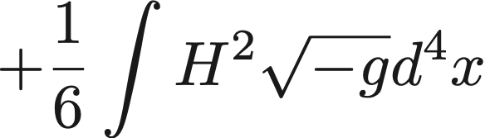
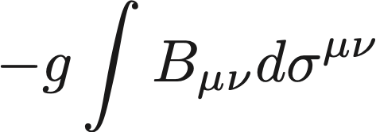
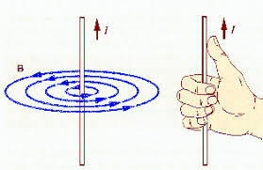



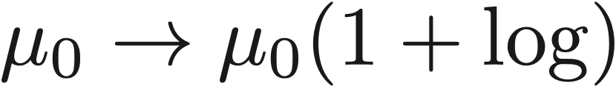
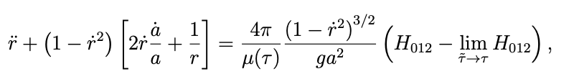
Effective theory
- Nambu-Goto string
+
Kalb-Rammond field
String
Axion
Coupling
- KR field renormalises NG string tension
  Example: circular loop
Dabholkar Quashnock 1990
Nambu Goto LHS
Axion in RHS
KR field in UV is a string, it should be proportional to NG part!
  - Large log limit tends to pure Nambu Goto
large logs suppress effect of KR field in the RHS
renormalised KR field (no UV) has no log
Notes:
In the post-inflation scenario, cosmic strings form when the axion is an angular field.
A huge energy is stored in the string gradients that can potentially produce more axions, complicating the estimation of the DM mass.
This can be in pcinciple estimated with numerical simulations although a huge dynamical range is required.
After having almost exhausted the HCP capabilities, we want to develop AMR to improve the dynamical range and pinpoint the axion mass.

Slide 11
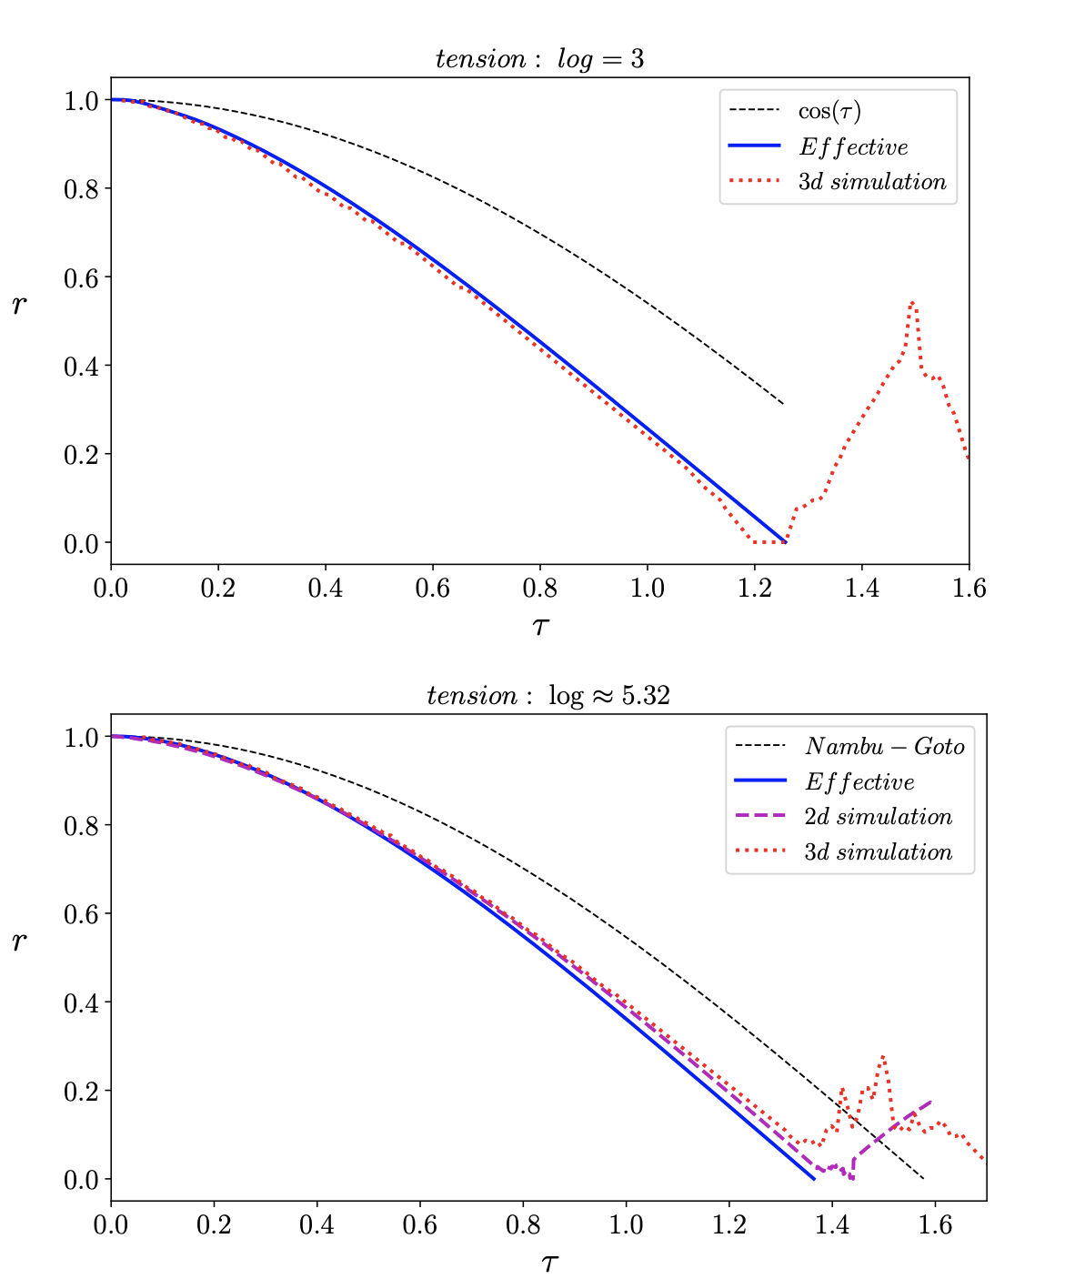
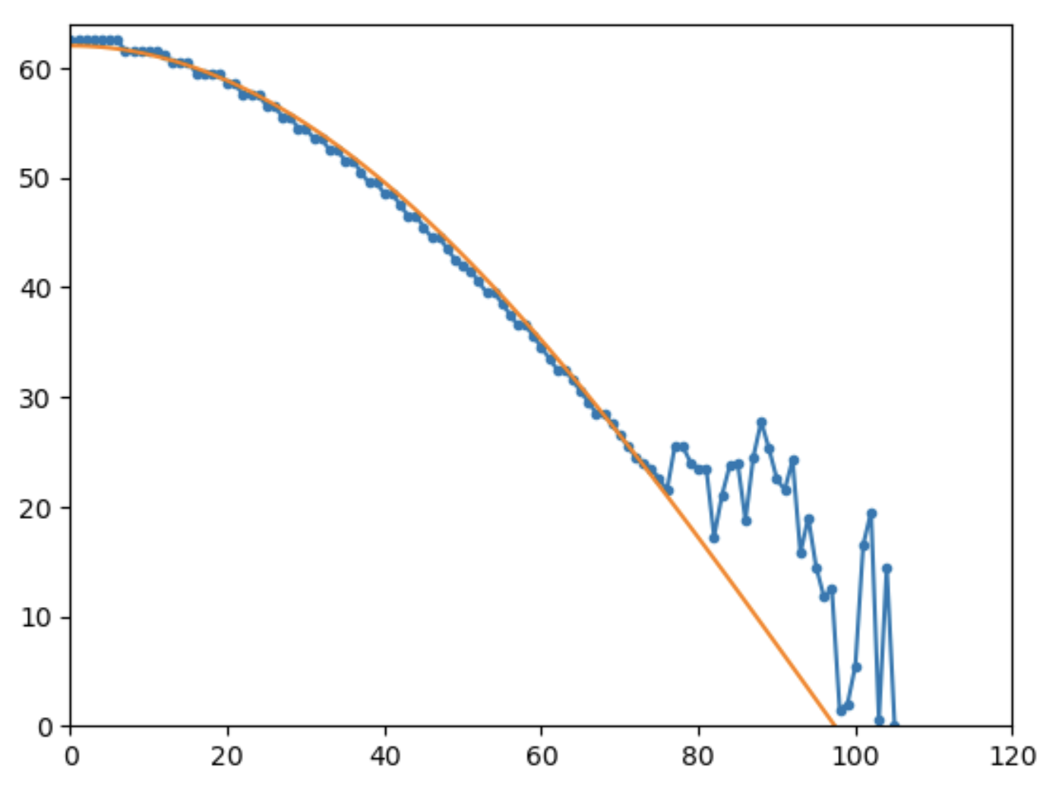
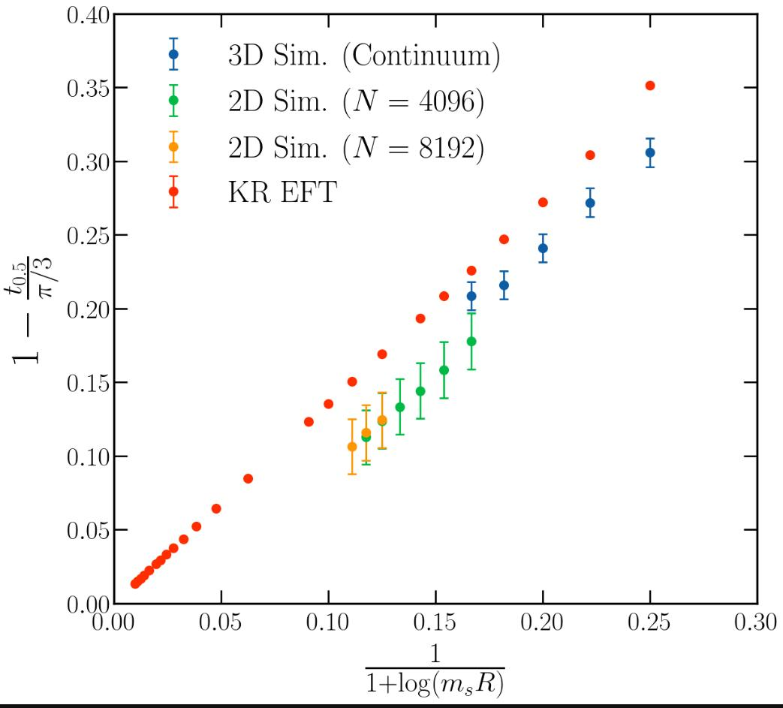
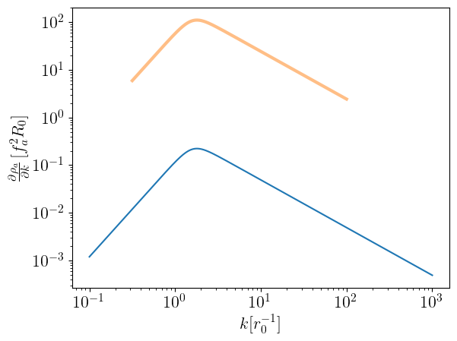
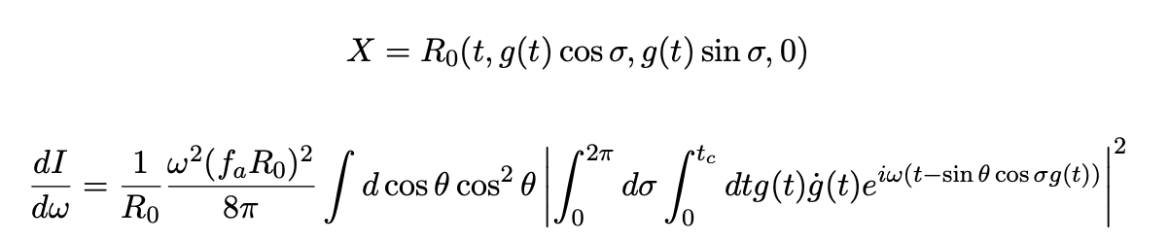




Effective theory vs numerical simulations
- Compare KR EFT with 3D and 2D sims
Guy Moore's large effective tension
Halving time
Similar accelerations
Correct trend towards NG
but some unaccounted diffs...
NG
4,3 log~70
Preliminary
Preliminary
- Loop radiation does NOT agree quantitatively
r
3D Simulation
NG limit
Effective theory (1 oscillation)
time
- Essentially String breaks at 1st collapse
- No significant bounce,
self fields abandoned
Notes:
In the post-inflation scenario, cosmic strings form when the axion is an angular field.
A huge energy is stored in the string gradients that can potentially produce more axions, complicating the estimation of the DM mass.
This can be in pcinciple estimated with numerical simulations although a huge dynamical range is required.
After having almost exhausted the HCP capabilities, we want to develop AMR to improve the dynamical range and pinpoint the axion mass.

Slide 12
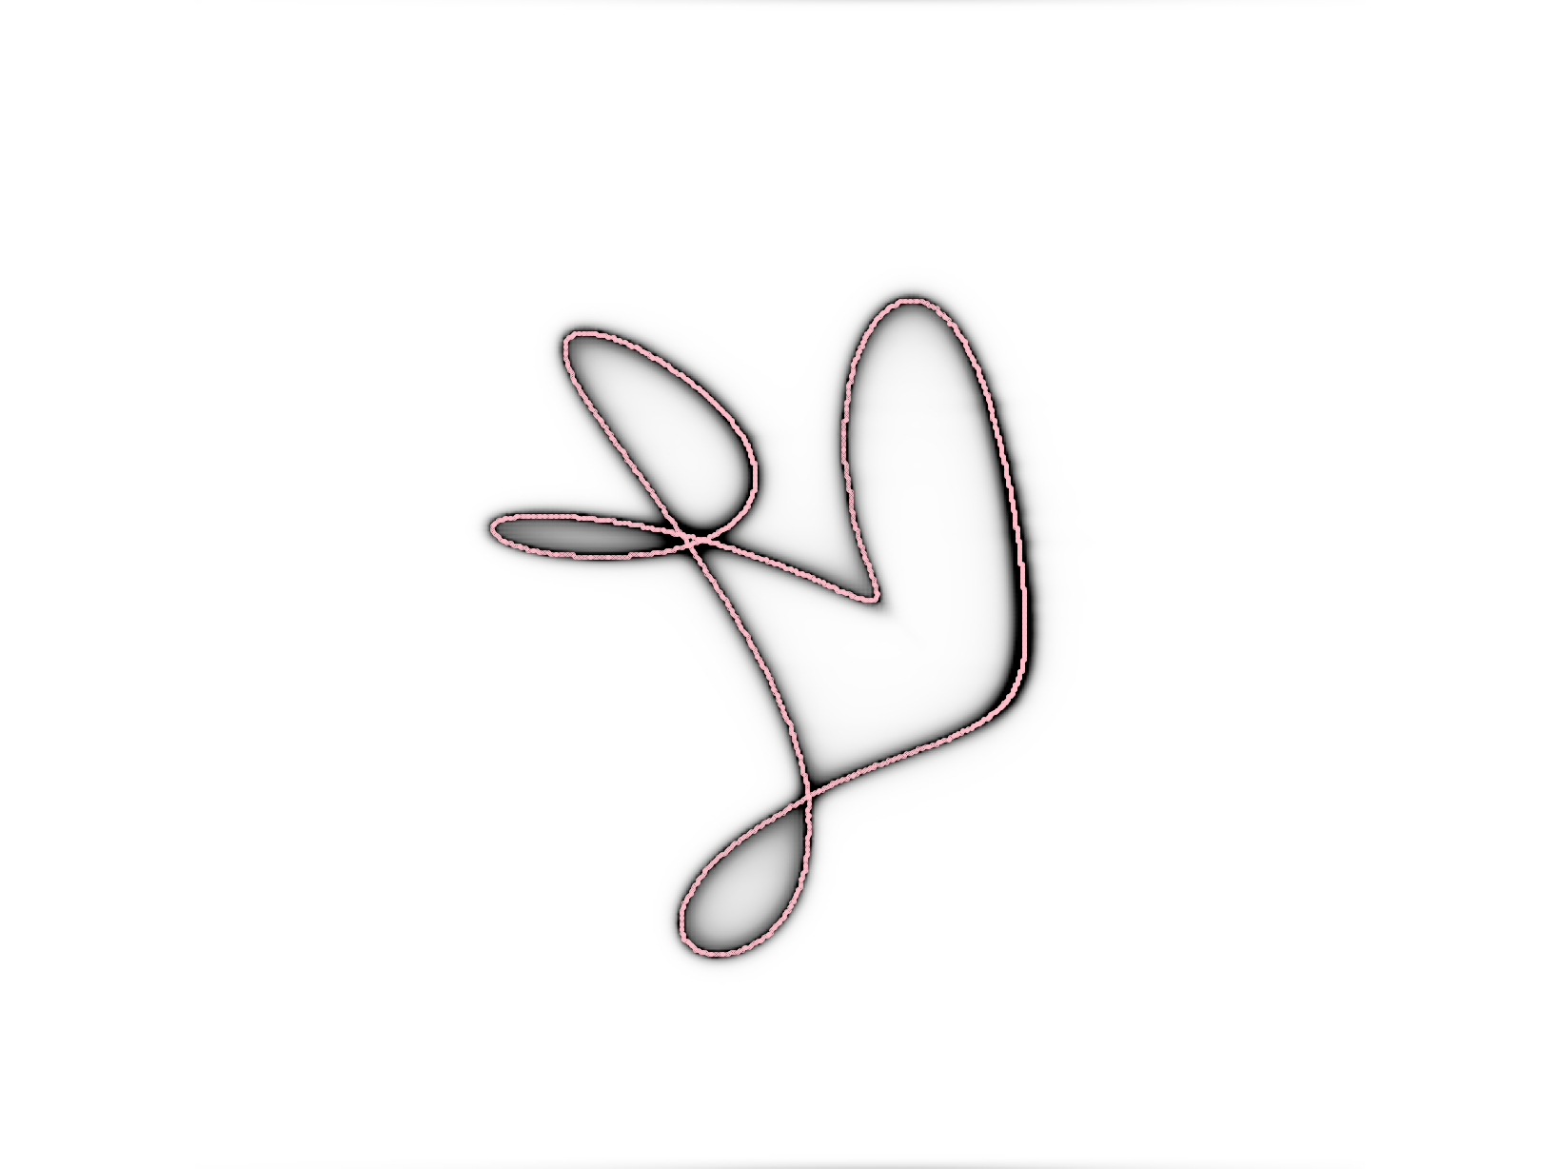

Effective theory vs numerical simulations
- Compare KR EFT with 3D and 2D sims
Similar accelerations
Correct trend towards NG
but some unaccounted diffs...
- Loop radiation does NOT agree quantitatively
- Essentially String breaks at 1st collapse
- No significant bounce,
self fields abandoned
Notes:
In the post-inflation scenario, cosmic strings form when the axion is an angular field.
A huge energy is stored in the string gradients that can potentially produce more axions, complicating the estimation of the DM mass.
This can be in pcinciple estimated with numerical simulations although a huge dynamical range is required.
After having almost exhausted the HCP capabilities, we want to develop AMR to improve the dynamical range and pinpoint the axion mass.

Slide 13
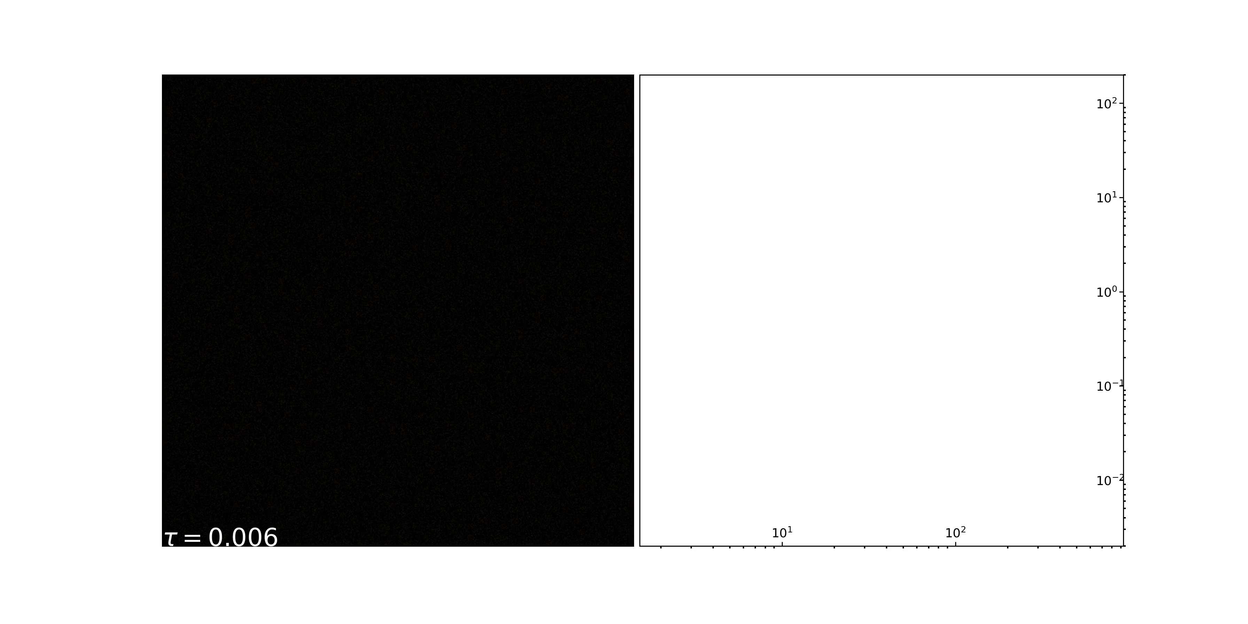



Network simulations
- Causality driven tracking solution identified, q estudied for the whole network by taking derivatives of spectra masking cores
Proyection plot of axion energy density (3D->2D)
Notes:
In the post-inflation scenario, cosmic strings form when the axion is an angular field.
A huge energy is stored in the string gradients that can potentially produce more axions, complicating the estimation of the DM mass.
This can be in pcinciple estimated with numerical simulations although a huge dynamical range is required.
After having almost exhausted the HCP capabilities, we want to develop AMR to improve the dynamical range and pinpoint the axion mass.

Slide 14
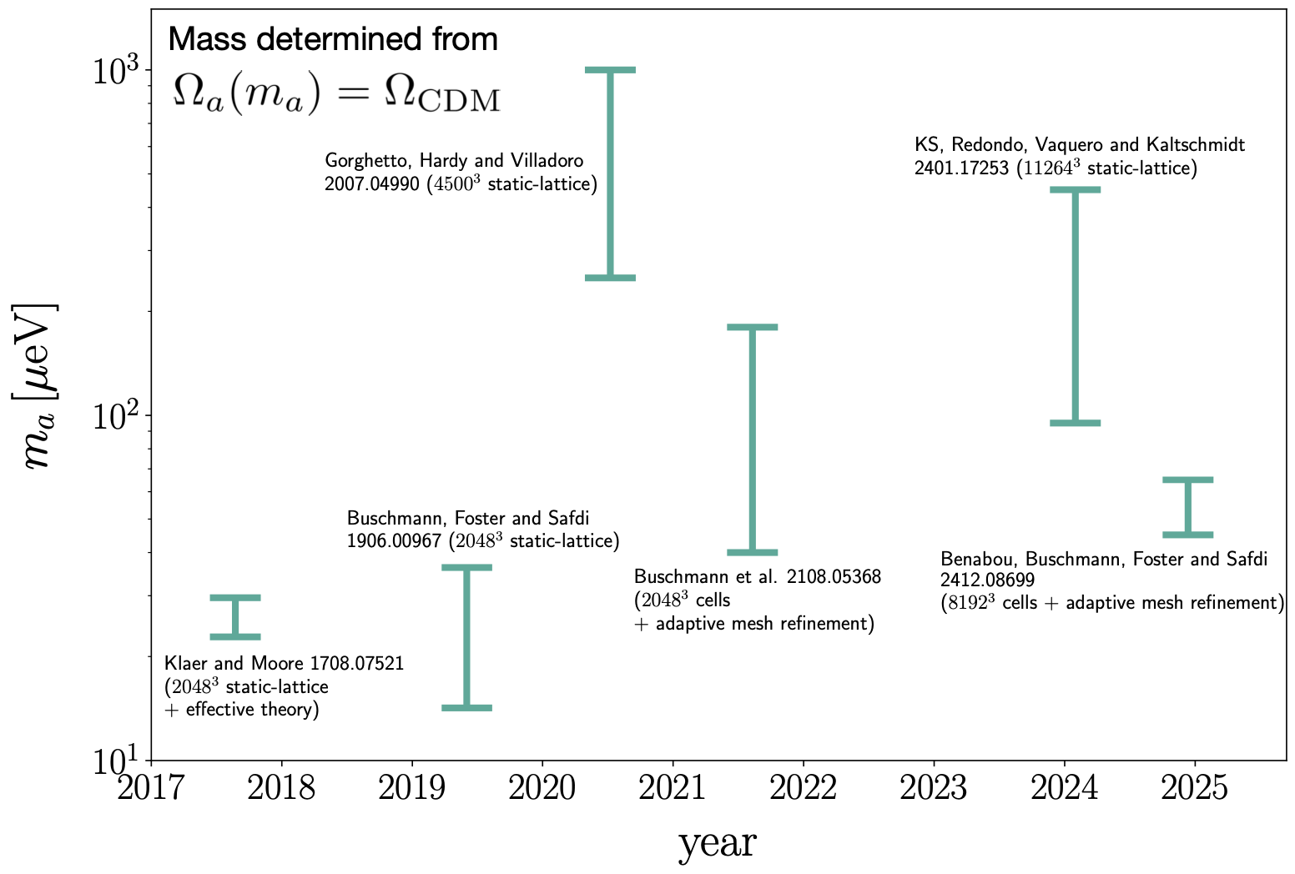
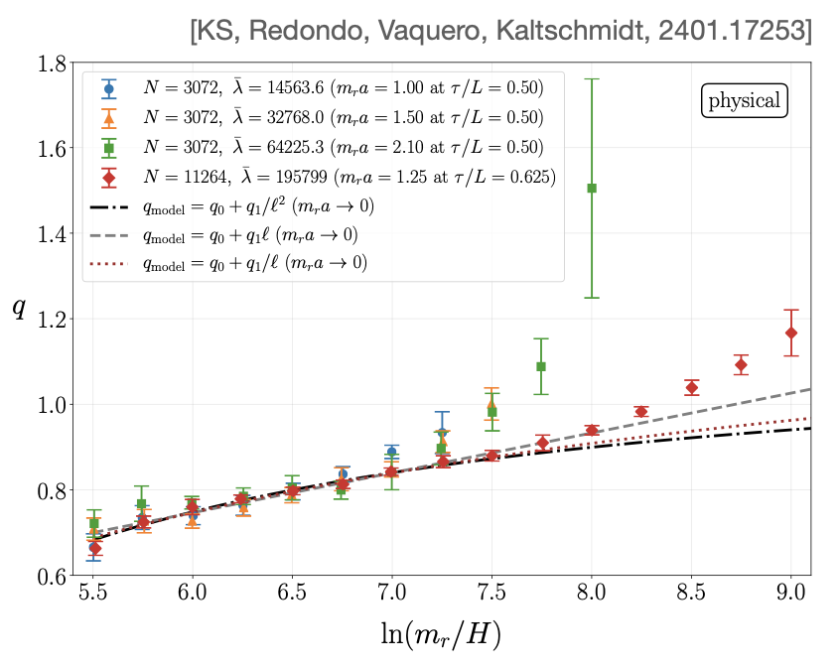
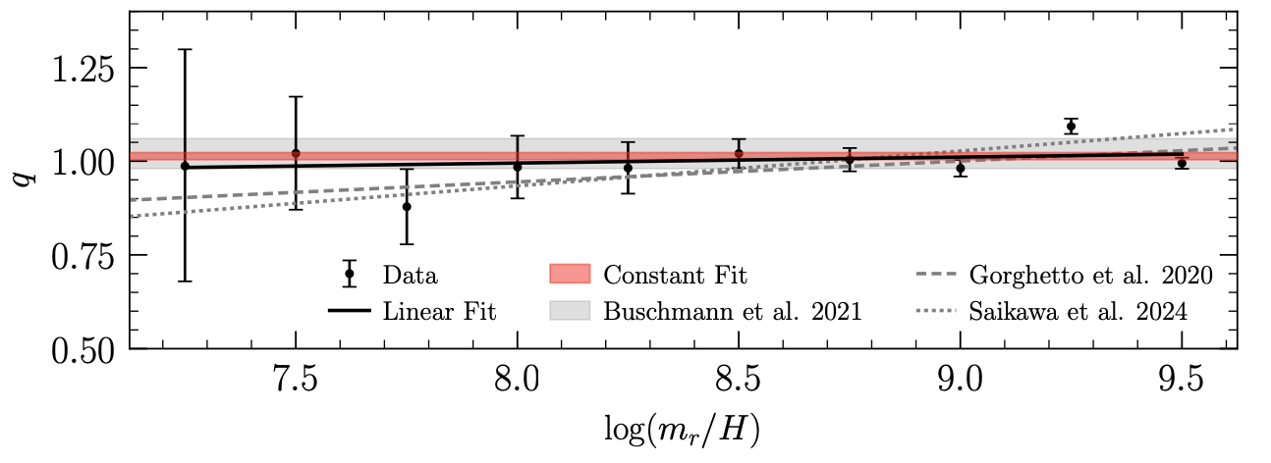
Results
- Summary of results from various groups
Saikawa 25
We found Equally good fits to linearly growing q or q->1
(once discretisation effects are accounted)
- My take:
- Self-fields have q~1
- Abandoned when loops break lead to q~1 axions + UV burst (effective q<1)
- 1 vs growing ... ICs, statistics,
Notes:
In the post-inflation scenario, cosmic strings form when the axion is an angular field.
A huge energy is stored in the string gradients that can potentially produce more axions, complicating the estimation of the DM mass.
This can be in pcinciple estimated with numerical simulations although a huge dynamical range is required.
After having almost exhausted the HCP capabilities, we want to develop AMR to improve the dynamical range and pinpoint the axion mass.

Slide 15
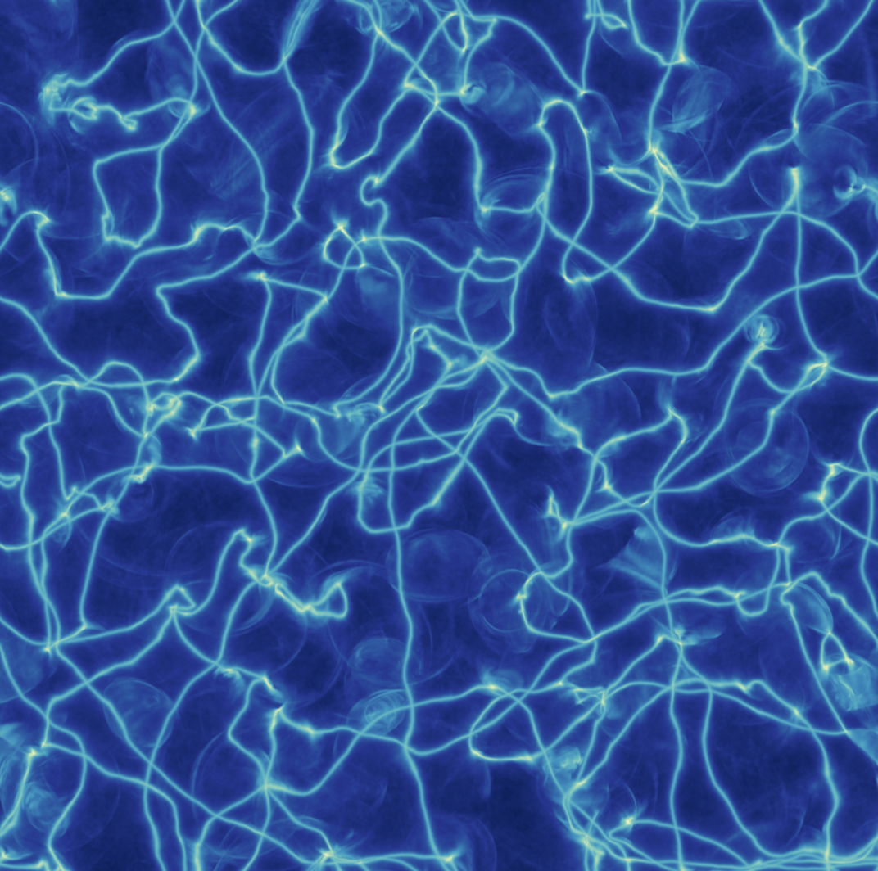





Miniclusters
Scaling
Misalignment
Axitons
Free-stream (RD)
Miniclusters form
hierarchical growth
Galaxy forms with MC halo
Notes:
In the post-inflation scenario, DM is inhomogeneous at small scales (~AU) which prompts the formation of very small halos of axion DM of typical size 10^-12 solar masses.
These MCs could be searched for by micro, pico and femtolensing techniques, allowing to discriminate between different DM models.

Slide 16



Previous work
- low - tension simulations, free-streamed to z~6 -> resampled with particles. GADGET to study gravitational evolution
- Early collapse M~10⁻¹³ Msun M~10⁻¹¹ at equality, then hierarchical merging
- Bound fraction ~ 80%!!!
- Microlensing very hard
First simulations of axion minicluster halos
First sims...
Microlensing
Notes:
In the post-inflation scenario, DM is inhomogeneous at small scales (~AU) which prompts the formation of very small halos of axion DM of typical size 10^-12 solar masses.
These MCs could be searched for by micro, pico and femtolensing techniques, allowing to discriminate between different DM models.

Slide 17


minivoids
- 80% of the axions in small MCs is very bad news ... what is the void density relevant to experiments??
- voids defined to be delta<-0.7, average density converges to ~8%, 80% of the volume
- Experiments in Post-inflation scenario are less sensitive?
rescaling sensitivites of haloscopes
Notes:
In the post-inflation scenario, DM is inhomogeneous at small scales (~AU) which prompts the formation of very small halos of axion DM of typical size 10^-12 solar masses.
These MCs could be searched for by micro, pico and femtolensing techniques, allowing to discriminate between different DM models.

Slide 18


@ galaxy formation
- what is the expected distribution of axion DM today?
- MCs extremely difficult to encounter ...
- MCs can get disrupted in stelar encounters forming DM streams
- Montecarlo evolution of streams with initial distributions from simulation
the local neighbourhood is expected to have ~1000 faint streams
and the average density is 70-90% from the homogeneous expectation
isolated MCs tend to survive, more massive (bigger, less dense) merged halos get disrupted
MCs have two populations, MCs and MChalos
Notes:
In the post-inflation scenario, DM is inhomogeneous at small scales (~AU) which prompts the formation of very small halos of axion DM of typical size 10^-12 solar masses.
These MCs could be searched for by micro, pico and femtolensing techniques, allowing to discriminate between different DM models.

Slide 19



Uncertainties in axion spectrum translate into minicluster uncertainties
- 3 types of early Universe simulations: low tension (log~7) high tension (Moore) and extrapolated axion configuration using q=2
- Bound fraction, void density does not change
- q>1, xi>>13 push fluctuations towards UV (up to 2 ord. of mag!)
- halos have lower masses, less microlensing likely!
High density networks and non-linearities if q>1
push the densitiy fluctuations towards the UV
HALO MASS FUNC: less power at small k, fewer massive halos!
Notes:
In the post-inflation scenario, DM is inhomogeneous at small scales (~AU) which prompts the formation of very small halos of axion DM of typical size 10^-12 solar masses.
These MCs could be searched for by micro, pico and femtolensing techniques, allowing to discriminate between different DM models.

Slide 20


Miniclusters in the pre-inflation scenario
- In both, large misalignment and kinetic misalignment scenarios, small density fluctuations can grow exponentially
- Adiabatic fluctuations in KM prop. to initial velocity
- Amplification at "trapping" depends on initial angle too!
- small fA requires large velocity -> large amplification > miniclusters
- density fluctuations O(1) (fragmentation of the condensate)
- @ smaller scales than typical misalignment, similar to q>1 scenario!
- microlensing not easier...
- might be difficult to disentangle both scenarios from MCs
- axitons and domain walls can form too
Arvanitaki, Co, Eroncel,etc...
The correct relic density can be obtained for several values of initial
misalignment angle and velocity
Notes:
In the post-inflation scenario, DM is inhomogeneous at small scales (~AU) which prompts the formation of very small halos of axion DM of typical size 10^-12 solar masses.
These MCs could be searched for by micro, pico and femtolensing techniques, allowing to discriminate between different DM models.

Slide 21
Conclusions
- Axions (and similar ALPs) are well motivated DM candidates
- We can predict the axion DM mass in the pre-inflationary scenario if we solve the axion string radiation problem
- Latest simulations point to O(10) uncertainty
- Minicluster sizes have O(100) uncertainty in mass, but other very rubust properties
- Miniclusters in the pre-inflationary scenario can have similar phenomenology, but always at relatively large masses.

Slide 22
T
Axion
stringS
H
A
  Javier Redondo
  23 September 2025,
  20thPatras Workshop
  La Laguna Tenerife
&
K
S
Mini
clusterS

Slide 23

Vacap

Slide 24

Atractor

Slide 25



Conformal networks
- Make log constant by
- log dependent scaling!
- model predicts Phys. and PRS atractors

Slide 26

DM mass prediction
- different assumptions
different extrapolations

