Slide 1
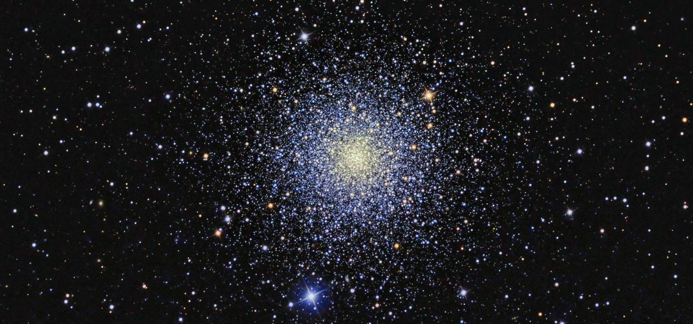
Olga Ryutina, George Gontcharov, Sergey Troitsky
Institute for Nuclear Research of the Russian Academy of Sciences, 22-12-00253
20th Patras Workshop on Axions, WIMPs and WISPs, 2025
Olga Ryutina, George Gontcharov, Sergey Troitsky
Institute for Nuclear Research of the Russian Academy of Sciences, 22-12-00253
20th Patras Workshop on Axions, WIMPs, and WISPs, 2025

Slide 2
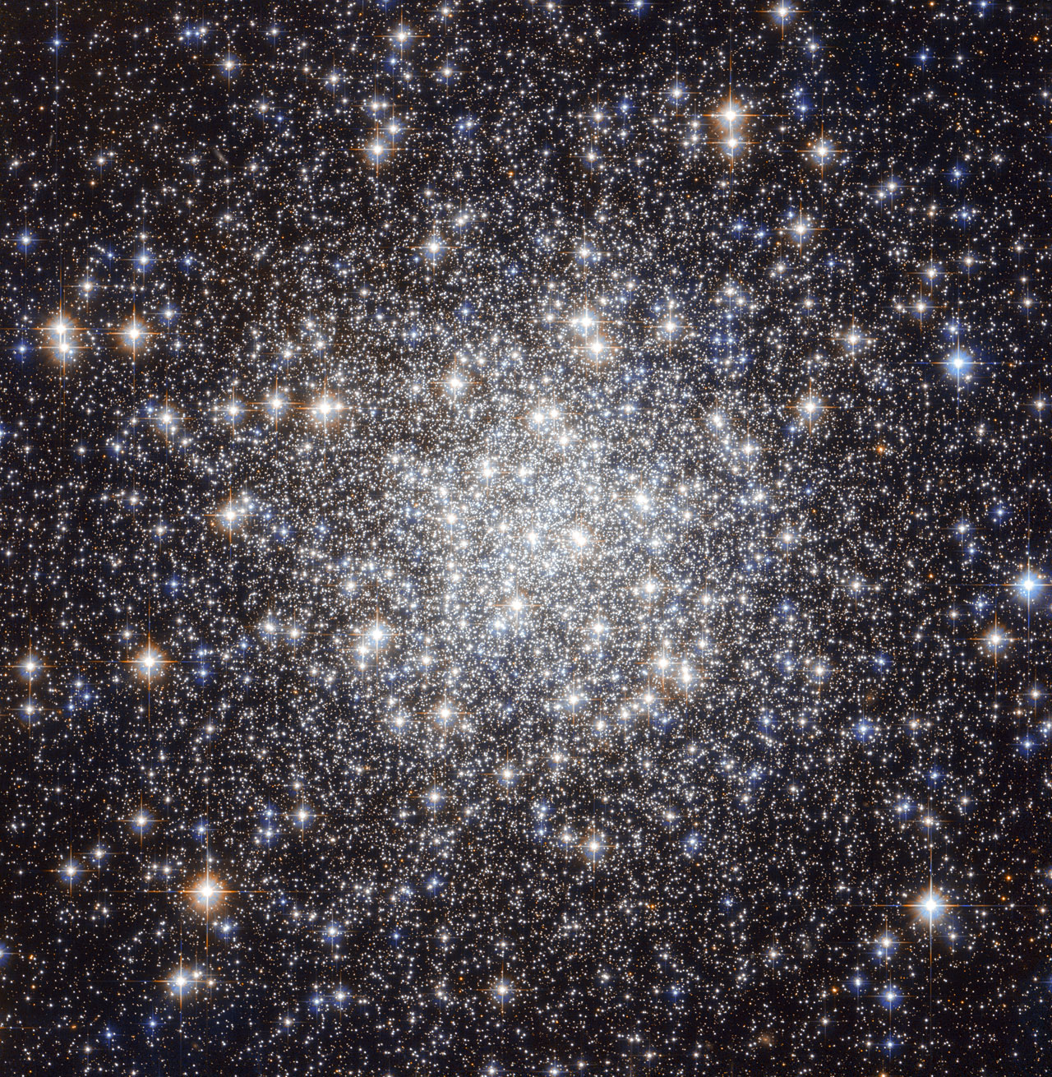
Globular clusters as probes of new physics
35 Galactic globular clusters
Photometry: Stetson + Gaia DR3 + HST
Cross-identification → reliable membership lists
Clean CMDs → cluster parameters
https://esahubble.org/images/archive/category/starclusters

Slide 3
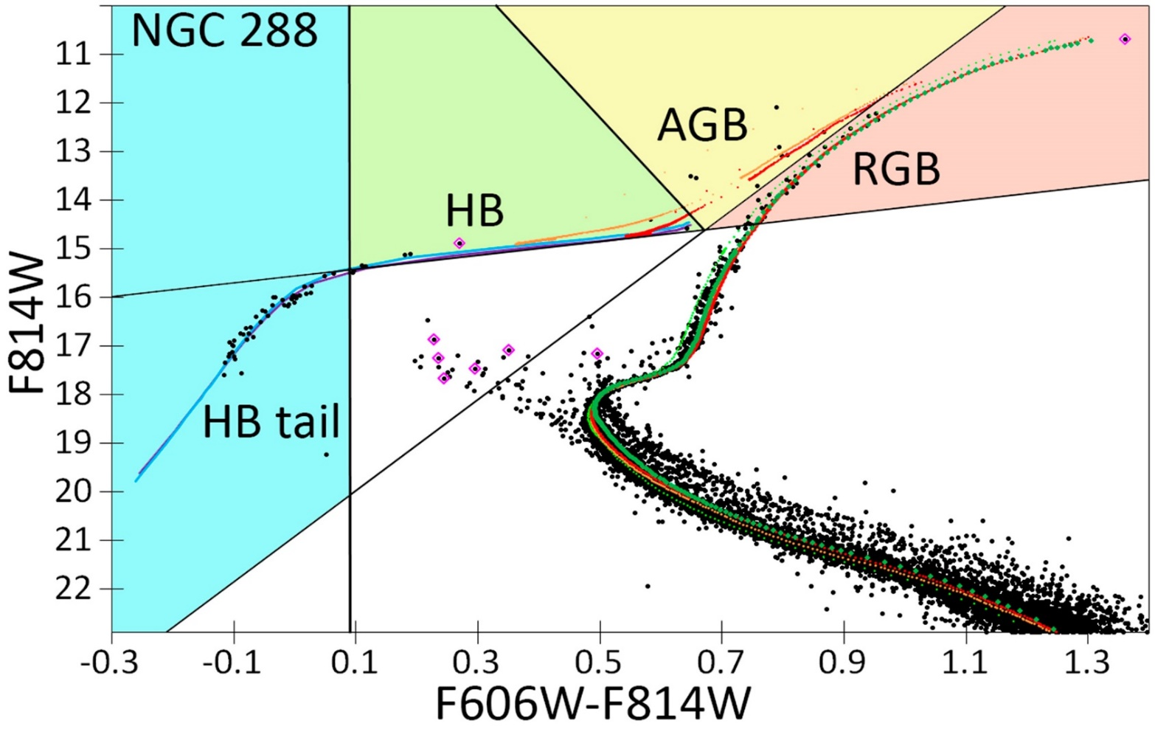
Stellar cooling by new particles
Axions & neutrinos → extra cooling
TRGB luminosity → gₐₑ, μν
HB/RGB ratio (R parameter) → gₐγ

Slide 4
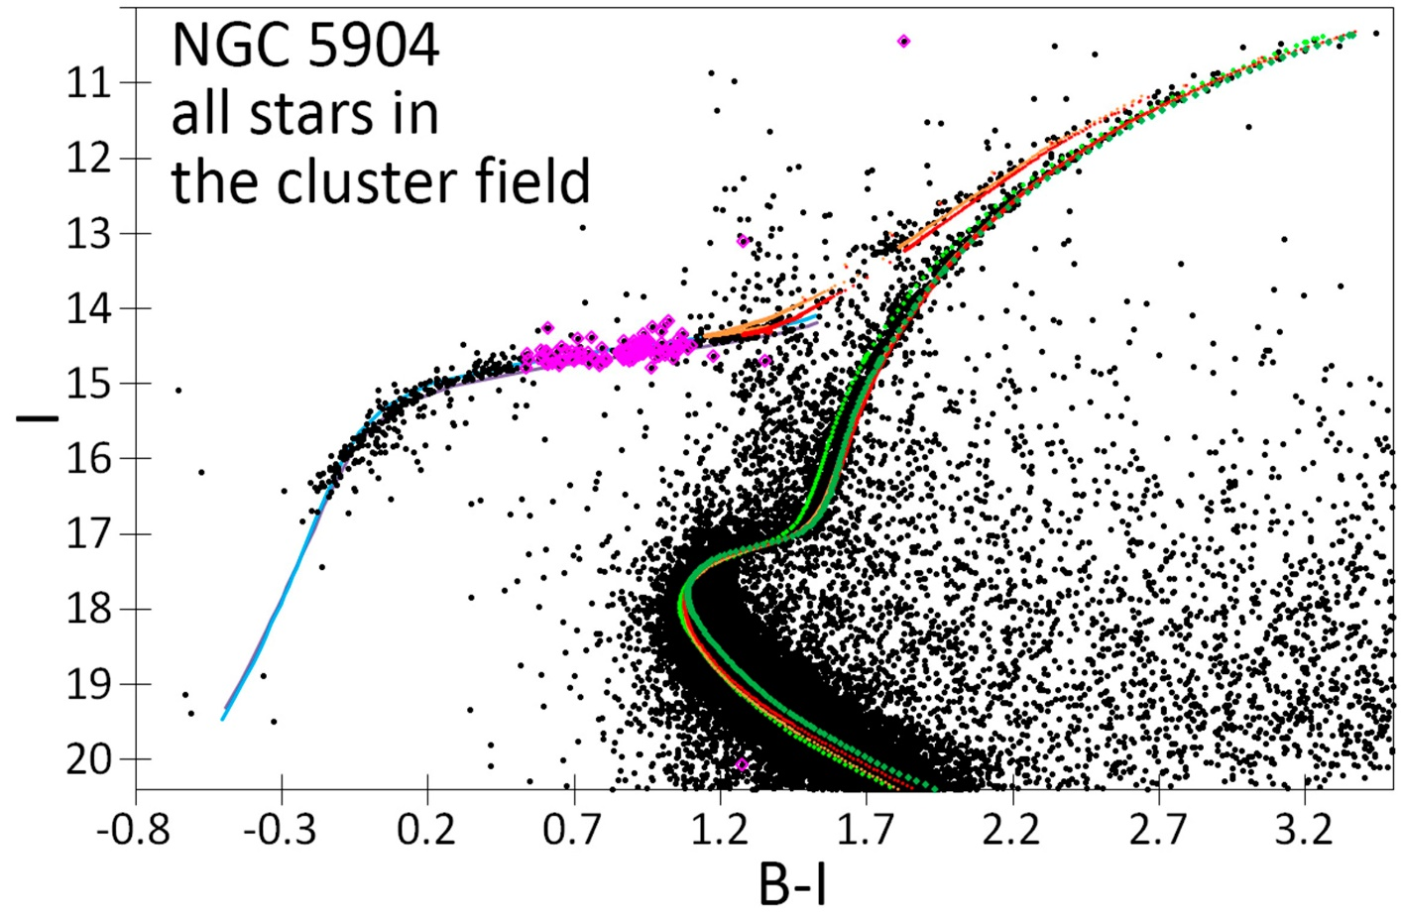
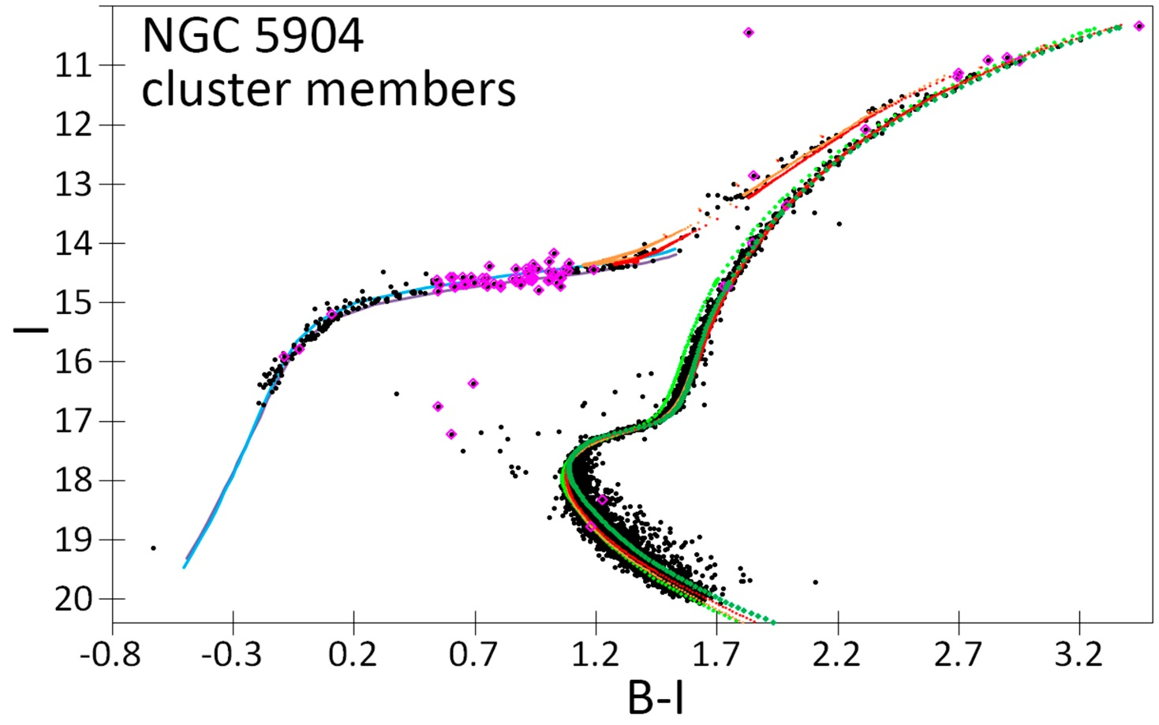
Preliminary results
NGC 5904: clean CMD → well-defined TRGB
TRGB: –4.17 ± 0.13 → –4.01 ± 0.10 from observations vs -3.99 ± 0.07 from theory

Slide 5
Preliminary results
No sign of gₐₑ or μν
Mild preference for non-zero gₐγ
Next: 35 clusters + refined helium

Slide 6
Thank you for your attention!
Contact: o.ryut1010@gmail.com, georgegontcharov@yahoo.com, st@inr-otf.ru

