Slide 1



Status of the Cosmic Axion Spin Precession Experiment
Jonathan Agil
20th Patras Workshop on Axions, WIMPS and WISPS
22-26 September 2025

Slide 2
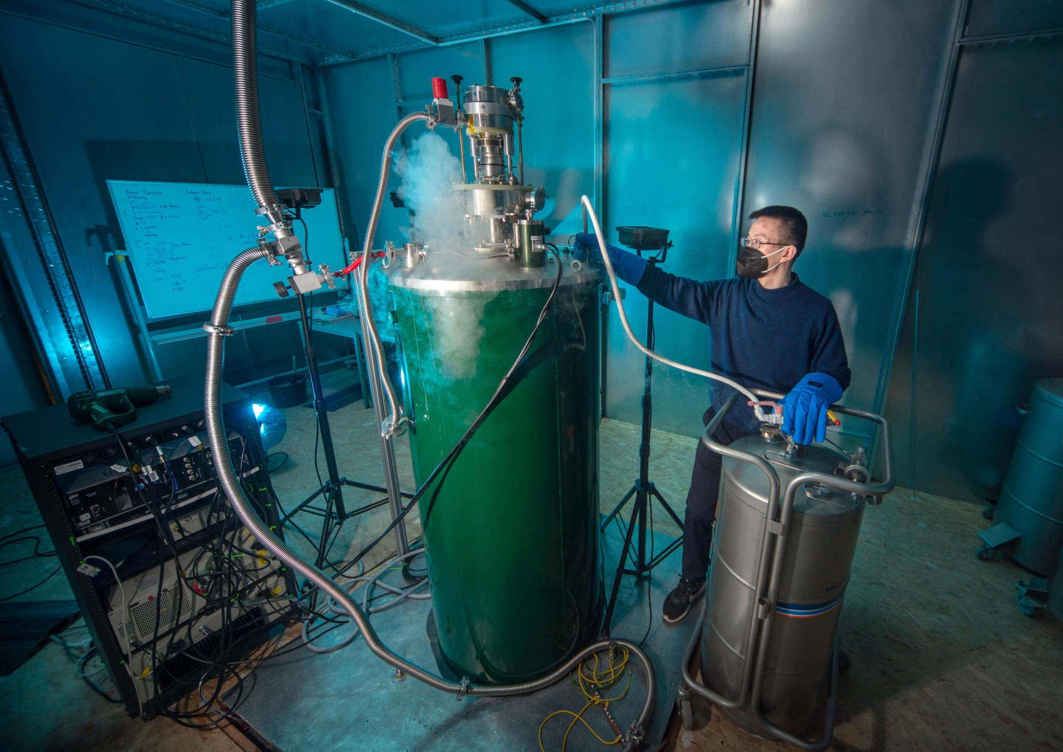
Outline
Introduction
Status of Low Field CASPEr
Status of High Field CASPEr
Summary
2

Slide 3
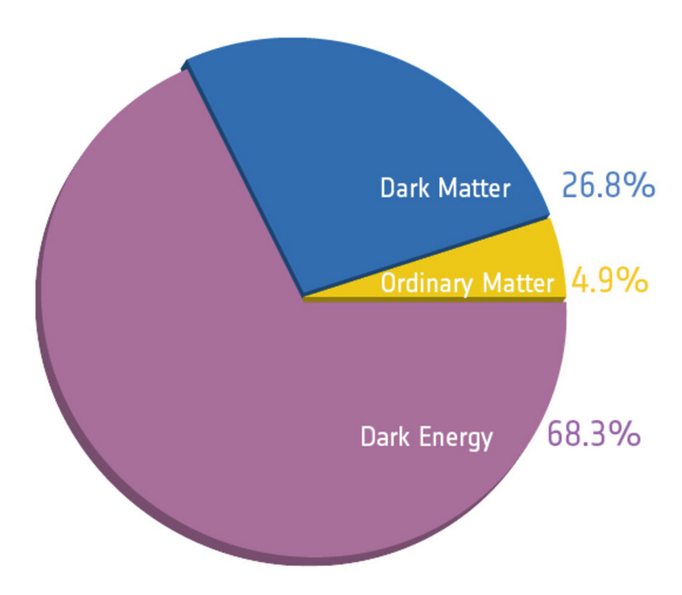
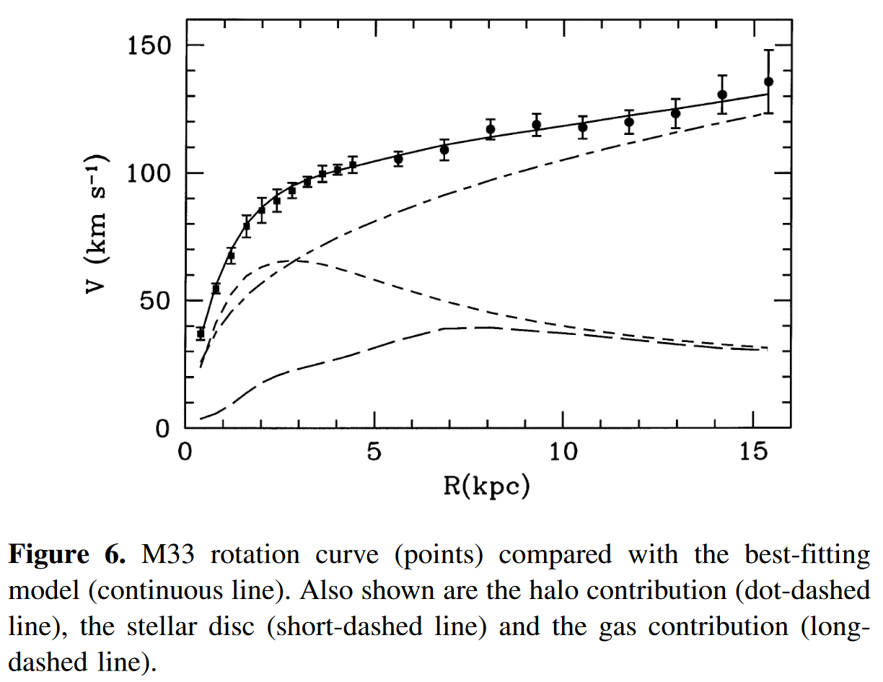
Dark matter?
Observational puzzle
https://www.esa.int/ESA_Multimedia/Images/2013/03/Planck_cosmic_recipe
Other evidence: velocity dispersion of elliptical galaxies, gravitational lensing, cosmic microwave background, …
Corbelli E., Salucci P., MNRAS (2000) 311 441-447
3

Slide 4
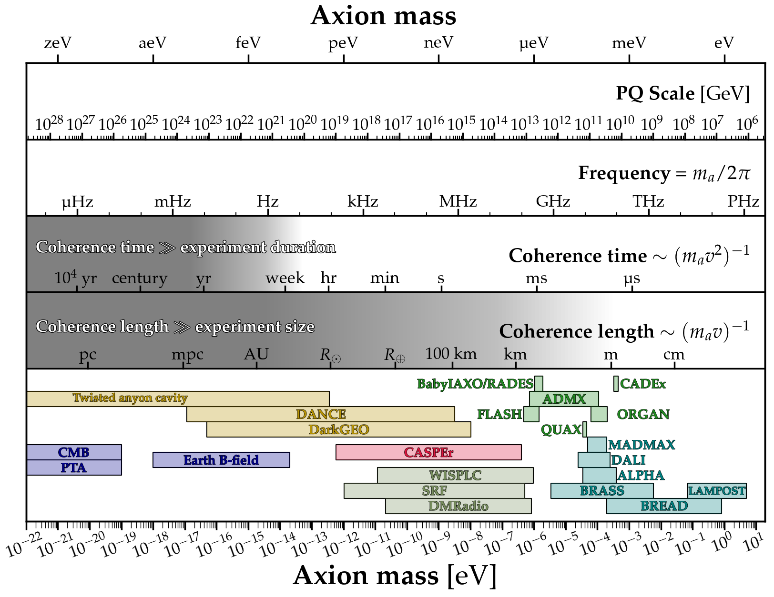
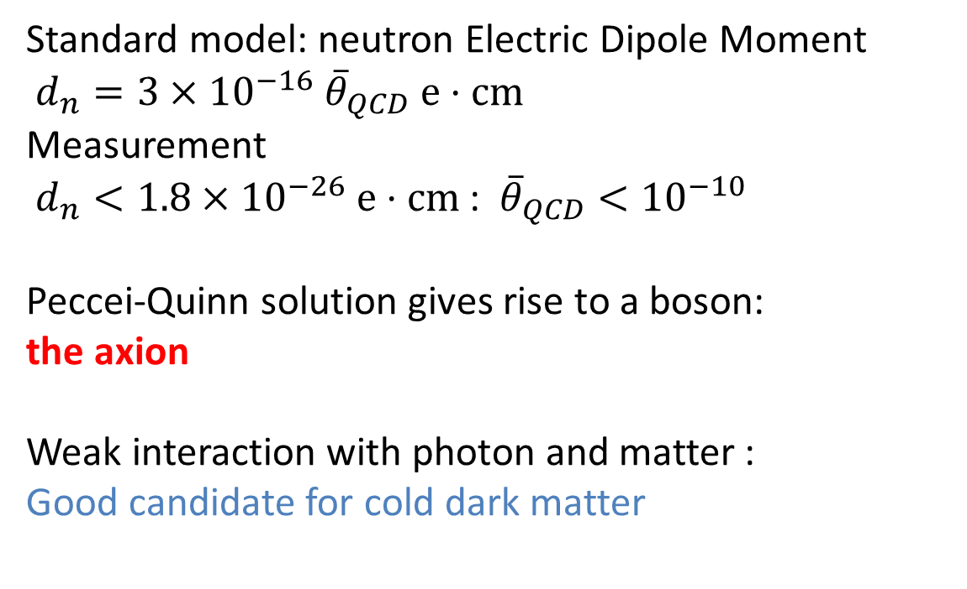
Axion Dark Matter
Standard model: neutron Electric Dipole Moment
$d_{n}=3×{10}^{−16} {\overline{θ}}_{QCD} e⋅cm$
Measurement
$d_{n}<1.8×{10}^{−26} e⋅cm$: ${\overline{θ}}_{QCD}<{10}^{−10}$
Peccei-Quinn solution gives rise to a boson:
the axion
Weak interaction with photon and matter :
Good candidate for cold dark matter
C. Abel et al., 2020
Peccei R.D., Quinn H.R., PRL (1977) 38 1440
https://github.com/cajohare/AxionLimits
4

Slide 5
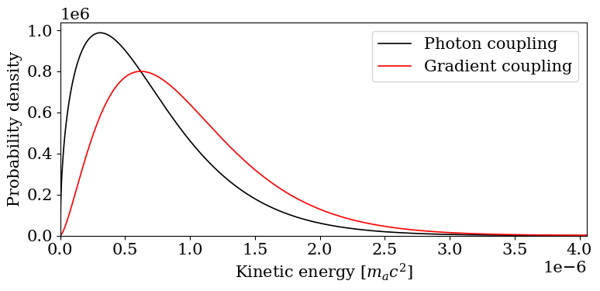


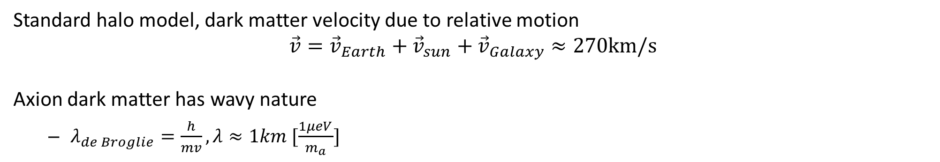

Axion Dark Matter
$$a\left(t\right)=a_{0}cos(ω_{a}t−k⋅r+φ)$$
Standard halo model, dark matter velocity due to relative motion
$$\vec{v}={\vec{v}}_{Earth}+{\vec{v}}_{sun}+{\vec{v}}_{Galaxy}≈270km/s$$
Axion dark matter has wavy nature
  $λ_{de Broglie}=\frac{h}{mv}, λ≈1km [\frac{1μeV}{m_{a}}]$
M. Turner, 1990
A. V. Gramolin et al., 2022

Slide 6
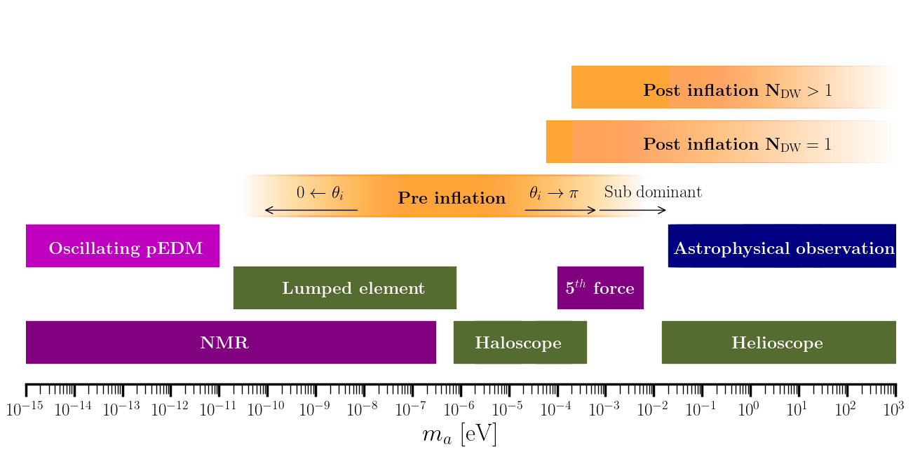
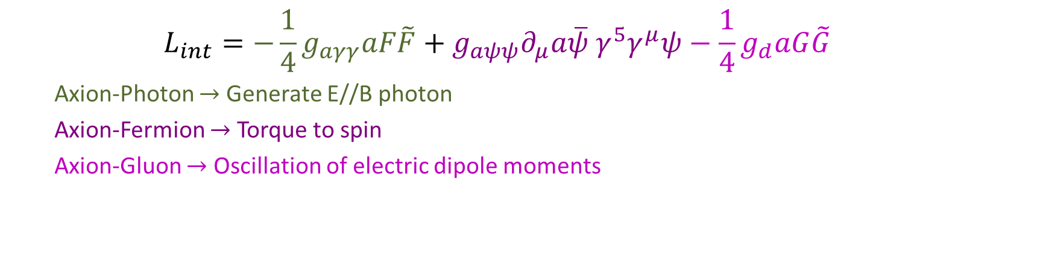
Axion Interactions
  $$L_{int}=−\frac{1}{4}g_{aγγ}aF\tilde{F}+g_{aψψ}∂_{μ}a\overline{ψ} γ^{5}γ^{μ}ψ−\frac{1}{4}g_{d}aG\tilde{G}$$
  Axion-Photon $→$ Generate E//B photon
  Axion-Fermion $→$ Torque to spin
  Axion-Gluon $→$ Oscillation of electric dipole moments
Y. K. Semertzidis and S. Youn, 2022.

Slide 7
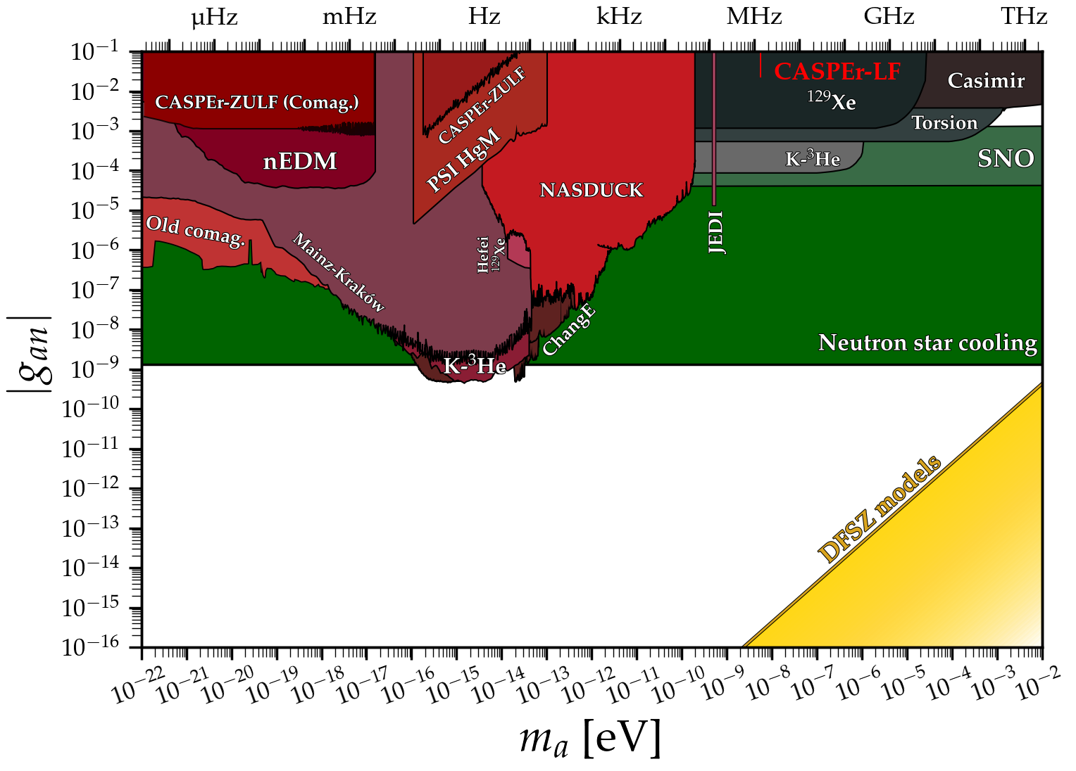
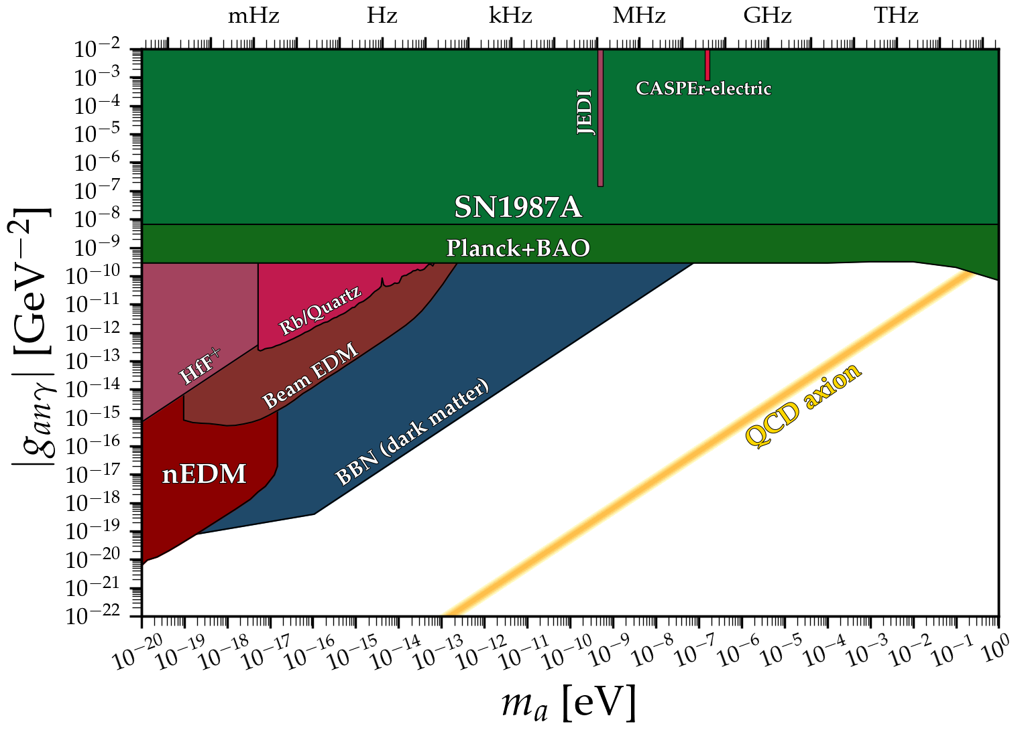

Axion spin interaction
$$[GeV^{−1}]$$
Axion limits Ciaran O'Hare

Slide 8
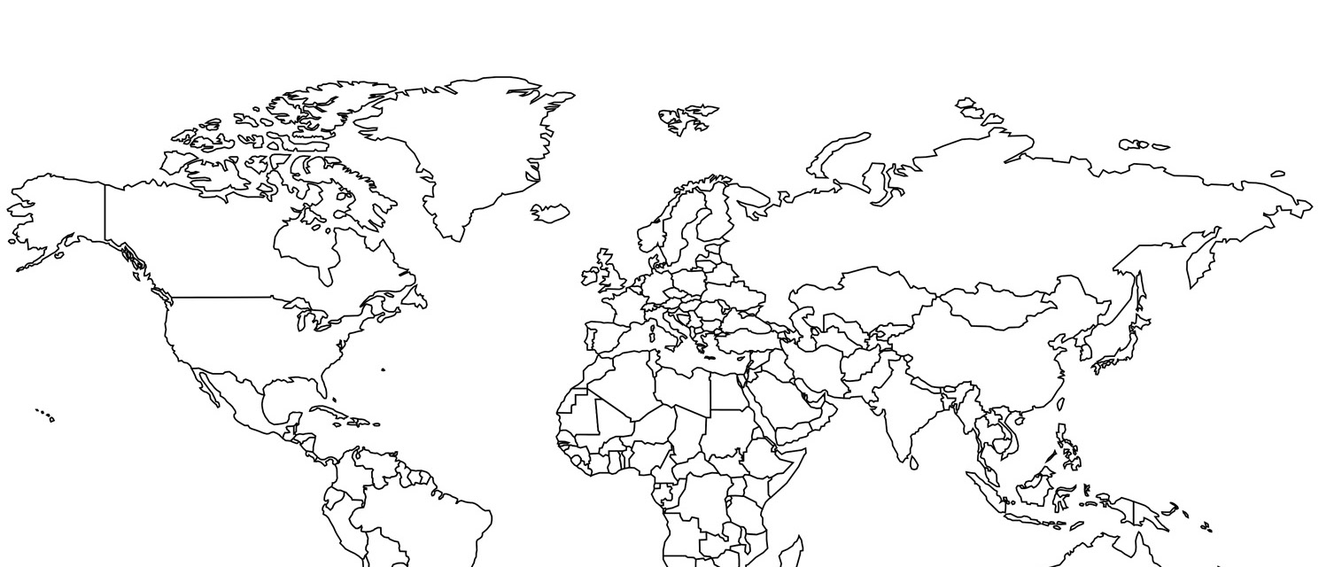

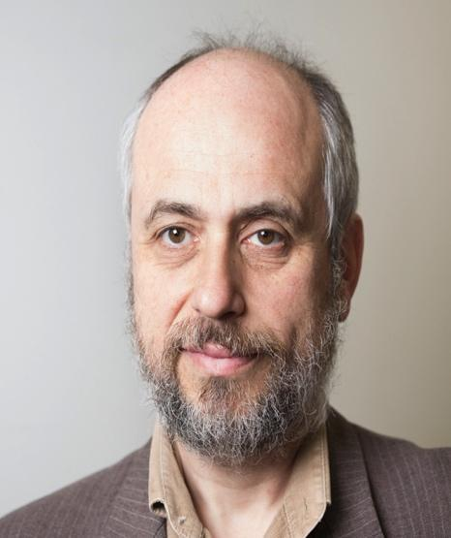





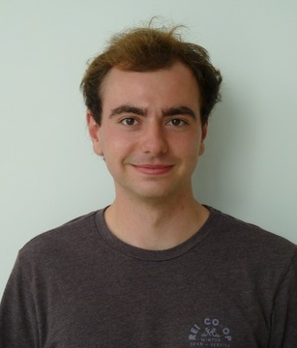













Cosmic Axion Spin Precession Experiment
Prof. Dmitry Budker
Dr. Hendrik Bekker
Dr. Arne Wickenbrock
Declan W. Smith
Vivian Gao
Arian Dogan
Yuzhe Zhang
Ophir Ruimi
Dr. Younggeun Kim
Dr. Jonathan Agil
Prof. Alexander
O. Sushkov
Julian Walter
Prof. Derek J. Kimball
Malavika Unni
Olympia Maliaka
8

Slide 9





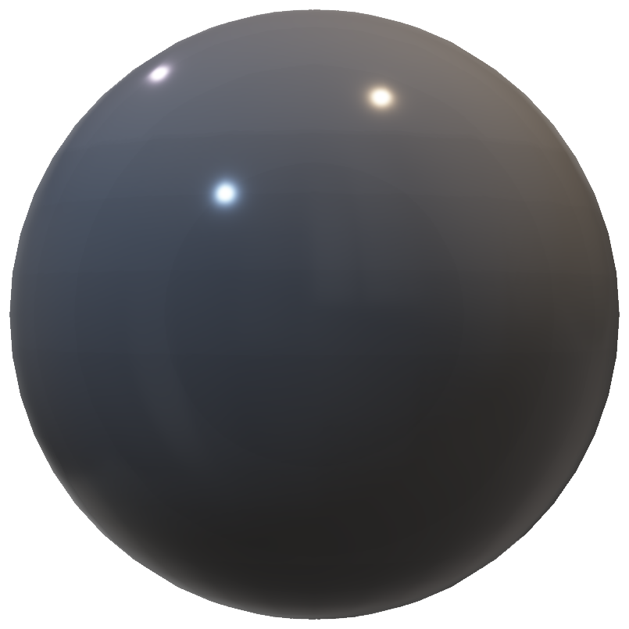
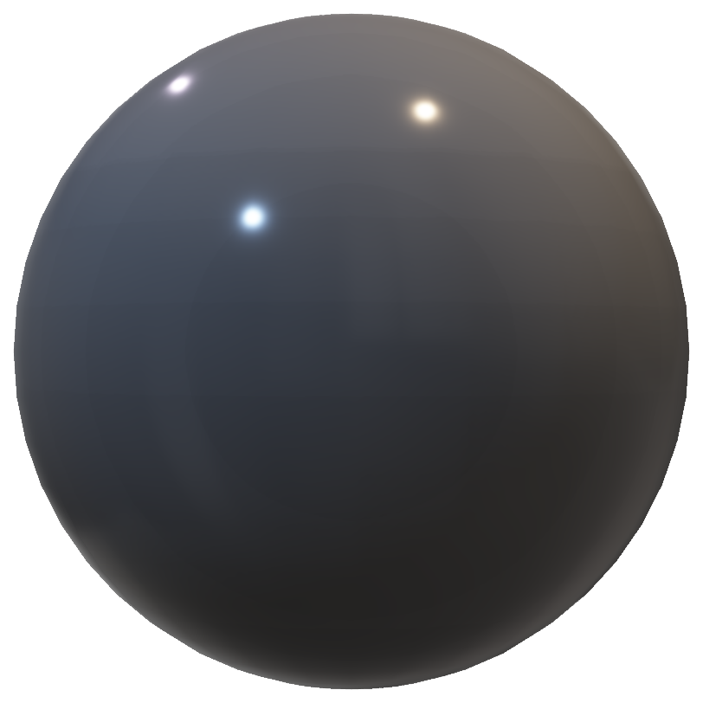

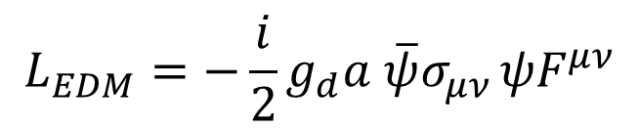

Cosmic Axion Spin Precession Experiment
$$L_{EDM}=−\frac{i}{2}g_{d}a \overline{ψ}σ_{μν }ψF^{μν}$$
$${L_{spin}=g_{aNN}∂}_{μ}a\overline{ψ}γ_{5}γ^{μ}ψ$$
Pickup coil
$$B_{0}$$
$${\vec{B}}_{0}$$
Pickup coil
$$\vec{μ}∝{\vec{d}}_{n}$$
$$\vec{μ}$$
$${\vec{B}}_{ac}$$
$$E_{0}^{∗}$$
Mainz
CASPEr- Electric
CASPEr- Gradient
Boston
Budker D. et al., PRX (2014) 4 021030

Slide 10
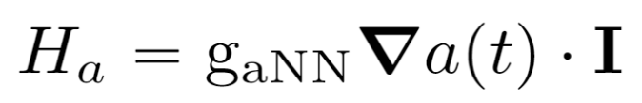

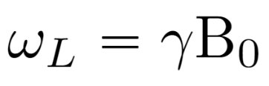
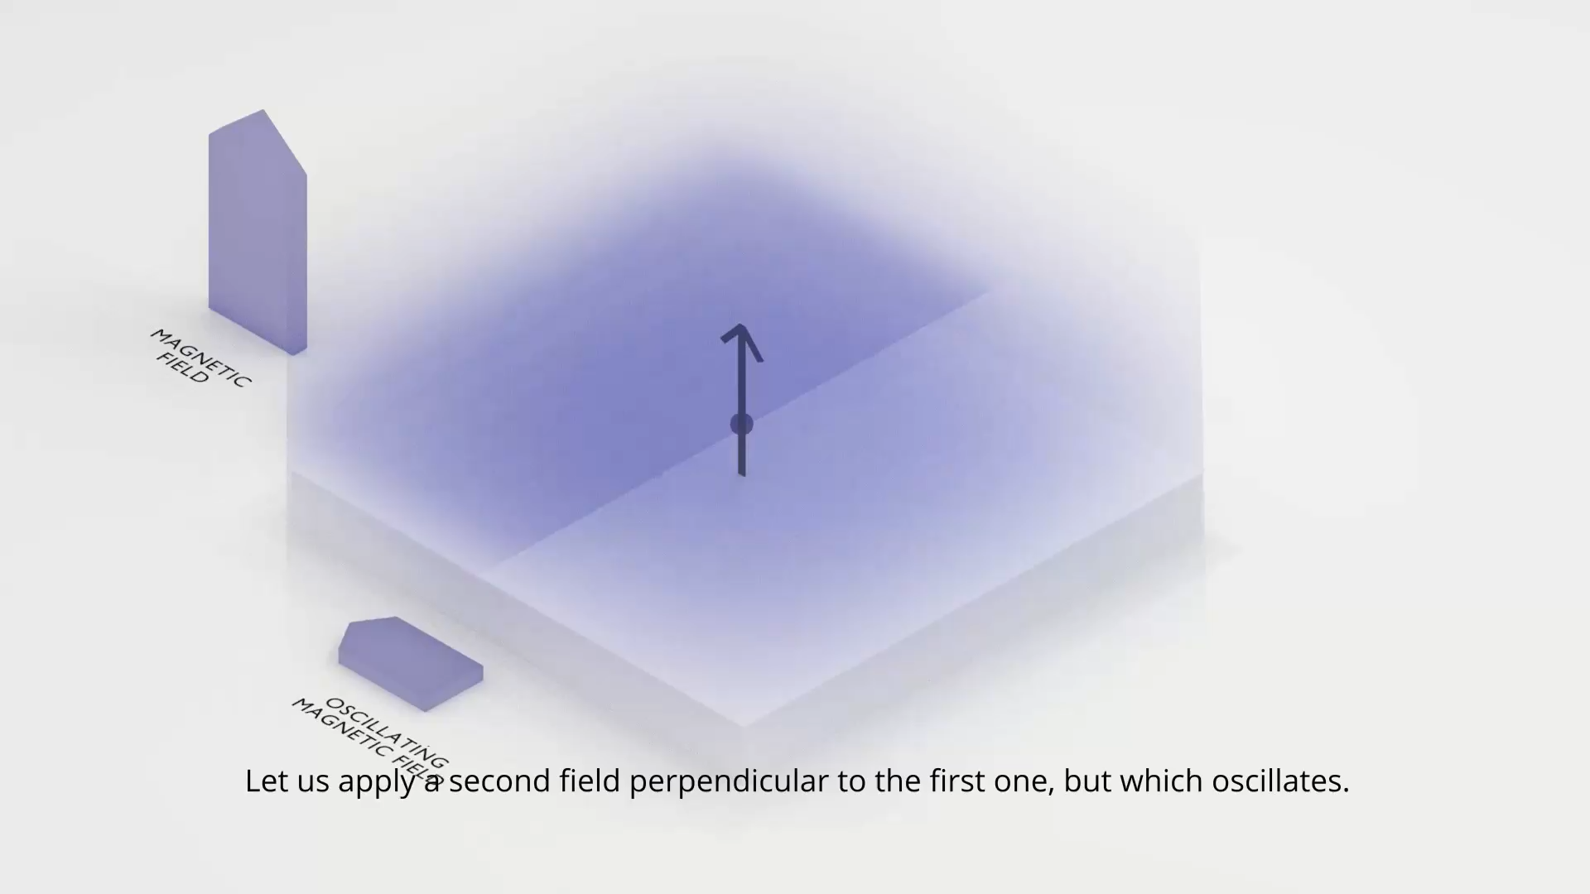

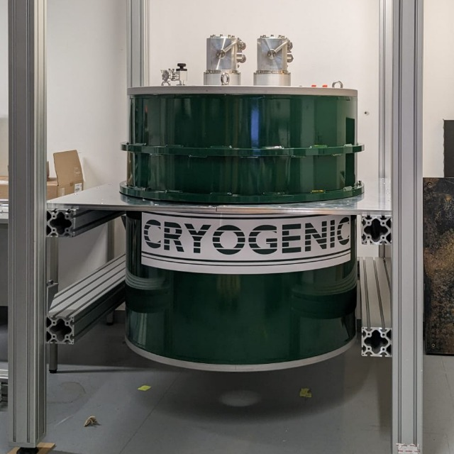
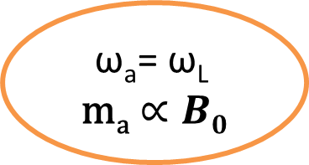


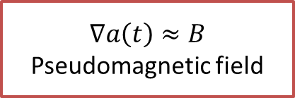
Search for ALPS by NMR
$\text{ω}\text{a}$= $\text{ω}\text{L}$
$$\text{m}\text{a}∝B0$$
$$a\left(t\right)=a_{0}cos(ω_{a}t−k⋅r+φ)$$
$$ω_{a}=\frac{m_{a}c^{2}}{ℏ}$$
$$∇a\left(t\right)≈B$$
Pseudomagnetic field
CASPEr Low Field
0.1T
(0.01-4MHz)
CASPEr High Field
Tunable 14.1T
(70MHz-600MHz)
Axion =
www.quantummadesimple.com
25.09.25
10

Slide 11
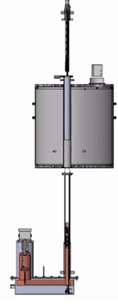

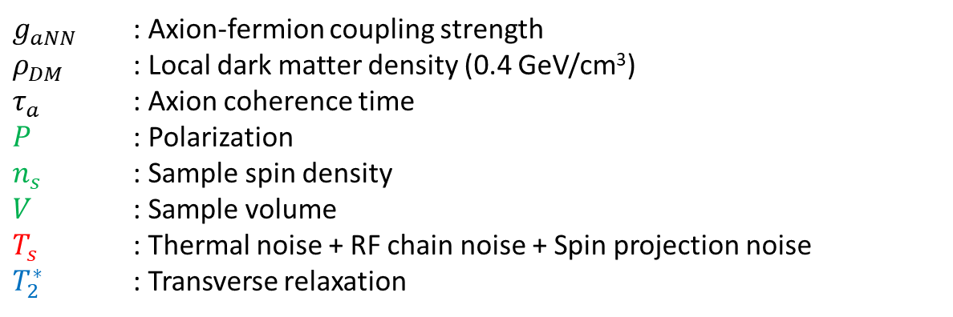
Experimental quantities
Sample properties
$$SNR∝g_{aNN}^{2}ρ_{DM}\frac{{ P}^{2}n_{s}^{2}V}{T_{s}} \frac{T_{2}^{∗}τ_{a}}{T_{2}^{∗}+τ_{a}}$$
Sample holder
Shim stack
System Noise
Field Inhomogeneity
Magnet
$g_{aNN}$ : Axion-fermion coupling strength
$ρ_{DM}$ : Local dark matter density (0.4 GeV/cm³)
$τ_{a}$ : Axion coherence time
$P$ : Polarization
$n_{s}$ : Sample spin density
$V$ : Sample volume
$T_{s}$ : Thermal noise + RF chain noise + Spin projection noise
$T_{2}^{∗}$ : Transverse relaxation
Detection coil
resonant circuit
1. Yuzhe Zhang et al., “Frequency-scanning considerations in axionlike dark matter spin-precession experiments” (2023)
2. Dongok Kim et al JCAP03(2020)066,” Revisiting the detection rate for axion haloscopes
11

Slide 12
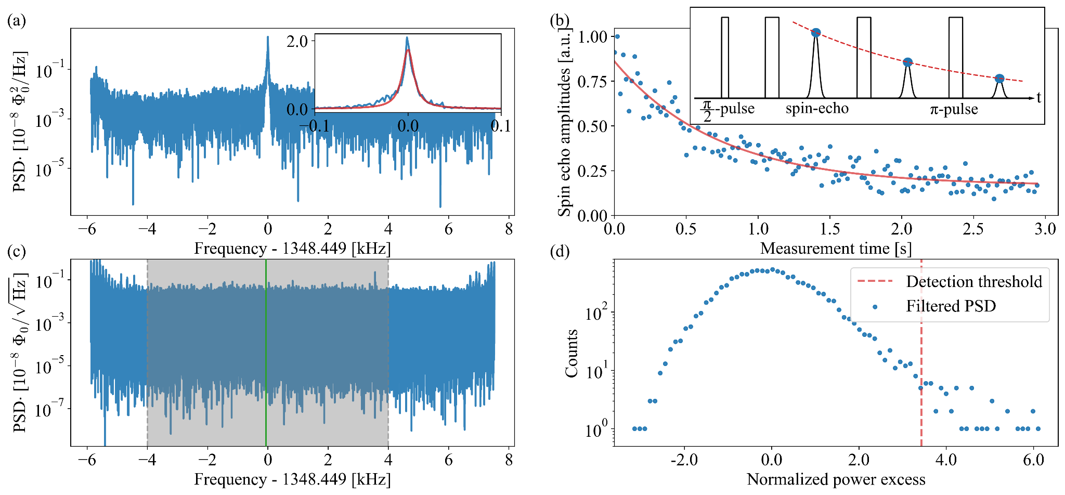
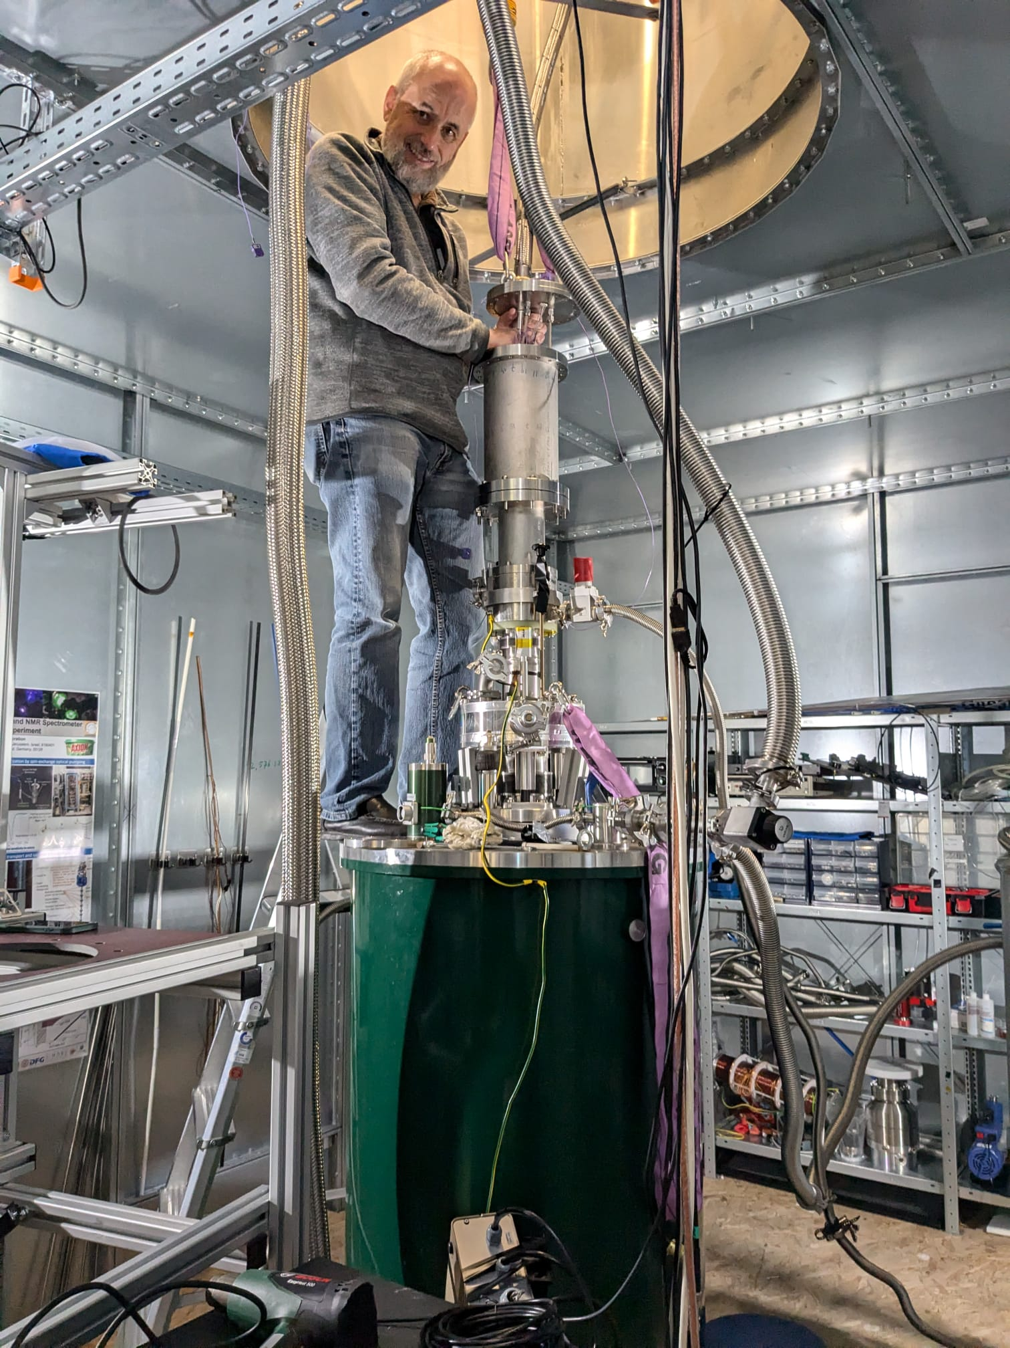
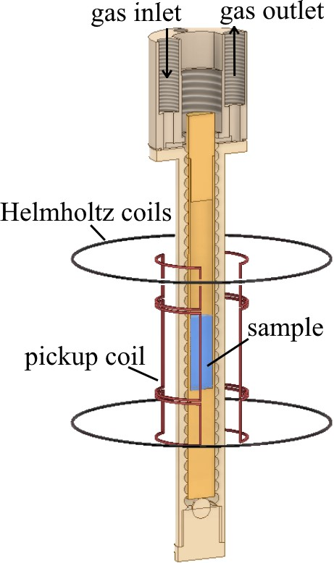
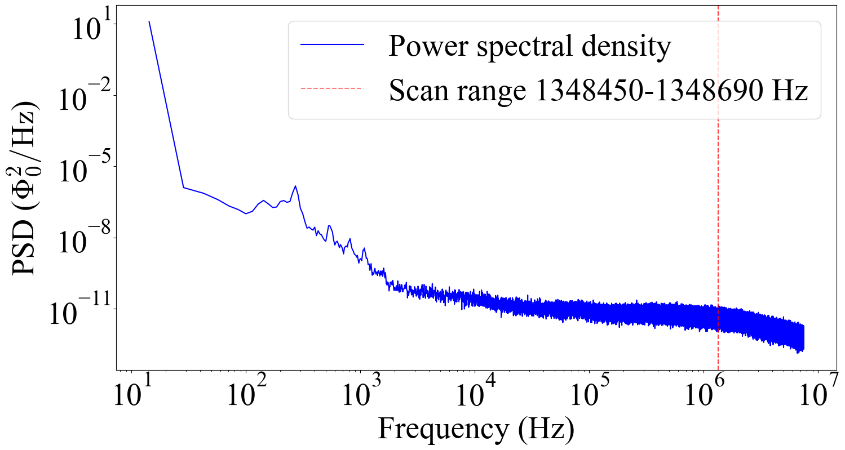


CASPEr-gradient-Low field
Thermal polarized Methanol(proton), $p≈{10}^{−7}$
$$T_{2}^{∗}=0.02 s, T_{2}=0.71 s$$
$$7μΦ_{0}/\sqrt{Hz}$$
J. Walter et al, 2025

Slide 13
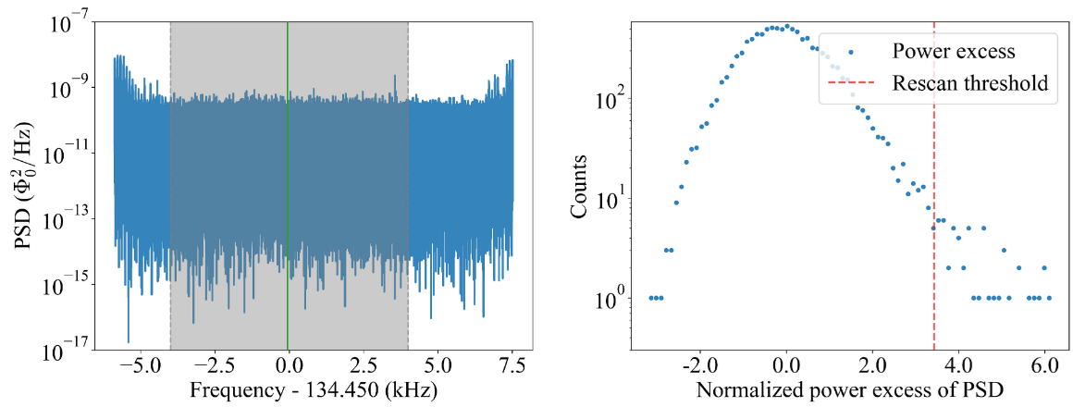
CASPEr-gradient-Low field
-Scan 240Hz around 1.348570 MHz (5.576741 to 5.577733 neV)
-100s acquisition every 6 Hz
-Spectrum smoothed, filter matched, normalized power excess
No Axion found

Slide 14
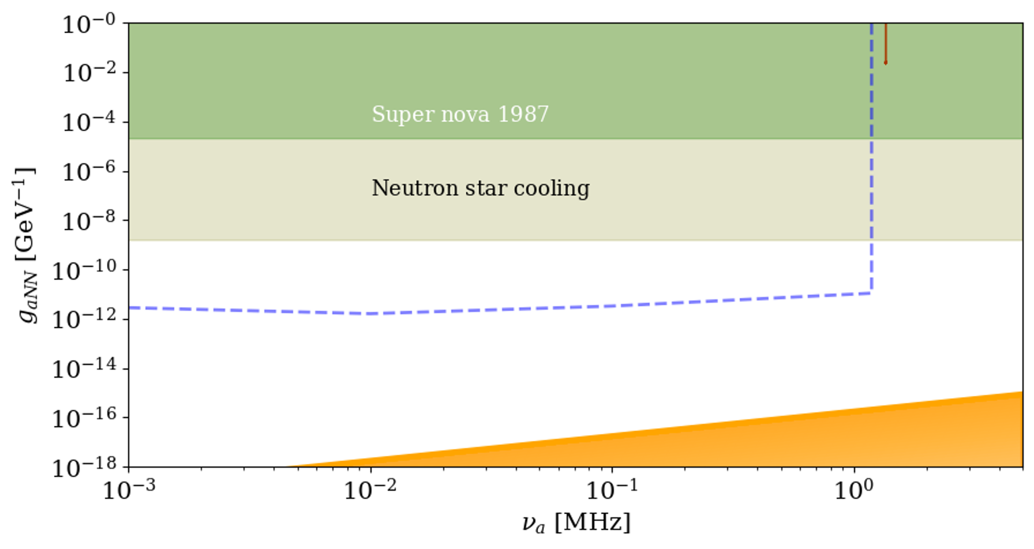
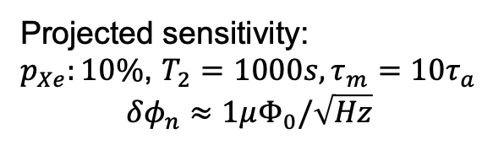
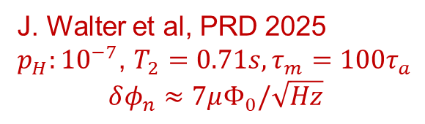
CASPEr-gradient-Low field
J. Walter et al, PRD 2025
$p_{H}:{10}^{−7}$, $T_{2}=0.71s,τ_{m}=100τ_{a}$
$$δφ_{n}≈7μΦ_{0}/\sqrt{Hz}$$
Projected sensitivity:
$p_{Xe}:10\%$, $T_{2}=1000s,τ_{m}=10τ_{a}$
$$δφ_{n}≈1μΦ_{0}/\sqrt{Hz}$$
DFSZ models
Next step: hyperpolarization

Slide 15
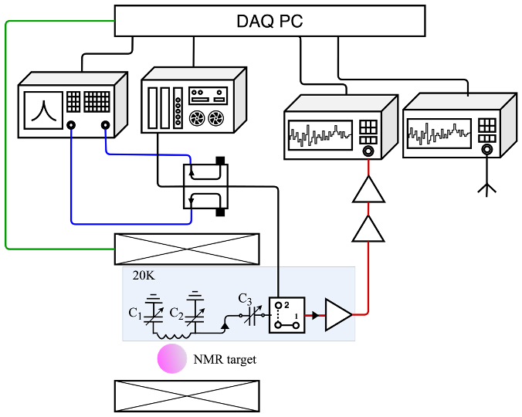
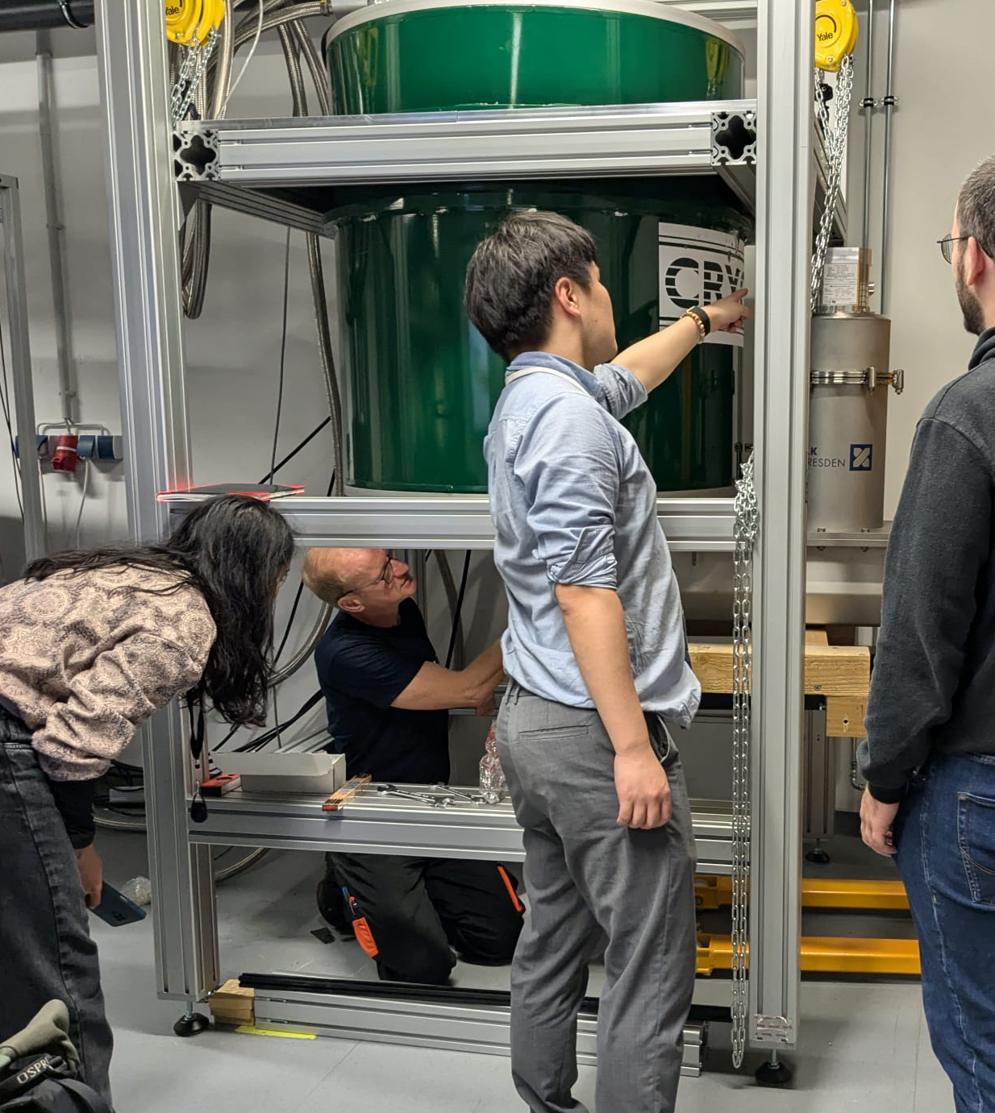
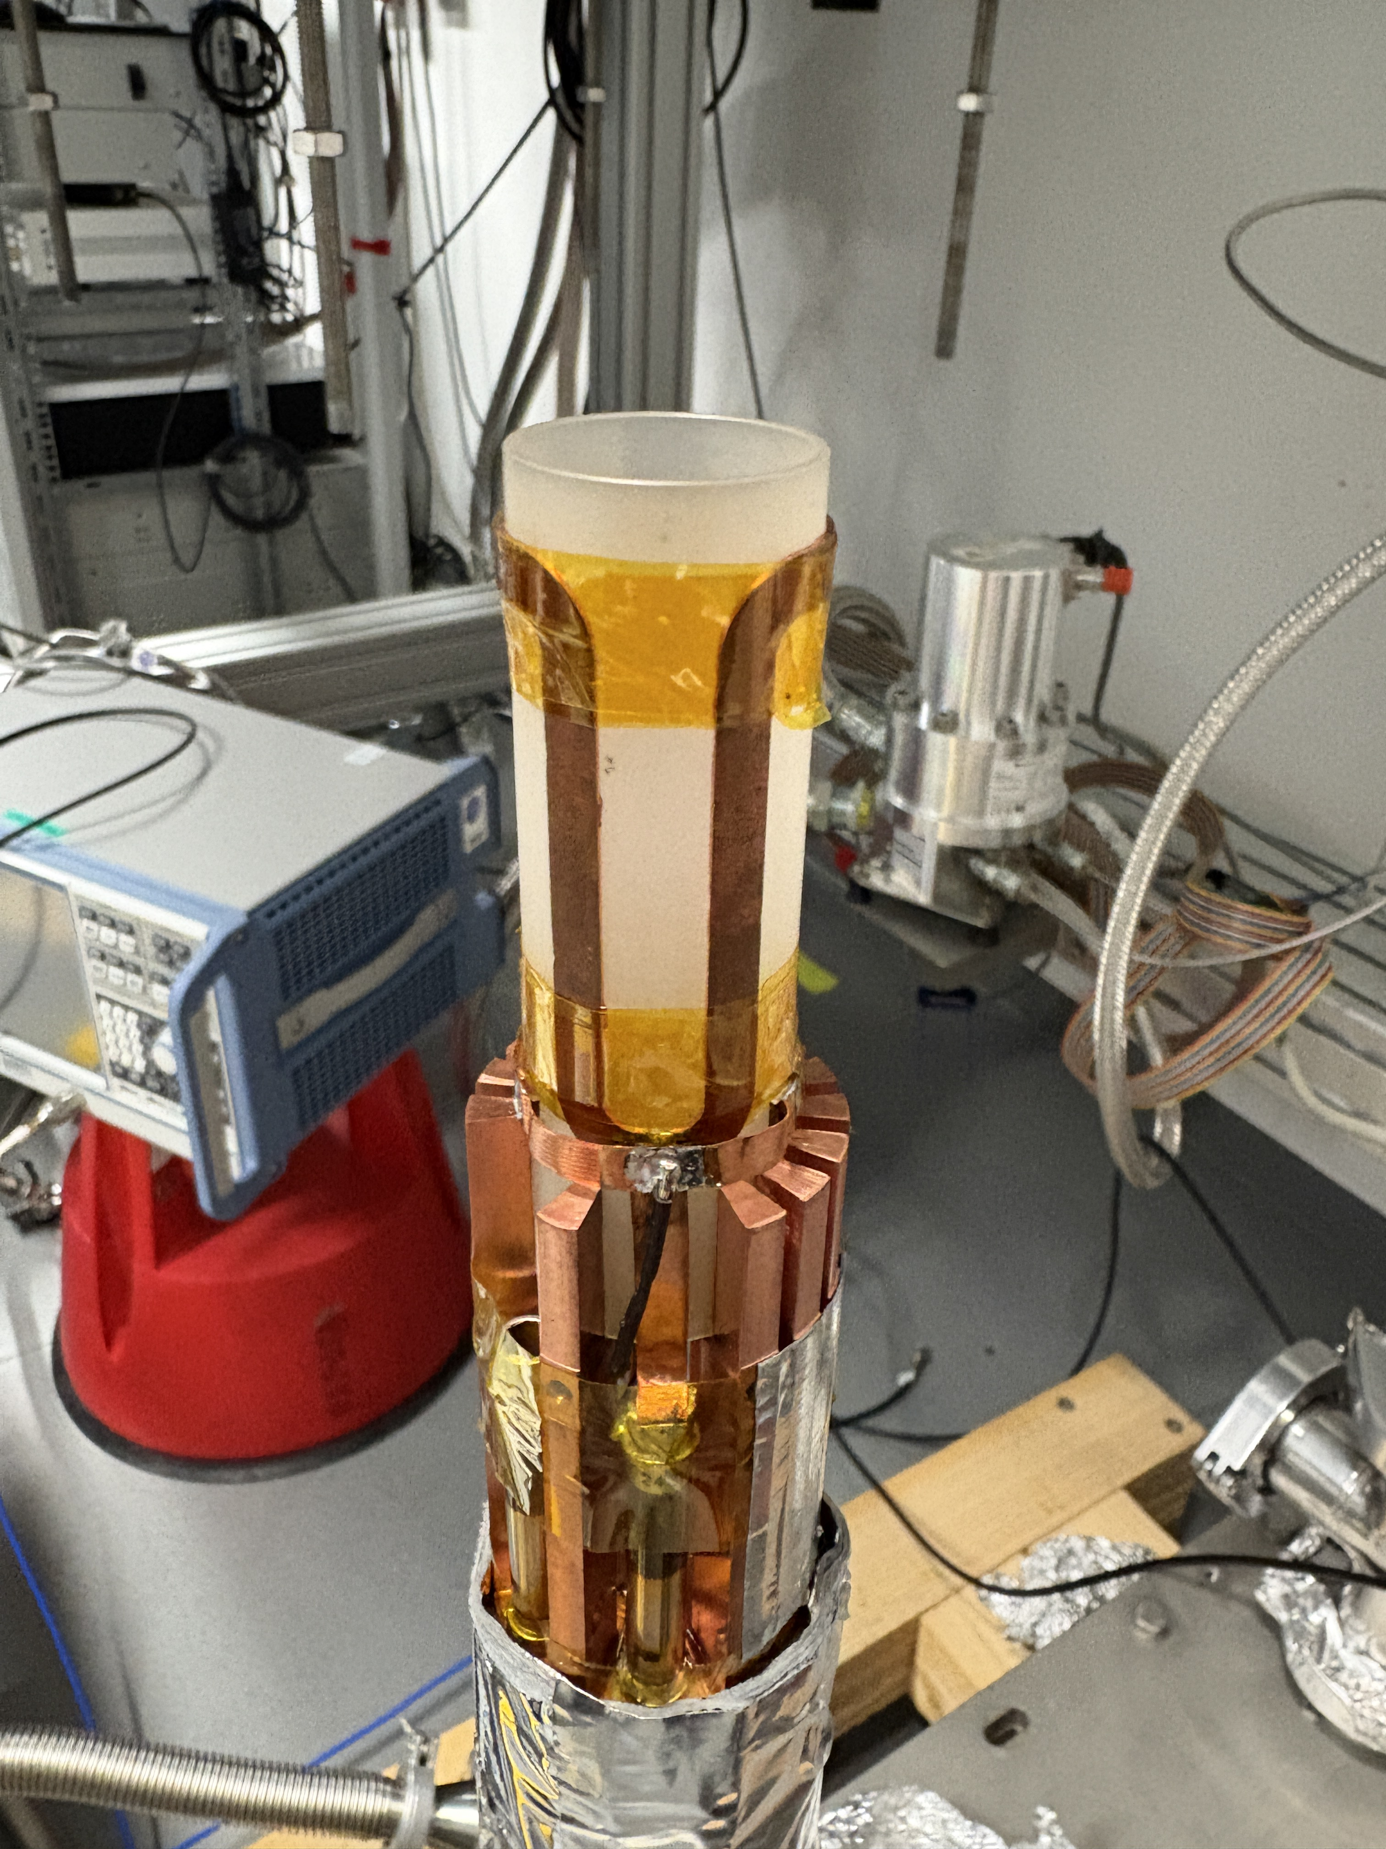
CASPEr-High field
14T magnet
Lock-in
Aerial
spectrum analyzer
15K
NMR characterize
Dark matter signal
Pickup loop tune/matching
Solenoid magnetic control

Slide 16
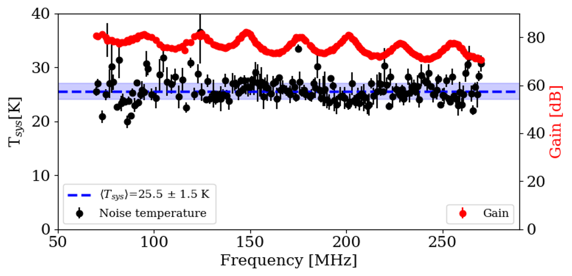
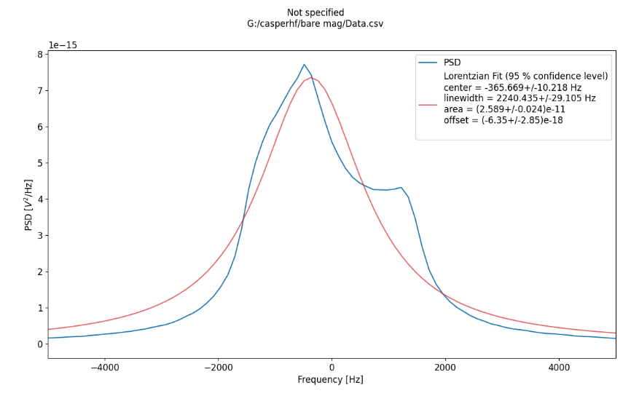
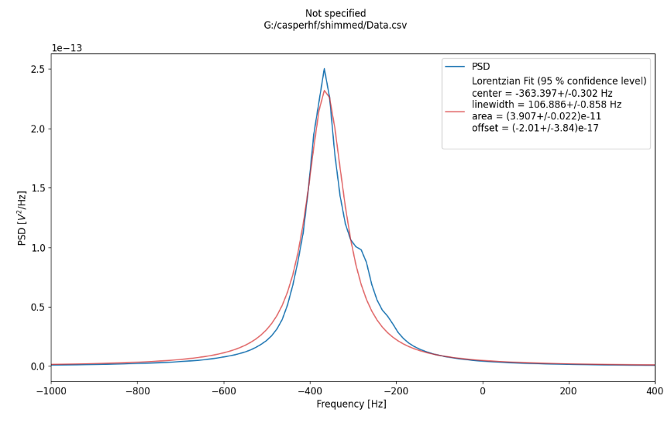
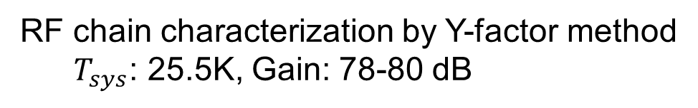
CASPEr-High field
RF chain characterization by Y-factor method
  $T_{sys}$: 25.5K, Gain: 78-80 dB
NMR signal characterization and shimming
22ppm
1ppm

Slide 17
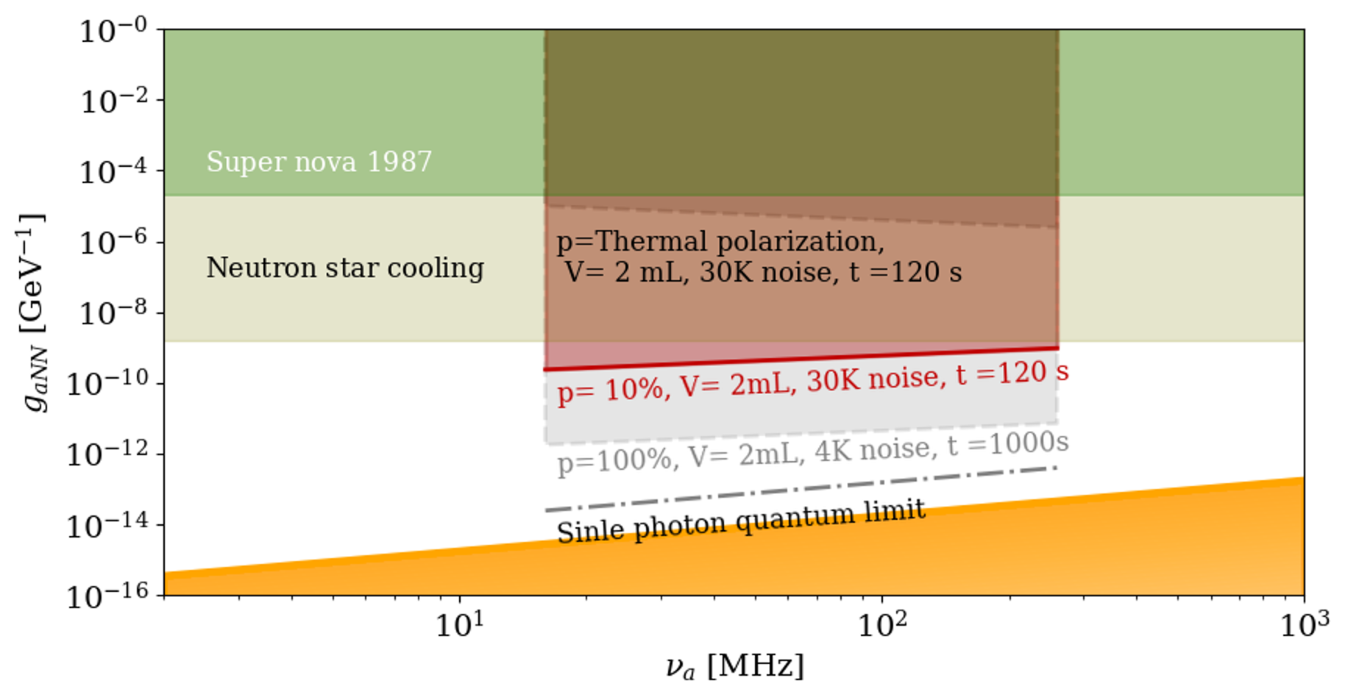
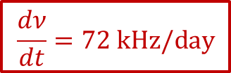
CASPEr-gradient HF projected sensitivity
$$\frac{dν}{dt}=72 kHz/day$$
DFSZ models
First limits very soon!

Slide 18
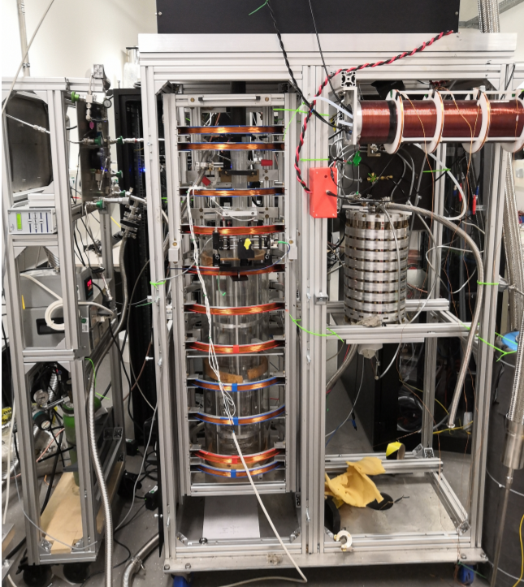
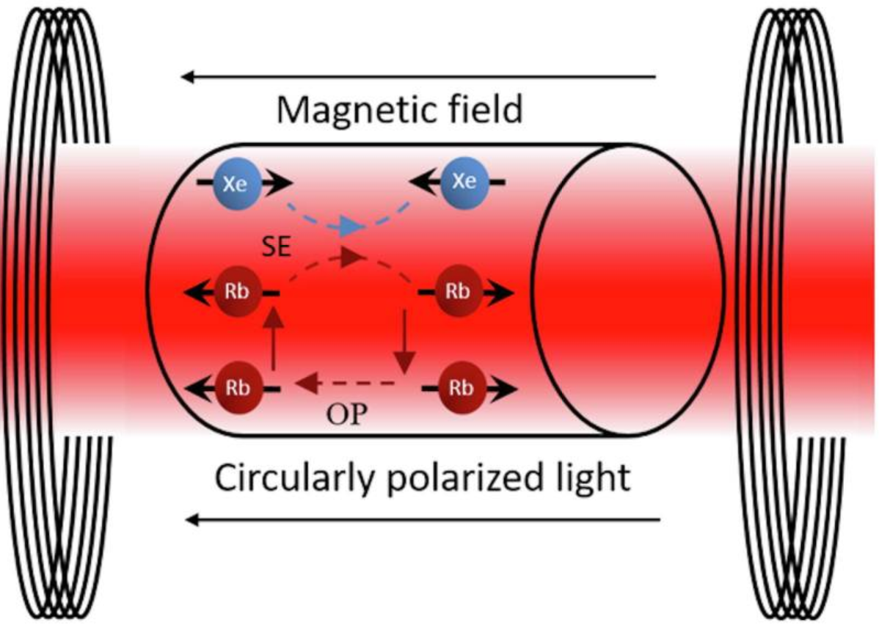
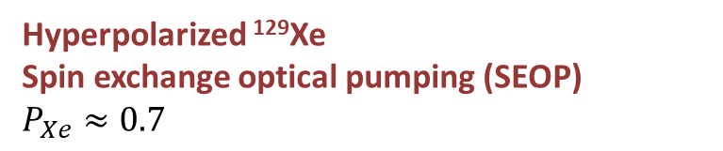
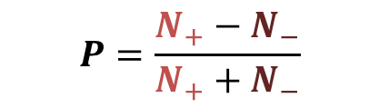
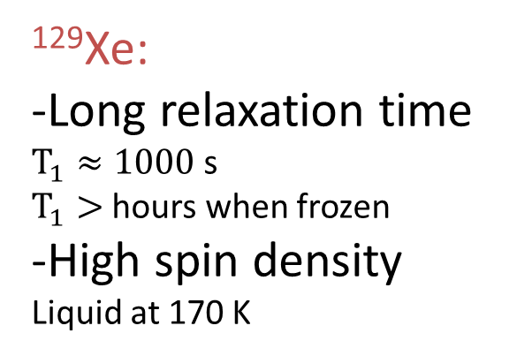

Sample: hyperpolarized ¹²⁹Xe
¹²⁹Xe:
-Long relaxation time $T_{1}≈1000$s
$T_{1}>$ hours when frozen
-High spin density
Liquid at 170 K
Thermal polarization
$P_{Xe}≈\frac{γ_{Xe}ℏB_{0}}{2k_{B}T}≈1.5×{10}^{−7}$ $(T=300 K, B_{0}=1 T)$
10⁶
Hyperpolarized ¹²⁹Xe
Spin exchange optical pumping (SEOP)
$$P_{Xe}≈0.7$$
¹²⁹Xe
$$P=\frac{N_{+}−N_{−}}{N_{+}+N_{−}}$$
18

Slide 19
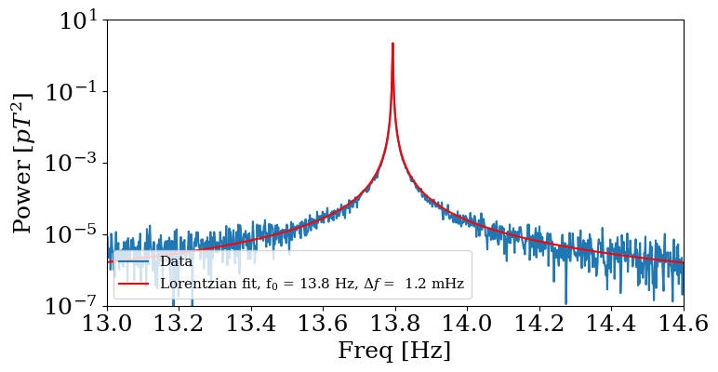
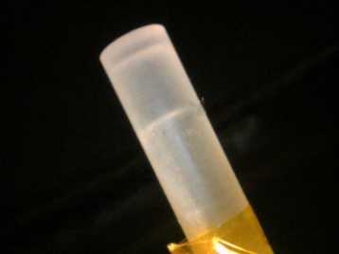
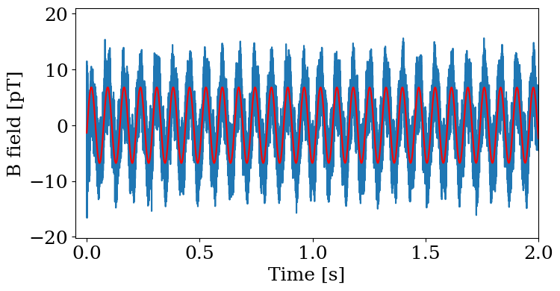

Sample: hyperpolarized ¹²⁹Xe
Signal of hyperpolarized ¹²⁹Xe gas ZULF NMR
$$P_{Xe}≈10\%$$
Next step: transport & liquefaction inside the sample holder
170K

Slide 20
Summary
CASPEr is looking at axion mass < µeV with spins
Setups in Mainz are commissioned
Limits beyond astronomical with hyperpolarized sample
20

Slide 21

21

