Slide 1
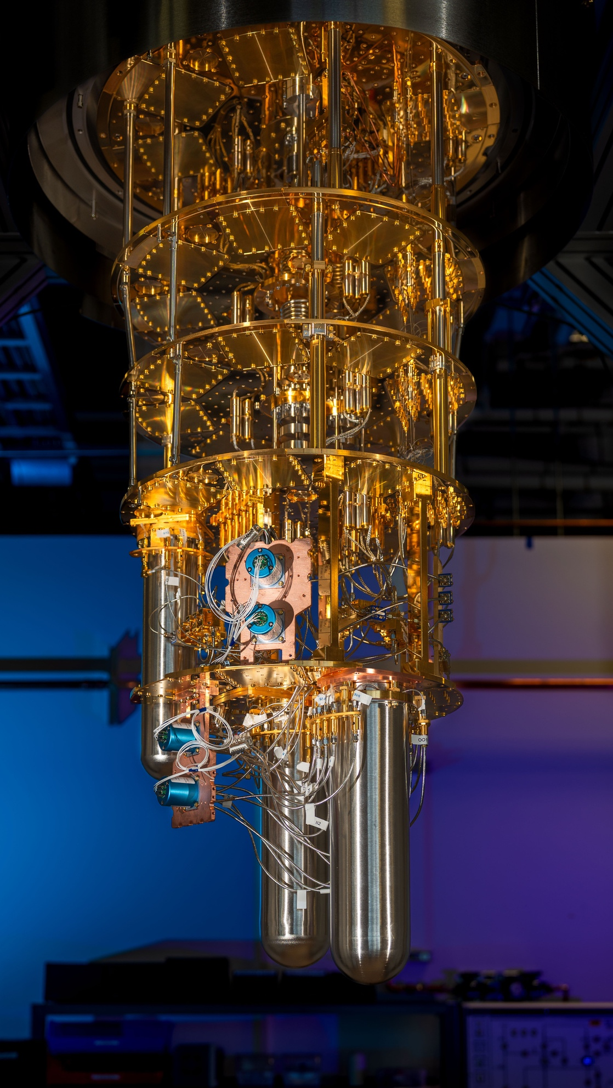




FERMILAB-SLIDES-25-0256-SQMS
A Dark Photon Dark Matter Search with a Widely-Tunable SRF Cavity
20th Patras Workshop on Axions, WIMPs and WISPs
Sep 25, 2025
Raphael Cervantes,
Bianca Giaccone, Oleksandr Melnychuk, Sergey Kazakov, Ivan Nekrashevich, Oleg V. Pronitchev Soka Suliman, Daniel Molenaar, Fabio Castañeda, Asher Berlin, Sam Posen, Roni Harnik, Crispin Contreras-Martinez, Yuriy Pischalnikov, Roman Pilipenko, Anna Grassellino

Slide 2
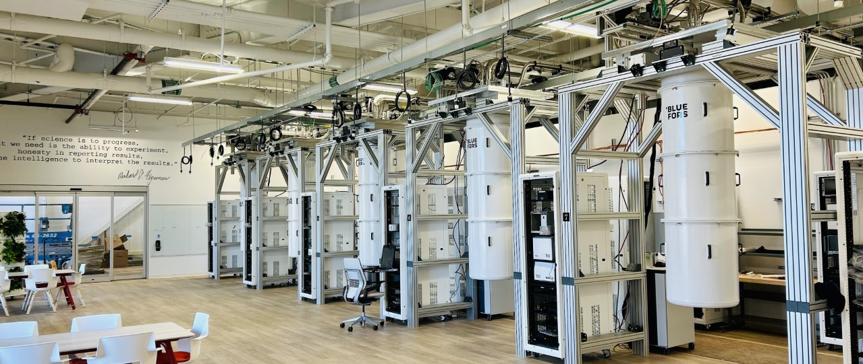
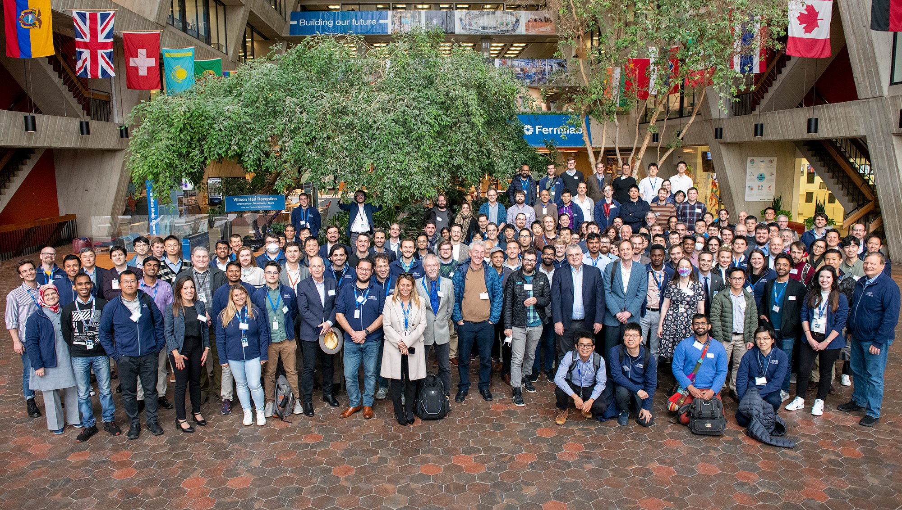
Superconducting Quantum Materials and Systems Center
The Quantum
Garage
Hosted at Fermilab.
Interdisciplinary QIS center comprising of experts in materials, quantum devices, SRF cavities, HEP, and algorithms.
Credit: A. Grassellino
Notes:
First, I’d like to introdruce our group. We are the Superconducting Quantum Materials and Systems Center. We are one of the QIS centers in the US, we consiste of many partnering institutions.. At Fermilab, we are experts in superconducting RF cavities, and we can make cavities with Qs of 10^9, 10^10. We are going to use our expertise to make dark matter searches more sensitive.

Slide 3
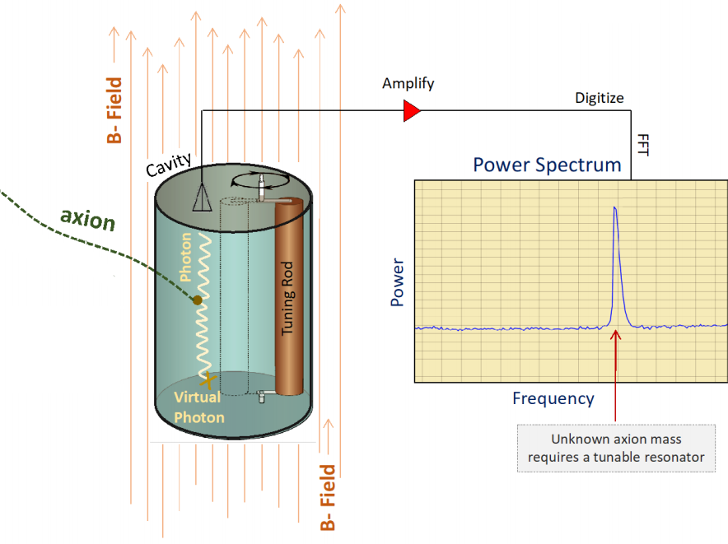
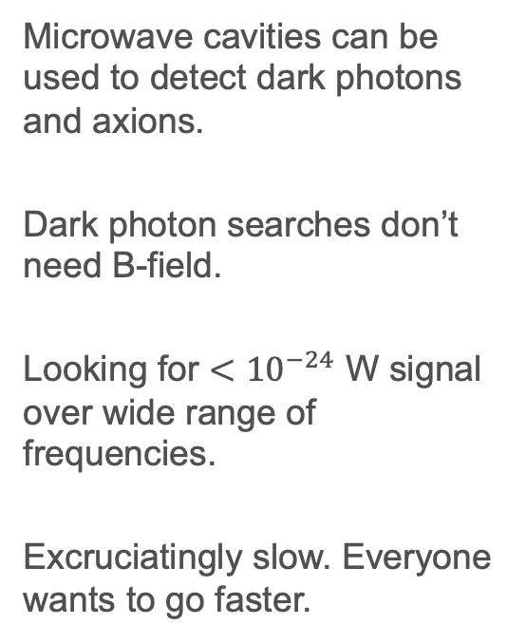
Sikivie Haloscope Search for Axions and Dark Photons Dark Matter
Microwave cavities can be used to detect dark photons and axions.
Dark photon searches don’t need B-field.
Looking for ${<10}^{−24}$ W signal over wide range of frequencies.
Excruciatingly slow. Everyone wants to go faster.
Dark
Photons,
Credit: C. Boutan
Notes:
Dark matter can be detected using haloscopes. Haloscopes often consist of ultracold microwave cavities connected to quantum sensors.
Dark photons can convert to photons. If that conversion happens inside of a microwave cavity, and if the resonant frequency of the cavity matches the frequency of the photon, then you get a resonant enhancement of the dark photon signal power. You can then read out that signal using low noise electronics and it will show up as a power excess over a noise floor. And we don’t know what the dark photon mass is, so these cavities have to be tunable to search through a large range of frequencies.
The other thing I wanted to mention is that this haloscope method also works for axion searches, except that axion searches need a magnetic field to convert axions into photons.
These searches are really hard because the signal is less than 10e-24 W and we have to search through a wide range of frequencies. So at SQMS, we are trying to develop technologies and methodologies to increase the scan rate of these dark matter searches.

Slide 4
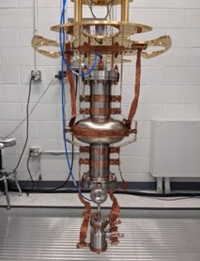
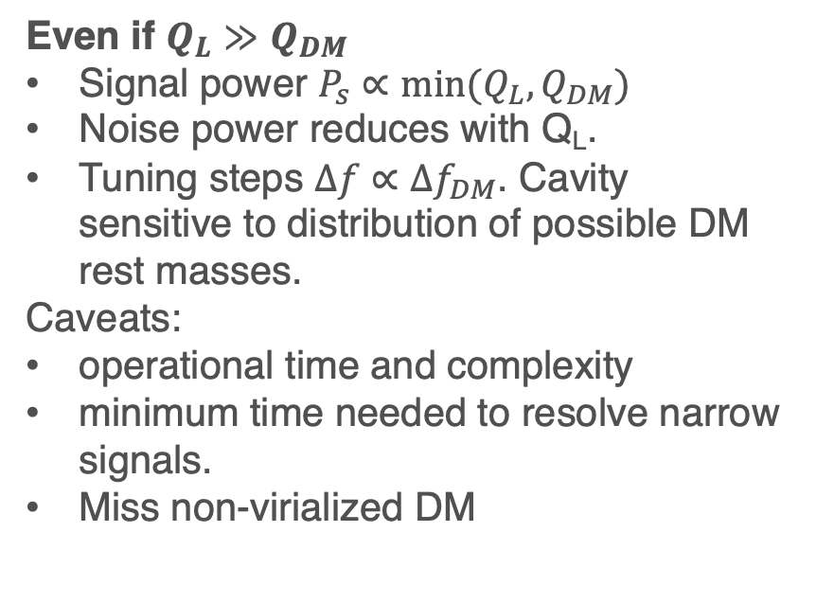
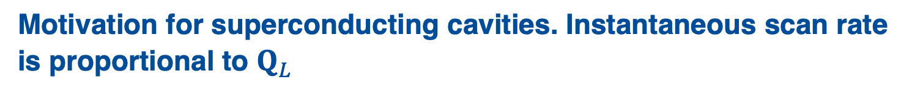
Motivation for superconducting cavities. Instantaneous scan rate is proportional to $Q_{L}$
Even if $Q_{L}≫Q_{DM}$
Signal power $P_{s}∝min⁡(Q_{L}, Q_{DM})$
Noise power reduces with Q_{L}.
Tuning steps $Δf∝{Δf}_{DM}$. Cavity sensitive to distribution of possible DM rest masses.
Caveats:
operational time and complexity
minimum time needed to resolve narrow signals.
Miss non-virialized DM
Phys. Rev. D 110, 043022
Notes:
The scan rate is proportional to the quality factor. The larger the Q, the longer the coherence time, the larger the signal power that accumulates in your cavity.
But there is a nuance to this. This nuance comes from the dark matter halo velocity distribution. The quality factor of this dark matter signal is 10^6.
But it’s been common wisdom that higher Q’s beyond 10^6 you get diminishing returns because you are only sampling a smaller fraction of the dark matter halo.
This is true. But I’m going to argue that the scan rate is proportional to Q even when we are in the ultra-high Q regime.
So yes, the signal power levels off for ultra-high Q. But your signal is now much narrower, which means there is much less noise power within your signal bandwidth. The noise power reduces by a factor of QL and that increases your SNR.
Furthermore, you don’t have to in steps of the cavity bandwidth. Your tuning steps don’t have to be smaller the the dark matter bandwidth because a single cavity frequency is sensitive to a range of axion or dark photon rest masses.
However, with this tuning scheme, we would only be sensitive to virialized axions and we wouldn’t catch the cold streams. But I think I can live with that.
And if you are still skeptical, I’d encourage you to read the paper I posted on the arxiv and to also talk to me.

Slide 5
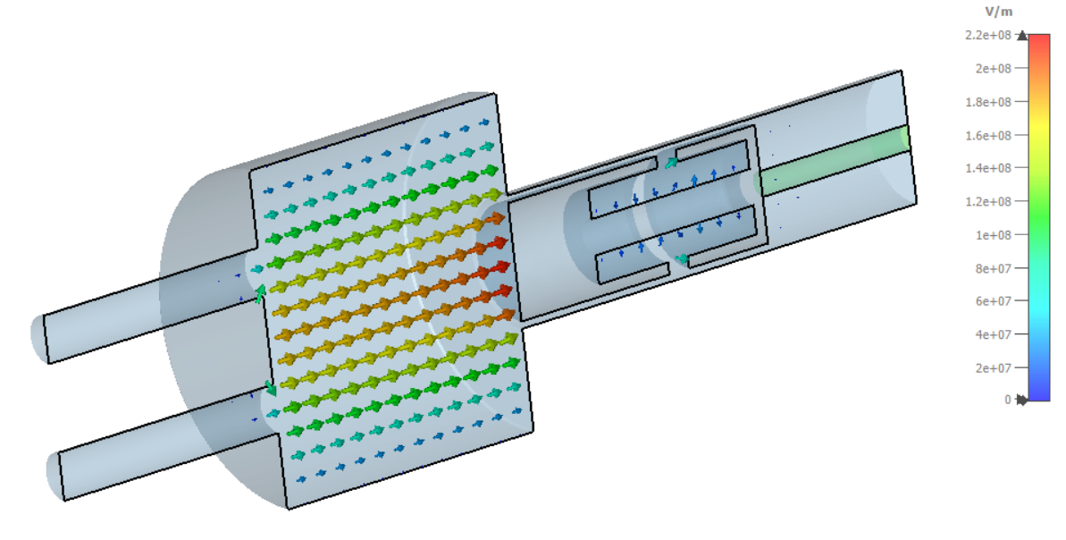
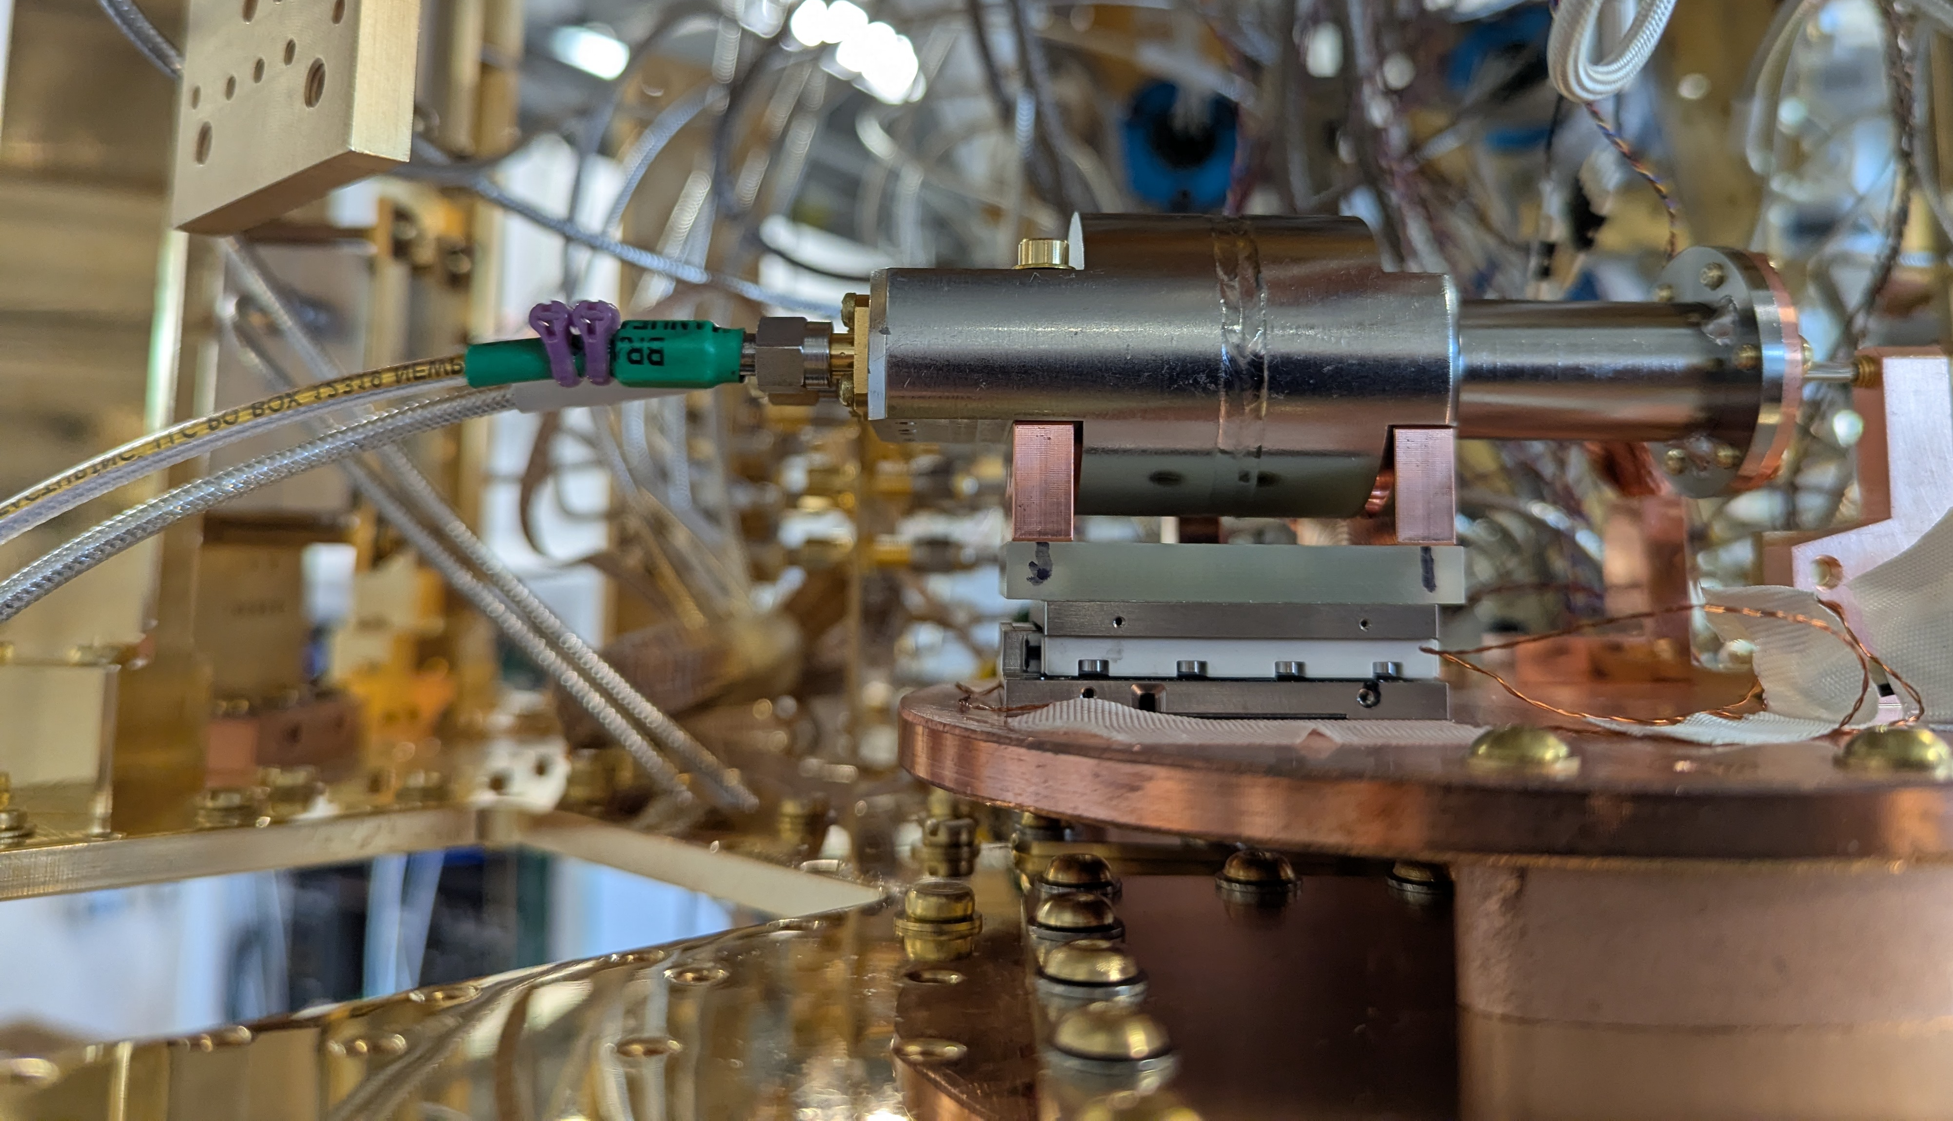
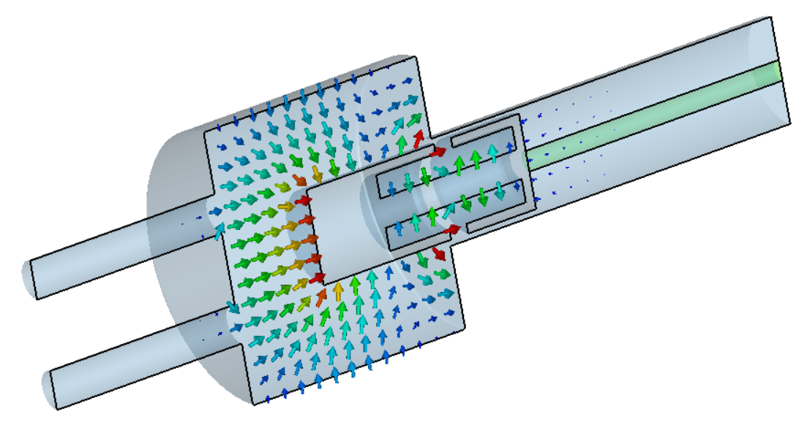
SERAPH: Widely tunable 4-7 GHz superconducting cavity
Niobium cavity. Niobium tuner is also RF choke held in place with sapphire rod.
Originally designed to characterize dielectric losses in the context of transmon qubits, the design was readapted for dark matter searches.
S. Kazakov
f_{c} = 7.08 GHz
f_{c} = 4.43 GHz
Plunger cavity installed in fridge.

Slide 6
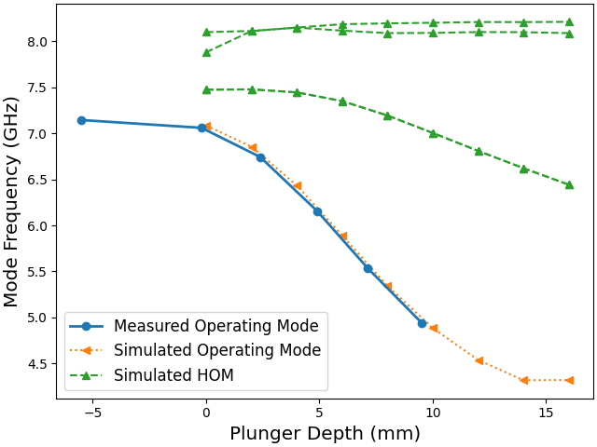
Simulated modes vs Measured Modes in Liquid Helium
S. Kazakov,
C. Contreras-Martinez
Straightforward tuning. No mode crossings. Good agreement between measurement and simulation.
Notes:
TODO: Take out dimensions

Slide 7
Simulated effective volume
Too small for QCD Axion sensitivity.
Need to optimize volume at cost of mode crossings.
S. Kazakov
Notes:
TODO Add 1/3
Make labels bigger.

Slide 8
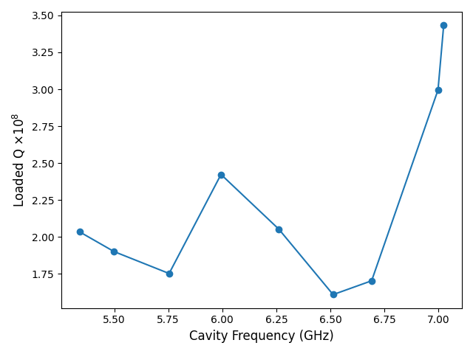
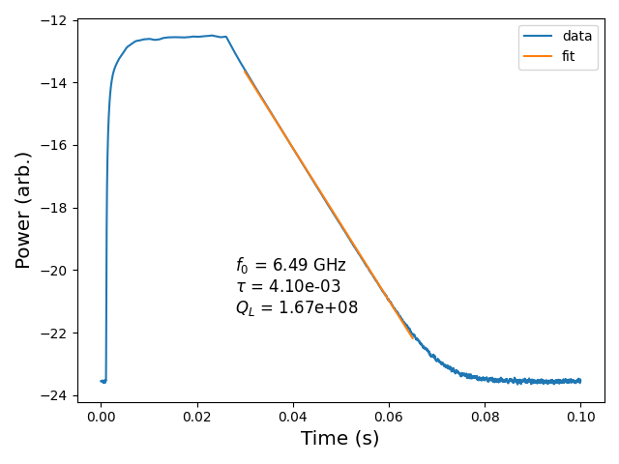
Measured Unloaded Q with decay measurement in LHe (1.4 K)
Energize cavity
Let cavity ringdown.
Limited range because sapphire rod broke during assembly.
Weakly coupled: QL ≈ Q0.
Basic cavity processing. Surface resistance could be reduced with more optimization.
Notes:
TODO: Antenna coupling

Slide 9
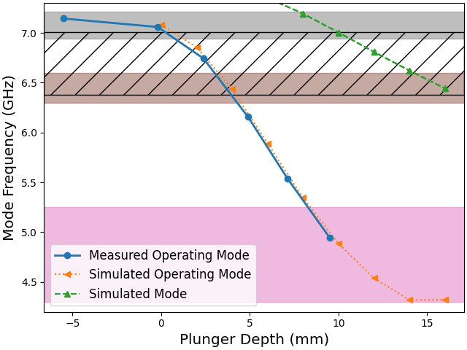
Plunger Cavity in the Fridge. Tuning is proving difficult.
Run3
Run 1 (6.3-6.6): Coax and heatsink braid push against piezo tuning.
Run 2 (4.3-5.25): Misalignment from multiple cooldowns. Plunger hits cutoff region wall.
Run 3(6.94-7.2): Added thermal strapping. Added too much mechanical tension for piezo.
Run 4(6.38-7.01(+)): Removed some thermal strapping. Better, but still not enough.
Run 4
Run 1
Run 2
Notes:
TODO make it easier to see what runs correspond to what.

Slide 10
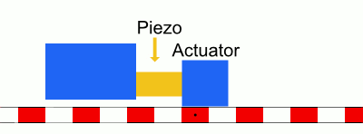
Piezo tuning requirements and strategy.
Requirements:
20 mm travel range.
10 nm (~kHz) resolution.
Low dissipation.
500 grams Max Load.
Low temperature. High Vacuum.
Moving the cavity instead of the plunger to mitigate “hot rod.”
Chose Attocube ANPx341/LT/HV - linear x-nanopositioner.
Stick and slip mechanism.
MotionPlus
Strategy:
DC tuning steps to achieve 10 nm tuning resolution, up to ~100 V. Very low power dissipation (~mK heating of cavity).
Then activate AC ramp to move large distance. Lots of dissipation.
Notes:
Add strategy.

Slide 11
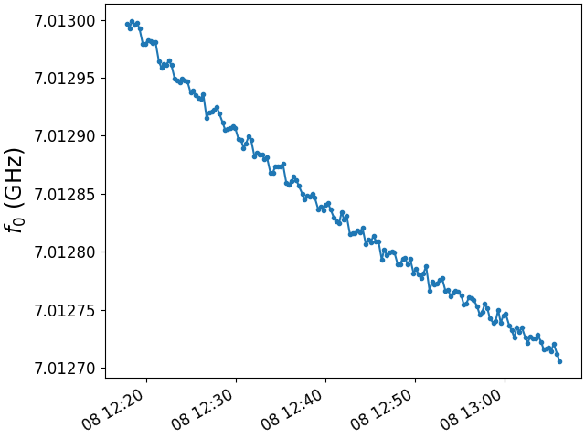
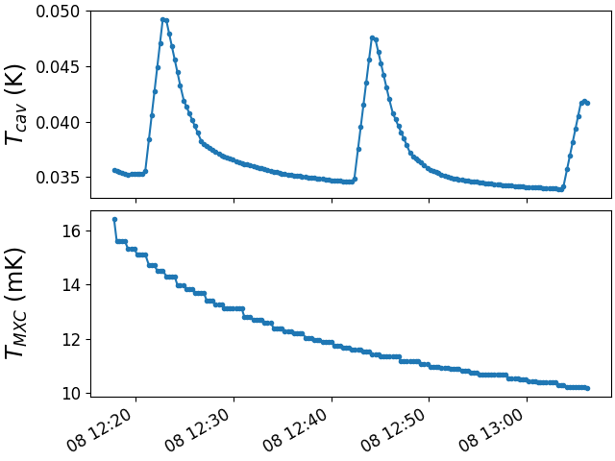
Piezo tuning. Sometimes smooth with modest impact on cavity temperature
Cavity and Fridge temperatures “manageable”
Cavity tuning
16 V DC increments x 4
25 V AC ramp voltage
A. Melnychuk

Slide 12
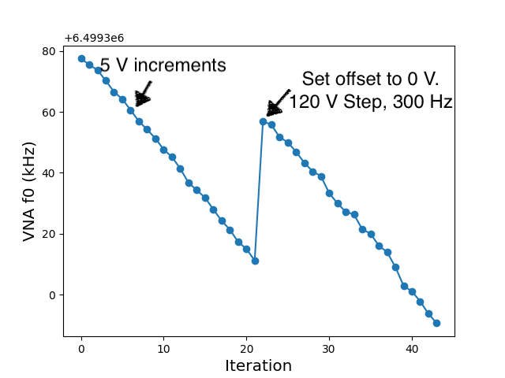
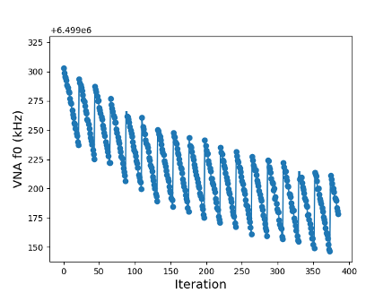
Piezo tuning. Can see mechanics push back against the piezo.
A. Melnychuk
Slip part of the stick-slip not slipping enough.
Need to better optimize thermal straps
Piezo has probably deteriorated after multiple cooldowns and abuses
Notes:
I don’

Slide 13
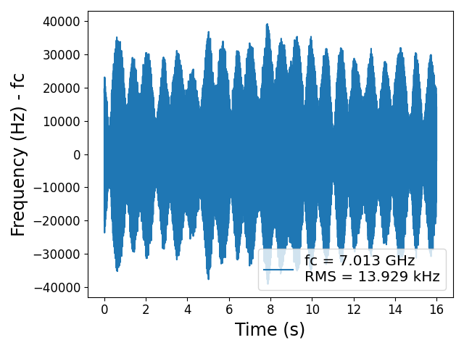
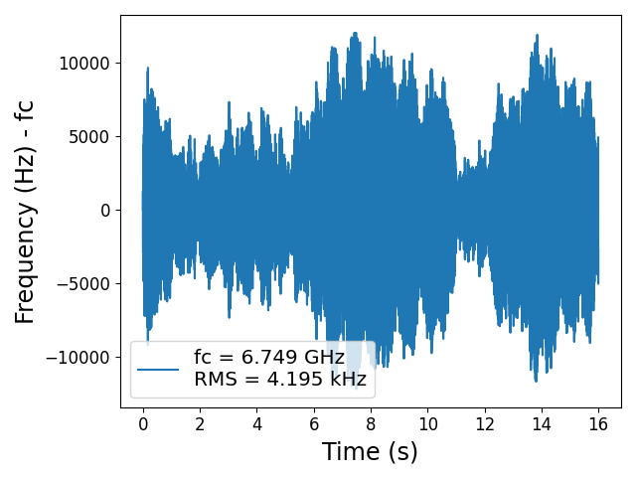
Plunger cavity microphonics
PNA
Measure with self-excited loop and phase noise analyzer.
Soka Suliman

Slide 14
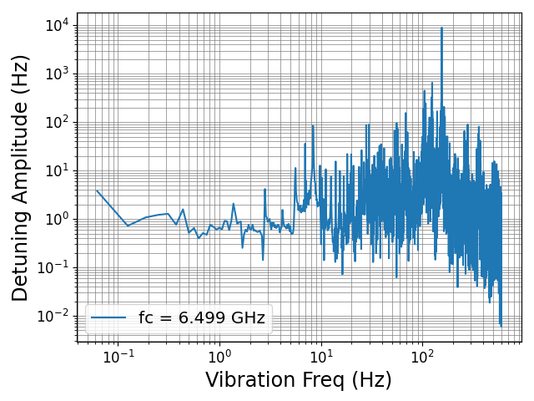
Take FFT of microphonics to understand source
Mechanical eigenmodes of plunger.
Harmonics of 1.4 Hz pulse tube motors.
Improvements:
Make plunger rod stiffer.
Mount cavity on vibration isolation.
Control phases between pulse tubes.
Separate pulse tubes from cryostat.
Stiffen cryostat frame.

Slide 15
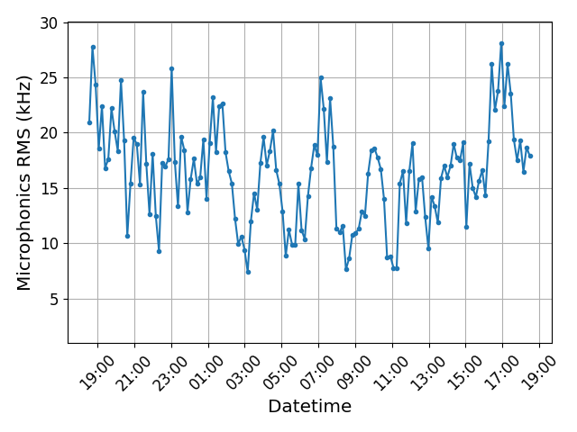
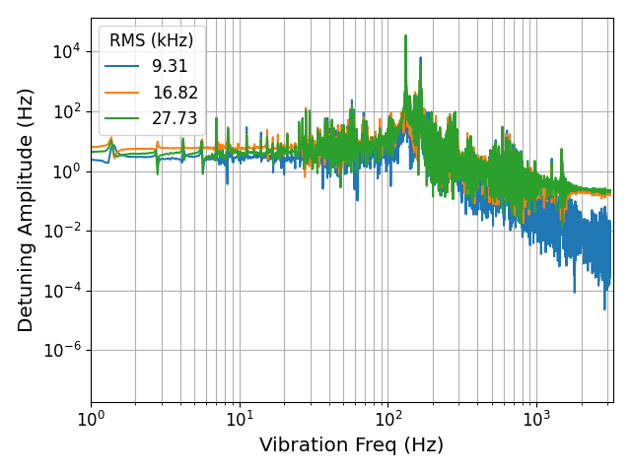
24 hour microphonics measurement at f_{c}~7 GHz
RMS varies from 4 kHz to 27 kHz throughout the day.
Spectral properties don’t seem to change, just amplitude.
Maybe because of 5 fridges running simultaneously + random phases between pulse tubes.

Slide 16
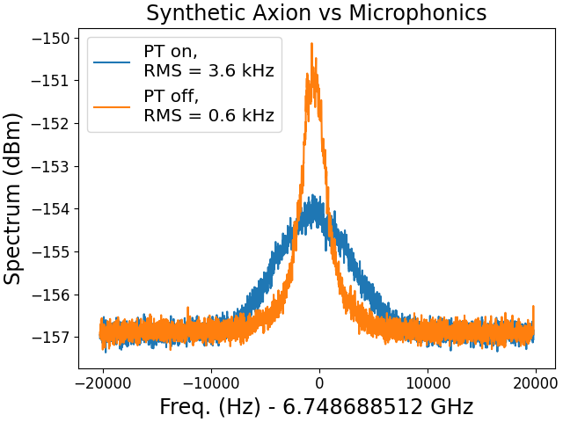
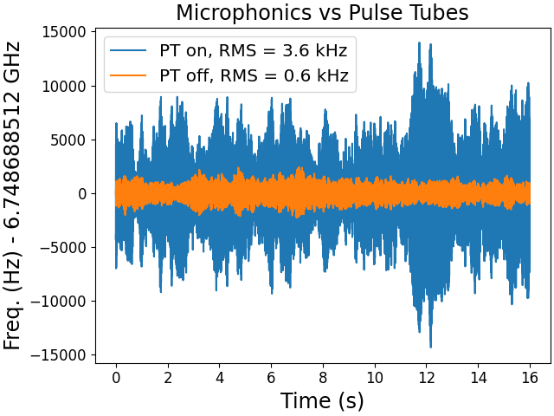
Measuring effect of microphonics on dark matter signal
Inject Q~10⁶ synthetic signal into cavity
Measure cavity spectra (look for DM)
Compare with pulse tube motors off.
~3 dB

Slide 17
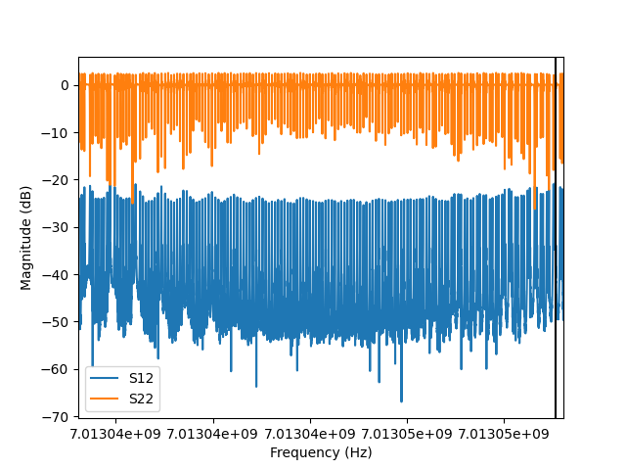
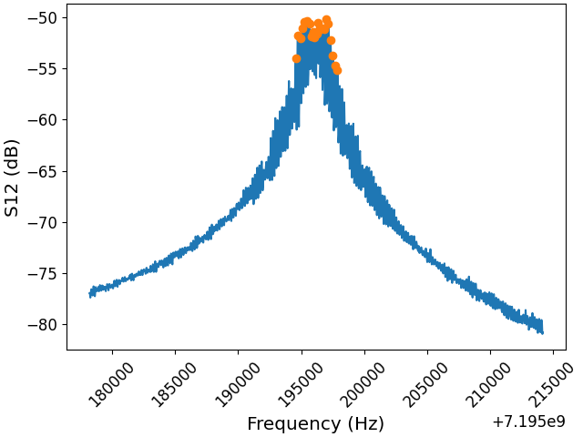
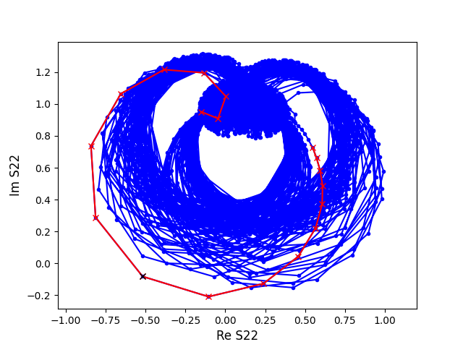
Your Haloscope on Microphonics.
VNA sweeps harder to interpret. More tricks to characterize cavity and systematics.

Slide 18
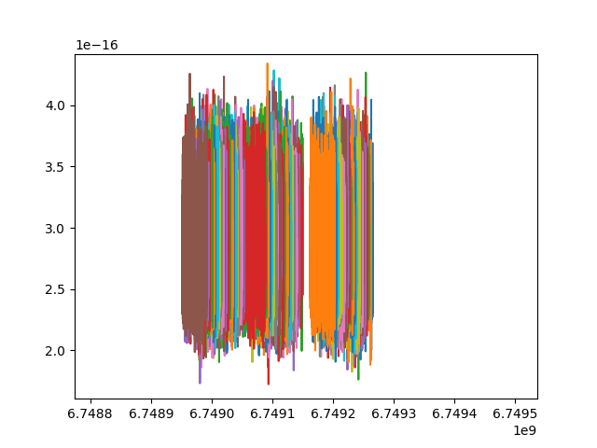
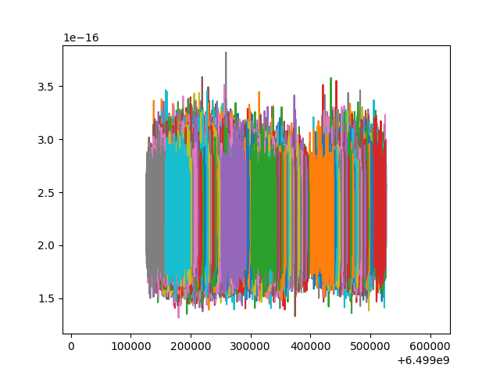
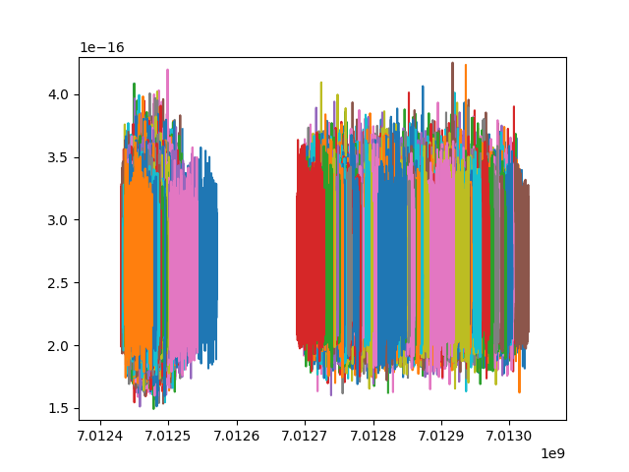
Dark Photon Dark Matter Search
Strongly overcoupled: QL ~ 10⁷
Tsys ~ 1 K
And here are some spectra

Slide 19
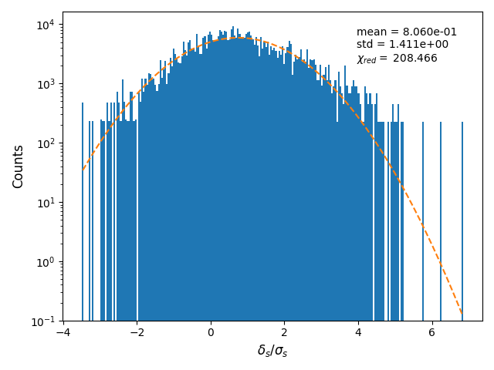
Spectra mostly white noise. Some candidates left to explore

Slide 20
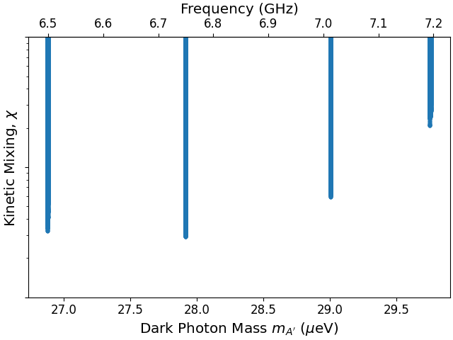
Dark Photon Dark Matter Limits in progress
Intentionally not showing other experiments and y-axis as analysis is ongoing.
Run 3
No JPA
Run 4

Slide 21
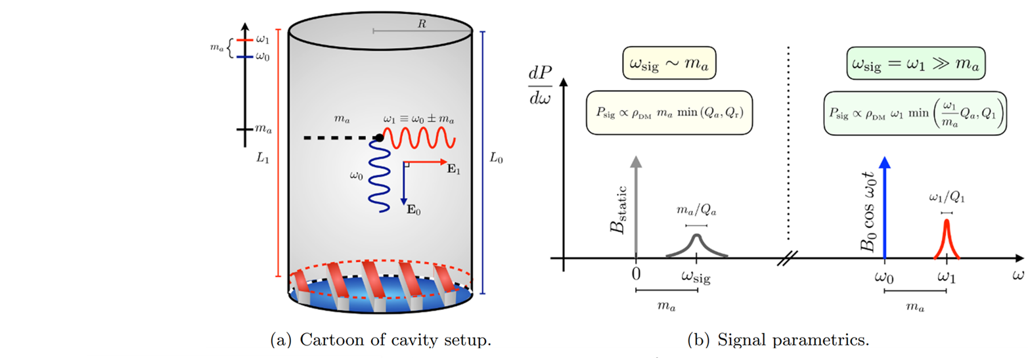
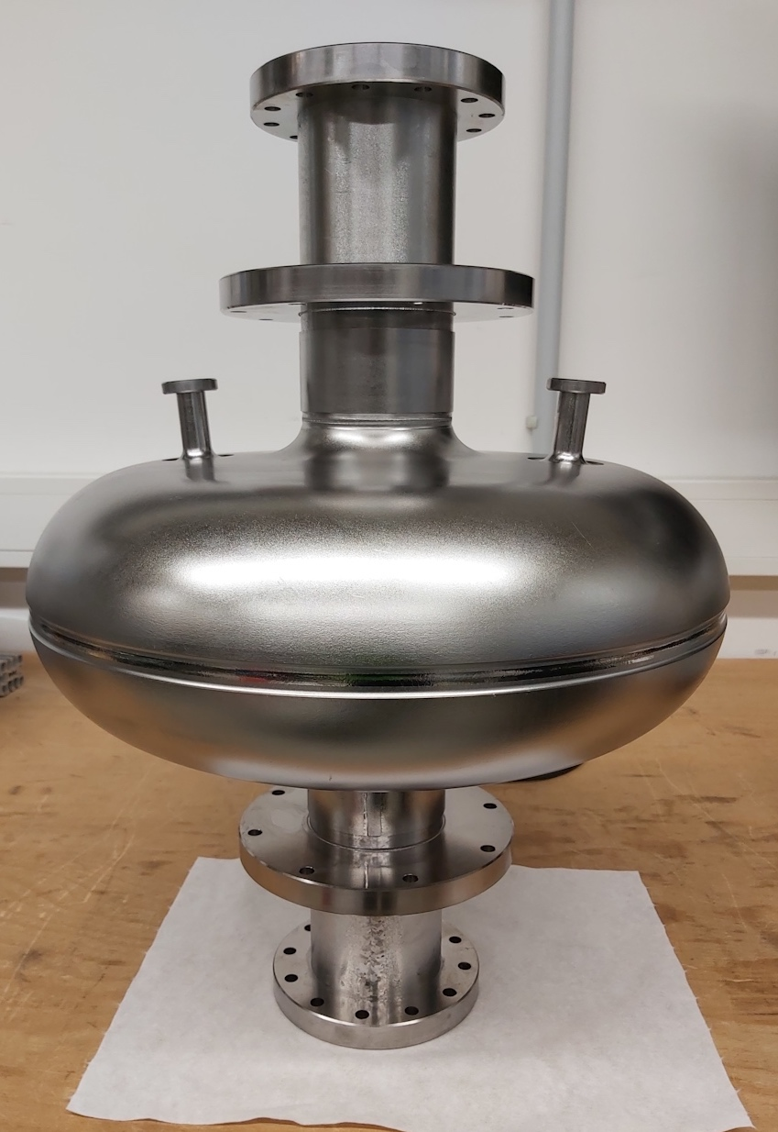
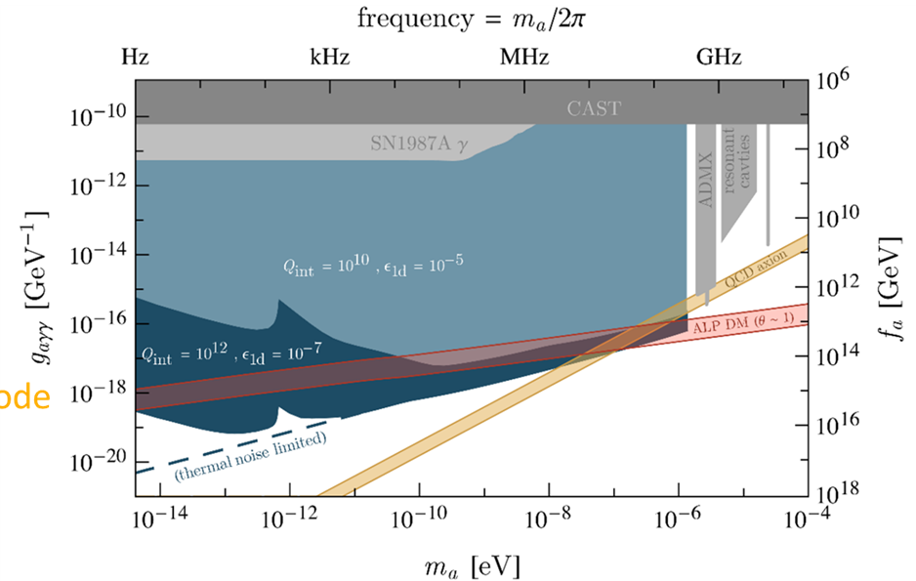
Shoutouts: Superconducting Heterodyne Axion Dark matter Experiment (SHADE)
Single SRF cavity, no applied 𝐵
TE₀₁₁ & TM₀₂₀ modes for axion DM search (𝑚ₐ ≈ Δ𝑓)
Enables small mass searches without large cavities
Pump: TM₀₂₀, Signal: TE₀₁₁, Δf ≈ 1 MHz by design
2024: Two prototype cavities designed & fabricated
Now: QC, bulk EP, heat treatment, room-temp RF tests
1st cold test conducted focused on characterization of cavity and ancillary systems
Next: further cold tests to follow
A. Berlin, et al., Journal of High Energy Physics 2020.7 (2020)
B. Giaccone et al., arXiv:2207.11346 (2022)

Slide 22
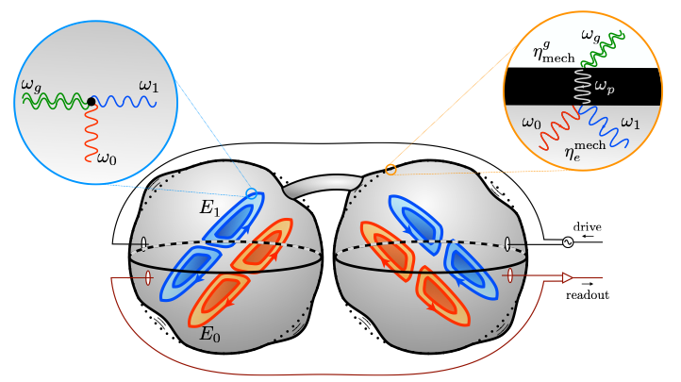
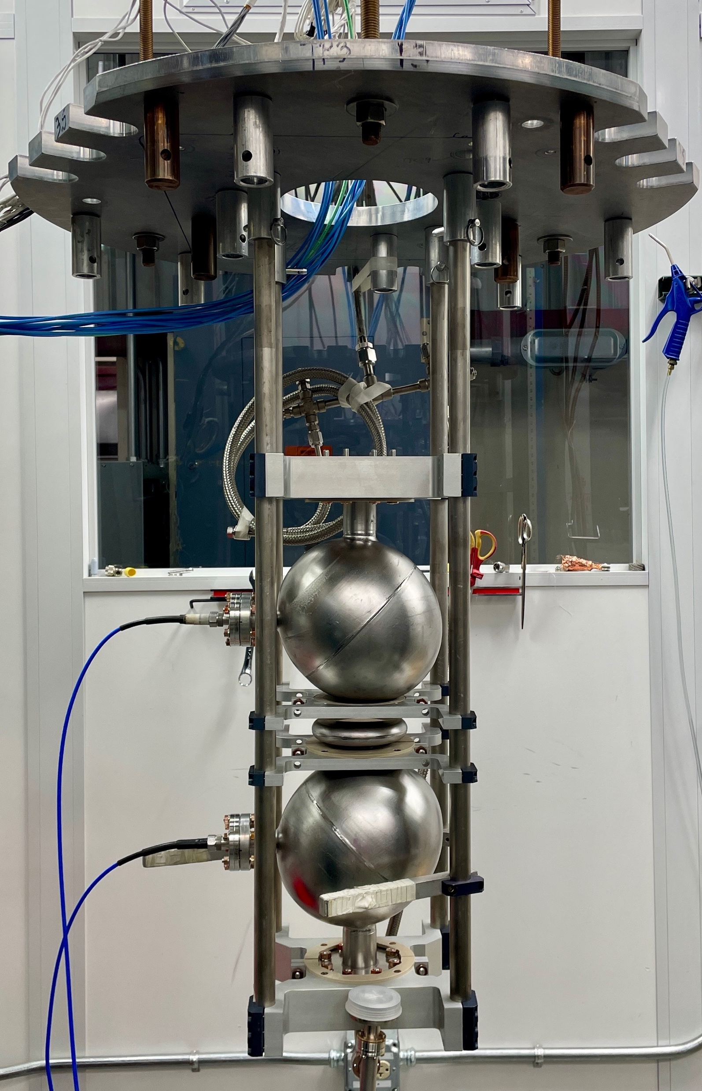
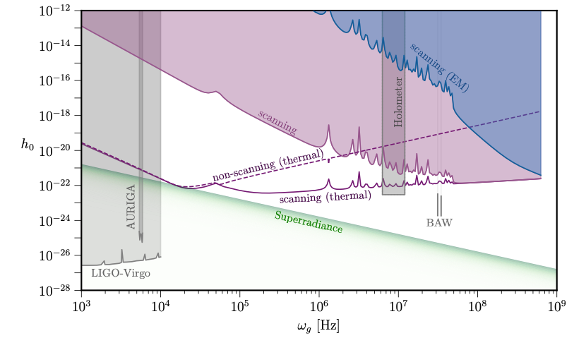
Shoutouts: High-Frequency Gravitational Wave Search search with ultrahigh –Q SRF cavities
MAGO (INFN & CERN, ~1998): Prototype experiments successful interaction but were later abandoned.
SQMS theorists further developed detection formalism (direct vs indirect)
Fermilab, DESY-UHH, and INFN are reviving MAGO
            Extensive room-temperature studies (RF, mechanical, tuning) led to the first RF cold test recently at 2K at Fermilab, and 4K at DESY.
            Developing an advanced RF readout system for the first physics run.
            See latest updates presented at SRF2025 conference this week: Marconato, G., et al., TUP078 and Giaccone, B., & Wenskat, M. FRB05
- Ballantini et al., Class. Quantum Grav. 20,2003, 3505–3522 (2003); - Berlin et al., Phys. Rev. D 105, 116011 (2022); - Berlin et al., arXiv:2303.01518v1 (2023); - Fischer et al, Class. Quantum Grav. 42 115015 (2025)

Slide 23
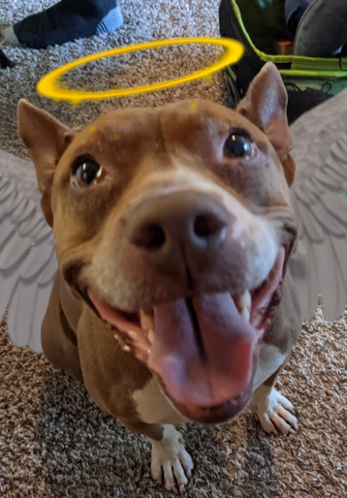

Summarize
Edited by T. Hucks
  Demonstrated widely tunable SRF cavity, 4-7 GHz.
  Struggling against microphonics and tuning reliability. V_{eff} also needs to be increased.
  Preliminary dark photon search accomplished. Data analysis and systematic studies ongoing.
Seraphine
the mascot.

Slide 24
The people
Scientists: Bianca Giaccone, Oleksandr Melnychuk, Ivan Nekrashevich, Asher Berlin, Sam Posen, Roni Harnik, Crispin Contreras-Martinez, Yuriy Pischalnikov, Anna Grassellino
Students: Soka Suliman, Daniel Molenaar, Fabio Castañeda
Engineers: Sergey Kazakov, Oleg V. Pronitchev, Akanksha Mishra, Roman Pilipenko, Tim Ring, Fumio Furata, Grzegorz Tatkowski, Matthew Dubiel, Michael Foley
Technicians: Tedd Ill, Mackenzie Ring, Dominic Baumgart, Damon Bice, Abraham Diaz, David Burke, Davida Smith
Machinists: Eddie Piezchala

Slide 25
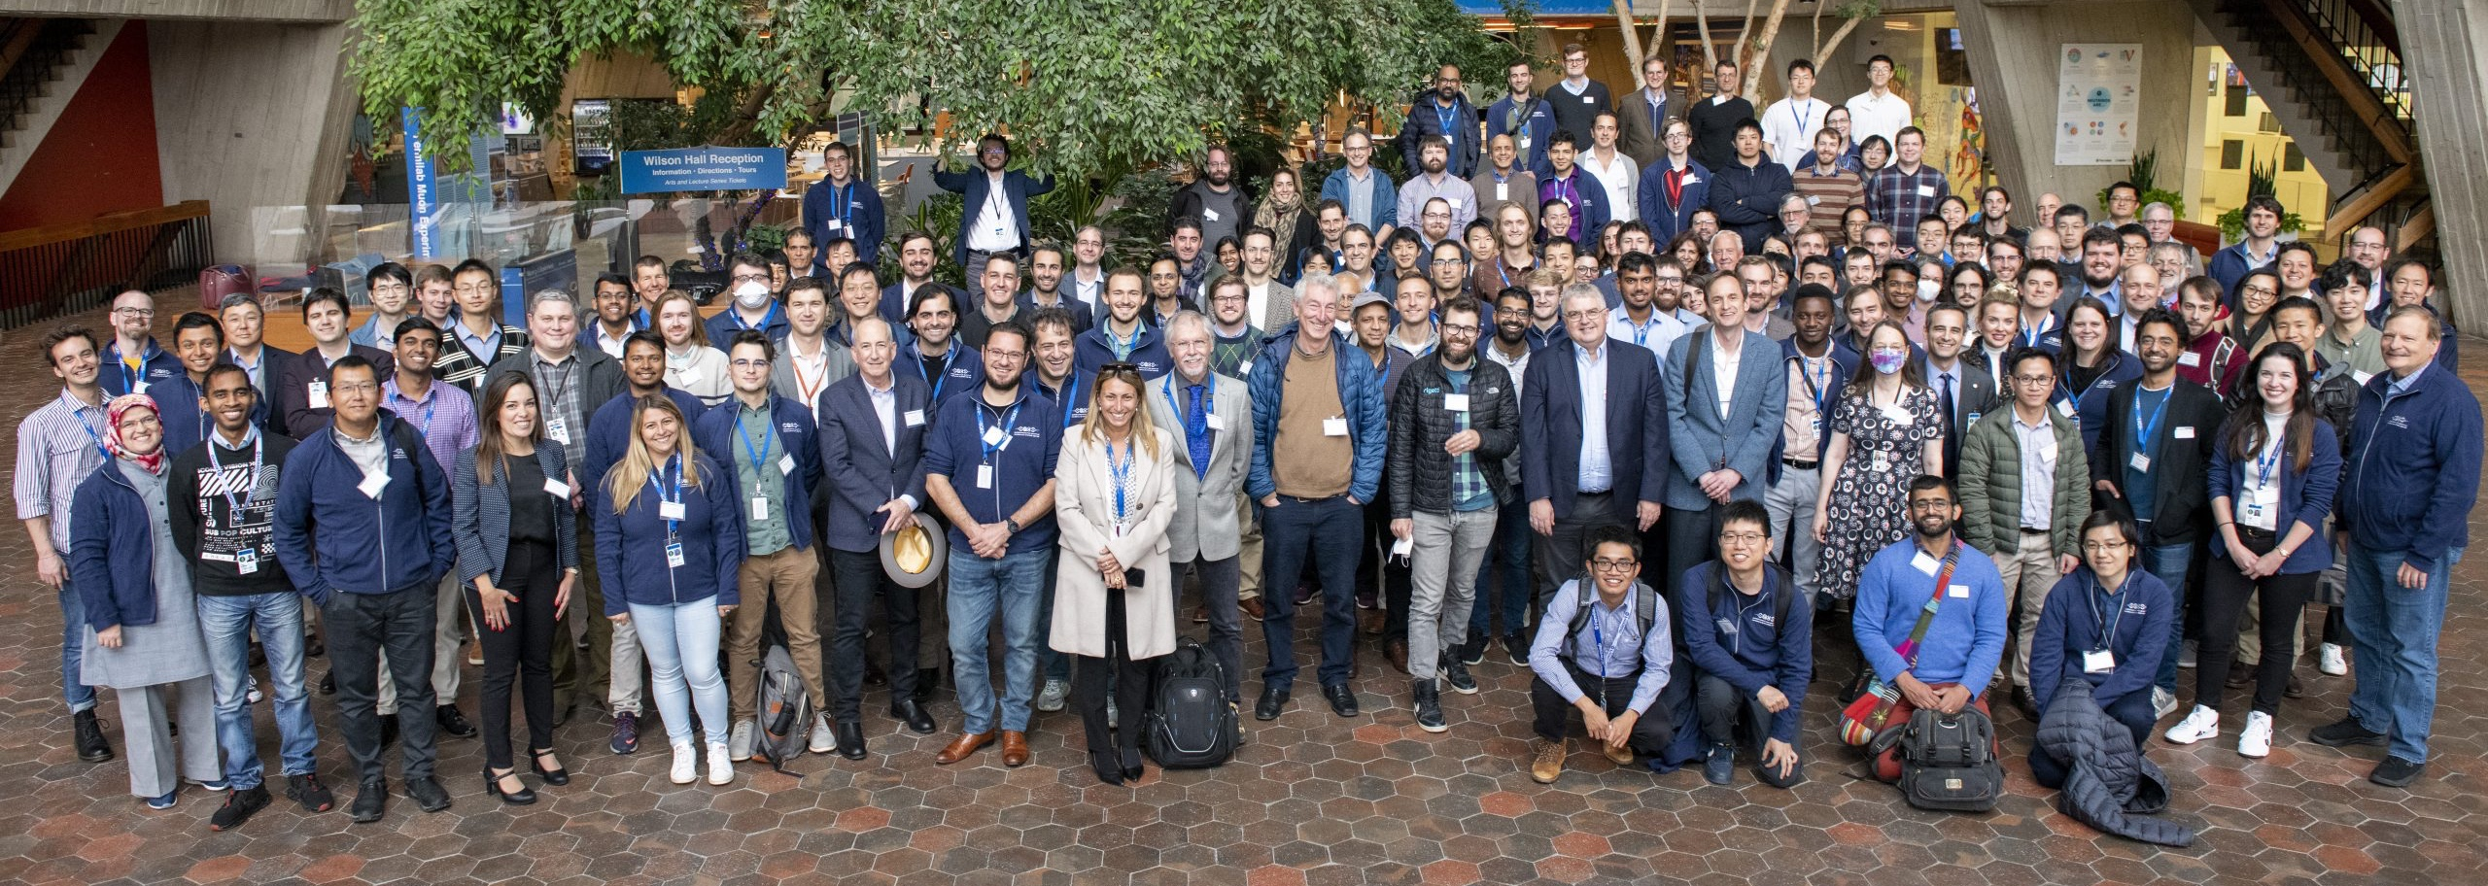
THANK YOU
This material is based upon work supported by the U.S. Department of Energy, Office of Science, National Quantum Information Science Research Centers, Superconducting Quantum Materials and Systems Center (SQMS) under contract number DE-AC02-07CH11359​

Slide 26
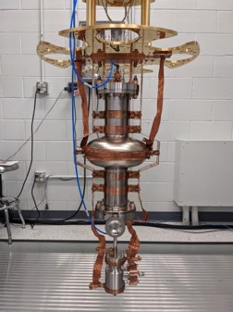
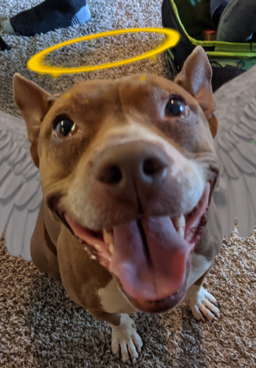
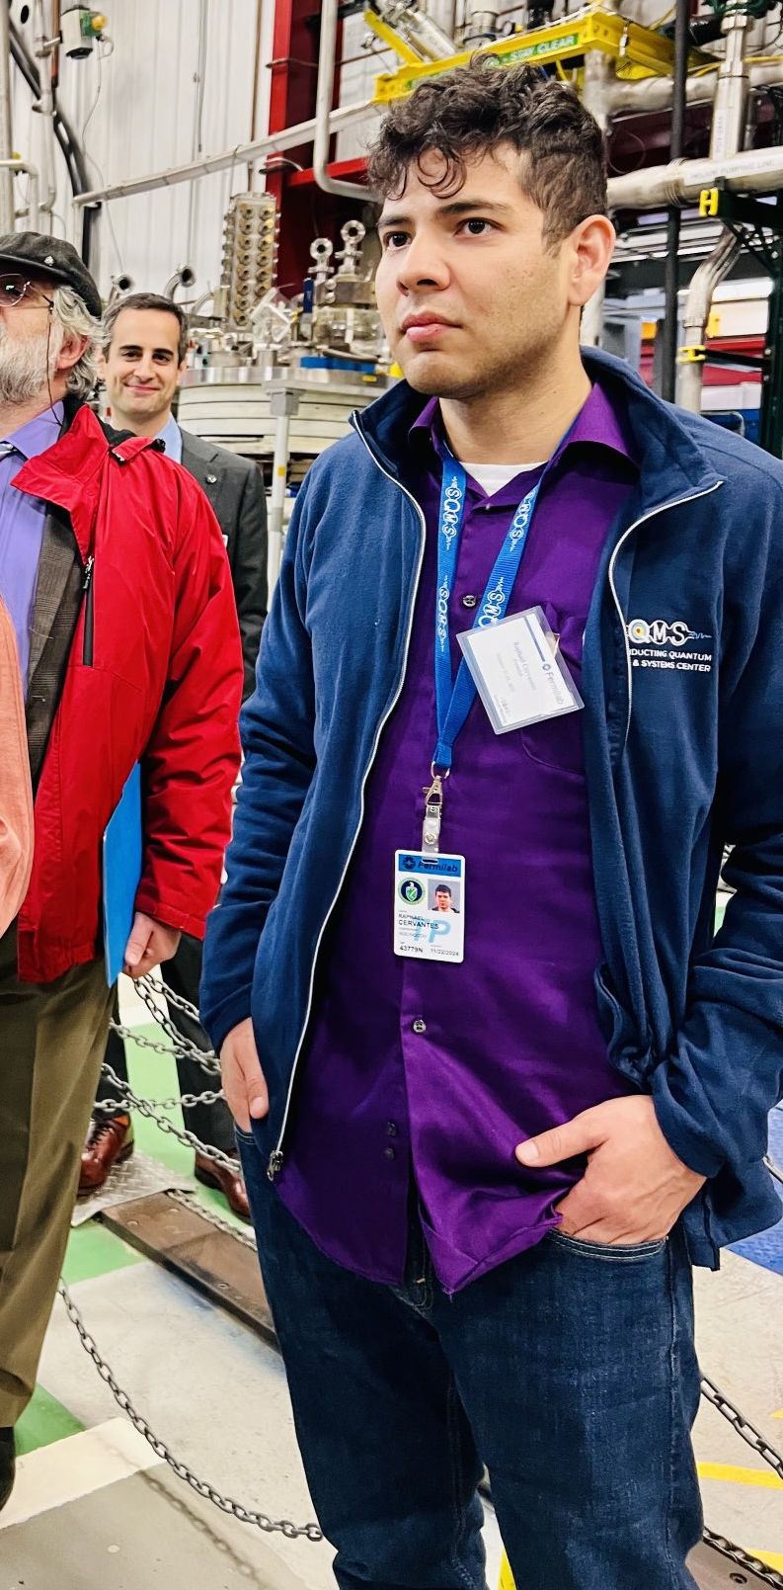
SERAPH: SupERconducting Axion and Paraphoton Haloscope
Family of SQMS SRF haloscope experiment. Name works on different levels.
SRF
Seraphine
Sir Raph(ael)
Edited by slimemoldgrappling

