Slide 1
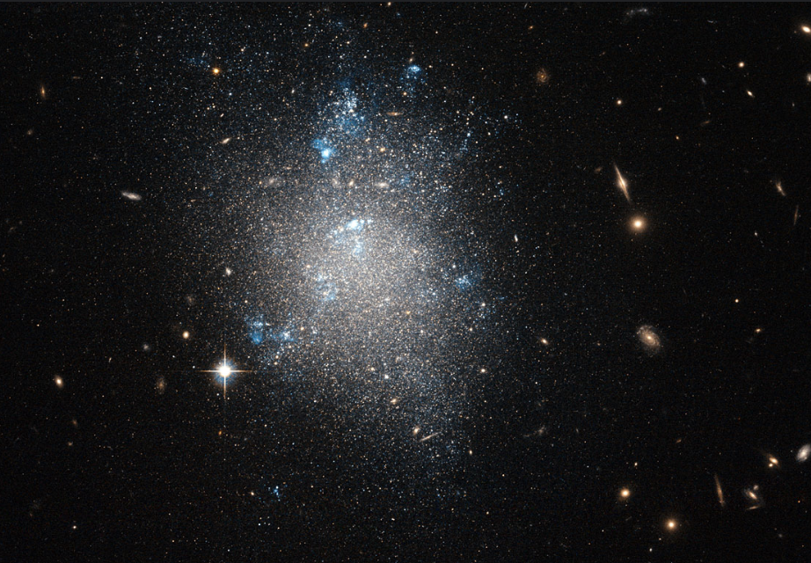





Looking for ultra-light axions using dwarf galaxies
Andrea Caputo
20th Patras Workshop
ERC Starting Grant
AstroDarkLS

Slide 2



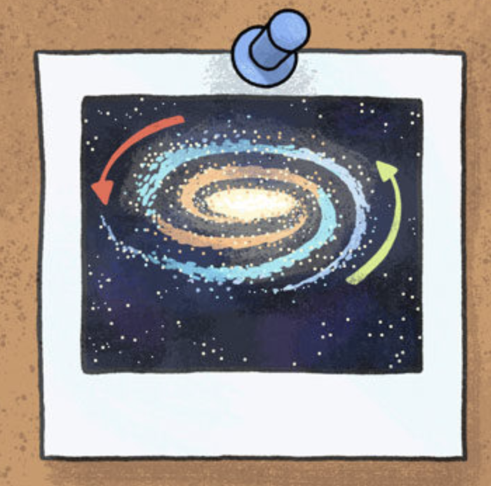
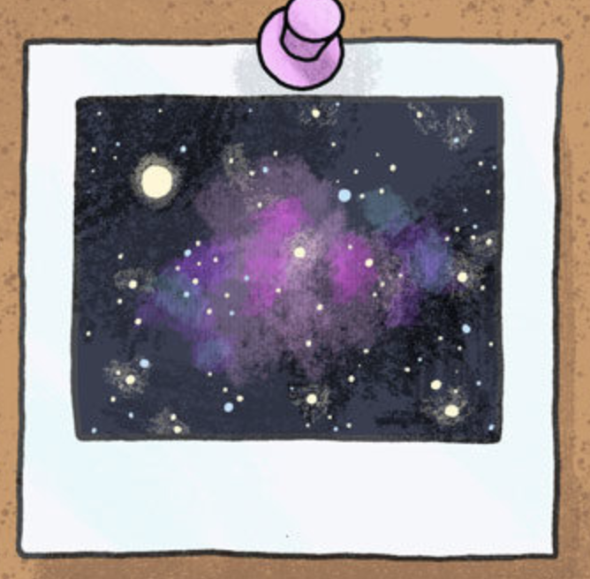
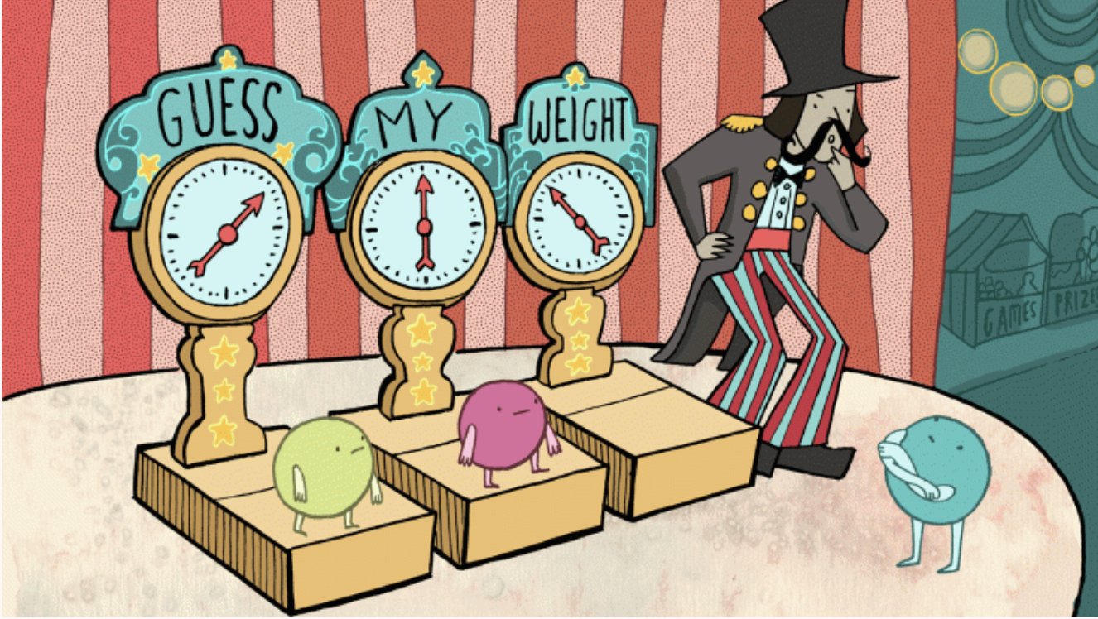


We have a lot of evidences for physics beyond the Standard Model
Dark Matter
Neutrino masses
Rotation Curves
Bullet Cluster
Matter-Antimatter Asymmetry

Slide 3

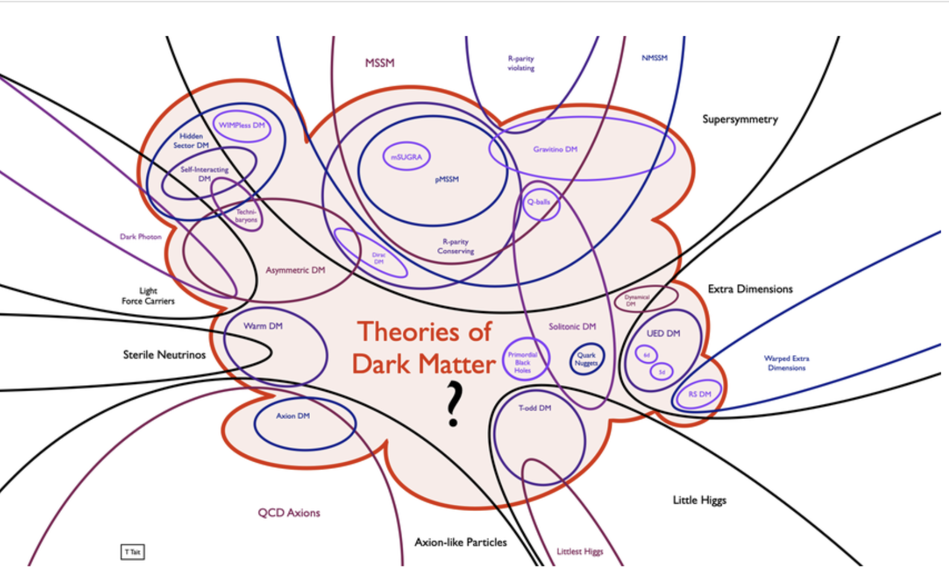
Let’s focus on dark matter
Tim Tait

Slide 4
In many models, DM interacts with the Standard Model beyond gravity. (Some) Motivated examples are the QCD axions and WIMPs.

Slide 5



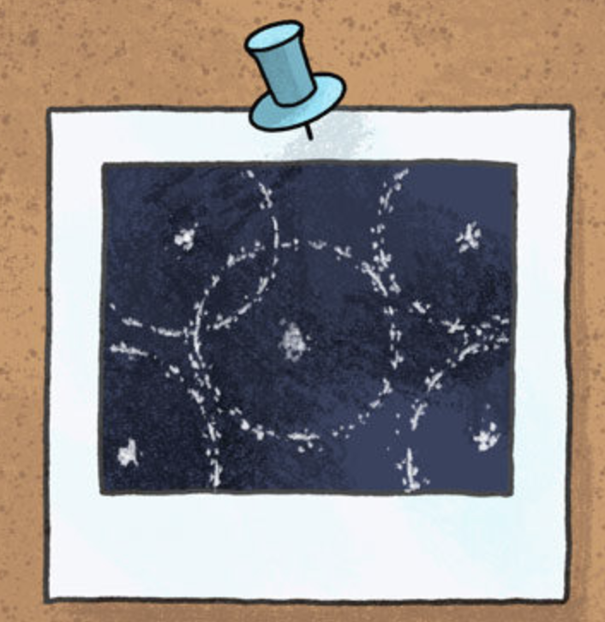
In many models, DM interacts with the Standard Model beyond gravity. (Some) Motivated examples are the QCD axions and WIMPs.
Nevertheless, so far all evidences for dark matter are based on gravitational interactions only.
Rotation Curves
Large Scale Structure
Bullet Cluster

Slide 6
Then, I think that a fair question is: what can we say about dark matter, if it happens to interact only gravitationally with baryonic matter?

Slide 7

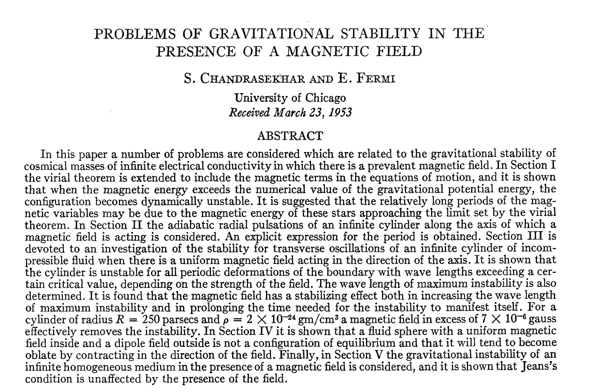

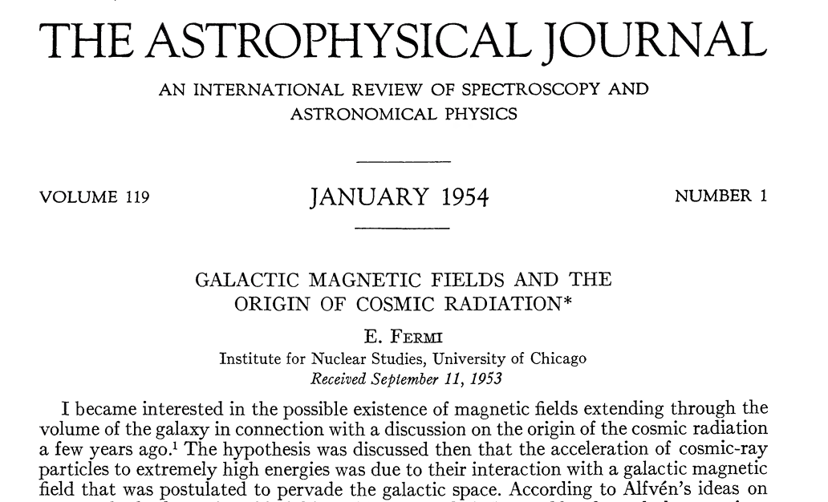

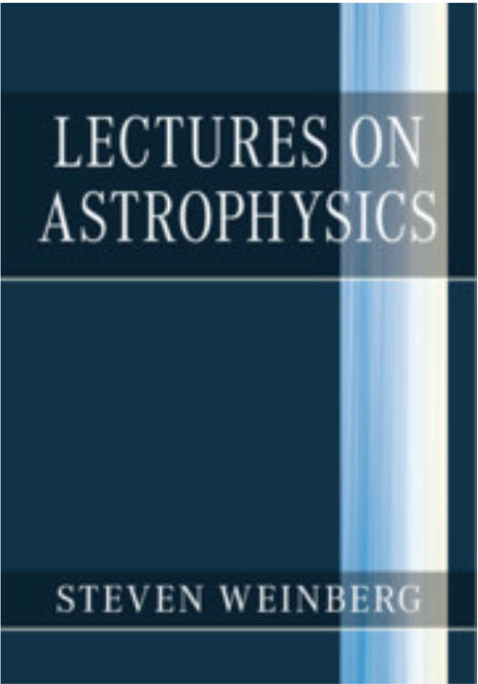

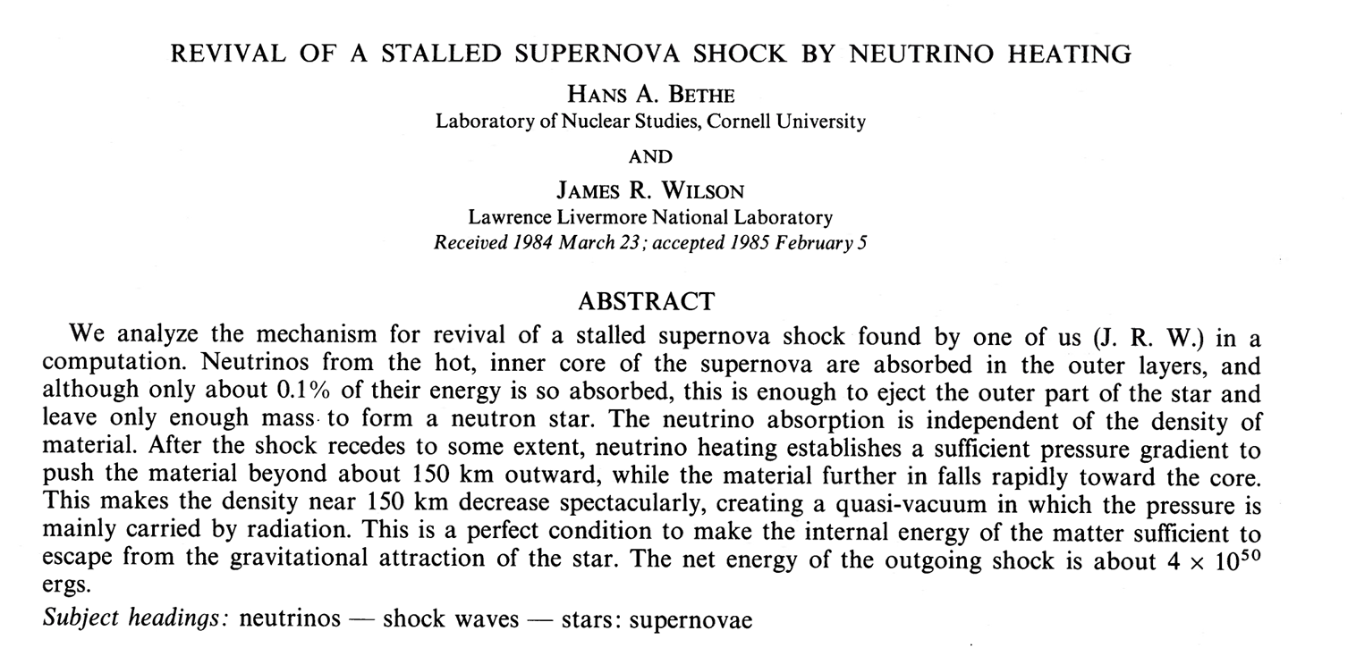

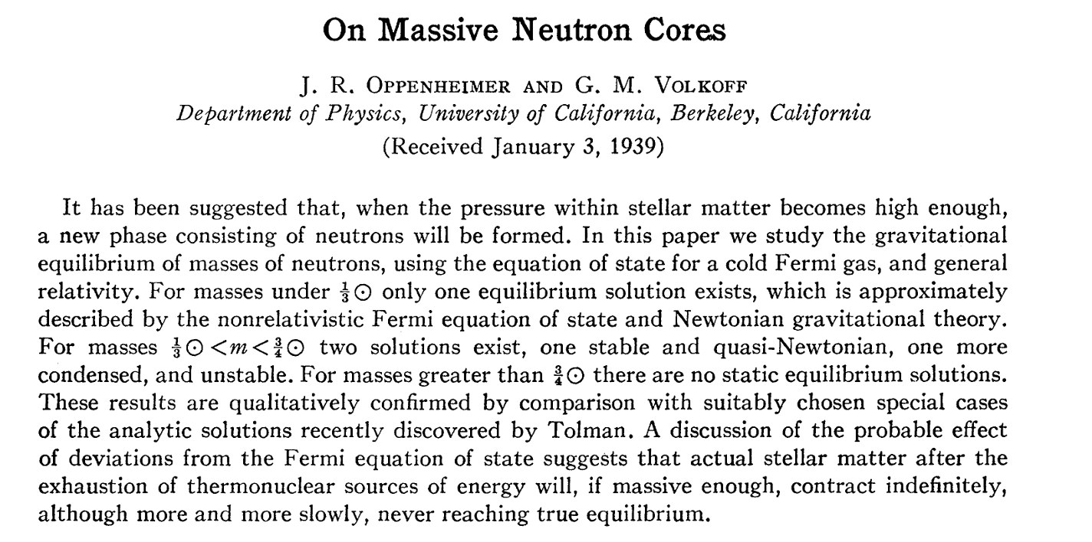

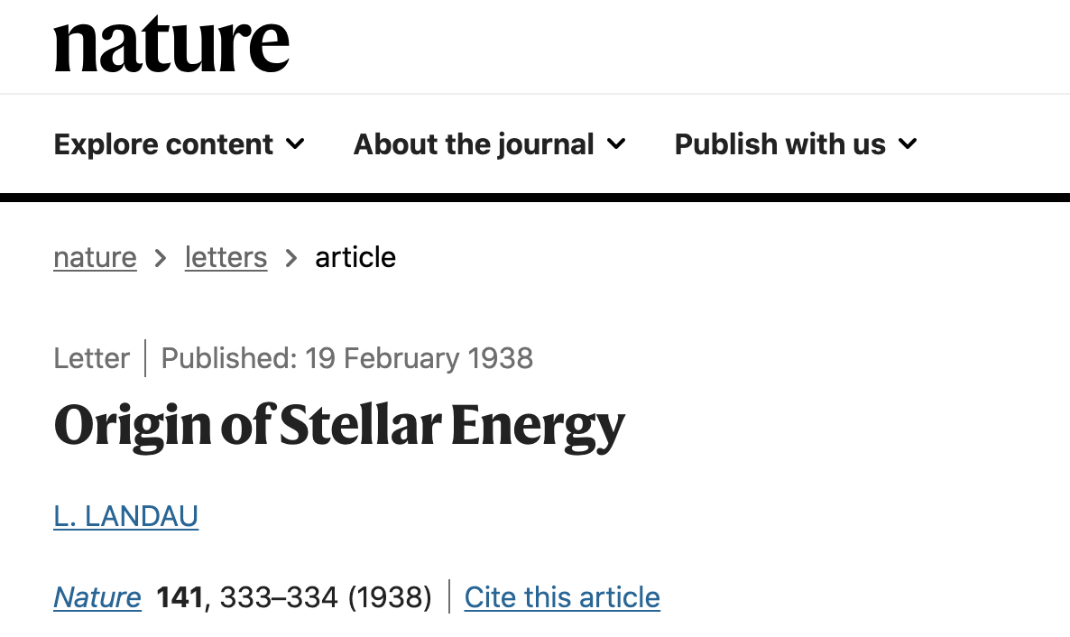
Intersection between particle physics and astrophysics

Slide 8

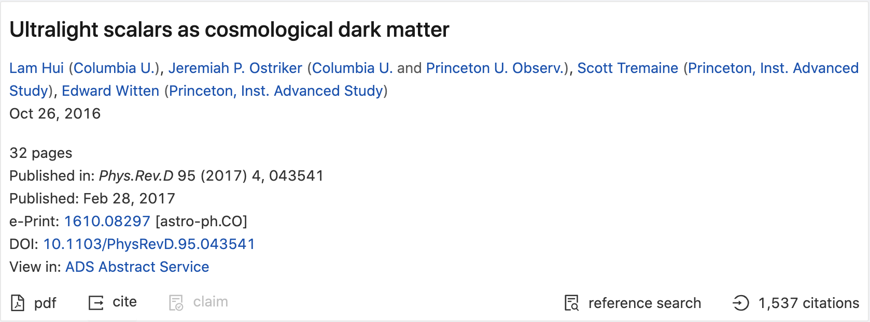
Fuzzy dark matter
$$m∼{10}^{-22}-{10}^{-21}eV$$

Slide 9

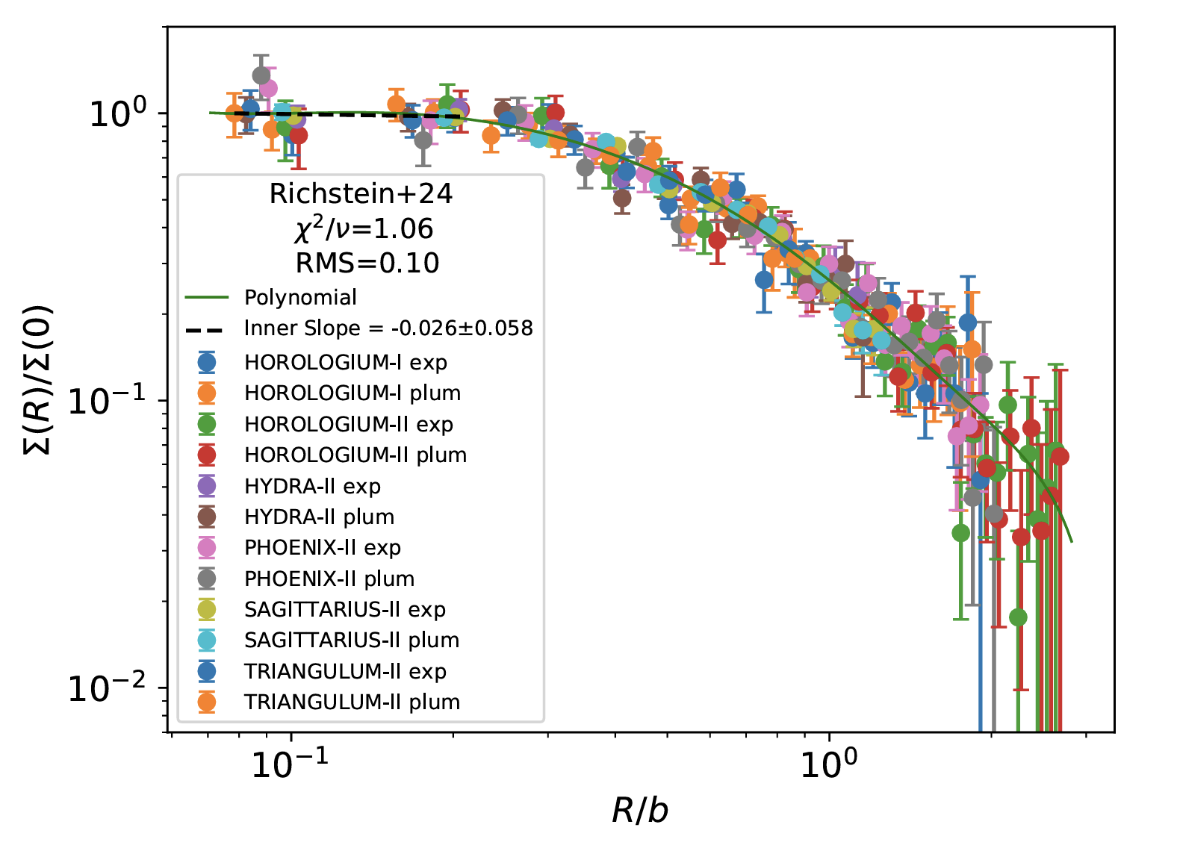

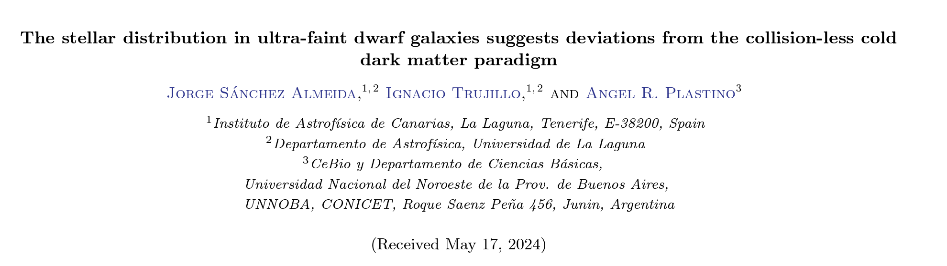
Fuzzy dark matter
$$m∼{10}^{-22}-{10}^{-21}eV$$
Motivations
1) Small-scales problems of LCDM (for example Cusp/core problem)

Slide 10
Fuzzy dark matter
$$m∼{10}^{-22}-{10}^{-21}eV$$
Motivations
1) Small-scales problems of LCDM (for example Cusp/core problem)
2) Easy to produce the right abundance via the misalignment mechanism
$$Ω_{a}∼0.1(\frac{f}{{10}^{17}GeV})^{2}(\frac{m_{a}}{{10}^{-22}eV})^{1/2}$$

Slide 11

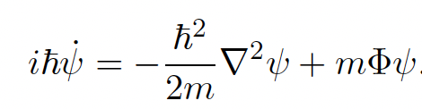


Fuzzy dark matter
$$m∼{10}^{-22}-{10}^{-21}eV$$
Motivations
1) Small-scales problems of LCDM (for example Cusp/core problem)
2) Easy to produce the right abundance via the misalignment mechanism
$$Ω_{a}∼0.1(\frac{f}{{10}^{17}GeV})^{2}(\frac{m_{a}}{{10}^{-22}eV})^{1/2}$$

Slide 12
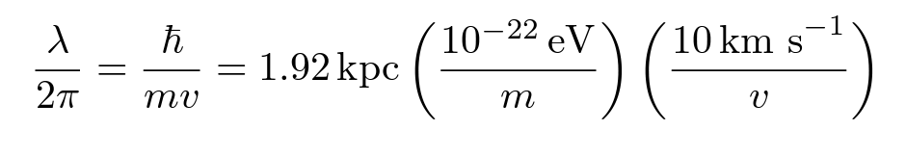
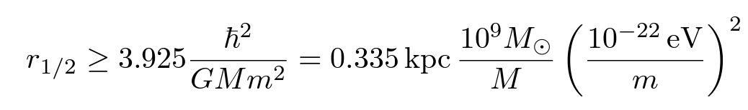
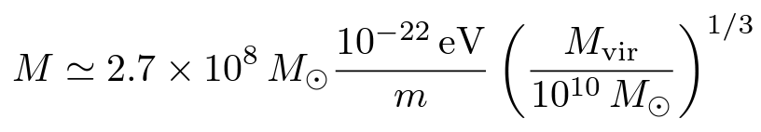
Some numbers and figures
H.-Y. Schive, M.-H. Liao, T.-P. Woo, S.-K. Wong, T. Chiueh, T. Broadhurst, and W.-Y. Pauchy Hwang,
Phys. Rev. Lett., 113, 261302 (2014)

Slide 13

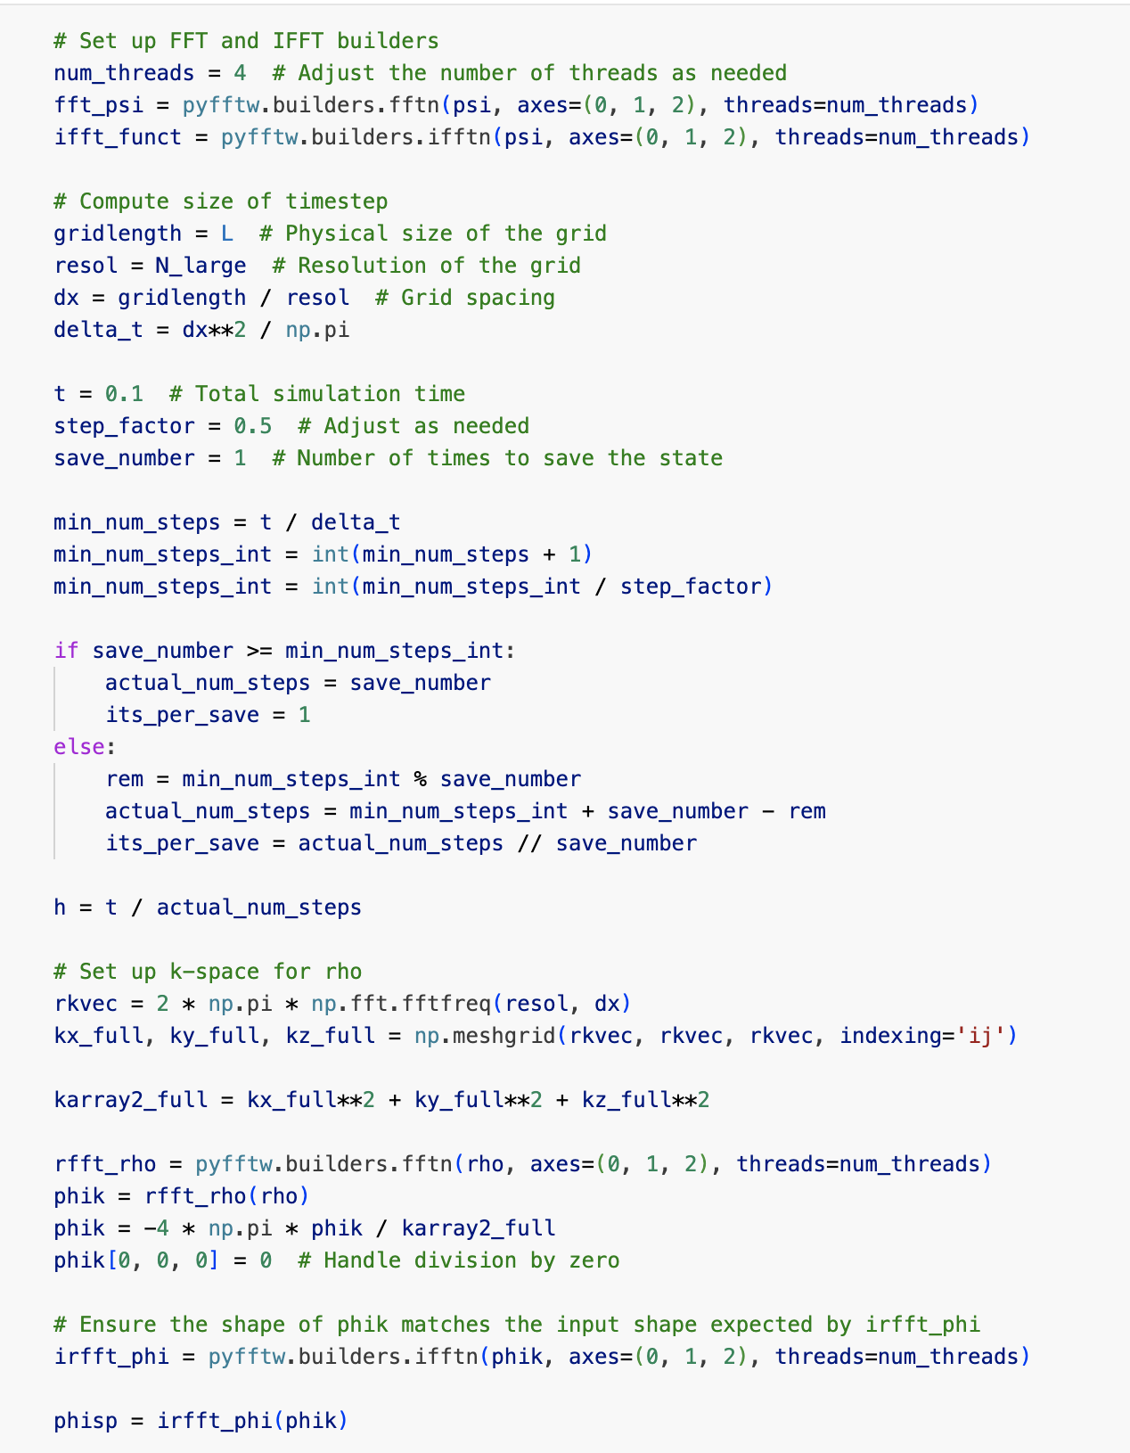
Some numbers and figures
Symmetrised split-step Fourier method
H.-Y. Schive, M.-H. Liao, T.-P. Woo, S.-K. Wong, T. Chiueh, T. Broadhurst, and W.-Y. Pauchy Hwang,
Phys. Rev. Lett., 113, 261302 (2014)

Slide 14
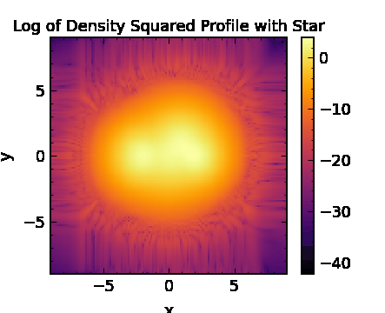
Some numbers and figures
Symmetrised split-step Fourier method
H.-Y. Schive, M.-H. Liao, T.-P. Woo, S.-K. Wong, T. Chiueh, T. Broadhurst, and W.-Y. Pauchy Hwang,
Phys. Rev. Lett., 113, 261302 (2014)

Slide 15

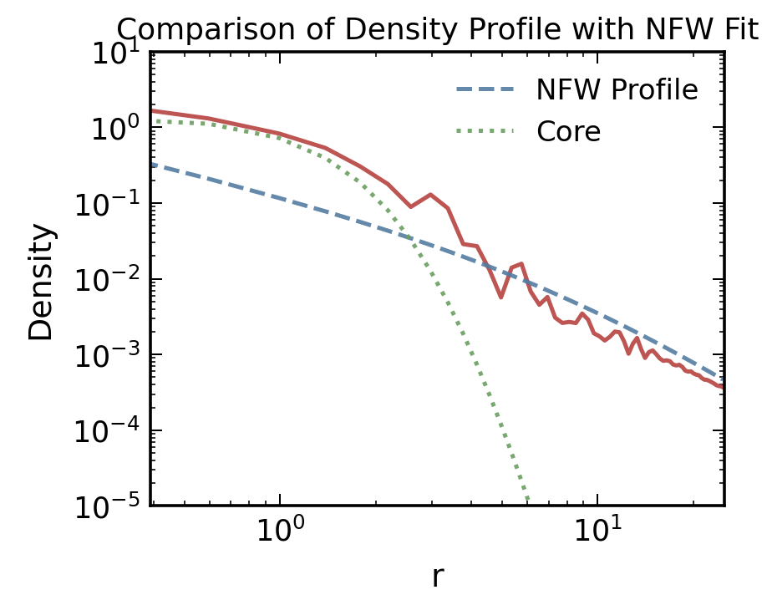
Some numbers and figures
Symmetrised split-step Fourier method
H.-Y. Schive, M.-H. Liao, T.-P. Woo, S.-K. Wong, T. Chiueh, T. Broadhurst, and W.-Y. Pauchy Hwang,
Phys. Rev. Lett., 113, 261302 (2014)

Slide 16

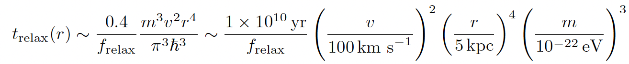
Some numbers and figures
Symmetrised split-step Fourier method
H.-Y. Schive, M.-H. Liao, T.-P. Woo, S.-K. Wong, T. Chiueh, T. Broadhurst, and W.-Y. Pauchy Hwang,
Phys. Rev. Lett., 113, 261302 (2014)

Slide 17
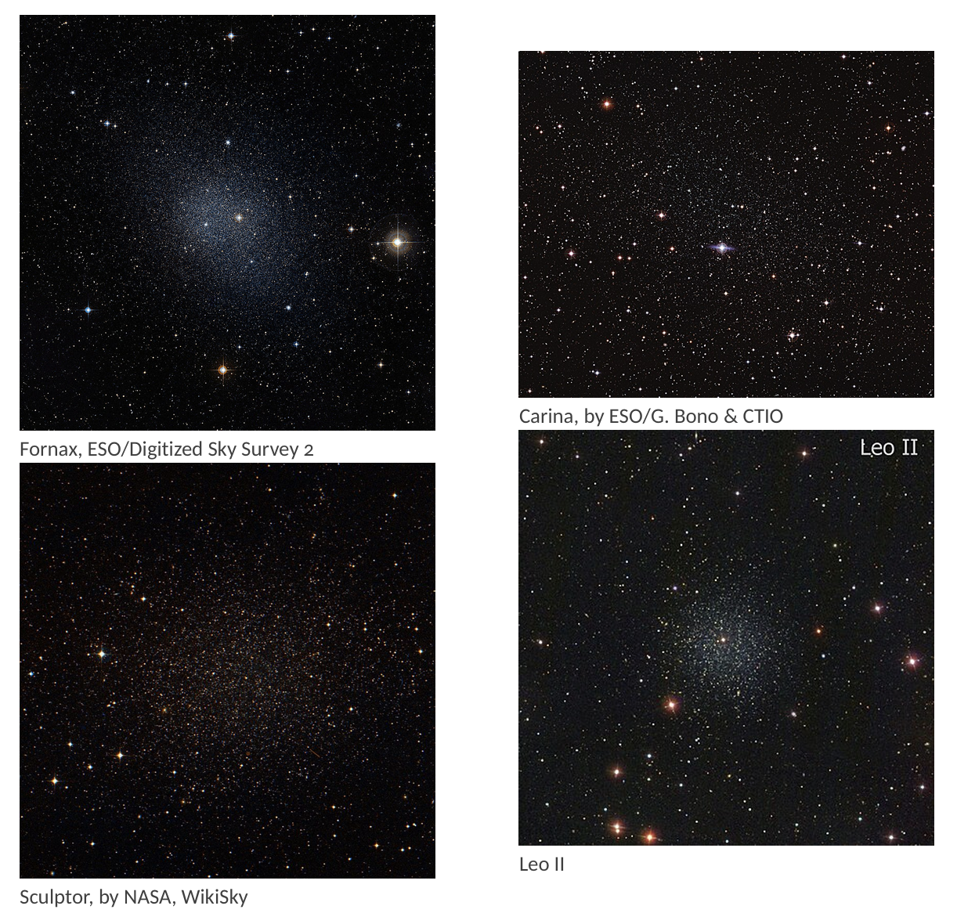
Dwarf Galaxies as a target
Why are they good?
Dark-matter dominated systems, ideal to probe DM-only effects
Milky way has order 20, radial stellar kinematics measurement possible
Many works focusing on these galaxies and ultrafaint ones, with different level of detail, e.g. D. D. Chowdhury et al 2023 [2303.08846], T. Zimmerman et al 2024 [2405.20374], D. J.E. Marsh et al 2019 [1810.08543], N. Dalal et al 2022 [2203.05750]

Slide 18
Dwarf Galaxies as a target
Why are they good?
Dark-matter dominated systems, ideal to probe DM-only effects
Milky way has order 20, radial stellar kinematics measurement possible
Many works focusing on these galaxies and ultrafaint ones, with different level of detail, e.g. D. D. Chowdhury et al 2023 [2303.08846], T. Zimmerman et al 2024 [2405.20374], D. J.E. Marsh et al 2019 [1810.08543], N. Dalal et al 2022 [2203.05750]
We improve upon previous works in that we study soliton dynamics self-consistently and trace stellar dynamics, confronting with data.

Slide 19

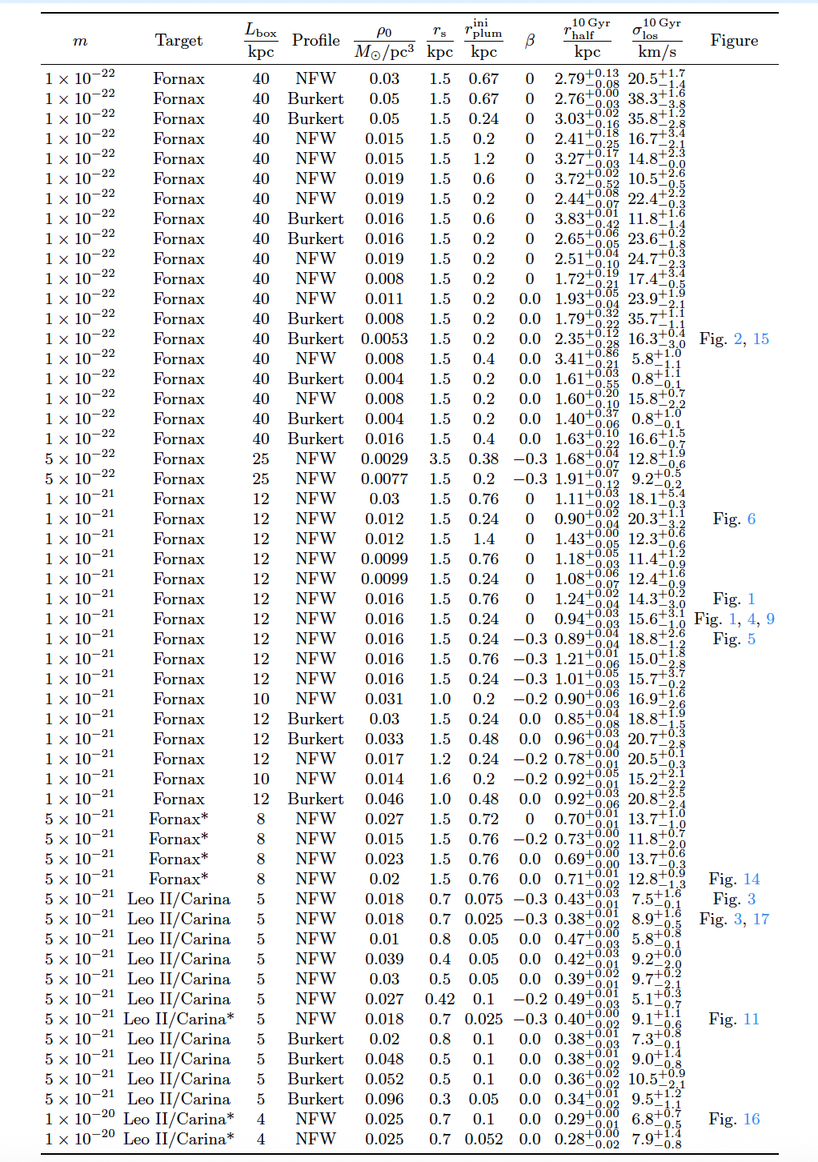
Dwarf Galaxies as a target
Why are they good?
Dark-matter dominated systems, ideal to probe DM-only effects
Milky way has order 20, radial stellar kinematics measurement possible
Many works focusing on these galaxies and ultrafaint ones, with different level of detail, e.g. D. D. Chowdhury et al 2023 [2303.08846], T. Zimmerman et al 2024 [2405.20374], D. J.E. Marsh et al 2019 [1810.08543], N. Dalal et al 2022 [2203.05750]
We improve upon previous works in that we study soliton dynamics self-consistently and trace stellar dynamics, confronting with data.

Slide 20



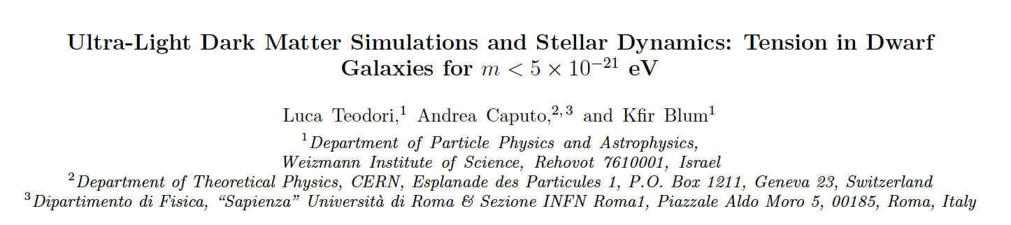
Many systems and observables to study!
A first work
w Kfir Blum and Luca Teodori

Slide 21
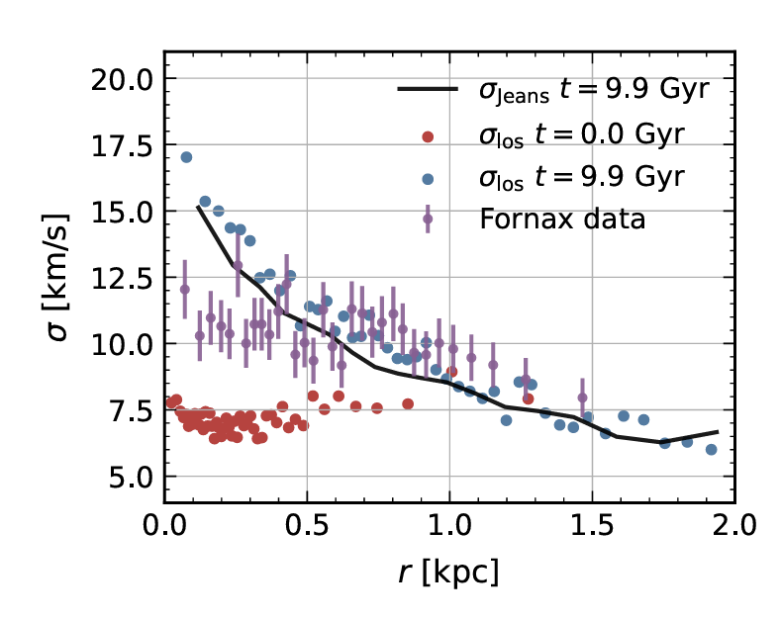
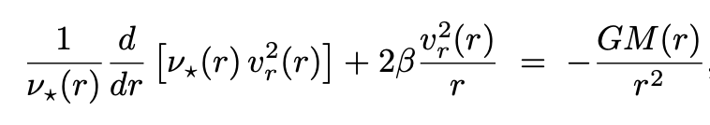
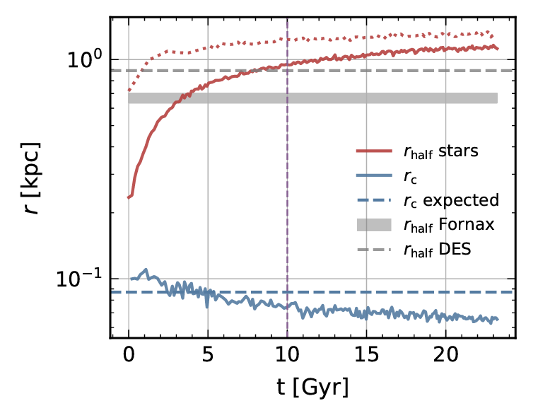
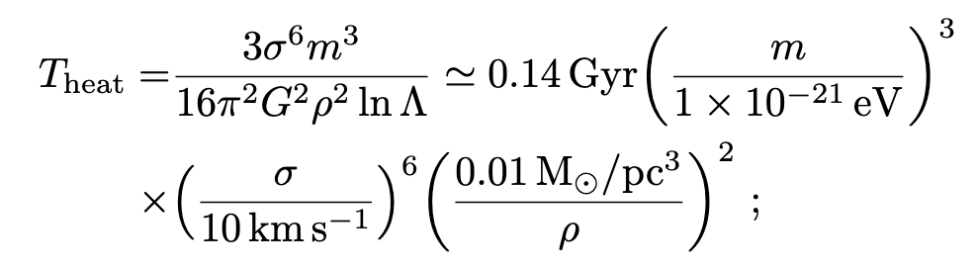
Many systems and observables to study!
A first work
w Kfir Blum and Luca Teodori
$$m_{a}={10}^{-21}eV$$
Two main probes: dispersion velocities and half-light radius
Jeans equation
Heating due to quasi-particles
Ben Bar-Or, Jean-Baptiste Fouvry, and Scott Tremaine., Astrophys. J.,
871(1):28, 2019

Slide 22
Many systems and observables to study!
A first work
w Kfir Blum and Luca Teodori
$$m_{a}={10}^{-21}eV$$
Depending on the DM mass, the soliton creates a peak in the dispersion velocity, inconsistent with the (almost) flat curves we observe
Two main probes: dispersion velocities and half-light radius
Jeans equation
Heating due to quasi-particles
Ben Bar-Or, Jean-Baptiste Fouvry, and Scott Tremaine., Astrophys. J.,
871(1):28, 2019

Slide 23
Many systems and observables to study!
A first work
w Kfir Blum and Luca Teodori
$$m_{a}={10}^{-21}eV$$
Depending on the DM mass, the soliton creates a peak in the dispersion velocity, inconsistent with the (almost) flat curves we observe
Two main probes: dispersion velocities and half-light radius
Jeans equation
ULDM quasi-particles as well as soliton random motion heat up stars, puffing the system.
Heating due to quasi-particles
Half-light radius: radius which encompasses half of the galaxy light (mass for us)
Ben Bar-Or, Jean-Baptiste Fouvry, and Scott Tremaine., Astrophys. J.,
871(1):28, 2019

Slide 24
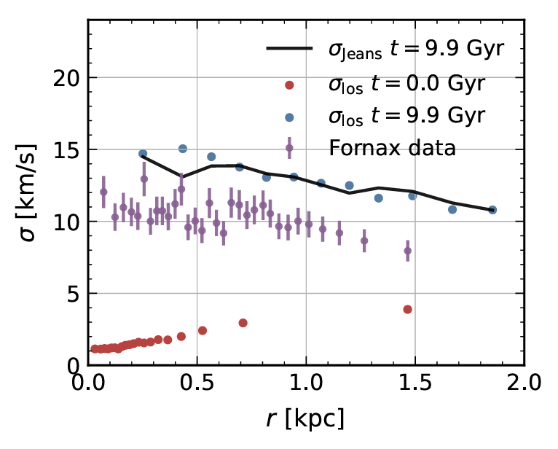
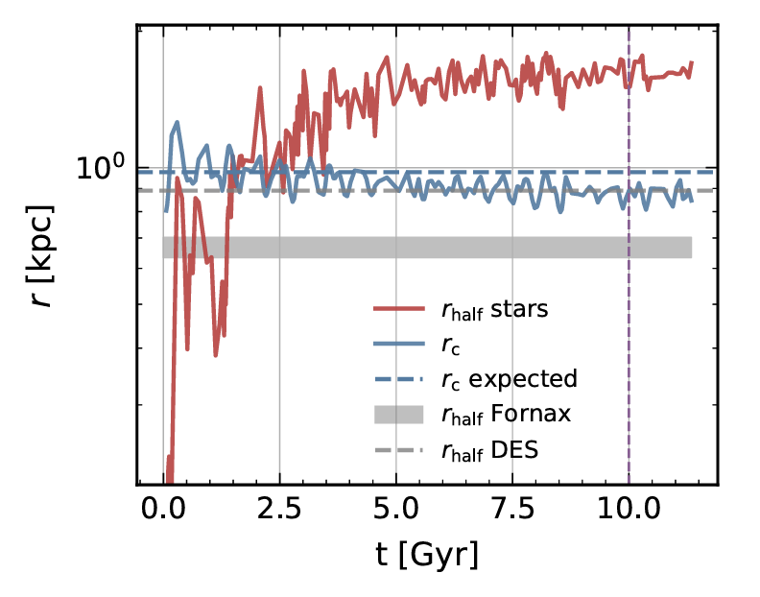
Many systems and observables to study!
A first work
w Kfir Blum and Luca Teodori
$$m_{a}={10}^{-21}eV$$
$$m_{a}={10}^{-22}eV$$
Two main probes: dispersion velocities and half-light radius
Jeans equation
Heating due to quasi-particles
Ben Bar-Or, Jean-Baptiste Fouvry, and Scott Tremaine., Astrophys. J.,
871(1):28, 2019

Slide 25
Many systems and observables to study!
A first work
w Kfir Blum and Luca Teodori
$$m_{a}={10}^{-21}eV$$
$$m_{a}={10}^{-22}eV$$
Two main probes: dispersion velocities and half-light radius
Jeans equation
$$m_{a}≲5×{10}^{-21}eV$$
disfavoured
Heating due to quasi-particles
Ben Bar-Or, Jean-Baptiste Fouvry, and Scott Tremaine., Astrophys. J.,
871(1):28, 2019

Slide 26
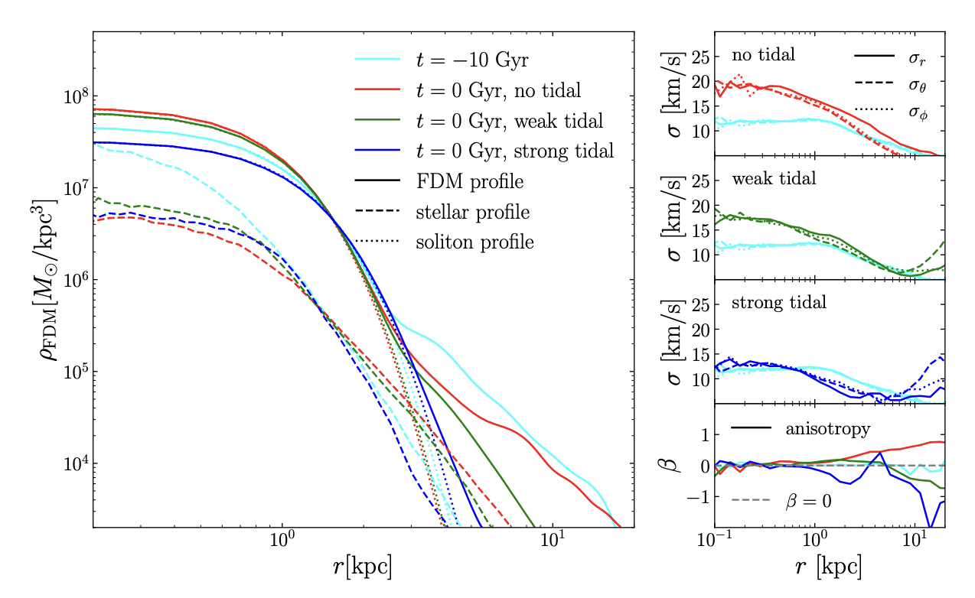
A few remarks
1) Tidal stripping from the MW could affect heating constraints from Fornax.
2507.01686

Slide 27
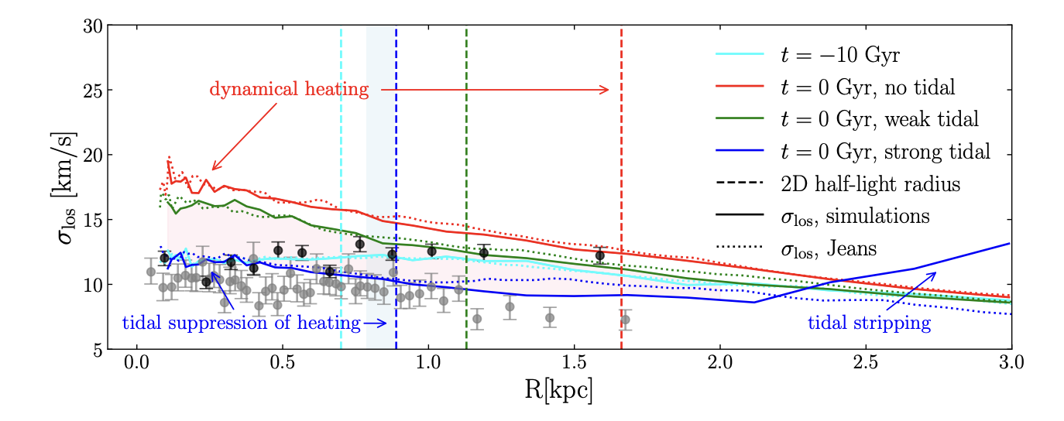
A few remarks
1) Tidal stripping from the MW could affect heating constraints from Fornax.
2507.01686

Slide 28
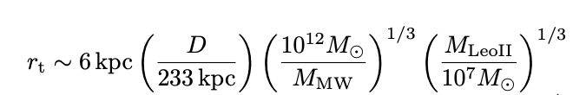
A few remarks
1) Tidal stripping from the MW could affect heating constraints from Fornax.
However this should not affect, for example, results for Leo II
2507.01686

Slide 29
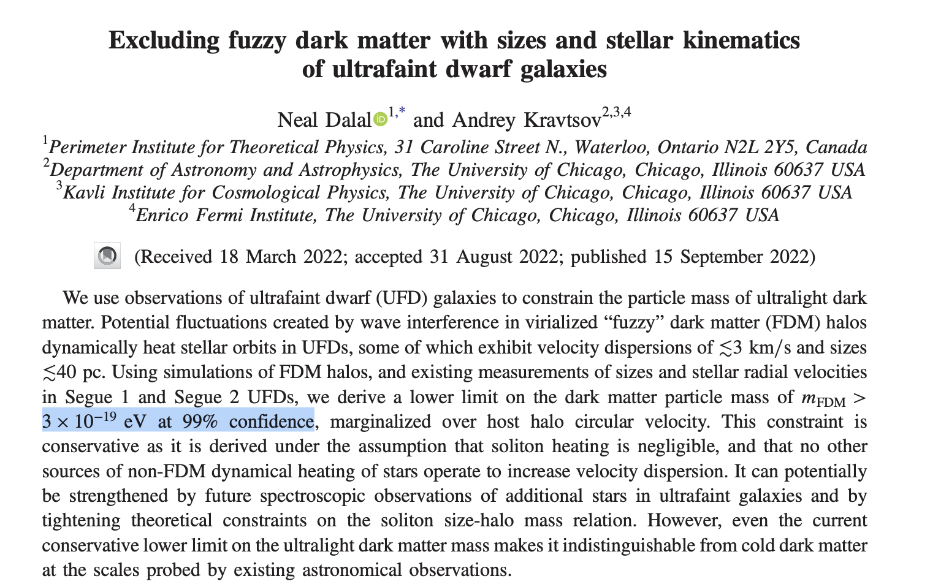
A few remarks
1) Tidal stripping from the MW could affect heating constraints from Fornax.
2) Segue I limits seem very strong, are they to be trusted?
2203.05750, see also the recent 2509.02781

Slide 30

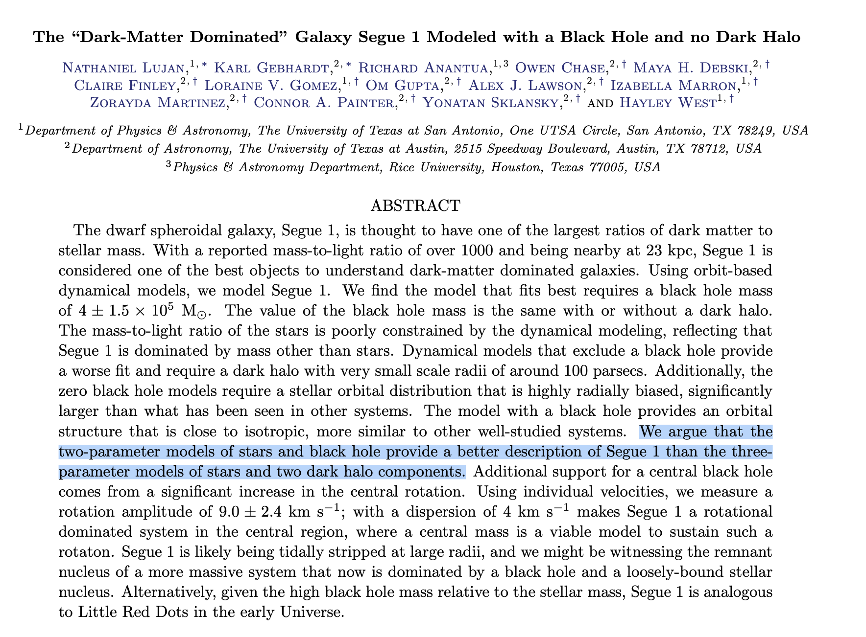
A few remarks
1) Tidal stripping from the MW could affect heating constraints from Fornax.
2) Segue I limits seem very strong, are they to be trusted?
2203.05750, see also the recent 2509.02781
Not so fast!

Slide 31
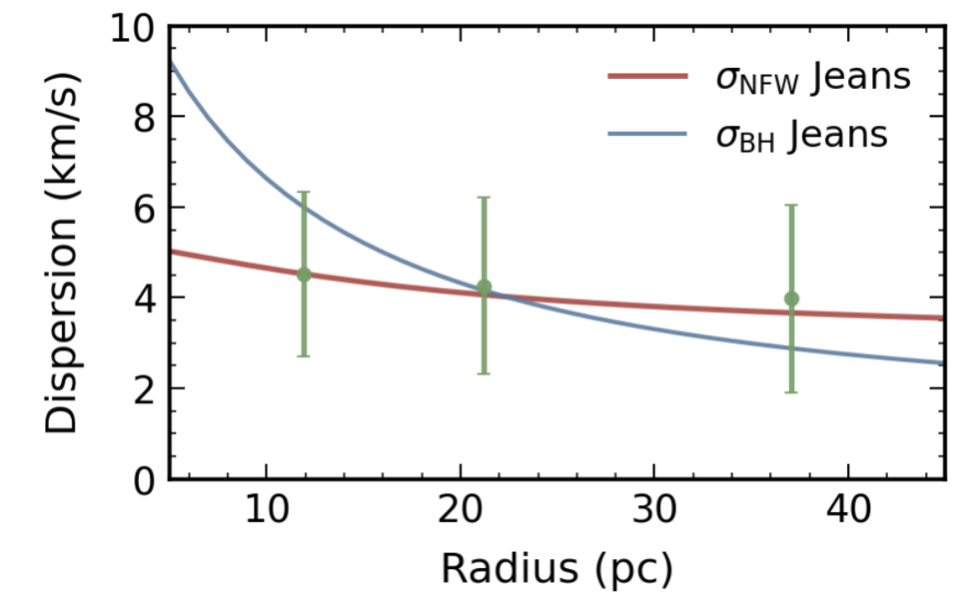
A few remarks
1) Tidal stripping from the MW could affect heating constraints from Fornax.
2) Segue I limits seem very strong, are they to be trusted?
2203.05750, see also the recent 2509.02781
Not so fast!
What do data really tell us about this system?
AC, K. Raman, B. Safdi, in progress

Slide 32
A few remarks
1) Tidal stripping from the MW could affect heating constraints from Fornax.
2) Segue I limits seem very strong, are they to be trusted?
3) Our simulations did not include N-body interactions between stars, can they alter heating evolution?
Carina’s heating could be reduced significantly, while Leo II limits seem unaffected. Ultra-faint dwarfs are indeed promising.
K. Blum, AC, L. Teodori, in preparation

Slide 33
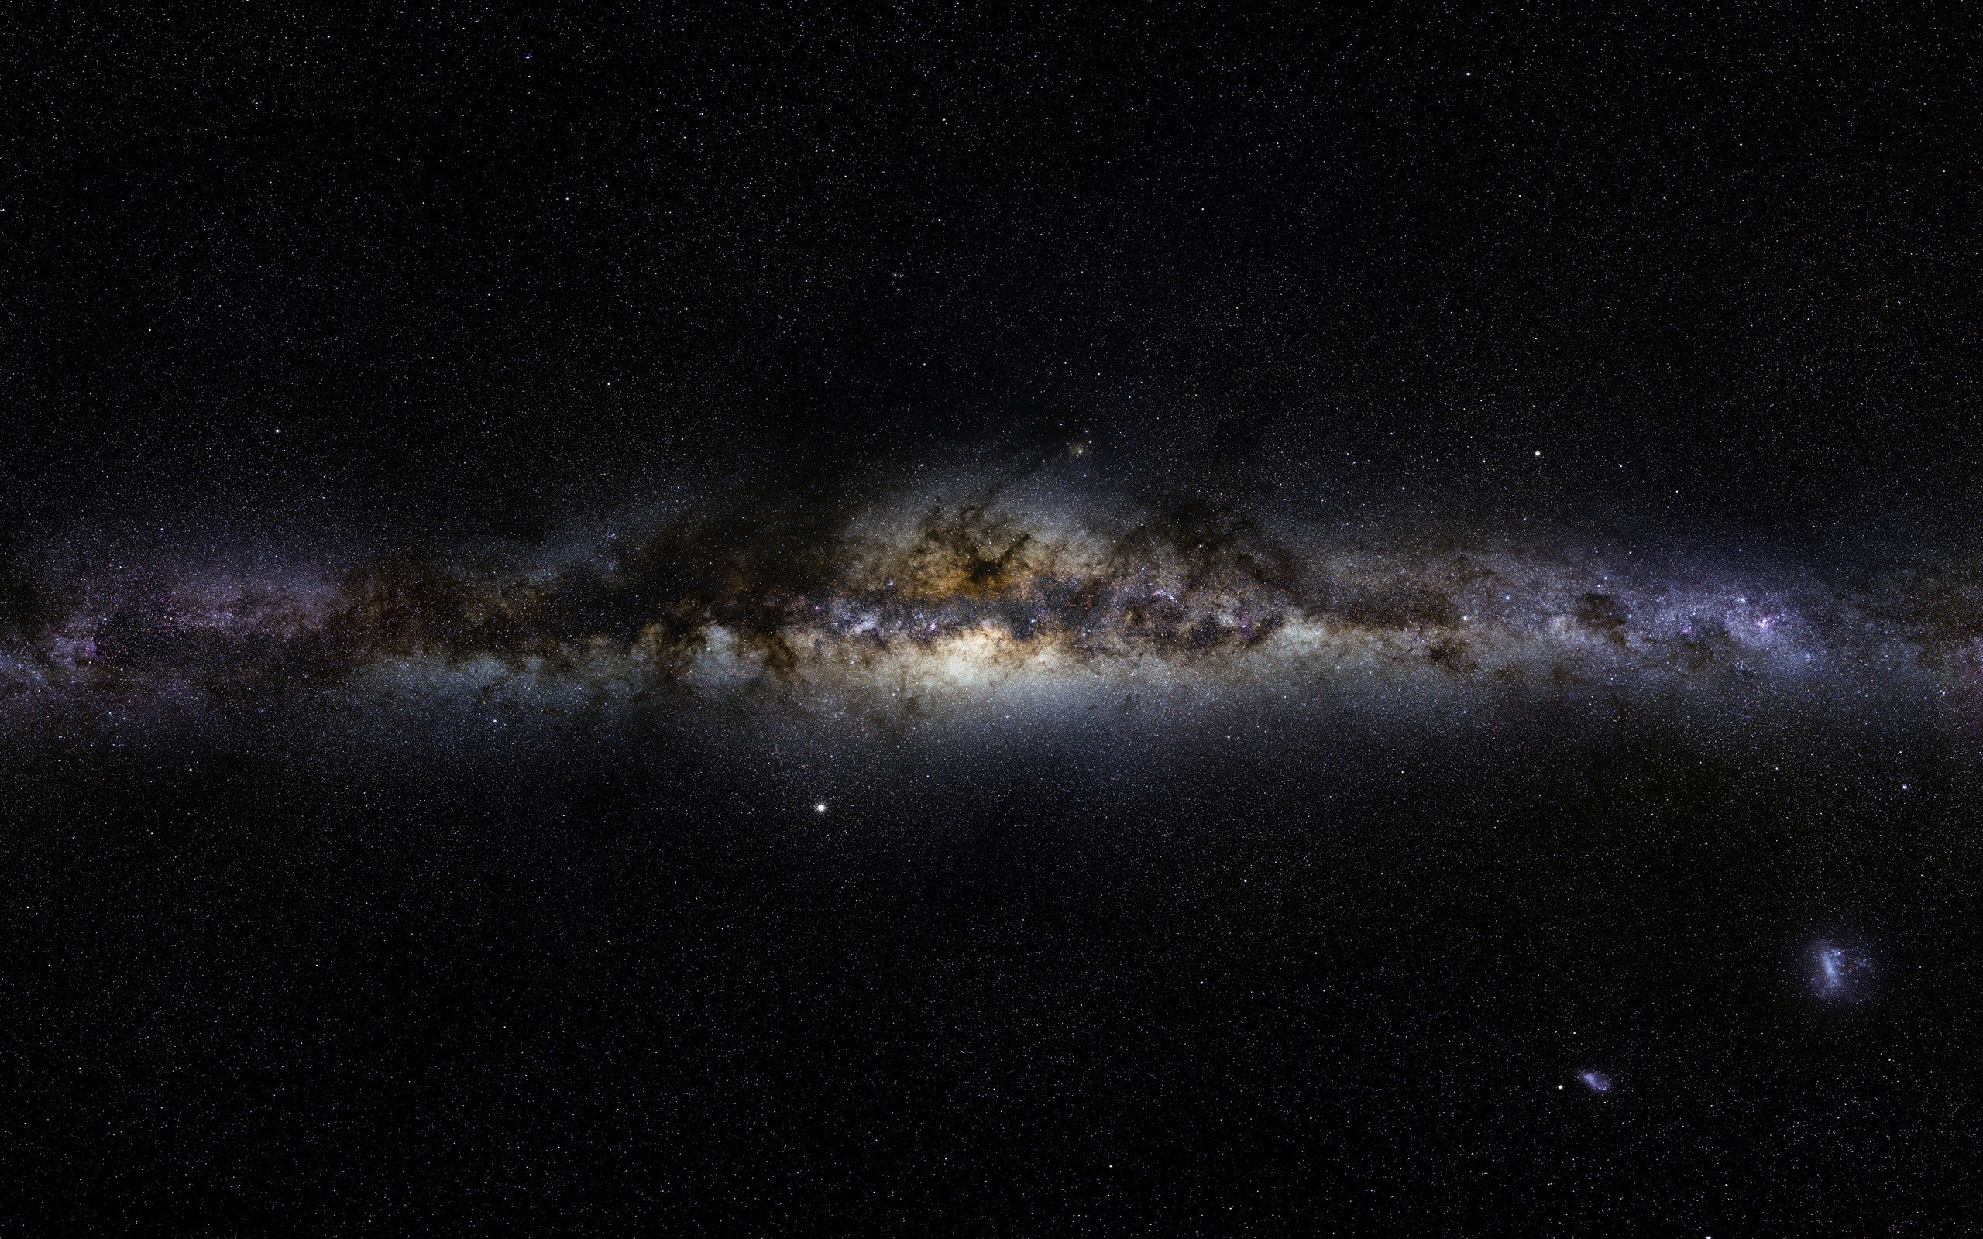
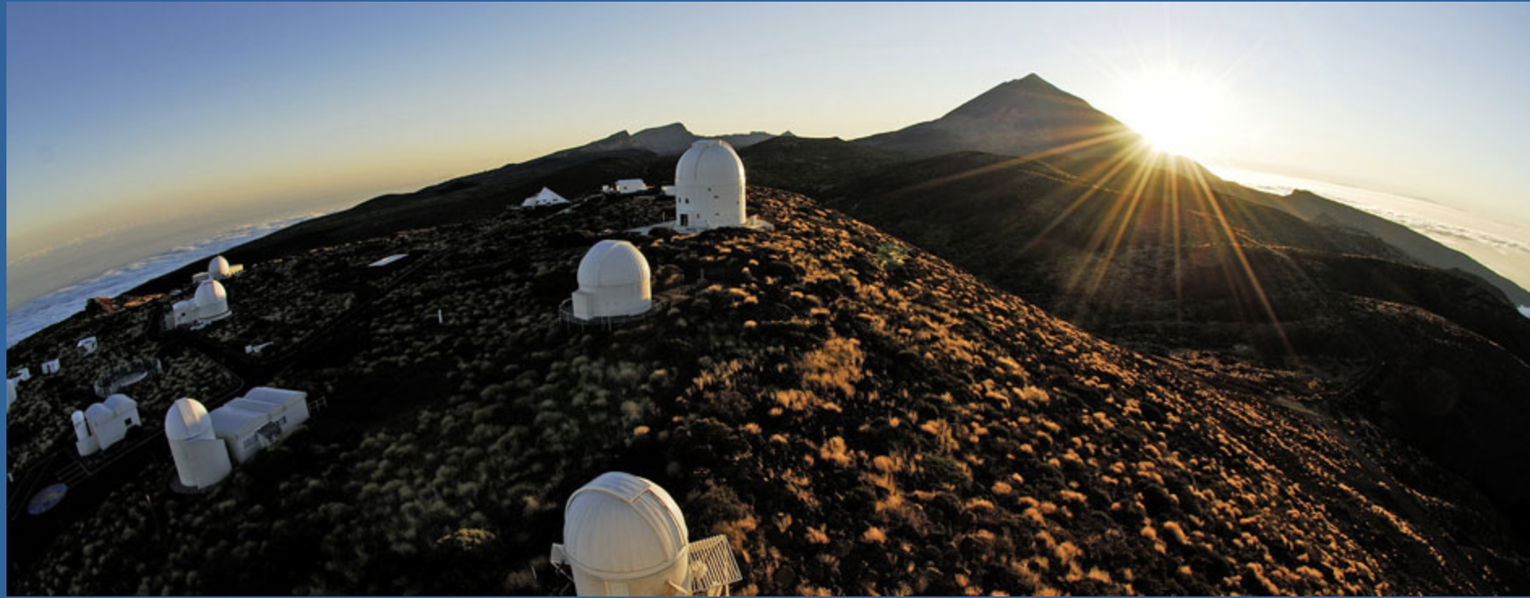

Thank you!
Funded by the European Union. Views and opinions expressed are however those of the author(s) only and do not necessarily reflect those of the European Union or the European Research Council Executive Agency. Neither the European Union nor the granting authority can be held responsible for them.
This work is supported by the ERC STG grant (``AstroDarkLS'', grant No. 101117510).
Caption

