Slide 1
Wafer production
Andrea Mazzolari

Slide 2
R&D on dicing
Serial production requires a series of technical automation
Upgrade of software of dicing machine
Developed a python code to automatize preparation of dicing programs

Slide 3
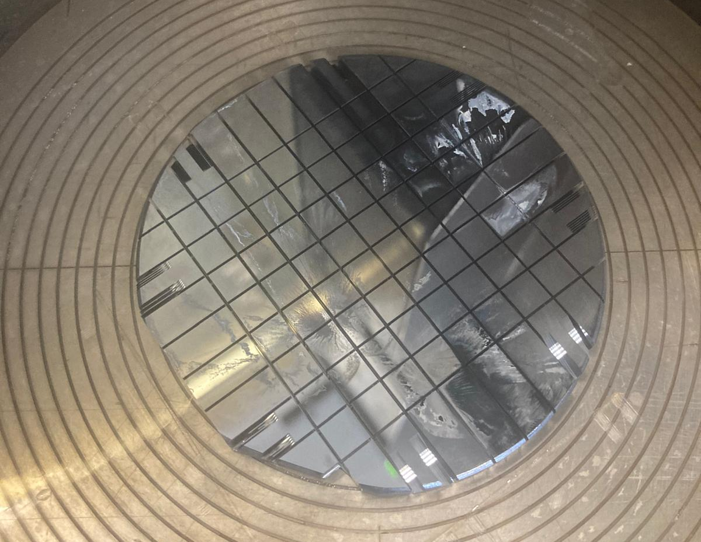
Laser marking system
First wafer produced through 100% automatic mode
This allows to increase the production rate and yield

Slide 4
Diced surfaces
Diced surfaces are now much more perpedicular to wafer’s surface

Slide 5
Laser marking system
Just received 10 wafers coated with silicon nitride+silicon oxide (delay from the supplier of about 1 month…as usual…). Wafers diameter is 3’’
Optimizing dicing recipe to operate under automation mode
Studying how to increase cleaning level after dicing operations.

