Slide 1
EuAPS, Status update.
CLAUDIO BORTOLIN (INFN-LNF)
EuAPS 1st Annual Meeting LNS 4/5 June 2025
1

Slide 2
The technical team (12+9 FTE)
INFN-Mi 2 Fixed term contracts +2 FTE
CNR-INO 2 Fixed Term Contracts +1FTE
CNR-ISM 2 Fixed Term Contracts +1FTE
INFN-LNS 2 Fixed term contracts +0,5 FTE
INFN-LNF 3 Fixed term contracts +3,5 FTE
UniToV 1 Fixed term contract +1 FTE
63%
37%
EuAPS 1st Annual Meeting LNS 4/5 June 2025
2

Slide 3
The Administrative/Financial team
INFN-LNF ->Tiziano Ferro (FO), Sara Silvi, Marco Traini
CNR -> Chiara Mustarelli, Paola Bolognesi
UniToV -> Alice Aldi
…and numerous calls, Teams meetings, and training sessions with the PMO and AC (V. Valsecchi, U. Dosselli, S. Bartocci)
EuAPS 1st Annual Meeting LNS 4/5 June 2025
3

Slide 4
PNRR documentation preparation and tracking
Expert-led video sessions
2
EuAPS 1st Annual Meeting LNS 4/5 June 2025
5

Slide 5
PNRR documentation and audits
INFN has implemented a tagging system for purchase documentation
2
EuAPS 1st Annual Meeting LNS 4/5 June 2025
4

Slide 6
EuAPS: 3 facilities (LNF, LNS, CNR Pisa), 4WPs, 46 IO
Tot. 22,3 MEur
EuAPS 1st Annual Meeting LNS 4/5 June 2025
7

Slide 7
The ambitious plan
Budget
Proposed timeline (30+6 months)
Design
Installation
Test report
Procurement
Commissioning
Project completion
Bim1
Bim3
Bim5
Bim7
Bim9
Bim11
Bim13
Bim15
Bim17
+
Bim2
Bim4
Bim6
Bim8
Bim10
Bim12
Bim14
Bim16
Bim18
EuAPS 1st Annual Meeting LNS 4/5 June 2025
6

Slide 8
Some “Relativistic” effects in contracts signatures…
Dec 24
Dec 23
Today
Dec 22
Tomorrow
Design + component selection
+tender processes
Delivery, installation, commissioning, tests
Controls, document requests
13 months
10 months
13 months
EuAPS 1st Annual Meeting LNS 4/5 June 2025
2
8

Slide 9
…even harder than my previous experiences…
EuAPS 1st Annual Meeting LNS 4/5 June 2025
20

Slide 10
PNRR reporting process
Dec 24
Dec 23
Today
Dec 22
Tomorrow
2
EuAPS 1st Annual Meeting LNS 4/5 June 2025
9

Slide 11
WPs Activities&IO status
See presentations by A. Falone (WP1) and A. Cianchi (WP2)
Bimester 15 was closed on 31st May
2
EuAPS 1st Annual Meeting LNS 4/5 June 2025
10

Slide 12
WPs Activities&IO status
See presentations by P. Cirrone (WP3) and L. Labate (WP4)
2
EuAPS 1st Annual Meeting LNS 4/5 June 2025
11

Slide 13
Reporting on GEA (MUR platform)
New feature
2
EuAPS 1st Annual Meeting LNS 4/5 June 2025
12

Slide 14
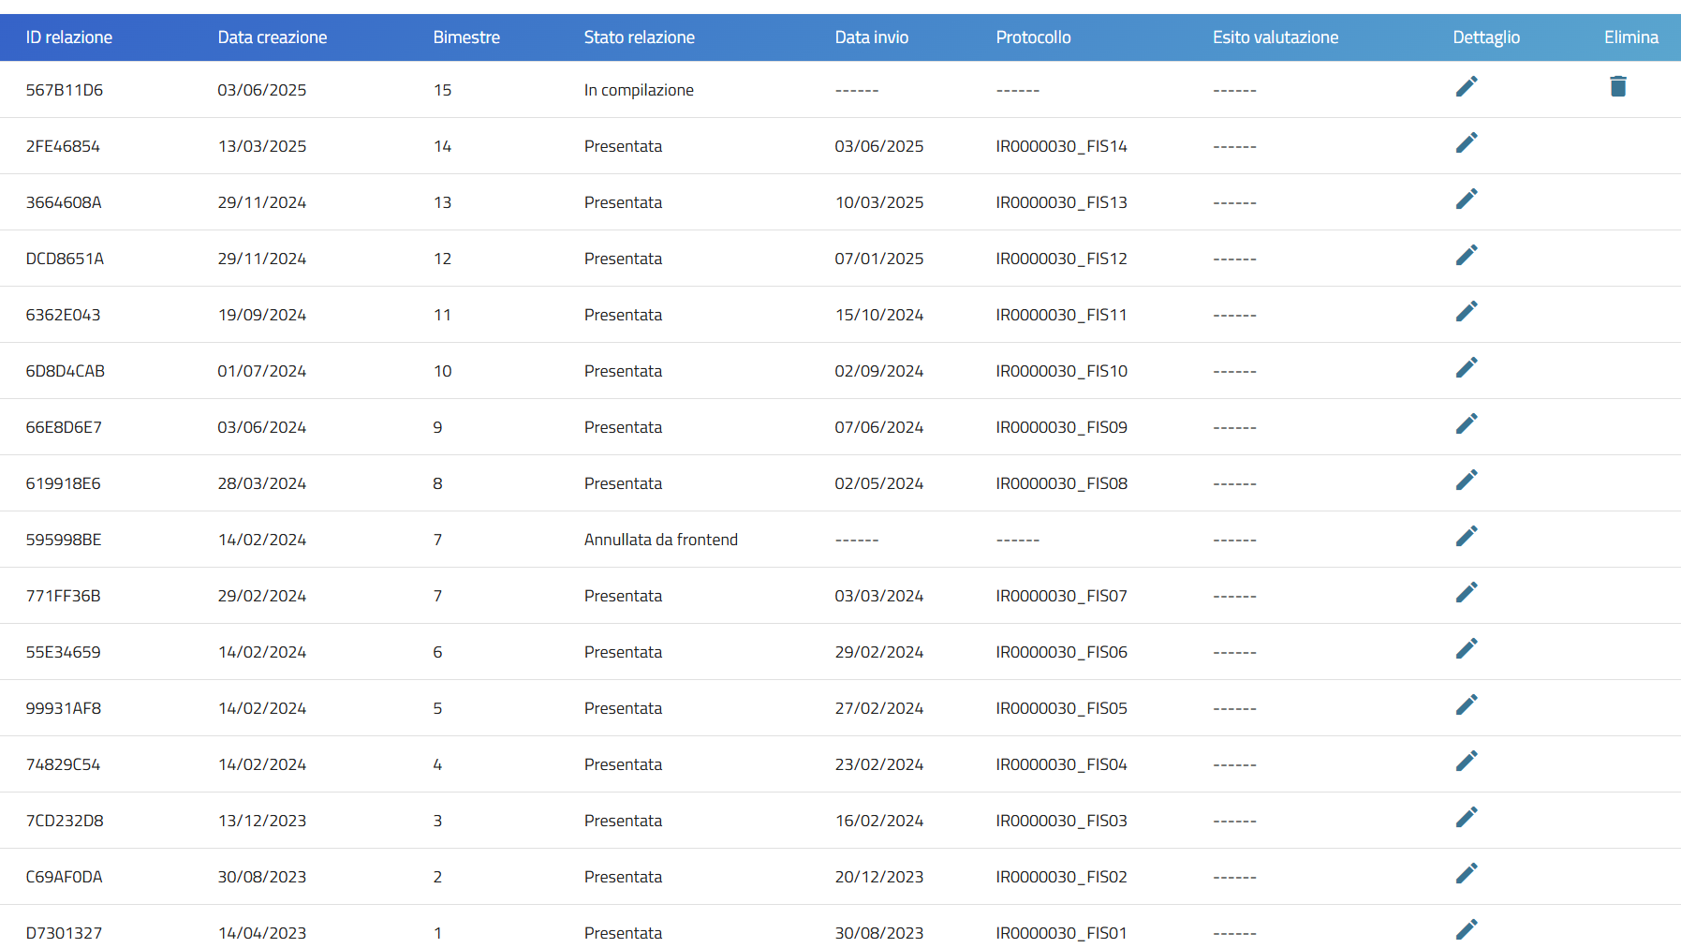
Reporting activities advancement (on schedule)
2
EuAPS 1st Annual Meeting LNS 4/5 June 2025
13

Slide 15
Financial reporting (on schedule)
Details on committed budget and expenses in next talk (S. Silvi)
2
EuAPS 1st Annual Meeting LNS 4/5 June 2025
14

Slide 16
Procedures reporting -> 87% closed
83 procedures closed
11 in the finalization phase (mostly recent orders)
2
EuAPS 1st Annual Meeting LNS 4/5 June 2025
15

Slide 17
Variation requests: preparing the next one
Approval process involves ETS (Pantaleo Raimondi) + MUR experts
2
EuAPS 1st Annual Meeting LNS 4/5 June 2025
16

Slide 18
Bimester 16 just started, fewer than 6 months until the deadline
Personnel contracts extension to 30/11 are ongoing (but then?)
Intense schedule of activities for all WPs
Significant number of stakeholders to be coordinated (see talk of A. Falone)
Laser systems production timeline very tight with risks of delays
2
EuAPS 1st Annual Meeting LNS 4/5 June 2025
17

Slide 19
The mid- to long-term perspective of EuAPS is not as follows…
…the facilities must run for 10 years (at least) after project completion.
2
EuAPS 1st Annual Meeting LNS 4/5 June 2025
18

Slide 20
KPI and sustainability
Some preliminary numbers provided to
INFN Management
Discussions with MUR for the operation financial support will take place
2
EuAPS 1st Annual Meeting LNS 4/5 June 2025
19

Slide 21
EuAPS looks a complicated journey but..
... to succeed, we also need less “them” and more “us,” because in the end, there is only us.
Thank you!
EuAPS 1st Annual Meeting LNS 4/5 June 2025
20

