Slide 1
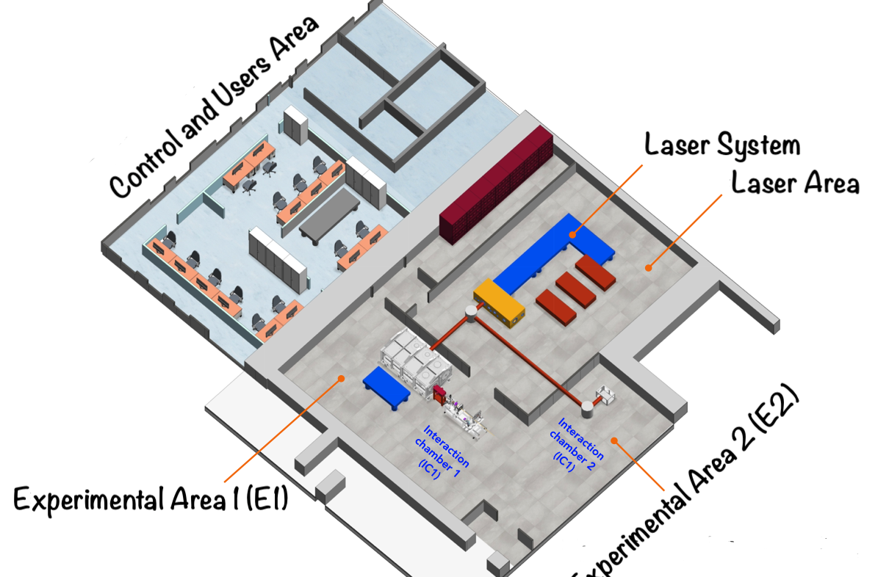
WP3
High power laser beam line
J. Suarez-Vargas, C. Altana, S. Arjmand, D. Bonanno, A. Caruso, R. Catalano,
G. Cuttone, D. Oliva, A. Pappalardo,
G. Petringa, S. Tudisco and G.A.P. Cirrone
Technical Division
Research Division
Accelerator Division
June 2025

Slide 2



WP.3 - High Power Laser Beam Line - Budget
Fixed term personnel specifically hired for the project (€ 150.000,00)
Scientific instrumentation and technological equipment, software, licenses and patent (€ 5.917.812,47)
Civil infrastructures and related systems (€ 1.300.006,38)
Indirect costs, including running costs (€ 496.681,15)
Total (€ 7.864.500,00)

Slide 3
WP.3 - High Power Laser Beam Line - Project Work Breakdown Structure
Task 3.1 - Infrastructure realization (€ 1.391.000,00)
- M3.1.1 Clean room design
- M3.1.2 Procurement and first payment
- M3.1.3 Second payment
- M3.1.4 Third payment
- M3.1.5 Assembling, commissioning and fourth payment
Task 3.2 - Laser design, procurement and installation (€ 5.189.508,34)
- M3.2.1 Laser design
- M3.2.2 Procurement and first payment
- M3.2.3 Second payment
- M3.2.4 Third payment
- M3.2.5 Assembling, commissioning and fourth payment

Slide 4
WP.3 - High Power Laser Beam Line - Project Work Breakdown Structure
Task 3.3 - Design and realization of the target system (€ 428.000,00) - Realized in-house
- M3.3.1 Design and procurement
- M3.3.2 Realization and tests
Task 3.4 - Plasma diagnostic: acquisition and installation (€ 428.000,00)
- M3.4.1 Design and procurement
Task 3.5 - Secondary beam diagnostic: acquisition and installation (€ 428.000,00)
- M3.5.1 Design, procurement and mechanical realization of diagnostic
- M3.5.2 Calibration under conventional beams
Tasks 3.4 and 3.5 have been incorporated into Task 3.2 and will be part of a single delivery

Slide 5
WP.3 - High Power Laser Beam Line - Procurement procedures > 140.000 €
 | Atto GE | Company | Cost [€]
Laboratorio di ottica e control room | 13629 del 21/07/2023 | RTI EMME4 | 437.874,43
Laser di alta potenza con impulsi ultra-brevi per l’accelerazione di particelle cariche e relativa camera del compressore | 13811 del 18/12/2023 | THALES LAS | 4.913.398,80
Camera d’interazione per sistema laser di alta potenza | 13843 del 22/12/2023 | Fantini Sud | 261.739,00
Sala sperimentale prefabbricata comprensiva di clean room | 13851 del 18/01/2024 | Phamm Engineering | 813.299,20
Modulo aggiuntivo camera d’interazione per sistema laser di alta potenza | 14021 del 17/07/2024 | Fantini Sud | 238.983,50
Laboratorio di ottica e control room (variante progettuale) | 14159 del 17/12/2024 | RTI EMME4 | 46.056,82
TOTAL (above the EU threshold) |  |  | 6.711.351,75

Slide 6
WP.3 - High Power Laser Beam Line - Other procedures < 140.000 €
 | Company | Cost [€]
N. 4 tavoli ottici e sistema di movimentazione micrometrico su tre assi | Crisel Instruments S.r.l. | 105.042,00
Misure di efficienza di schermatura nel range di frequenze tra 10 kHz e 6 GHz | MPB S.r.l. | 3.660,00
Pavimentazione in acciaio inox 304 per lo schermaggio elettromagnetico presso i LNS-INFN | Soliani EMC S.r.l. | 15.860,00
Assistenza logistica per l'organizzazione del "First Annual Meeting of the EuAPS project" (4-5 giugno 2025) | A.S.T.E.CONGRESS S.r.l. | 10.980,00
TOTAL (below the EU threshold) |  | 135.542,00
TOTAL (above and below the EU threshold) |  | 6.846.893,75

Slide 7
WP.3 - High Power Laser Beam Line - Upcoming procedures < 140.000 €
 | Estimated cost - VAT included | Expected order
Interlock and search system for experimental areas) | 122.000,00 | within July 2025
Shielded cabinets | 24.400,00 | within July 2025
Desk, monitors and audio/video system | 60.000,00 | within June 2025
Shielding for electromagnetic pulse mitigation | 110.000,00 | within September 2025
Modular clean cabinets | 35.000,00 | within June 2025
Thorlabs components | 24.400,00 | within June 2025
Laser beam transport elements from CC to IC1 & IC2 | 115.000,00 | within June 2025
Total | 490.800,00

Slide 8
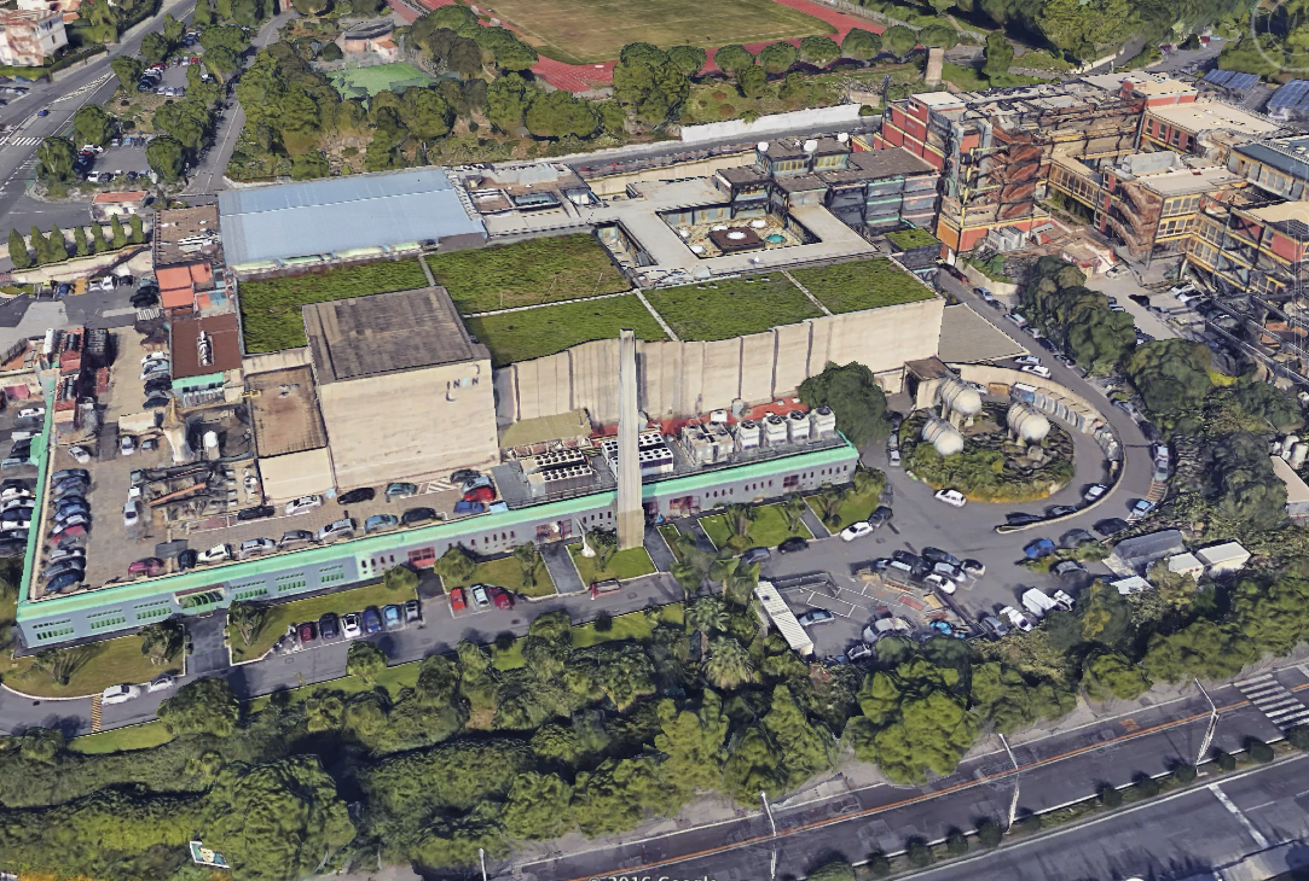
Experimental areas
Offices
Laser bay
Tandem
Cyclotron
8

Slide 9
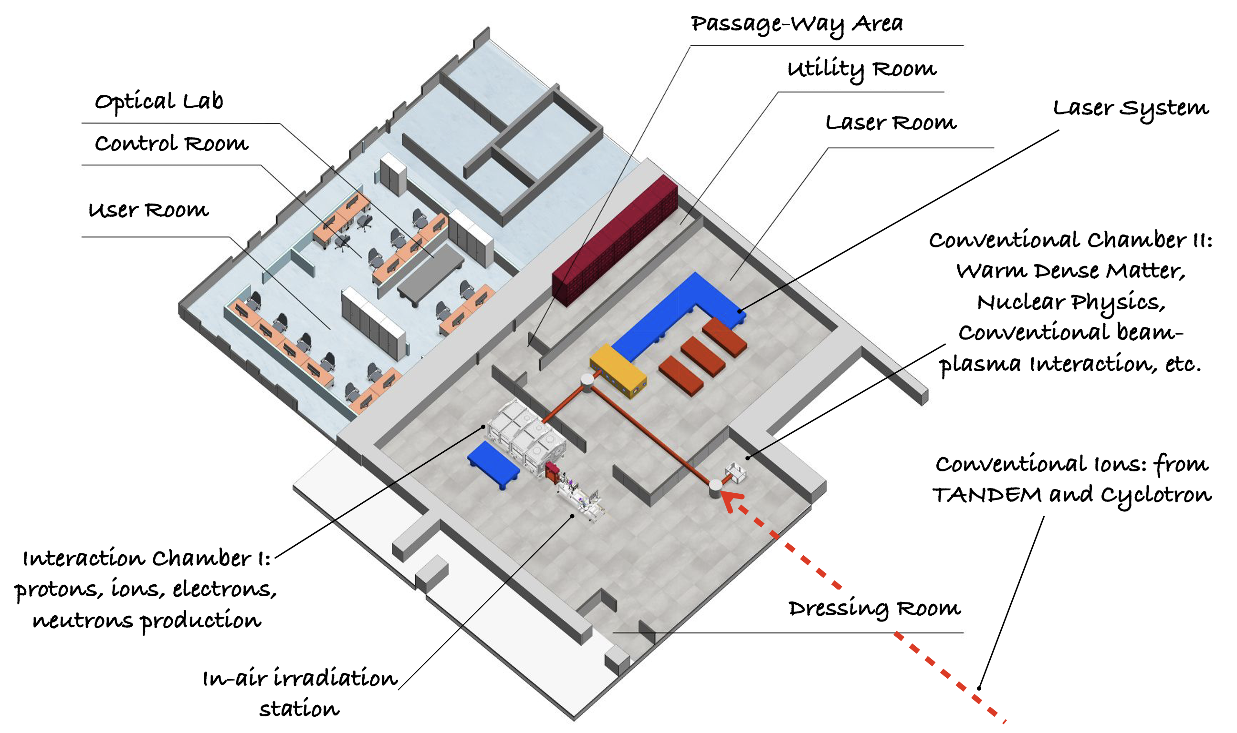
May 2025
February 2026
L1
L2
ES1
ES2
ES3
ES4

Slide 10

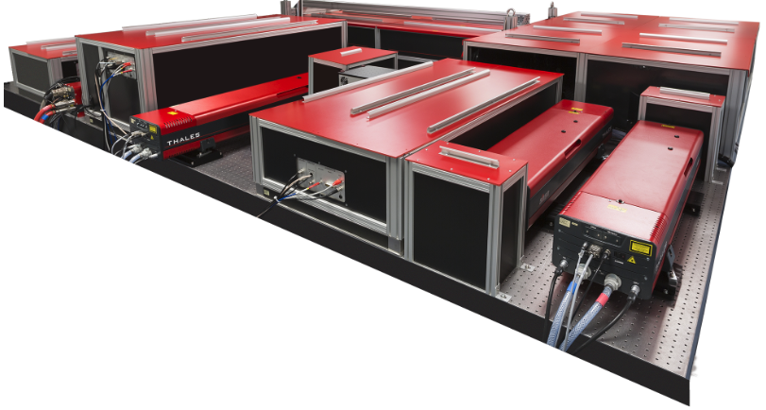
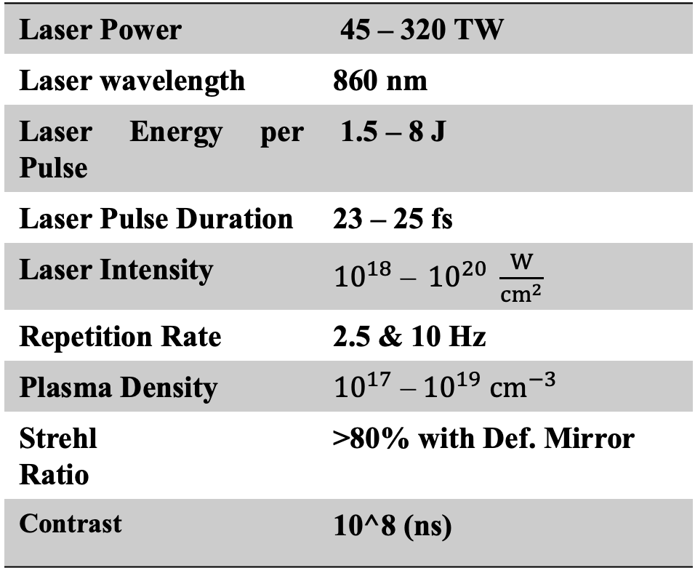
Main facility Laser:
L1
Laser Power |  | 45 – 320 TW
Laser wavelength |  | 860 nm
Laser Energy per Pulse |  | 1.5 – 8 J
Laser Pulse Duration |  | 23 – 25 fs
Laser Intensity |  | ${10}^{18}$ – ${10}^{20} \frac{W}{{cm}^{2}}$
Repetition Rate |  | 2.5 & 10 Hz
Plasma Density |  | ${10}^{17}$ –${10}^{19}$ ${cm}^{−3}$
Strehl Ratio |  | >80% with Def. Mirror
Contrast |  | 10^8 (ns)
Quark 320 system

Slide 11
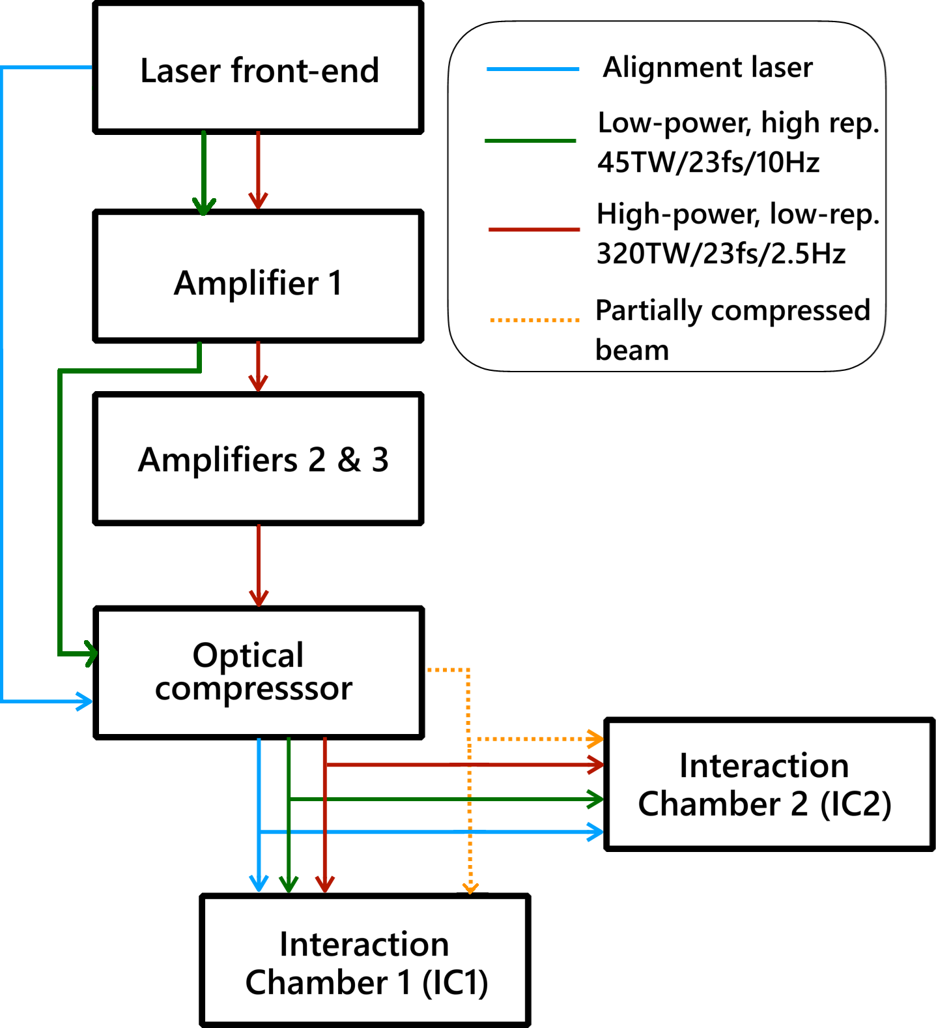
I-LUCE main-laser (EuAPS)

Slide 12
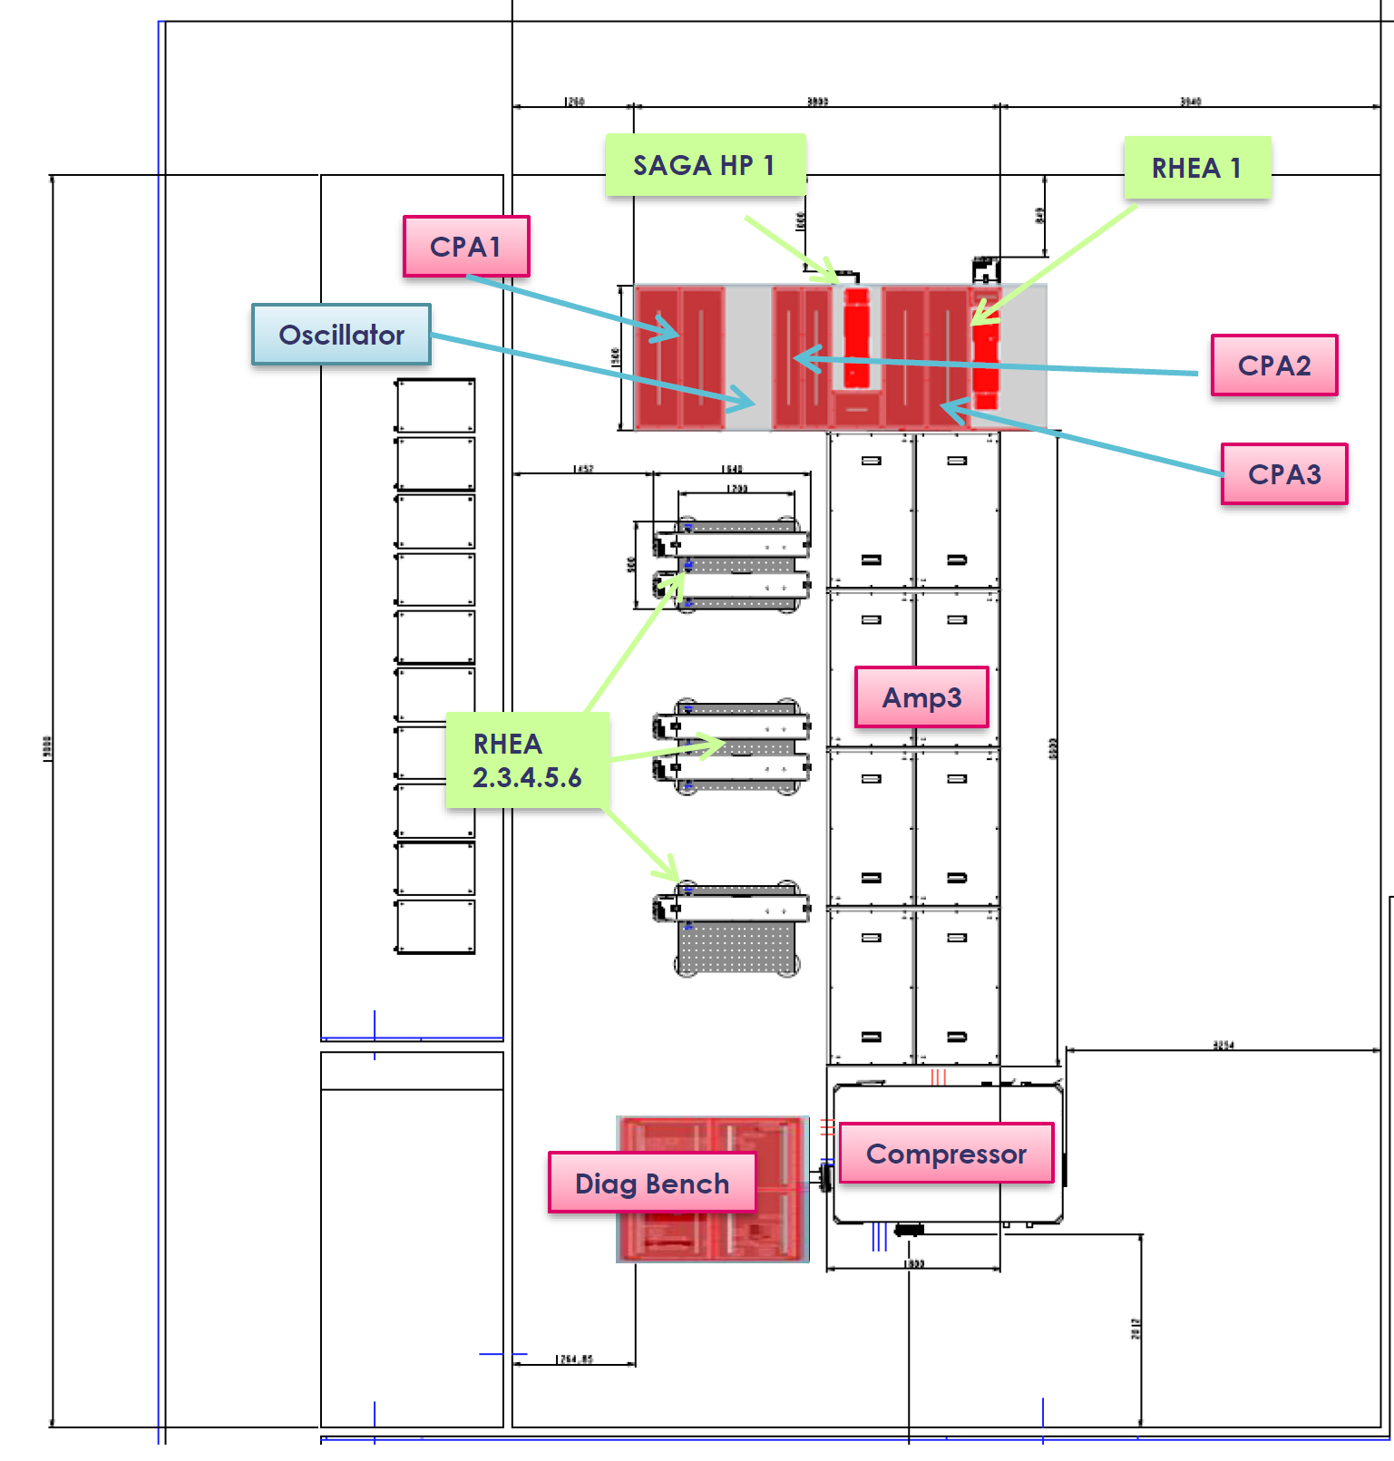
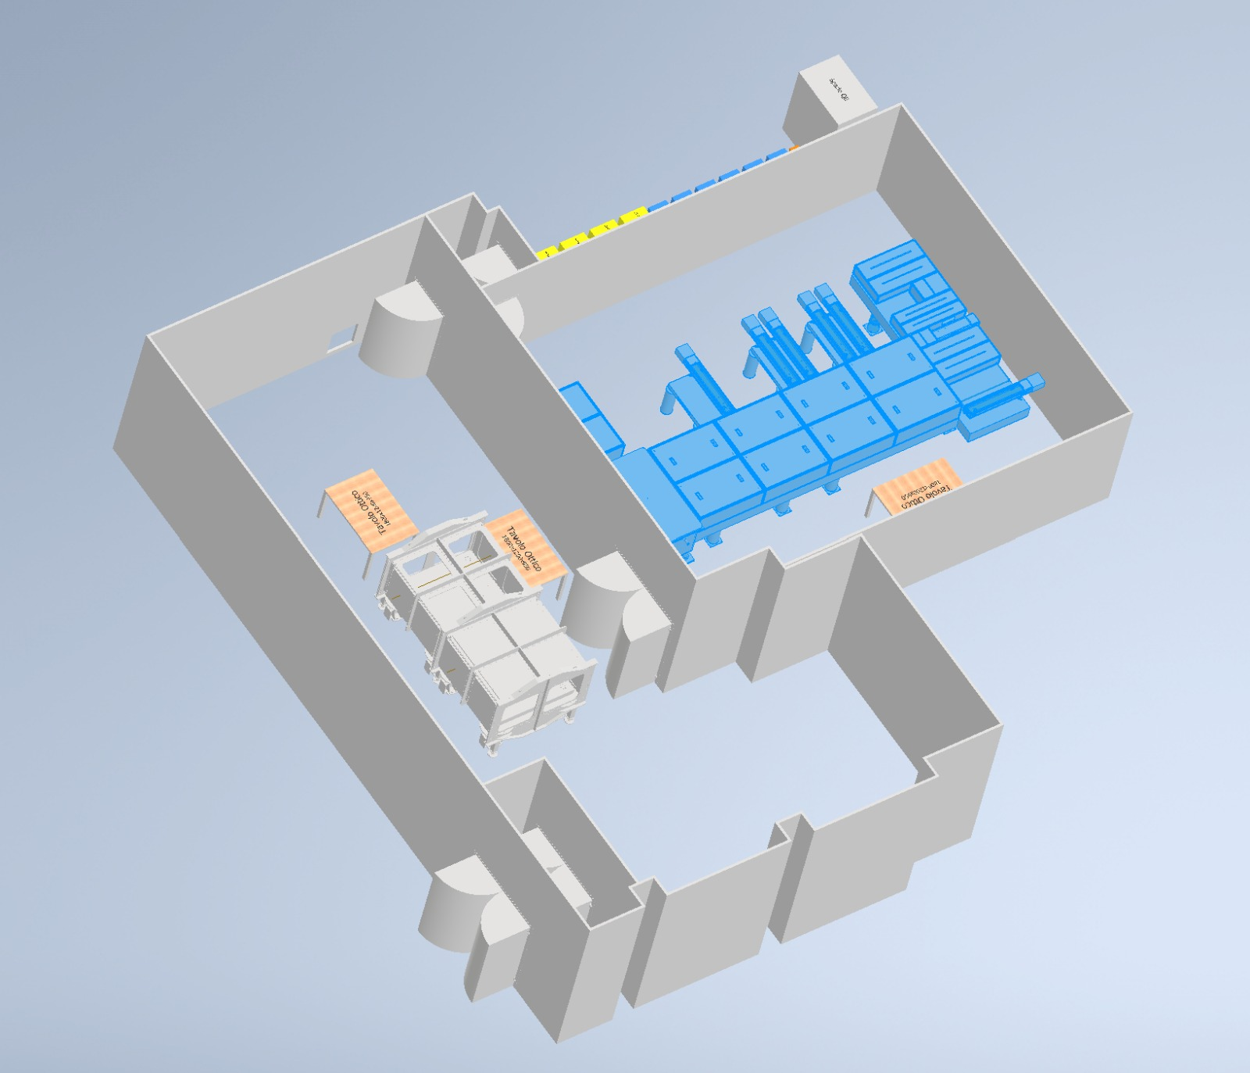

Slide 13

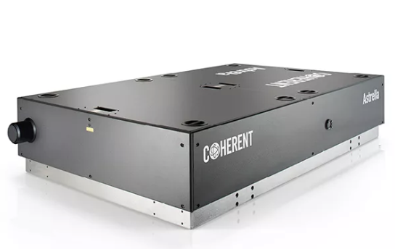
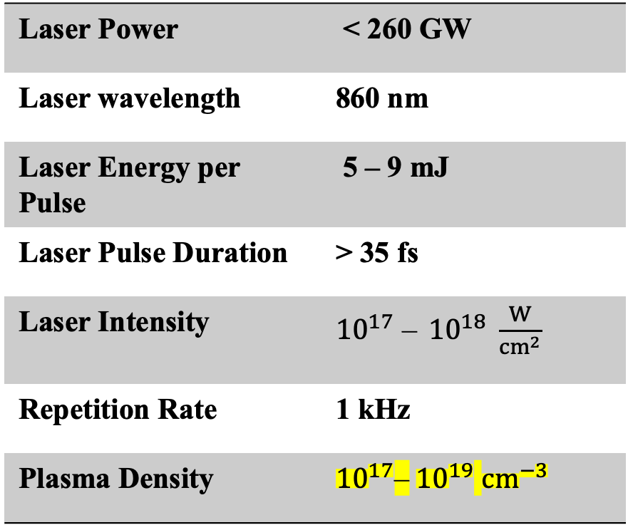
Second Facility Laser:
L2
Laser Power | < 260 GW
Laser wavelength | 860 nm
Laser Energy per Pulse | 5 – 9 mJ
Laser Pulse Duration | > 35 fs
Laser Intensity | ${10}^{17}$ – ${10}^{18} \frac{W}{{cm}^{2}}$
Repetition Rate | 1 kHz
Plasma Density | ${10}^{17}$–${10}^{19}$ ${cm}^{−3 }$
Astrella laser system

Slide 14
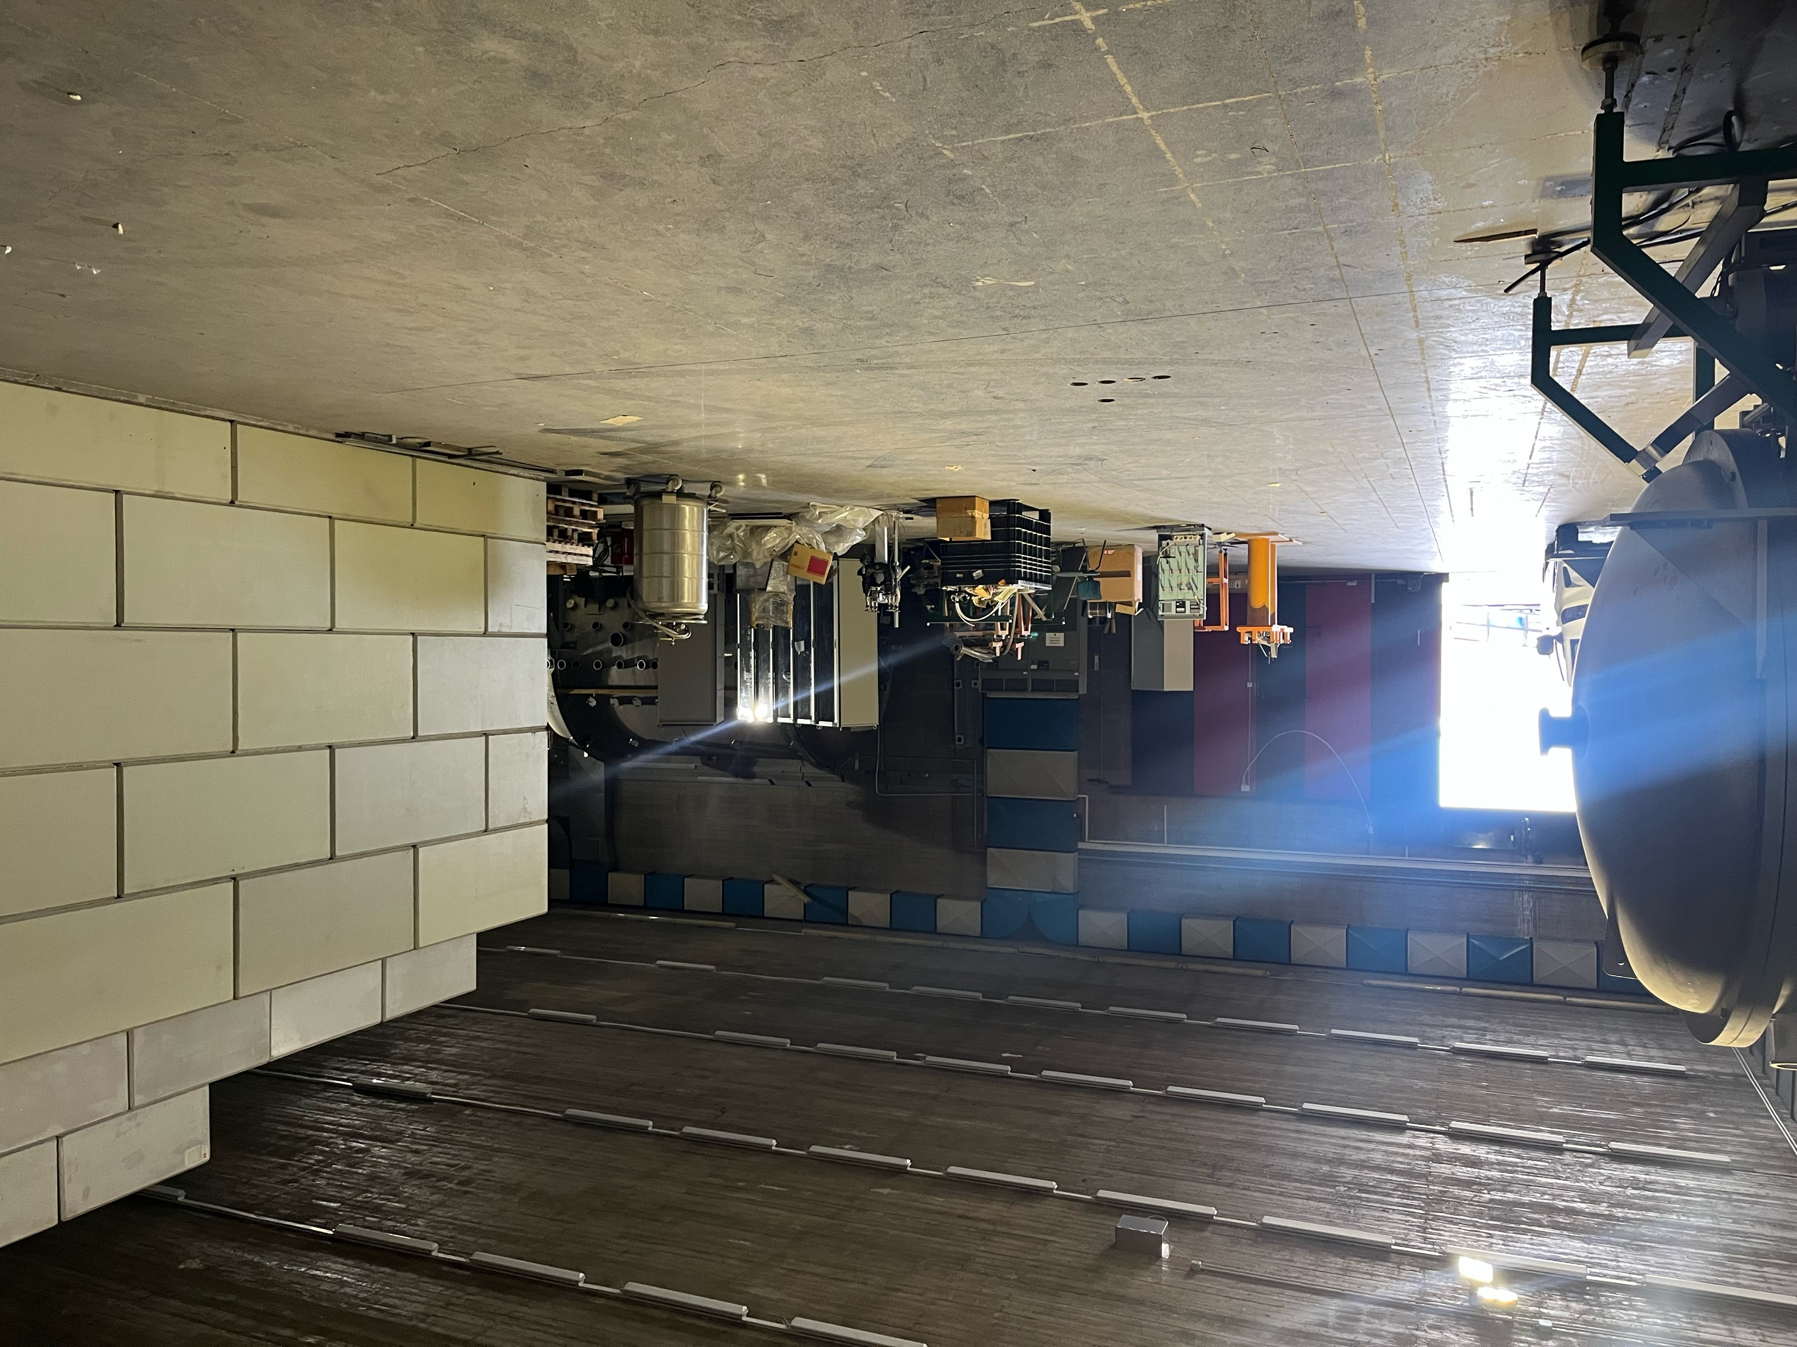
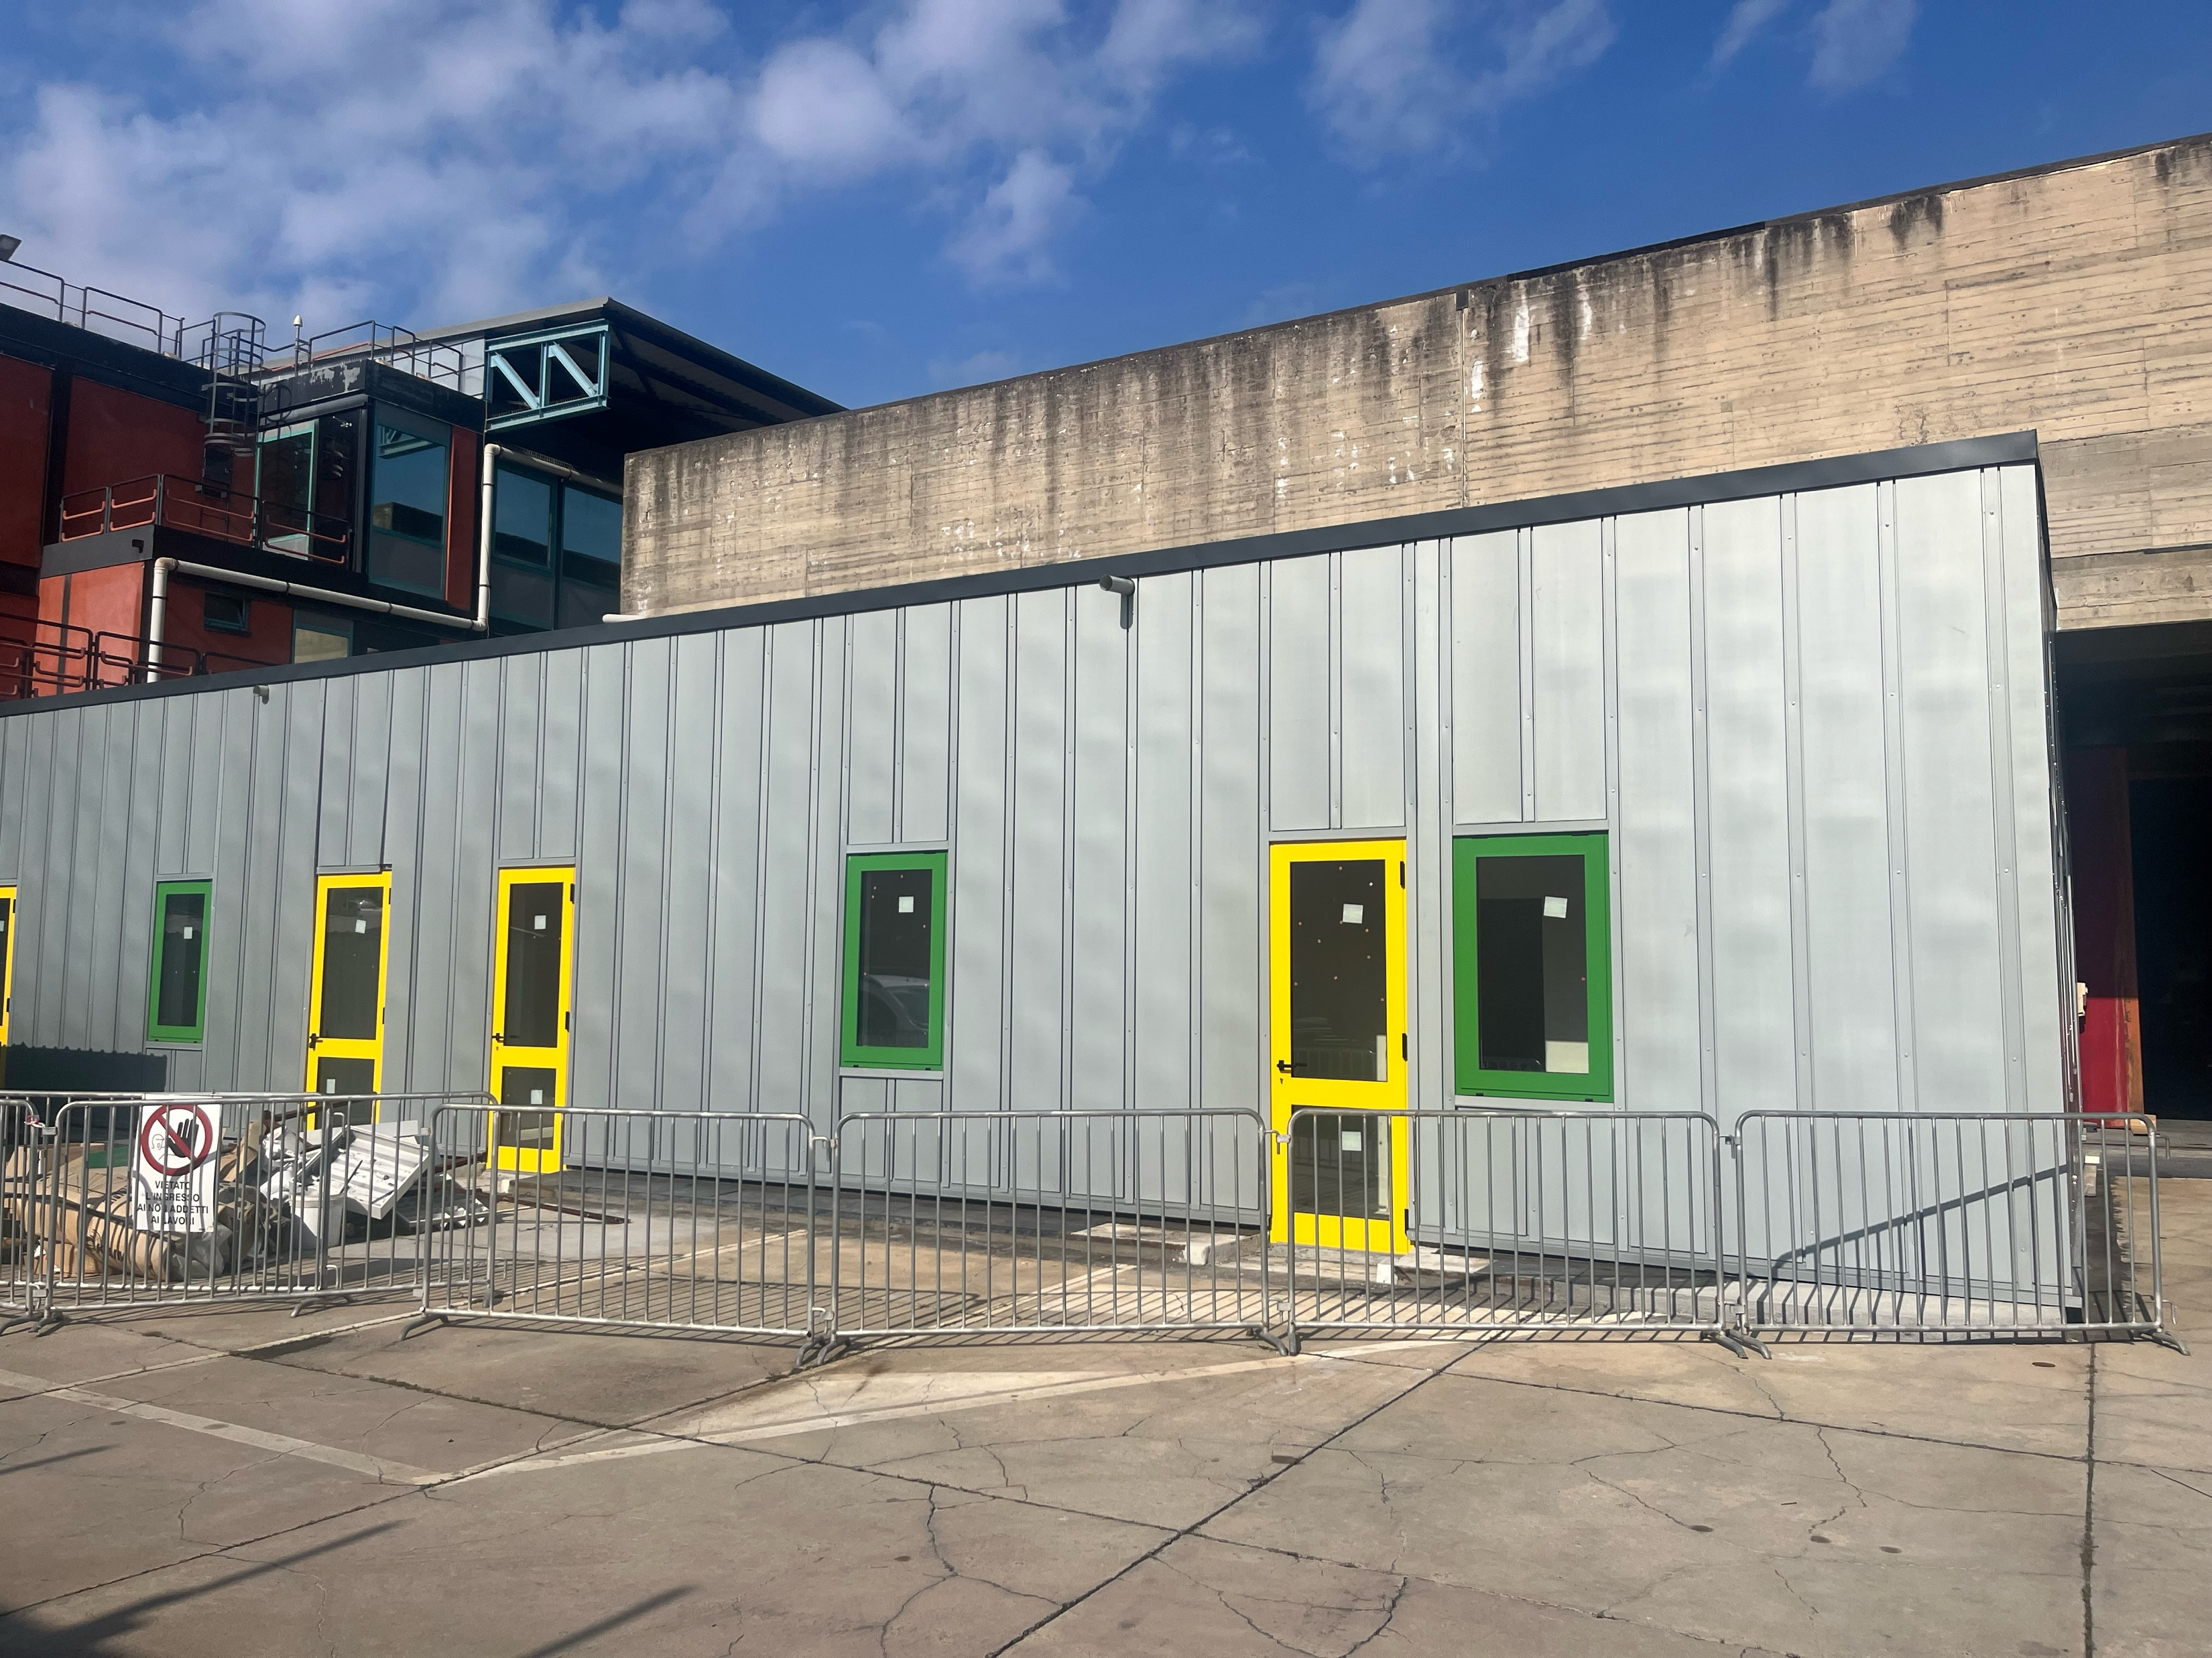
Current and Future Experimental areas
Main experimental area
Control and Users room

Slide 15
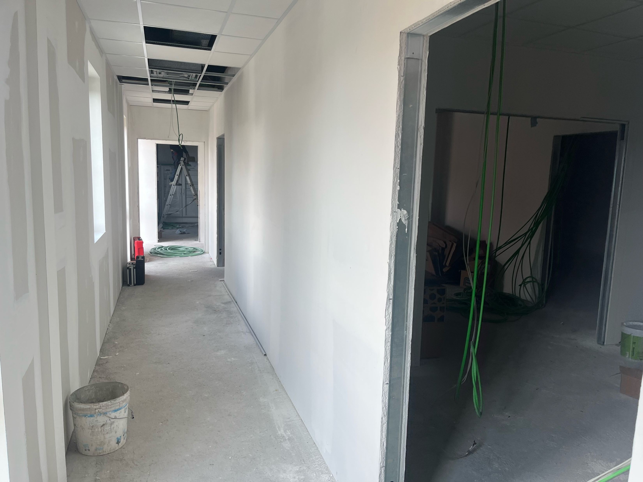
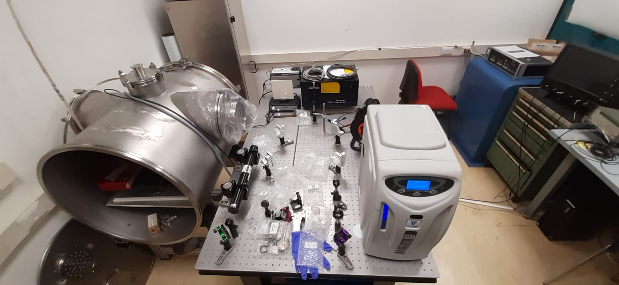
Current and Future Experimental areas
Plasma laboratory
Optical laboratory

Slide 16
I-LUCE first phase
Three Interaction Chambers:
Interaction chamber n.1 (ES1): Astrella Laser: Target tests, low-energy nuclear reaction, electron acceleration with micro-capillary.
Interaction Chamber n.2 (ES2 and ES3): Radiation production: protons/ions, electrons, neutrons, gamma, etc.). One in-air irradiation station for multidisciplinary studies.
Interaction Chamber n.3 (ES4): Warm Dense Matter studies (WDM); Nuclear physics and fusion in plasma; Interaction of ion beams with laser-generated plasma

Slide 17
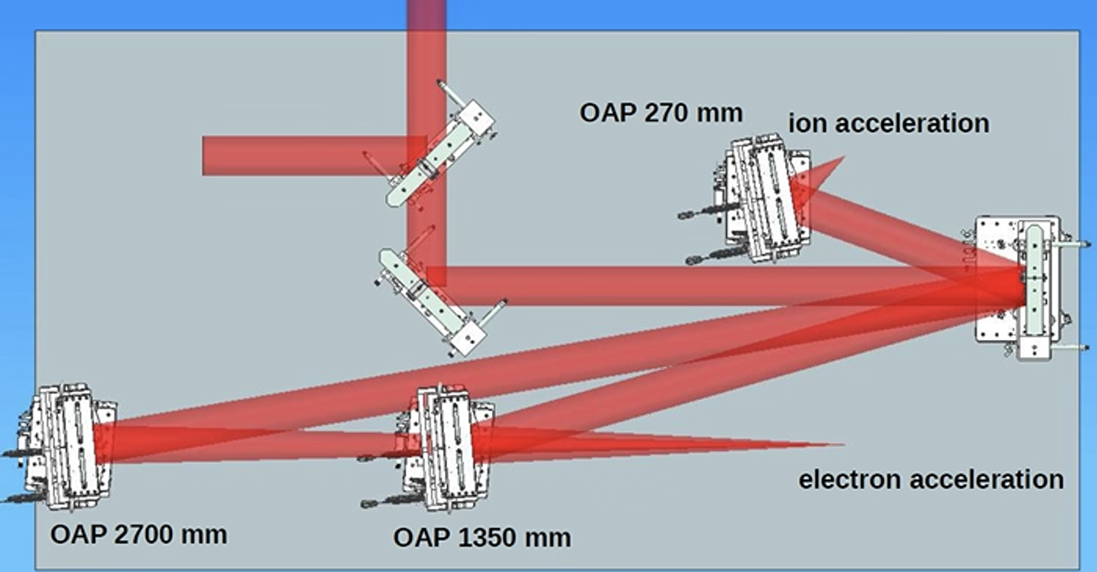
Radiation production interaction chamber (ES2 and ES3)

Slide 18
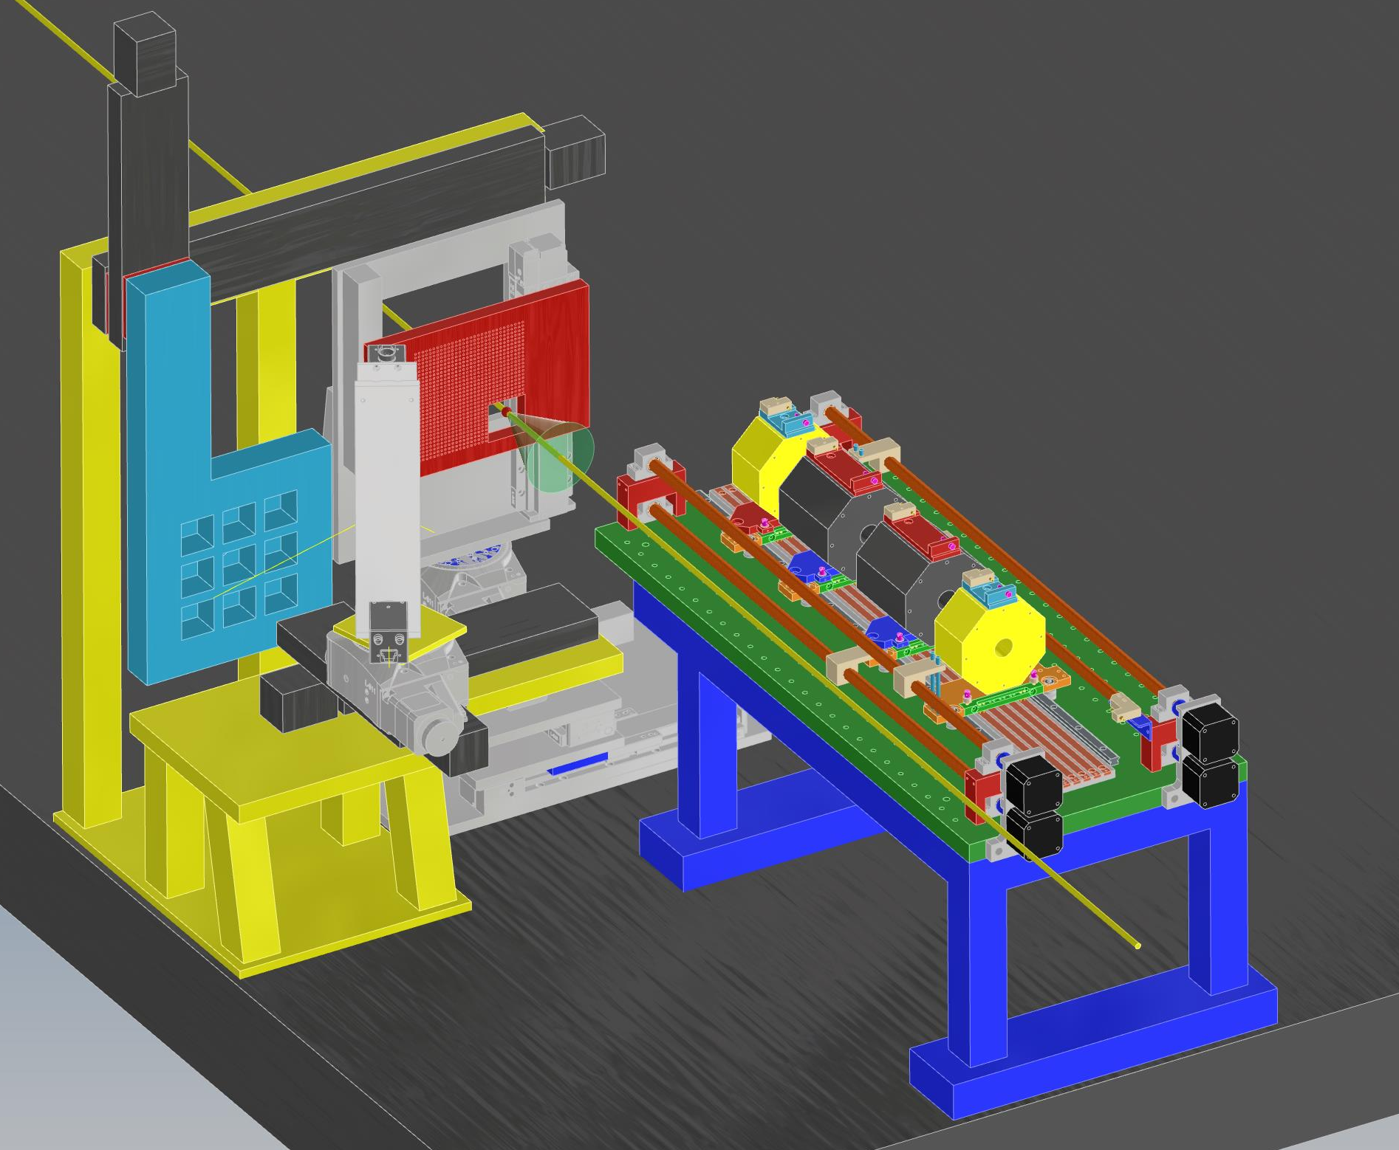
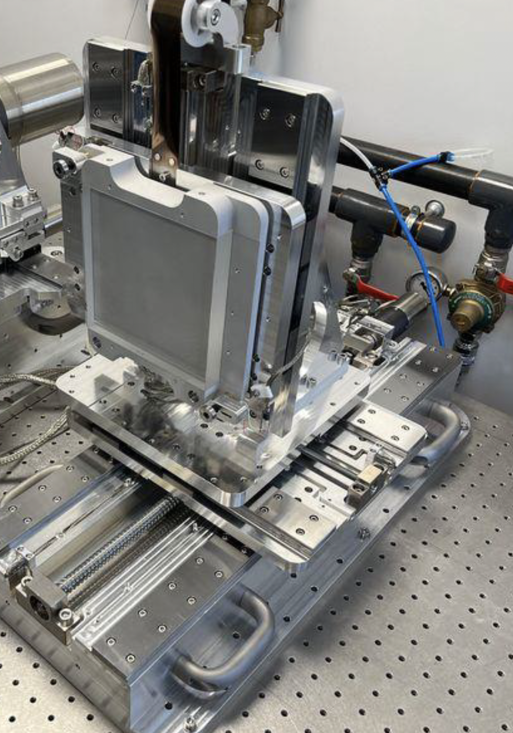

Ion acceleration station (ES2)
Up to 900 targets
Max rep rate: 3 Hz
Five degrees of freedom
1 um resolution in Z
5 um in other directions
12 cm/s max velocity
EMP compatible
Courtesy of SourceLab

Slide 19
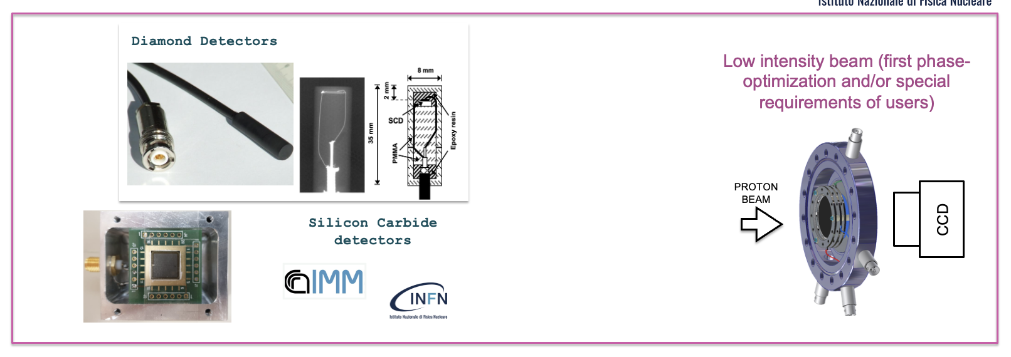
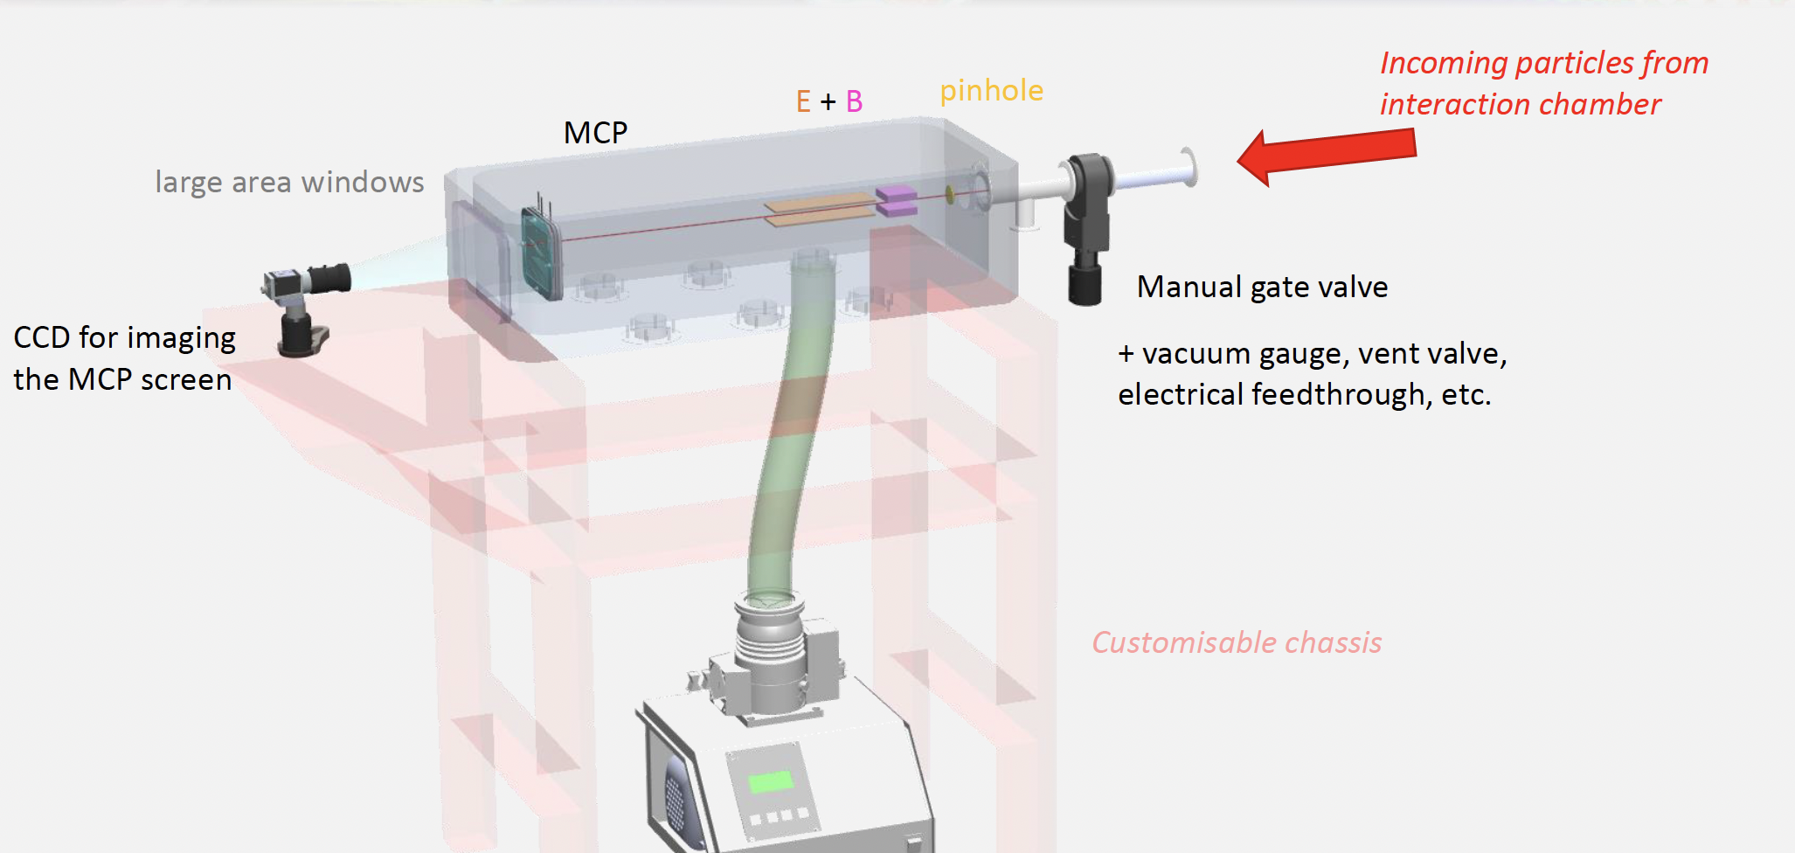
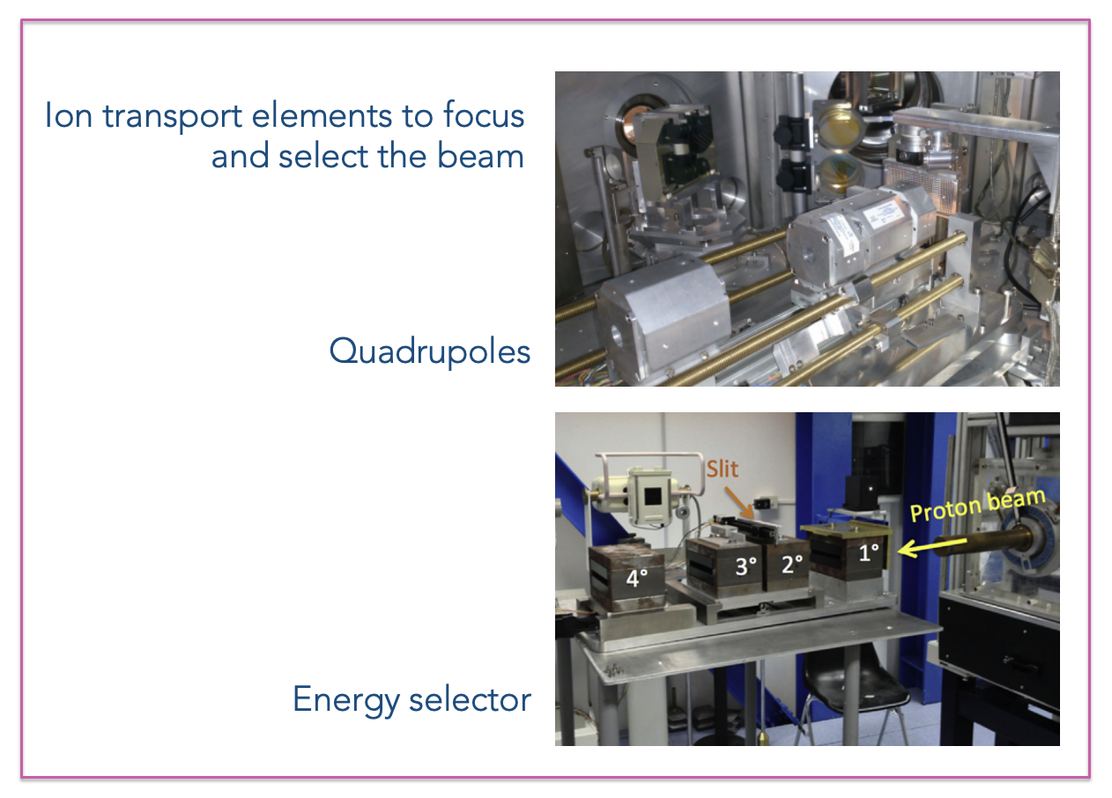
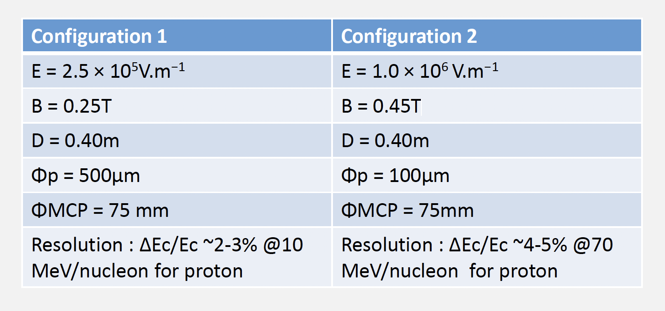
Ions diagnostic and transport
Time of flights (diamonds and Silicon Carbide)
Thomson spectrometer
Integrating Current transformer
Fluence/dose meters

Slide 20
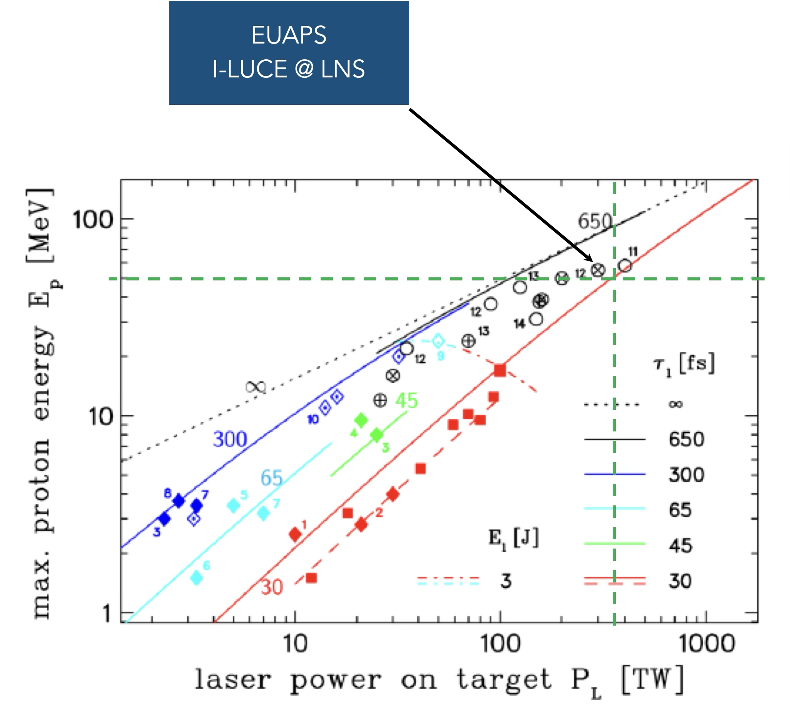
I-LUCE first phase
Protons acceleration up to 15 MeV with solid target (up to 50 MeV)
Electrons acceleration up to 300 MeV with capillary and gas-jet system
Neutron beam
Irradiations stations for both protons and electrons for medical and multidisciplinary applications
Radiobiology
FLASH radiotherapy applications
Material science
Interaction of conventional ion beams with laser-generated plasmas

Slide 21
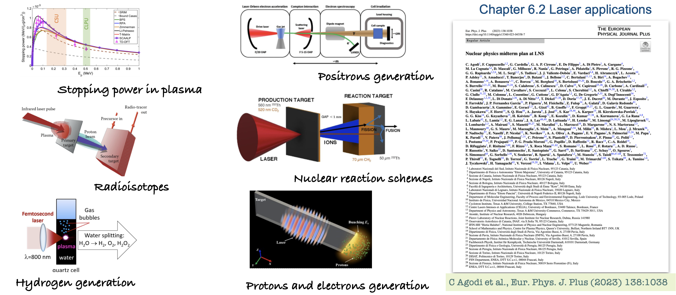
Physics cases

Slide 22
List of publications
C. Agodi et al., Nuclear Physics midterm plan at LNS, Eur. Phys. J. Plus, 138:1038, 2023.
S. Arjmand et al., Parametric study of voltage in plasma-discharge capillary systems: a benchmarking of experimental and simulation data,
JINST 20 C03035, 2025.
S. Arjmand et al., Preformed Plasma Waveguides: Enabling High-Energy Electron Beams for FLASH Radiotherapy, NIMA, 2025 (Accepted).
Arjmand et al., Implementing Capillary Design for Very High Energy Electron (VHEE) Applications at I-LUCE Facility, RAD Conference
Proceedings, 2025 (Accepted).
S. Arjmand et al., Real-Time Wavelength Calibration and Multi-Technique Plasma Diagnostics in Discharge Capillary, Laser and Particle Beams,
2025 (Submitted).
S. Arjmand et al., Simulation-Based Modeling and Machine Learning Optimization of Plasma Discharge Capillary in LWFA Systems, Laser and Particle Beams, 2025 (Submitted).
GAP. Cirrone et al., lon acceleration by laser-matter interaction: status and perspective with the upcoming I-LUCE facility at INFN-LNS, in Proc.
PAC 23, 4386-4388, 2023.
GAP. Cirrone et al., Laser Driven User Facilities and Status of I-LUCE at Laboratori Nazionali del Sud of INFN (ITALY) , RAD Conference Proceedings, 2025, (Accepted).
GAP. Cirrone et al., Beam Delivery Methods for Laser-Driven Proton Sources, NIMA 2025 (Accepted).
G. Petringa, et al., A comprehensive Beamline for Proton and lon Beams Accelerated via Laser-plasma Interaction: the Approach Implemented at the I-LUCE Facility, RAD Conference Proceedings, 2025 (Accepted).

Slide 23
C. Altana, S. Arjmand, D. Bonanno, A. Caruso, R. Catalano,
G.A.P. Cirrone, D. Oliva, A. Pappalardo, G. Petringa, J. Suarez-Vargas, S. Tudisco
The Research Division, in particular C. Calì, P. Litrico, A. Massara, D. Passarello, S. Passarello, G. Passaro, D. Rizzo, G. Sapienza, F. Vinciguerra,
The Accelerator Division, in particular A. Amato, C. Manno, G. Messina, A. Russo
The Technical Division that fully supported (and is supporting) the building and systems realisations

