Slide 1




The EuAPS project:
WP2
Alessandro Cianchi
University of Rome Tor Vergata
On behalf of the EuAPS collaboration

Slide 2
Outline
Goal of WP2
Design of the source and the components
Status of installation of the facility
Open problems, critical aspects

Slide 3
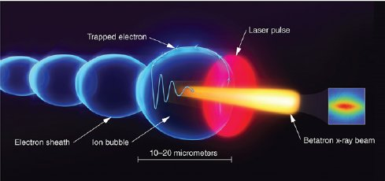
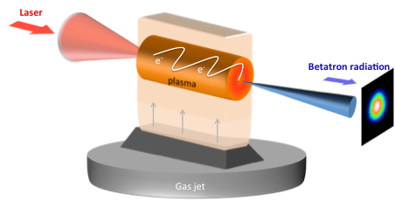
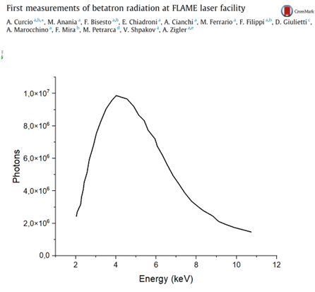
Betatron radiation emission
The radiation has its own characteristics of both FELs and synchrotrons
  Large bandwidth as Synchrotrons
  Short pulse duration like a FEL

Slide 4
Expected Parameters
Parameter | Value | unit
Electron beam Energy | 100-500 | MeV
Plasma Density | 10¹⁷-10¹⁹ | cm⁻³
Photon Critical Energy | 1 -10 | keV
Number of Photons/pulse | 10⁶-10⁹
Repetition rate | 1-5 | Hz
Beam divergence | 3-20 | mrad

Slide 5
Possible applications
In order of increasing difficulty
1- Static imaging ​
2- Static absorption spectroscopy​
3- Static emission spectroscopy
​4- Time-resolved pump-probe absorption spectroscopy
​5- Time-resolved pump-probe emission spectroscopy​
6- Time resolved imaging (plasma dynamics).
Courtesy F. Stellato

Slide 6
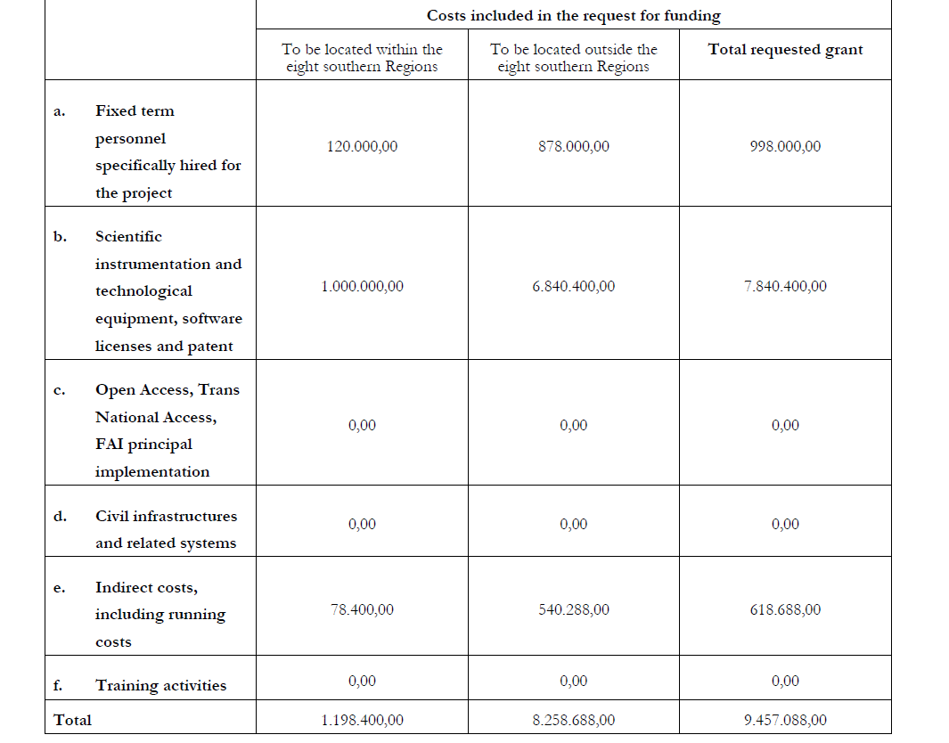
Budget

Slide 7
Where?
The source will be hosted at LNF-INFN
Several parts are realized at CNR (Photon Diagnostics) and at Tor Vergata (User end station)
INFN-Mi takes care of the simulation and data analysis
Activity | Where | Target
2.1 | INFN-Mi | Simulation & Data Analysis
2.2 | LNF-INFN | Plasma source
2.3 | LNF-INFN | Synchronization
2.4 | CNR-Potenza | Photon Diagnostics
2.5 | Tor Vergata | End user station
2.6 | CNR- Montelibretti | Photon time diagnostics

Slide 8
Laser upgrade System 2.263.867,38 euro vat included
The upgrade of the pump lasers of the last FLAME amplifier with TITAN YAG, 20 J of pump energy at 532 nm at 5 Hz, with an almost flat-top single pump laser profile and energy stability — for each individual laser and for the amplified laser — of 1.2%. Power supplies and cooling units are also included.
The new optical compressor.
A set of optics for the existing compressor at FLAME (4 gratings, 2 rectangular mirrors for the retroreflector, and 2 flat mirrors for beam redirection toward the compressor output).
A set of Titanium-Sapphire crystals for the 3 FLAME amplifiers (a square crystal with 6 mm sides for MP1, a round crystal with a 16 mm diameter for MP2, and two square crystals with 50 mm sides for MP3).
Two periscopes for polarization change, with a height difference between input and output beam centers of 17 cm.
A half-wave plate with a 90 mm optical aperture and AR coating at 0° in the wavelength range between 700 and 900 nm, including the mount for polarization control inside the cleanroom.
A set of spare parts for the TITAN lasers, including a full set of flashlamps and filters, a two-channel power supply, a chiller, a pumping chamber for the oscillator and one for an amplifier, and a set of optics (two dichroic mirrors, a Pockels cell, and an LBO crystal).

Slide 9
Laser Upgrade Front end 533.375,46 euro VAT included
Terra 527-50-M
Upgrade of existing Booster and Regenerative Amplifier to 100 Hz
Regenerative Amplifier optical kit
Saturable Absorber
Stretcher Grating
Terra and Inlite II integration kit
Dazzler HR 800
Mazzler
Single shot autocorrelator
Wizzler 800
Inlite II pump laser
Spectrometer
Hardware for Laser 4.0 HE upgrade

Slide 10
Laser Upgrade Diagnostics and adaptive optic 173.240 euro VAT included
Wizzler 800
Deformable mirror
The total laser upgrade is 2.970.482,84 euro VAT included

Slide 11
2.293 keuro vs 2.970.842= 677.482
Laser oscillator (300k+66k)
Optics for laser focusing system (350k+77k)
Laser beamline diagnostics (50k+11k)
High intensity laser extraction system (200k+44k)
Ultra stable femtosecond laser for pump and probe (100k+22k)
New compressor for FLAME laser (optics+vacuum) (300k+66k)
Laser compressor near the interaction region (300k+66k)
Dazzler (100k+22k)
New Optical beamline(180k+40k)

Slide 12
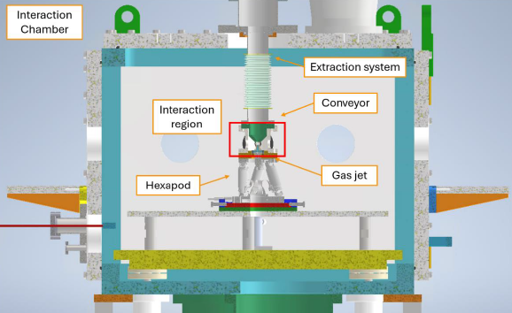
Design of the interation region
A dedicated gas Extraction System (ES) has been developed to ensure the pressure can be at the level of 10⁻⁴ mbar in the parabola at 1 meter of distance.
The supersonic gas jet, adopted for the experiments, is characterized by a divergent nozzle, with inner and outer diameters of 0.5 mm and 2.8 mm, respectively, and an angle of 14°.
The gas conveyor is located 6 mm above the nozzle with an aperture of 6 mm.

Slide 13
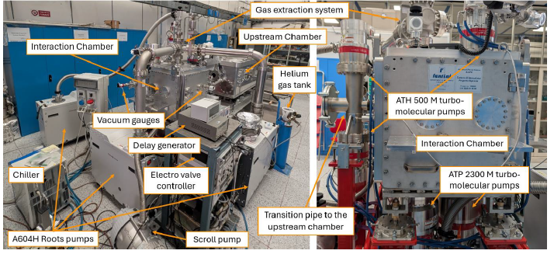
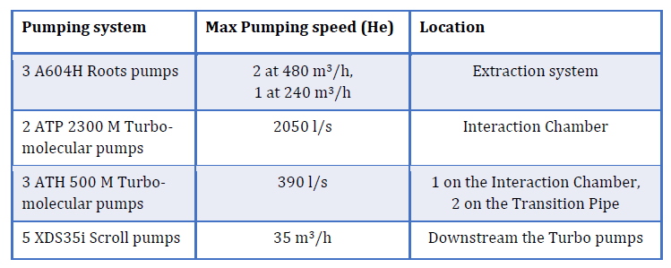
Test bench for vacuum test
L. Crincoli, A. Biagioni
V. Lollo

Slide 14
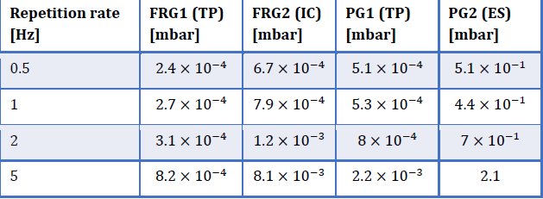
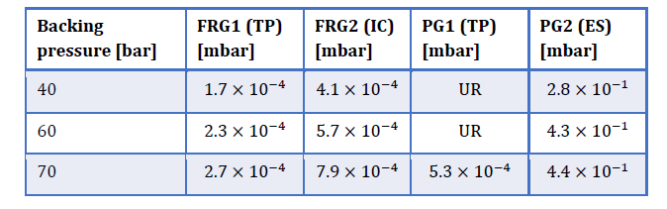
Results of the vacuum tests
L. Crincoli, A. Biagioni
V. Lollo
Notes:
FRG=Full rage Pirani Penning
PG Pirani Gauge
TP Transition Pipe
IC Interaztion Chamber
ES Extraction system.

Slide 15
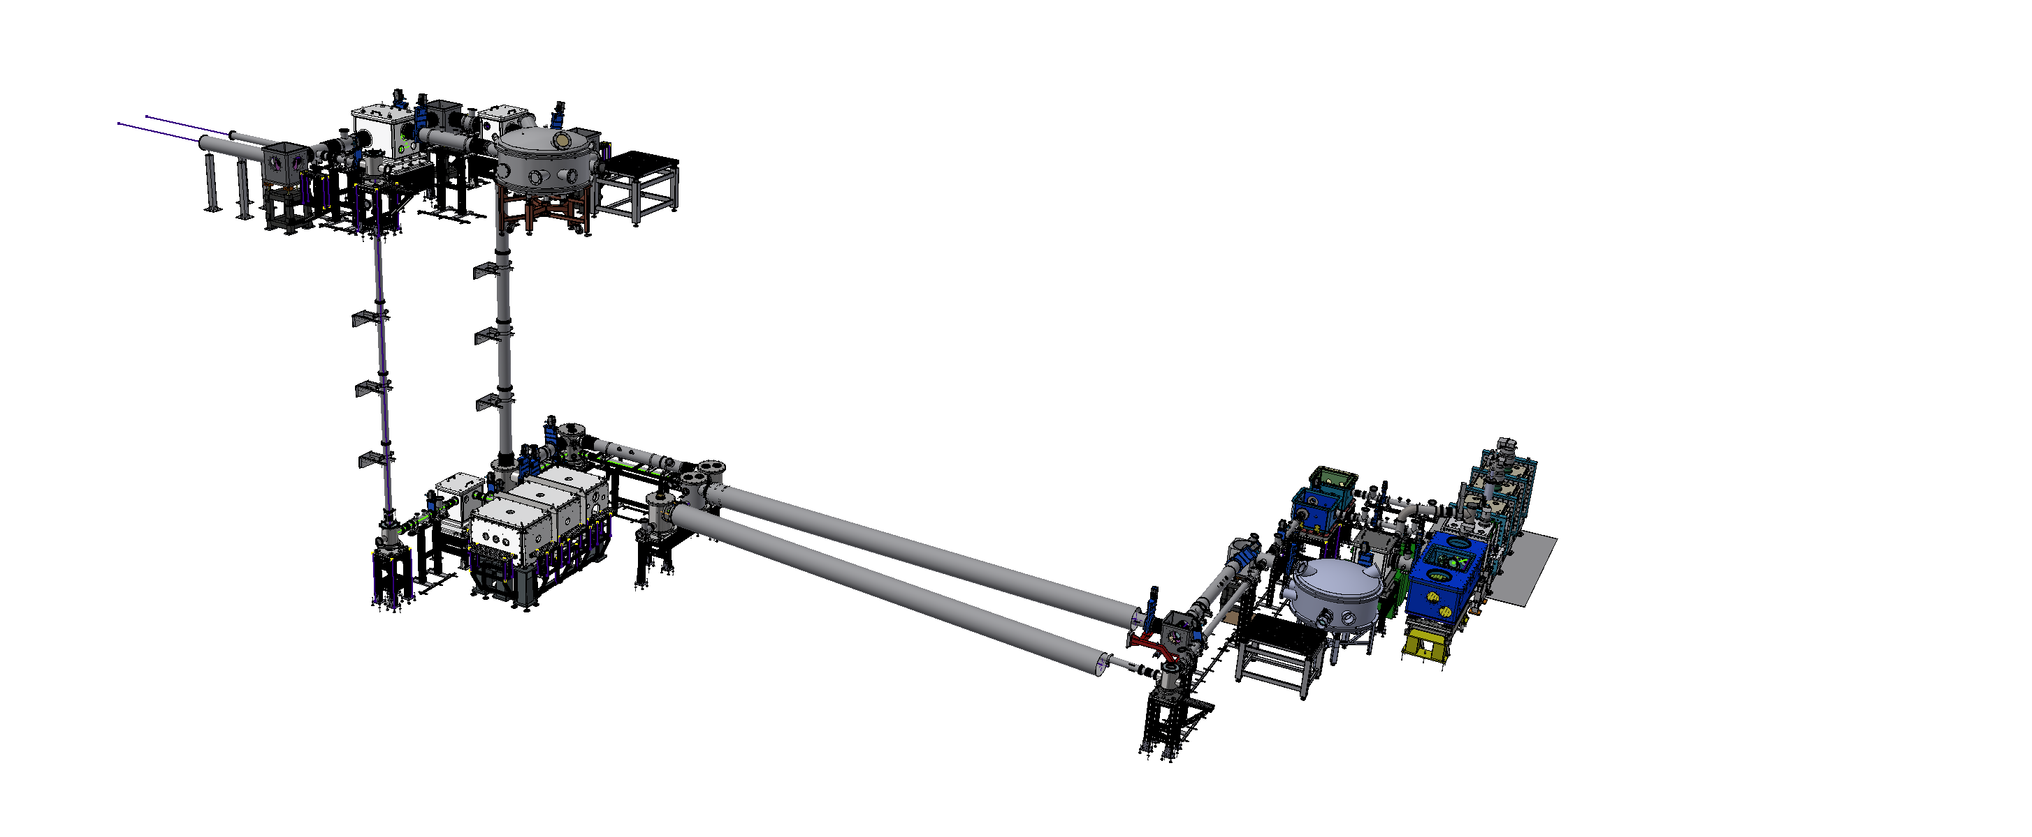
Outline of the source
Our source is designed to operate in dual mode
In the FLAME bunker to perform R&D on the laser and components, and fine-tuning
In the SPARC bunker to give the beam to users
FLAME PARADISO
FLAME INFERNO
SPARC Bunker
S. Lauciani

Slide 16
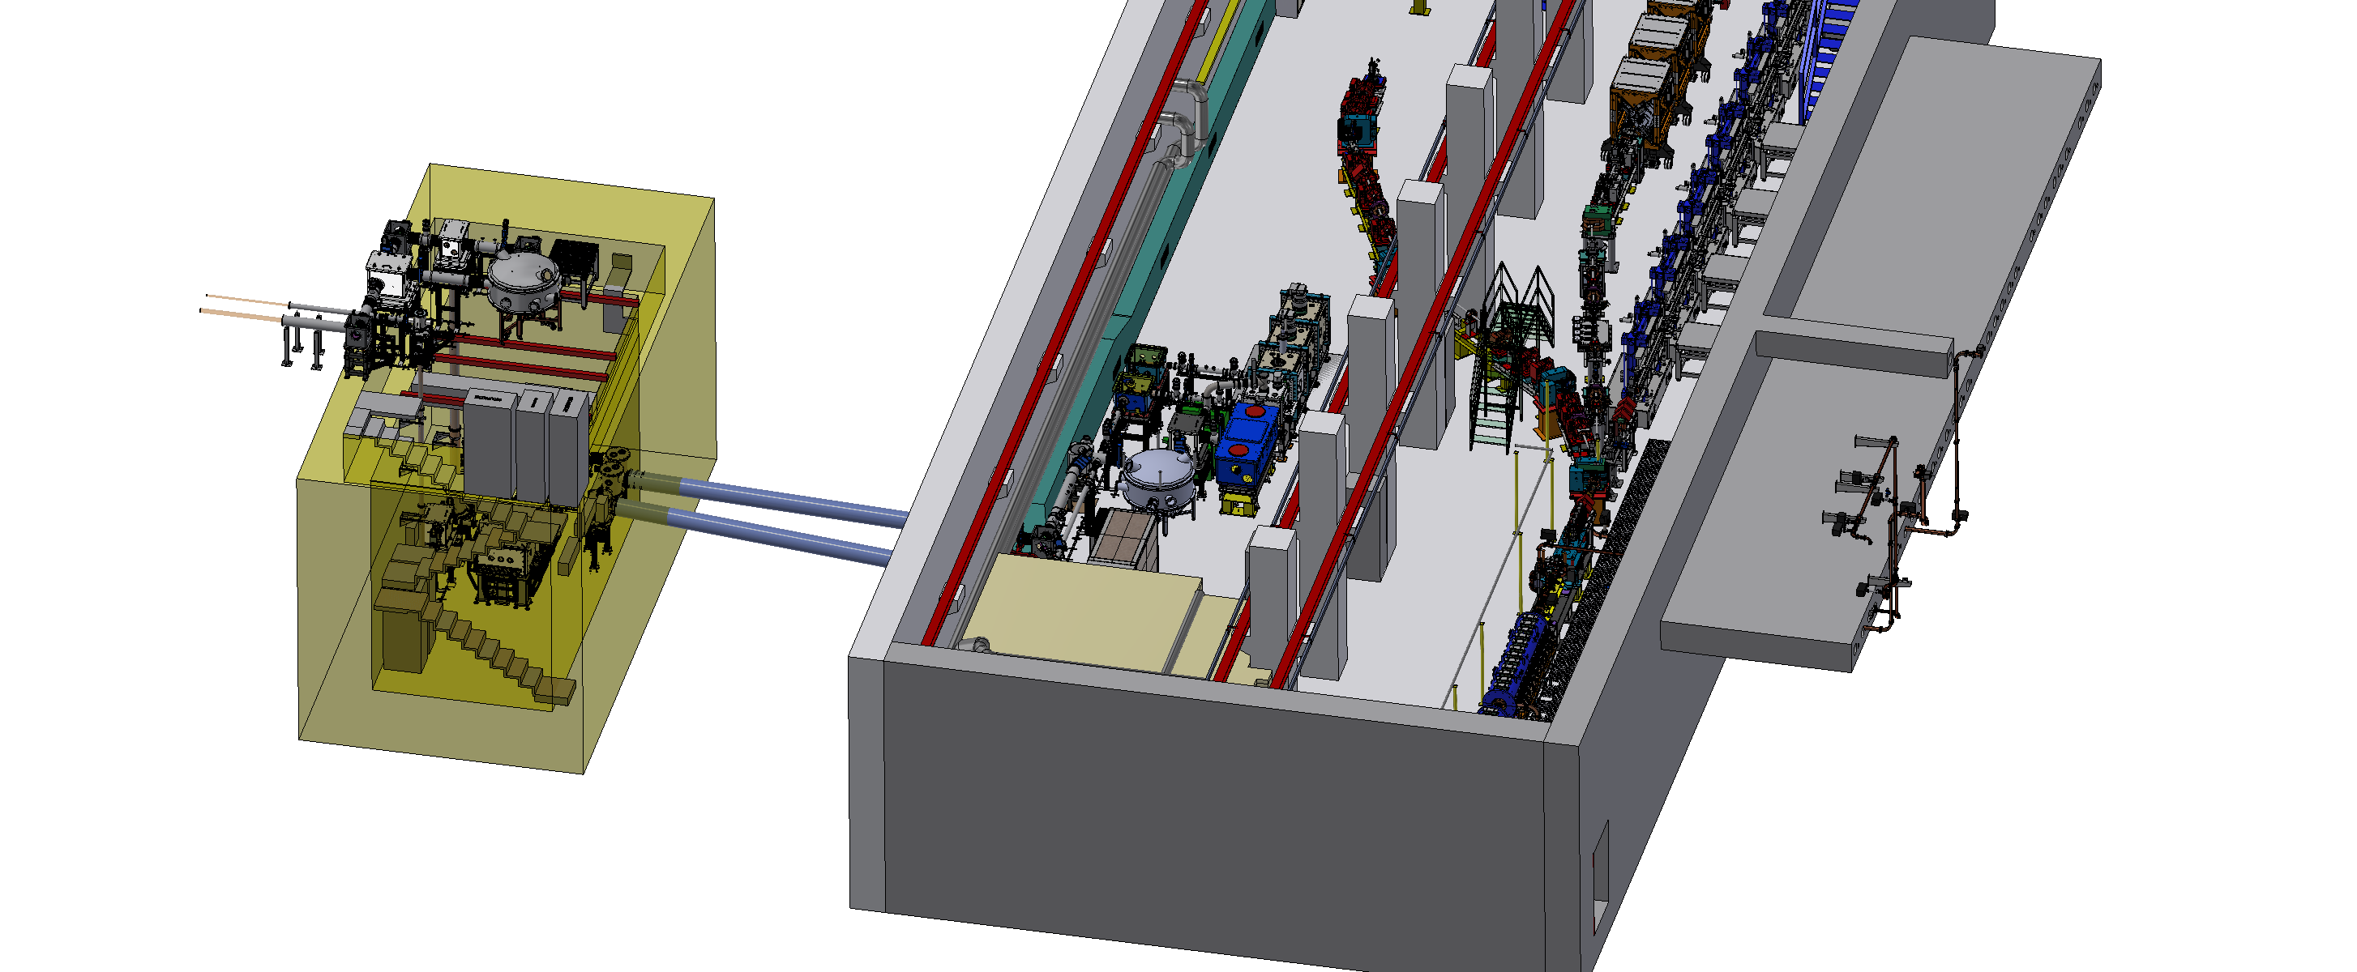
FLAME building and SPARC building
The distance between the two buildings is about 8 meters
SPARC bunker is shared with SPARC linac
The simultaneous use of two facilities in the same place obviously poses security and organizational problems
S. Lauciani

Slide 17
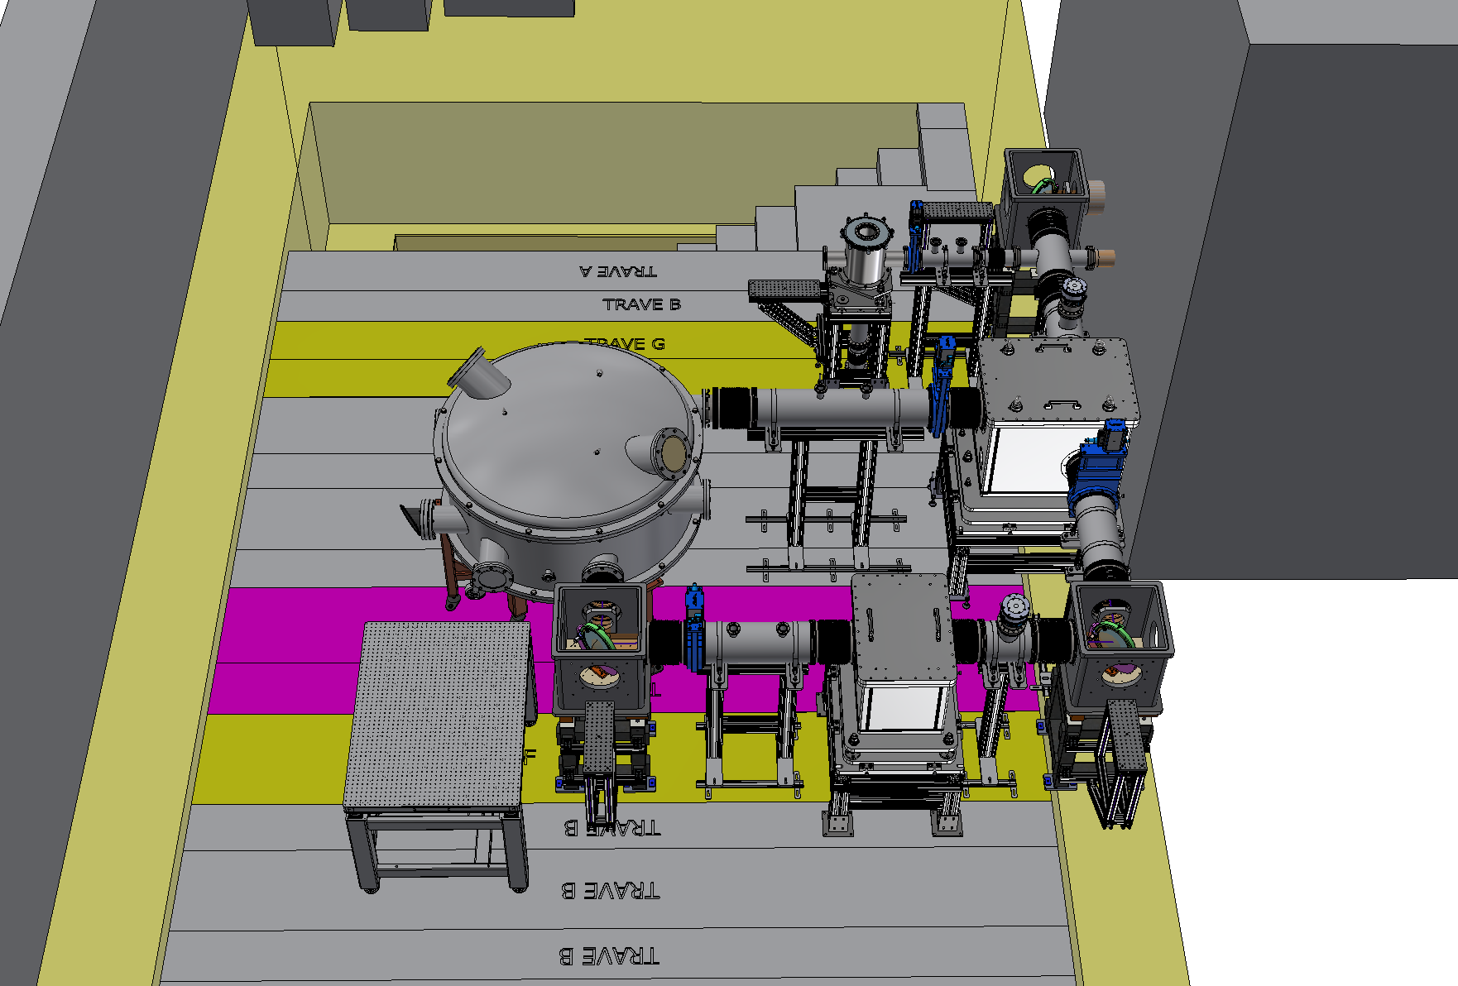
Flame paradise
Laser is coming from laser room
There are two different paths:
  In one line, the beam is directed to FLAME hell uncompressed, to be delivered in the SPARC bunker
  In the second line, the beam is compressed and then sent to the FLAME INFERNO
S. Lauciani

Slide 18
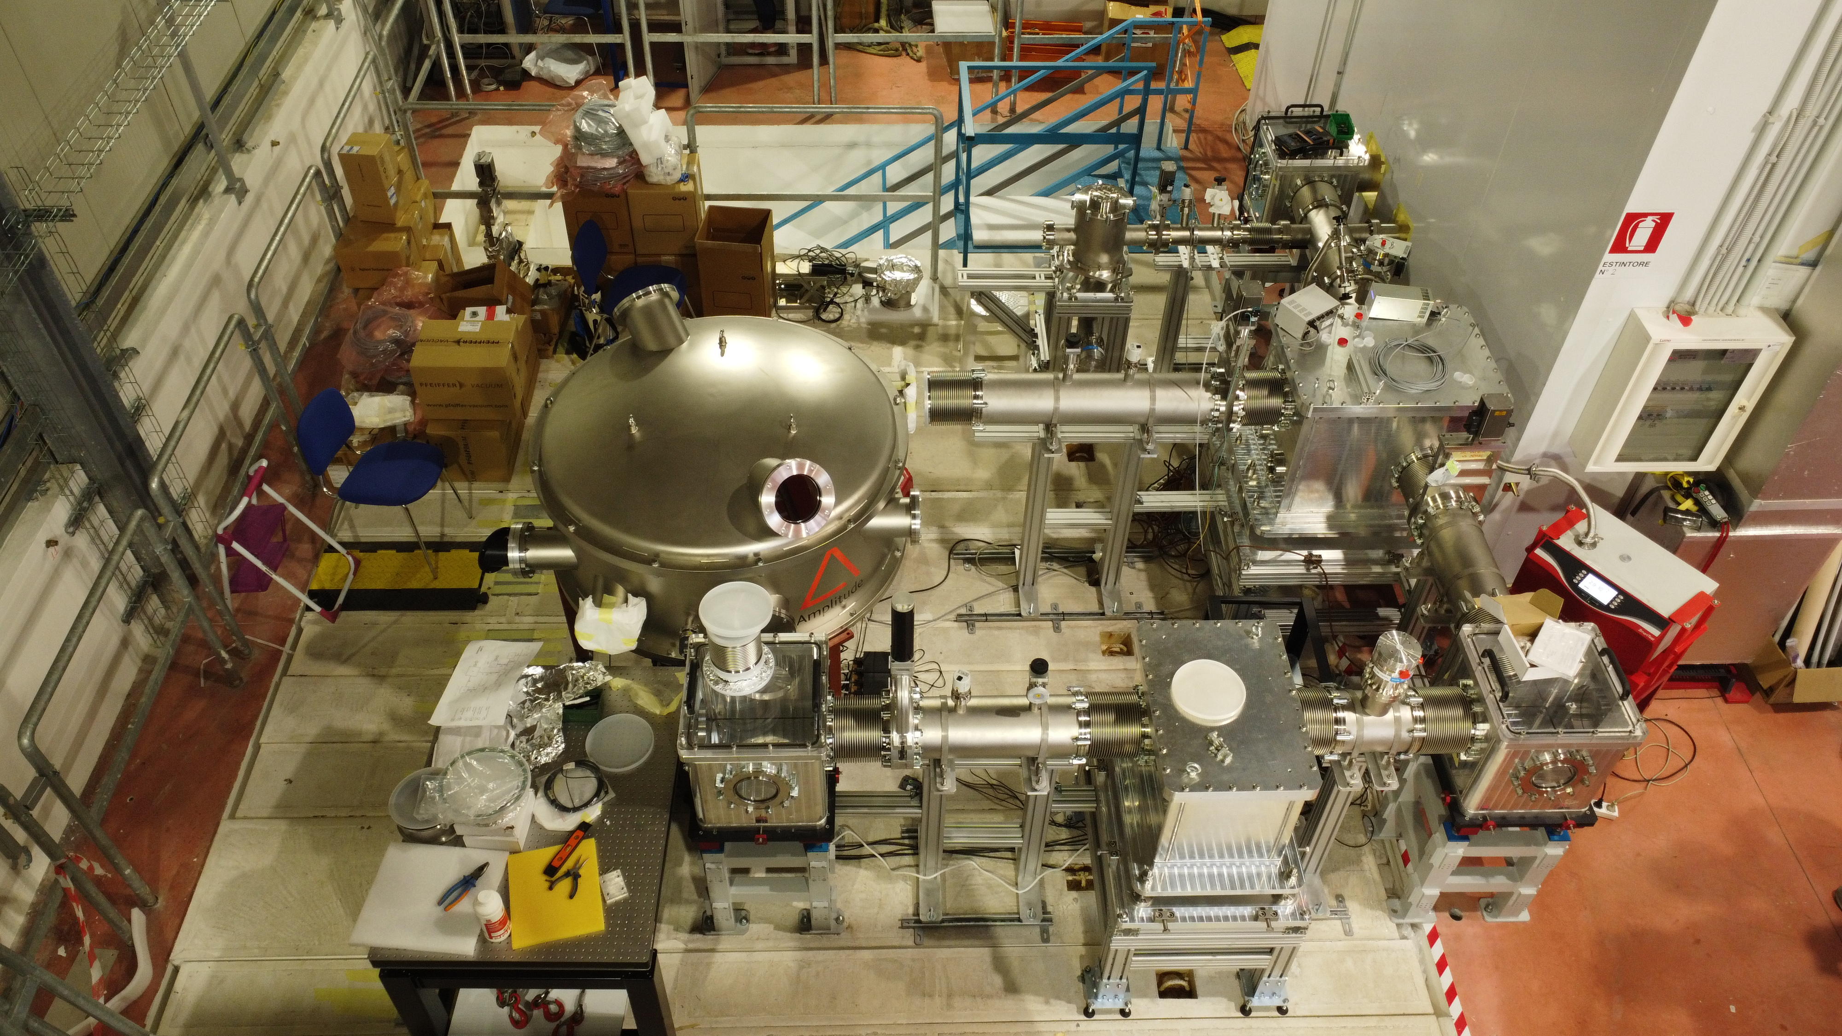
Installation progress
S. Lauciani, F. Fransesini

Slide 19
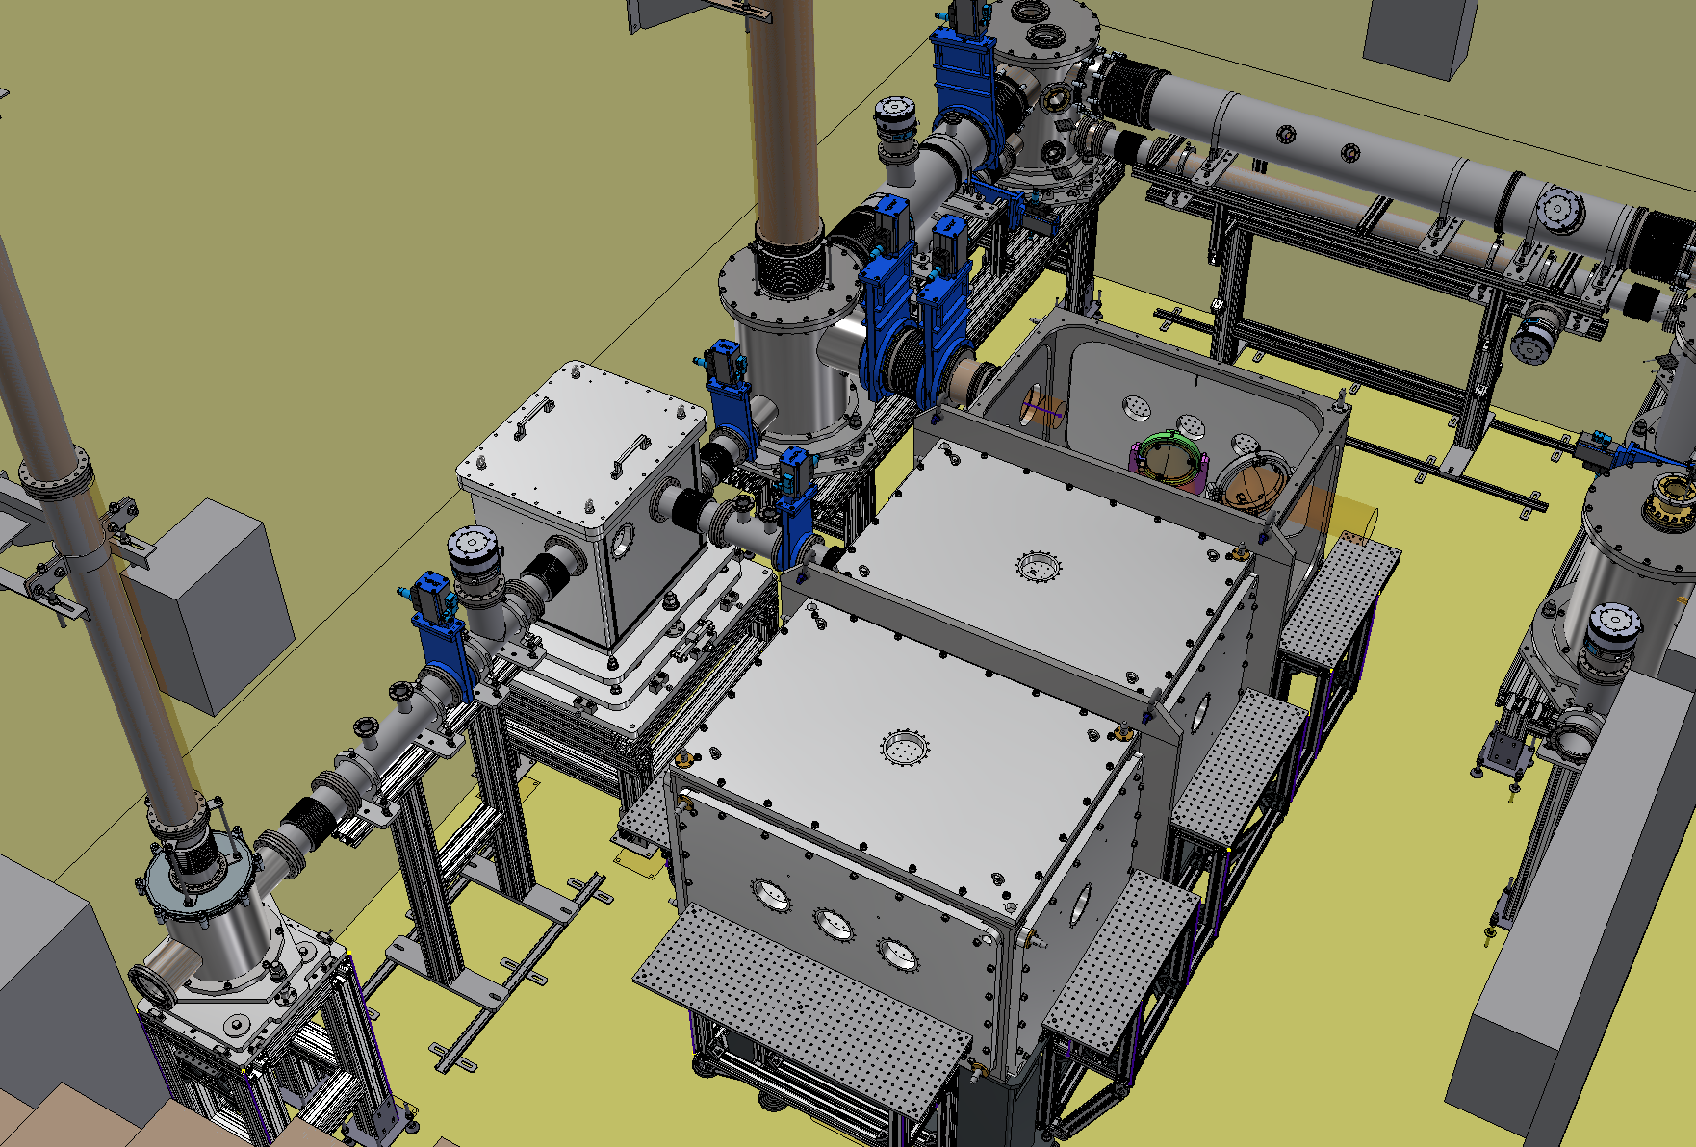
FLAME Hell
There are two pipes that are coming from paradise, related to the Main and the Probe pulse.
If the beam must be used here, the Main is compressed; otherwise, not, and the beam is transported to the SPARC bunker
S. Lauciani

Slide 20
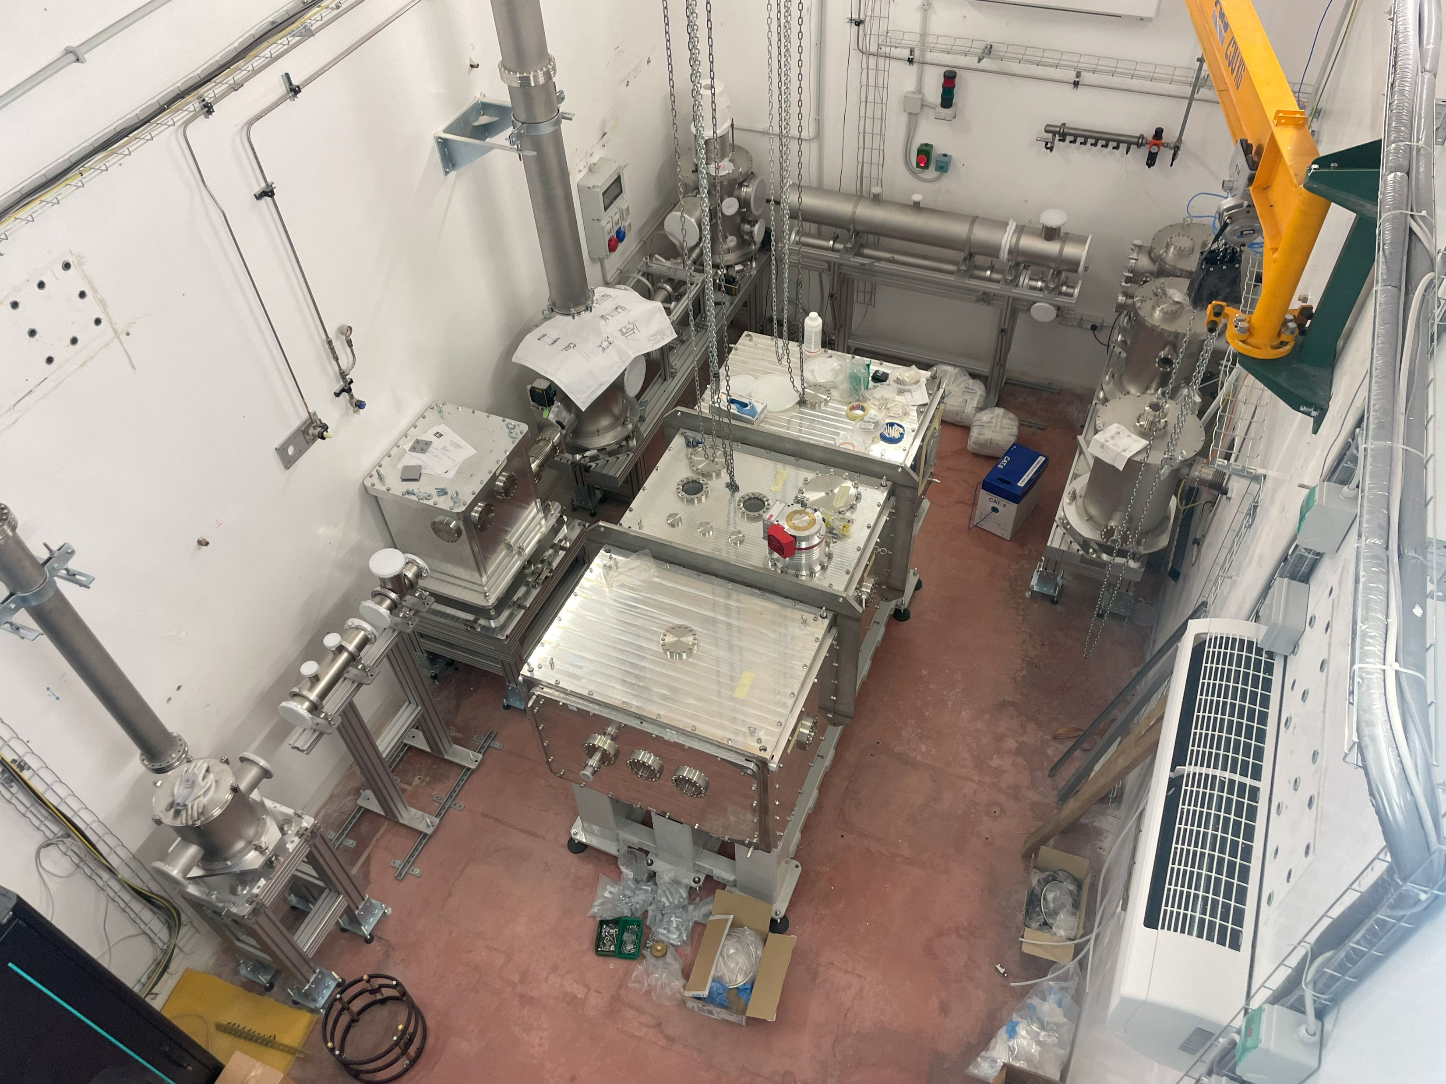
Installation progress
S. Lauciani

Slide 21
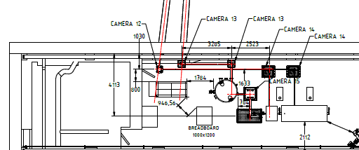
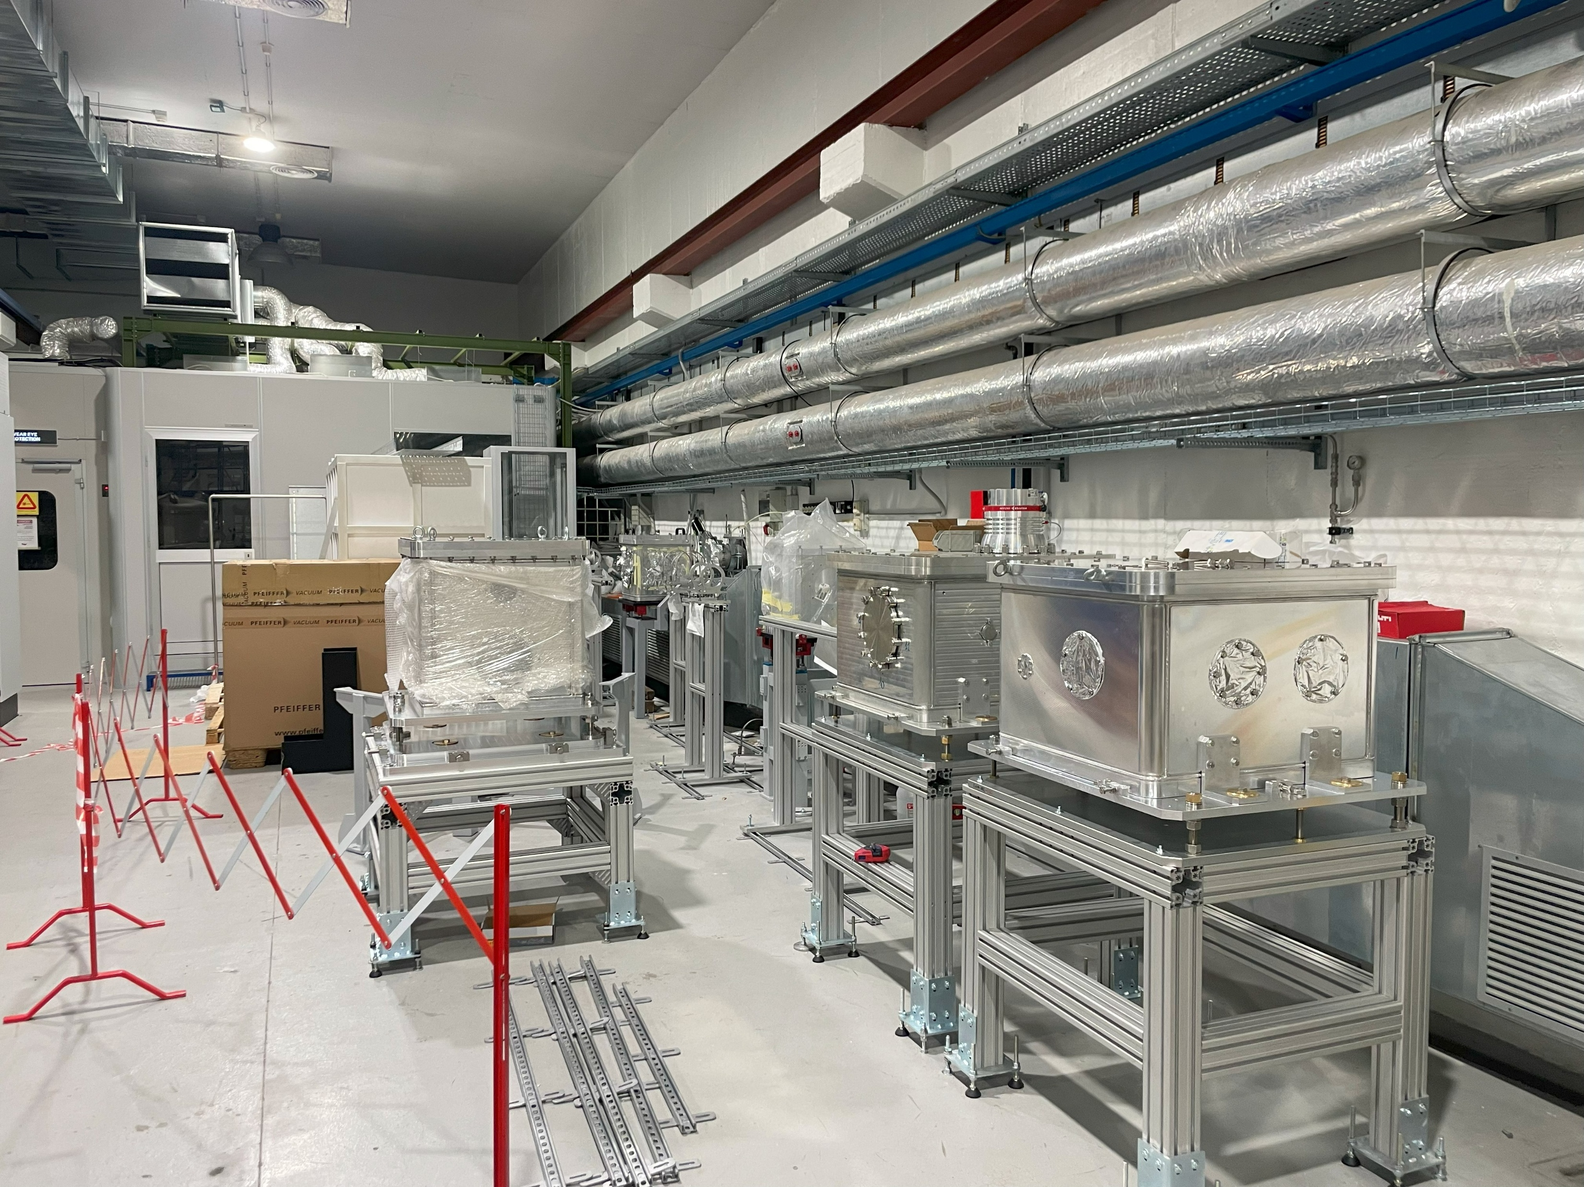
SPARC Bunker installation in progress
S. Lauciani

Slide 22
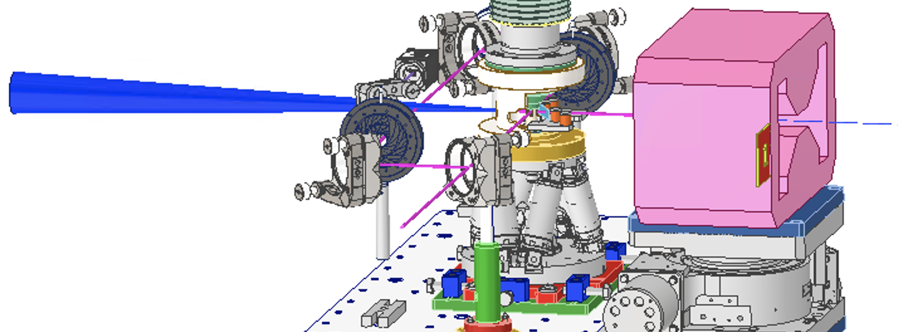
inside the EuAPS@SPARCbunker interaction chamber
gas extraction system
dipole
main laser pulse
hexapod
probe laser pulse
for interferometry
G. Costa, M. Zottola

Slide 23
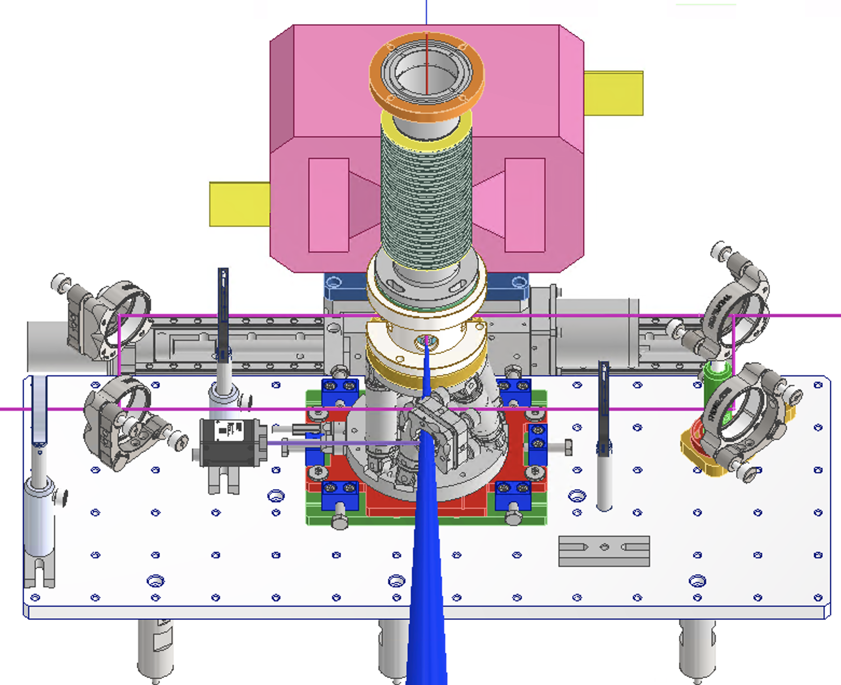
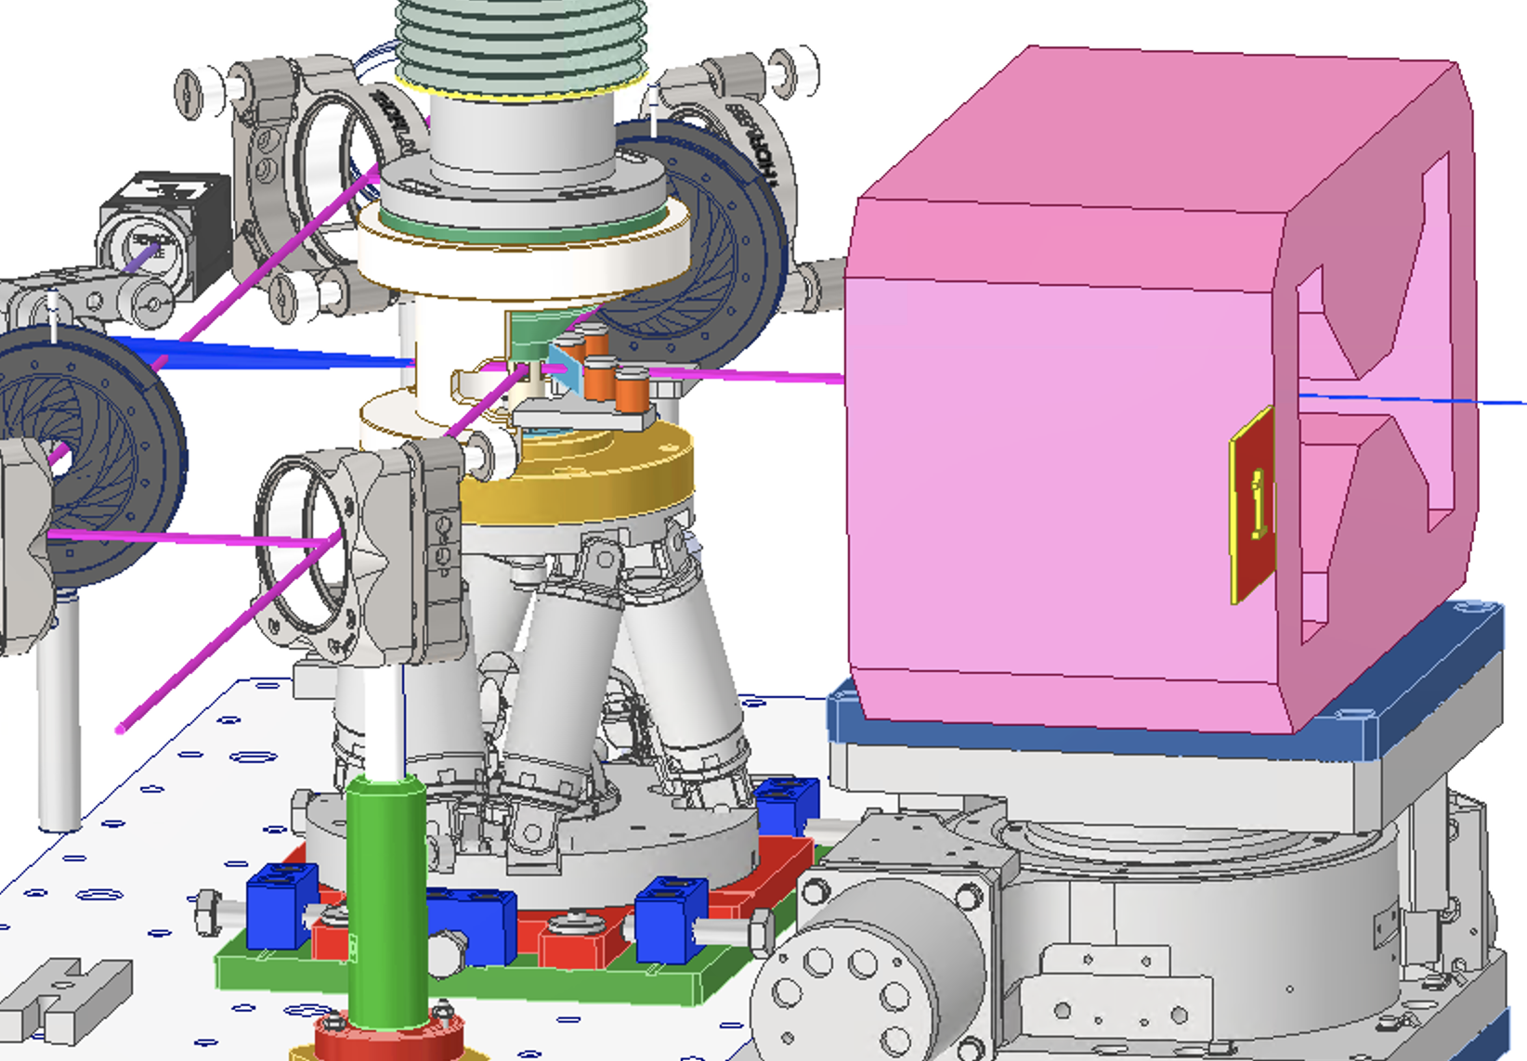
lanex plates for electrons
Tape driver
dipole stage
G. Costa, M. Zottola

Slide 24
Tape driver issues
The hexapod has only relative movements and not absolute
This means that every time it does the home its movement can bring it to touch the tape driver
We need to evaluate the weight of the tape driver to see if it is possible to anchor it to the hexapod
Alternatively, we are studying another system in parallel

Slide 25
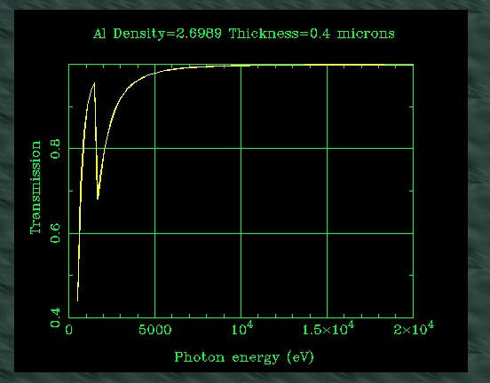
Alternative solution
400 nm*100mm*100mm aluminum foil
In our case, we would be below the threshold if the aluminum is in front of the target (around 1.3 m) and with a 45° angle if the threshold is verified.
CON: It is really difficult to design a frame for a 400 nm of Al.
LIDT in different papers in the literature from 0.03 to 2 J/cm²
Paper 1 | https://www.researchgate.net/publication/260152592_Laser-induced_damage_thresholds_of_bulk_and_coating_optical_materials_at_1030_nm_500_fs/figures
Paper 2 | https://arxiv.org/pdf/2012.02574
M. Galletti

Slide 26
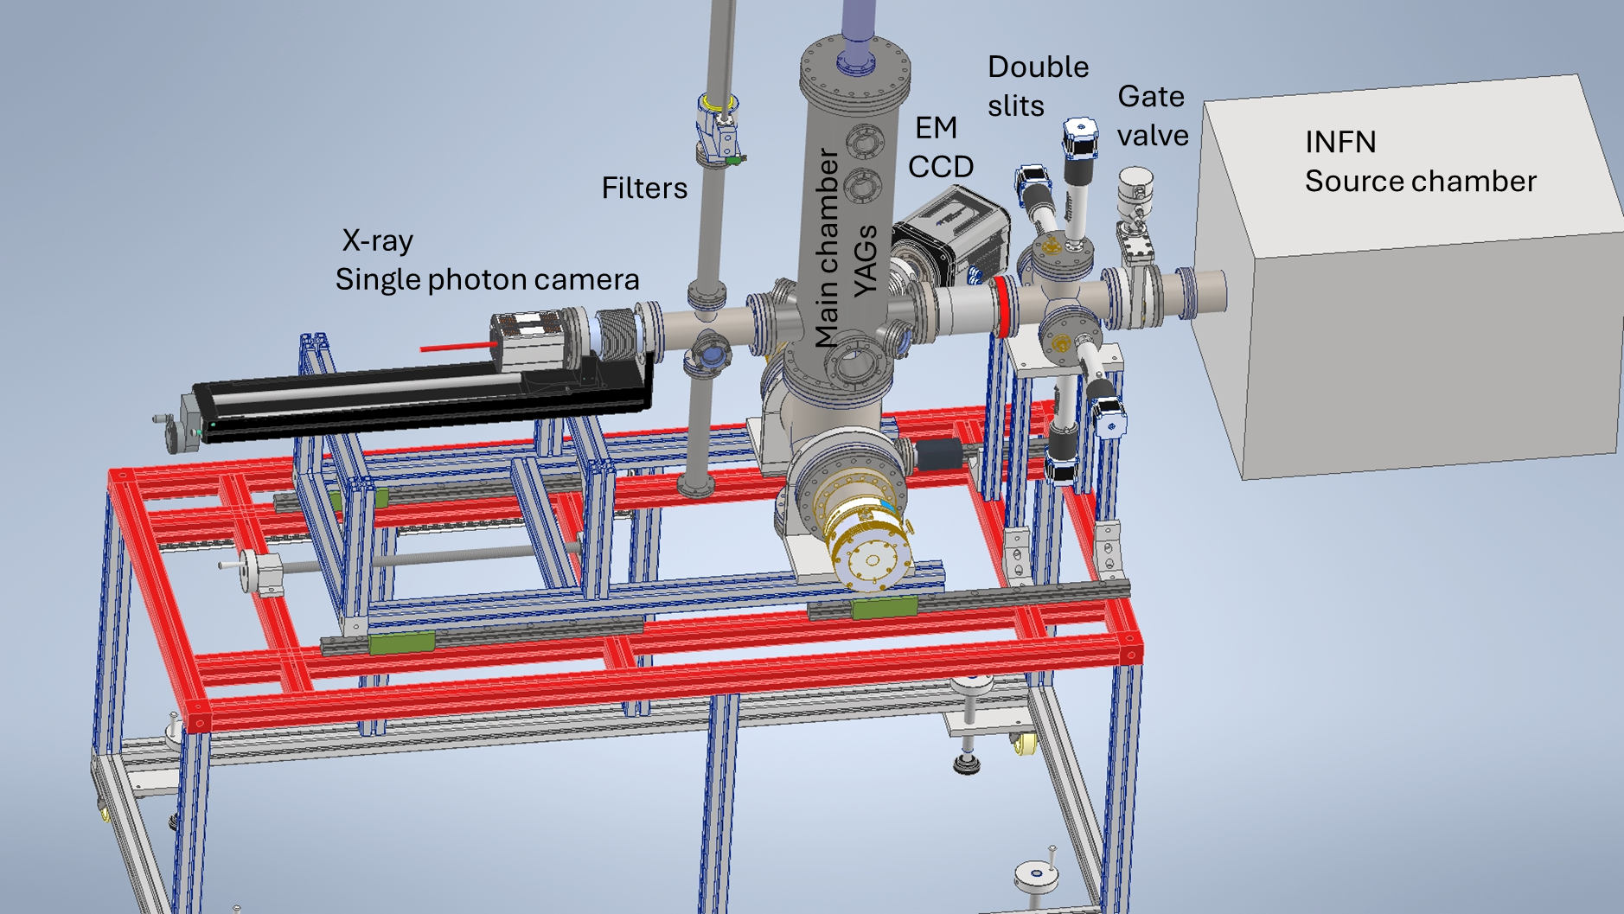
CHARACTERISATION CHAMBER CNR-ISM
P. Bolognesi, J. Chiarinelli

Slide 27
Characterization chamber
It consists of three independent sections for pulse characterisation, shot-by-shot:
a/ Double slit chamber with four independent motorised slits with for current reading → 1/ Beam shape definition
b/ Bellows for distance adjustment towards the main chamber
c/ Main chamber with motorised tool holder (linear and rotational degree of freedom) allocates 5 interchamber ‘characterisation tools’ . Currently:
YAG:Ce on Al metal ring (15 x 0.02 mm, 40 x 0.1 mm, 40 x 0.2 mm, chromium pattern 1x1 mm)
YAG:Ce on Al metal ring (40 x 0.2 mm with central hole dia. 3 mm, chromium pattern cel size 1x1 mm)
Faraday cup
Windows at +/- 40°, 90° with respect to beam for EM-CCD. → 2/ Beam shape/stability/relative intensity distribution shot-by-shot
d/ Filter Chamber with motorised filter holder allocates 3 filters to position in front of X-Ray camera → 3/ Caratterizzazione of the shot-by-shot spectral distributions.
  Currently available Al, Cu, Fe of different thickness
  X-Ray camera for ‘single photon counting’. Linear translator with 500mm drive
P. Bolognesi, J. Chiarinelli

Slide 28

Side view
Each section of the characterisation setup can be used independently
of the others or together.
Removing the section will allow moving closer to the source.
3
4
1/ Double slits
2/ Bellows
3/ Main chamber
4/ Filter chamber.
5/ X-Ray camera
6/ Frame
1
2
5
6
P. Bolognesi, J. Chiarinelli

Slide 29
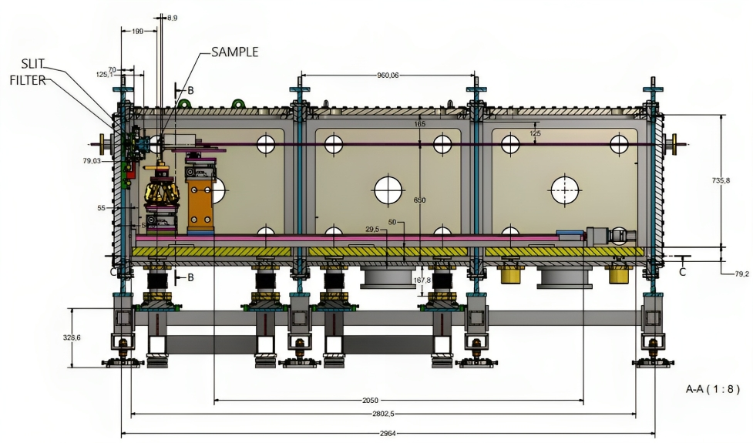
Experimental chamber
This experimental chamber is built around the idea of allowing different kinds of experiments, starting from simpler and more rounded ones and ending with complex measurements in pump-probe mode.
We have designed the chamber as composed of three different modules: each one of them can be detached and used independently from the others or rearranged to accommodate complex optical geometry.
This will permit us to have the best possible chamber for each application (Imaging, Spectroscopy, pump-probe).
F. Galdenzi, V. Lollo

Slide 30
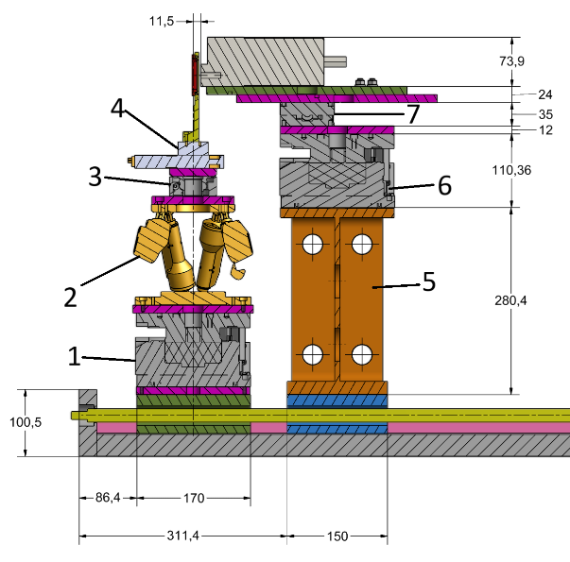
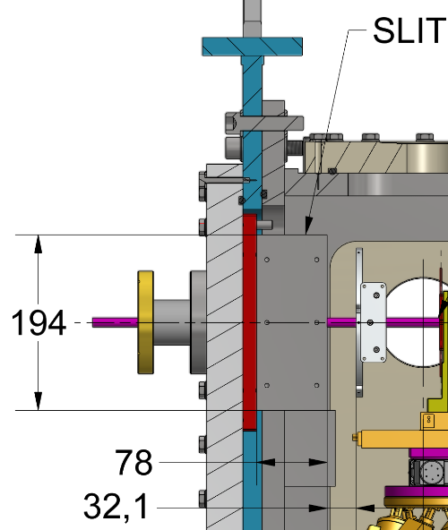
Inside the chamber
1 - Linear stage XY, 25 mm travel range, 25 N load max, 133x35x20 mm size, 0,73 kg weight, stainless steel/aluminium.
2 - Rotary stage, 360° rotation, 0.125 Nm maximum torque, 50 N max load, ±20 mdeg accuracy, 0,7 kg weight, 194x90x70 mm size, Stainless Stee.
3 - Hexapod, ±17 mm travel range, 5 kg load capacity, Repeatability to ±0.06 µm, 2.2 kg weight, lower circular base 136 mm, higher circular base 100 mm, height 114 mm, stainless steel/aluminium
4 - Linear stage (z-direction, perpendicular to the ground), 40 mm travel range, 0,02 mm Spindle pitch, 0,05 µm resolution, 150 N max load, 0,3 Nm Min. Drive Torque, weight 7.5 kg, size 170x170x90 mm, aluminium.
Not Numbered - Custom-built sample holder, 200 g weight, 133x23,5x7 mm size (with angular step for bolts), stainless steel.
F. Galdenzi, V. Lollo

Slide 31
Other open issues
Dipole design and construction require more than expected, mainly due to overlap with other activities
Authorizations to run the facility are under way but a clear estimation is not yet available
There are two main authorization processes, one for FLAME and the other for SPARC bunker.
The CCD-X camera in vacuum is not working yet

Slide 32
Conclusions
WP2 is underway
The construction is mainly in the schedule, and we could foresee the first beam in early September, depending on the authorizations
Risk mitigation strategy:
  In case of having only FLAME authorization before the end of the project we will run a small pilot experiment in FLAME hell
  But this will impact CNR and Tor Vergata that deliver the main components for SPARC bunker.
  Other suggestions are more than welcome

