Slide 1

Yearly Meeting 2025
27 September 2025, Elba, Italy
Ralph Assmann, GSI & University Frankfurt
Massimo Ferrario, LNF/INFN

Slide 2
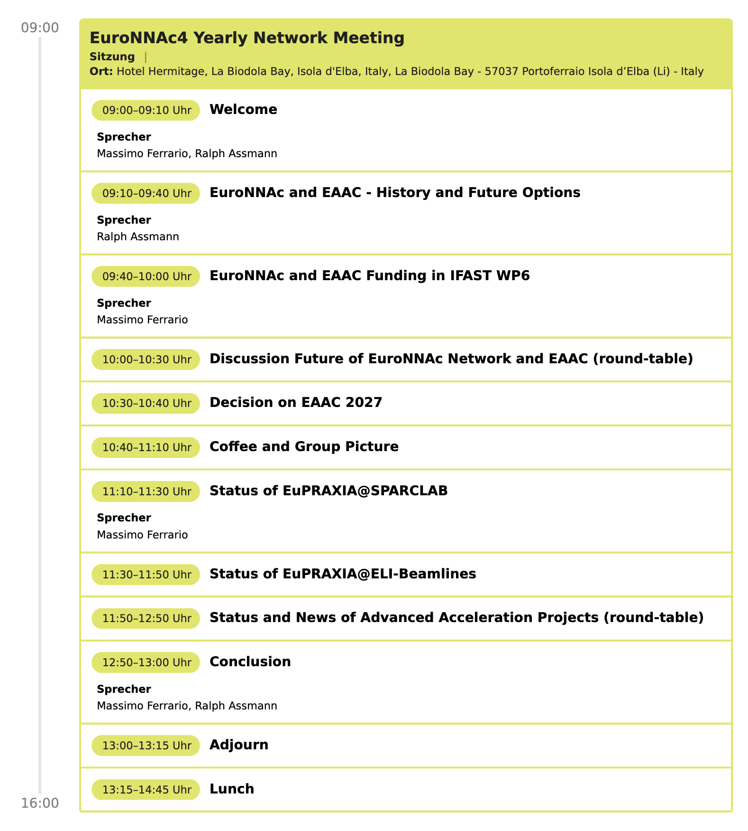

Slide 5
History I
2010 First discussions – Advanced accelerator landscape in
Europe very fragmented with sub-optimal impact
2011 Initiative R. Assmann at CERN to form a network
Community meeting at CERN with CERN DG R. Heuer
Network EuroNNAc formed with CERN budget
2012 EuroNNAc integrated into CERN led EU acc. R&D projects
EuCARD, EuCARD2, IFAST → about 50k€ EU funding / year
2013 Network went with R. Assmann from CERN to DESY
First EAAC at Elba, organized with Massimo Ferrario
2014 European initiative EuPRAXIA, outcome of EuroNNAc& EAAC
2020 EuroNNAc now 50% DESY, 50% INFN (RA DESY & INFN)
… 2023 EAAC, reports, inputs to European strategy, ESFRI, ECFA, …

Slide 7
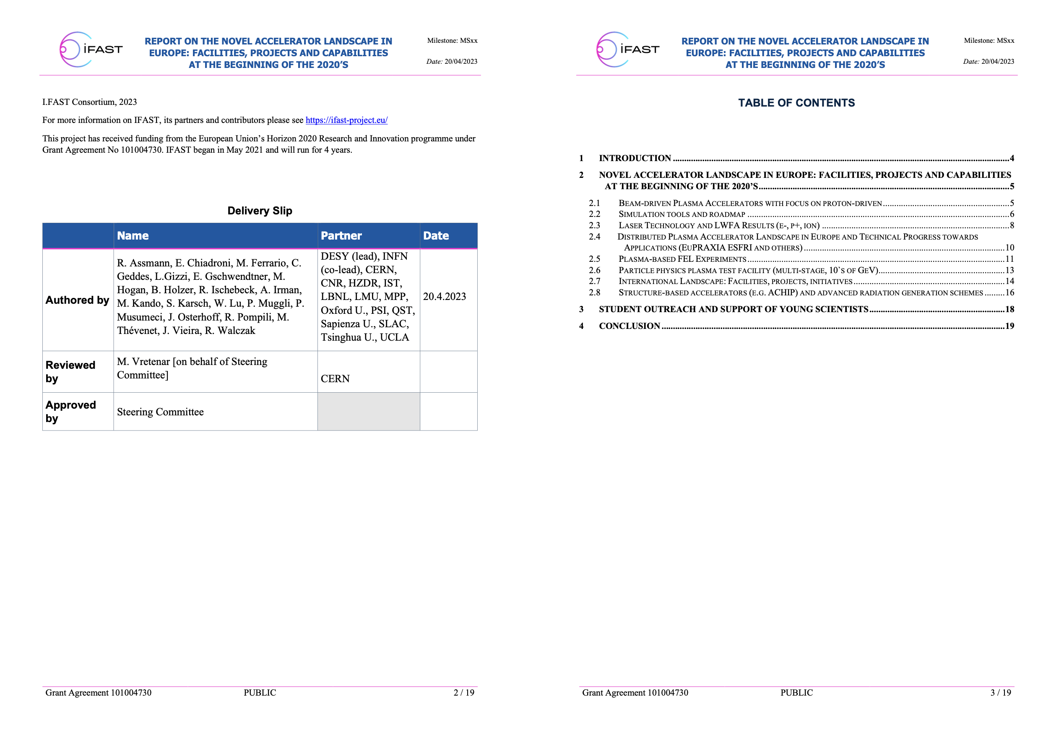

Slide 8
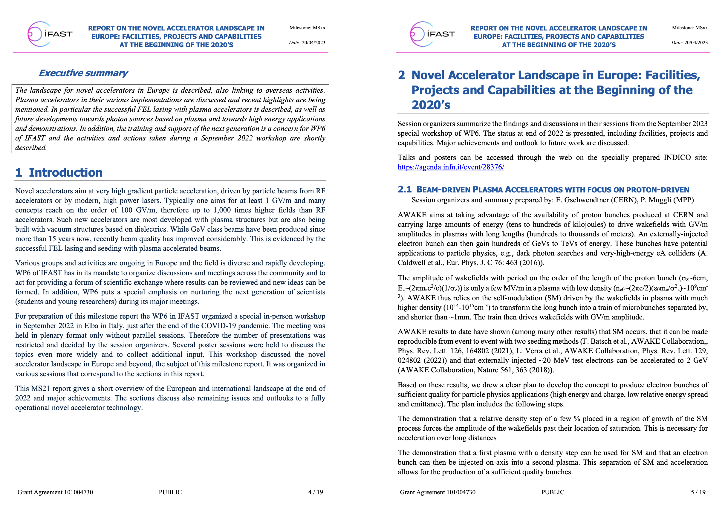
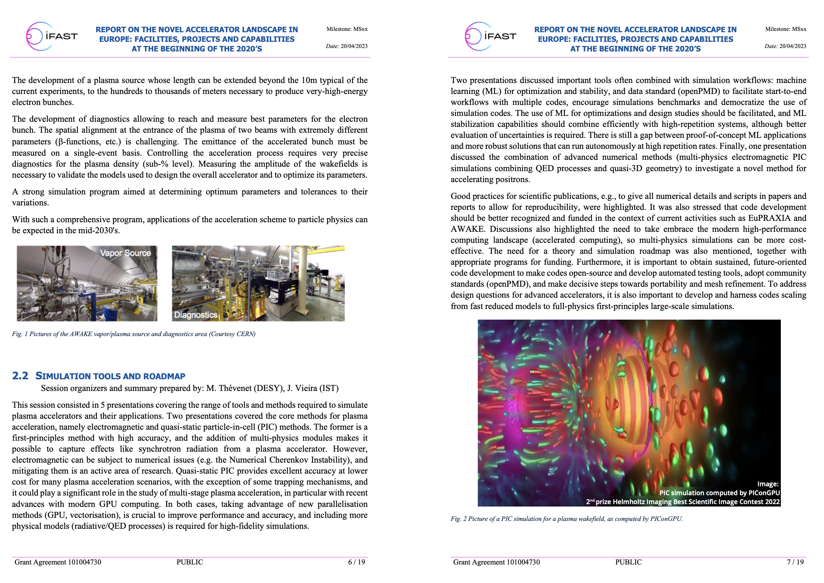

Slide 10
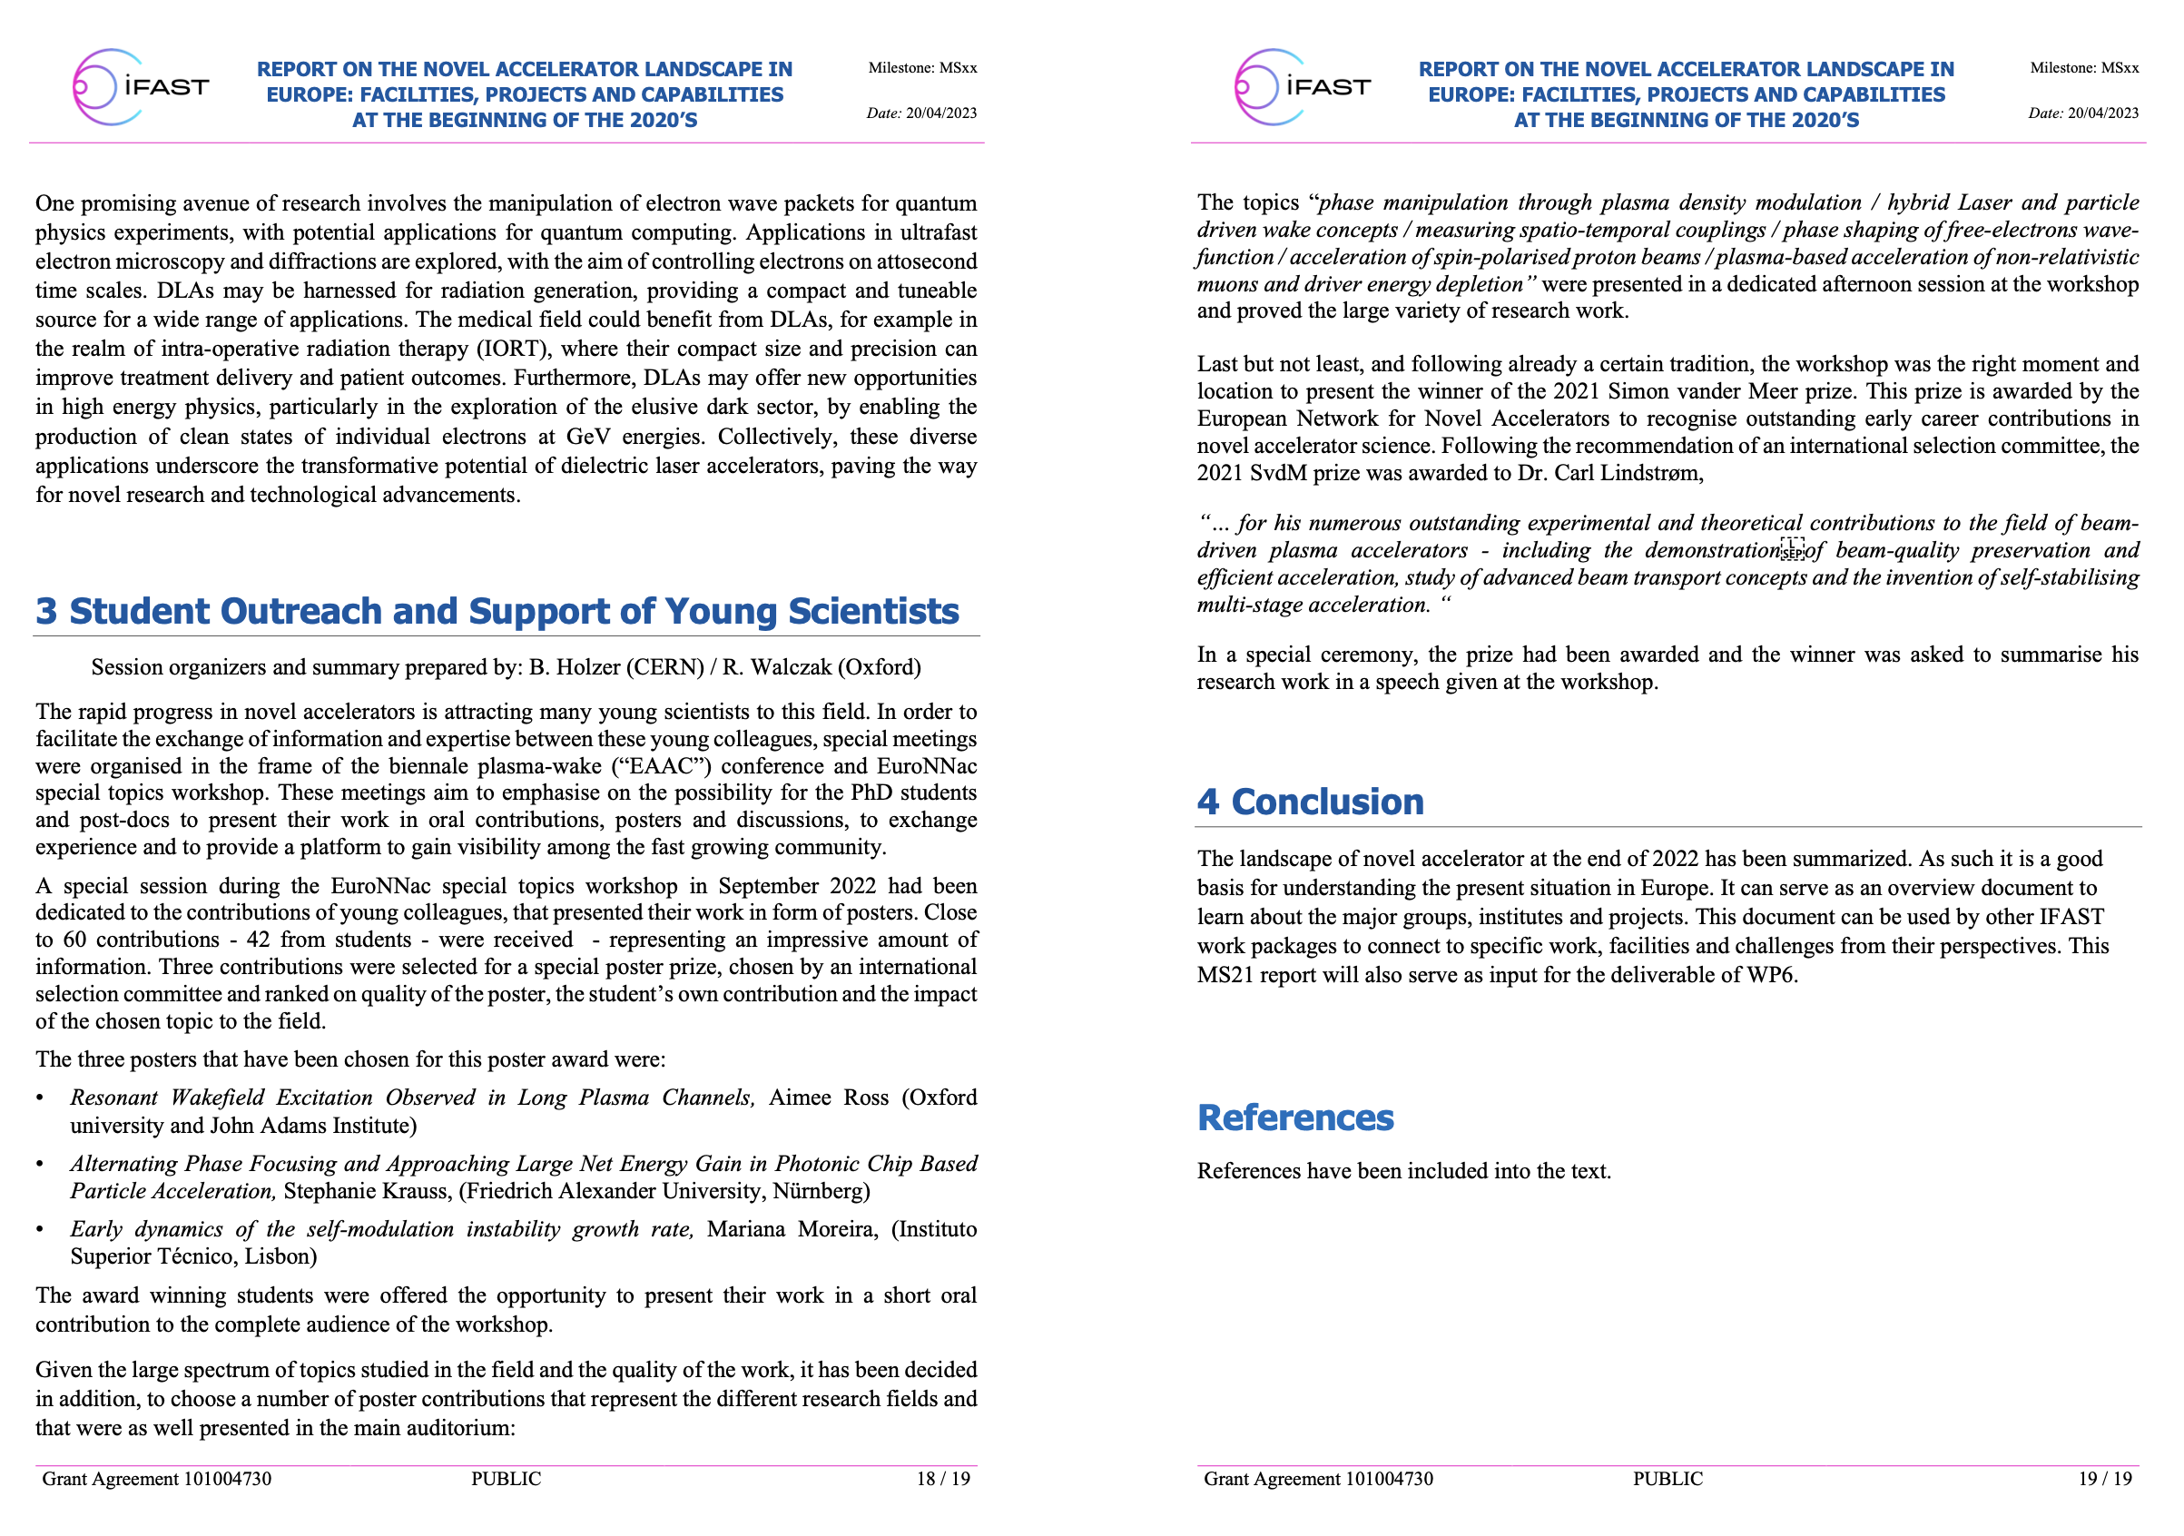

Slide 11
History II
2023 R. Assmann leaves DESY, network stays at DESY & INFN
M. Ferrario takes over official lead
R. Assmann with reduced effort for EuroNNAC/EAAC
2025 EAAC2025 organized with final IFAST budget
End of EU support through IFAST
2025 CERN/TIARA (M. Vretenar) decision → EuroNNAc not
included in IFAST2 project
2025 To decide: Future of EuroNNAc

Slide 12
Roles of EuroNNAc
Community body which can form community opinion, can voice and submit those opinions and can promote our field
  Made a good impact
  European landscape thrived, plenty of budget obtained
Scientific sponsor of the European Advanced Accelerator Conference
  appointing the conference chairs, organizing committee, international scientific advisory body, SPC chair
  international scientific advisory body = representatives of EuroNNAc member institutes from Europe, US, Asia
  decides location
Financial sponsor of the EAAC and other conferences / workshops – focus on student support, peer-reviewed proceedings & prizes
  Promoting the young colleagues

Slide 13
5 Future Options EuroNNAc
Continue EuroNNAc and apply for EU funding
  EU programs exist
  Who is helping?
  C. Welsch, R. Assmann, M. Ferrario willing to support
Continue EuroNNAc with funding, fees member institutes
  50 members → average 1 k€ per year – propose 2-3 k€ / year for institutes
Continue EuroNNAc with funding, as add on to EAAC
  Finance EuroNNAc with EAAC participation fees
Continue EuroNNAc without funding, as add on to EAAC
  Impact will depend on initiative and volunteering of members
Stop EuroNNAC and continue only with EAAC

