Slide 1

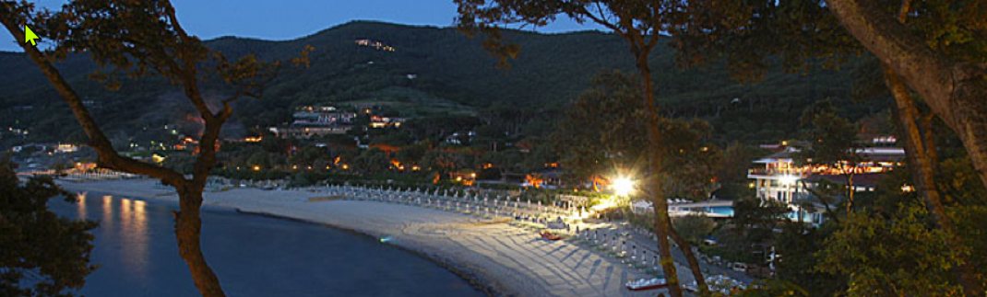
Advanced Accelerators in the
ESPPU process
Tor Raubenheimer
September 23, 2025

Slide 2
Outline
ESPP Strategy Process
Comments from the Open Symposium in Venice
Thoughts about next steps for wakefield accelerators
T. Raubenheimer, EAAC2025
2

Slide 3
ESPP Strategy Process
Every 6 years or so, Europe reviews the plan for Particle Physics and presents guidance to CERN Council
Last review in 2020 recommended:
  Feasibility Study of FCC-ee and FCC-hh
  Strengthened accelerator R&D guided by the LDG (Lab Directors Group or something) which also launched the International Muon Collider Collaboration
Present ESG is tasked with recommending next major accelerator-based project at CERN as well as backups should the primary plan prove not feasible
Goal is to complete process in early 2026
Complementary to US process of Snowmass in 2021 followed by P5 in 2022-2023
T. Raubenheimer, EAAC2025
3

Slide 4
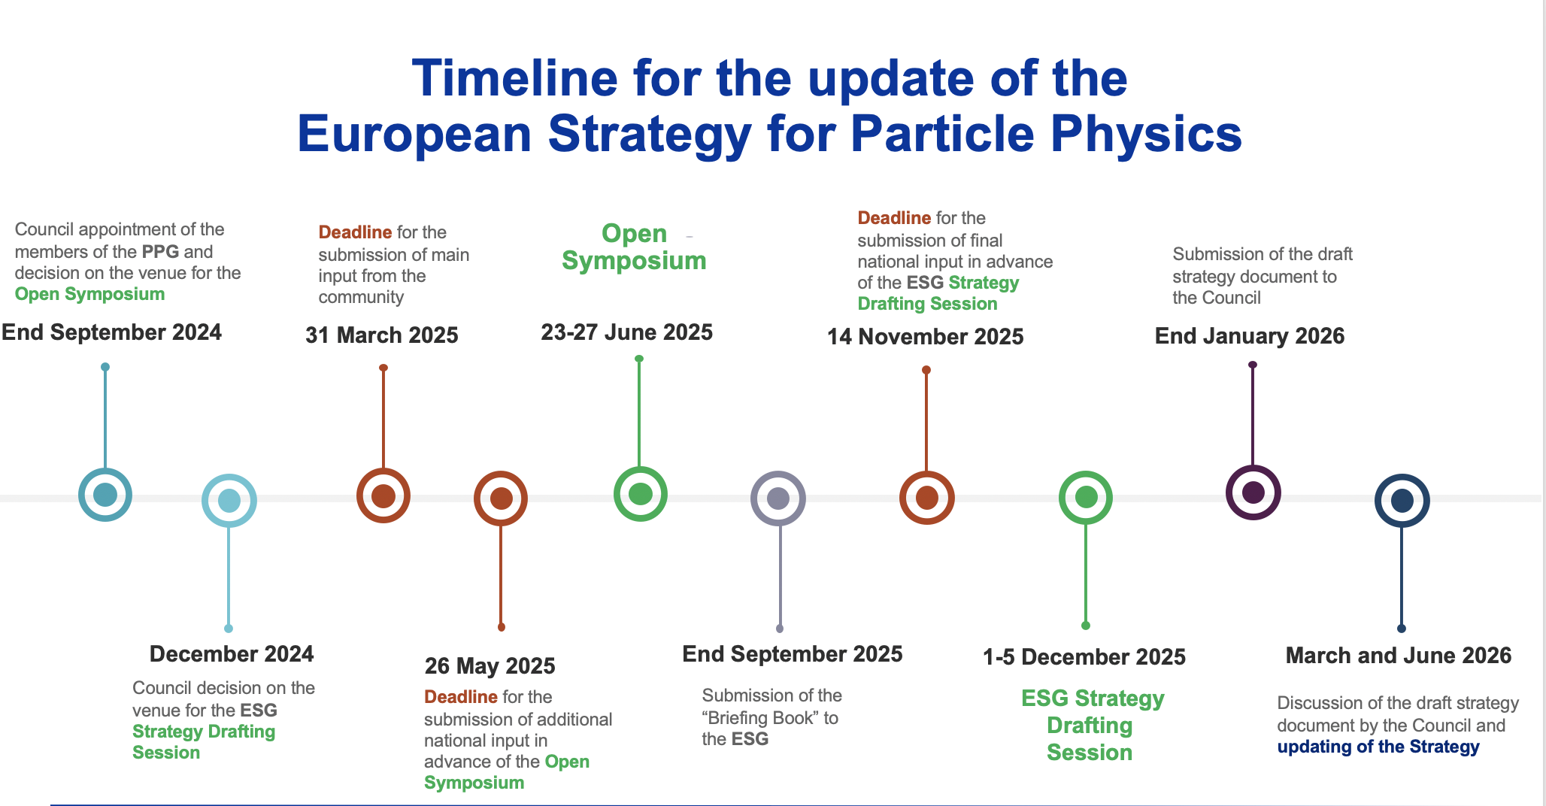
(in Venice)
We are here
(Monte Verita /
Ascona, CH)
More details on ESPP web page: https://europeanstrategyupdate.web.cern.ch/
T. Raubenheimer, EAAC2025

Slide 5
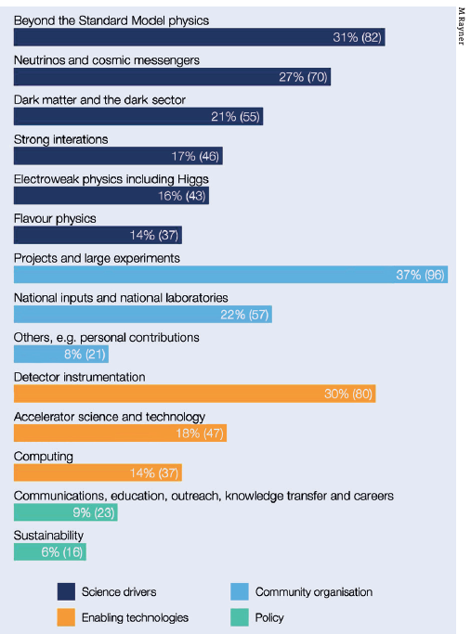

Input received
263 contributions received by 31 March,
+ 3 new contributions + updates by 26 May:
- Major flagship projects
- Many projects in other physics areas
- Input from national HEP communities in ECFA countries and beyond
- Input from National European Labs (e.g. DESY, Frascati, …)
- Input from Early Career Researchers (via ECFA ECR panel)
- Input from APPEC, NuPECC, ..
All contributions are public: https://indico.cern.ch/event/1439855/contributions/
Alphabetical list: https://europeanstrategyupdate.web.cern.ch/sites/default/files/Submitted_Input_2025.03.04.pdf
These submissions have been analysed by the Physics Preparatory Group (PPG) and ESG working groups;
They provide the input for the presentations and discussions at this Open Symposium
Self-attributed themes of the 263 community
inputs
T. Raubenheimer, EAAC2025

Slide 6

ESPPU Open Symposium
Opportunity to discuss physics and accelerator options that are being considered
by the European Strategy update
T. Raubenheimer, EAAC2025

Slide 7
Purpose of the Open Symposium
The Open Symposium is an important step in the process of updating the European Strategy
The community is invited to debate the scientific input, to define the scientific goals and priorities for the
upcoming generation of facilities and experiments
🡪 Ample time for discussions foreseen in each of the physics and technology sessions;
The focus is on physics potential and priorities
🡪 Get engaged in discussions in the Parallel (Monday) and Plenary Sessions
The submitted input and the outcome of the discussions at the Symposium will provide the basis for writing the Physics Briefing Book (to be released on 30 Sept. 2025)
The Physics Briefing Book in turn – together with final input from the National HEP communities –
will provide the basis for drafting the final recommendations in Dec. 2025
T. Raubenheimer, EAAC2025

Slide 8
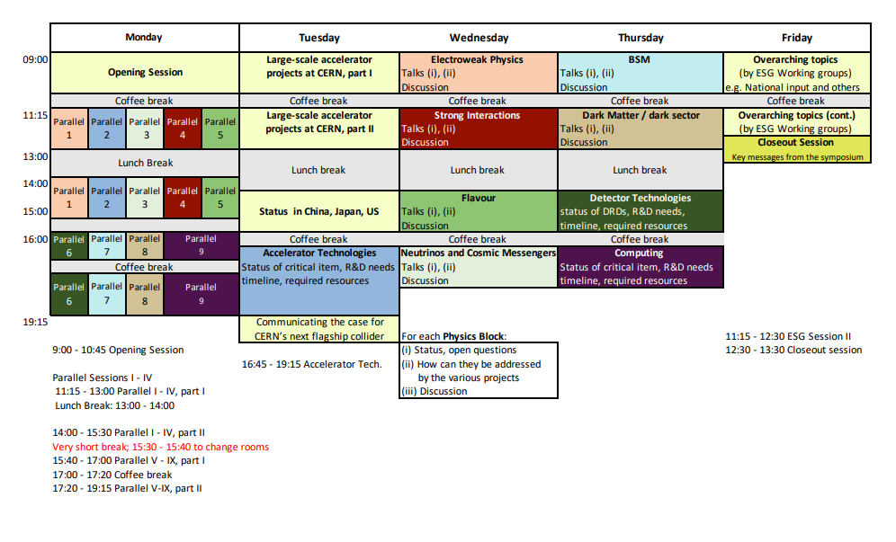
Agenda of Open Symposium

Slide 9
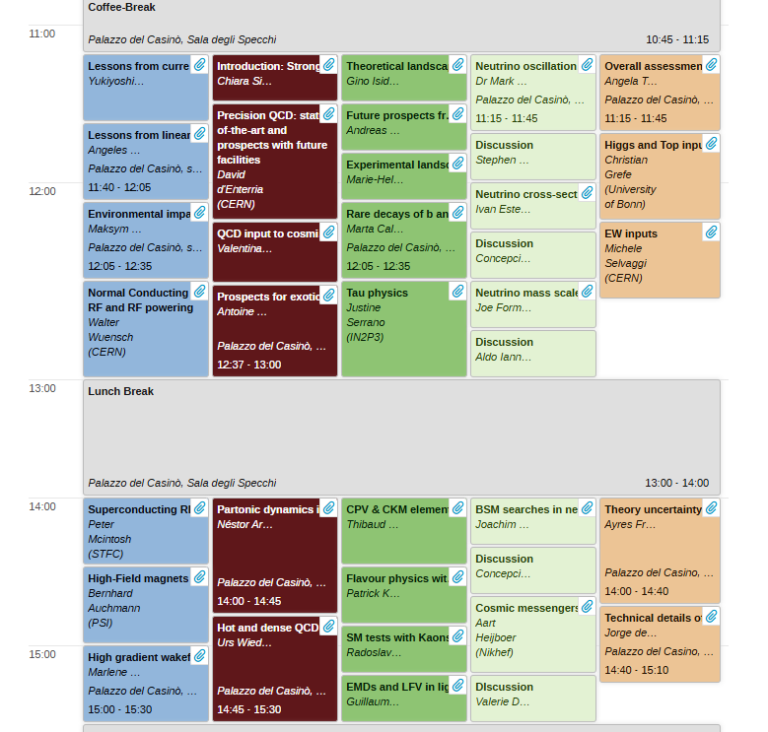
Open Symposium
Parallel Sessions
Excellent reviews of
Accelerator Technology
and Readiness
SuperKEKB → FCC-ee
Test Facilities → LC
NCRF and SRF
High Field Magnets
Advanced Acceleration
T. Raubenheimer, EAAC2025

Slide 10
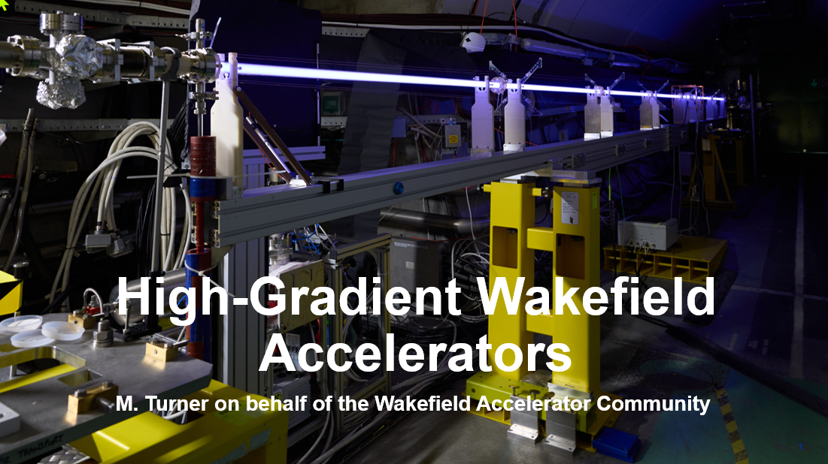
Advanced Accelerator Technologies

Slide 11
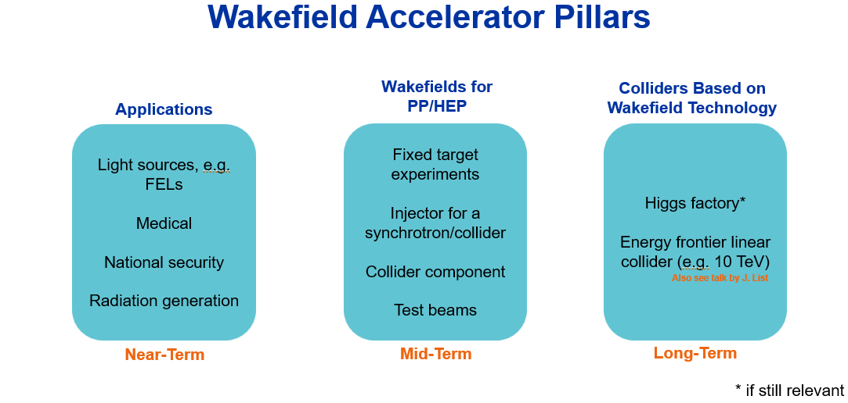
Marlene Turner

Slide 12
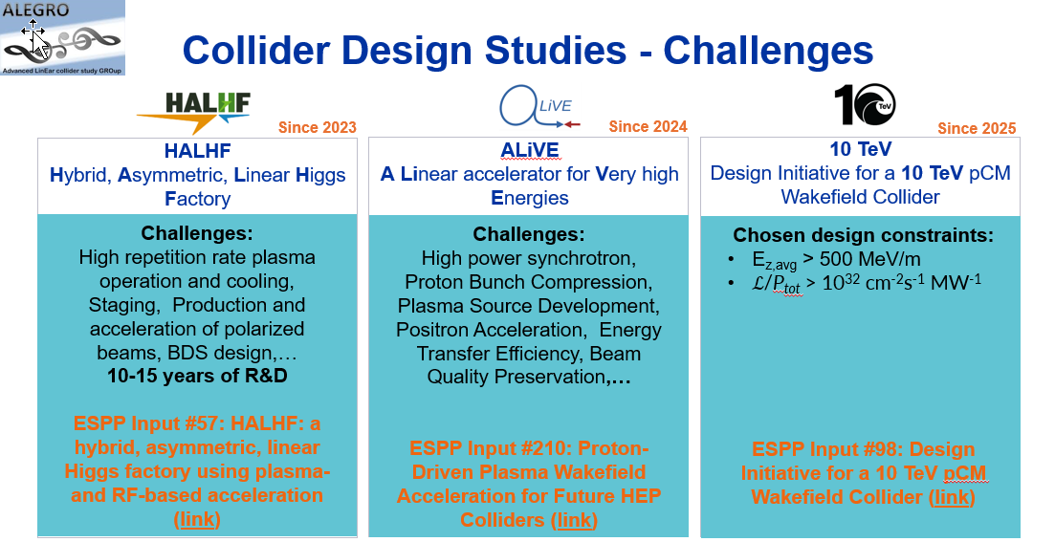
Marlene Turner

Slide 13
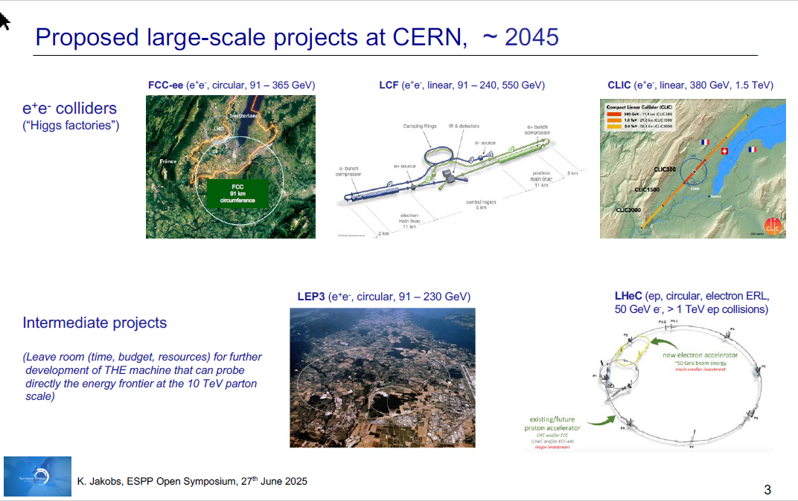

Slide 14
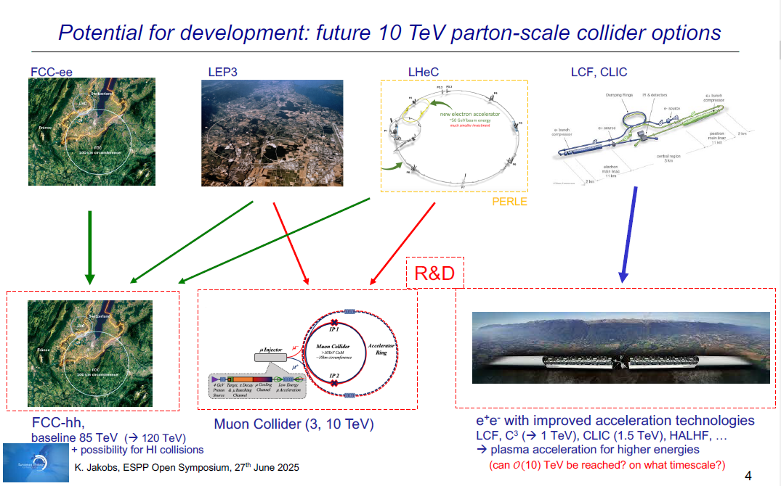

Slide 15
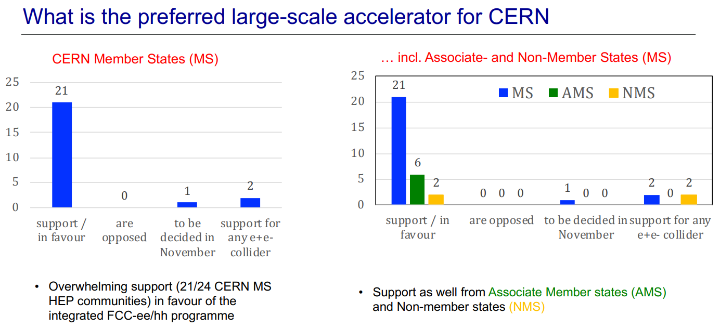
Karl Jacobs, Key messages from the Open Symposium

Slide 16
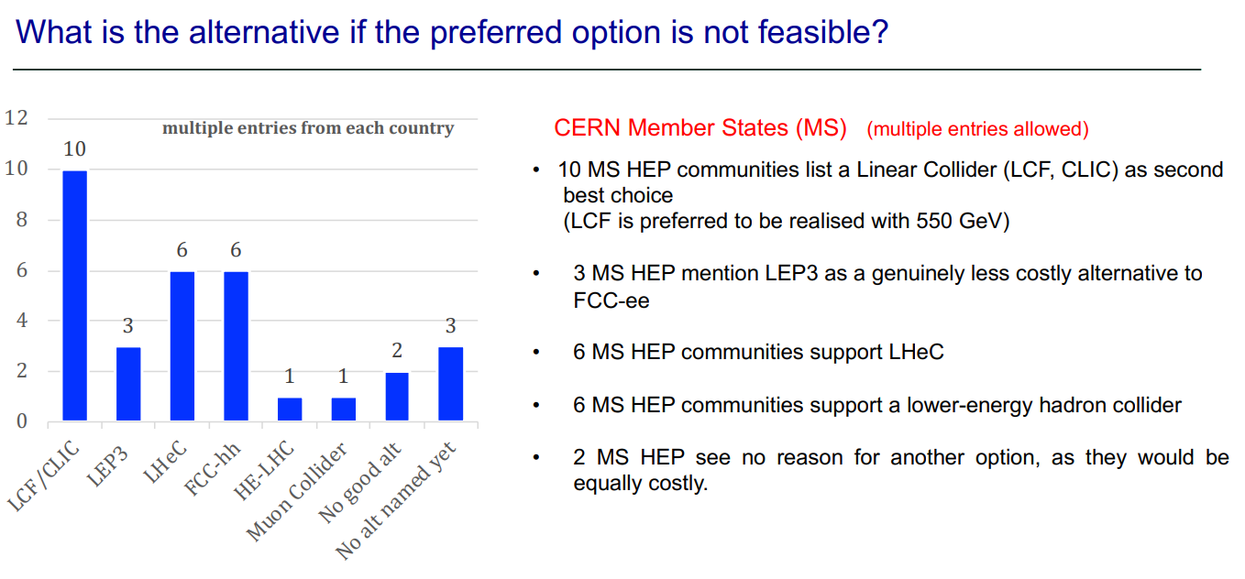
Karl Jacobs, Key messages from the Open Symposium

Slide 17
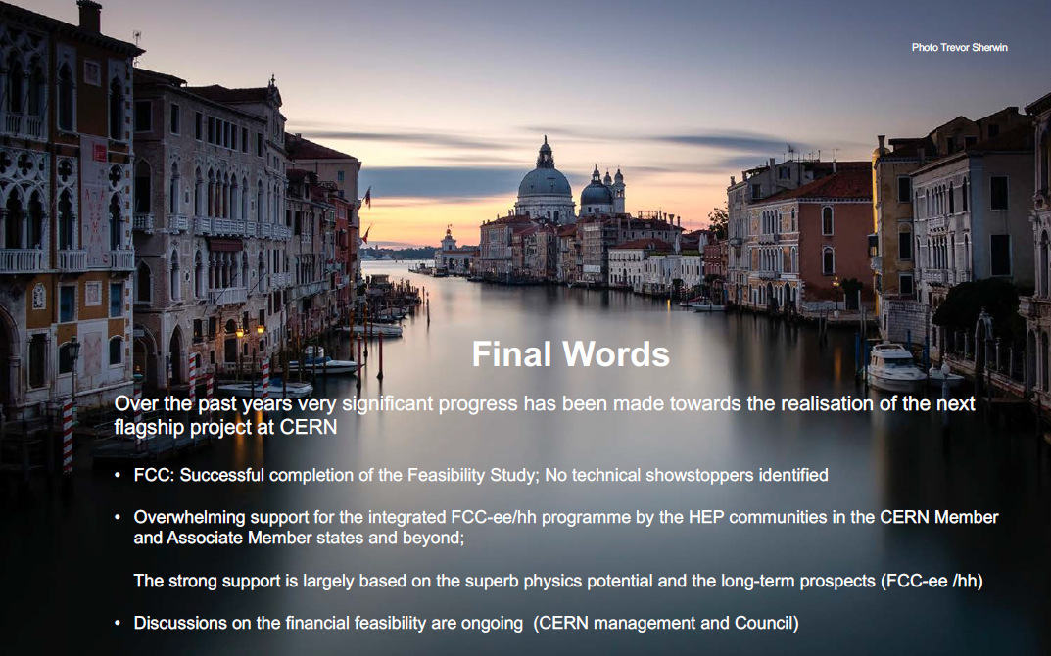
Karl Jacobs, Key messages from the Open Symposium

Slide 18
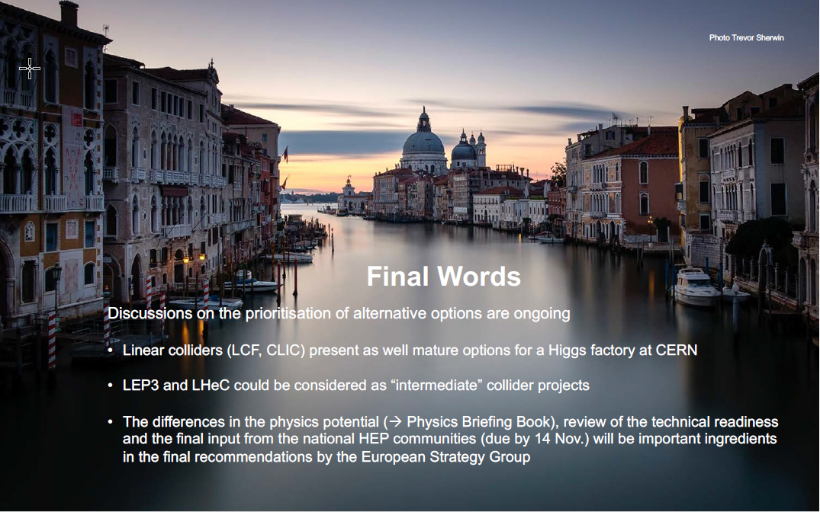
Karl Jacobs, Key messages from the Open Symposium

Slide 19
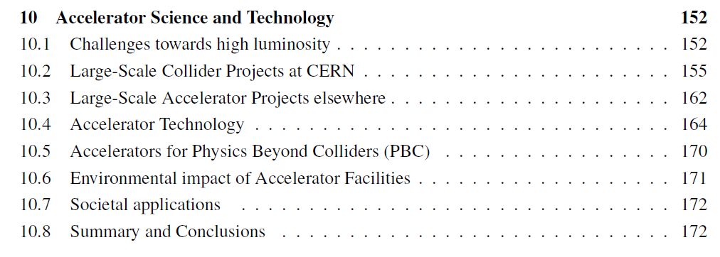
PPG Briefing Book
Challenges for e+/e- (rings
and linear), hadron rings,
muons
Large scale projects: CLIC,
FCC, LCV, LEP3, LHeC, MC
Accelerator Technology: HFM, SRF, NCRF, RF Power, High Gradient Wakefield Accelerators (HGWFA)
The HGWFA section discusses HALHF, ALIVE, and 10TeV. It notes that:
    HGWFA are starting to delivering quality beams for different applications
    first projects are expected to become operational within the next decade.
    Continued technology R&D will be essential for HGWFA to have an impact
T. Raubenheimer, EAAC2025

Slide 20
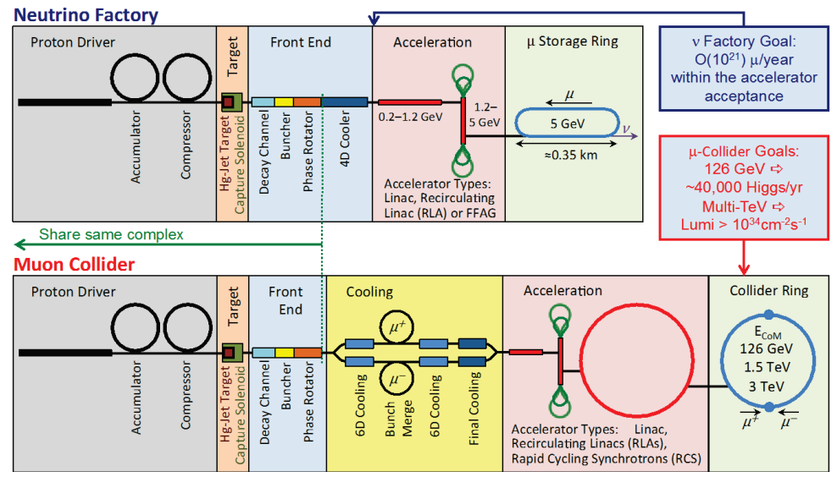
Muon Collider
The Muon Collider is considered differently from HGWFA by the HEP community and the MC is listed as one of the large projects
Why?
In the US, the Muon Accelerator Program did “systems” studies from 2010-2017 with ~10M$ per year followed by strong European enthusiasm and a very strong Muon Collider community at Snowmass
Developed designs and tried to bound
complexity with tolerances and R&D
roadmaps – projectized the program
Many challenges but were able to engage
community
Schematic from MAP ~2013
T. Raubenheimer, EAAC2025

Slide 21
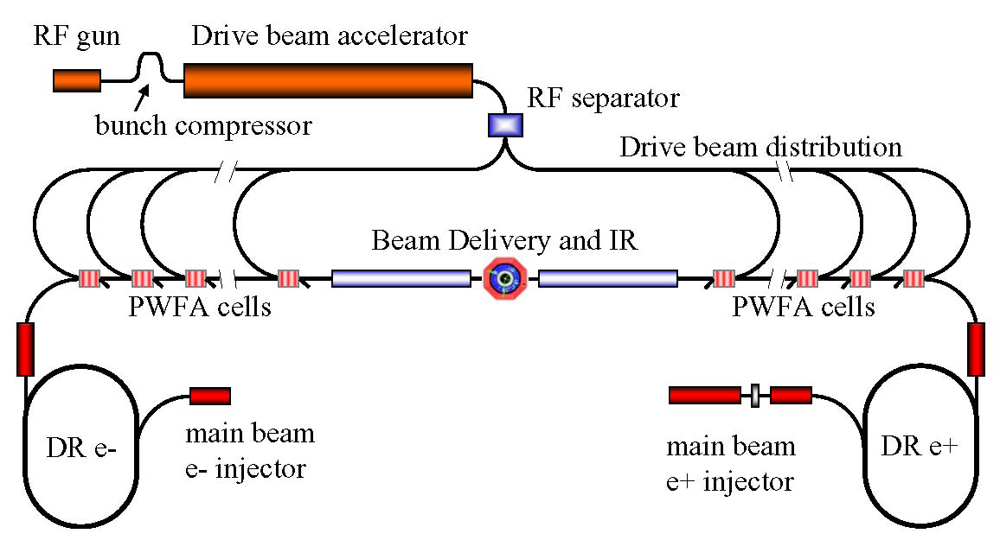
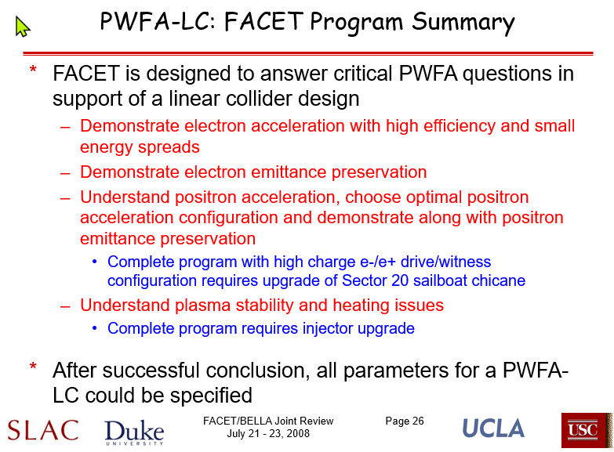
FACET and PWFA-LC
Combined PWFA with existing
LC concepts (ILC, NLC, CLIC)
to clarify challenges to be
addressed at FACET
T. Raubenheimer, EAAC2025

Slide 22
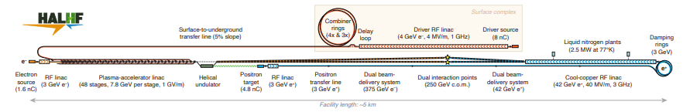
HALHF
HALHF is putting together a pre-CDR
  Start from what works pretty well, e.g. beam-driven electron acceleration
  Address failures of previous iterations
  Include tolerances and start-2-end simulations
T. Raubenheimer, EAAC2025

Slide 23
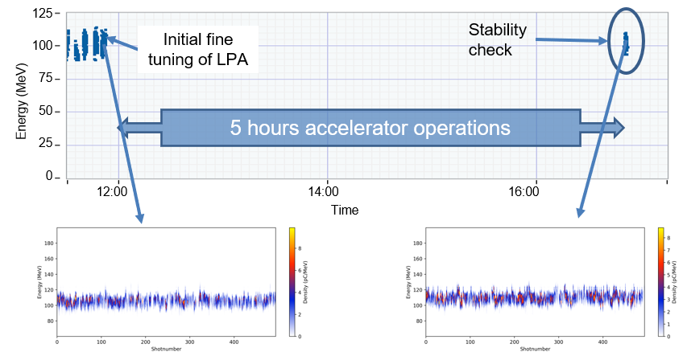
Applications
Plasma-based FEL’s are demonstrating key attributes: SIOM, INFN, Soleil, LBNL
    Emittance, charge, stability
    Routine operation
    Ultimately photon science (which will also provide another funding source)
    Other applications that demonstrate
    routine operation would be great, e.g.
    PETRA-IV injector and Eupraxia
    Are there other applications that should
    be pursued?
LBNL HTU operation
T. Raubenheimer, EAAC2025

Slide 24
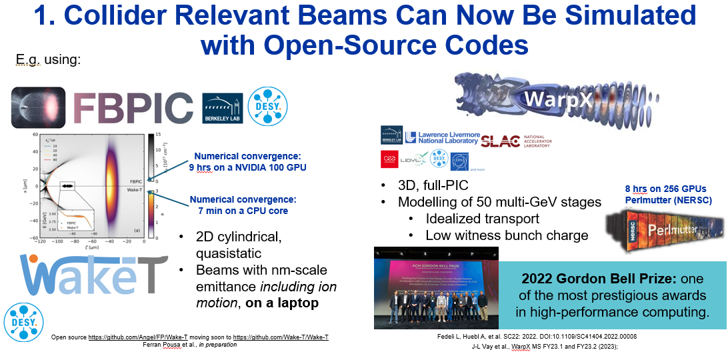
Marlene Turner

Slide 25
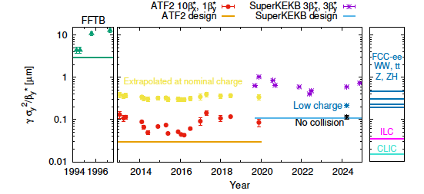
Challenge for any Collider:
Technical Validation
What scale of systems demonstrations and (test) facilities are needed to "validate" technology?
This plot of “effective normalized emittance” illustrates the optics challenges.
One can also plot the vertical spot size but that is more pessimistic for the future colliders at high energy since the beam size naturally decreases as the sqrt of energy.
https://arxiv.org/pdf/2506.12361, Tomas, Ohnishi, Zimmermann (2025)
T. Raubenheimer, EAAC2025

Slide 26
Next Steps
Pre-CDR’s are critical
    Simulation tools are fantastic … use them
    Quantify stability and tolerances
    Detail the R&D and necessary steps
    What test facilities are needed and be clear about purpose and goals
Demonstrate capabilities with applications
    FEL’s are excellent but injectors and other applications are also great
Engage the community
    Convey the enthusiasm but don’t oversell
T. Raubenheimer, EAAC2025

Slide 27
Summary
Many challenges
Lots of innovation but needs to be shown to be realistic
Most of the old guys who looked at this got disenchanted
This is your opportunity to prove us wrong … but the challenges need to taken seriously to demonstrate a viable linear collider
HALHF is a great example but is coming too late to impact choices on the next collider. Can HALHF be upgraded to HALTV (Hybrid Asymmetric Linear Ten teV collider)?
T. Raubenheimer, EAAC2025

Slide 28
Question?
T. Raubenheimer, EAAC2025

