Slide 1







Laser-Driven Very High Energy Electrons for Femtosecond-Scale Irradiation of In Vitro Cell Lines
Hannah Maguire
EAAC 26th September 2025

Slide 2

Motivation
Very high energy electrons (VHEEs, >50MeV) can:
achieve excellent dose conformity and deep penetration depths
enhance the sparing of critical structures while providing similar/superior target coverage than photons
show reduced susceptibility to tissue inhomogeneities
laser systems achieve accelerating gradients >10s GV/m
[1] A. Hart et al. (2024). doi: 10.1109/JSEN.2024.3353190
[2] B. Palma et al. (2015). doi: 10.1118/1.4925419
[3] K. Kokurewicz et al. (2021). doi: 10.1038/s42005-021-00536-0
EAAC 2025

Slide 3
Proof of Principle Experiments
Single-shot, Gy-scale irradiation at dose rates >10¹³ Gy/s
significant increases in RBE following femtosecond VHEE irradiation
Single-shot, Gy-scale irradiation at dose rates >10¹⁰ Gy/s
no significant differences in RBE following picosecond electron beam irradiation
McAnespie et al. (2025)
McAnespie et al. (2024)
EAAC 2025

Slide 4
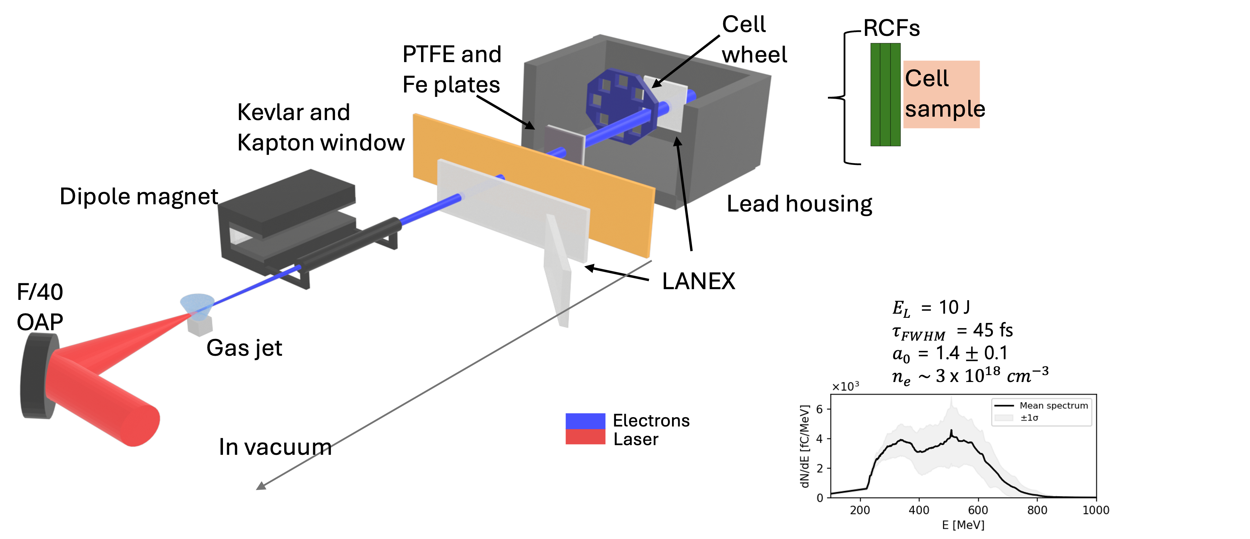
Astra-Gemini Laser, CLF
EAAC 2025

Slide 5
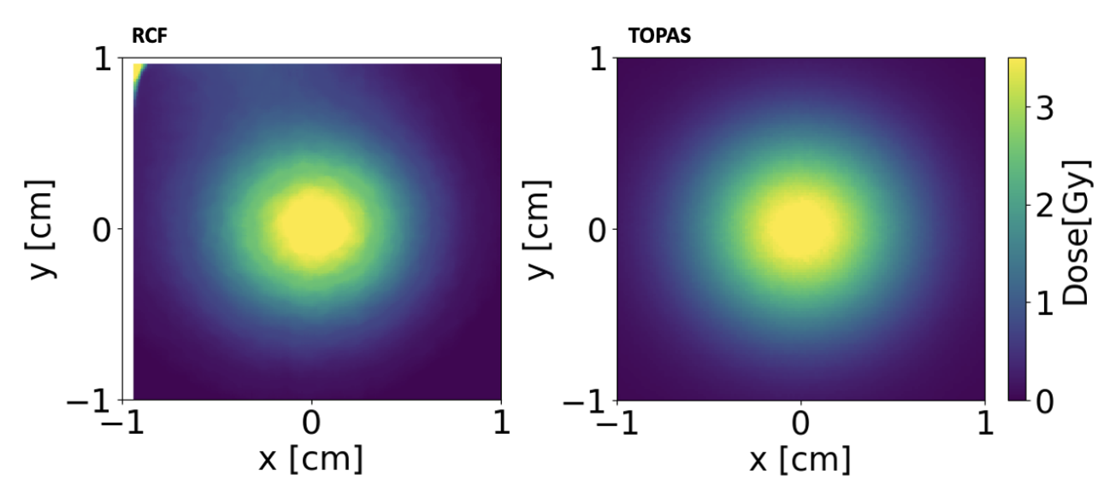
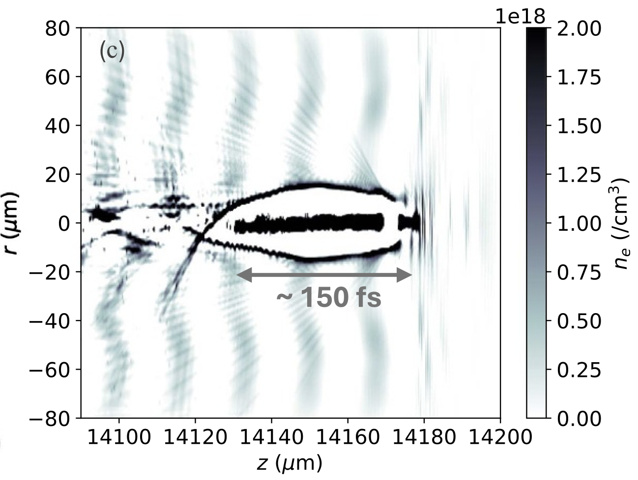
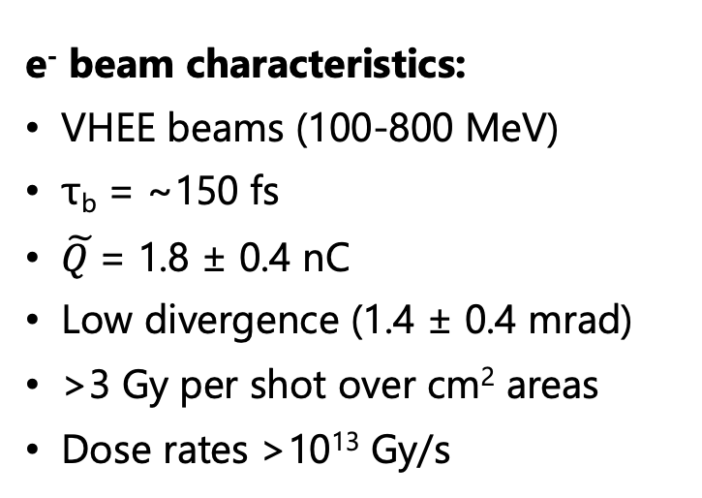
Astra-Gemini Laser, CLF
e⁻ beam characteristics:
VHEE beams (100-800 MeV)
τ_{b} = ~150 fs
$\tilde{Q }$= 1.8 ± 0.4 nC
Low divergence (1.4 ± 0.4 mrad)
>3 Gy per shot over cm² areas
Dose rates >10¹³ Gy/s
EAAC 2025

Slide 6
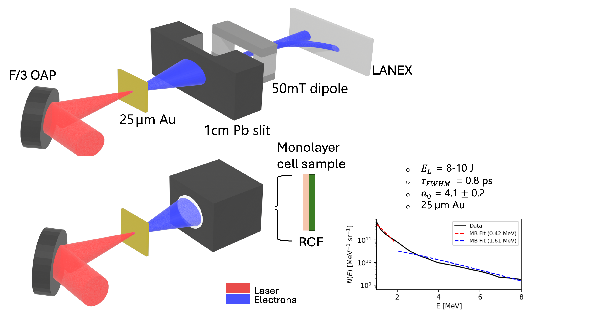
TARANIS Laser, QUB
EAAC 2025

Slide 7
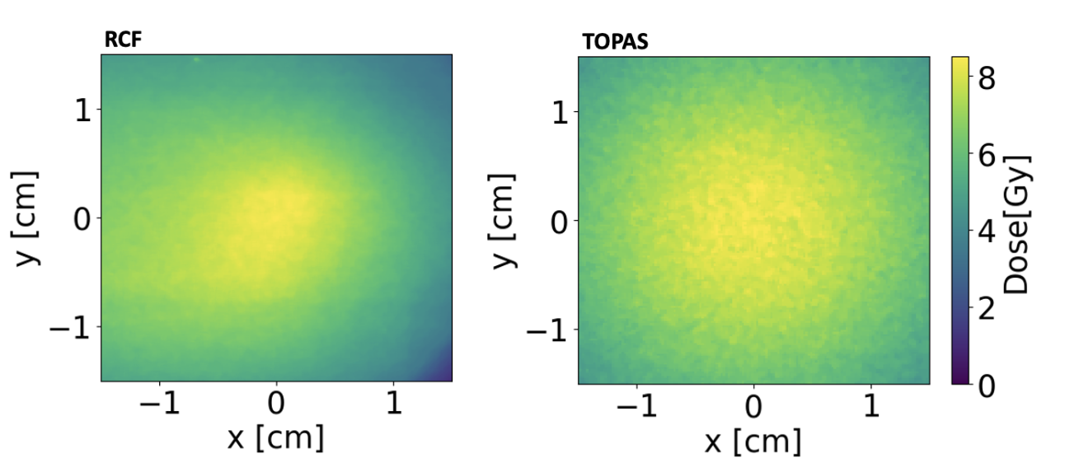
TARANIS Laser, QUB
e⁻ beam characteristics:
1-8MeV (T = 1.6 MeV)
τ_{b} = ~10-20ps
N_{e} = ~2.9 x10¹¹
Large divergence (560 mrad)
>8 Gy per shot over cm² areas
Dose rates >10¹⁰ Gy/s
EAAC 2025

Slide 8
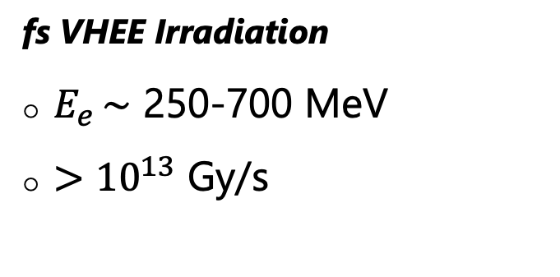
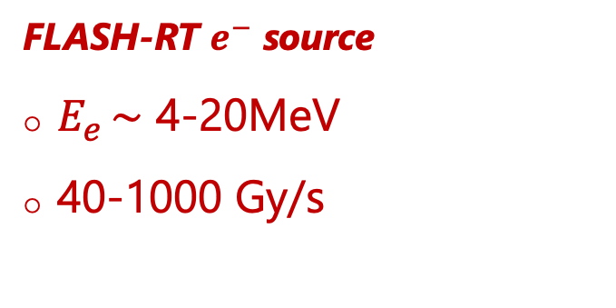
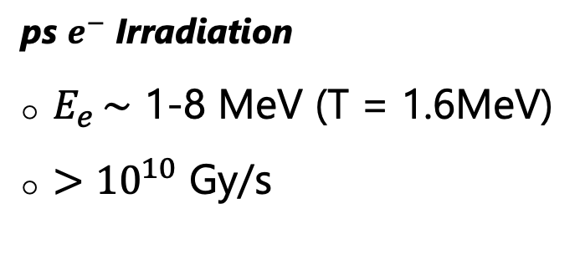
Radiation Sources
fs VHEE Irradiation
$E_{e }\sim$ 250-700 MeV
$>{10}^{13}$ Gy/s
ps $e^{−}$ Irradiation
$E_{e }\sim$ 1-8 MeV (T = 1.6MeV)
$>{10}^{10}$ Gy/s
Conventional X-ray source (CONV)
X-Ray energies < 160keV
2.4 Gy/min
FLASH-RT $e^{−}$ source
$E_{e }\sim$ 4-20MeV
40-1000 Gy/s
EAAC 2025

Slide 9

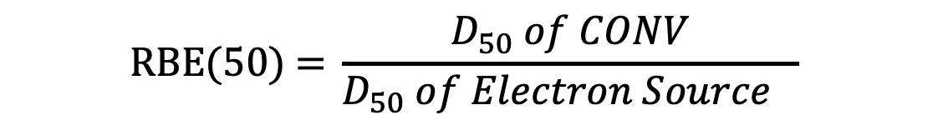
Clonogenic Assays
Surviving Fraction
Cell survival 12 days following irradiation
Survival dependant on delivered dose (D/Gy)
7 different cell lines
$$SF=\exp{− (αD+ βD^{2})}$$
Relative Biological Effectiveness
DU145 (prostate)
MCF7 (breast)
HeLa S3 (ovarian)
H460 (lung)
RPE-1 (retinal)
E2 (glioblastoma)
AGO 1552D (skin)
$$\text{RBE}\text{(50) = }\frac{D_{50} of CONV}{D_{50} of Electron Source }$$
Radioresistance
Parameters and RBE calculations were obtained using MCMC sampling with emcee.
Statistical analysis: Wilcoxon Rank-Sum test;
ns, not significant, *p < 0.05, **p < 0.01.
EAAC 2025

Slide 10
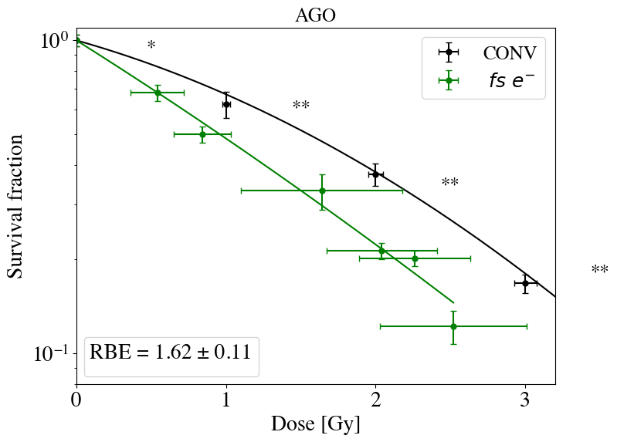
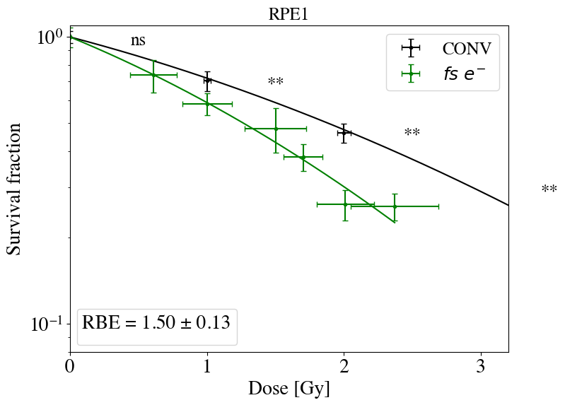
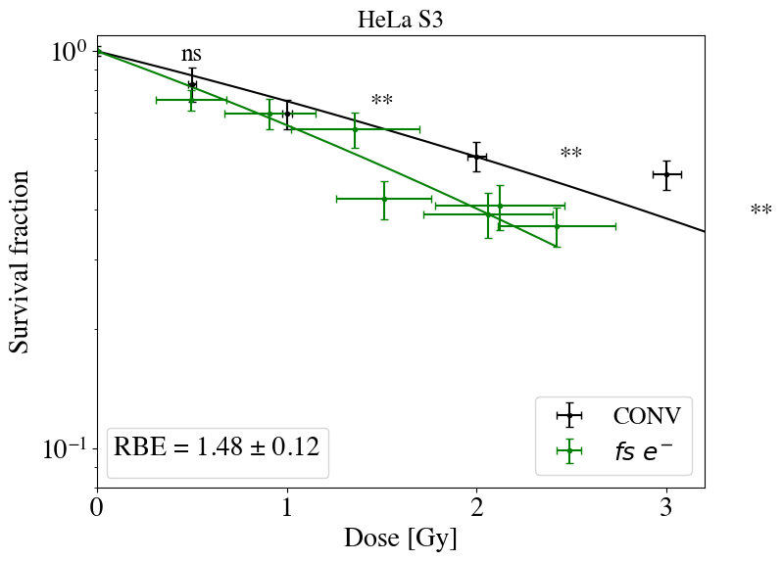
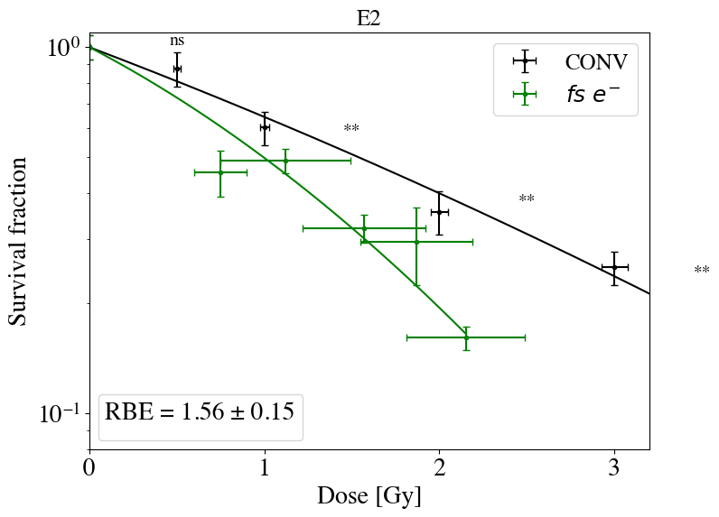
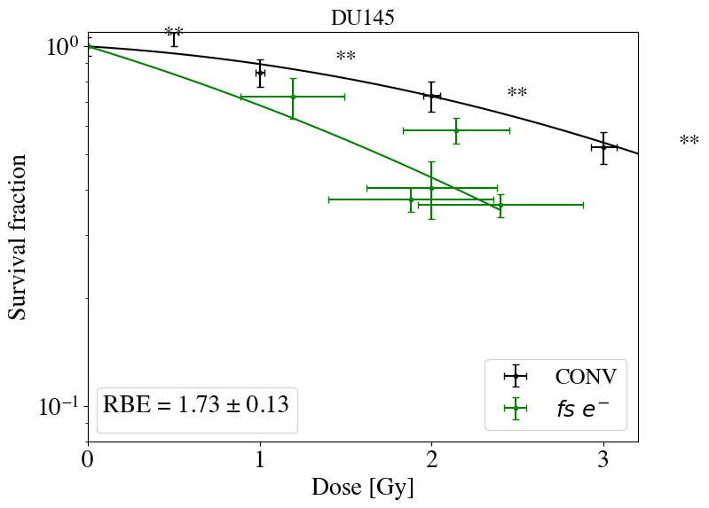
Cell Response to fs VHEE Irradiation
Significant increases in RBE
P values <0.01 for majority of dose points
Consistent with results obtained in McAnespie et al. (2025).
EAAC 2025

Slide 11
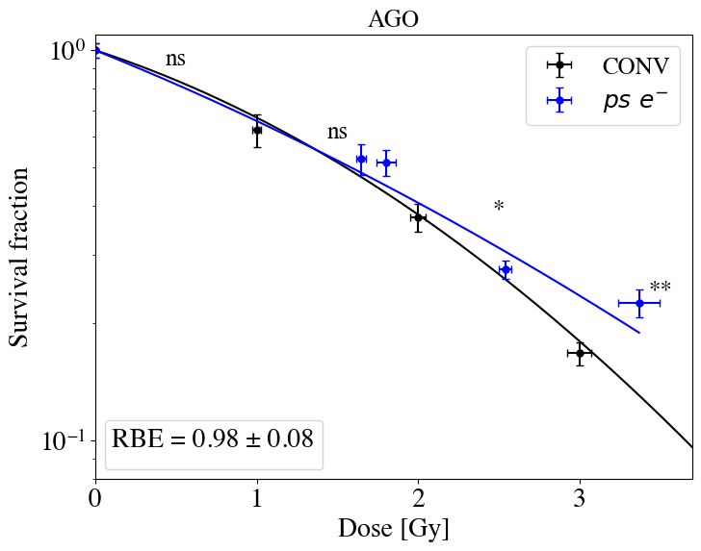
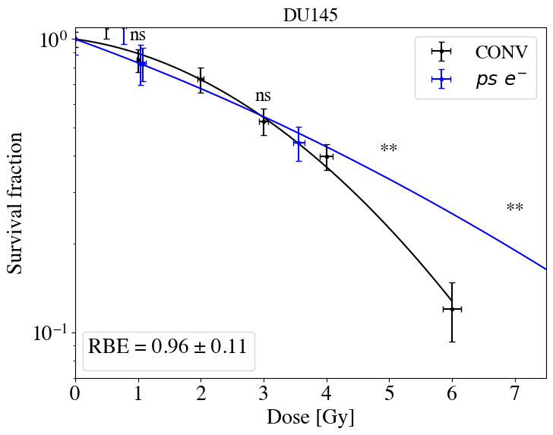
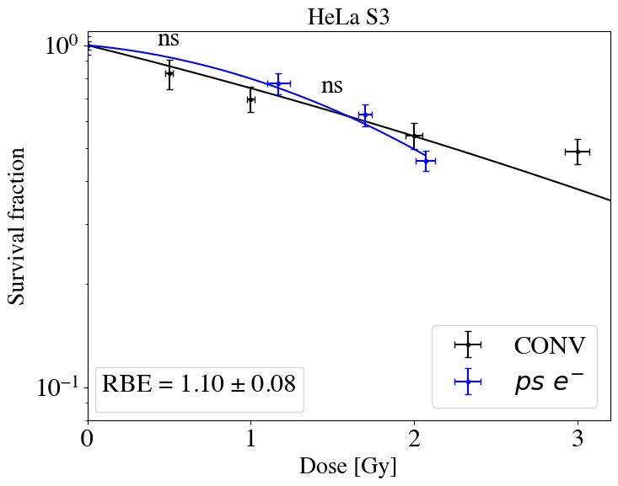
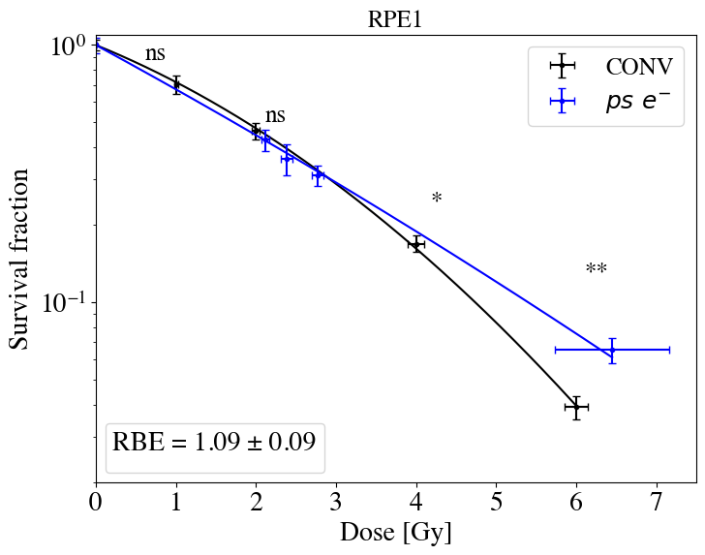
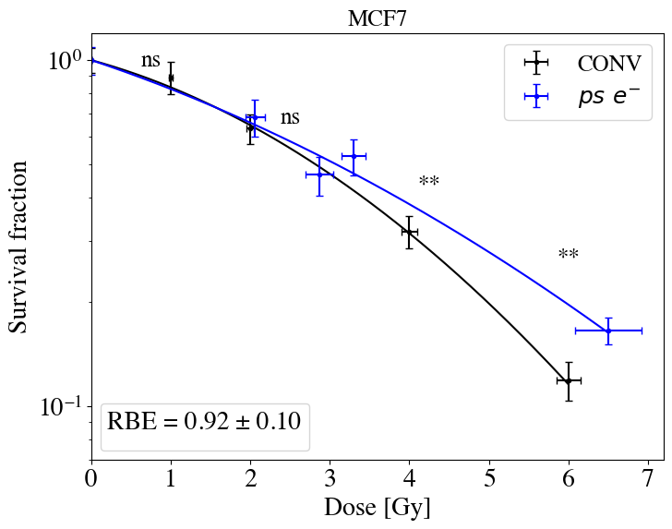
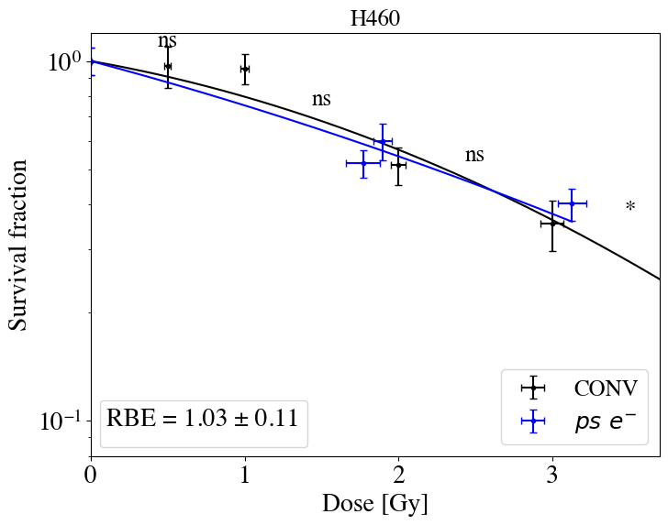
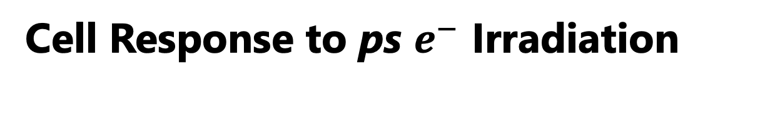
Cell Response to ps $e^{−}$ Irradiation
No significant differences in RBE at low doses
FLASH-like sparing effect observed at higher doses- first demonstration at dose-rates >10¹⁰ Gy/s
Consistent with results obtained in McAnespie et al. (2024).
EAAC 2025

Slide 12
Conclusions and Next Steps
Significant increase in RBE was observed for all cell lines following irradiation with fs VHEE beams
No difference in RBE was observed following irradiation with ps electron beams at low dose
  - At higher doses, a FLASH-like sparing effect was shown for 4/6 cell lines, indicated as significant increases in SF
  First demonstration of FLASH-like effects at dose-rates >10¹⁰ Gy/s
53BP1 Immunofluorescent Assays- analysis ongoing
3D Spheroid Models (CLF, Jan 2026)
  Spheroids mimic the 3D structure and cellular environment of tumors advancing towards future in vivo applications
Dosimetry of ultra-short electron beams is not trivial:
  Plane-parallel ionisation chambers experience charge collection inefficiency at high dose-rates
  RCFs are suitable for high dose-rate VHEE dosimetry but fail to provide dose measurements in real-time
EAAC 2025

Slide 13
Acknowledgements
QUB PGJCCR
Carla McDonnell
Stephen McMahon
Kevin Prise
National Physical Laboratory, UK
Pankaj Chaudhary
Giuseppe Schettino
Central Laser Facility, Harwell Campus, UK
Stan Botchway
Sarah Needham
Oliver Finlay
QUB Mathematics and Physics
Conor McAnespie
Elias Gerstmayr
Luke Calvin
Temour Foster
Daniel Molloy
Gagik Nersisyan
Matt Streeter
Gianluca Sarri
EAAC 2025

