Slide 1





Machine learning-based optimisation of plasma density ramps
@ CLARA FEBE
Jiaqi Zhang^{1,2}, Hossein Saberi^{1,2}, Guoxing Xia^{1,2}, Oznur Apsimon^{1,2}, Stewart Boogert^{1,2}, Thomas Pacey^{3,2}, Toby Overton^{3,2}
¹Department of Physics and Astronomy, University of Manchester, UK
²Cockcroft Institute, UK
³Accelerator Science and Technology Centre (ASTeC), STFC Daresbury Laboratory, UK
European Advanced Accelerator Conference
21–27 Sept. 2025, Isola d'Elba, Italy

Slide 2
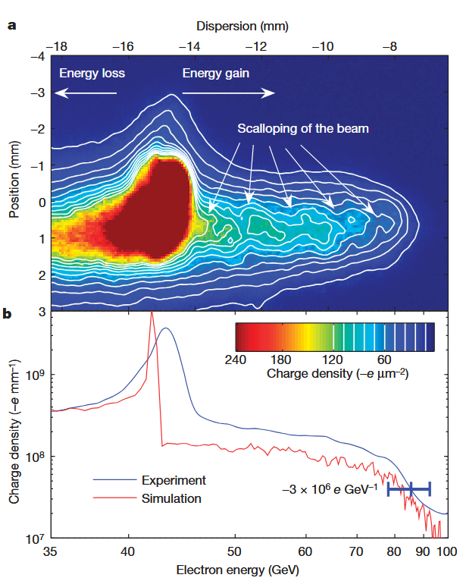
Background & Motivation
Gradient:
  By achieving GV/m-scale ^{[1]} acceleration gradients, plasma wakefield acceleration (PWFA) offers a promising pathway toward more compact and cost-effective alternatives to traditional RF-based accelerators.
Beam quality:
  Existing energy doubling experiments ^{[2]} focused on the gradient, which normally sacrifices the beam quality
An 85-cm-long plasma cell
Peak gradient: 52 GV/m
Several pC charge got energy doubled
[1] P. Muggli et al., Comptes Rendus Phys. 10, 116 (2009).
[2] I. Blumenfeld et al., Nature 445, 741 (2007).

Slide 3

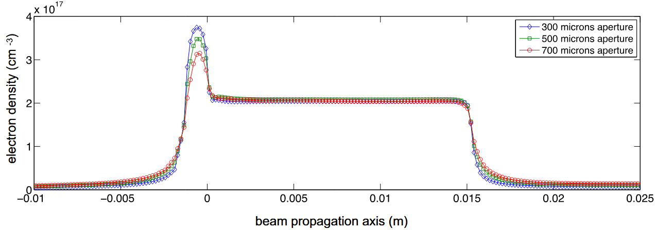
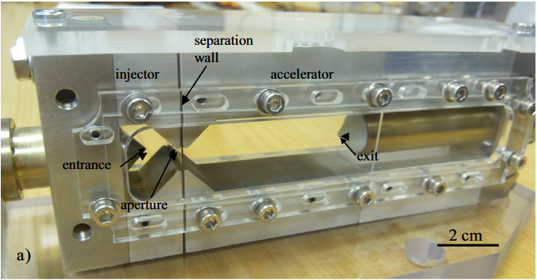
Background & Motivation
Why plasma density ramp?
Reduction of the phase velocity, trapping more plasma electrons
Limited implement in PWFA
@ DESY:
  Gaussian ramps are more realistic than linear ramps ^{[1]}, based on measurements through the gas cell ^{[2]}.
The real gas cell
Measured electron density vs. the gas cell axis
[1] A. Martinez De La Ossa et al., Phys. Rev. Accel. Beams 20, 1 (2017).
[2] O. Kononenko et al., Nucl. Instrum. Methods Phys. Res. A 829, 125 (2016)

Slide 4
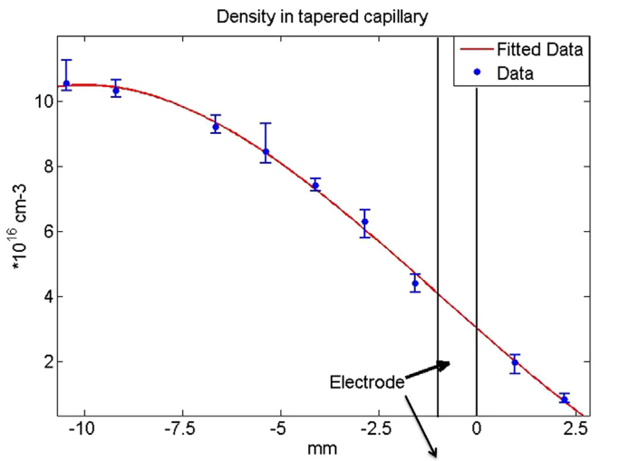
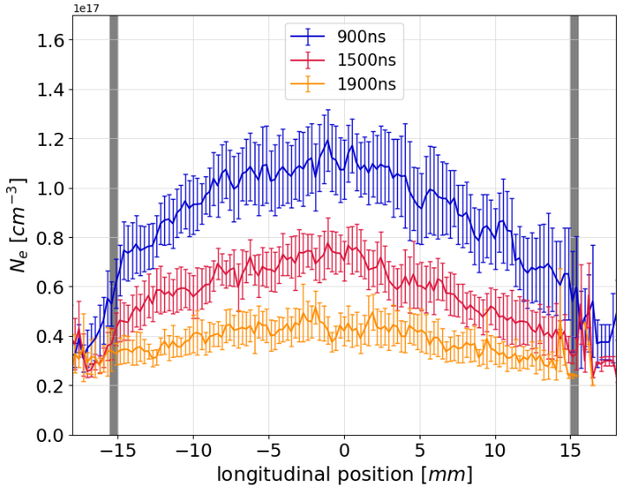
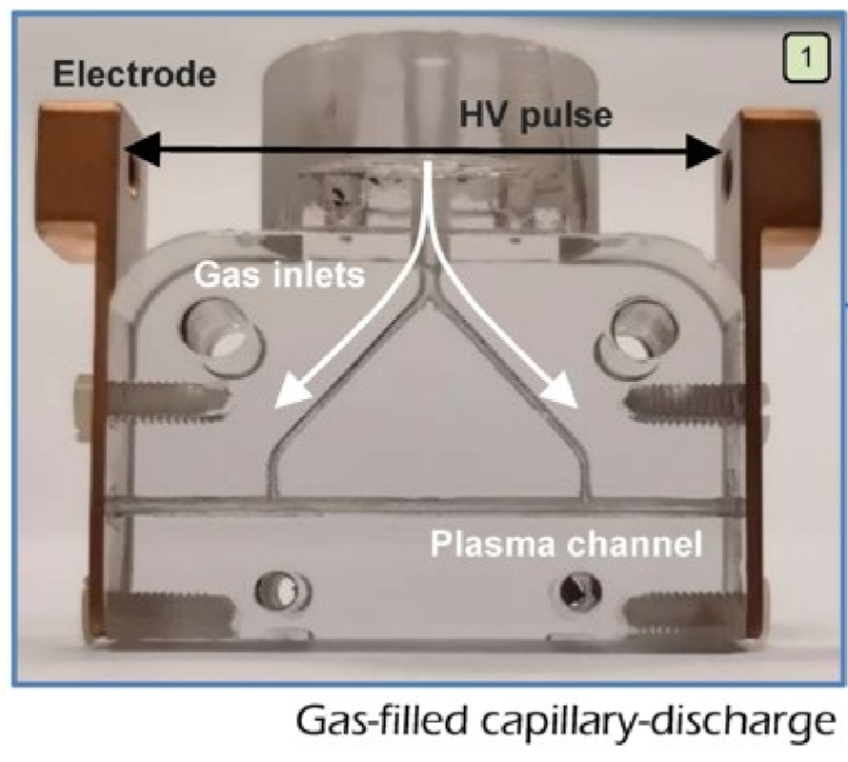
Background & Motivation
@ SPARC LAB:
  The linear plasma density ramp is used for theoretical simplifications ^{[1]}.
  A third-order polynomial fitting function was used to model a tapered plasma capillary ^{[2]}.
  An example of the real plasma density profile ^{[3]}.
Plasma density in tapered capillary
Gas-filled discharge capillary
Channel diameter: 1 mm
Air pressure: 800 mbar
Discharge: 7 kV ~ 380 A
[1] A. Marocchino et al., Nucl. Instrum. Methods Phys. Res. A 909, 408 (2018).
[2] F. Filippi et al., Nucl. Instrum. Methods Phys. Res. A 829, 326 (2016).
[3] C. Mariani et al., Politecnico di Milano, 2022.

Slide 5
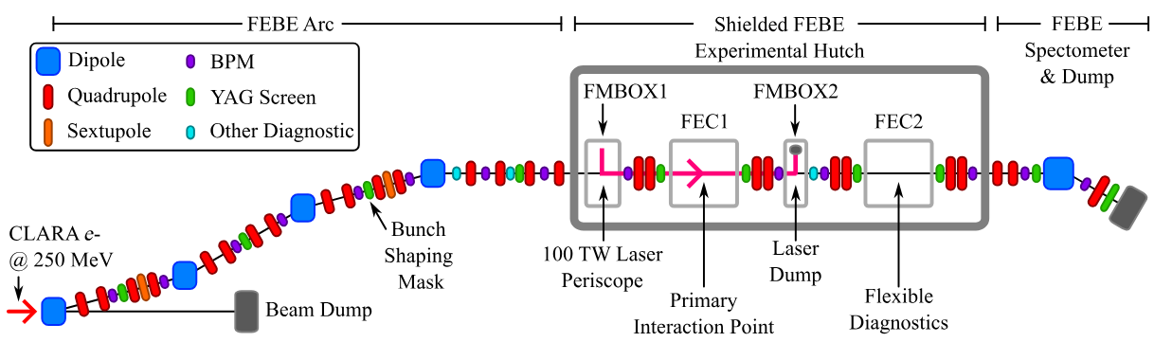
Facility
CLARA FEBE
FEBE beamline ^{[1]}
Parameters | Commissioning | Developing
Energy (MeV) Charge (pC) RMS bunch length (μm) RMS transverse size (μm) Energy spread (%) Emittance (mm mrad) | 50 – 250 5 – 250 15 – 30 20 – 100 < 5 < 5 | 50 – 250 5 – 250 <<15 – 30 1 – 100 ~1 ~1
FEBE specifications ^{[1]}
[1] E. W. Snedden et al., Phys. Rev. Accel. Beams 27, 41602 (2024).
Notes:
The Compact Linear Accelerator for Research and Applications (CLARA) at the Daresbury Laboratory, capable of producing 250-MeV electron bunches. Recently, a new beamline attached to CLARA, the Full Energy Beam Exploitation (FEBE) facility, has been designed to provide ultra-short and low-emittance electron bunches.

Slide 6
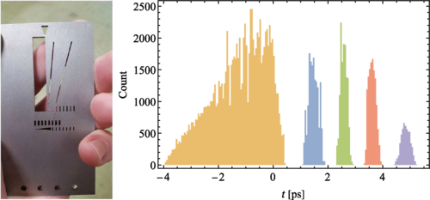
Energy Doubling Scheme
Schematic of PWFA Experiments @ CLARA FEBE^{[1]}
Driver/witness configuration is generated by the mask technology.
The discharge method is planned to form the ramp plasma density profile.
Diagnostics include 6D beam characterisation.
[1] E. W. Snedden et al., Phys. Rev. Accel. Beams 27, 41602 (2024).

Slide 7
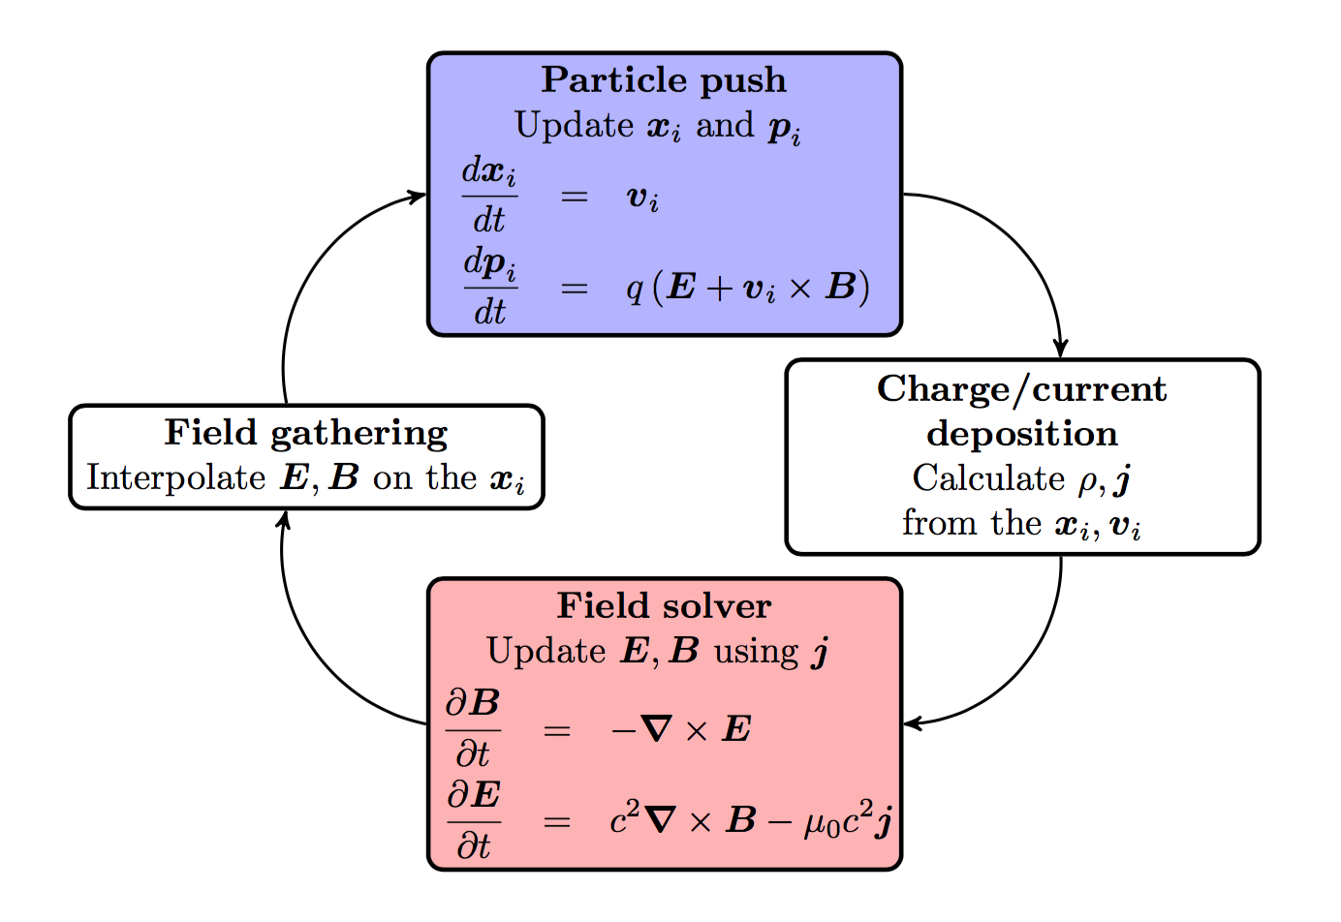
Simulation Code
Particle-in-cell: FBPIC^{[1]}
LBNL, open-source, developed in 2018
Quasi-3D cylindrical coordinate
Maxwell solver in the spectral space
Significantly reduces the spurious numerical dispersion
GPU support
Running on STFC SCARF and CSF3 in UoM
[1] R. Lehe et al., Comput. Phys. Commun. 203, 66 (2016).

Slide 8
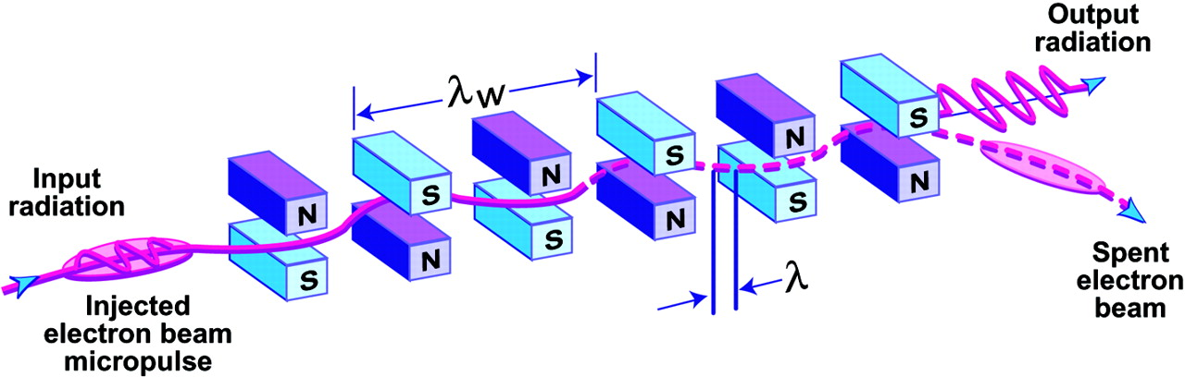
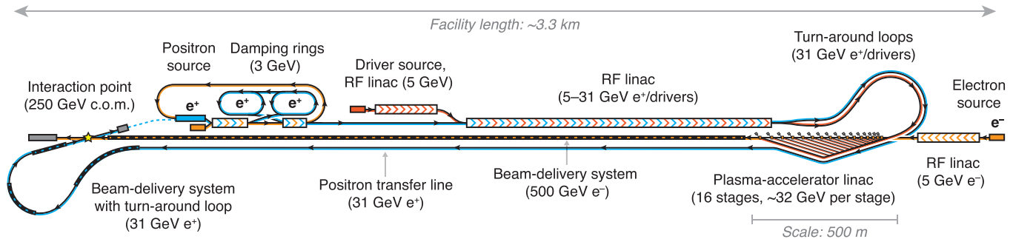
Objectives & Applications
Research Objectives:
  Obtain the optimal beam quality based on the neural network
  Review beam quality stability around the optimal parameter point.
Applications:
  Free electron lasers (FELs) ^{[1]}
  Future high-energy physics experiments ^{[2]}
[1] P. G. O. Shea et al., Science 292, 1853 (2001).
[2] B. Foster et al., New J. Phys. 25, (2023).

Slide 9
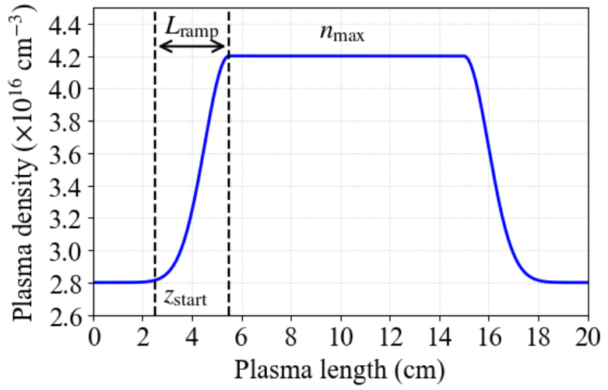
Simulation Parameter Settings
Simulation Parameter Settings
Initial stage (S1): Fixed 2.8×10¹⁶ cm⁻³
Up-ramp stage (S2): Gaussian profile to be optimised
Plateau stage (S3): One of the parameters
Down-ramp stage (S4): A symmetrical Gaussian profile
Final stage (S5): Fixed 2.8×10¹⁶ cm⁻³
Parameters | Driver | 10 pC witness
Beam density (cm⁻³) Charge (pC) Energy (MeV) Bunch length (μm) Transverse size (μm) Energy spread (%) Emittance (mm mrad) | 1.19×10¹⁵ 150 250 10 50 1 5 | 1.98×10¹⁵ 10 250 10 10 1 5
S3
S2
S4
S1
S5

Slide 10
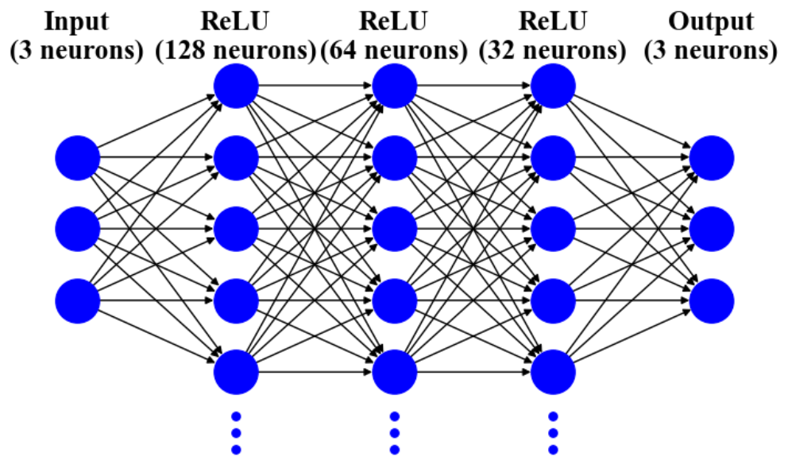
Architecture of the Neural Network
Training Parameter Settings
Layer (Type) | Output Shape | Param #
Input Layer (Dense) Hidden Layer 1 (Dense) ReLU Activation 1 (ReLU) Hidden Layer 2 (Dense) ReLU Activation 2 (ReLU) Hidden Layer 3 (Dense) ReLU Activation 3 (ReLU) Output Layer (Dense) | (None, 3) (None, 128) (None, 128) (None, 64) (None, 64) (None, 32) (None, 32) (None, 3) | 0 512 0 8256 0 2080 0 99
Total parameters: 32843

Slide 11
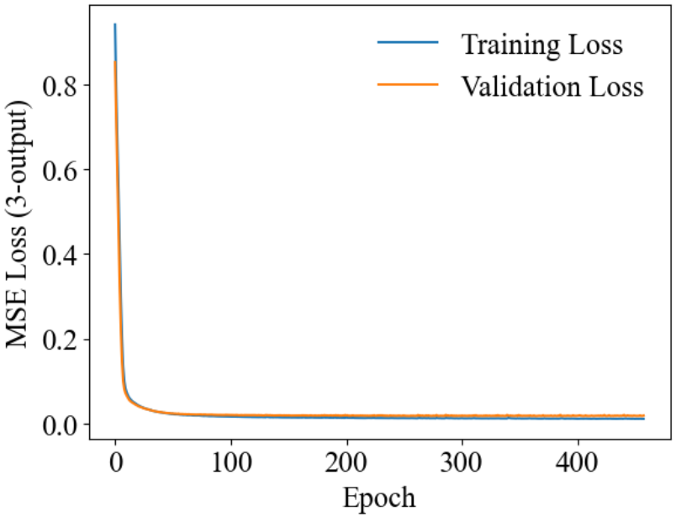
Model Training and Evaluation
Learning process
A total of 1000 simulations were performed, with 20% reserved for validation.
The training loss (based on seen data) decreases rapidly within the first 10 epochs.
The training curve remains smooth and stable throughout.
The validation curve (based on unseen data) closely follows the training curve, with no signs of significant overfitting.

Slide 12
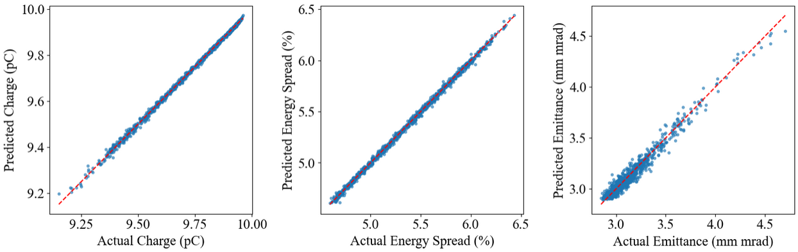
Model Training and Evaluation
Model Evaluation
Mean Absolute Error (with percentage):
0.006 pC (0.063%), 0.015% (0.290%), 0.043 mm mrad (1.366%)
The surrogate model achieved all MAPEs below 2%.

Slide 13
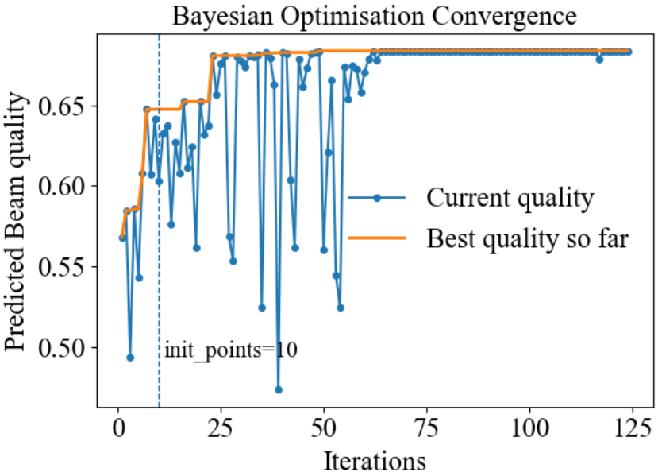
Bayesian optimisation & Final Quality
Beam quality definition ^{[1]}:
Optimal parameters (predictions):
z_{start} = 2.49 cm, Q = 9.52 pC (9.54)
n_{max} = 4.24×10¹⁶ /cm³, σ_{E} = 4.75% (4.74)
L_{ramp} = 1.19 cm, ε_{N} = 3.06 mm mrad (2.95)
Quality = 0.655 (0.682)
Final quality for energy doubling:
Non-ML: Q = 8.60 pC, σ_{E} = 5.77%, ε_{N} = 6.50 mm mrad, Quality = 0.229
ML: Q = 9.54 pC, σ_{E} = 5.84%, ε_{N} = 2.74 mm mrad, Quality = 0.596 (160% higher)
[1] A. Giribono et al., Phys. Rev. Accel. Beams 26, 83402 (2023).
Notes:
Acquisition function：Upper Confidence Bound

Slide 14
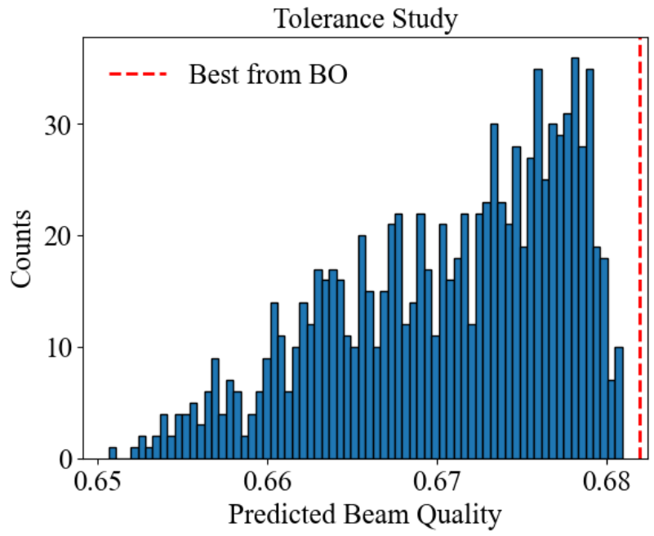
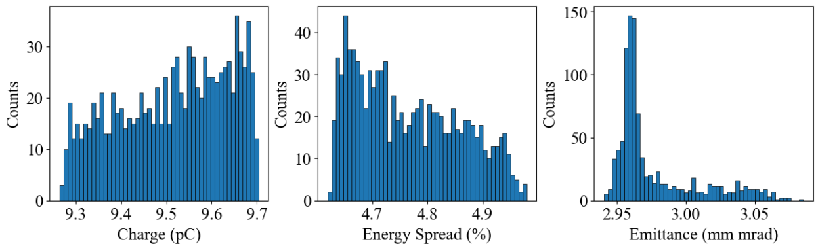
Robustness & Parameter Sensitivity
Parameter Variation:
z_{start} = 2.24 – 2.74 cm (±10%), n_{max} = 4.03 – 4.45×10¹⁶ /cm³ (±5%)
L_{ramp} = 1.09 – 1.33 cm (±10%)
Tolerance analysis (1000 LHS samples):
Q : mean = 9.514 (-0.27%), σ = 0.122 (1.28%)
σ_{E} : mean = 4.765 (0.53%), σ = 0.095 (1.99%)
ε_{N} : mean = 2.977 (0.91%),, σ = 0.031 (1.04%)

Slide 15
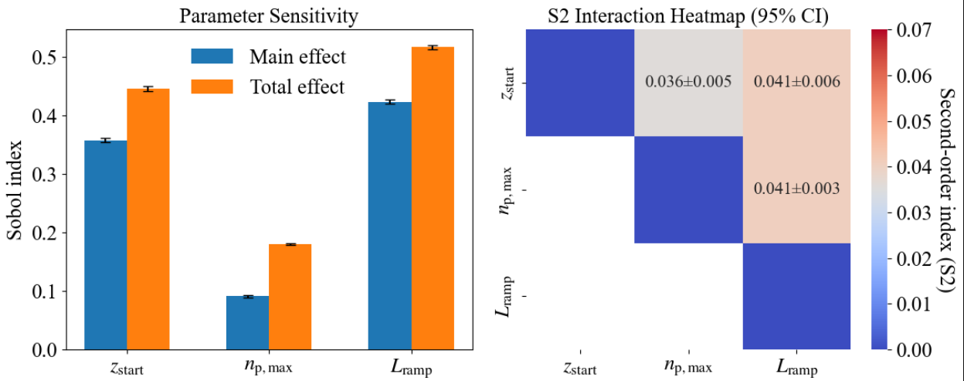
Robustness & Parameter Sensitivity
Parameter Variation:
z_{start} = 2.0 – 5.0 cm, n_{max} = 3.5 – 4.5×10¹⁶ /cm³, L_{ramp} = 0.5 – 5.0 cm
Sobol sensitivity analysis (2¹⁸ LHS samples):
Main effects dominate, explaining 87% of the variance:
Sensitivity ranking: L_{ramp} > z_{start} > n_{max}.
Pairwise interactions account for ~12% (~91% of total interaction effects).
Higher-order interactions contribute < 2%.

Slide 16
Conclusions
We performed machine learning-based optimisation of PWFA for the energy-doubling scheme at CLARA FEBE.
The surrogate model achieved mean absolute percentage errors below 2%.
Using Bayesian optimisation, we identified the optimal parameters and obtained a final-energy beam quality of 0.596, representing a 160% improvement compared with the non-ML baseline.
Tolerance analysis confirmed that the mean beam quality remains within 1%, with deviations below 2%.
Sensitivity studies further revealed that the main effects dominate the variance, with the sensitivity ranking following L_{ramp} > z_{start} > n_{max}.
Acknowledgements
This project has received funding from the European Union’s Horizon 2020 Research and Innovation programme under Grant Agreement No 101004730 'I.FAST’.
We acknowledge the support from the Cockcroft Institute Core Grant No. ST/V001612/1.
Computing resources are provided by STFC Scientific Computing Department’s SCARF cluster.

Slide 17
点击添加文本
Thanks for your attention!
Thanks for your attention!
Thanks for your attention!
Thanks for your attention!
Thanks for your attention!
Thanks for your attention!
Thanks for your attention!
点击添加文本
Thanks for your attention!
点击添加文本
点击添加文本

