Slide 1

THz streaking for ultrashort beam measurements at UCLA Pegasus
P. Musumeci
UCLA Department of Physics and Astronomy

Slide 2

Acknowledgements
M. Lenz, B. Schaap, P. Denham, A. Kulkarni, D. Garcia, Z. Liu (UCLA)
Y. Yang, R.K. Li (Tsinghua University)
M. Ota (Osaka University)
A. Murokh, G. Andonian. RadiaBeam Technologies
Work supported by DOE grants DE-SC0009914 and DE-SC0021190
Photocathode development funded by Center for Bright Beams NSF grant PHY-1549132

Slide 3
Outline
Ultrashort high brightness electron beams applications
Generation of fs electron beams
Measurements of fs electron beams
THz streaking structures
Conclusions

Slide 4

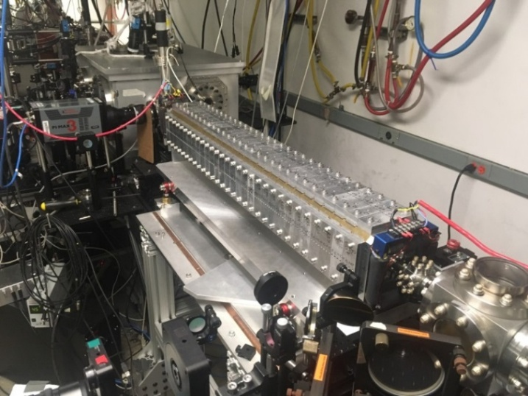
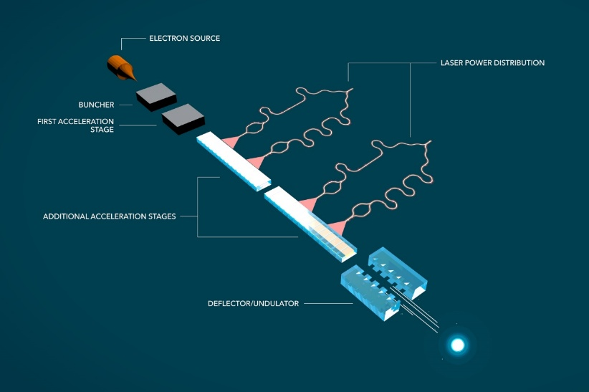
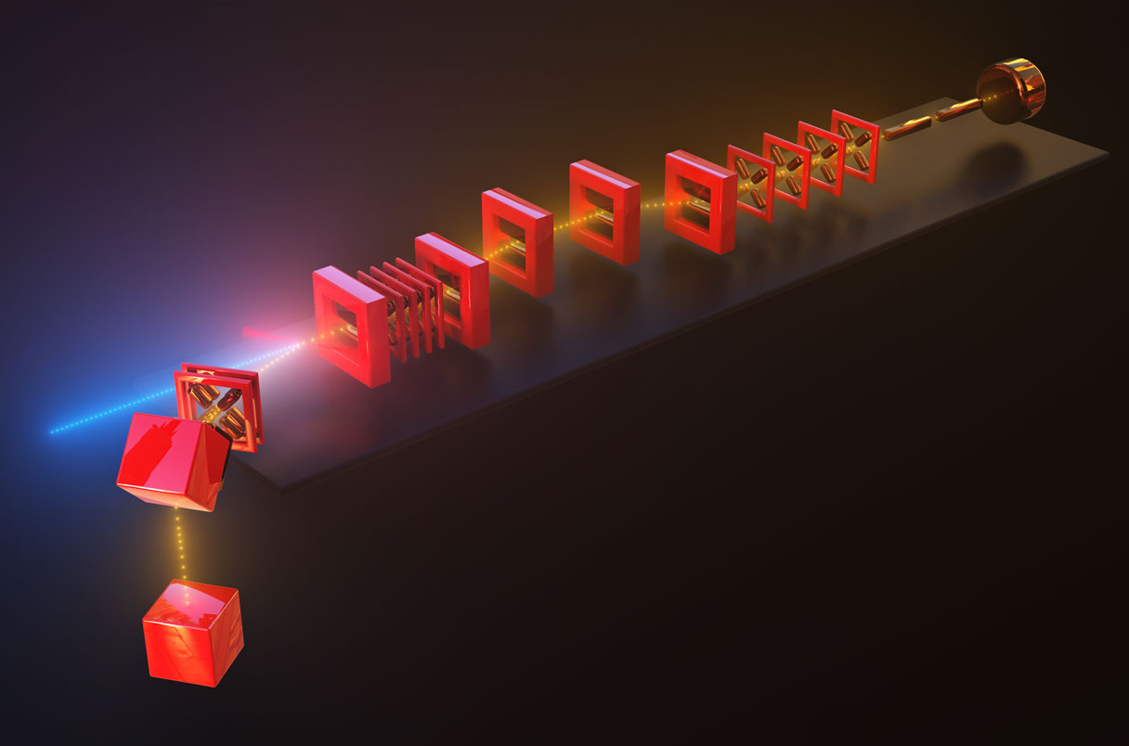
Applications of ultrashort relativistic e-beams
Ultrafast electron diffraction
Free electron lasers
Advanced accelerator injection
Coherent radiation generation

Slide 5
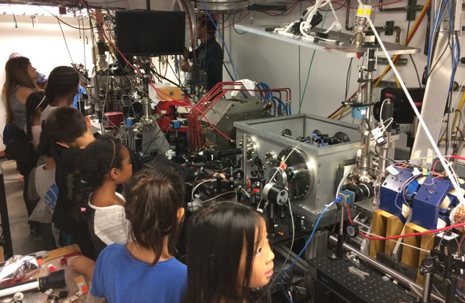
Pegasus Laboratory
High peak brightness beam research at UCLA
3-14 MeV student-run university-size accelerator beamline optimized for sub-pC beams
Ultralow charge beams with high peak brightness or phase space density:
  Single shot imaging / UEM
  High resolution ultrafast electron diffraction
  ACHIP: few fs acceleration bucket, sub-micron aperture
  THz acceleration / amplification
E. Curry et al. Meter-scale THz-driven acceleration of a relativistic electron beam. Phys. Rev. Lett. 120, 094801 (2018)
D. Cesar et al., Onset of non-linear effects in high gradient dielectric laser accelerator. Communications Physics 1, 46 (2018)
D. Cesar, et al., Demonstration of single-shot picosecond time-resolved MeV electron imaging using a compact permanent magnet quadrupole based lens. Phys. Rev. Lett., 117, 024801 (2016)
J Maxson, et al., Direct measurement of sub-10 fs relativistic electron beams with ultralow emittance. Phys. Rev. Lett., 118 154802 (2017)
Gun
Sol
Linac
Dipole
Sol
Quads
Spectrometer
Deflector
6 m
Notes:
One of the few/only MeV high brightness beamlines in a university. Much different environment than National Laboratory
Education and outreach (here is me trying to explain to 4th graders what is it that we do).
Focus on low charge high brightness beam research.
Don’t have time to show highlights here, just point you to the list of recent publications from the laboratory

Slide 6
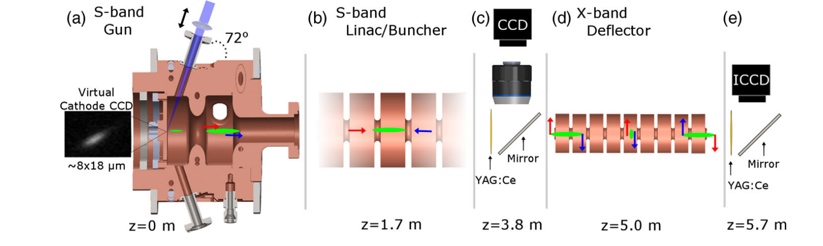
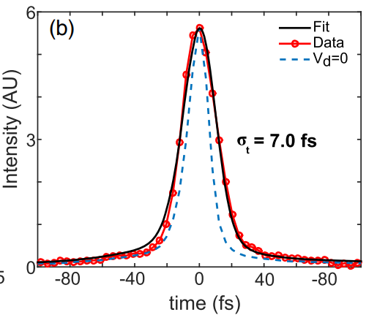
How to generate fs beams ?
Longitudinal phase space manipulation using RF cavities
Standard technique in accelerator and beam physics
Suffers from timing jitter
High harmonic linearization for even shorter bunches
Multi bend achromat or alpha magnet for jitter-free compression
Laser-based THz compression to synchronize
Maxson et al., PRL 118, 154802 (2017)
L. Zhao. Phys. Rev. X 8, 021061 (2018)
Bunch length controlled by different methods
H. W. Kim et al., Nat. Phot., 14, 245 (2020)
F. Qi et al., Phys. Rev. Lett. 124, 134803 (2020).
Y. Yang et al. https://arxiv.org/abs/2508.03946 (2025)

Slide 7
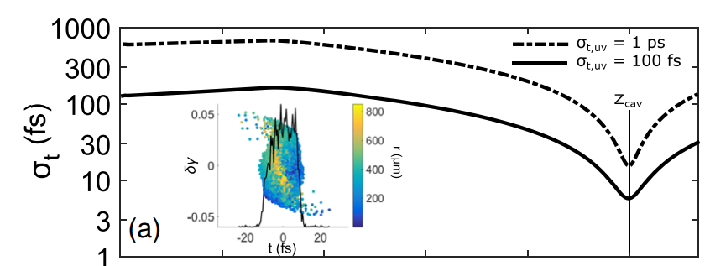

Limitations of RF compression: longitudinal phase space nonlinearities
RF curvature
Electric field
in RF cavity
Vacuum dispersion [1]
Phase
Phase advance in compression point
Drift length
In our case typical 10 - 100 fs in focus due
to vacuum dispersion alone
Solution: start with short initial bunch [2]
However, short bunch at cathode results in more uncorrelated energy spread due to stronger Coulomb forces, which
limits bunch compression (or charge)
[1] K. Floettmann (2014) NIM-A ,740, 34
[2] J. Maxson (2017), PRL 118, 154802
[3] P. Denham (2023), Instruments 7:49.

Slide 8
RF compression at Pegasus beamline
Short pulse on cathode, limited by space charge

Slide 9
RF compression at Pegasus beamline
Long pulse on cathode, limited by vacuum dispersion and other nonlinearities introduced in the gun

Slide 10
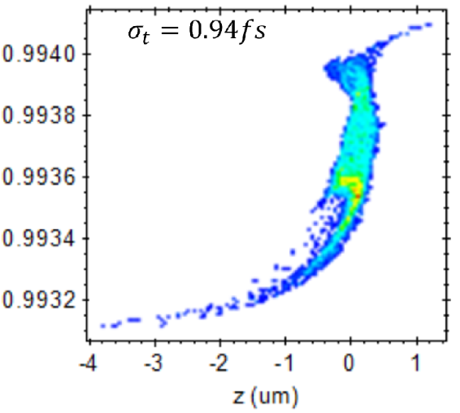
Phase space linearization for RF compression at Pegasus beamline
Long pulse and phase space linearization using X-band accelerator
[1] Denham (2023),
Instruments, 7(4), 49
Linear chirp + 2nd order curvature
Linear chirp
Deacceleration field
2nd order curvature
Curvature removed

Slide 11
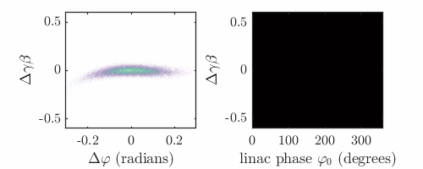
Tomography of longitudinal phase space linearization
Longitudinal phase space
Sinogram
Long pulse and phase space linearization using X-band accelerator
?
?
Deflection cavity cannot be used since we have only one X-band klystron
Use linac to rotate longitudinal phase space and measure energy spectra: tomography

Slide 12
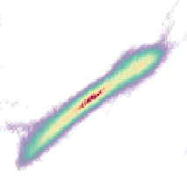
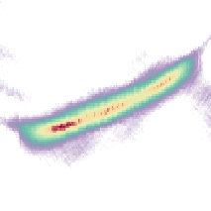
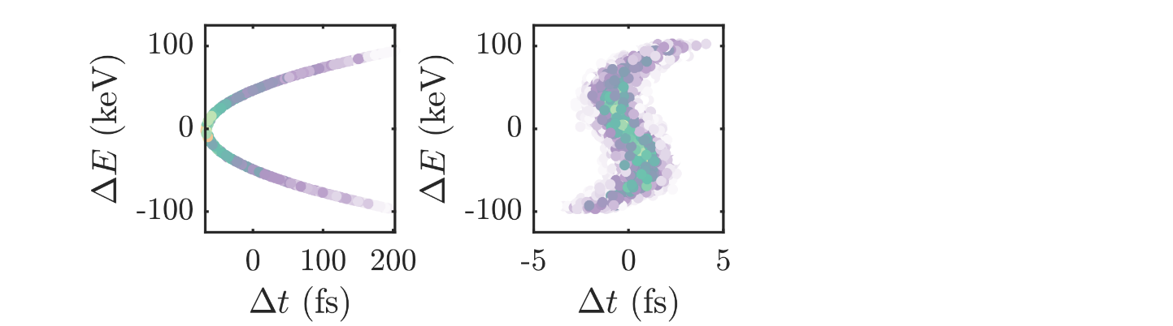
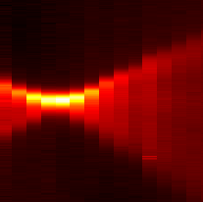
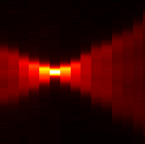
Tomography of longitudinal phase space linearization
for the generation of attosecond electron bunches [1]
Reconstruction algorithm: neural-network assisted algebraic reconstruction technique
x-band off
x-band on
Rf curvature induced by photo-injector on 7 ps beam characterized
Measured phase space compensation by x-band for generation of sub-femtosecond bunches
x-band off
x-band on
Next: measuring of bunch length at compression point
[1] Schaap (2025) PRAB, 28, 012802

Slide 13
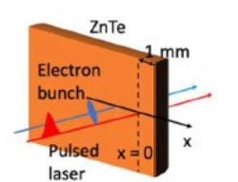
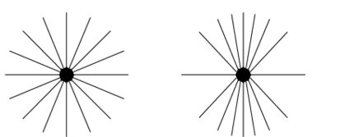
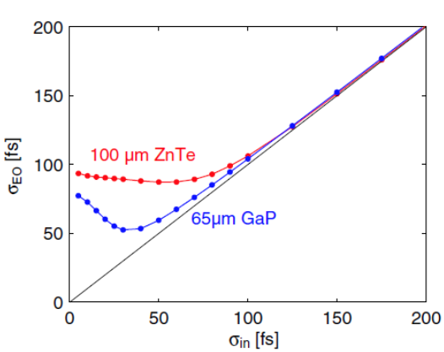
Electro-optic sampling of the relativistic Coulomb field
An indirect measure of the bunch length at compression point
EOS is a tool for characterizing fields that are slowly varying (with respect to the probing optical cycle) such as THz radiation [1,2] or Coulomb fields [3,4] inducing a temporary birefringence in an electro-optic crystal
Ota, M, (2022) IRMMW-THz
Coulomb field of particle in uniform motion in vacuum
Field electron bunch given by convolution of single particle field and density distribution
Known limitation due to frequency response of EO crystal
Rest frame
Lab frame
[1] Q. Wu (1995) Appl. Phys. Lett. 67, 3523–3525
[2] M. Lenz (2022) Optics Express 30, 19, 33804-33816
[3] R. Pompili (2014),NIM-A, 740, 216-221
[4] E. Roussel (2022) Light: Science & Applications 11, 14

Slide 14
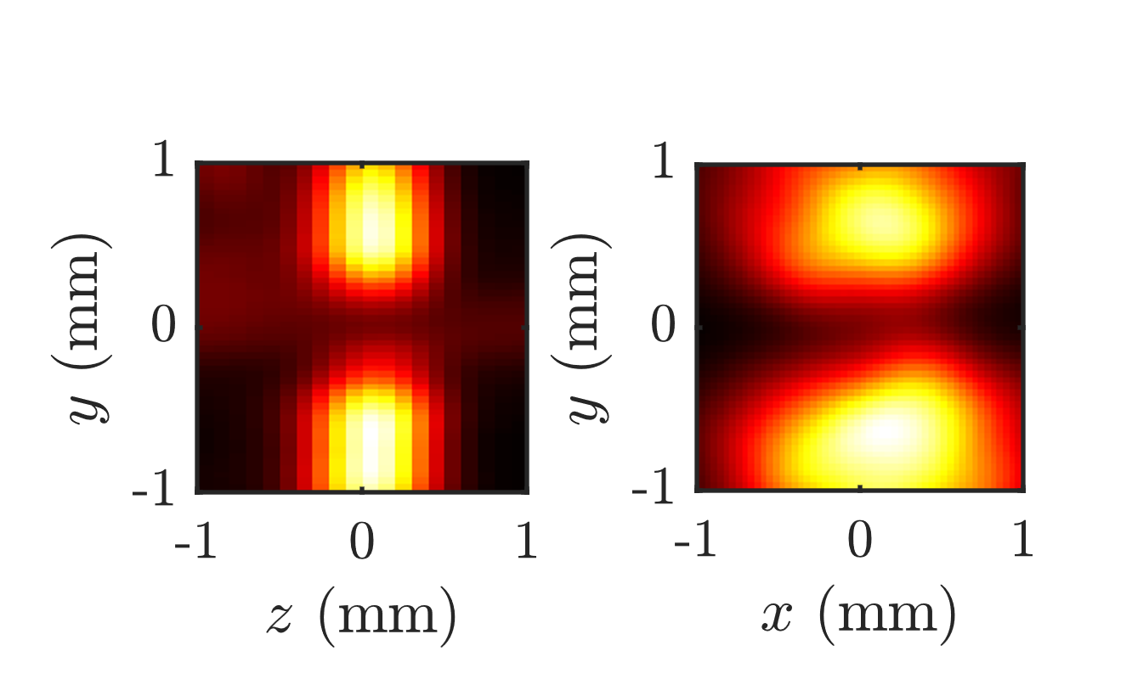
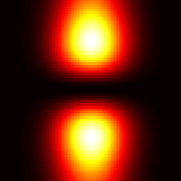
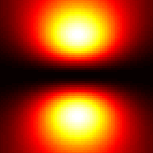
Electro-optic sampling of compressed bunches
vacuum
chamber
ebeam
ZnTe
Looking at EO effect amplitude (not time-trace)
An indirect measure of the bunch length at compression point
Example: 20 pC bunch, 5 MeV
polarizer
polarizer
Transverse slice
Signal strength is measure for bunch length
(more sensitive if length < waist)
detector
Longitudinal slice
Measured
Analytic
Results:
Compressed bunches allow for EOS of very low charges <100 fC
Potentially bunch length measurement above THz absorption resonance in Zn Te

Slide 15
THz streaking
THz generation by optical rectification in lithium niobate with pulse front tilted femtosecond laser pulse
A direct measure of the bunch length at compression point
Mapping temporal distribution to transverse with time-dependent deflecting field
vacuum
chamber
ebeam
~5 MeV
~100 fC
structure
screen
0.4 THz, 20 uJ, single cycle
iCCD
f₇₅
f₅₀₀
HWP
Streaked rms bunch size
Mg:LiNbO₃
grating
780 nm, 4 mJ, 100 fs
Mg:LiNbO3 prism (stoichiometric, 62∘ cut)
Optical rectification with tilted pulse front
Two lens telescope system for pulse front tilt tuning
Pump: 4mJ, 100fs, 785nm
Output: 20 uJ 0.4THz single cycle THz pulses
0.5% IR to THz conversion efficiency at room temperature (outcoupled)
Short period of THz wave compared to RF
significantly boosts streaking power (angle/time).
Streaking with laser synchronized wave (direct time of arrival measurement for applications)
Final temporal resolution also determined by unstreaked beam size and screen psf
Zhao, Lingrong, et al. "Terahertz streaking of few-femtosecond relativistic electron beams." Physical Review X 8.2 (2018): 021061.
Li, R. K., et al. "Terahertz-based subfemtosecond metrology of relativistic electron beams." Physical Review Accelerators and Beams 22.1 (2019): 012803.

Slide 16
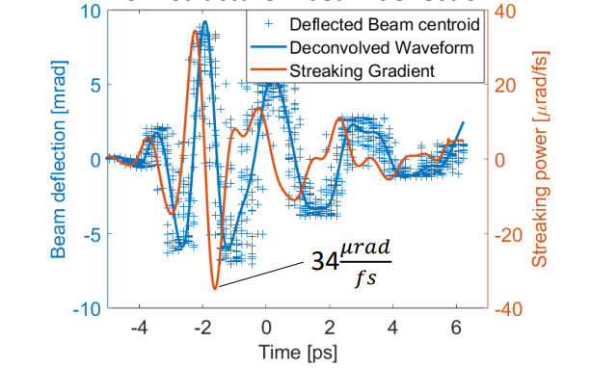
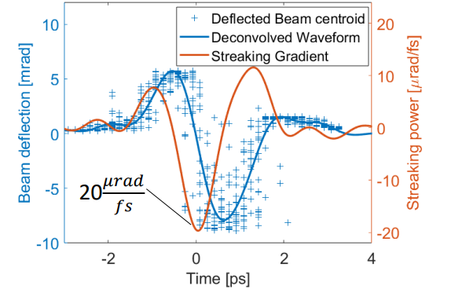
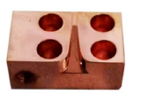
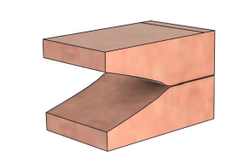
Streaking power from different structures
THz streaking calibration
Tsinghua Horn structure [1]
Parallel plate waveguide (UCLA)
High frequencies lead to strong streaking power ~35 murad/fs
Even larger streaking power at 3 MeV gun only
To compare, streaking power in Maxson experiment (500 kV x-band deflector) ~1 urad/fs
Nondispersive, more transmission due to larger opening ~20 murad/fs
Pixel resolution at L =1.3 meter downstream YAG ~ 200 – 500 as/pxl!
[1] Yang (2025), arXiv:2508.03946v1

Slide 17
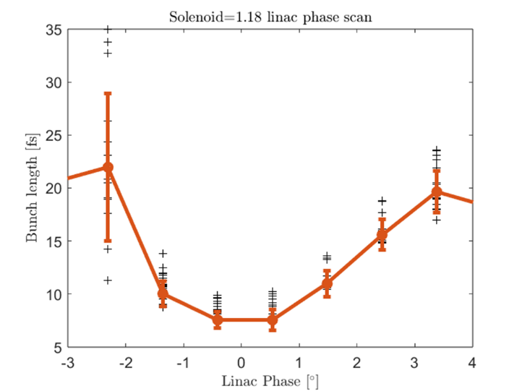
THz streaking of femtosecond bunches
Preliminary results
Operating at compressing gun phase:
short pulse in buncher
~5 fs bunch length (record at Pegasus)
at low charge <10 fC
Next step is to use linearizer to go to even shorter bunches (at higher charge)
Unstreaked
Streaked

Slide 18
Conclusions and next steps
Towards sub-fs electron beams for coherent radiation generation and ultrafast electron diffraction by linearized RF compression
Benchmarking beam dynamics
  Indirect tomographic LPS measurements
  EOS amplitude based peak current reconstruction
Direct THz streaking.
  Novel waveguide structures
  Record streaking power
  Sub-fs resolution

