Slide 1



Higher Order Modes in Accelerating Structures for Flat Beams
Gerard Andonian (UCLA)
21-27 September, 2025
EAAC 2025, Isola d’Elba

Slide 2
Outline
Background
Skew wakefield experiment
    Theory and Modeling
    Experiment Results
    Reconstruction algorithm
Alternating DWA experiment
    Preliminary Results
Summary

Slide 3
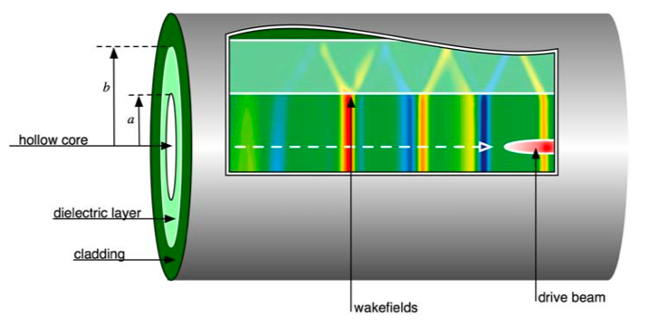
Background
Beam-driven structure wakefield acceleration (SWFA)
  Dielectric wakefield acceleration (DWA)
  Corrugated metal structures, etc.
High frequencies accessible
  dependent on material, geometry
  Scale to THz (sub-mm) scale structures
Applications
  HEP: future collider (E_{z} ~ GeV/m)
  Compact Light Source driver
  Radiation Source (THz)
  Phase Space Manipulations
    Self wake interactions (dechirper, shaper)
  Diagnostics - streaker
Bettoni PRAB 19, 021304 (2016)
Djikstal PRR 4, 013017 (2022)
100 µm
Notes:
Electron bunch drives wakefield in dielectric structure
Wakefields accelerate trailing bunch
Dependent on structure geometry

Slide 4
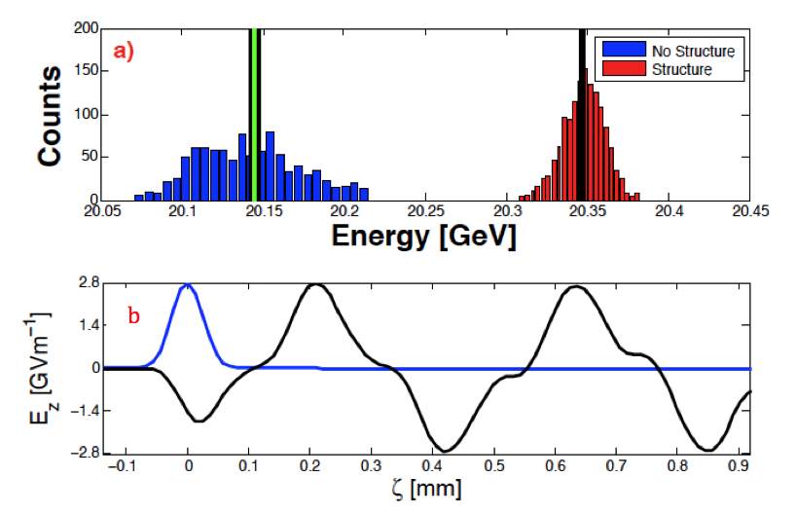
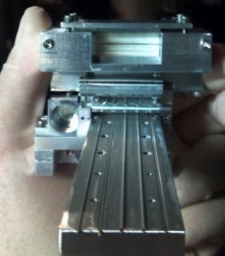
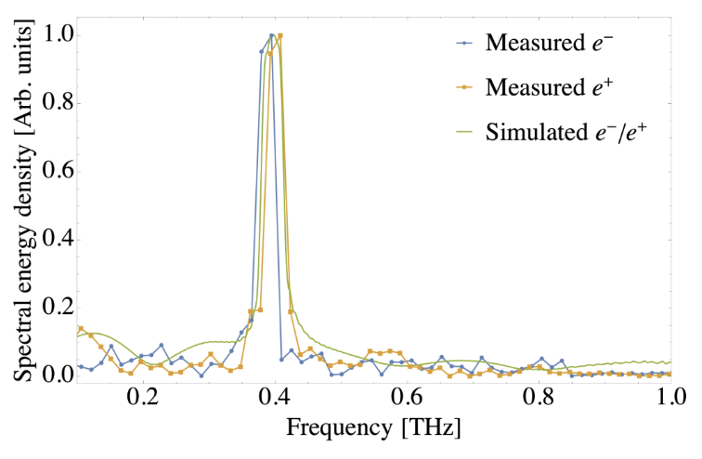
Important results in DWA
High gradient acceleration observed
  ~2 GeV/m peak field in cylindrical structure
  300 MeV/m in drive witness mode
Novel geometry
  Planar, Bragg, 3D-photonic (woodpile)
  BNL ATF experiments
DWA driven by positrons
  FACET experiment
  Similar spectral results and behavior e-driven
  Possible application to e⁺ -e⁻ collider
Pertinent issues:
  Transverse wakefields accompany longitudinal fields
200 MeV
  O’Shea Nat. Comm. 7, 12763 (2016)
  Majernik, PRR 4, 023605 (2022)

Slide 5
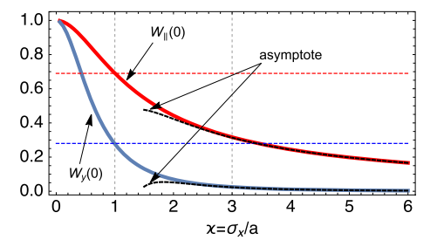
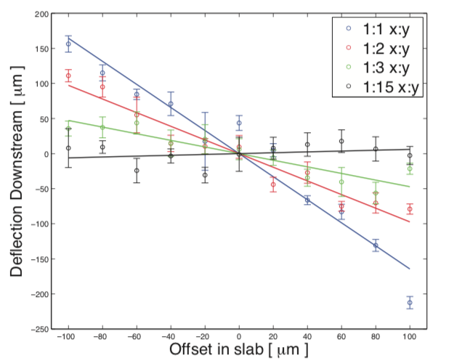
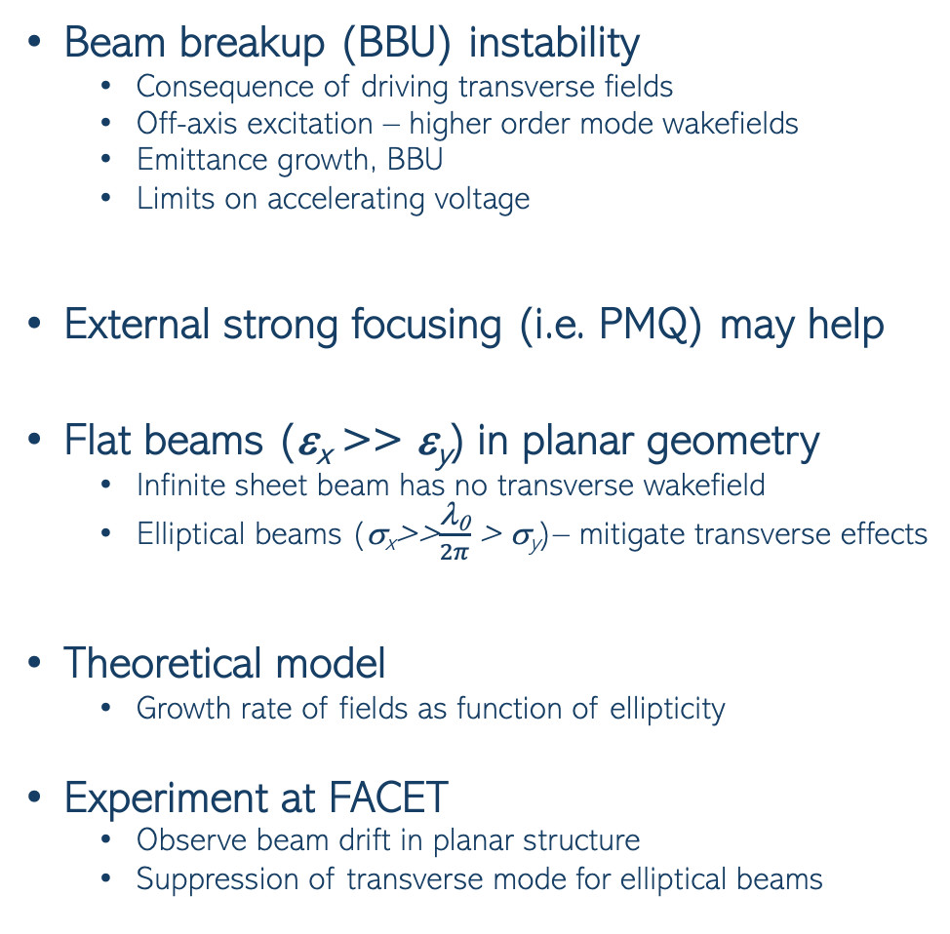
Flat beams in planar structure
W_{z}
Beam breakup (BBU) instability
  Consequence of driving transverse fields
  Off-axis excitation – higher order mode wakefields
  Emittance growth, BBU
  Limits on accelerating voltage
External strong focusing (i.e. PMQ) may help
Flat beams (ε_{x} >> ε_{y}) in planar geometry
  Infinite sheet beam has no transverse wakefield
  Elliptical beams (σ_{x}>>$\frac{\text{l}\text{0}}{2π}$ > σ_{y})– mitigate transverse effects
Theoretical model
  Growth rate of fields as function of ellipticity
Experiment at FACET
  Observe beam drift in planar structure
  Suppression of transverse mode for elliptical beams
  Baturin, PRAB 21, 121302 (2018)
  Saveliev, PRAB 25, 081302 (2022)
W_{y}
Ellipticity
  Li, PRST-AB 17, 091302 (2014)
Round beam
  Tremaine, PRE 56 7204 (1997)
Elliptical beam
  O’Shea, PRL 124, 104801 (2020)

Slide 6
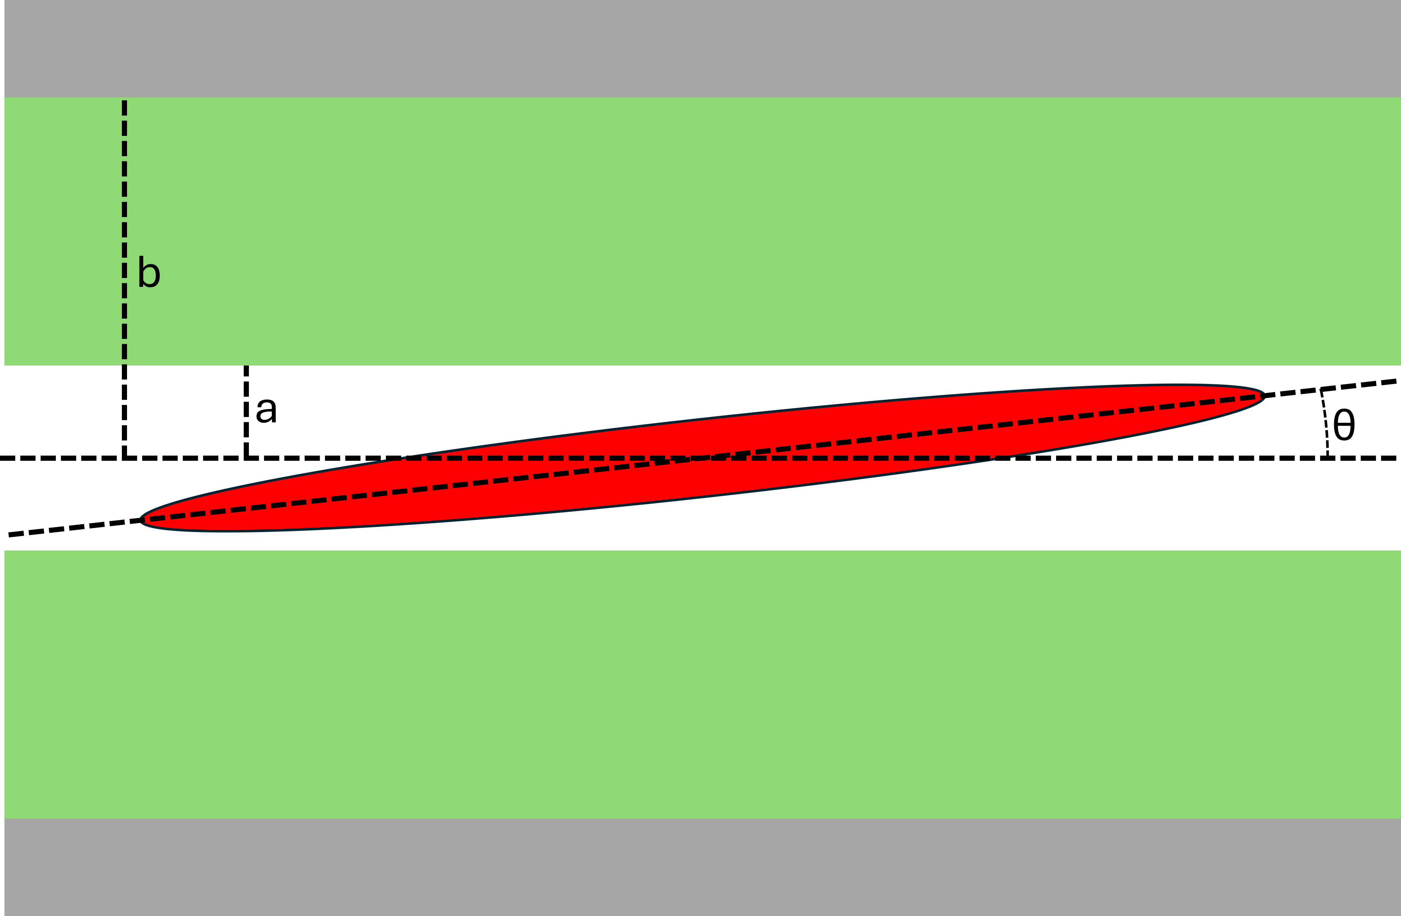
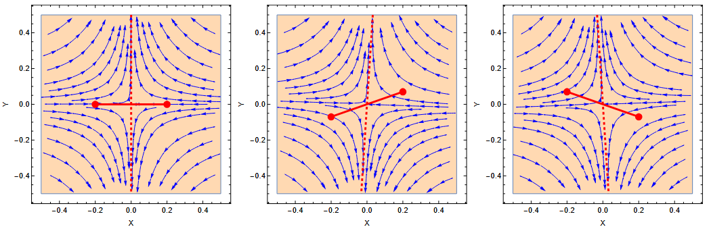
Skewed-wakefields in DWA
Flat beam (red) going into page
Further examine flat beam interaction in DWA
  Important for future flat beam applications (i.e. collider luminosity)
Simple analytic model
  Baturin, PRAB 21, 121302 (2018)
  Two particle model proxy for flat beam
Wakefield map shows higher order modes
  Quadrupole mode dominant
  Skew quadrupole mode with incoming angle
Dielectric
Metal
W. Lynn, PRL, 132 165001 (2024)

Slide 7
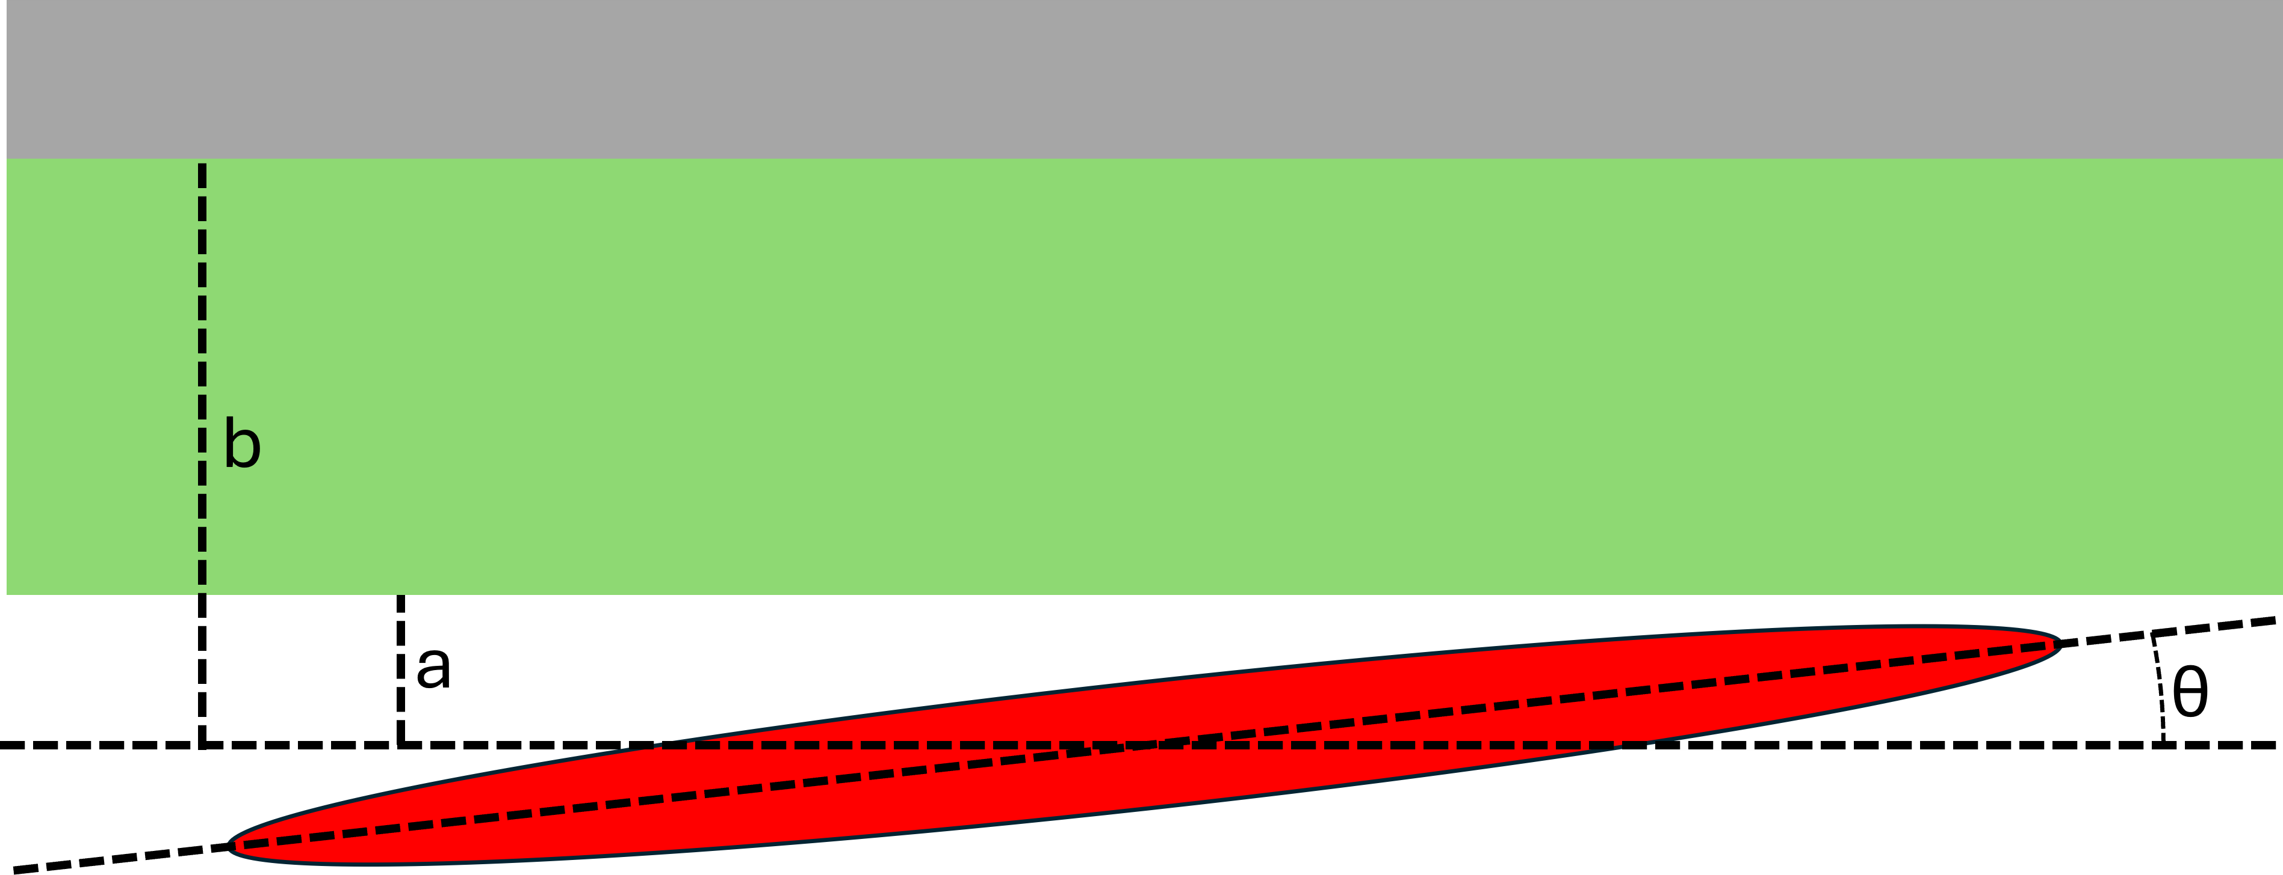
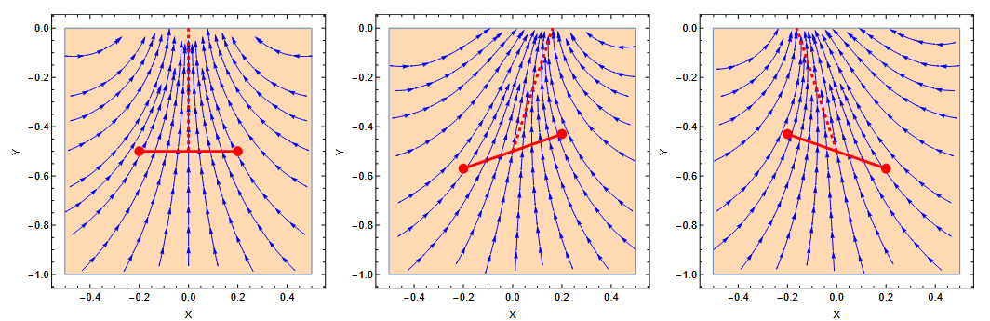
Skewed wake model
Flat beam (red) going into page
Single-slab structure
  Simple analytic model
  BAR, PRAB 21, 121302 (2018)
Wakefield has higher order mode content
  Dipole mode and quadrupole modes
  Skewness observed with incoming angle
Dielectric
W. Lynn, PRL, 132 165001 (2024)

Slide 8

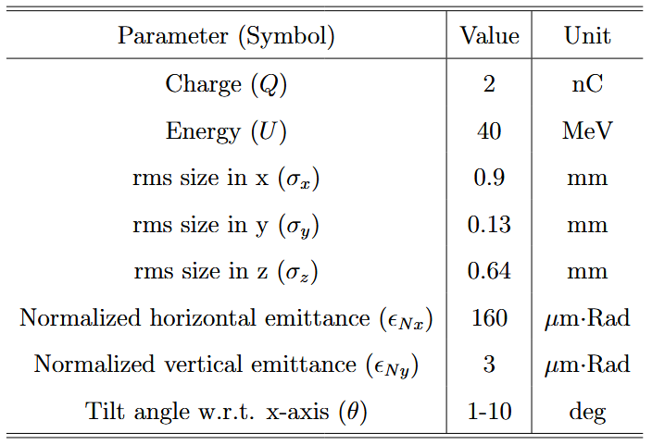
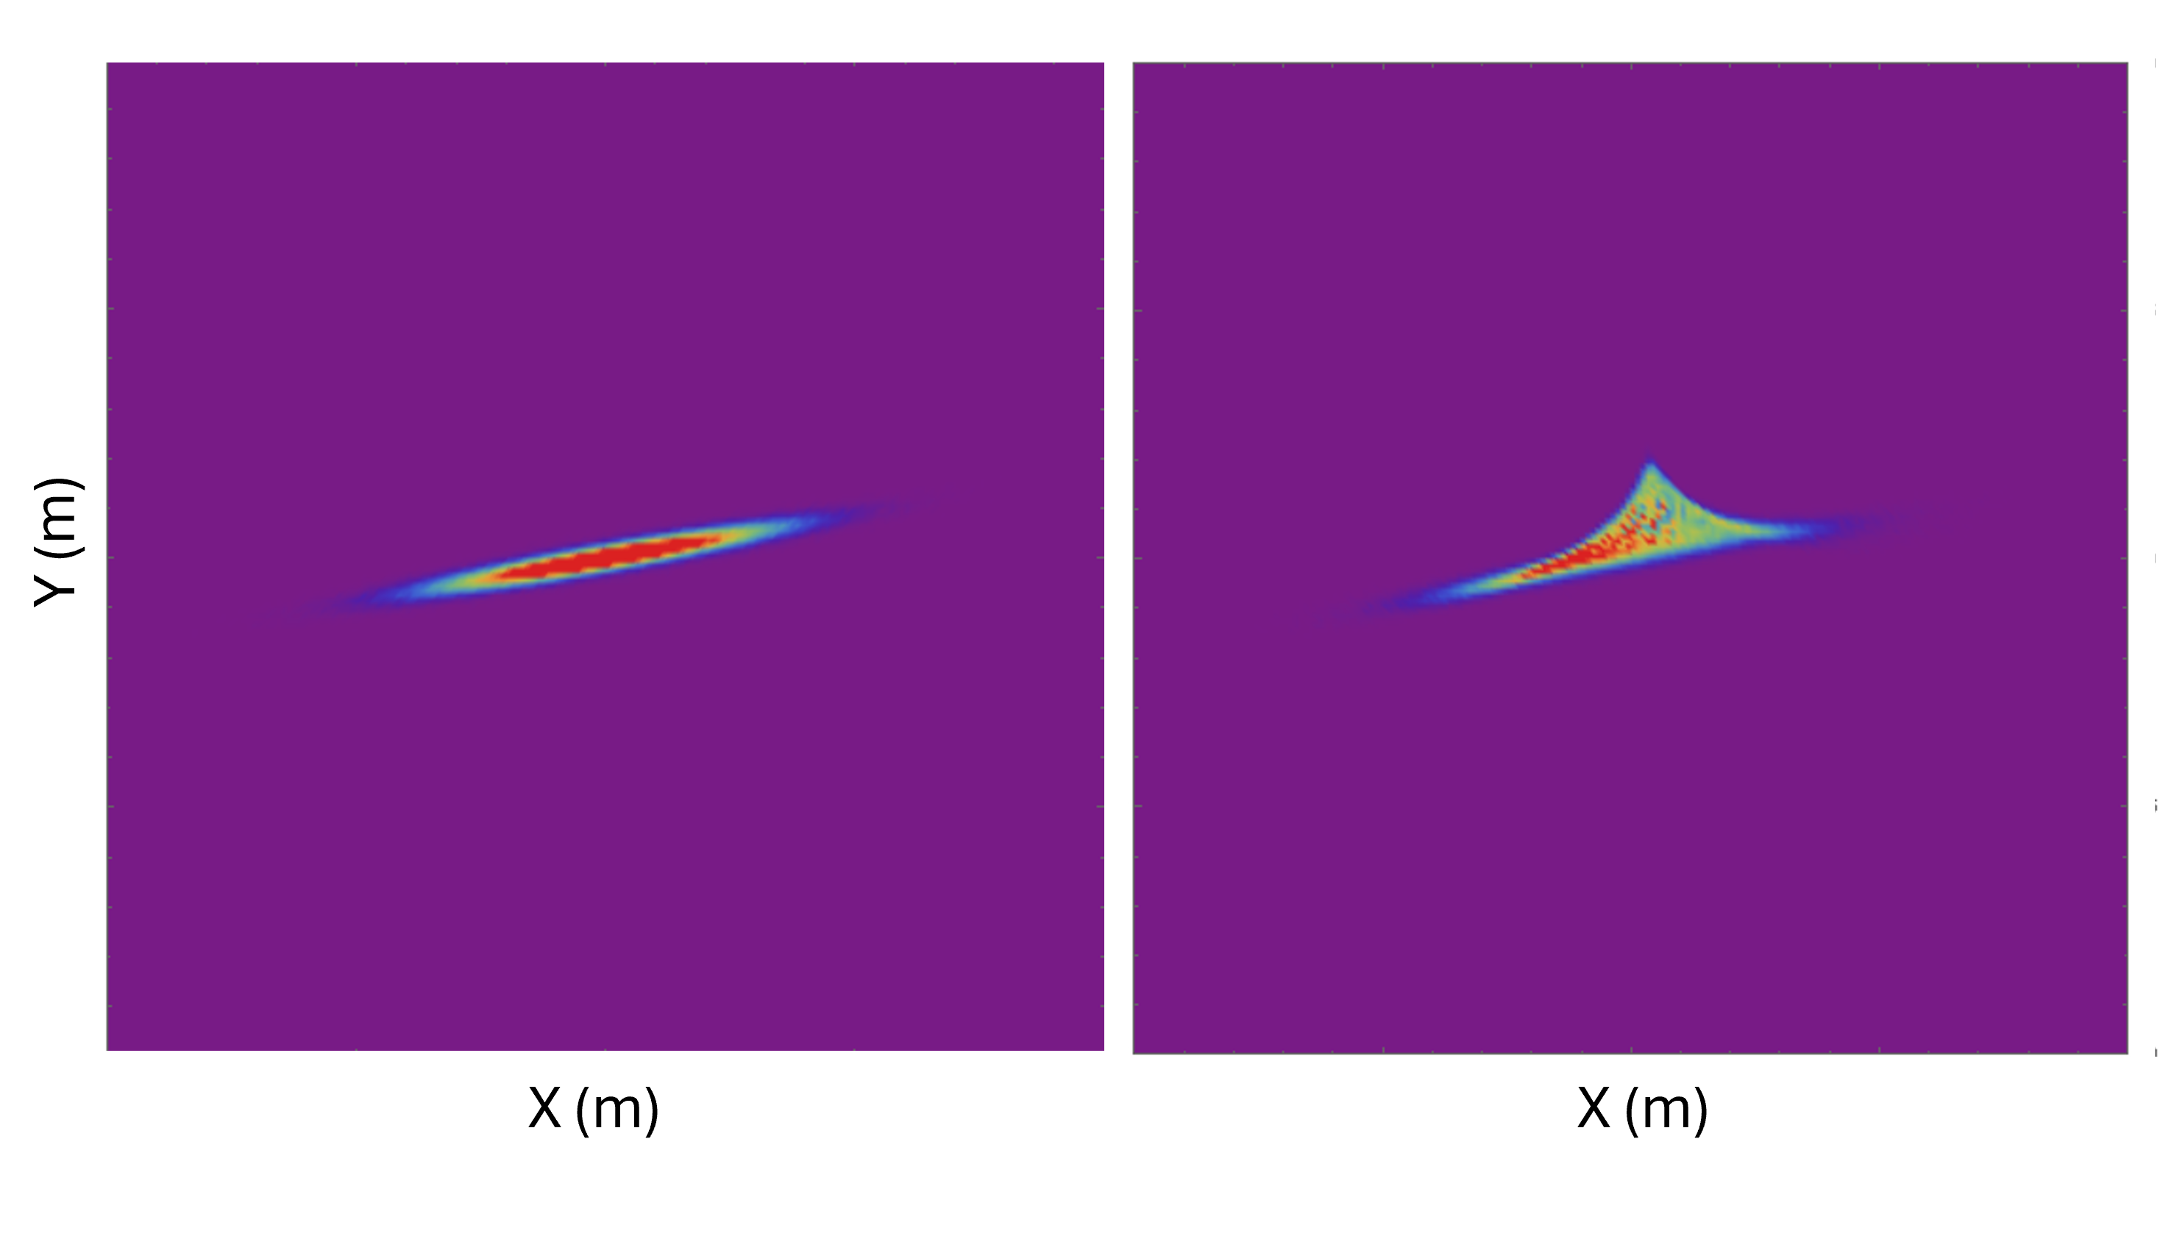
Skewed wake experiment at AWA
AWA
Argonne Wakefield Accelerator (AWA)
  Demonstrator facility for SWFA and PWFA
  Round-to-flat-beam transformer
    Magnetized beam at cathode
    Remove angular momentum with skew quadrupoles
    Flat beam (up to 100:1 ratio)
  Focus through planar DWA structure
    Diagnostics: transverse distribution
Dielectric Surface
Simulation
Drift
Single slab

Slide 9
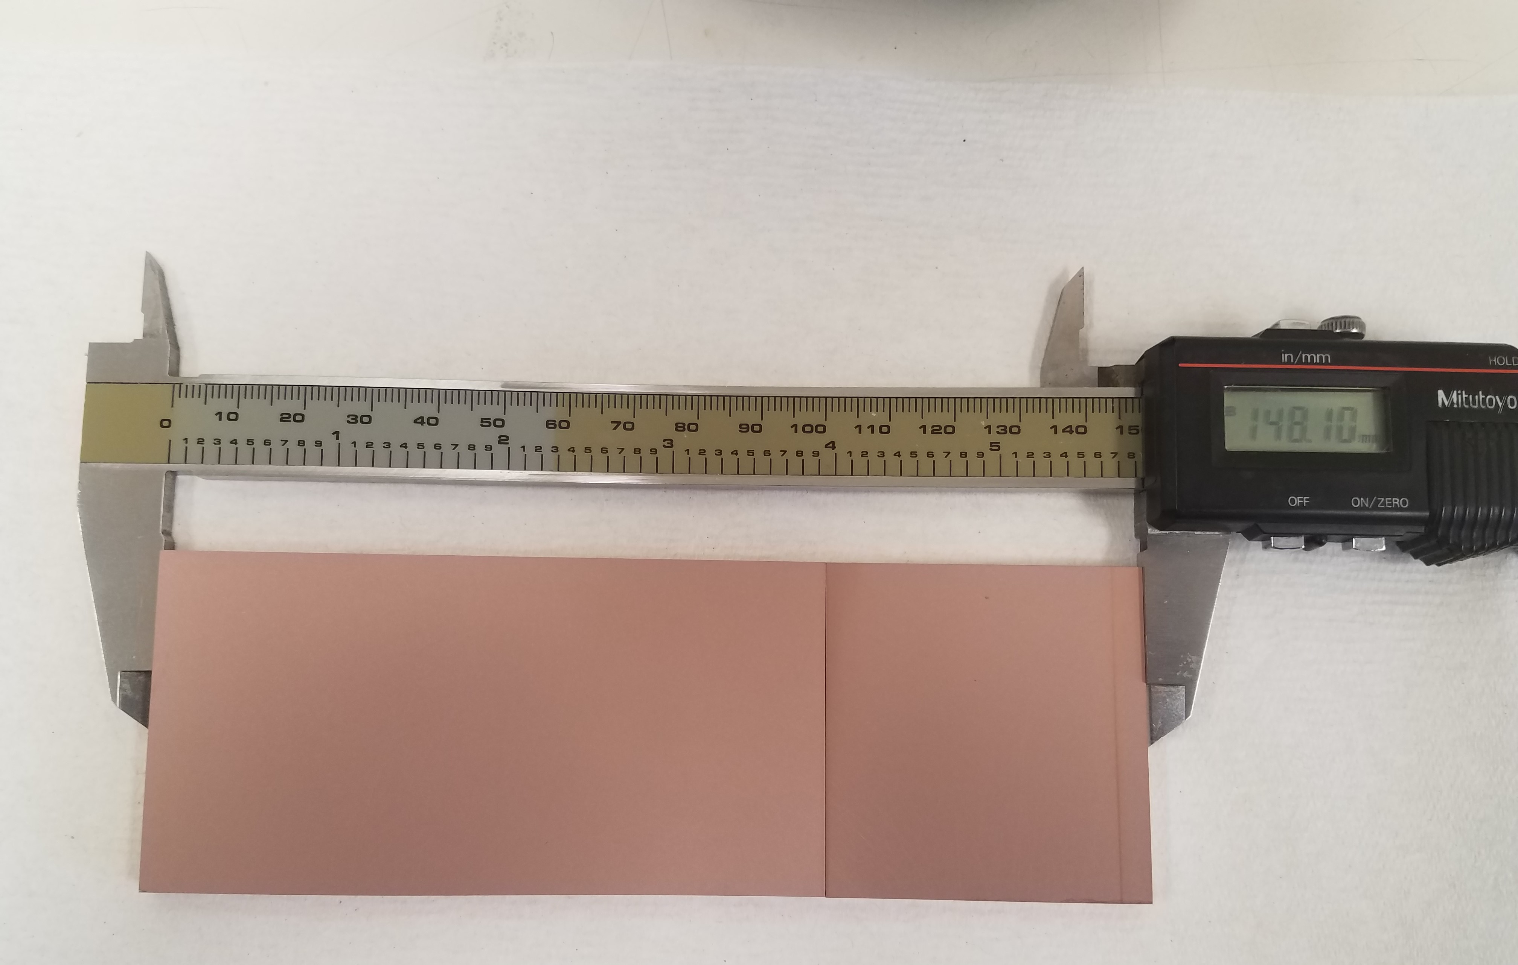
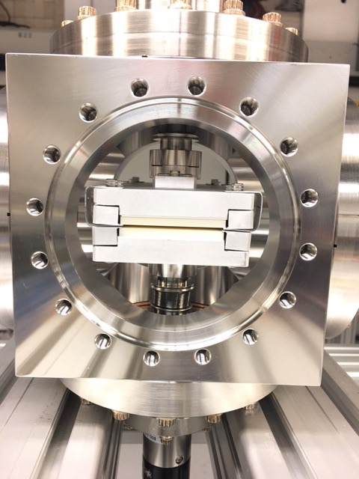
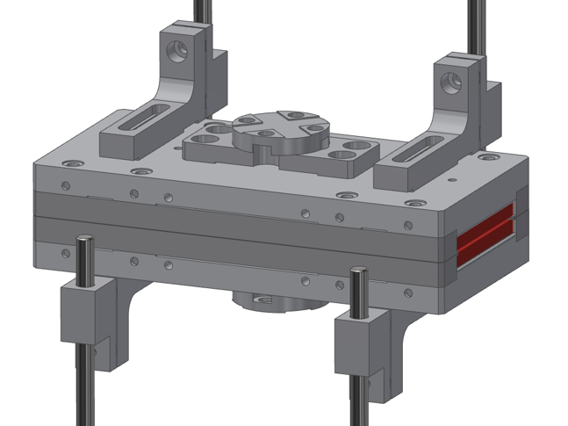
Skewed wake experiment - structure
Dielectric material: Alumina
  ε = 9.4 (Al₂O₃)
  Width = 40mm
  Length =150 mm
  Thickness = 5mm
  Half-gap (a) = 5 mm
  Coated with thin metal layer
  Fixed spacers
Alumina
Installed on AWA beamline
15cm
Rails for adjustable gap
Two independent motors
for single slab or double slab
Can operate in fully-open mode (“no structure”)

Slide 10
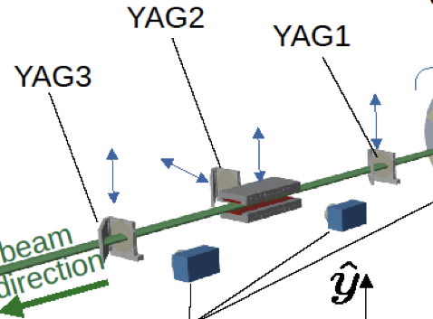
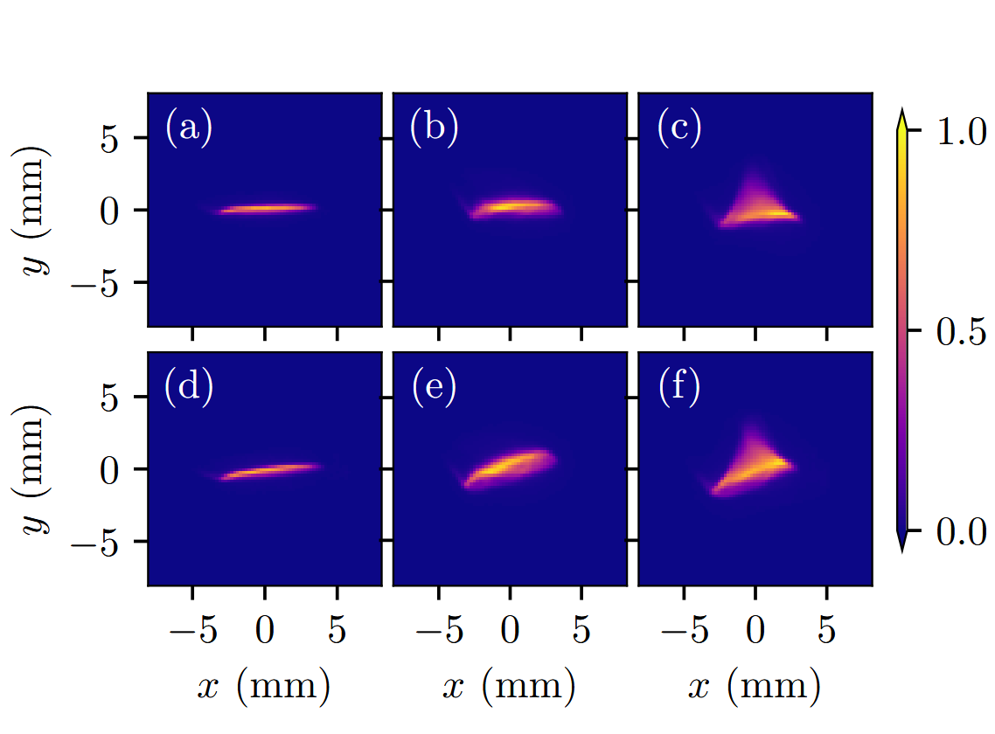
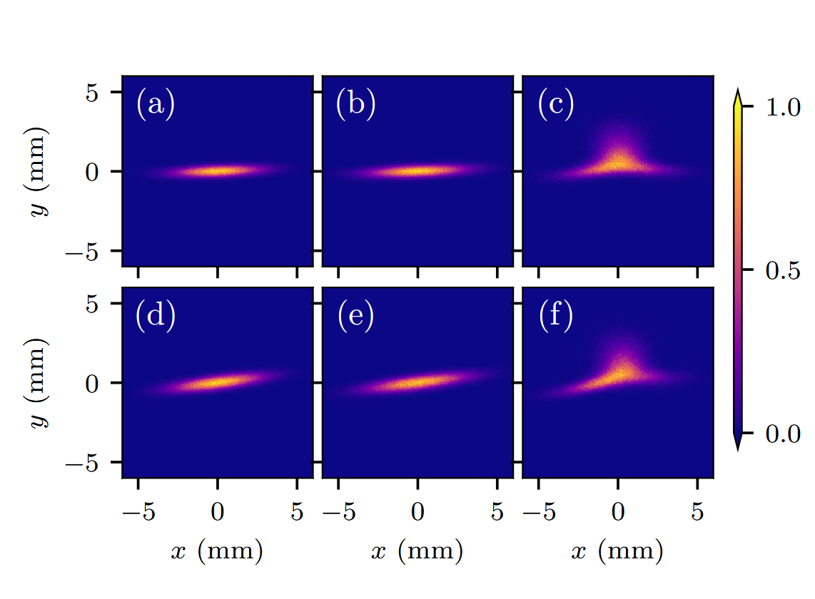
Skewed Wake experiment - Results
Single sided slab
  Beam injection
  0.9mm away from slab surface
  Injection angle varied (2˚ and 7˚ shown below)
Transverse wake induced effect
  Agreement with two-particle model and simulations (WARP)
θ
DWA
YAG2
YAG3
(no slab)
YAG3
(slab)
Simulations
θ = 2˚
θ = 2˚
θ = 2˚
θ = 2˚
θ = 2˚
θ = 7˚
θ = 7˚
θ = 7˚
θ = 7˚
θ = 7˚

Slide 11
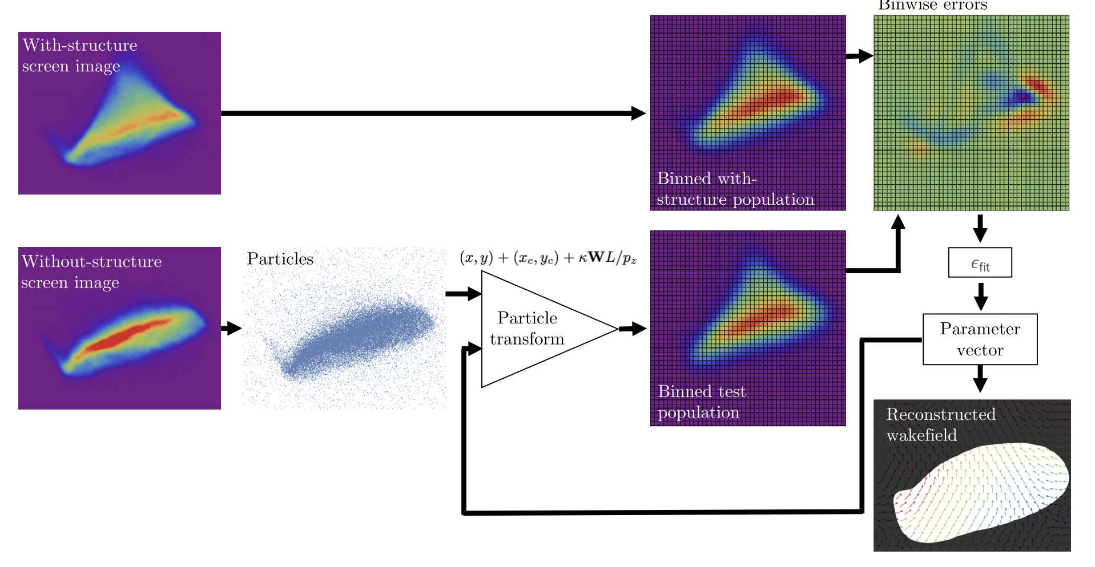
Reconstruction algorithm
Binning
Error map
INPUT
Drift only
(no structure)
OUTPUT
Extract transverse info from diagnostic screens
Single-shot technique
High dimensional parameter space explored efficiently
Multipole components of transverse wakefield
N. Majernik, et al Phys. Rev. Accel. Beams 26, 094601 (2023)
Notes:
Inputs:
transverse screen image of beam at same location, with and without structure
Steps:
Generate particle distribution
Apply transformation
Compare error plot
Iterate to convergence threshold
Output: kick vector map

Slide 12
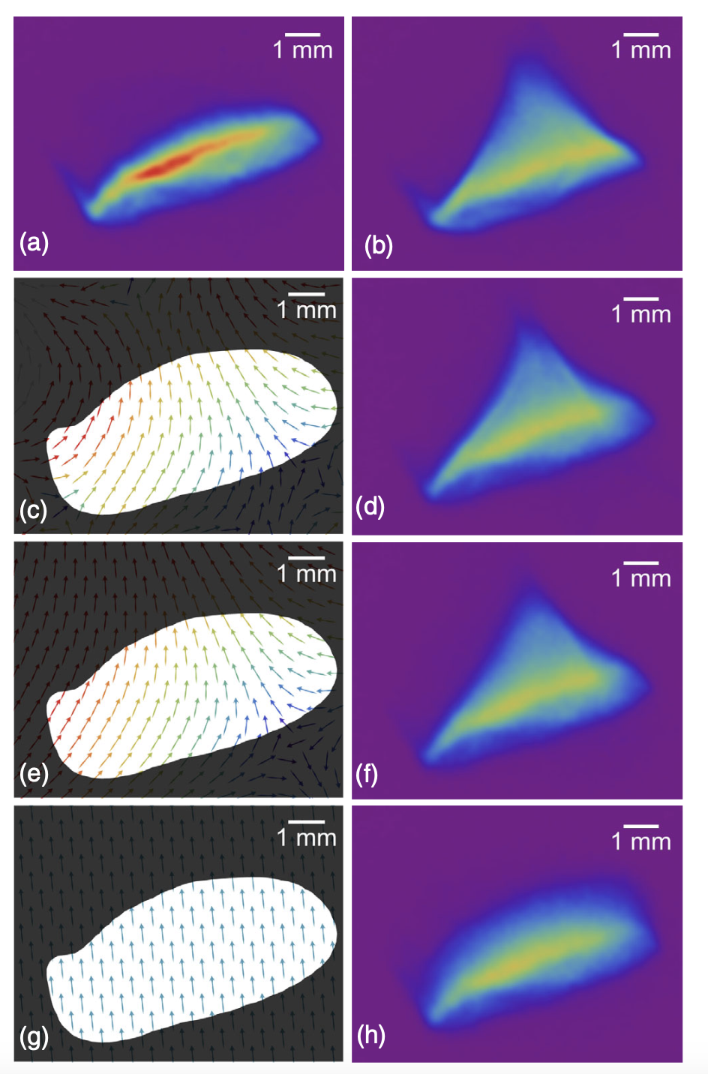
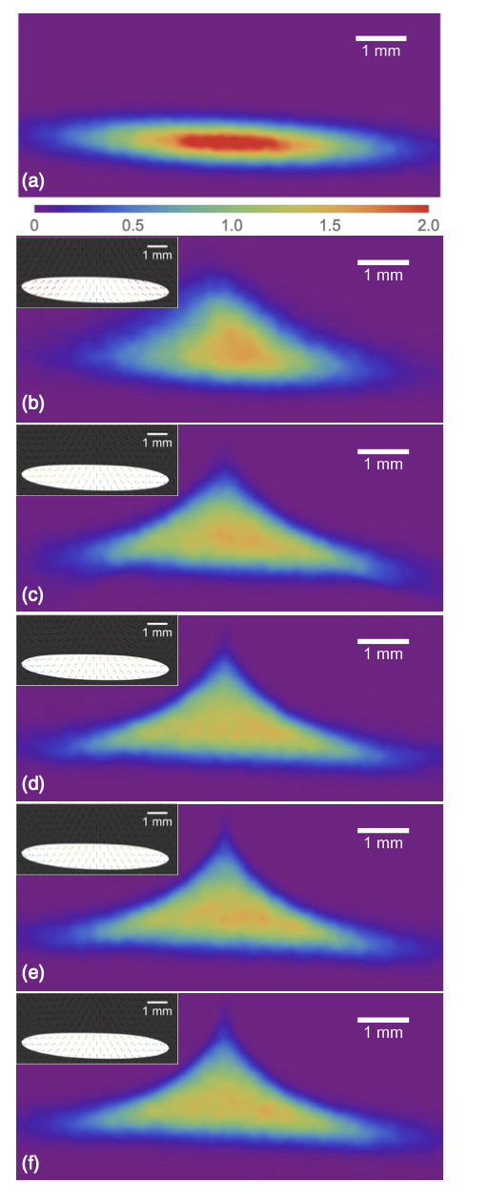
Reconstruction algorithm - output
Algorithm test with simulations (WARP)
Simulate screen distributions
Use arbitrary number of modes in expansion
Convergence with higher modes (n=4)
Experimental Data
No structure,
7˚ e-beam tilt
Single-slab structure,
7˚ e-beam tilt
WARP
No structure
Structure
n = 6
n = 2
Reconstructed
Field maps
n = 3
n = 4
n = 1
n = 6

Slide 13
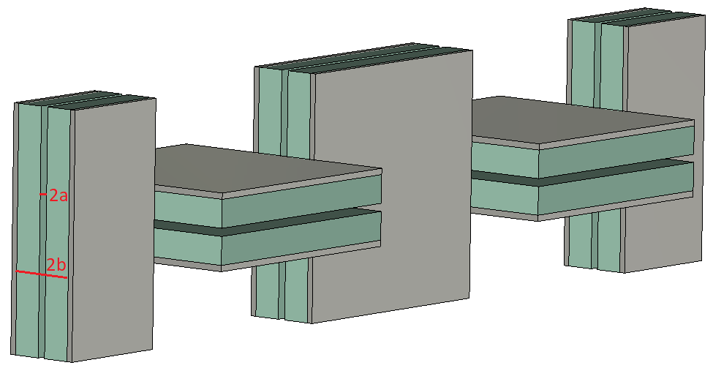
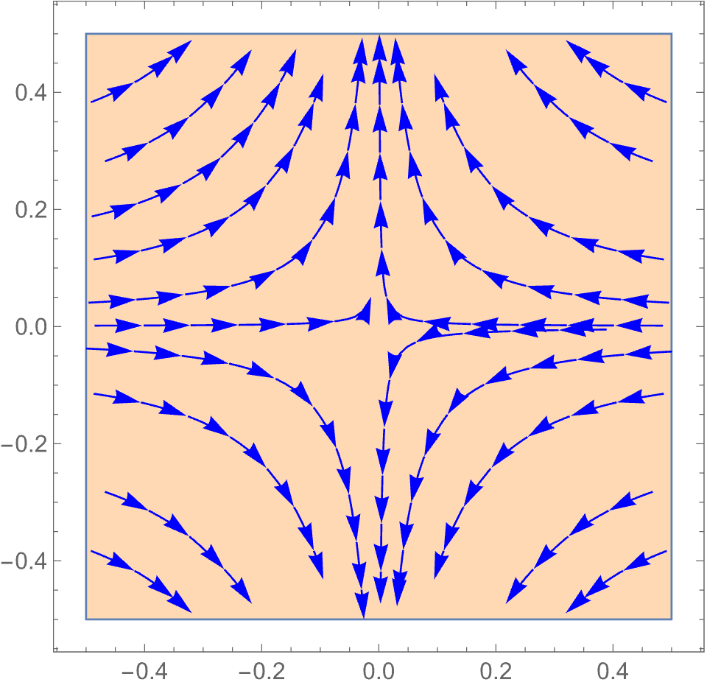
Alternating DWA Concept
Manipulation of transverse wakefields
Asymmetry in beam to structure
  Quadrupole dominated wake
  90˚ rotation each period
  Analogous to alternating gradient focusing
  Focus beam in both planes
Potentially stabilizing effect
  May be competitive with magnetic quadrupoles & beam energy spread for damping
beam direction
after one period
Kick map experienced by a test particle
Kick map rotates with structure

Slide 14
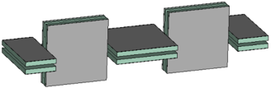

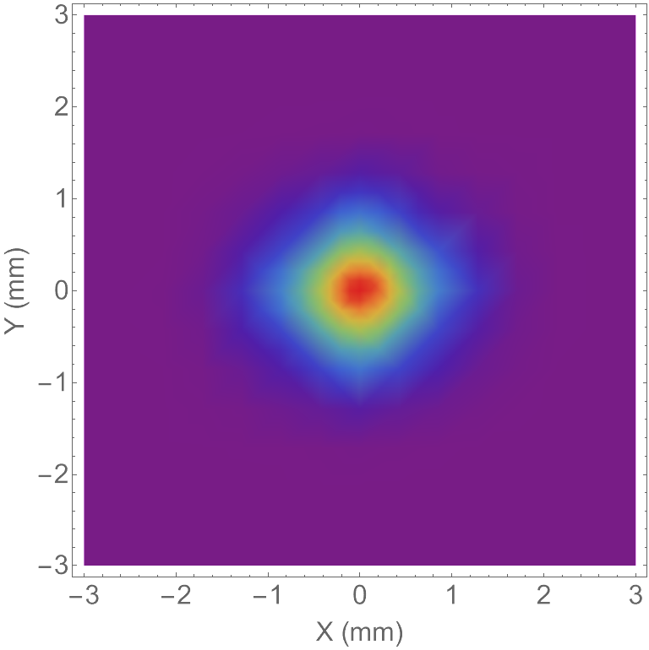

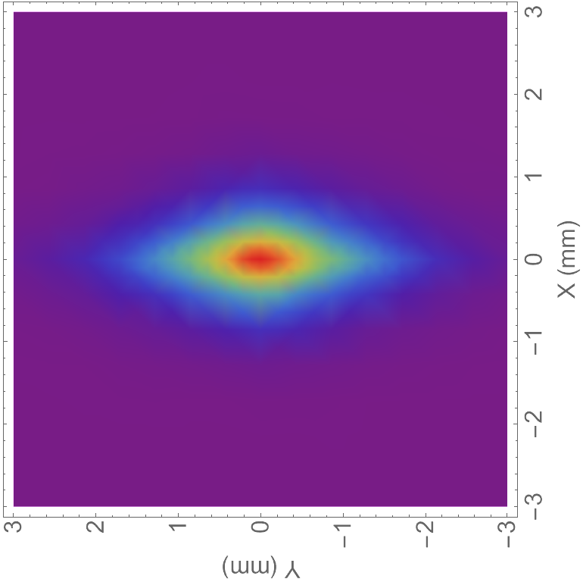
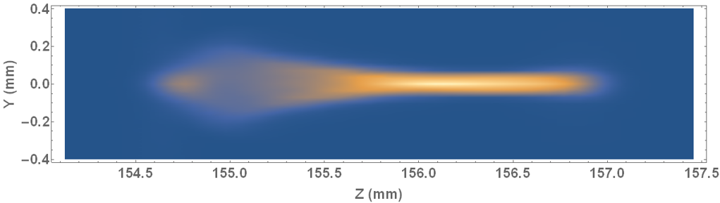
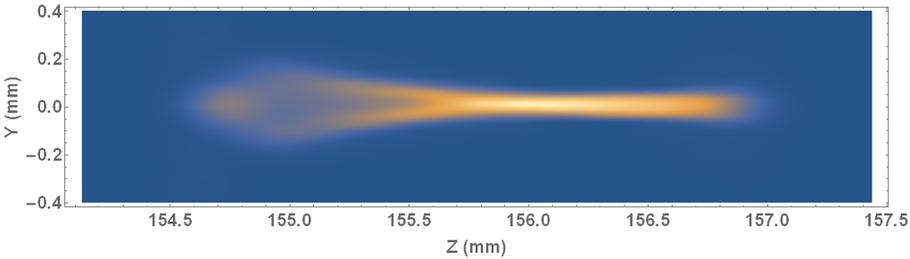
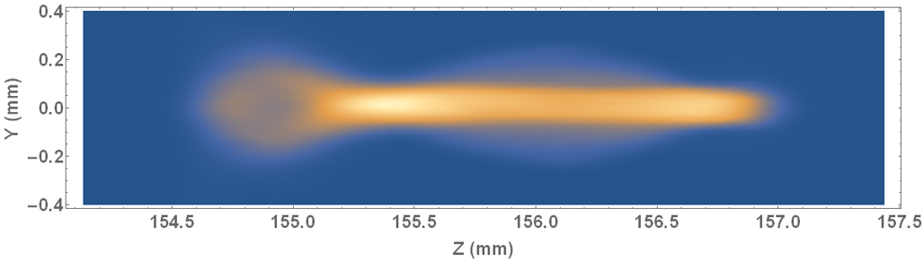
Alternating DWA experiment
ADWA
Compare ADWA to planar slab DWA
Adjustable gap in both planes
Remove one axis for planar DWA
Diagnostic: transverse screens
Planar DWA
Drift (no structure)
ADWA
Planar DWA
y
x
x
x
Drift (no structure)
ADWA
Planar DWA
Longitudinal dependence of wakefield
Focusing in core of beam after ADWA
z
z
z

Slide 15
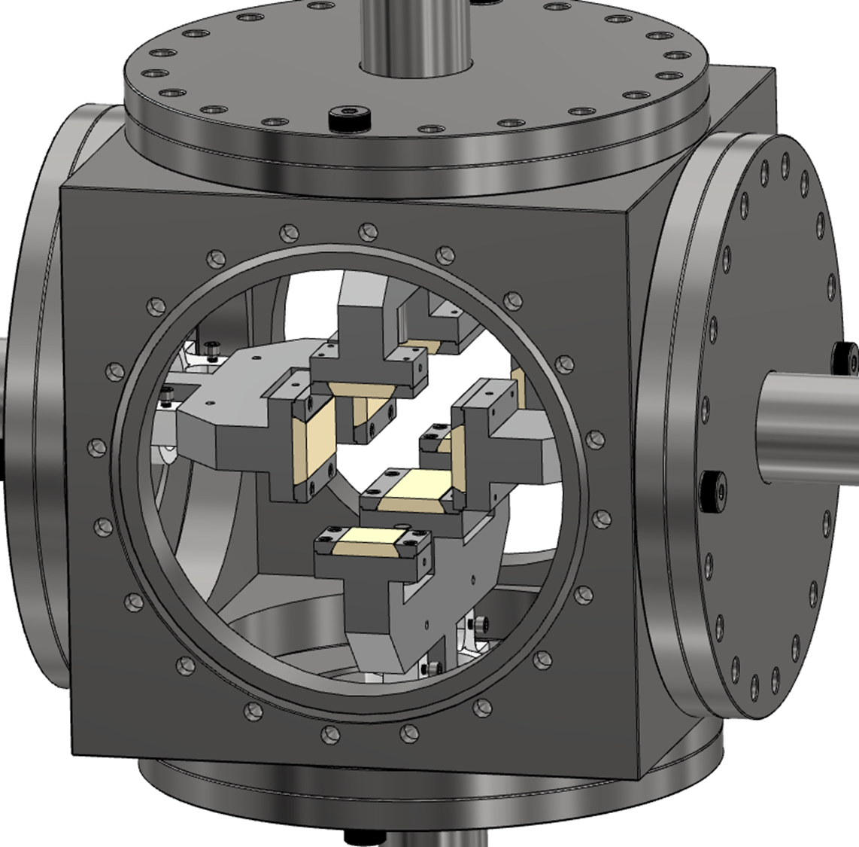
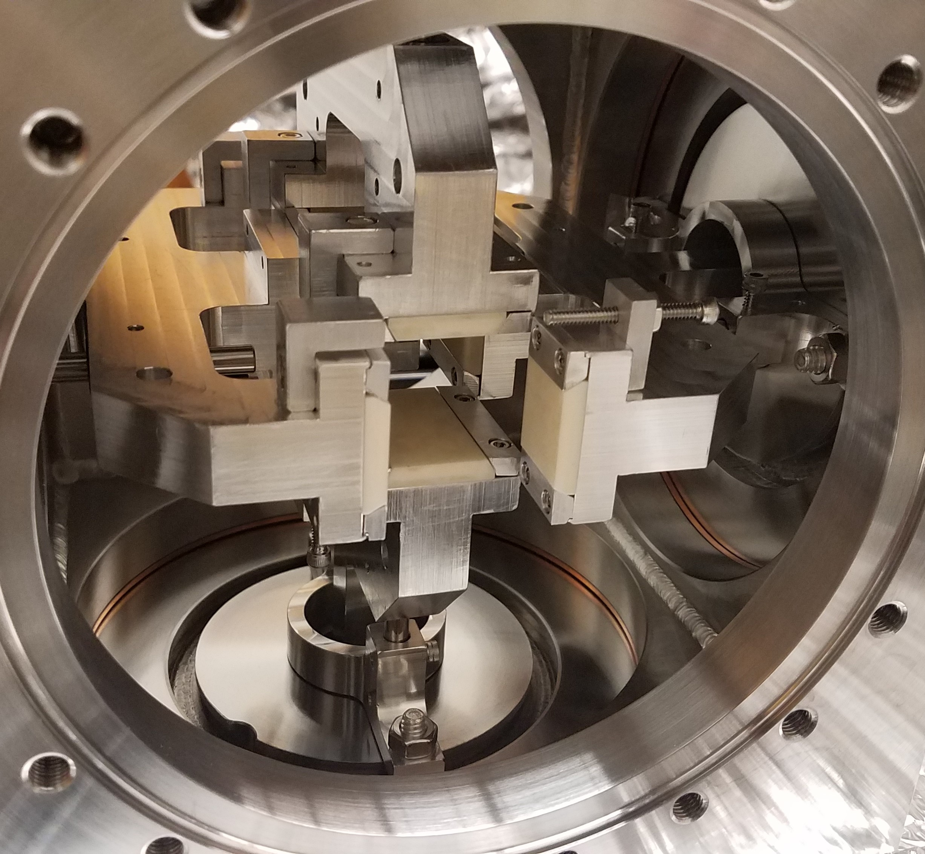
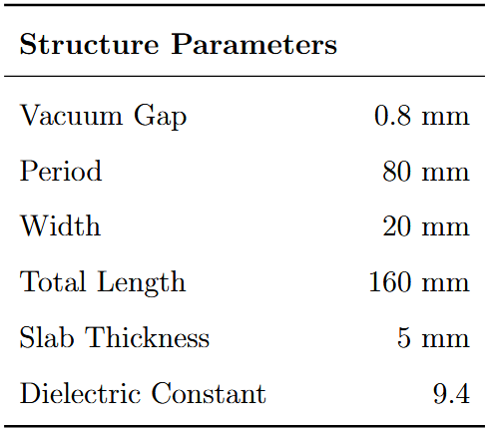
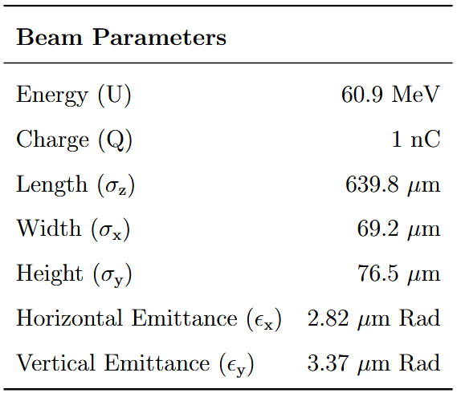
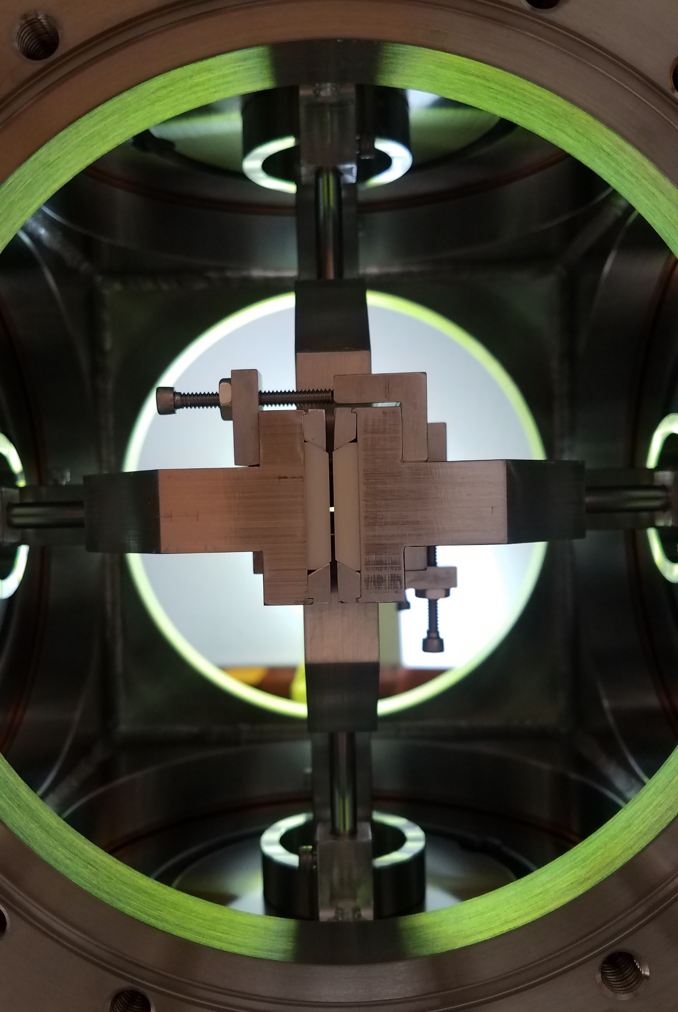
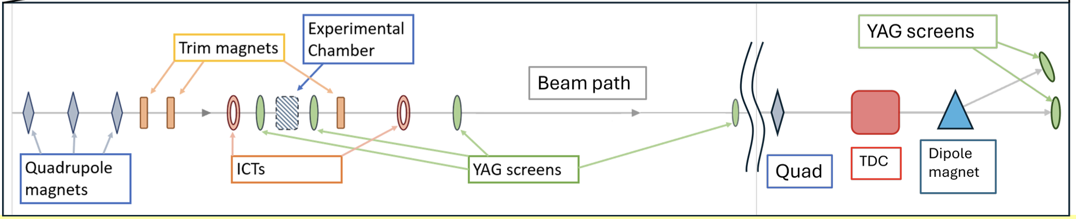
ADWA experiment at AWA
4 independent motors
Hold gap fixed in x, vary y spacing
Observe: transverse distribution and z-dependence

Slide 16
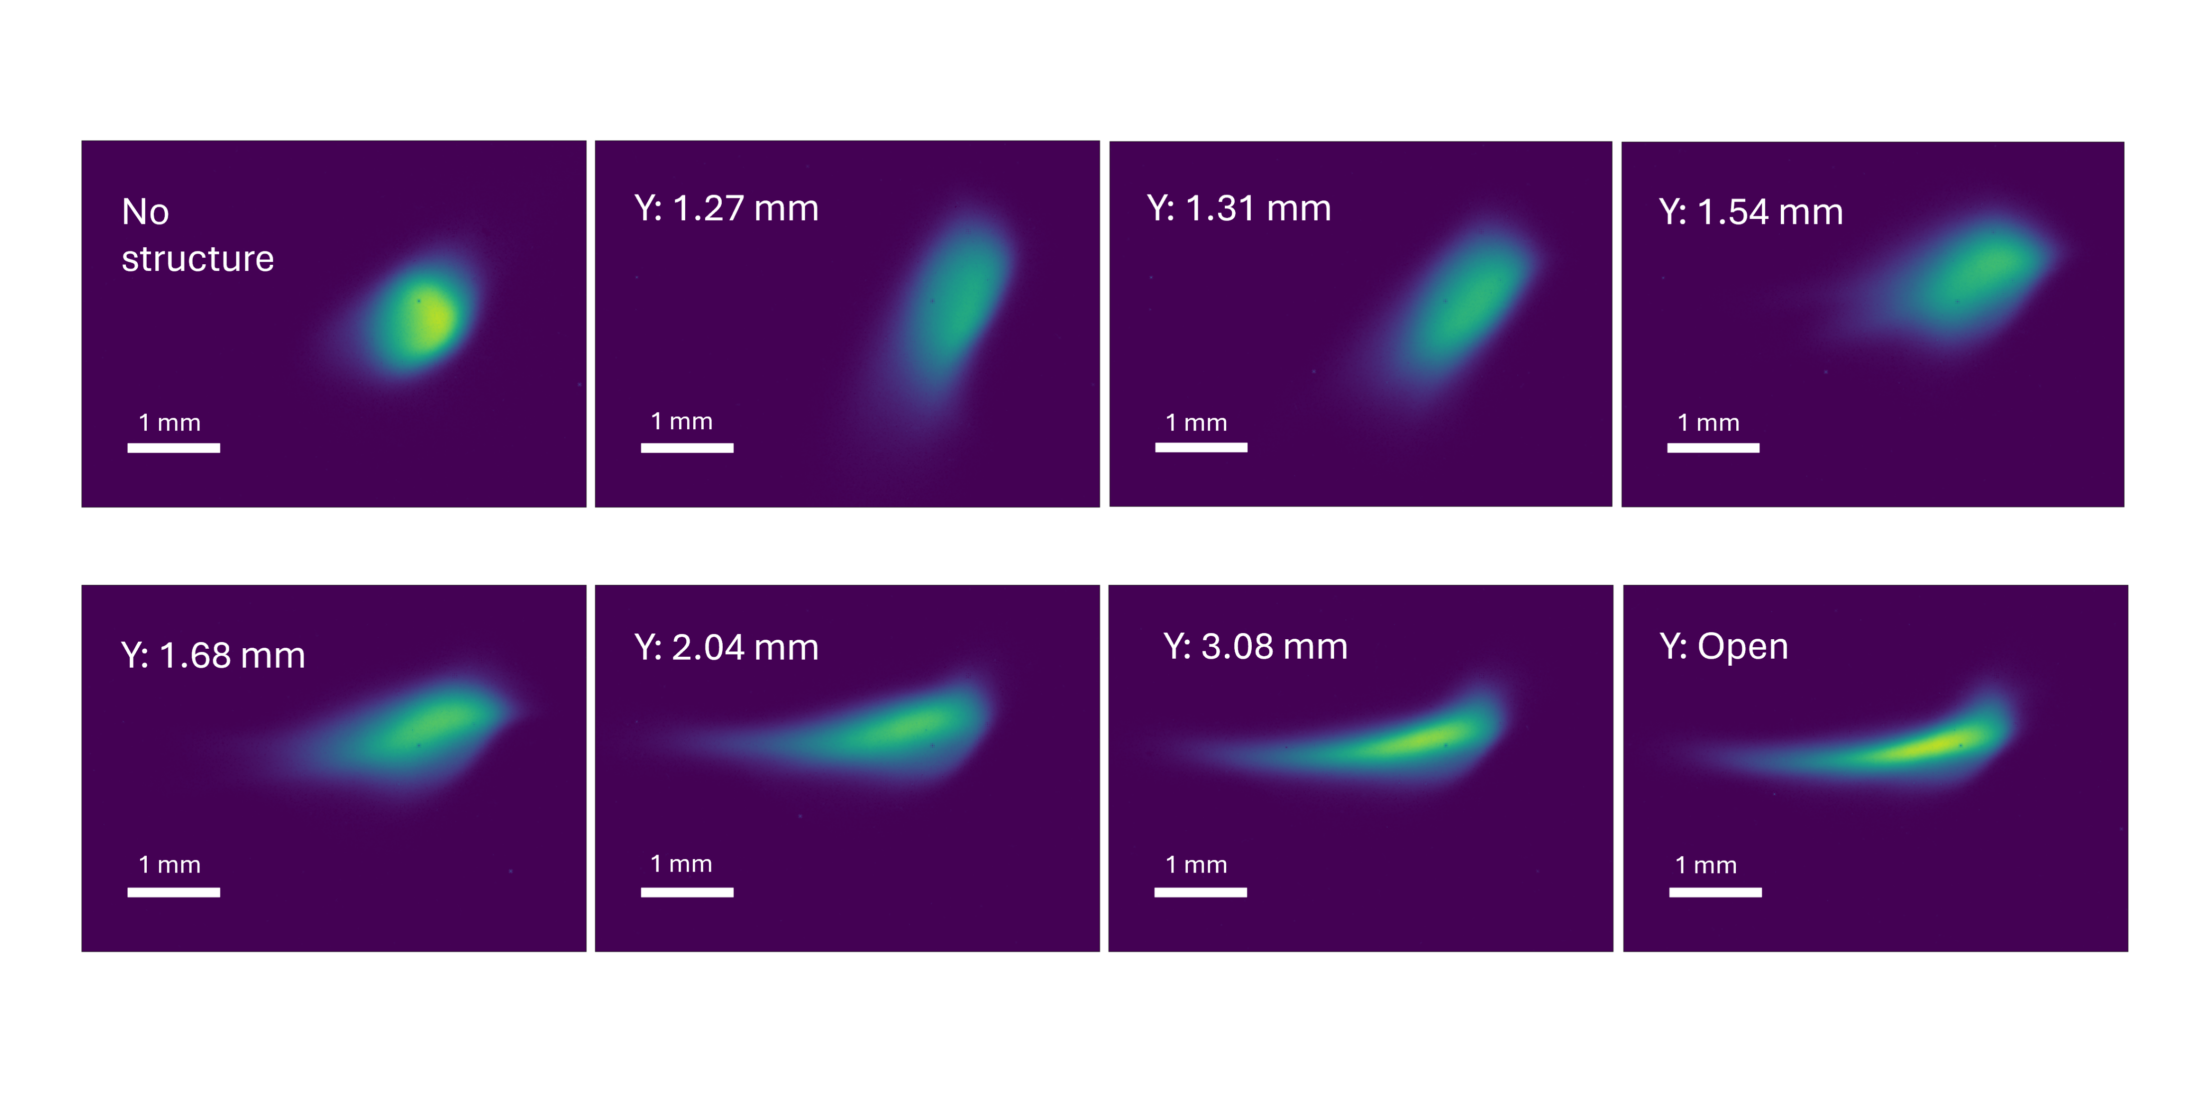
Experiment results ADWA (preliminary)
Transverse beam distribution at screen downstream (23cm)
x-gap constant at 1.31mm but y-gap varies
Change structure from symmetric ADWA to planar
Functionally tune the net effect of the quadrupole-like transverse mode
Symmetric focusing
Path towards controlling beam size with wakefields
Transverse Distributions on YAG screen

Slide 17
Summary
Flat beams in SWFA generate higher order modes
  Tradeoffs with longitudinal gain and competing effects
  Skew transverse wakefields observed
  Reconstruction method for wakefield analysis
Future work in transverse dynamics of flat beams
  Novel solutions and hybrid schemes under study
  Extendible to other applications (Flat beam driven PWFA – see P. Manwani Thursday)
  Analysis on alternating DWA imminent
Thank you for your attention!
Acknowledgements
W. Lynn, N. Majernik, P. Manwani, S. Baturin, J. Power, G. Ha, T. Xu, P. Piot, S. Kim, S. Doran, E. Wisniewski, A. Ody, J. B. Rosenzweig
Support from US DOE DE-SC0017648

Slide 18
BACKUP SLIDES

