Slide 1
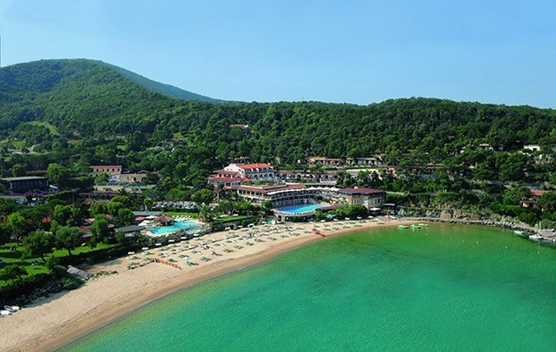



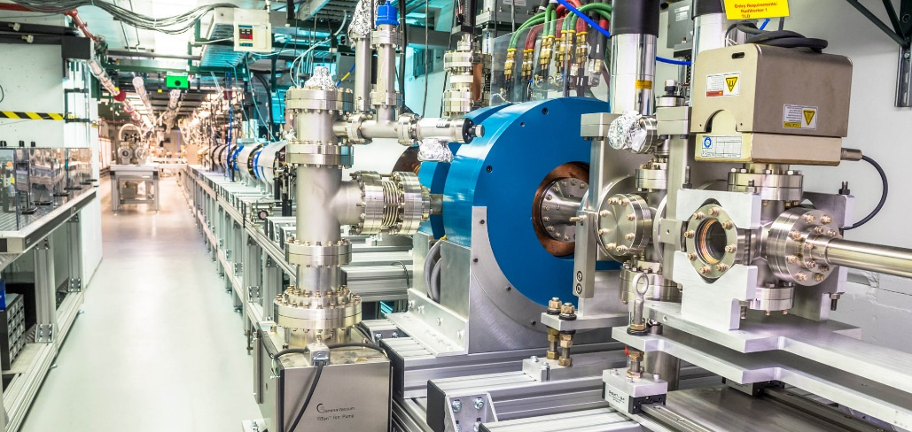
Progress Toward High-Gradient Structure Wakefield Accelerators
at the
Argonne Wakefield Accelerator
Sept 24, 2025
Argonne National Laboratory
jp@anl.gov
https://www.anl.gov/awa
John power for the Argonne Wakefield Accelerator collaboration

Slide 2
Outline
What is Structure Wakefield Acceleration?
Motivation: SWFA-based applications
Progress: SWFA recent milestones
The Argonne Wakefield Accelerator (AWA) Facility
Roadmap: keeping the progress going
2/34

Slide 3
What is swfa?
3/34

Slide 4
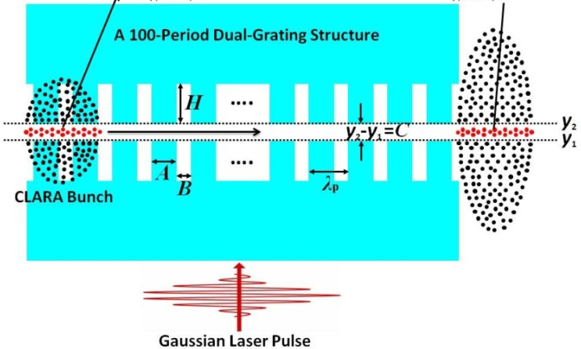
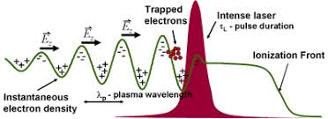
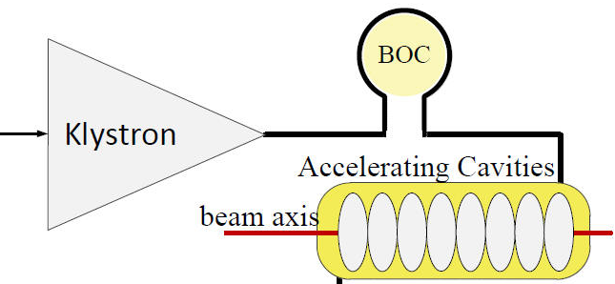
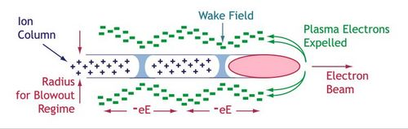
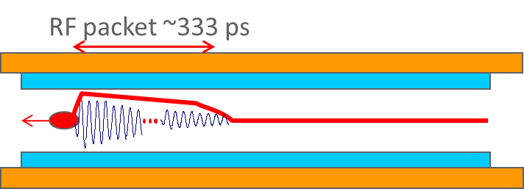
Where does Structure Wakefield Acceleration fit in?
The 4 Advanced Accelerations Concepts
LWFA
(Laser WF Accelerator)
DLA
(Dielectric Laser Accelerator)
RF Driven Structure
Laser pulse
Energy Source
PWFA
(Plasma WF Accelerator)
SWFA
(Structure WF Accelerator)
Particle beam
Medium
(structure)
Plasma
Structure
Medium
Energy source
(Drive beam)
OVERLAP 2
OVERLAP 1
4/34

Slide 5
Structure Wakefield Acceleration (SFWA)
Beam-Structure Interaction (Drive beam + Main beam)
Collinear Wakefield Acceleration (CWA)
Two Beam Acceleration (TBA) – like CLIC
PWFA-like
Klystron-like
main beam
MB
main beam
Accelerator
drive beam
drive beam
(train)
Power Extraction and Transfer Structure (PETS)
DB
A. Zholents et al, “A high repetition rate millimeter wavelength accelerator for an X-ray free-electron laser”, 2025 JINST 20 P01023
W. Gai, J.G. Power, and C. Jing, “Short-pulse dielectric two-beam acceleration”, J. Plasma Phys., vol. 78, 339–345.
G. Ha, et al., “” Status of the experimental demonstration of GW power generation from THz-TBA”, WEP083, NAPAC2025 (2025)
R. Margraf-O'Neal et al., "Simulated performance of a compact water-window FEL driven by a structure wakefield accelerator", LINAC2024, THPB005
Application: Light Source
Application: High Energy Physics
5/34
M. Rosing and W. Gai, Phys. Rev. D Vol 42, No. 5 (1990)

Slide 6
Motivation →
4 examples
Future Swfa based applications
6/34

Slide 7

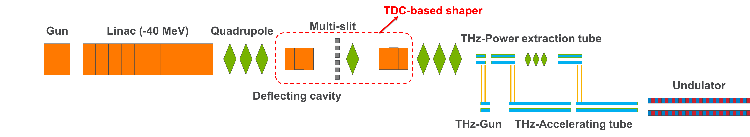



Structure wakefield acceleration: TBA
Two Beam Acceleration
EUV light source
400 MeV
THz-TBA accelerator
Radiation Generation
THz PET (~4GW)
1 m
2 m
THz Power Extraction Tube
Undulator
hν
THz Gun
THz Accelerating Tube
THz Acc (700 MV/m)
EUV/Soft-Xray
400 GHz SWFA linac
G. Ha, et al., TUPL057, IPAC2023 (2023)
7/34

Slide 8
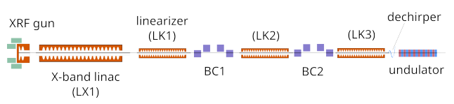
Structure wakefield acceleration: TBA
Two Beam Acceleration
Compact water-window FEL
1 GeV
50 m
hν
SWFA X-band and K-band linac
  1 GeV, high brightness
to drive an FEL
  water-window regime [2,4] nm
  Energy/pulse [100, 300] μJ
  Short [10’s of fs]
  High-power (GW-scale)
P. Piot, “Design of a Water-Window Free-Electron Laser Using the Two-Beam Acceleration Scheme”, THURS. 16:40 - 17:00, Bonaparte 2 (Hotel Hermitage)
R. Margraf-O'Neal et al., "Simulated performance of a compact water-window FEL driven by a structure wakefield accelerator", in Proc. LINAC2024, Chicago, IL, USA, Aug. 2024, pp. 637-640. doi:10.18429/JACoW-LINAC2024-THPB005
8/34

Slide 9
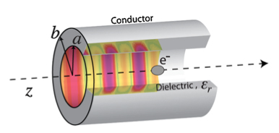
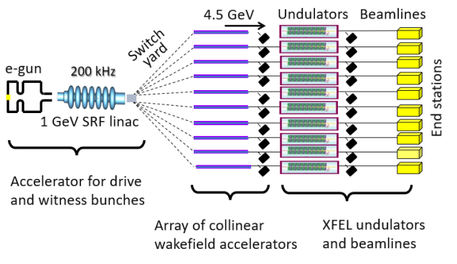
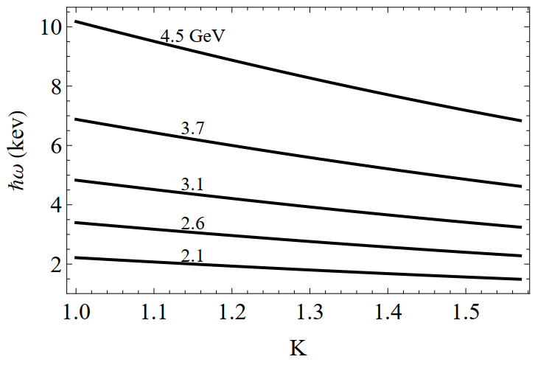
Structure wakefield acceleration: CWA
Collinear Wakefield Acceleration
High repetition rate multi-user X-ray FEL facility
drive beam
4.5 GeV
10 Beamlines
Independently tunable
Repetition rate of up to 20 kHz
X-ray spectrum:1.5 keV to 10.2 keV
A-STAR
main beam
A. Zholents et al, “A high repetition rate millimeter wavelength accelerator for an X-ray free-electron laser”, 2025 JINST 20 P01023
Photon energy ℏ𝜔 versus undulator parameter 𝐾 calculated for an undulator with a period of 12.6 mm and different beam energies shown above the lines.
Notes:
A-STAR, an acronym for Argonne Sub-Terahertz Accelerator.

Slide 10
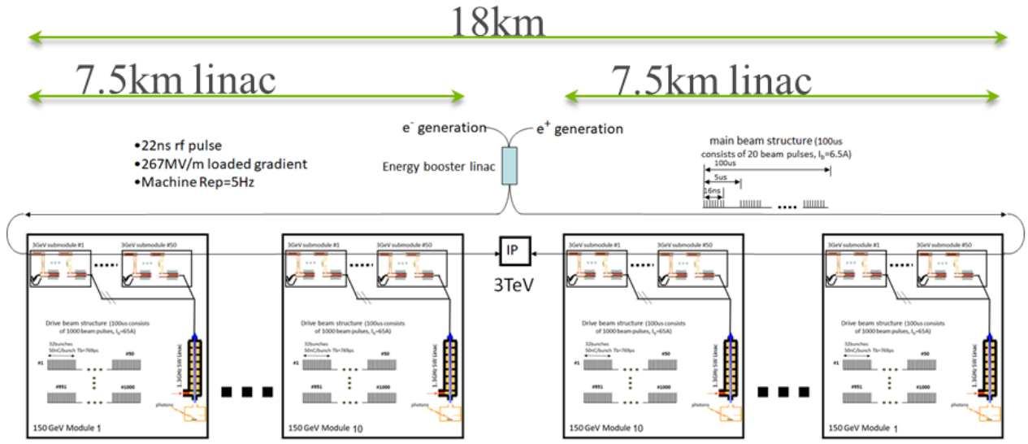
Structure wakefield acceleration: TBA
Two Beam Acceleration
Linear Collider
2013 P5. 3 TeV Linear Collider concept.
  High Power ~1 GW
  320 MV/m unloaded gradient
  267 MV/m loaded gradient
  200 MeV/m real estate gradient
2023 P5. 10 TeV Linear Collider concept.
  500 MeV/m real estate gradient
?
1.5 TeV (x2)
Argonne Flexible linear collider
W. Gai, J.G. Power, and C. Jing,
J. Plasma Phys., vol. 78, 339–345.
  Modular design
  (easily staged)
    e⁺ e⁻ 267 MeV/m of loaded gradient
    (200 MeV/m effective gradient)
10/34
Notes:
1,500,000 MeV/7500m = 200 MeV/m

Slide 11
The awa facility
11/34

Slide 12



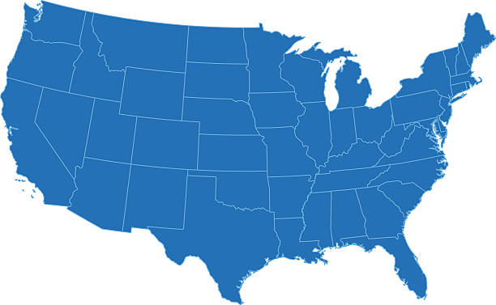




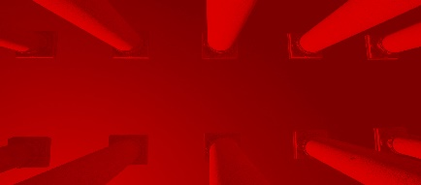






Network of American beam test facilities
Experimental demonstration of emerging accelerator science
FAST/IOTA
https://lasernetus.org/
Particle Beam
FACET-II
AWA
BELLA
https://www.beamnetus.org/
ELL
ATF
UT³
Laser Beam
U.S. advanced and novel accelerator beam test facilities
[C. Clarke et al 2022 JINST 17 T05009, https://iopscience.iop.org/article/10.1088/1748-0221/17/05/T05009 ]
National Laboratories
Universities
12/34

Slide 13
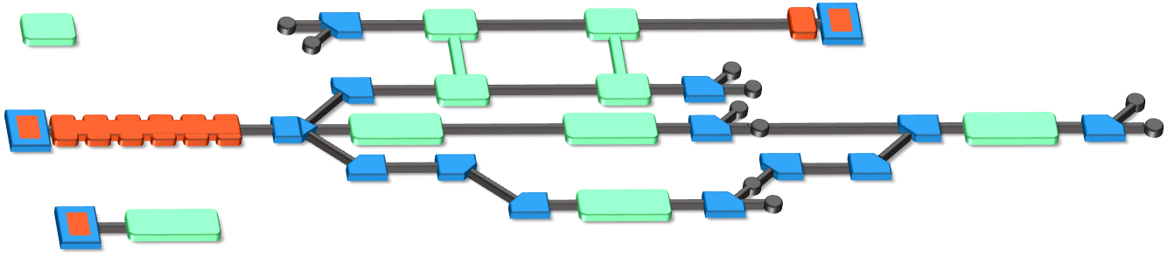
The Argonne Wakefield Accelerator (AWA) Facility
Beam Test Facility to enable novel acceleration
Witness RF photoinjector (15 MeV)
Provides two-beam capability
Bright beams for low-energy experiments
Drive RF Photoinjector (65 MeV)
  single bunch: 100nC
  bunch train: 600 nC
Experimental Switchyard
Highly reconfigurable
6D phase space manipulation
Laser
Photoinjector laser
100 mJ (800nm), 10 mJ (262nm),
300 fs – 6 ps (UV)
temporal shaping
Diagnostic laser
81.25 MHz (1550 nm)
Argonne Cathode Test Stand (2-4 MeV)
Cathode research and diagnostics
Physics of high-gradient breakdown
https://www.anl.gov/awa
13/34

Slide 14
Progress in short-pulse swfa
milestones
achieved
14/34

Slide 15
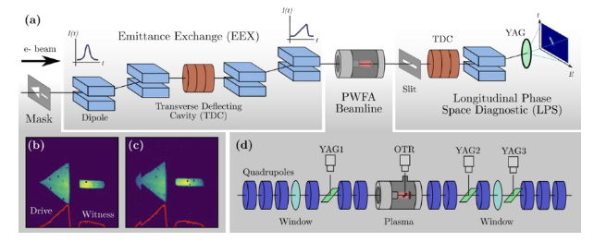
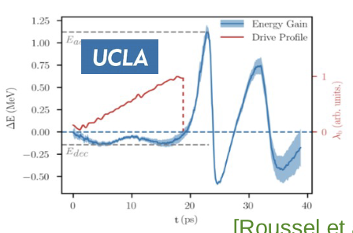
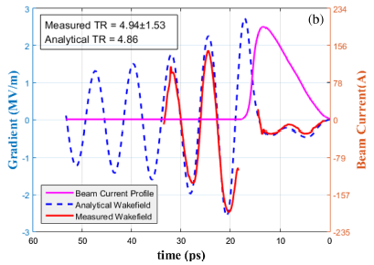

Milestone: CWA
demonstration of >5 transformer ratios
$$R=\frac{E_{acc}}{E_{dec}}$$
The transformer ratio relates to efficiency
To achieve R>2 → bunch shaping
Shaping with an emittance-exchange (EEX) beamline
Two experiments demonstrated R>2:
  PWFA using a plasma R~7
  SWFA using a structure R~6
High R with shaped beams
PWFA SWFA
R. Roussel et al. PRL (2020]
Q. Gao, et al, PRL (2018)
15/34

Slide 16
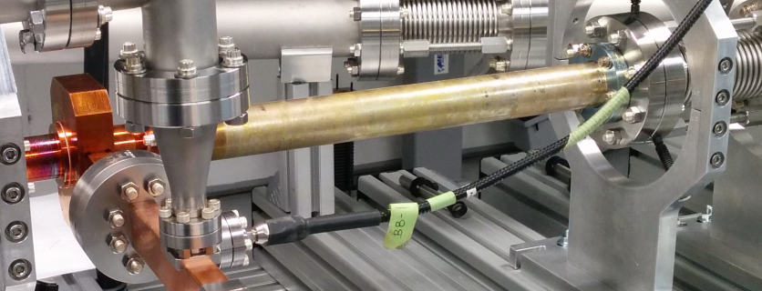
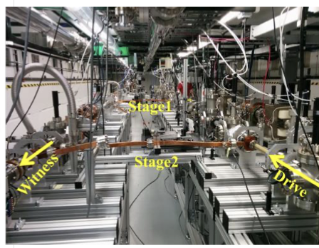
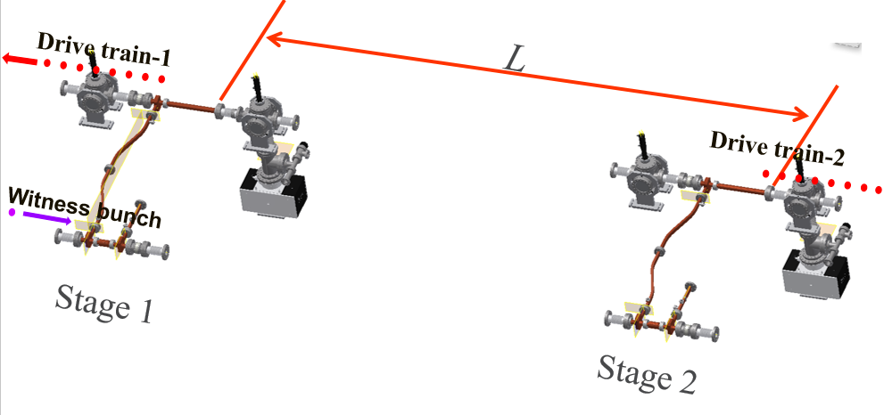
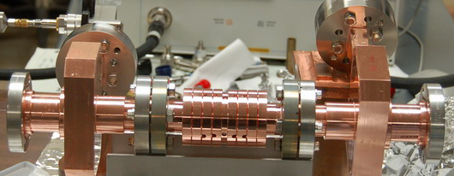
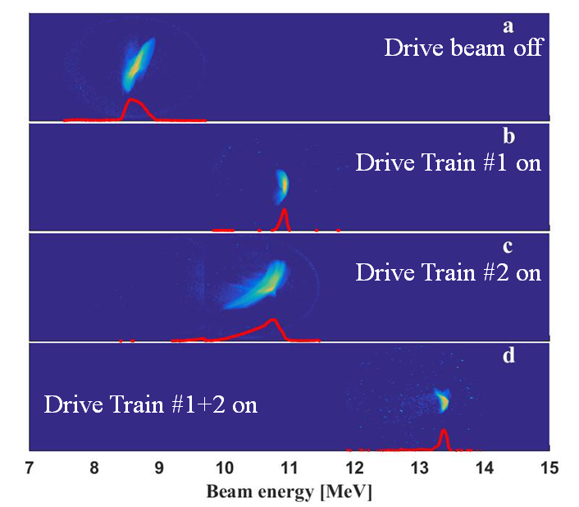
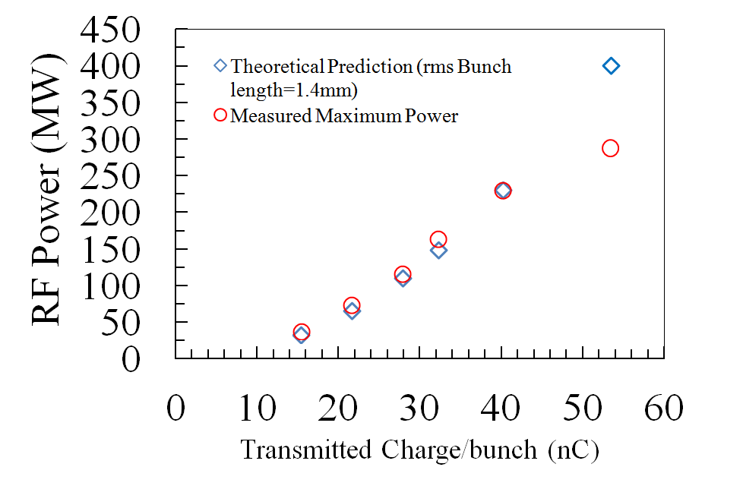
Milestone: TBA
X-band 11.7 GHz structures
Staging of acceleration
Demonstration (simplified) two-stage SWFA
Scalable to any number of accelerating module
power extractor
accelerator
70 MeV/m
acceleration in each stage
300 MW, 150 MeV/m
acceleration single stage
C. Jing, et al, Nucl. Instrum. Meth. A., 898, 72-76 (2018)
16/34

Slide 17
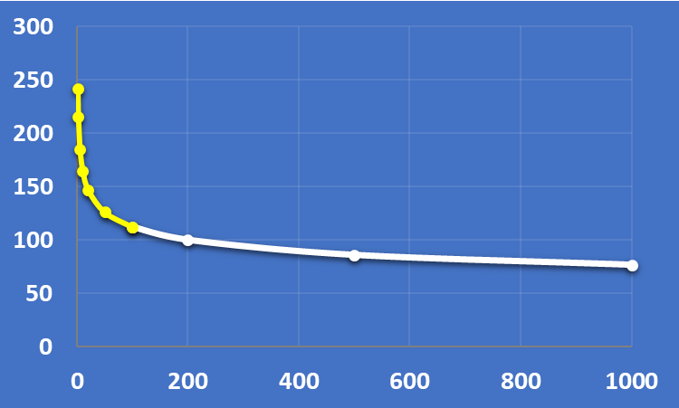
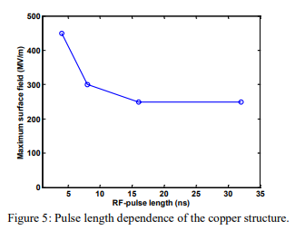



Why Short Pulse RF? (Part I): TBA
3e−7 breakdowns/pulse/m, 100 MV/m, 200ns
0.1 μs
1 μs
Motivation #1:
the CLIC scaling law
explored
long pulse regime
$$E (\frac{MV}{m})$$
$$BDR∝E^{30}τ^{5}$$
unexplored
RF pulse length
BreakDown Rate
Accelerating field
τ
$$(ns)$$
Short
Pulse
Regime
CLIC 2003
S. Doebert et al.,PAC’05
A. Grudiev, S. Calatroni, and W. Wuensch, Phys. Rev. ST Accel. Beams 12,102001 (2009)
W. Wuensch, et al., “A demonstration of high-gradient acceleration”, PAC’03
*W. L. Millar, et al, “High-Power Test of Two Prototype X-Band Accelerating Structures Based on SwissFEL Fabrication Technology, IEEE Tran. NS, 70, 1, (2023),1-19.
17/34

Slide 18



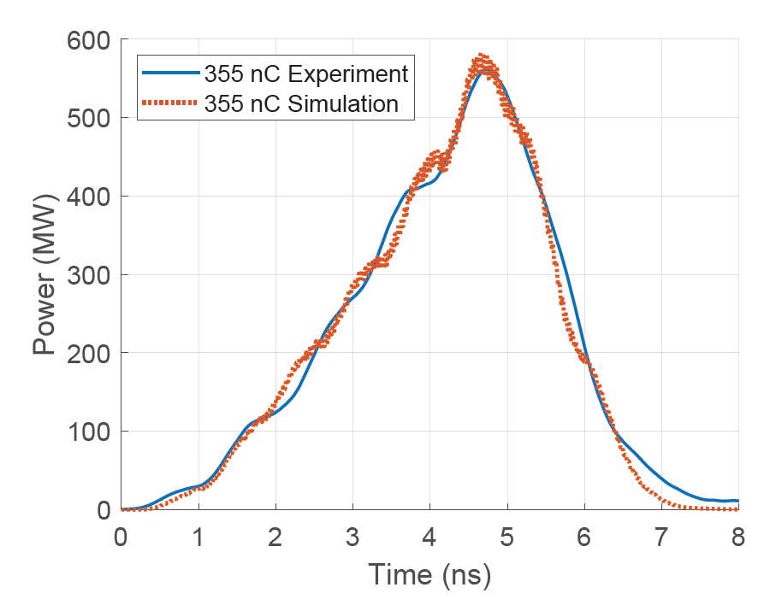
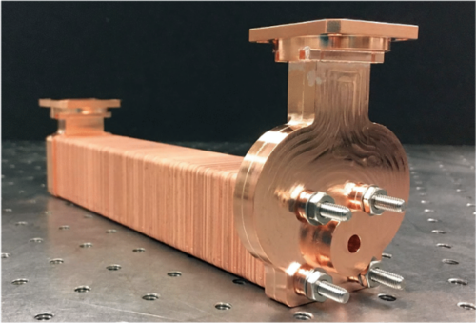
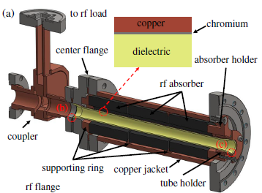
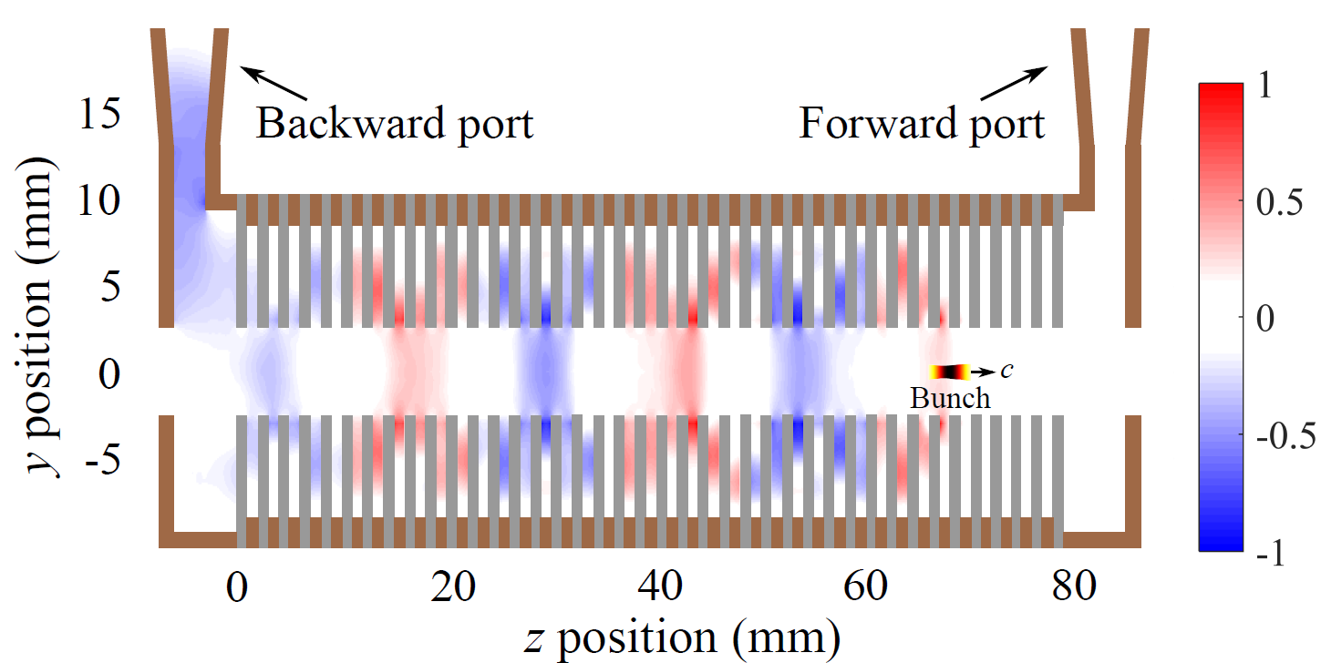
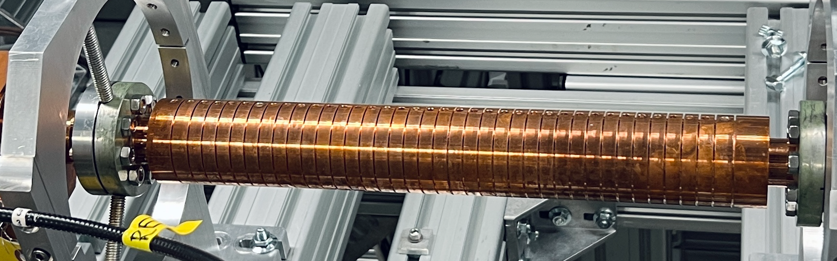
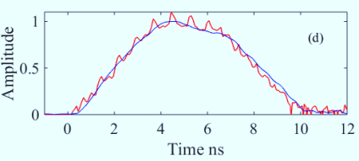
Milestone: TBA
High Power RF
MTM X-band PETS (565 MW)
Dielectric X-band PETS (200 MW)
DOI: 10.1103/PhysRevAccelBeams.23.011301
  Highest peak power as 565 MW from a train of eight bunches with a total charge of 355 nC
J. Picard et al., PRAB 25, 051301 (2022)
1000 MW
900 MW
800 MW
700 MW
600 MW
500 MW
400 MW
300 MW
200 MW
100 MW
0 MW
Target: GW
AWA energy upgrade
15 MeV → 65 MeV
X-band MTM (2021)
Metallic X-band PETS (400 MW)
X-band metallic (2020)
X-band MTM (2019)
C-band
dielectric
(2008)
X-band metallic (2018)
C-band
dielectric
(2000)
X-band dielectric (2018)
K-band dielectric (2010)
18/34
J. Shao et. al., https://accelconf.web.cern.ch/ipac2019/papers/MOPRB069.pdf
2000 2005 2010 2015 2020 2025

Slide 19
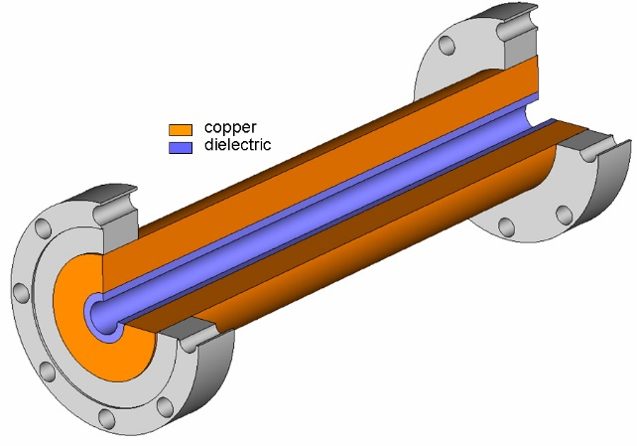
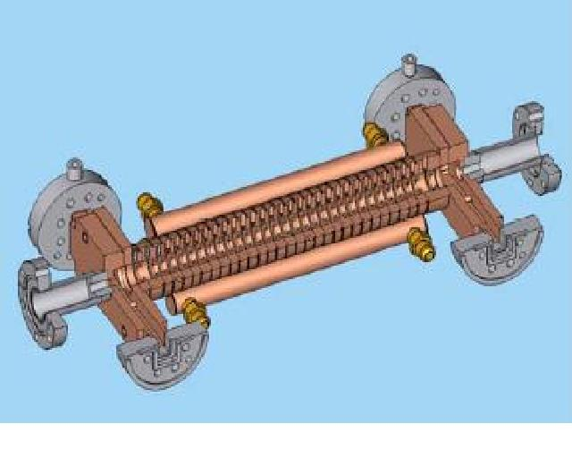
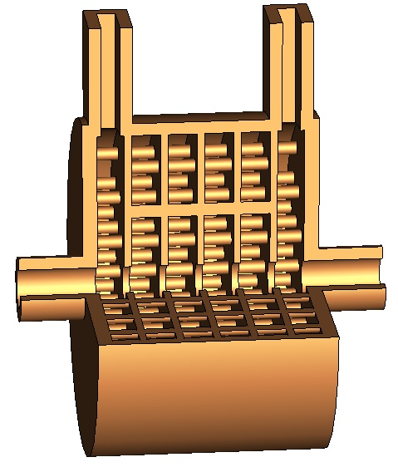
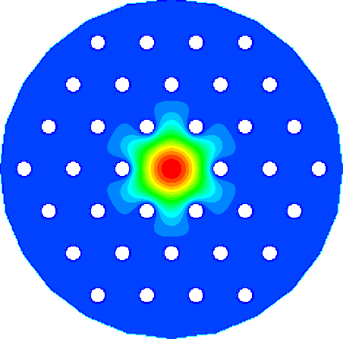
Milestone: TBA
High fields
Novel accelerating structures
Evolution of peak field in structures
over the last two decades at AWA
Dielectric
Iris loaded
400 MV/m
350 MV/m
300 MV/m
250 MV/m
200 MV/m
150 MV/m
100 MV/m
50 MV/m
0 MV/m
AWA energy upgrade
15 MeV → 65 MeV
X-band PC Gun (2021)
X-band metallic (2021)
X-band MTM (2023)
Photonic Band Gap
Metamaterial
X-band metallic (2018)
C-band TBA
DLA (2008)
W-band CWA metallic (2015)
X-band TBA DDA (2022)
C-band TBA
DLA (2000)
C-band CWA
PBG (2009)
K-band TBA DLA (2018)
2000 2005 2010 2015 2020 2025
Demonstrated accelerating fields:
~300 MV/m in accelerating structures (~500 MV/m surface field)
~400 MV/m in RF gun (~600 MV/m surface field)
Current work includes
Design and testing of new structures
Fundamental studies on high fields
19/34

Slide 20
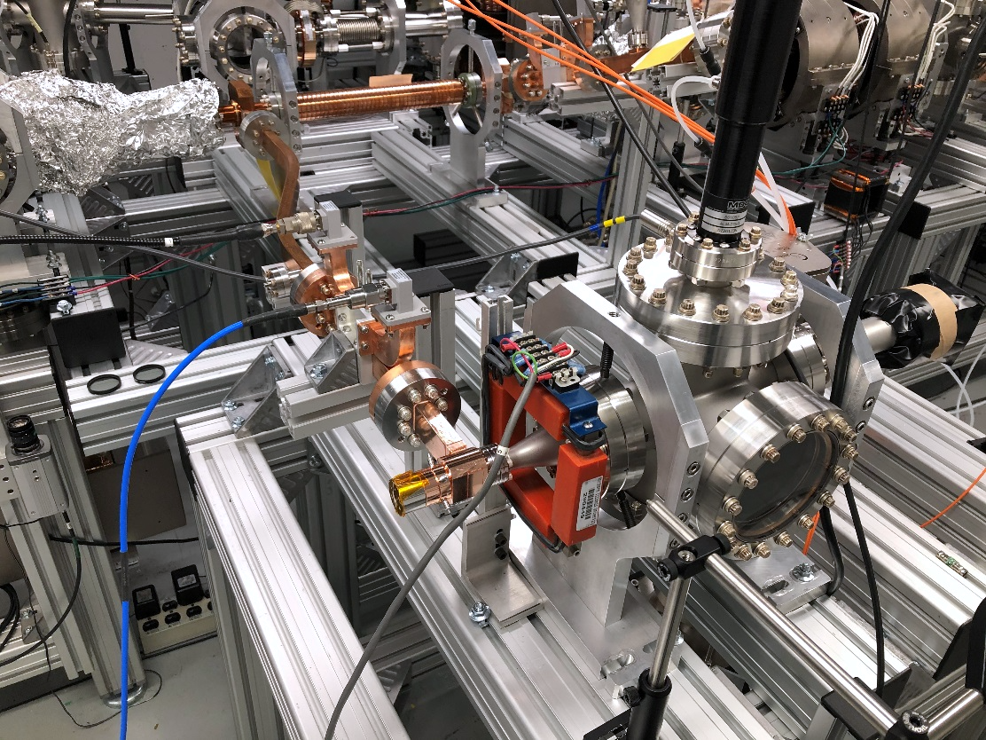
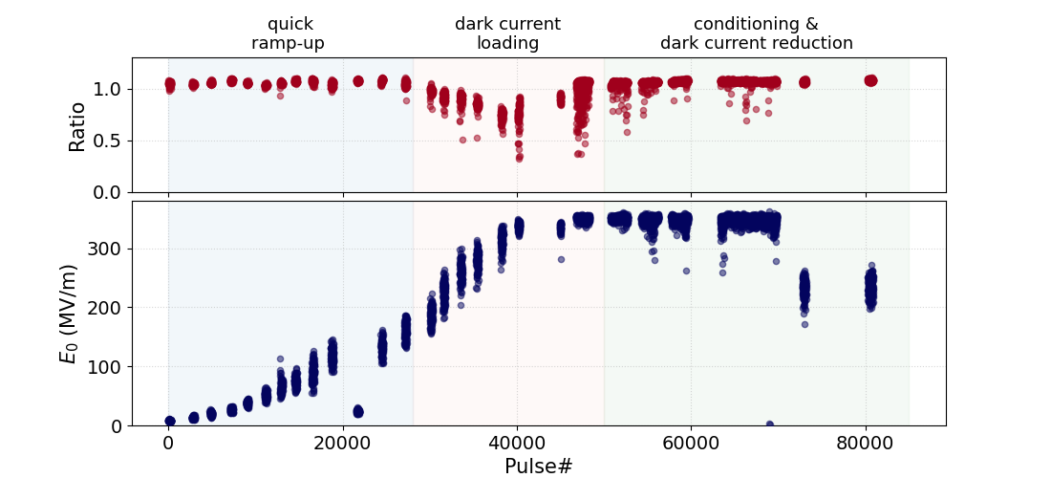
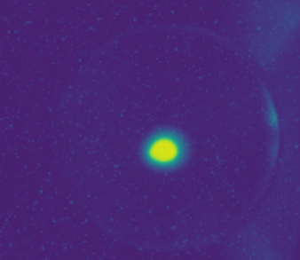
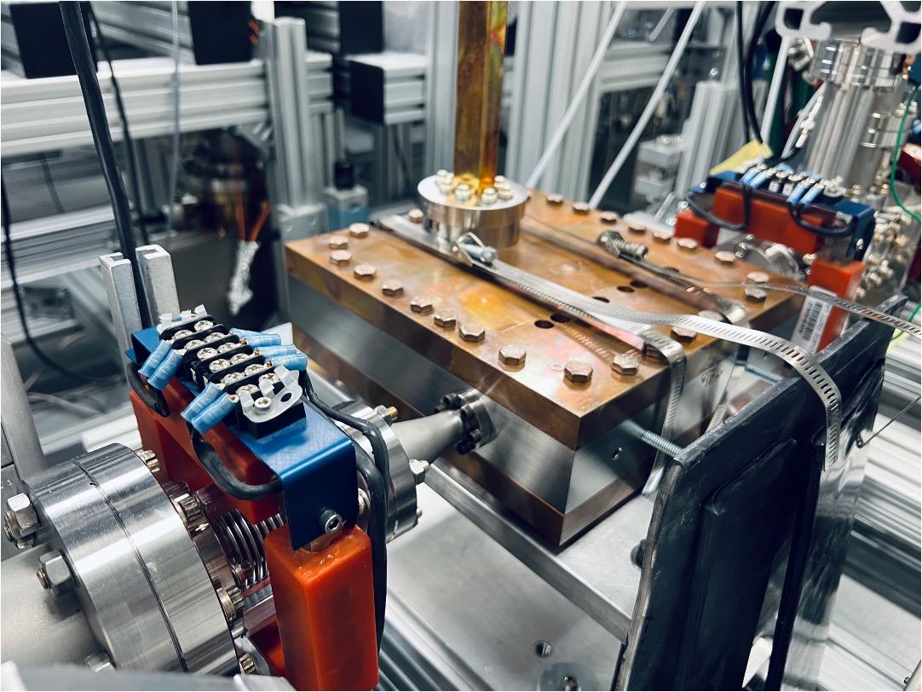
Milestone: TBA
Photoemission from a high-field RF gun
HIGH-GRADIENT & LOW DARK CURRENT
Fast RF conditioning (70,000 pulses)
Xgun conditioning
test stand
Faraday cup & YAG
RF
Xgun
FIRST BEAM FROM PHOTOCATHODE GUN
Gun milestones
0.4 GV/m on photocathode, 0.6 GV/m surface
BDR ~4e-6 (estimated)
Ultra low dark current (<1pC per RF pulse)
~3 MeV
387 MV/m
(confirmed)
LINAC
~6 MeV
Boosted with linac
J. Shao et. al., 10.1103/PhysRevLett.115.264802
W.H.Tan et. al., Phys. Rev. Accel. Beams 25, 083402, August 2022 (2022)
20/34

Slide 21
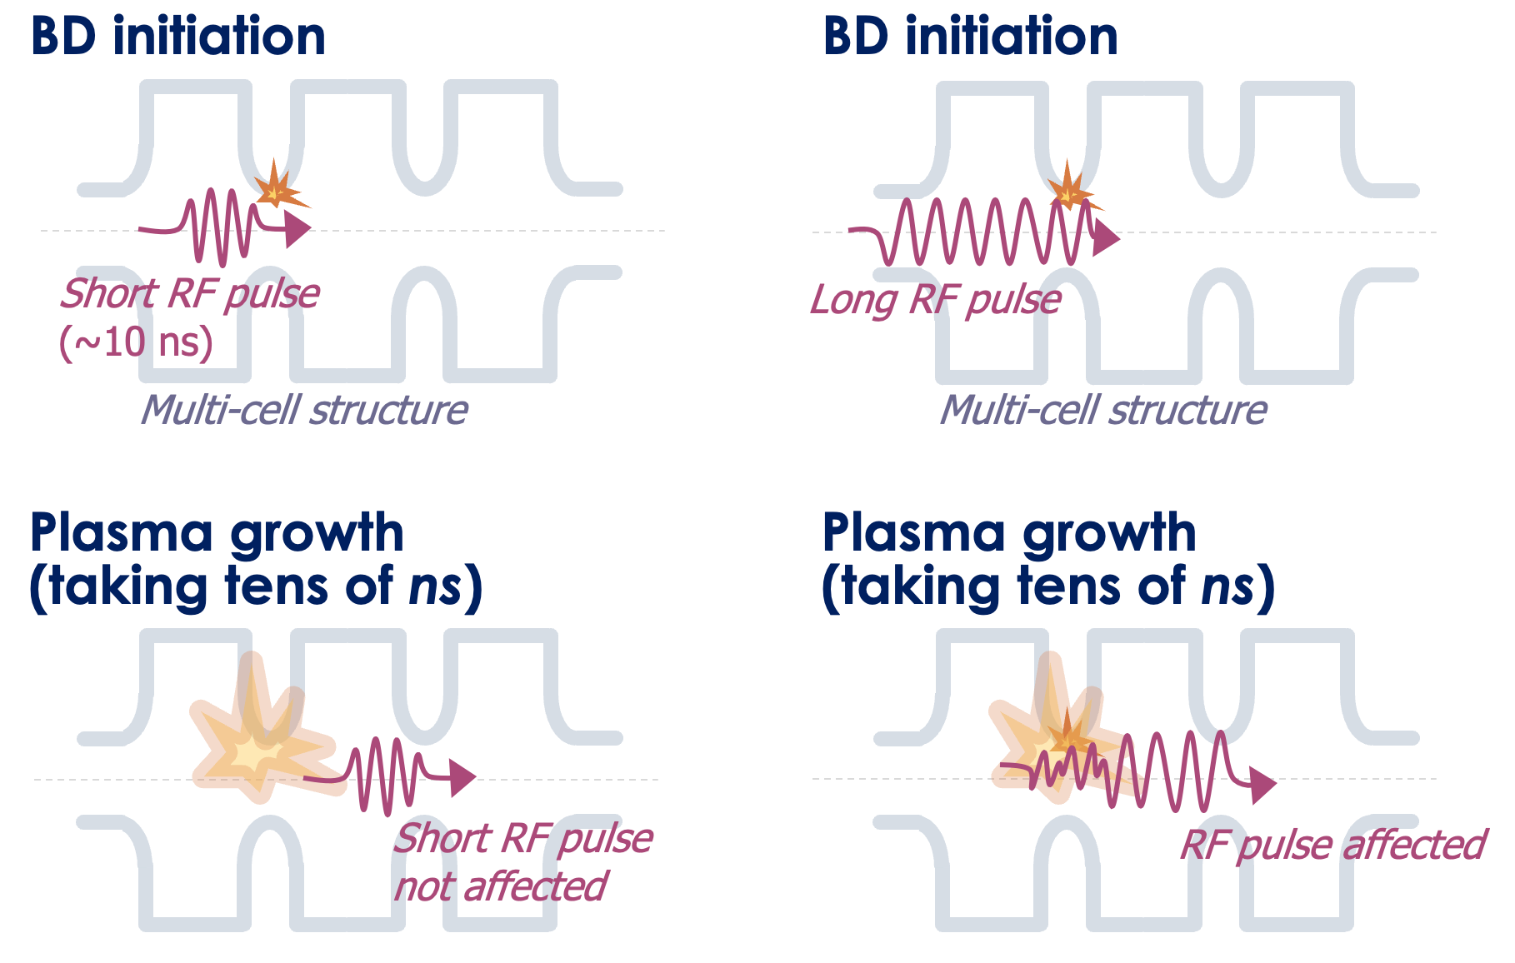

Why Short Pulse RF? (Part II)
BDR vs. pulse length doesn’t follow the CLIC empirical scaling law in the short-pulse regime
(τ ~<15 ns)
Motivation #2:
beyond the CLIC scaling law (<15ns)
Breakdown insensitive acc. regime (hypothesis):
(BIAR)
E_{a}τ_{p}^{1/6} =Const.
Short Pulse vs. Long Pulse
$${(\frac{54 ns}{6 ns})}^{1/6}$$
If BD initiates plasma, the short RF pulse may transmit through the structure and remain largely unaffected [1, 2]
21/34
[1] J. Shao et al., IPAC2022, doi: 10.18429/JACOW-IPAC2022-FROXSP2.
[2] D. Merenich et al., Phys. Rev. Accel. Beams, vol. 27, no. 4, p. 041301, Apr. 2024

Slide 22
SWFA roadmap
22/34

Slide 23
SWFA Roadmap
How do we get from HERE to a linear collider?
Fundamental R&D
Demonstrated 2025
Simplified staging
>5 transformer ratio
0.4 GV/m field
BIAR regime
Technology Demonstrators
Integration (2026-2030)
100 MeV high brightness injector
500 MeV demonstrator
Applications
Applications (>2030)
1 GeV WW-FEL
5 GeV Multiuser XFEL
10 GeV Hard X-ray FEL
380 GeV High Factory
10 TeV linear collider
23/34

Slide 24
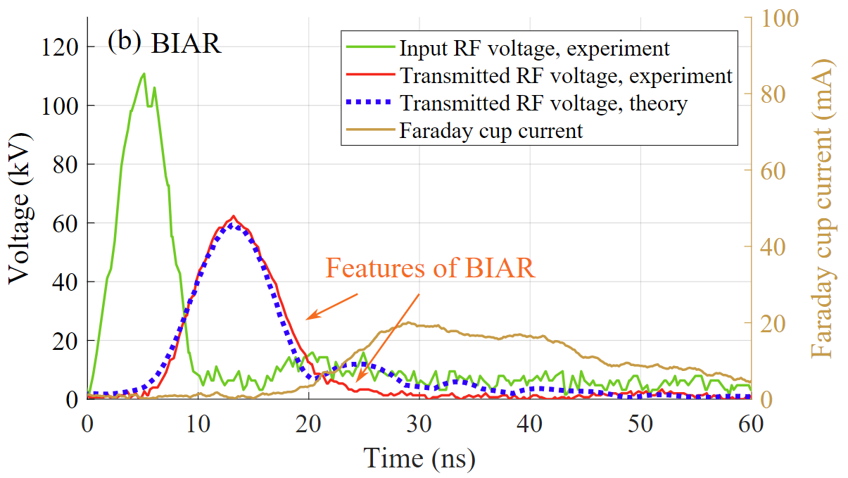
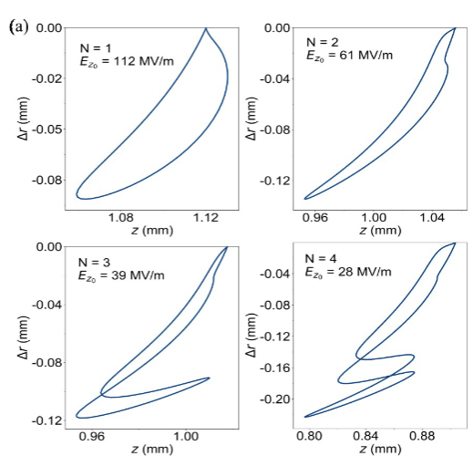
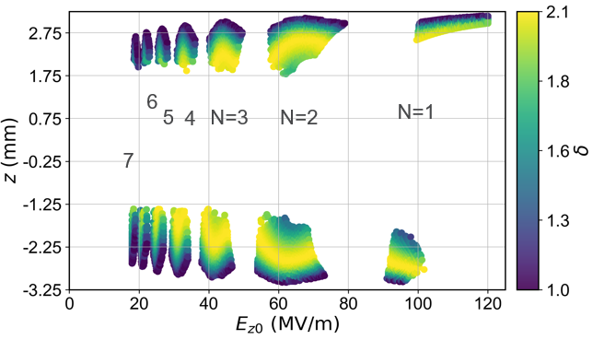

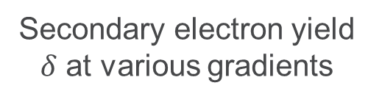
Moving forward:
Fundamental R&D
PI: Xueying Lu (NIU/ANL)
Example: MTM studies
Dark current, multipactor, and breakdown in the short-pulse regime
Dark current / mutlipactor
Breakdown Insensitive Acceleration Regime (BIAR)
Analytical
Simulations
Secondary electron yield $δ$ at various gradients
Multipacting resonances
BIAR breakdown
Primary pulse not interrupted
Secondary pulse not present
Number of multipacting electrons
24/34
D. Merenich et al., Phys. Rev. Accel. Beams, vol. 27, no. 4, p. 041301, Apr. 2024

Slide 25
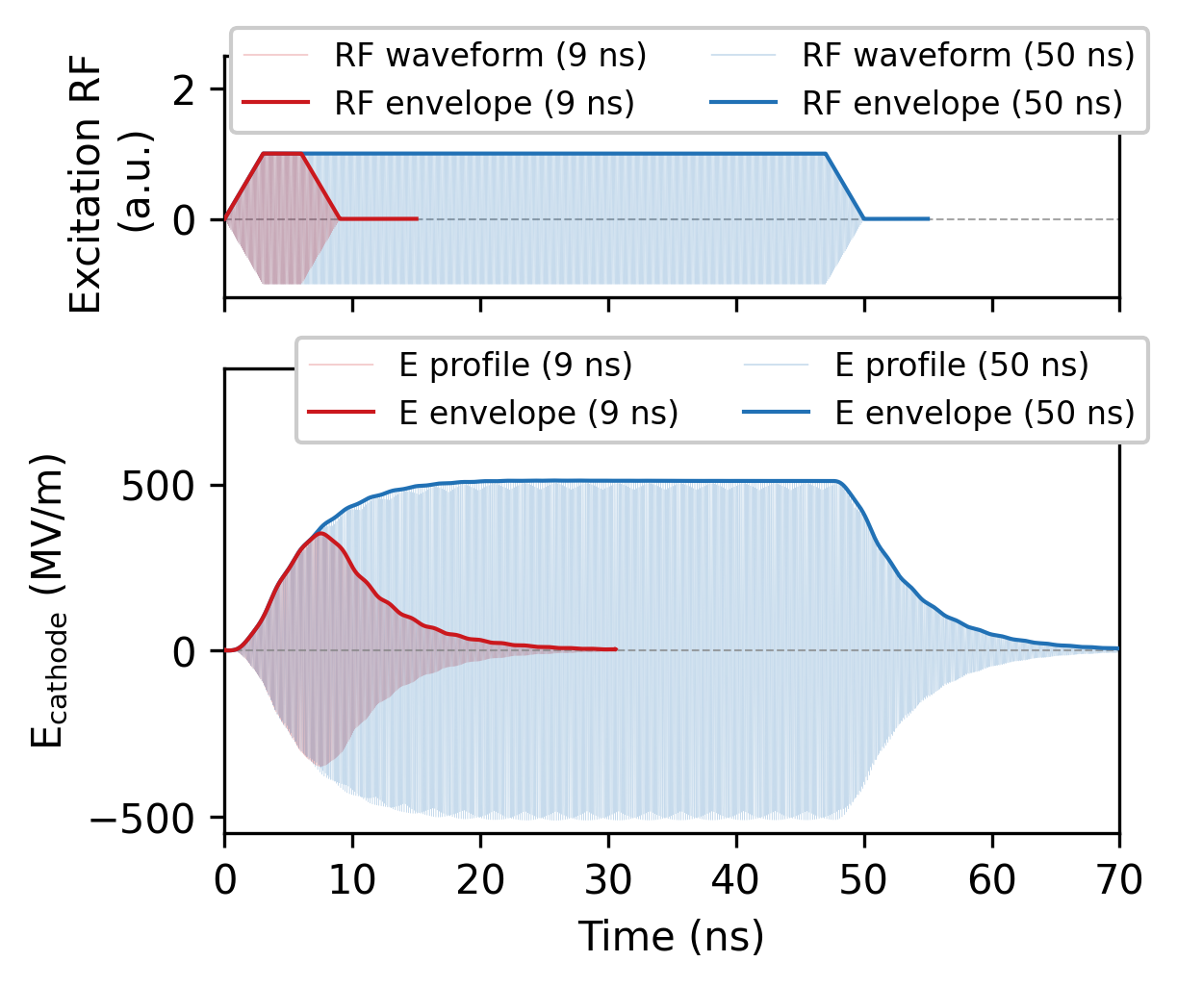
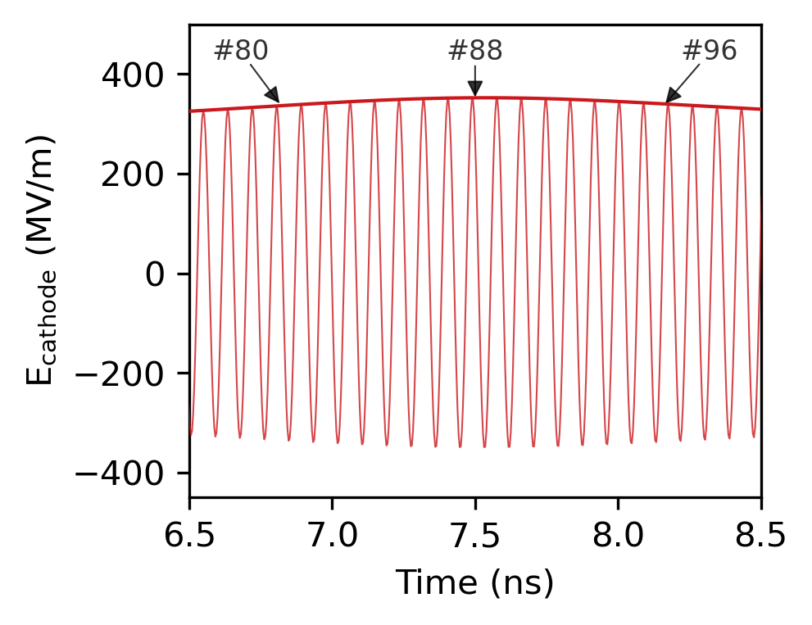
Moving forward:
Fundamental R&D
PI: Gongxiaohui Chen
Beam dynamics in the Transient Regime in the short-pulse regime
Zoom-in around the mostly filled region
(peak)
350 MV/m @ ~7.6 ns
Zoom here
If driven by 9 ns pulse, Xgun is under-filled and staying in the transient state during the full RF duration.
E-field on cathode is changing cycle by cycle.
Broad high-gradient operational window.
G. Chen, et al.,: arXiv:2503.09575. doi: 10.48550/arXiv.2503.09575.
25/34

Slide 26
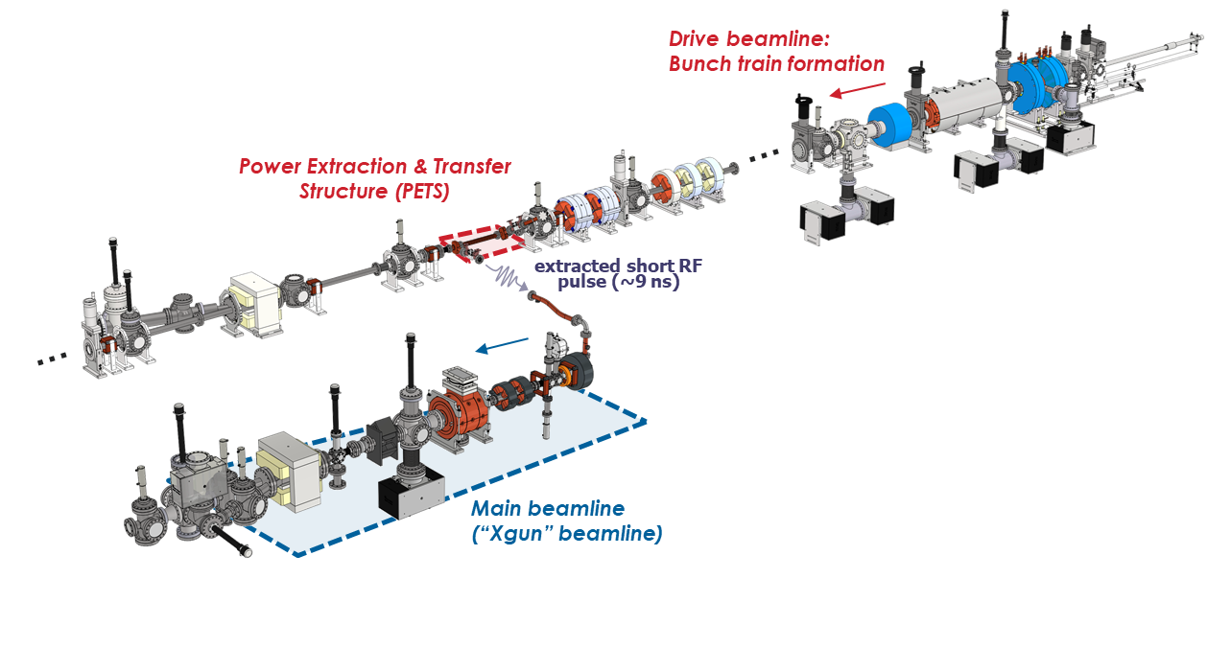


Moving forward:
Technology Demonstrators
PI: Gongxiaohui Chen
(Near term ~5 years)
Injector: 100-MeV, 100 pC, 100 nm
Gun milestones demonstrated
0.4 GV/m on photocathode, 0.6 GV/m surface
BDR ~4e-6 (estimated)
Ultra low dark current (<1pC per RF pulse)
2025-27
2028-31
Acceleration to
10 MeV
Acceleration to
100 MeV
3 MeV
new Xgun design with removable cathode stalk
Add booster linac
Local emittance compensation
Beam characterization
Design of “shovel-ready” 100 MeV injector
Add staging to 100 MeV
Characterize bright electron beam
26/34

Slide 27







Technology Demonstrators
Moving forward:
0.5 GeV demonstrator
Demonstrate key technologies of SWFA based linear collider
Fits into AWA’s existing bunker
70 MeV drive beam decelerated to ~20 MeV
15 MeV main beam Accelerated to ~500 MeV
Pulser off
Pulser on
Critical Technology Elements
GW power level
300MV/m gradient
Full staging (drive beam distribution)
Fast kicker
27/34

Slide 28








Moving forward:
Applications
Light Source: 400 MeV EUV light source
THz PET (~4GW)
Gun
Linac (~40 MeV)
QMs
THz Power Extraction Tube
G. Ha, et al., TUPL057, IPAC2023 (2023)
Led by an International collaboration
Power Transfer
Drive beam source
(20 nC, 40 MeV)
Undulator
THz Gun
THz Accelerating Tube
Structure Fabrication
THz Acc (700 MV/m)
200 GHz
Die-stamping
Preparation toward GW Power Generation
200 GHz
~10 MV/m/nC
400 GHz
Lithography
400 GHz Compatible drive bunch train (1 nC/bunch)
Later will be 16 bunches
Horn antenna with OAP will extract the power
H. Kong, et al., Scientific Reports 13, 3207 (2023)
28/34
G. Ha, et al., WEP083, NAPAC2025 (2025)

Slide 29


Moving forward:
Applications
Light Source: 1 GeV WW-FEL
Brightness from the injector
B_{5d}~3x10¹⁴ A/m²
200 MeV
400 MeV
1 GeV
150 MV/m Ka band
250 MV/m X-band linacs
250 MV/m X-band linacs
P. Piot, “Design of a Water-Window Free-Electron Laser Using the Two-Beam Acceleration Scheme”, THURS. 16:40 - 17:00, Bonaparte 2 (Hotel Hermitage)
400 MV/m X-band gun
29/34

Slide 30





Moving forward:
Applications
PI: Branko Popovic
A CWA-based High repetition rate multi-user X-ray FEL facility
A-STAR
NEXT GOAL: CONTINUE MOVING TOWARDS A CWA MODULE
Accelerator Module
Vacuum chamber
0.22 m
0.5 m
182 GHz Corrugated Waveguide
Demonstrated
Fabricated 182 GHz CWA
Measured beam wakes
Water in and out channels.

Slide 31


Moving forward:
Applications
  10 TeV Wakefield Collider Design Study
linear colliders
SWFA
Strawman Design (2013)
18 km
PWFA
    3 TeV e⁺ e⁻ linear collider
LWFA
S. Gessner et al., “Design Initiative for a 10 TeV pCM Wakefield Collider”, https://arxiv.org/abs/2503.20214
How can SWFA contribute?
All SWFA
Hybrid SWFA-PWFA
Injector for L/PWFA
    320 MV/m unloaded gradient
    267 MV/m loaded gradient
    200 MeV/m real estate gradient
31/34

Slide 32


Moving forward:
Applications
SWFA e⁺ e⁻ linear collider options
A Linear Collider Vision for the Future of Particle Physics (CERN)
https://arxiv.org/abs/2503.19983
Global Collider Roadmap
ILC (Japan): 250 GeV – 1 TeV (SRF, 31.5 MeV/m).
CLIC (CERN): up to 3 TeV (NCRF, ~100 MeV/m).
Plasma/Structure-Wakefield Colliders: long-term R&D for 10 TeV+.
1. Fully SWFA-Based Linear Collider.
2. Hybrid SWFA – L/PWFA Linear Collider.
3. SWFA-Based Injector into Plasma (L/PWFA) Linear Collider. (Bubble 30/100 μm ↔ Frequency 3-10 THz)
X. Lu et al., "RF acceleration with short pulses: Breaking the high-gradient barrier," in Proc. 16th Int. Particle Accelerator Conf. (IPAC'25), Taipei, Taiwan, 2025, doi: 10.18429/JACoW-IPAC2025-MOYD3.
32/34

Slide 33



Moving forward:
Applications
Can SWFA achieve 500MeV/m of geographical gradient?
535 MV/m
180 MV/m
Ka-band structure
Developing X-band short-pulse structure
$$\frac{R}{Q}=\frac{{\left(E_{a}L\right)}^{2}}{ωU}$$
$$U=\frac{P}{V_{g}}$$
1. f = 11.7*3 = 35.1 GHz
2. Scale (R/Q and Vg are the same)
3. Given P=1.2GW. then gradient=764 MV/m.
4. Given fill factor is 0.7, then geographical gradient will be 535MeV/m.
Challenge: Small aperture. (ref. CLIC 30GHz has aperture 2.4mm~3.2mm.)
Scale x3
Structure Parameters | Designed Values
Freq. | 11.7 GHz
Filling time | 6 ns
Structure length | 30 cm
Input Power | 600 MW
Gradient | 180 MV/m
Ka-band PETS
1200 MW
Scale 11.7*3=35.1GHz, If P=1.2GW, then Q=16.7nC/bunch (assuming F~1). Challenge: Small aperture only 17.6mm/3=5.9mm.
G. Andonian, “Higher order modes in accelerating structures for flat beams”, WED., 12:00 - 12:30,
B. Higuera-Gonzalez, Proposal to control BBU instability in SWFA by using adjustable rectangular dielectric waveguides. TUES., 17:00 - 17:20, Bonaparte 2 (Hotel Hermitage)
33/34

Slide 34





SWFA summary
Now
Demonstrated staging,
high transformer ratio
0.4 GV/m field
100-MeV bright beams
AWA w/ ongoing upgrades
0.5-GeV demo
AWA-II
Integration
Small-scale
facility
(e.g. water
window FEL)
Stepping-stone facility
Deploy technology
to supports a user facility
(e.g. XFEL)
AWA energy
upgrade
Collider applications
- Higgs-factory upgrade
- 10-TeV linear collider
Fundamental R&D
Technology Demonstrators
Applications
time
34/34

Slide 35
extras

Slide 36


Moving forward
Upgrade to AWA-II
(funding dependent)
Upgrade path
AWA: Ongoing upgrades
Quality upgrades
  Brightness. Emittance improvement by RF symmetrized gun (AWA) & RF symmetrized cavities (LBNL)
  Stability. New RF synchronization system (LBNL BACI), RF Station stability project (APS RF group)
Capabilities upgrades
  Extended Bunch shaping. (SLM based Laser shaping, TDC shaping, EEX multi-leaf Collimator, etc.)
  Machine Learning. For machine control, virtual diagnostics and physics (EPICS upgrade w/ APS Controls group)
  AWA-II: High energy version of AWA
  Drive beam 65 MeV → ~150 MeV
  Tighter focus for acceleration research
    High-quality ~1 GeV TBA demonstrator (roadmap)
    Allows SWFA to enter GV/m regime
    High beam density needed for PWFA
  Increase the size the experimental switchyard
AWA
FY21-26
current
45 ft
klystron
Control, laser, vacuum, rf, office, cathode
AWA-II
>FY26
(funding dependent)
36/34

