Slide 1

Wakefield-Based Diagnostics for High-Brightness Beams
From linac- to plasma-based FELs
Paolo Craievich and Philipp Dijkstal
7th EAAC, La Biodola Bay, Isola d’Elba (Italy), 21-27 September 2025

Slide 2
Outline
Introduction: motivations and measurements with e- streaking approach
SwissFEL: overview of the wakefield-based passive devices used for LPS reconstruction and beam manipulation
Results and capabilities
Resolution for plasma-based FELs (case study: EuPRAXIA@SPARC_LAB)

Slide 3
Motivations for high-resolution time-resolved diagnostics
Measuring the temporal properties of electron beams is of fundamental importance in particle accelerators.
Here we focus on X-ray free-electron lasers (FELs), tools that produce short pulses (fs or below) to study matter with time and spatial resolution at the atomic level.
FEL performance is determined by the electron bunch duration and the time-resolved properties of the electron beam (e.g. peak current and emittance).
Time-resolved measurements of electron and photon beams are fundamental in X-ray free-electron laser facilities, ideally with sub-femtosecond resolution.
Novel high-gradient acceleration techniques, e.g. plasma-based FELs, are characterized by short period of accelerating field and therefore naturally produce or accelerate fs long bunches (and sometime at lower charge).

Slide 4
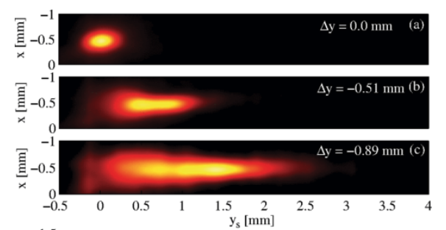
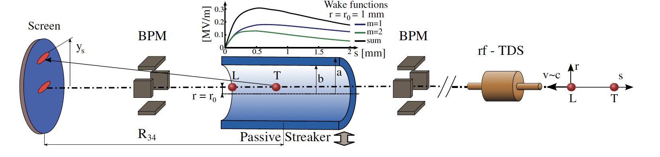
Measurement methods using transverse streaking
Streaking is the standard way to access the time-resolved properties of electron beams:
  With RF deflectors: Transverse Deflection Structure (TDS) are RF-based devices used for the manipulation and/or the diagnostics of charged particle beams to retrieve longitudinal/temporal proprieties.
sub-fs resolutions for C- and X-band TDSs:
[Rev. Sci. Instrum. 94, 043103 (2023)]
[Advanced Photonics, 2025, 7 (2): 026002]
    With dispersion: elegant but only suitable for specific FEL operation modes, showed ~ fs resolution [E. Prat et al, PRR 4, L022025, 2022]
    With wakefields (“passive” streaking): An electron beam traveling off-axis through such a device excites transverse wakefields, resulting in a non-linear time-dependent kick that streaks the electron beam, this talk.
S. Bettoni et al., PR AB 19, 021304 (2016)

Slide 5
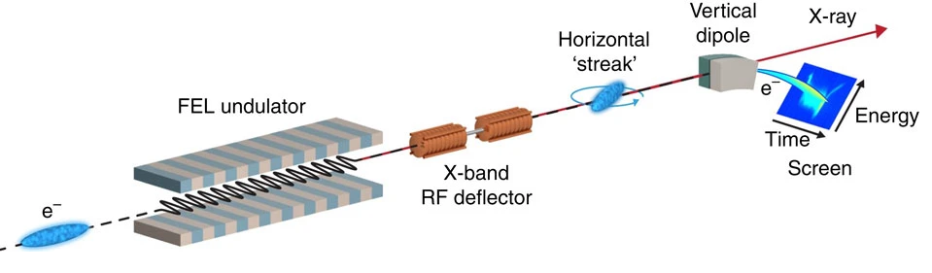
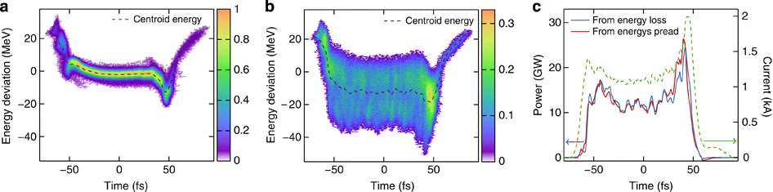
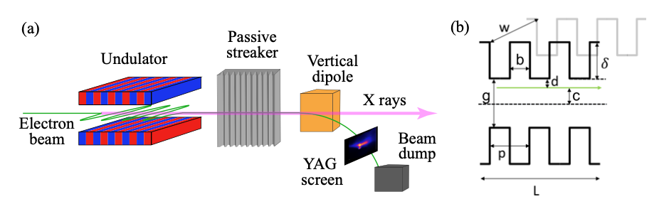
Longitudinal phase space and FEL power profile
If streaking is combined with dipole, the longitudinal phase space (LPS) can be reconstructed.
If streaking is done after the undulator (post-undulator TDS)→ FEL power profile measurement by comparing energy and energy spread between lasing on and off conditions [Ding et al, PRSTAB 14, 120701, 2011].
Images taken from [C. Behrens et al, Nat. Comm. 5, 3762 (2014)]
It was proposed for active RF TDSs, now we also applied this technique using wake-based streaking.
P. Dijkstal, Temporal FEL pulse shaping and diagnostics at SwissFEL, Ph.D. thesis, ETH Zurich, 2022.

Slide 6
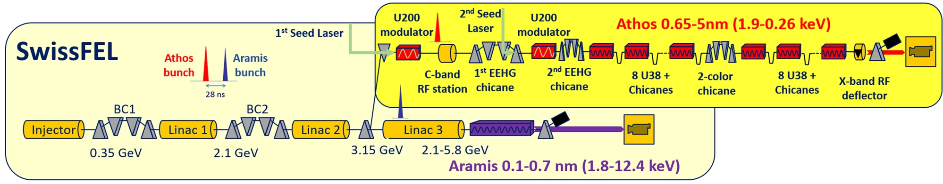
SwissFEL: overview
Main parameters:
Photon wavelength: 0.1–5 nm
Photon energy : 0.2–12 keV
Pulse duration : <1–20 fs
Electron energy : up to 6.2 GeV
Electron bunch charge: 10–200 pC
Repetition rate: 100 Hz (2-bunches)
Aramis:
Hard X-ray FEL, λ=0.1–0.7 nm
Linear polarization, in-vacuum undulators
First users 2018
up to 6.2 GeV
Athos:
Soft X-ray FEL, λ=0.65–5.0 nm
Variable polarization, Apple-X undulators
First users 2021
up to 3.4 GeV

Slide 7
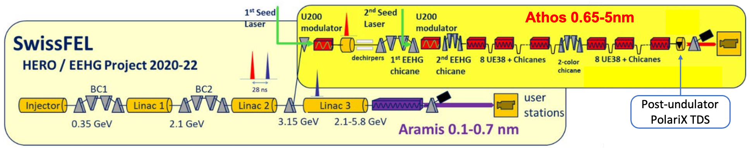

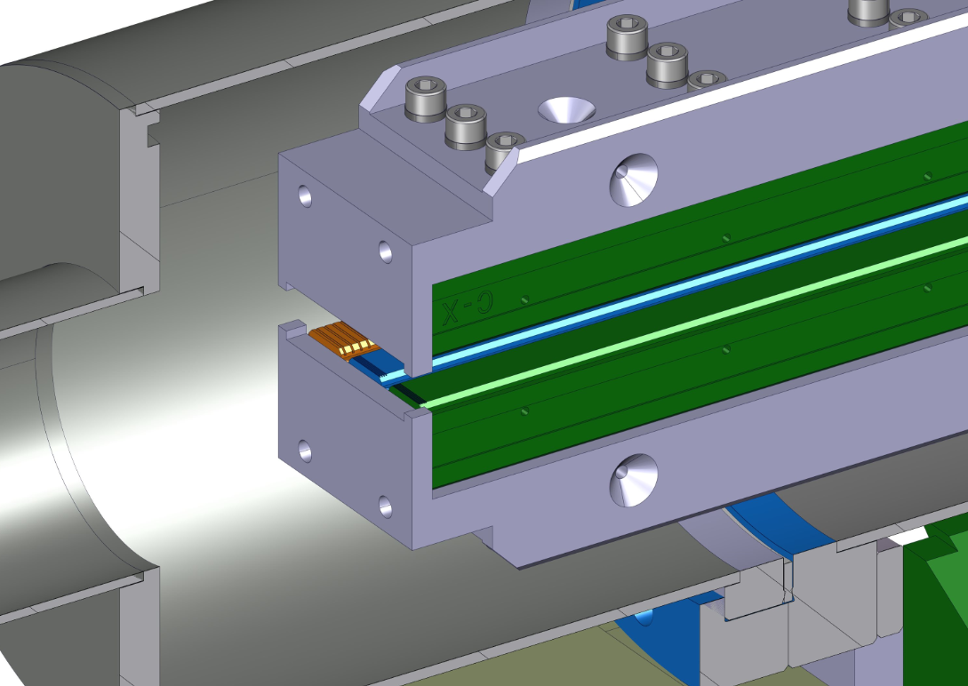
SwissFEL: Active and passive streaking systems
Beam manipulation with passive devices at the injector until 2020
Athos: 5 dechirpers (pre-undulator)
one passive device for streaking (post-undulator)
Variable polarization TDS
Advanced Beam Diagnostics with PolariX TDS: Experimental 5D phase space reconstruction at SwissFEL, F. Demurtas, this conference
2 dielectric-lined device for
beam manipulation.
2 passive device for streaking (post-undulator)
Controlling FEL bandwidth at SwissFEL using a dielectric wakefield structure, E. Ericson this conference.
Presently 10 structures in total at PSI, for diagnostics and for beam manipulation.
Both plates are movable with few um accuracy.
Up to 3 corrugations next to each other. They can be changed manually.
Three RF TDS systems:
S-band at injector
C-band at the end of linac 3 (before undulator)
PolariX TDS: Athos post-undulators

Slide 8
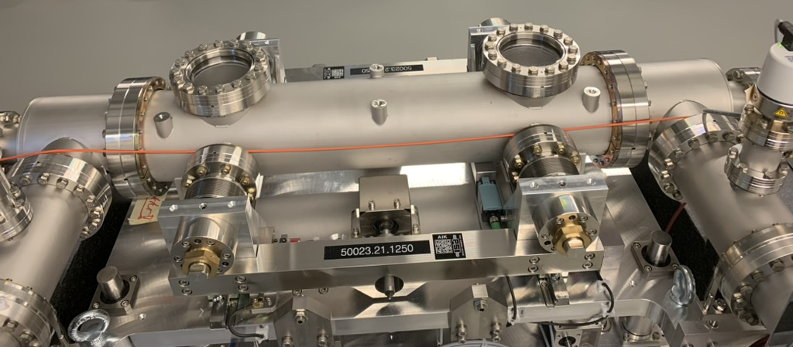
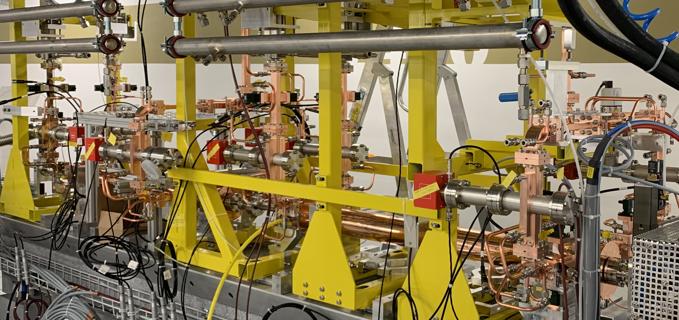
Post-undulator passive streaking – few remarks
Passive wake streaking (nonlinear)
  Advantages
    Reduced costs
    Self-synchronized with beam!
  Disadvantages
    Strongly varying time (and energy) resolution along the bunch, i.e. head is not resolved
    Streaking depends on bunch duration and charge
    Stronger longitudinal wakes and higher-order wake terms
    Most disadvantages can be overcome!
Active rf streaking (linear)
  Advantages
    Linear streaking, approximately uniform time resolution
    Simple calibration and analysis!
  Disadvantages
    Expensive hardware and infrastructure
    RF phase jitter (can limit the resolution)
    Requires synchronization
    High maintenance and running costs

Slide 9
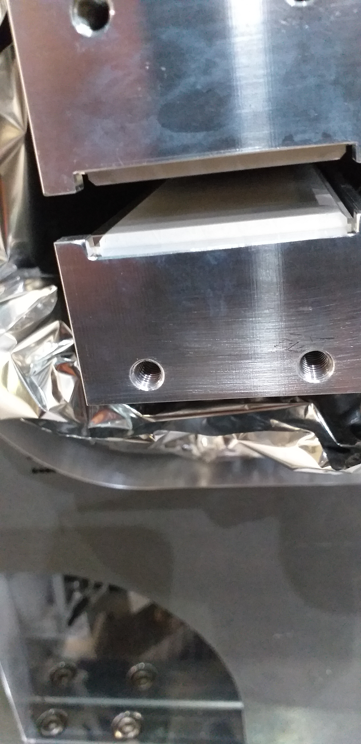
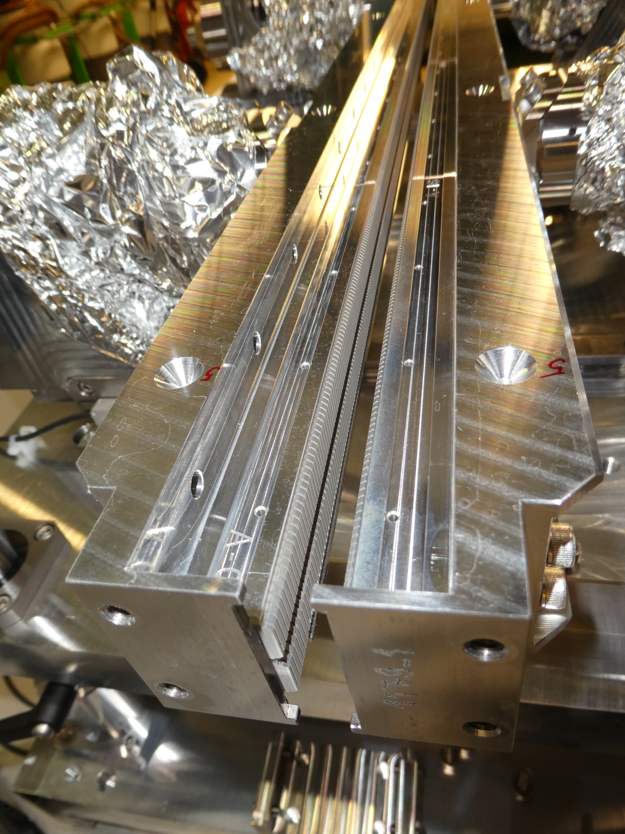
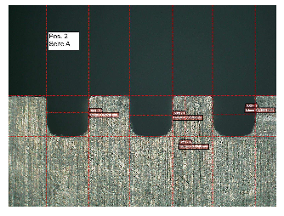
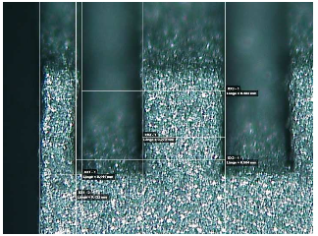
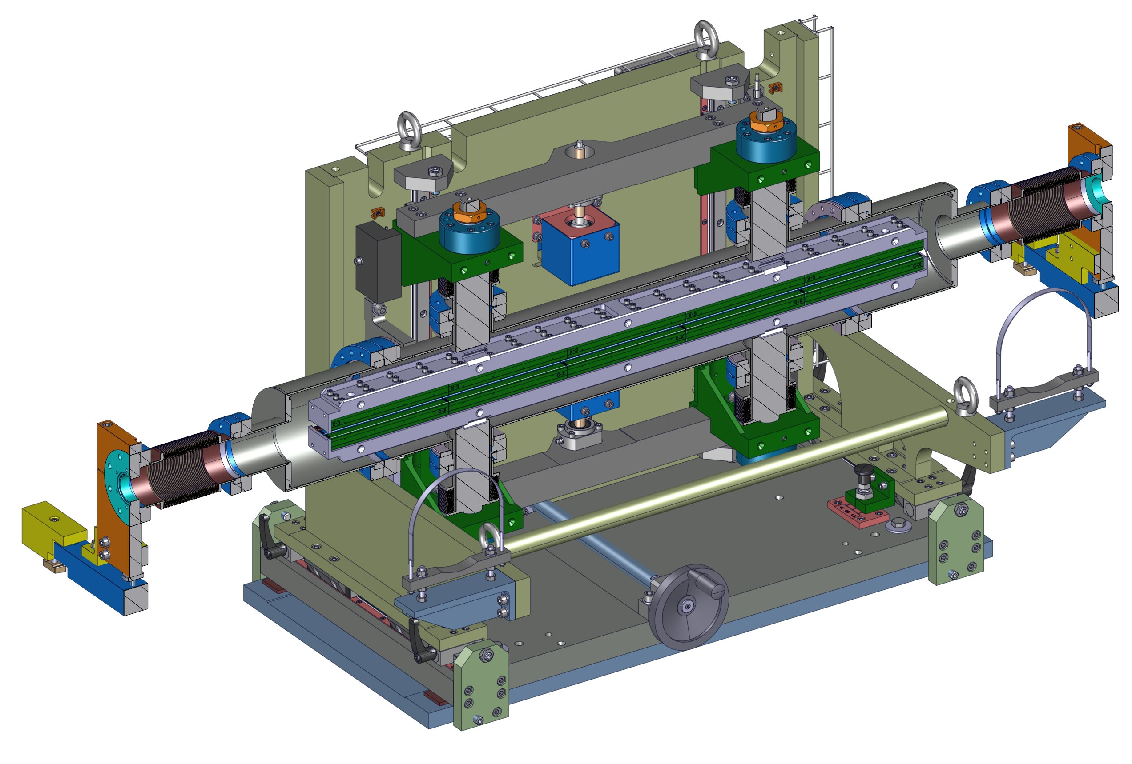
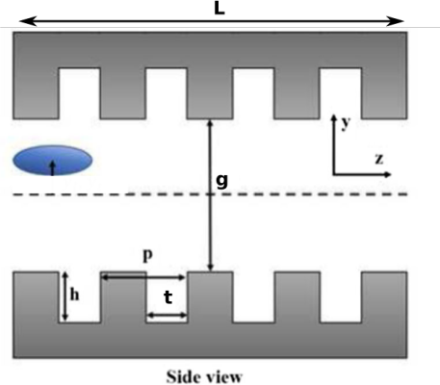
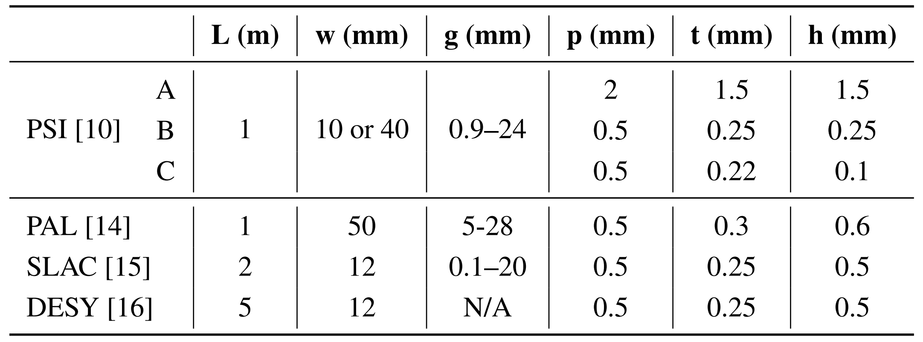
PSI Dechirper – corrugated and dielectric-lined waveguide
Dielectric-lined waveguide: Alumina
thickness 400 μm
Metallic corrugations
Wire erosion using a 0.1 mm diameter wire
Corrugated shape obtained by milling
Comparison of corrugation parameters of wakefield deflectors designed for different facilities
[1]
[2]
[2]
[3]
[4]
[1] P. Dijkstal et al., IPAC 2023 and S. Bettoni et al., IPAC 2018.
[2] P. Emma et al., Phys. Rev. Lett., vol. 112, 3, 2014.
[3] A. Novokhatski et al., IPAC 2026.
[4] S. Tomin et al., IPAC 2022.
Movable parallel yaws, 1-m long, used successfully in range between 75 and 200 pC

Slide 10
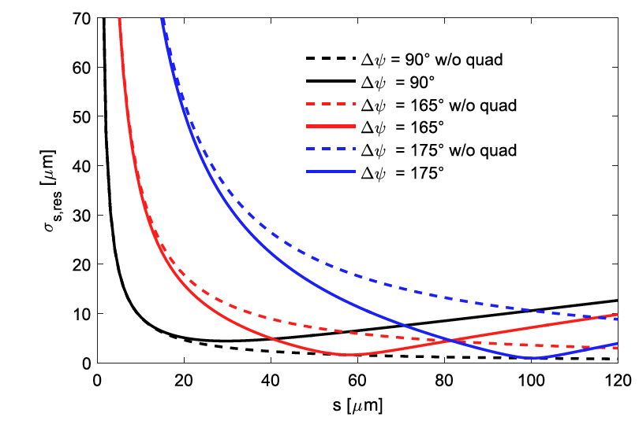
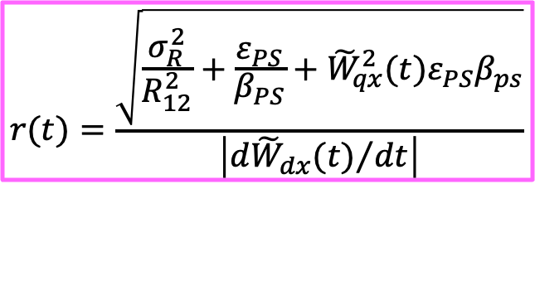
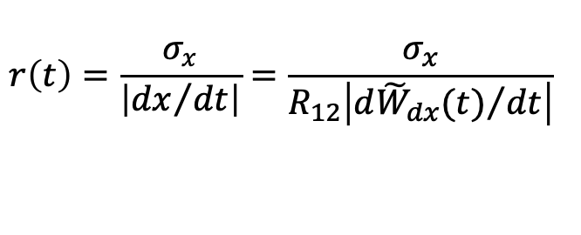
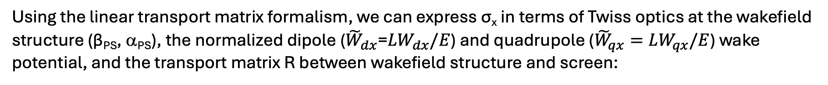
Time resolution
(x: streaking direction)
Time resolution r_{t} is the ratio between the beam size at the screen and the derivative of the normalized dipole wake potential multiply by the distance to the screen:
$$r\left(t\right)=\frac{σ_{x}}{\left|{dx}/{dt}\right|}=\frac{σ_{x}}{R_{12}\left|{{d\tilde{W}}_{dx}(t)}/{dt}\right|}$$
σ_{x} depends on the screen resolution σ_{R}, the natural transverse beam size, and the defocusing effect of the quadrupole wakefield term.
Using the linear transport matrix formalism, we can express σ_{x} in terms of Twiss optics at the wakefield structure (β_{PS}, α_{PS}), the normalized dipole (${\tilde{W}}_{dx}$=${LW}_{dx}/E$) and quadrupole (${\tilde{W}}_{qx}=LW_{qx}/E$) wake potential, and the transport matrix R between wakefield structure and screen:
β_{PS} at the structure in streaking direction → compromise between the two terms
ε_{PS} = geometric emittance
large R₁₂ to minimize the contribution of the screen resolution but limited from the distance of the screen
$$r(t)=\frac{\sqrt{\frac{σ_{R}^{2}}{R_{12}^{2}}+\frac{ε_{PS}}{β_{PS}}+{\tilde{W}}_{qx}^{2}(t)ε_{PS}β_{ps}}}{\left|{{d\tilde{W}}_{dx}(t)}/{dt}\right|}$$
r(s) [μm]
Reference: Nucl. Instr. and Meth. A, 865, p. 55 (2017)

Slide 11

Energy resolution
The slice energy spread resolution of a passive streaker setup has 3 contributions:
(x: dispersive direction)
Dipole spectrometer resolution
Energy spread increase from Panofsky-Wenzel
Spillover of time to energy resolution
  Energy resolution of a dipole spectrometer, with natural beam size σ_{x0} (i.e., without dispersion) and dispersion D.
  The wakefield structure also causes an increase in energy spread of the beam, which we estimated using the the Bane-Stupakov model and applied the Panofsky-Wenzel theorem.
  A spillover of time into energy resolution if the beam is energy-chirped. The time resolution causes particles from different time slices to arrive at the same streaked coordinate at the screen. If these time slices have different central energies, the observed slice energy spread increases.
P. Dijkstal et al., https://doi.org/10.48550/arXiv.2402.11252 (2024)

Slide 12


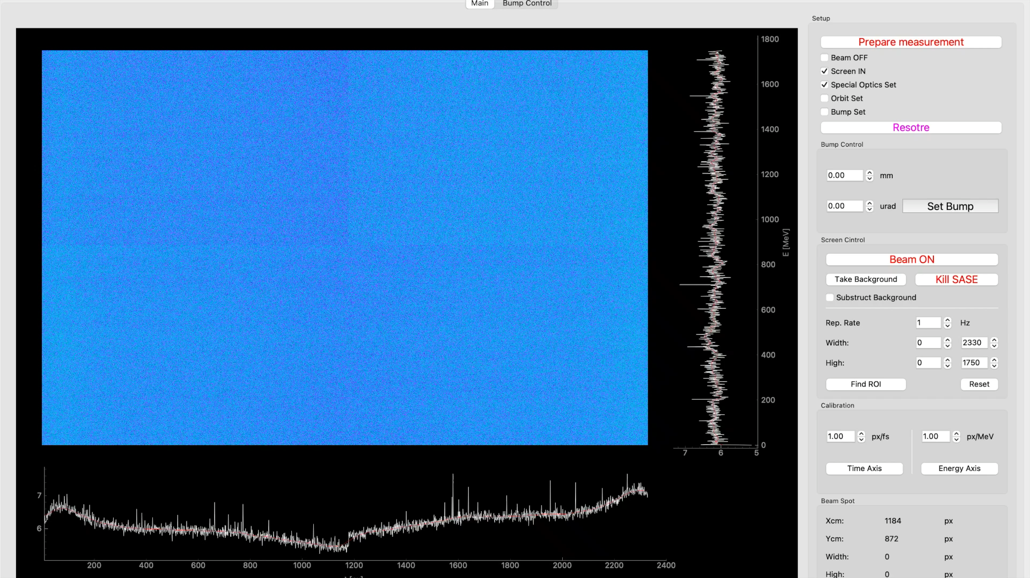
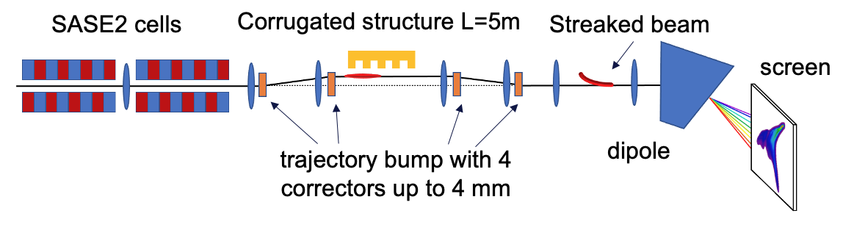
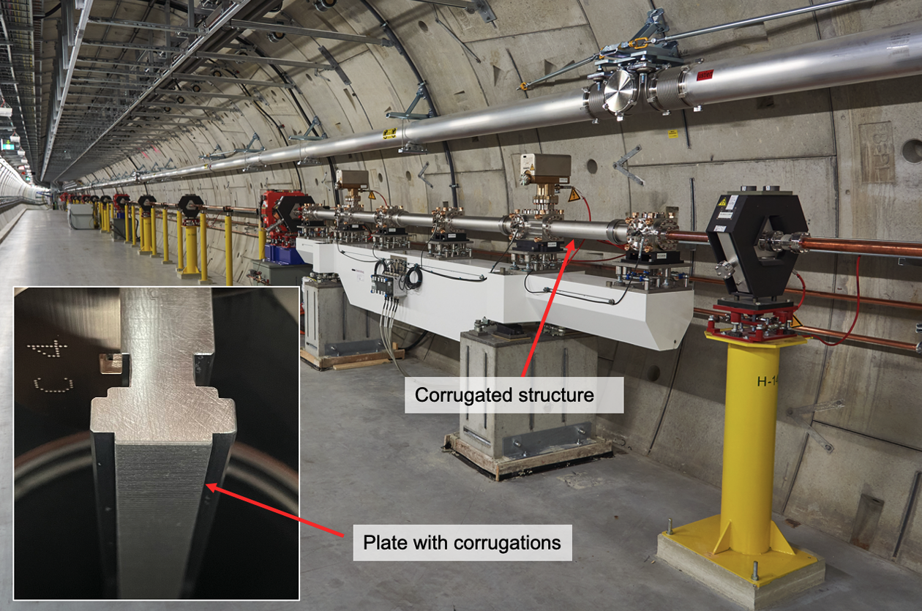
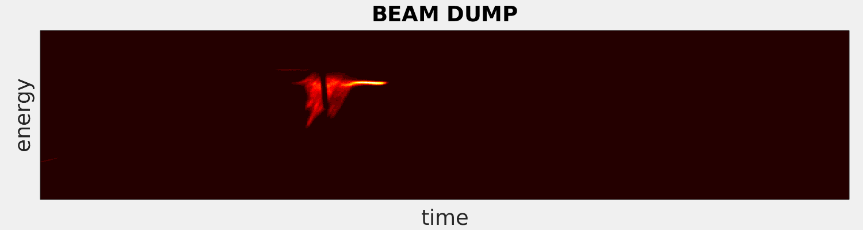
Post-undulator passive streaking at EuXFEL
Passive streaking is also employed at EuXFEL (hard X-ray beamline) up to 17.5 GeV beam energy and 250 pC with fixed corrugated structure.
Passive streaking at EuXFEL
Corrugated structure design: Torsten Wohlenberg (DESY)
Courtesy of S. Tomin et al., Proc. IPAC 2022
and P. Dijkstal et al., Phys. Rev. AB. 4, 013017 (2022)
PolariX TDS at PSI

Slide 13
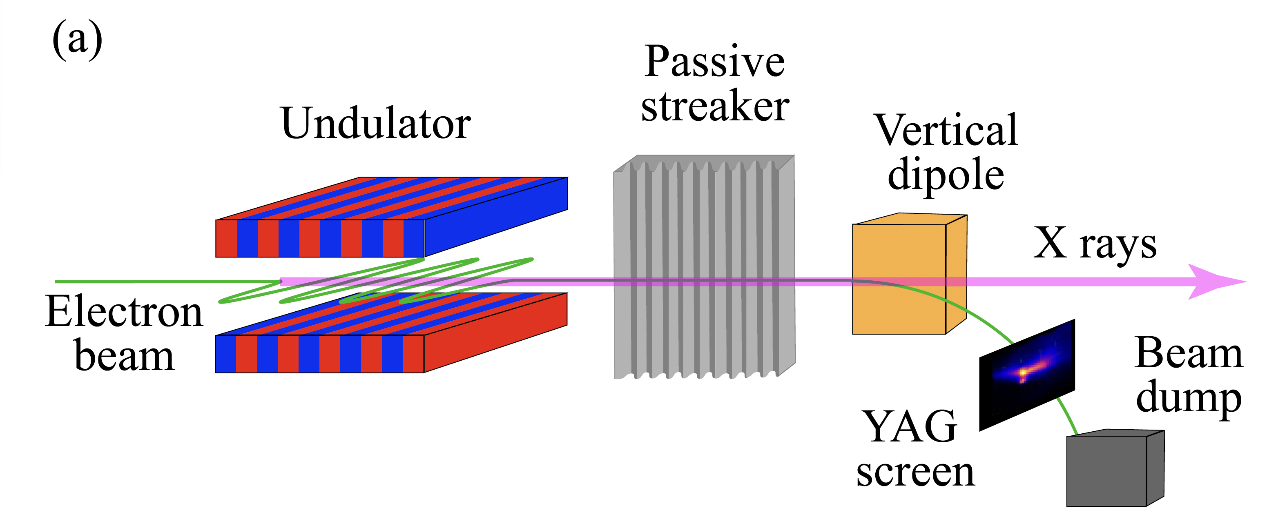
Example of reconstruction with self-calibration
SwissFEL 6.1 GeV, 200 pC
Active TDS
Profile reconstruction: Measured profile (black) with TDS and reconstructed profiles for different initial Gaussian distributions (colors). The current profile reconstruction algorithm converges at the orange profile.
Screen reconstruction: Measured horizontal image projection (black) and forward propagated (colors) corresponding to the reconstructed profiles.
Distance scan: Measured (solid) and reconstructed (dashed) image projections for different positions of the passive streaker.
Profile comparison: Reconstructed current profiles corresponding to the horizontal projections. For comparison, the TD measured profile is shown in black.
Time resolution: using the measured time profile for two different gaps, with (solid) and without (dotted) quadrupole field effects.

Slide 14
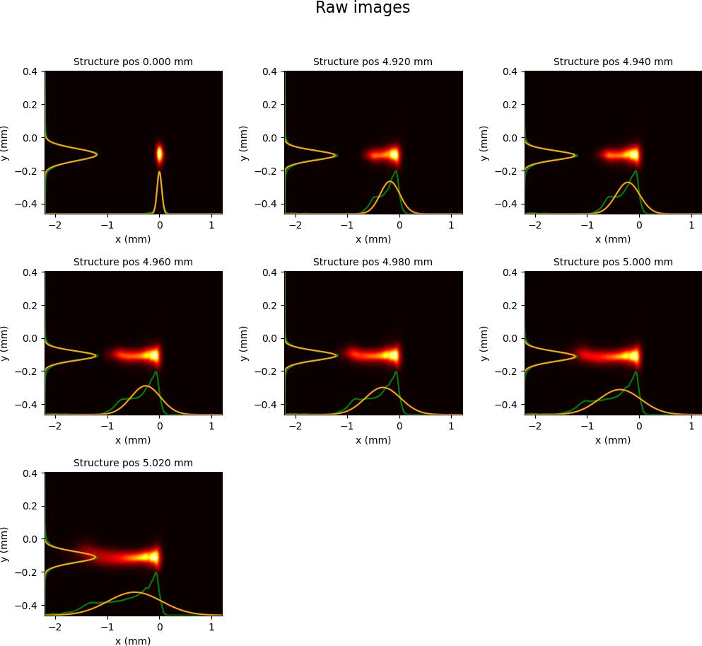
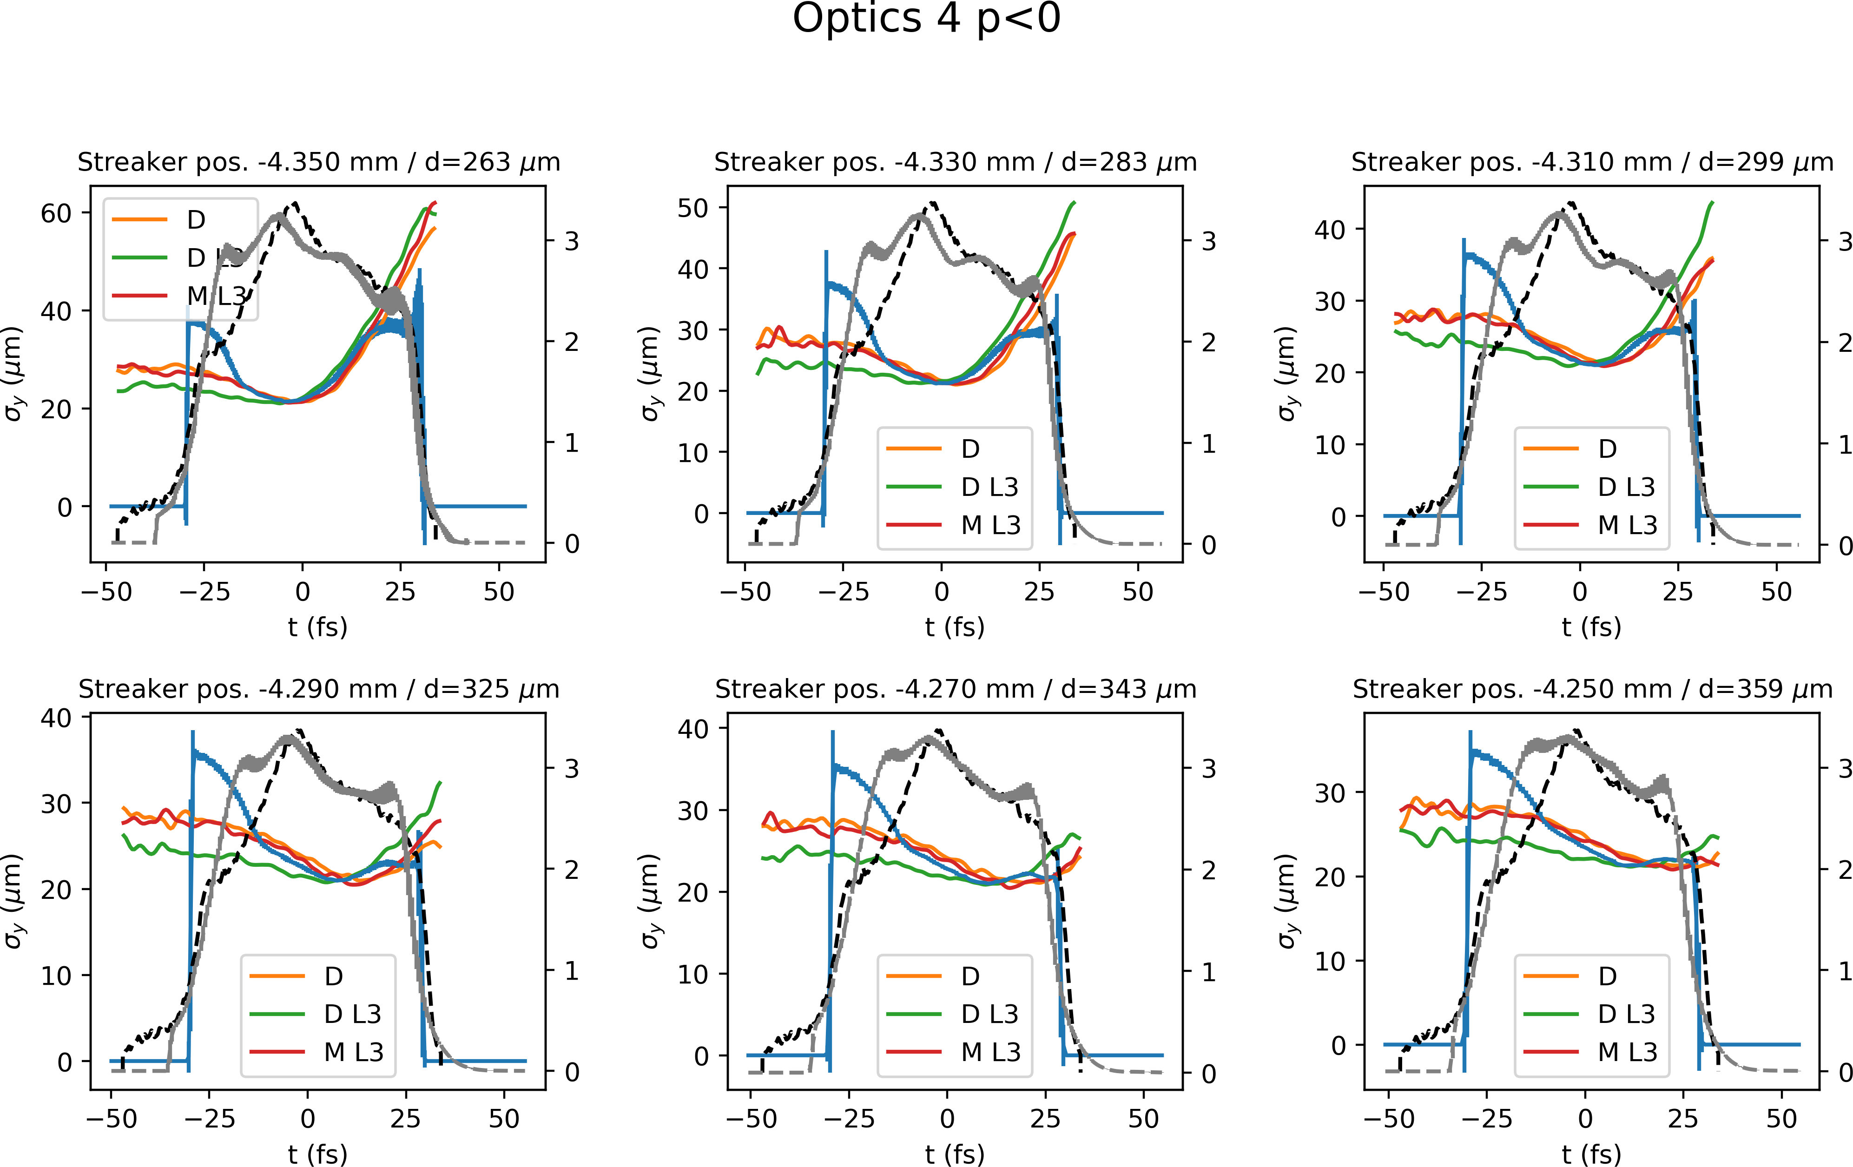
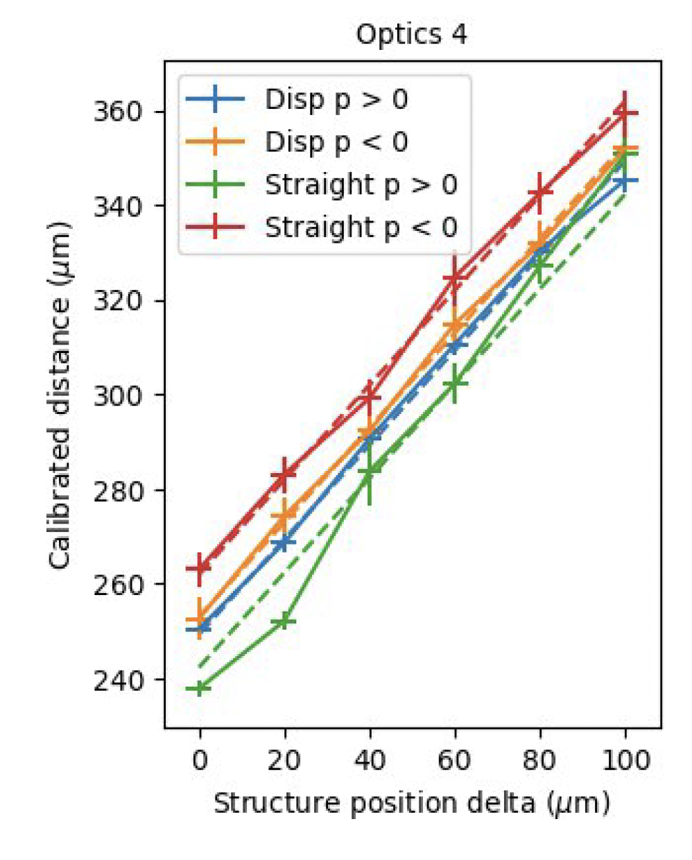
Transverse wakefield measurements (dipole and quadrupole)
No streaking
dipole wake
Scan the offset and acquire images on non-dispersive and dispersive screens
Measure current profile with TDS and ~1 fs time resolution
Compare expected (from models) to observed wakefield effects
  Center of mass deflection (dipole wakefields)
  Horizontal beam size changes (quadrupole wakefields)
quadrupolewakes
Dipole wakefields
Quadrupole wakefields
Dipole wake: Overall excellent agreement between model and measurements.
Quad wake: Good agreement at the core and tail
Quad wake: Model seems to overestimate the quad. wake at the head.

Slide 15
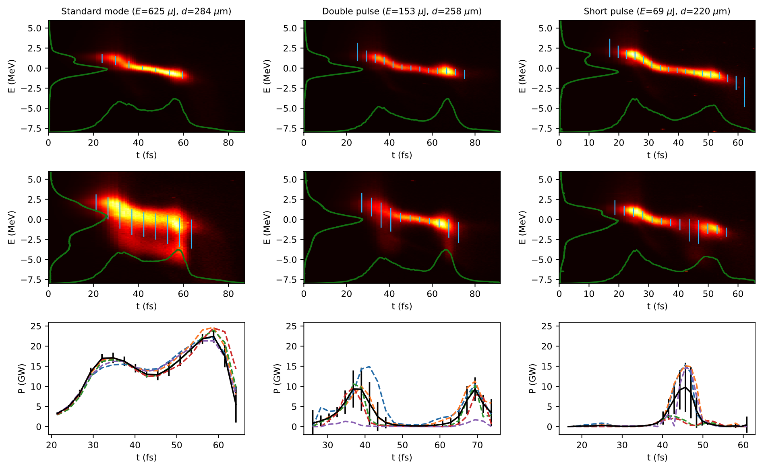
Post-undulator passive streaking - capabilities
Diagnostics for lasing modes at SwissFEL (6 GeV)
FEL pulse duration is measured on request from photon beamline during beam setup (routinely used!).
Two calibration methods are available, one of them the independent calibration (self-calibration). It requires precision in setting the beam trajectory relative to the corrugated structure.
Time resolution down to few fs
The diagnostic is useful even when uncalibrated!
more information: P. Dijkstal et al., Phys. Rev. Res. 4, 013017 (2022)

Slide 16
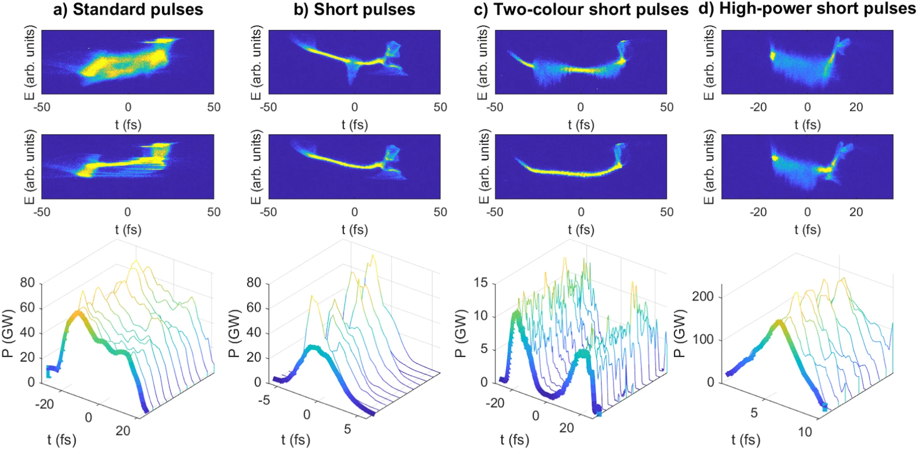

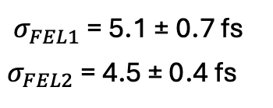


PolariX TDS measurements – just a comparison
Extremely useful device to setup and optimize FEL for standard and special operation modes
$σ_{FEL1}$ = 5.1 ± 0.7 fs
$σ_{FEL2}$ = 4.5 ± 0.4 fs
$σ_{FEL}$ = 2.0 ± 0.3 fs
$σ_{FEL}$ = 15.6 ± 0.9 fs
$σ_{FEL}$ = 1.4 ± 0.1 fs
E. Prat et al., Nature Communications, (2023)14:5069

Slide 17
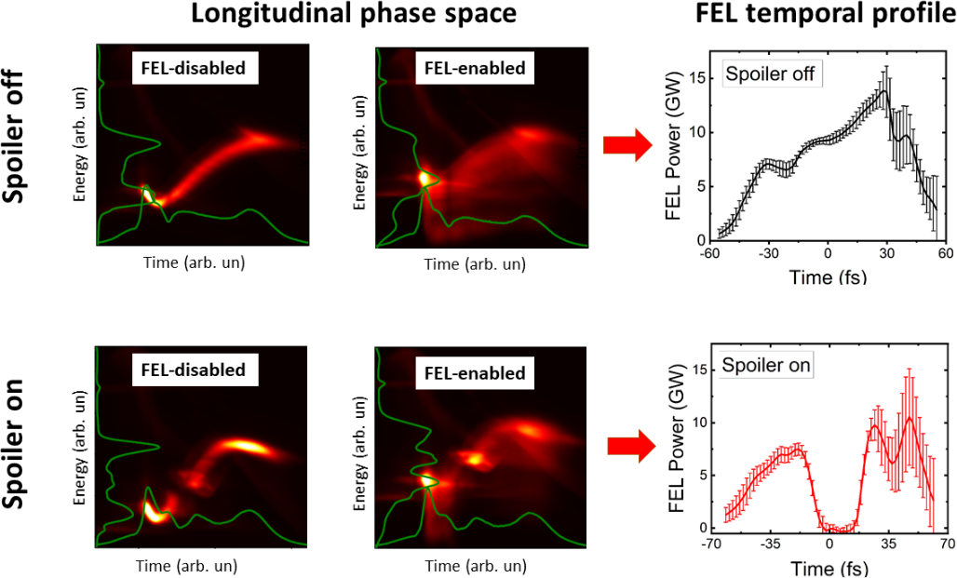
2-color FEL with emittance spoiler
Second cathode laser pulse arrives in the center of the first laser pulse and increases the slice emittance
Suppression of lasing well resolved by passive streaker.
C. Vicario et al., Proc. SPIE 2023, https://doi.org/10.1117/12.2665579

Slide 18
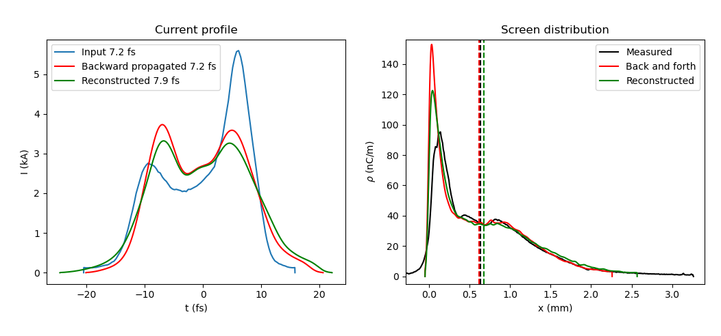
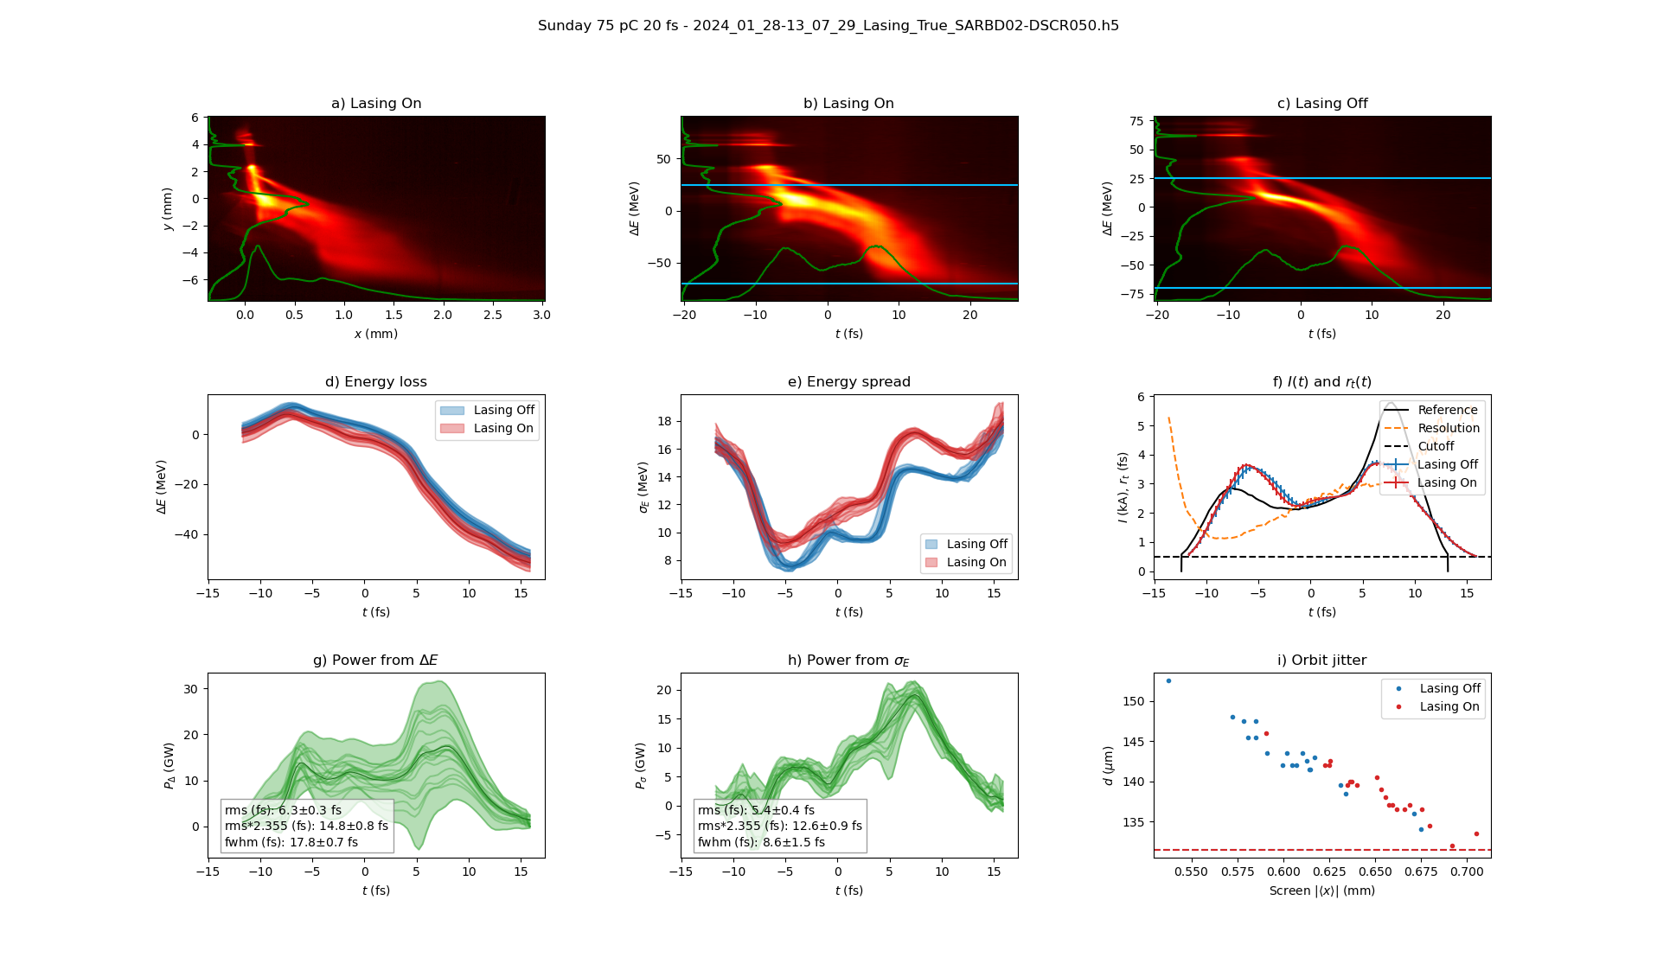
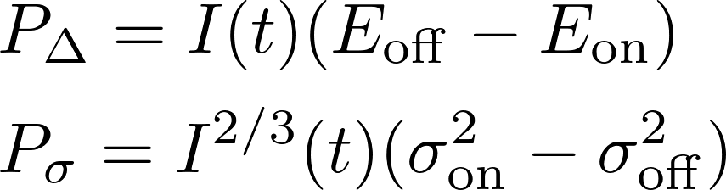
Measurements at 75 pC
Example LPS measurements
TDS calibration
lasing ON
lasing OFF
Slice analysis for 20 images per case
Passive streaker diagnostics still works at 75 pC, but not at 10 pC → Limit in charge not yet determined.
Incoming beam energy jitter could have an effect → some correction should be implemented.
In this measurements, only the photon pulse peak power obtained form the energy spread provide a reliable reconstruction.
Lasing OFF- blue
Lasing ON - red

Slide 19
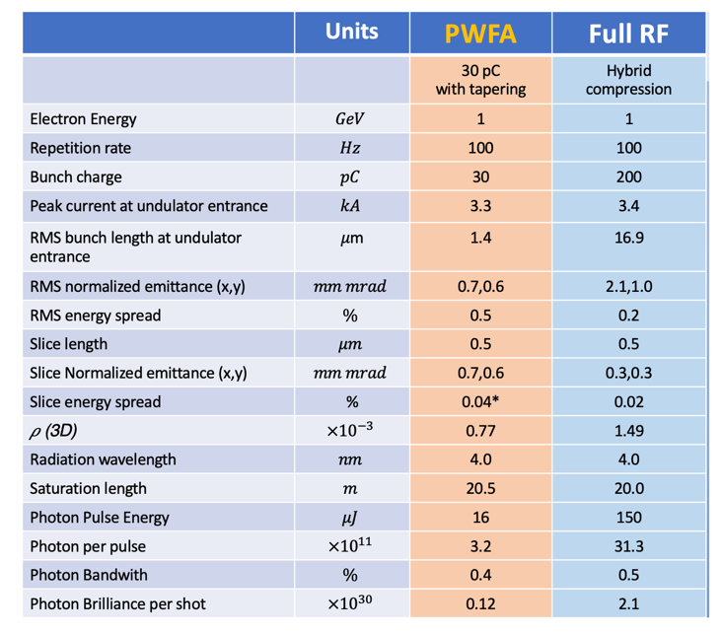
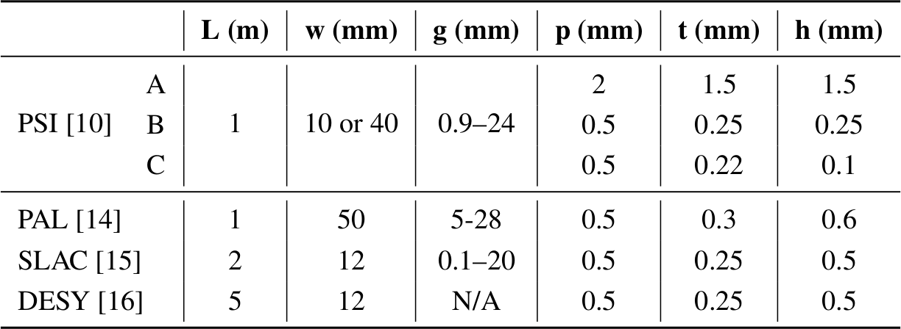
Case study: EuPRAXIA@SPARC_LAB
Resolution calculation when moving to lower charge and fs-bunch length
Optics at structure: βx = 5 m, αx = 0.5
Lattice: 10 m drift to a screen
Structure parameters:
Parameters
Table from A. Falone’s slides

Slide 20
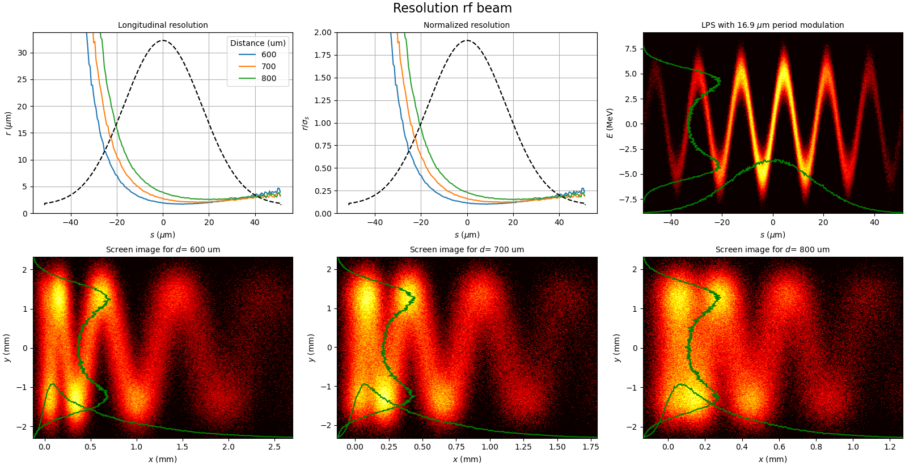
Resolution for “Full RF” beam parameters, 17 μm (56 fs) EuPRAXIA@SPARC_LAB
LPS with energy modulation to better interpret the meaning of longitudinal resolution.
Simulated screen images
Streaking in X
Dispersion in Y
Resolution reaches about 0.1*σ (rms bunch duration) at the core of the beam
Relatively large distance between beam and plate. Structure length could be further reduced.
An energy modulation with wavelength equal to c*σ can be resolved!

Slide 21
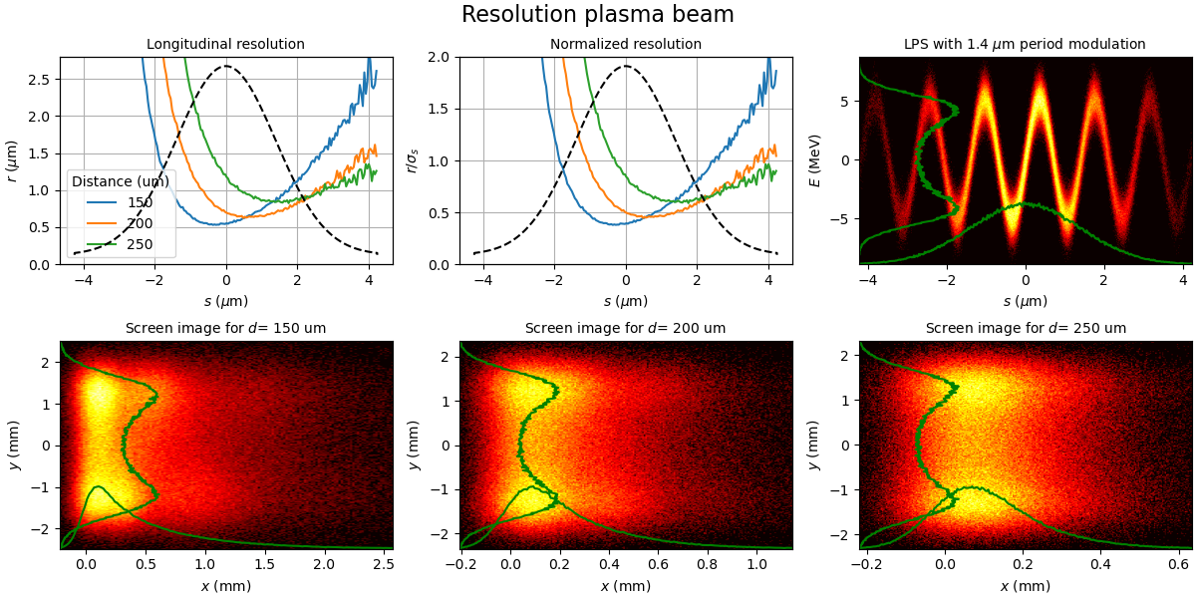
Resolution for “PWFA” beam parameters, σ = 1.4 um (4.7 fs)
EuPRAXIA@SPARC_LAB
Resolution reaches about 0.5*σ (rms bunch length) at the core of the beam.
A LPS modulation with wavelength equal to σ cannot be resolved. Beam is too short or has too large emittance!

Slide 22
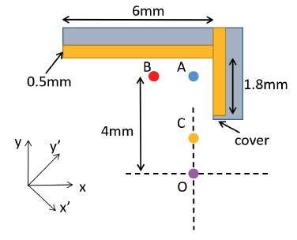
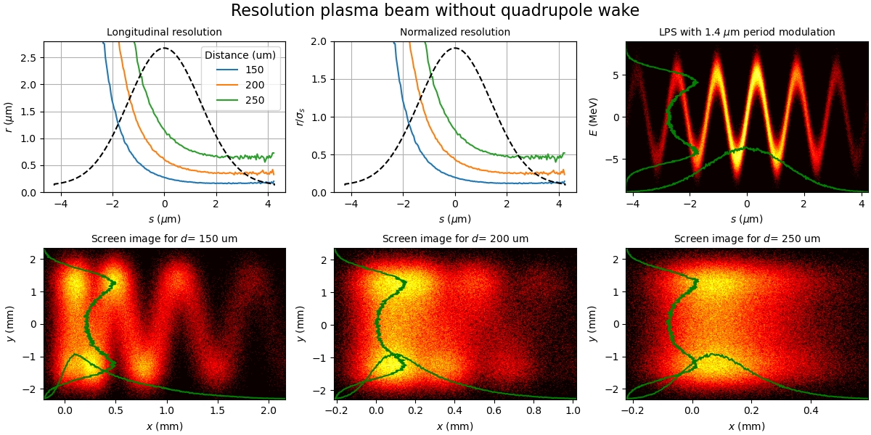
Resolution for “PWFA” beam parameters – L shaped streaker
EuPRAXIA@SPARC_LAB. Resolution without quadrupole wake
Quadrupole wakes can be avoided by using an L-shaped structure! We used the wake function for standard structure and neglect quadrupole effect.
Example:
- W. Qin, PR AB 26, 064402 (2023)
- W. Qin, FEL conference 2022
The distance between beam and the two plates needed to achieve a useful resolution is very small!

Slide 23
Conclusion
Summary
Wakefield-based diagnostics are a viable alternative to active rf streaking. In SwissFEL, passive streaking is used for post-undulator longitudinal phase space reconstruction (6 GeV) and pre-undulator beam manipulations.
The main advantages are reduced costs (and also reduced support from technical groups).
The main disadvantage is the nonlinearity of the streaking. The time and energy resolution vary along the bunch. The beam head is not resolved!
At PSI we measure the FEL pulse duration on request from the beamlines (photon pulse reconstruction and duration), and during each machine setup (if there is time). The diagnostic is useful even when uncalibrated.
To further improve the resolution for lower charge, L-shaped with metallic corrugation or dielectric-lined waveguides should be used to cancel the quadrupole wakes.
Outlook
While the wake models for the metal corrugations are in good agreement with the measurements, work is still ongoing on the dielectric-based dechirper/streaker installed upstream of the undulators.
Generative machine learning techniques could be useful both for temporal profile retrieval and for 5D/6D phase space reconstruction (even with non-linear temporal correlation).

Slide 24

Aknowledgments
P. Dijkstal to provide me most of the material presented in the slides and to push this this topic at PSI and DESY.
F. Marcellini and E. Ericson for useful discussions on the wake models.
E. Prat and S. Reiche for their valuable guidance during the setup and measurements.
SwissFEL operation team to support us during the shifts in SwissFEL.
PSI , Areal view

Slide 25
Back slides

Slide 26
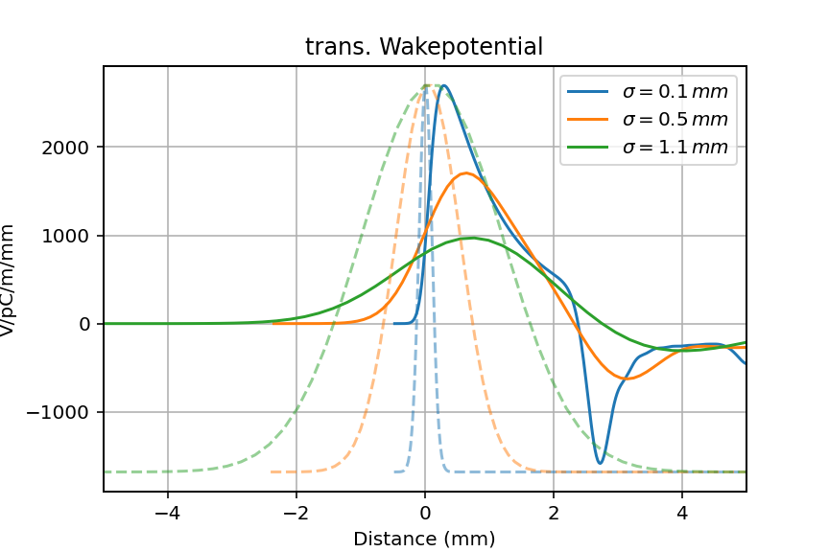
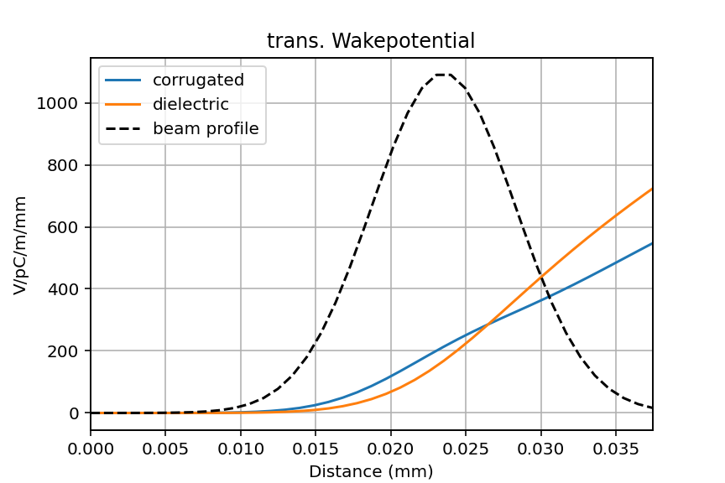
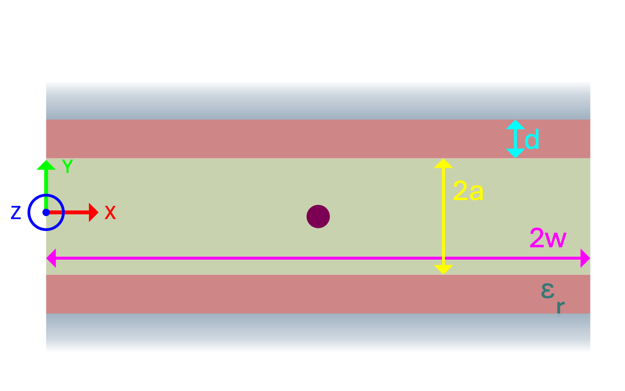
Wakefield models and simulation codes
Corrugated metallic yaws (parallel plates):
K. Bane et al., Phys. Rev. Accel. Beams 19, 084401 (2016)
K. Bane et al., SLAC-PUB-16881 (2016)
→ Analytical expression for short wake functions
one dielectric yaw
offset =300 μm
Time domain solver:
CST Studio Suite
I. Zagorodnov. ECHO4D. url: https://echo4d.de/
S. Baturin et al., PRST AB 16, 051302
Dimensions of the metallic corrugation yaw
Comparison between streaking with dielectric and corrugated yaws
offset ~ 300 μm
Dimensions of the dielectric yaws
400μm
g = 250 μm
p = 500 μm
d = 250 μm
Beam goes into page
0.5-15 mm
Courtesy of E. Ericson
~10

