Slide 1

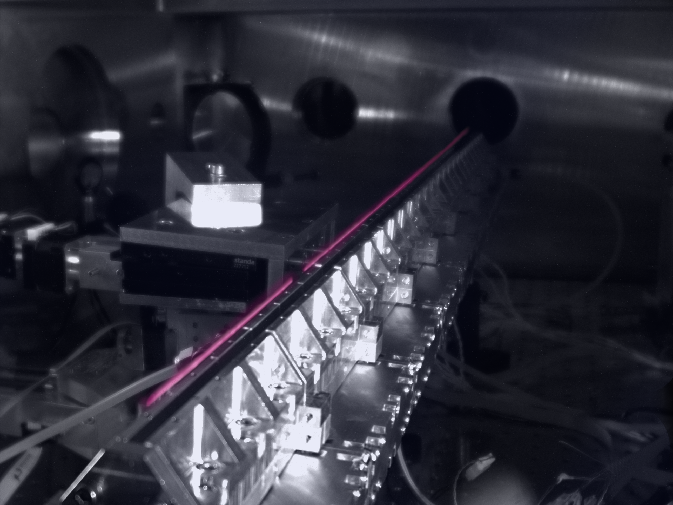








UNIVERSITY OF MARYLAND AT COLLEGE PARK
Dept. of Physics
Dept. of Electrical and Computer Engineering
Institute for Research in Electronics and Applied Physics
Meter-Scale Supersonic Gas Jets for Multi-GeV Laser-Plasma Accelerators
Ela Rockafellow, Bo Miao, Jaron E. Shrock, Ari J. Sloss, Scott W. Hancock, and Howard M. Milchberg
Institute for Research in Electronics and Applied Physics and Department of Physics, University of Maryland, College Park, Maryland 20742, USA
Supported by DARPA under the Muons for Science and Society (MuS2) program
LLNL work done under Contract DE-AC52-07NA27344
E. Rockafellow supported by NSF GRFP (Grant No. DGE 1840340)

Slide 2


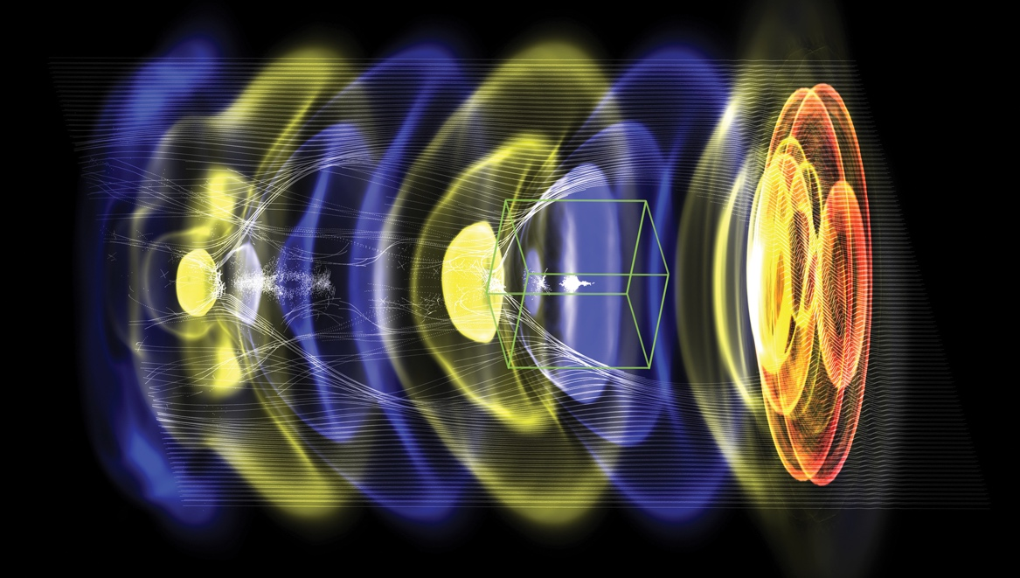



Acknowledgements
WarpX: open-source particle-in-cell code with advanced algorithms at Exascale
Bo Miao, Jaron E. Shrock, Ari J. Sloss, Nishchal Tripathi, Manh S. Le, Scott W. Hancock, Frederica Sorkin, Mayank Gupta
PI: Jean-Luc Vay (LBNL)
DoE Exascale Computing Project
J. Šišma , M. Nevrkla, F. Vitha, A. Špádová, S. Lorenz, I. Zymak, G. Grittani, A. Cimmino, R. Versaci, C. Lazzarini, S. V. Bulanov
Advanced algorithms for plasma acceleration
Performance-portability
Built on AMReX (LBNL, ECP co-design center)
Users/contributors welcome!
>30 contributors from LBNL, LLNL, CEA, DESY, SLAC
2021: 10 multi-GeV stages
Goal 2023: TeV multi-stage collider
S. Zahedpour, R. C. Hollinger, S. Wang, J. King, P. Zhang, J. J. Rocca
https://ecp-warpx.github.io
Vay, J-L., et al., Nucl. Instrum. Meth. A 909 (2018)
I. Pagano, F. Treffert, S. Kerr, B. Reagan, J. Williams
FBPIC: Fourier Bessel Particle-in-Cell code
open-source
R. Lehe et al., CPC, 2016
R. Lehe et al., PRE, 2016
M. Kirchen et al., PoP, 2016
A. Picksley, J. Stackhouse, A. Gonsalves
Remi Lehe (LBNL)

Slide 3


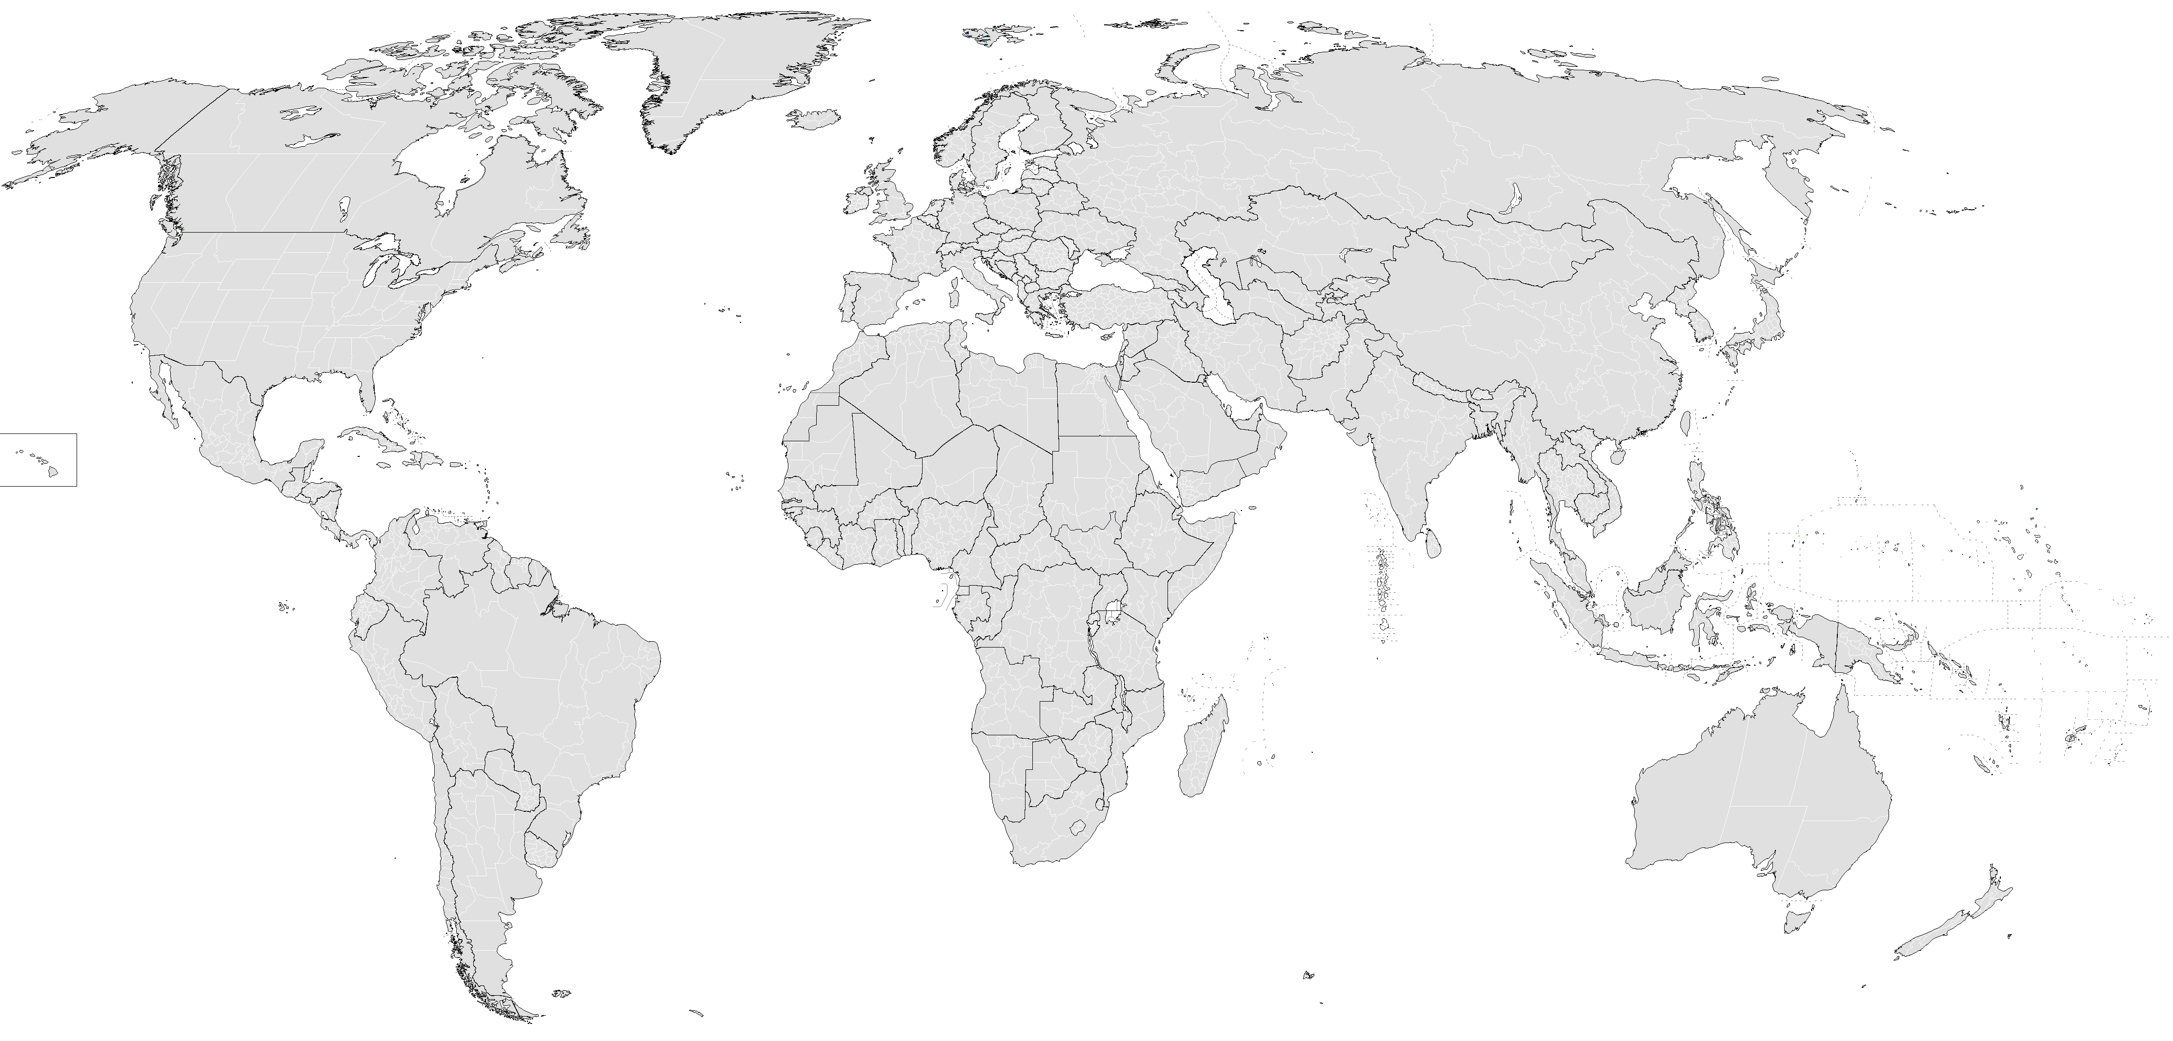

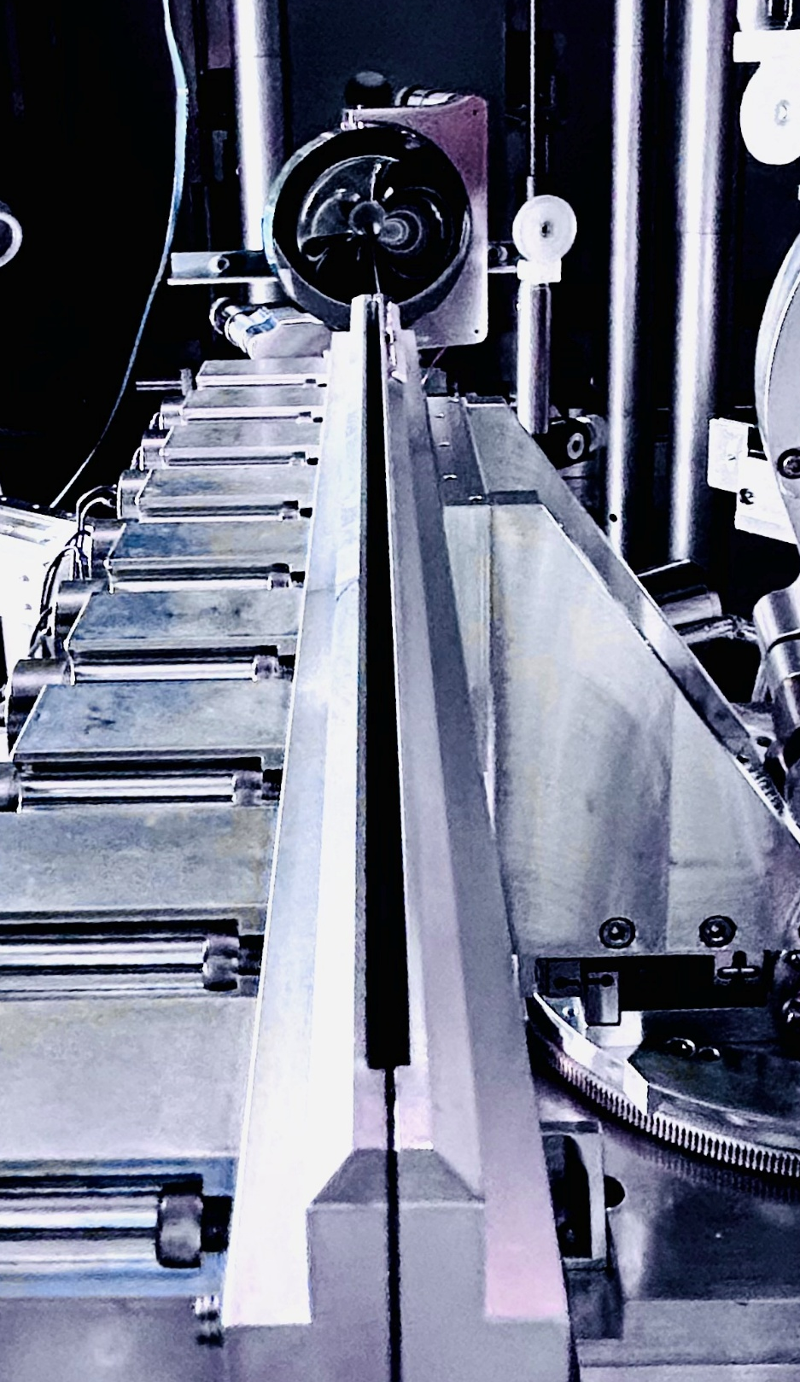

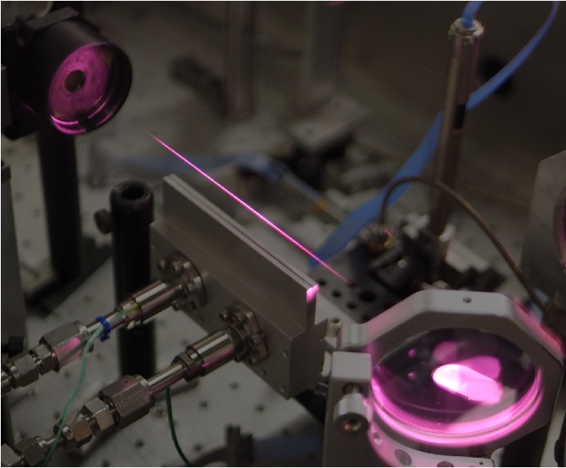
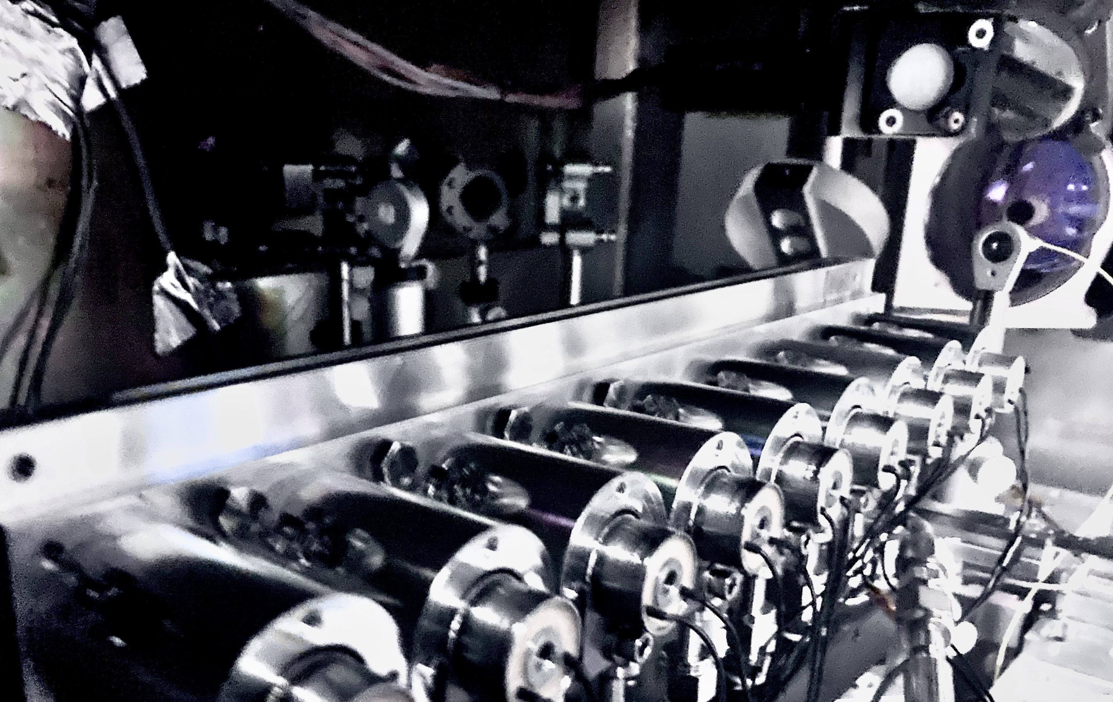


Meter-scale Low-density Gas Jets
$J16$ beam

Slide 4
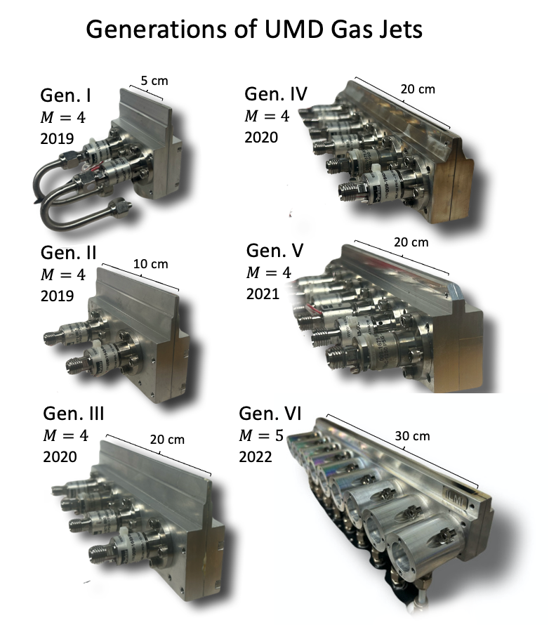
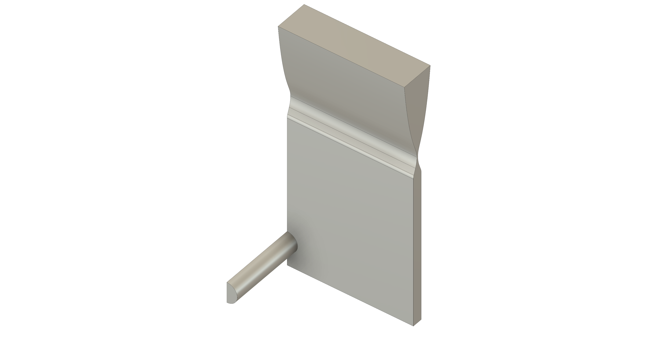


Multi-Valve Gas Jet Development
(a)
(b)
S1: plane bisecting the gas flow channel
orifice
$J16$ beam
200-μm throat
gas flow channel
reservoir
$J0$ beam
S2: Mid-plane between two adjacent valves
inlet
E. Rockafellow et al., Phys. Plasmas 32, 053102 (2025) B. Miao et al., Rev. Sci. Instrum. 96, 043003 (2025)

Slide 5
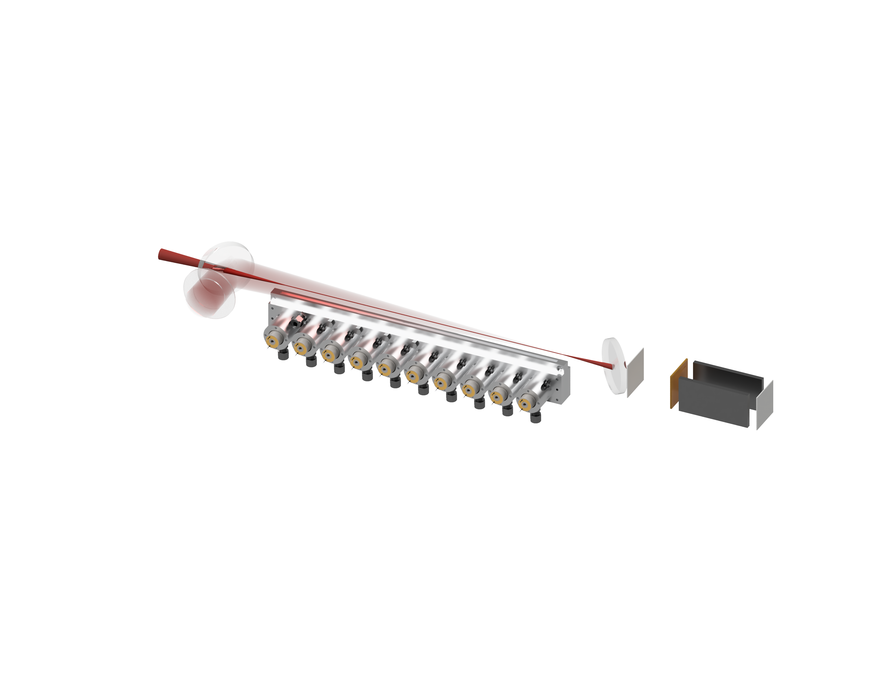
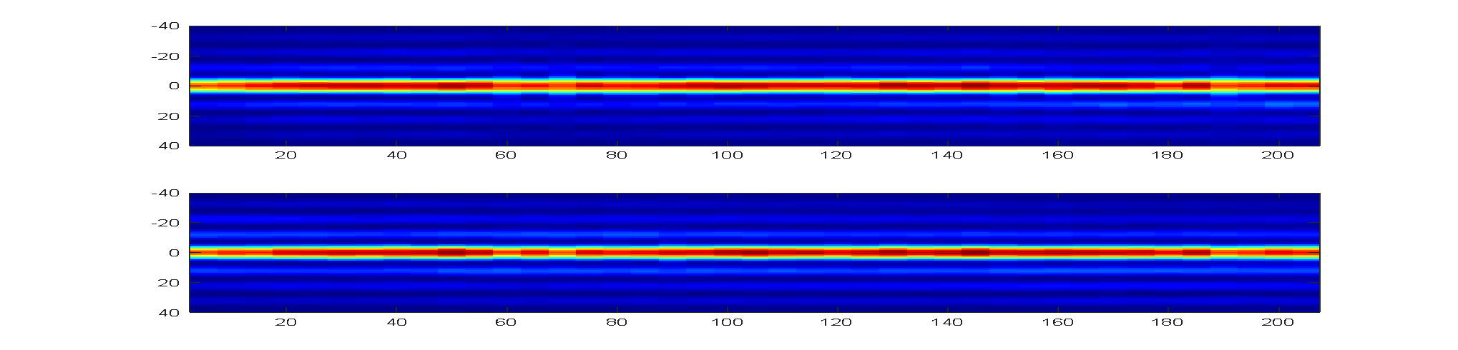
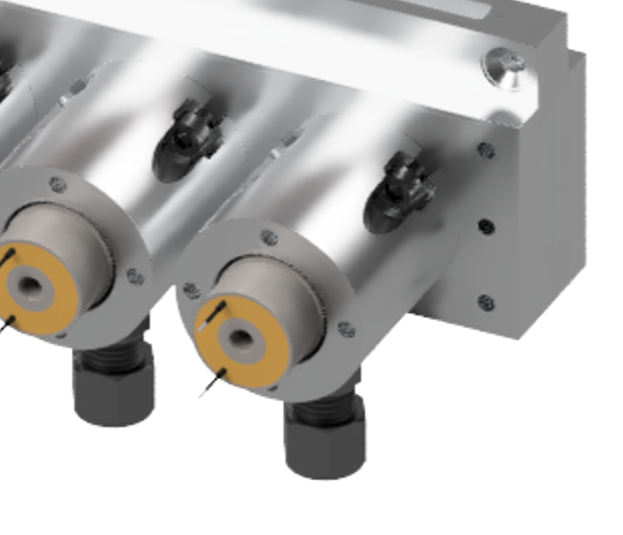

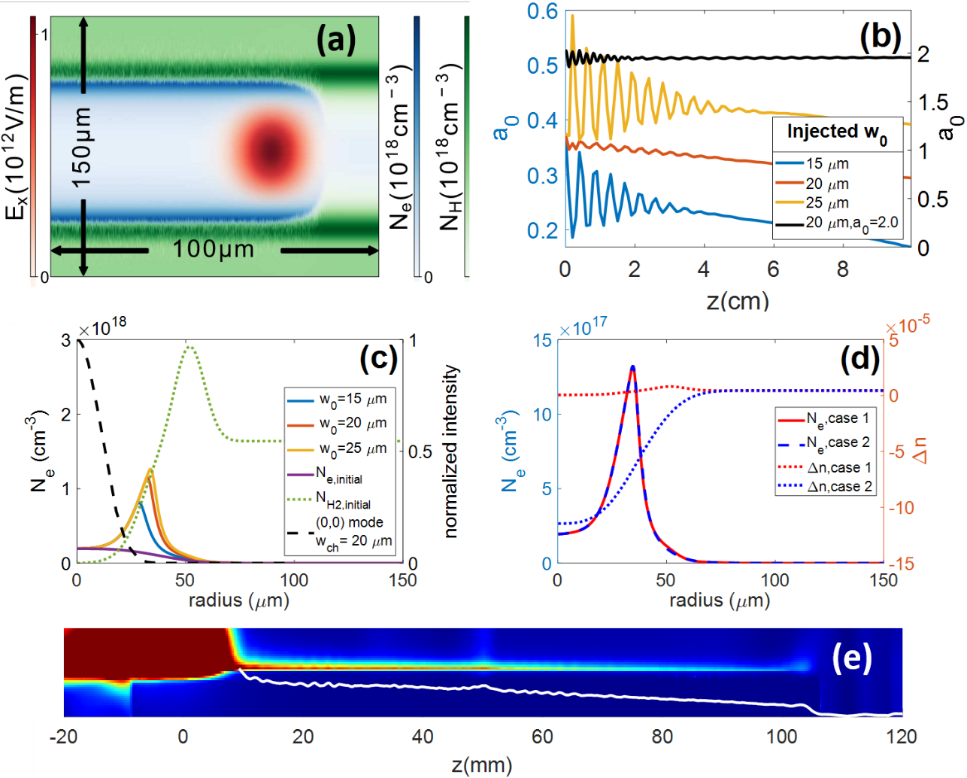


LWFA in Meter-Scale Low-Density Channels
P1
DM1
P3
30 cm
P2
DA
DM2
LA1
LA2
UMD developed 30 cm supersonic gas jet (Gen. VI)
LA3
First plasma waveguides: Durfee and Milchberg, PRL 71, 2409 (1993)
N. Lemos et al., Phys. Plasmas 20 061302 (2013)
R. Shalloo et al., Phys. Rev. E 97, 053203(2018)
A. Morozov et al., Phys. Plasmas 25, 053110 (2018)
B. Miao et al., Phys. Rev. Lett. 129, 074801 (2020)
L. Feder et al., Phys. Rev. Res. 2, 043173 (2020)
A. Picksley et al., Phys. Rev. Accel. Beams 23, 1 (2020).
J. E. Shrock et al., Phys. Plasmas 29, 073101 (2022)
B. Miao et al., Phys. Rev. Accel. Beams 27, 08132 (2024)
Gas inlets
Magnetic spectrometer
Leading wings of injected high intensity pulse ionize neutral shock

Slide 6
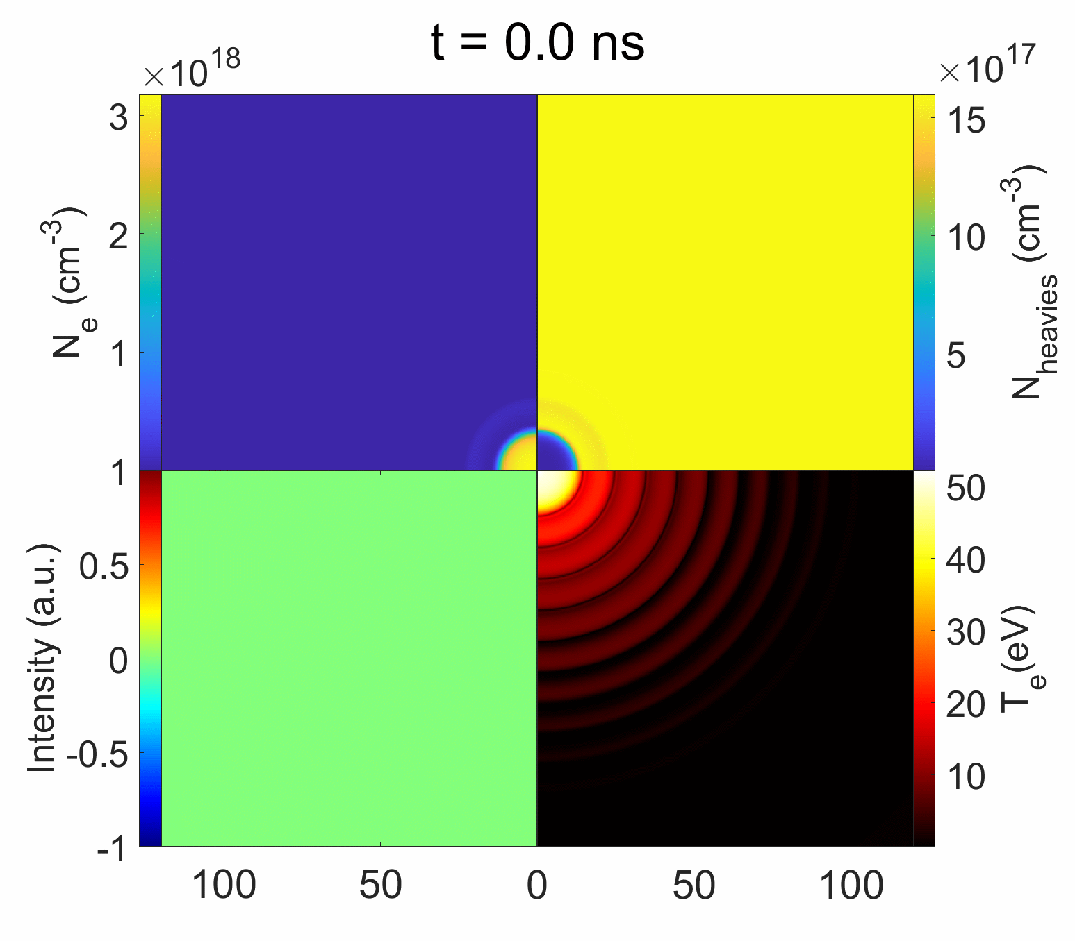
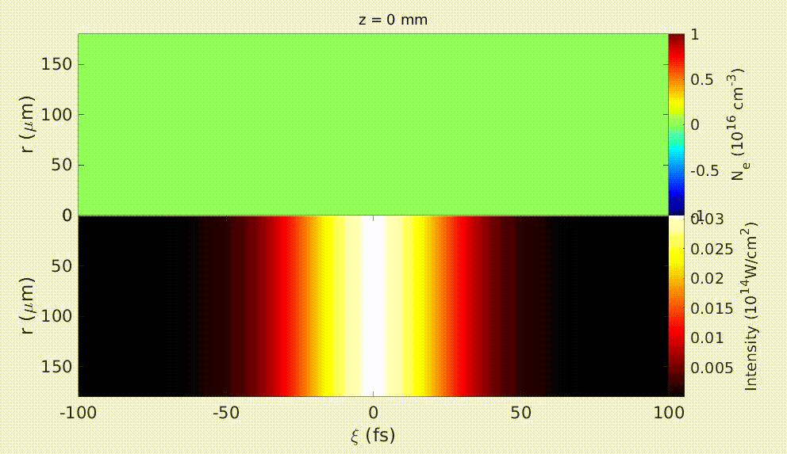
Bessel-Hydro Waveguide Model
Hydro-model SPARC used in collaboration with Dan Gordon (NRL)
Media1.gif
Neutrals density
Electron density
atom/ion/H₂ density
3D YAPPE* self-consistent simulation of Bessel beam OFI heating.
Guided mode intensity
Electron temperature
intensity
Electron temperature
* B. Miao et al., Phys. Rev. Accel. Beams 27, 08132 (2024)
A. Goffin et al., Phys. Rev. X 13, 011006 (2023).
r (µm)
6

Slide 7
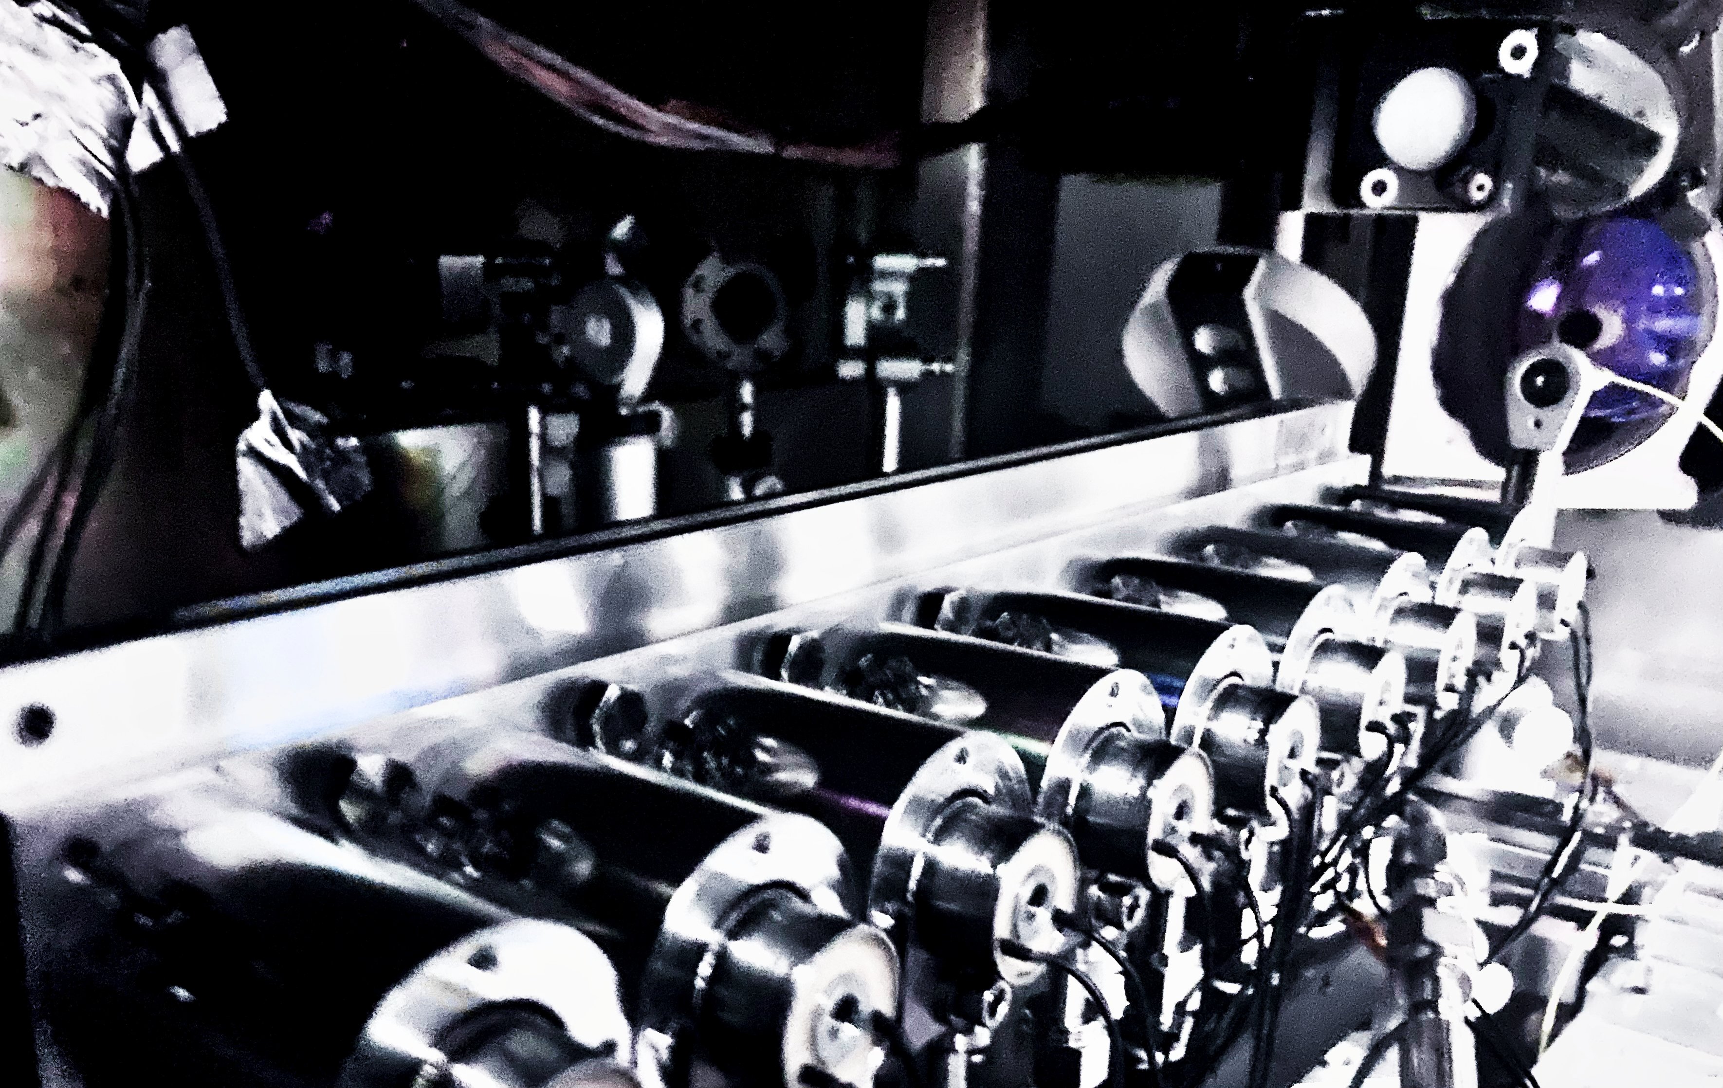
Outline
30 cm Gen. VI Gas Jet
10 GeV, Multi-Joule LWFA at Colorado State University
Custom plasma waveguides for improved stability
Localized dopant for controlled injection
Modular Gen. VII Gas Jet for Customizable Accelerators
Three types of controlled injection at ELI Beamlines
Demonstration of rephasing electron beams with customizable density profile
Recent applications of LWFA electron beams as secondary radiation sources

Slide 8
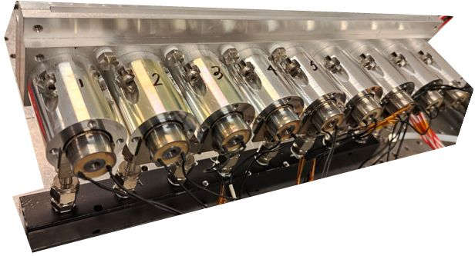
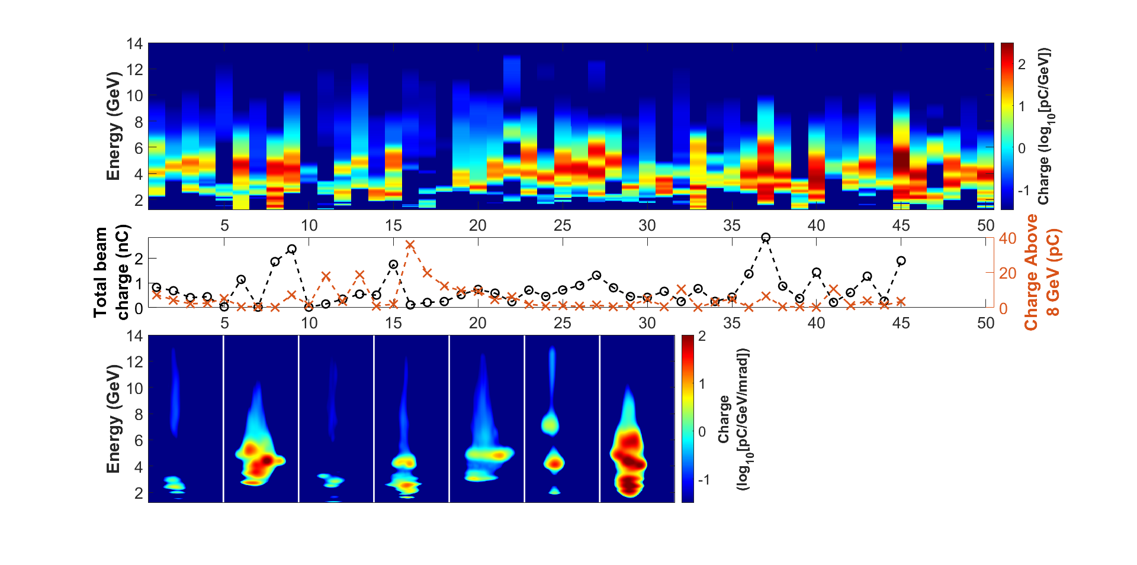
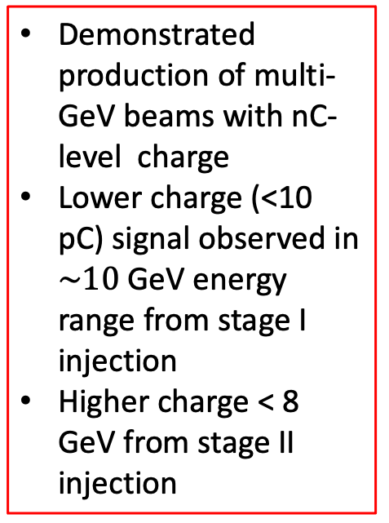
30 cm
Multi-GeV Beams with ~10 GeV Features
UMD 30 cm jet
50 highest energy shots from 2024 campaign
Demonstrated production of multi-GeV beams with nC-level charge
Lower charge (<10 pC) signal observed in $\sim 10$GeV energy range from stage I injection
Higher charge < 8 GeV from stage II injection
(a)
(b)
*9.2 GeV electrons from self-waveguided LWFA observed by collaborators @ LBNL (see A. Picksley, et al., PRL 133(25), 255001 (2024))
E. Rockafellow et al., Phys. Plasmas 32, 053102 (2025)

Slide 9
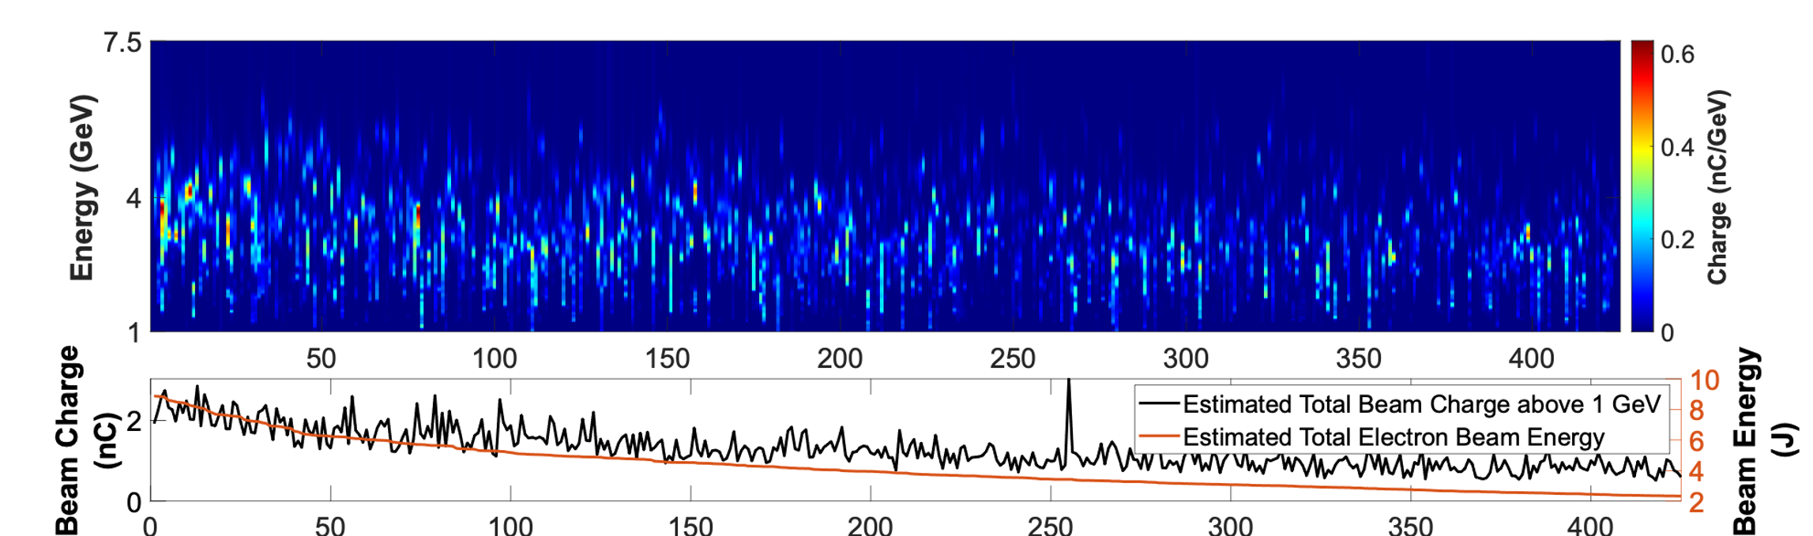
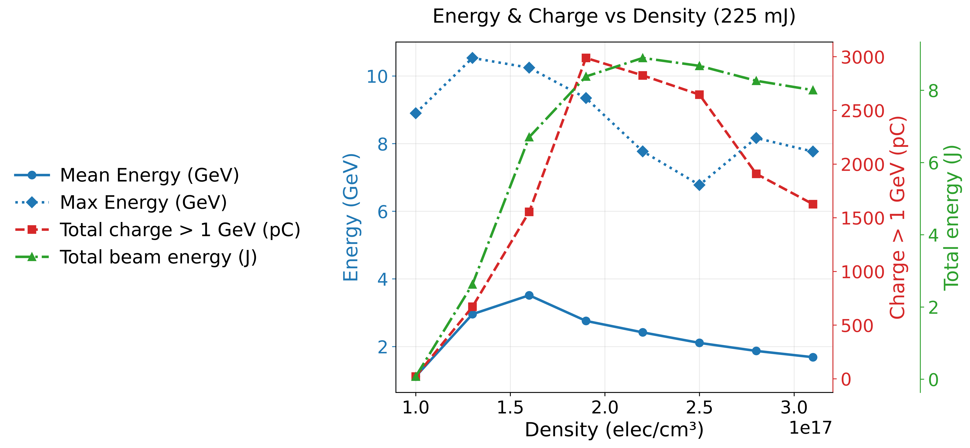

Multi-Joule Electron Beams with nC-level Charge
(a)
(a)
Demonstrated production of multi-GeV beams with nC-level charge
Corresponds to >30% laser-electron-conversion efficiency measured through slit
(b)
(d)
(c)
(c)
E. Rockafellow et al., Phys. Plasmas 32, 053102 (2025)
J. Shrock et al., in preparation
(a)

Slide 10
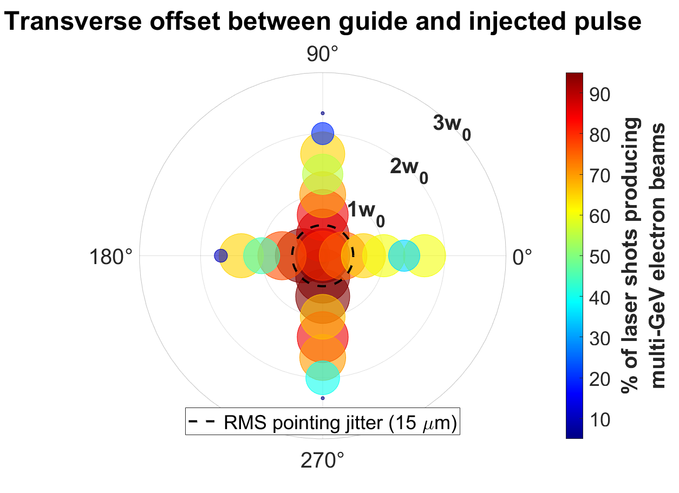

Funnel-Mouth Waveguide Improves Stability
(a)
Typically, acceleration would only occur withing 1w₀ of perfect alignment. The log axicon allows acceleration within 2w₀
(c)
(b)
funnel-mouthed plasma
N. Tripathi et al., Opt. Lett. 50, 3441-3444 (2025)
E. Rockafellow et al., In preparation
The funnel-mouth waveguide created by this log axicon creates a plasma-lensing effect allowing the accelerator to be much more robust to misalignment.

Slide 11
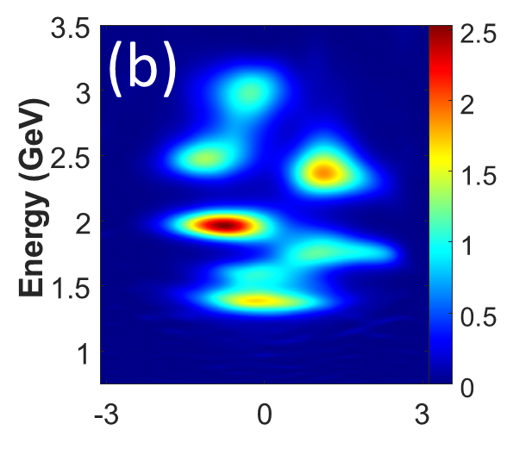


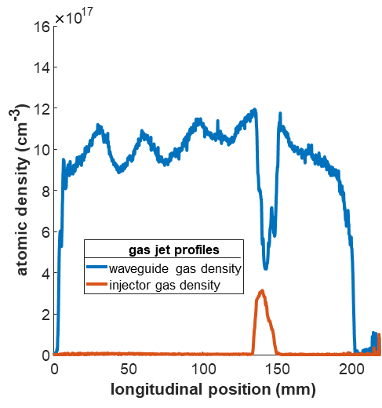
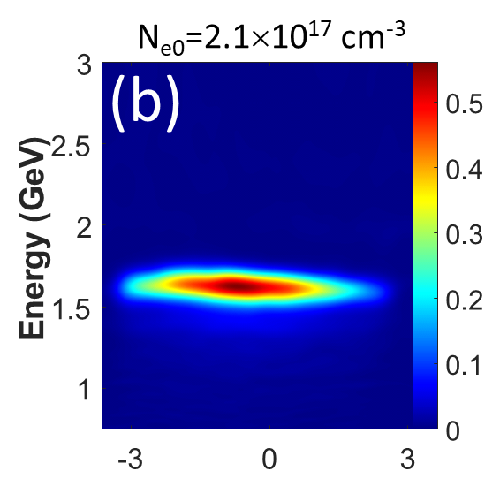
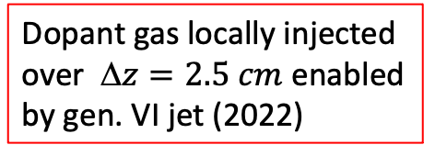
Controlling Ionization Injection via Locally Doped Jet
Multi-peaked spectra over range of densities
Dopant gas locally injected over $ z=2.5 cm$ enabled by gen. VI jet (2022)
(a)
(a’)
Single-peaked spectra over a range of densities
(b)
(b’)
Controlled ionization injection produced quasi-monoenergetic electron bunches with <10% energy spread
J. E. Shrock et al., Phys. Rev. Lett. 132, 045002 (2024)

Slide 12
Outline
30 cm Gen. VI Gas Jet
10 GeV, Multi-Joule LWFA at Colorado State University
Custom plasma waveguides for improved stability
Localized dopant for controlled injection
Modular Gen. VII Gas Jet for Customizable Accelerators
Three types of controlled injection at ELI Beamlines
Demonstration of rephasing electron beams with customizable density profile
Recent applications of LWFA electron beams as secondary radiation sources

Slide 13
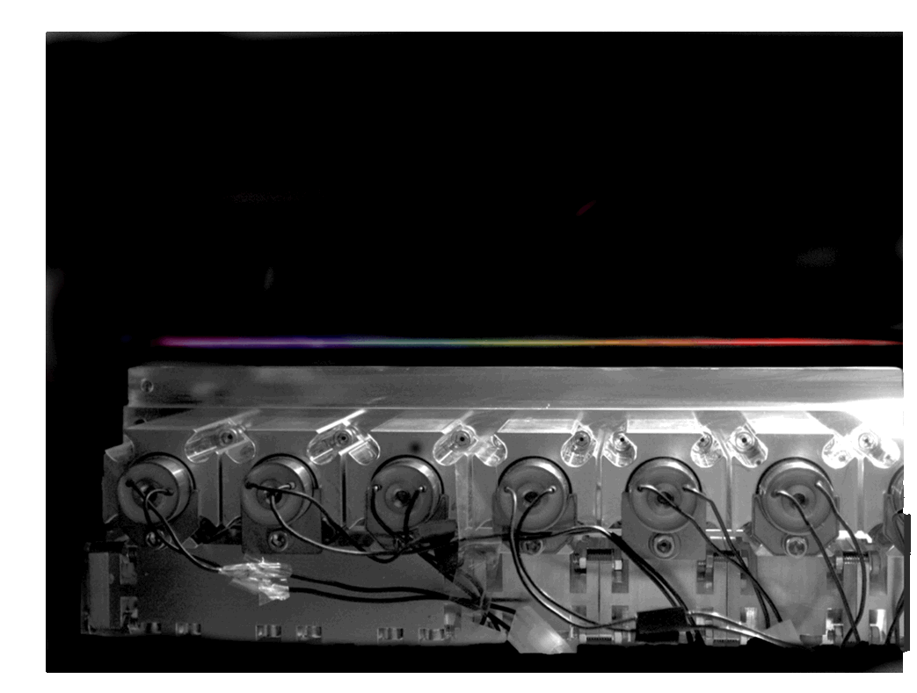
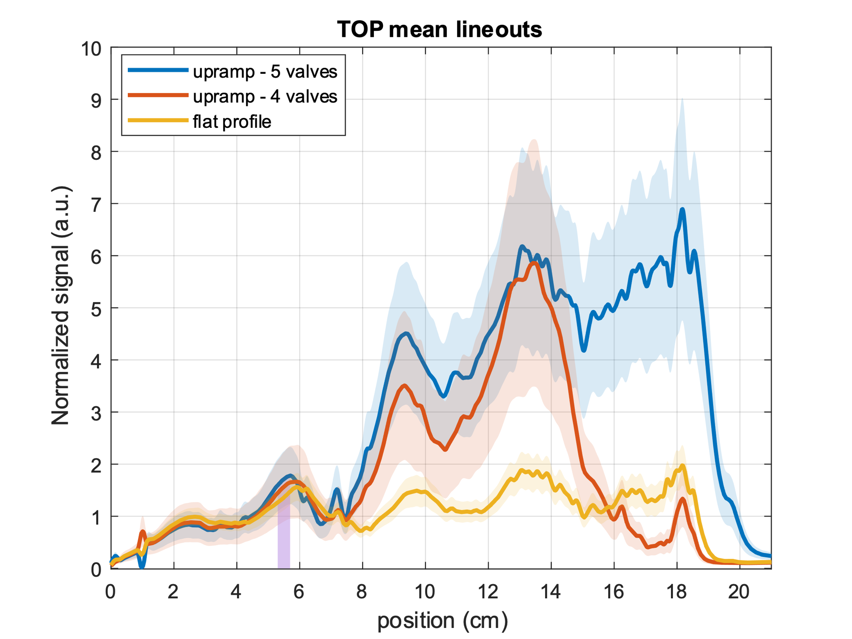
Longitudinal Control of Plasmas
(a)
(b)
Localized injection in 4 mm region
Generation VII Maryland gas jet:
Modular gas jet with controllable axial density and dopant locations
Extendable to any length
Hydrogen and Helium versions available
B. Miao et al., Rev. Sci. Instrum. 96, 043003 (2025)
Notes:
3.4 cm modules

Slide 14
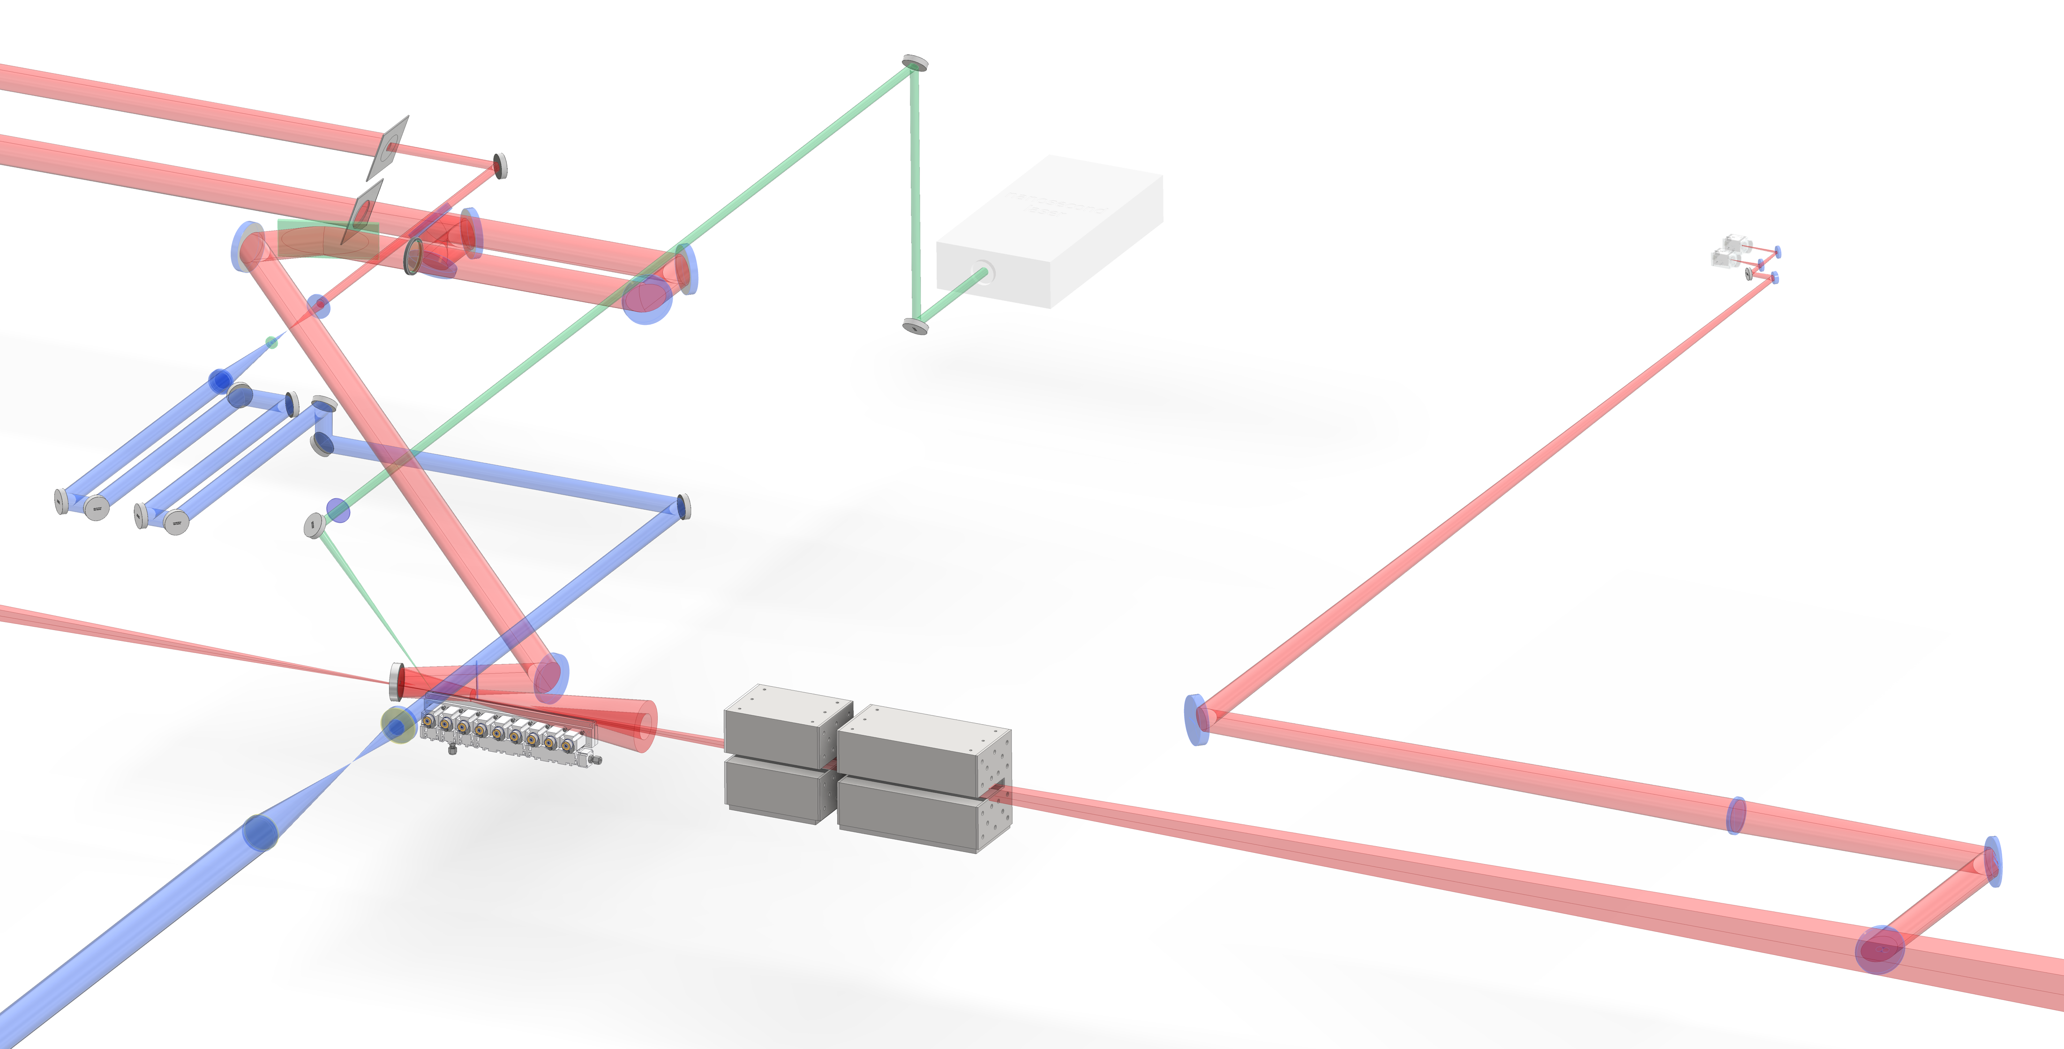
Three Controlled Injection Schemes
channel forming beam
probe
Localization of dopant to first two valves
Controlled nano-particle generation*
Channel modification or “break” injection*
Two new injection schemes!
(a)
ns-pulse
Localized ionization Florescence figure
pi-step phase plate
LWFA drive pulse
(b)
BM7
off-axis
axicon
He Gen. VII Jet
ELI beamlines setup designed and implemented by Jiří Šišma and ELBA team including: Bessel beam split post compression, all-reflective optical design, first use of Helium in this scheme, Bessel-beam formed with off-axis axicon. Both UMD Gen. VII gas jet and ELI gas jet were used.
ELI Beamlines Experimental Design: J. Šišma et al., in preparation
UMD Modular Gas Jet: B. Miao et al., Rev. Sci. Instrum. 96, 043003 (2025), modified for He by Ari Sloss
ELI Gas Jet: S. Lorenz et al., Matter Radiat. Extremes 4, 015401 (2019)

Slide 15
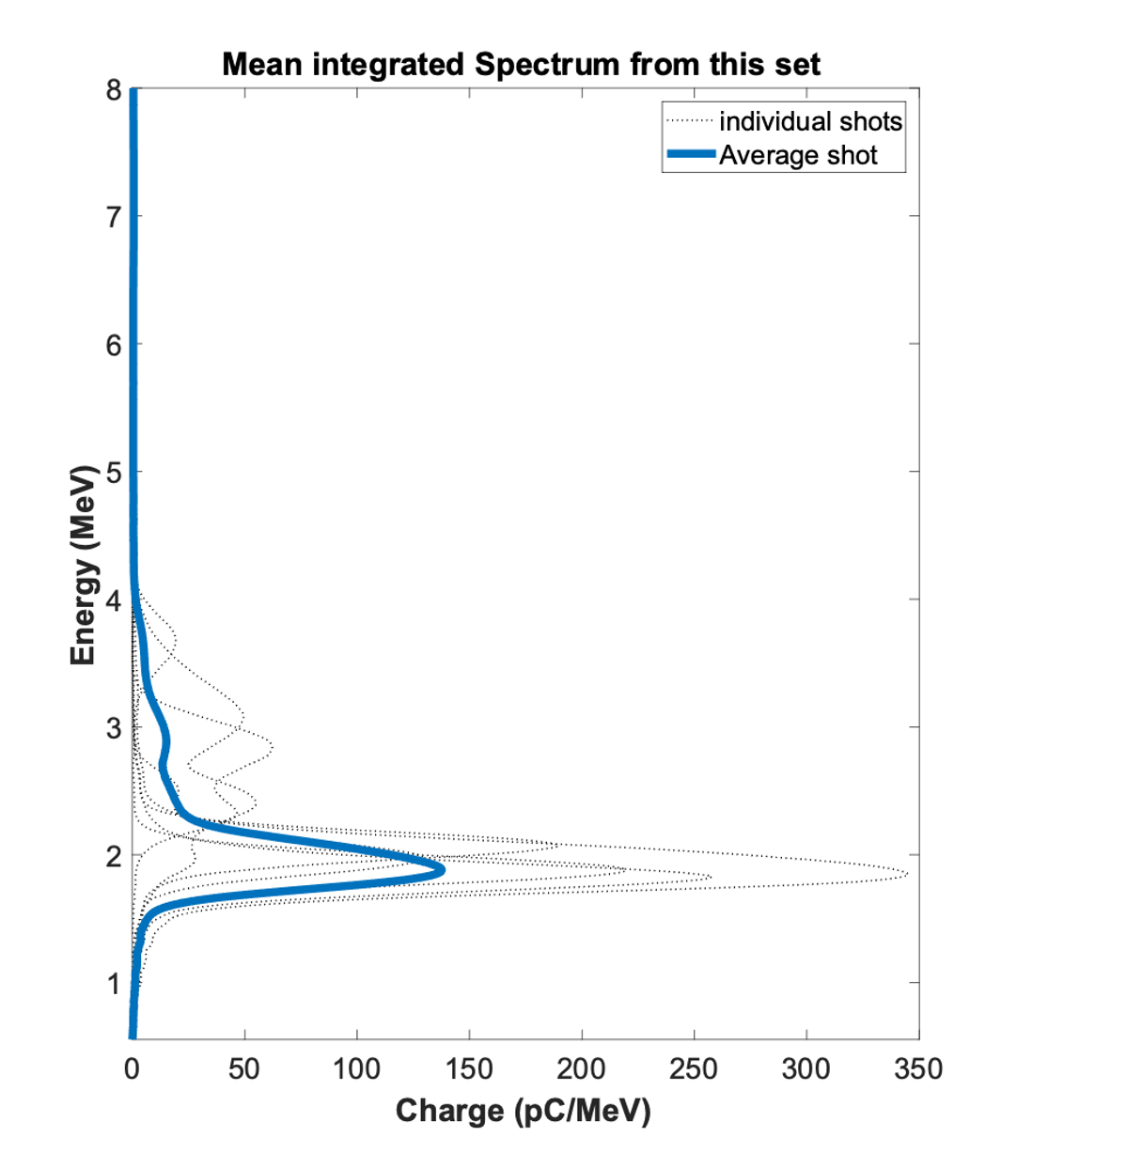
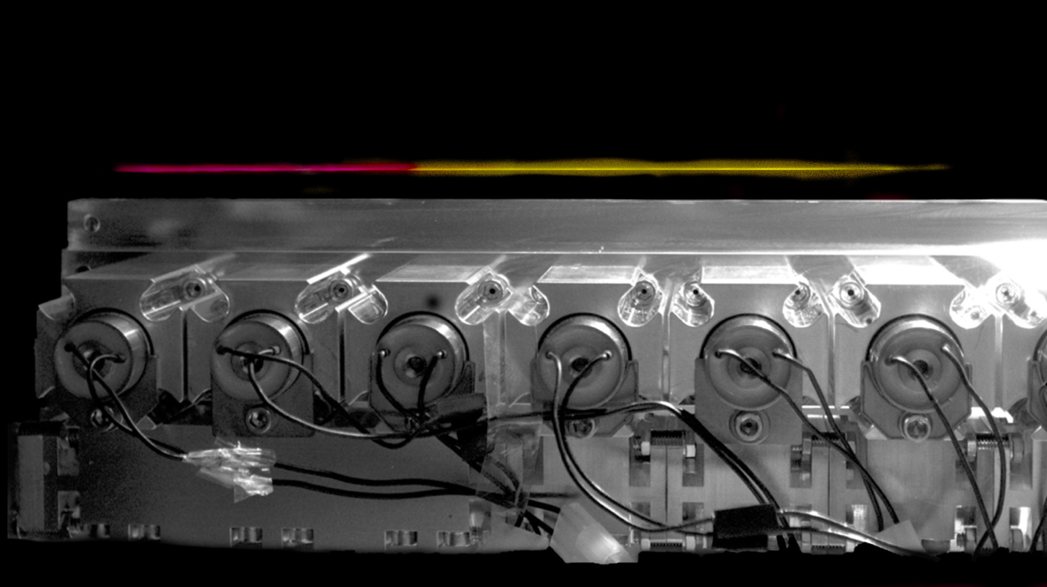
Localized Dopant
Localizing dopant to the beginning of the jet can reduce energy spread
7.6 cm: 1% N₂ 99% He
11.4 cm: 100% He
Limited energy spread, but inconsistent
Energy (GeV)
(b)
(a)
Charge (pC/GeV)
First localized dopant in gas jet: J. E. Shrock et al., Phys. Rev. Lett. 132, 045002 (2024)
Applied to 9.2 GeV: A. Picksley, et al., PRL 133(25), 255001 (2024))

Slide 16
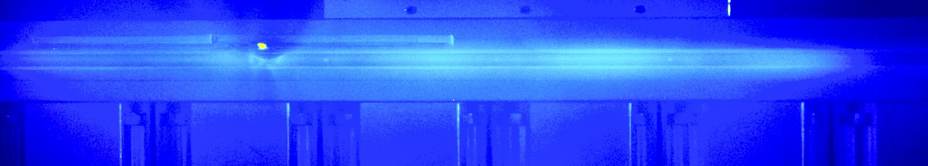
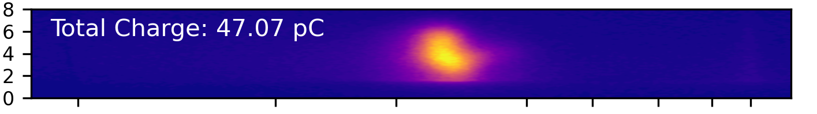
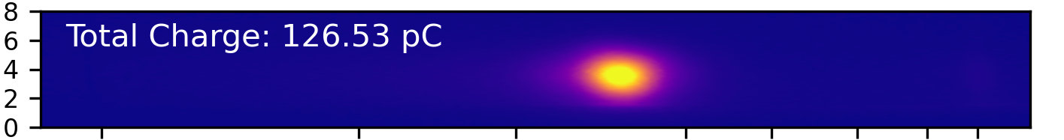
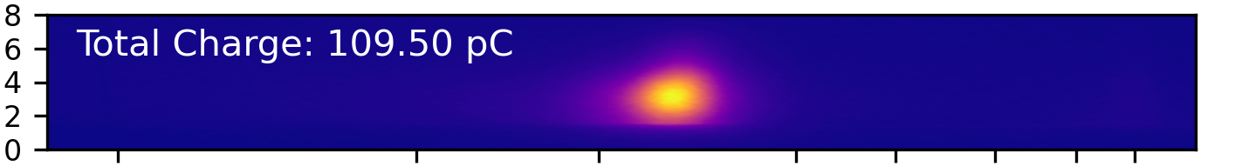
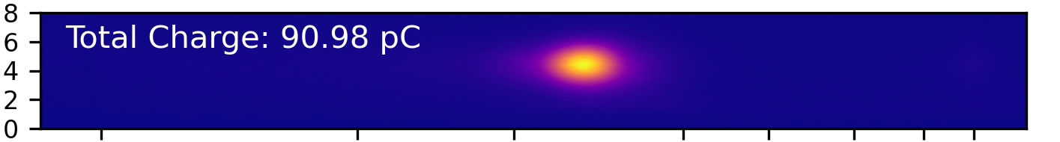
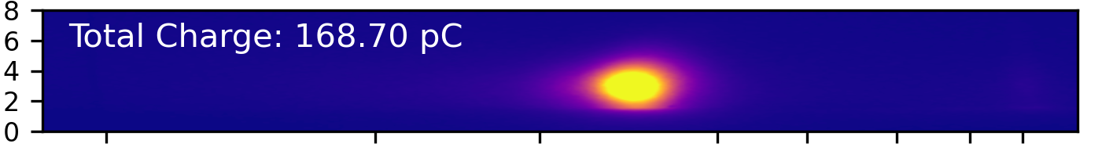
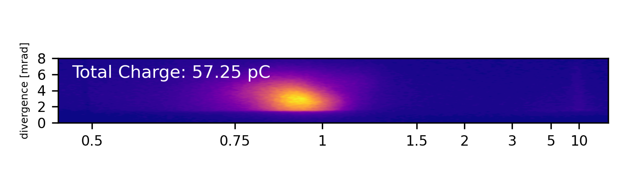
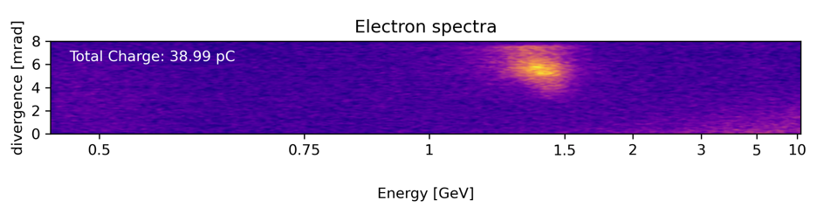
Controlled Nanoparticle Injection
Pure helium fluorescence showing localized nanoparticle generation from ablation of copper target with nanosecond laser
Example electron spectra from localized nanoparticle injection. No injection occurred without ns laser.
(a)
Ablation Laser:
Pulse length: 6-8 ns
Energy: 110 mJ
Wavelength: 532 nm
Injection 6 cm into jet
Cu Target
ns laser
waveguide
6 cm
ns laser
1 cm
20 cm
A. Špádová et al. arXiv:2508.10685 (2025)
A. Špádová et al. In preparation
C. Aniculaesei et al., Matter Radiat. Extremes 9, 014001 (2024)

Slide 17
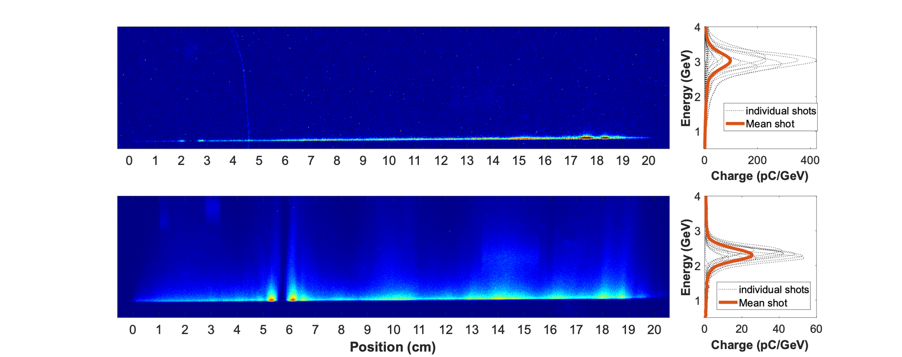
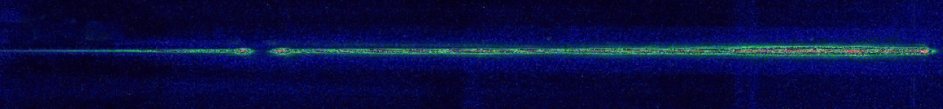
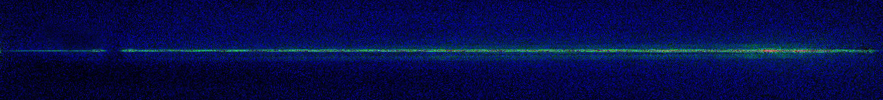
Channel Modification Injection
Phase change in channel forming beam creates 4 mm break in plasma, allowing highly controlled and repeatable new injection method with longitudinal control.
(a)
Resulting Spectra
Bessel Fluorescence – Channel Break at 5.8 cm
Phase shift from funnel-mouthed plasma
Channel modification or “break“
5.8 cm
Position (cm)
Bessel Fluorescence – Channel Break at 2.4 cm
Channel modification or “break“
2.4 cm
(b)
Position (cm)
Manuscript in preparation
Results used both UMD gas jet and ELI beamlines gas jet by S. Lorenz

Slide 18
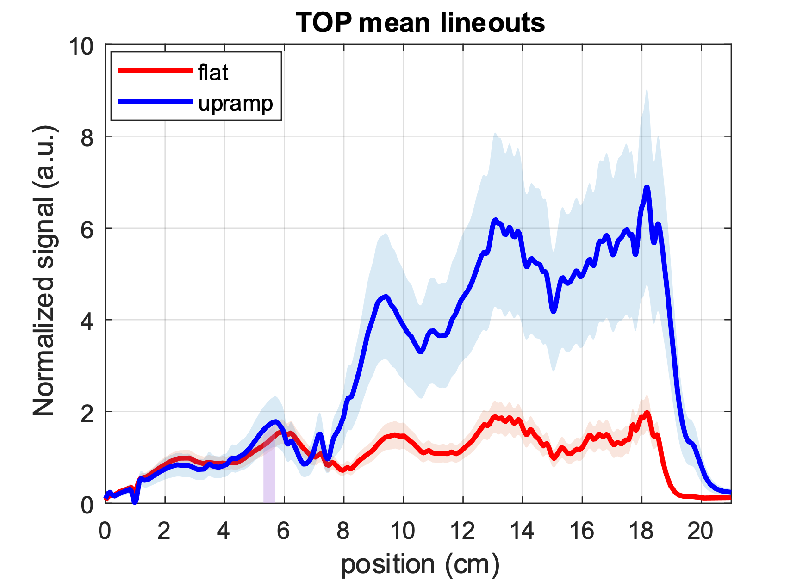
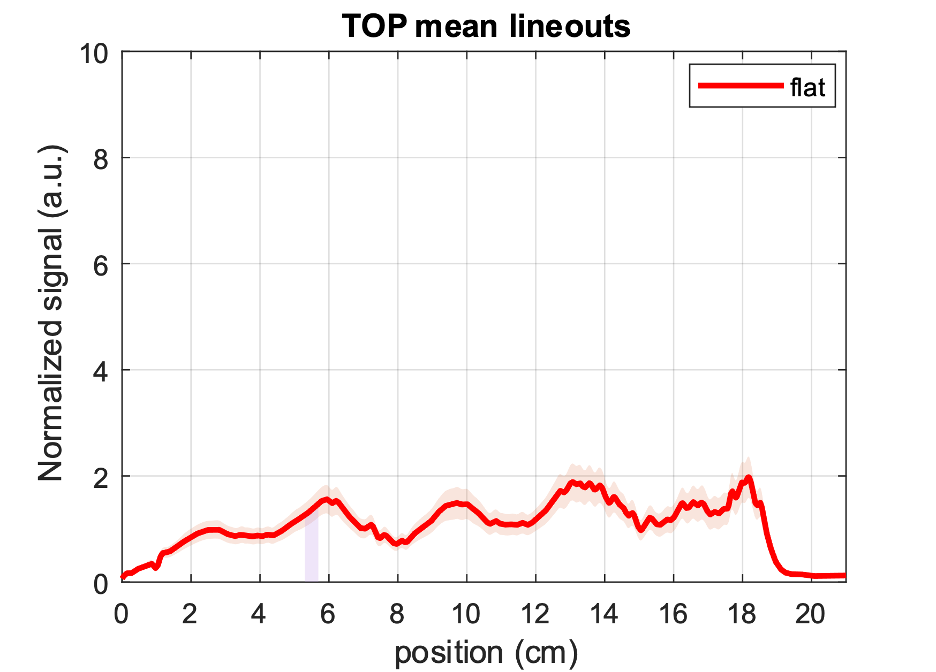
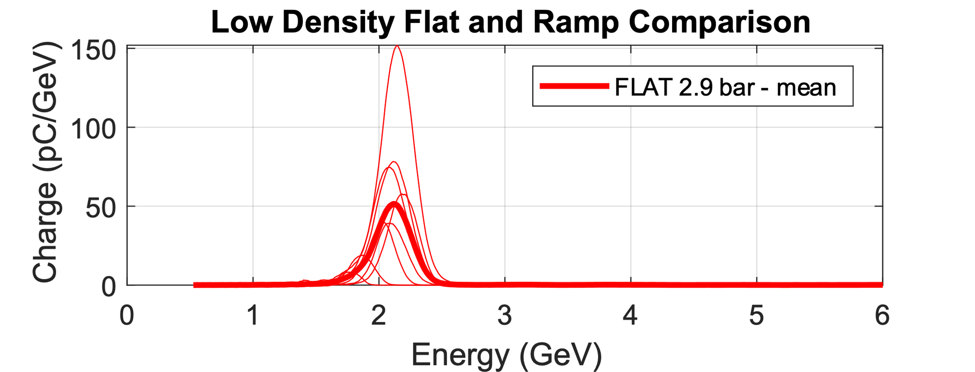
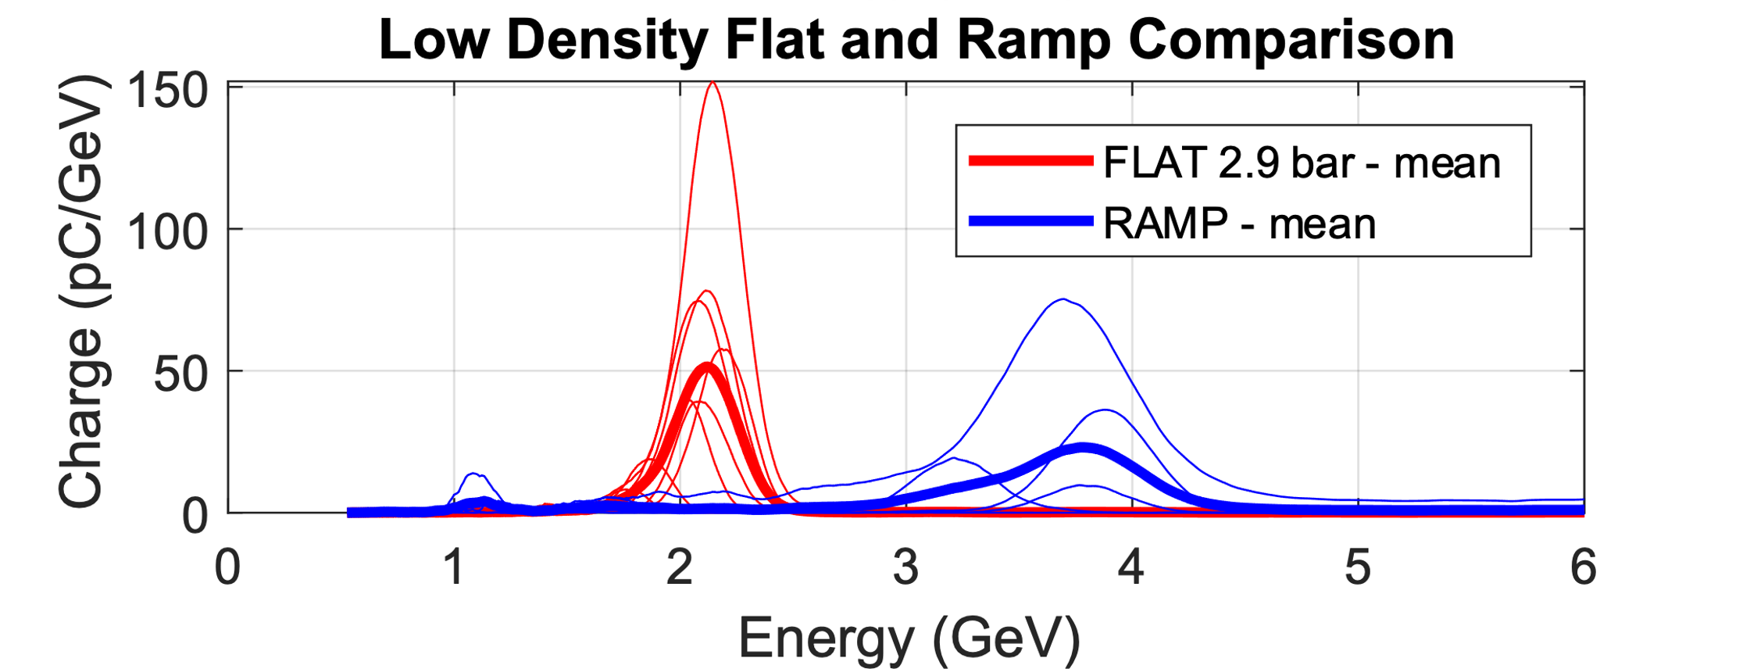
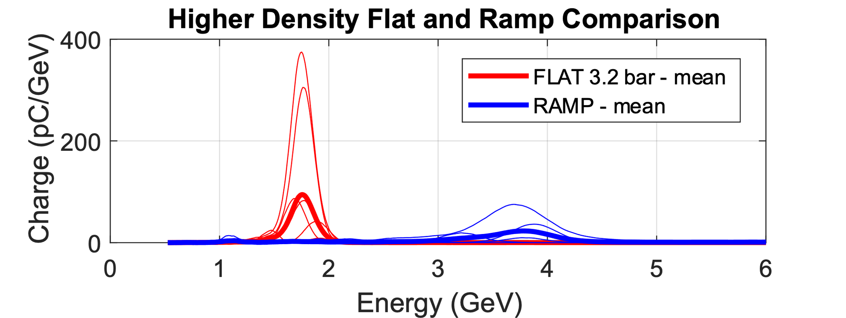
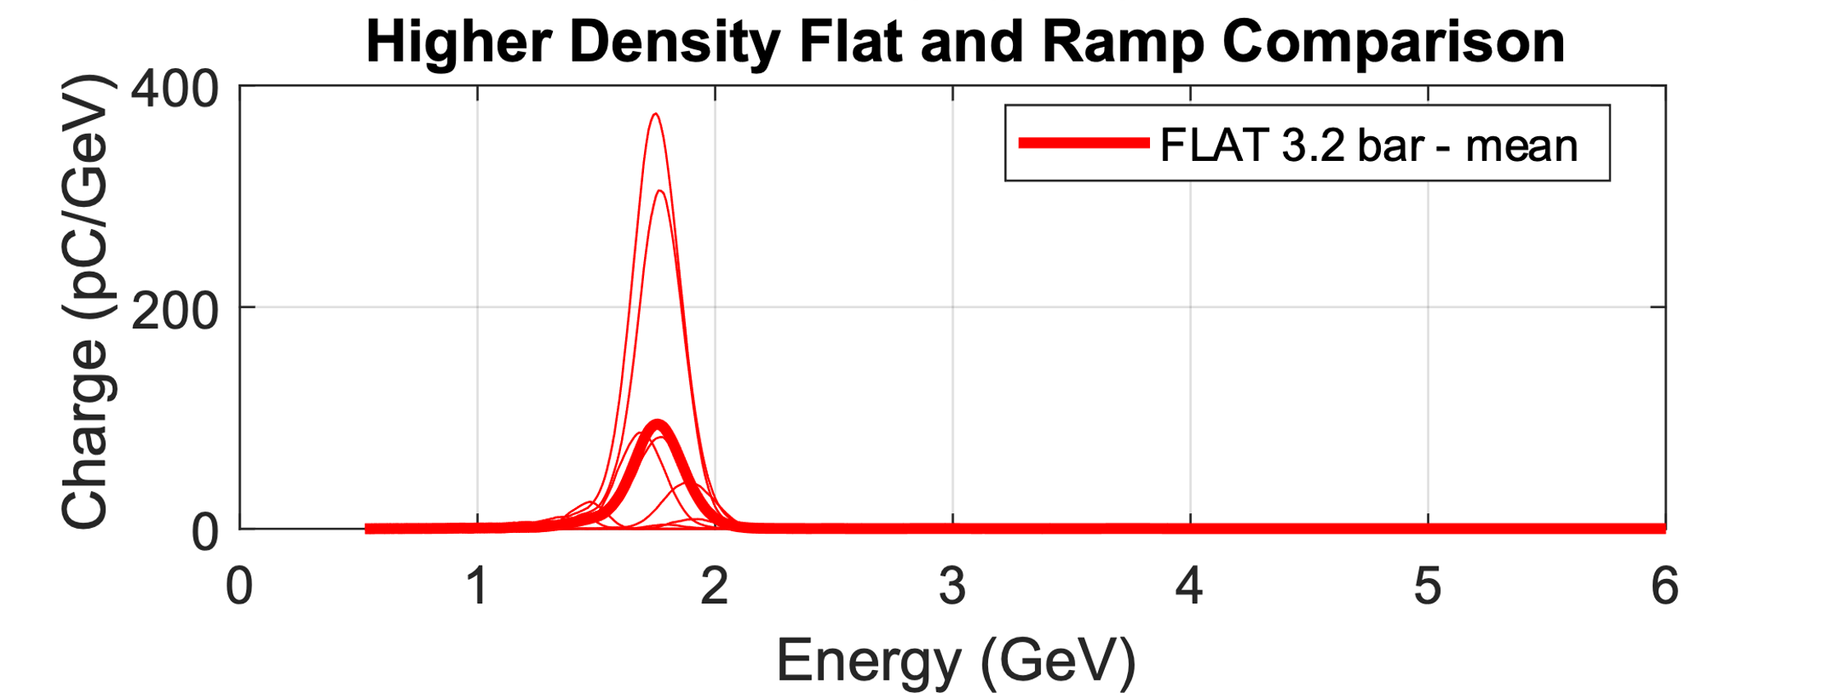
Rephasing Electron Beams
20 cm density ramp (selected by optimizing energy after each 3.8 cm region) increases energy by ~2x.
(a)
Single shots
~1.8x energy gain
(b)
Mean energy
Localized injection in 4 mm region
~2x energy gain
Mean energy
P. Sprangle et al. Phys. Rev. E 63, 056406 (2001)
E. Guillaume et al. Phys. Rev. Lett. 115, 155002 (2015)
Manuscript in preparation

Slide 19
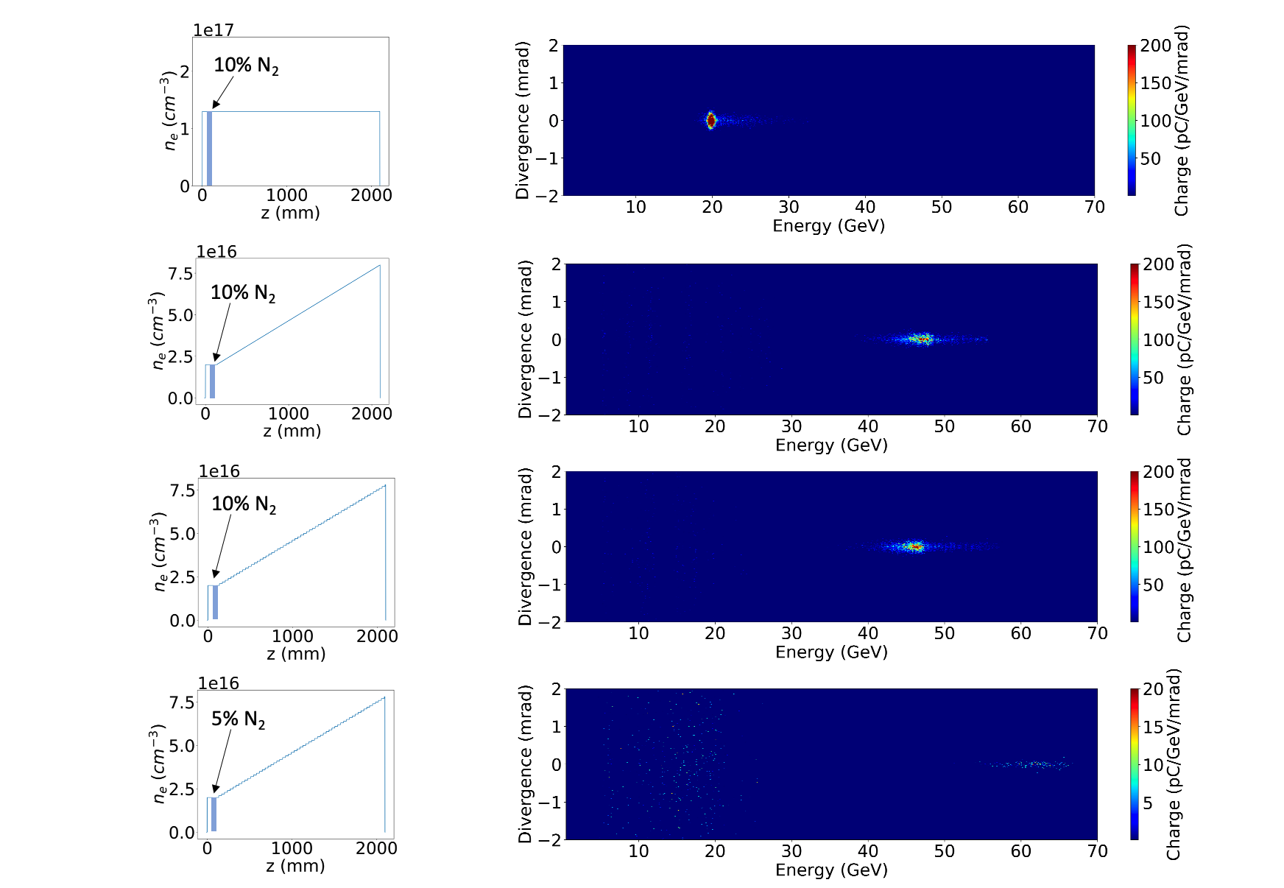
50 GeV Single Stage LWFA
(a)
(b)
H₂ plasma fluorescence above 1 meter jet
Localized injection section (N₂)
~2x energy gain
1 m log axicon used to make the plasma
Preliminary FBPIC simulations show density up-ramp rephasing can increase energy by ~2x accelerating electrons to ~50 GeV in 1.4 meters with 110 J on target
E. Rockafellow et al., Phys. Plasmas 32, 053102 (2025)
E. Rockafellow et al., in preparation
Notes:
3.4 cm modules

Slide 20
Outline
30 cm Gen. VI Gas Jet
10 GeV, Multi-Joule LWFA at Colorado State University
Custom plasma waveguides for improved stability
Localized dopant for controlled injection
Modular Gen. VII Gas Jet for Customizable Accelerators
Three types of controlled injection at ELI Beamlines
Demonstration of rephasing electron beams with customizable density profile
Recent applications of LWFA electron beams as secondary radiation sources

Slide 21
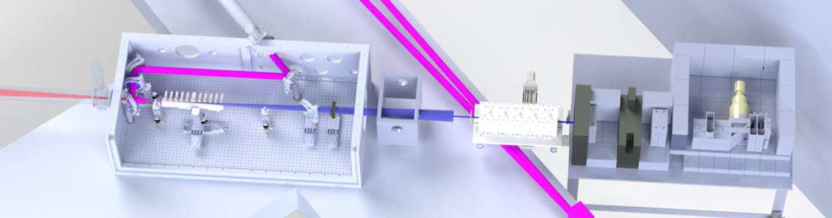
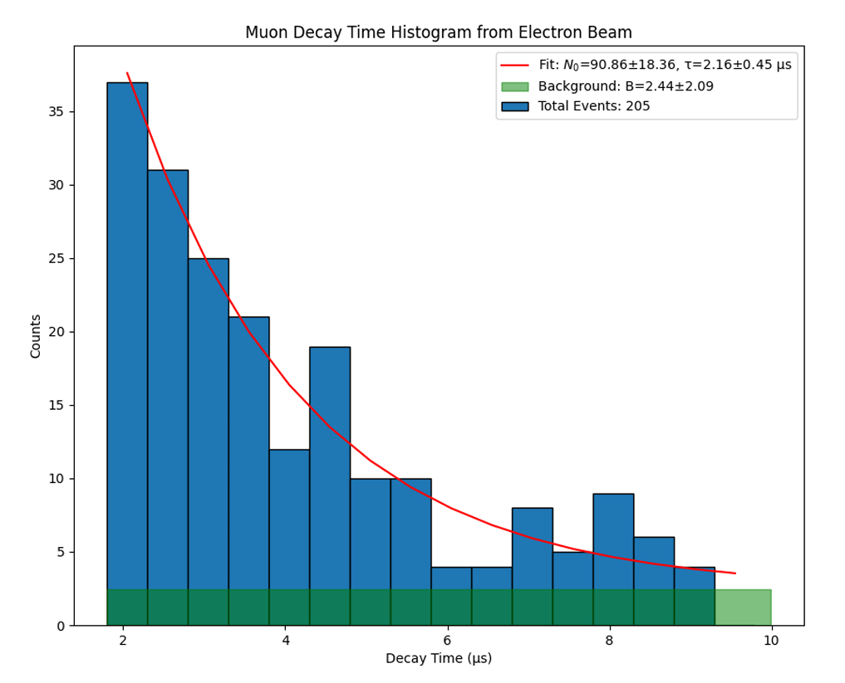
Multi-GeV Electron Source for Muons
Muon Detector Array
Channel-forming pulse
Self-waveguiding LWFA drive beam
Electron spectrometer
Super-sonic gen. VI gas jet
CSU High Energy Physics team: Kaixin Zhu, David Warner, Nikola Durand, Jay Jablonski, and John Harton
ELI-BL team: Anna Cimmino and Roberto Versaci
1 day of CSU muon candidate signals
Multi-GeV, nC beams used as driver for muon generation and positron generation experiments
Setup capable of producing up to ~1000 multi-GeV beams/day at 0.1 Hz rep rate
Fit = 2.16 ± 0.45 μs
Time (μs)

Slide 22




Demonstration of Lab-Generated Muon Imaging
Scintillator/SiPM Detector Array
Single shot “imaging” demonstration
All Particles (no object)
Object obscuring two detectors
Ratio
laser accelerator
Muon Beam
Lead “object”
Object
Detection and analysis team: K. Zhu, D. Warner, N. Durand, J. Jablonski, J. Harton, J. Williams, B. Reagan, A. Cimmino, R. Versaci

Slide 23



Guided LWFA Betatron Source
(a)
channel forming beam
350 μm strut size
probe
LWFA drive pulse
magnets
target
Gen. VII Jet
8 mm
Betatron x-rays
Steel Target
Betatron x-rays with guided LWFA
electrons
X-ray critical energy ~300 keV
Magnification in images: 2x
Detector: Andor camera (10 μm resolution)
Arial density: steel - 6.2 g/cm², tungsten - 15.44 g/cm²
8 mm
LLNL-CFPRES-2011540
Images curtesy of Lawrence Livermore National Laboratory Team: I. Pagano, F. Treffert, S. Kerr
Ball bearing, steal target, tungsten target

Slide 24
Summary
Meter-scale gas targets have enabled:
10 GeV, multi-Joule electron beams with >30% conversion efficiency
Demonstration of three distinct injection mechanisms
Demonstration of rephasing electrons with tapered density profile
LWFA electrons used as source for secondary sources such as muon radiography and betatron x-rays
1 meter
Looking into applying these results to 50 GeV single stage accelerator!

