Slide 1


Efficient high energy and high-repetition-rate proton acceleration from cryogenic hydrogen foil targets
Stefan Assenbaum^{1,2}, M. Rehwald¹, P. Ordyna^{1,2}, J. D. Schilz^{1,2}, M. Müller^{1,2}, T. Streil^{1,2},
J. Garreis^{1,2}, T. Kluge¹, R. Gebhardt¹, S. Bock¹, S. Göde³, M. Gauthier⁴,
C. Schoenwaelder⁴, M. Ikeya⁴, S. Glenzer⁴, U. Schramm^{1,2} and K. Zeil¹
(1) Helmholtz-Zentrum Dresden-Rossendorf e.V. (HZDR), Institut für Strahlenphysik, Bautzner Landstraße 400, 01328 Dresden, Germany
(2) Technische Universität Dresden, 01069 Dresden, Germany
(3) European XFEL GmbH, Holzkoppel 4, 22869 Schenefeld, Germany
(4) Stanford Linear Accelerator Center (SLAC), 2575 Sand Hill Road, Menlo Park, CA, 94025, USA
7th European Advanced Accelerator Conference
26.09.2025, Elba, Italy

Slide 2
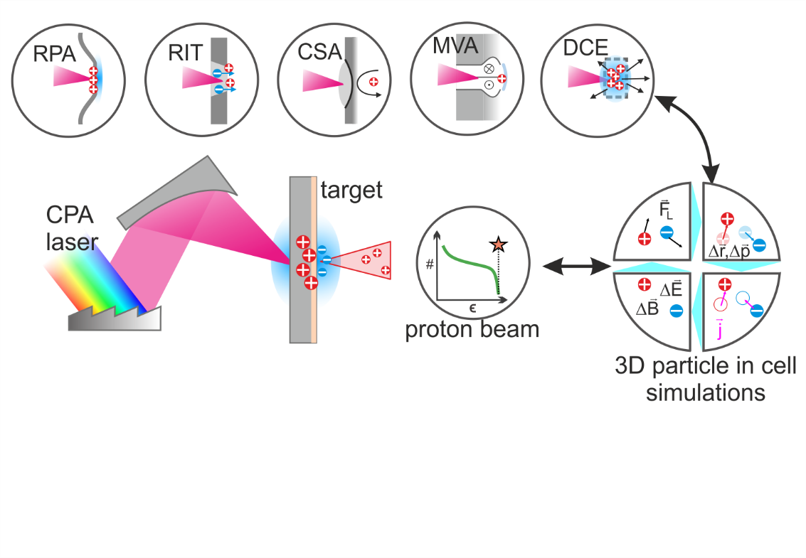
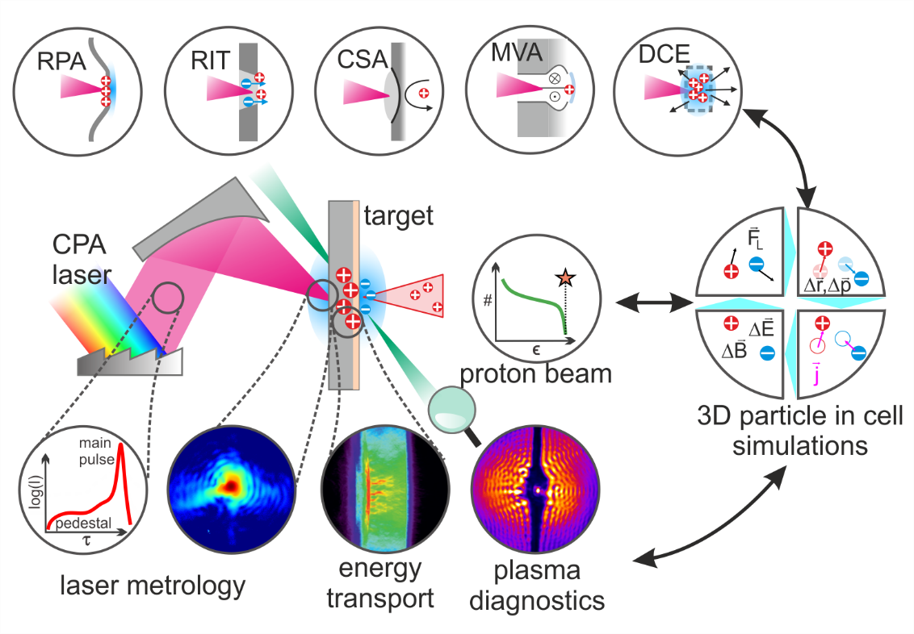
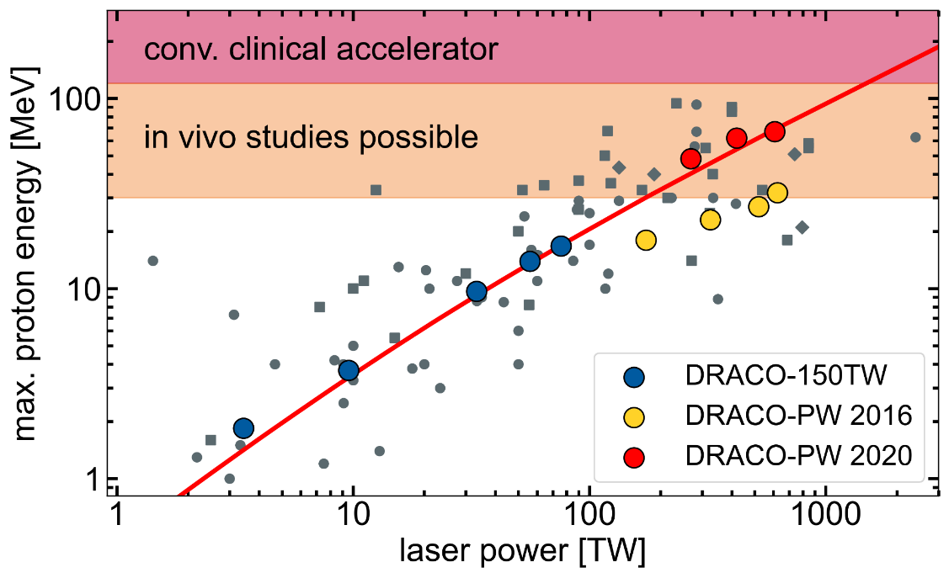
Laser-driven proton acceleration: A brief overview
Proton energy scaling remains challenging:
More laser power?
Can we Increase acceleration efficiency?
Target-normal
sheath acceleration
(TNSA)
Utilize advanced acceleration mechanisms
From back-illuminated photo anode
to bulk acceleration in quasi co-moving schemes
at near-relativistically critical density (near-RCD)
Indirect, highly non-linear processes
Exact knowledge and control of target and laser parameters required
Predictive 3D Particle in cell (PIC) simulations
2020 Roadmap on Plasma Accelerators, NJP 2021
Notes:
Extreme spatial, temporal and energy scales
Zoo of mechanisms. Reality also: combinations/cascades
WICHTIG:
Advanced acc physics is subject to research of the whole community in the last 10 years. Not really our work but all efforts combined
→ We have our niche: PW, fs, near-RIT regime

Slide 3
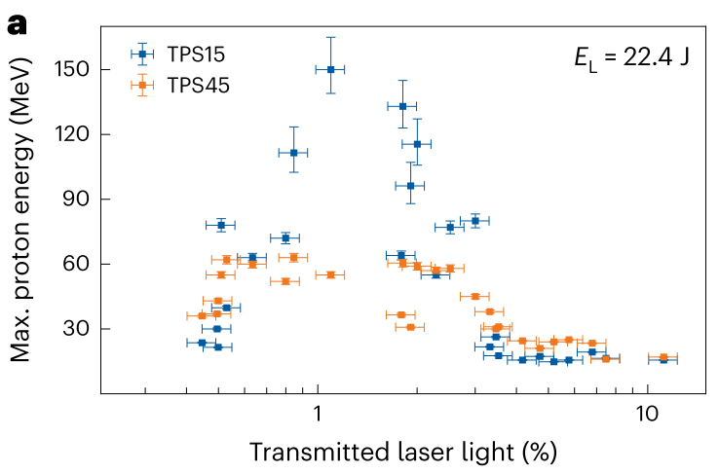
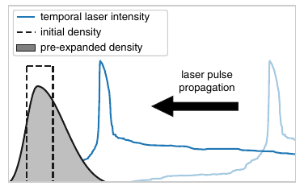
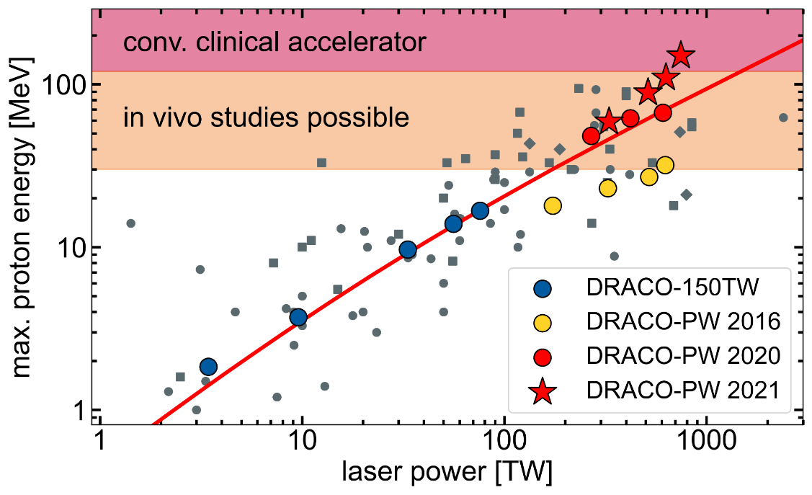
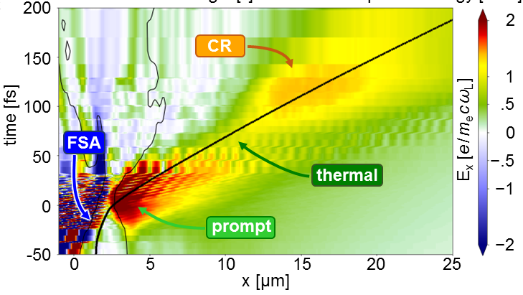
Near-RCD ion acceleration: Laser-target matching
To access the near-RCD acceleration regime,
Laser and target conditions must match.
Large fluctuations even at optimal matching
250nm Formvar
For solid density targets like plastic foils: → Target pre-expansion
Use intrinsic pre-expansion by the rising laser pulse flank:
Optimal matching:
250nm Formvar:
Only at ideal conditions:
cascade of acceleration mechanisms
Matching target thickness to laser contrast for optimal proton energies
Dover, Ziegler et al. (2023) Light Sci. Appl. 12:71
T. Ziegler et al. (2024) Nat. Phys. 20 1211–1216

Slide 4
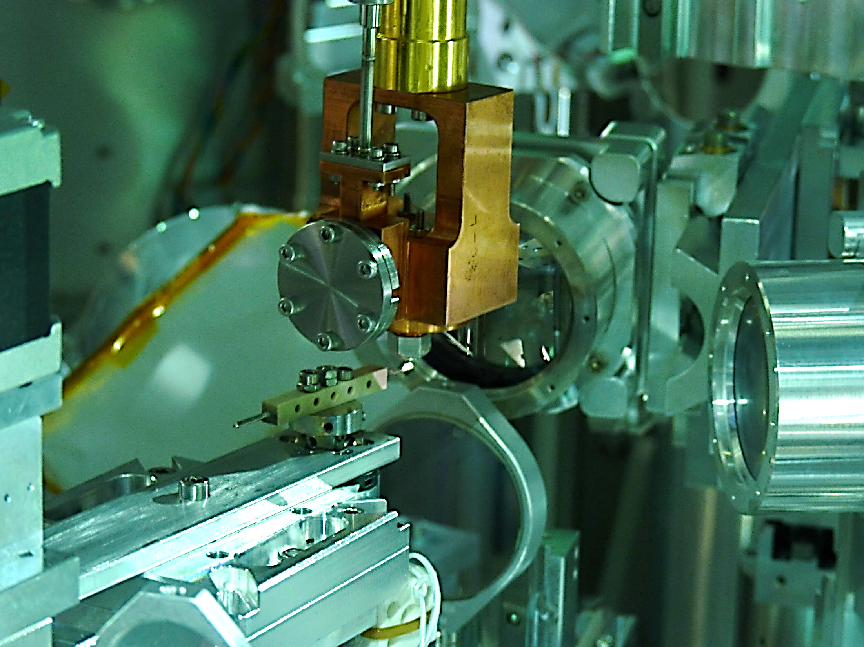
Open Questions and tasks:
Further improve the matching of laser
and target properties
  Use different target materials
  Scan laser energy instead of
  target thickness
Investigate and reduce fluctuations
  Record Larger data sets
Explore new and different acceleration
schemes and cascades
  PIC simulations
High-repetition-rate
cryogenic solid hydrogen target platform

Slide 5




The cryogenic solid Hydrogen jet platform:
laser ion acceleration and
plasma benchmark experiments
Pure hydrogen, low solid density,
(simple p⁺ / e⁻ plasma)
→ facilitates near-RCD
ion acceleration
→ simplifies numerical modelling
Cryogenic jet
source
Hydrogen is liquefied at ~20 K, ~5 bar
Cryogenic liquid Hydrogen is ejected into vacuum
through µm sized aperture
at high velocity
Evaporative cooling causes rapid freezing (~500 µm below source)
Continuous jet of solid Hydrogen
V ~100 m/s
J. Kim, Rev. Sci. Instr., (2016)
L. Obst, Sci. Rep. (2017)
C. Curry, JoVE (2020)

Slide 6
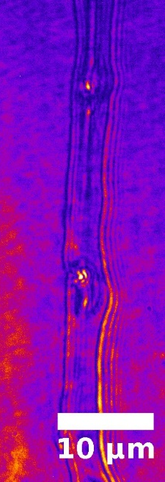
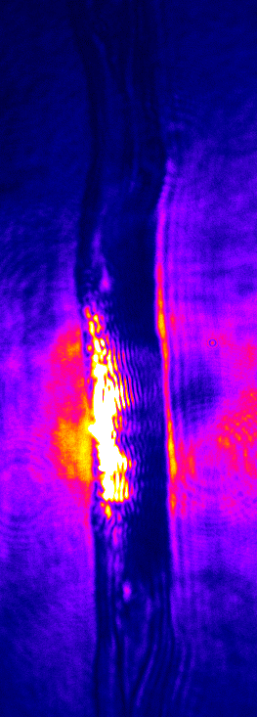
The cryogenic solid Hydrogen jet platform:
laser ion acceleration and
plasma benchmark experiments
Pure hydrogen, low solid density,
(simple p⁺ / e⁻ plasma)
→ facilitates RCD
ion acceleration
→ simplifies numerical modelling
Debris free, self-renewing
→ High repetition rate capability
Free standing geometry
→ Facilitates probing
Cryogenic jet
source
Hydrogen is liquefied at ~20 K, ~5 bar
5µm
Optical probing system
High power laser
Continuous jet of solid Hydrogen
V ~100 m/s
C. Bernert Phys. Rev. Appl. (2023)

Slide 7
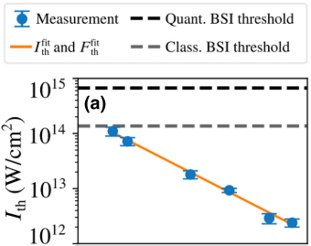
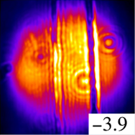
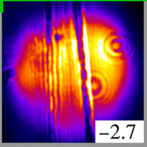
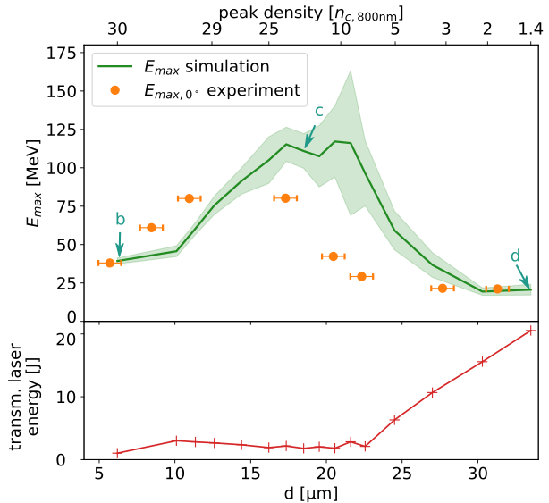
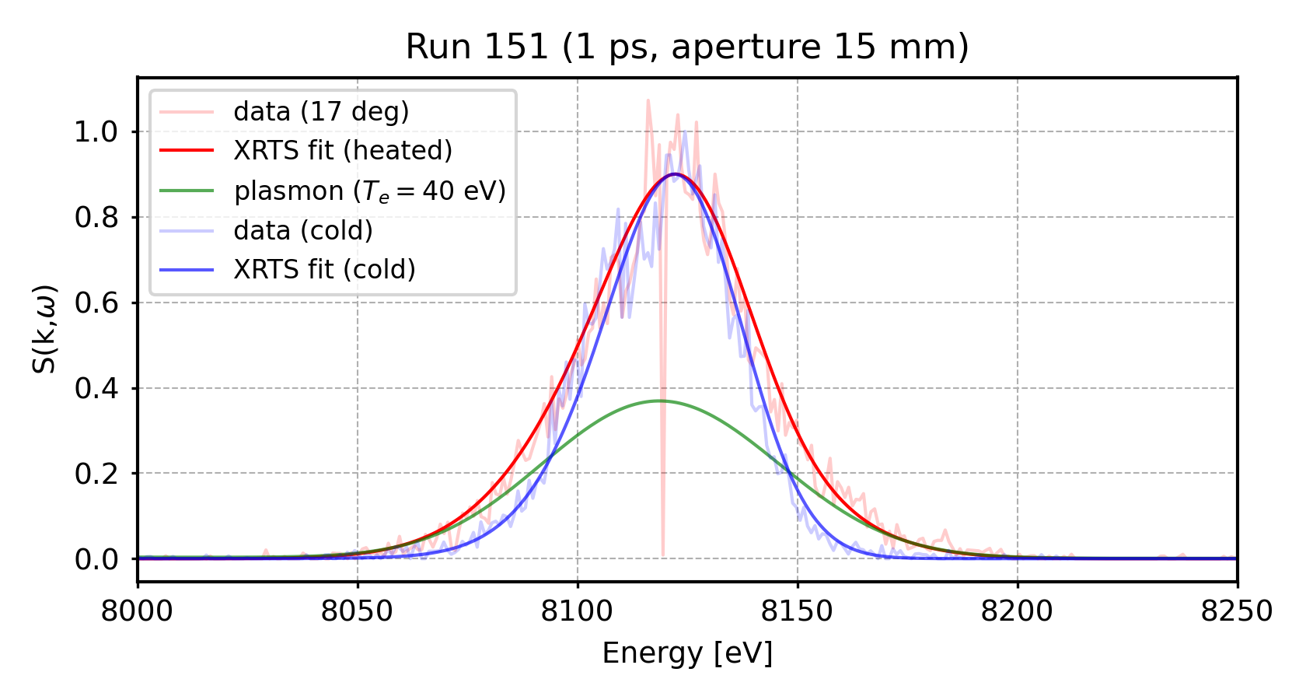
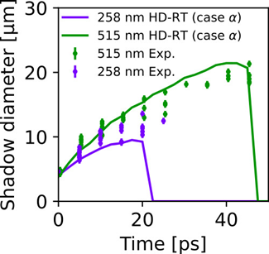
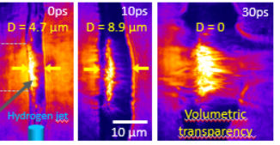
Jet target als einzigartige Plattform, um verschiedenste Aspekte von Lasergetriebenen Festkörperplasmen zu studieren
Different exp. Usecases vor dem Hintergrund des „Testbed“ – also zum prinzipiellen, grundsätzlichen Verständnis der verschiedenen Aspekte von LPA
  Entweder wie Constantin – sortiert über die Intensität nicht gut, da es das Konzept des Kontrast benötigt
  Oder losgelöst davon, dann aber dennoch logisch miteinander verknüpfen
Verbindende Elemente: simple Plasmabeschreibung (Simulationen), Repetitionsrate
The cryogenic solid Hydrogen jet platform
Laser-induced breakdown (LIB)
I ~ 10¹² - 10¹⁴ W/cm²
A universal testbed to study different aspects of laser-target interaction
Controlled target pre-expansion, enhanced proton acceleration
I ~ 10²¹ W/cm²
Log(Intensity)
TNSA
MVA
RTF-RPA
C. Bernert et al. Phys. Rev. Appl., 10, 14070 (2023)
S. Assenbaum et al. PPCF 67 015032 (2025)
Time
Short-pulse ineractions and thermalization
I ~ 10¹⁶ - 10¹⁷ W/cm²
M. Rehwald et al., Nat. Com. 14, 4009 (2023)
Plasma expansion and
simulation benchmarks
I ~ 10¹⁸ W/cm²
XRTS (x-ray
Thomson scattering)
→ direct measure-ments of T_{e}
courtesy of L. Fletcher
L. Yang et al.
Commun. Phys. 6, 368 (2023)
S. Assenbaum, et al. in preparation

Slide 8
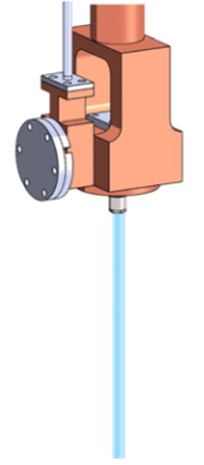
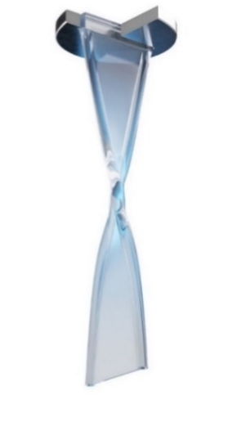
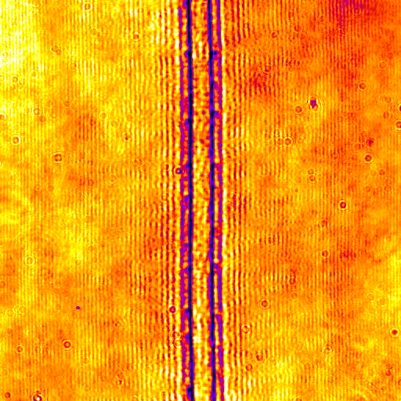
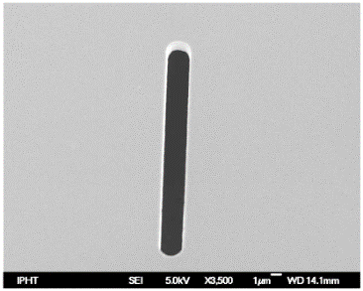
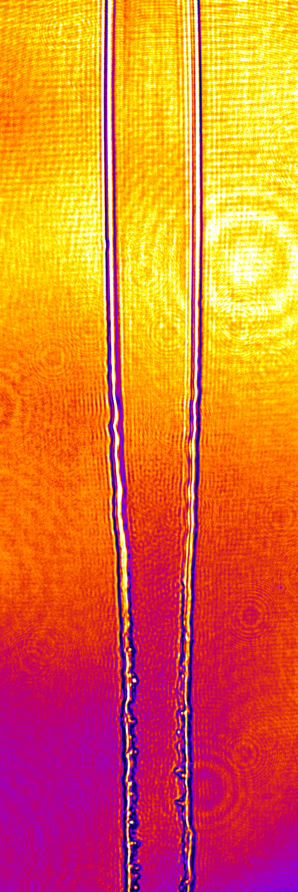
Adapting the cryogenic Hydrogen target
to near-RCD acceleration from foils
M. Gauthier
S. Goede
Shape the H2 jet while still in it‘s liquid state
using a slit aperture:
→ Introduces transversal flow
→ Forms alternating orthogonal leafs
At the right operation parameters:
The freezing of H2 preserves the shape
Stability at
ideal conditions
4µm
8 mm below cryostat
20 µm
Rotation: 45°
Jitter: ~3 µm
100 m/s
25 µm
Nicht immer on-demand
Immer noch subject to day to day fluctuations
Liquid Jet
5 µm
Planar sheet
Width: ~ 25 µm
Thickness: ~500 nm
Cylincrical rims
Ø 5 µm
freezing
20 µm
Real-time target position monitoring at 10 Hz
Frozen
solid
Foil-like, high-repetition-rate, pure solid hydrogen target
at fixed thickness
L. Obst, Scientific Reports (2017), C. Curry, JoVE (2020)
M. Rehwald, S. Göde, S. Assenbaum et al. in preparation
Notes:
Nicht immer on-demand
Immer noch subject to day to day fluctuations

Slide 9
Cryogenic H2 foil: experimental setup at Draco
Target: Cryogenic hydrogen jet
Foil-like geometry with cylindrical rims
Draco PW
f/2.2 OAP → 2.5 µm FWHM
intrinsic contrast
1.6J – 4.5∙10²⁰ W/cm²
2.7J – 7.8∙10²⁰ W/cm²
Up to 1Hz repetition rate
0°
15°
Proton diagnostics
Magnet spectometer
(15° and 45°) equipped
with Lanex scintillator
(and multichannel plate)
Time of flight (0°, 31°)
Monocrystalline diamond
31°
Other diagnostics:
Target alignment
& optical probing
Reflected/transmitted light
Online Laser diagnostics
…
45°

Slide 10
Efficient proton acceleration at 1 Hz
45°
1.6 J laser energy (50TW laser power)
1 Hz repetition rate.
In 45° direction (target normal axis):
>1000 consecutive shots without any corrections necessary
Median cutoff energy: 29 MeV
Up to 50 MeV maximum proton energy
We have removed the content of this slide.
For a low resolution preview of it, pleare refer to the presentation of Ulrich Schramm on Tuesday April 23rd in the ion acceleration session.
(title „Efficient laser proton acceleration in the near critical density regime”)

Slide 11
1011 shots, 1.6 J laser energy | 1 Hz repetition rate.
Proton emission angle
Laser forward direction
Target normal direction

Slide 12
1011 shots, 1.6 J laser energy, 1 Hz repetition rate.
Proton emission angle: statistics
>50 MeV detected in all spectrometers
Highest average cutoff energies and smallest
cutoff energy spread in in 31° and 45° direction
Reduced stability in 0° and 15° direction
High particle numbers up to ~12 MeV in all directions
Flat spectral region in high energy shots
Sometimes modulated spectra (spectral gaps)
Notes:
0° mean: 18 MeV, median: 12.7 MeV
15° mean: 25 MeV, median 25 MeV
31° mean: 32.7 MeV, median 34.8 MeV
45° mean: 28.2 MeV, median 28.7 MeV

Slide 13
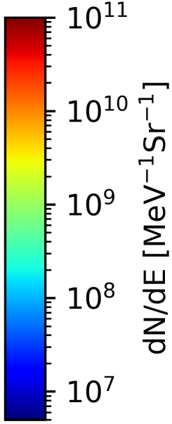
Increasing laser energy
2.7 J laser energy (80TW laser power) | 0.2 Hz repetition rate.
Spektren eher weg.
Stattdessen lieber:
histogramme, if reasonable
Energy scan weiter hoch zu 5J case
Notes:
0° mean: 26.2 MeV, median: 22 MeV
15° mean: 32.4 MeV, median 30.2 MeV
31° mean: 43.5 MeV, median 46.4 MeV
45° mean: 39.4 MeV, median 41.8 MeV

Slide 14
2.7 J laser energy (80TW laser power) | 0.2 Hz repetition rate.
Increasing laser energy:
Increased cutoff energy
in all directions
  Median >40 MeV
  in 45° and 31°
  >60 MeV in 0° and 15°
Increased cutoff energy
spread in 45° and 31°
Spectral Modulations
are more common
5.3 J laser energy (160TW laser power)
Reduced cutoff energies in all directions except 0°
Strong increase of transmitted light
Notes:
0° mean: 26.2 MeV, median: 22 MeV
15° mean: 32.4 MeV, median 30.2 MeV
31° mean: 43.5 MeV, median 46.4 MeV
45° mean: 39.4 MeV, median 41.8 MeV

Slide 15
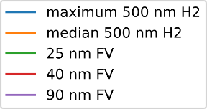
Foil comparison:
Start simple with 45°, one large plot.
Show best shot @1.6J
Add a random, normal TNSA spectrum from the recent campaigns – should be much more particles (??)
Show the real mean or at least a more „median“ spectrum – what to expect reliably.
Then compare to Foils. Take best shots each but remind that statistics is low here
Comparable proton numbers
Less energy than best H2, but comparable to median of H2
  Reminder: thickness sampling is rather rough
Only then: generalize to different directions
  Show 15° direction data (but with abs calib = lanex data!)
  ToF‘s saturated
Direct comparison with Formvar foils
Matching thin formvar foils to the given laser parameters
Best shots per data set
1.6 J laser energy on target
2.7 J laser energy on target
H2 foils give higher energies and Particle numbers than for Formvar foils
Median H2 energy similar to highest Formvar energy
Notes:
Higher energies doesn‘t make sense beacuse H2 starts to burn through.
(verify by TL)

Slide 16

Energy scaling
DRACO-PW 2025
500nm solid H2 – 1 Hz (0.2 Hz)
median performance
DRACO-PW 2025
Formvar – thickness matched
Near-RCD scaling?
DRACO-PW 2025
500nm solid H2 – laser power matched
Notes:
Überleitung zu Sim dann: wie kommt es zu den ganz ganz hohen Energien?
And can we find some systematics in the emission angle characteristics?

Slide 17

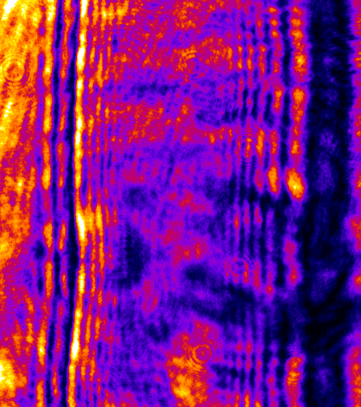
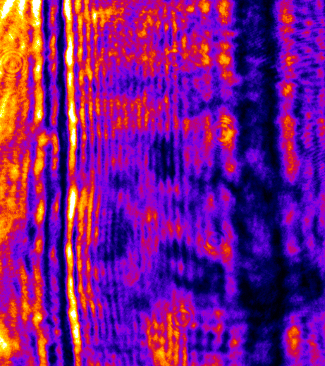
PIC simulations: modelling pre-expansion
Courtesy of Paweł Ordyna
Near-RCD laser ion acceleration requires
correct modelling of pre-expansion
Typically: combination of PIC and
hydrodynamic simulations
Laser Induced Breakdown
ionization starts here
Here: „All in one“ approach:
Use real, measured temporal profile of laser pulse (including pedestal)
Start at -32 ps: Experimentally measured Laser-induced breakdown
Simulate full interaction including
main pulse in one PIC simulation
LIB measured with off-harmonic optical probing
N. Dover et al. Light Sci. Appl. 12:71 (2023)
L. Yang et al. Commun. Phys. 6, 368 (2023)
A. Hirsch Passicos et al. in preparation
C. Bernert et al. Phys. Rev. Appl., 10, 14070 (2023)
S. Assenbaum et al. PPCF 67 015032 (2025)
2D3V, a₀=14.5
(4.5 ∙ 10²⁰ W/cm²)
-32 ps
~32ps takes approx. 7 days on 4 v100 GPUs
Notes:
High average efficiency

Slide 18
PIC simulations: a first look
2D3V, a₀=14.5
32 ps: from LIB to peak
Simple foil geometry
45°
31°
15°
Electron density
0° | Laser
Highest ion energies at
15° to laser axis
Reproduces near-RCD
acceleration from Formvar
Including the rims
45°
31°
Electron density
15°
0° | Laser
Nearly uniform angular emission. Slightly reduced cutoff energy
~32ps takes approx. 7 days on 4 v100 GPUs
Notes:
Übergang zwischen sims: 45° passt garnicht

Slide 19
PIC simulations: The influence of the rim
Angular proton spectra depend on relative timing of field evolutuion from foil and rim
Proton density
45°
31°
4
3
15°
1
0° | Laser
2
0 fs
20 fs
40 fs
80 fs
110 fs
200 fs
300 fs
Forward accelerated protons from foil bulk
Compression by surface current
Isotropic proton emission from right rim
Ion are affected by accelerating fields from foil + rim
central hit
Position of laser focus strongly influences the dynamics
right hit
left hit
Further details + full 3D sims: work in progress

Slide 20
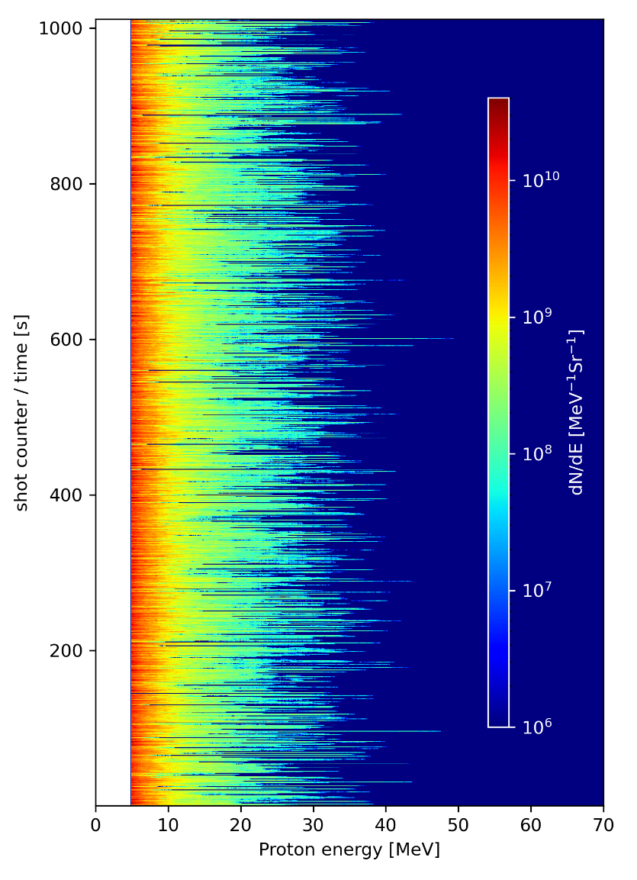
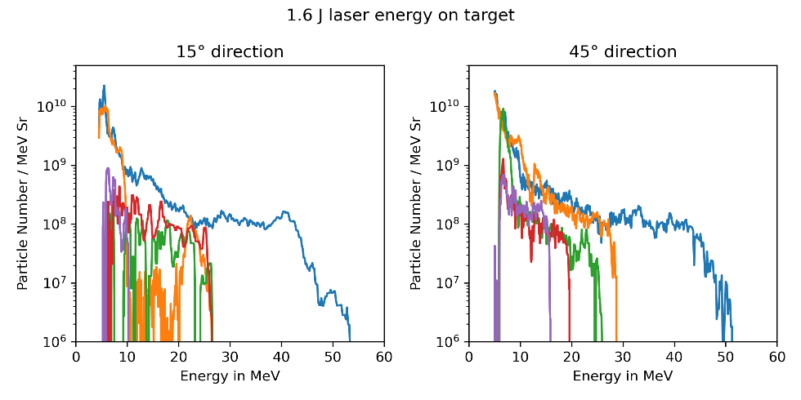

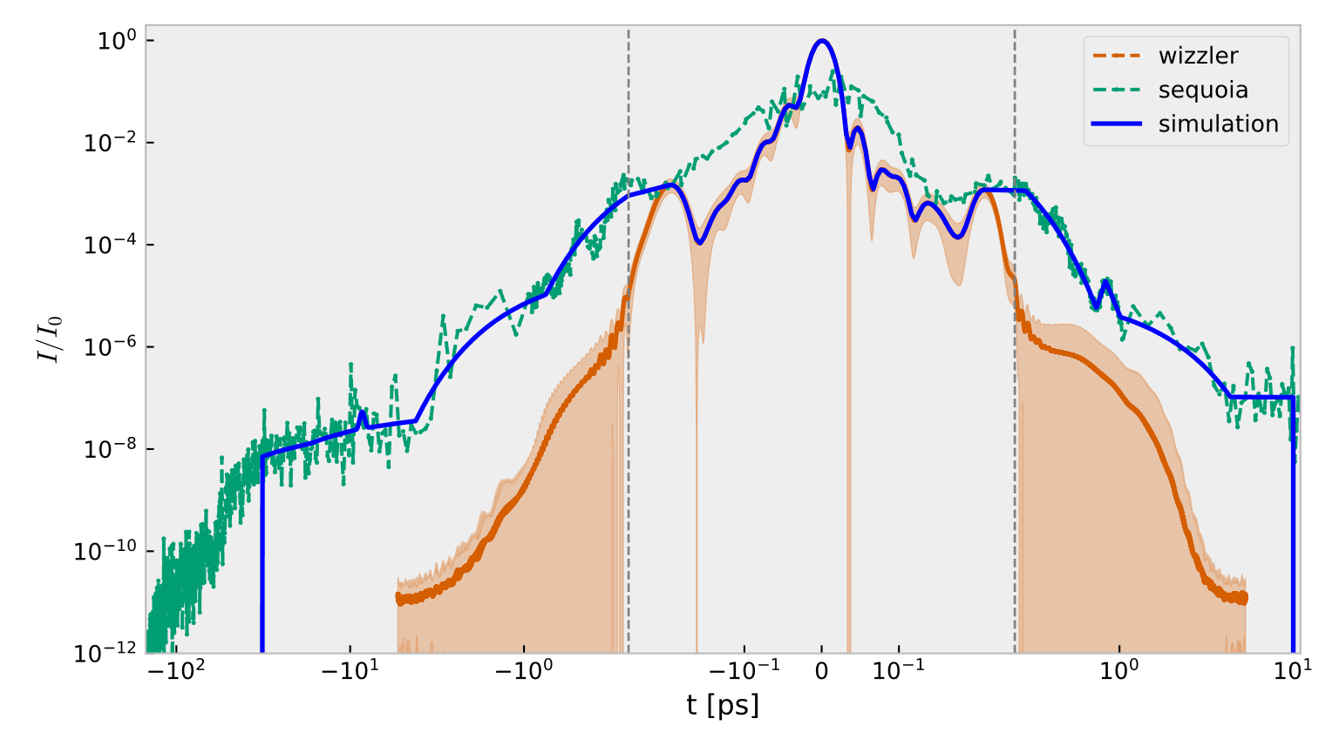
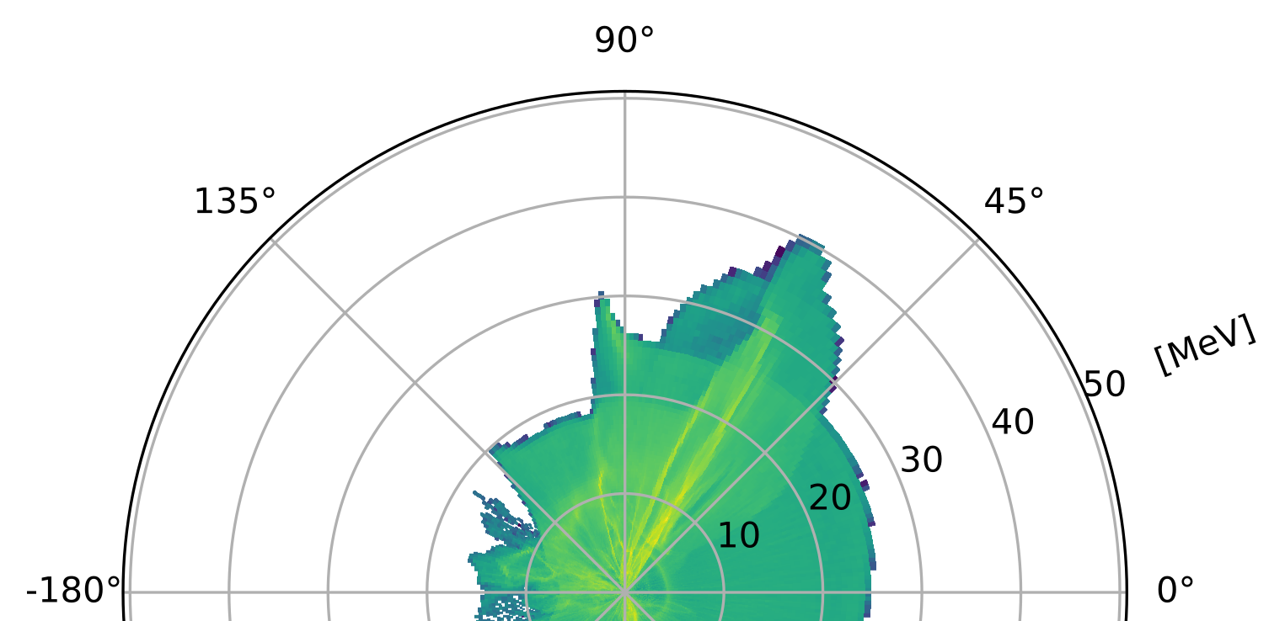
Summary
Cryogenic solid Hydrogen jet target adapted for near-RCD proton acceleration
from foil targets
Comparison to Formvar targets
100 m/s
Liquid Jet
2D PIC simulation for pre-expansion
and acceleration
High efficiency
high repetition rate
high stability
proton acceleration
50 MeV from 1.6J energy
freezing
Frozen
solid

Slide 21
Thank you for your attention
And thanks to all my colleagues and collaborators
HZDR:
Martin Rehwald, Joshua D. Schilz, Thomas Streil, Maximilian Müller, Julian Garreis,
Paweł Ordyna, Thomas Kluge, Arthur Hirsch-Passicos,
Constantin Bernert, Milenko Vescovi, Tim Ziegler, Hans-Peter Schlenviogt, Josefine Metzkes-Ng,
Florian Kroll, Marvin E.P. Umlandt, Radka Štefaníková, Thomas Cowan, Ulrich Schramm
and Karl Zeil
René Gebhardt, Uwe Helbig, Thomas Püschel, and Stefan Bock
Christoph Eisenmann, Simon Grams
HED group from EuXFEL
Sebastian Göde
HEDS group from SLAC:
Maxence Gauthier, Christopher Schönwälder, Megan Ikeya, Siegfried Glenzer

Slide 22
Backup

Slide 23
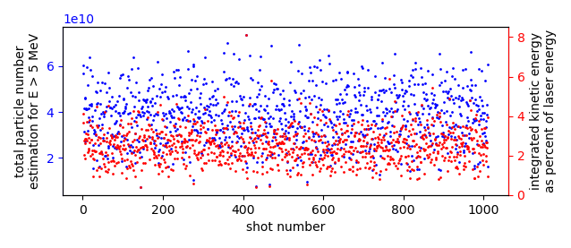
Conversion efficiency
Assumptions:
Use spectrum from
0° / 15° / 31° / 45°
spectrometers
Spectrum is representative for
  +-7.5° (horizontal plane)
  +-10° (vertical)
Only use E>5MeV protons
0°
Mean conversion efficiency: ~3%
Peak conversion efficiency: 8%
  Dominated by large particle numbers in 0°
  (too large??)
15°
31°
45°

Slide 24
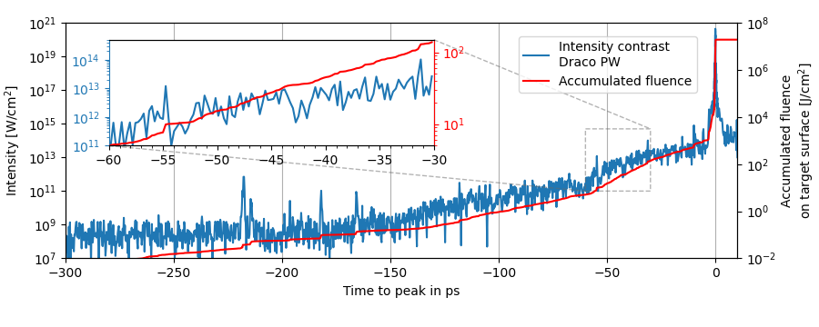
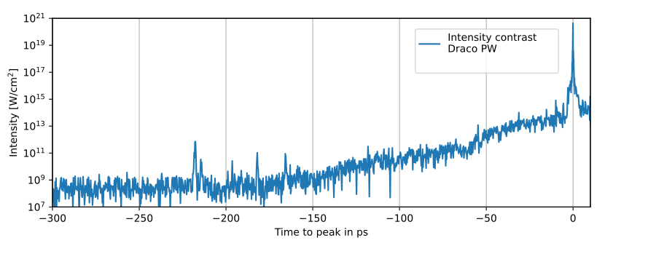
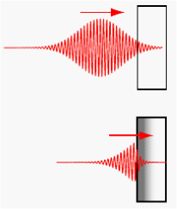
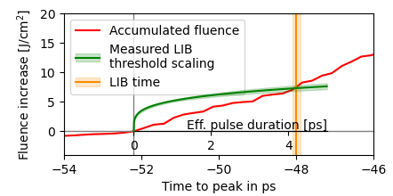
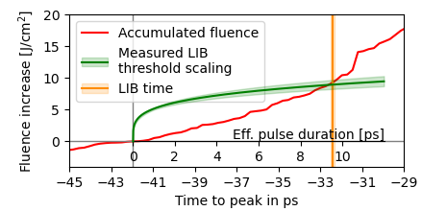
Laser contrast and laser-induced breakdown (LIB)
LIB = n_{e} in conduction band > n_{c}
Change of laser-target interaction mechanism
Start of plasma formation and pre-expansion
Transmittive
Reflective
Direct LIB time measurement in acceleration experiment
LIB at 32 ps
Expectation:
Laser contrast 6x better:
LIB at 48 ps ??
Mismatch between prediction and measurement
Try adjusting contrast manually until LIB time matches:
LIB at 32.5 ps
small pre-pulse
at 31.3 ps
C. Bernert et al., Phys. Rev. Appl., 10, 14070 (2023)
S. Assenbaum et al. PPCF 67 015032 (2025)

Slide 25
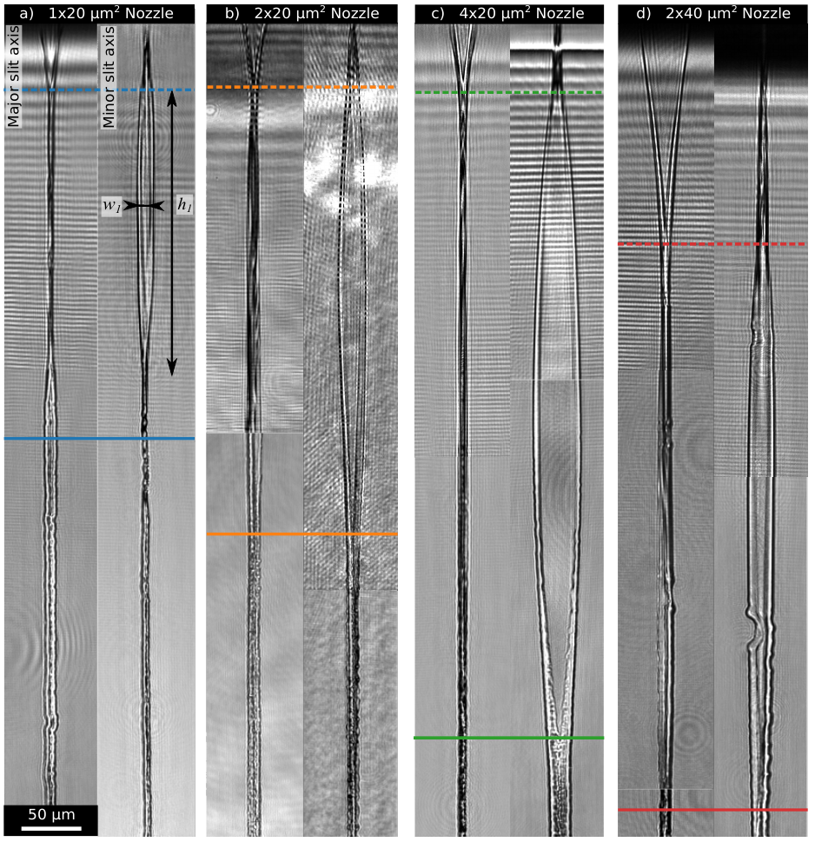
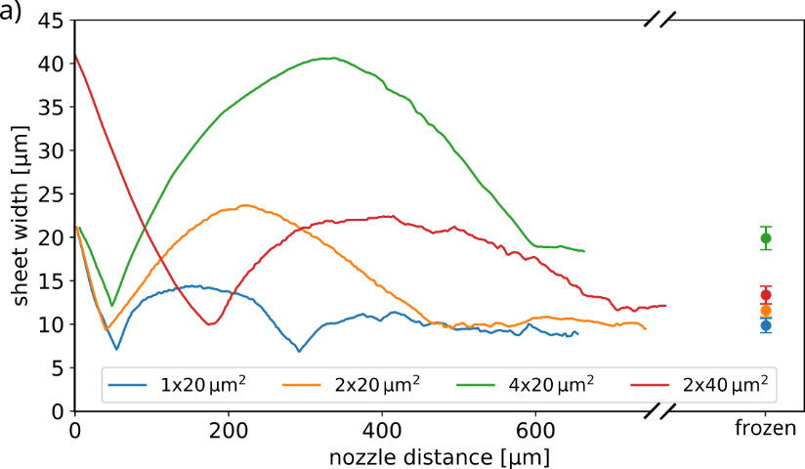
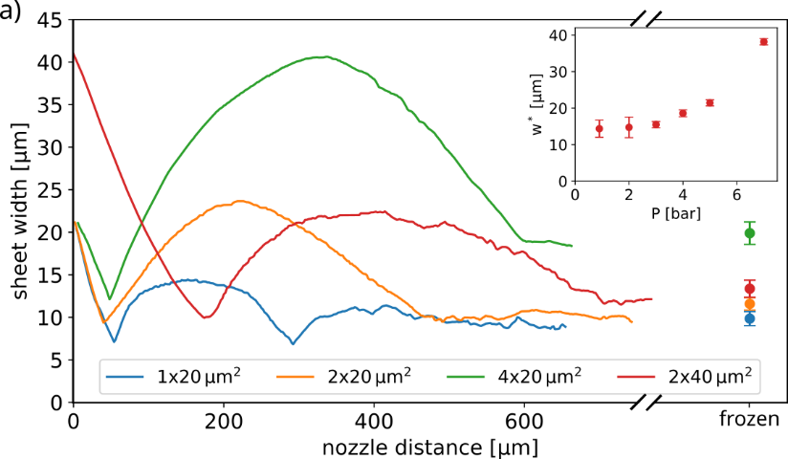
Optimal sheet jets for laser-ion acceleration
Straight slit nozzle characterization study
Different sizes and aspect ratios
~500 µm
to nozzle
Find optimal nozzle aspect ratio + ideal operation parameters
Liquid Jet
Jet starts to freeze
Jet fully
frozen
4x20 µm Planar slit nozzle shows
promising results at high pressures
Width: >30 µm, Thickness: ~500 nm
Solid Jet
~20 µm
M. Rehwald, S. Göde, S. Assenbaum: in preparation

Slide 26
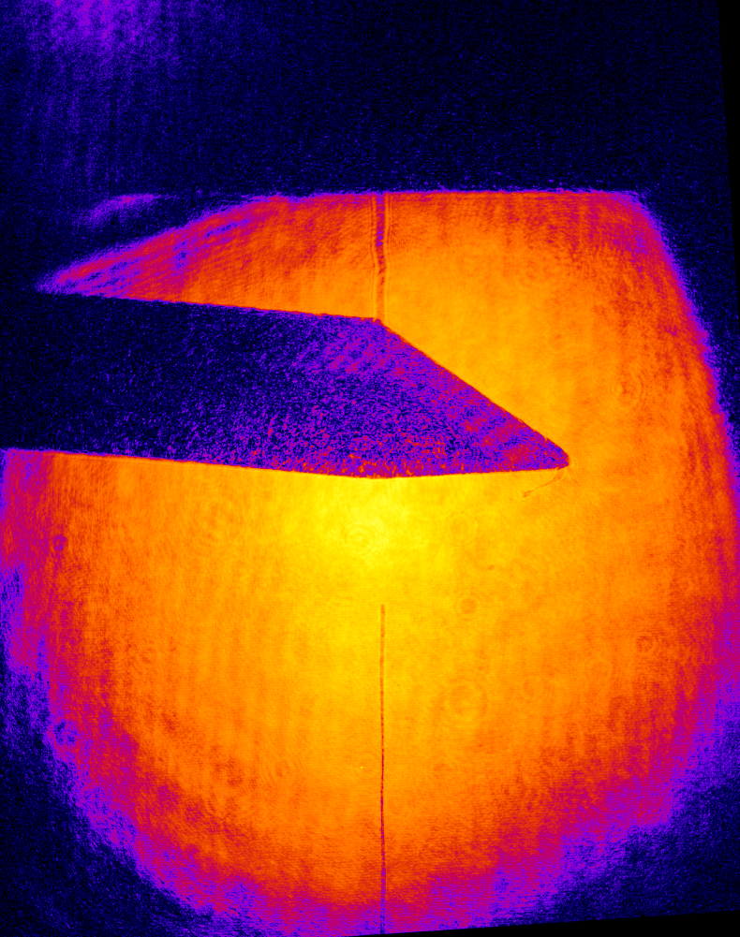
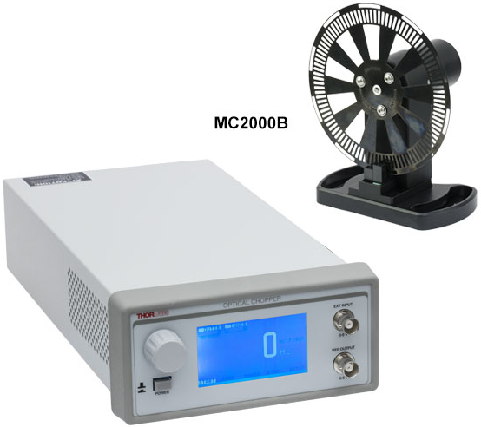
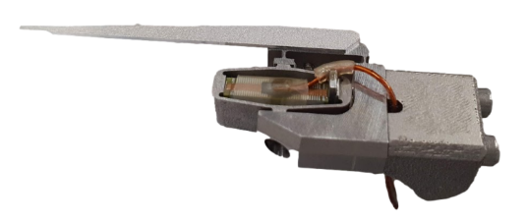
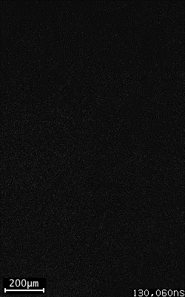
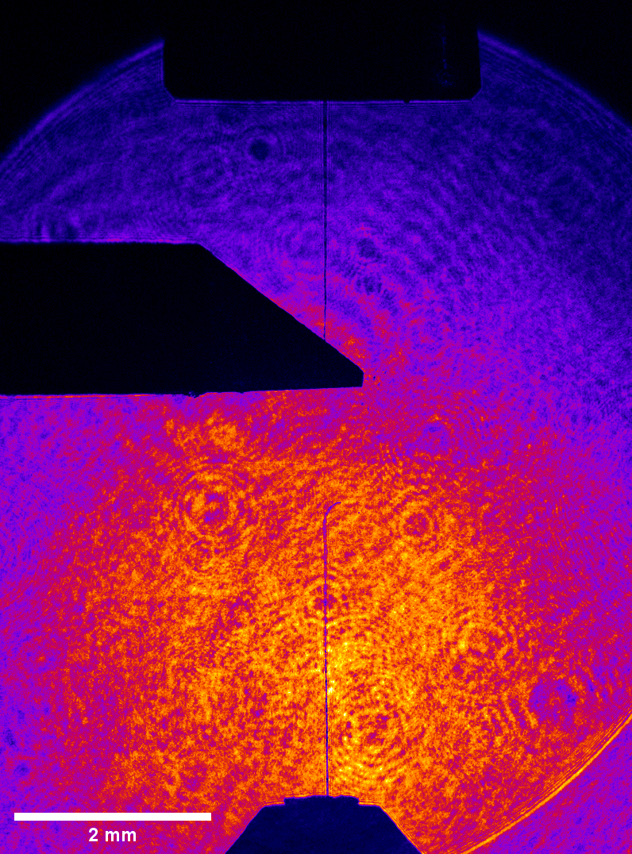
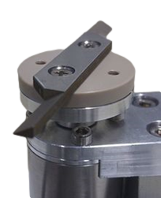
Chopper: Different approaches
Option 1:
Rotating blade:
High velocity
Timing is tricky
Option 2:
Piezo-actuator
Timing is easy
Low velocity
Cryostat
~1mm
Initial design (2018):
modified commercial
optical chopper
Design by S. Göde (2021/22)
1.5 mm
Courtesy of S. Göde
~2.5 mm
10 m/s, 20 µs timing jitter
laser ~ 10mm from nozzle
Cryostat
https://thorlabs.com
20mm
New design (2020 – 2024):
synchronous motor with
LIDAR Polygon motor driver
Chopper
~5 mm
~1 m/s, <<1 µs
timing jitter
laser ~1.5 mm
from cryostat
30m/s, 2 µs timing jitter
laser ~ >3 mm from nozzle
(limited by chopper blade)
25mm

Slide 27
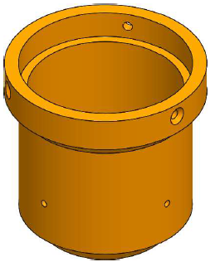

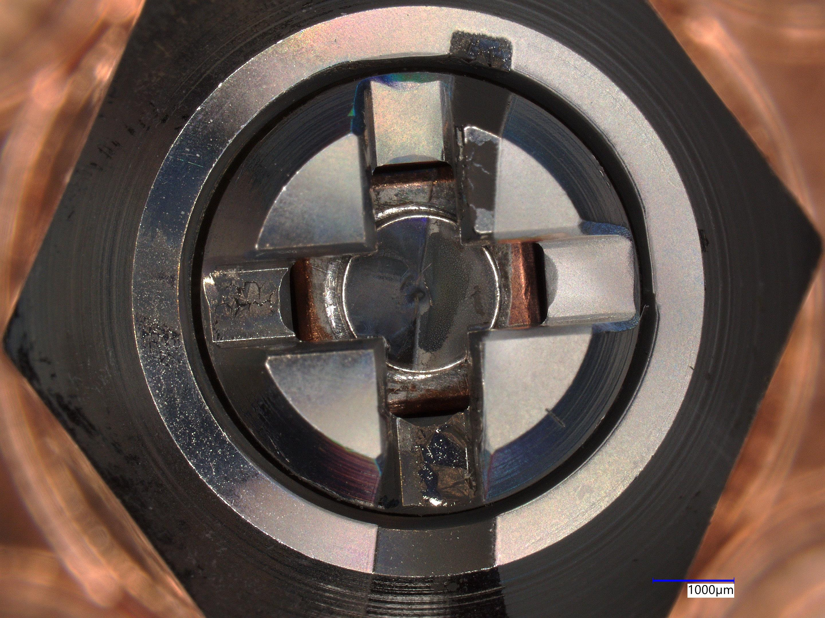
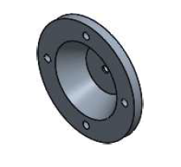
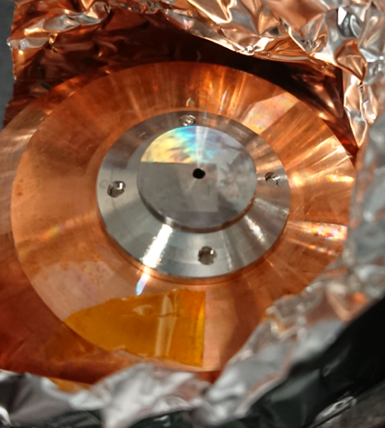
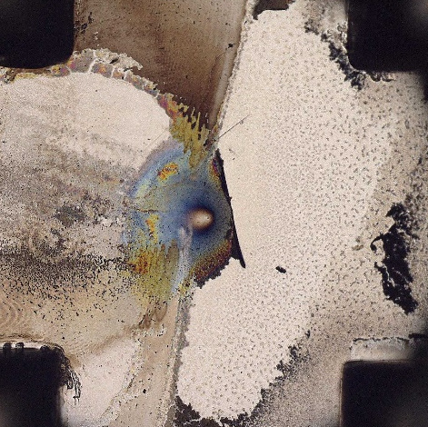
Long term operation
Large experiment at EuXFEL (2023)
→ New effects observed:
Solution:
Design for Draco Setup:
Copper „bell“,
flanges to cryostat
Ø 60 mm
Ø 1.5 mm stainless
steel orifice for jet
thickness: 500 µm
Full radiation shield
Damage accumulation
Transient temperature spikes
Radiation
shield
Cryogenic
source
After 20k shots
~ 10¹⁹ Wcm⁻²
„Shadow“
of piezo chopper
Piezo
Chopper
After 4k shots
5∙10²⁰ Wcm⁻²
> 10²⁰ W/cm²
Rotating
Chopper
„Shadow“
of rotating
chopper
Option 1: Faster and wider chopper
  covers more area during shot
Option 2: Encapsulate the source with
full radiation shield:
  Prevents heat influx and damage
  Tradeoff: + 1 mm distance to nozzle
Nozzle
No damage to Cryosource!

Slide 28

Challenges on the way to 1 Hz operation
Target: solid hydrogen sheet jet
Cryogenically liquified H2
Protecting the cryogenic source
Laser-driven relativistic plasma
close to source can:
damage the Nozzle
de-stabilize the
target after each
laser shot
Solutions:
radiation shield
„Chopper“
Slit nozzle creates alter-
nating, orthogonal sheets
Evaporative cooling freezes the jet into a solid H2 foil
  Width: ~ 25 µm
  Thickness: ~500 nm
  Cylincrical rims Ø 5 µm
Very stable, HRR capable, debris-less foil-like target
4µm
20 µm
Cryogenic
source
Liquid Jet
8 mm below nozzle
Rotation: 45°
freezing
Jitter: ~2 µm
5∙10²⁰ W/cm²
Rotating
Chopper
Frozen
solid
M Rehwald, et al, 2023 J. Phys.: Conf. Ser. 2420 012034
M. Rehwald, S. Göde, S. Assenbaum in preparation
15 µm

Slide 29




Longitudinal Probing: on pump laser axis
Imaging with Laser OAP
Inspired by:
Robert M. Malone et al., Proc. SPIE 6288, Current Developments in Lens Design and Optical Engineering VII, 62880Z (1 September 2006)
Dielectric Beamline mirror
515nm
Target plane
y
OAP
x
z
y
OAP introduces image plane tilt
Low magnification
Large field of view
  Restricted by image plane tilt
real on-axis probing
no additional expensive objective

