Slide 1


Laser driven proton acceleration from imploded gas targets
Santhosh Krishnamurthy
Dong Jing, Sheroy Tata, Yinren Shou, Eyal Kroupp, Anda Maria Talposi, Ivan Kargapolov, Arujash Mohanty, Mihail Cernaianu, Victor Malka
7th European Advanced Accelerator Conference, 2025

Slide 2

Outline
Outline
Near Critical Density Plasma
Optical tailoring of gas targets
Proton acceleration from imploded gas targets
Conclusion and perspectives
7th European Advanced Accelerator Conference, 2025
7th European Advanced Accelerator Conference, 2025

Slide 3
Near Critical Density Plasma
n_{e} < n_{c}
n_{e} = n_{c}
n_{e} > n_{c}
Near Critical Density Plasma
Underdense
Overdense
Plasma Density
How to generate a Near Critical Density (NCD) target?
Foam targets, Pre-expanded foil targets, Structured targets, Gas targets
Gas targets: Reproducible, High repetition rate compatible, Density controllable
But the density of gas from a conventional gas nozzle is low!
7th European Advanced Accelerator Conference, 2025
3

Slide 4
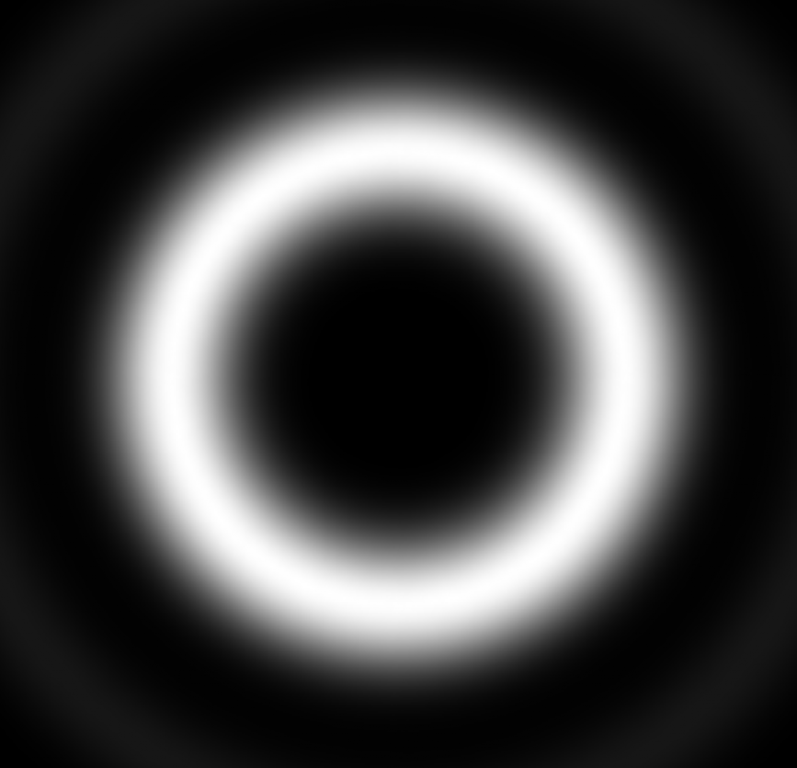
Imploded Gas Targets
Gas target
Optical tailoring
Imploded Gas Target
Gas from a conventional gas nozzle
In implosion geometry
High density gas regions
Laguerre-Gaussian Beam
(Donut beam)
Practical tool
7th European Advanced Accelerator Conference, 2025
4

Slide 5
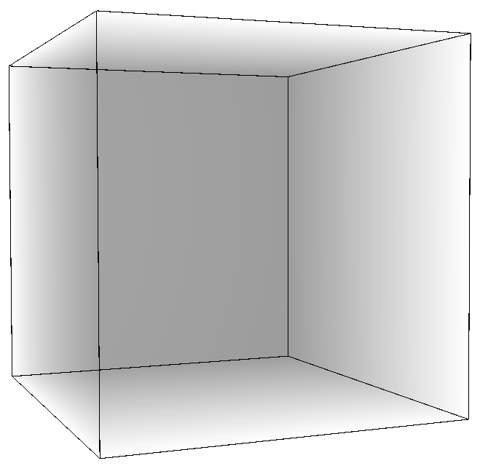

Imploded hydrogen gas targets
0.1
Density (n_{c})
0.05
0
Initial electron density: 0.003n_{c}
Final electron density: 0.1n_{c}
Compression factor > 30
Laser direction
30fs, 800nm
Intensity = 10¹⁵ W cm⁻²
7th European Advanced Accelerator Conference, 2025
5

Slide 6
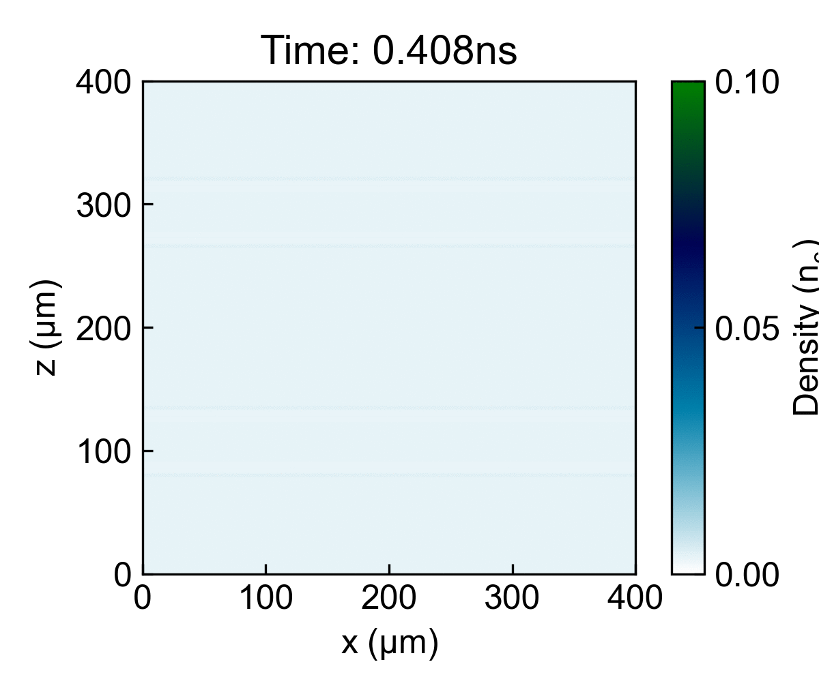
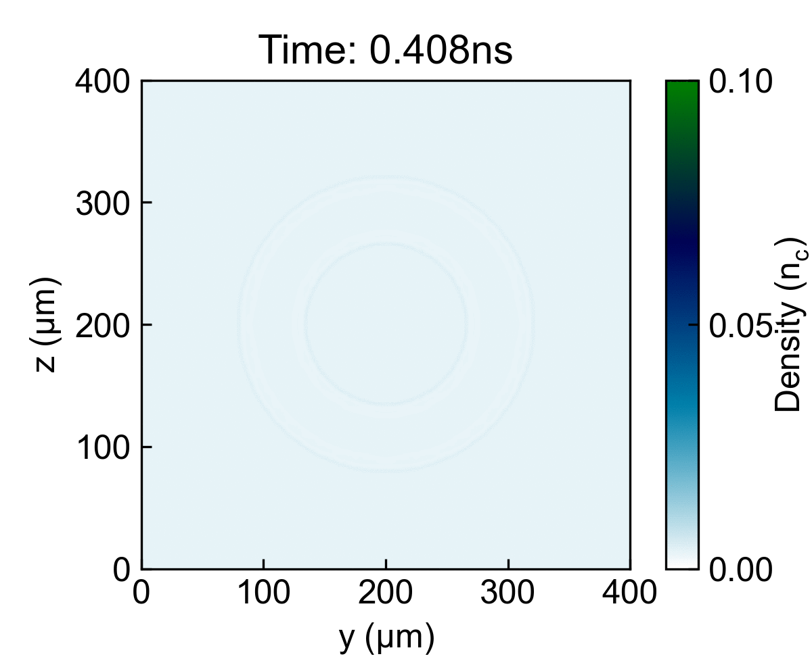
Imploded hydrogen gas targets
7th European Advanced Accelerator Conference, 2025
6

Slide 7
Imploded hydrogen gas targets
Key Idea:
Donut beam
(Heater)
Main laser
(Driver)
30fs, 800nm
Intensity ~ 10¹⁹ - 10²⁰ W cm⁻²
Protons
Hydrogen gas
Density gradient
Add another heater beam: A line focus
OR
7th European Advanced Accelerator Conference, 2025
7

Slide 8
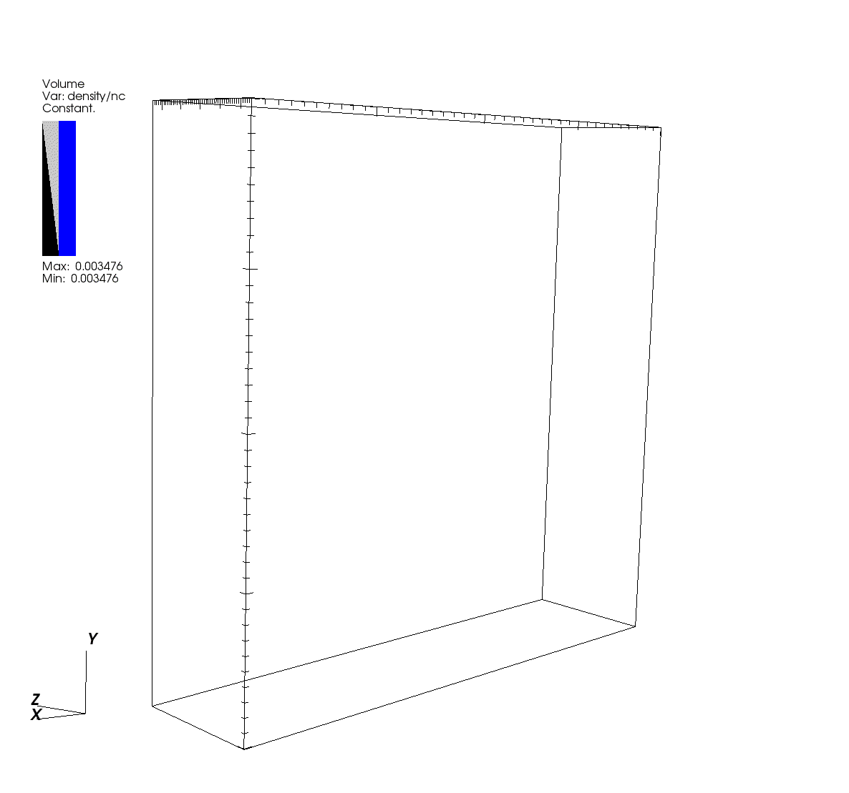
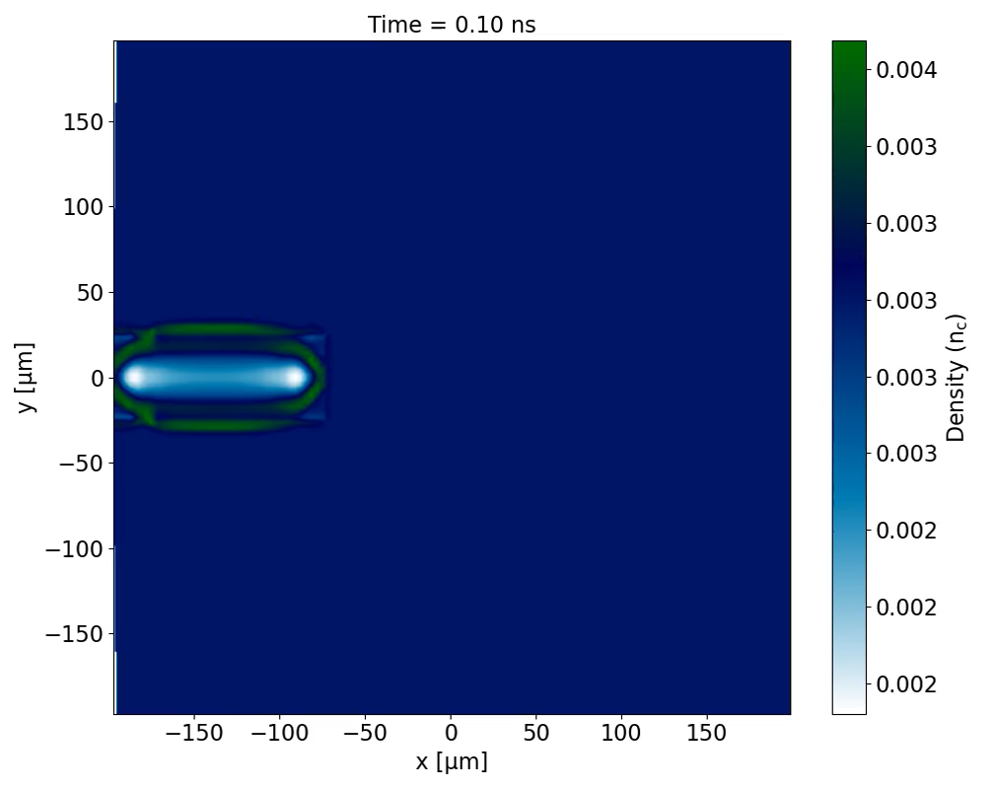
Imploded hydrogen gas targets
50fs, 800nm
Intensity ~ 10¹⁶ W cm⁻²
Driver
Heater
7th European Advanced Accelerator Conference, 2025
8

Slide 9
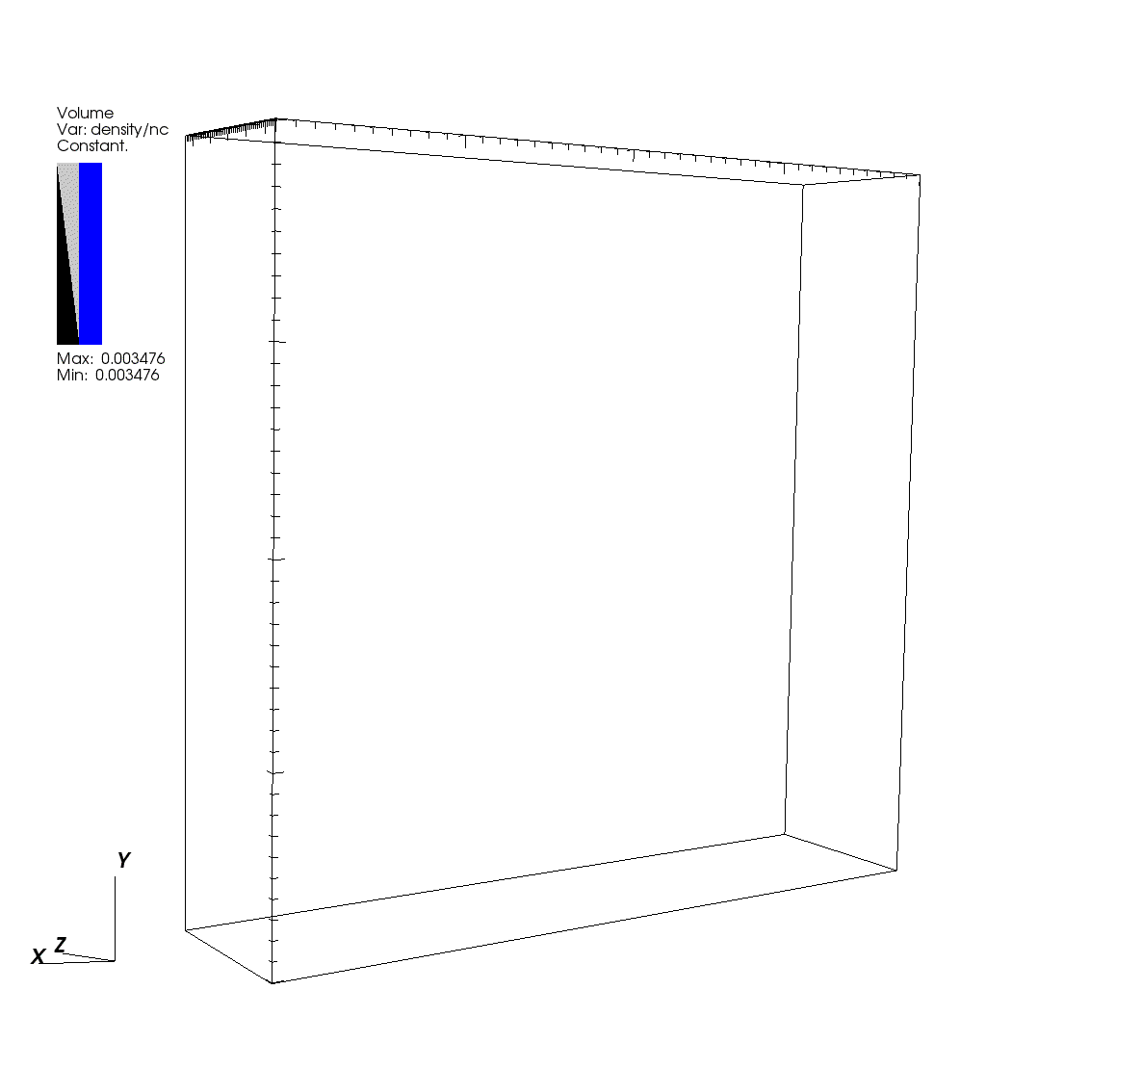
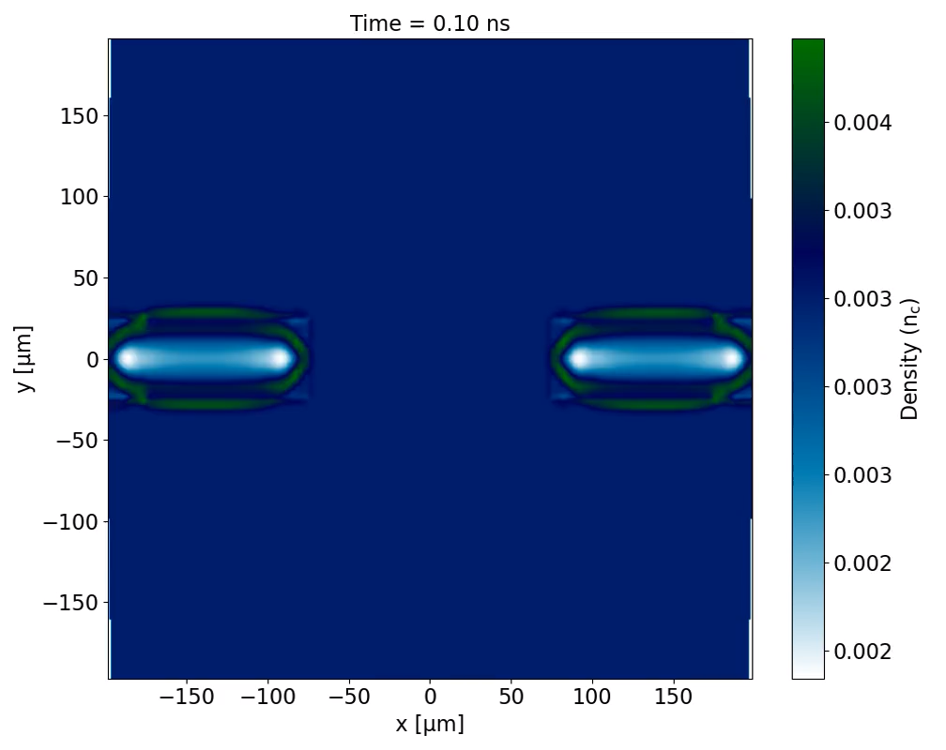
Imploded hydrogen gas targets
50fs, 800nm
Intensity ~ 10¹⁶ W cm⁻²
Driver
Heater
7th European Advanced Accelerator Conference, 2025
9

Slide 10
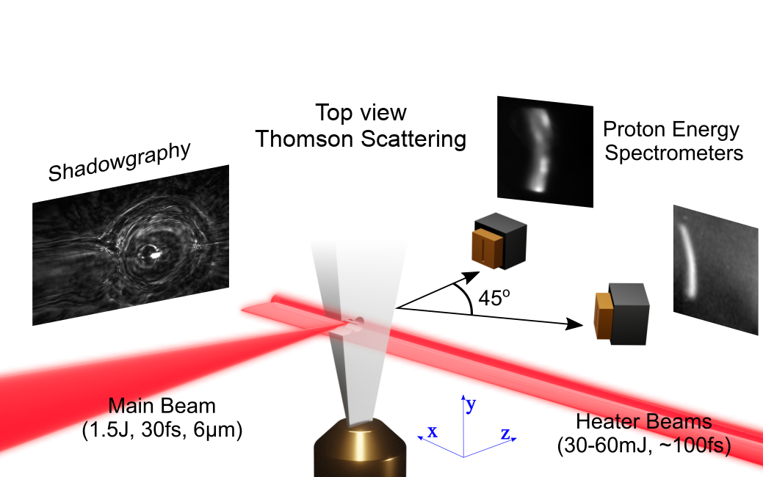
Proton acceleration
Schematic of experimental setup
Shadowgraphy
7th European Advanced Accelerator Conference, 2025
10

Slide 11
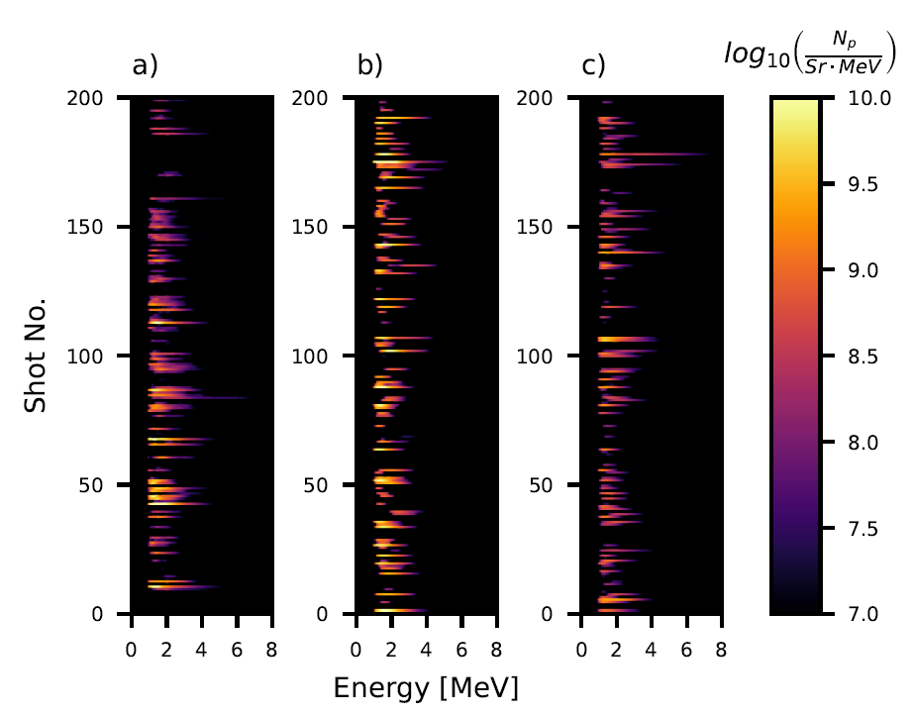
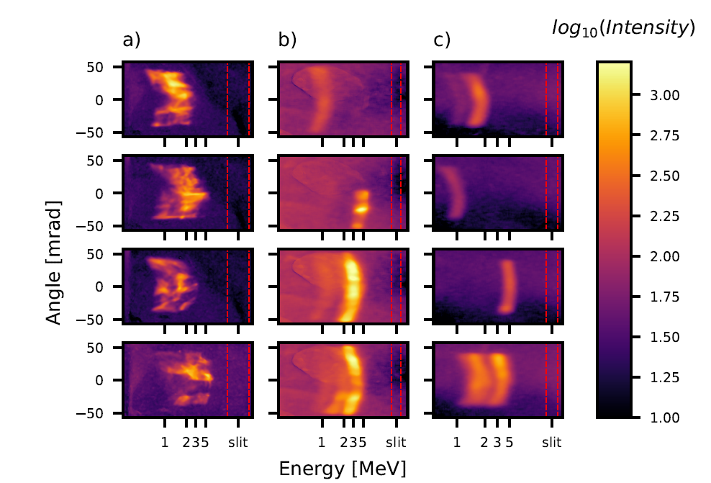

Proton acceleration
0º
45º
0º
45º
Phys. Rev. Lett. 133, 025001 (2024), Omri Seemann, Yang Wan, Sheroy Tata, Eyal Kroupp and Victor Malka
7th European Advanced Accelerator Conference, 2025
11

Slide 12
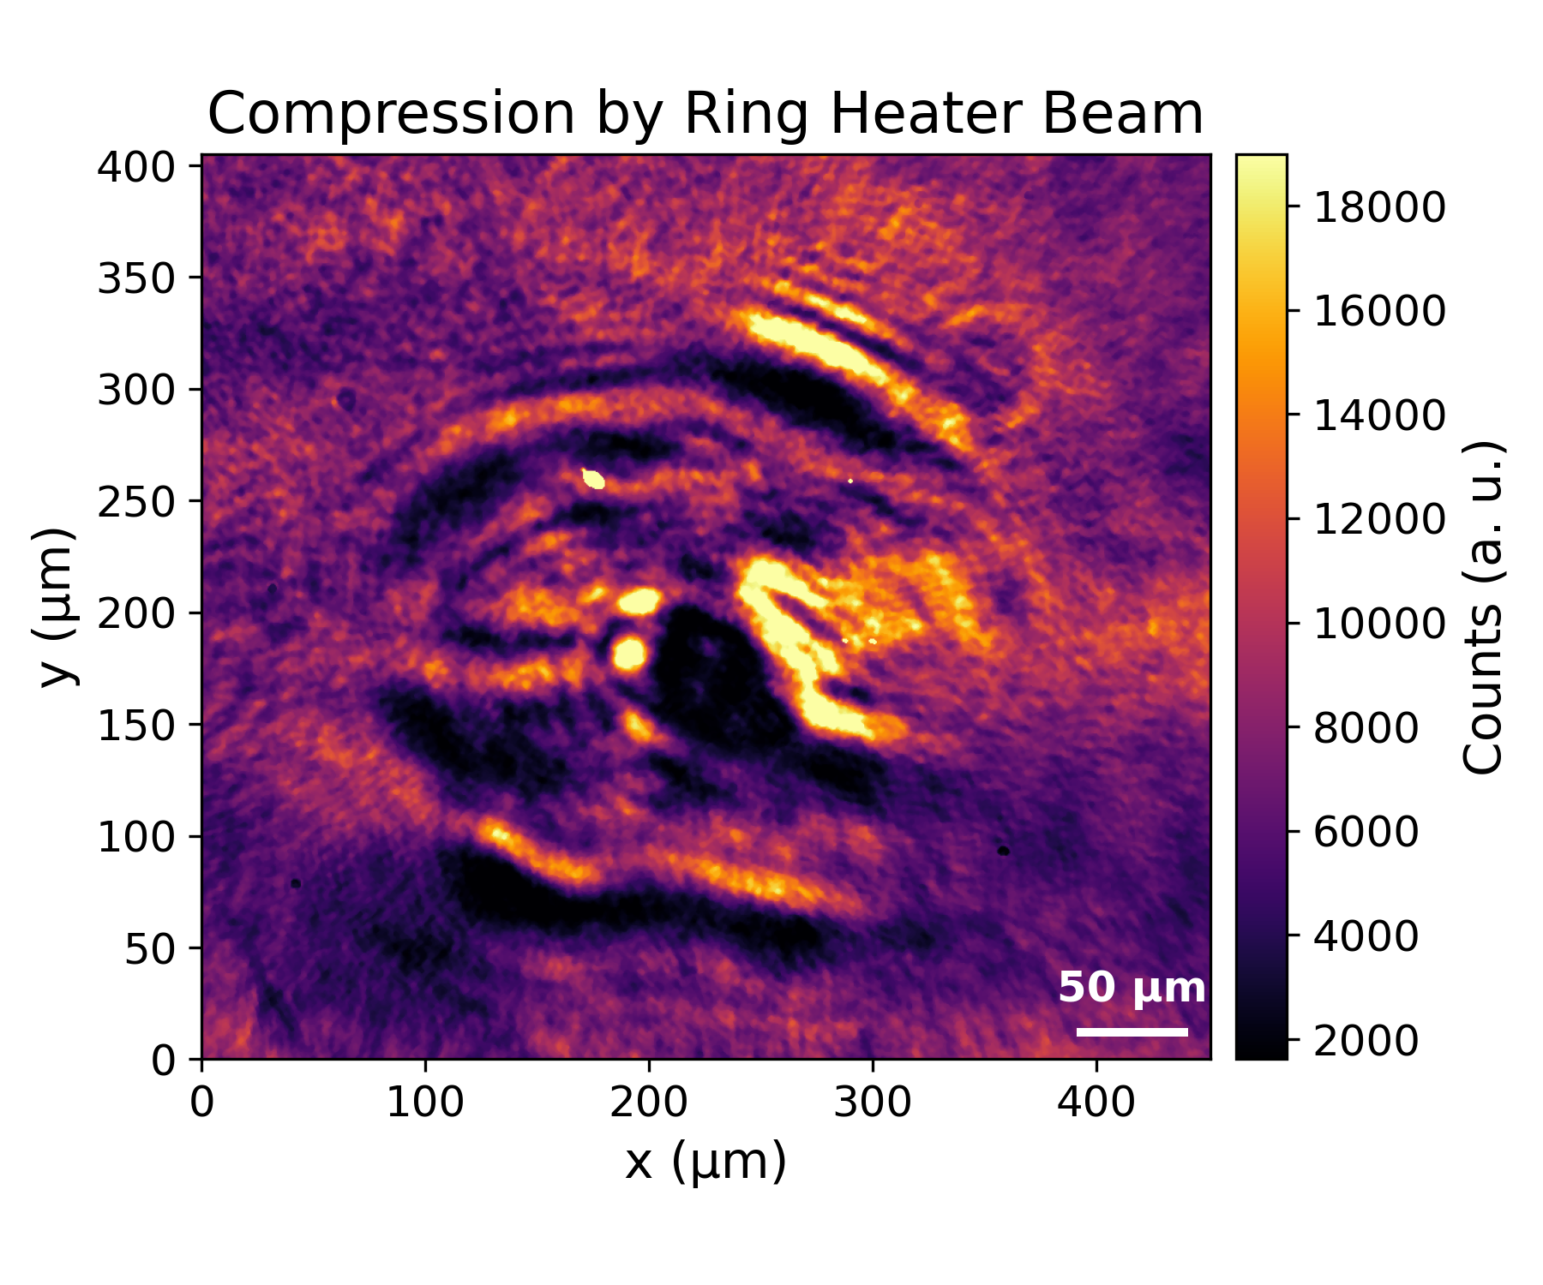
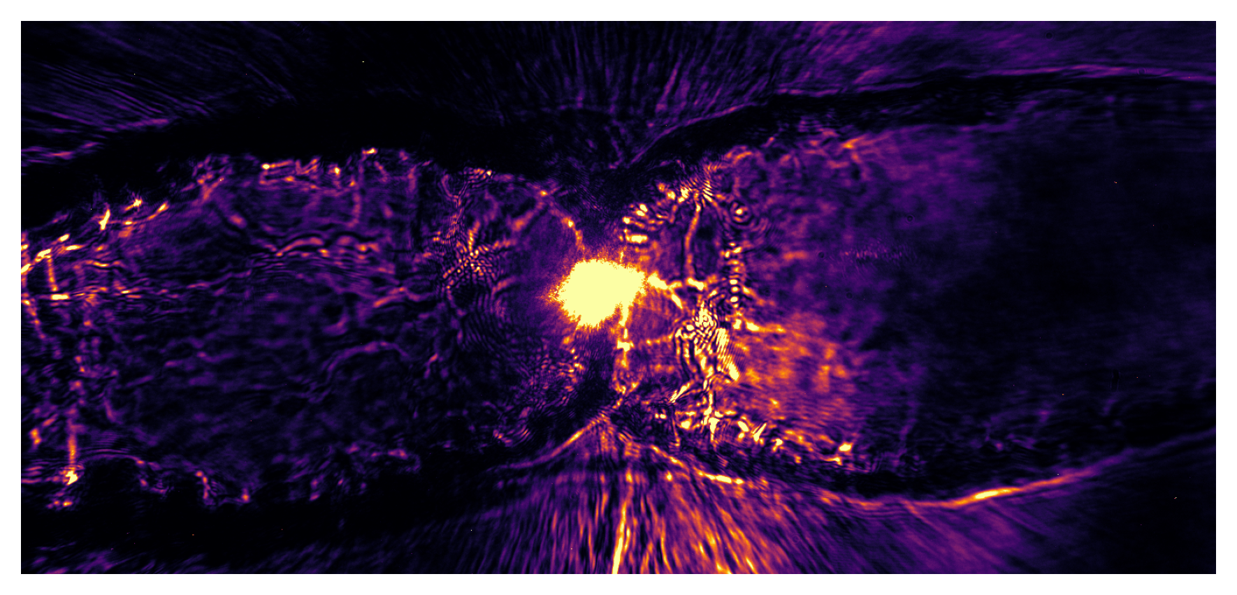
Proton acceleration
Magnets + Scintillators
0º
45º
Protons
Line Heater
H₂ Gas
Driver
Ring Heater
7th European Advanced Accelerator Conference, 2025
12

Slide 13
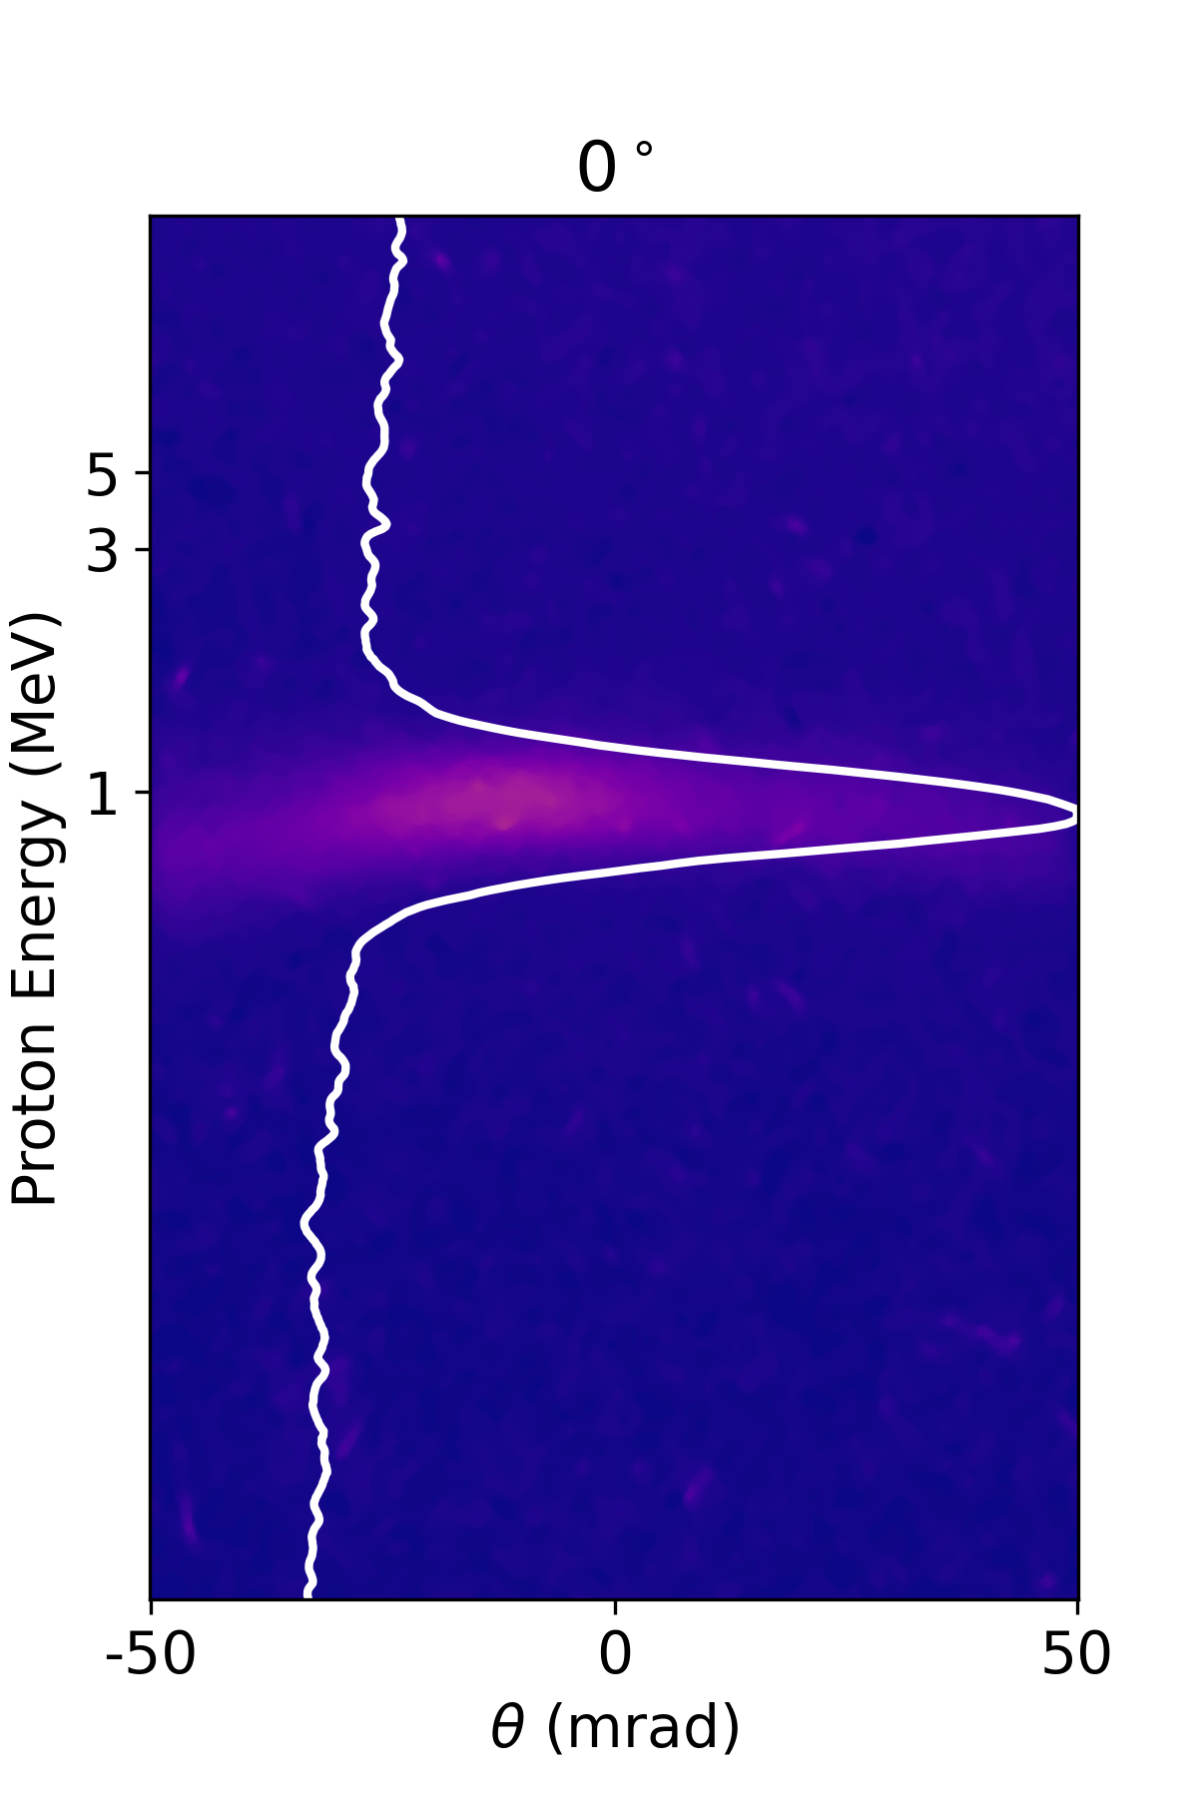
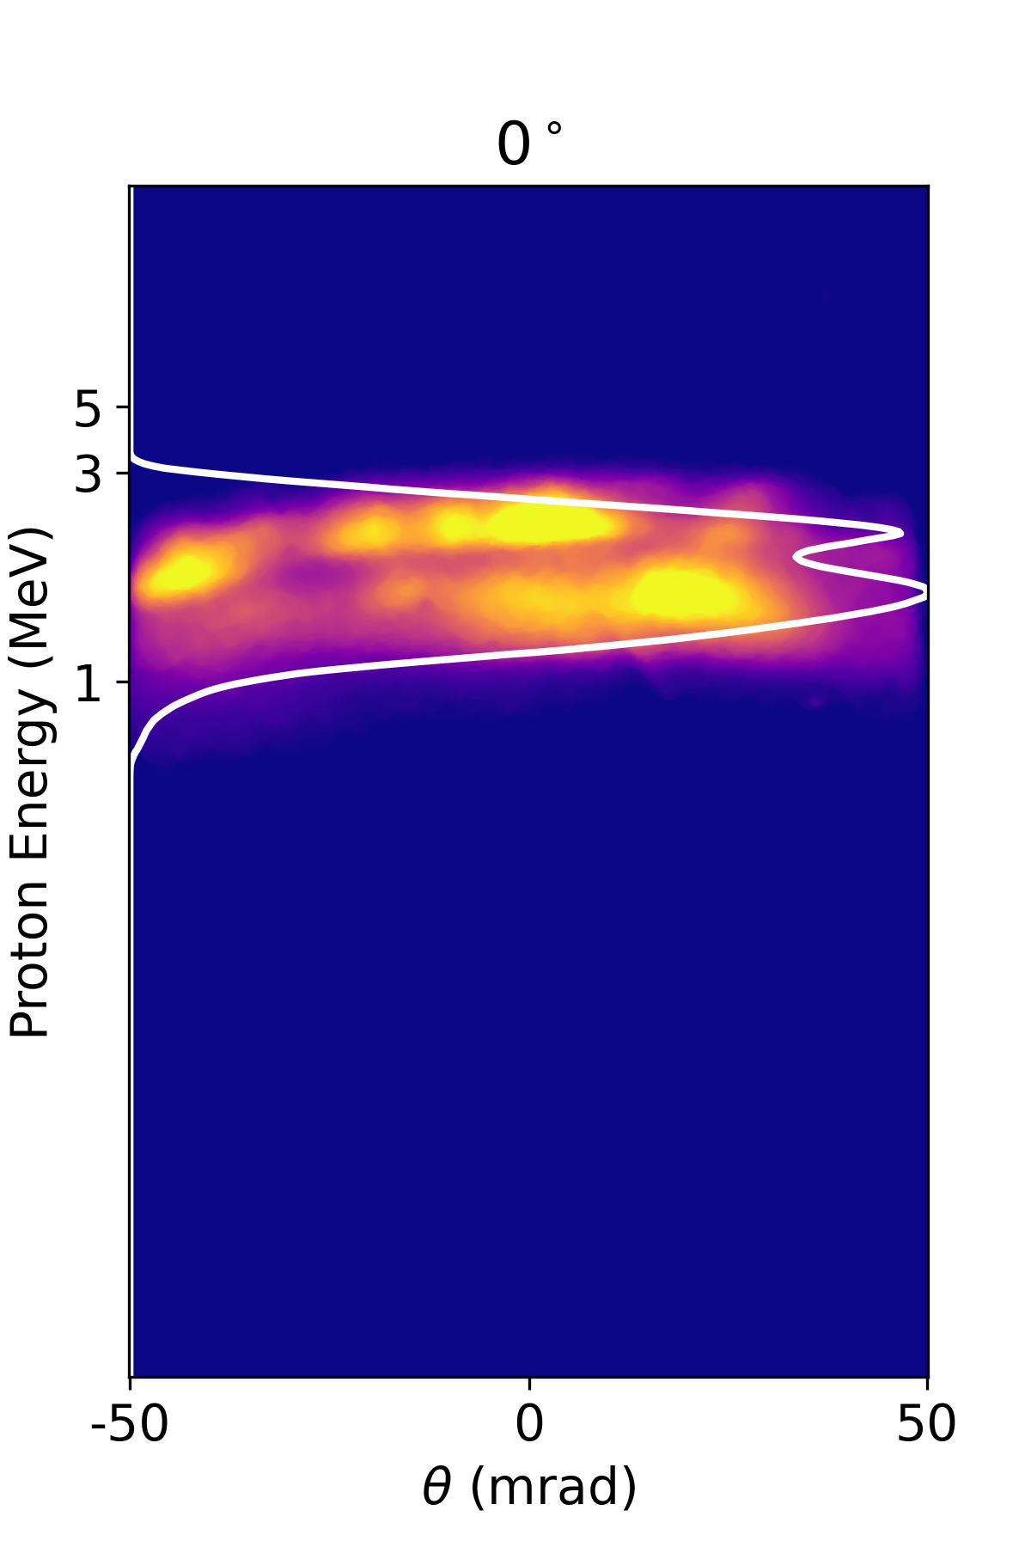
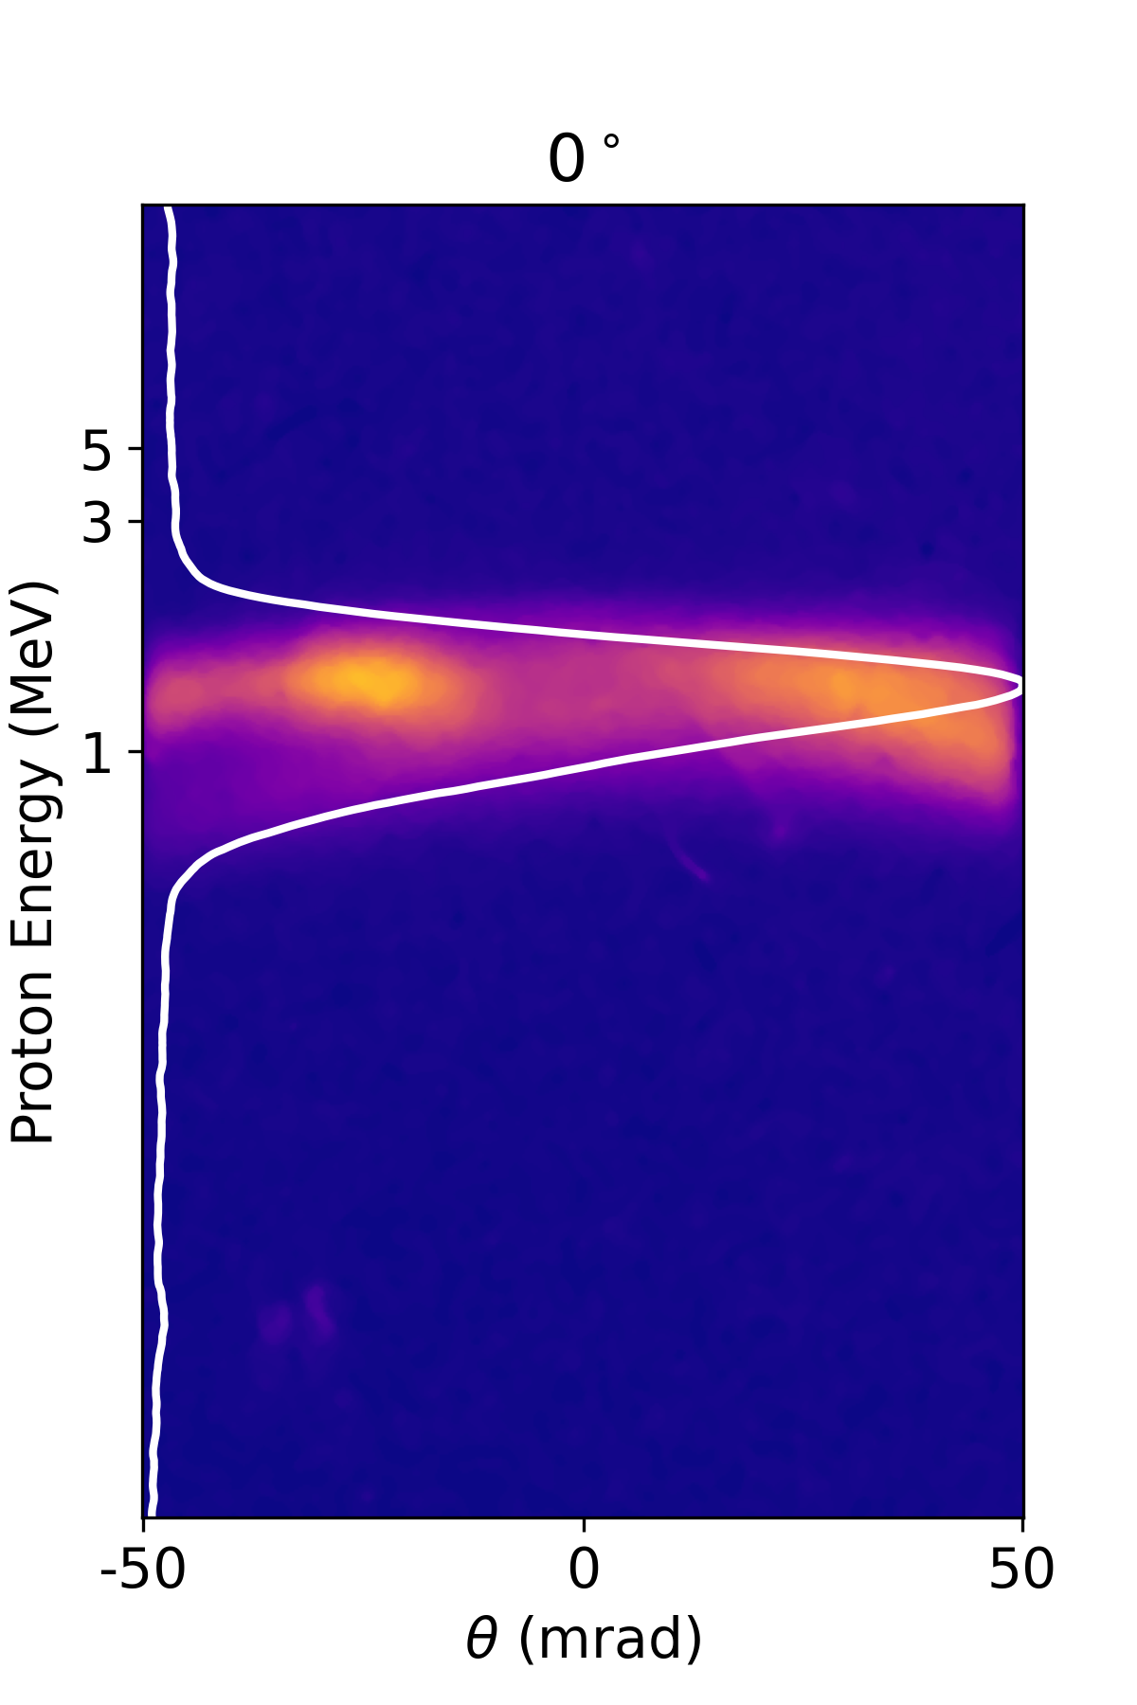
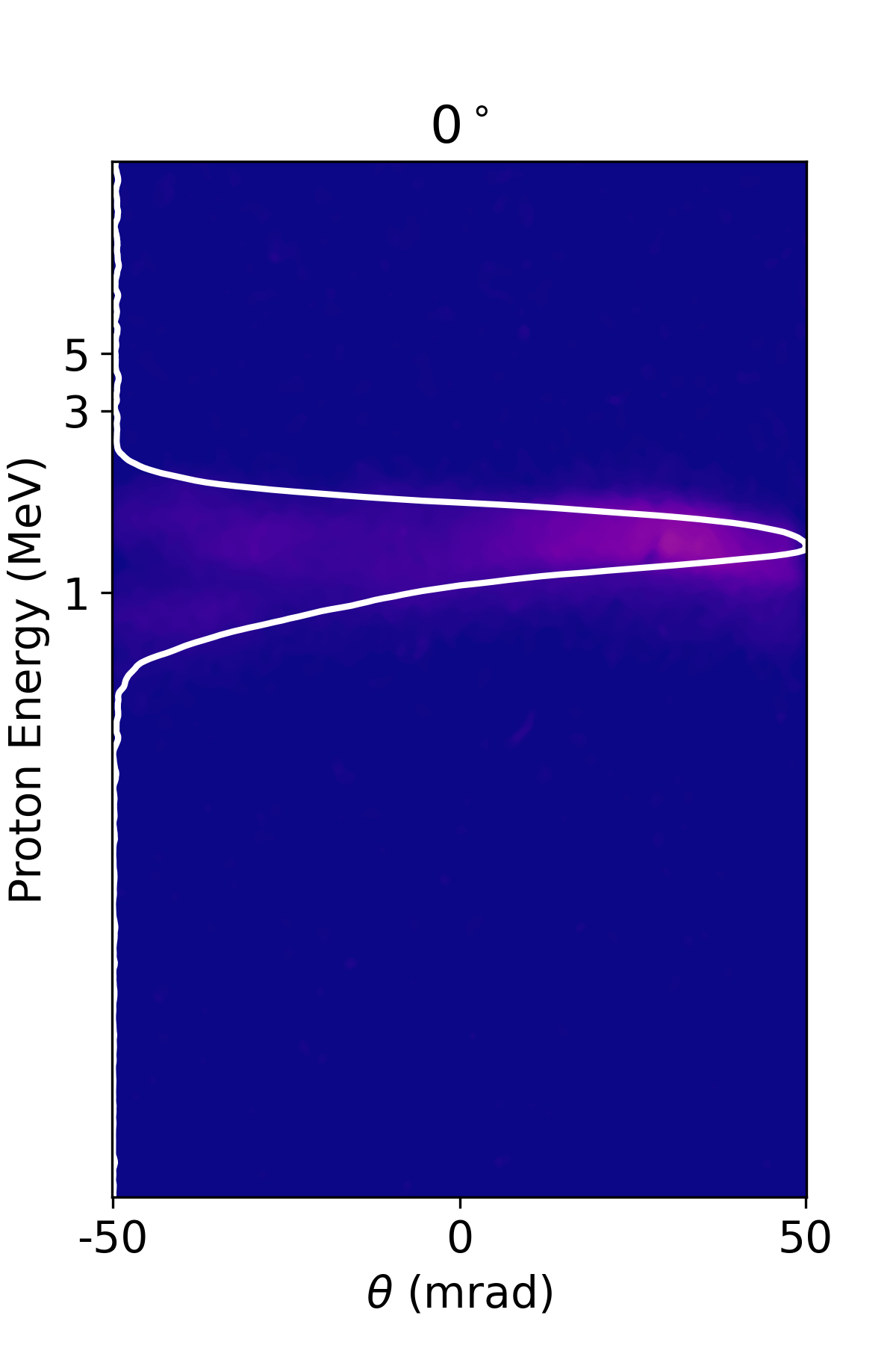
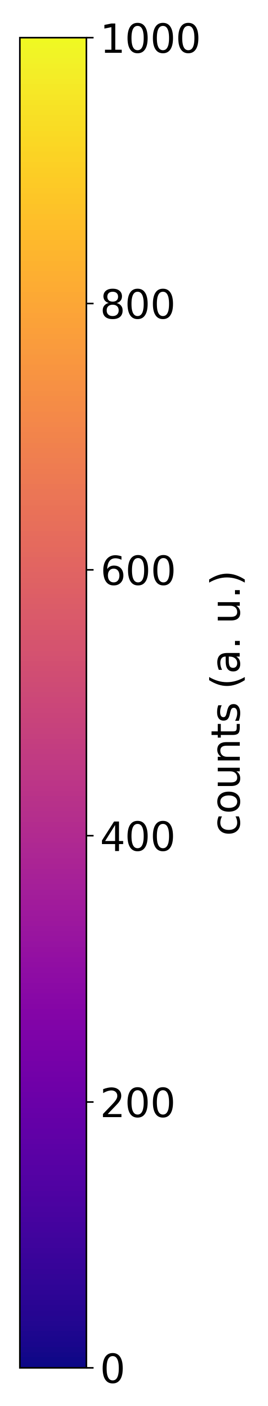
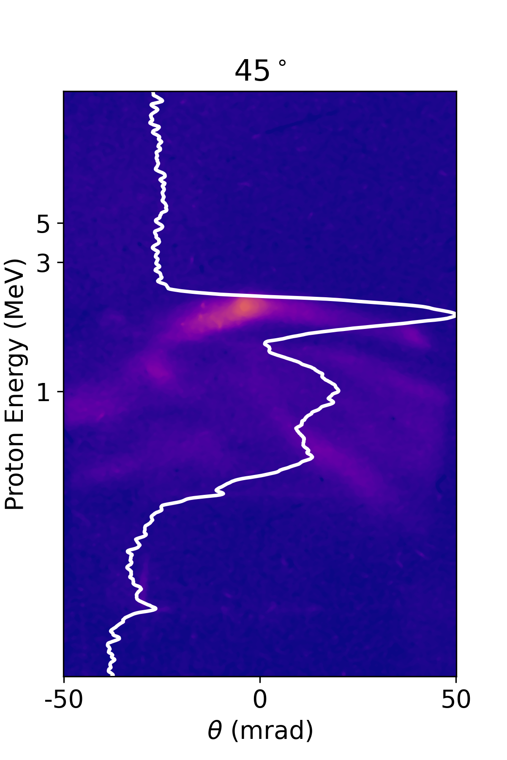
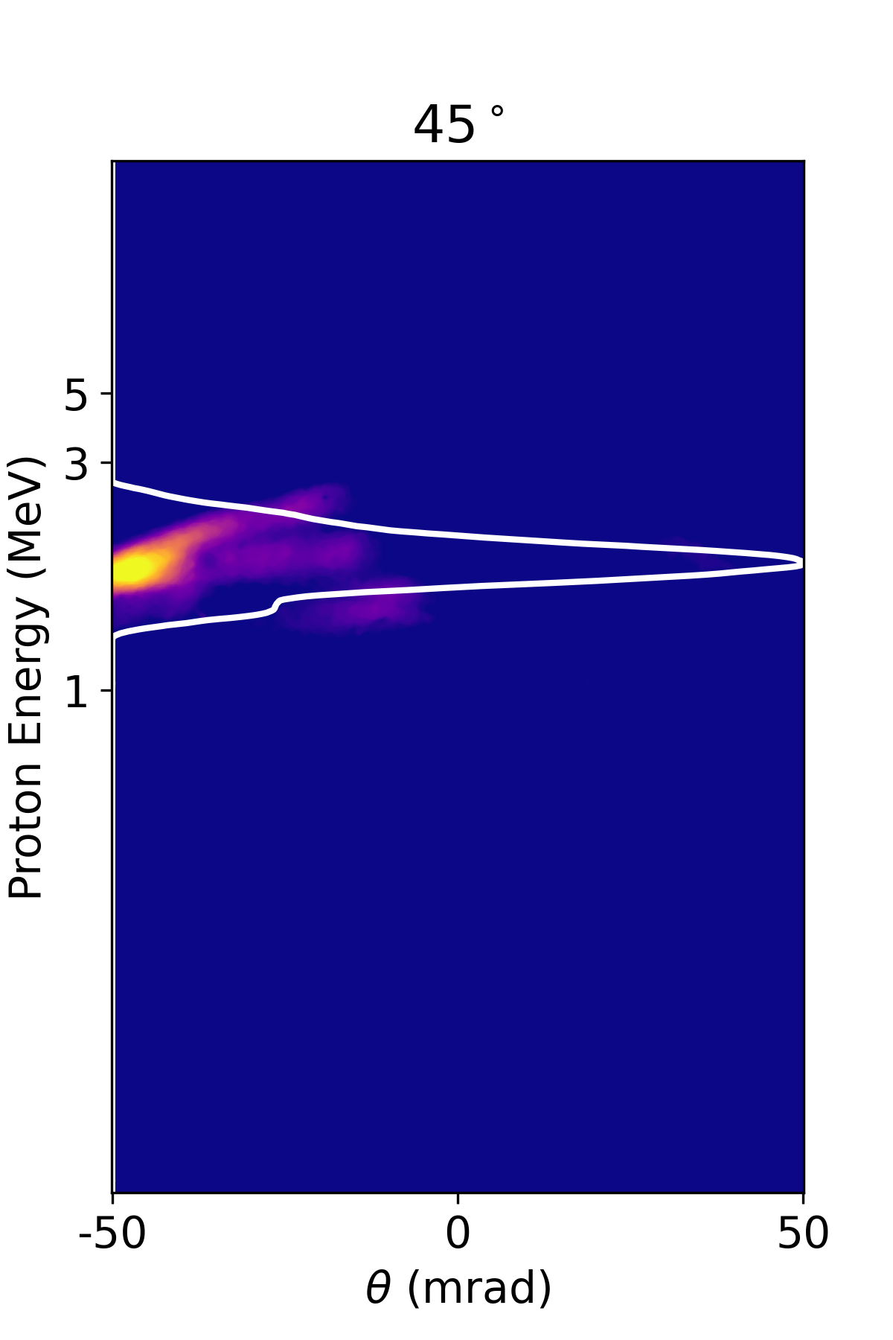
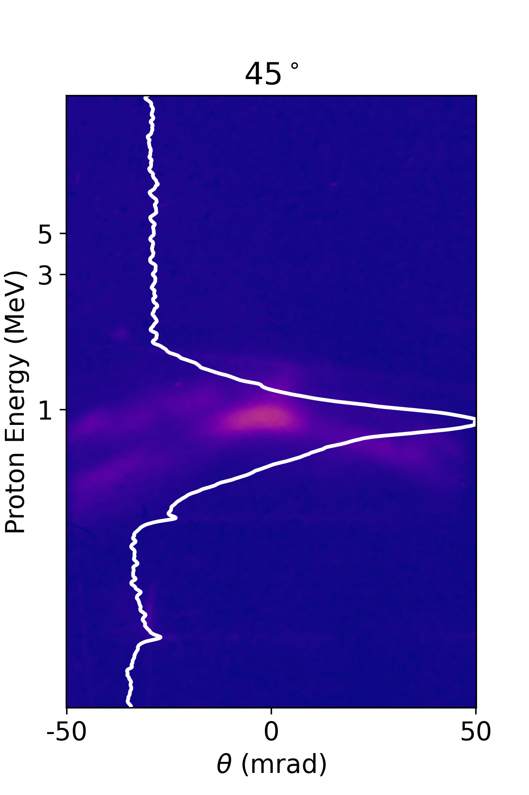
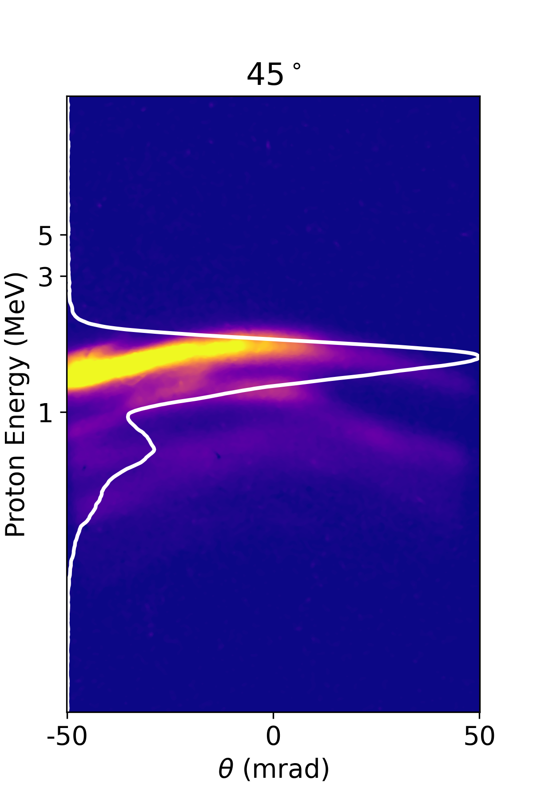
Proton acceleration
Few examples of protons detected at different angles of emission simultaneously
7th European Advanced Accelerator Conference, 2025
13

Slide 14
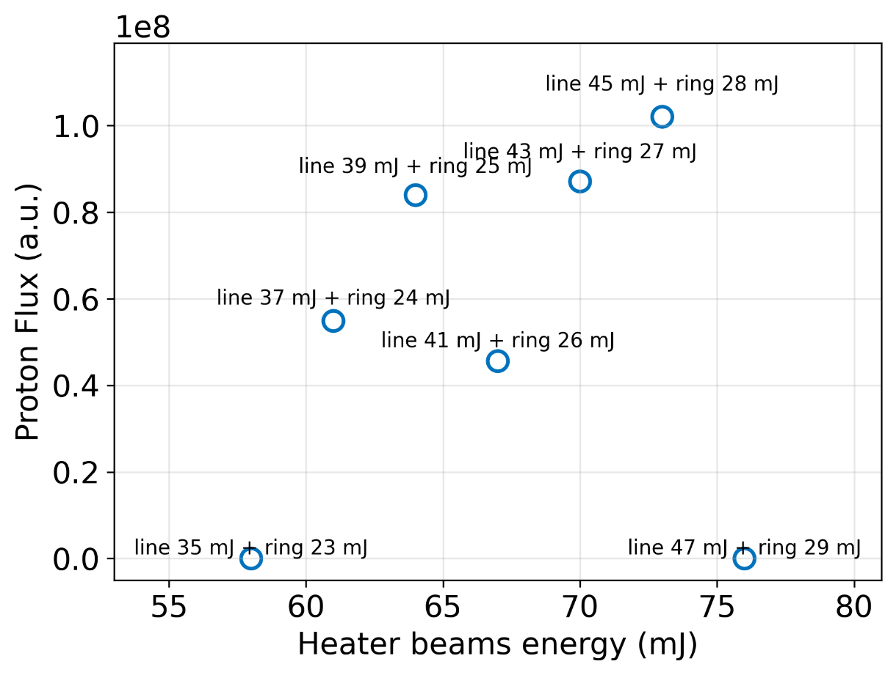
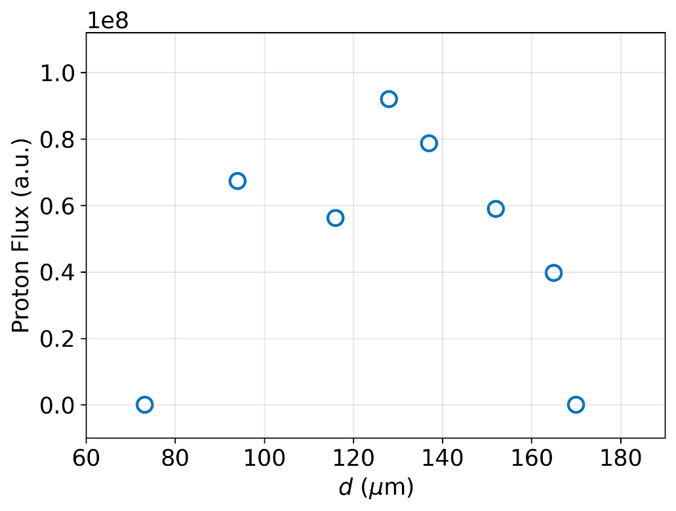
Proton acceleration
Heater beam energy range
Positioning of Shocks
Tolerance: ~10% of heater beam energy, ~100µm in positioning the shocks
7th European Advanced Accelerator Conference, 2025
14

Slide 15
Perspectives and Challenges
Near Critical Density could be achieved by imploded gas targets using moderate power lasers
Protons accelerated to few MeV energies from imploded targets, by a 100TW laser
Scalable to high power lasers, first attempt made at ELI-NP
Prospective scheme for High Repetition Rate operation subject to practical constraints
More experiments with additional diagnostics, insight into Physics, 3D PIC + Hydrodynamic simulations
7th European Advanced Accelerator Conference, 2025
15

Slide 16

Acknowledgments
Weizmann Institute of Science
Victor Malka, Eyal Kroupp, Sheroy Tata, Anton Golovanov, Yinren Shou, Arnaud Courvoisier, Anda Maria Talposi, Arujash Mohanty, Dong Jing, Ivan Kargapolov, Aaron Liberman, Lidan Fridman, Tomer Friling, Salome Benracassa, Michael Adelberg, Ruben Piloposian
ELI-NP, Romania
Mihail Cernaianu, Petru Ghenuche, Domenico Doria, Marius Gugiu, Florin, Septimiu Balascuta, Daniel Dorobantu, Cristina Marin, Saidbek Norbaev
7th European Advanced Accelerator Conference, 2025
16

Slide 17
Acknowledgments
Visit us ☺
https://www.weizmann.ac.il/complex/malka/
Thank you for your attention
7th European Advanced Accelerator Conference, 2025
17

