Slide 1


Synthetic Radiation Diagnostic in Hybrid LPWFA
Finn-Ole Carstens^{1,2}, Alexander Debus¹, Klaus Steiniger¹, Michael Bussmann¹, Fabia Dietrich^{1,2}, Maxwell LaBerge¹, Susanne Schoebel¹, Jessica Tiebel^{1,2}, Patrick Ufer^{1,2}, Nico Wrobel^{1,2}, Arie Irman¹, Ulrich Schramm^{1,2}, Richard Pausch¹
1) Helmholtz-Zentrum Dresden-Rossendorf (HZDR)
2) Technical University Dresden
Institute of Radiation Physics · Laser Particle Acceleration · Finn-Ole Carstens · f.carstens@hzdr.de · www.hzdr.de

Slide 2
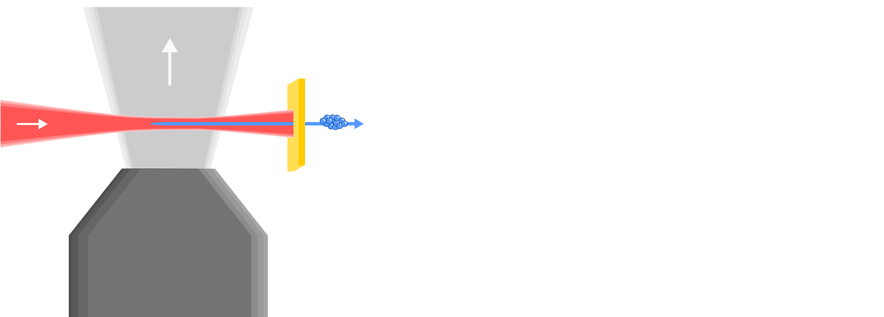
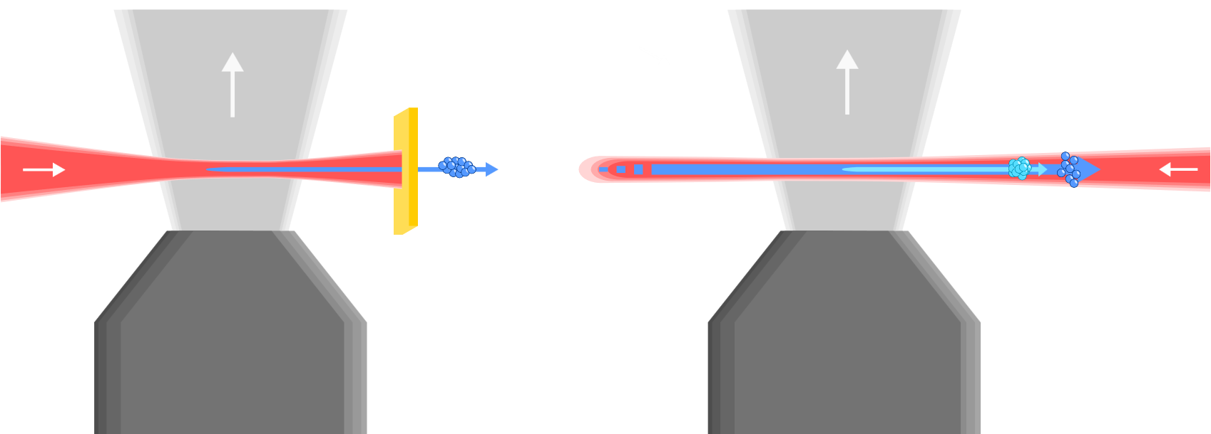
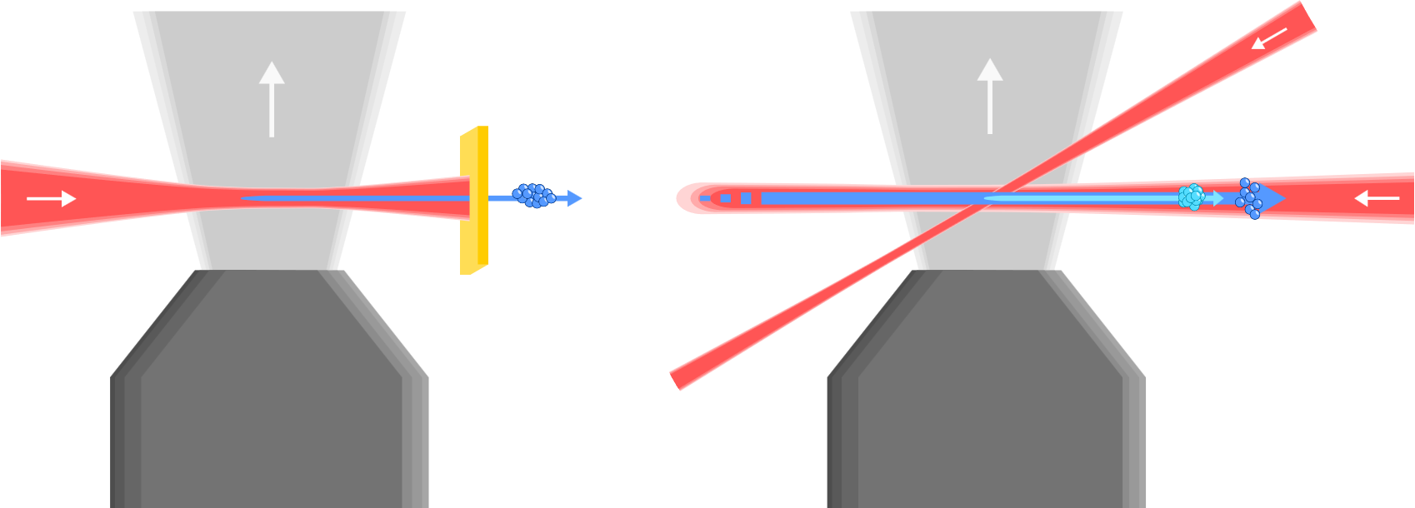
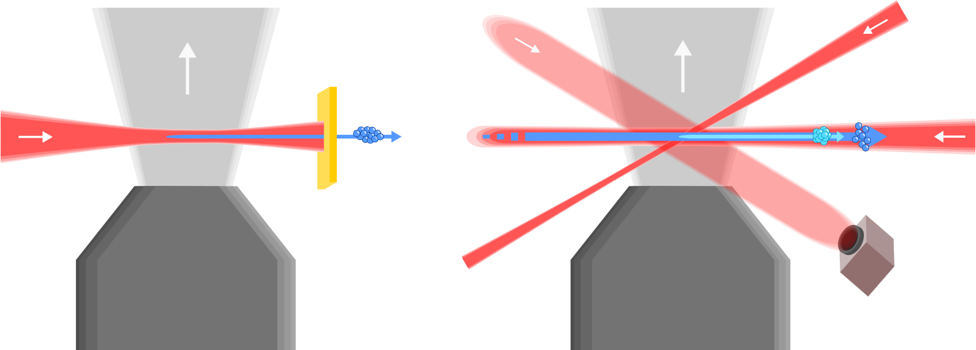
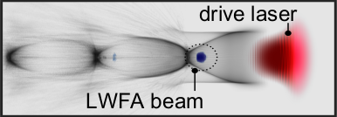
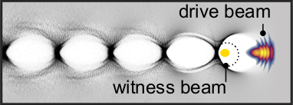
Laser Driven Plasma Wakefield Acceleration
Accelerating high-brightness electron beams with plasma photocathode injection (trojan horse)
Wed 10am:
Overview of the hybrid LWFA-driven PWFA
(Susanne Schoebel)
Few-Cycle Probe
τ~10fs
Injector
τ~40fs
Gas: H
Gas: H-He
TW Laser
τ~30fs
Pre-Ionizer
Blocker Foil
Imaging System
Gas Nozzle
Gas Nozzle
Stage 1: Electron bunch is accelerated by high intensity laser
Stage 2: Electron bunch now accelerates a second witness electron bunch
Deng, A., Karger, O.S., Heinemann, T. et al. Nat. Phys. 15, 1156–1160 (2019)
Ufer. P., submitted

Slide 3
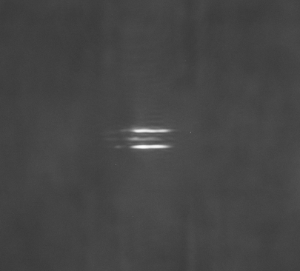
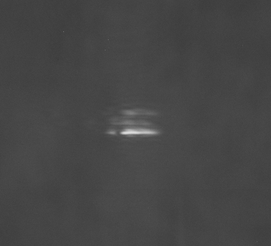
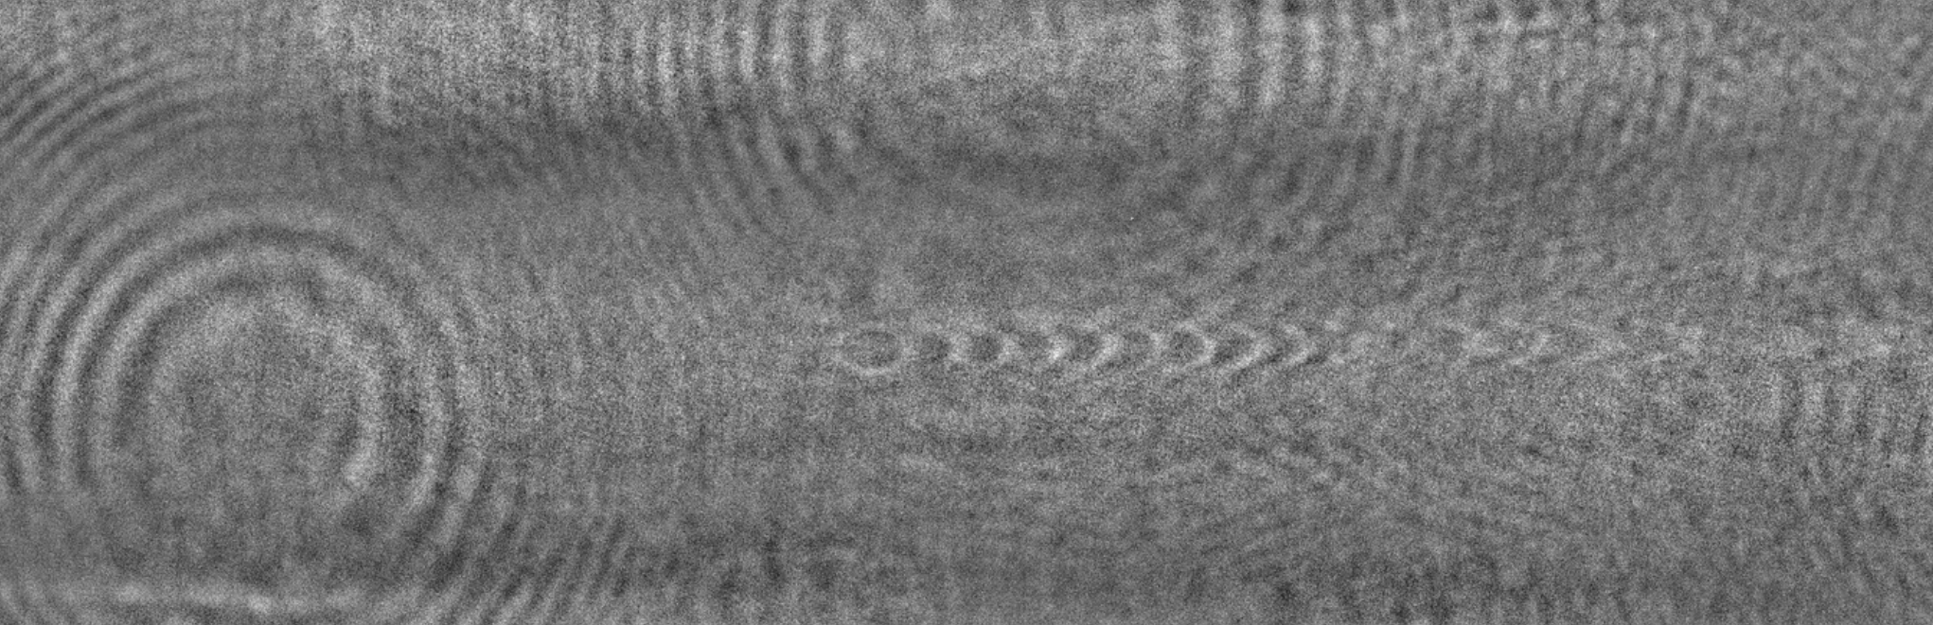
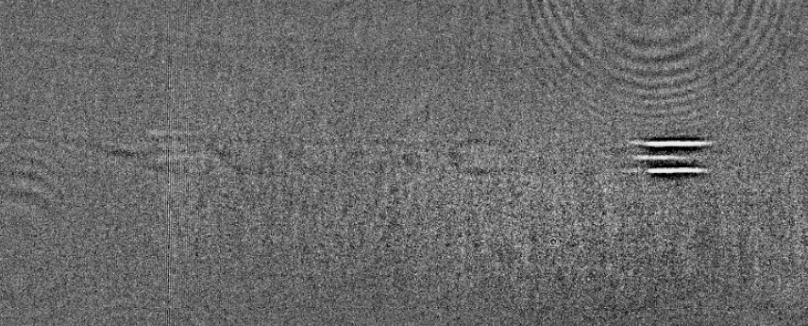

Experimental Insights: Shadowgraphy and Radiation Signals
Probe is used to create pictures of plasma wakes
Probe + Injector lead to scattering
Injector without probe also leads to scattering
Scattering does depend on polarization
Shadowgraphy reveals unexpected radiation patterns in LPWFA experiments
Probe → Plasma Wake
Injector + No Probe → Signal
Example 1
Example 2
Injector + Probe → Signal
Polarization dependent
Parallel → Strong
Ionization independent
Relevant for experimental timing calibration!
The signal is not yet fully understood!

Slide 4
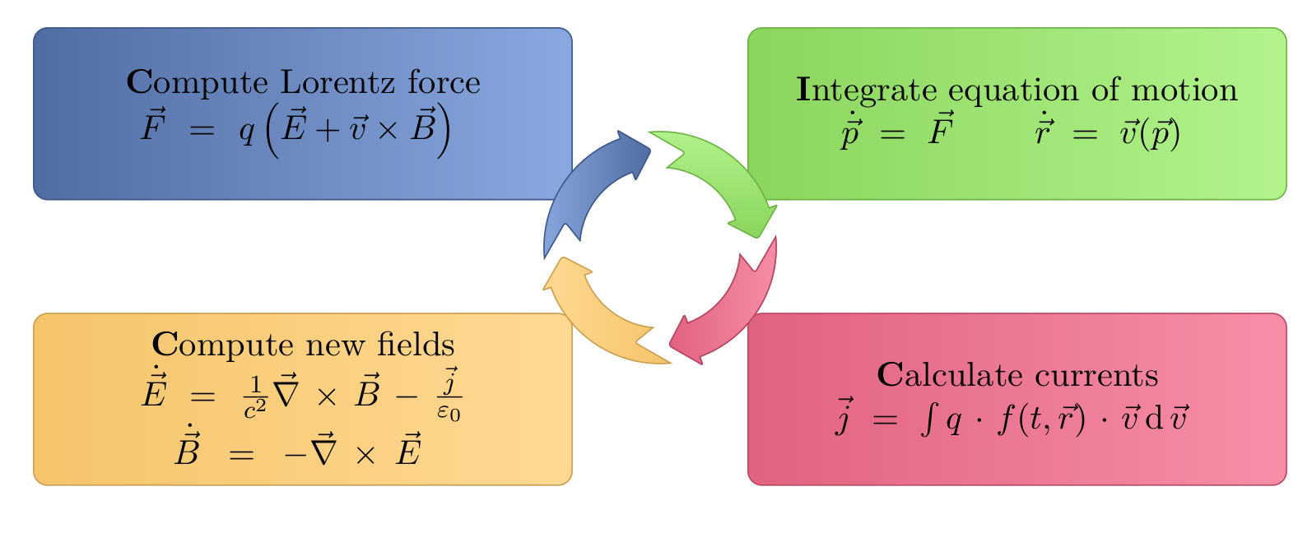
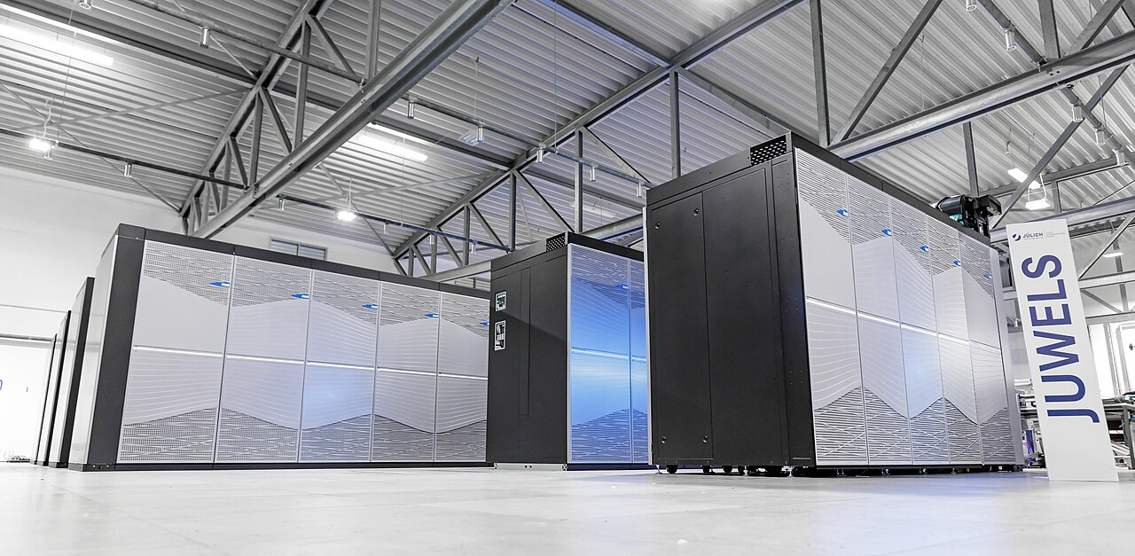
PIConGPU Simulates Laser-Plasma Interactions
Solving plasma dynamics on high performance computers
Thursday PS4:
Towards improved control of laser-wakefield accelerators with multidimensional parameter scans
(Jessica Tiebel)
Exascale Plasma Accelerator Simulations with PIConGPU (Finn-Ole Carstens)

Slide 5
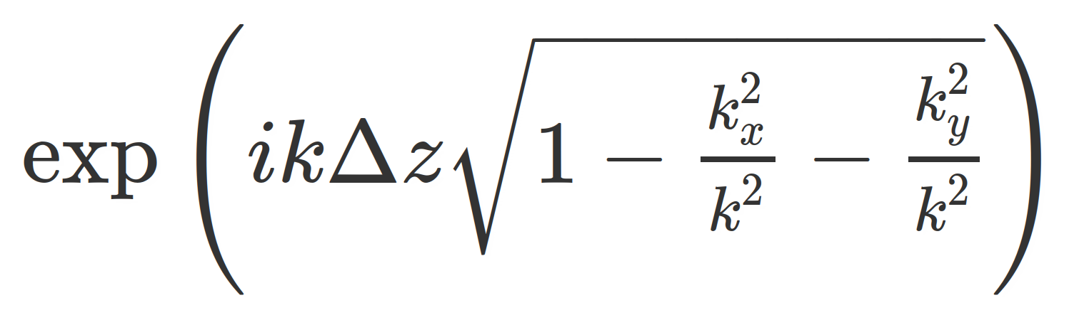
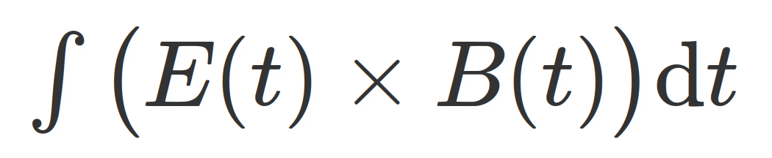
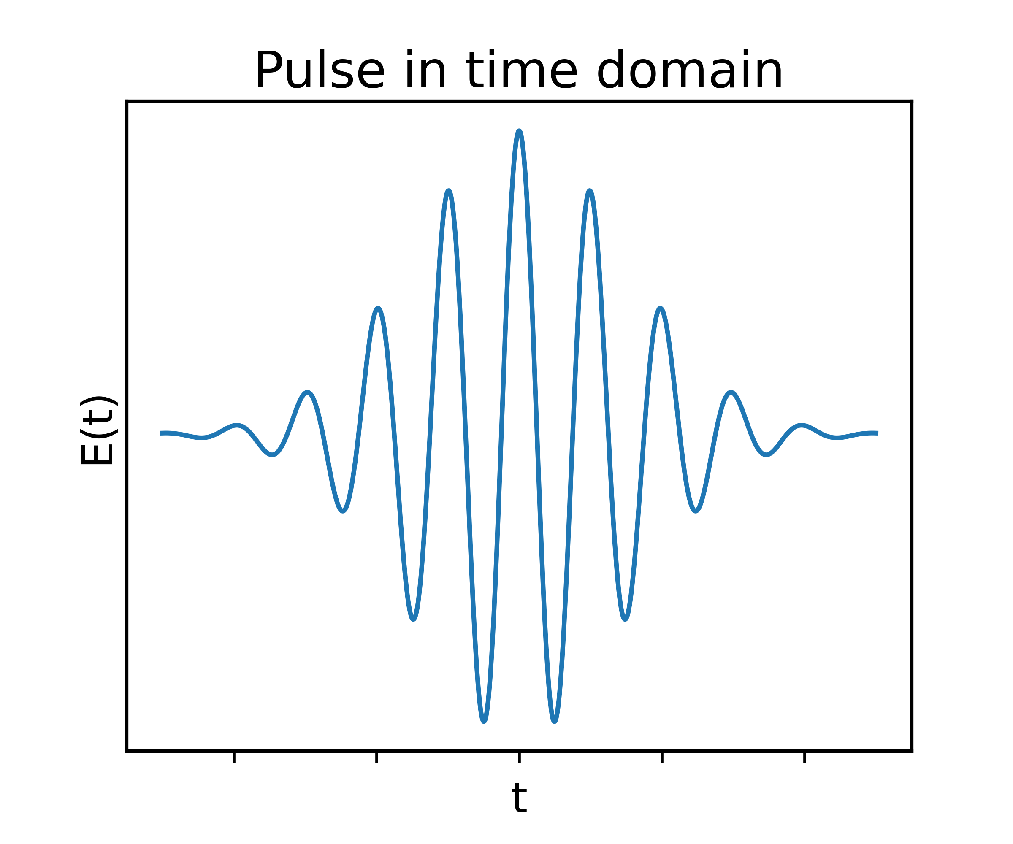
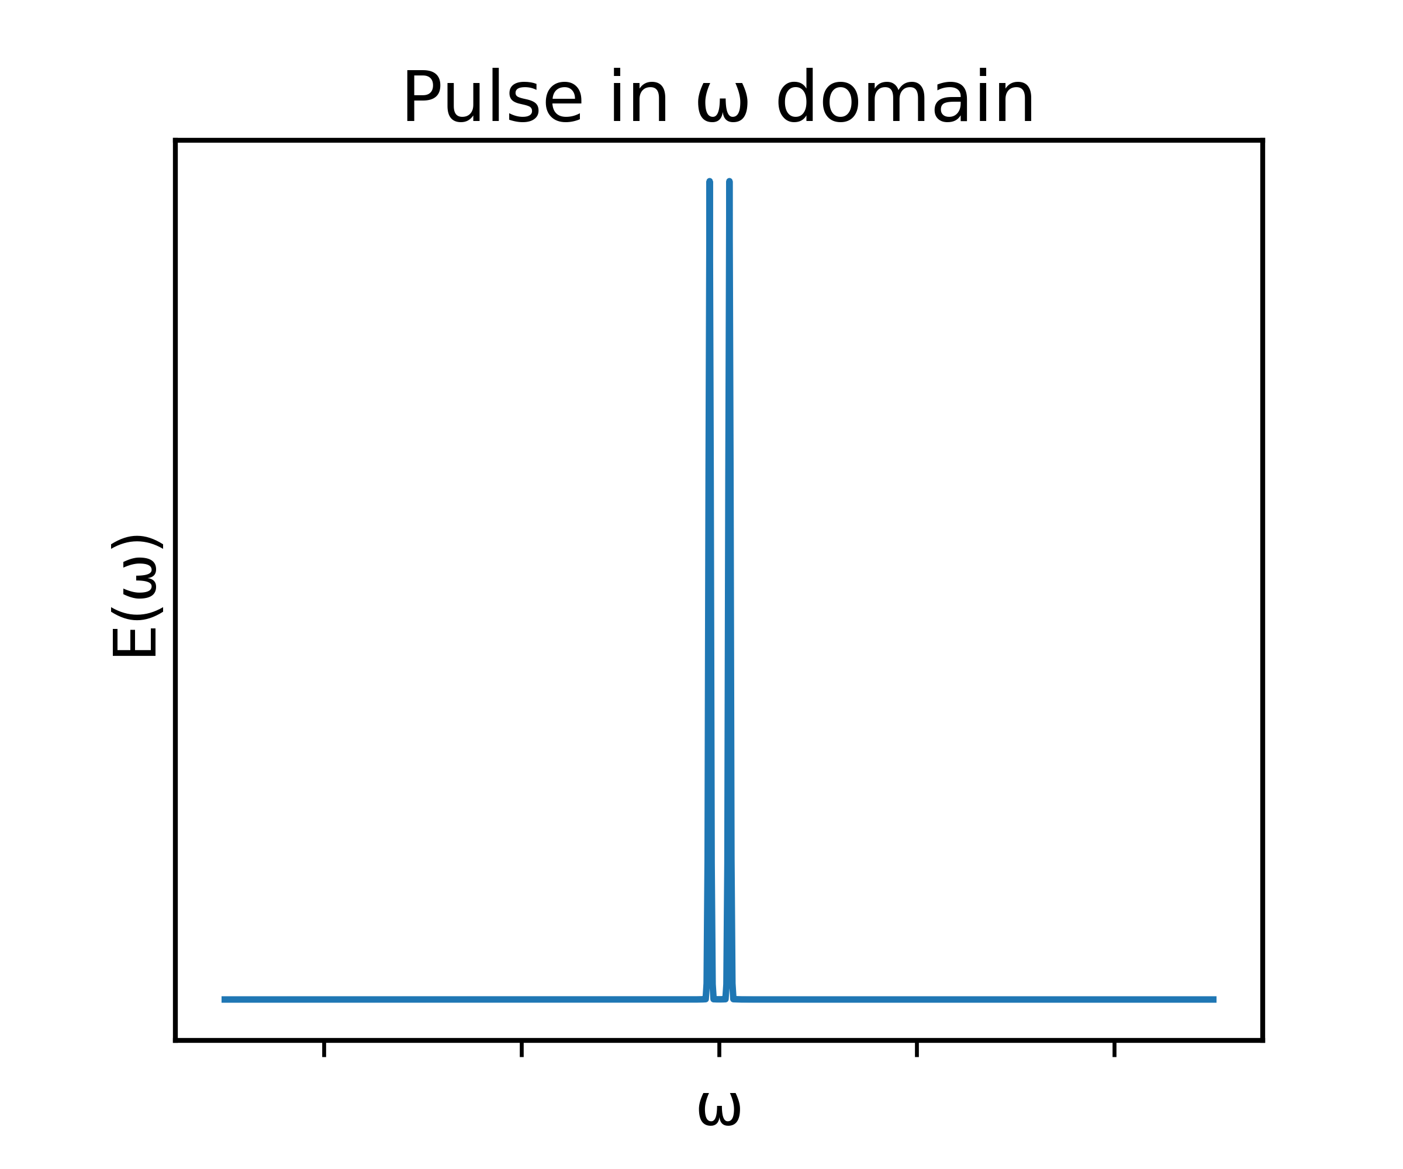
Optical Imaging Plugin in a Nutshell
Plugin propagates any radiation signal out of simulation into far field on virtual detector screen
Integrate
Inverse FT
Propagate
FT

Slide 6
Simulation Setup: PWFA with Injector Laser
Mimicking experimental conditions to synthesize lobster signal
Typical LWFA generated electron bunch
Fully ionized Hydrogen
Injector pulse
(30° to probe direction, polarized in y)
Plugin field extraction
Vertical direction (x)
Vertical direction (x)
Side View
Front View
Acceleration direction (y)
Probing direction (z)

Slide 7
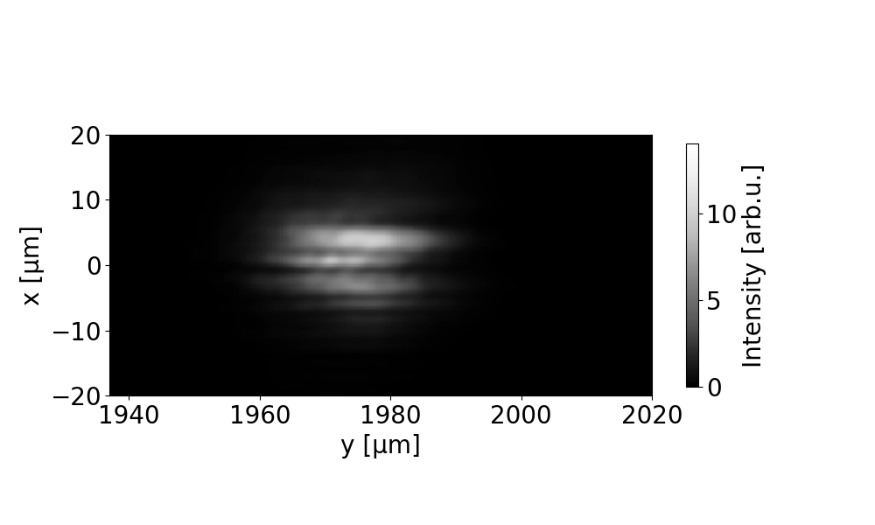
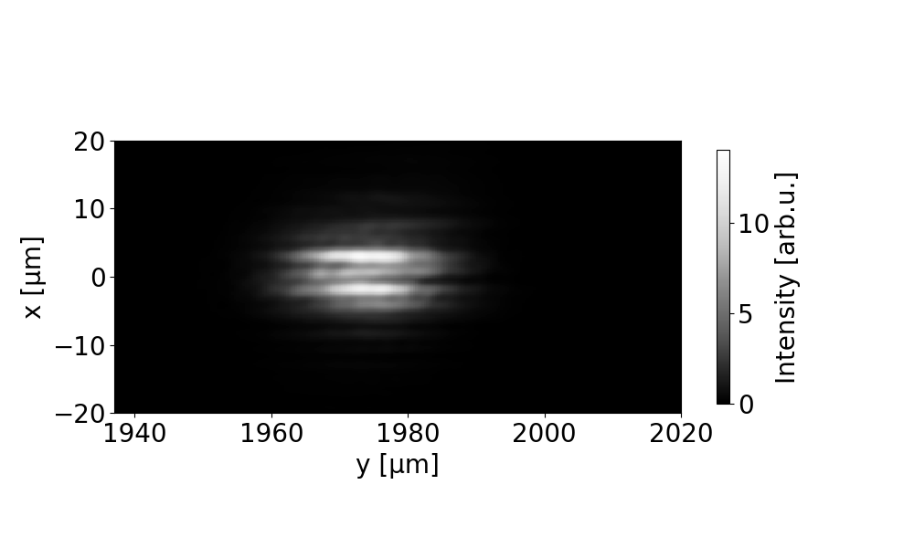
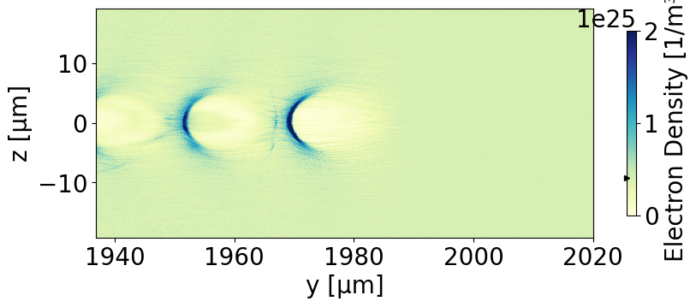
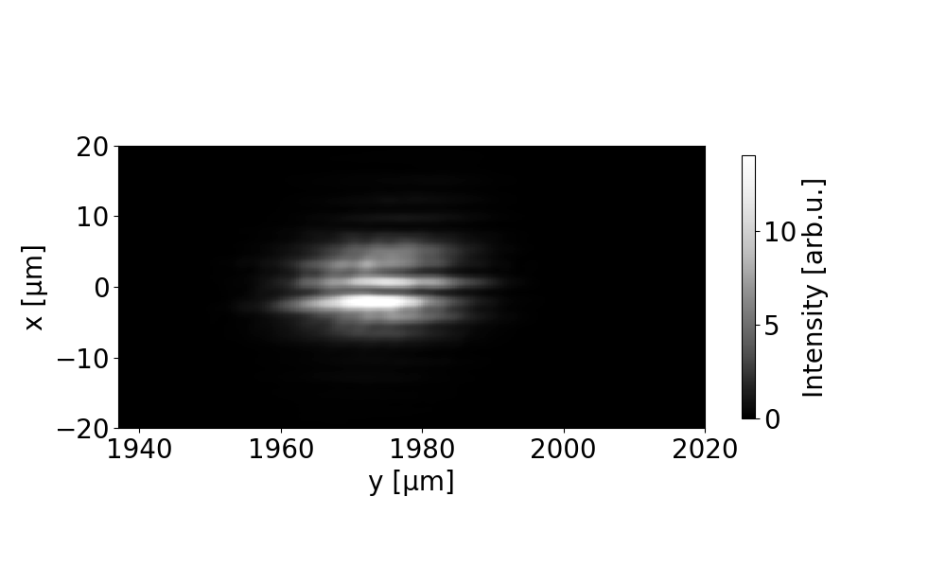
Reproducing the Experimental Radiation Signal in Simulations
Measuring horizontal jitter of wake structures through lobster signature

Slide 8
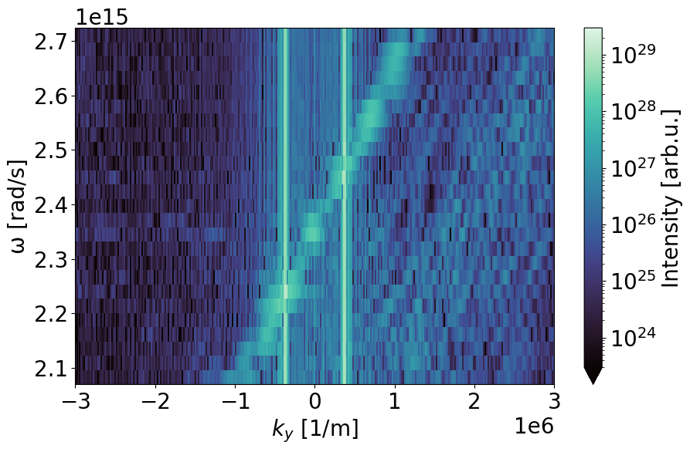
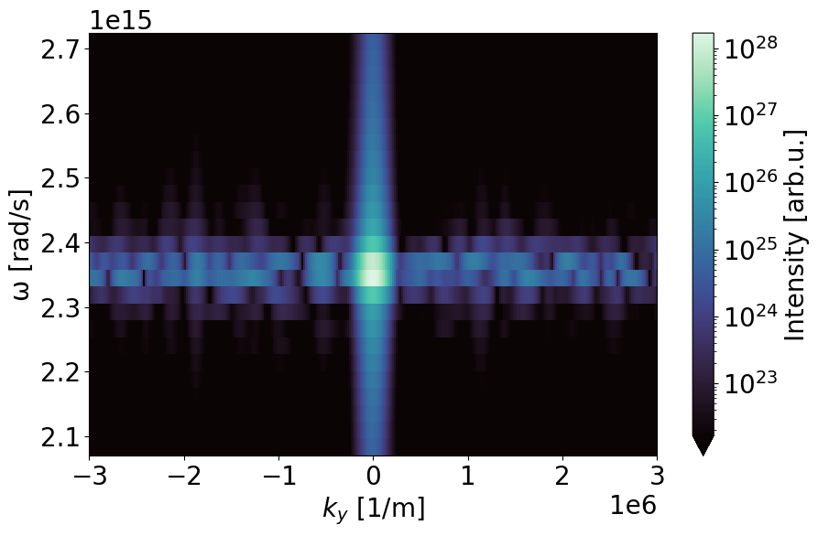
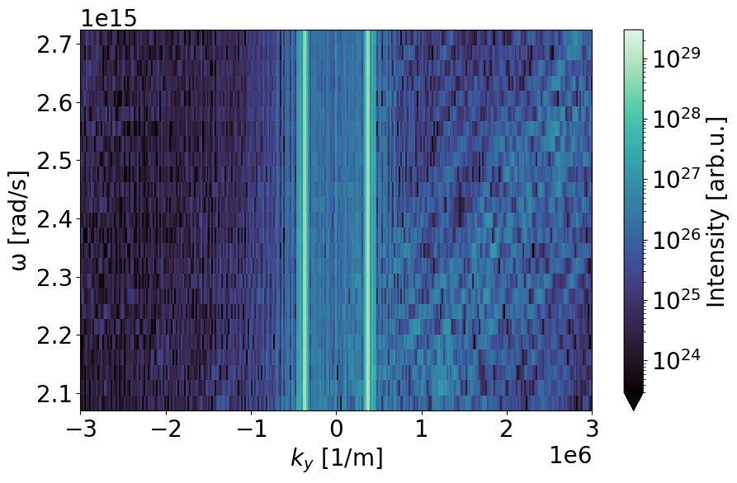
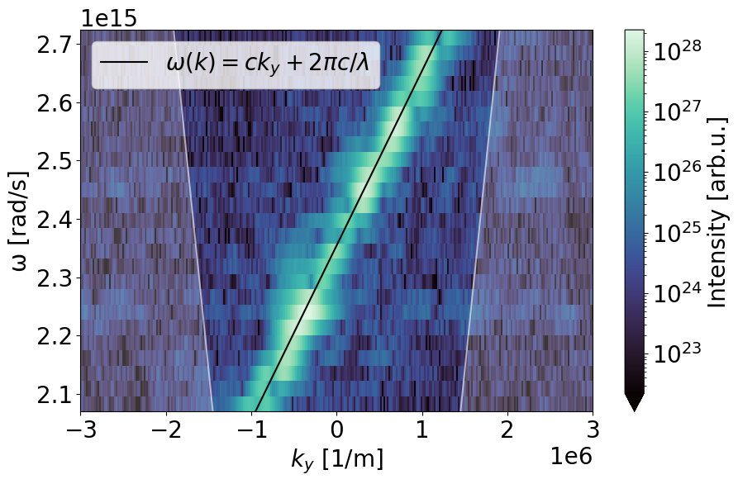
Fourier Domain Characterization of Signal
Doppler shift of signal in longitudinal direction

Slide 9
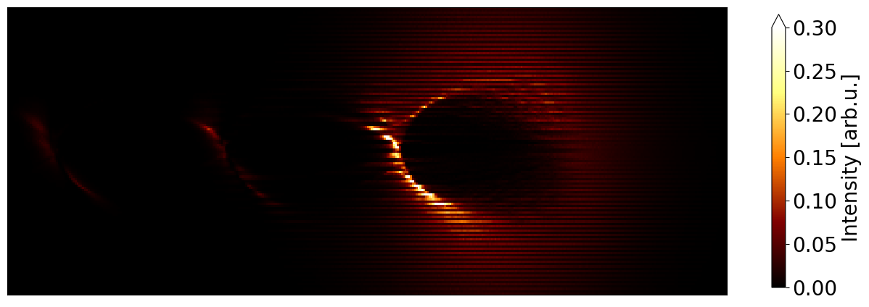
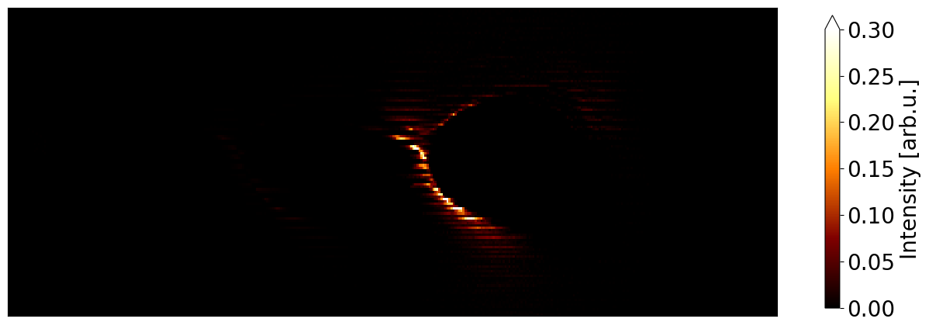
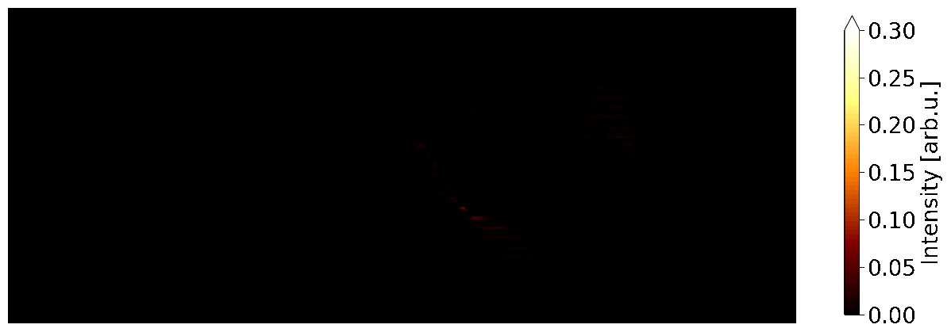
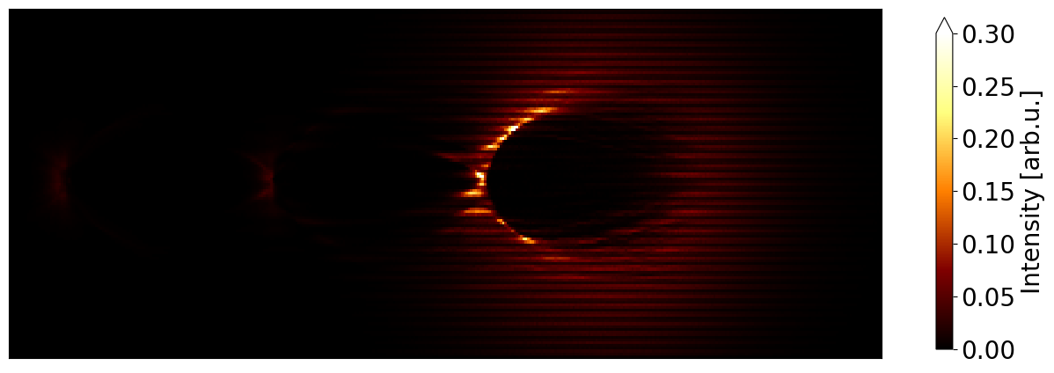
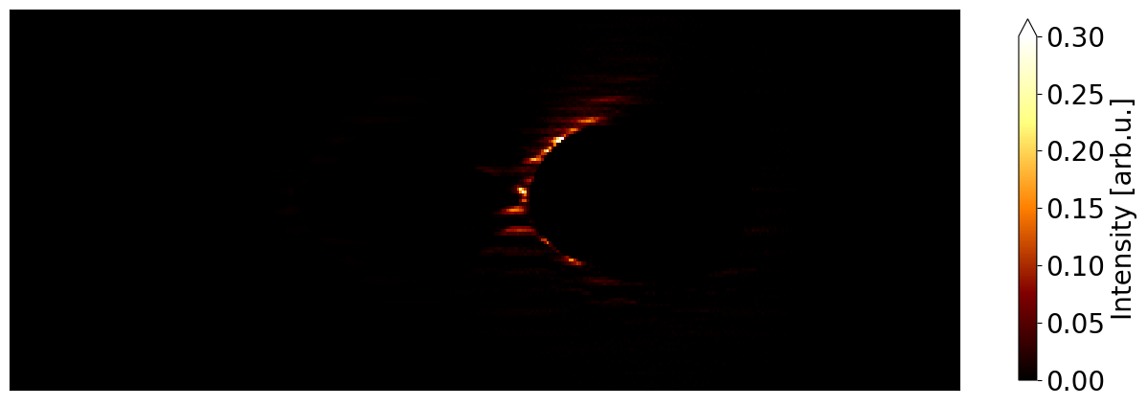

Determining Origin of Signal with Radiation Binning
Sheath of first and second cavity and detached sheath electrons contribute to signal
Vertical direction (x)
Detector direction (z)
Detector direction (z)
Vertical direction (x)
Vertical direction (x)
Detector direction (z)

Slide 10
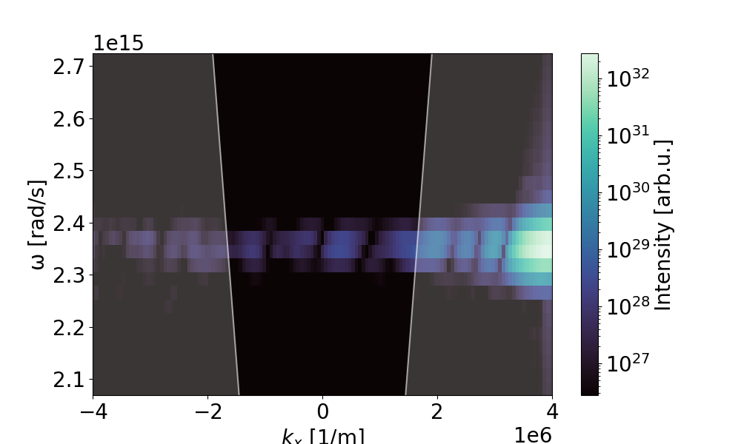
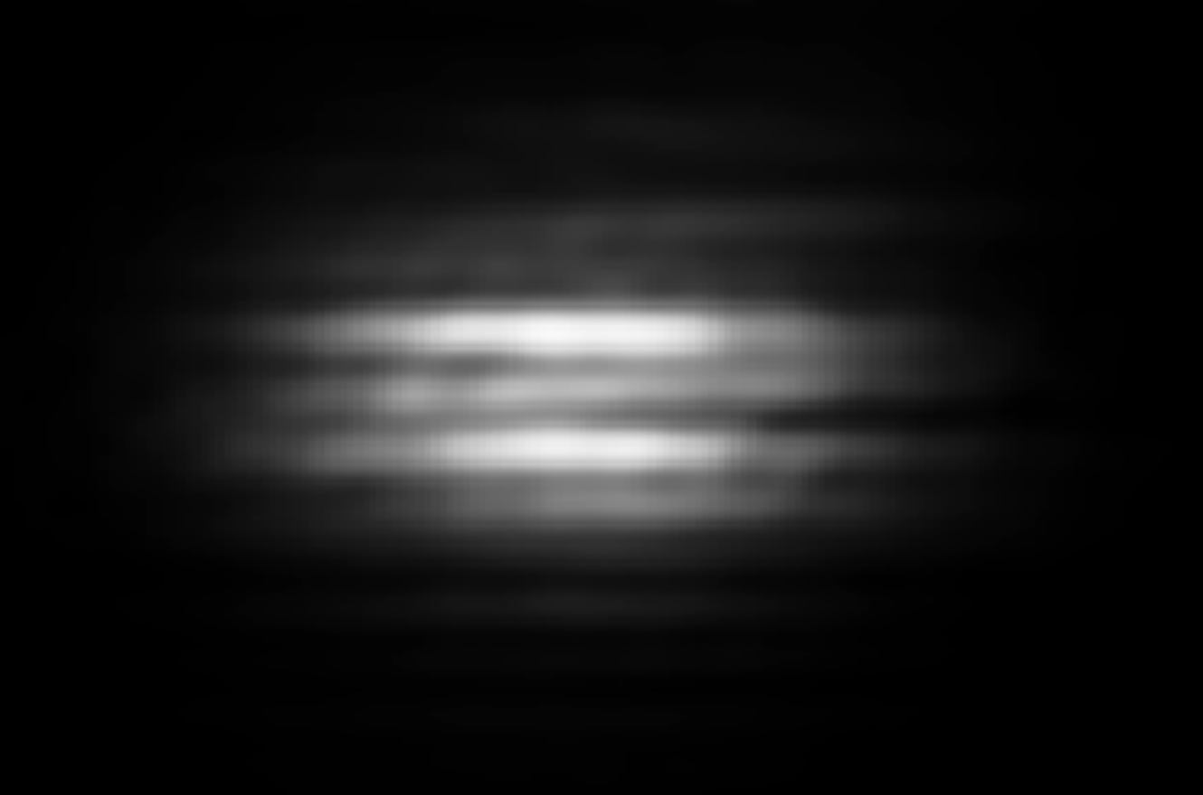
Summary
Successful recreation of lobster signal & deeper understanding of its origin
Experiment:
Fourier Domain
Origin from Cavity Sheath
Synthetic:

