Slide 1
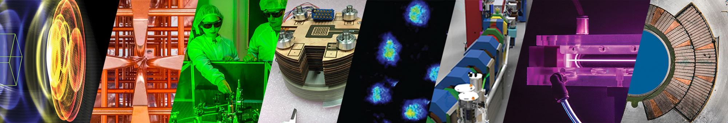

Advanced modeling tools for 10 TeV wakefield colliders
Jean-Luc Vay (on behalf of many)
Advanced Modeling Program
Accelerator Technology & Applied Physics Division
September 21 – 27, 2025
La Biodola Bay, Isola d'Elba, Italy

Slide 2

Outline
Source
10s-1000s stages
>10 TeV IP
10s-1000s stages
Source
Collider design studies
  The 10 TeV Design Initiative for a 10 TeV pCM wakefiled collider
The Simulations/Computing/AI Working (SCAI) Group
The Collaboration for Advanced Modeling of Particle Accelerators (CAMPA)
Standardized data & tools: openPMD, PICMI, LASY, PALS, GeSt-api
Toward multi-modal AI-ready data sources & models
Summary
2
Notes:
10 TeV Wakefield Collider Design Study - Simulations/Computing/AI WG
Organizing the community
CAMPA, standards (openPMD, PICMI, LASY, PALS, HELPMI)

Slide 3
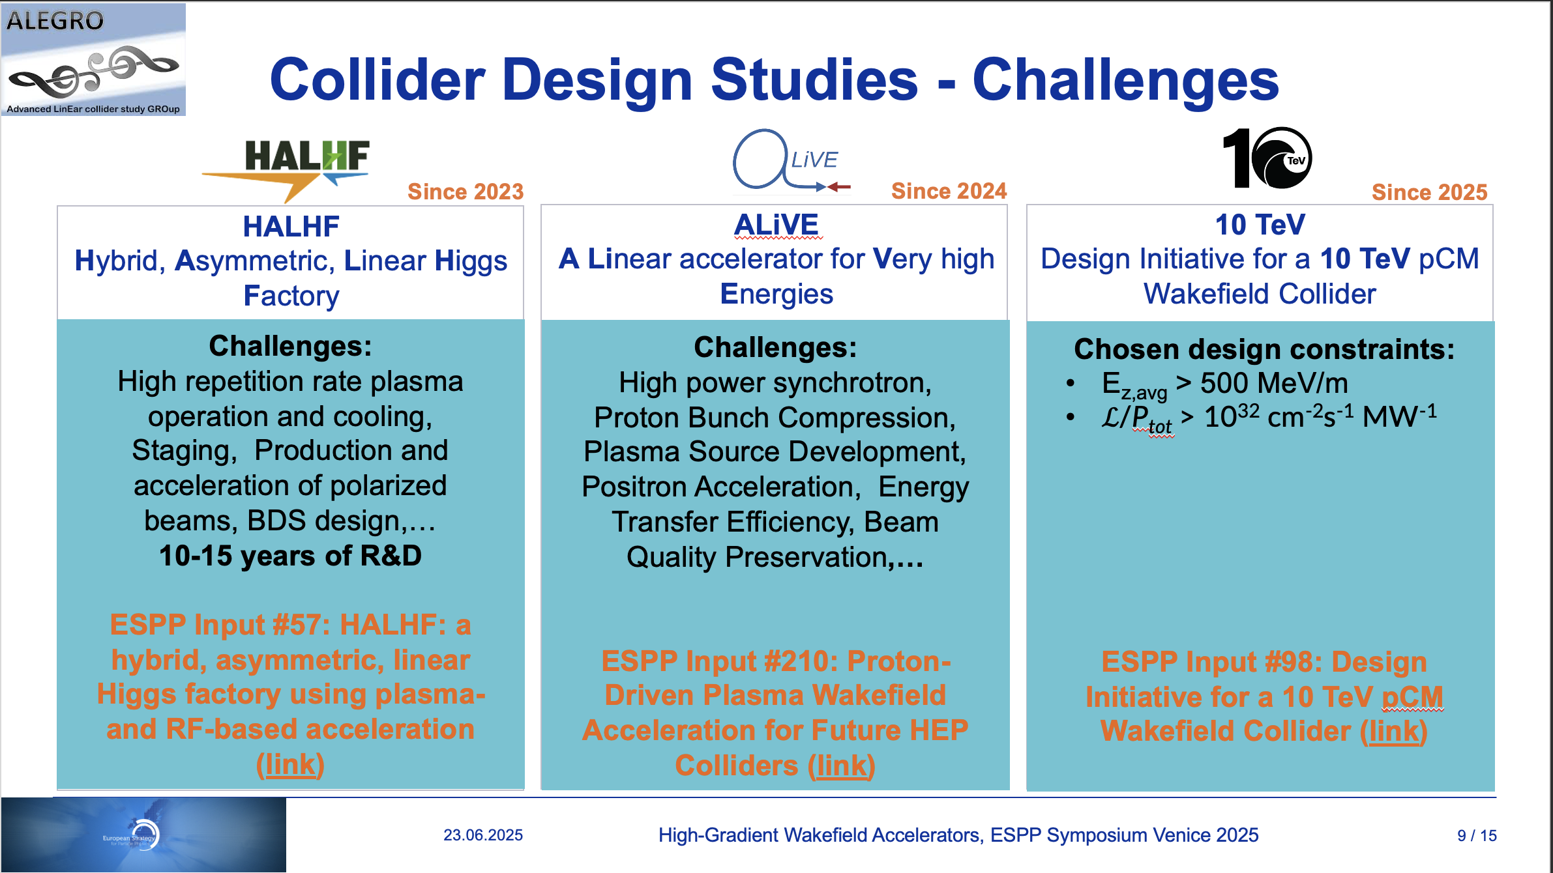
Ongoing high-gradient wakefield collider studies
M. Turner, Open Symposium on the European Strategy for Particle Physics, Venice, Italy, Jun 23 – 27, 2025
3

Slide 4
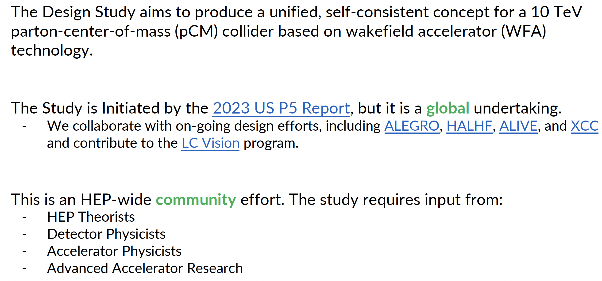
10 TeV Wakefield Collider Design Study
S. Gessner, APS Division of Particles & Fields Community Meeting, July 31-August 1, 2025.
4

Slide 5
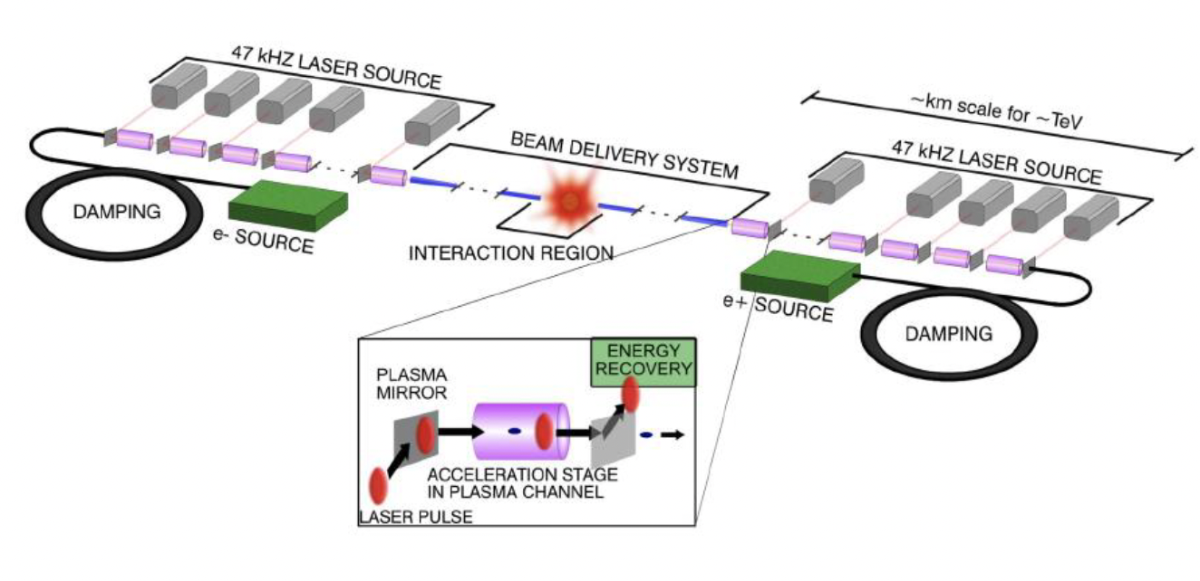
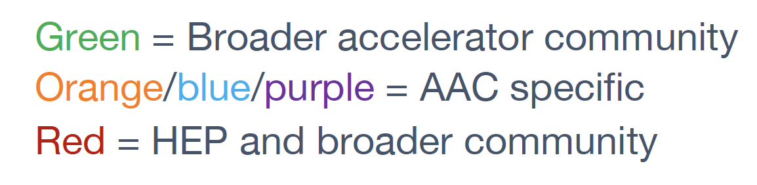
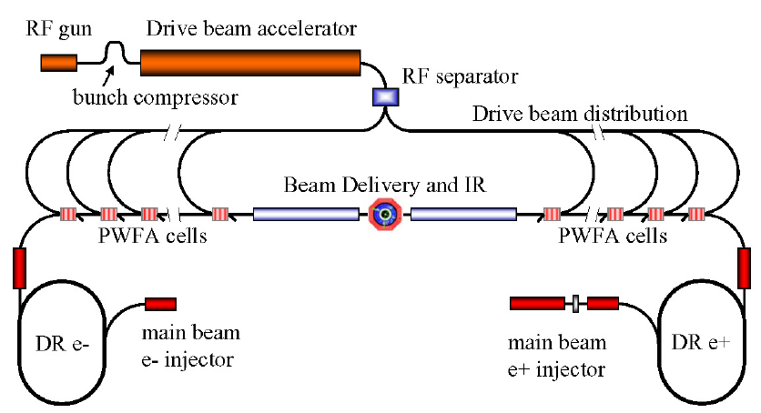
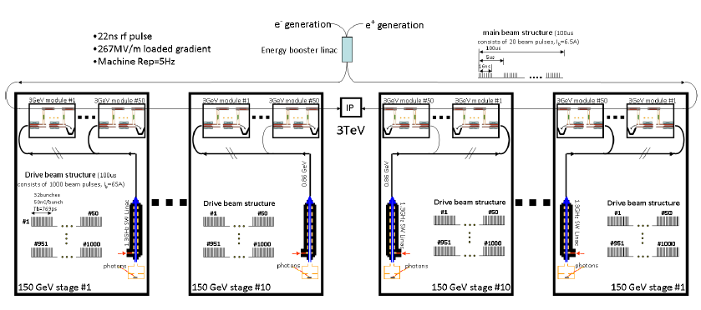
Working Groups: includes “Simulations/Computing/AI” (SCAI)
Several options:
  System integration and optimization
  Beam sources (incl. damping rings)
  Drivers
    Laser
    Beams - SWFA
    Beams - PWFA
  Beam delivery system
  Beam-beam interactions
  Beam diagnostics
  Machine-detector interface
  HEP detector
  HEP physics case
  Environmental impact
  Simulations/computing/AI
  Linacs
    LWFA
    SWFA
    PWFA
LWFA
PWFA
This talk
Most of the design work requires simulations!
➔ We are limited by what we can compute…
SWFA
…the SCAI is the limit!
5
(adapted from) R. lehe & M. Thevenet, Kick-off meeting for the simulation WG for a 10TeV wakefield-based collider, July 25, 2024

Slide 6
Next Steps
Pre-CDR’s are critical
    Simulation tools are fantastic … use them
    Quantify stability and tolerances
    Detail the R&D and necessary steps
    What test facilities are needed and be clear about purpose and goals
Demonstrate capabilities with applications
    FEL’s are excellent but injectors and other applications are also great
Engage the community
    Convey the enthusiasm but don’t oversell
Simulations are key to address many AAC-based collider challenges
T. Raubenheimer, EAAC2025

Slide 7
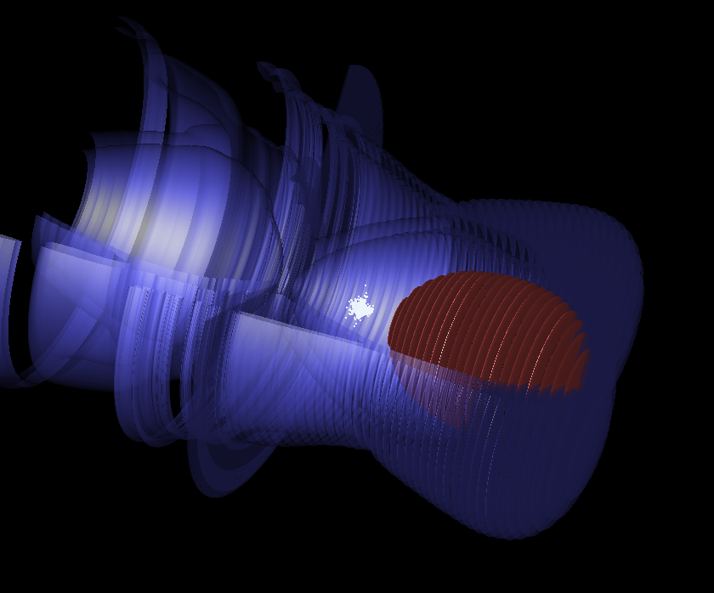
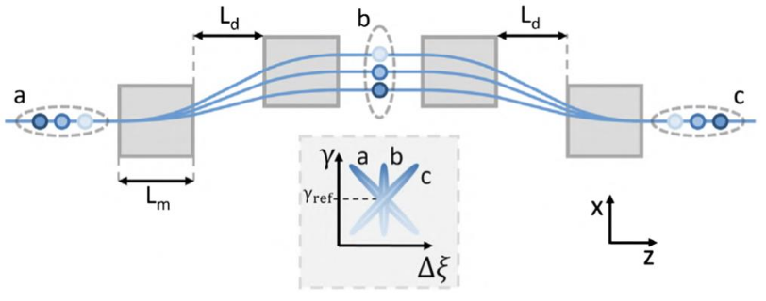
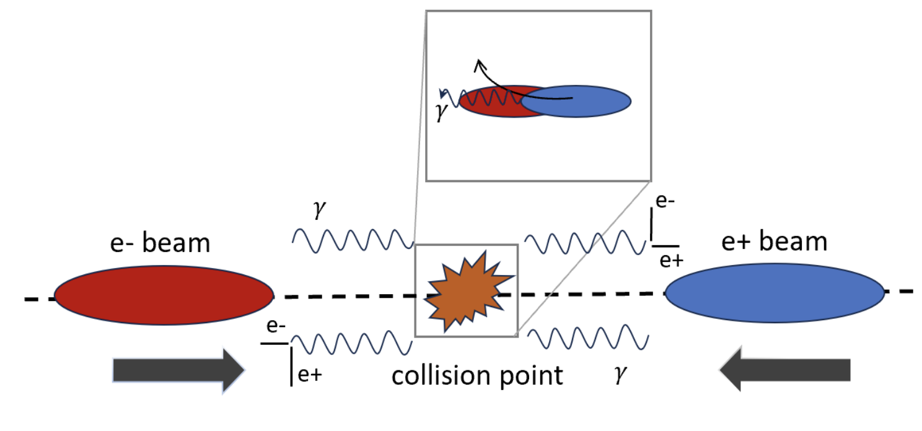
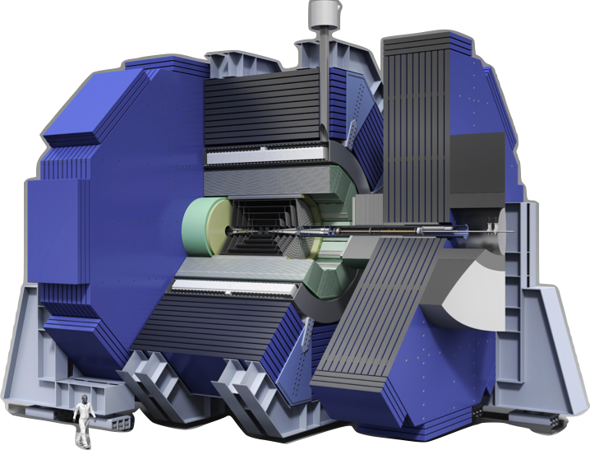
Simulation tools cover a wide range of codes
Accelerator stages
Beam
dynamics/transport
Interaction point
(Detectors)
E.g., QPAD, HiPACE++,
Inf&rno, QuickPIC, Wake-T, LCODE, TurboWAVE, FBPIC, WarpX, OSIRIS, Smilei, VLPL, Epoch, …
E.g., ImpactX, Elegant, XSuite, BMAD, Wake-T, …
E.g., Guinea-Pig,
CAIN, WarpX,
Osiris, VLPL …
E.g., DDSim,
DD4HEP, …
+ “Systems code” for design, optimization & costs (e.g., ABEL)
Axel Huebl, “Modelization of Plasma Accelerators in the Exascale Era”, EAAC25, Thursday @11:30AM
More codes: not really
Better codes & algorithms; more physics; benchmarking: always!
More & better documentation; examples: definitely!
More integration & interoperability; workflows: definitely!
Needs
(adapted from) R. lehe & M. Thevenet, Kick-off meeting for the simulation WG for a 10TeV wakefield-based collider, July 25, 2024

Slide 8
SCAI WG can leverage & help coordinate efforts
New website with samples input scripts for various codes
Coordination with, e.g.:
  Codes developers to provide examples, participate to benchmarking, add physics, …
  CAMPA: openPMD, PICMI, LASY, PALS, GeSt_api
  HElmholtz Laser Plasma Metadata Initiative (HELPMI)
  HALHF: ABEL
  ALiVE
  …
Coordinate simulation efforts to address 10TeV collider questions/challenges
8

Slide 9
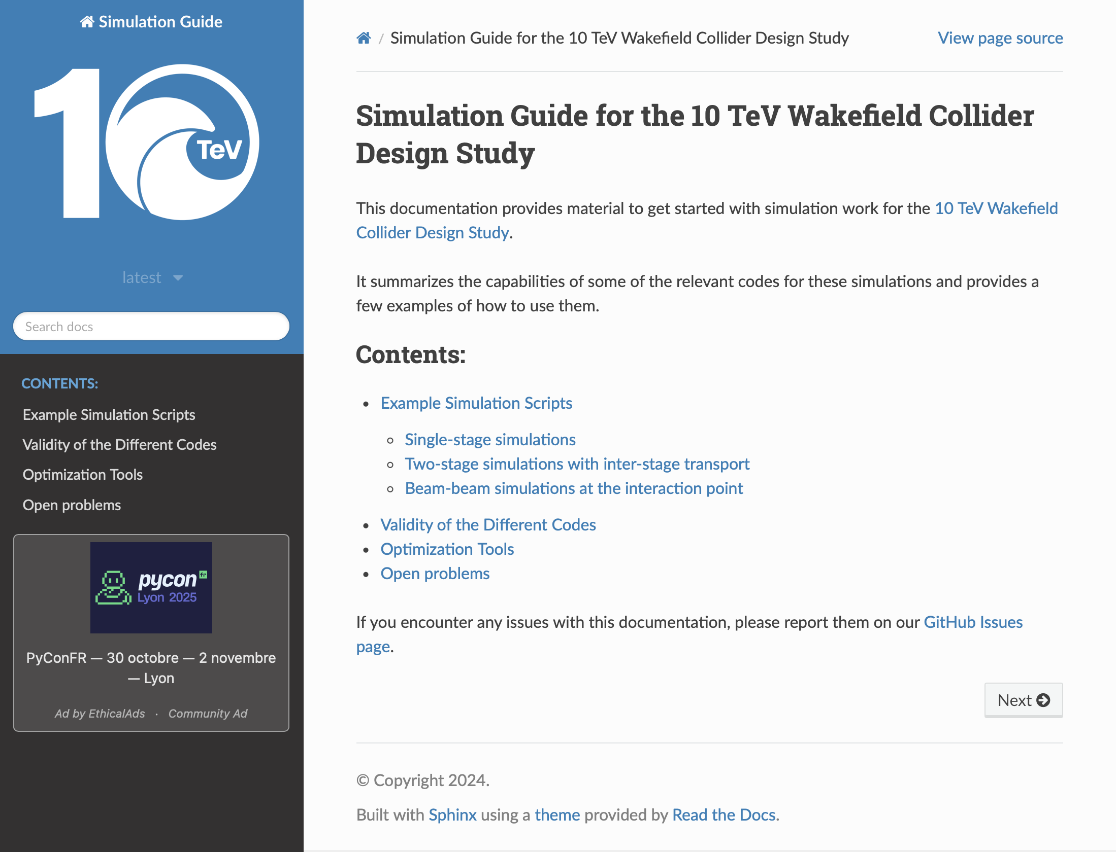
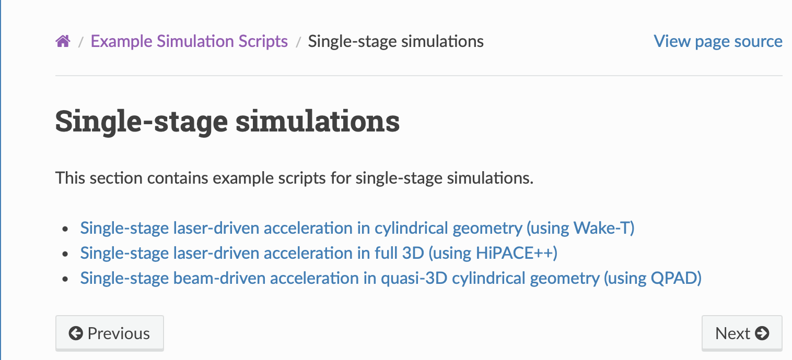
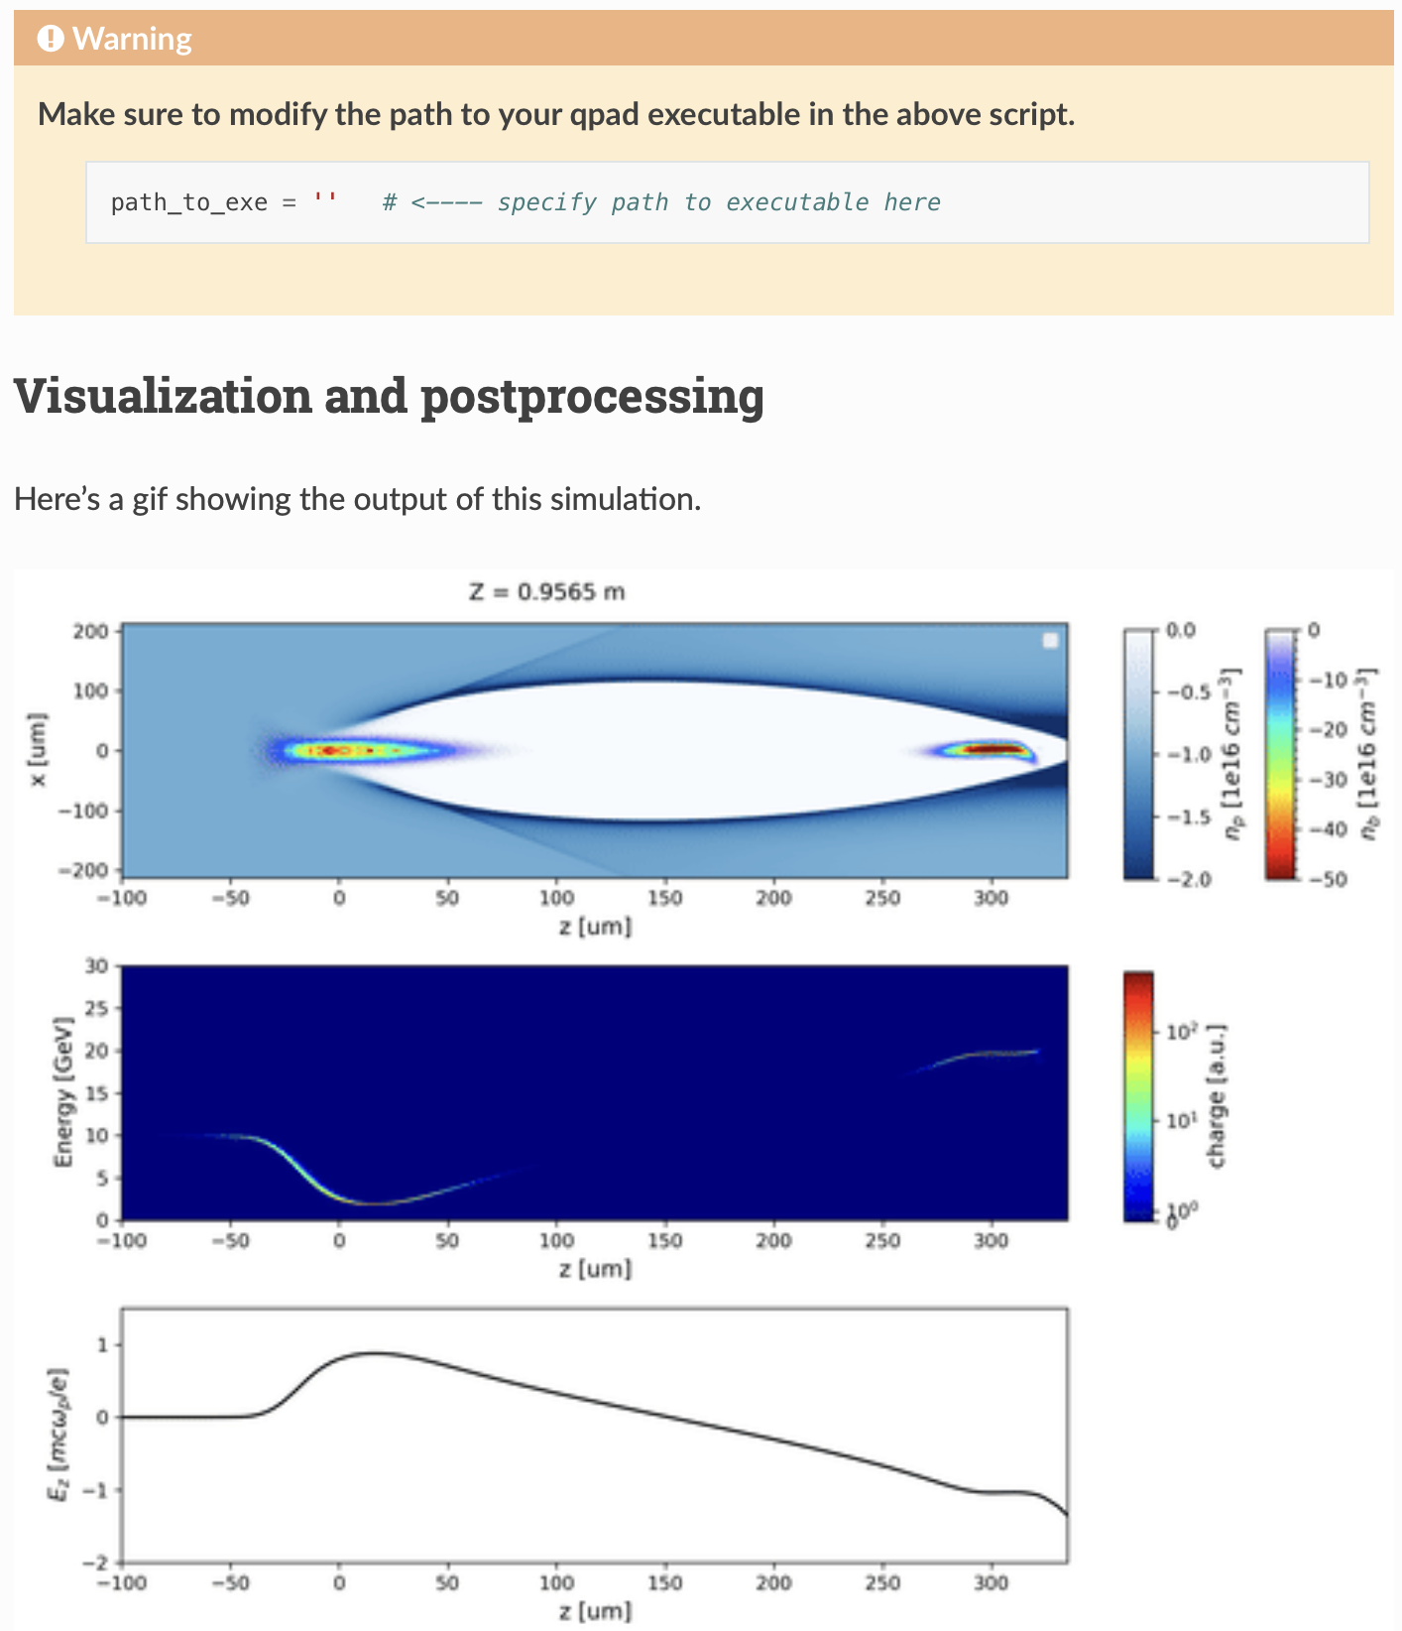
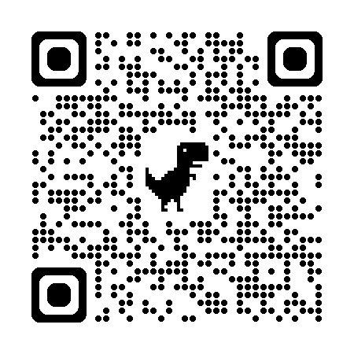
SCAI WG Website is being developed
https://10tev-simulation-guide.readthedocs.io
9

Slide 10
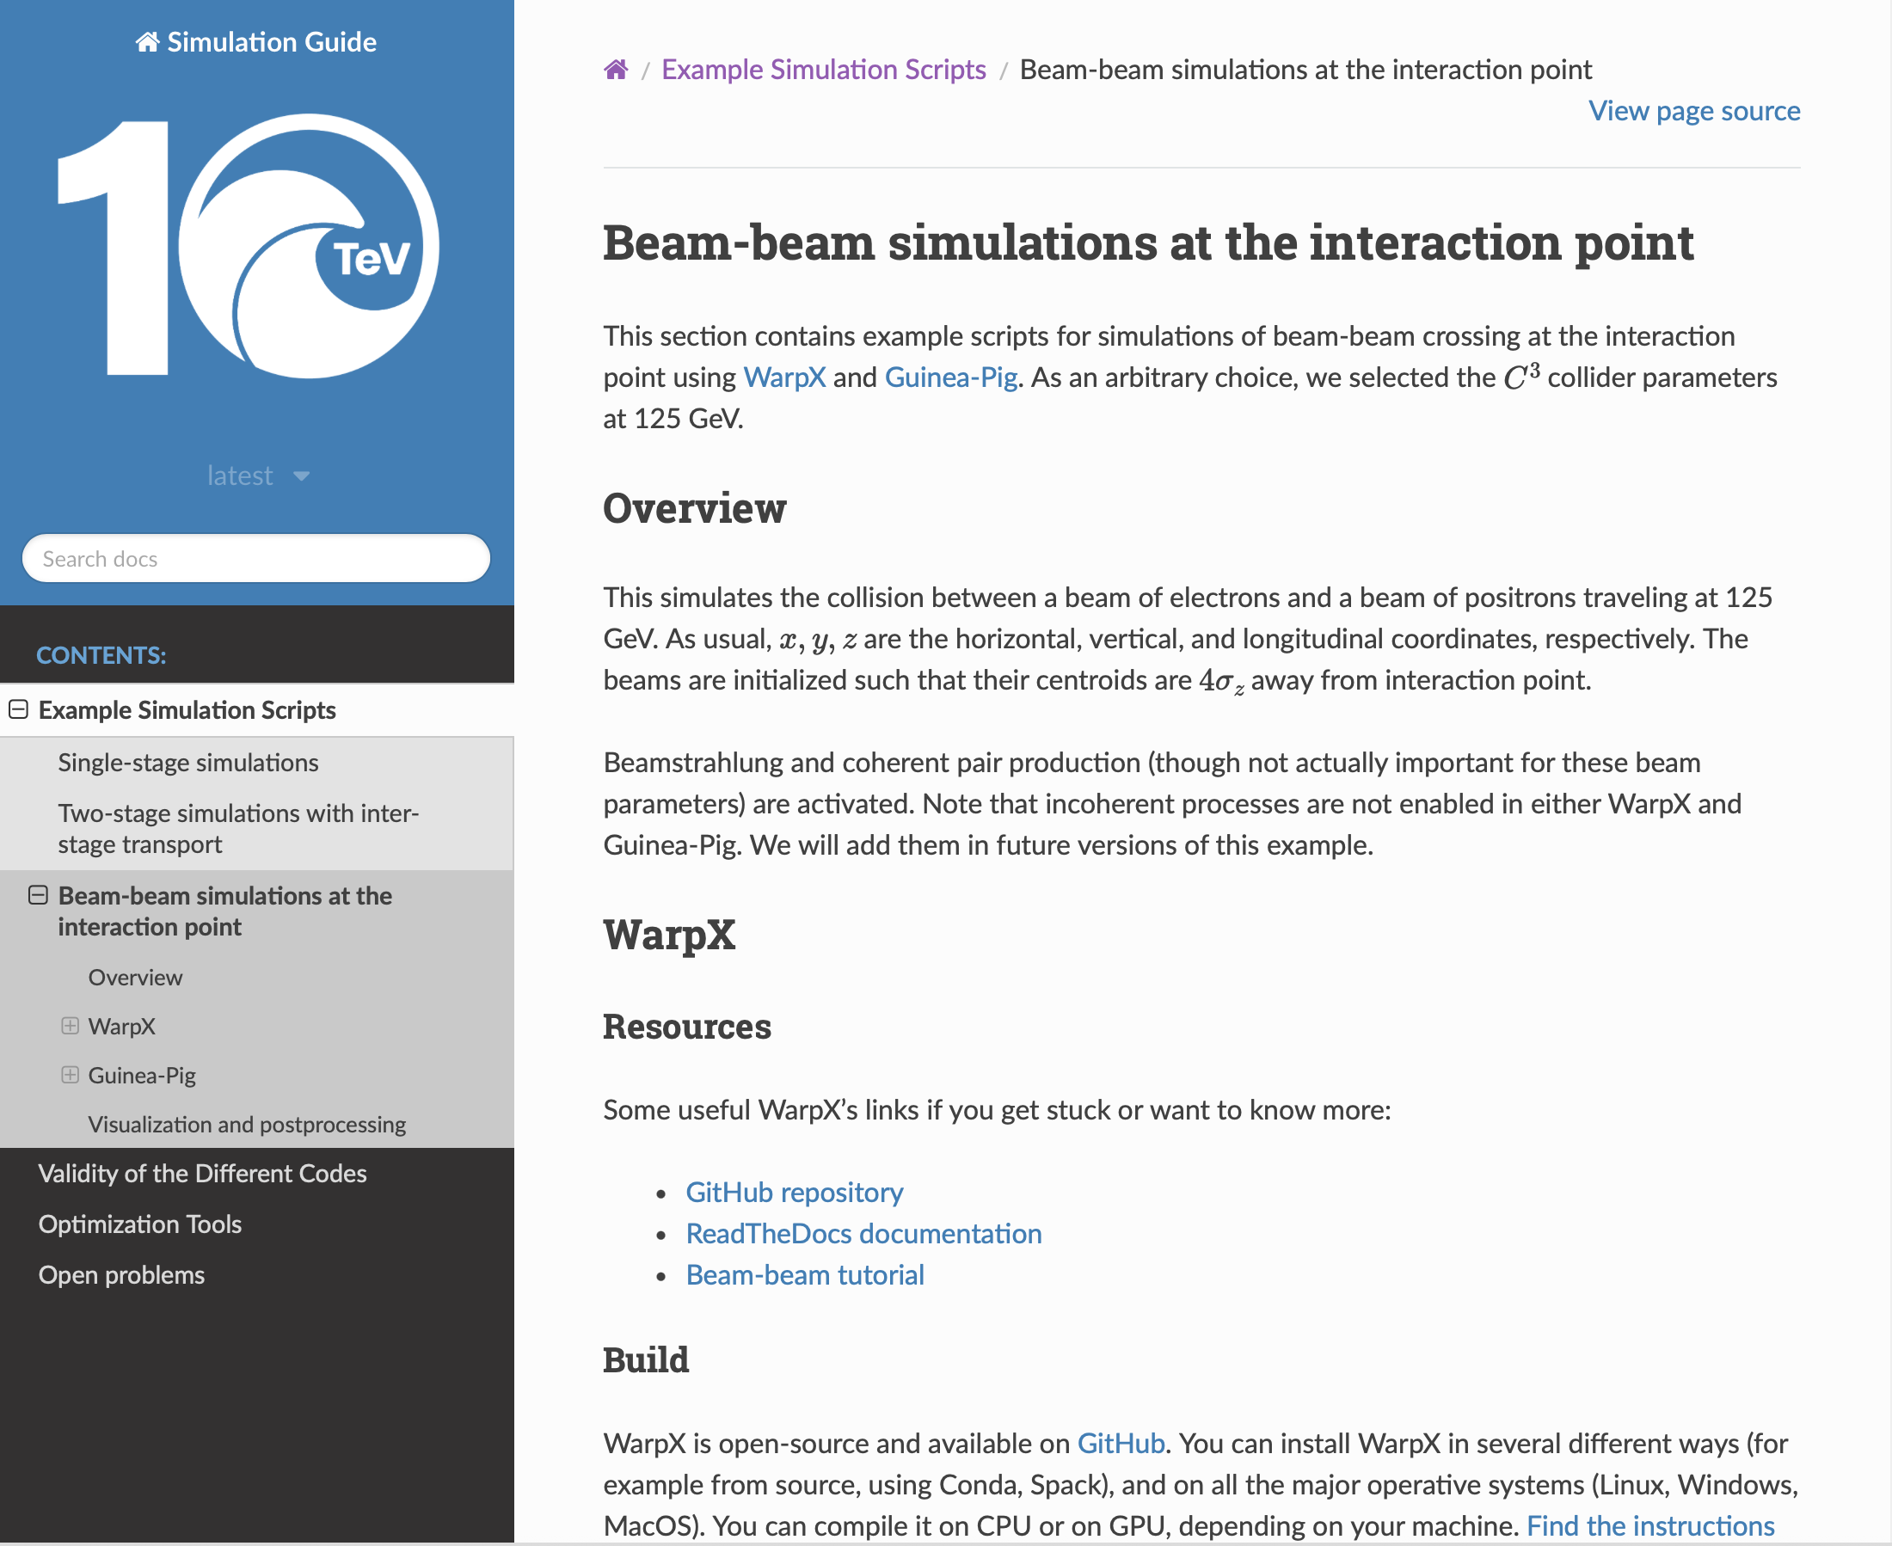
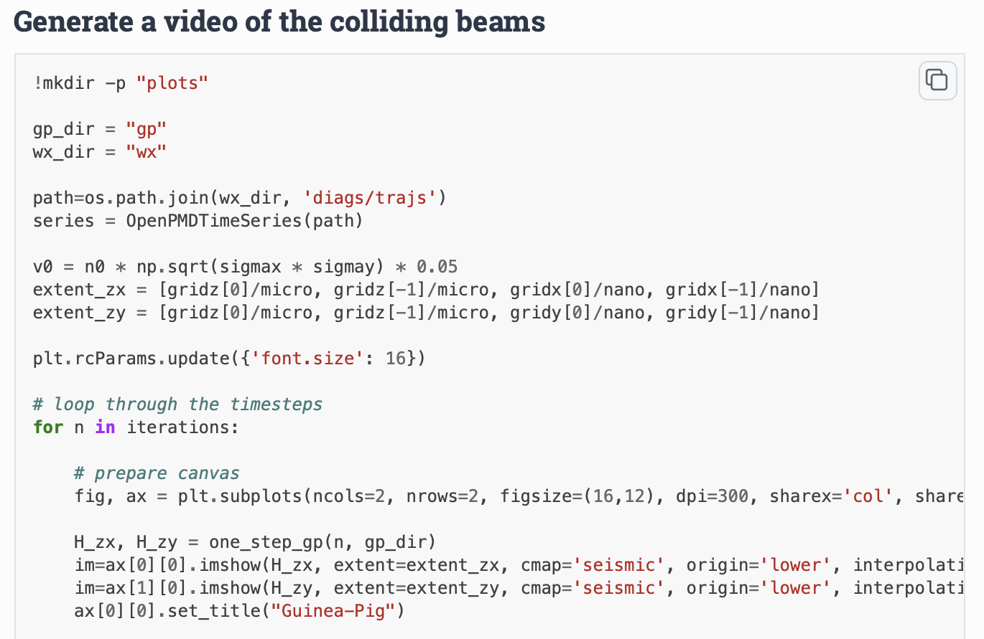
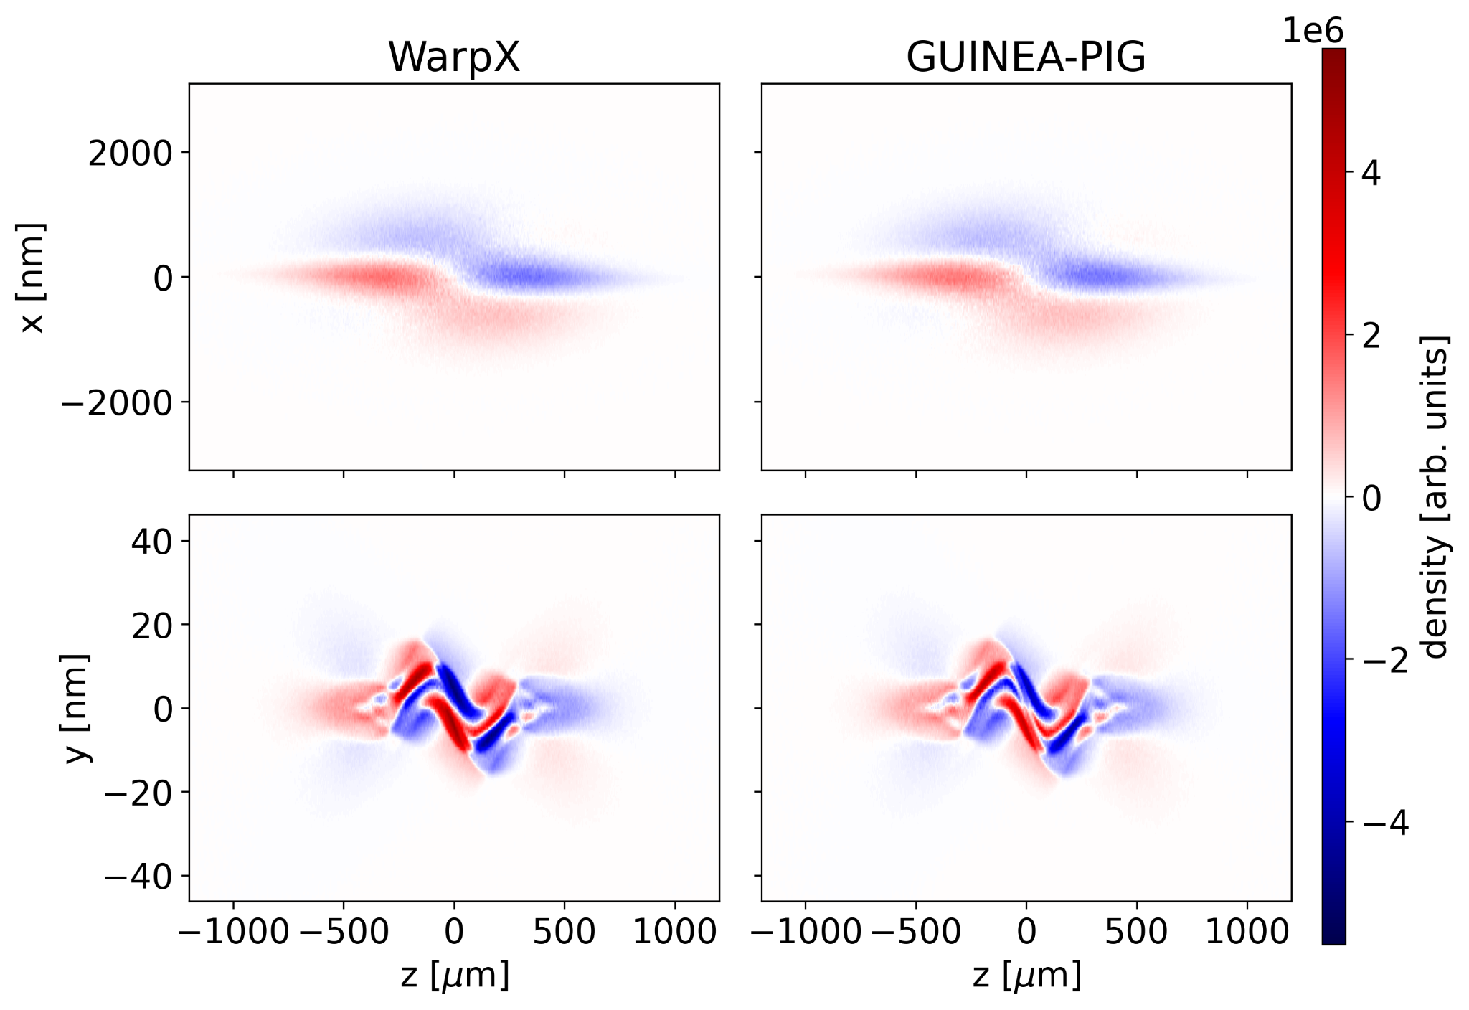
SCAI WG Website is being developed
10

Slide 11

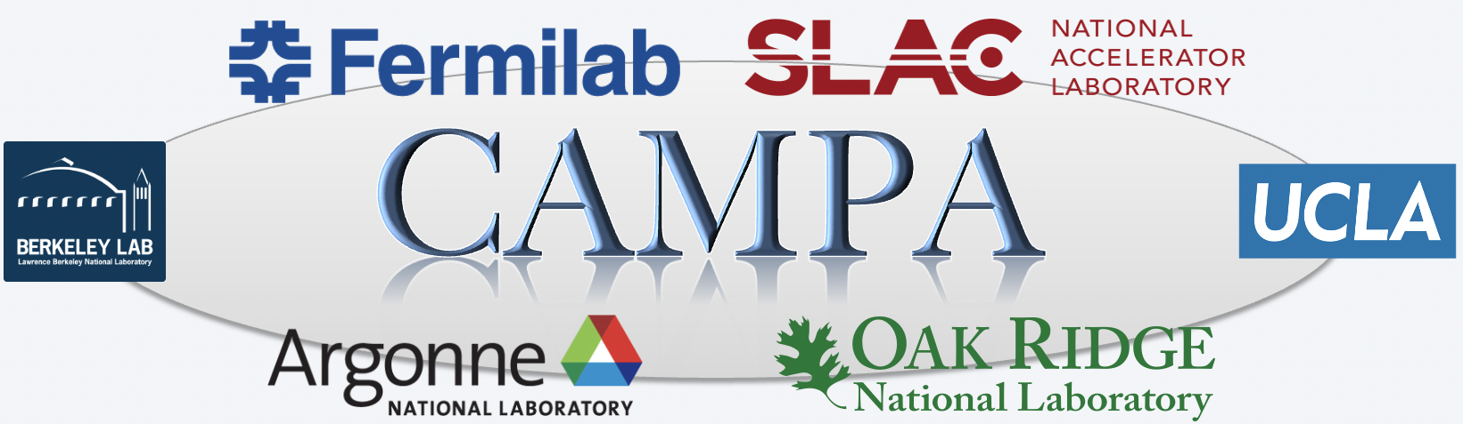

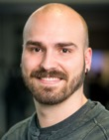
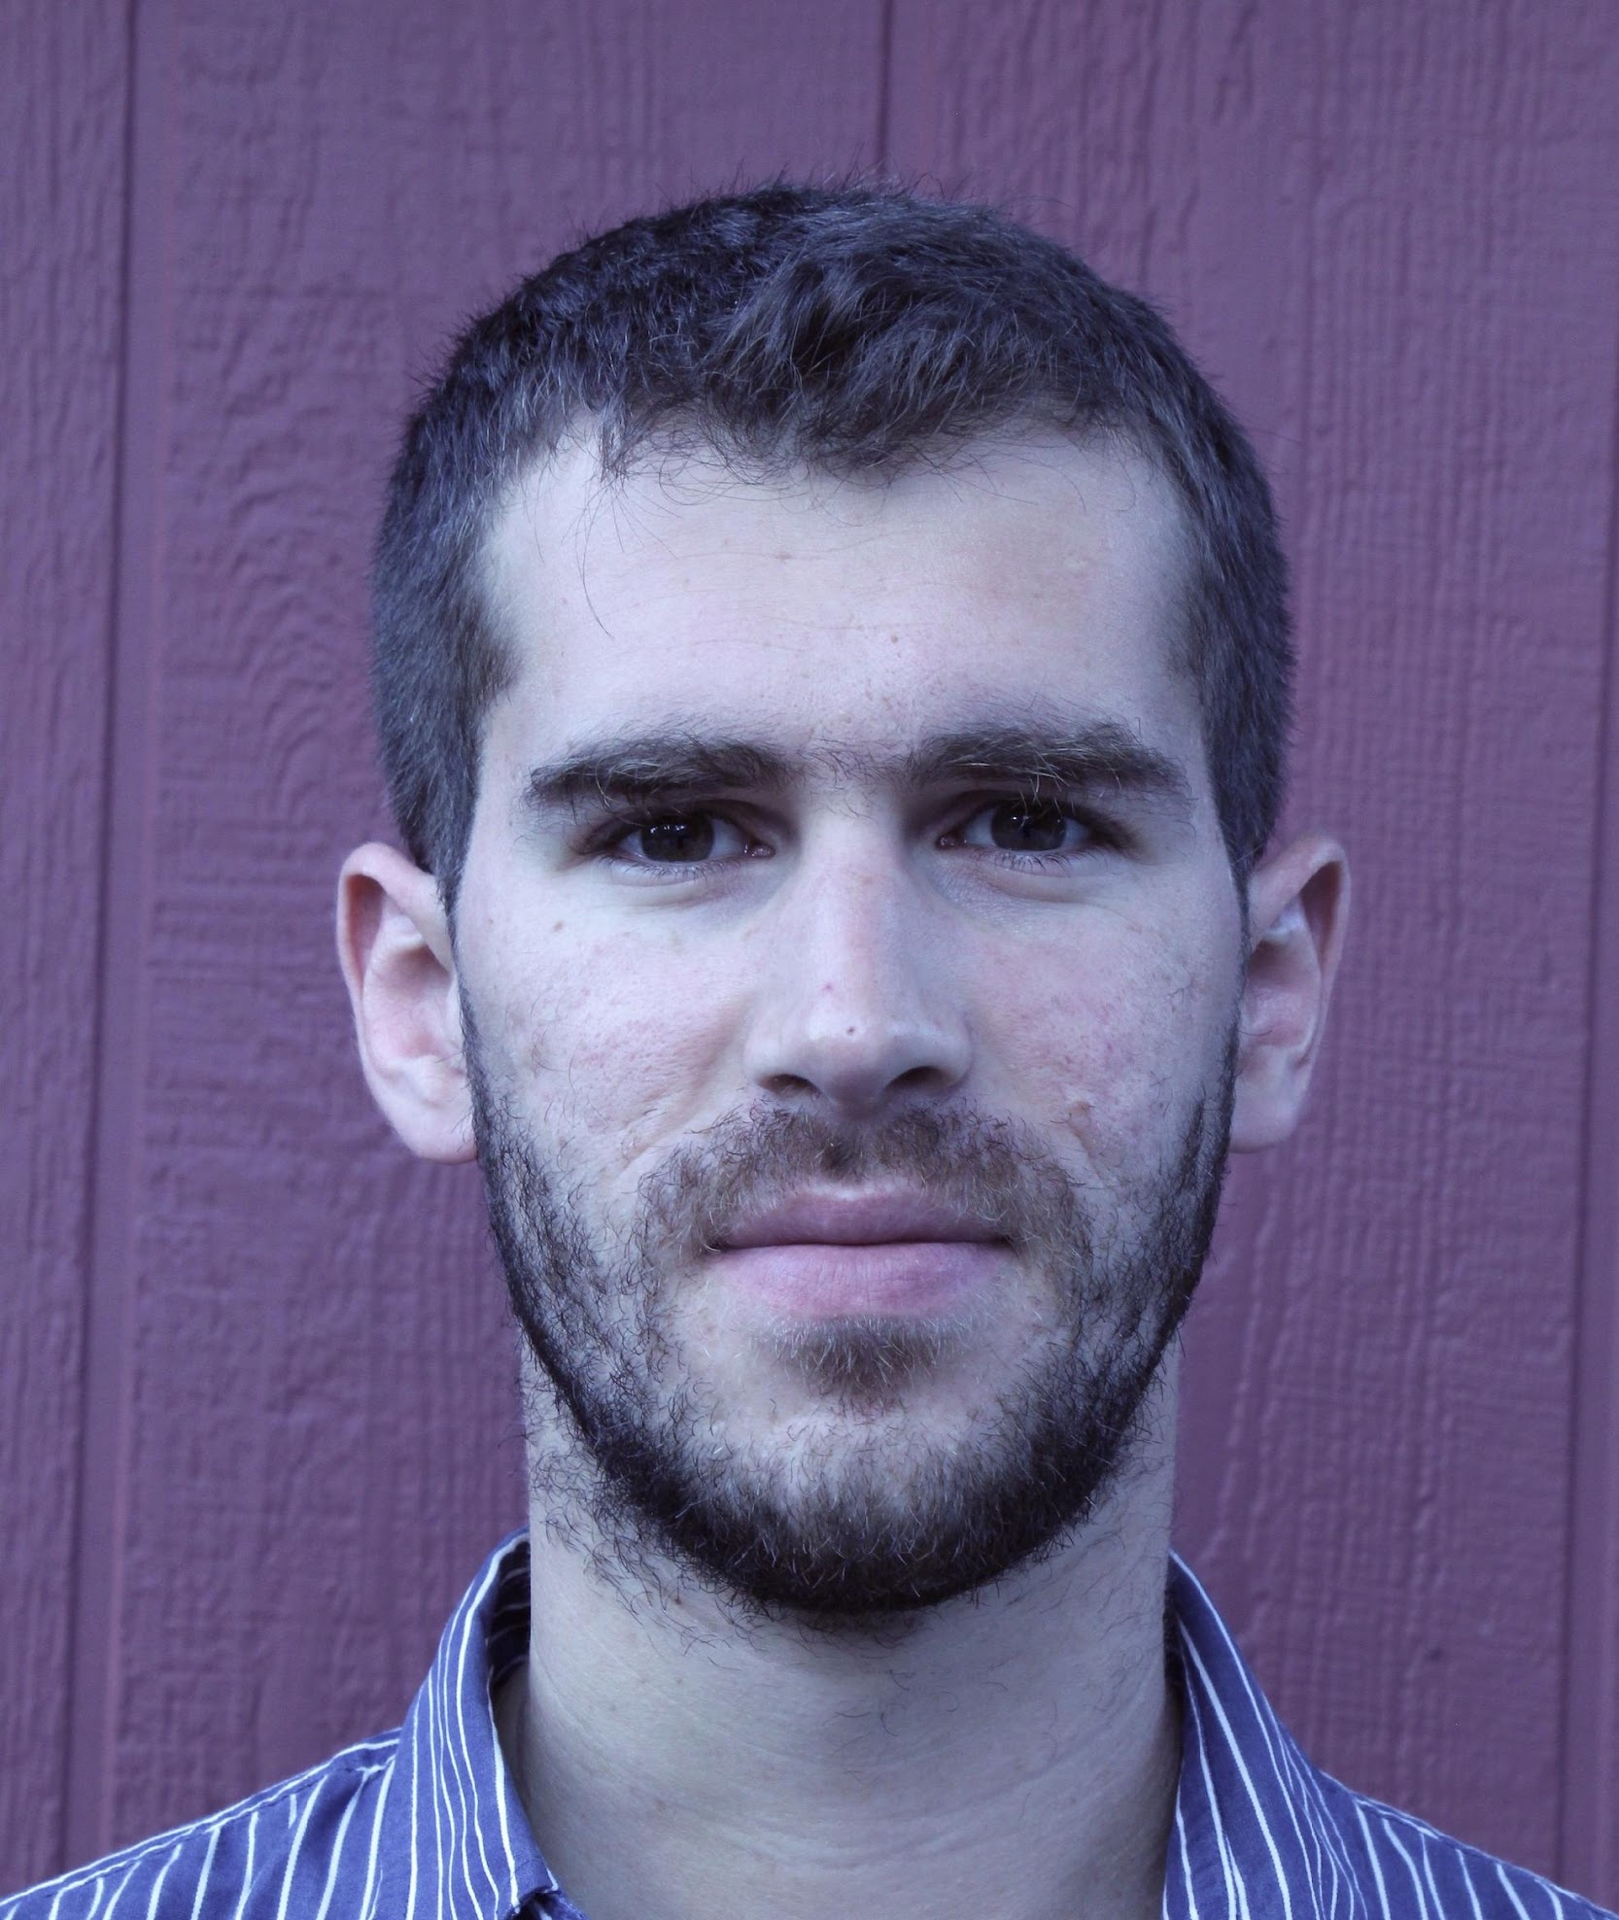
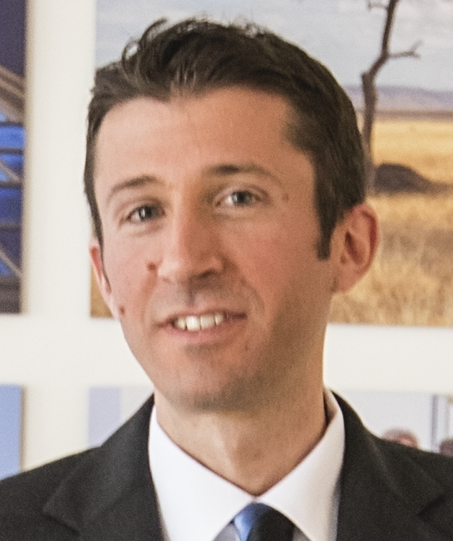
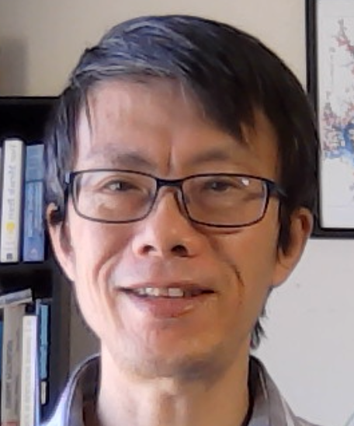
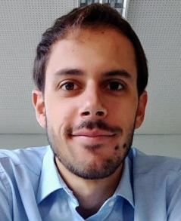
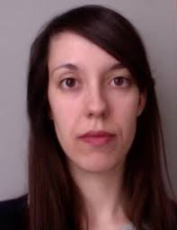


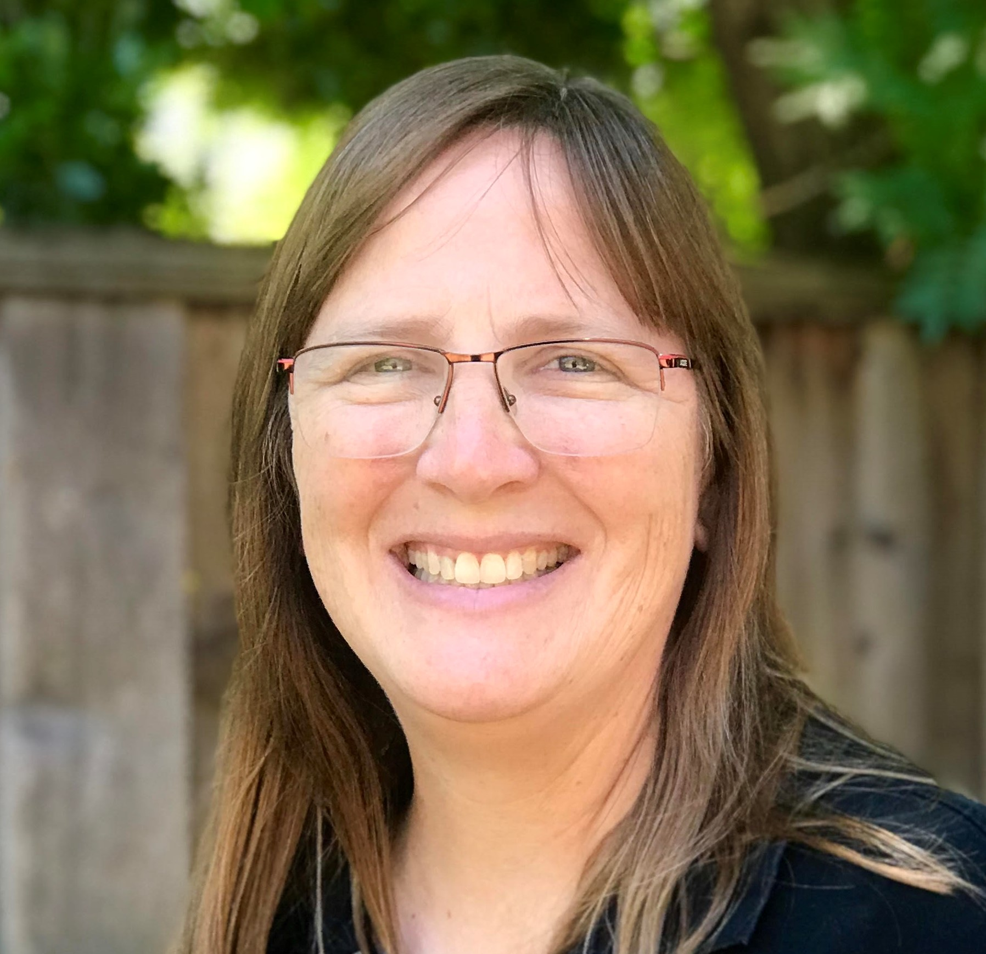


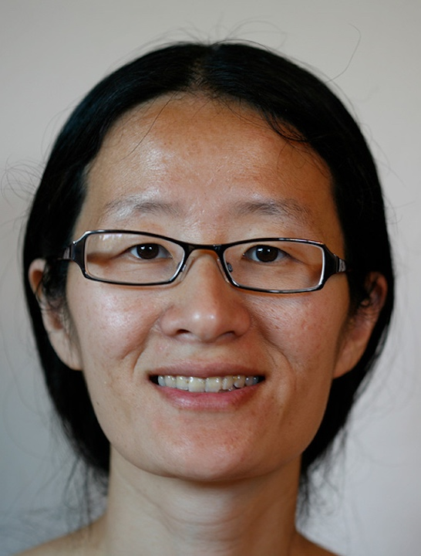

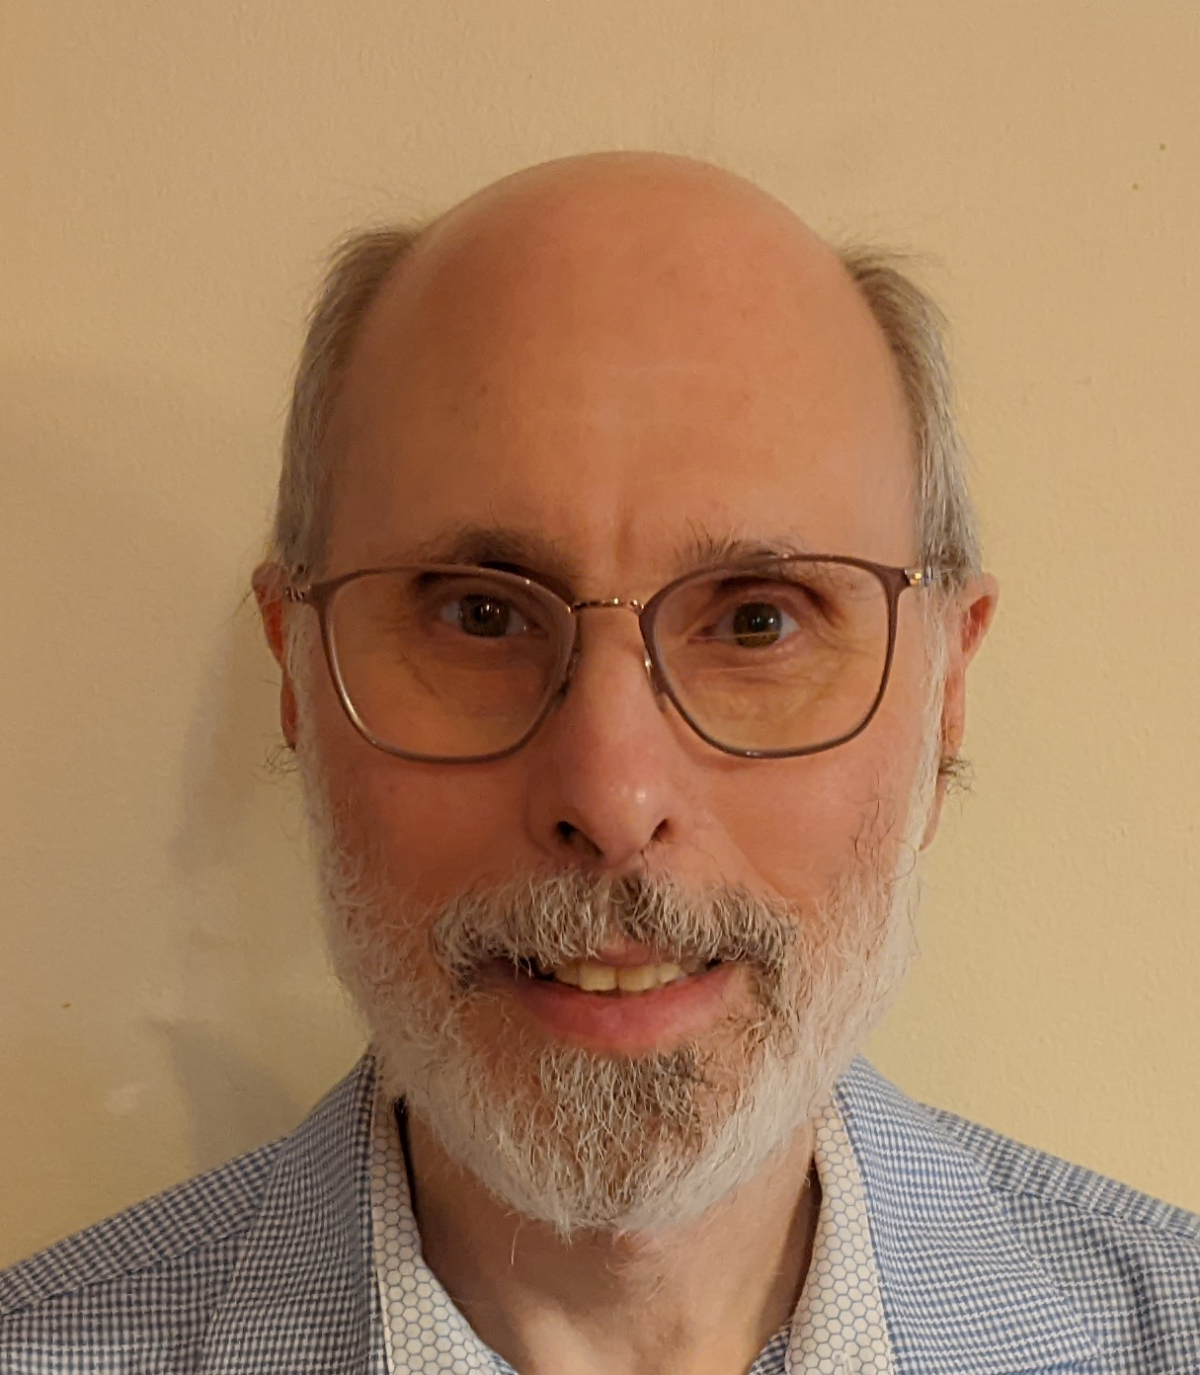
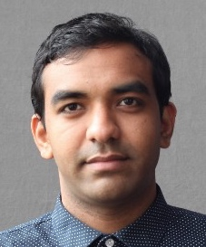
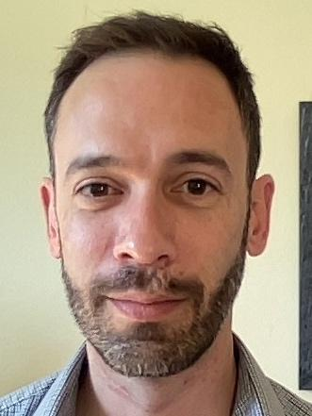

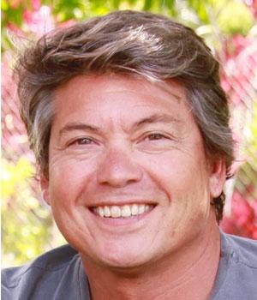
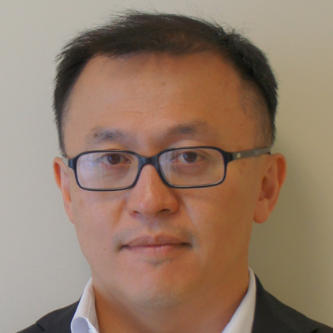

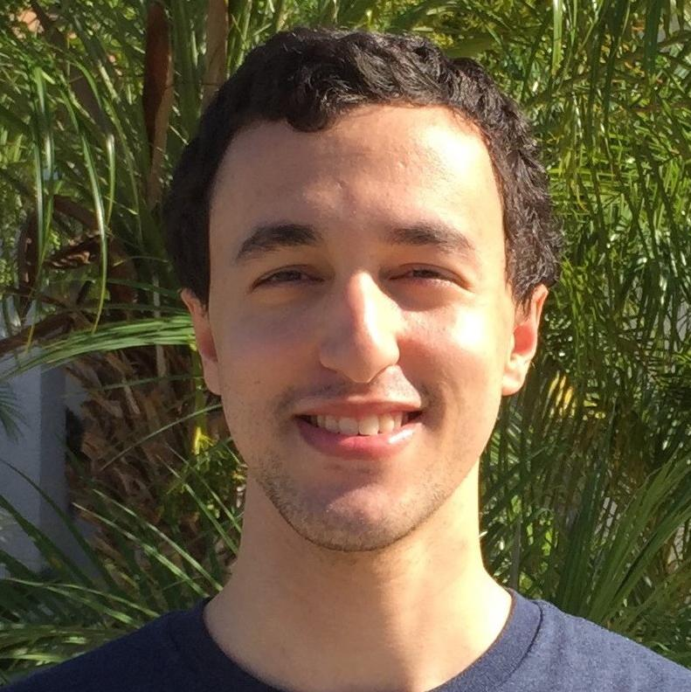

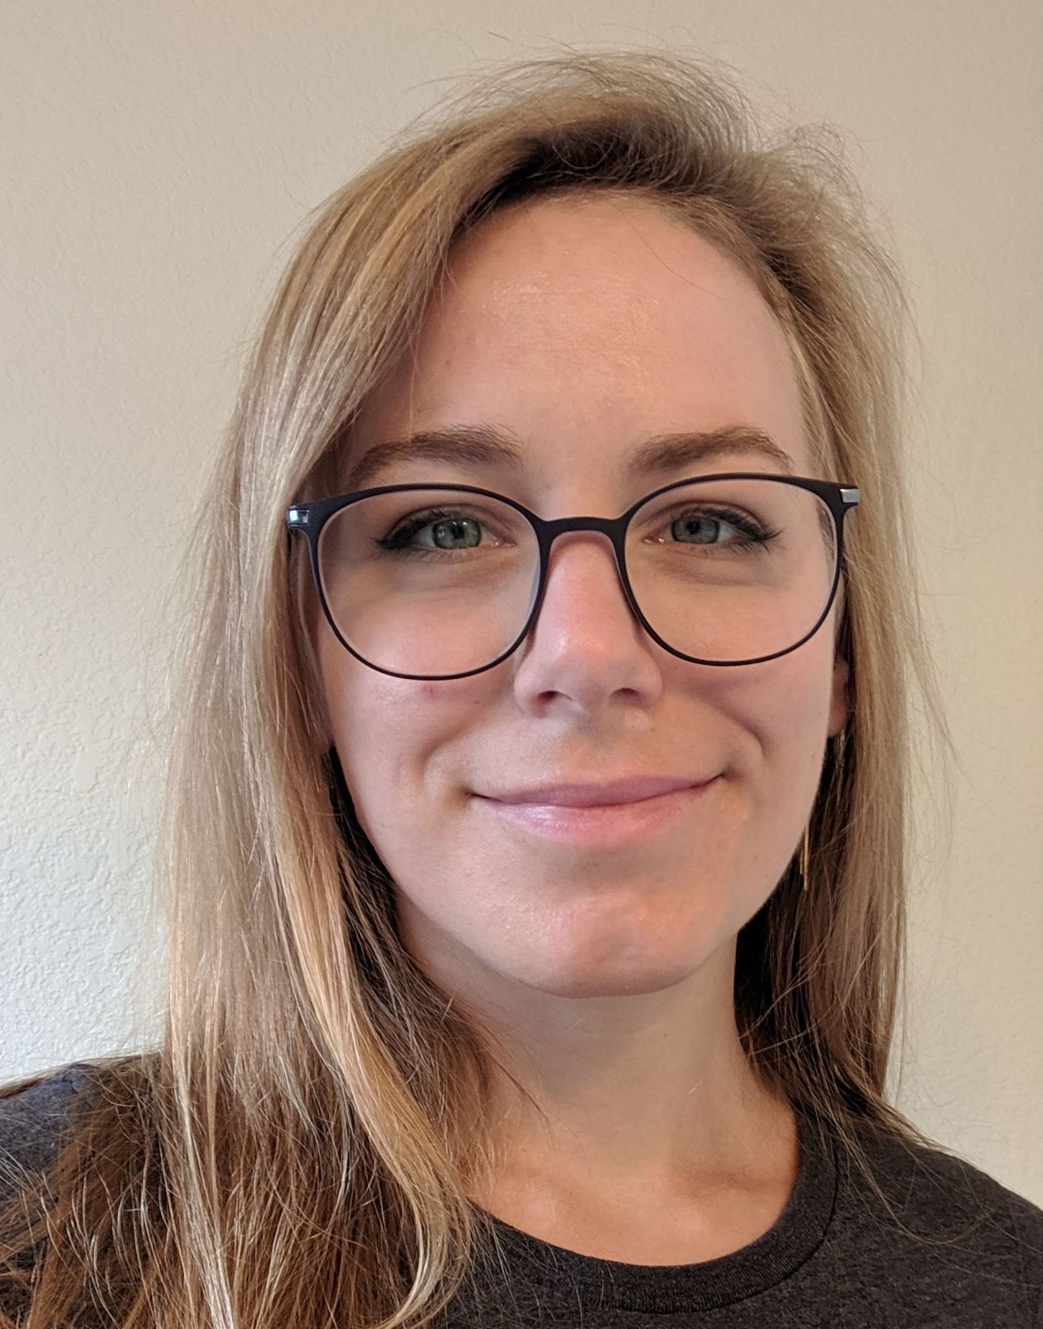
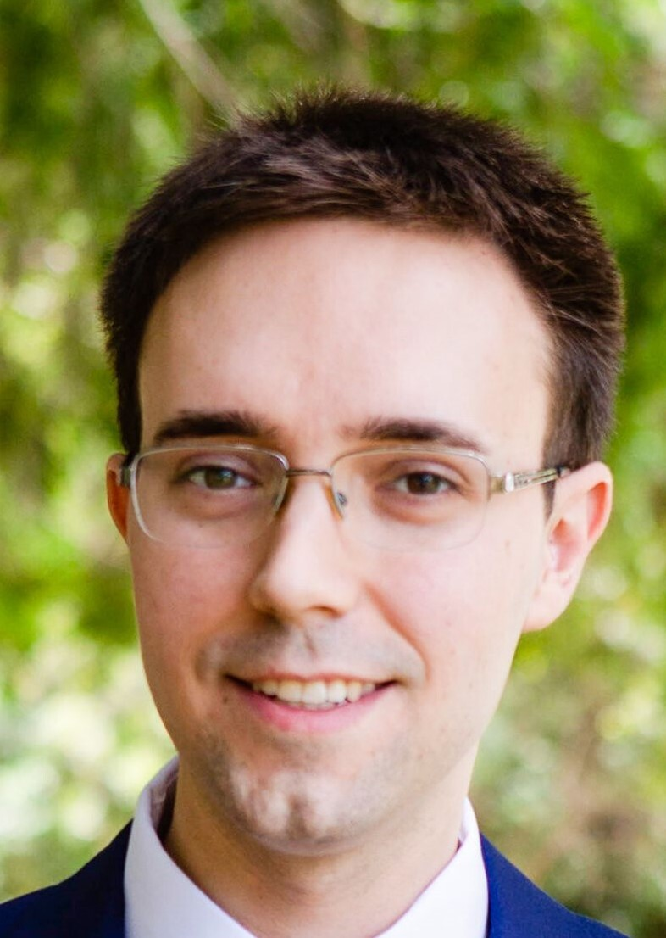

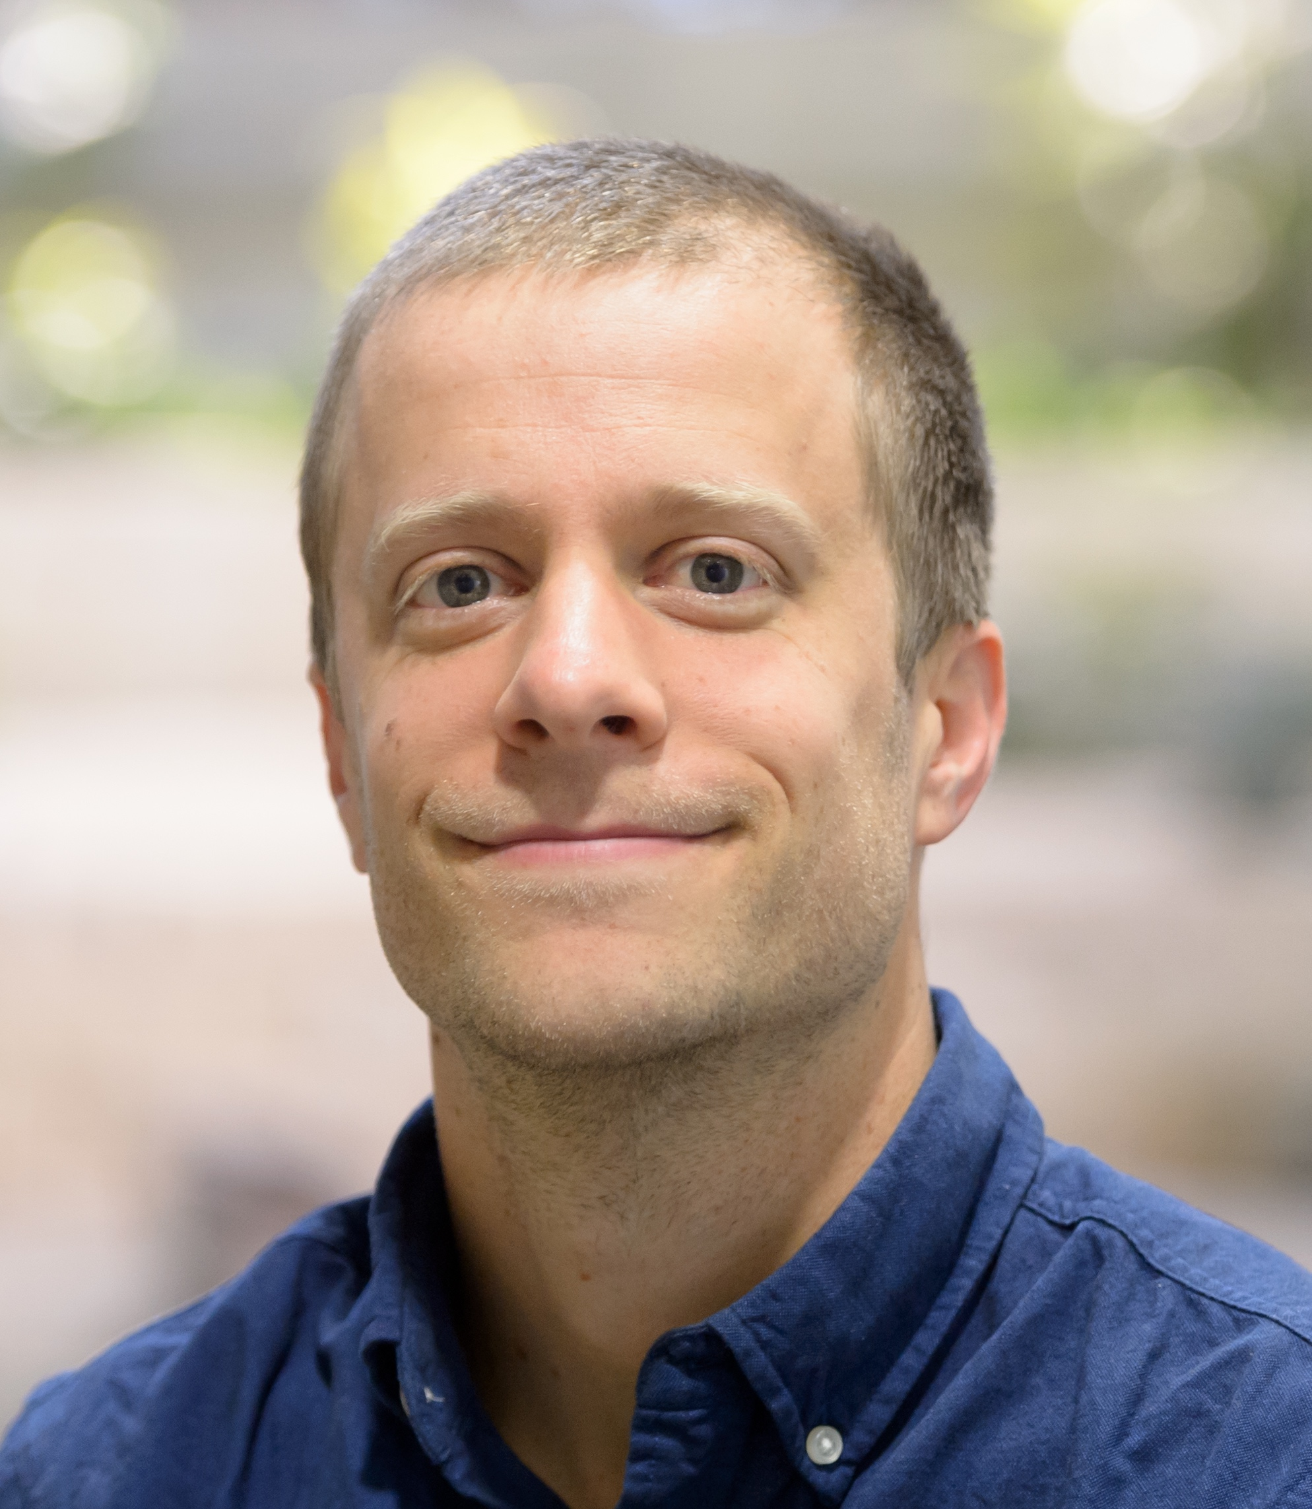
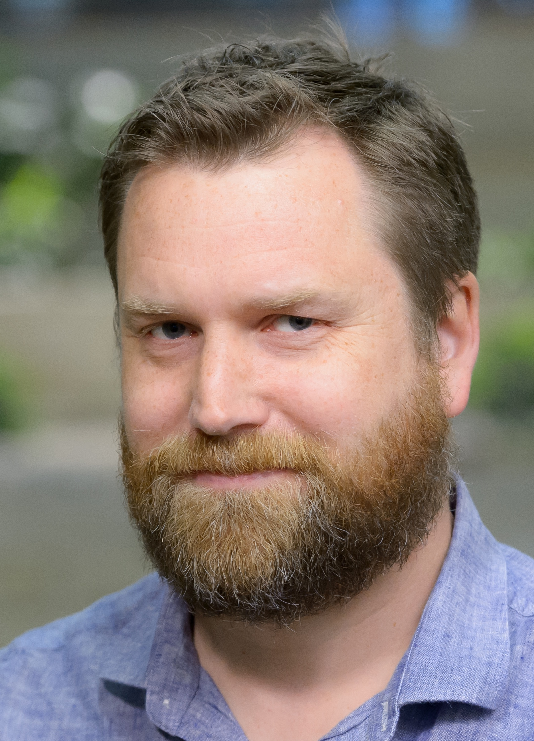

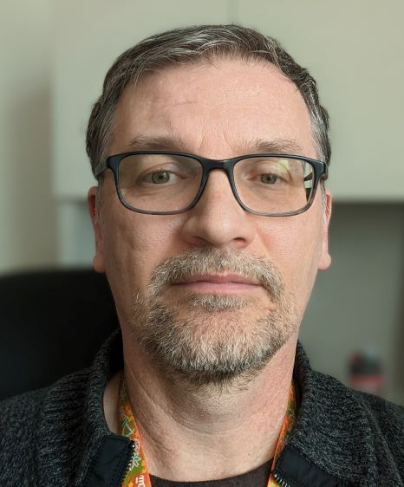
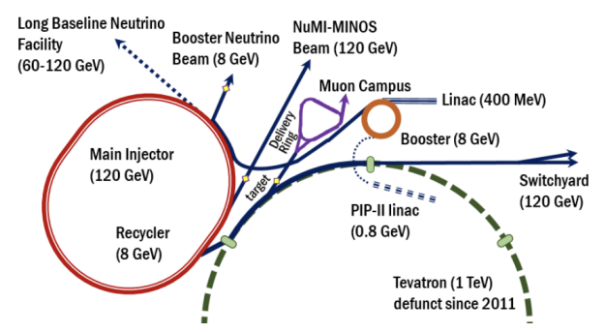


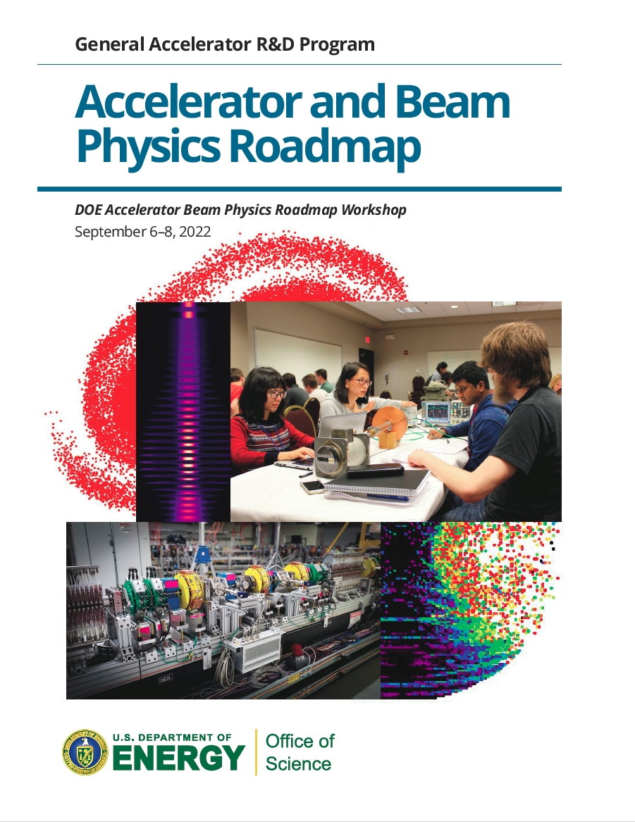

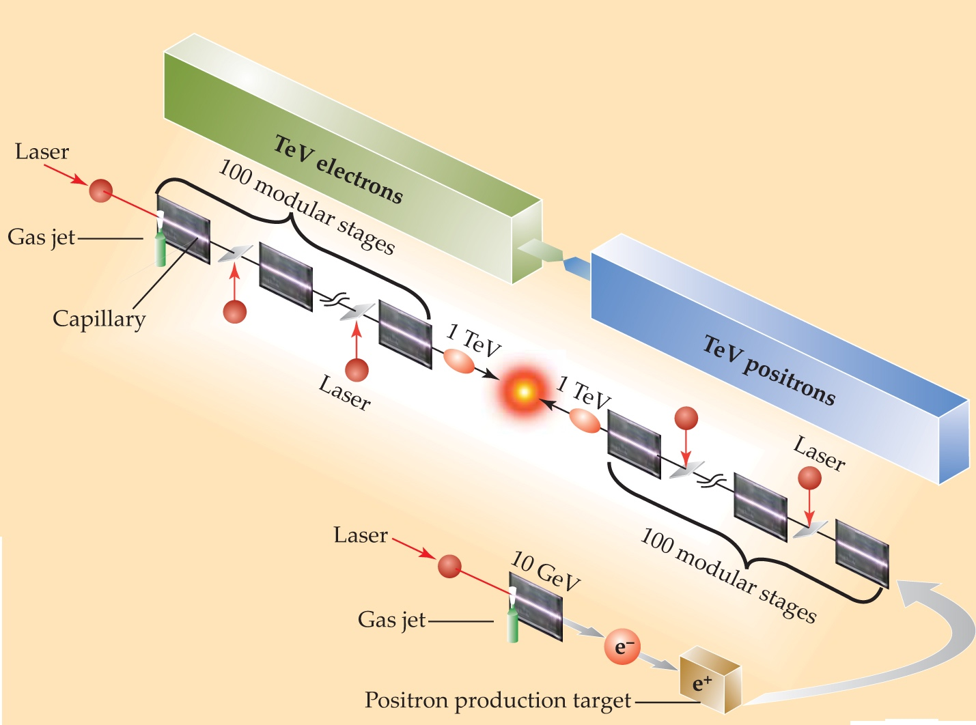
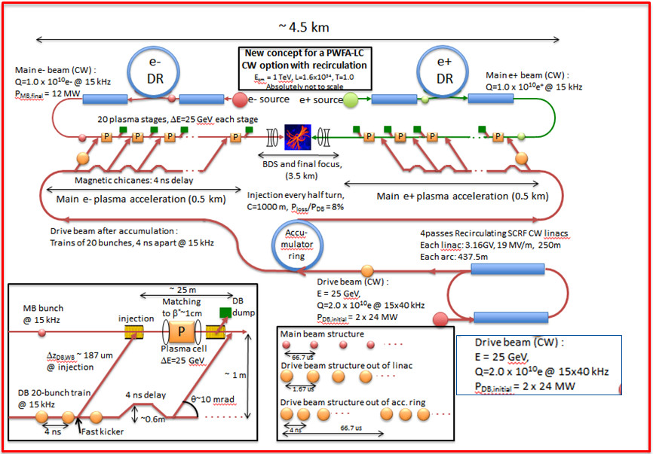
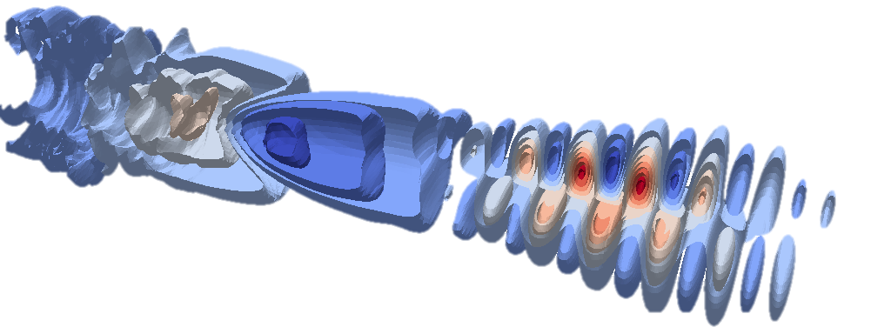
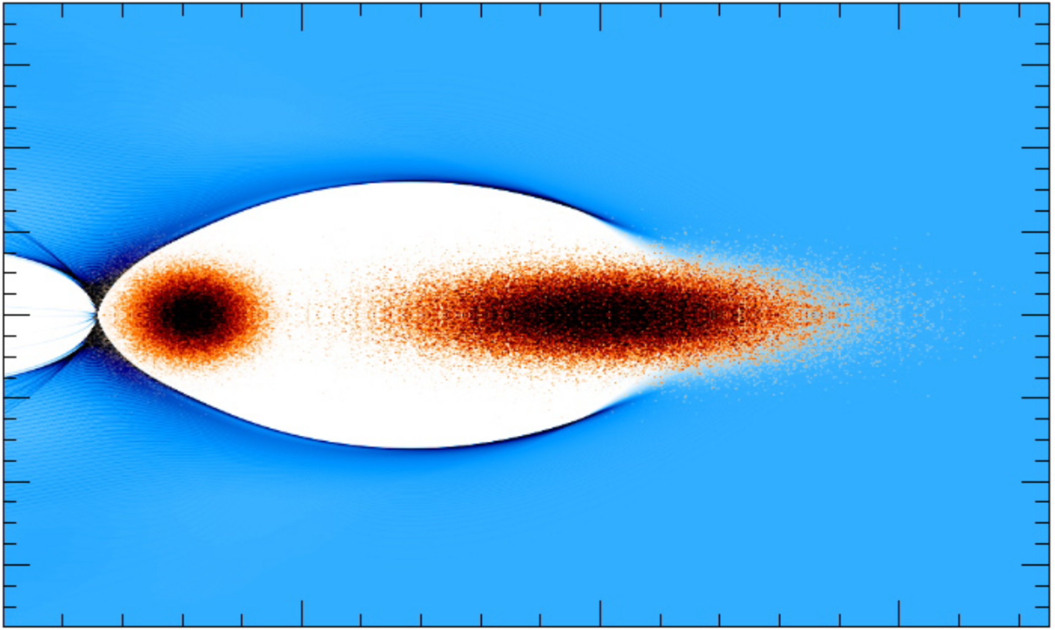
Collaboration for Advanced Modeling
of Particle Accelerators
(lead)
PIC algorithms & WarpX Code, Plasma Modeling
Team
AMReX, Solvers
Conventional/Plasma Accelerator Modeling
Science thrusts (aligned w/ 2023 P5)
Fermilab complex: PIP-II+booster.
design of plasma-based colliders.
AI/ML, Optimization
Data I/Os
Modeling tools for beam intensity, quality, control and prediction Grand Challenges
Support Fermilab complex (PIP-II, IOTA, …)
Support R&D & designs of Higgs factory & 10 TeV CoM colliders (RF, plasma or muons)
Support key cyberinfrastructure components such as shared tools & a sustained R&D effort in computing…
Adapt software & computing systems to emerging hardware
Leverage AI/AML for accelerator modeling & collider design
Foster development of standards & workflows
2023 P5
11

Slide 12
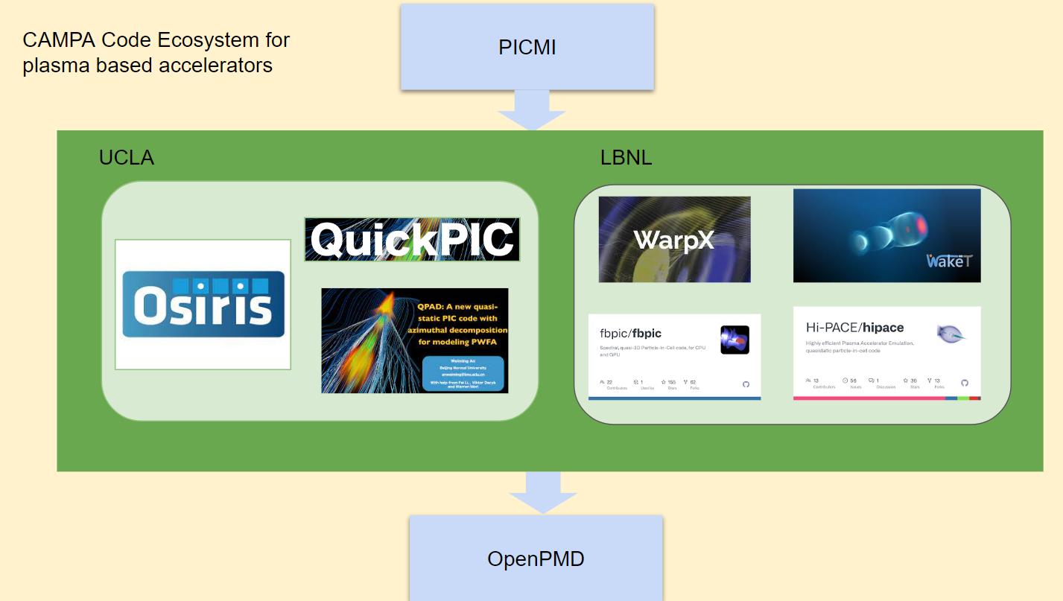
Particle-in-cell Modeling Interface (PICMI) &
open Particle-Mesh Data (openPMD) standards
Conventions for input and output (I/O)
Particle-in-Cell Modeling Interface (PICMI) standard for naming and structuring of Particle-In-Cell input decks in Python.
open particle-mesh data standard (openPMD) for metadata and naming conventions of scattered (e.g., particles) and mesh-based (structured & unstructured) data, with support for
ADIOS & HDF5 data format (other data formats possible).
Status
openPMD is quite mature and supported by many codes within & beyond CAMPA
PICMI is being developed and supported by multiple codes within CAMPA
CAMPA Ecosystem for AAC-based accelerators
PICMI
LASY
PALS*
BLAST
openPMD
Conventional accelerator codes
Machine learning/
optimization
*in development
12

Slide 13
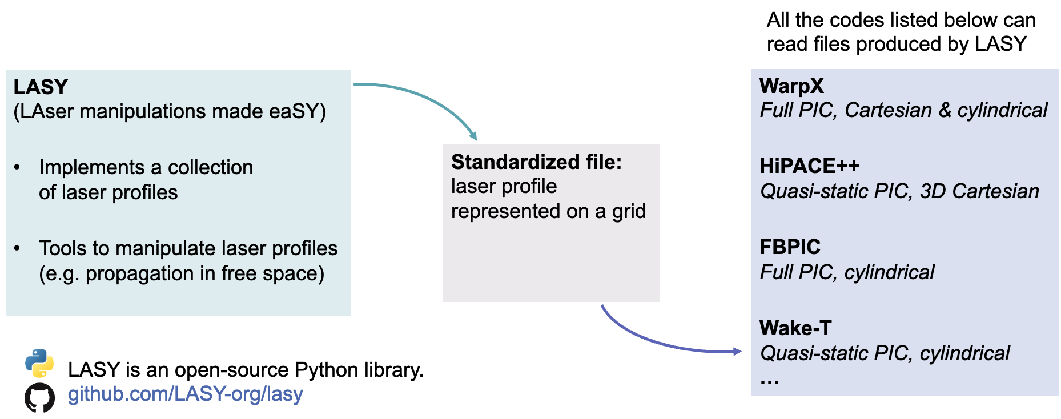

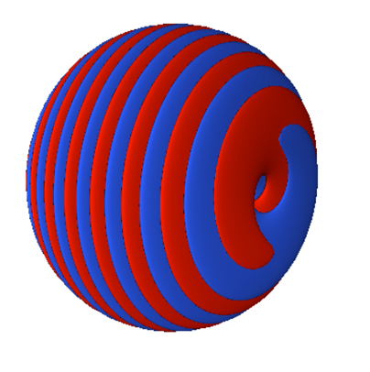
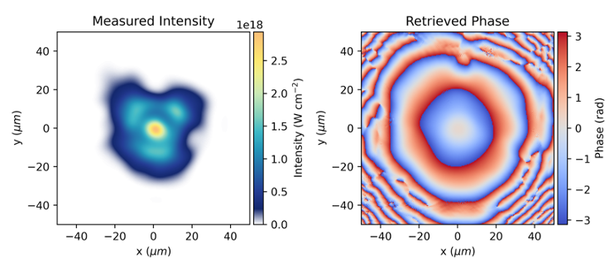
LASY: LAser manipulations made eaSY
  simple Python implementation allows rapid addition of new laser profiles
  w/ advanced laser manipulation tools, including calculation of propagation through complex optical elements
  leveraged by several projects requiring modeling of sophisticated and/or experimentally realistic laser pulses
current contributors
Rob Shalloo, “LASY: LAsers manipulations made eaSY”, EAAC25, Today @19:00.
  LASY supports many types of laser profiles, including:
Profile defined by
experimental
measurements
Profile with orbital
angular momentum
¹M. Thévenet, et al, "LASY: LAser manipulations made eaSY", Proc. EAAC 2023 https://arxiv.org/abs/2403.12191.
13

Slide 14
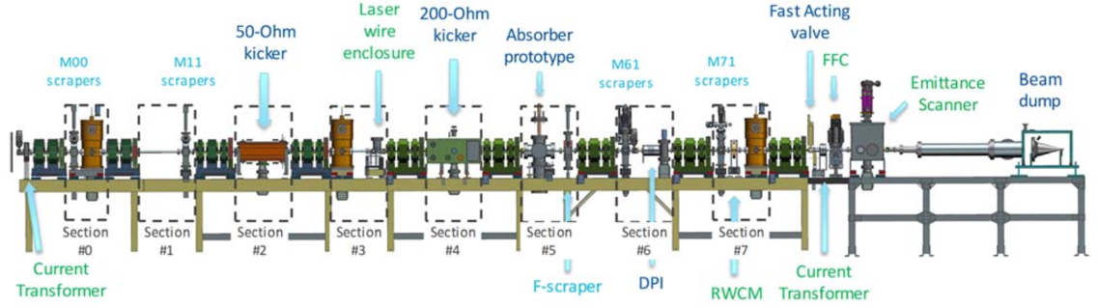

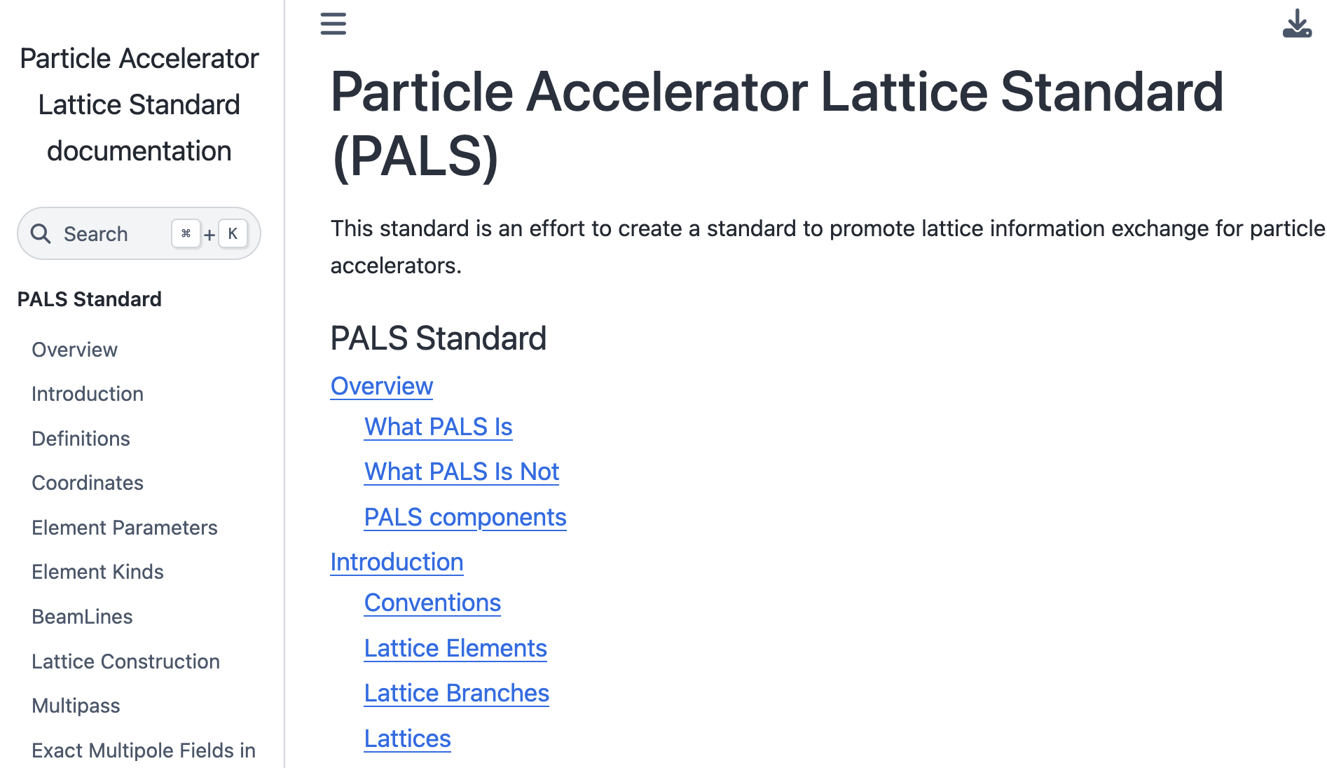

New, open Particle Accelerator Lattice Standard (PALS)
Accelerator community currently uses different
file formats for the accelerator lattice description
PALS¹ is a standard for sharing lattice description across simulation codes, experiments, etc
Facilitates global collaboration on
increasingly complex accelerator projects
Enables creation of standardized datasets
for AI/ML training
➔ Key to initiatives such as the upcoming
“American Science Cloud”
Weekly meetings w/ partakers from LBNL, Cornell U., ANL, FNAL, SLAC, BNL, ORNL, JLAB, MSU, MIT, Radiasoft, Xelera Research, CERN, GSI, DESY, ESRF, …
  Join the fun! david.sagan@cornell.edu, jlvay@lbl.gov
github.com/campa-consortium/pals
¹Mitchell et al, "A Community Effort Toward a Particle Accelerator Lattice Standard (PALS)," in Proc. NAPAC2025, TUP004, Sacramento, CA, 2025.
14

Slide 15





Generator Standard (GeSt-api) for optimization studies
Simulation-based design optimization is an important workflow when designing accelerators
Efficient optimizers (e.g., TurBO, APOSMM, etc.) have been implemented in separate optimization frameworks (e.g., Xopt, libensemble, optimas, …) and have different interfaces
A standardized interface is now being implemented in the above frameworks to foster interoperability
github.com/campa-consortium/generator_standard
15

Slide 16


Coordination & standardization will enable
multi-modal (incl. multiple facilities) AI-ready data sources & models
Virtual World (cloud)
Real World
Accelerator/Collider DT
Source DT
Laser DT
Plasma stage DT
BDS DT
MDI DT
… DTs
Techno-Economic Model
Computing (laptops to HPC)
Archives
First Principles Simulations
Surrogates
Optimization
Experiments logs
Codes source/doc
Litterature
16

Slide 17
Coordination & standardization will enable
multi-modal (incl. multiple facilities) AI-ready data sources & models
Virtual World (cloud)
Real World
Accelerator/Collider DT
Data
AI Readiness
Standardization
Labeling
Normalization
Versioning
Source DT
Laser DT
Plasma stage DT
BDS DT
MDI DT
… DTs
Techno-Economic Model
Computing (laptops to HPC)
Archives
First Principles Simulations
Surrogates
Optimization
Experiments logs
Codes source/doc
Litterature
17

Slide 18
Summary
Source
10s-1000s stages
>10 TeV IP
10s-1000s stages
Source
          Collider design studies based on AAC tech are ongoing
          10 TeV Design Initiative includes a Simulations/Computing/AI Working (SCAI) Group
          Many simulation tools exist and continue to be improved
            ➔ see A. Huebl plenary talk tomorrow
          Increasing efforts to develop standardized data and tools
            ➔ From nice to have to must have for multi-modal AI-ready data sources/models
          All these require a community effort: look for community workshops to come to organize the community and develop these standardized data & tools
          Let’s avoid to develop N new standards & workflows!
          Looking forward to work with all of you!
18

Slide 19
          Thank you!
          Questions?
          jlvay@lbl.gov
19
Notes:
Collider design studies
The 10 TeV Design Initiative for a 10 TeV pCM wakefiled collider
The Simulations/Computing/AI Working (SCAI) Group
The Collaboration for Advanced Modeling of Particle Accelerators (CAMPA)
Standardized data & tools: openPMD, PICMI, LASY, PALS, optimization
Toward multi-modal AI-ready data sources & models
Summary

