Slide 1


Development of high peak and high pulse rate drivers for accelerators:
opportunities and challenges
Mariastefania De Vido
Centre for Advanced laser Technology & Applications (CALTA)
Central Laser Facility (CLF)
STFC Rutherford Appleton Laboratory, UK
EAAC 2025
Elba, 25th September 2025
mariastefania.de-vido@stfc.ac.uk
Notes:
Add authors

Slide 2

Outline
Laser-driver requirement for future accelerator applications
State of the art laser technology
Overview of laser technologies being developed
Recent development at the Central Laser Facility

Slide 3
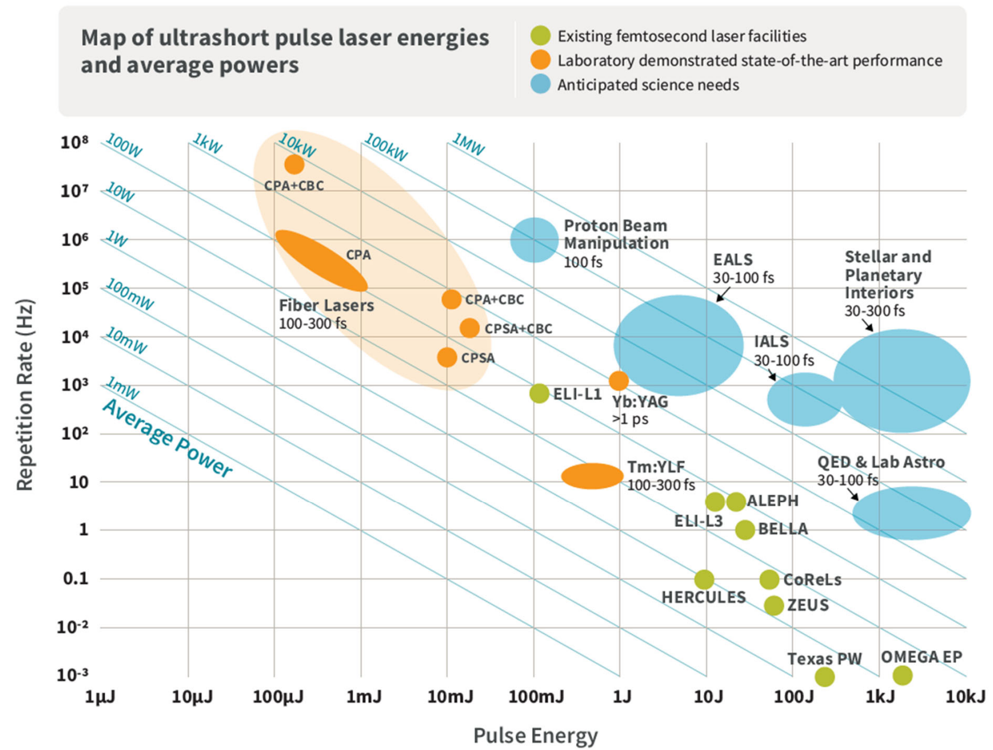
Plasma accelerator requirements
Laser-driven accelerators and secondary radiation sources need lasers delivering:
Energy = 1 – 100 J
Pulse duration = 25 fs – 100 fs
Pulse rates = 100 Hz – multi-kHz
Stability and reliability
Small footprint
High wall-plug efficiency
HAPLS, EPAC
GEMINI
J-KAREN-P
From “Report of the basic research needs workshop on laser technology,”
https://science.osti.gov/- /media/ardap/pdf/2024/ Laser-Technology-Workshop-Report_20240105_final.pdf

Slide 4
State of the art
Laser architectures:
Flashlamp-pumped glass
Indirect CPA using Ti:sapphire
Optical Parametric Chirped Pulse Amplification (OPCPA)
Direct Chirped Pulse Amplification (CPA)
Coherent combination
HAPLS, EPAC
GEMINI
J-KAREN-P
“Report of the basic research needs workshop on laser technology,”
https://science.osti.gov/- /media/ardap/pdf/2024/ Laser-Technology-Workshop-Report_20240105_final.pdf

Slide 5
Indirect CPA in Ti:sapphire
Broad gain bandwidth [1] → fs-pulses & tuneable outputs ☺
High thermal conductivity (46 W/mK @ 300 K) → heat extraction ☺
∼34% quantum defect → high thermal load ☹
Short lifetime (τ ∼ 3.2 µs) → needs to be pumped by a laser → performance limited by the pump laser

Slide 6
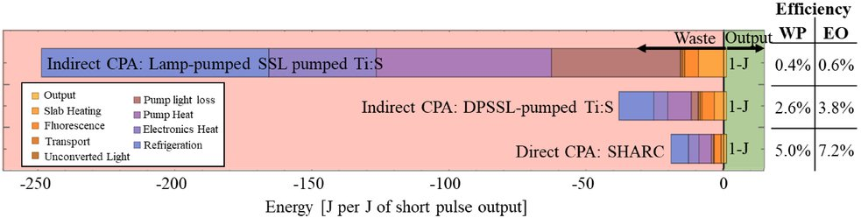
Indirect CPA in Ti:sapphire
Broad gain bandwidth [1] → fs-pulses & tuneable outputs ☺
High thermal conductivity (46 W/mK @ 300 K) → heat extraction ☺
∼34% quantum defect → high thermal load ☹
Short lifetime (τ ∼ 3.2 µs) → needs to be pumped by a laser (traditionally: flashlamp-pumped laser ☹)
Low pulse rate and efficiency New solutions required
Flashlamp-pumped laser
SHG
From [1]
E. Sistrunk, et al., Proc. SPIE 11034, Short-pulse High-energy Lasers and Ultrafast Optical Technologies, 1103407 (2019)
Ti:S amplifier

Slide 7
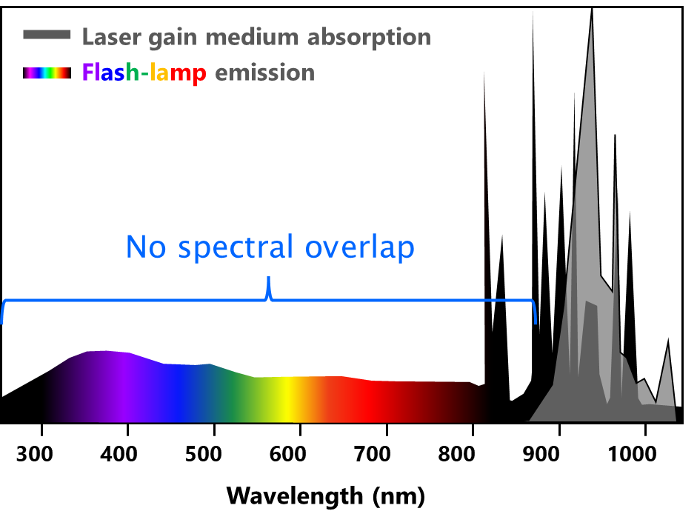
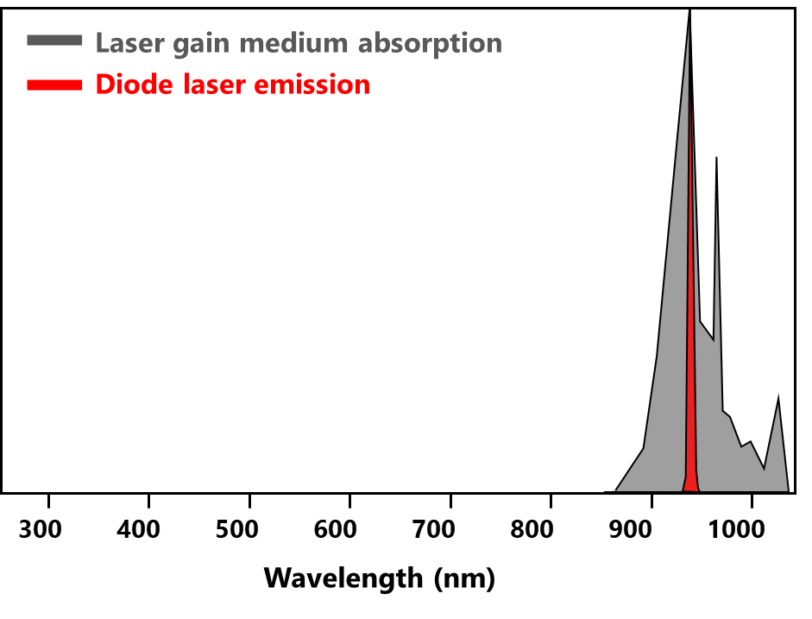

Pump laser technology
Flashlamp-pumped laser
Diode-pumped laser (DPSSL)
Plus + crystalline and ceramic materials and advanced active cooling schemes for amplifiers, optics and opto-mechanics
SHG
SHG
Ti:S amplifier
Ti:S amplifier

Slide 8
Indirect CPA in Ti:sapphire
Broad gain bandwidth [1] → fs-pulses & tuneable outputs ☺
High thermal conductivity (46 W/mK @ 300 K) → heat extraction ☺
∼34% quantum defect → high thermal load ☹
Short lifetime (τ ∼ 3.2 µs) → needs to be pumped by a laser
Improved efficiency and pulse rate if pumped with DPSSLs + advanced cooling schemes
Diode-pumped laser (DPSSL)
SHG
From [1]
E. Sistrunk, et al., Proc. SPIE 11034, Short-pulse High-energy Lasers and Ultrafast Optical Technologies, 1103407 (2019)
Ti:S amplifier

Slide 9
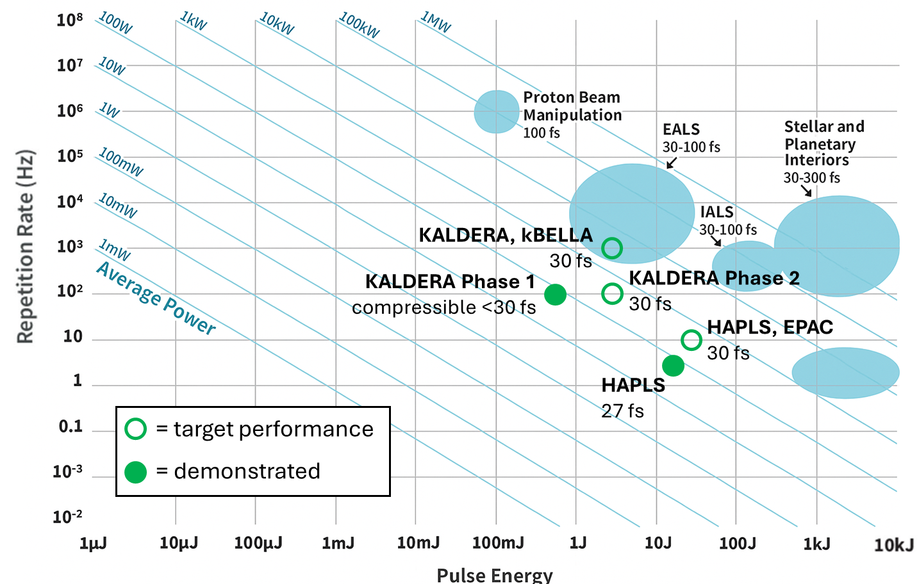
Notable Ti:Sa systems under development
HAPLS (ELI-L3, LLNL): 30 J/ 30 fs/ 10 Hz;
  16 J / 27 fs / 3.33 Hz demonstrated [1]
EPAC (CLF): 30 J / 30 fs/ 10 Hz [2]
KALDERA (DESY): 3 J / 30 fs / 1 kHz;
  Phase 1: 750 mJ / 100 Hz / compressible to < 30 fs demonstrated [3]
  Phase 2: 3 J / 30 fs / 100 Hz ongoing.
kBELLA (LBNL): 3 J / 30 fs / 1 kHz [4]
Commercial: Amplitude, Thales
QED & Lab Astro
30-100 fs
https://up.eli-laser.eu/laser/l3-1415610404
P. Mason, et al., Conference on Lasers and Electro-Optics/Europe, paper ca_8_2 (2023).
T. Eichner, et alOpt. Lett. 50, 4890-4893 (2025)
W. Leemans, et al. “BELLA laser and operations,” Proceedings of PAC2013.

Slide 10
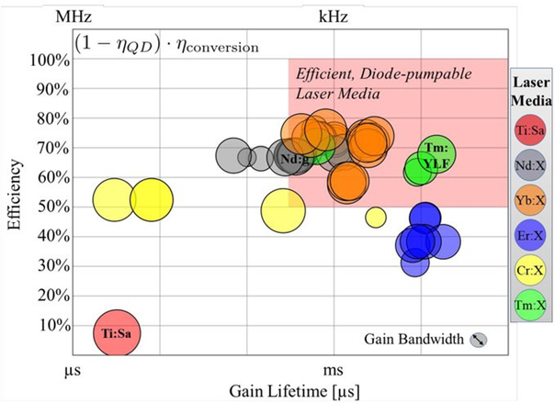


Direct CPA
Higher efficiency from direct diode pumping ☺
Simpler, more compact laser architectures ☺
Gain material choice restricted to long lifetime materials
Some gain materials can have limited apertures & bandwidth ☹
Diode laser
Broadband amplifier
From [1]
E. Sistrunk, et al., Proc. SPIE 11034, Short-pulse High-energy Lasers and Ultrafast Optical Technologies, 1103407 (2019)

Slide 11
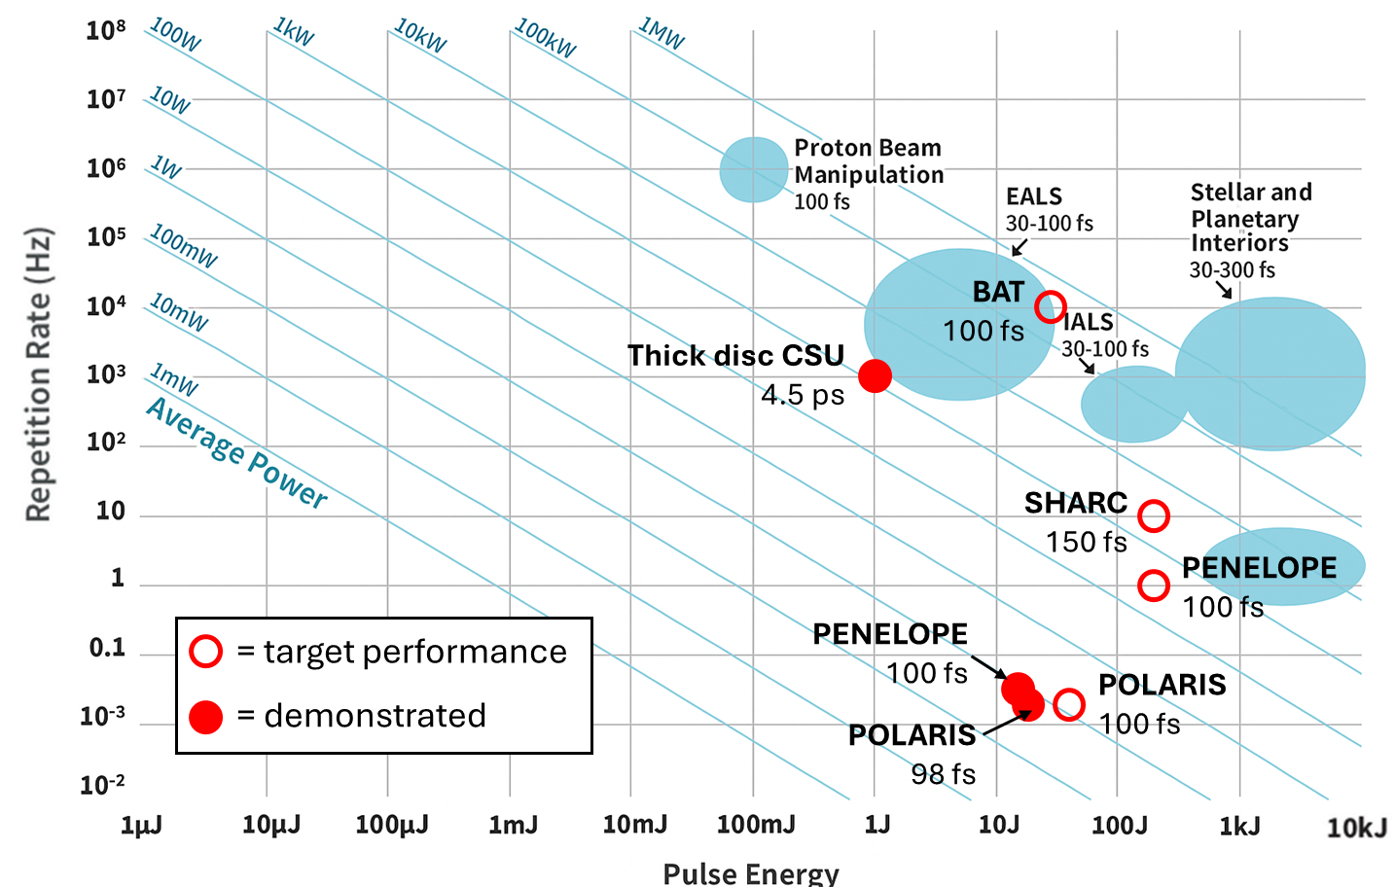
Direct CPA
POLARIS (HI-Jena): Yb:glass/Yb:CaF2, 40 J / 100 fs / 0.02 Hz
  17 J / 98 fs / 0.02 Hz demonstrated (54 J before compressor) [1];
PENELOPE (HZDR): Yb:CaF₂, 150 J / 100 fs / 1 Hz
  12.6 J / broadband ns / 3.3·10⁻³ Hz demonstrated [2]
“Thick disk” geometry (CSU): Yb:YAG, 1.1 J / 4.5 ps / 1 kHz [3]
SHARC (LLNL): Nd:glass, 150 J / 150 fs / 10 Hz proposed [4]
BAT (LLNL): Tm:YLF, 30 J / 100 fs / 10 kHz
  1.5 J / 270 fs reduced rep rate [5]
M. Hornung, et al., Opt. Lett. 41(22), 5413-6 (2016).
D. Albach, et al., High Power Laser Science and Engineering 7, 1-9 (2019).
Y. Wang, et al., Opt. Lett. 45, 6615-6618 (2020).
E. Sistrunk, et al., Proc. SPIE 11034, Short-pulse High-energy Lasers and Ultrafast Optical Technologies, 1103407 (2019).
I. Tamer, et al., OL 49, 1583-1586 (2024).

Slide 12
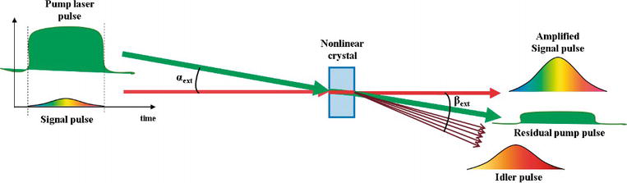
OPCPA Architectures
High single pass parametric gain → compact geometries ☺
Large gain bandwidth → few-fs pulses, tuneable ☺
High intensity contrast ☺
Non-dissipative → lower thermal effects, but likely to still require cooling due to residual absorption
High rep rate if DPSSL pump
Limited options for large aperture, high quality crystals ☹
Requires high quality pump beam ☹
Image from R. Dabu DOI: 10.5772/intechopen.70708

Slide 13
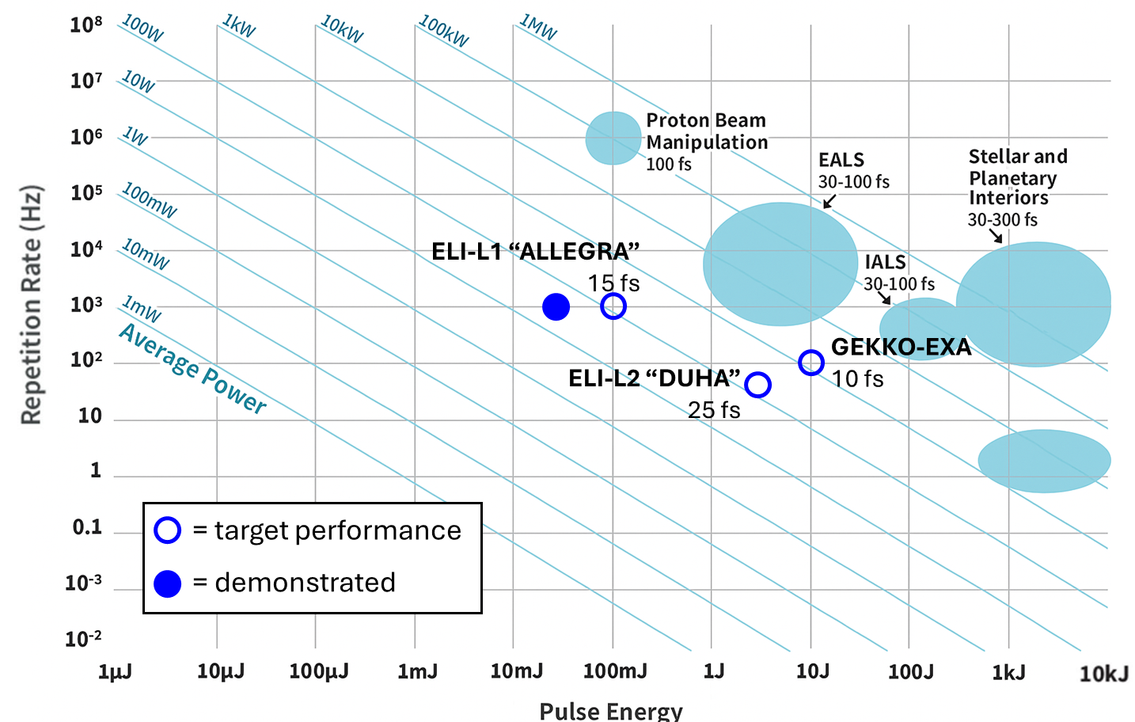
OPCPA Architectures
L1 ALLEGRA (ELI-Beamlines): 30 mJ / 15 fs / 1 kHz [1], upgrade to 100 mJ planned
L2 DUHA (ELI-Beamlines): under commissioning, targeting 3 J / 25 fs / 50 Hz [2]
GEKKO-EXA (Osaka, Japan): 10 J / 10 fs / 100 Hz (high energy amplification stage 1) – conceptual design [3]
QED & Lab Astro
30-100 fs
P. Bakule, et al., "Readiness of L1 ALLEGRA Laser System for User Operation at ELI Beamlines," in OSA High-brightness Sources and Light-driven Interactions Congress 2020, paper HF1B.7.
L. Indra, et al., "Development of L2-DUHA laser front-end for near-IR and mid-IR generation at ELI-Beamlines," Proc. SPIE 12577, High-power, High-energy Lasers and Ultrafast Optical Technologies, 125770B (2023).
J. Kawanaka, et al., “Conceptual design of sub-exa-watt system by using optical parametric chirped pulse amplification,” J. Phys.: Conf. Ser. 688 012044 (2016).

Slide 14
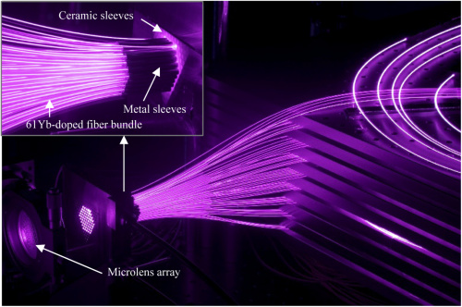

Coherent Combination of Fibres
High efficiency with direct diode pumping ☺
  Up to ~50% wall-plug efficiency with commercial ~100kW cw systems
Distributed heat dissipation enables efficient cooling ☺
Compact architecture ☺
Gain bandwidth limited to ~50-100fs ☹
Active phasing for coherent combining ☹

Slide 15
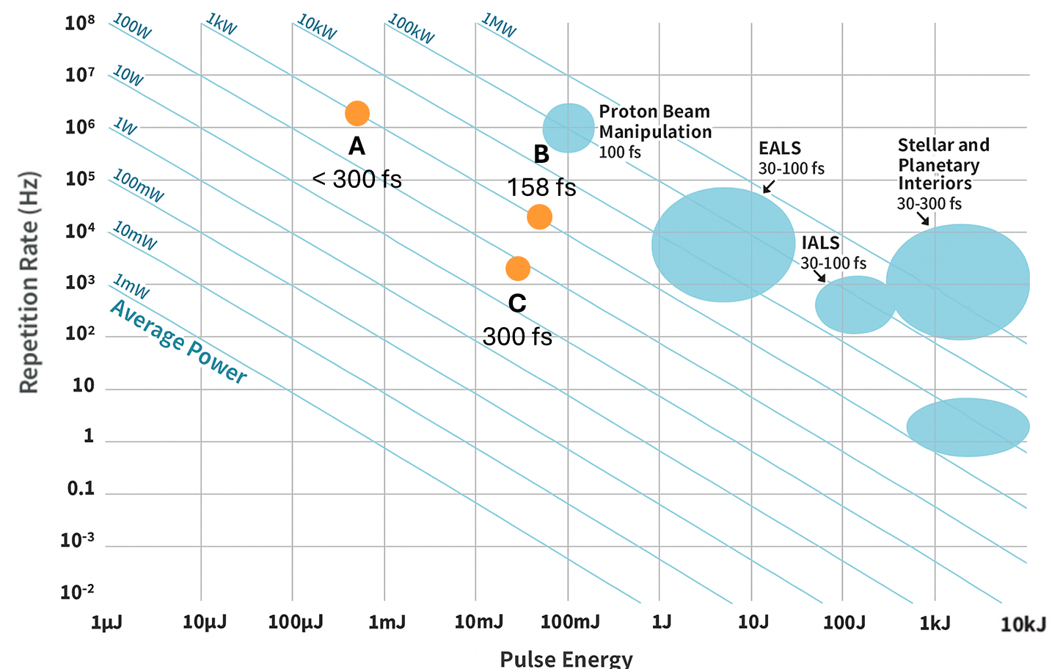
Coherent Combination of Fibres
Coherent beam combining (CBC) of 61 parallel fiber CPA channels [1]
    ~500µJ (8.2µJ/channel) at 2 MHz and <300fs pulses
    Would need >12 000 channels for ~10J of combined energy
CBC of 16 parallel fiber 3ns CPA + 8-pulse divided pulse amplification (DPA) [2]
    ~48mJ (~3mJ/channel) at 20kHz and 158fs pulses (~1kW average power)
    Would need ~3300 channels for ~10J of combined energy
CBC of 4 parallel fiber channels + 81-pulse CPSA [3]
    ~27mJ (~7mJ/channel) at 2kHz and ~300fs pulses
    With demonstrated[4] ~10mJ/channel would need ~1000 channels for ~10J of combined energy
[1] I. Fsaifes at al. Opt. Express 28, 20152-20161 (2020)
[2] H. Stark et al. Opt. Lett. 48, 3007-3010 (2023)
[3] A. Rainville et al. in CLEO 2023, (Optica Publishing Group, 2023), paper SF3H.6.
[4] A. Rainville et al. Optica 11, 1540 (2024)

Slide 16
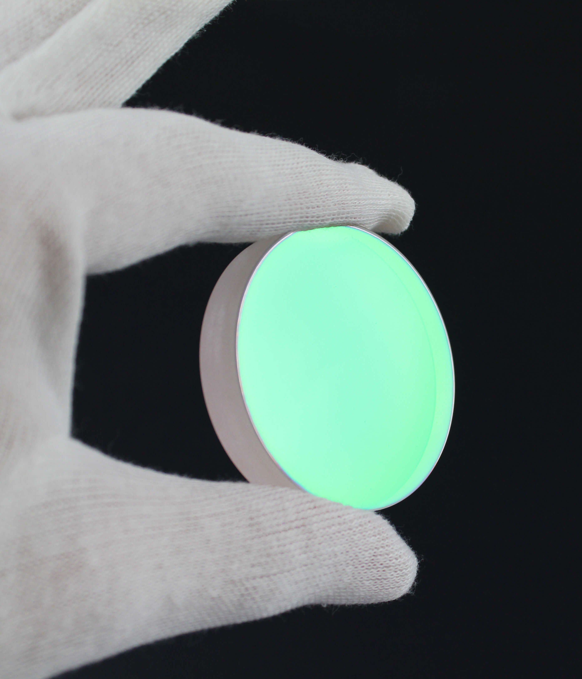
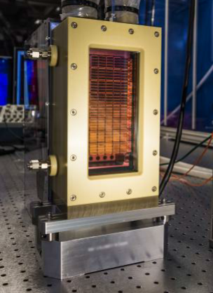
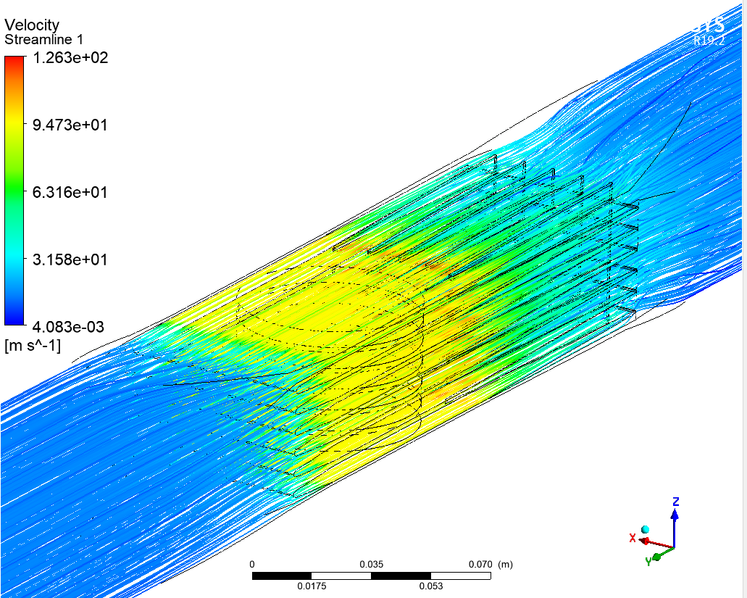
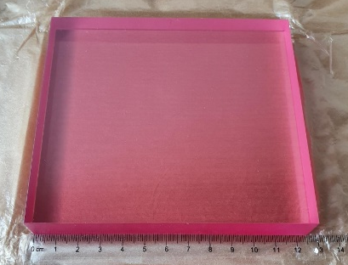
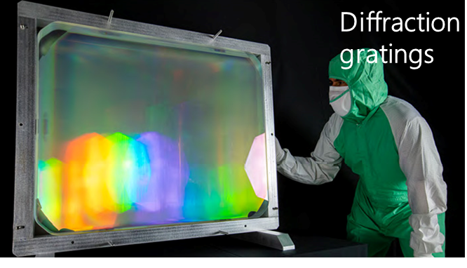
Enabling Technologies
High resilience coatings
Thermal Management
Diode Lasers
Diode Lasers
Control systems
Active feedback stabilisation
Machine learning systems
…
Large aperture optics

Slide 17
Developments at the Central Laser Facility (UK)

Slide 18
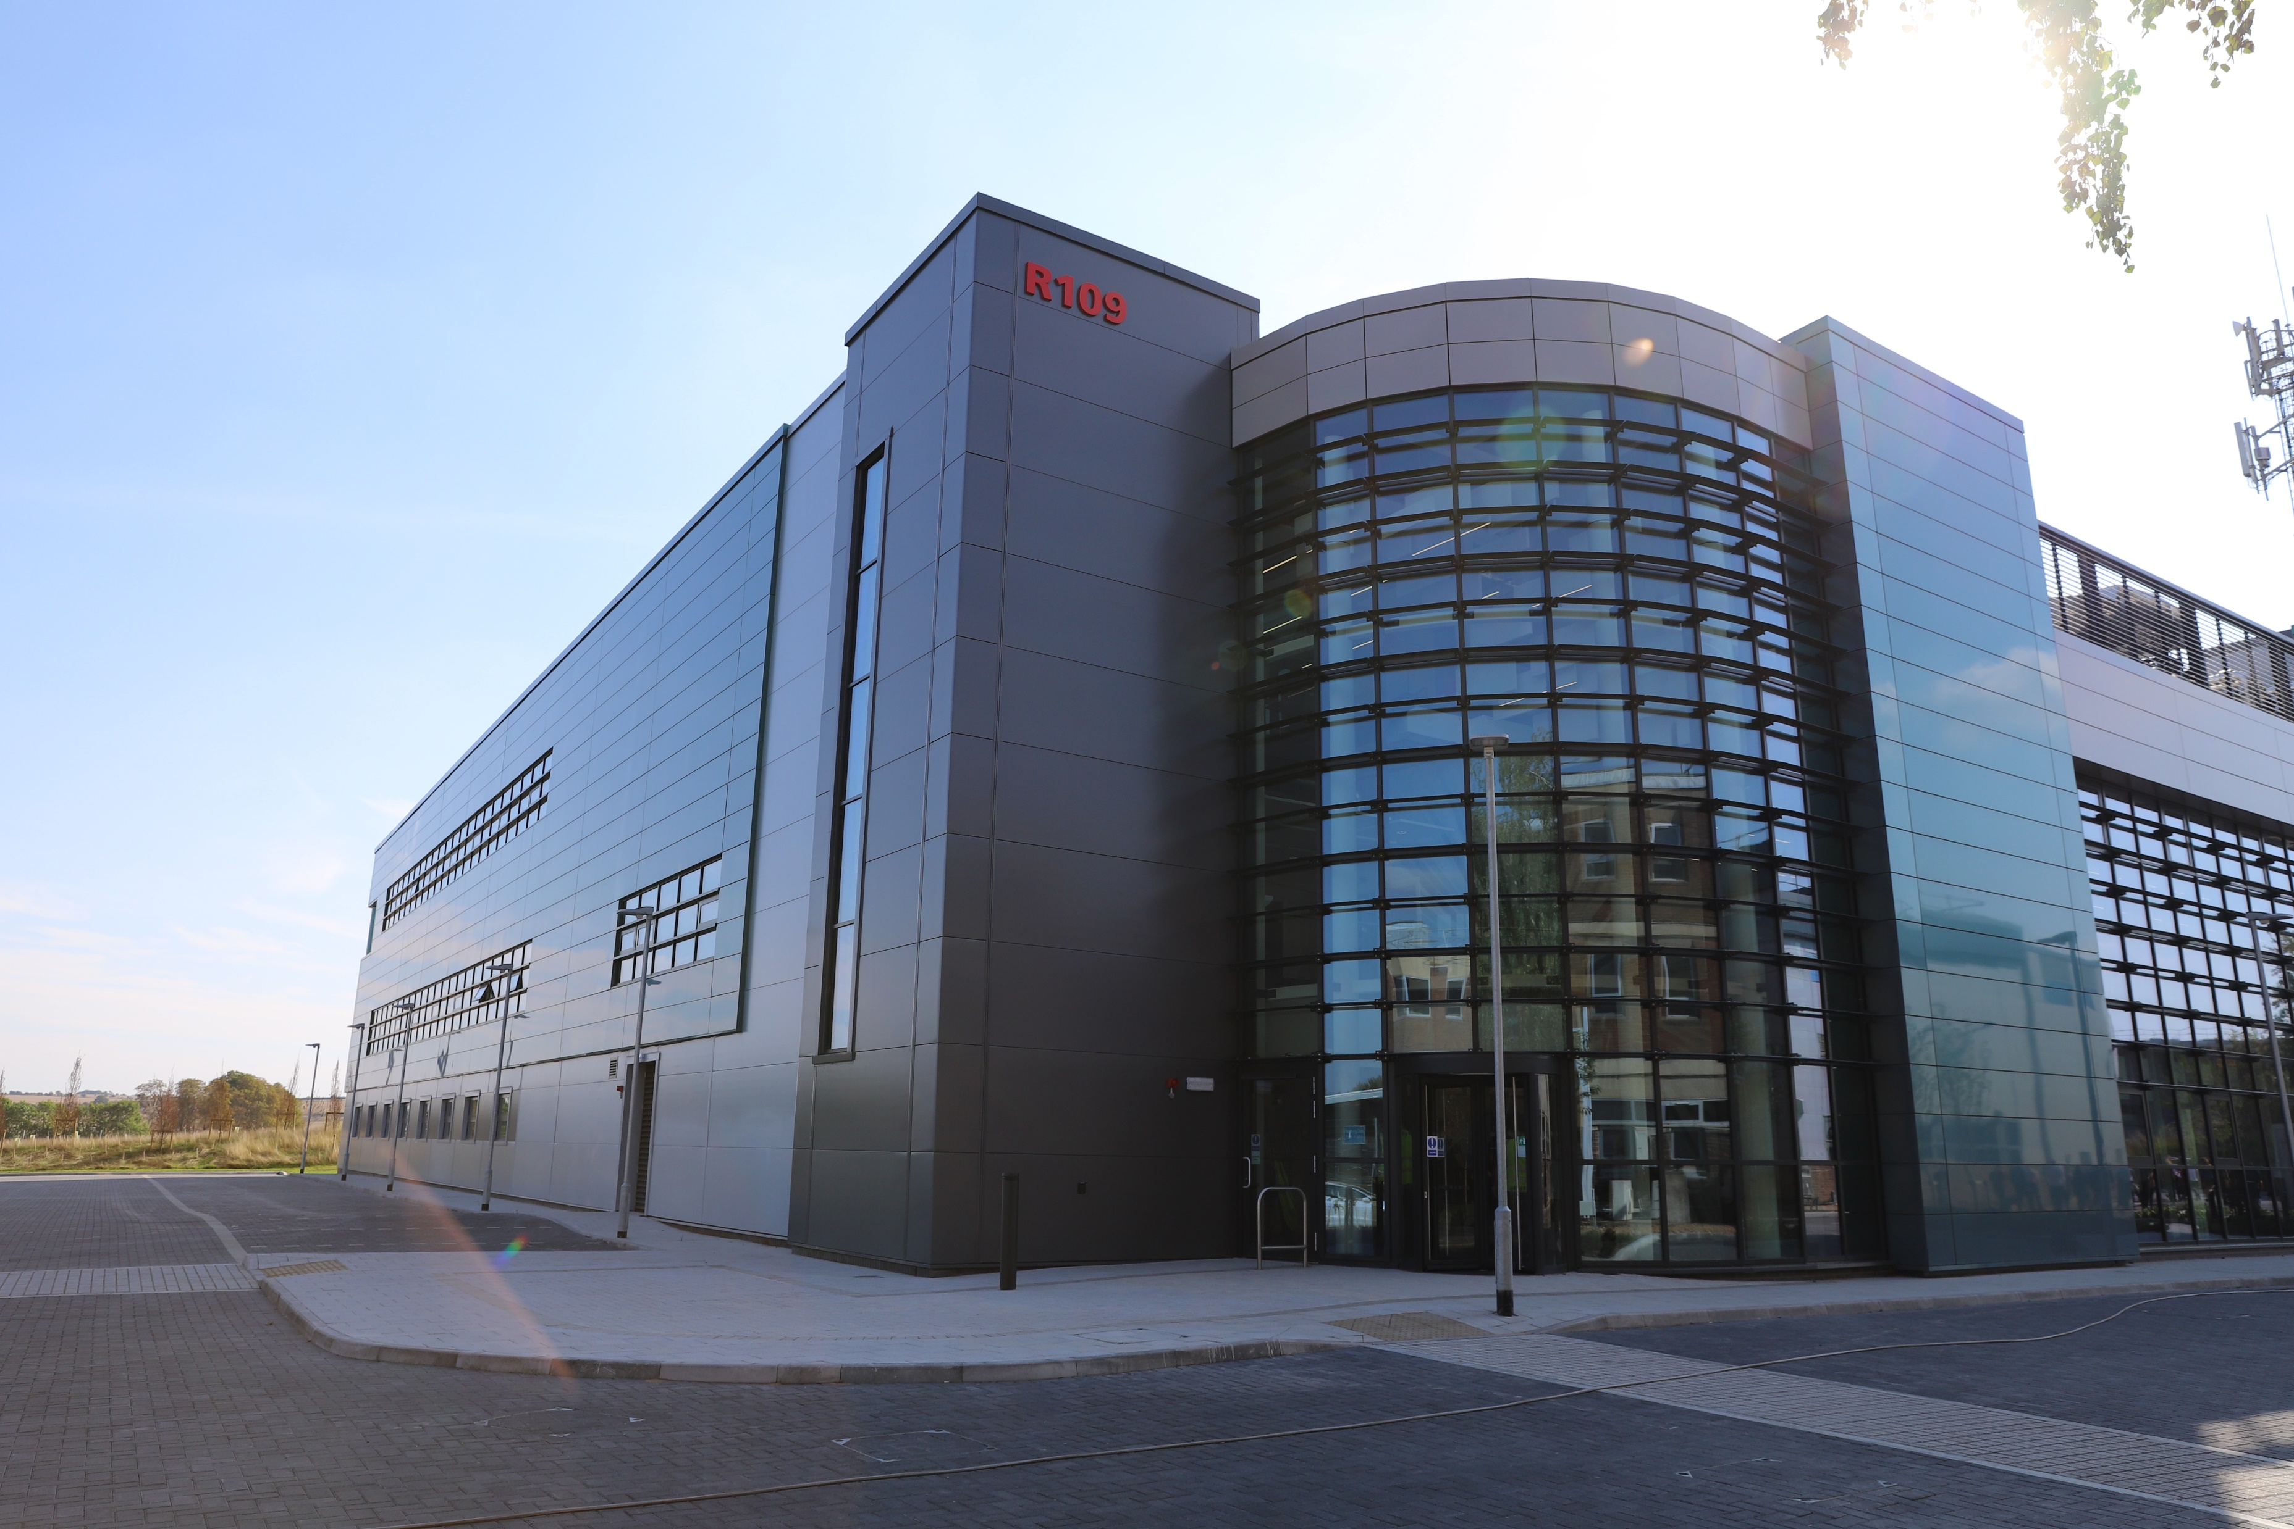

Extreme Photonics Applications Centre (EPAC)
New £106m centre for applications of laser-driven sources in industry, medicine & security
  Up to 10 GeV e- beams, 100 MeV x-rays
  Near real-time, high frame rate x-ray imaging capability
At the interface of science and industry
First laser system
  1 PW, 30 fs, 10 Hz
  10 Hz operation enabled by DiPOLE technology

Slide 19
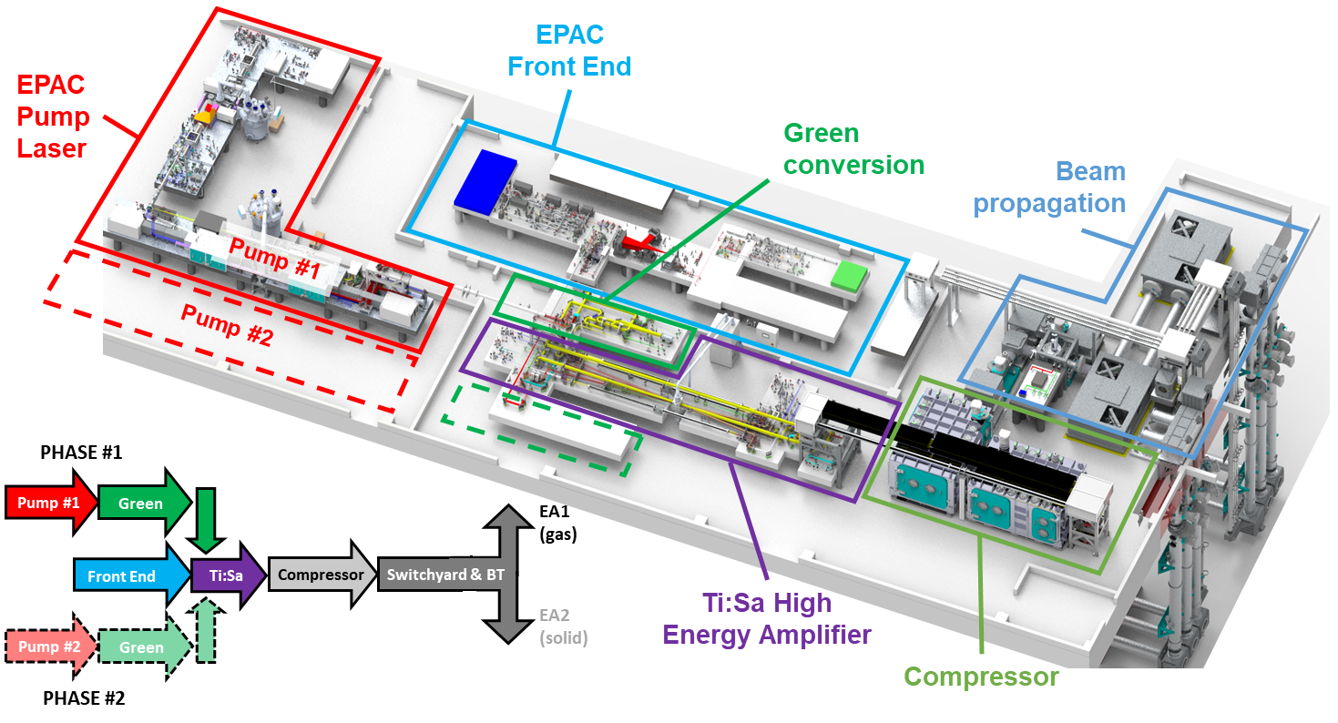

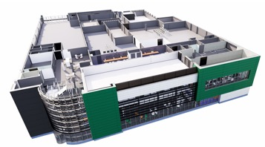
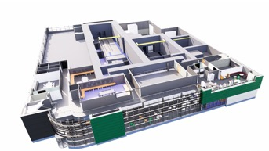
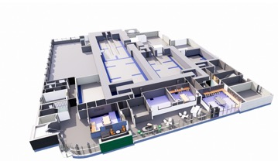
EPAC – Laser Technology
Pump
Front End
Ti:Sa Amp
2nd Floor
Switchyard
Compressor
Beam
Transport
1st Floor
EA2
EA1
Ground Floor
3-storey building with radiologically shielded experimental areas (EA)

Slide 20
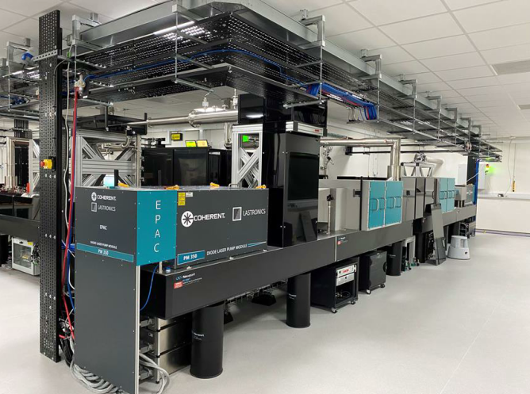
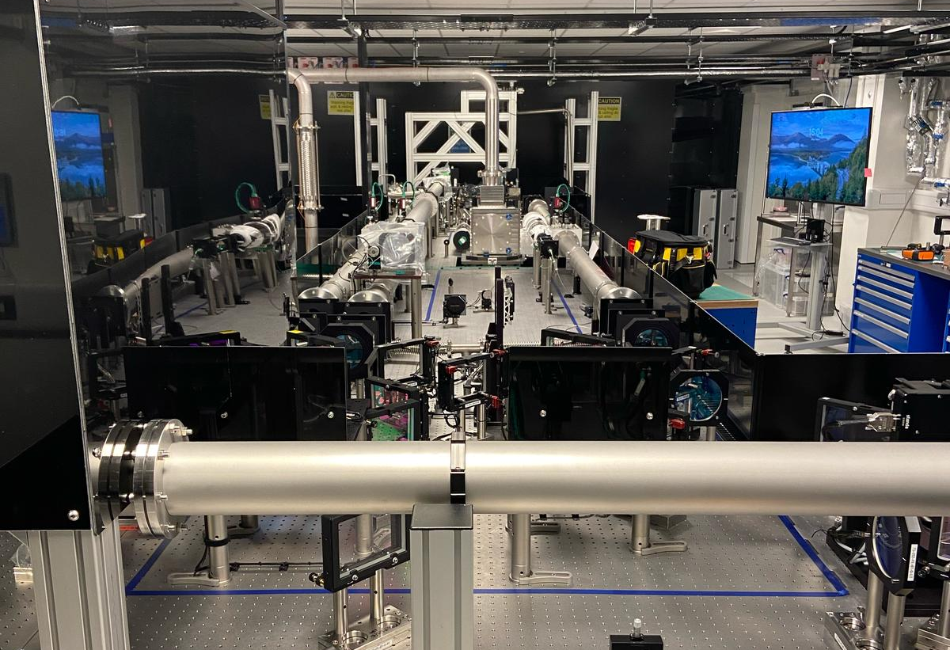
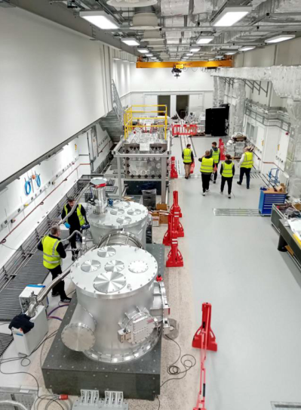
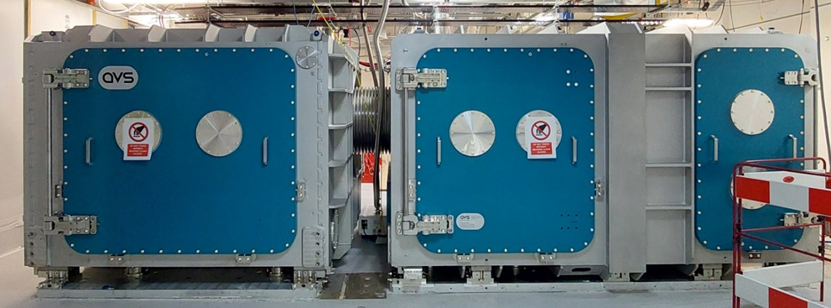
EPAC – Installation & Commissioning
DiPOLE 120J, 10 Hz pump
Ti:Sa amplifier
Experimental area 1
Compressor chamber

Slide 21
EPAC – Installation & Commissioning
DiPOLE 120J, 10 Hz pump
Ti:Sa amplifier
Experimental area 1
Compressor chamber

Slide 22
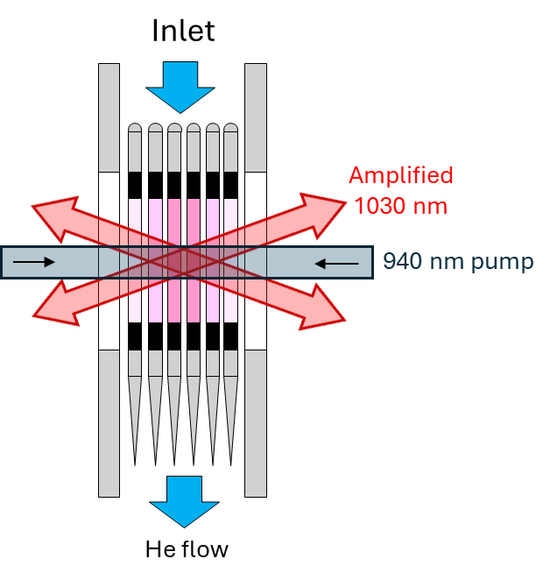
DiPOLE Amplifier Concept
Developed @ CLF over the last ~ 15 years
Fundamental DiPOLE architecture aspects:
  Yb:YAG gain material (1030 nm, nanosecond pulses)
  Face-cooled by cryogenic Helium gas
  Face-pumped by 940 nm diode lasers
  Seed beam propagates several times through the gain material
Scalable design
K. Ertel et al., Optics Express, 19, No. 27, 26610 (2011).
Brown et al., IEEE J. of Select. Topics in Quant. Elect. 11, No.3 (2005).
Dong et al., J. Opt. Soc. Am. B 20, No.9 (2003).

Slide 23
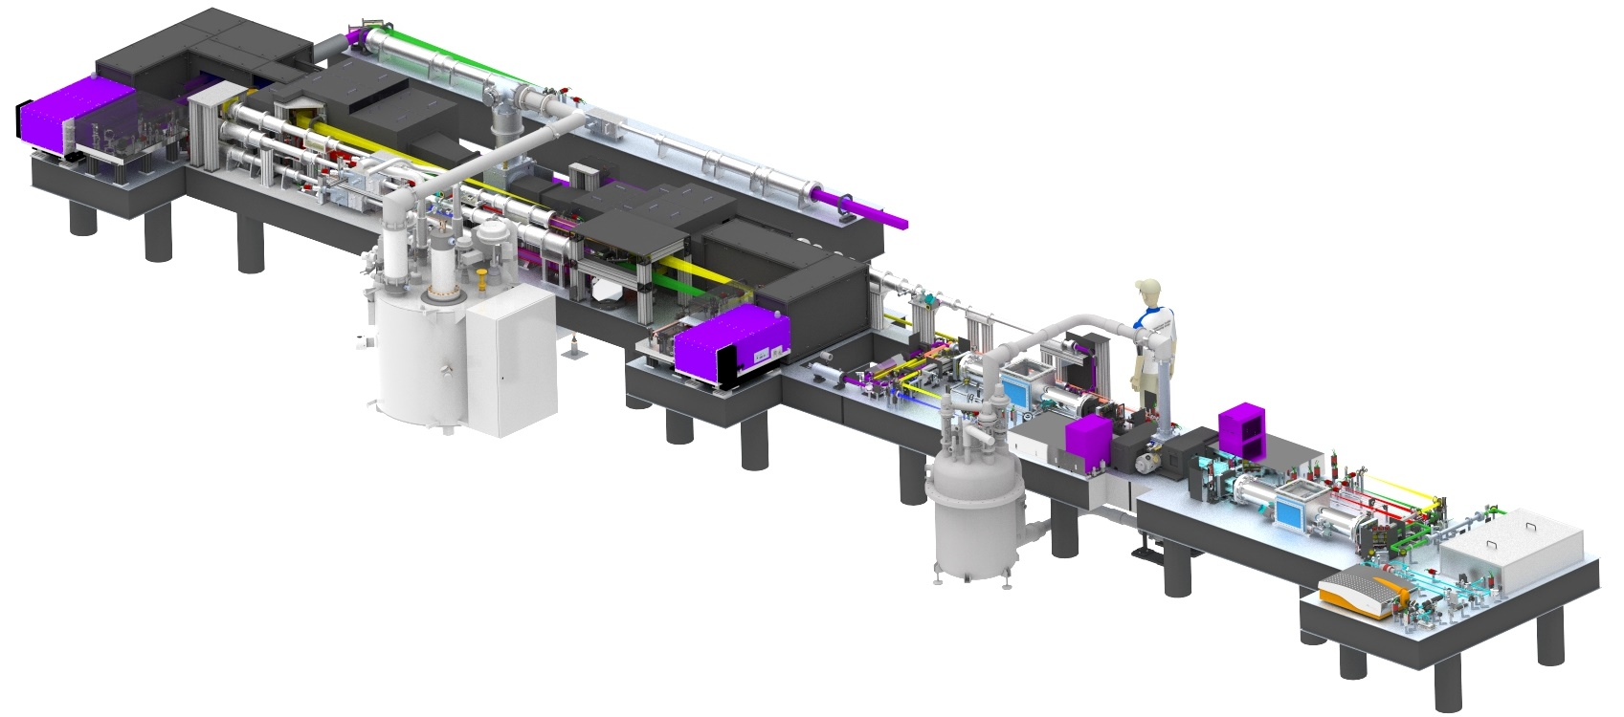
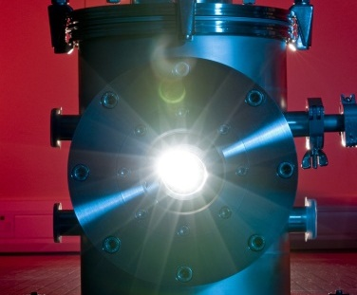


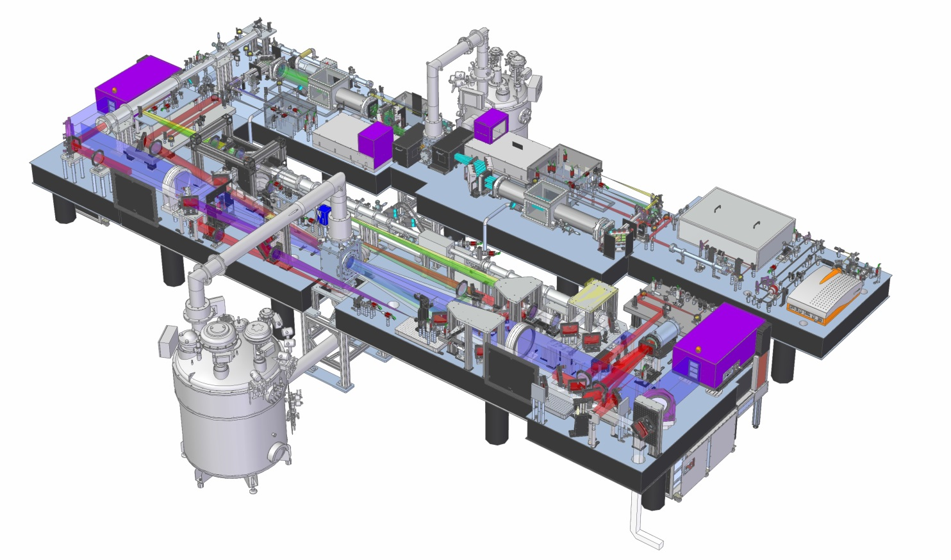


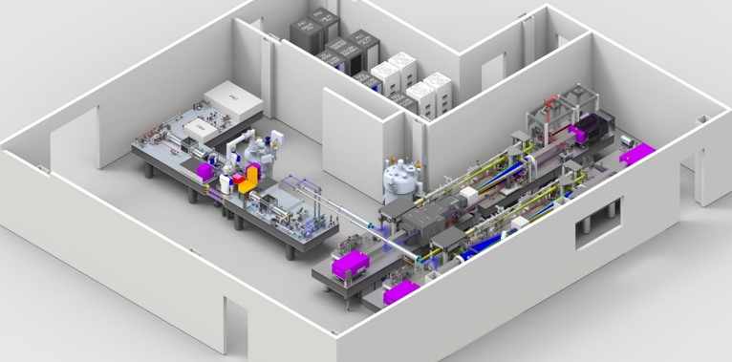
DiPOLE 10 Hz
DiPOLE100: 100 J+, 10 Hz
@ HiLASE (Bivoj)
World’s first demonstration of multi-J laser operating at 1 kW
Industrial applications
@ European XFEL
High-energy density physics research
Enhanced temporal pulse shaping capabilities.
10 J, 10 Hz
@ Central Laser Facility
Proof-of-concept
Test bed for tech and applications development
@ EPAC, Central Laser Facility
Pump laser for 1 PW, 10 Hz laser
Under installation

Slide 24
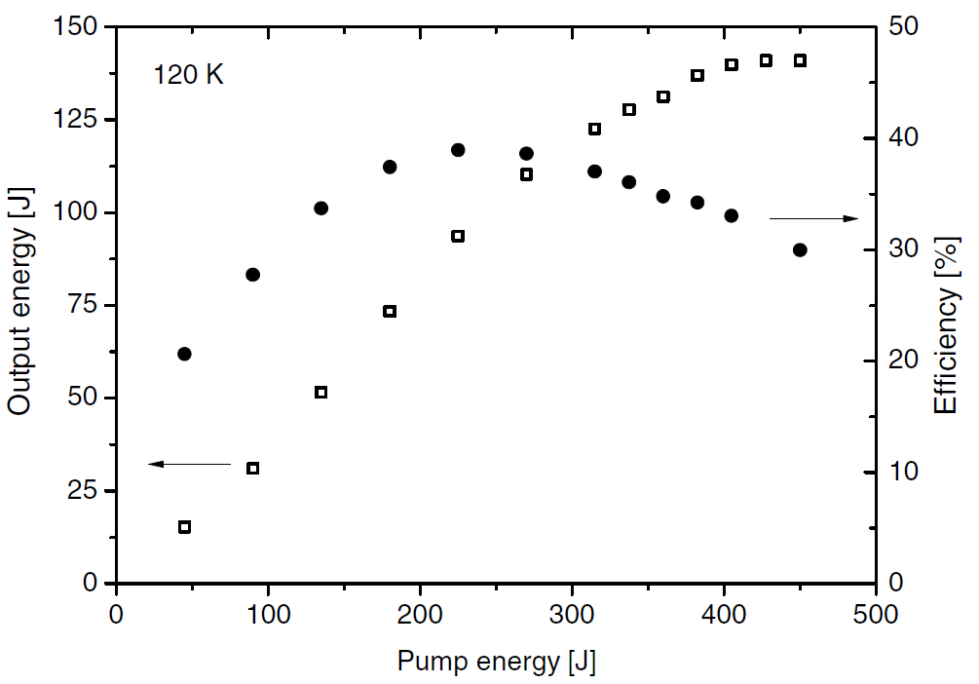
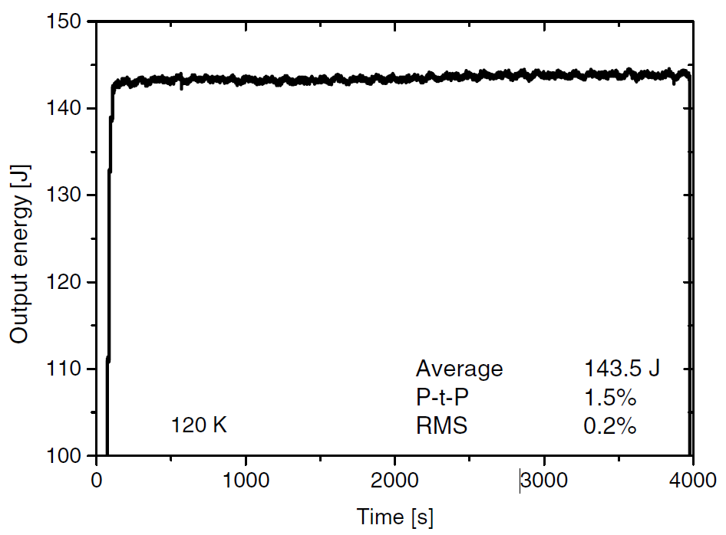



150 J, 10 Hz Results
Stable, long-term operation at 145 J, 10 Hz
Optical-to-optical efficiency = 30% (wall-plug efficiency = few %)
M. Divoky et al., “150 J DPSSL operating at 1.5 kW level” Opt. Lett., 46(22), 2021.

Slide 25
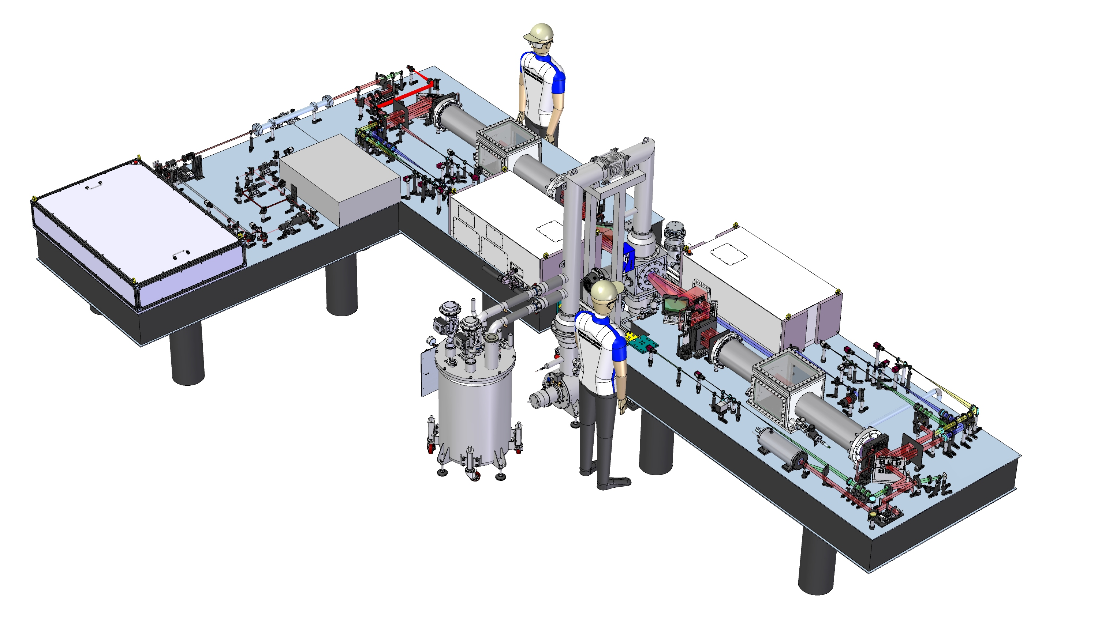
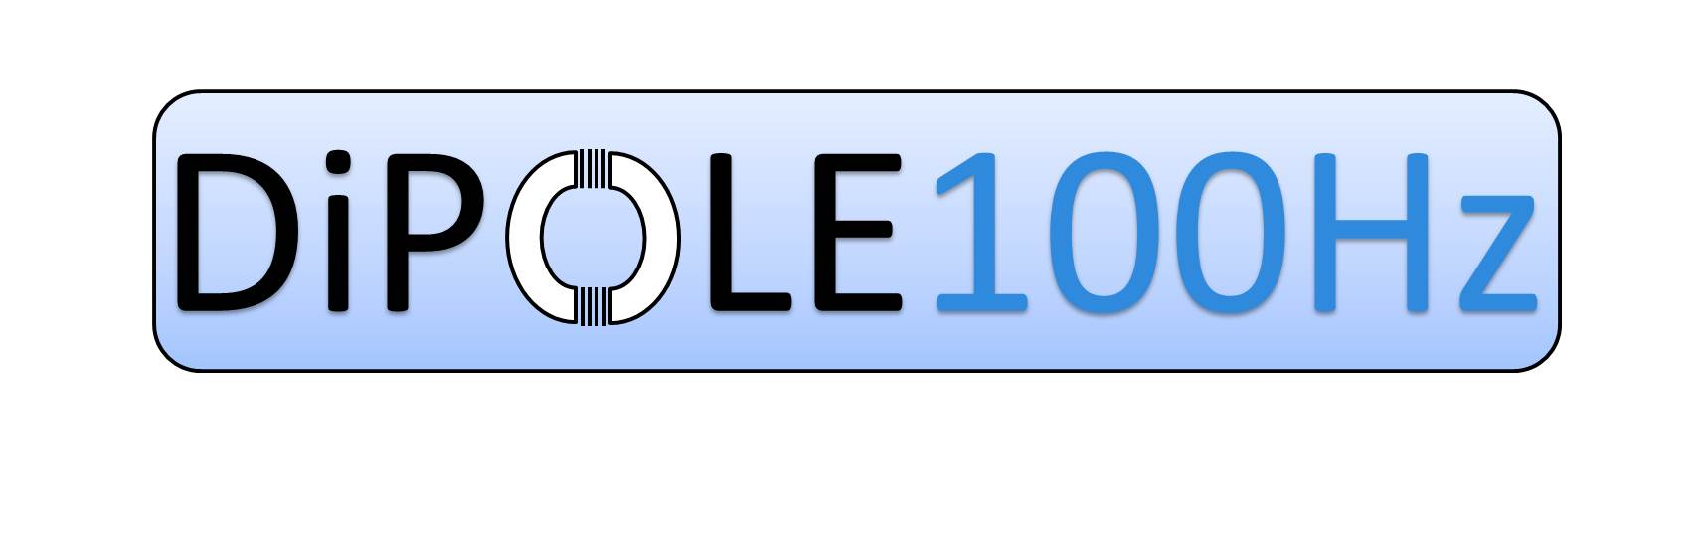

Pulse Rate Scaling: DiPOLE 10J @ 100 Hz
1 kW average power, more compact compared to 100 J, 10 Hz systems
Industrial & scientific applications requiring: high pulse energy, pulse rate, average power & production rates
Challenge – thermal management:
Gain medium
Pump diodes
Optics and optomechanics
10J amplifier head
PA1
PA2
YDFO
YDFA
PA1
PA2
MA
RT
RT
Cryostat
Energy:
7 nJ
4 mJ
100 mJ
10 J
M. De Vido et al., “Design of a 10 J, 100 Hz diode-pumped solid state laser,” Advanced Solid State Lasers, JTu3A. 14 (2019).

Slide 26
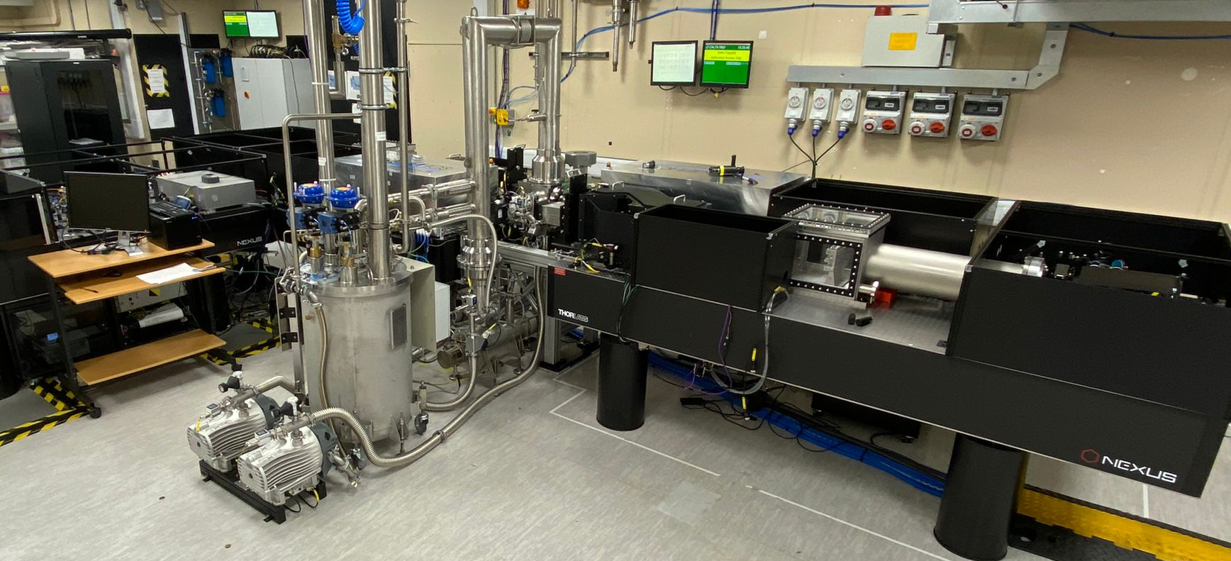
How it looks like

Slide 27




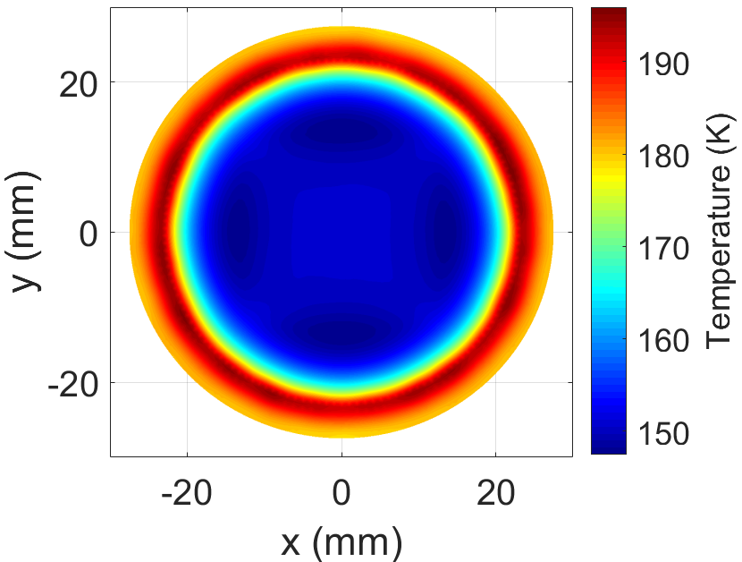
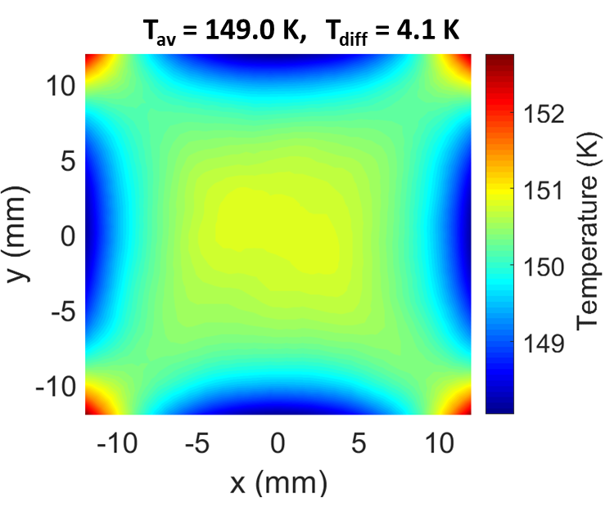
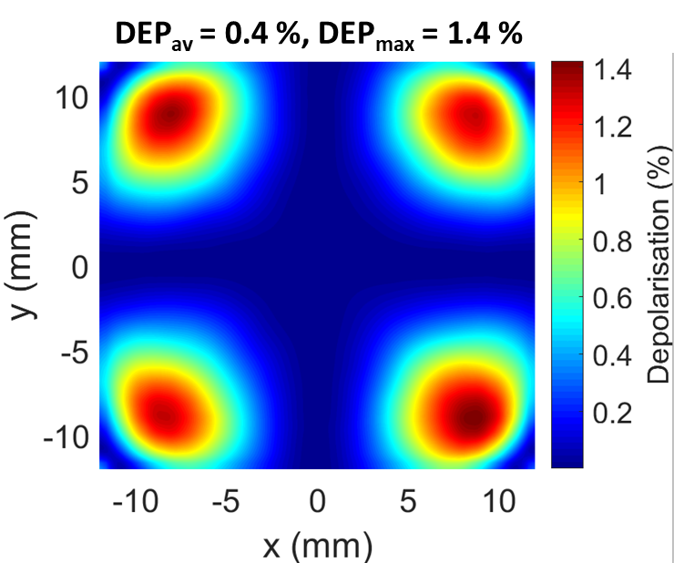
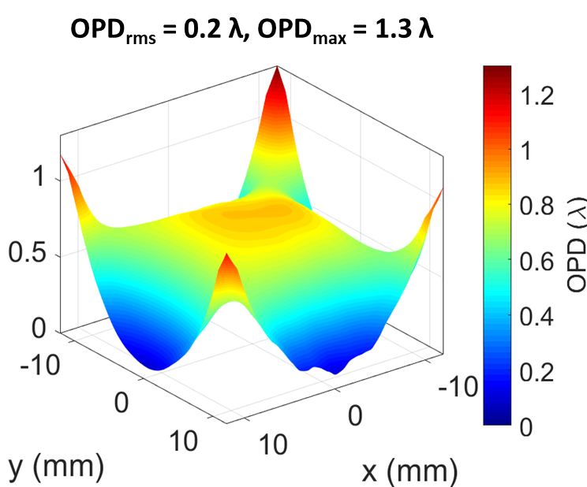
CFD modelling & Thermal Effects Simulations
Gain medium
CFD Modelling
Mass flow rate = 200 g/s
He temperature set-point = 140 K
He pressure = 10 barA
In-house thermo-optical simulation software
Wavefront aberrations
Thermal stress-induced depolarisation
He
flow
Slab temperature:
Pumped area temperature:
1 pass depolarisation:
1 pass wavefront distortion:
M. De Vido, “Beyond 1 kW average power: scaling pulse energy and repetition rate in diode-pumped solid state laser amplifiers,” EngD thesis, Heriot-Watt University (2020).
M. Sawicka-Chyla, et al., IEEE Journal of Quantum Electronics, vol. 55(5), 1-8 (2019).
G. Quinn, et al., “Modelling of Thermal Stress-Induced Depolarisation in a 10 J, 100 Hz Diode-Pumped Yb:YAG Laser,” ASSL Conference 2022.

Slide 28
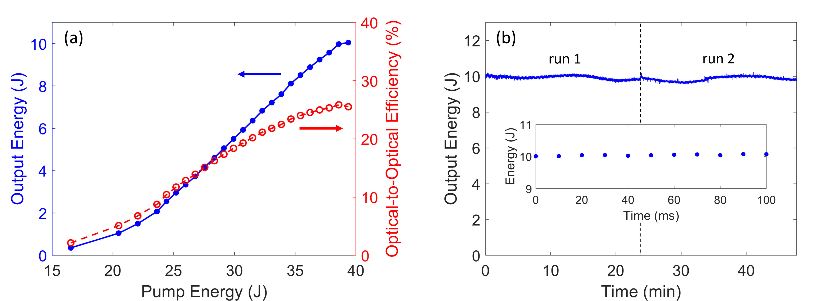
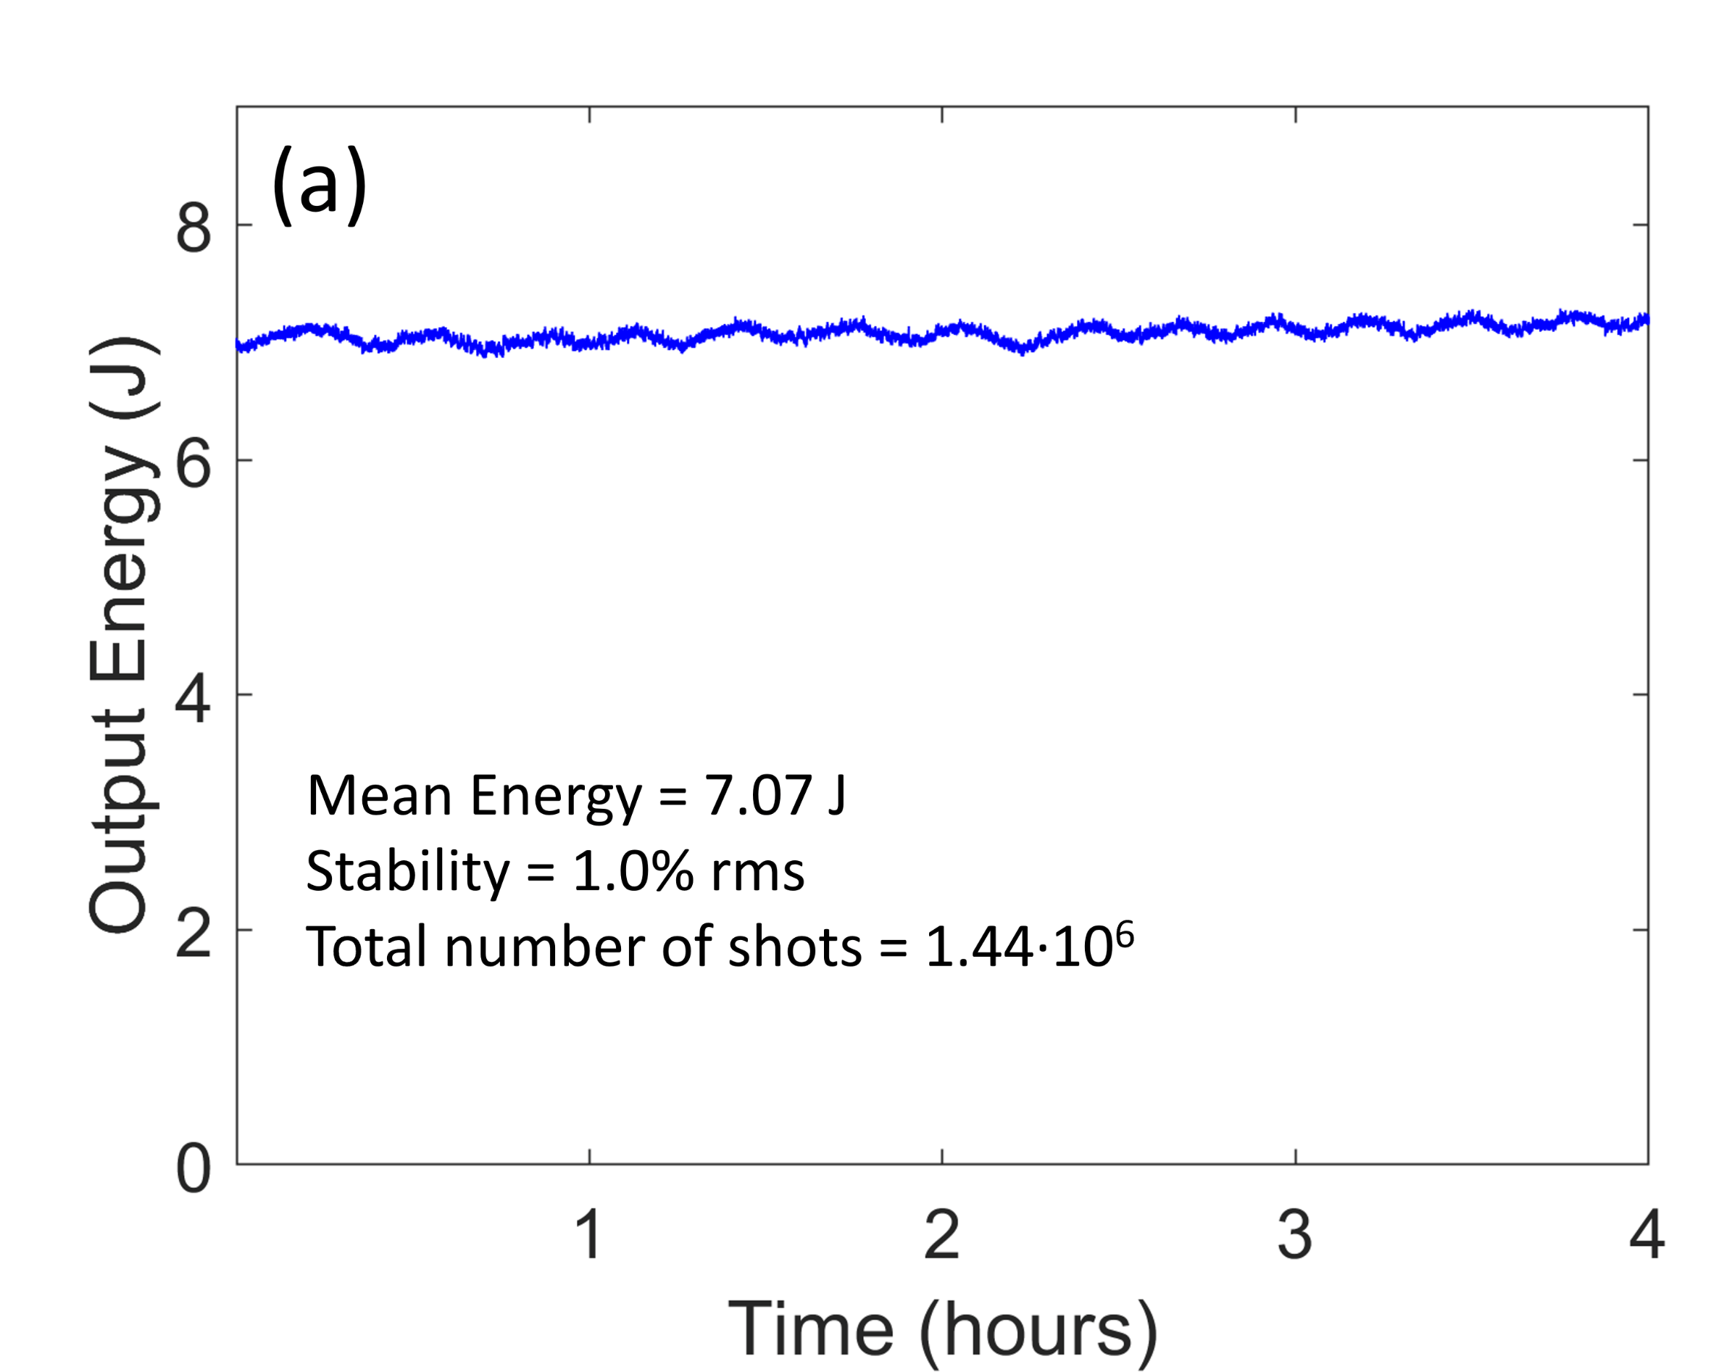
10 J @ 100 Hz - Experimental Results
25.4% optical-to-optical efficiency
∼300,000 shots @ 10 J, 100 Hz
∼ 1,500,000 shots @ 7 J, 100 Hz
1% rms energy stability
World’s first demonstration of stable, long-term multi-J amplification @ 100 Hz
M. De Vido et al., “Demonstration of stable, long-term operation of a kW-class nanosecond pulsed DPSSL operating at 10 J, 100 Hz,” Optics Express 32(7), 11907-11915 (2024).

Slide 29


Future EPAC upgrade: 100 TW @ 100 Hz laser
2nd generation DiPOLE-100Hz undergoing installation
Evaluating approached to reach operation at 10+ J at 100 Hz
Development of “EPAC-100Hz”: 100 TW (3J, 30 fs) , 100 Hz laser driver based on DiPOLE-100Hz technology
Design of broadband amplifier line is ongoing
CLF is a collaborator in the PACRI project – leading collaboration on Ti:Sa high rep rate, multi-J scale amplifier (20-100 Hz)
2nd Floor
100 Hz laser
1st Floor
Ground Floor

Slide 30
Conclusion
Future accelerators require laser drivers with high P_{peak} & P_{av} and high stability
100 Hz operation is a requirement for the EUPRAXIA facility for acceleration to GeV at 100 Hz
A number of new approaches to high P_{peak} & P_{av} laser development
  Different approaches → >1 solution
  Extension of the parameter space for applications
Commercial players involved: maturity of technology
Enabling technologies ecosystem is developing
Development of 10 Hz & 100 Hz high peak power sources under development at the CLF

Slide 31
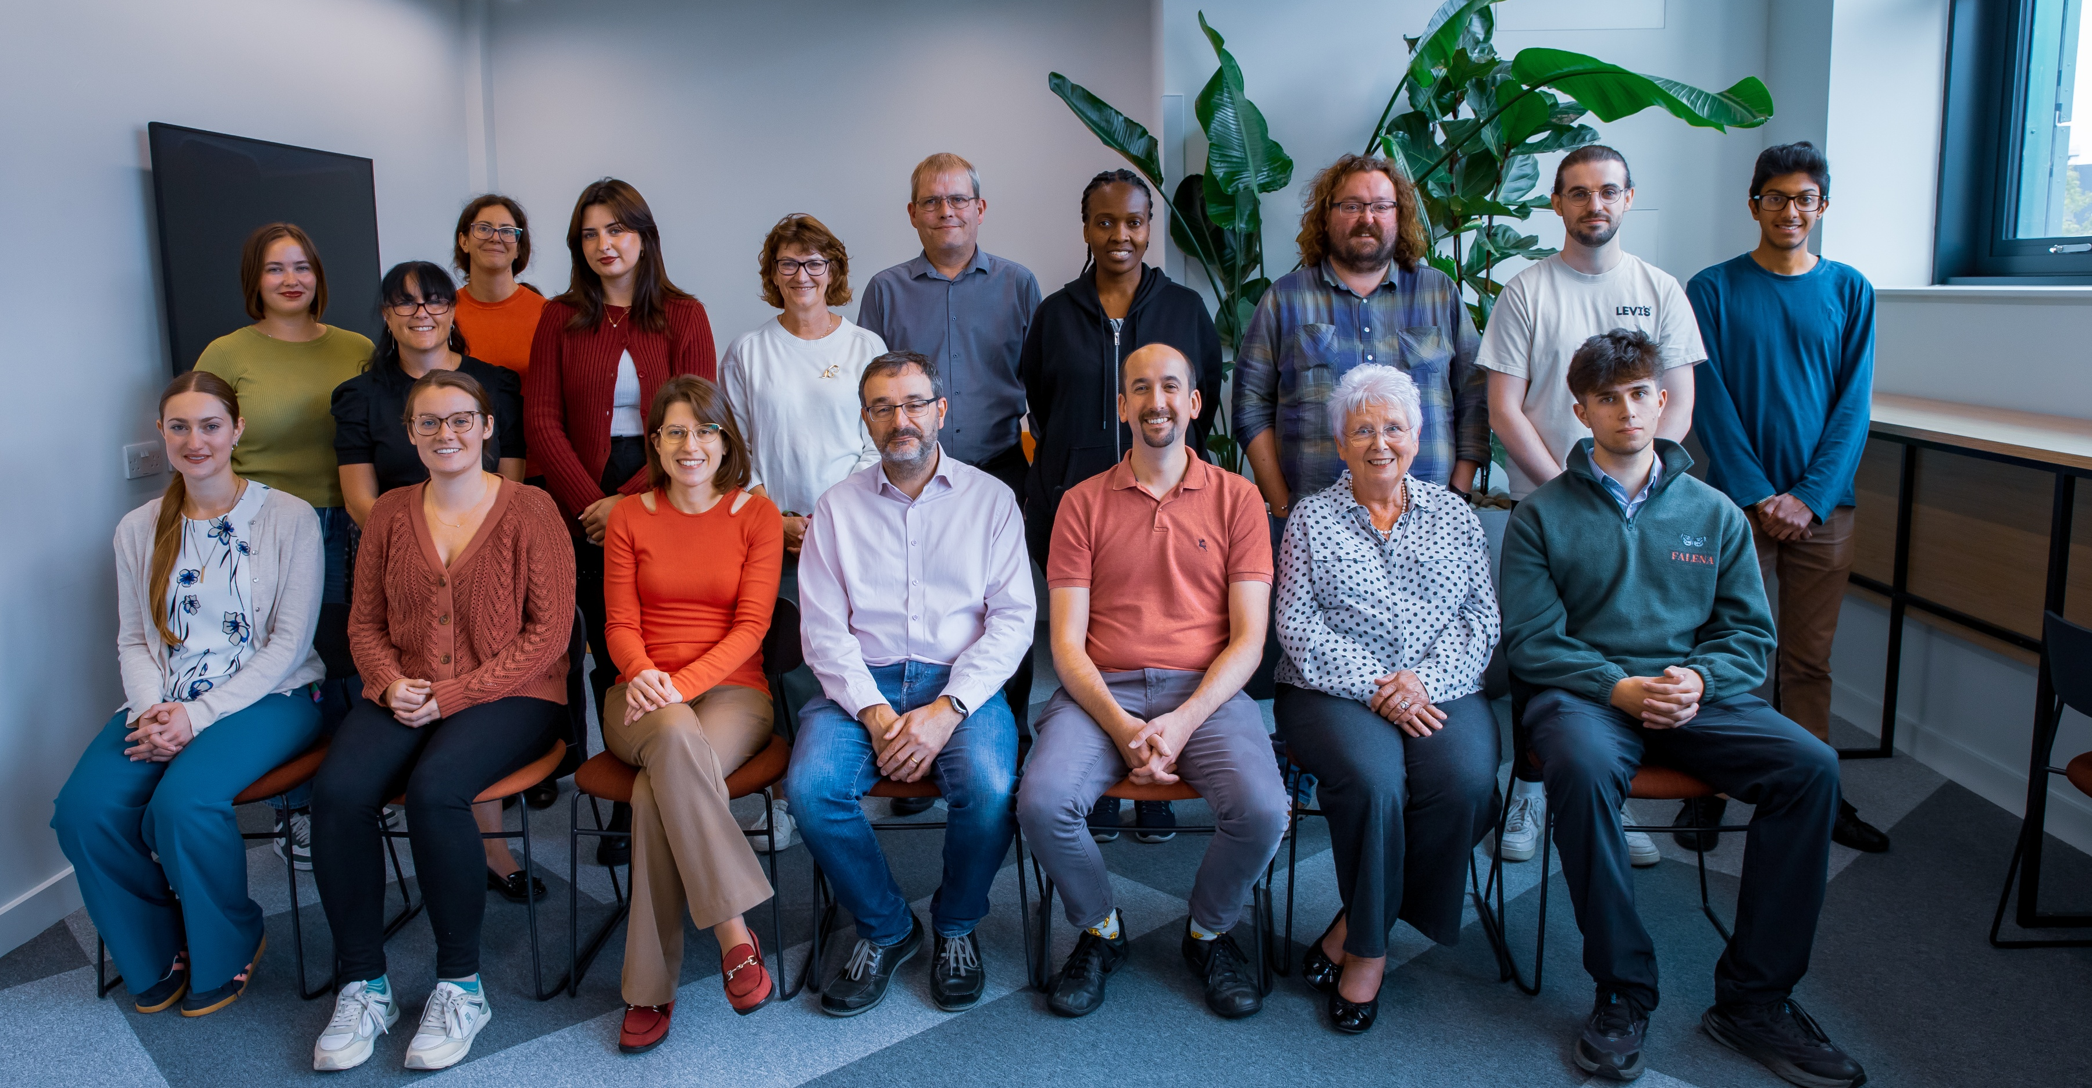
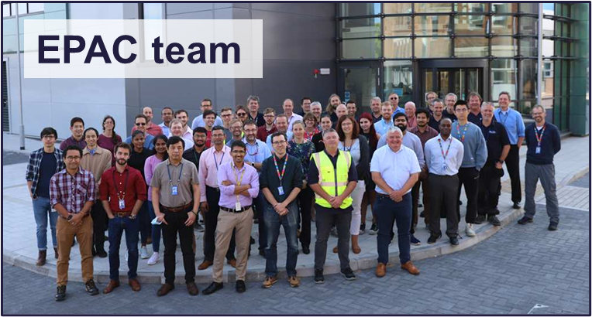
Thank You!
CALTA team

