Slide 1
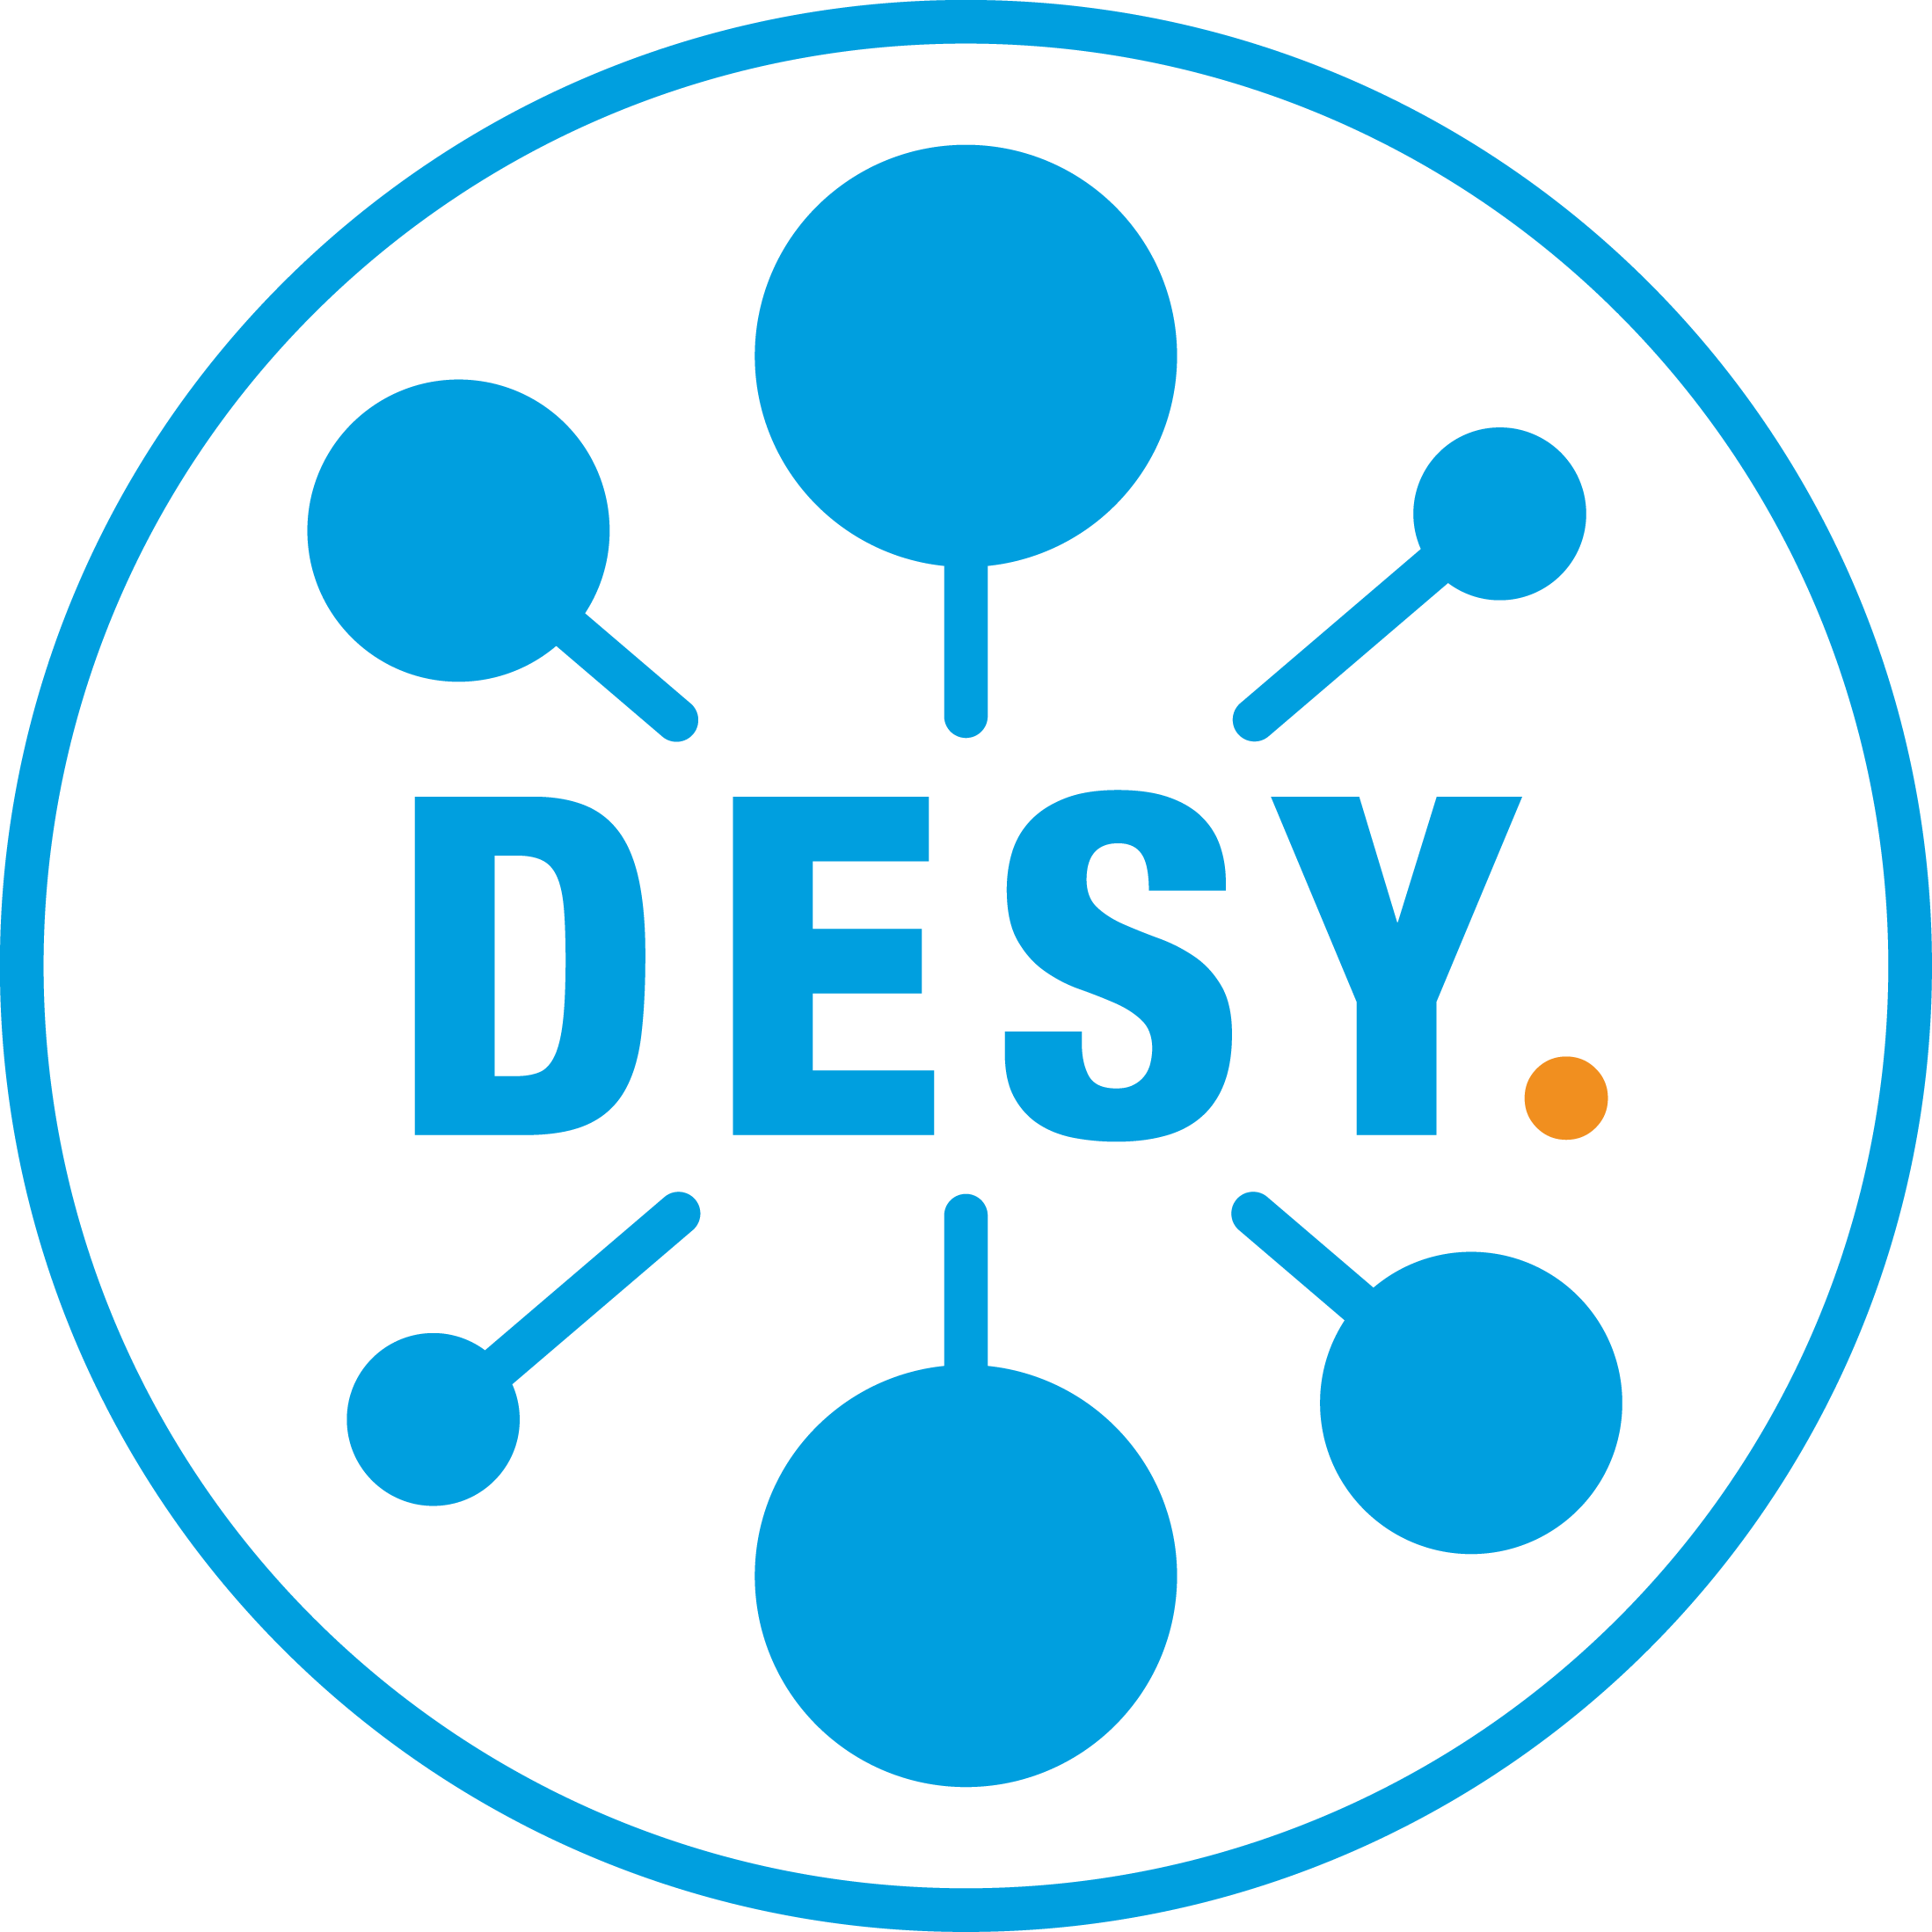



Optimisation of Inverse Compton Scattering via spatio-temporal tailoring of the scattering pulse
C. Mariani ^{1,2}, M. Meisel ¹, L. Martelli ¹, K. Põder ¹
¹ Deutsches Elektronen-Synchrotron DESY, Notkestr. 85, 22607 Hamburg, Germany
² University of Hamburg, Department of Physics, Jungiusstr. 9, 20355 Hamburg, Germany
  Cristina Mariani
  cristina.mariani@desy.de
  plasma.desy.de

Slide 2
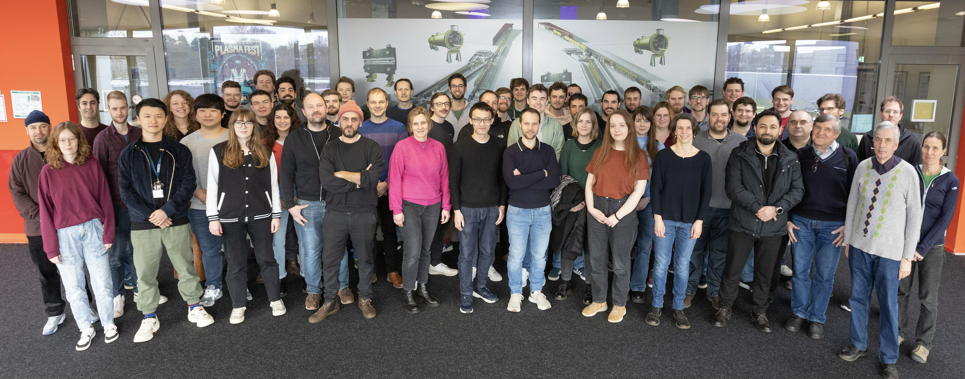
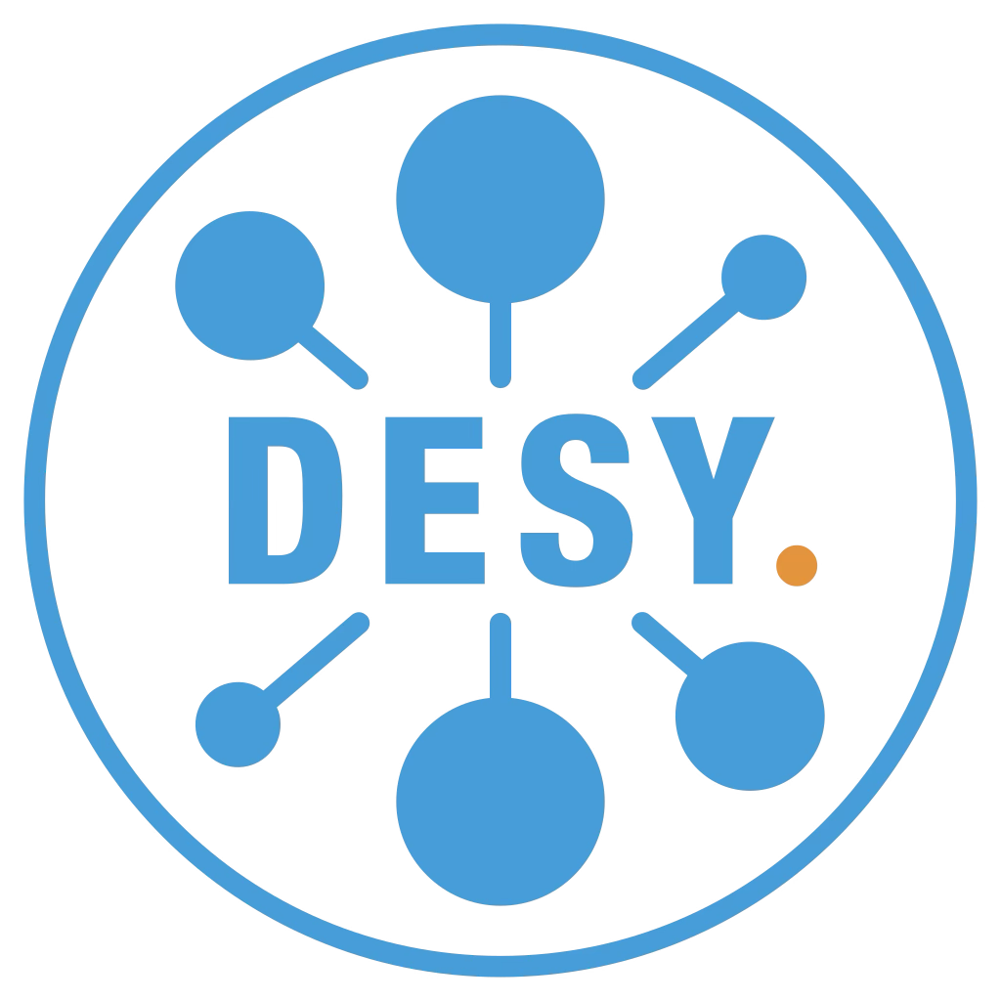
MPL – Plasma Accelerator and Laser Group at DESY
Fig: Marta Mayer (DESY)
See out webpage at plasma.desy.de
For a full list of teams and activities

Slide 3
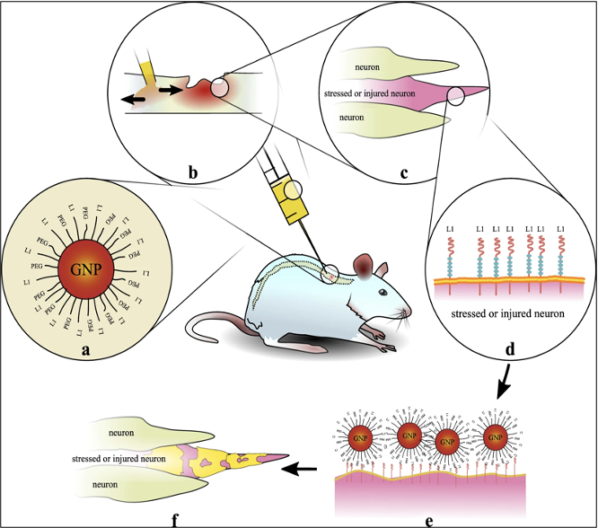
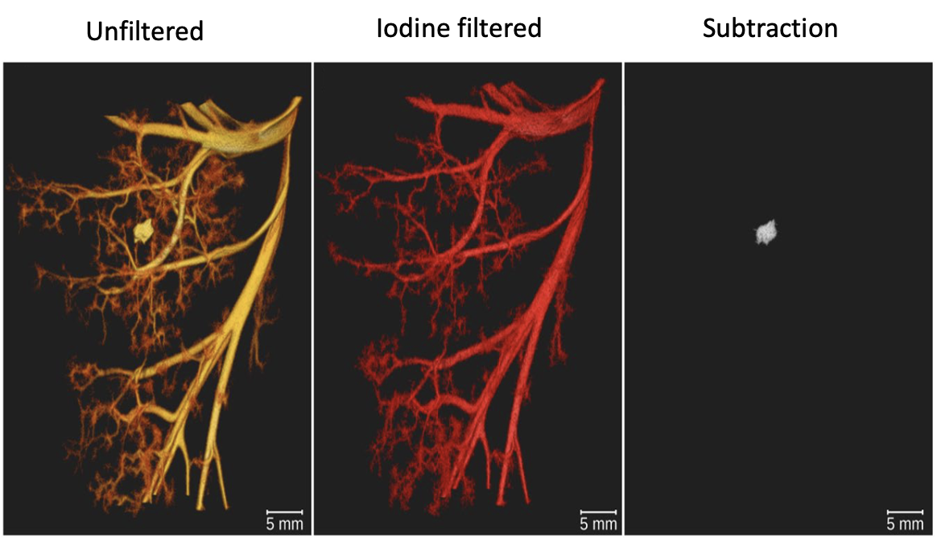
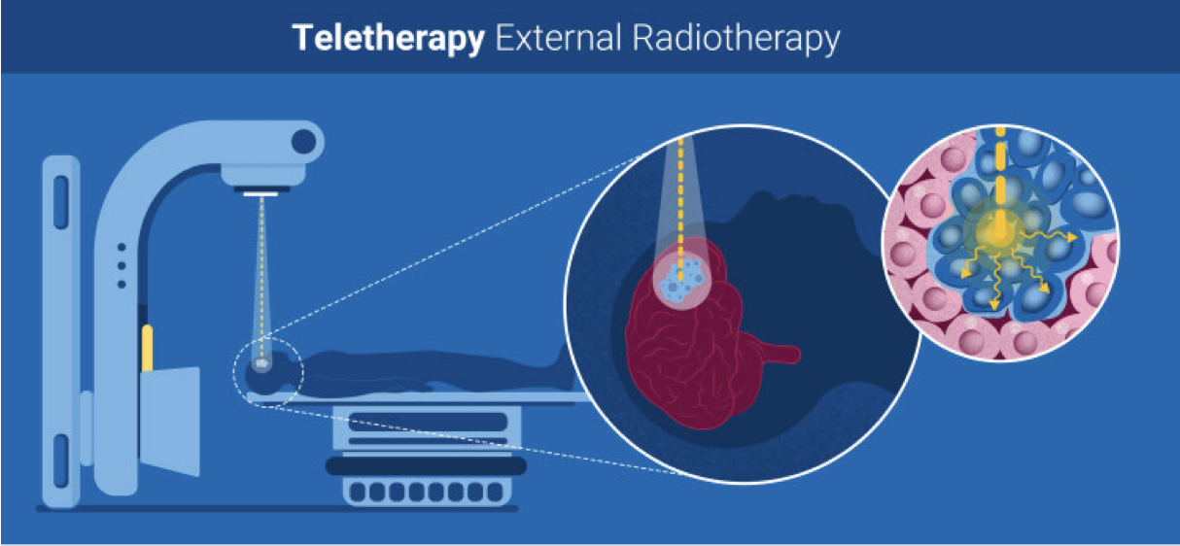
High Energy X-ray applications need low bandwidth and a high photons flux
X-ray fluorescence imaging ^{[2]}
High Energy X-rays (HEX) are used in many industrial and medical applications
Radiotherapy ^{[3]}
K-edge subtraction imaging ^{[1]}
[1] S. Kulpe et al., Scientific Reports 9, 13332 (2019).
[2] F. Grüner et al., Scientific Reports 8, 16561 (2018).
[3] https://www.iaea.org/

Slide 4
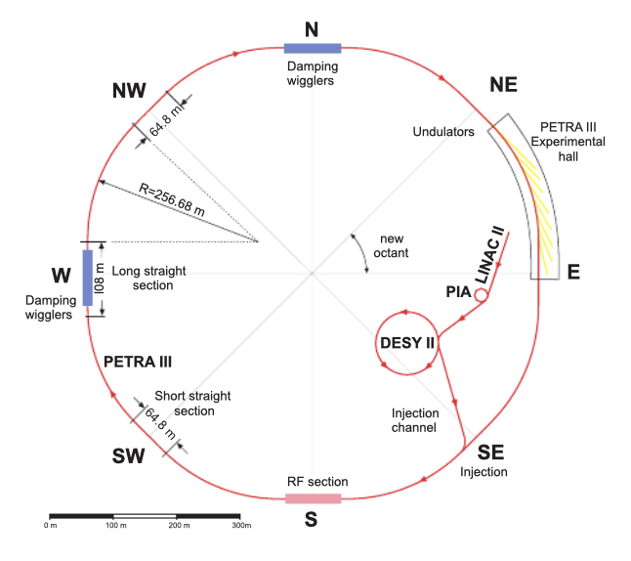
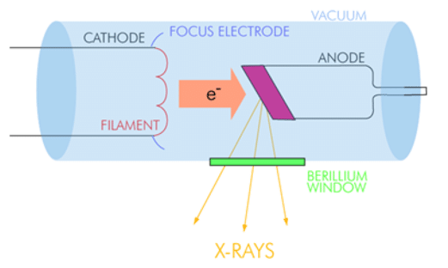
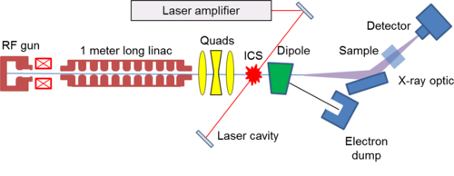
Inverse Compton Scattering (ICS) based X-ray sources lead the way among the different source types
Conventional X-ray tubes ^{[1]}
Synchrotrons ^{[2]}
Inverse Compton Scattering (ICS) sources ^{[3]}
 | Compactness and cost | Small source size and divergence | High repetition rate | Low bandwidth
Conventional X-ray tubes
Synchrotrons
Inverse Compton Scattering (ICS) sources
[1] Van der Snickt, G. (2012), PhD thesis, University of Antwerp.
[2] J. Keil et al, Proocedings of IPAC’10, Kyoto, Japan
[3] W. S. Graves, Phys. Rev. ST Accel. Beams 17, 120701
Table from: J. Synchrotron Rad. (2020). 27, 1395–1414

Slide 5
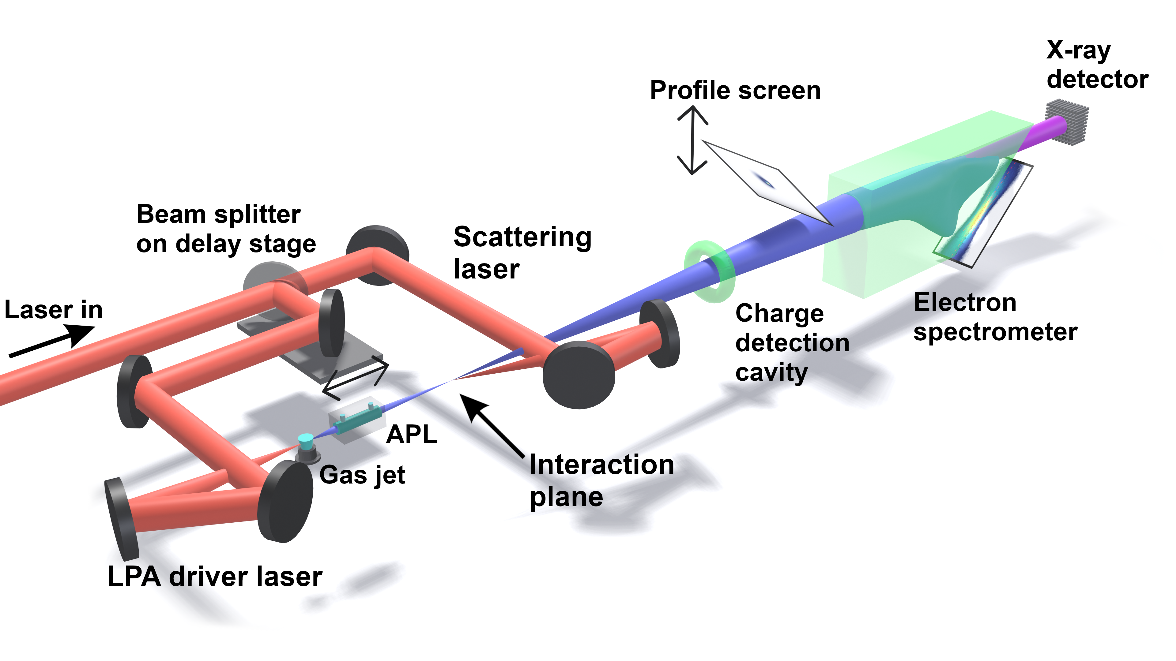
APHEX project combines a Laser Plasma Accelerator (LPA) with the ICS process
Requirements for an X-ray source:
Compactness
Tunability

Slide 6
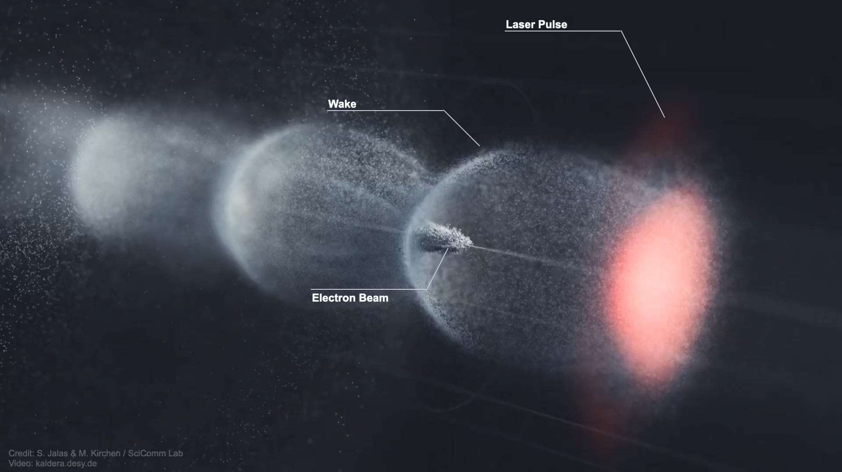
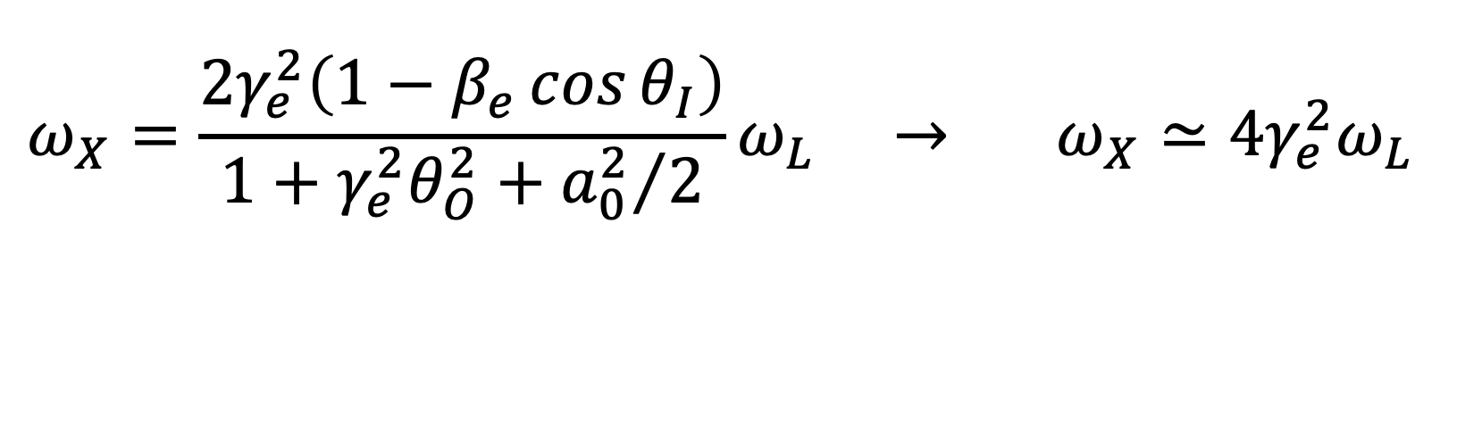
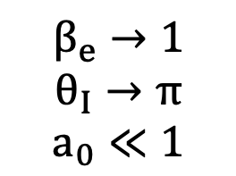
APHEX project combines a Laser Plasma Accelerator (LPA) with the ICS process
X-ray energy
$$ω_{X}=\frac{2γ_{e}^{2}\left(1−β_{e}\cos{θ_{I}}\right)}{1+γ_{e}^{2}θ_{O}^{2}+{a_{0}^{2}}/2}ω_{L} → ω_{X}≃4γ_{e}^{2}ω_{L}$$
$$β_{e}→1$$
$$θ_{I}→π$$
$$a_{0}≪1$$
Laser plasma accelerator ^{[4]}
[4] Credit video: S. Jalas & M. Kirchen / SciComm Lab
Video: kaldera.desy.de

Slide 7
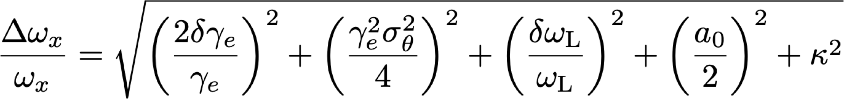
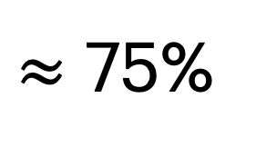
The bandwidth of the process can be optimised
$≈$ 75%
Electron beam energy spread
Electron beam divergence
Ti:Sa laser bandwidth
Ti:Sa laser strength
[5] L. Serafini, Phys. Rev. Accel. Beams 20, 080701 (2017)

Slide 8
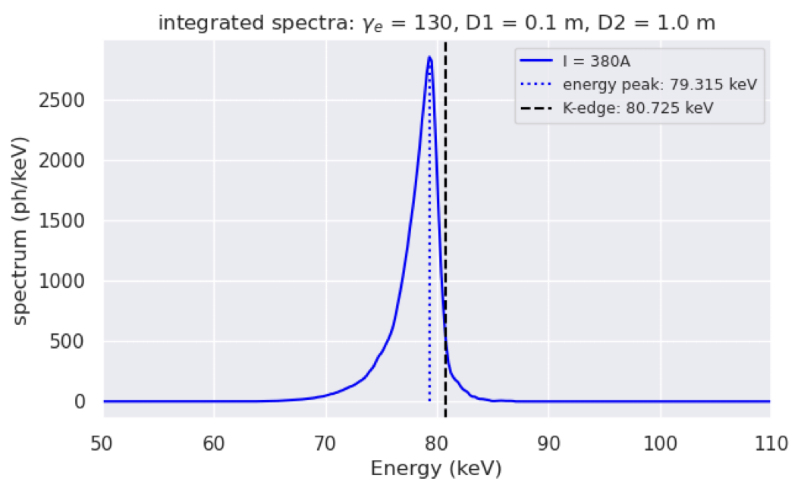
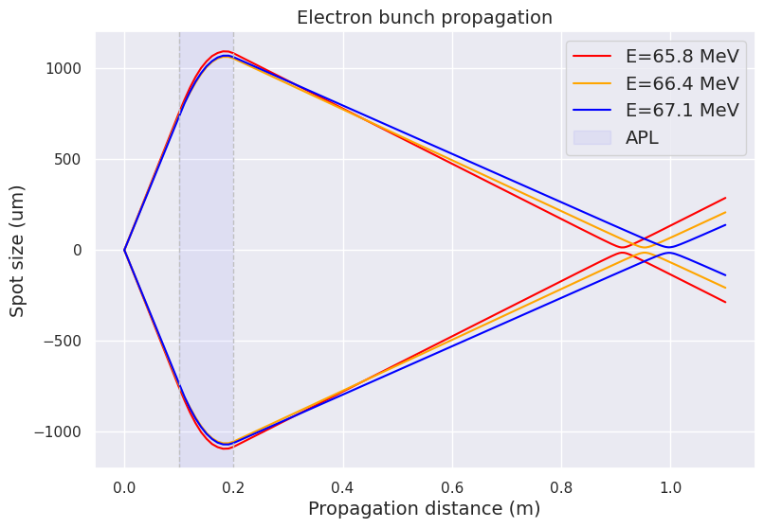
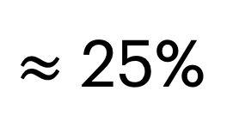
The bandwidth of the process can be optimised
$≈$ 25%
Ti:Sa laser bandwidth
Ti:Sa laser strength
Electron beam energy spread
Electron beam divergence
Active Plasma Lens
The electron beam contributions have been minimised ^{[6][7]}
[6] M. Meisel et al, “Tunable narrowband Thomson source
based on a laser-plasma accelerator “, in preparation.
[7] T. Brümmer et al., Sci Rep 12, 16017 (2022).

Slide 9
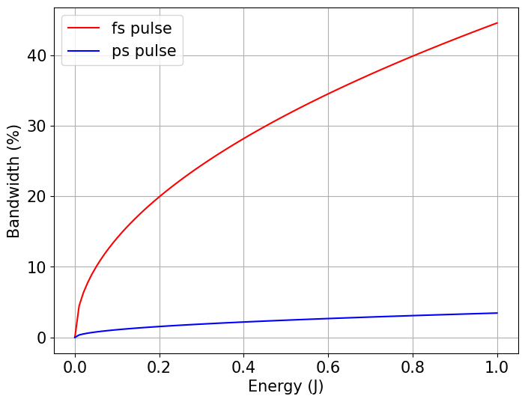
The bandwidth of the process can be optimised
Electron beam energy spread
Electron beam divergence
Ti:Sa laser bandwidth
Ti:Sa laser strength
The main contribution is now given by the laser

Slide 10
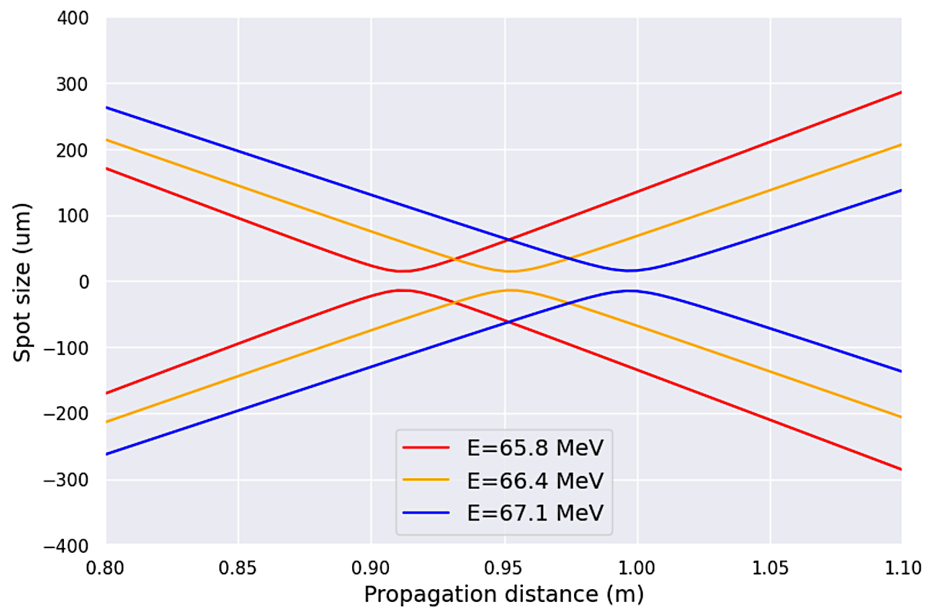
The electrons focus at different positions after an active plasma lens
Low energy e⁻ focus earlier
High energy e⁻ focus later

Slide 11
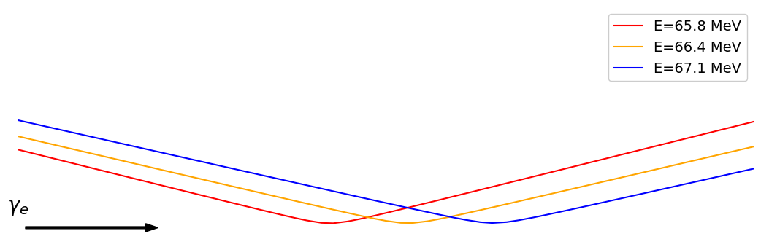
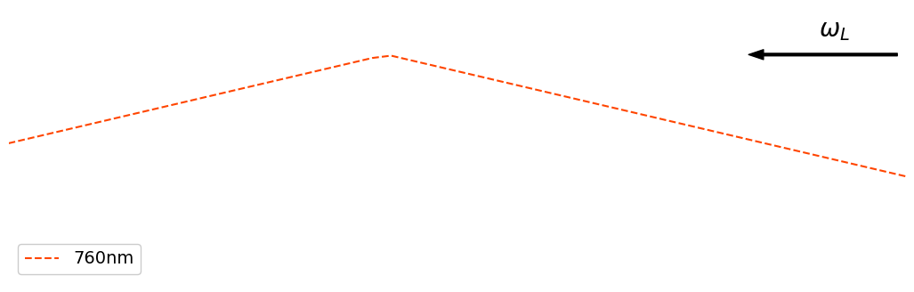
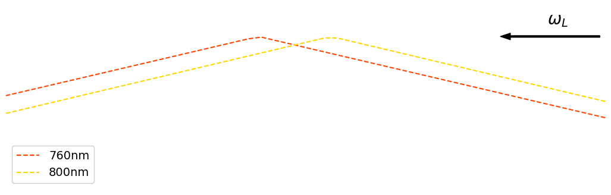
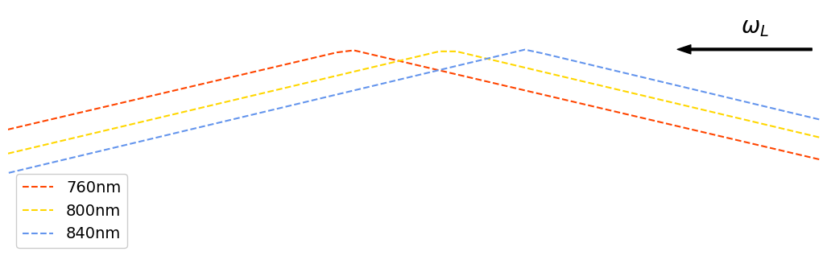

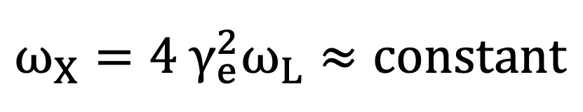

The laser needs to be tailored to match the length and timing of the electron beam
Low energy e⁻ focus earlier
High energy e⁻ focus later
$$ω_{X}=4 γ_{e}^{2}ω_{L}≈constant$$
Requirements for the laser:
Chromatic and extended laser focus
Proper focusing time of the different laser frequencies
High $ω_{L}$ focus earlier
Low $ω_{L}$ focus later

Slide 12
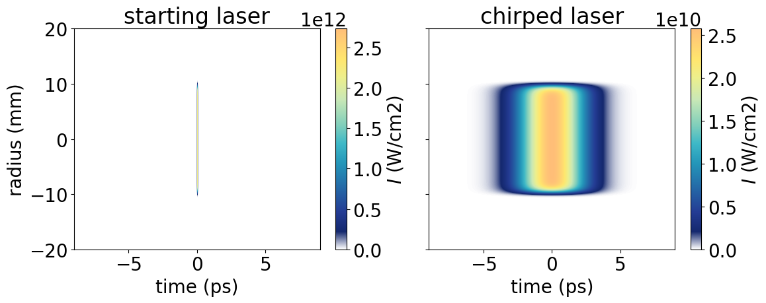
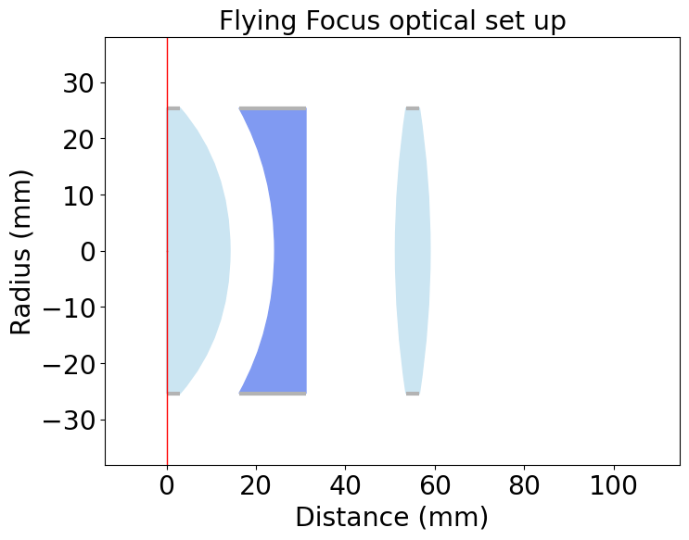
Implementing a flying focus offers complete control over the spatiotemporal shape of the laser
Chirping the laser enables the control of the focusing time for the different frequencies
An Elongated and chromatic focus is obtain by a customised optical set up

Slide 13
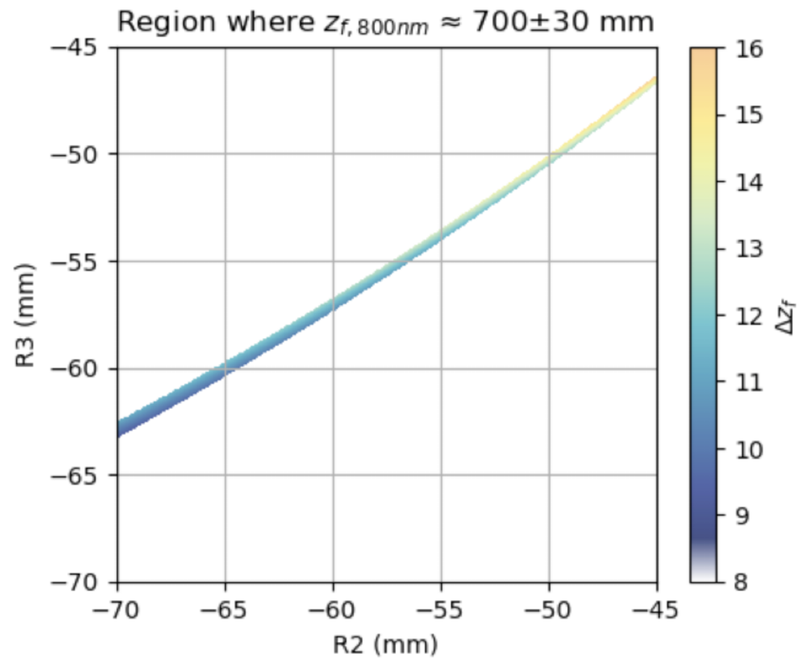
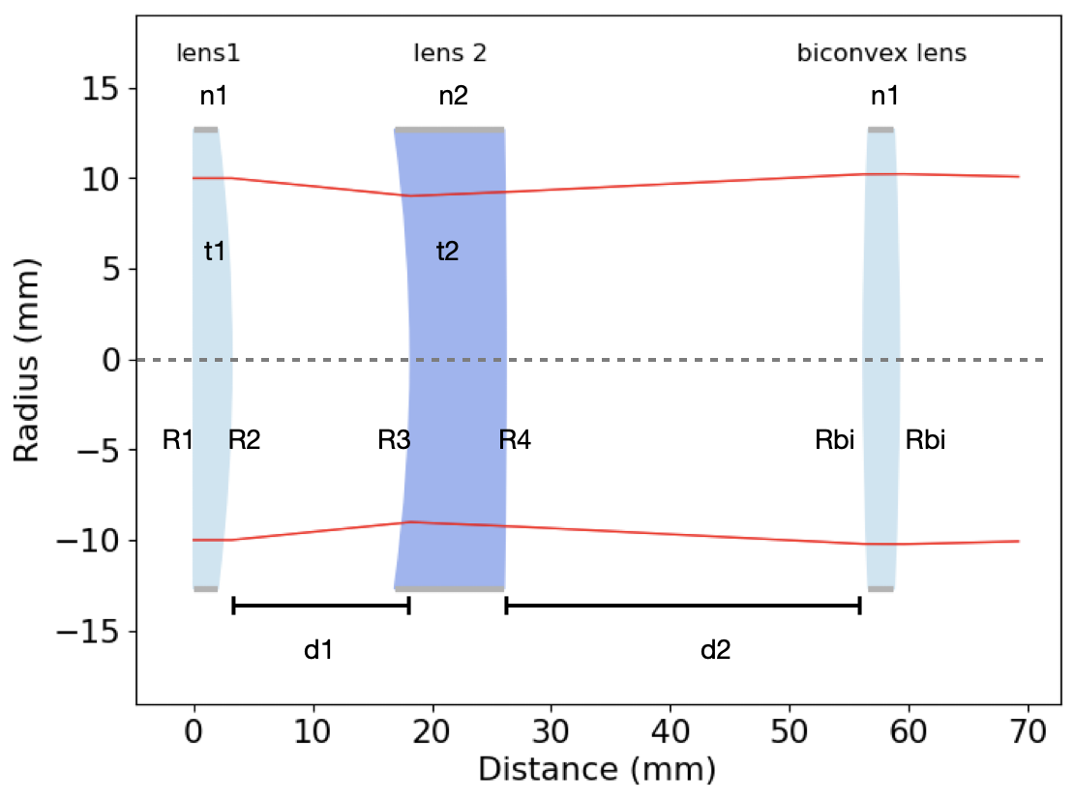
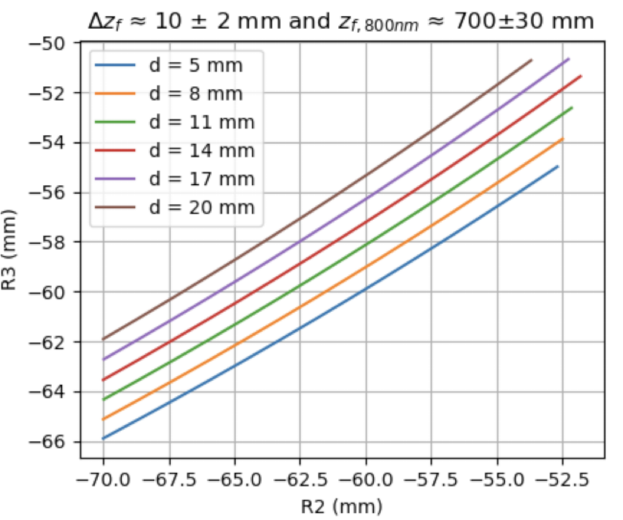
Theoretical study of the flying focus
Relation between R2 and R3
Out of 12 variables, some can be ignored
The choice of the material is made using Zemax^{[8]} and Optiland^{[9]}
Out of the remained variables, the dominant ones are R2, R3 and d1
[8] https://www.ansys.com/products/optics/ansys-zemax-opticstudio
[9] Harrison, K., & Contributors: Optiland – https://optiland.readthedocs.io

Slide 14
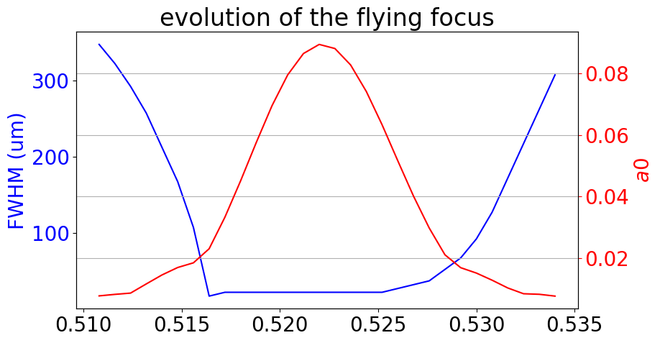
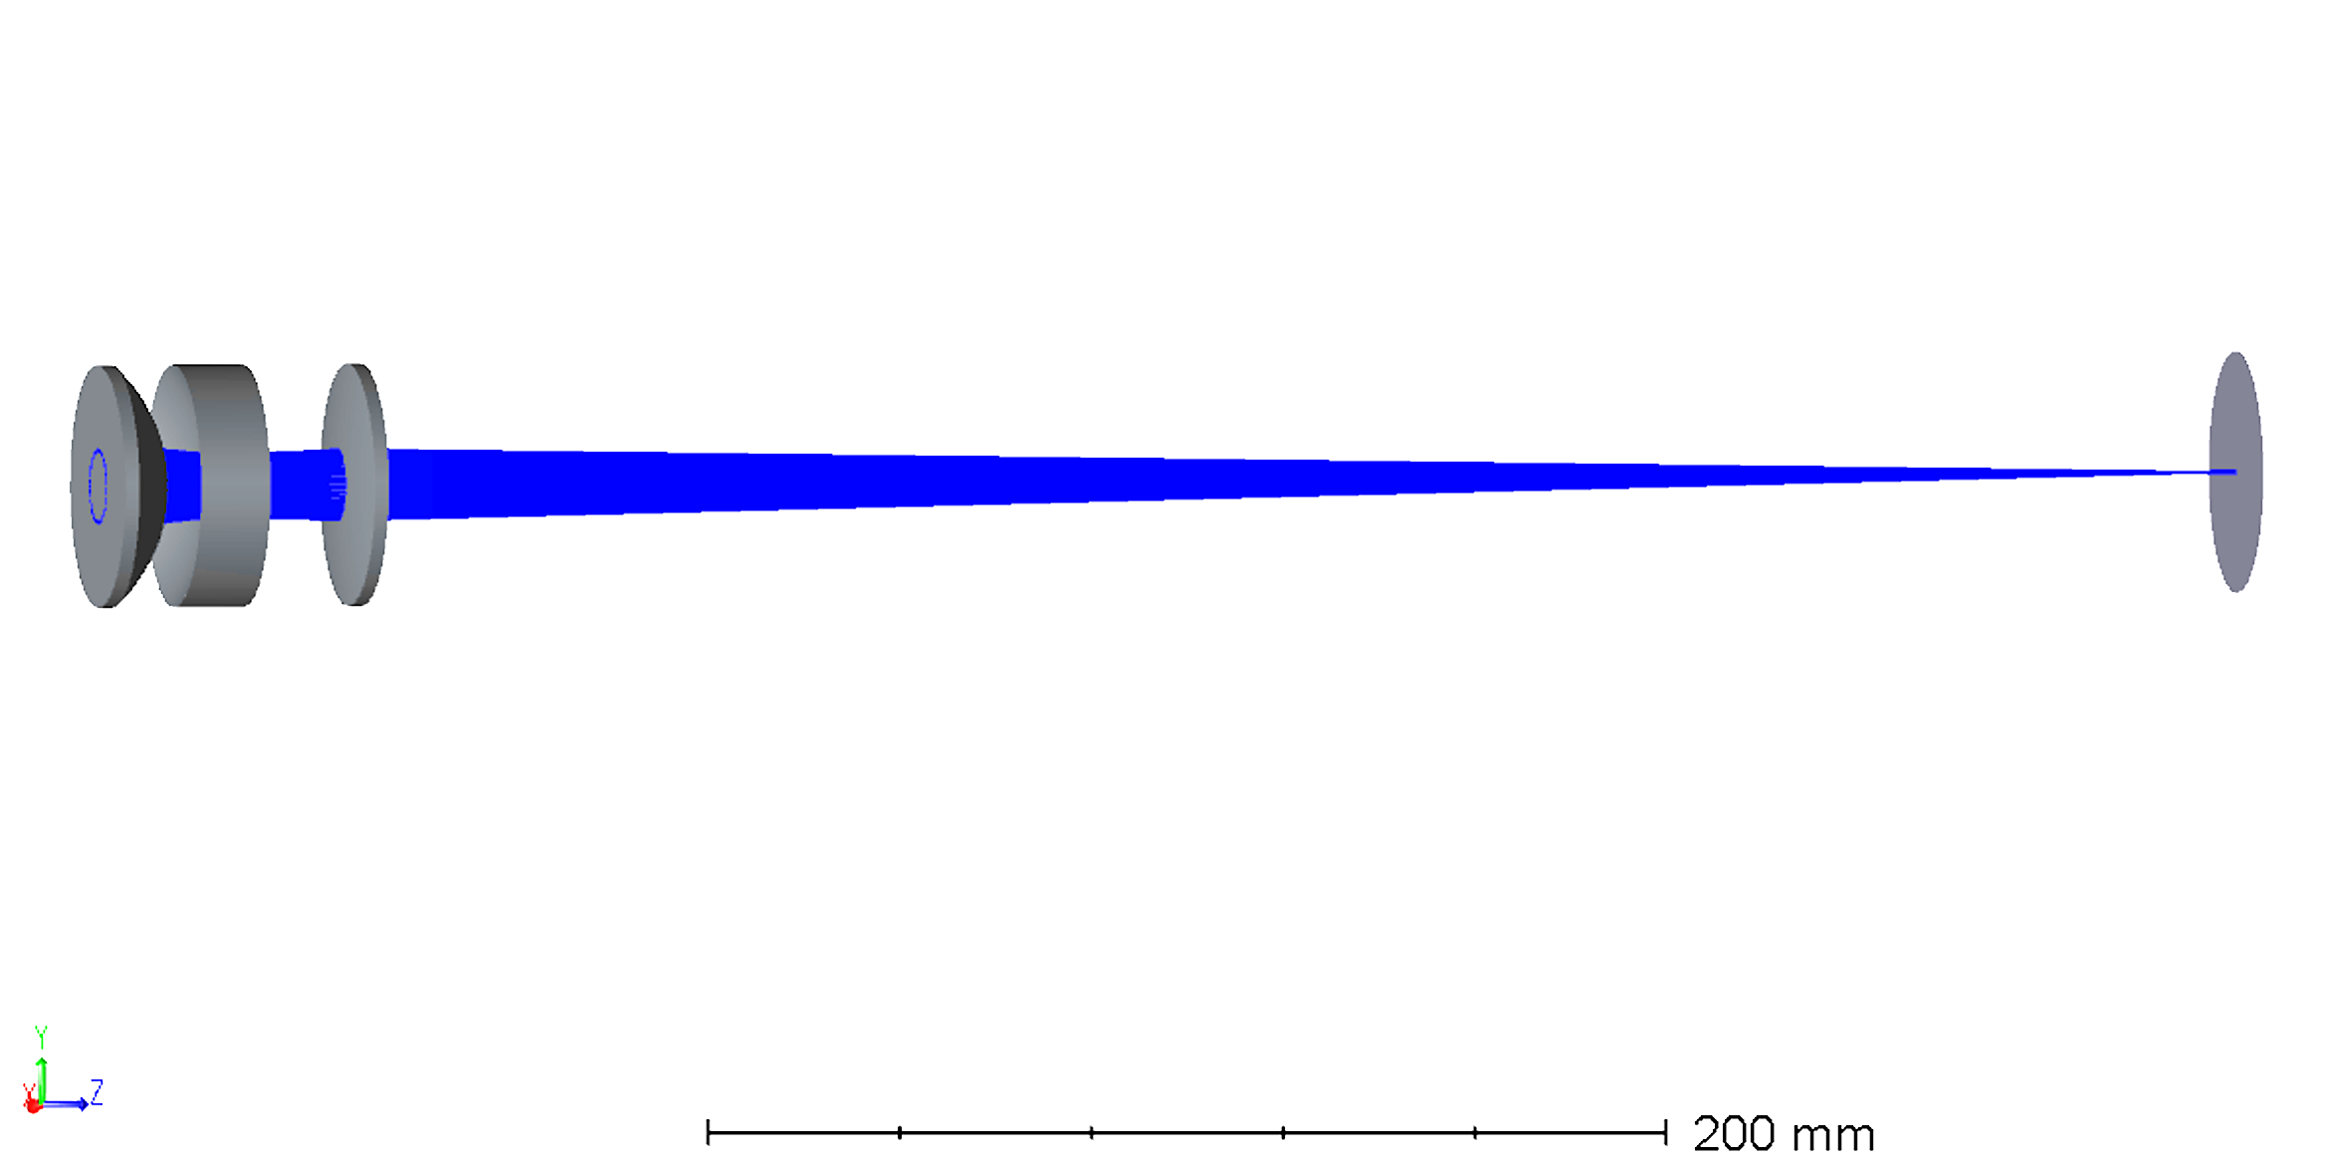
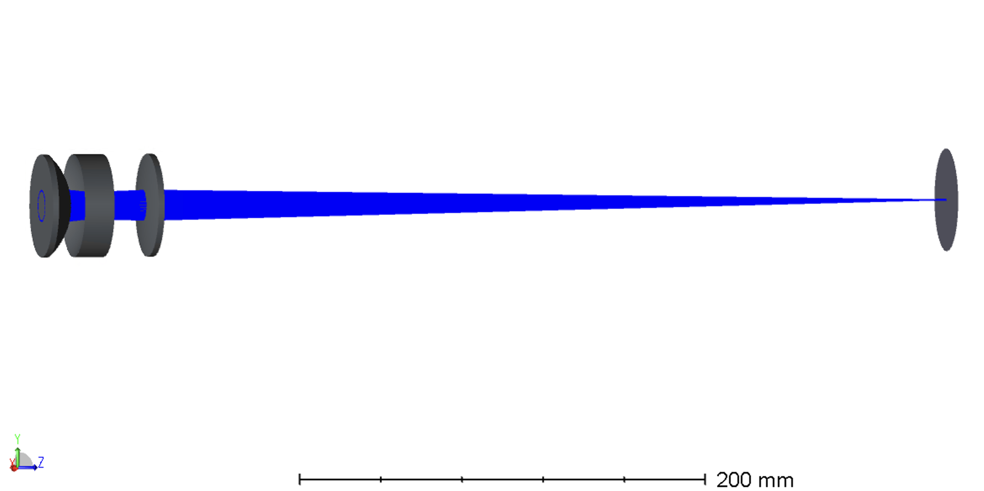
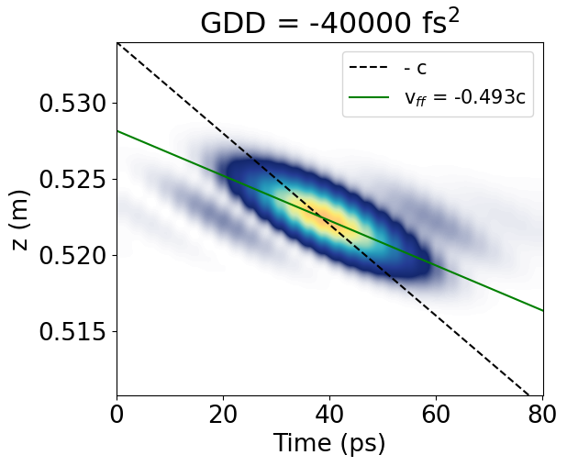

Simulations show a speed and an elongation coherent with the values required
Zemax layout
long focal region
Chromatic focus
Tunable speed with the chirp
Lower a₀, far from non linear effects
Simulations made with LASY: https://lasydoc.readthedocs.io

Slide 15
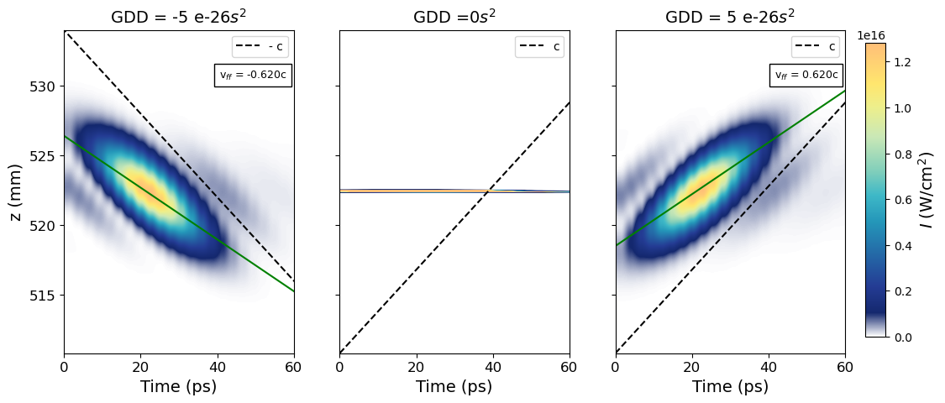
By tuning the chirp is possible to control the speed of the flying focus
GDD= -50000 fs² GDD= 0fs² GDD= 50000 fs²
Simulations made with LASY: https://lasydoc.readthedocs.io

Slide 16
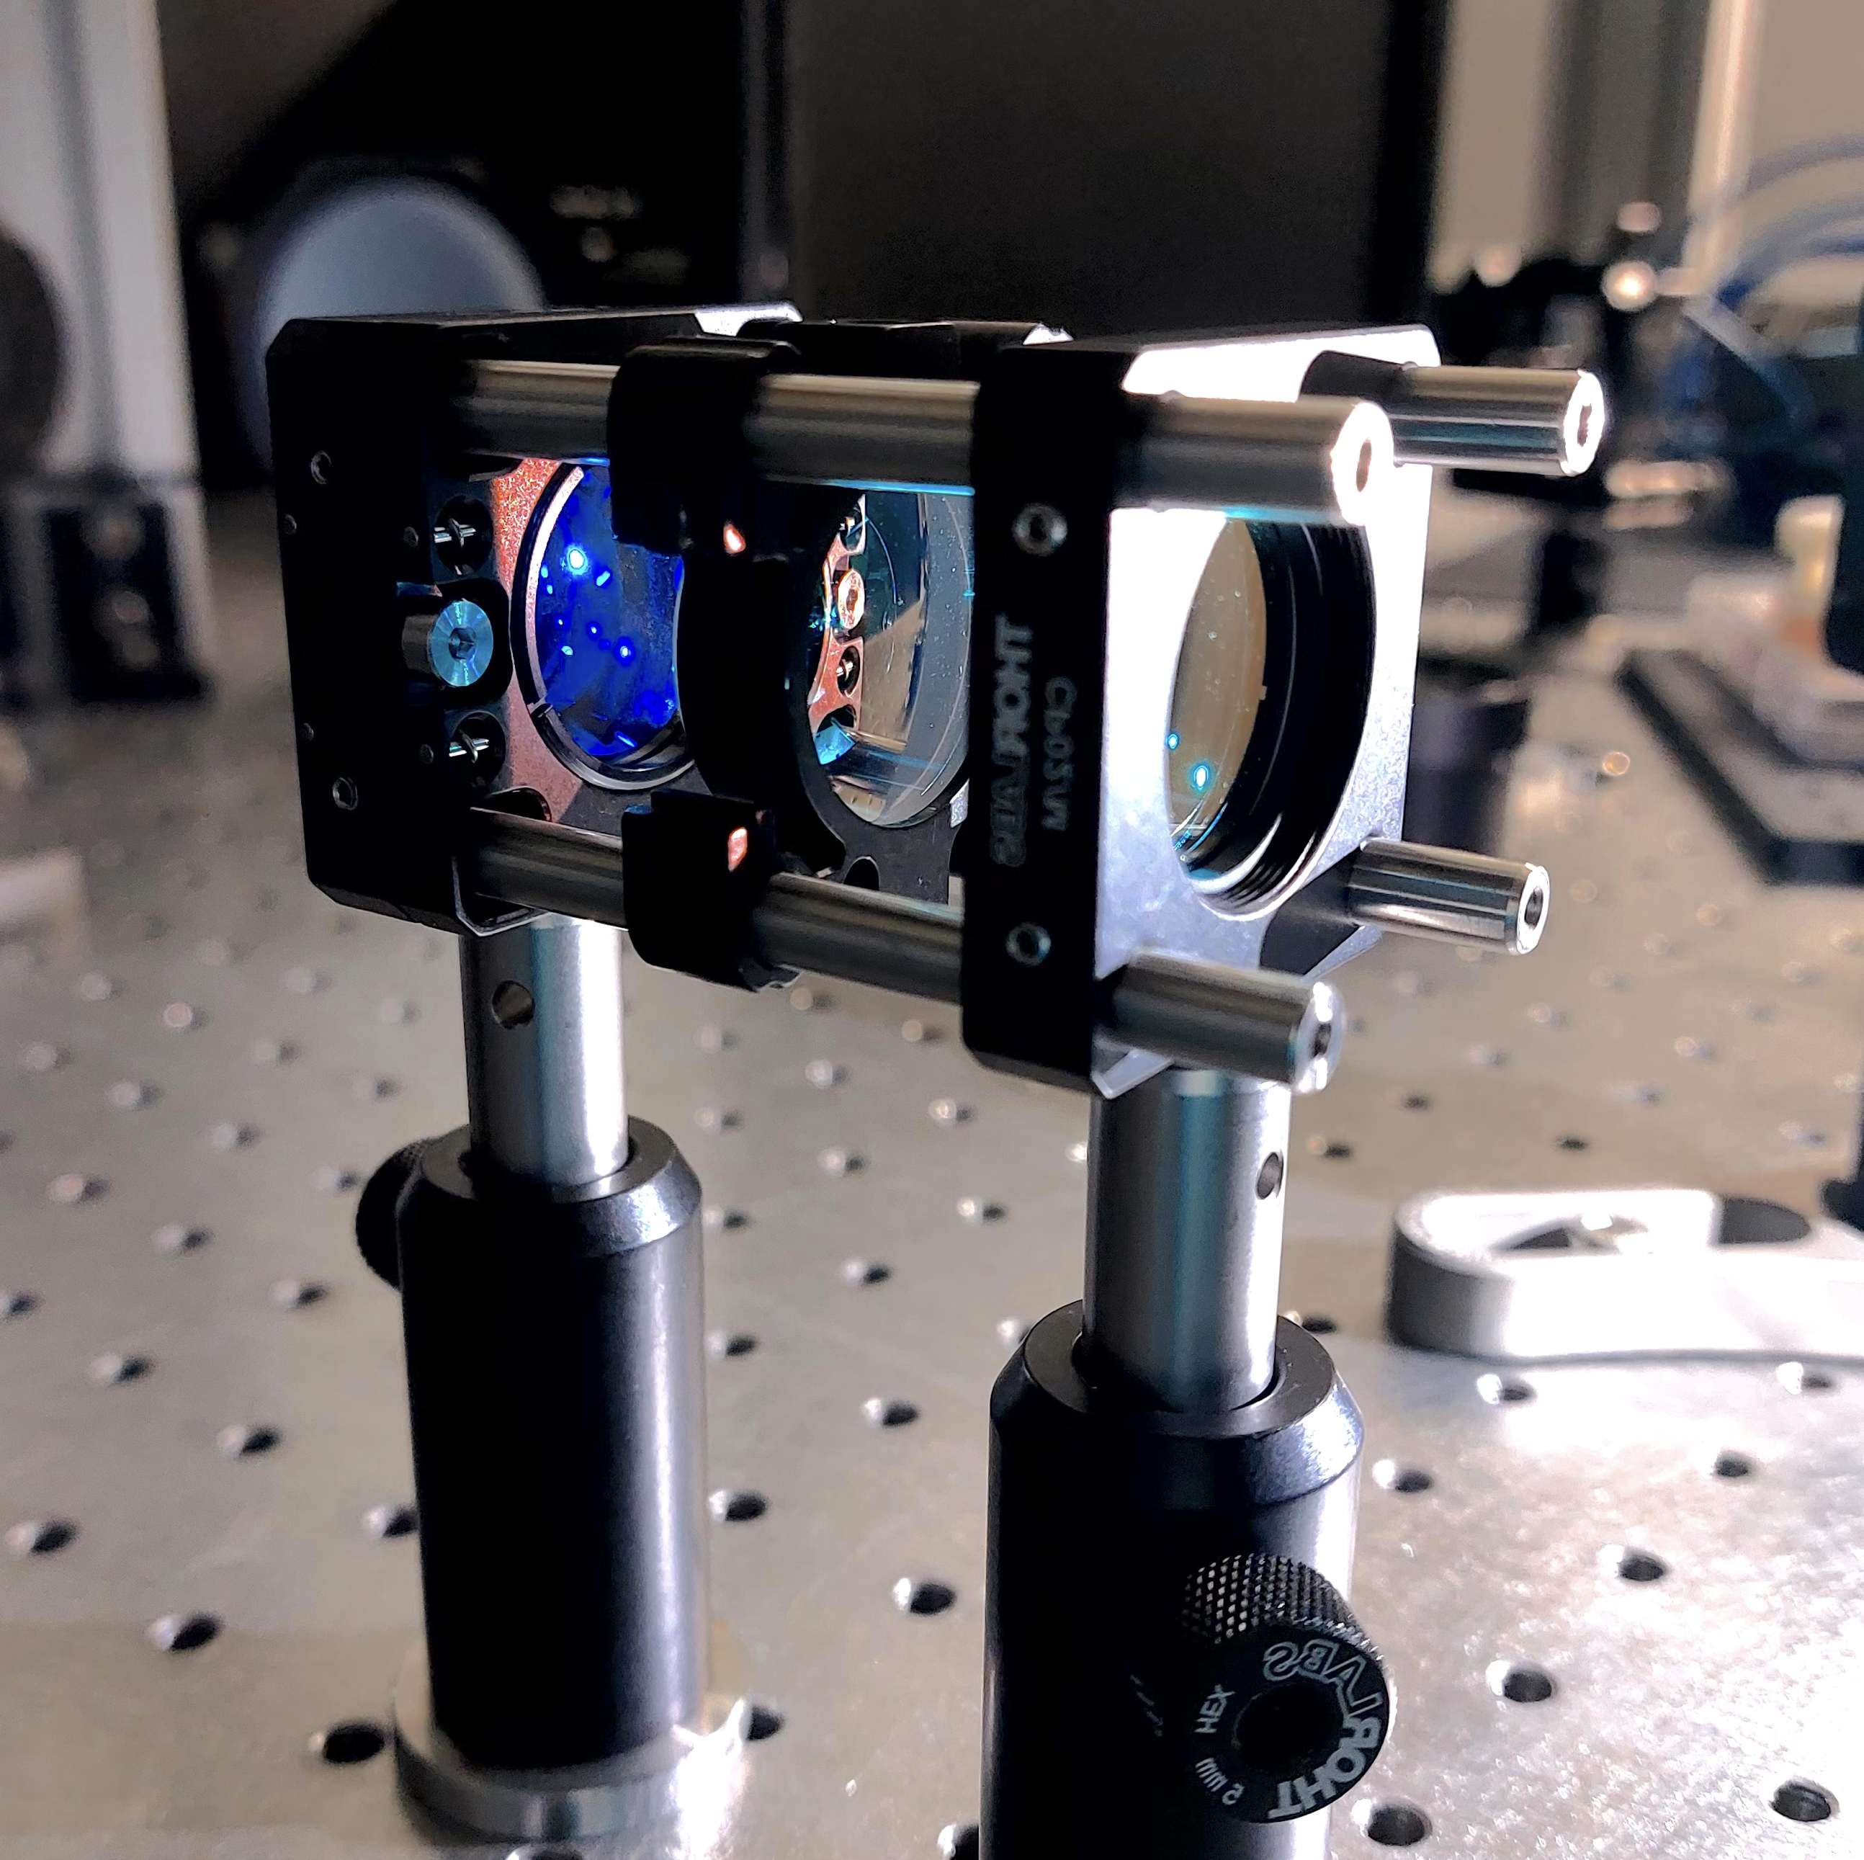
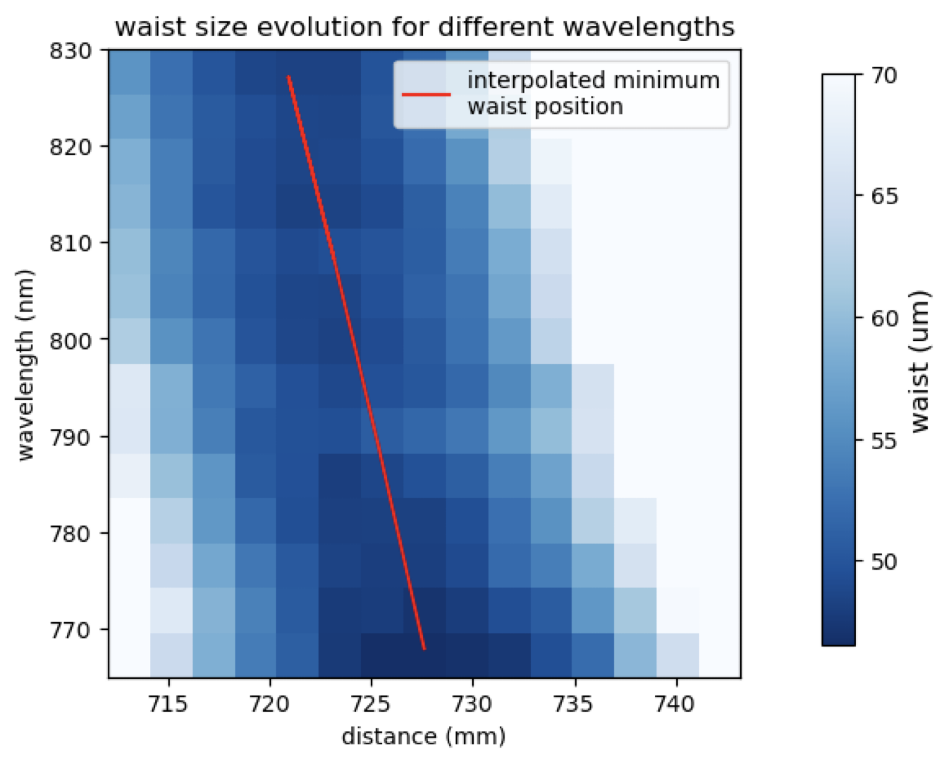
A first experimental test set up shows promising results of a flying focus implementation

Slide 17
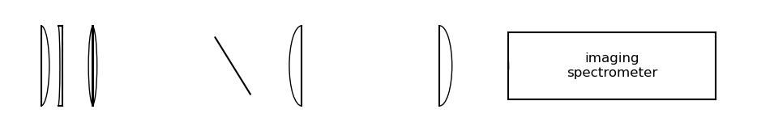
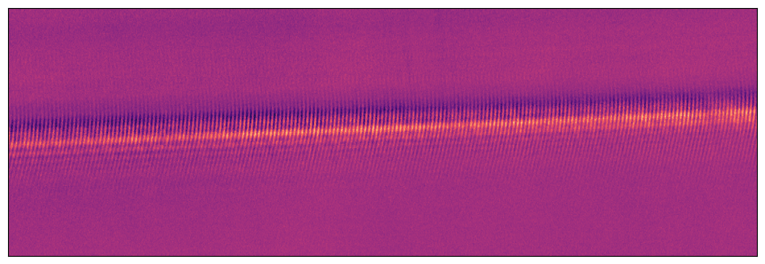
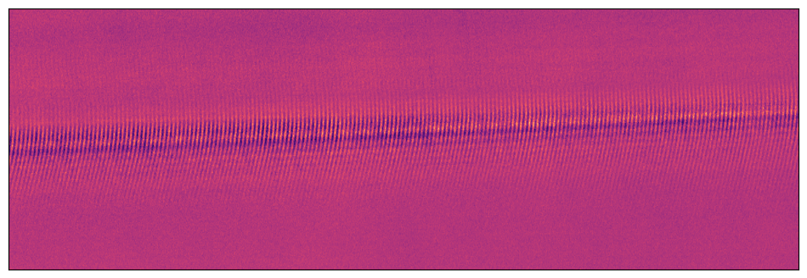
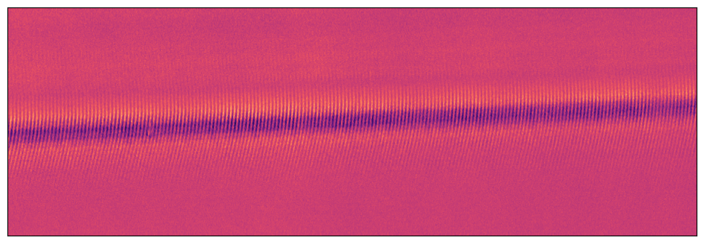


A first experimental test set up shows promising results of a flying focus implementation
Flying focus speed is calculated by interferometry of the scatter beam and a Fourier limited beam [10].
Fourier limited beam
-1 mm
Scattering beam
0 mm
+1 mm
$v_{ff}=\frac{c}{1+c\frac{dt}{dz}}≈−0.12 c$
$$λ$$
[10] S. W. Jolly et al., Opt. Express 28, 4888-4897 (2020)

Slide 18
Summary and outlook
What to take home from this talk:
The laser pulse can be tailored to have an extended chromatic focus and backwards moving intensity peak
The matching of electrons and laser can increase the overall efficiency of the ICS process
Next steps:
Testing the optical set up that will be used for APHEX
Implementing the flying focus set up in the experiment and in the simulations of the ICS process
Generate X-rays!

Slide 20
BACK UP SLIDES

Slide 21
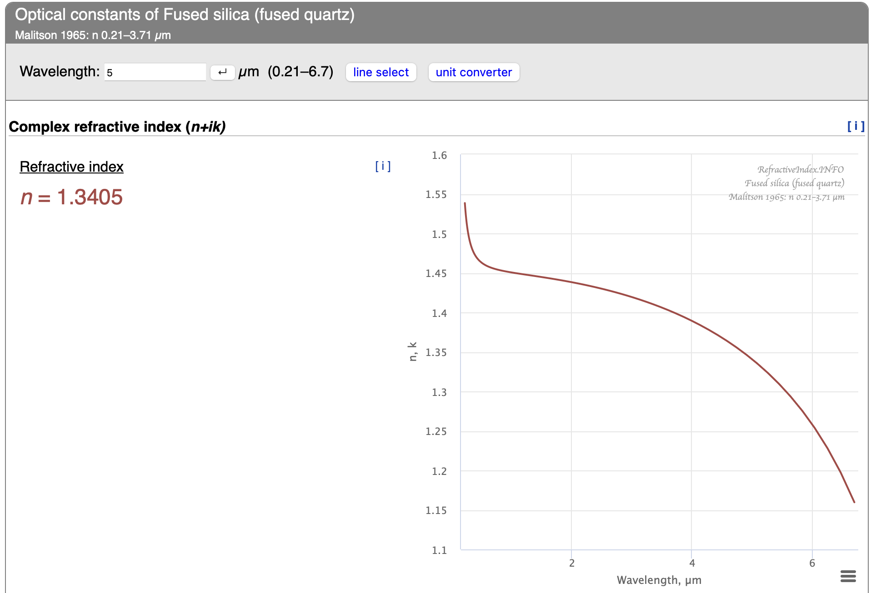
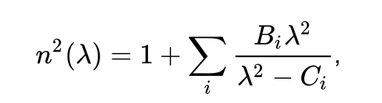
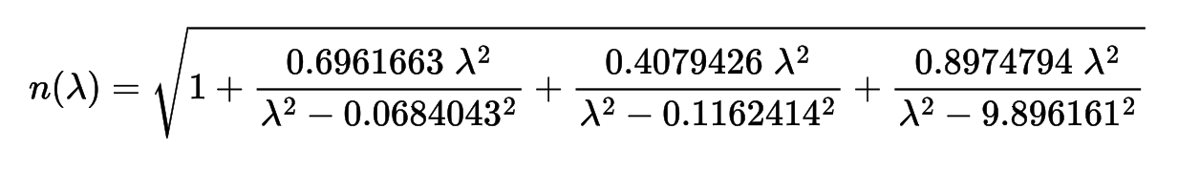
Materials selection
Sellmeier equation describes the wavelength-dependent refractive index of a transparent optical material:
[11] https://refractiveindex.info

Slide 22
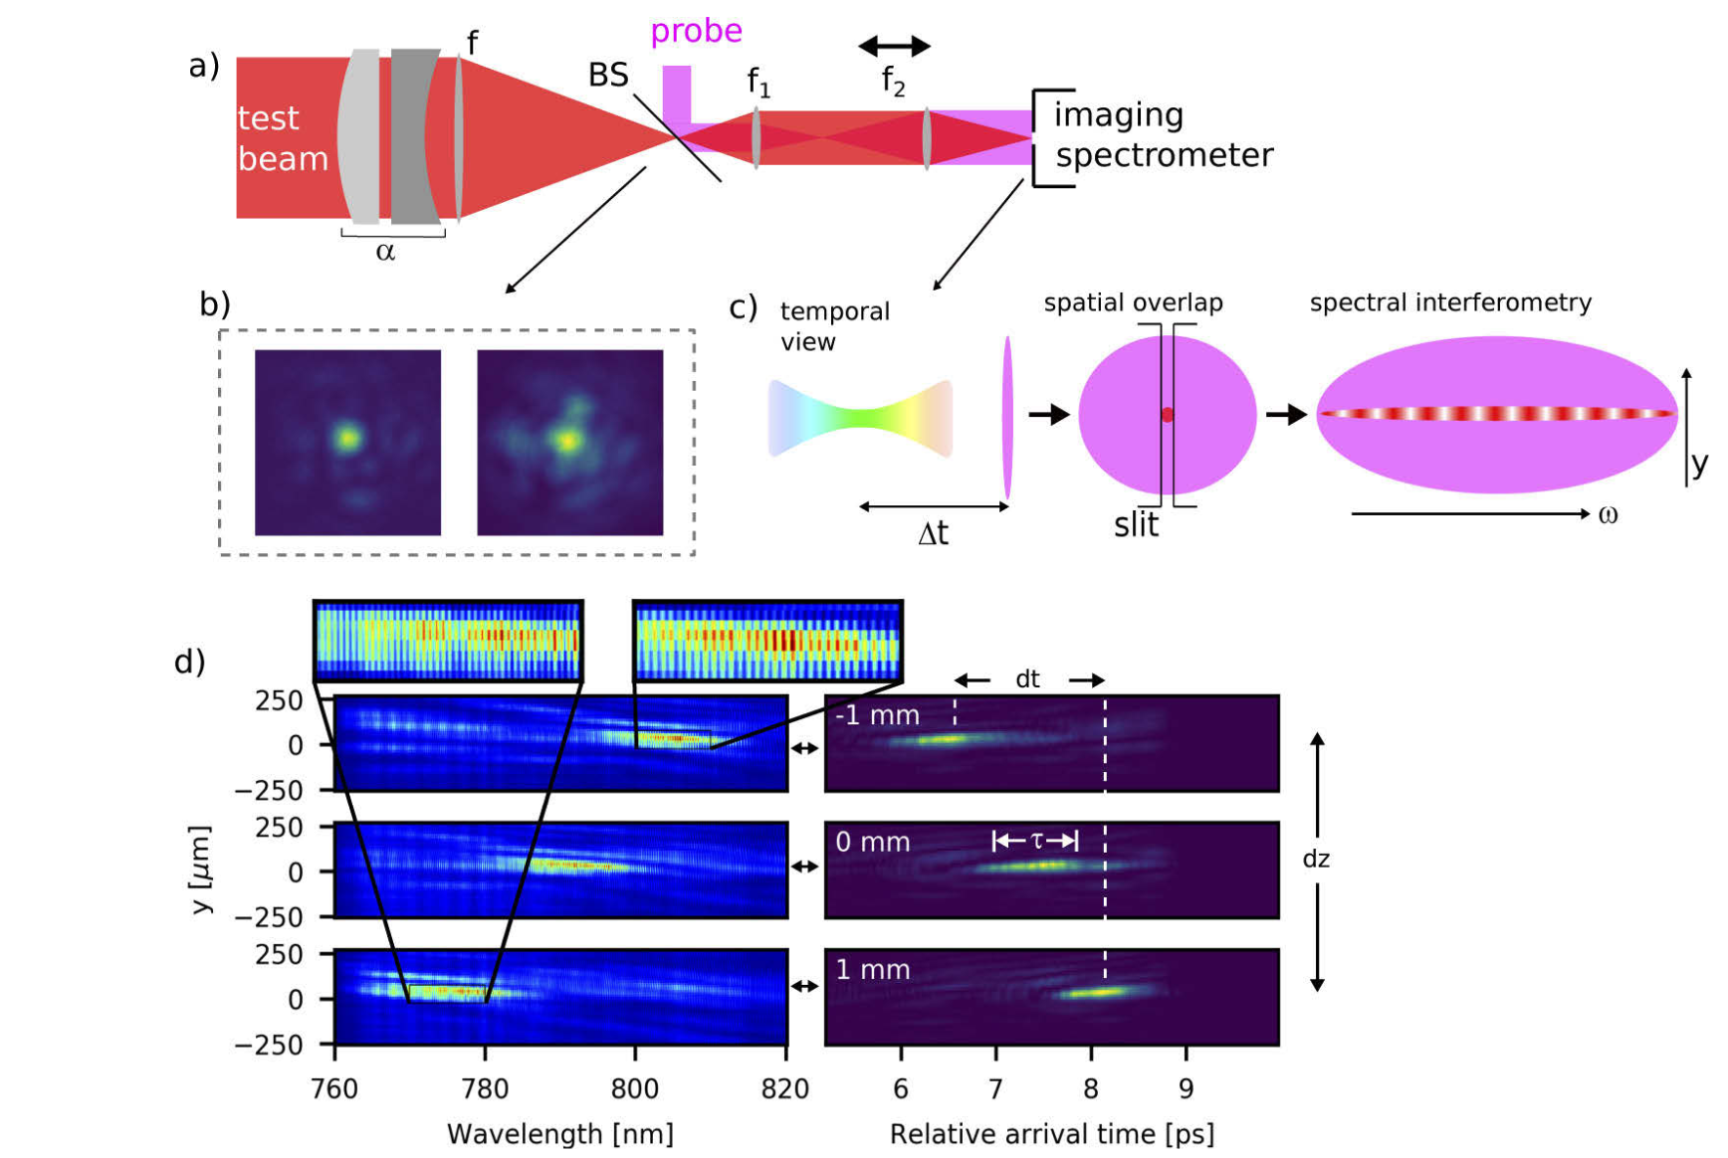
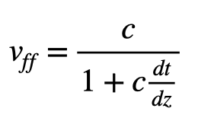
Speed measurements set up
If the arrival time does not change (dt = 0), then the test beam is traveling at the same velocity as the probe, c, but if the arrival time varies over z, then the test beam intensity is traveling at a velocity different from c [10][12].
The relative arrival time of the test to the probe for these different z positions is deviating from the imposed ∆t
[12] A. Sainte-Marie, O. Gobert, and F. Quéré, Controlling the velocity of ultrashort light pulses in vacuum through spatio- temporal couplings, Optica 4, 1298 (2017)

