Slide 1


Transverse tolerances in the plasma-wakefield acceleration blow-out regime examples from HALHF
Erik Adli, J. B. B. Chen,
P. Drobniak, O. G. Finnerud, D. Kalvik, C. A. Lindstrøm, K. N. Sjobak,
Department of Physics, University of Oslo, Norway
Erik.Adli@fys.uio.no
EAAC 2025 - The European Advanced Accelerator Conference, Italy
September 24, 2025

Slide 2
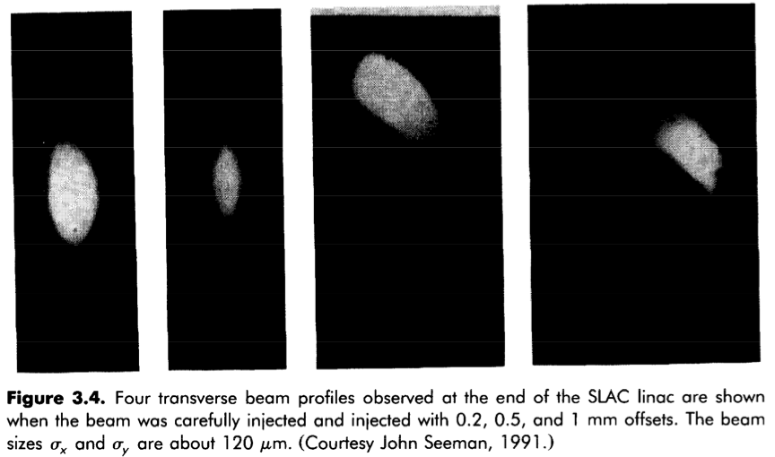
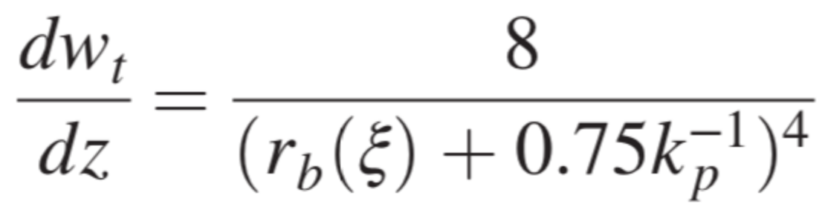
Transverse wake and BBU
MB: main beam
DB: drive beam
Metal and dielectric structures, and hollow channel plasmas: intrabeam wake for DB, MB, multi-bunch wake DB to MB. Leads to the beam-break-up instability, BBU.
SLAC-
linac
Δx₂
Δx₁
Important consideration in RF-collider design. CLIC:
Design limit for transverse single bunch wake: 100 kV/pC/m/m
Pulse charge is spread into multi-bunch trains for BBU-mitigation
Constraints the CLIC wake-to-RF efficiency to ∼30%
MB: main beam
DB: drive beam
The PWA-BBU must also be taken into account in PWA-collider design.
Stupakov-model: dipole-component of wake follows roughly 1/a⁴ scaling, many order more severe in PWA than RF structures (a∼1 mm)
PWA blow-out: DB creates the channel, suppresses intrabeam DB wake, as well as multi-bunch wake.
G. Stupakov, PR AB 21, 041301 (2018)
Δx
However, intrabeam wake for MB is not suppressed -> PWA-BBU

Slide 3
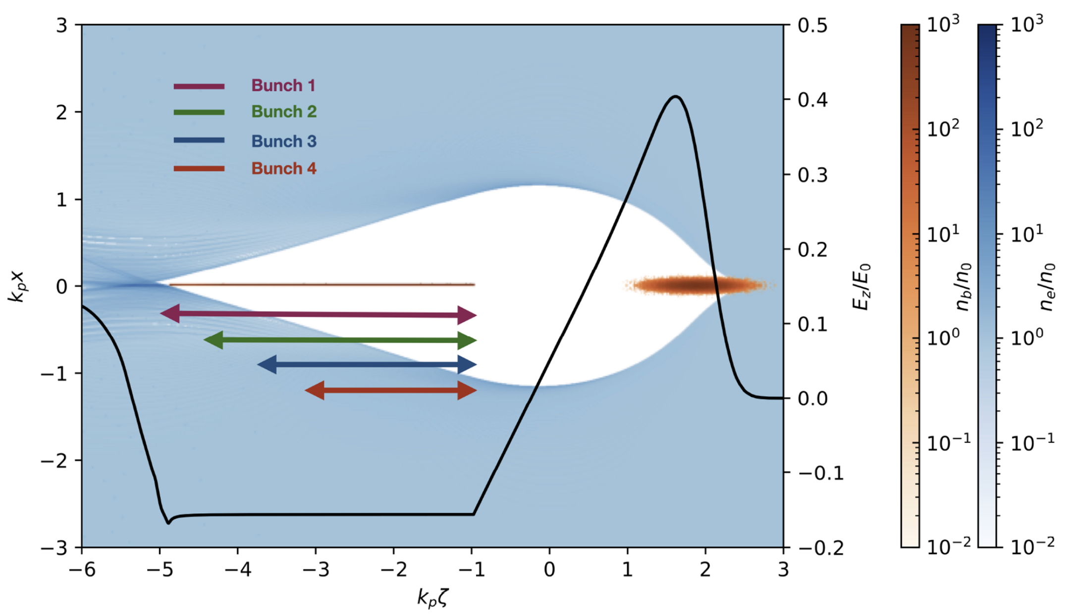
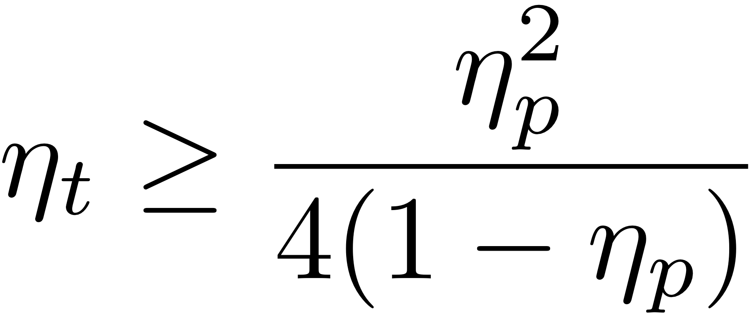
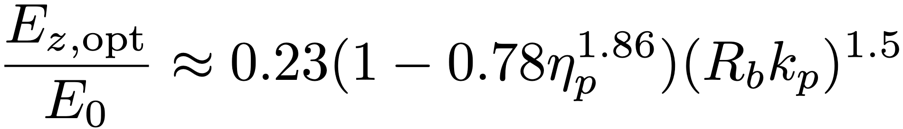
Efficiency-instability: verification
Details: see talk Ole Gunnar Finnerud,
Wednesday 1720
η_{p}: efficiency
η_{t}: deflecting field
V. Lebedev, A. Burov, and S. Nagaitsev, PR AB 20, 121301 (2017)
Mitigation
by ion motion
Mitigation of instability:
lower efficiency
increase energy spread
low plasma density
optimal phasing
some ion motion
Finnerud, O. G., Lindstrøm, C. A., & Adli, E.
Parametric mapping of the efficiency–instability relation in plasma-wakefield accelerators.
Phys. Rev. Accel. Beams, 28(7), 071301 (2025)

Slide 4
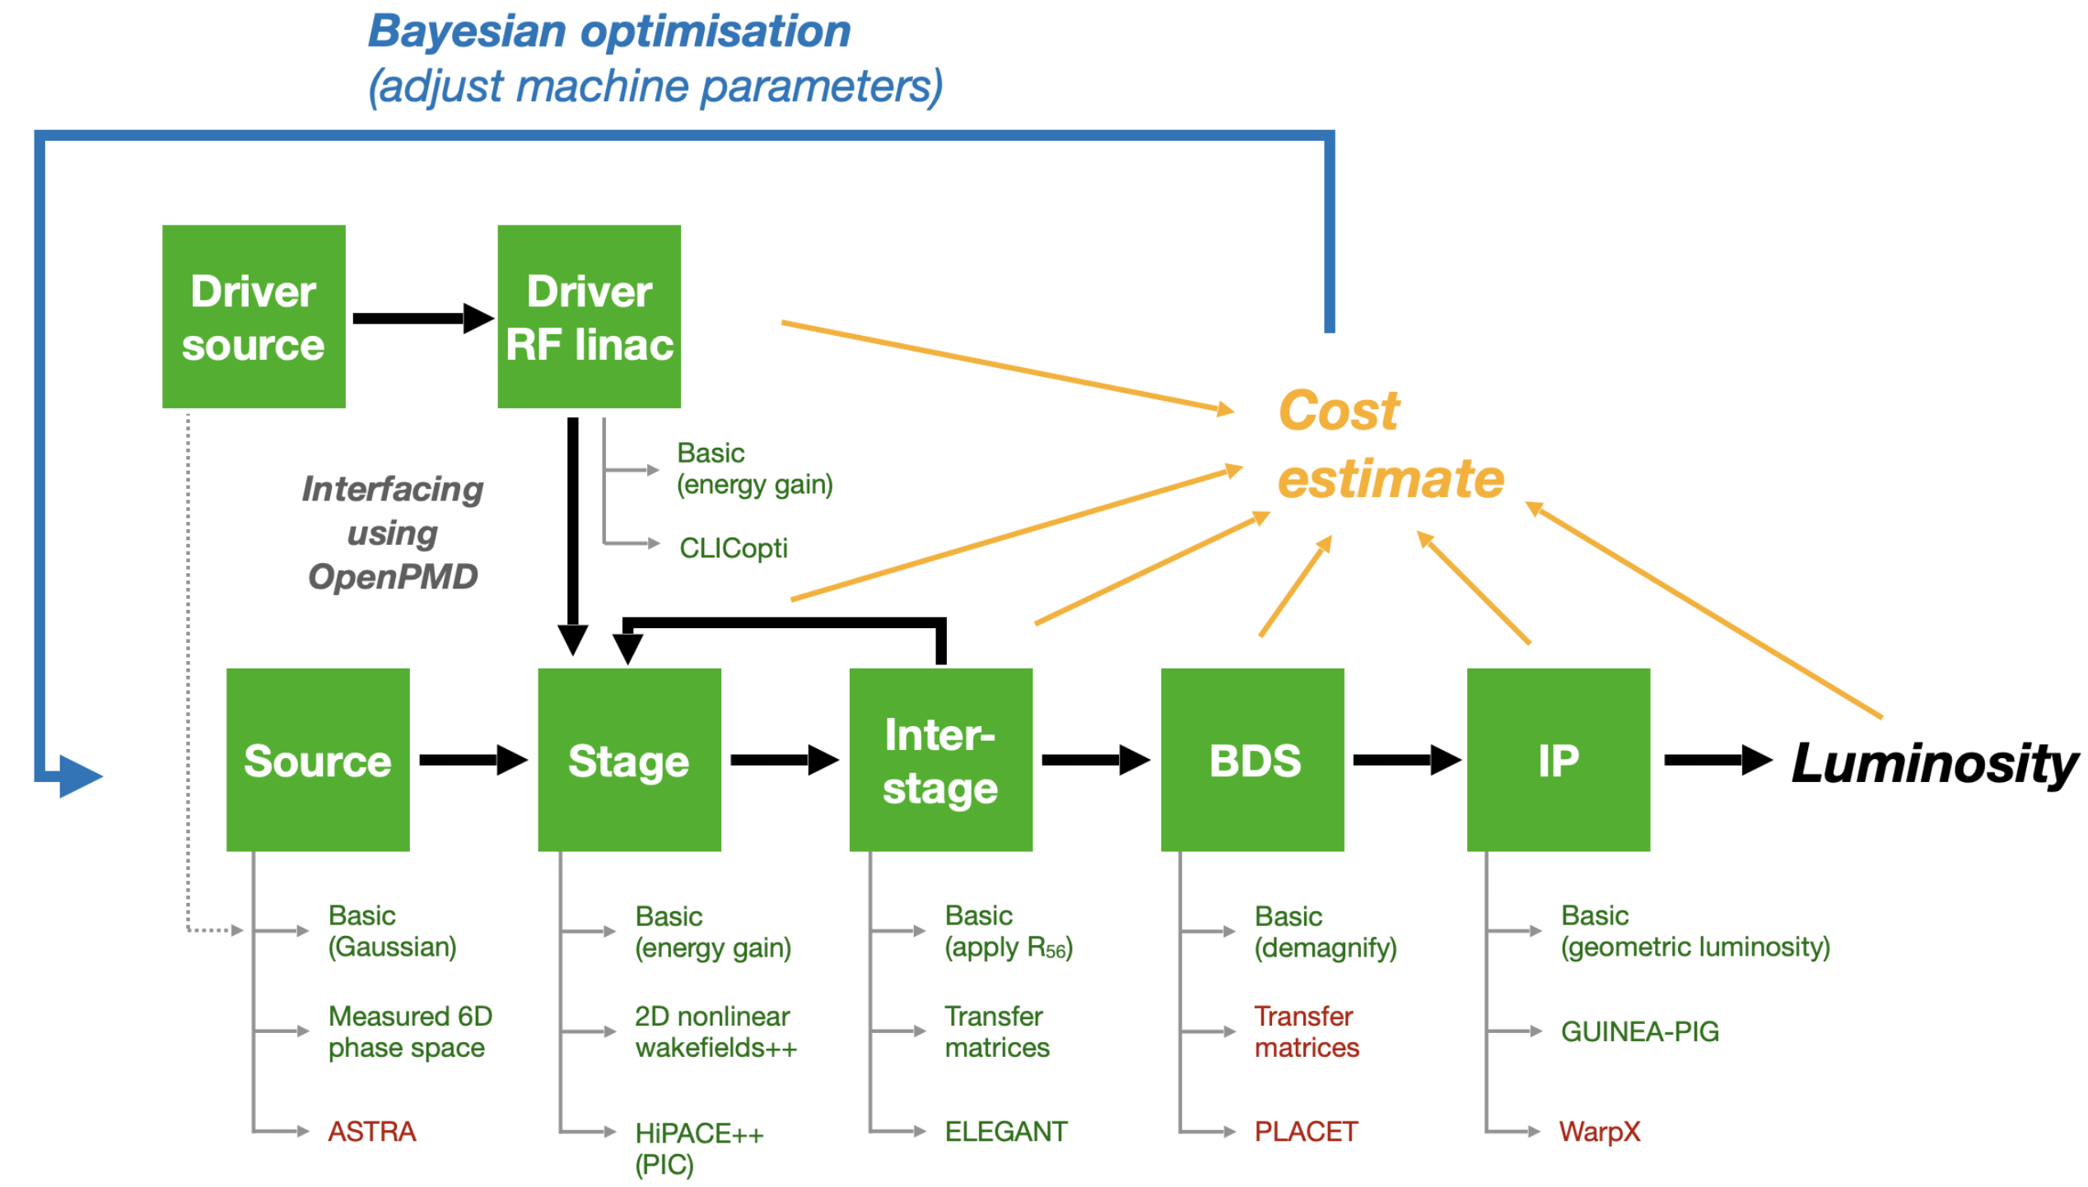
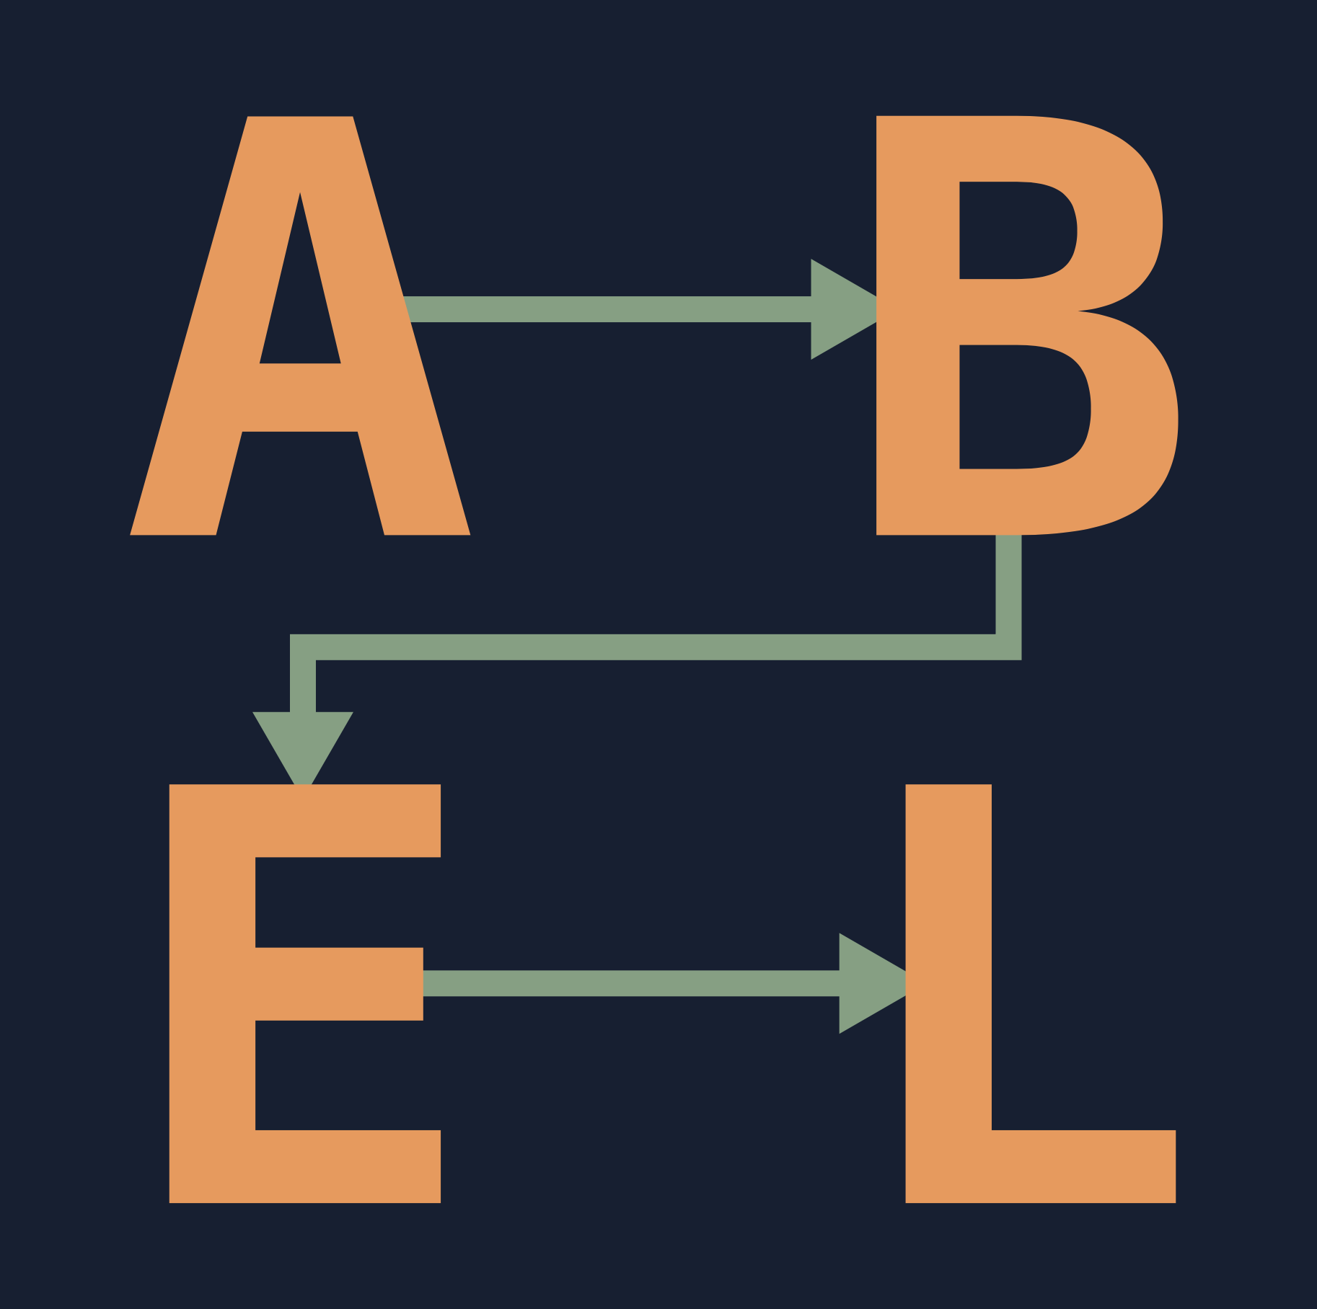
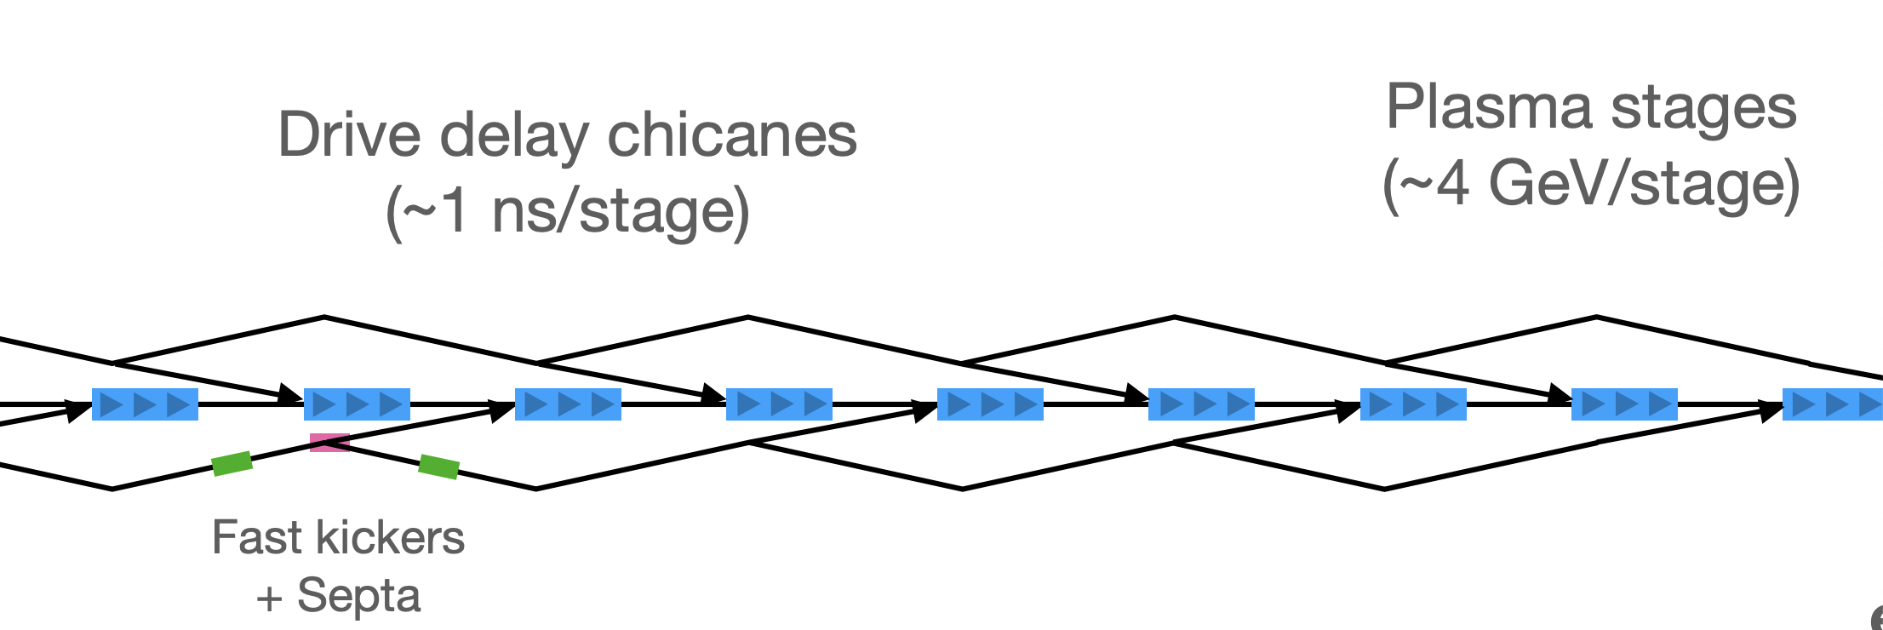
Translation into tolerances?
Random drive-beam jitter applied at each injection
Requires start-to-end simulations of the PWA-linac
Parameter scans, statistics -> fast, simplified models -> ABEL
ABEL: talk Ben Chen, Tuesday 1620
+ tutorial Thu lunchtime++ in Elena
Δx
We have performed tolerances studies in ABEL as follows:
the machine starts perfectly aligned
the drive beam has a certain vertical jitter-emittance
At the injection into each plasma cell, a random jitter-emittance value is converted into a drive-beam offset and angle
Ion motion can be turned off or on
The jitter-emittance level is increased until the emittance growth increases above a certain threshold—here taken to be a factor two—yielding a tolerance level for this type of jitter

Slide 5
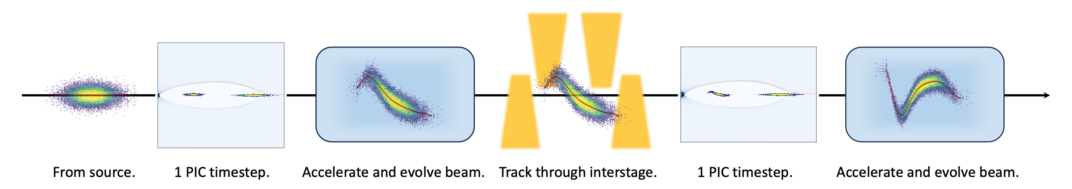
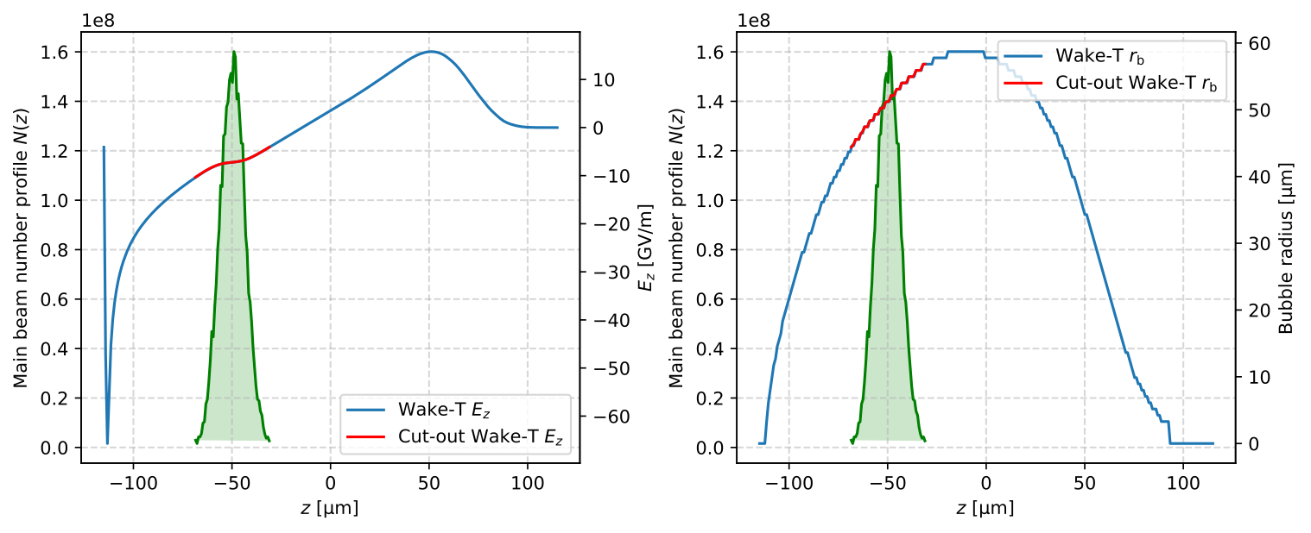


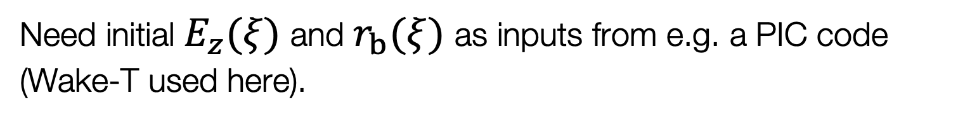

ABEL model: transverse wake
Wakefield formalism: simplified model - as has been done in CLIC, to study the limitations on charge and efficiency.
Ansatz: for small offsets/perturbations, transverse instability in PWFA should behave similarly to BBU in conventional accelerators.
Outline for start-to-end simulation processes using simplified transverse instability model.
Transverse intra-beam wakefield (G. Stupakov):
  $$𝒲_{x}(ξ,s)=−\frac{2e}{πε_{0}}\overset{ξ}{\underset{ξ_{H}}{∫}}\frac{ξ^{′}−ξ}{(r_{b}(ξ^{′})+αk_{p}^{−1})^{4}}Θ(ξ^{′}−ξ)λ(ξ^{′},s)x(ξ^{′},s)dξ^{′}$$
Combine with Deng et al. equations for radiation reaction:
  $\frac{1}{c}\frac{du_{x}}{dt}≈−\frac{1}{2}k_{p}^{2}x−\frac{e}{m_{e}c^{2}}𝒲_{x}−\frac{1}{2}k_{p}^{2}cτ_{R}u_{x}\left(1+\frac{1}{2}k_{p}^{2}γ(x^{2}+y^{2})\right)$
  $\frac{1}{c}\frac{du_{z}}{dt}≈k_{p}\frac{E_{z}}{E_{0}}−\frac{1}{4}k_{p}^{4}cτ_{R}γ^{2}(x^{2}+y^{2})$
  $\frac{dx}{dt}≈\frac{u_{x}}{u_{z}}c$
$s$: beam location.
$ξ^{′}$: long. coordinate of driving particle.
$ξ$: long. coordinate of reference particle.
$ξ_{H}$: long. coordinate of beam head.
$α$: numerical factor ~1.
$k_{p}^{−1}$: plasma skin depth.
$Θ(ξ)$: Heaviside step function.
$λ(ξ,s)$: long. beam number density.
$x(ξ,s)$: particle transverse offset.
$u(ξ,s)=p/m_{e}c$: normalised $e^{−}$ momentum.
$$τ_{R}=2r_{e}/3c$$
$E_{0}=m_{e}cω_{p}/e$: wavebreaking field.
Need initial $E_{z}(ξ)$ and $r_{b}(ξ)$ as inputs from e.g. a PIC code (Wake-T used here).
Model thoroughly benchmarked with PIC-codes (QuickPIC, HiPACE++)
J. B.B. Chen, PhD Thesis, UiO (2021)
2024-10-05 | Ben Chen | HALHF Workshop 3-8 October 2024
Page

Slide 6
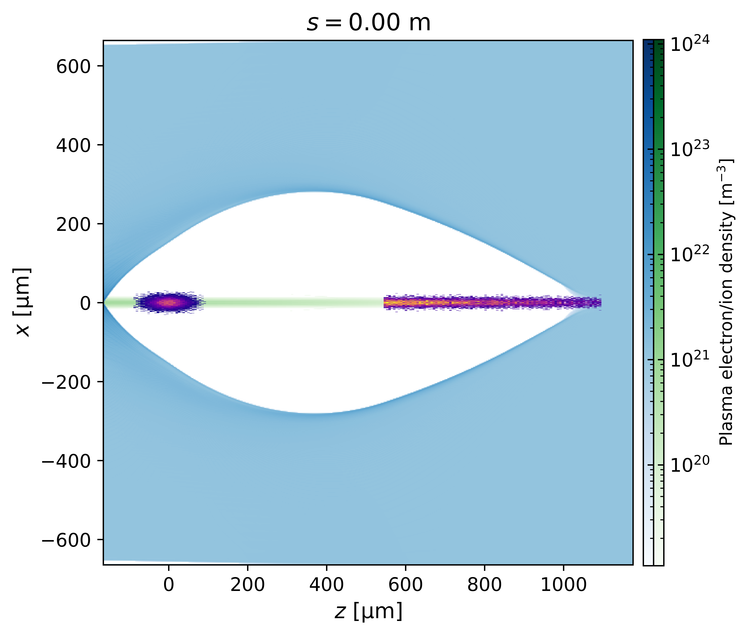
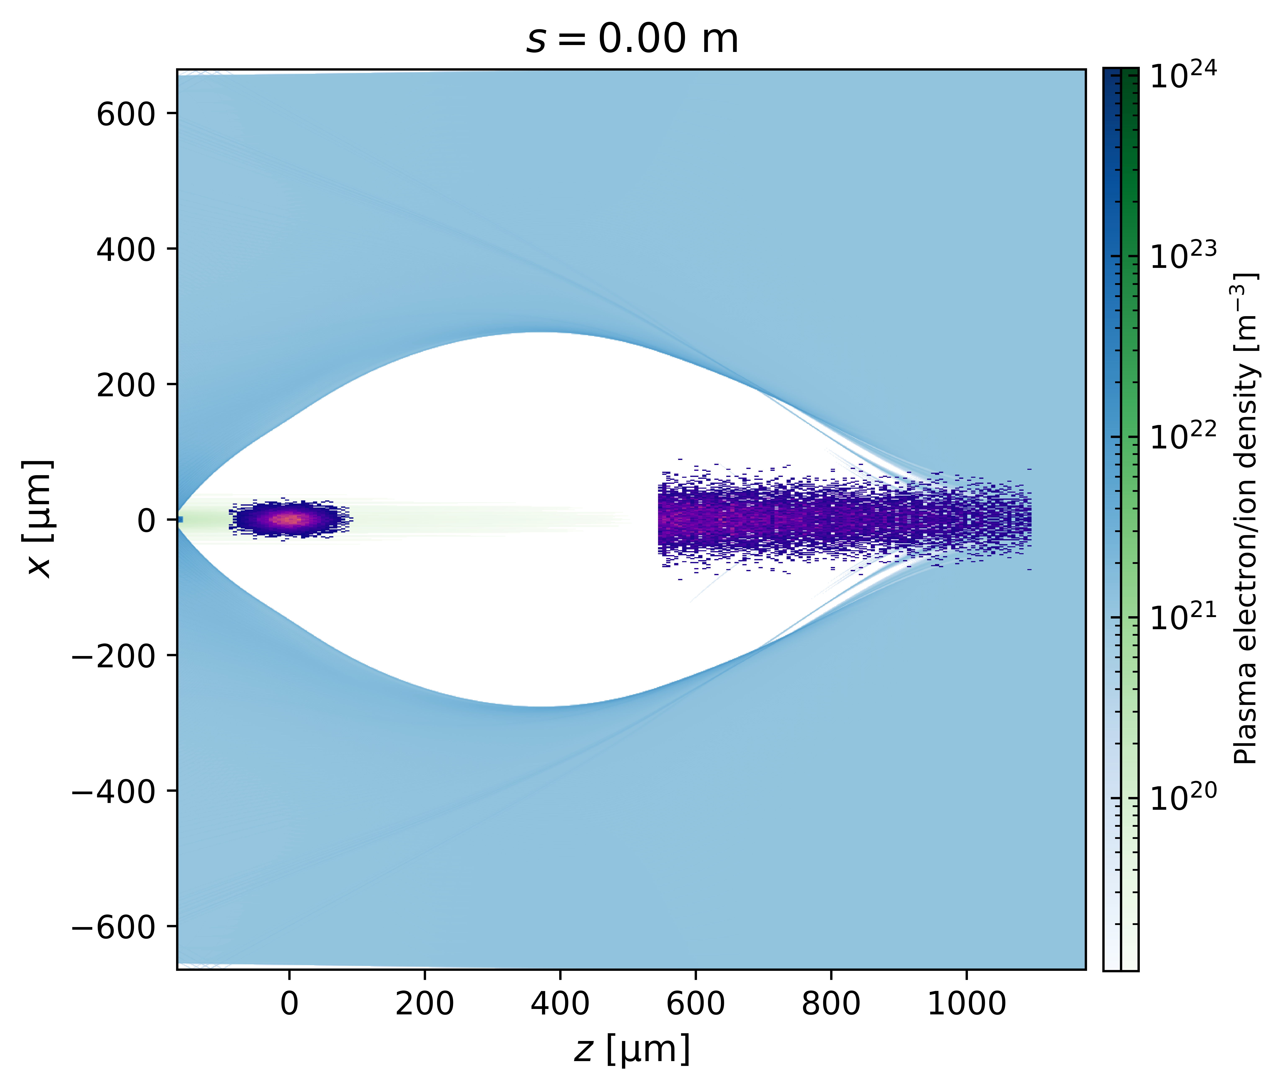
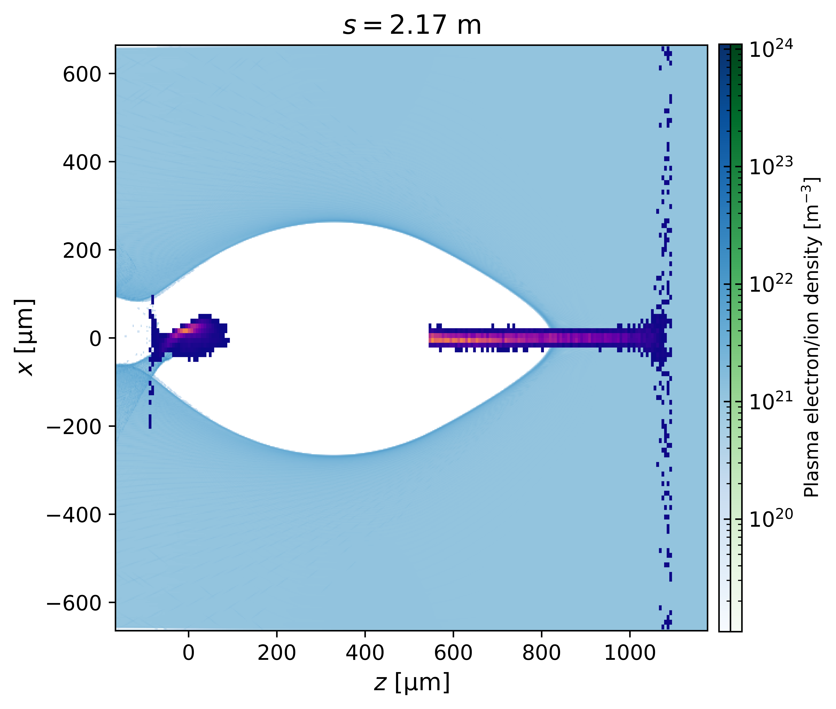
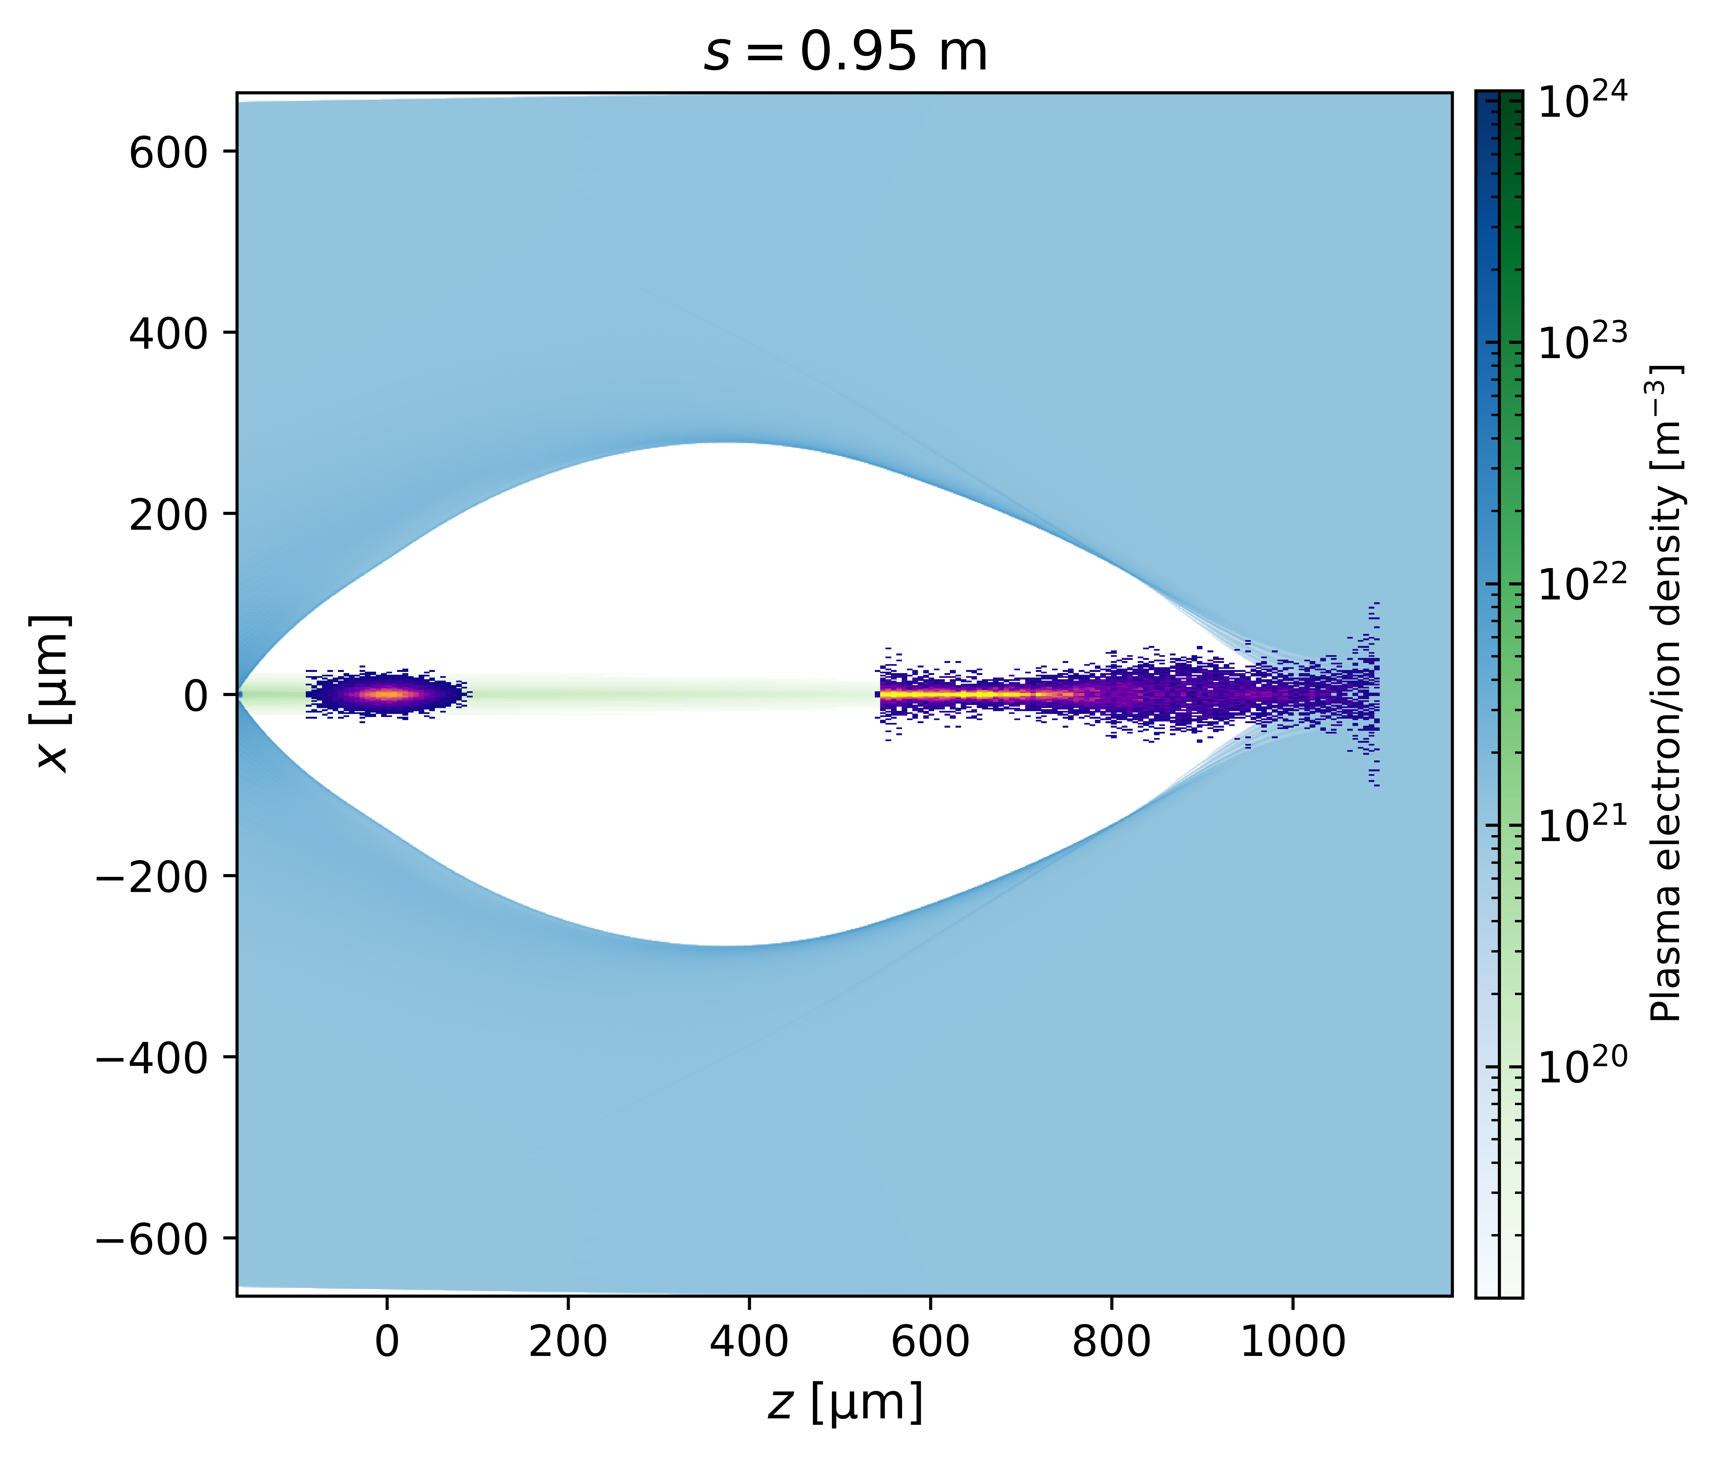
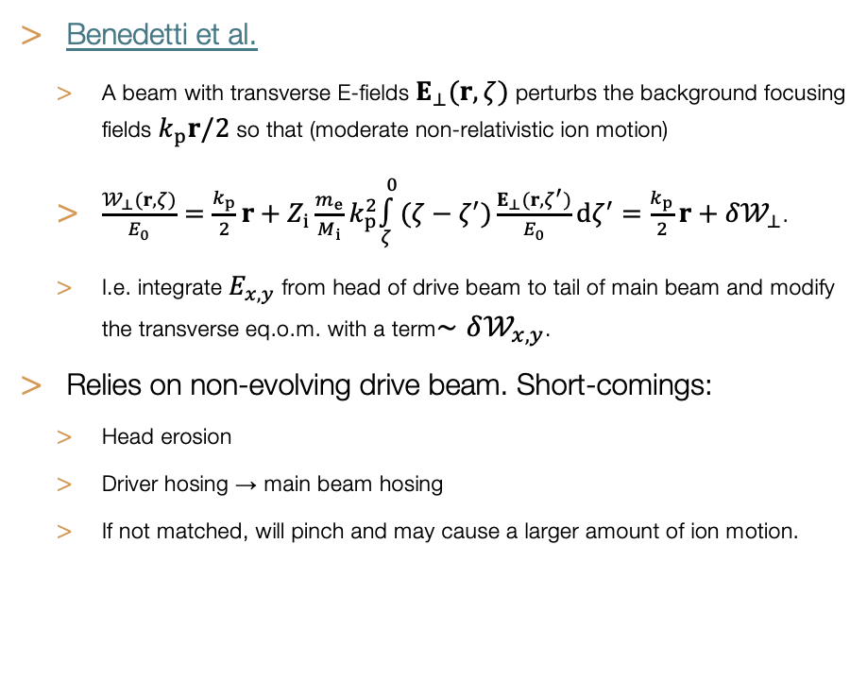
ABEL model: ion motion
Simplified model for non-relativistic ion motion
HiPACE++
Benedetti et al.
  A beam with transverse E-fields $E_{⊥}(r,ζ)$ perturbs the background focusing fields $k_{p}r/2$ so that (moderate non-relativistic ion motion)
  $\frac{𝒲_{⊥}(r,ζ)}{E_{0}}=\frac{k_{p}}{2}r+Z_{i}\frac{m_{e}}{M_{i}}k_{p}^{2}\overset{0}{\underset{ζ}{∫}}(ζ−ζ^{′})\frac{E_{⊥}(r,ζ^{′})}{E_{0}}dζ^{′}=\frac{k_{p}}{2}r+δ𝒲_{⊥}$.
  I.e. integrate $E_{x,y}$ from head of drive beam to tail of main beam and modify the transverse eq.o.m. with a term$∼δ𝒲_{x,y}$.
Relies on non-evolving drive beam. Short-comings:
  Head erosion
  Driver hosing → main beam hosing
  If not matched, will pinch and may cause a larger amount of ion motion.
2024-10-05 | Ben Chen | HALHF Workshop 3-8 October 2024
Page

Slide 7
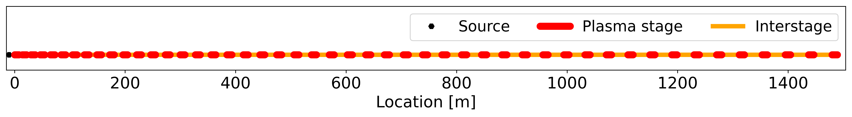
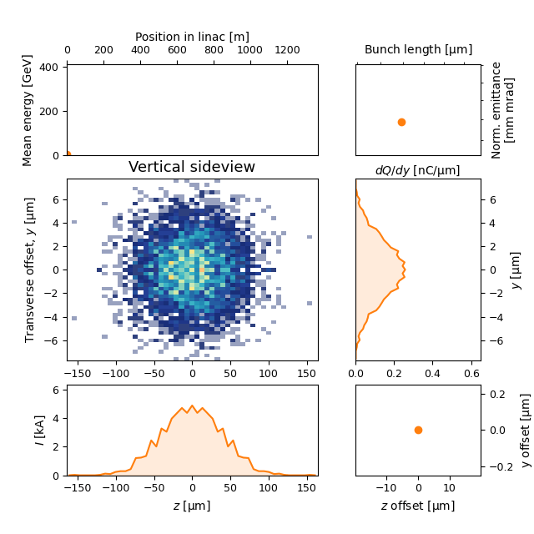
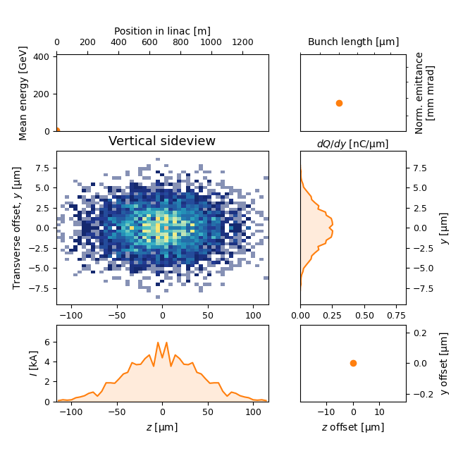
Details HALHF: see talk Richard D’Arcy
Monday 1200
ABEL simulation of HALHF
With wakefields
NO ion motion :
With wakefields
With ion motion :
7

Slide 8
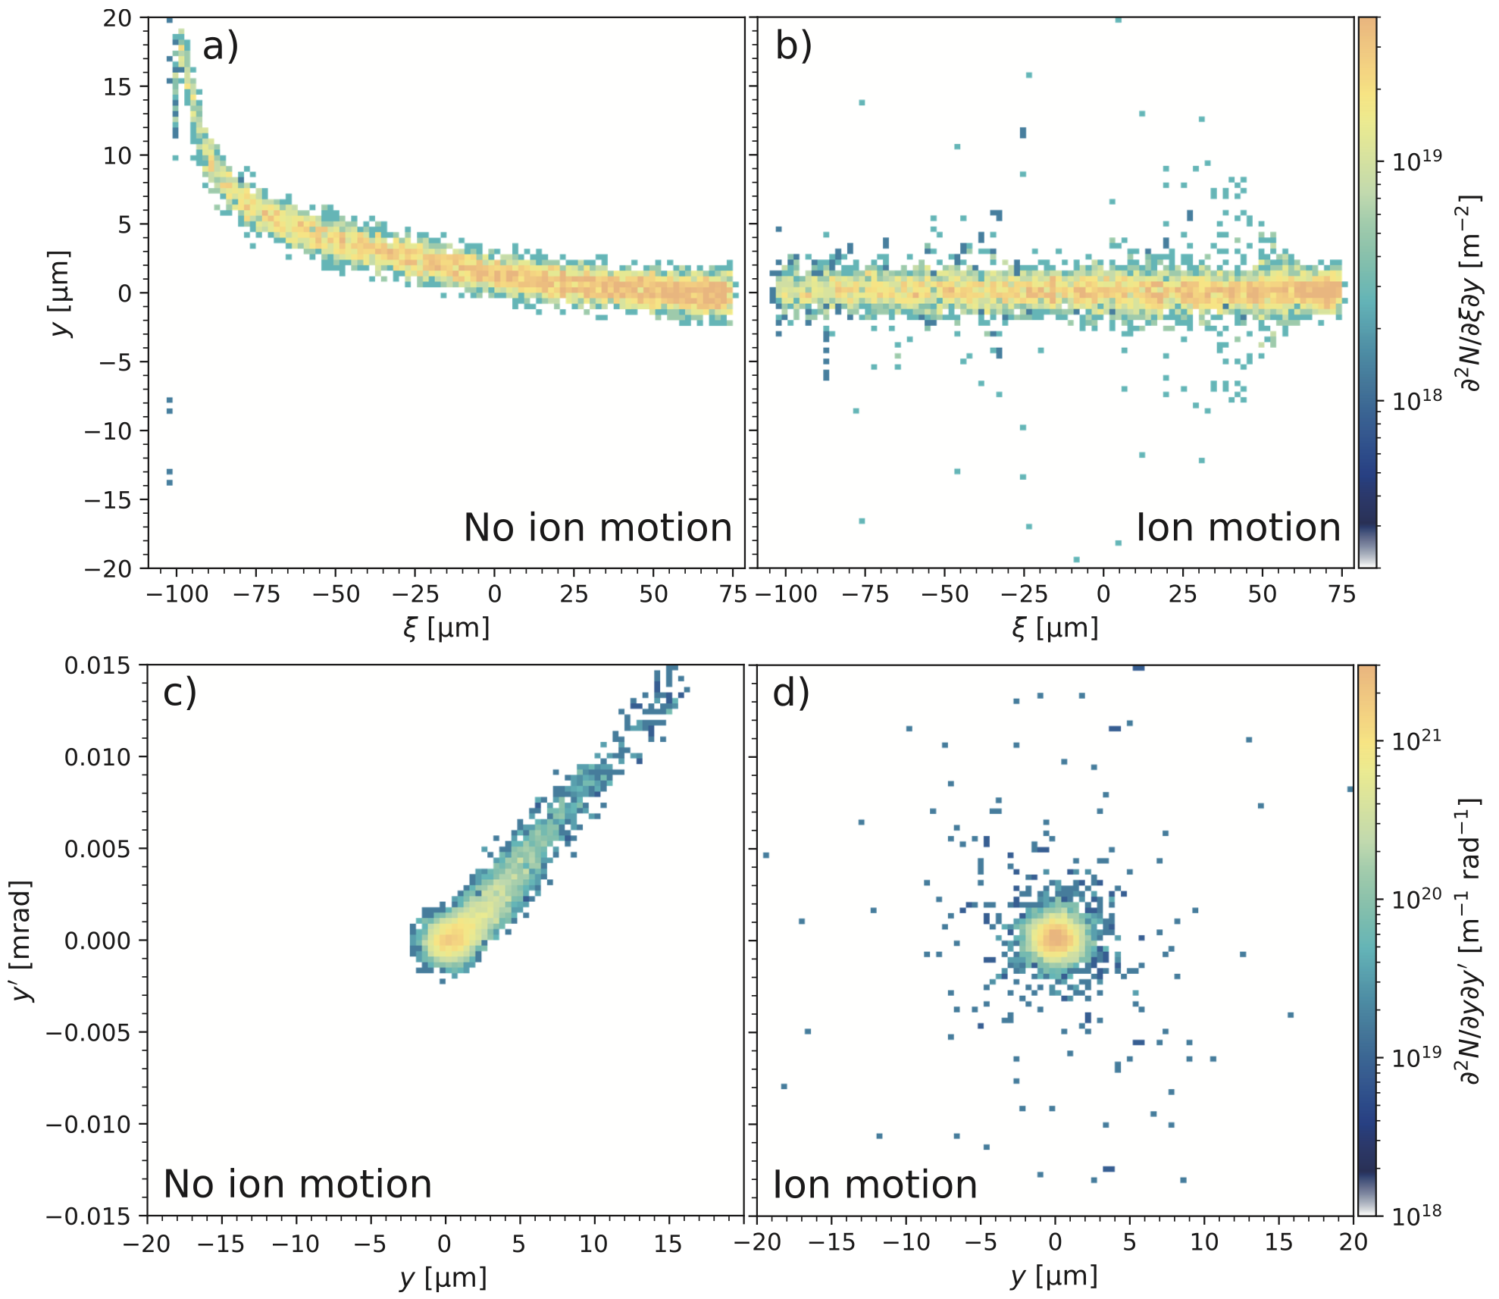
HALHF results
At the end of the HALHF linac:
E. Adli, IPAC’25
Preliminary results for HALHF (simplified interstage, driver guiding assumed): With no ion motion, the BBU is large. With ion motion, the BBU is efficiently mitigated up 10⁻² nm rad drive-beam jitter-emittance – “state of the art” FLASH@DESY - position jitter of ~30 nm. A halo of large amplitude particles has formed, driving up the rms emittance, while the 90%-percentile emittance is better preserved.

Slide 9
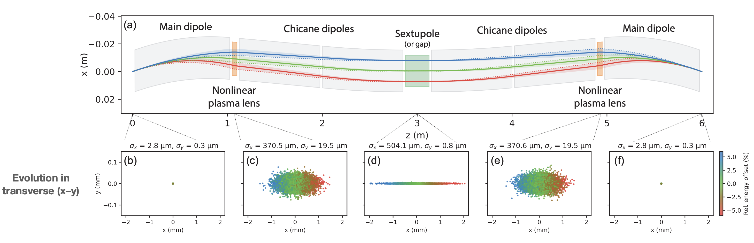
Interstages, main beam kicks
Δx
Lindstrøm et al., (manuscript in preparation)
Also emittance growth without wakefields, due to kicks from the focusing channel : Preliminary results indicate a drive-beam emittance jitter tolerance of order one nm rad before the threshold is reached, an order of magnitude larger than that of the transverse wake study.
Luminosity loss is ultimately the figure of merit (ABEL)
E. Adli, IPAC’25
Further work :
tolerances studies with both wakefields + the full interstage lattice
Study dependence on number of stages
Many other tolerances....
PRELIMINARY

Slide 10
Summary and further work
BBU and its mitigation starts to be well understood
mitigation mechanisms, as applied to HALHF (at 40% DB-to-MB efficiency):
  low plasma density
  optimal phasing
  Ion motion -> at the cost of some emittance growth
tolerancing study for plasma linacs can be performed with ABEL
HALHF drive-beam jitter tolerances from BBU look very tight (10—100 nm)
scans of the full interstage optics + wakefield still to be performed
  required to check if HALHF emittances can be reached, assuming reasonable jitter
  may impact the global design optimum (BBU not part of global optimisation)
similar tolerance studies important for any plasma collider study

Slide 11
Extra

Slide 12
Efficiency RF vs PWFA
CLIC
After the two-beam module
Optimized for efficiency, assuming 100 MV/m, and limited by transverse stability.
Before the two-beam module
DB
dump
100%
28%
19.1%
ACC wall
and dump
53%
WB
DB
CLIC CDR
2013 PWFA-LC
After the plasma interaction
Assuming Gaussian bunches assumed, and transverse stability not considered.
Before the plasma interaction
DB
dump
100%
50%
23%
PLASMA
27%
WB
DB
HALHF 2.0 PWFA-LC
After the plasma interaction
With self-correction, and careful parameter optimization, including transverse stability
40% > 28%
Before the plasma interaction
DB
dump
100%
40%
20%
PLASMA
40%
WB
DB
Erik Adli, U. Oslo, 2025-01-15

Slide 13
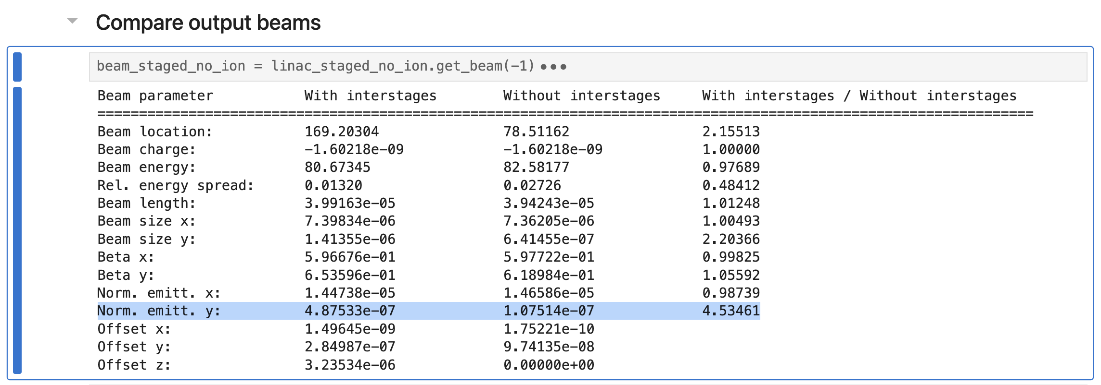
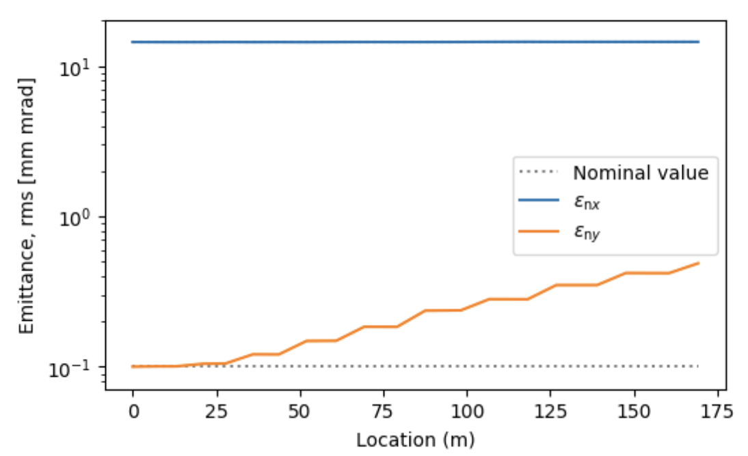
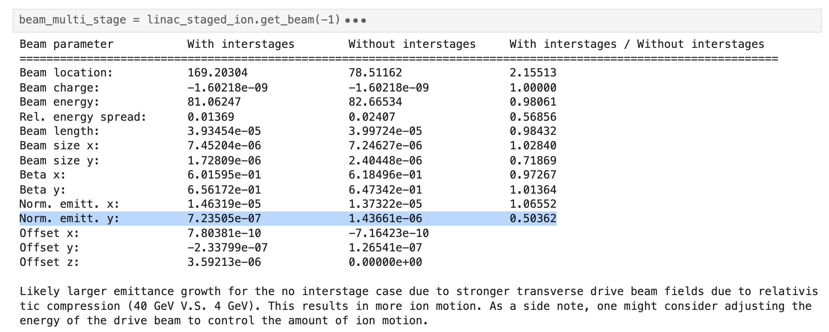
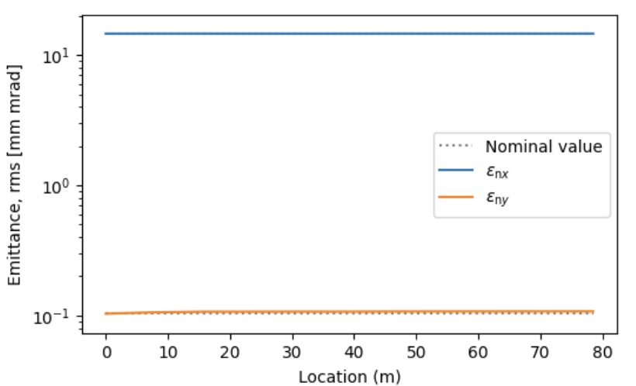
Dependence on number of stages
Stages (no ion)
Merged stage (no ion)

Slide 14
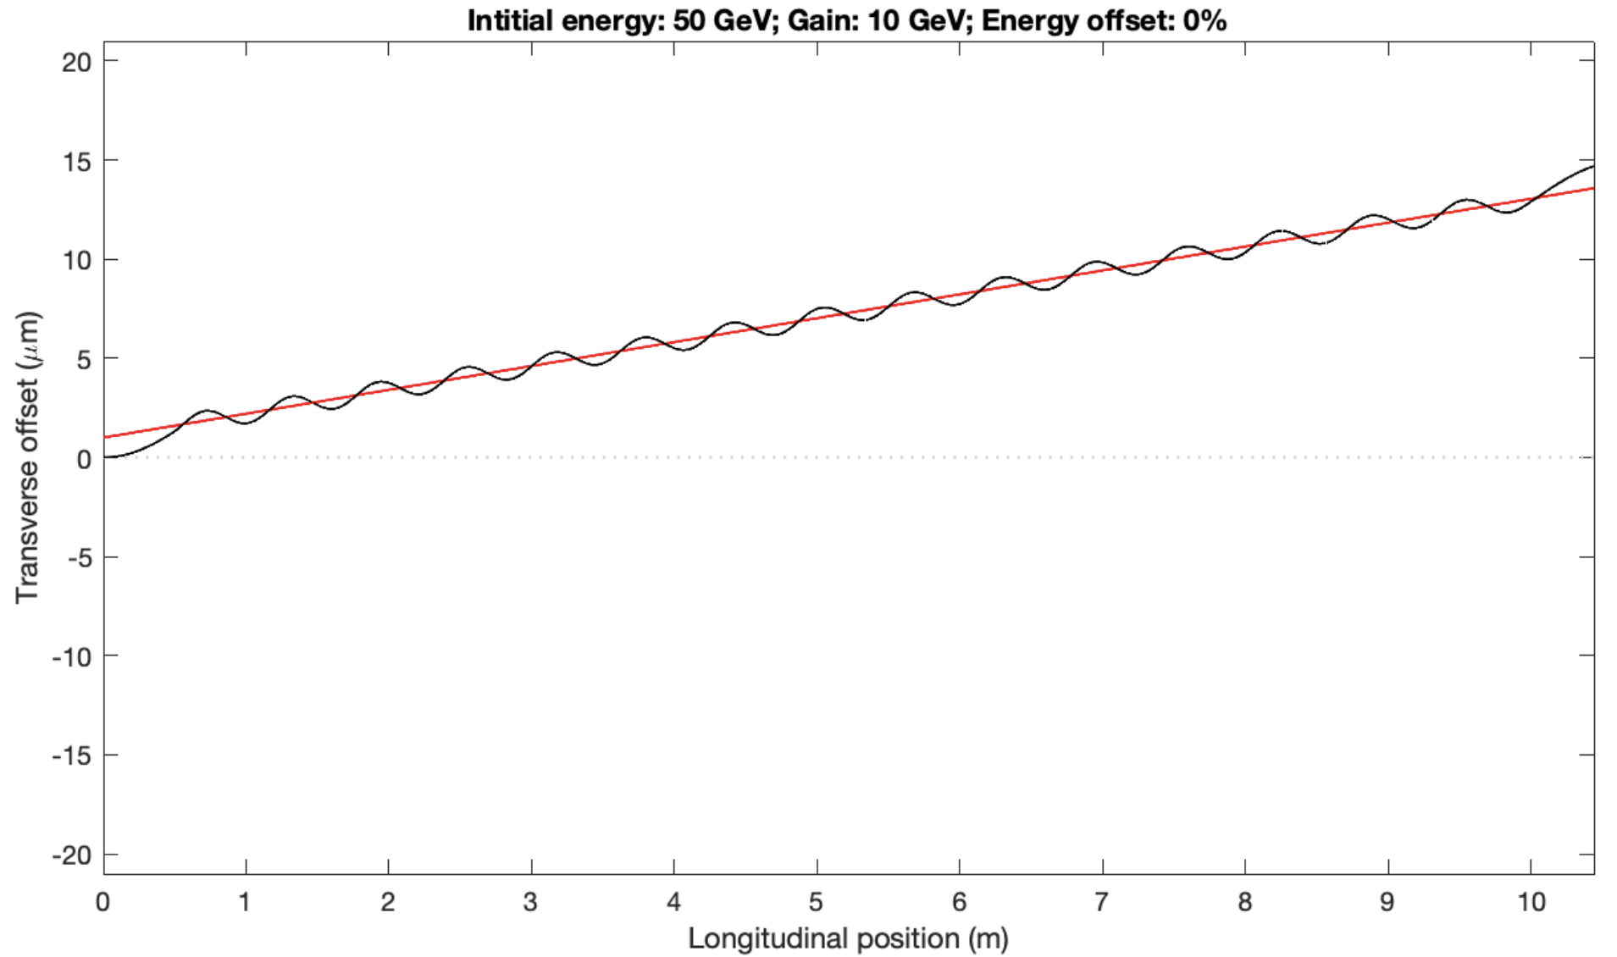
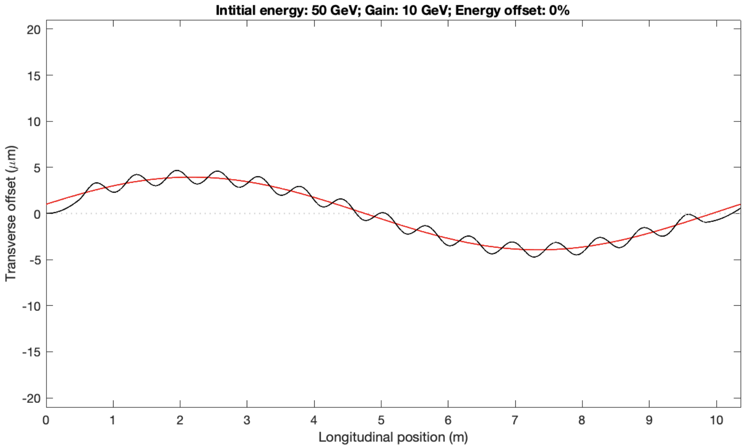
Importance of driver guiding
Mitigation: guiding driver with an external magnetic field,
here simulated in HiPACE++ (radially focusing field).
Driver injection angle:
may lead to large main beam offset
Centre of cell
Centre of drive beam
Without magnetic guiding-field
Main beam trajectory
Driver guiding has been assumed in the following ABEL simulations
With magnetic guiding-field

Slide 15
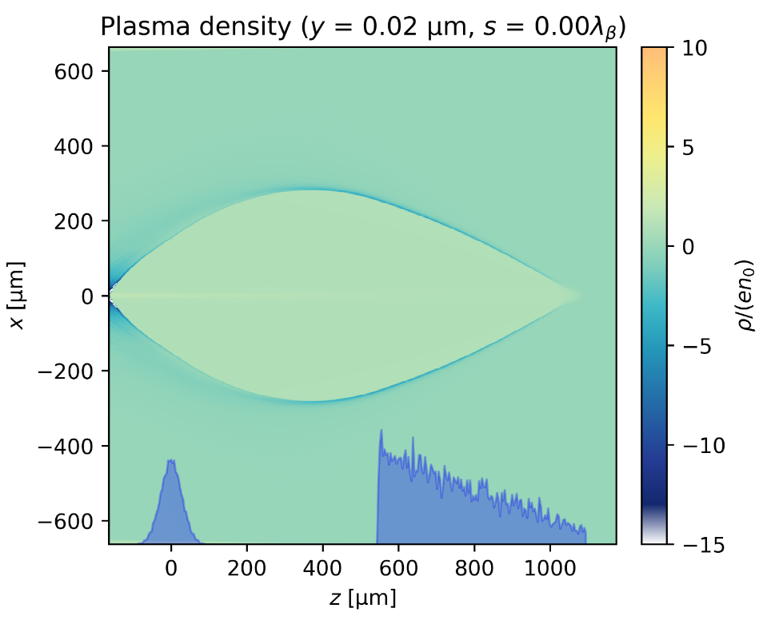
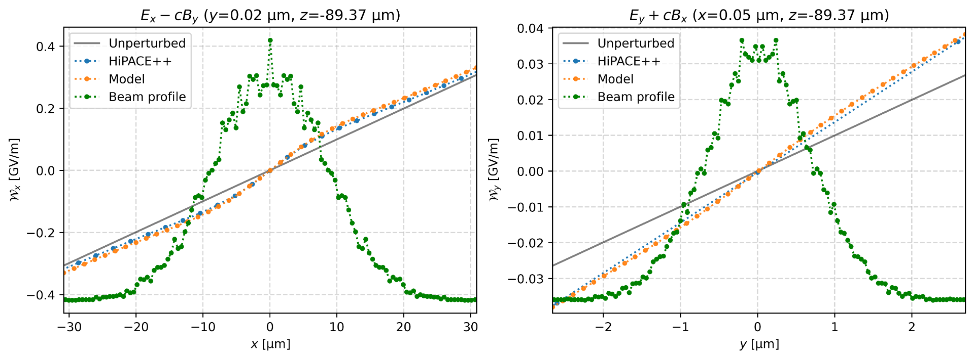
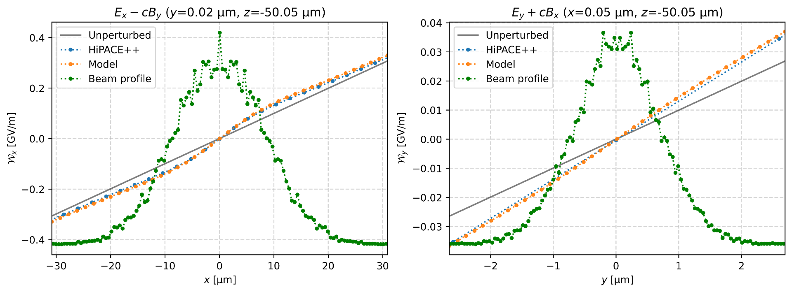
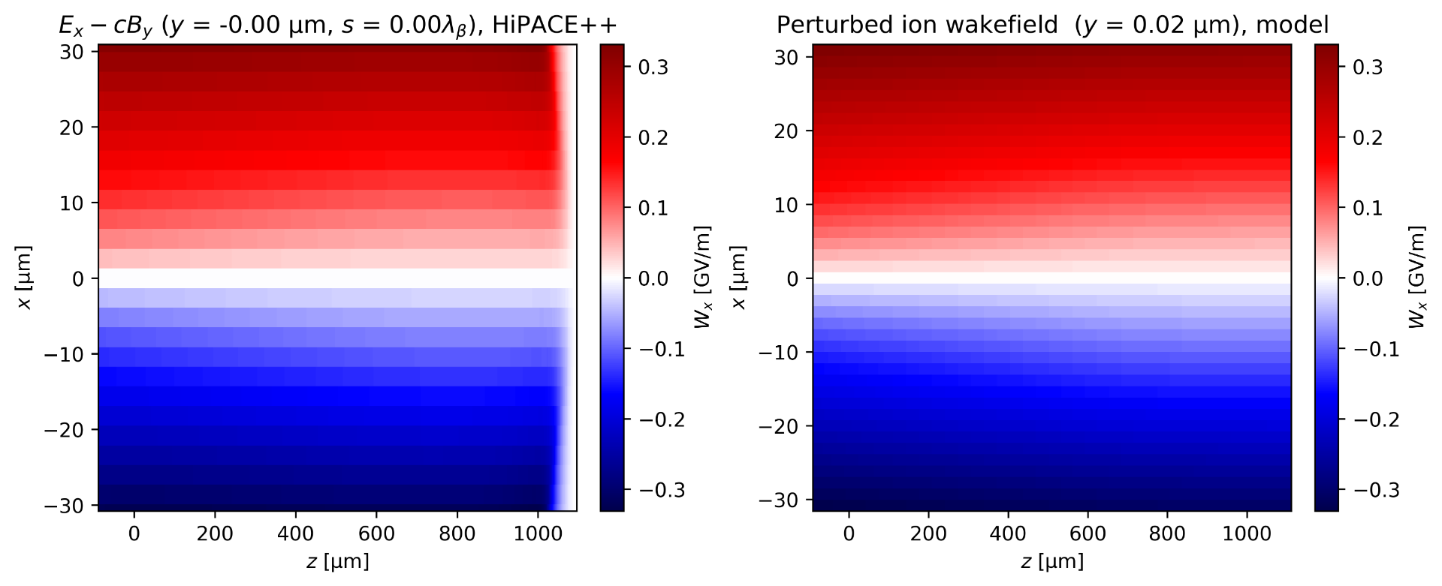
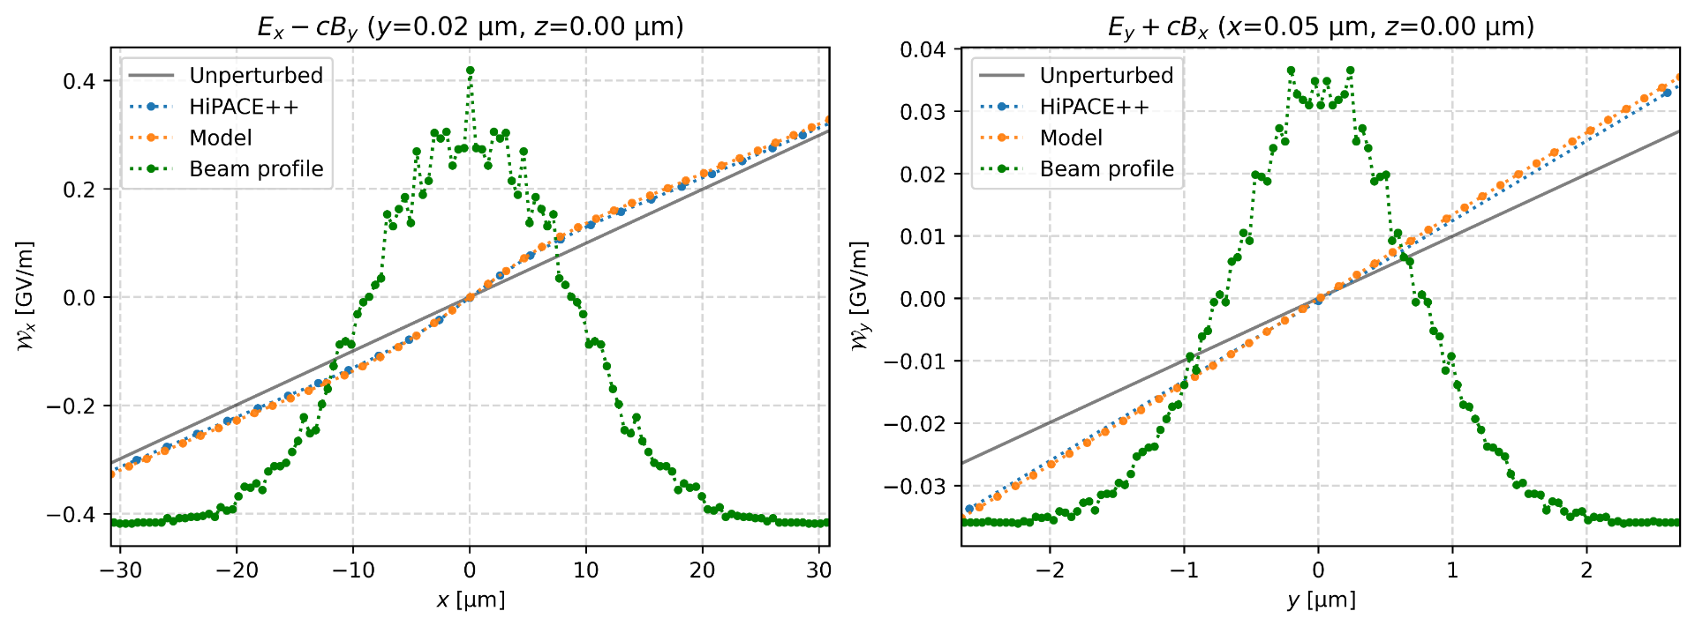
Benchmarking against HiPACE++
Benedetti et al.
A beam with transverse E-fields perturbs the background focusing fields so that (moderate non-relativistic ion motion)
I.e. integrate from head of drive beam to tail of main beam and modify the transverse eq.o.m. with a term.
2024-10-05 | Ben Chen | HALHF Workshop 3-8 October 2024
Page

Slide 16
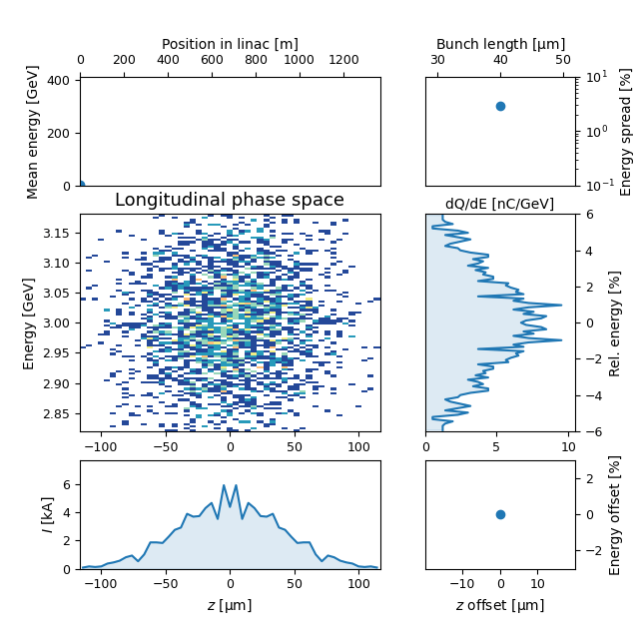
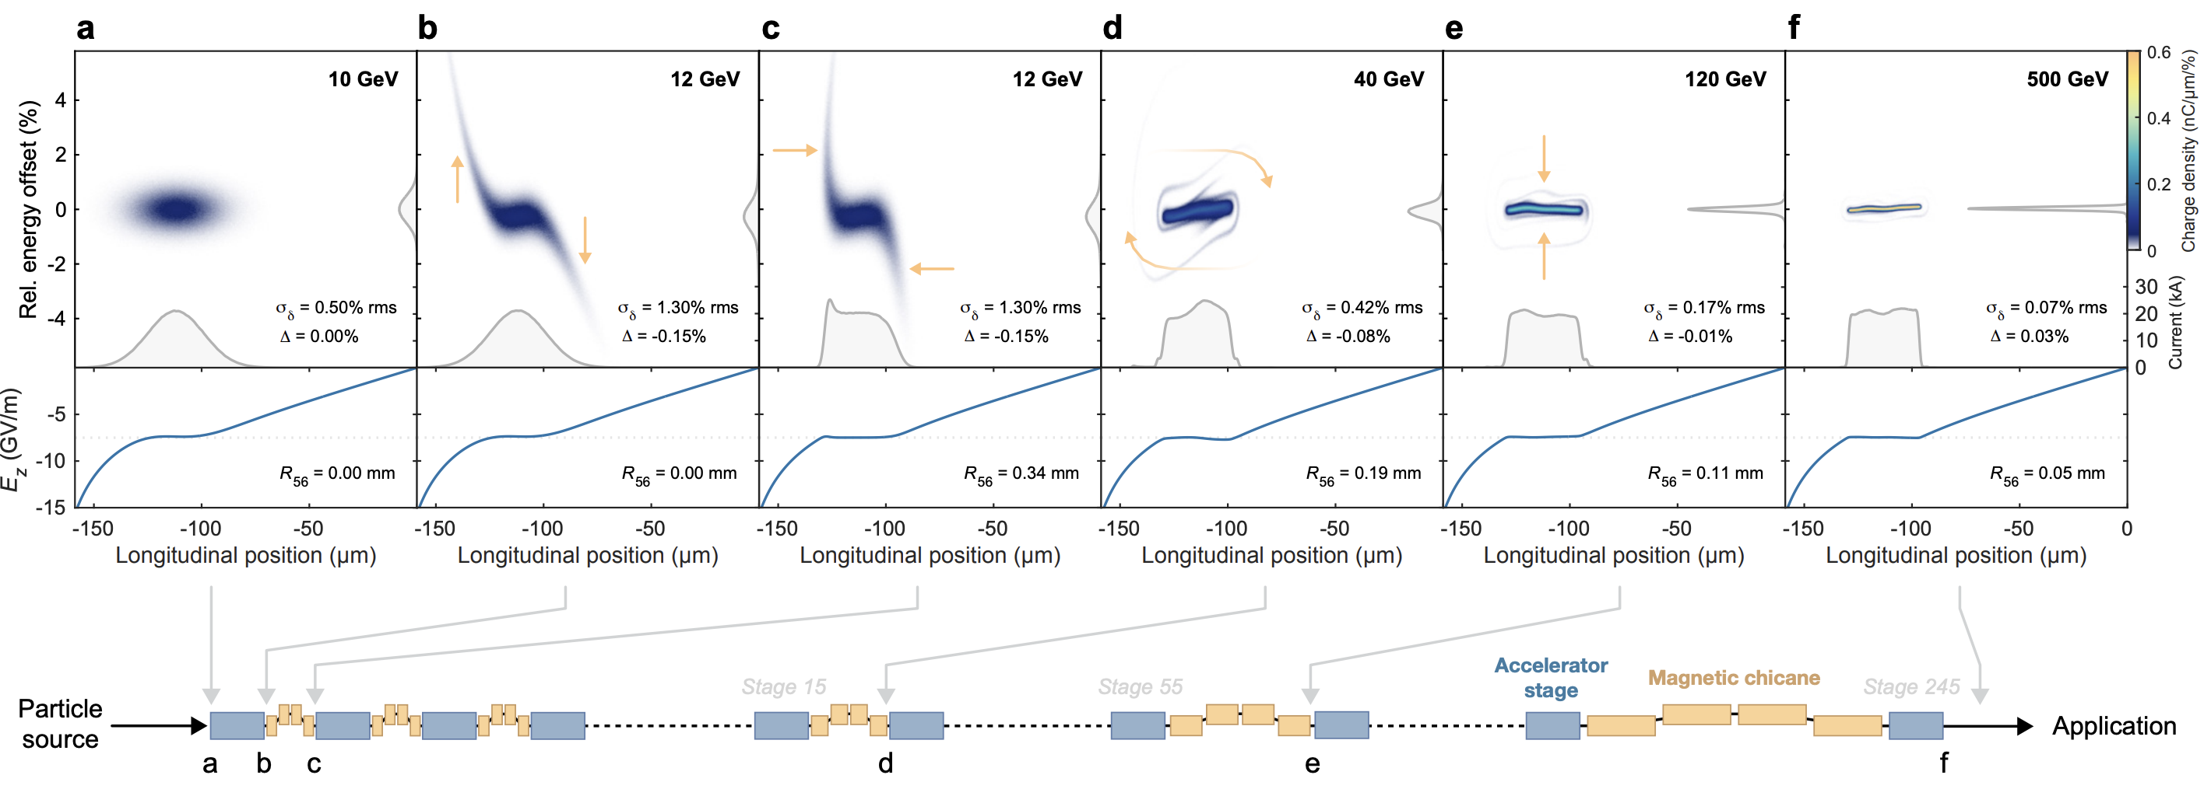
Longitudinal self-correction
C. A. Lindstrøm
Self-correcting longitudinal phase space in a multistage plasma accelerator
arXiv:2104.14460 (2021)

