Slide 1



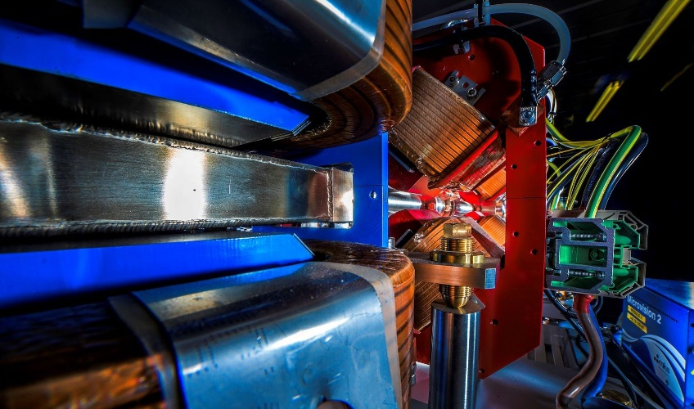

Making a brighter future through advanced accelerators
Transition of CLARA Facility at Daresbury Laboratory to User Facility
Deepa Angal-Kalinin
ASTeC, STFC Daresbury Laboratory
and The Cockcroft Institute
On behalf of the CLARA Team
, Elba, 24th September 2025

Slide 2
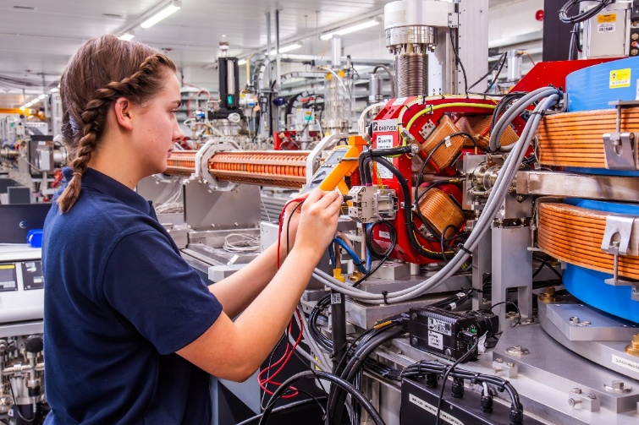
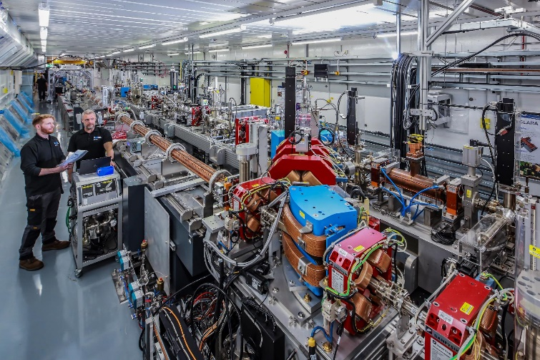
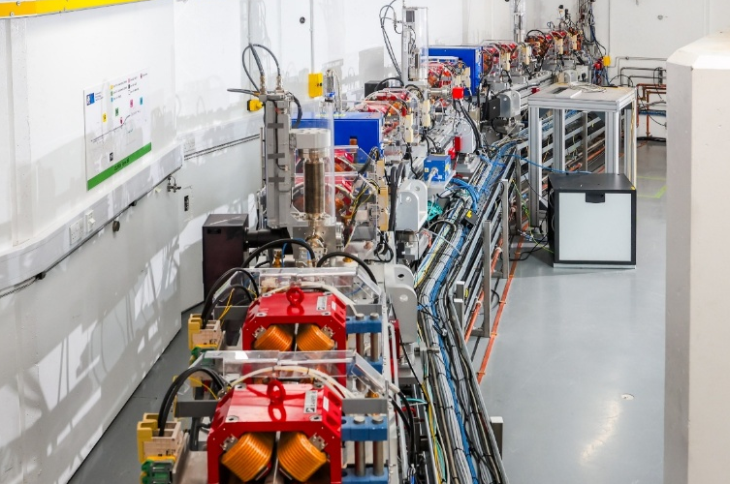

Outline
Making a brighter future through advanced accelerators
CLARA upgrade to 250 MeV
FEBE beamline and hutch
Current Status
Potential for Novel Acceleration R&D
Summary
D. Angal-Kalinin | EAAC25, Elba | 24/09/2025

Slide 3
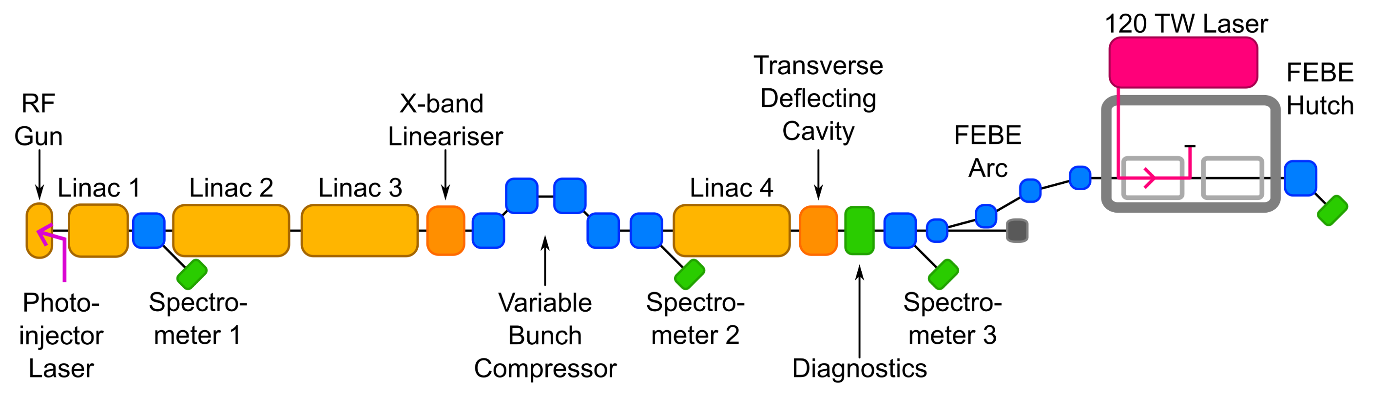
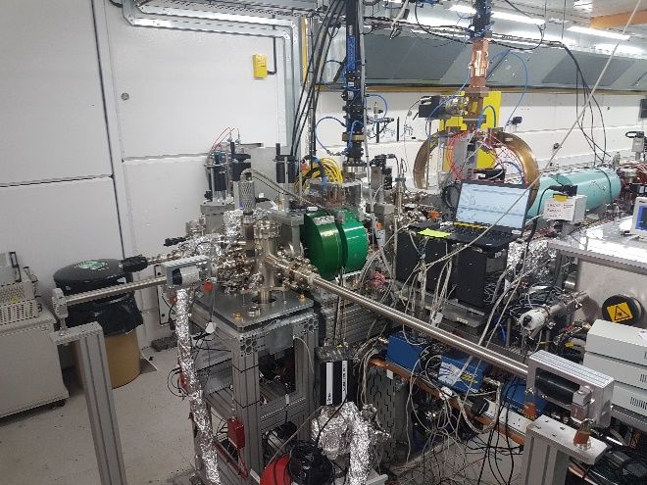
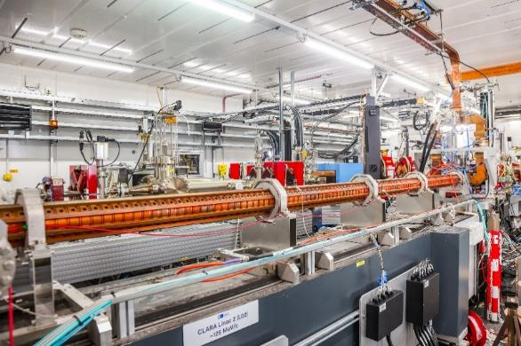
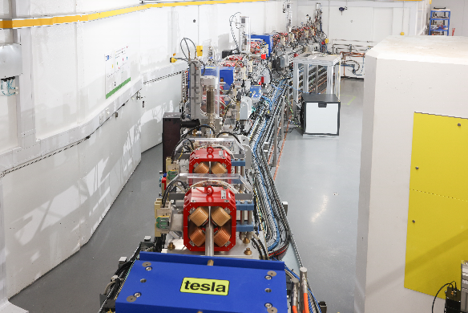
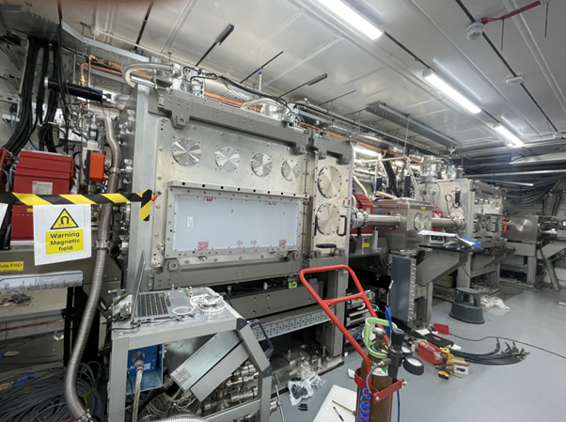
CLARA
250 MeV normal conducting S-Band electron beam facility.
Two successful novel acceleration experiments with ‘CLARA Front End’ at 35 MeV (2018-2022).
Accelerator Hall
~90 m x 3.5m x 3m
Generate
Accelerate + Manipulate + Accelerate
Characterise in 6D
Experiment
D. Angal-Kalinin | EAAC25, Elba | 24/09/2025
3
CLARA Gun
S-band Linac
Arc to FEBE hutch
FEBE hutch

Slide 4
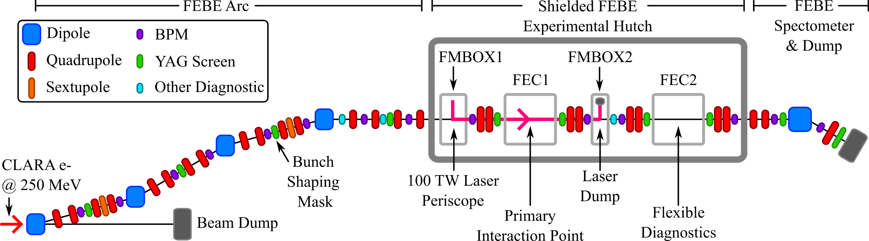
Full Energy Beam Exploitation (FEBE) Beamline
ICT
CTR
ICT
Up to 250 MeV
250 – 600 MeV
FEL ready high brightness beam
120 TW laser + electron beam in FEC1
Highly instrumented beamline to support setup & characterisation of novel accelerated beam
250 MeV – 2 GeV
D. Angal-Kalinin | EAAC25, Elba | 24/09/2025
4

Slide 5
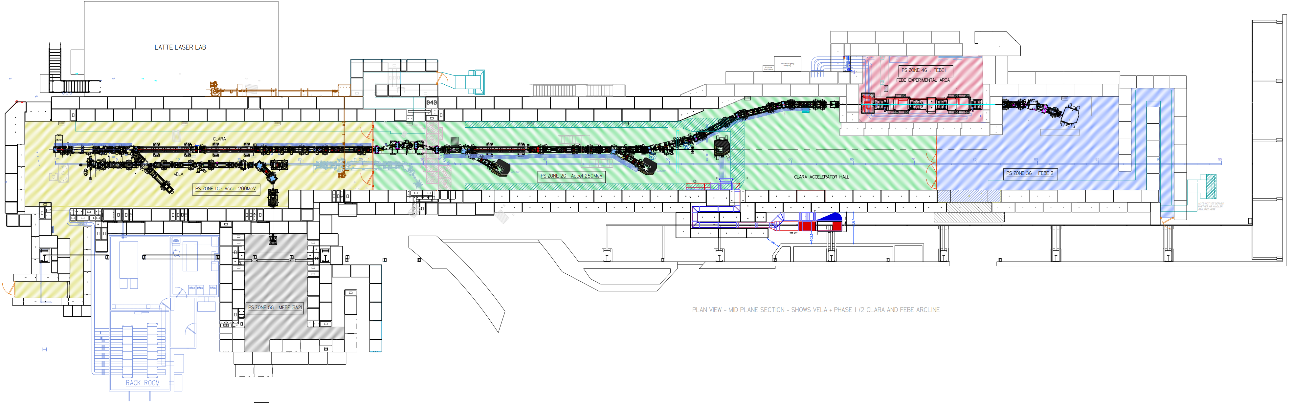
Configuration
Shielded FEBE
Experimental Hutch
Accelerator length ~ 85 m to final beam dump
Access to CLARA electron beam within a shielded hutch for users.
The hutch can be accessed whilst the accelerator is operating (and FEBE beamline magnets off), enabling users to set up their experiments and access the hutch during experiment without switching off the accelerator.
  Beam stability and fast turn around.
D. Angal-Kalinin | EAAC25, Elba | 24/09/2025

Slide 6
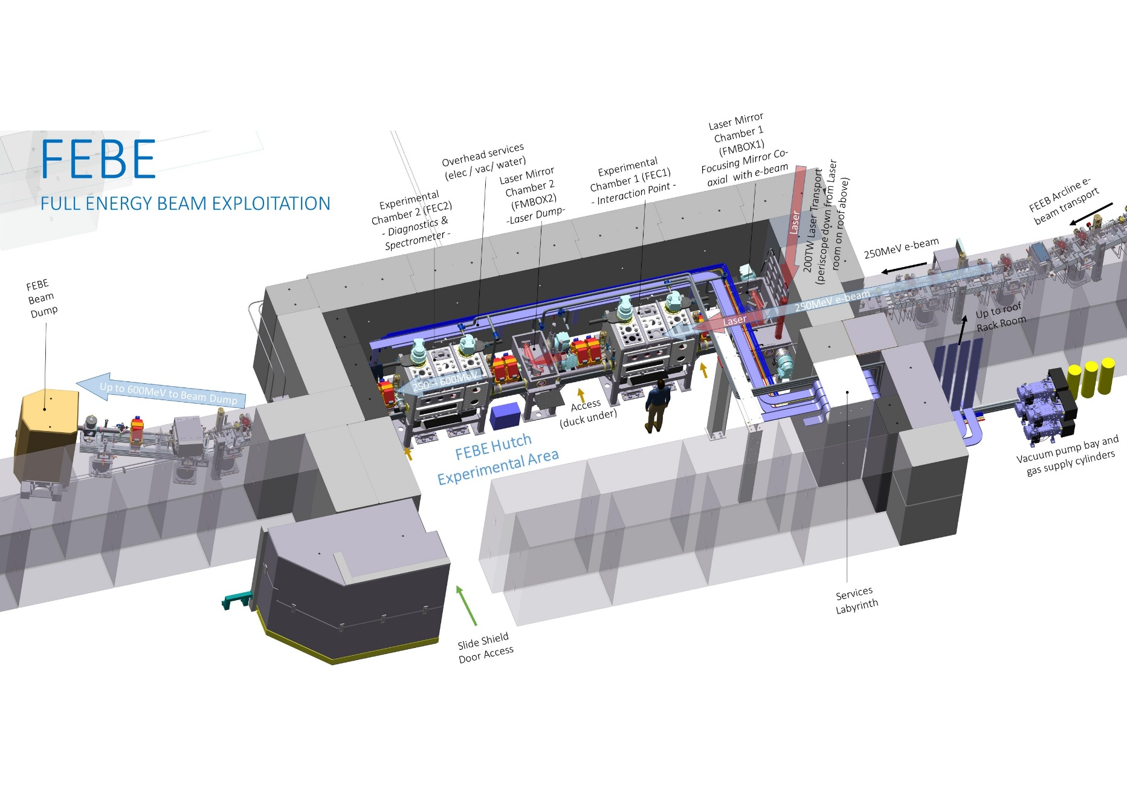
FEBE Hutch Overview
Hutch footprint: 10 × 5.4 × 3 m³, Shielding: Total beam power 6 W
Flexibility with bunch charge (maximum 250 pC), bunch repetition rate (maximum 100 Hz), beam energy (50 MeV – 250 MeV)
CLARA
250 MeV e-
Two identical chambers: more flexible, provides diagnostic support, and a route towards ambitious interaction/transport/application
D. Angal-Kalinin | EAAC25, Elba | 24/09/2025

Slide 7
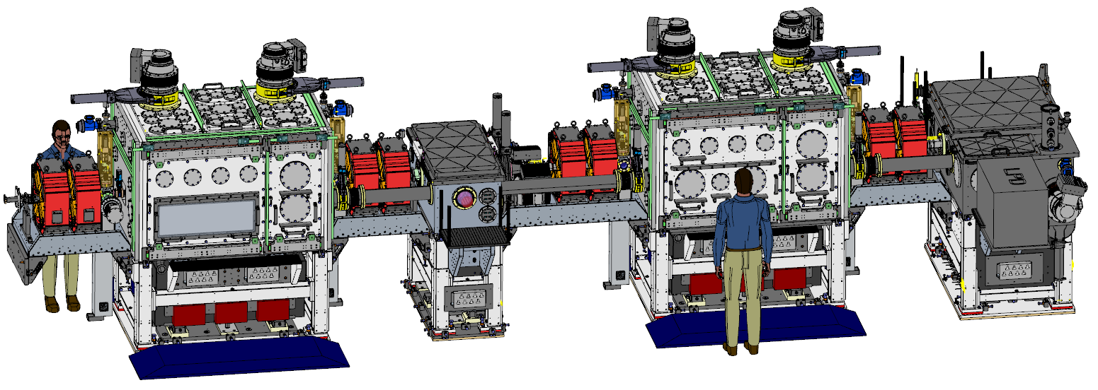
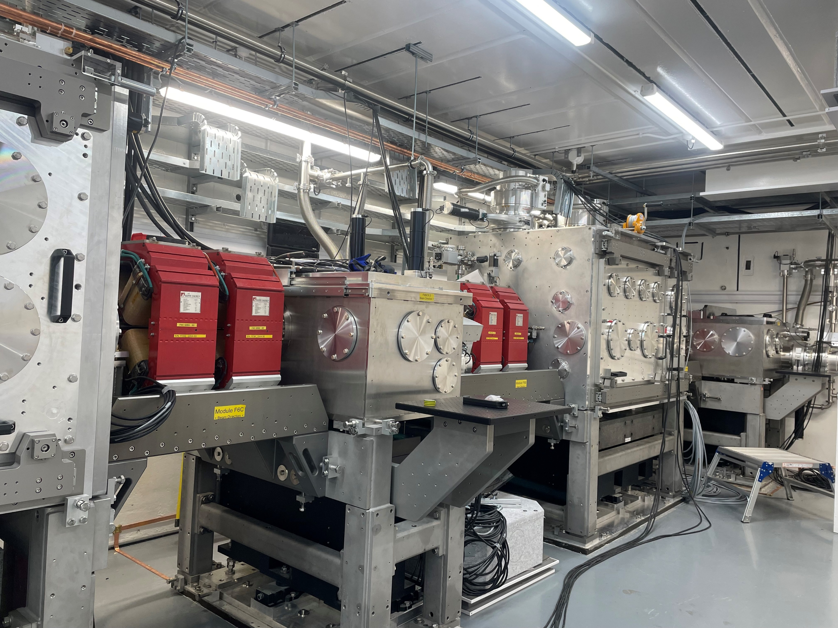

FEBE Hutch Beamline
FEC1
Laser from roof
FEC2
FMBOX1
FMBOX2
CLARA
250 MeV e-
D. Angal-Kalinin | EAAC25, Elba | 24/09/2025

Slide 8
Electron Beam Parameters
To be delivered at Interaction Point in FEC1 and/or FEC2 chambers.
Day 1
Future potential
Parameter | High charge | Low charge
Energy [MeV] | 250 | 250
Charge [pC] | 250 | 5
RMS t [fs] | 100 | 50
σ_{E}/E [%] | <5 | <1
RMS x [µm] | 100 | 20
RMS y [µm] | 100 | 20
ε_{N} x [µm] | 5 | 2
ε_{N} y [µm] | 5 | 2
Parameter | High charge | Low charge
Energy [MeV] | 250 | 250
Charge [pC] | 250 | 5 → <5
RMS t [fs] | 100 → 50 | 50 → <50
σ_{E}/E [%] | <5 → 1 | <1
RMS x [µm] | 100 → 50 | 20 → ~1
RMS y [µm] | 100 → 50 | 20 → ~1
ε_{N} x [µm] | 5 → <5 | 2 → 1
ε_{N} y [µm] | 5 → <1 | 2 → <1
Snedden, E. W., et al. PRAB 27.4 (2024): 041602. https://doi.org/10.1103/PhysRevAccelBeams.27.041602
  R&D: Meeting these parameters will require upgraded and/or new diagnostics
D. Angal-Kalinin | EAAC25, Elba | 24/09/2025

Slide 9
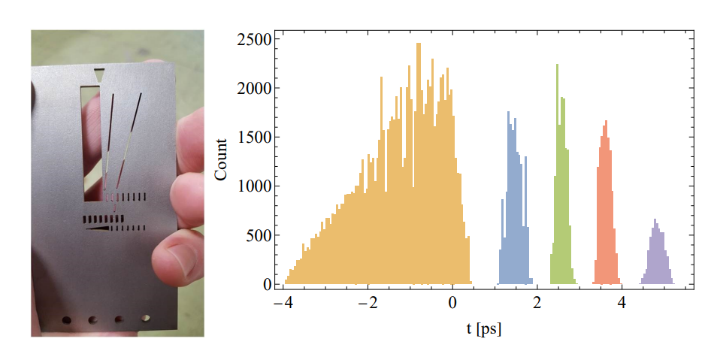
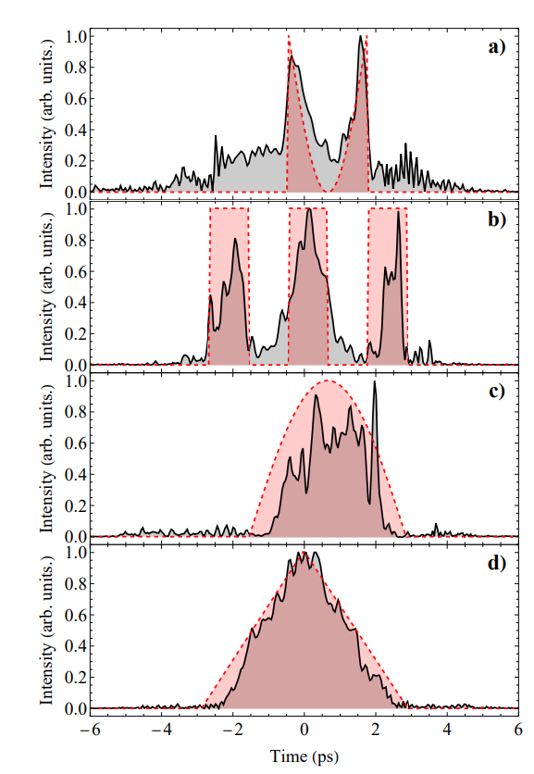
Electron Beam Pulse Shaping
Tungsten mask in FEBE Arc
  Configurable and changeable
  Drive-witness, pulse trains…all possible
Photoinjector Laser longitudinal shaping
  Machine Learning driven
  Large number of possibilities
D. Angal-Kalinin | EAAC25, Elba | 24/09/2025
9

Slide 10
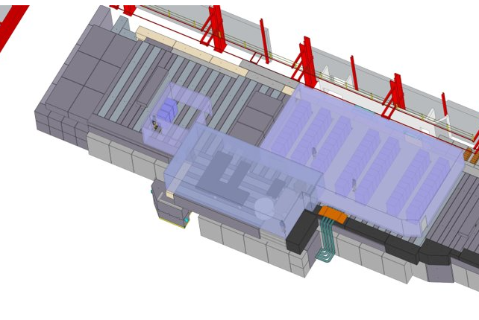
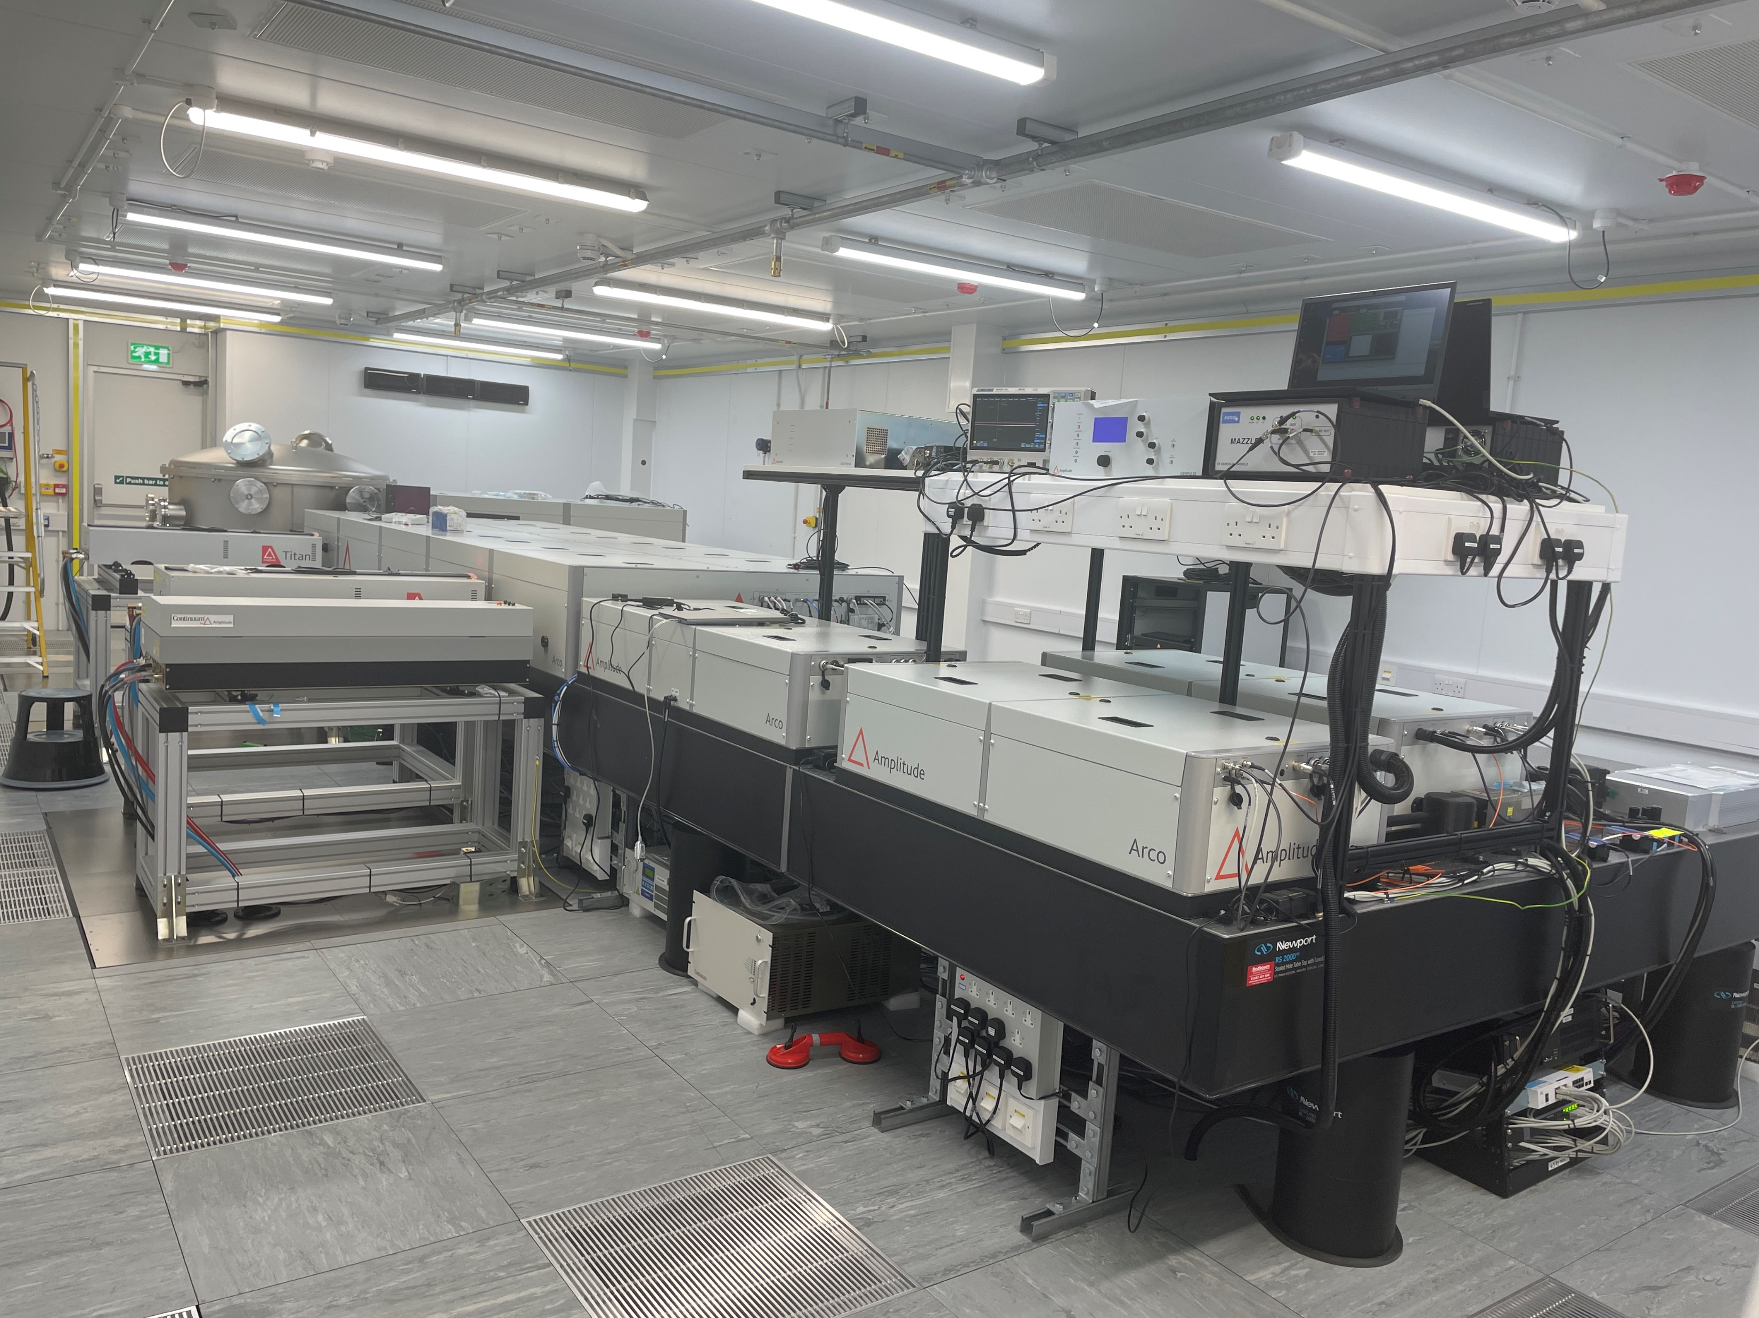
FEBE Laser System
A commercial 5 Hz, 120 TW laser system (Arco, Amplitude) based on top of the hutch.
Estimated laser properties at IP using standard OAP with co-linear geometry.
Laser control room
Parameter | F = 3.5 m OAP
Wavelength [nm] | 800
Energy [J] | 2.6
τ_{FWHM} [fs] | 23
ω₀ [µm] | 30
I_{pk} [Wcm⁻²] | 8.0×10¹⁸
a₀ | 1.93
FEBE hutch
Laser room
D. Angal-Kalinin | EAAC25, Elba | 24/09/2025
10

Slide 11
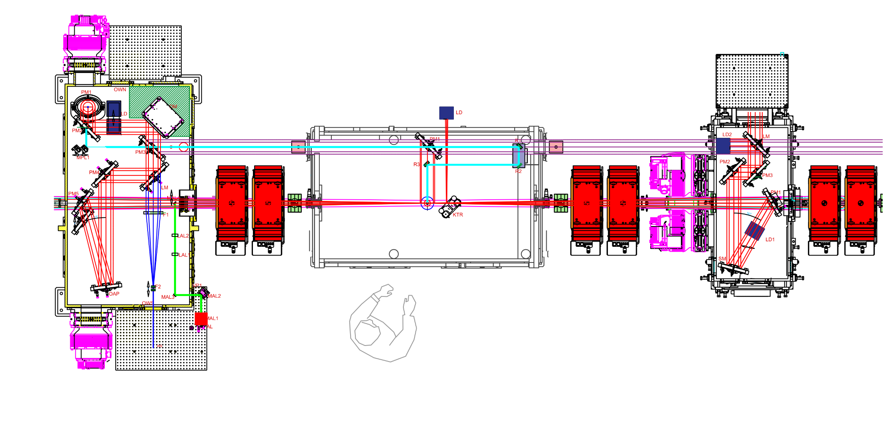
FEBE Laser System
Input from laser room periscope (compressor above)
Deformable mirror
Probe line
CLARA
250 MeV e-
e⁻ @ 250 MeV
IP1
Dump
OAP
Wavefront
Sensor
FMBOX1
FEC1
FMBOX2
D. Angal-Kalinin | EAAC25, Elba | 24/09/2025
11

Slide 12


CLARA: Current Status
D. Angal-Kalinin | EAAC25, Elba | 24/09/2025

Slide 13
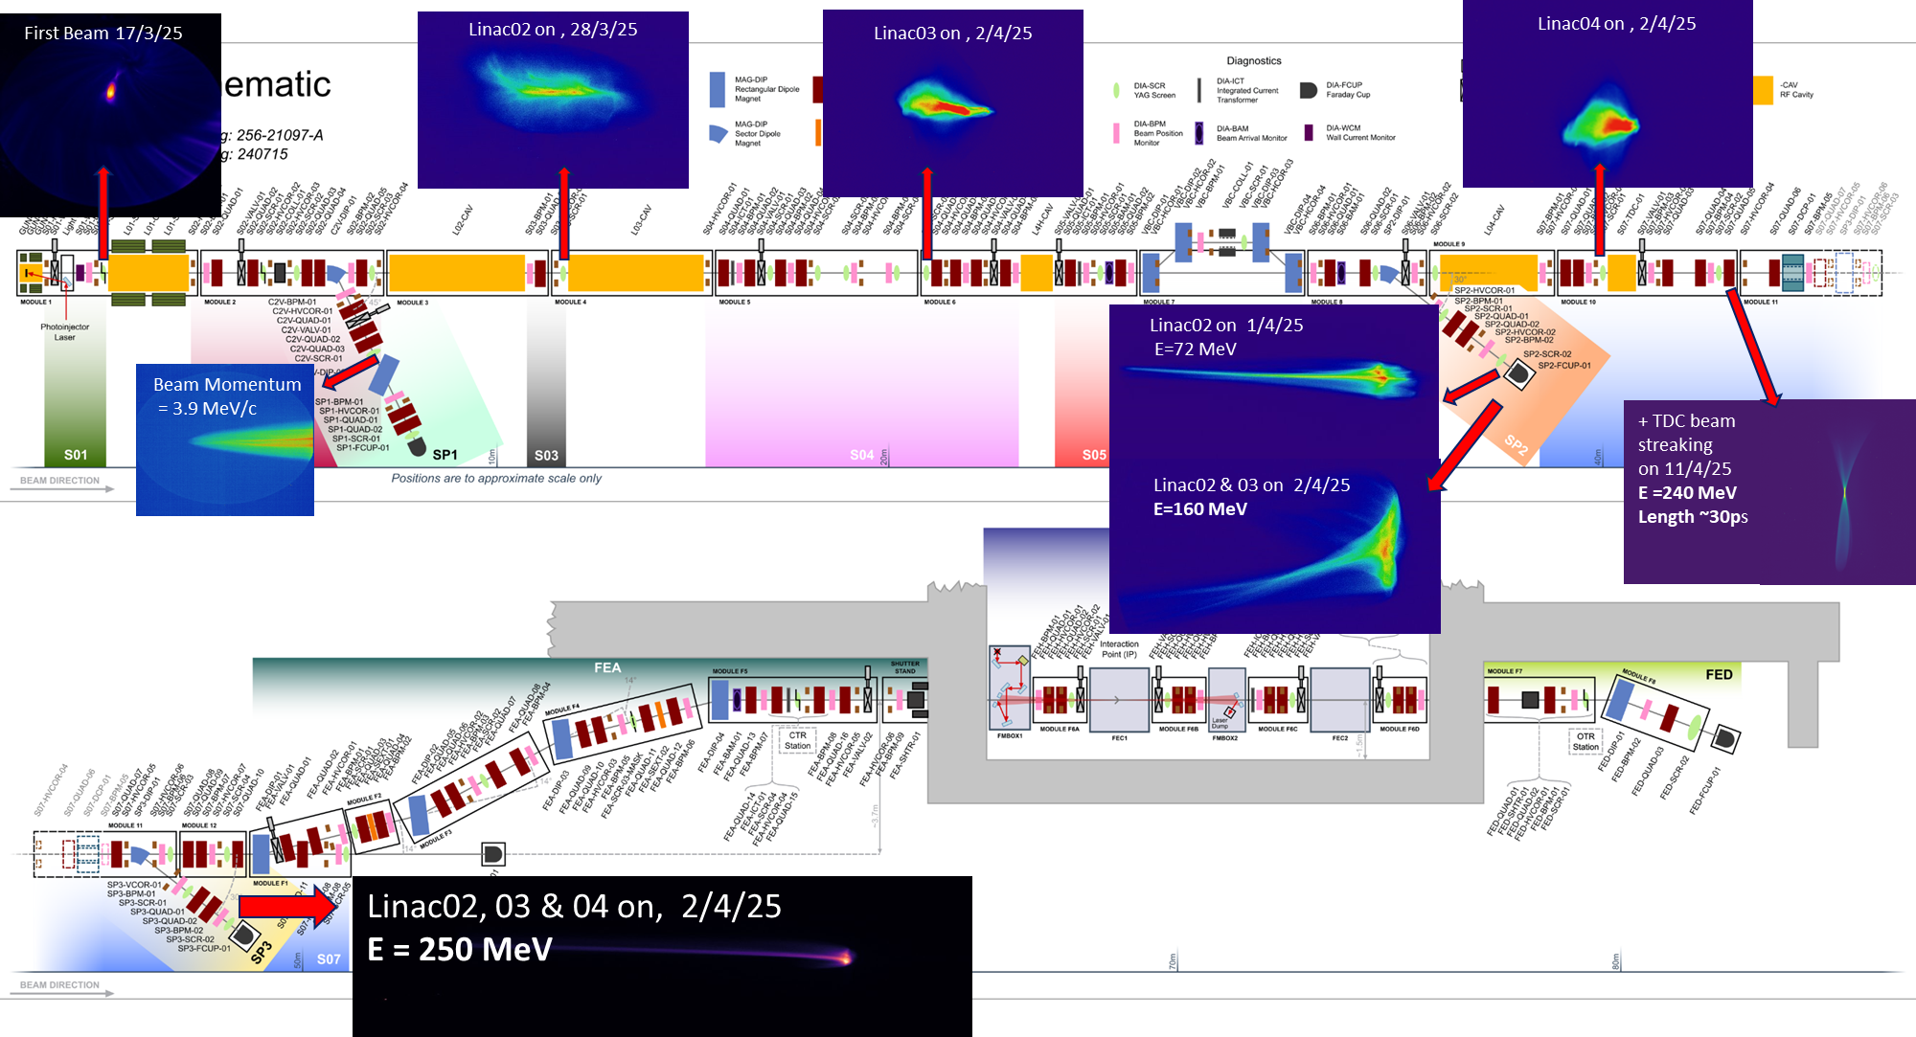
250 MeV at 100 Hz, 50 pC, Copper Photocathode
D. Angal-Kalinin | EAAC25, Elba | 24/09/2025
13

Slide 14
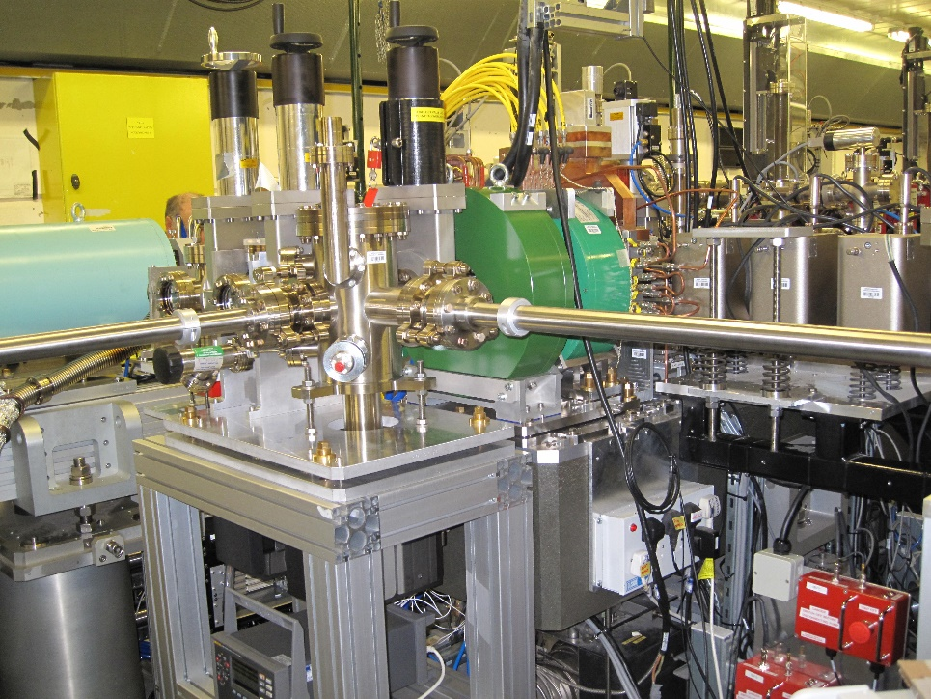
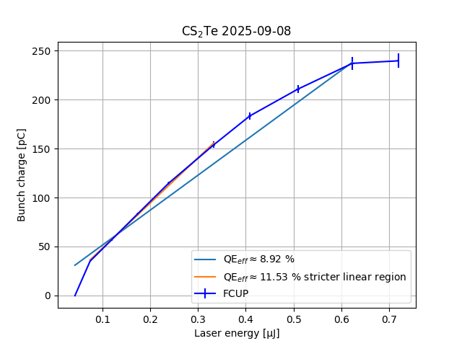
Photocathode change from Cu to Cs₂Te (Sep 25)
Copper photocathode was recently replaced with Cs₂Te photocathode.
Laser transport was designed and modified to address expected QE increase.
Increase in QE from Cu Photocathode ~ 10⁻⁵ to ~ 12 x 10⁻²
  Lot of headroom to deliver 250 pC over operational period & for laser pulse shaping
Dark current lower than Copper photocathode and expect to reduce over time.
D. Angal-Kalinin | EAAC25, Elba | 24/09/2025
14

Slide 15
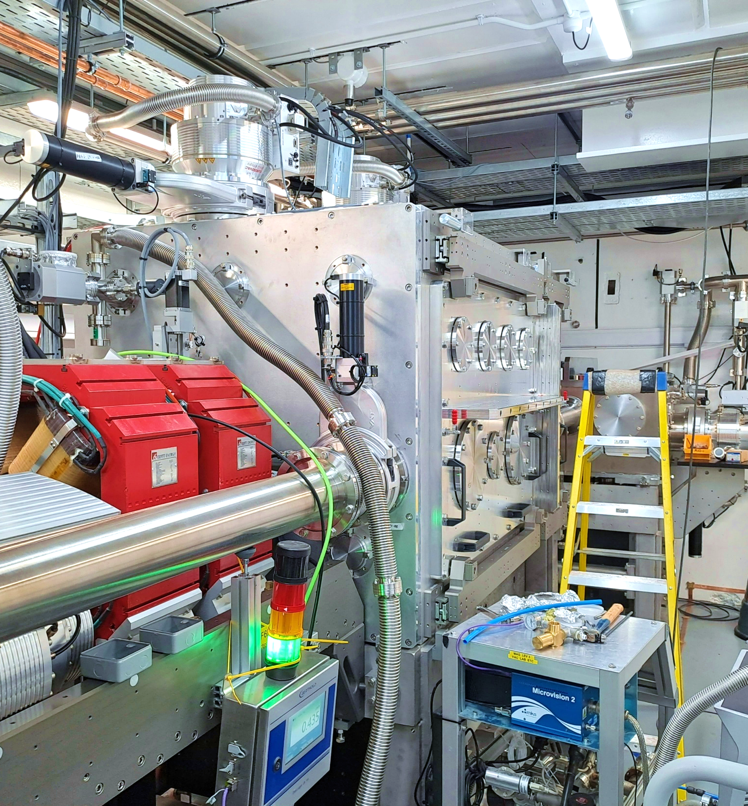
Current Status
Technical systems commissioning with beam in the accelerator hall ongoing.
Targeting first electron beam threading through FEBE hutch – early October 25
Day 1 parameters – January 2026
First friendly user experiments without laser– February/March 2026
FEBE 120 TW Laser has been installed. Targeting SAT Completion Q3 25
Laser transport in the hutch will be commissioned Q2 26.
D. Angal-Kalinin | EAAC25, Elba | 24/09/2025

Slide 16
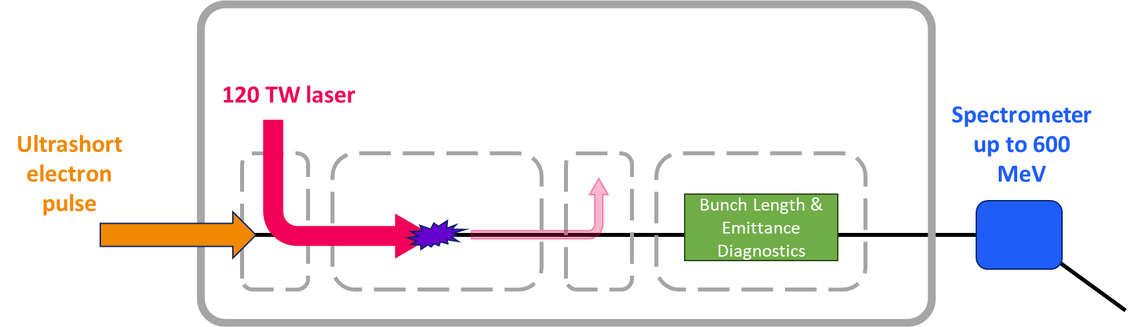
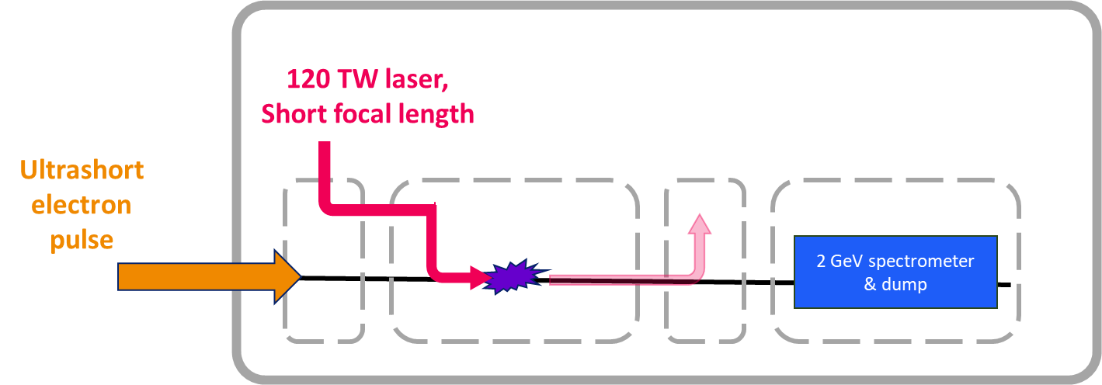
Potential for Novel Acceleration R&D at CLARA
Several R&D challenges to demonstrate high quality beam driven plasma acceleration can be potentially addressed at CLARA.
Only ideas! Many potential possibilities!
External Injection – LWFA
Witness beam stability & Staging challenges
Interstage optics tests for PWFA staging
External Injection – LWFA
Higher energy gain & Energy stability
D. Angal-Kalinin | EAAC25, Elba | 24/09/2025
16

Slide 17
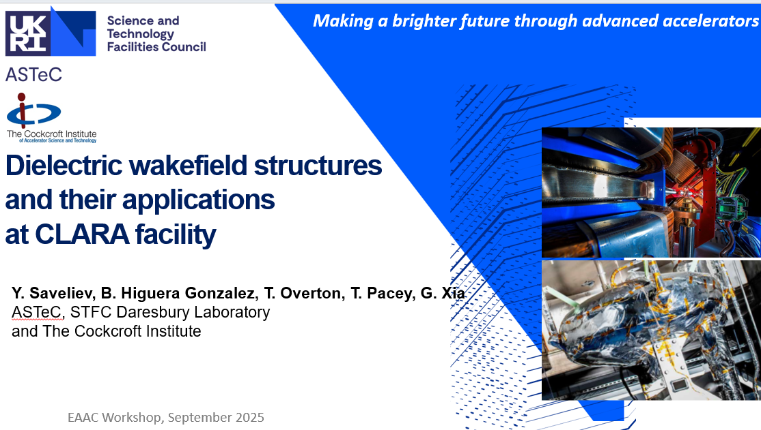
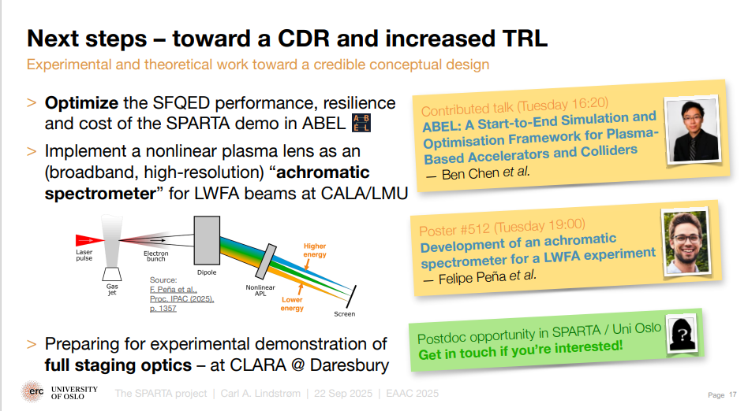
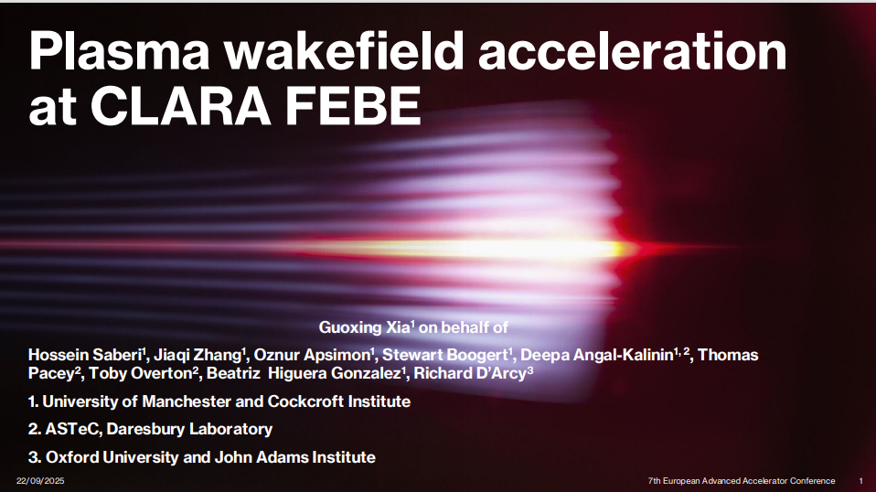
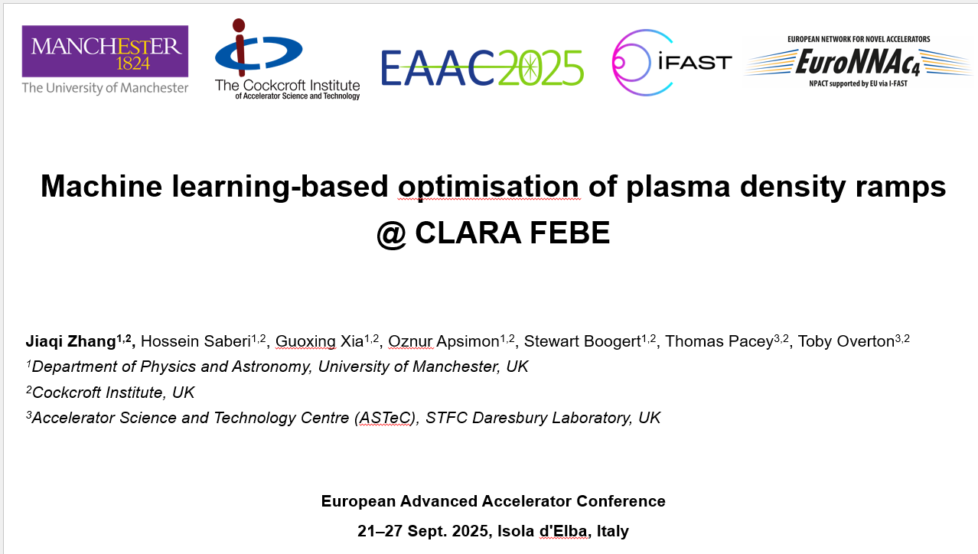
Novel Acceleration R&D – EAAC25
C. Lindstrøm, Monday, PS1
Y. Saveliev, Monday, PS2
G. Xia, Monday, PS1
J. Zhang, Tuesday, PS7
D. Angal-Kalinin | EAAC25, Elba | 24/09/2025
17

Slide 18
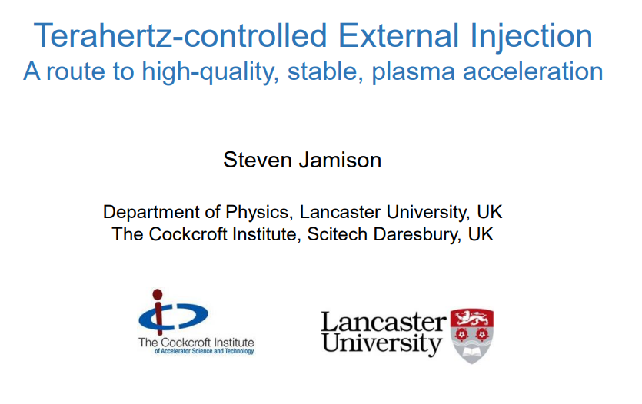
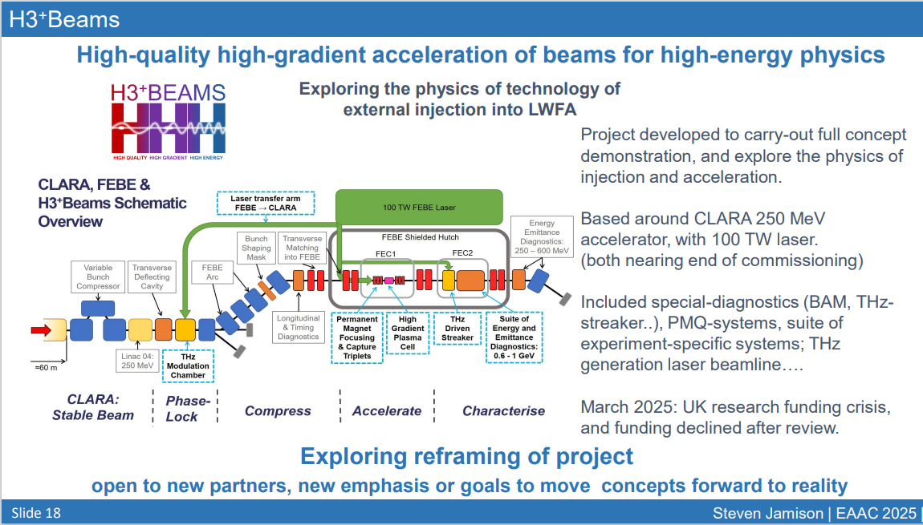
Potential for Novel Acceleration R&D at CLARA
S. Jamison, Tuesday, PS1
D. Angal-Kalinin | EAAC25, Elba | 24/09/2025
18

Slide 19
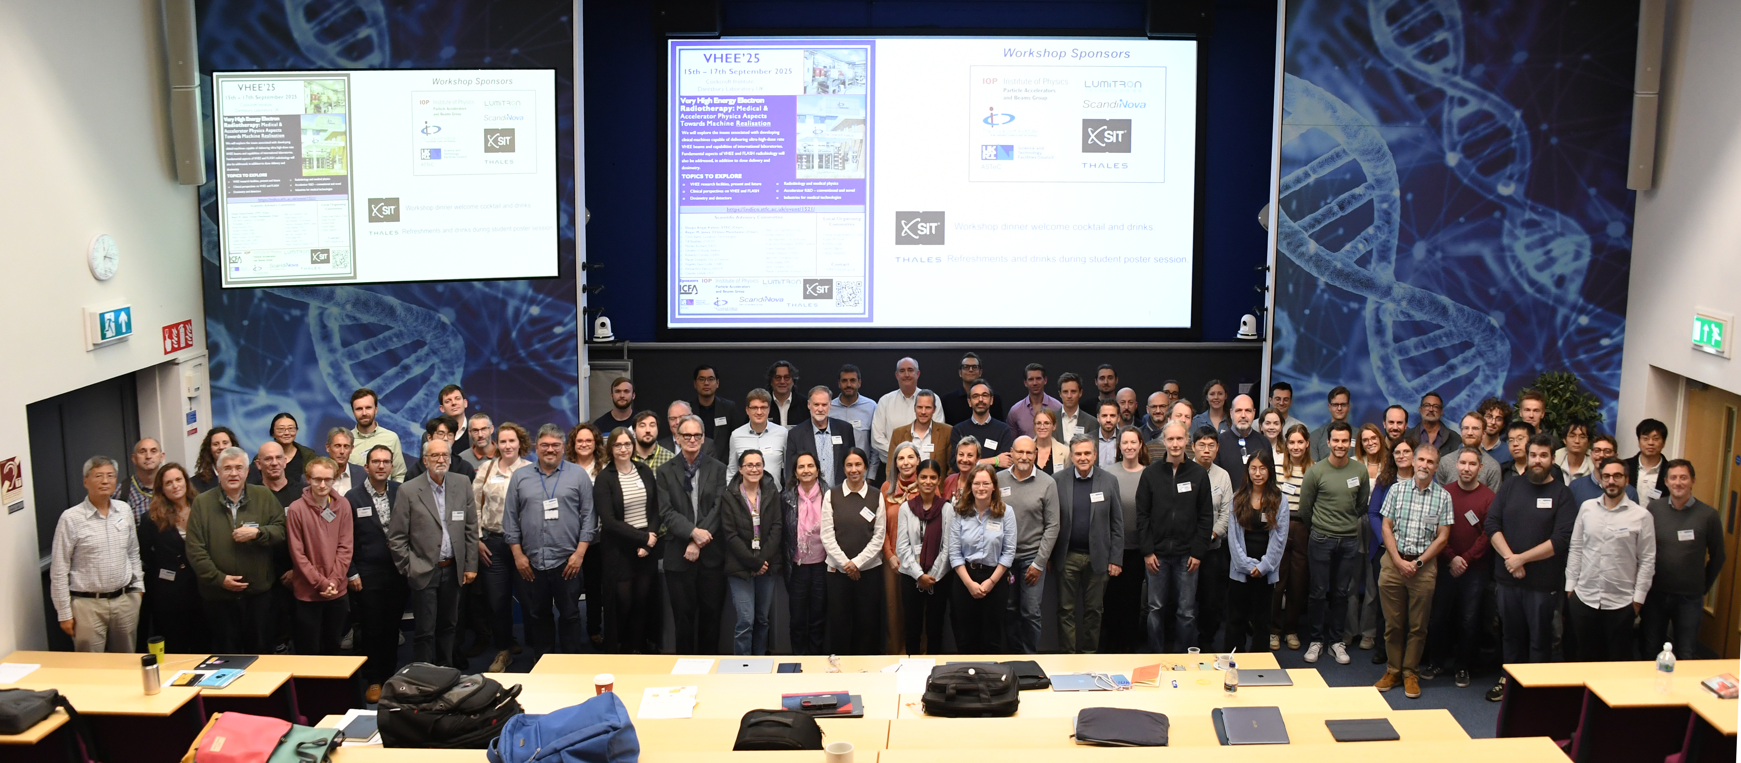
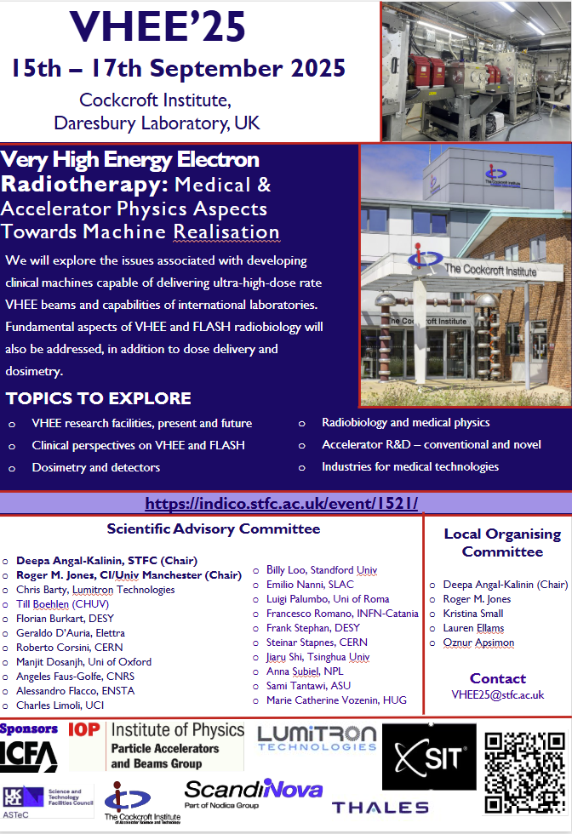
Potential for VHEE RT R&D at CLARA
International Workshop on Very High Energy Electron Radiotherapy (VHEE’25) (15-17 September 2025): Overview · STFC Indico
Details of VHEE/FLASH RT R&D on CLARA in Facility Update Session
D. Angal-Kalinin | EAAC25, Elba | 24/09/2025
19

Slide 20
Summary
Making a brighter future through advanced accelerators
CLARA has achieved design beam energy (250 MeV), bunch charge (250 pC) and rep rate (100 Hz).
Beam threading through the FEBE hutch is planned in October 2025.
CLARA will transition next year into fully operational user facility.
  First friendly user experiments likely to be in February/March 2026.
  Open user call will be issued sometime in 2026 and then on a regular basis.
There is a huge potential to exploit the full flexibility and performance of the CLARA Beam & the FEBE Hutch.
If you are interested to use CLARA for R&D, please contact thomas.pacey@stfc.ac.uk; deepa.angal-kalinin@stfc.ac.uk
D. Angal-Kalinin | EAAC25, Elba | 24/09/2025
20

Slide 21

Thank you for listening
Any Questions?
Notes:
The abstract pattern can be removed or repositioned if required. Be careful to ‘Send to Back’ so that it does not obscure any important information.

