Slide 1
Proton-driven plasma wakefield acceleration for high-energy lepton beams
24/09/2025
Alexander Pukhov for the ALiVE Collaboration

Slide 2
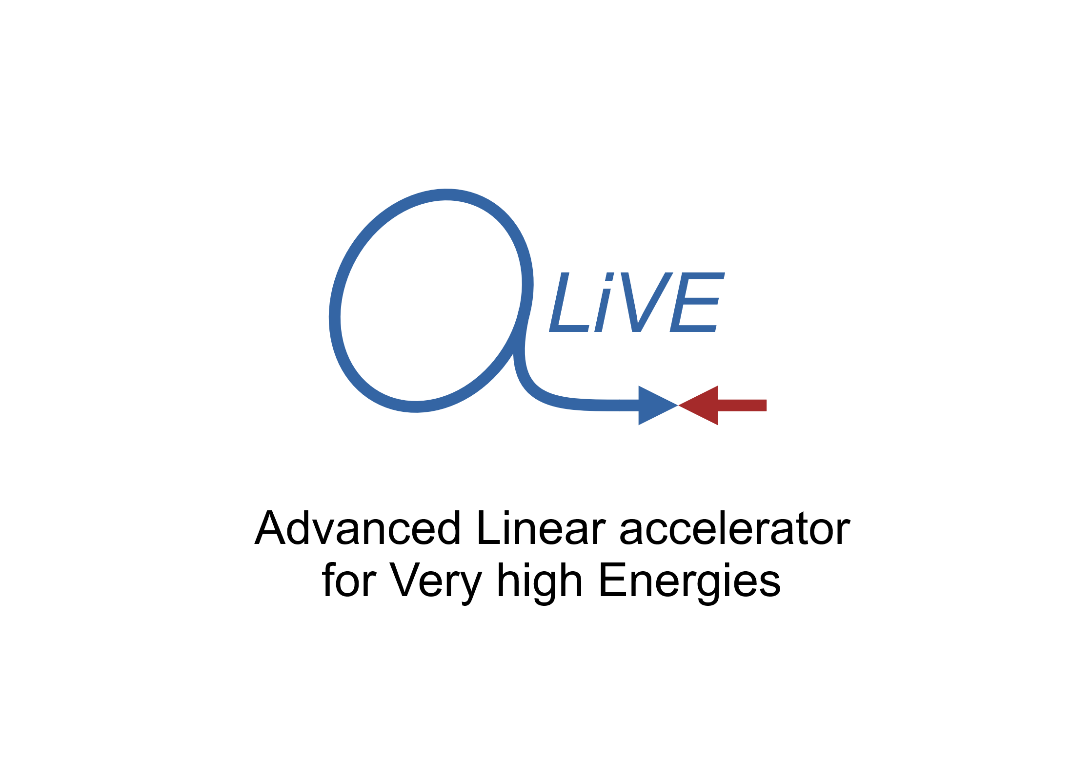


Motivation
Motivation
An electron-positron Higgs factory is the highest-priority next collider.
2020 Update of the European Strategy for Particle Physics

Slide 3
Outline
Motivation and introduction
Proton-driven wakefield acceleration
ALiVE: proof-of-concept
Towards a collider
Conclusions

Slide 4
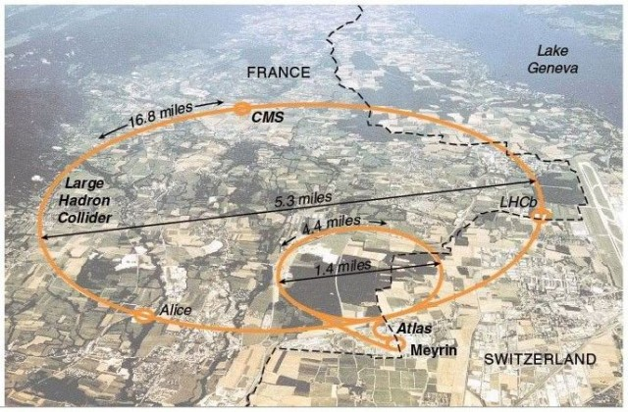
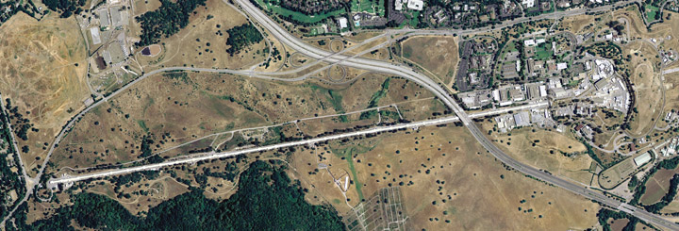
Motivation
Current state-of-the-art
for accelerators is the LHC
Why large?
Why hadrons?
Alternatively, use a linac.
Size determined by
acceleration gradient.

Slide 5
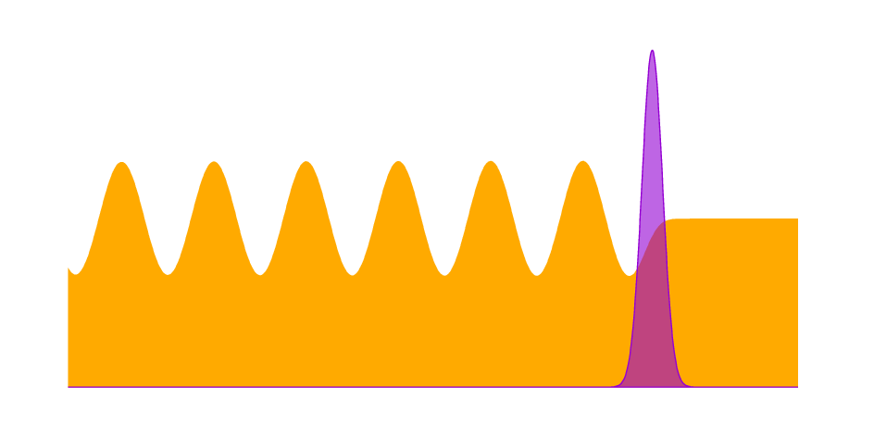
Plasma wakefield acceleration
Choice of drivers:
Laser pulse
Electron beam
Proton beam
High gradients not sufficient - need to maintain fields over long distances. Laser and electron drivers have insufficient energy to accelerate to collider-relevant energy.
Driver
Plasma

Slide 6
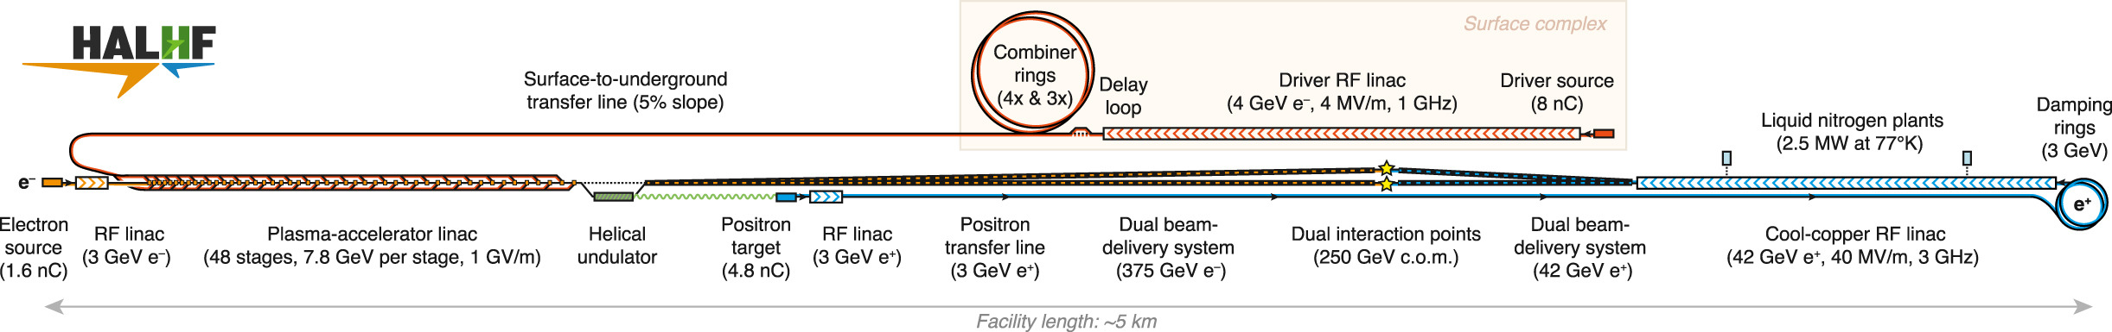
Plasma wakefield acceleration: staging
Foster et al., Physics Open (2025)
Limited driver energy can be overcome with “staging”.
HALHF is a good example: 48 plasma stages, each with a fresh 4 GeV electron driver, accelerate electrons to 375 GeV.

Slide 7
Plasma wakefield acceleration: staging
Staging introduces additional challenges:
lower average accelerating gradient
  development of new plasma lens technology
alignment tolerances become tighter at high energy
synchrotron losses in staging optics may become significant at high energy
Can we avoid it?

Slide 8

Plasma wakefield acceleration
Choice of drivers:
Laser pulse
Electron beam
Proton beam
Currently-available proton beams have sufficient energy to accelerate a witness to collider relevant energy in a single plasma stage. Comes with its own unique challenges.
Driver
Plasma

Slide 9

Plasma wakefield acceleration
Proton beams have plenty of energy
BUT available beams “too long”
to drive high-gradient wakefields
Short driver efficiently excites wakefield
Long driver suppresses its own wake

Slide 10
Plasma wakefield acceleration
Characteristic length is the plasma skin depth, 1/kp = c/ωp,
scales as n^{-1/2}.
Drive bunch should be ≈1/kp.
Characteristic field strength is mc²/e per 1/kp.
For competitive gradients
(E > 500 MV/m),
need sub-millimetre bunches.
Short driver efficiently excites wakefield

Slide 11
Plasma wakefield acceleration
Short proton bunches suitable for high-gradient wakefield acceleration don’t exist. Two options:
AWAKE:
Use long bunches and exploit plasma instabilities
ALiVE:
Motivate development of short proton bunches

Slide 12
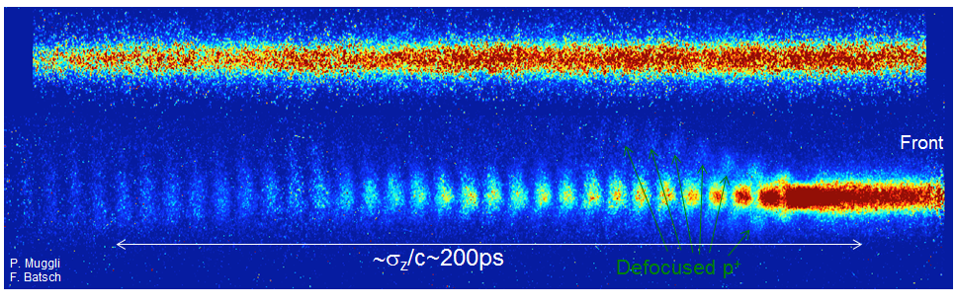
AWAKE
Plasma wake additionally provides focussing/defocussing fields
Resulting train of microbunches can drive large wakefields
Long proton beam
Self modulation instability
Train of short microbunches

Slide 13
AWAKE
AWAKE has first particle physics applications in the 2030s for fixed-target experiments.
Why not build an AWAKE collider?
Luminosity
SPS drive beam every ~30 seconds
SMI limits efficiency (driver loss and saturation)

Slide 14
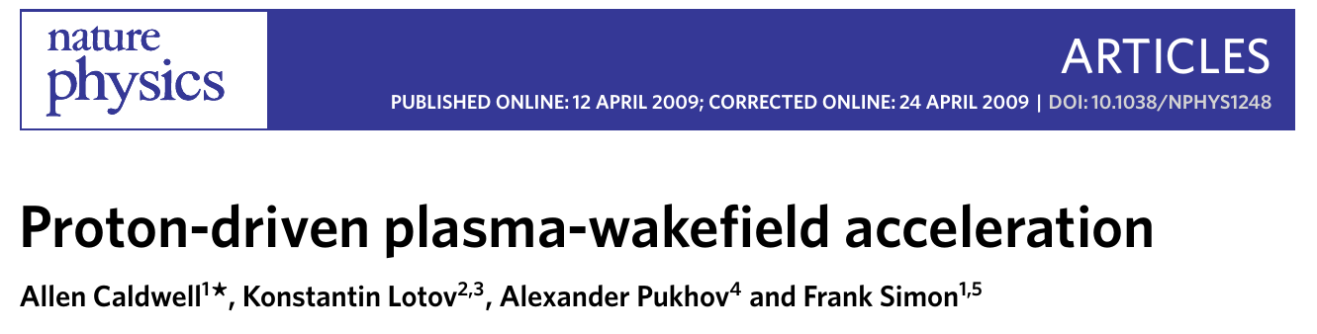
ALiVE: short proton drivers revisited
Caldwell et al. (2009)
A short proton wakefield driver is not a new idea (2009).
Predates AWAKE! So why now?
Developments in fast-ramping magnets would allow high-rep-rate (~5 Hz) proton beams. Would allow for competitive luminosities.
Piekarz et al. (2022)

Slide 15
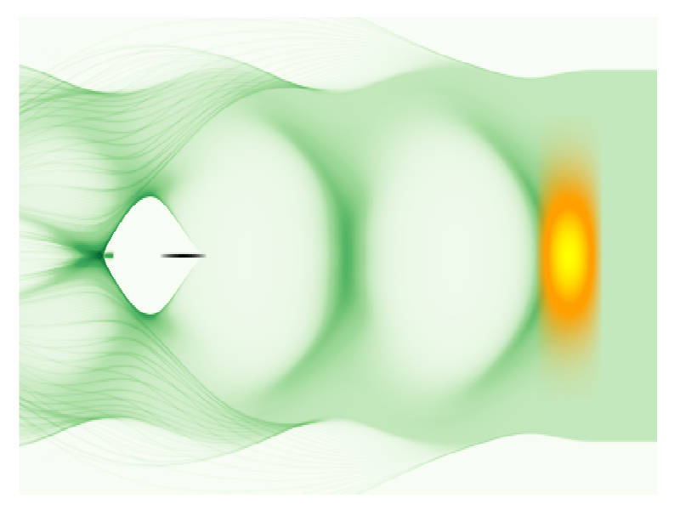
ALiVE: short proton drivers revisited
Short proton bunches suitable for high-gradient wakefield acceleration don’t exist.
Making these bunches isn’t impossible, but no-one is going to work towards this without some physics motivation.
Plasma simulations can play
a key role in demonstrating
the feasibility of the scheme.

Slide 16
Outline
Motivation and introduction
Proton-driven wakefield acceleration
ALiVE: proof-of-concept
Towards a collider
Conclusions

Slide 17
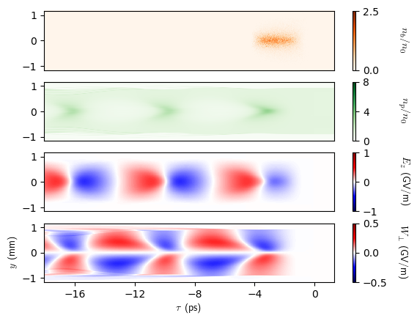
Stable wakefields
Initial proton driver chosen to generate suitable wakefields
Tailored profile
stable for 200 m
Acceleration limited by longitudinal dispersion.
s=200 m

Slide 18
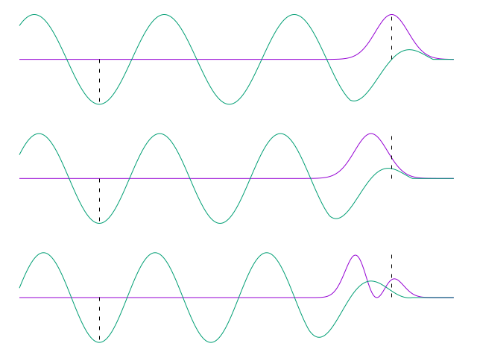
Stable wakefield phase
Protons are fast,
but not that fast.
Driver evolution
will also modify
wakefield phase.
Witness will “catch up”
ith the driver.
Change plasma density to keep phase constant

Slide 19
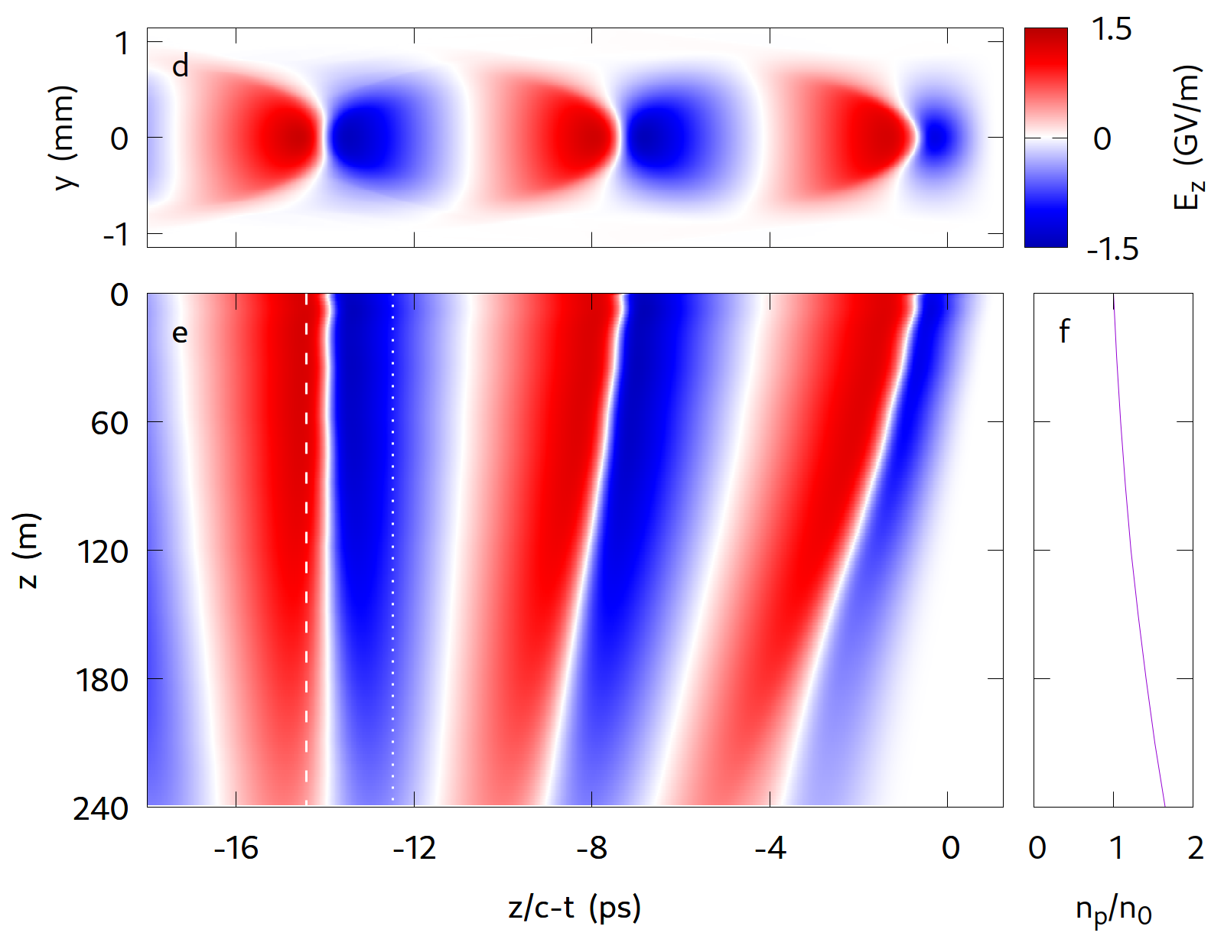
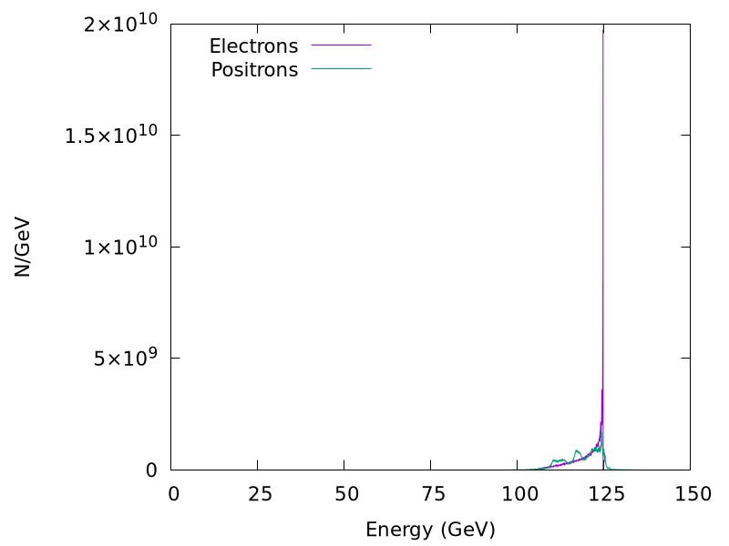
ALiVE: proof-of-concept simulations
10¹¹ protons at 400 GeV
(10% energy spread)
accelerate
10¹⁰ e+/e- to 125 GeV.
Farmer et al.,NJP (2024)

Slide 20
ALiVE: proof-of-concept simulations
Assume:
A suitable driver
moderate optimisation of the electron bunch
a solution for positron acceleration
gives a Higgs factory with a geometric luminosity
of 1.7x10³⁴ cm⁻²s⁻¹.
Preliminary investigation of a Higgs factory
based on proton-driven plasma wakefield acceleration
Farmer, Caldwell and Pukhov, New Journal of Physics (2024)

Slide 21
Outline
Motivation and introduction
Proton-driven wakefield acceleration
ALiVE: proof-of-concept
Towards a collider
Conclusions

Slide 22
ALiVE: towards a collider
Acceleration is necessary, but not sufficient.
Luminosity
proton source
witness energy spread
witness emittance control and disruption
Beyond Higgs
efficiency

Slide 23
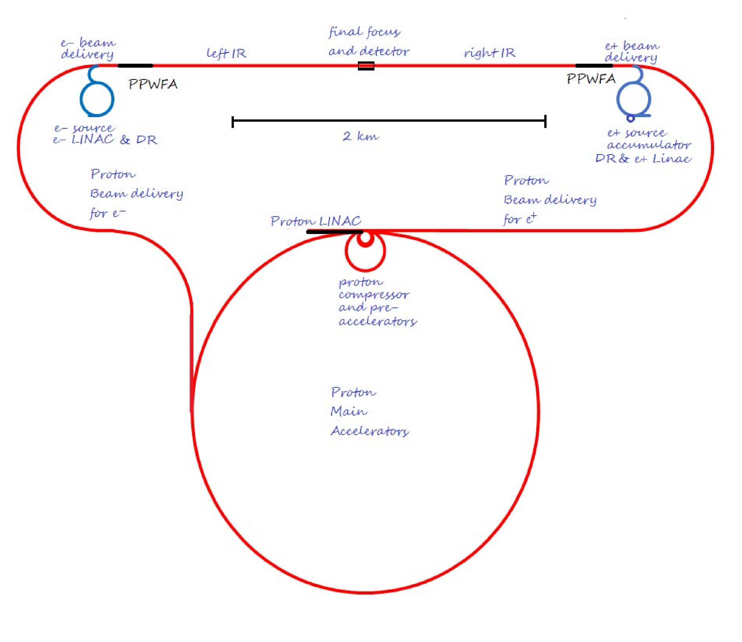
Proton source
Even with modern HTS
magnets, fast-ramping
synchrotron probably
isn’t fast enough.
Alternative is to use a
Fixed-Field Alternating-Gradient
accelerator (FFAG/FFA).
No need to ramp up, each bunch follows the same spiral trajectory.
Ferdinand Willeke
ALiVE input to the EPPSU

Slide 24
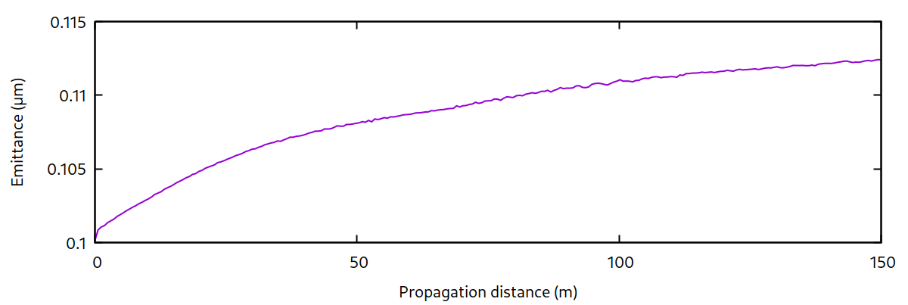
ALiVE: emittance control
Electron bunch drives its own blowout
→ emittance control
ALiVE builds on AWAKE:
emittance control in AWAKE Run2c
Extreme witness fields
leads to ion motion.
Emittance growth can be managed for round beams.
Farmer et al., Proc LCWS (2024)

Slide 25
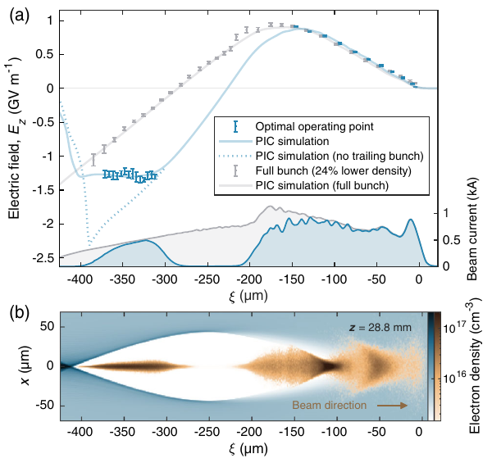
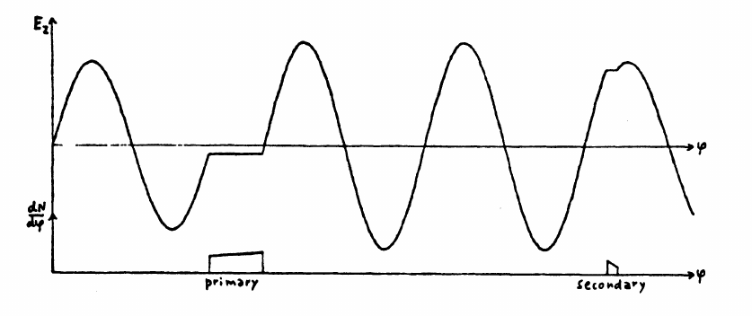
ALiVE: energy spread
Solution is known, shape beams
to flatten wakefields.
Optimisation problem.
van der Meer, CLIC Note No. 3 (1985)
Lindstøm et al., PRL (2021)

Slide 26
ALiVE: the positron problem
Positron acceleration in plasma remains an issue,
one of the ”Grand Challenges” of wakefield acceleration.
Community-wide effort on this, including methods to avoid the problem:
e⁻e⁻ / ɣɣ collider
HALHF approach – use RF for positrons

Slide 27
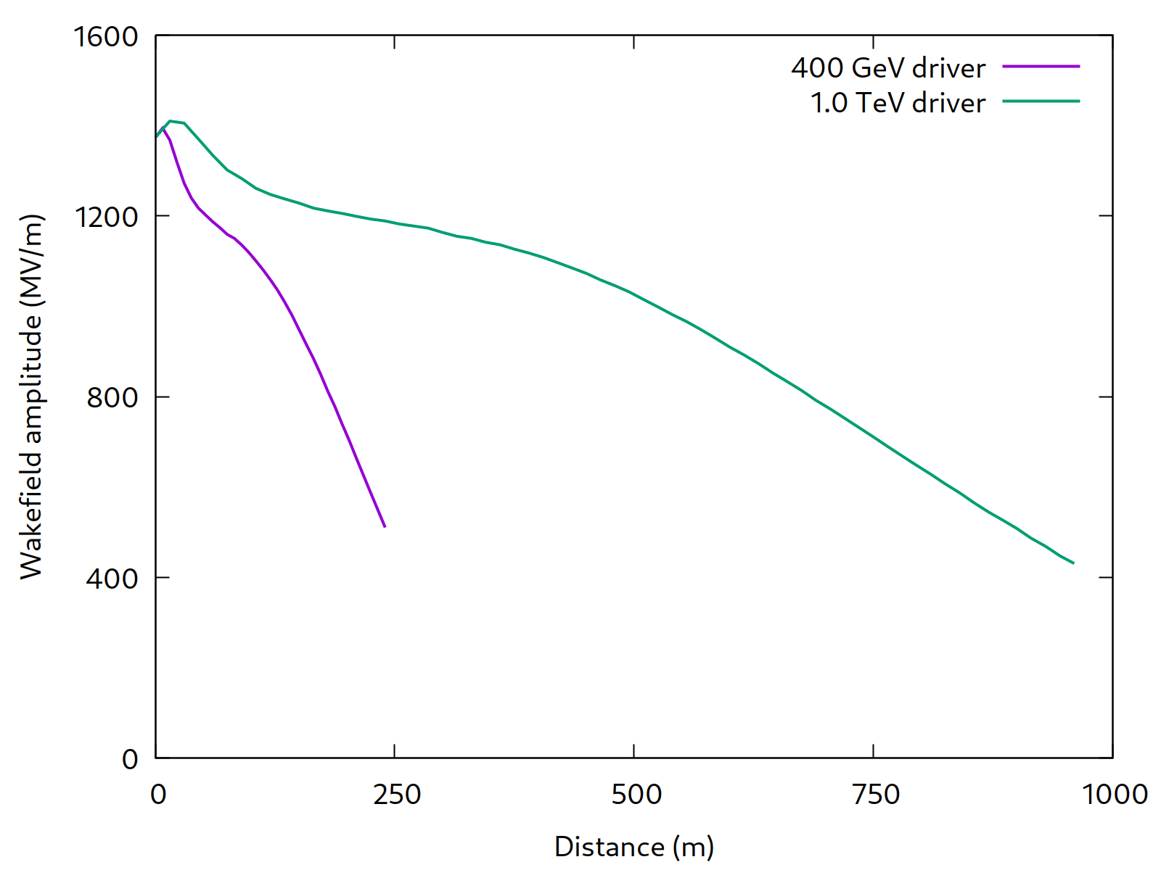
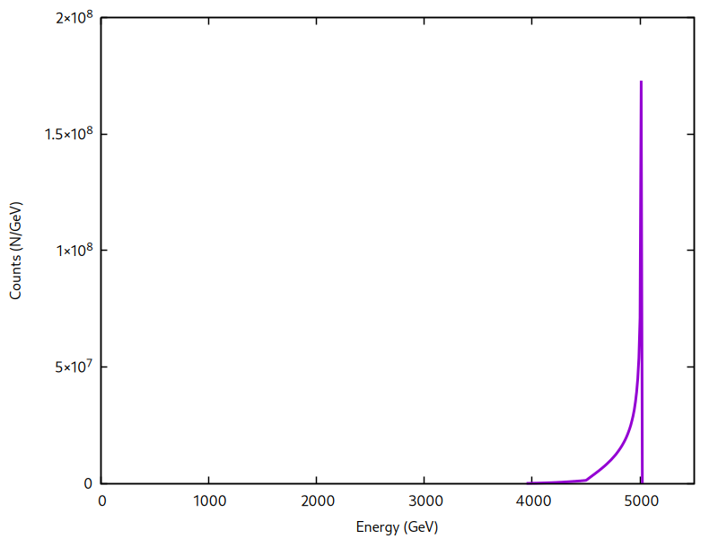
ALiVE: beyond Higgs
Acceleration is limited by longitudinal dispersion
→ better than linear scaling with driver energy
6.8 TeV driver allows
e⁻ acceleration to 5 TeV
2.5 x more driver energy,
~4x more witness energy

Slide 28
Conclusions
Significant R&D still required, but the question is now
less “is this possible?”, but “is this competitive?”
Requires significant optimisation, start-to-end simulations,
detailed plans.
Plenty of exciting work, and move towards fixed parameters helps focus the community effort.

Slide 29
Conclusions
Preliminary investigation of a Higgs factory
based on proton-driven plasma wakefield acceleration
Farmer, Caldwell and Pukhov, New Journal of Physics (2024)
Proton-Driven Plasma Wakefield Acceleration
for Future HEP Colliders
Caldwell, Farmer, Lopes, Pukhov, Willeke, Wilson, Input to the EPPSU (2025)
The next big thing™
You?

