Slide 1


Experimental Progress of Passive Plasma Lens at FACET-II
EAAC 2025
Sep. 25, 2025
Elba, Italy
Authors: Michael Litos (speaker, CU Boulder), Shutang Meng(CU Boulder)
On behalf of E-308 collaboration
Notes:
Done

Slide 2
Co-Authors
Alexander Knetsch (SLAC National Accelerator Laboratory) Brendan O'Shea (SLAC National Accelerator Laboratory) Chandrashekhar Joshi (UCLA) Chaojie Zhang (UCLA) Christopher Doss (Lawrence Berkeley National Laboratory) Claire Hansel (University of Colorado Boulder) Claudio Emma (SLAC National Accelerator Laboratory) Doug Storey (SLAC National Accelerator Laboratory) Elena Ros (University of Colorado Boulder) Erik Adli (University of Oslo, Norway) Jiawei Cao (UiO) Ken Marsh (UCLA) Mark Hogan (SLAC National Accelerator Laboratory) Nathan Majernik (SLAC National Accelerator Laboratory) Robert Ariniello (SLAC National Accelerator Laboratory) Prof. Sebastien Corde (Laboratoire d'Optique Appliquée) Spencer Gessner (SLAC) Thamine Dalichaouch (University of California Los Angeles) Valentina Lee (University of Colorado, Boulder)
(Apologies if incomplete!)

Slide 3

Research Funding and Facility Credit
U.S. Department of Energy, Office of Science, Office of High Energy Physics, under Award Number DE-SC001796.
This research used resources of the Facility for Advanced Accelerator Experimental Tests II (FACET-II), which is a DOE Office of Science User Facility.

Slide 4
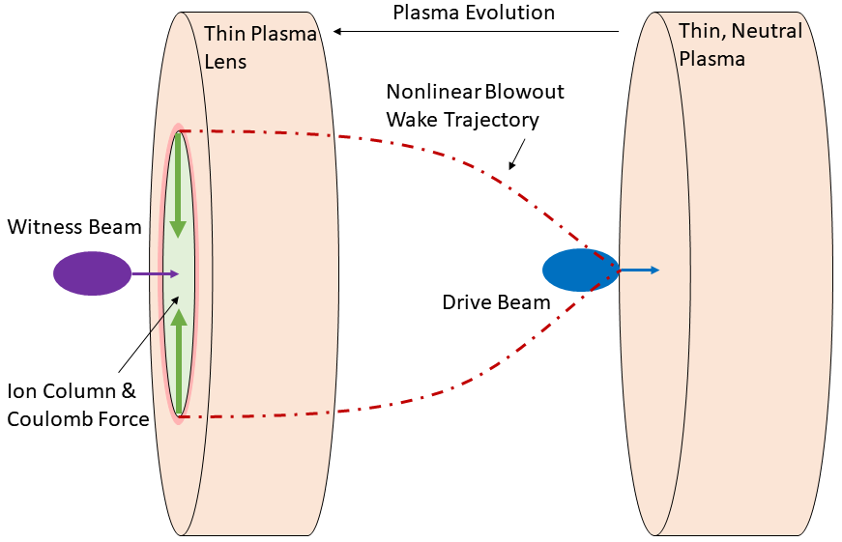
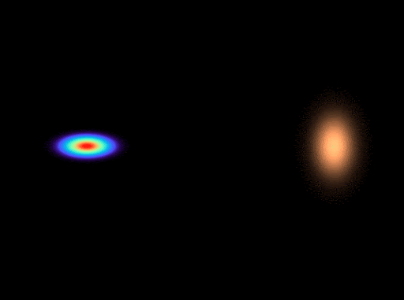
Thin, Underdense, Passive Plasma Lens (TUPPL)
Thin – PWFA much shorter than one betatron period
Underdense – Nonlinear blowout regime
Passive – No reliance on externally driven current
Plasma Lens – Transverse focusing impulse with negligible energy change

Slide 5
Thin, Underdense, Passive Plasma Lens (TUPPL)
Thin – PWFA much shorter than one betatron period
Underdense – Nonlinear blowout regime
Passive – No reliance on externally driven current
Plasma Lens – Transverse focusing impulse with negligible energy change

Slide 6
Attractive Features of TUPPL
Extremely strong focusing
  Orders of magnitude beyond electromagnets, PMQs, APL
Axisymmetric focusing
  Single lens can achieve symmetric focus in x & y
Ultra-compact
  Plasma lens itself: ~400 µm
  Gas jet & laser hardware: <1 cm footprint along beam line
Rapidly and easily tunable
  Strength scales with density → gas pressure
  Strength scales with length → laser energy / focus/ height above gas jet
  Density length product → plasma expansion
Self-aligning
  Central axis of blowout determined by electron beam

Slide 7
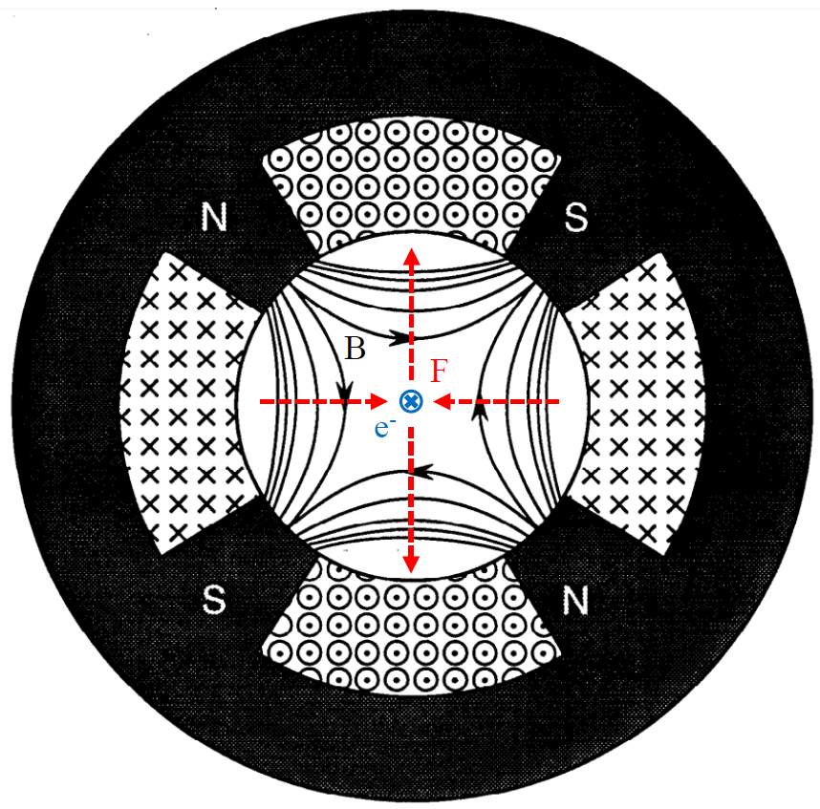

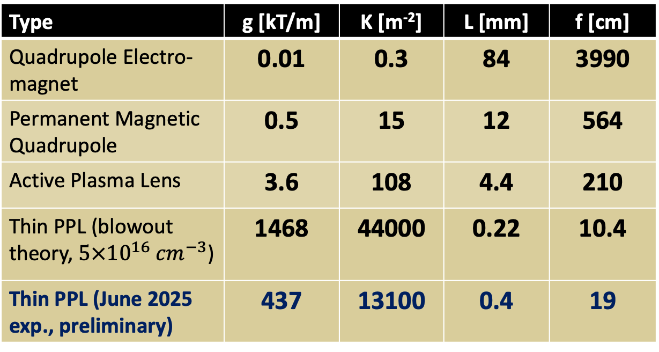
Comparison to other focusing optics
PPL focusing strength is orders of magnitude stronger than magnets of equivalent phase advance (normalized length).
Phase advance (normalized length):
$$∆ψ=\sqrt{K}L=0.0458$$
Quadruple Magnet
Type | g [kT/m] | K [m⁻²] | L [mm] | f [cm]
Quadrupole Electro-magnet | 0.01 | 0.3 | 84 | 3990
Permanent Magnetic Quadrupole | 0.5 | 15 | 12 | 564
Active Plasma Lens | 3.6 | 108 | 4.4 | 210
Thin PPL (blowout theory, $5×{10}^{16} {cm}^{−3}$) | 1468 | 44000 | 0.22 | 10.4
Thin PPL (June 2025 exp., preliminary) | 437 | 13100 | 0.4 | 19
Adapted from Taylor, SLAC-PUB-5621 (1991)

Slide 8
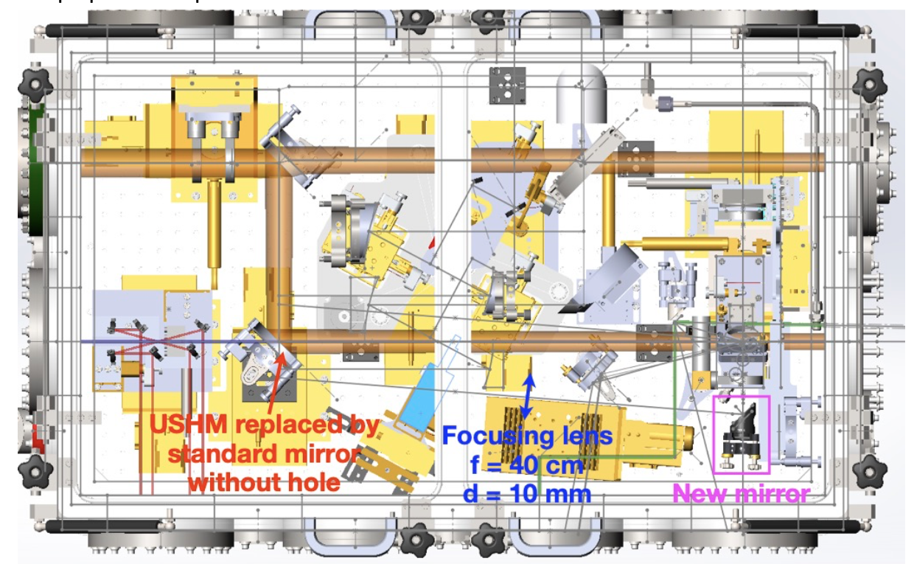
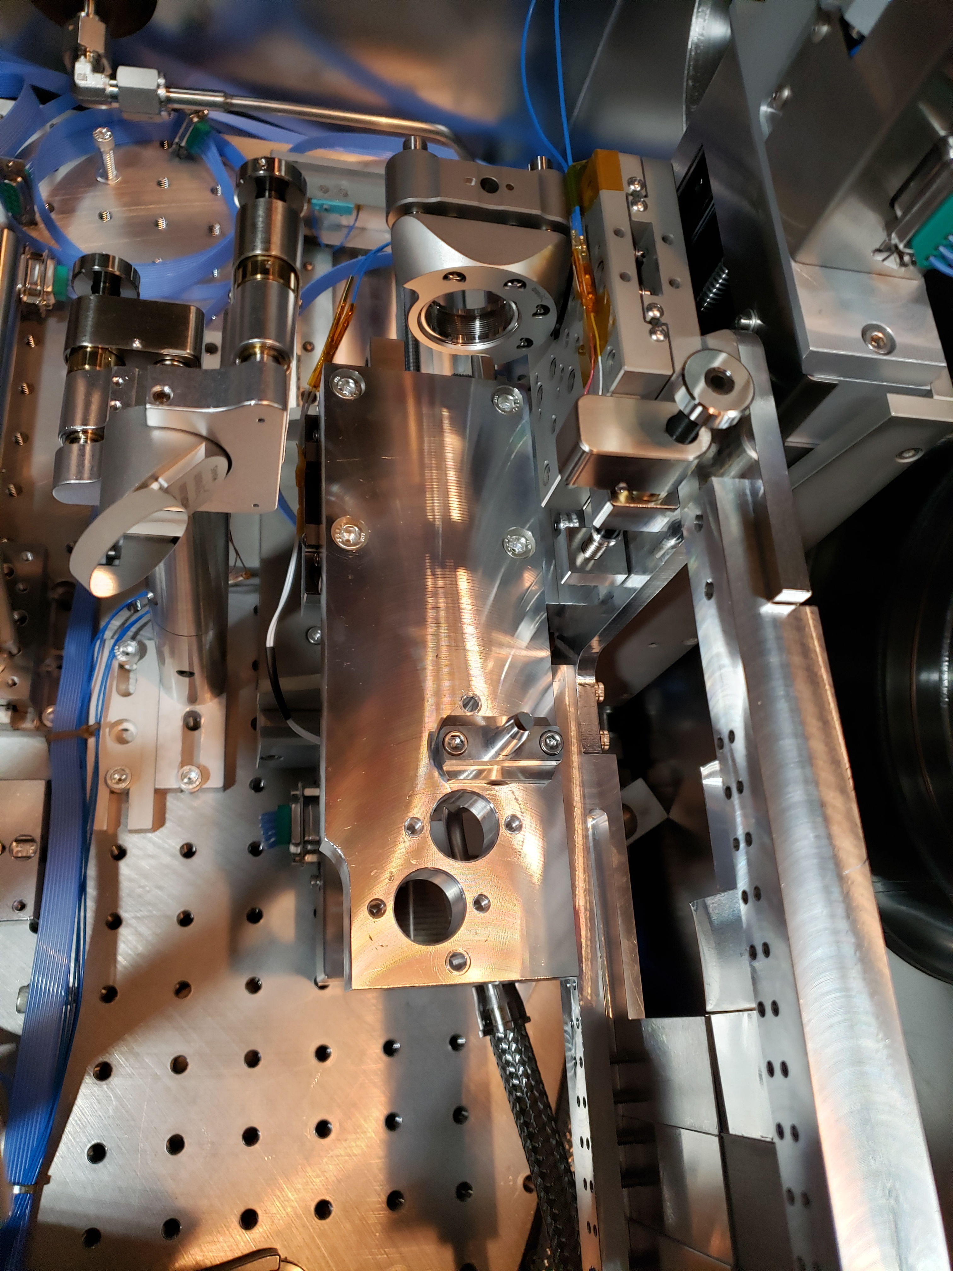
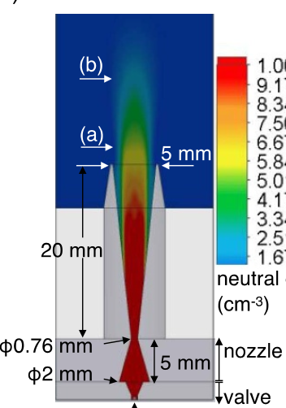
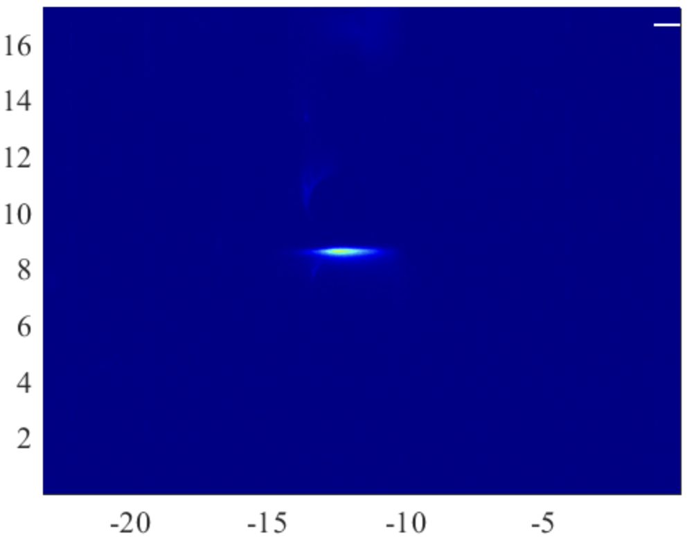

Ε-308 Experimental Setup
Laser-ionized H₂ gas jet
Chaojie Zhang et al 2021 Plasma Phys. Control. Fusion 63 095011
Laser, 3 mJ
5mm $D_{exit}$; ~50 psi
E-beam
Top view
Laser
Plasma
E-beam

Slide 9
Plasma Requirements
Maximize focusing strength: minimize focal length → maximize n_{p}L
Remain in thin lens regime: keep phase advance ≲ 0.2 → keep sqrt(n_{p})L low
Remain in underdense blowout regime: 2 n_{p} ≲ n_{b} → keep n_{p} sufficiently low
Summary: Requirements push toward lower density and longer length.
Experimental conditions made it challenging to optimize n_{p} and L.
Result: operated in overdense thin lens regime during previous run.
Improved modeling, diagnosis, and control of plasma source expected next run.

Slide 10
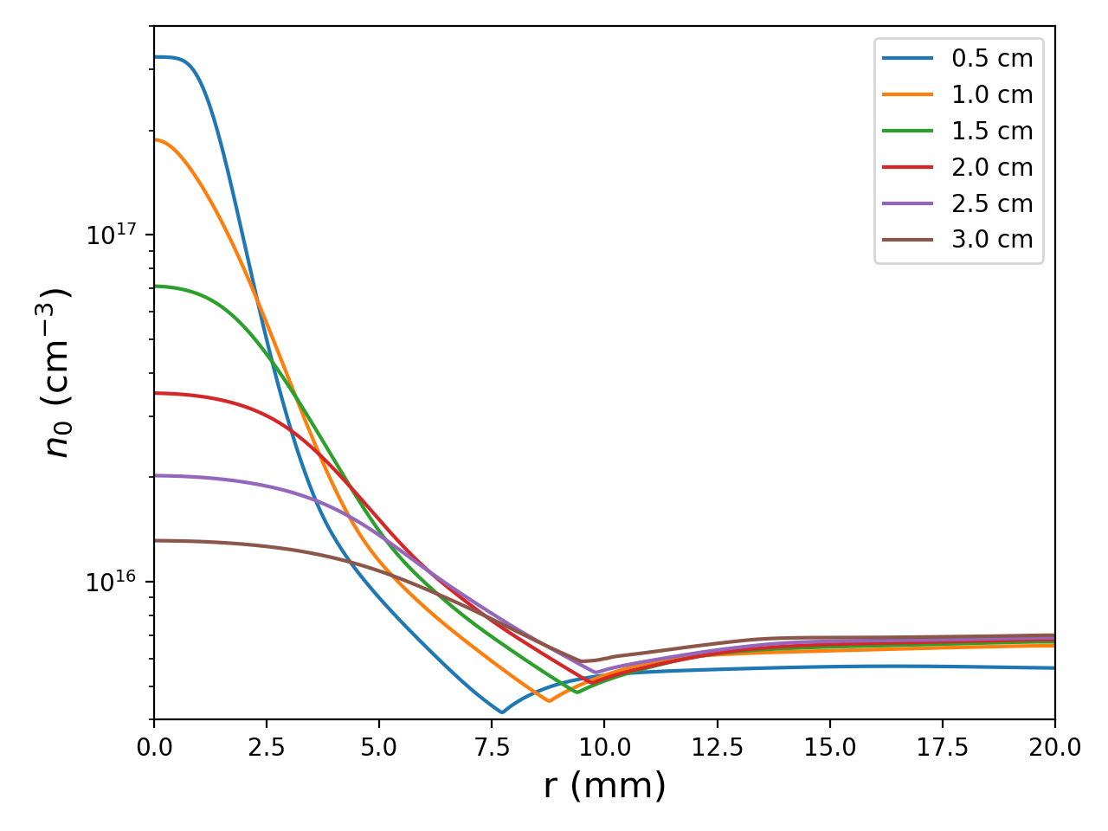
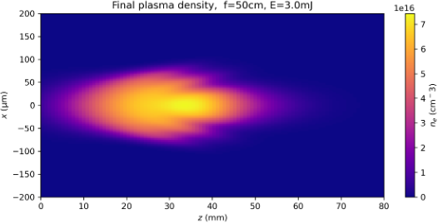
Plasma Source Modelling
Laser energy was limited to 3 mJ to avoid damaging final mirror
→ limited initial plasma lens length
Fluid models used to estimate gas density above jet nozzle, but large uncertainty on backing pressure in experimental device (no local gauge)
Challenging to reach low densities with minimum operating backing pressure
Solution: ionize small volume at high density and allow plasma to expand
Split-step Fourier ionization code
Radial neutral density profile
Fluent simulation
E-beam
Max L: 132 um
assume 1e17
Need to rely on plasma expansion to reach target plasma length ~ 500 um.
Laser

Slide 11
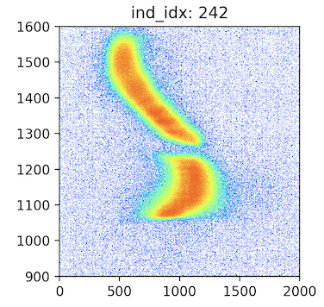
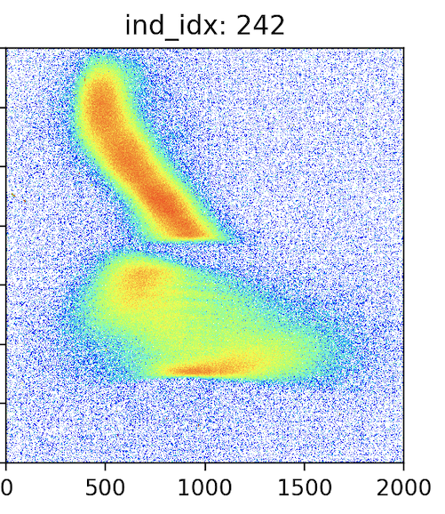
Plasma Length Estimation
Laser / e-beam arrival delay scan performed to find good working point
  Set electron imaging spectrometer to parallel-to-point
  Scanned delay and looked for strong divergence increase of witness beam
Two different Working Points (WP) studied:
Both produced very similar results
Laser position scan performed to estimate plasma lens length
  Assumed azimuthally symmetric plasma profile w.r.t. laser axis, perp. to e-beam
  Translated laser above/below e-beam axis until interaction ended
  Measured movement of laser to find the plasma length L ≈ 400 µm for both WP’s
No Interaction
Interaction
Drive
 | Working Point 1 | Working Point 2
Nozzle Height | -1.5 cm | -1.0 cm
Delay Time | 3 ns | 20 ns
E
Wit.
x’
x’

Slide 12
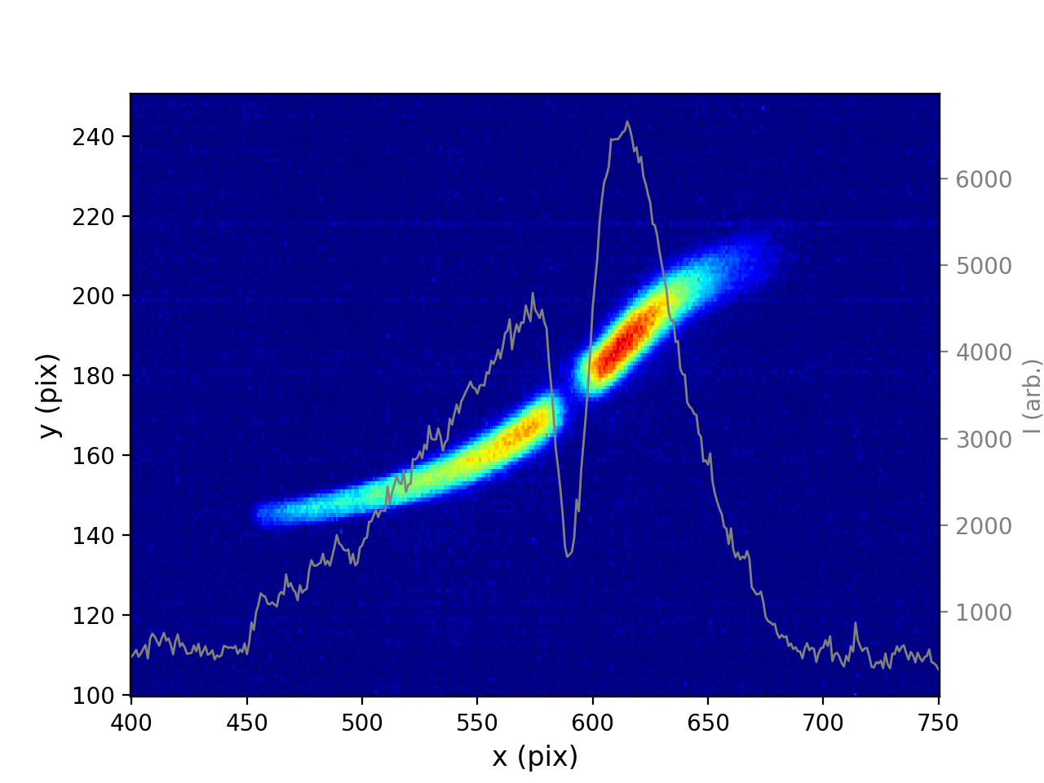
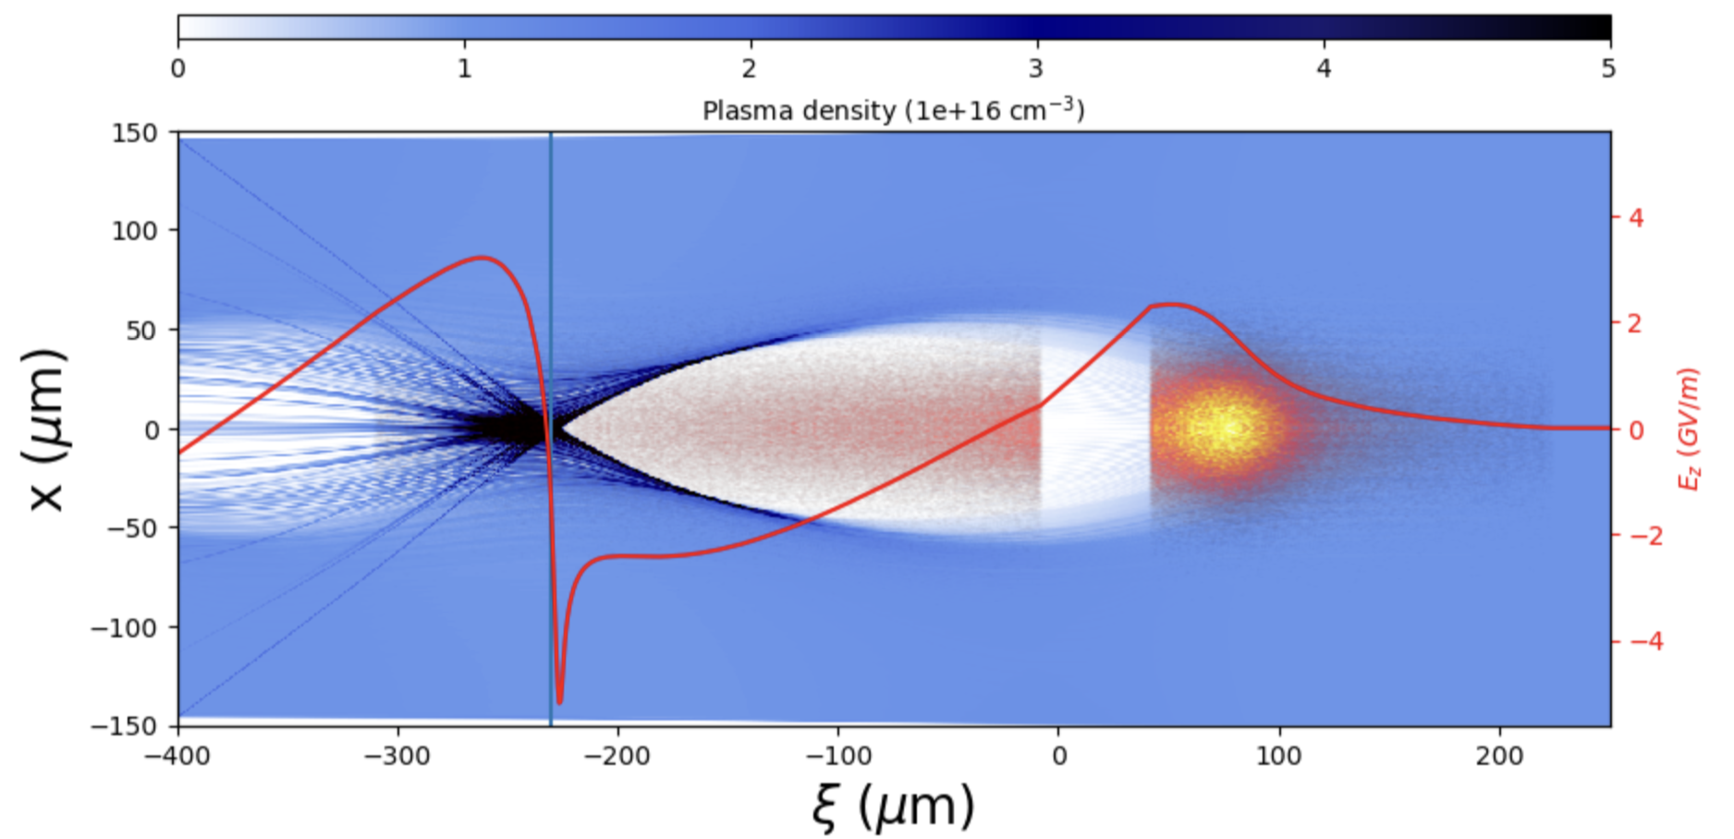
Electron Beam Configuration: Two Bunches
Two-bunch configuration generated using notch collimator with chirped beam
Long, roughly linearly chirped witness beam
Can sample long region inside wake
Chirp permits longitudinally resolved measurement of focusing with imaging spectrometer
TCAV measurement
PIC Simulation
(HiPACE++)
Drive
Witness
time
Drive Bunch: ~780 pC
Witness Bunch: ~650 pC
Δz gap: ~40 µm

Slide 13
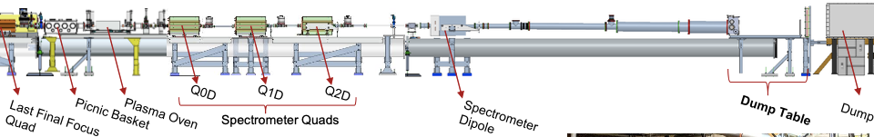
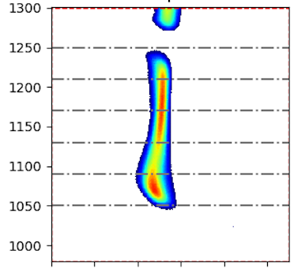
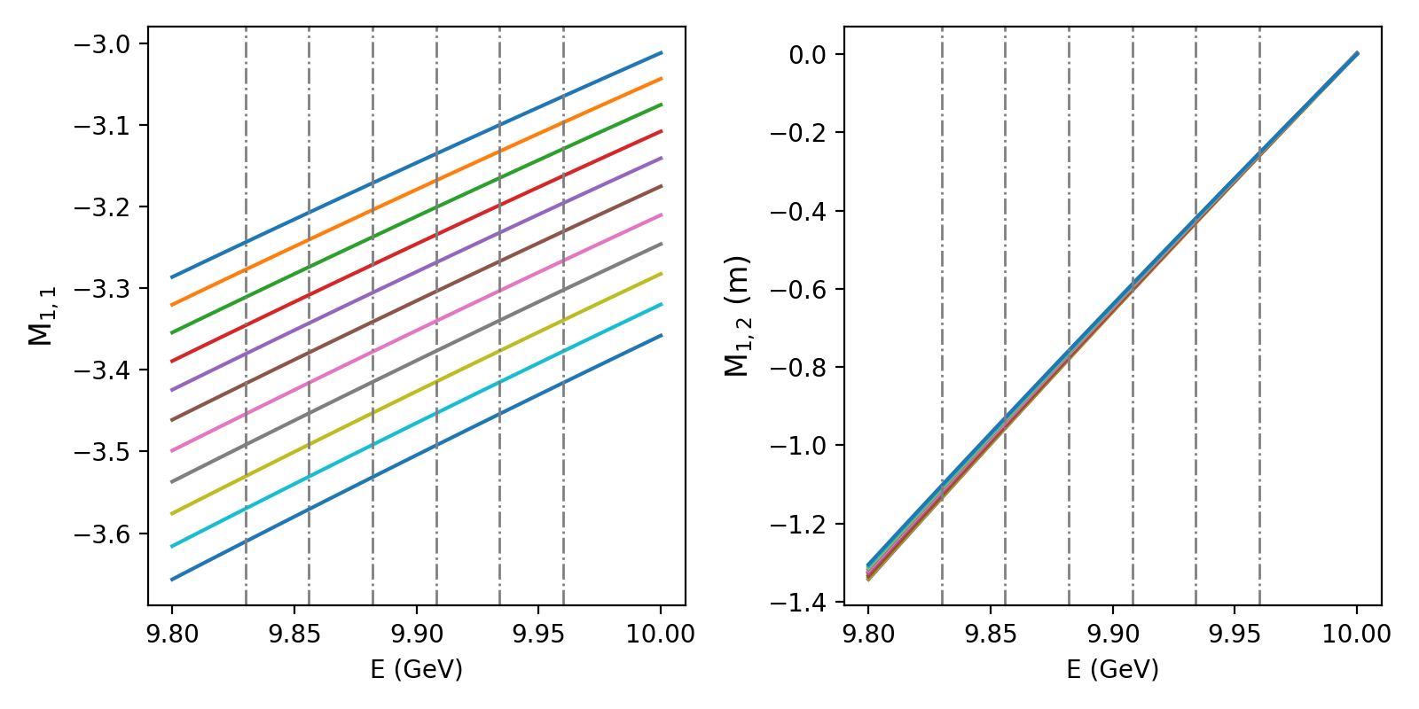
FACET-II Electron Imaging Spectrometer
Plasma Lens
Beam Direction
OTR Screen
Dispersed beam after Imaging Spectrometer
Chromaticity for object plane scans from z_{lens} to z_{lens} + 50 cm
Point-to-Point scans of object plane and Parallel-to-Point scans of M₁₂ were performed to analyze beam dynamics.
Chromaticity of imaging spectrometer must be taken into account during analysis.
E
x

Slide 14
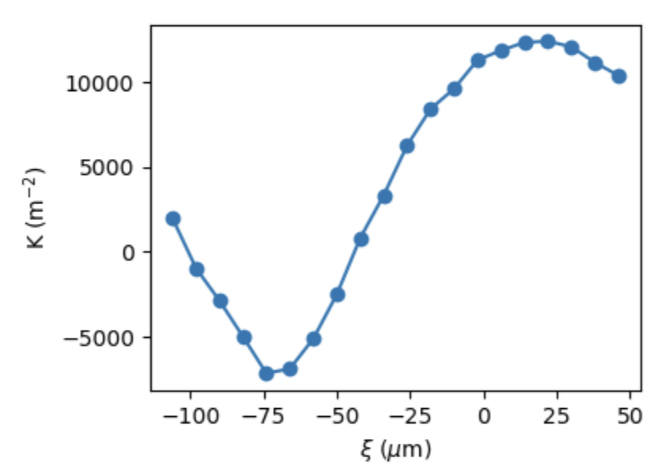
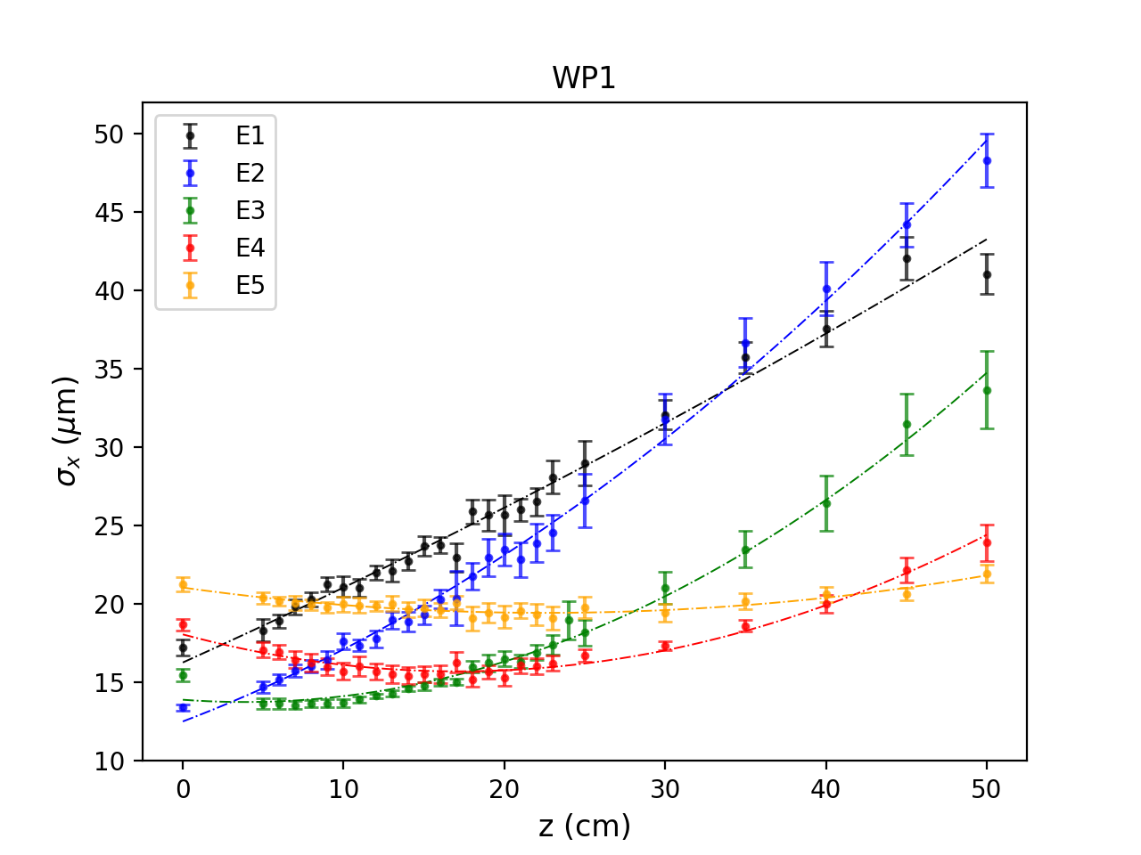
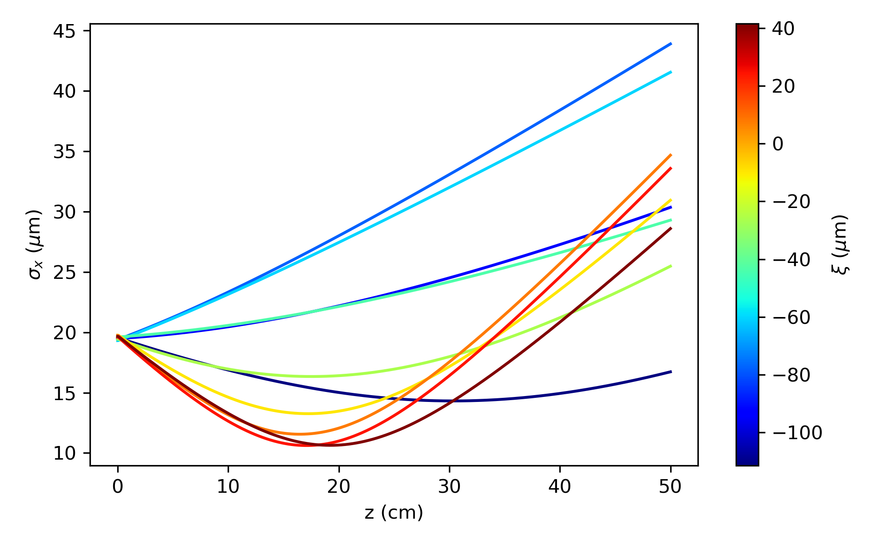


Strong Focusing of Witness Beam
Object plane scan preliminary results (still need chromatic correction)
Observed strong focusing of 200-300 pC witness bunch
Reduced min. spot size to σ* ≈ 11-14 µm from initial value of 20 µm
Reduced min. beta function to β* ≈ 14-21 cm from initial value of 75 cm
Moved waist upstream by 20-30 cm
Rear of witness beam was beyond first wake period and defocused
Focusing along bunch
front
rear
WP1 Data
PIC simulation results
No chromatic correction
$σ^{∗}\sim 11$ um
$β^{∗}\sim$ 14 cm
$σ^{∗}\sim 14$ um
$β^{∗}\sim$ 21 cm
First wake
E5: front
E1: rear
Defocused

Slide 15
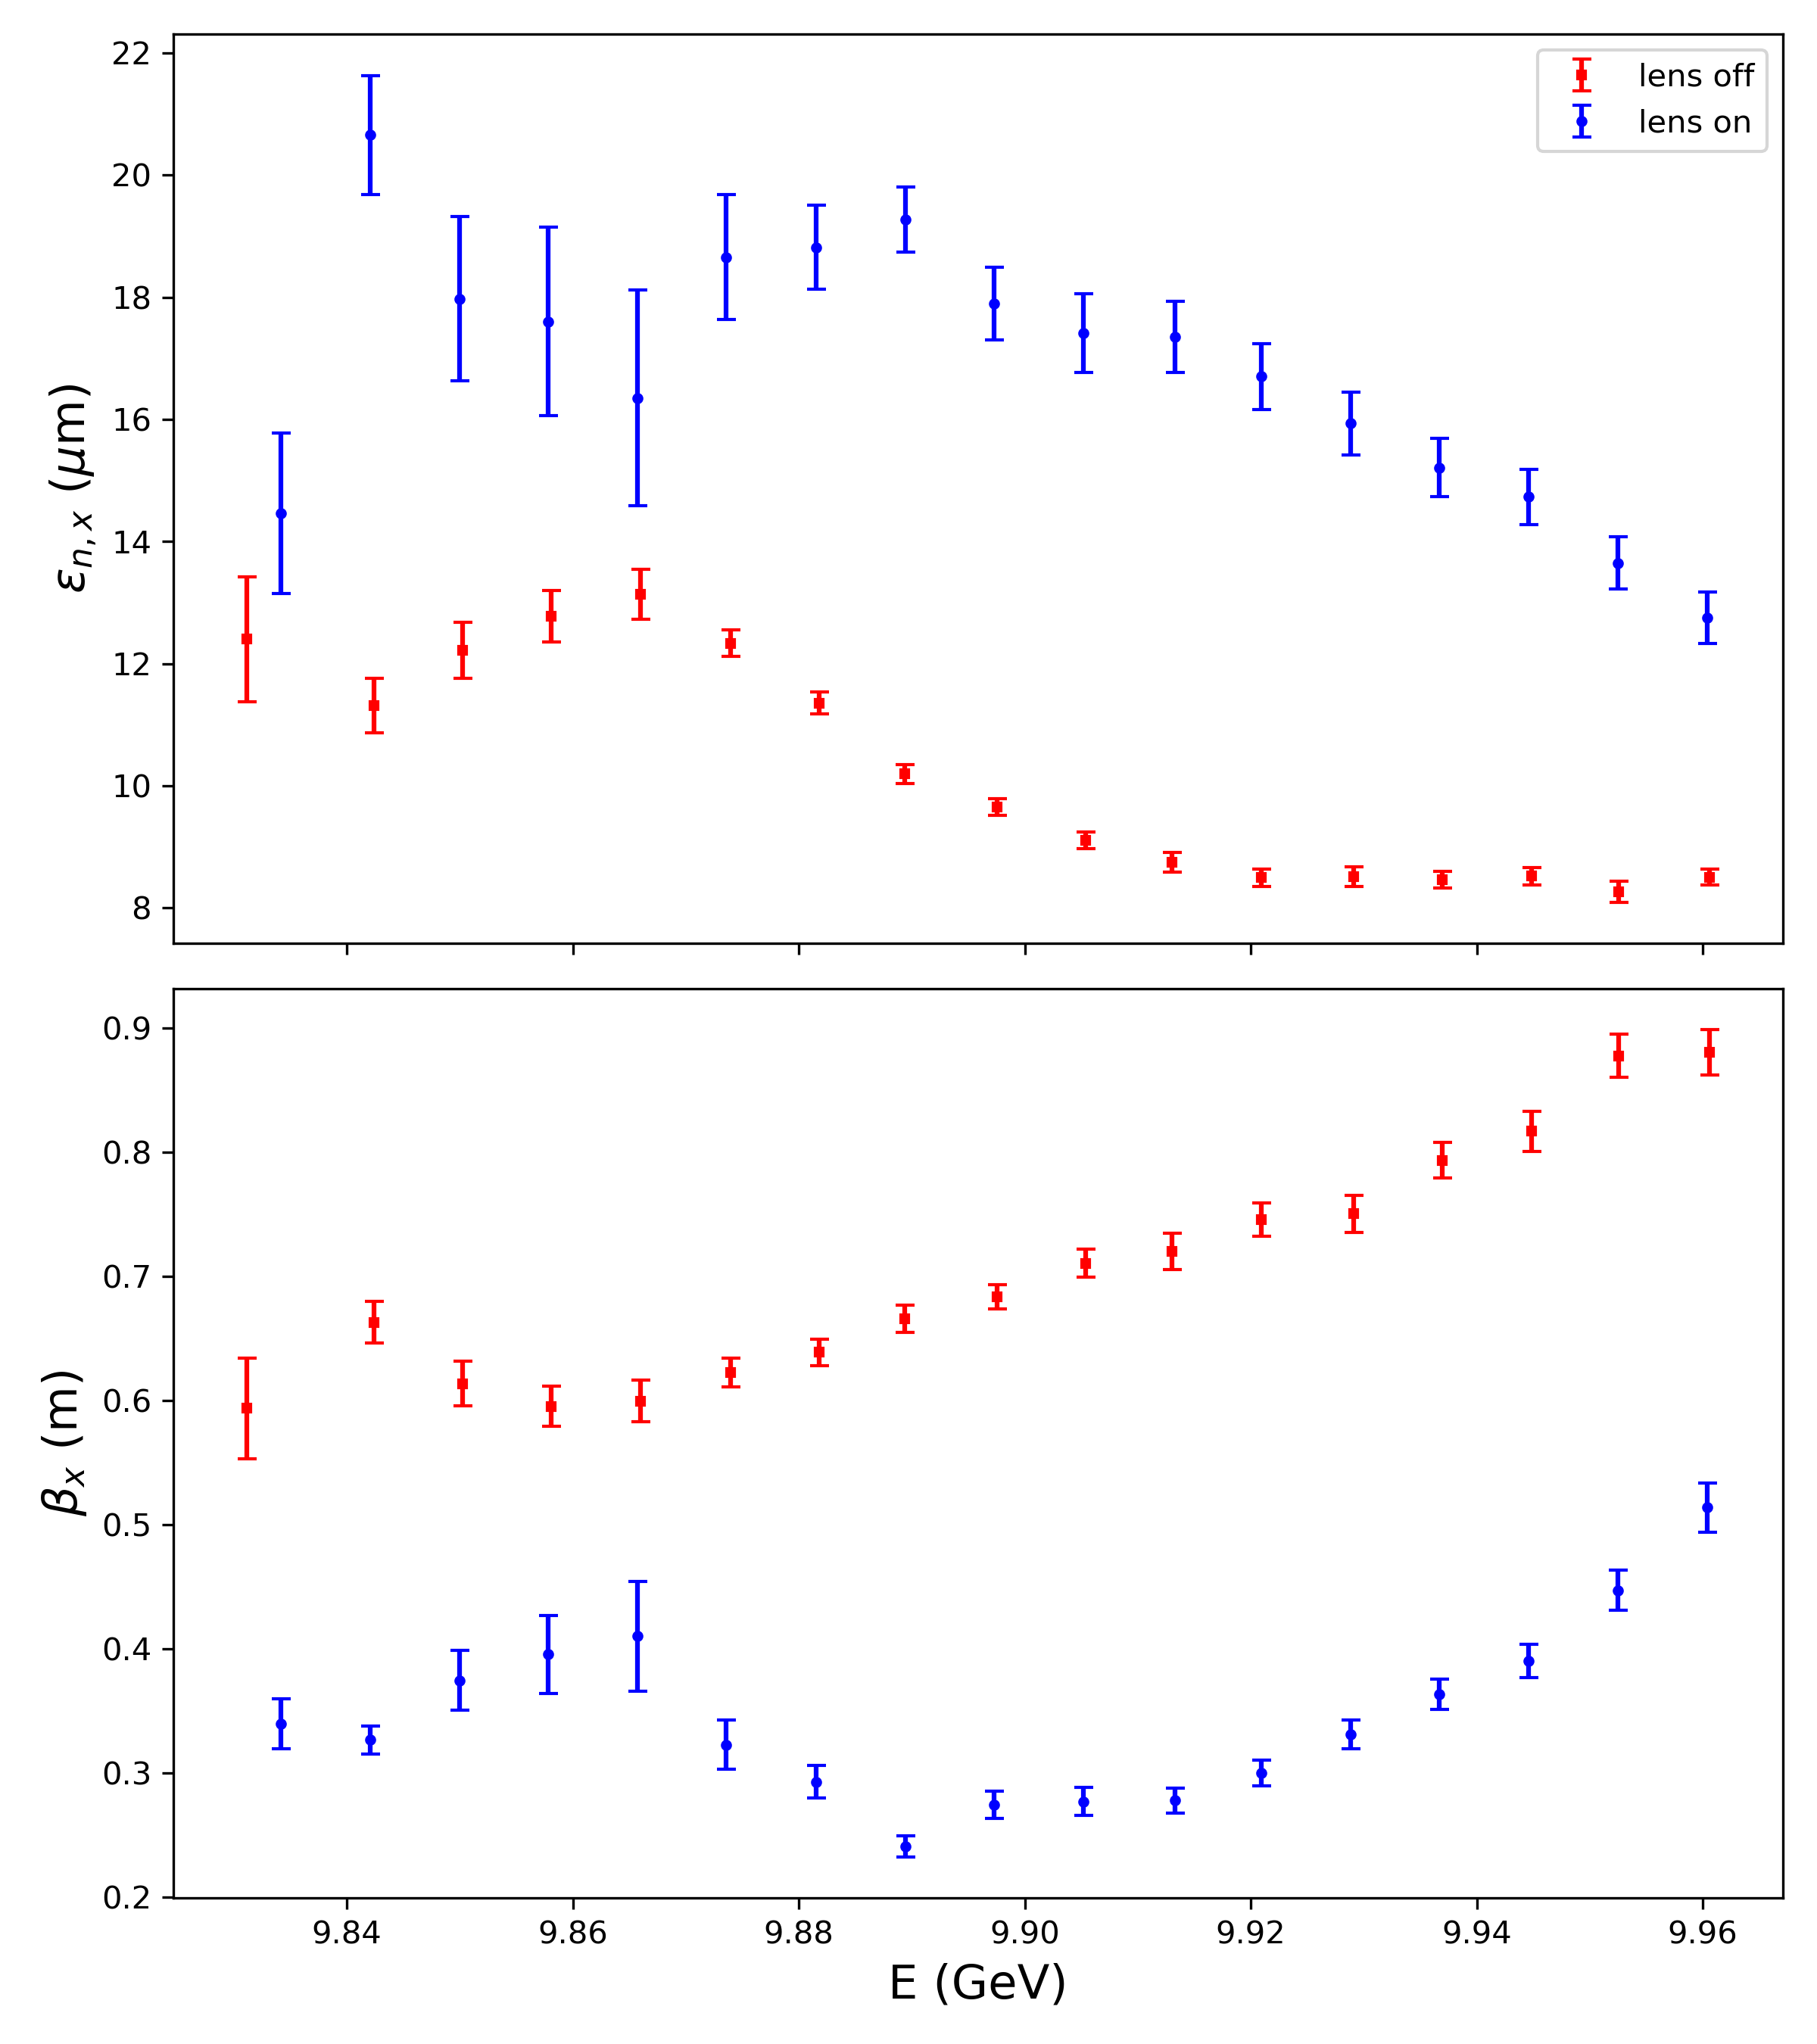
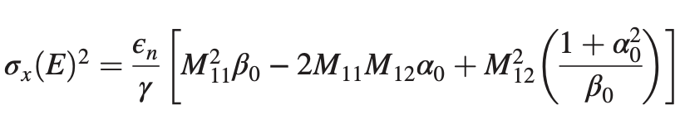
Witness Bunch Emittance Analysis
Data Analysis:
Analyzed emittance of 20 energy slices of ~10 MeV
Used object plane and M₁₂ scan data
Fit to equation:
Preliminary Observations
Significant emittance growth in plasma lens
  Roughly factor of 2
  Not in underdense regime
  k_{p} σ_{r} ≳ 1
Beta function reduced due to emittance growth in addition to focusing
WP1 Witness Bunch Emittance
rear
front

Slide 16
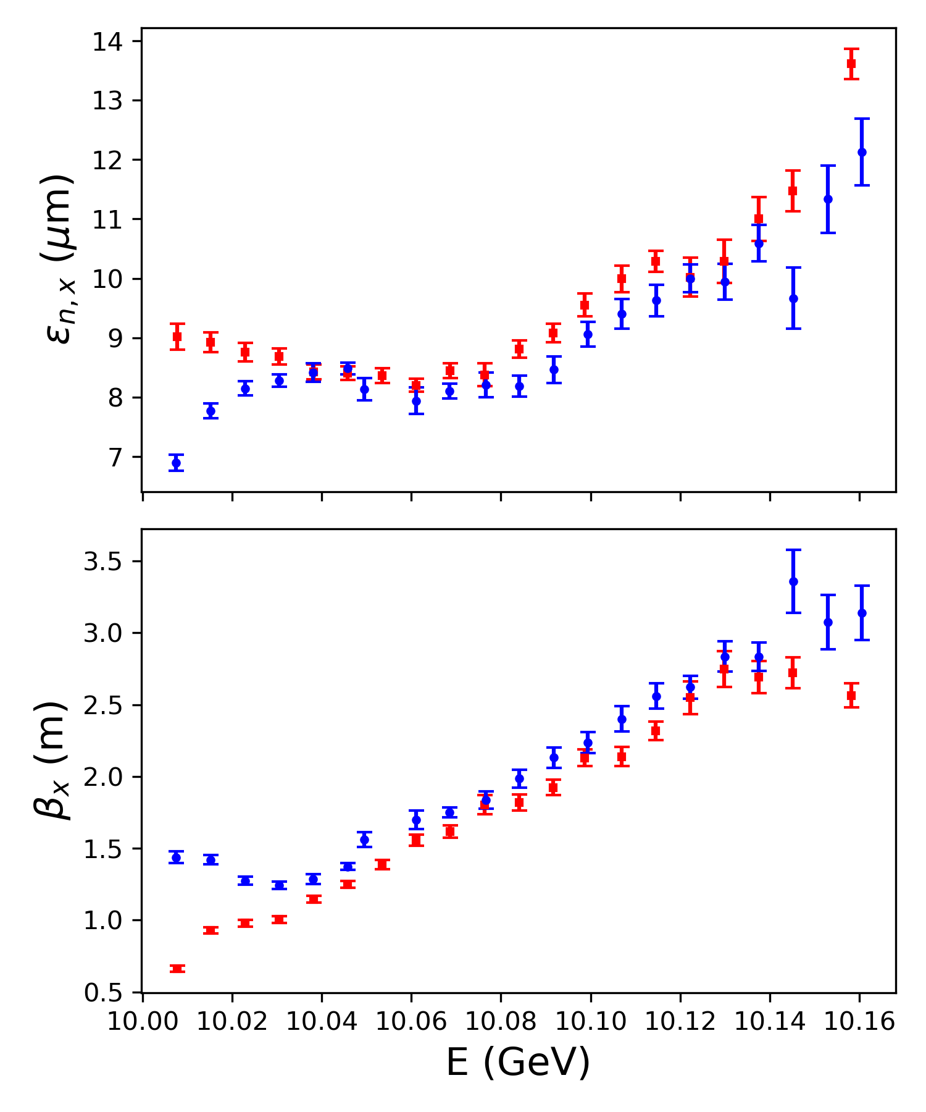
Drive Bunch Emittance Analysis
WP1 Drive Bunch Emittance
Preliminary Observations
No appreciable growth for most of the bunch
Small emittance growth at very tail of bunch
Strong wake must start to develop near tail of drive bunch
Agrees well with simulations
rear
front

Slide 17
Summary
Observed strong focusing of witness bunch in a thin, passive plasma lens
  200-300 pC, σ*: 20 µm → 11-14 µm, β*: 75 cm → 14-21 cm, Δz*: 2-30 cm
  Preliminary results – chromatic correction required
Did not reach the underdense blowout regime
  Emittance growth by factor of ~2 due to nonlinear focusing fields
  Tail of bunch extended beyond first wake period
Expect optimized performance in underdense regime next run
  Better plasma source modeling, diagnostics, and control
  Will lower plasma density and increase length
Will eventually use in combination with other experiments at FACET-II
  Strong focusing for matching into a PWFA
  Focusing boost prior to multi-foil transition radiation focusing device
  Asymmetric driver and blowout (w/ Pratik Manwani, UCLA)
  Transverse gradient TUPPL
  Divergence control of plasma-injected beams

Slide 18
Publications
S. Meng, et al., [strong focusing with a passive plasma lens, in preparation]
C. E. Doss, et al., “Laser-ionized, beam-driven, underdense, passive thin plasma lens”, Phys. Rev. Accel. Beams 22, 111001 (2019) https://doi.org/10.1103/PhysRevAccelBeams.22.111001
C. E. Doss, et al., “Underdense plasma lens with a transverse density gradient”, Phys. Rev. Accel. Beams 26, 031302 (2023) https://doi.org/10.1103/PhysRevAccelBeams.26.031302

Slide 19
Publications

Slide 20
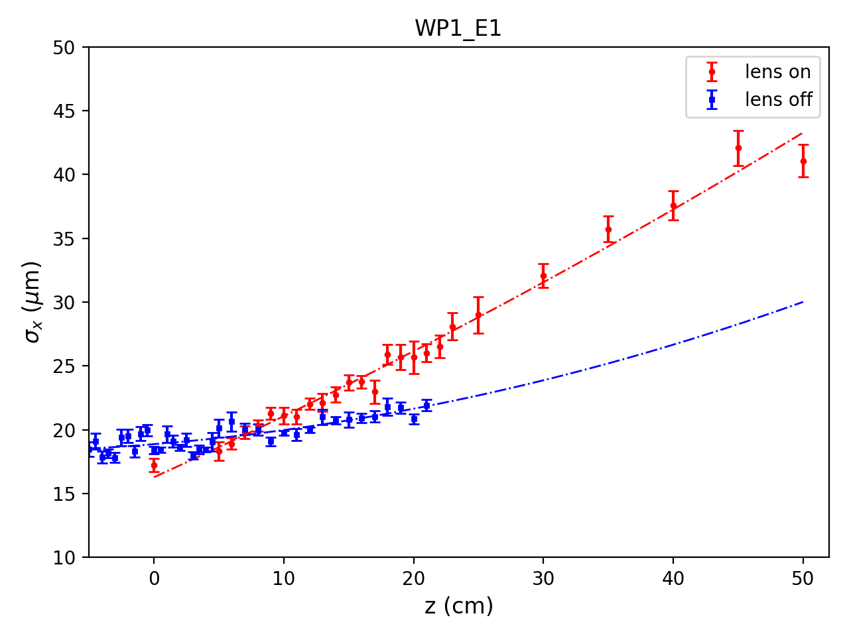
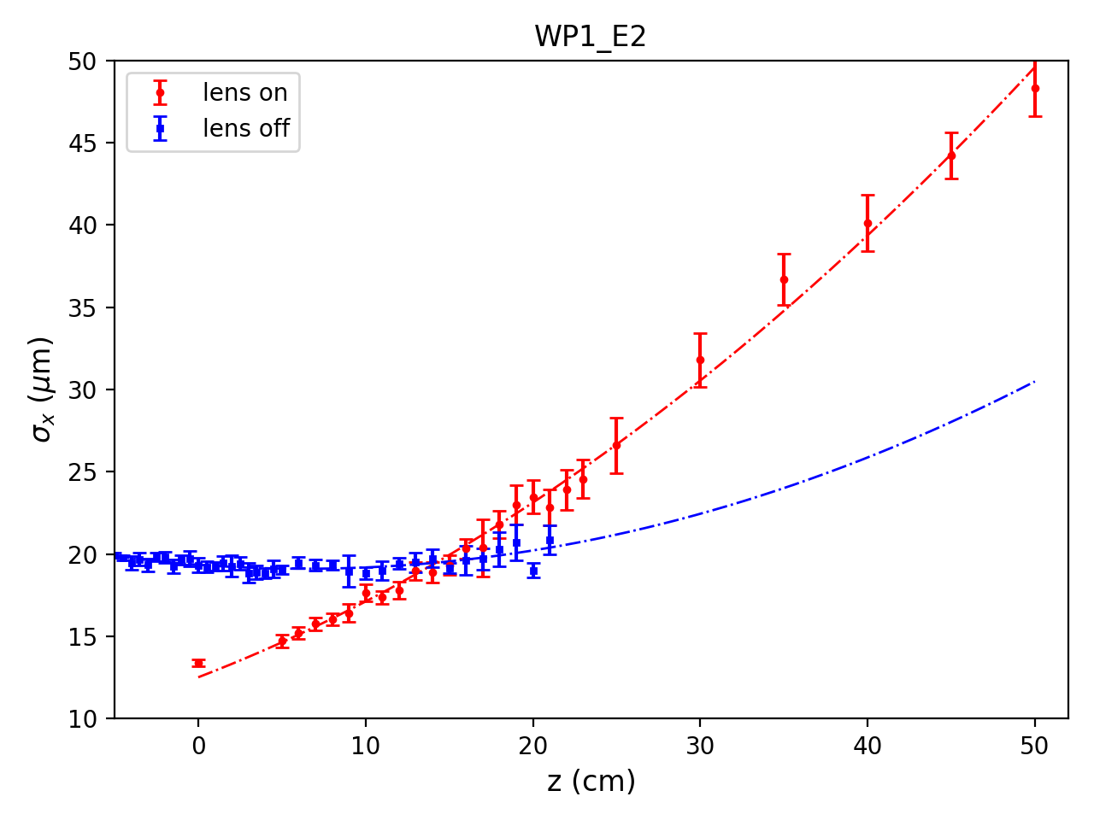
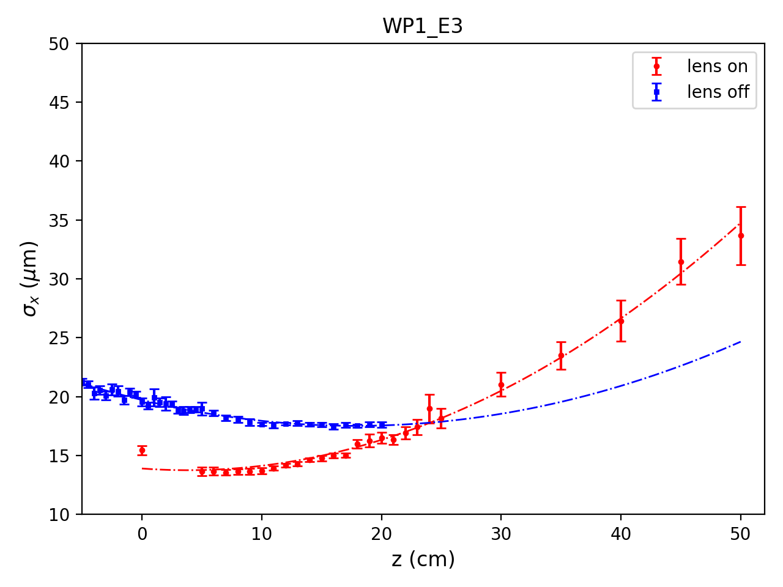
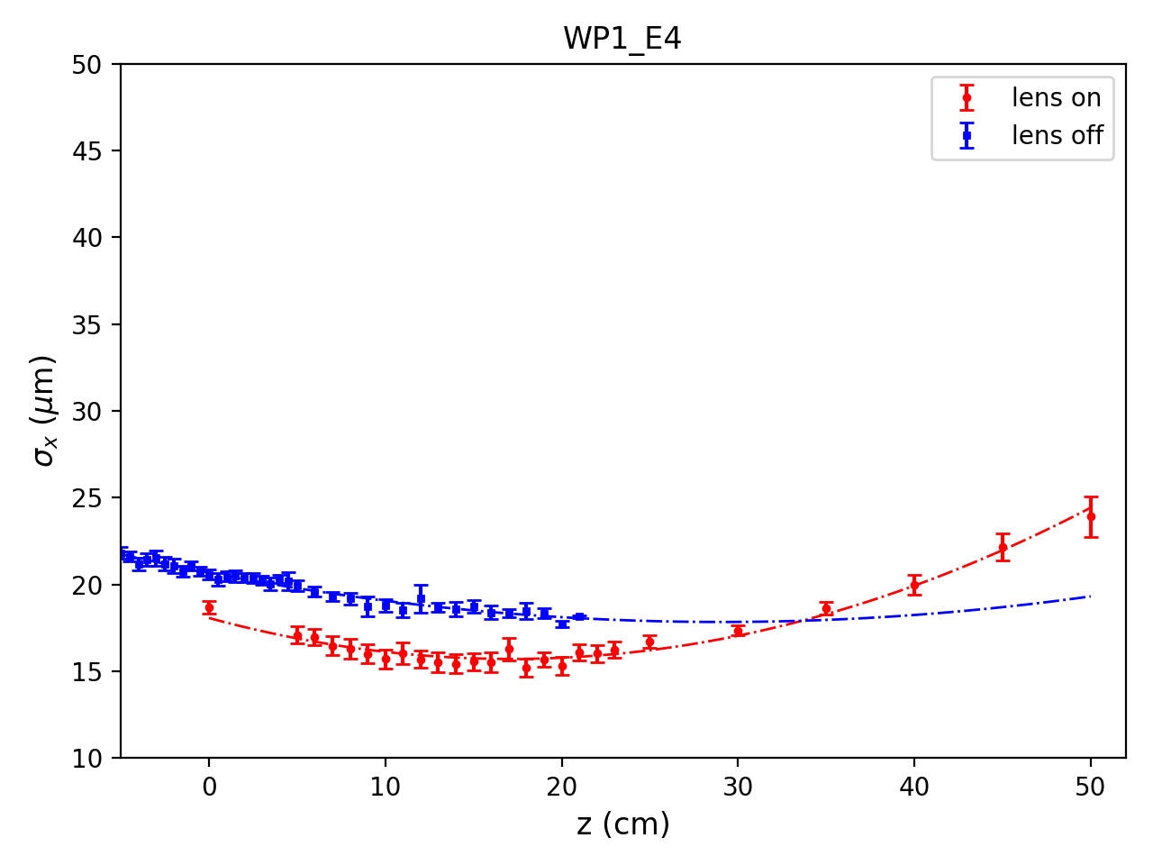
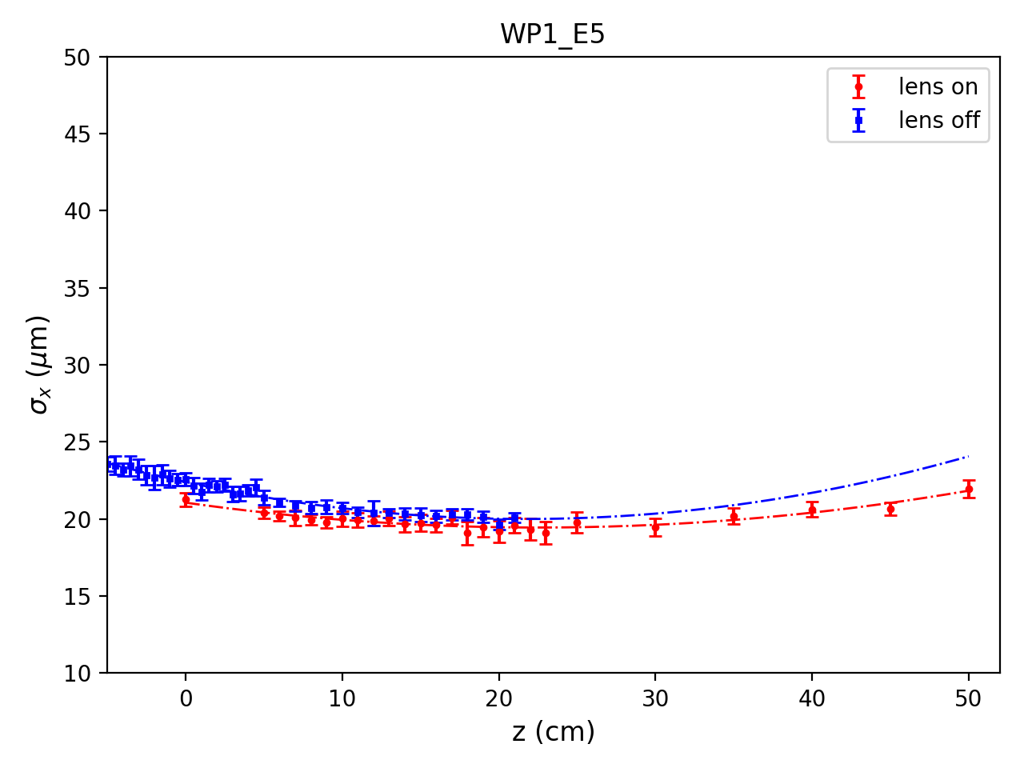
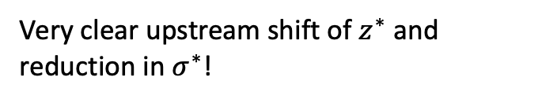
Evidence of passive plasma lensing
Object plane scan with no chromaticity correction
E1 → E5 with increasing energy
E5
E4
E2
E3
E1
E2
E1
5 energy slices
Very clear upstream shift of $z^{∗}$ and reduction in $σ^{∗}$!
E3
E4
E5

Slide 21
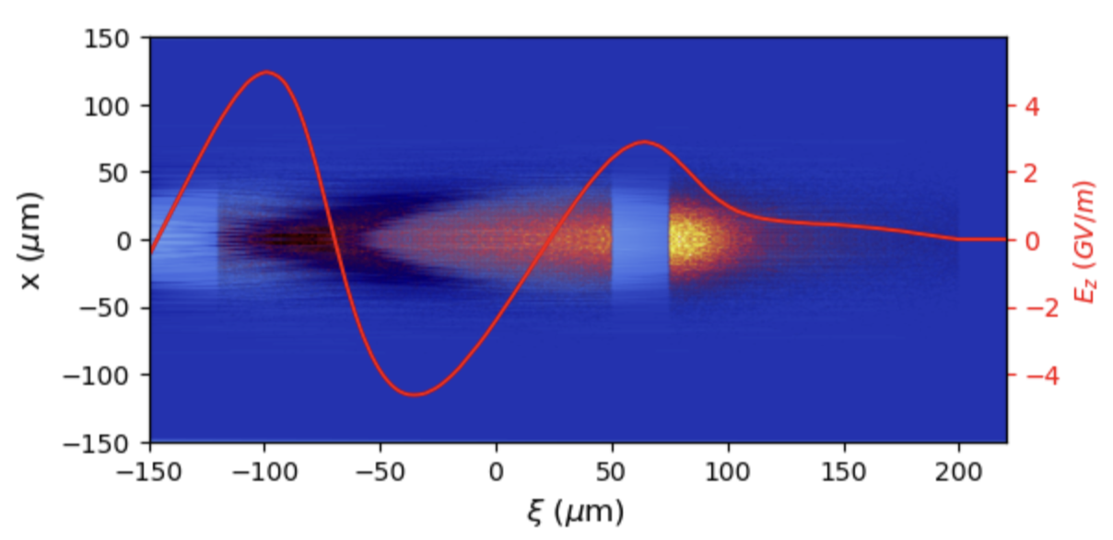
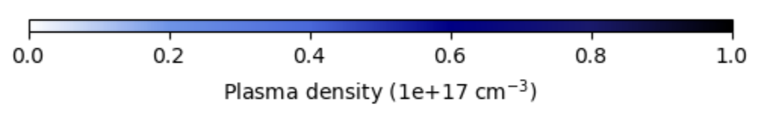
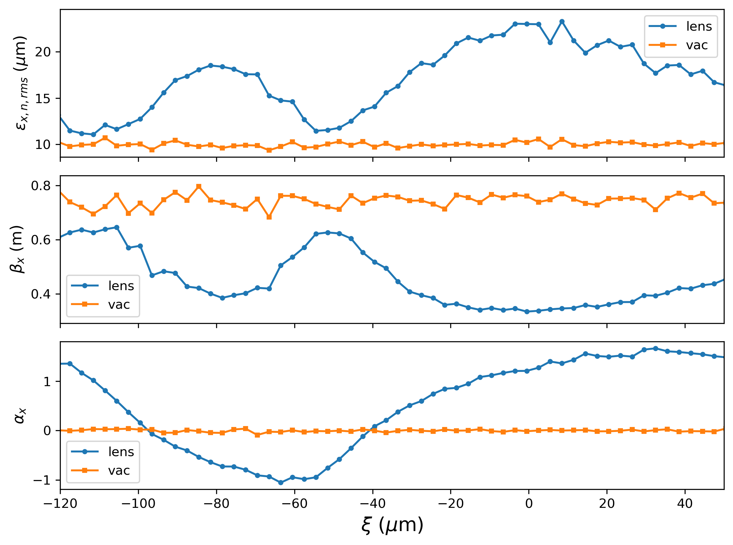
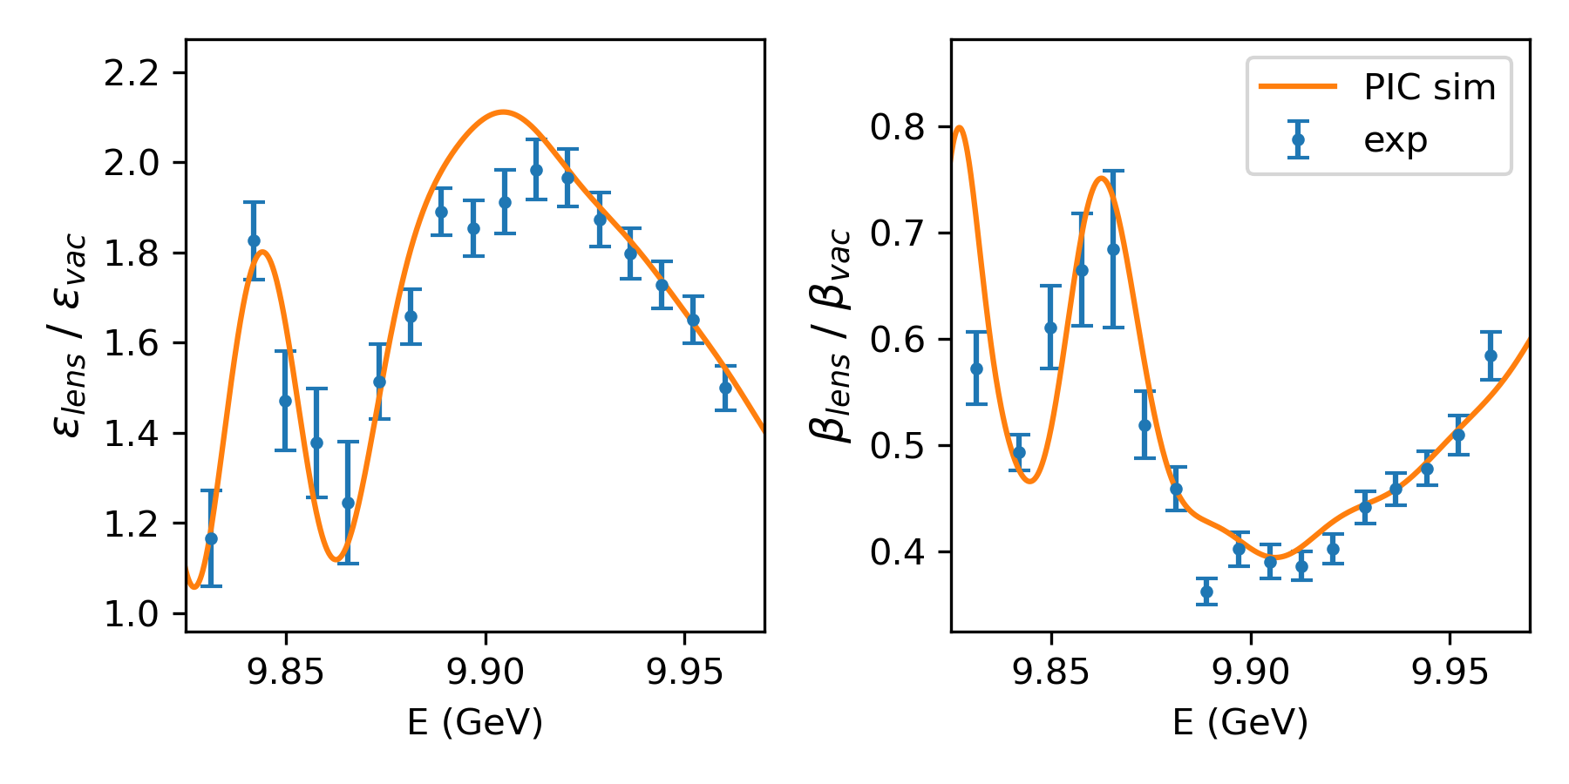

Preliminary PIC simulation studies
Simulation parameters:
  Gaussian transverse profile with 20 um spot size and 75 cm beta that match x-plane measurement.
  Current profile from BMAD simulation generated by Claudio, similar to TCAV measurement.
  Plasma density ~ $5×{10}^{16} {cm}^{−3}$; plasma length ~ 400 um.
Witness beam samples three regions: first wake, defocusing region, front of the second wake.
Simulation value scaled by 6%
Good agreement!
150 um

Slide 22
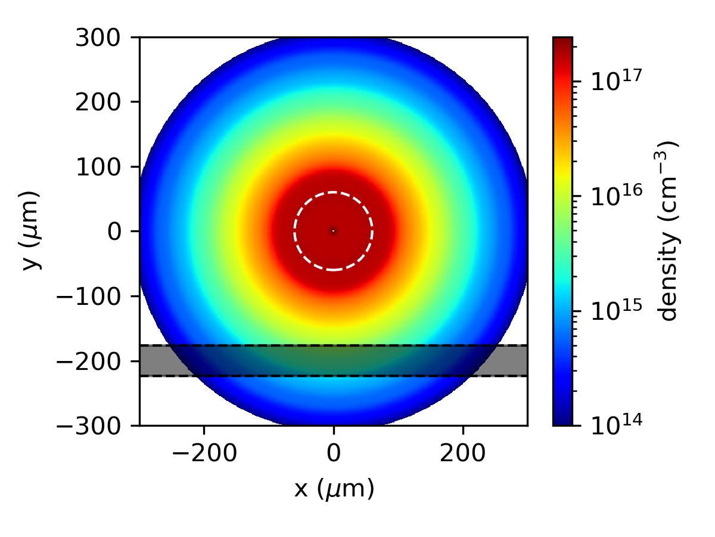
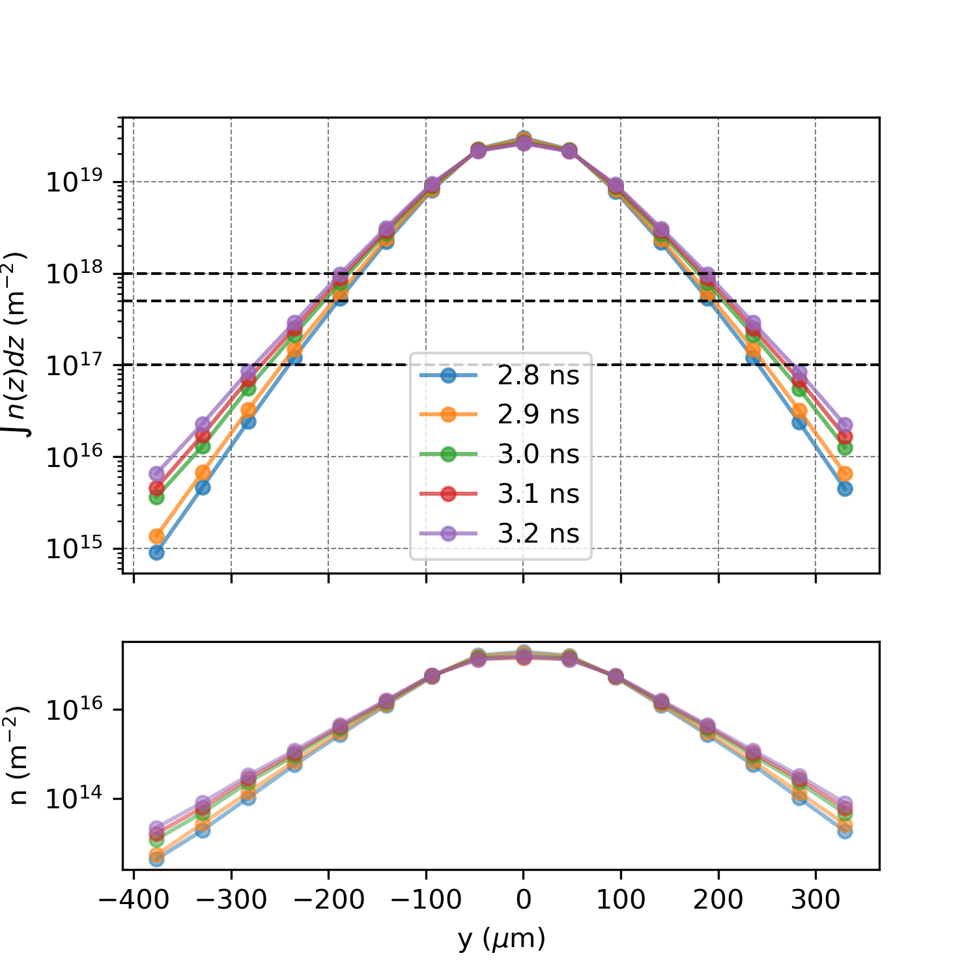
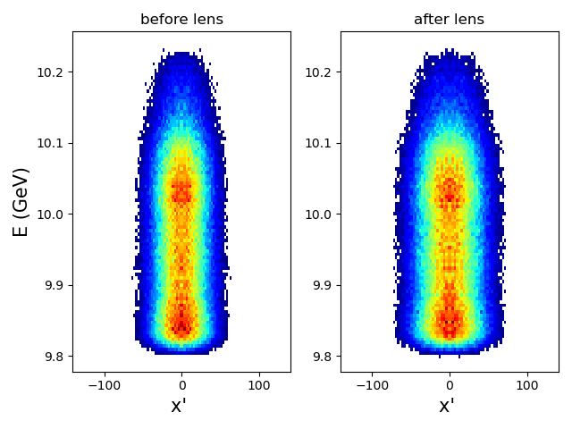
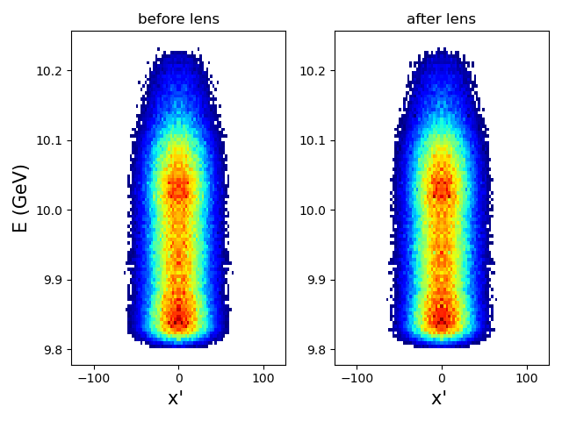

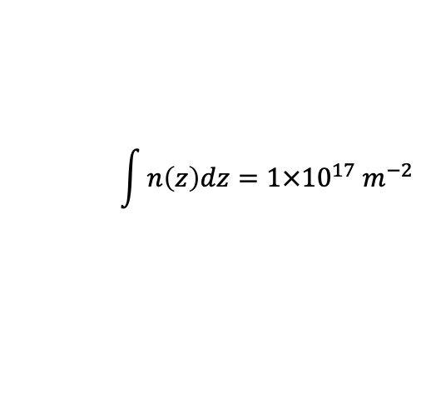
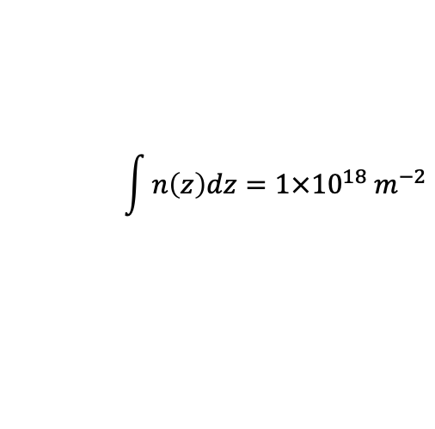
Plasma Expansion Simulation
Initial density: $4×{10}^{17} {cm}^{−3}$
Initial boundary
Beam direction
$$\int{n\left(z\right)dz=1×{10}^{18} m^{−2}}$$
$$\int{n\left(z\right)dz=1×{10}^{17} m^{−2}}$$
Agrees well with the 400 $μm$ measurement!
Some magnification
No magnification

Slide 23
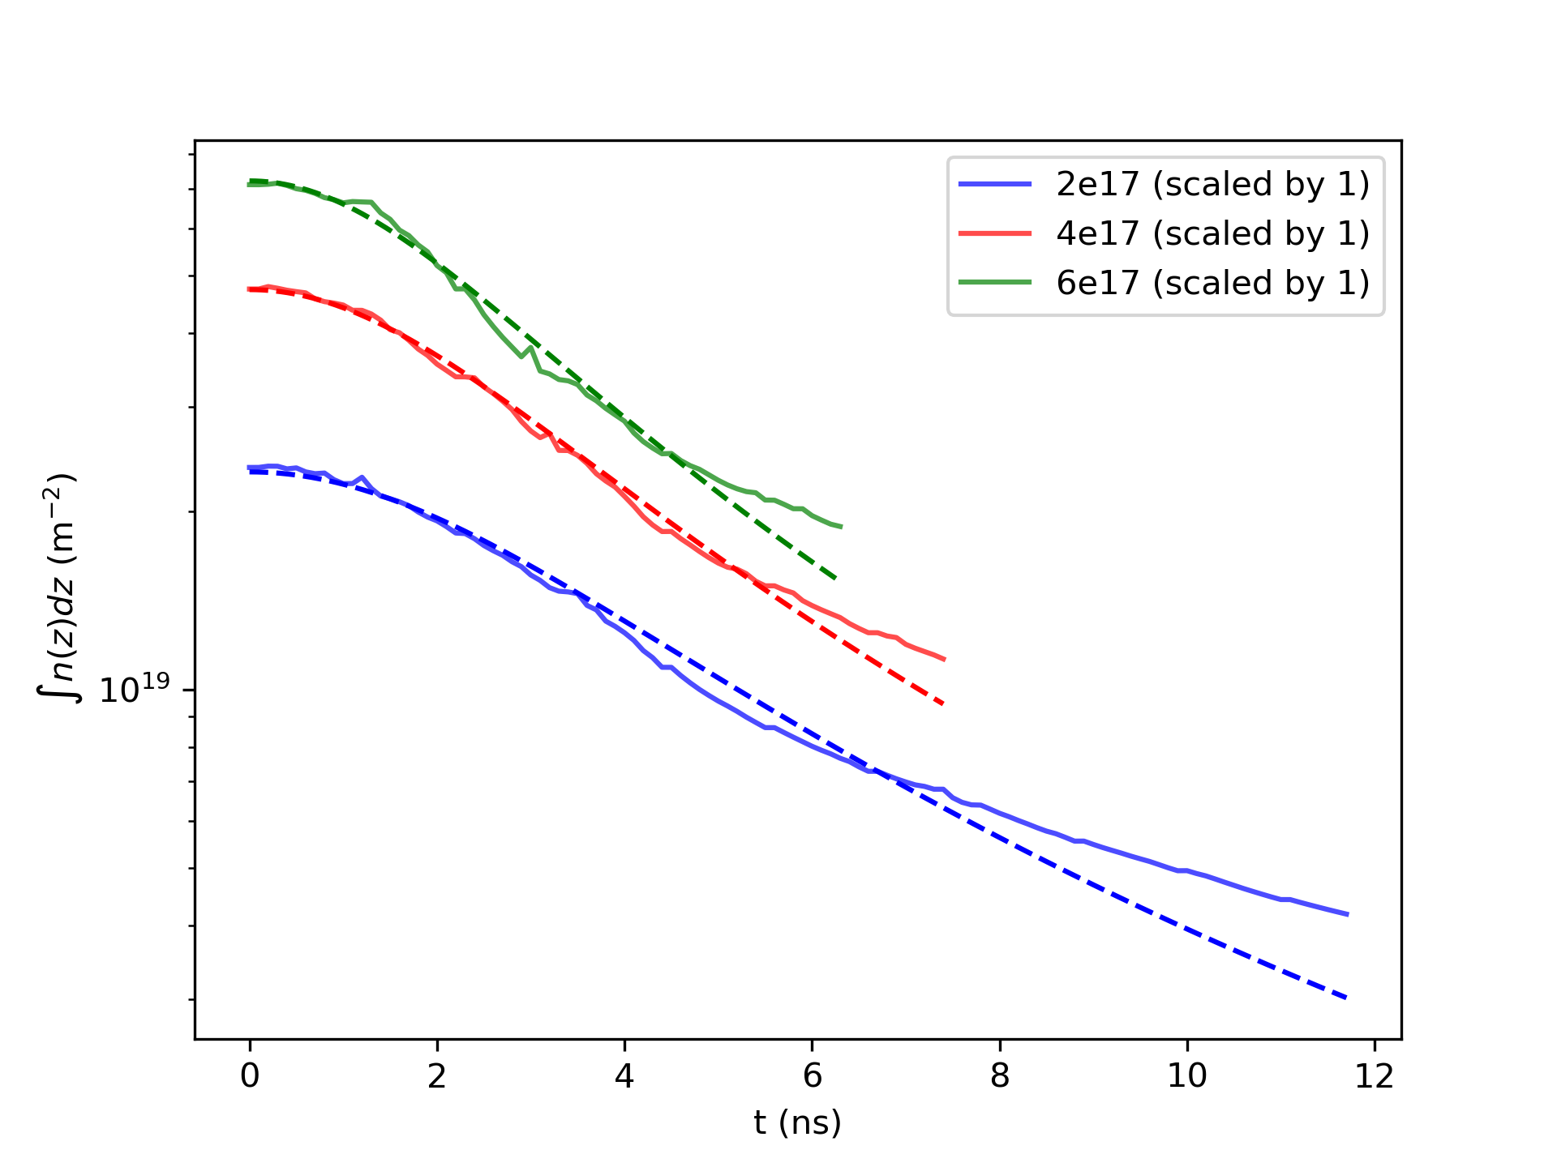
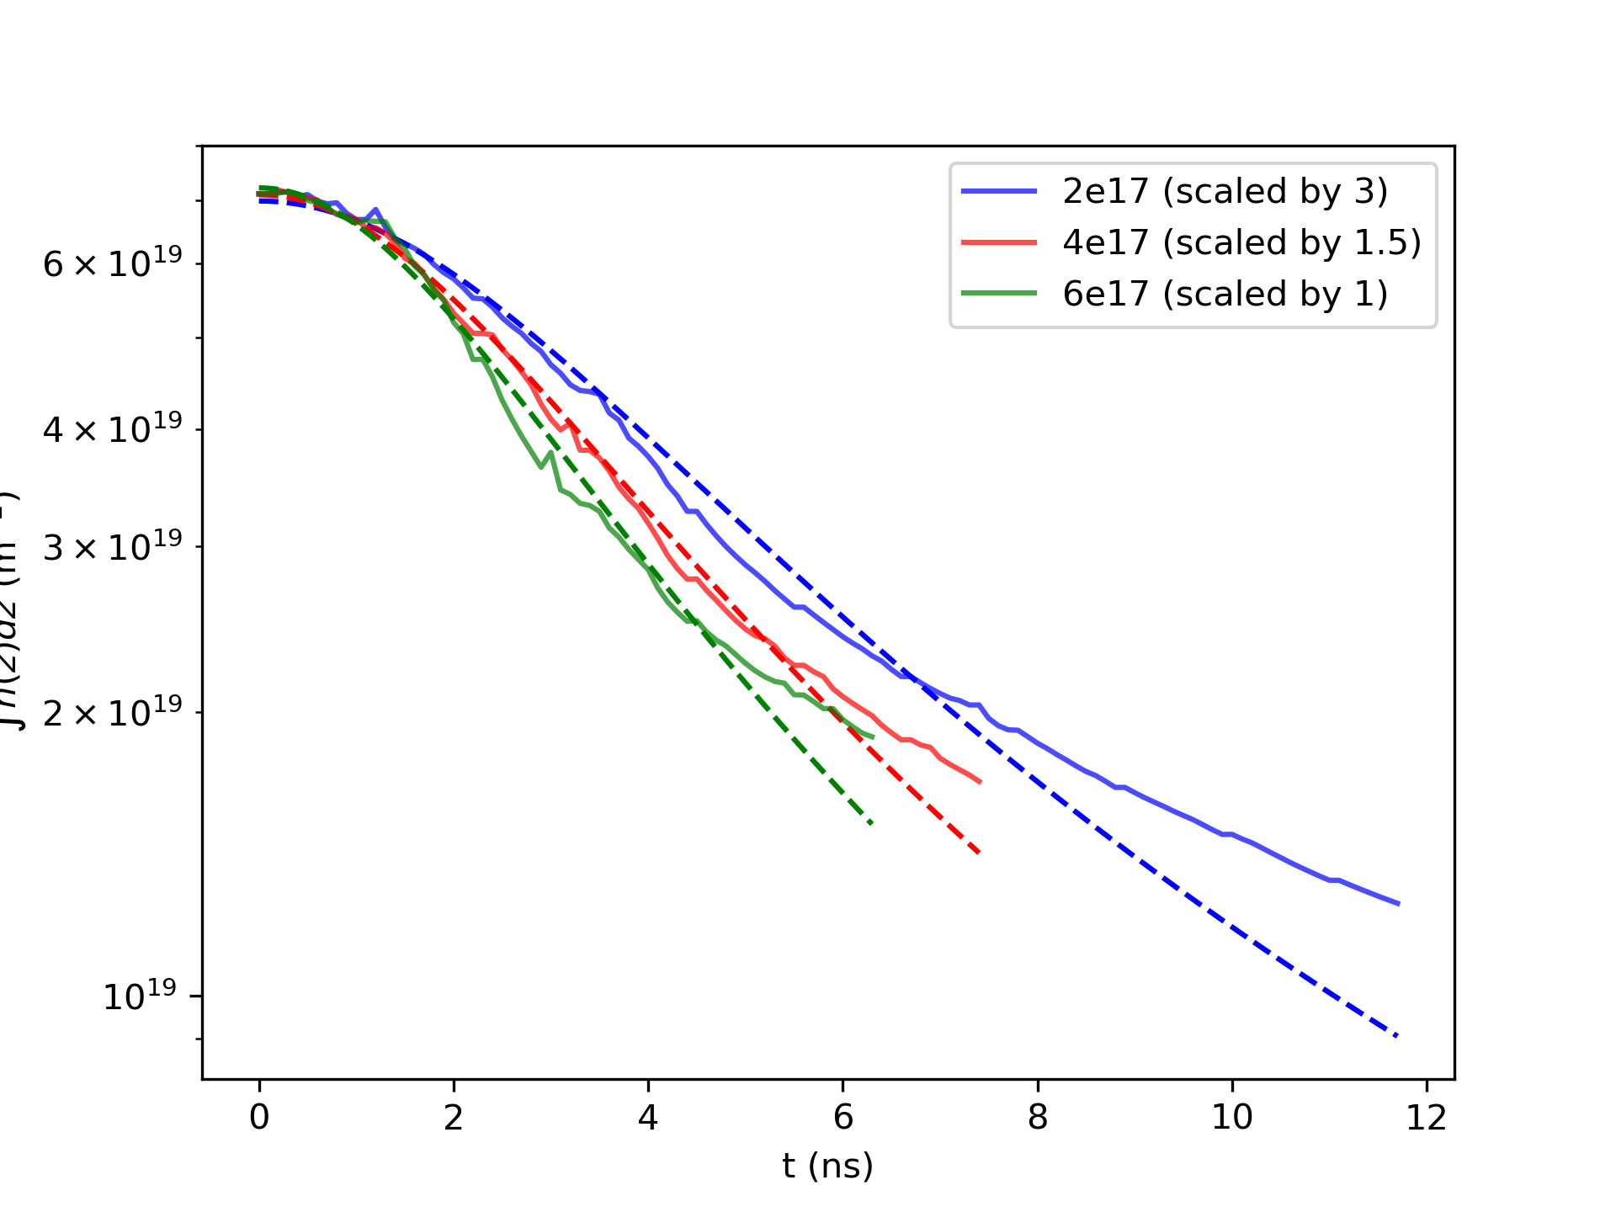
Density Length Product Evolution
Not scaled
scaled
Lorentzian fit

