Slide 1

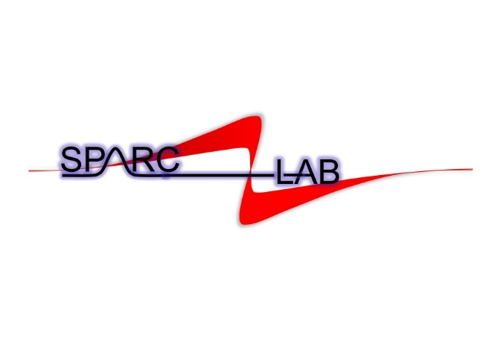

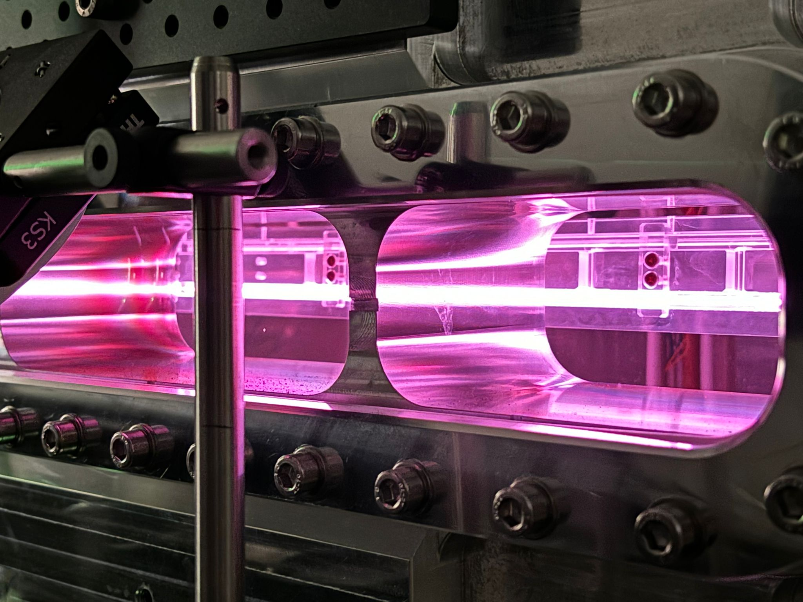

Plasma density manipulation in gas-filled discharge capillaries designed for the EuPRAXIA@SPARC_LAB project
7th European advanced Accelerator Conference
Isola d’Elba 2025, Italy
21-27 September
Angelo Biagioni | LNF-INFN
on behalf of the SPARC_LAB collaboration

Slide 2

Outline
Gas-filled discharge plasma sources at SPARC_LAB test facility
Plasma density manipulation by means of segmented discharge capillaries
Combined discharge capillaries
Driver-witness separator by means of plasma devices
Very long plasma sources designed for the EuPRAXIA@SPARC_LAB project
Angelo Biagioni | LNF-INFN | EAAC 2025 | Page 2

Slide 3
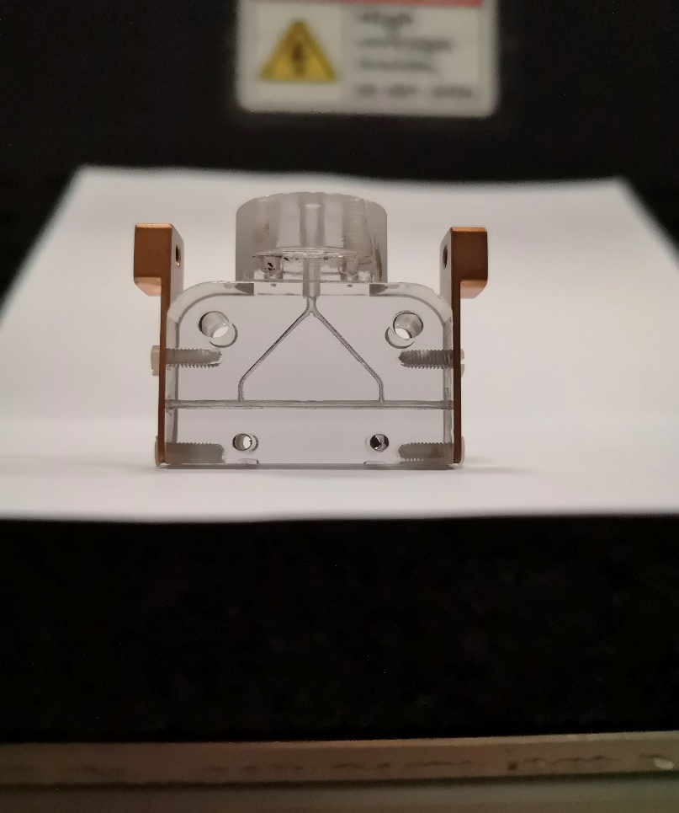
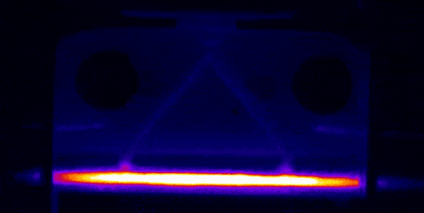
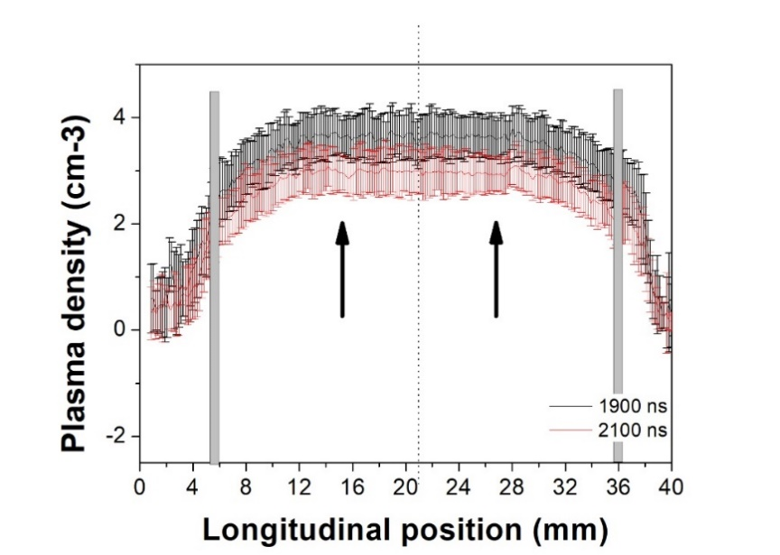
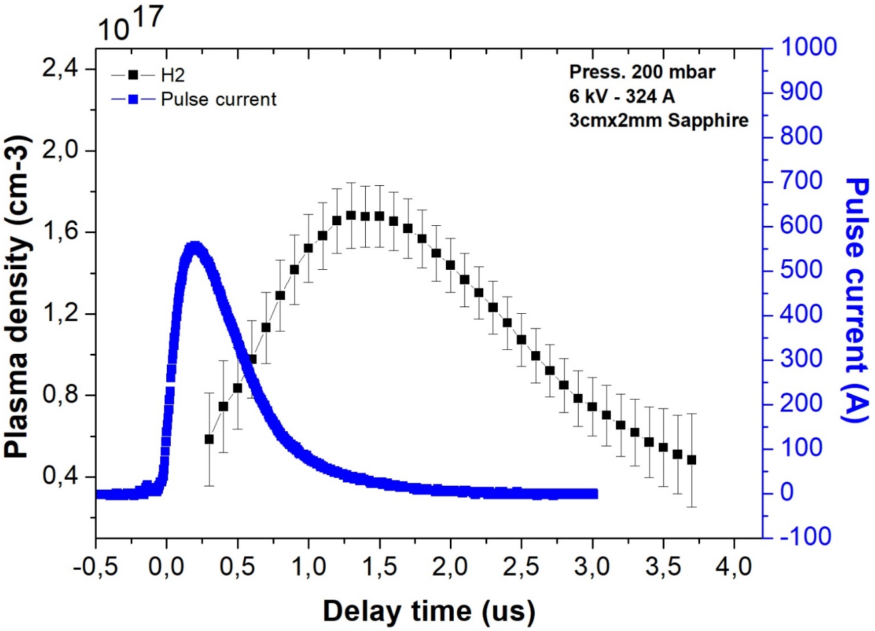
Gas-filled discharge capillary
Spatial profile
Time profile
Electrode
(x10¹⁷)
HV pulse
Acceleration
Gas inlets
Plasma channel
Density profile
Region of uniform neutral gas contained by differential pumping at two input/output extremities and realized by a thin capillary
Modulation of longitudinal gas distribution by special geometric shapes
Small gas flow to operate in steady state regime with continuous flow (P < 1 bar)
There is no movable parts
Small dimension of the HV source to produce plasma
Plume of gas from front and back of cell, plasma ramps to be controlled
Density easily adjusted by controlling gas flow, geometry or voltage in the range: 10¹⁵ - 10¹⁹ cm⁻³
Erosion of the plasma channel due to the electrical discharges to form plasma
Angelo Biagioni | LNF-INFN | EAAC 2025 | Page 3

Slide 4
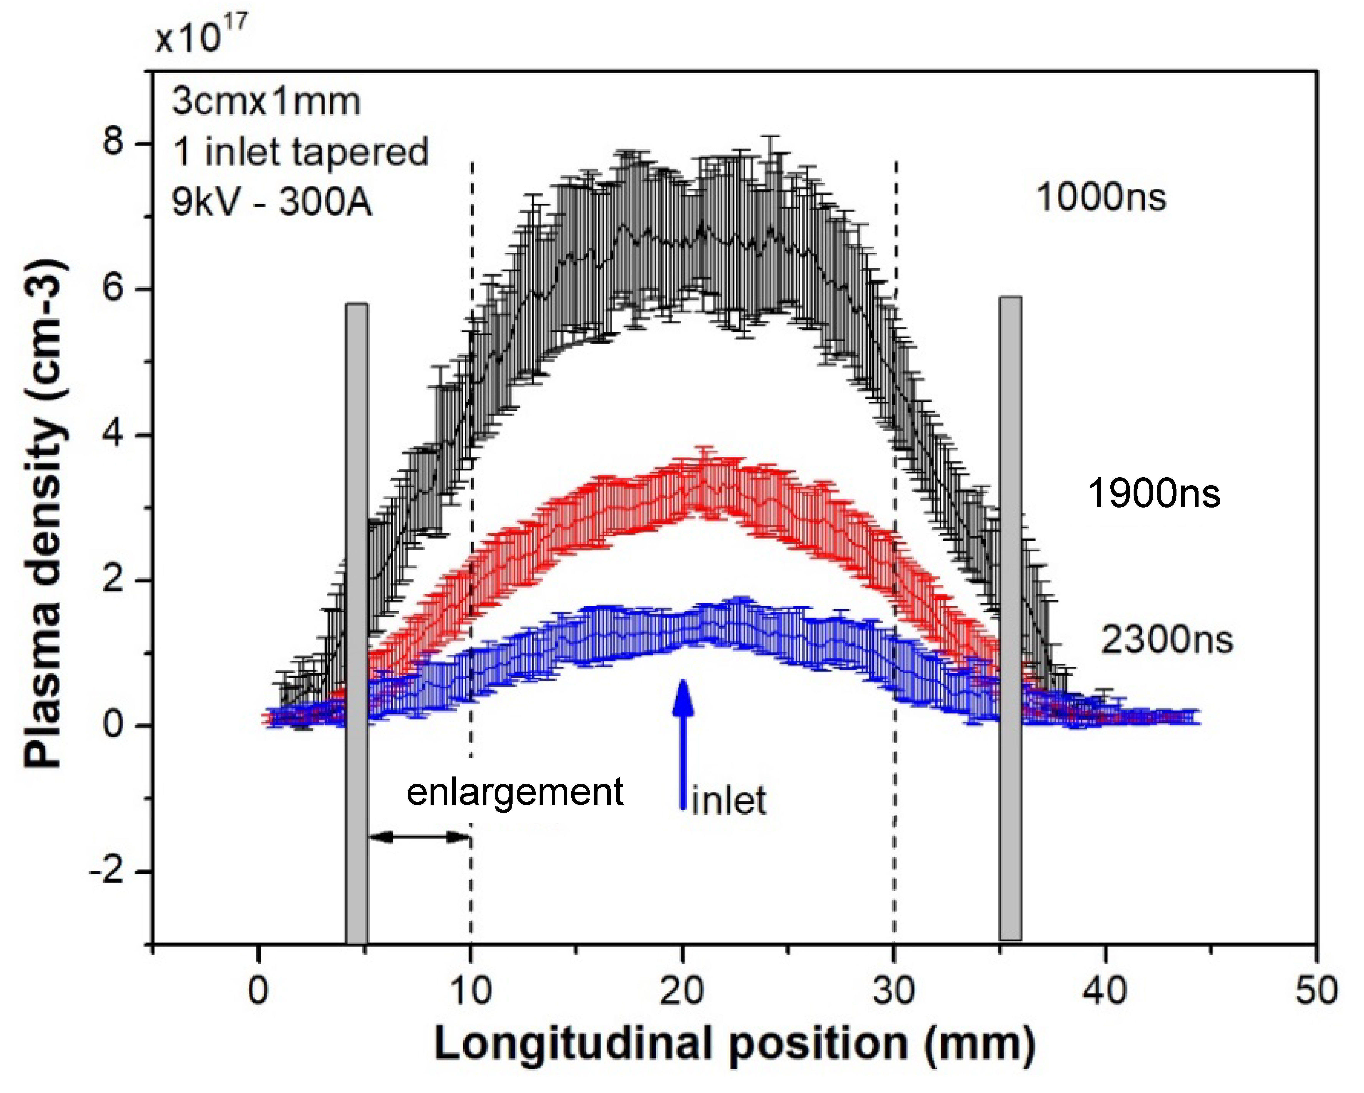
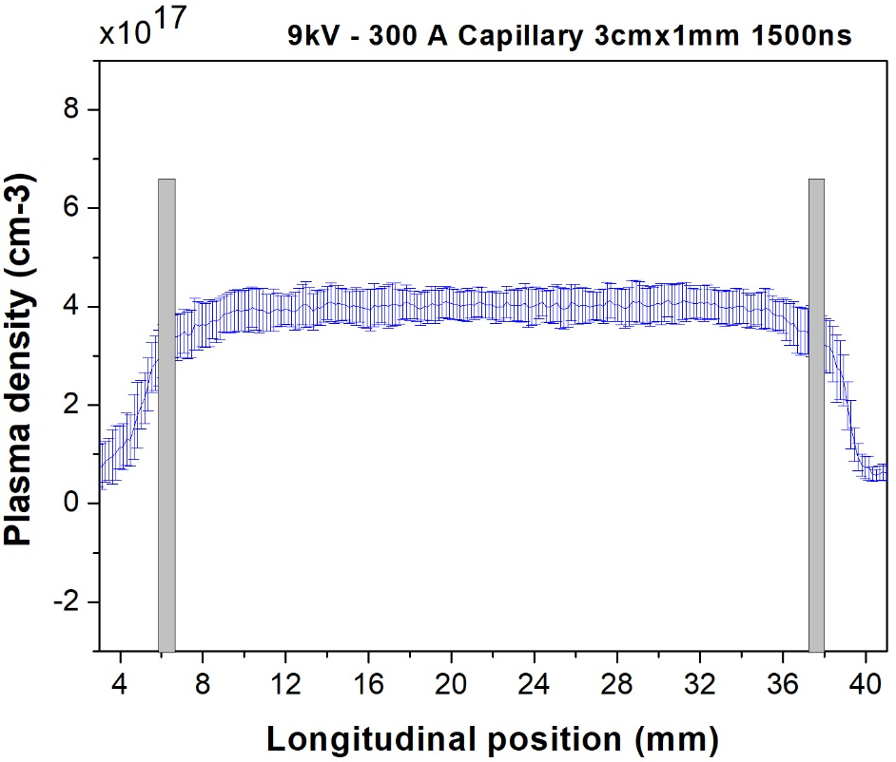
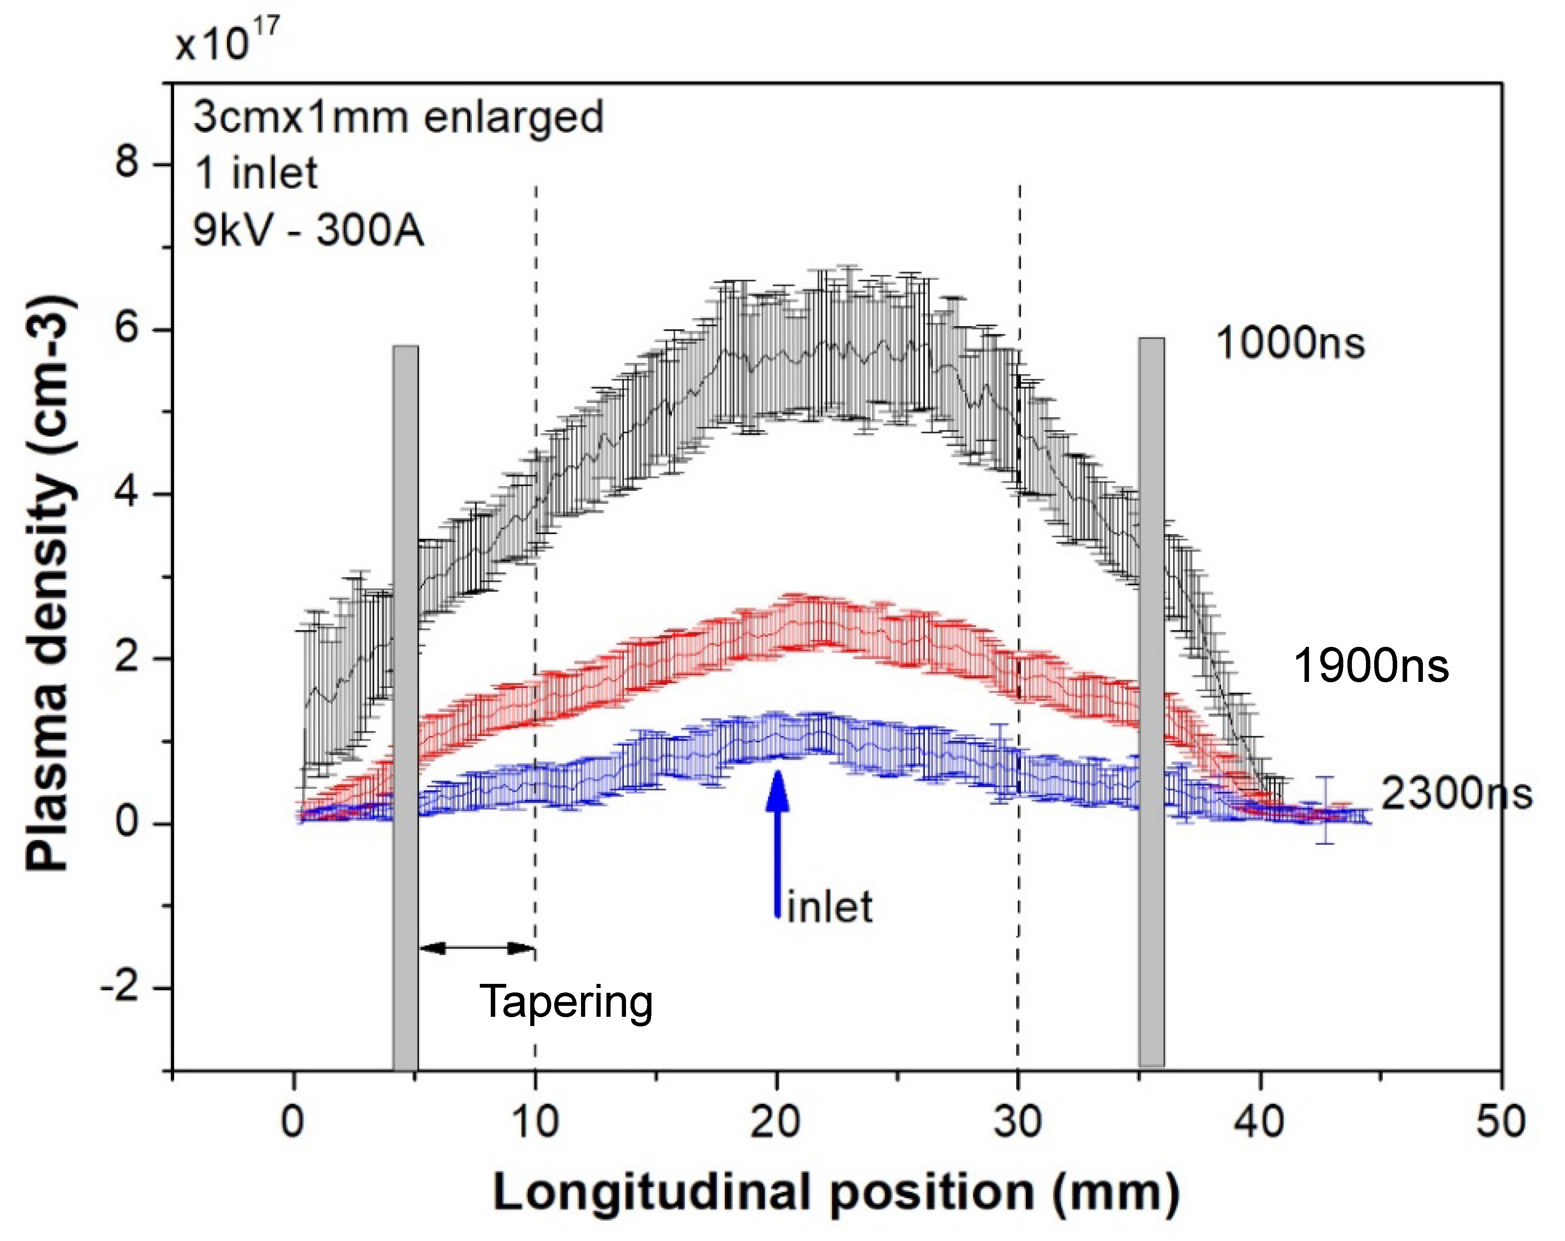
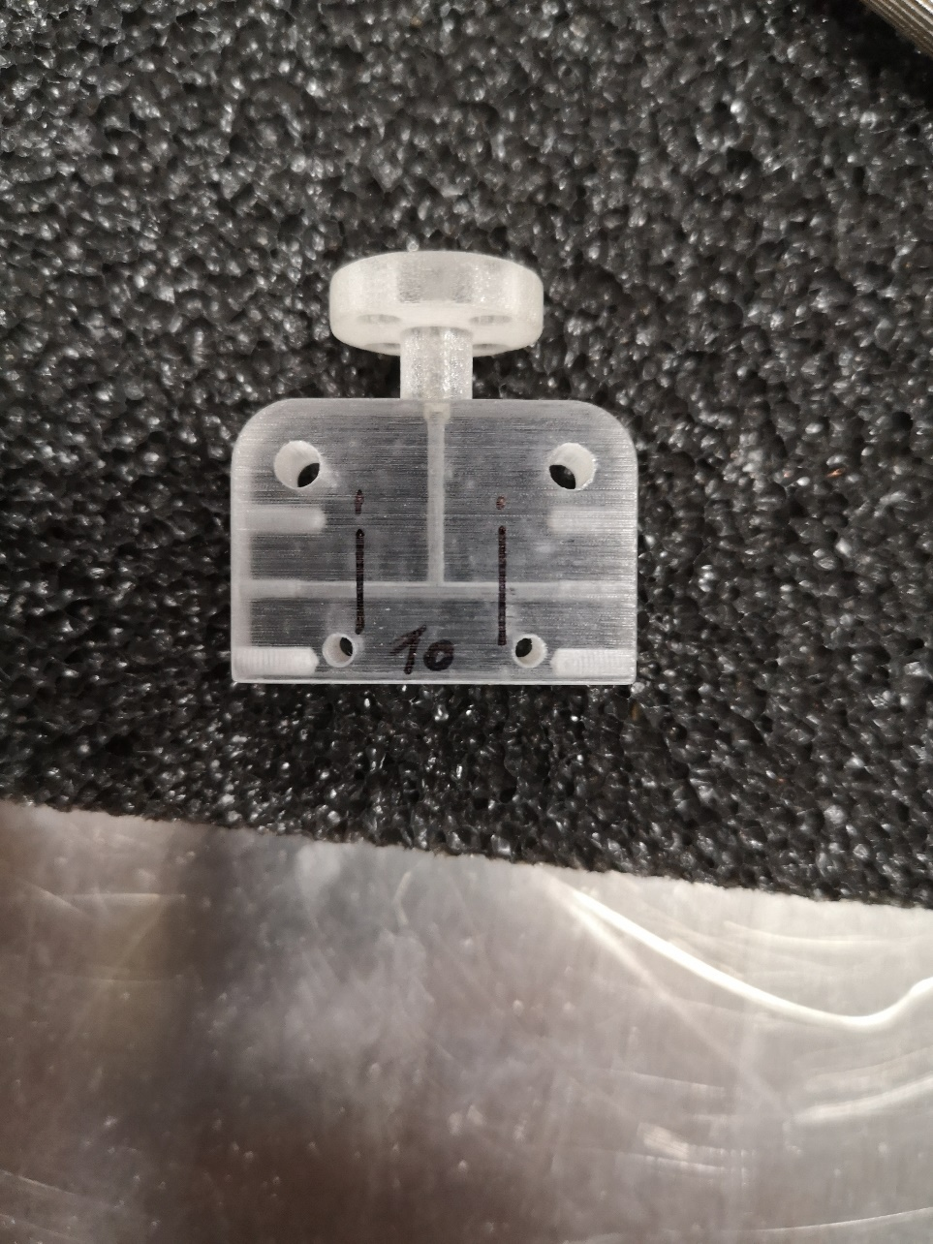
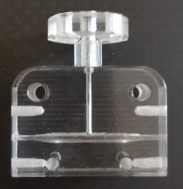
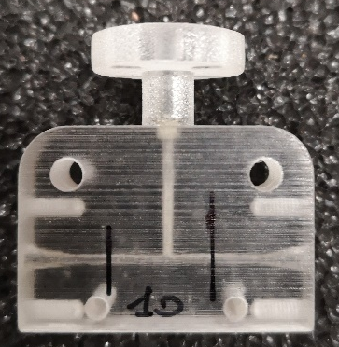
Plasma ramps manipulation
Cigar-shape
inlet
Cigar-shape capillary
Angelo Biagioni | LNF-INFN | EAAC 2025 | Page 4

Slide 5
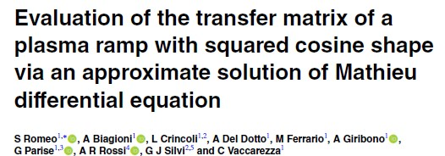
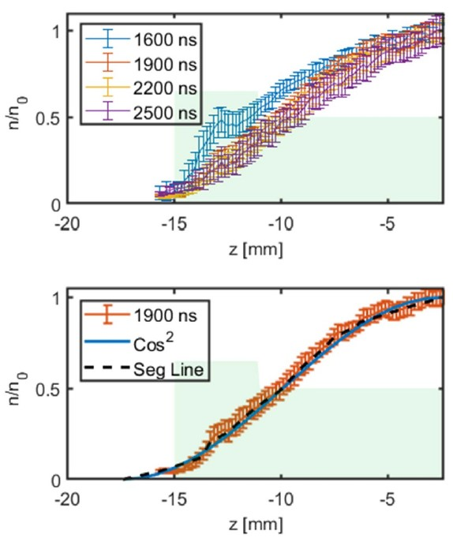
Plasma ramps manipulation
Courtesy of S. Romeo
After 2 μs the profile stabilizes at a squared cosine like plasma profile, with an approximation of the line made of 20 segments.
For this kind of ramp a solution that satisfy the matching condition at the plateau
Angelo Biagioni | LNF-INFN | EAAC 2025 | Page 5

Slide 6
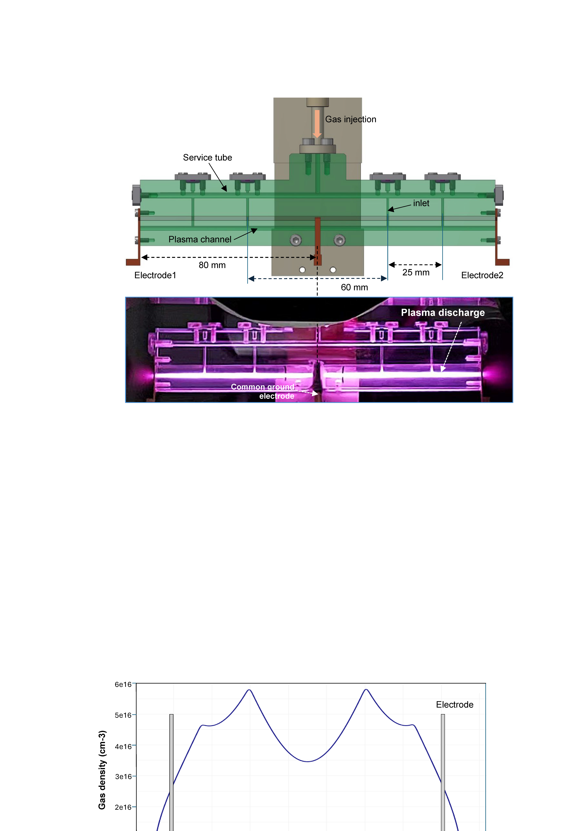
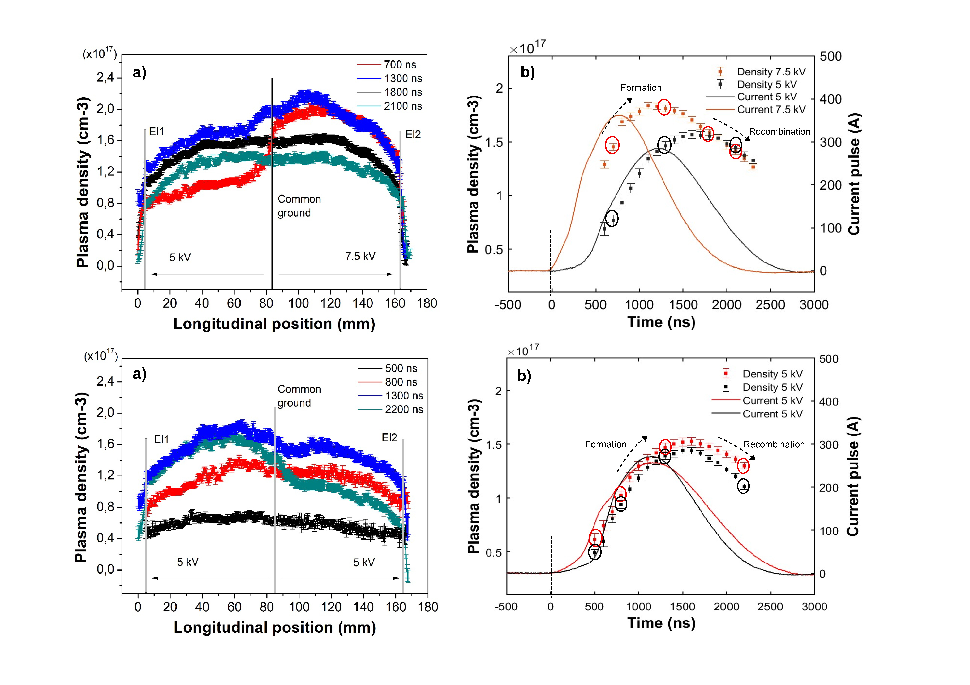
Segmented discharge capillary
+
Common ground
+
HV
HV
Plasma sources in the m-scale with HV pulses less than 10 kV
Longitudinal density modulation depending on both discharge voltage and recombination time
Uniform profiles for very long plasma sources
Modulated profiles for integrated components
Angelo Biagioni | LNF-INFN | EAAC 2025 | Page 6

Slide 7
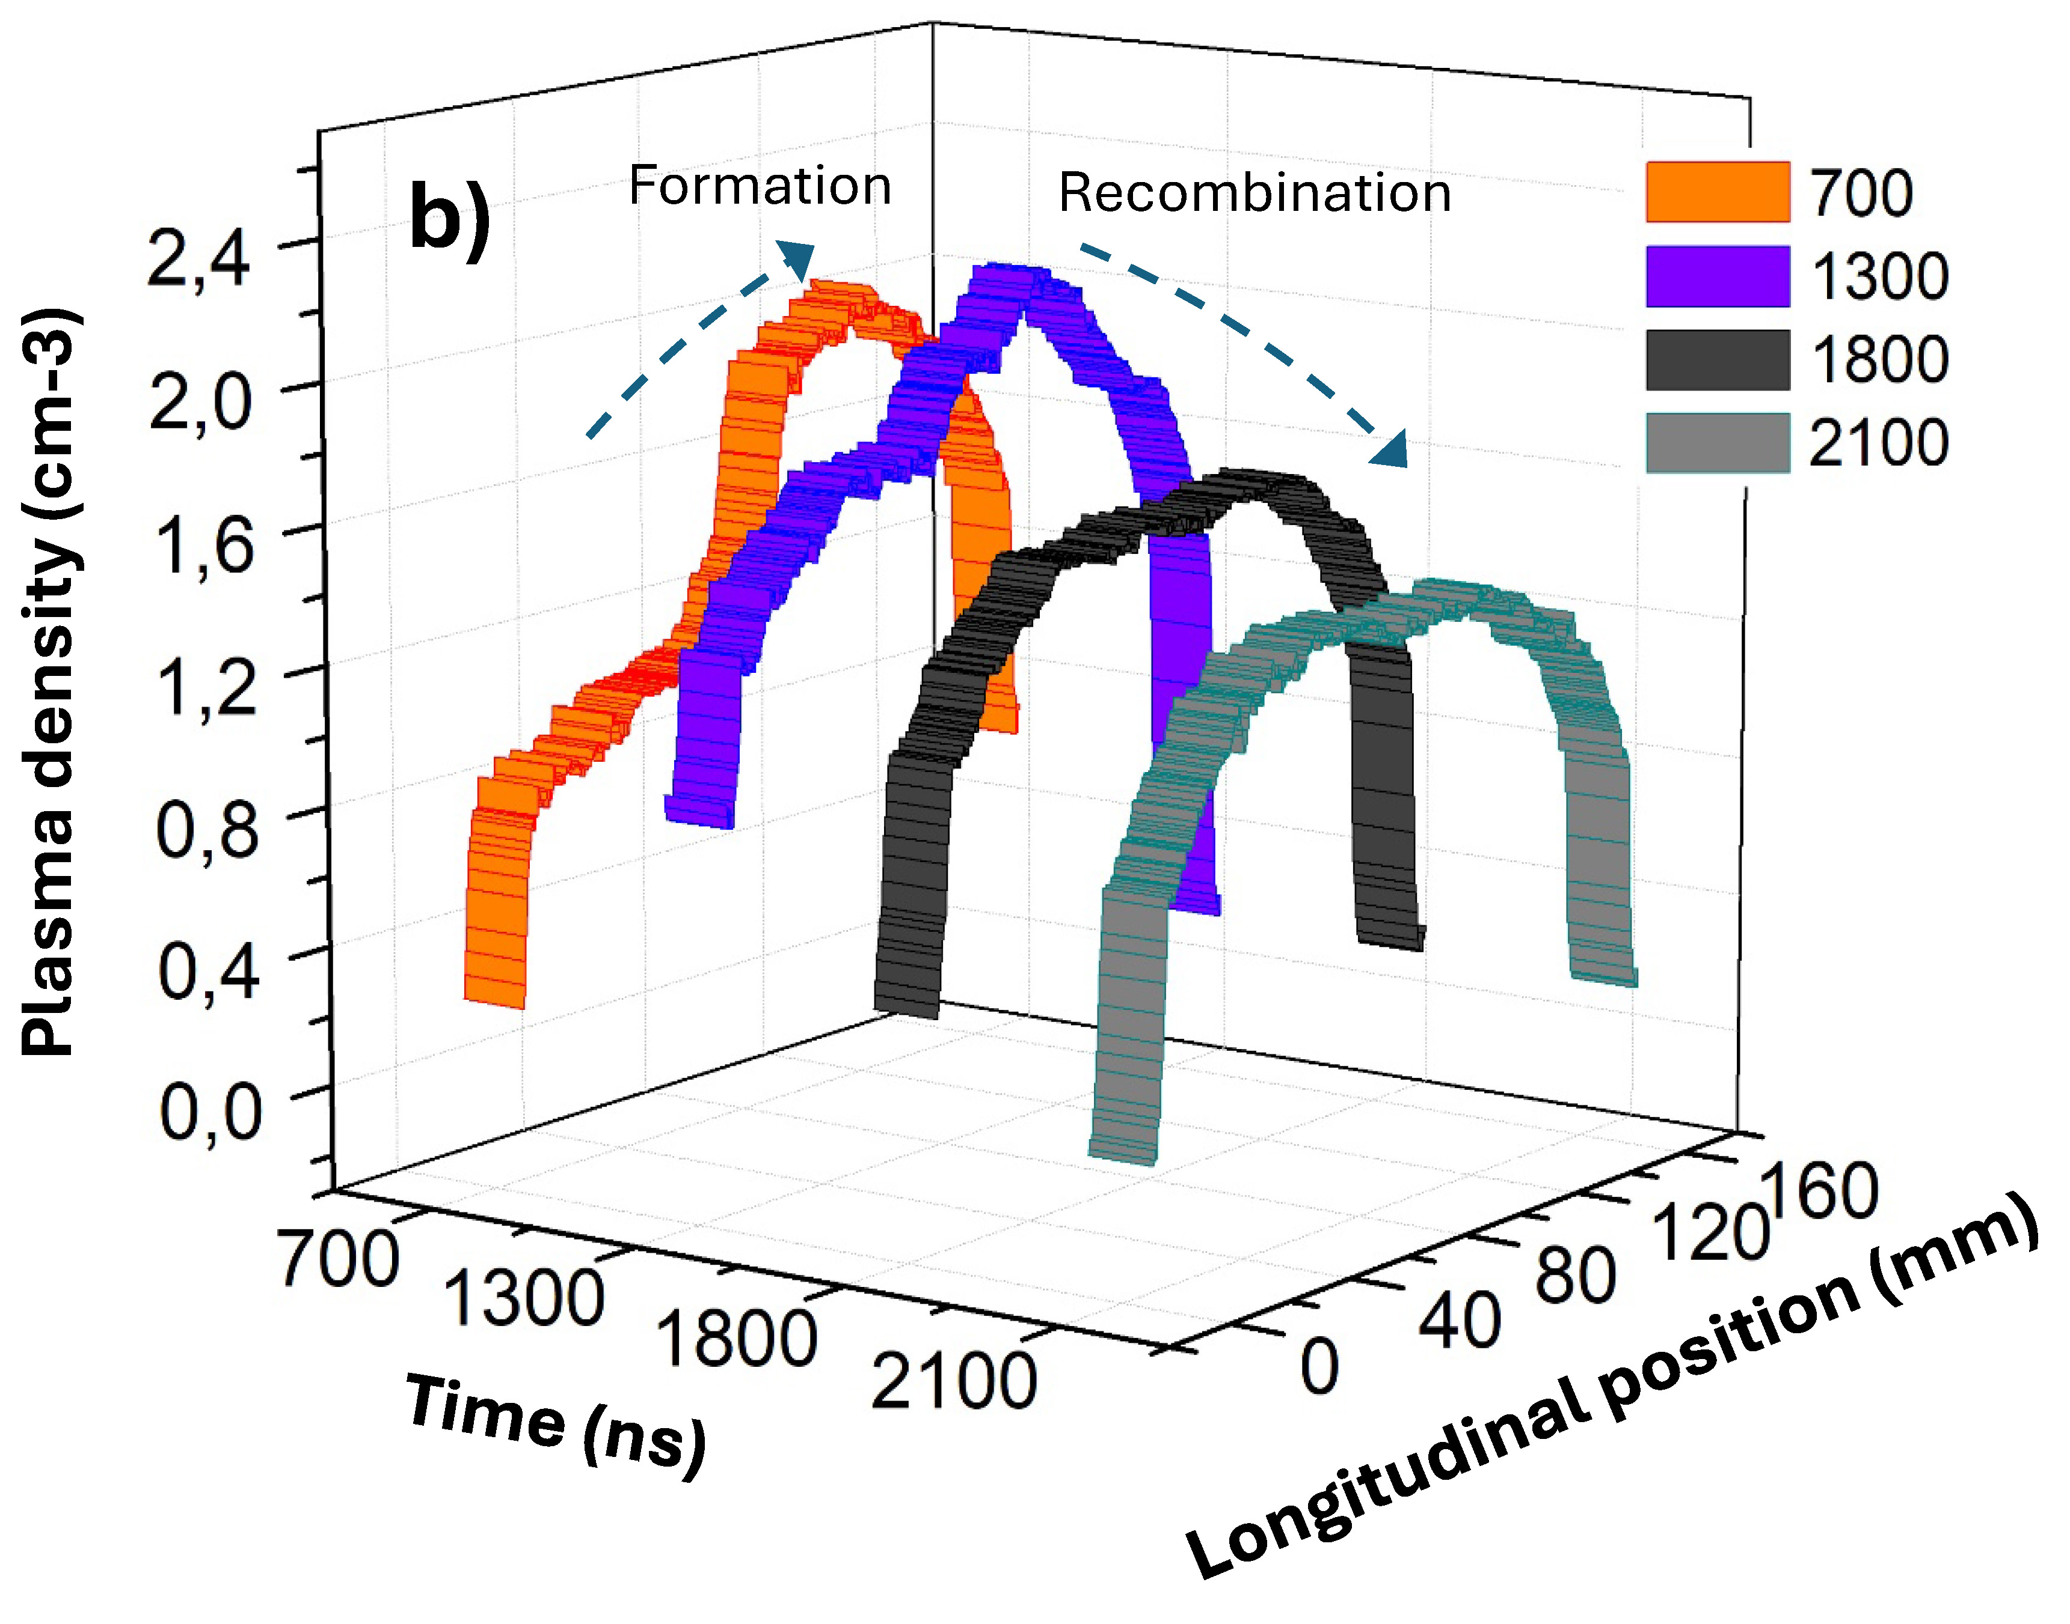
Logitudinal plasma density modulation
Also, in the case of uniform profiles, the main advantage is offered by the possibility of sectioning the supply voltage, avoiding values of many tens or hundreds of kV, which would not be easy to produce.
The same plasma source could provide either uniform profiles to be used to achieve high energies in m-scale devices or tailored profiles to realize different elements within the same structure or optimize particle beam matching.
Angelo Biagioni | LNF-INFN | EAAC 2025 | Page 7

Slide 8
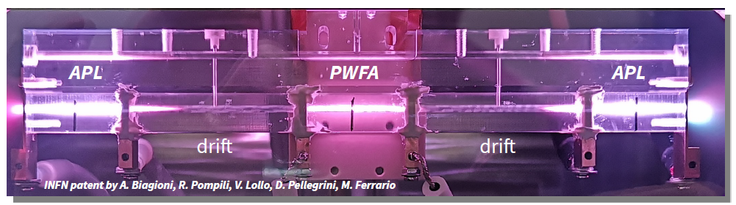
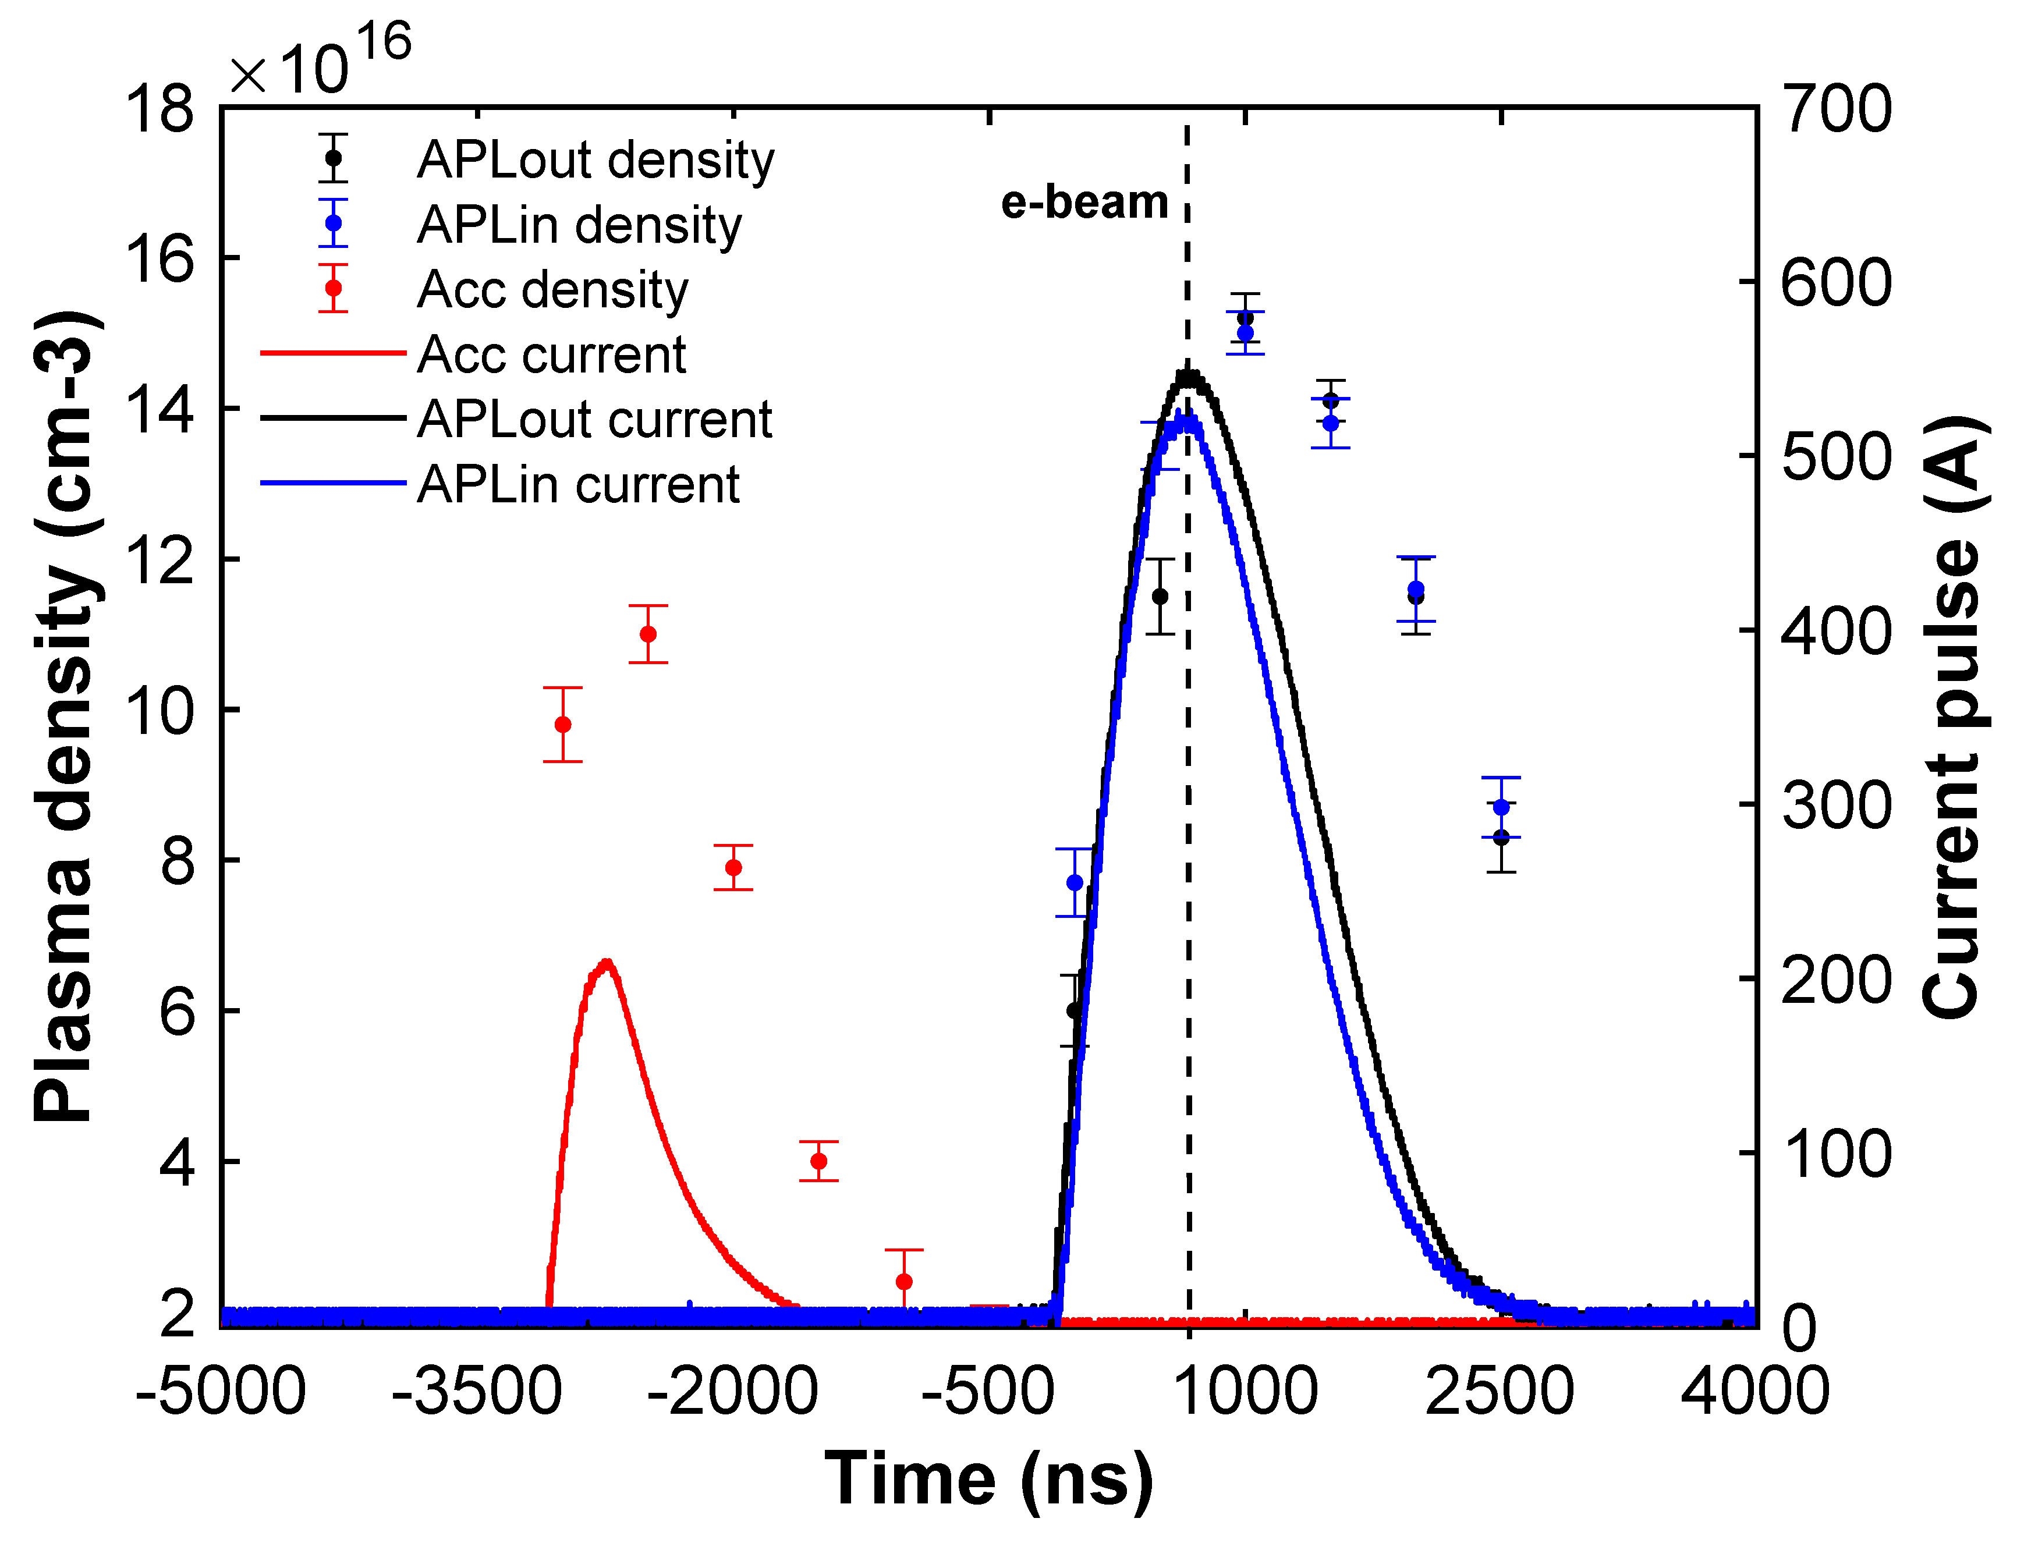
Staged discharge capillary
The main advantages of a plasma device that integrates
multiple functional elements within the same
structure lie in :
its compactness (19 cm)
the simplification of the neutral gas distribution and injection system
the intrinsic mechanical alignment ensured by the joint fabrication of all components.
Accelerator
- 500-200-500 A ionization current
- 2x10¹⁵ cm⁻³ accelerator
- 150 MV/m acc. gradient
APLs
Angelo Biagioni | LNF-INFN | EAAC 2025 | Page 8

Slide 9
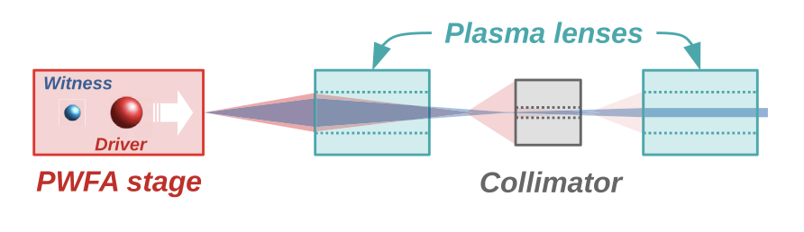
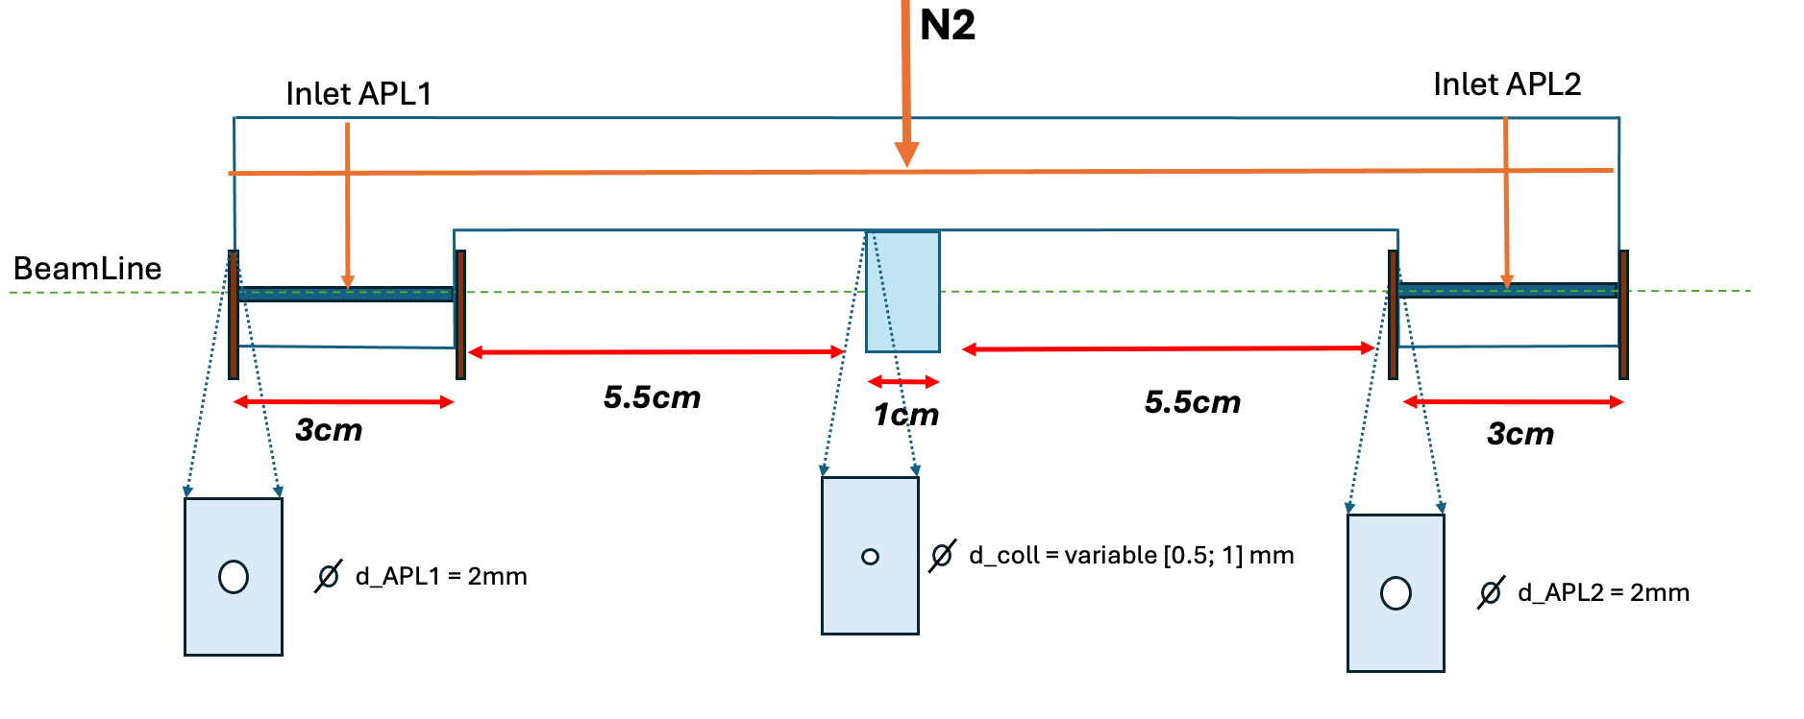
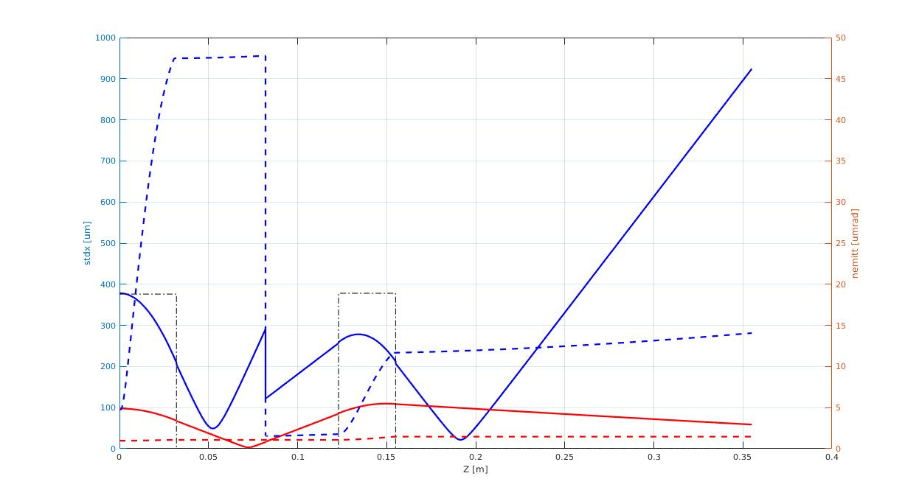
Active Plasma Lens Remove System
Two goals:
transport the witness bunch by preserving its charge, normalized emittance, and peak current;
remove the high-charge driver bunch during the transport to completely discard it before the FEL undulator beamline.
The focusing is provided by two active-plasma lenses (APLs)
Collimator remove the driver bunch overfocused to a spot size much larger than the collimator aperture.
Driver
stdx (um)
nemitt (um)
Courtesy of Martina Carillo
500pC
490pC
70pC
witness
70pC
Angelo Biagioni | LNF-INFN | EAAC 2025 | Page 9

Slide 10
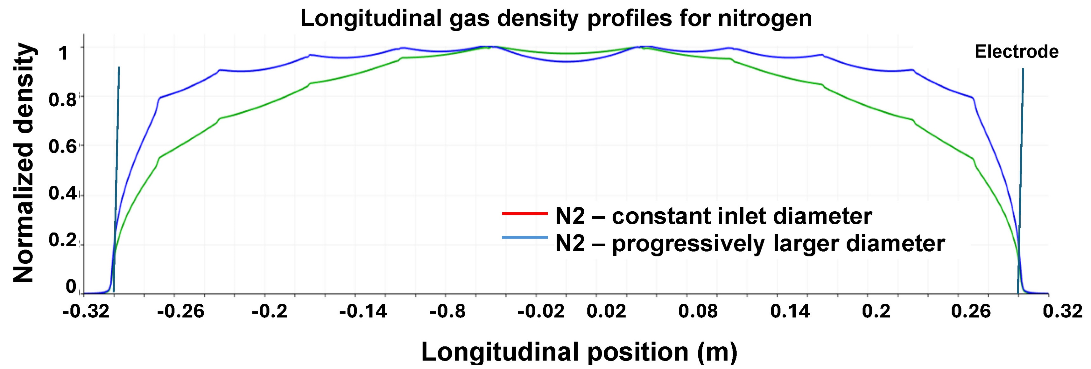

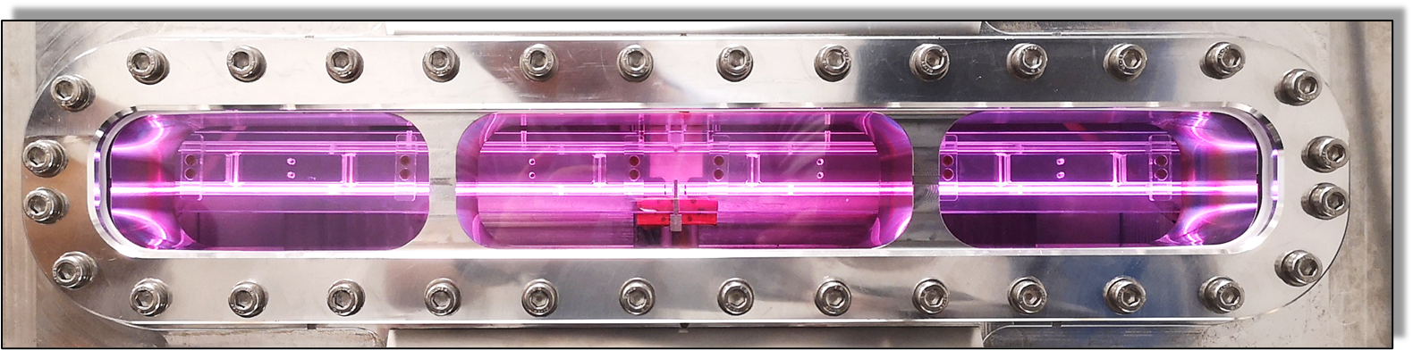
60 cm long discharge capillary for EuPRAXIA@SPARC_LAB
The geometry allows the longitudinal plasma distribution to be controlled
In particular, internal ramps are an important tool for optimising the match between the input beam and plasma density.
10 injectors of constant diameter and progressively closer together
10 injectors progressively closer together and having progressively increasing diameters
20%
60cm
Angelo Biagioni | LNF-INFN | EAAC 2025 | Page 10

Slide 11
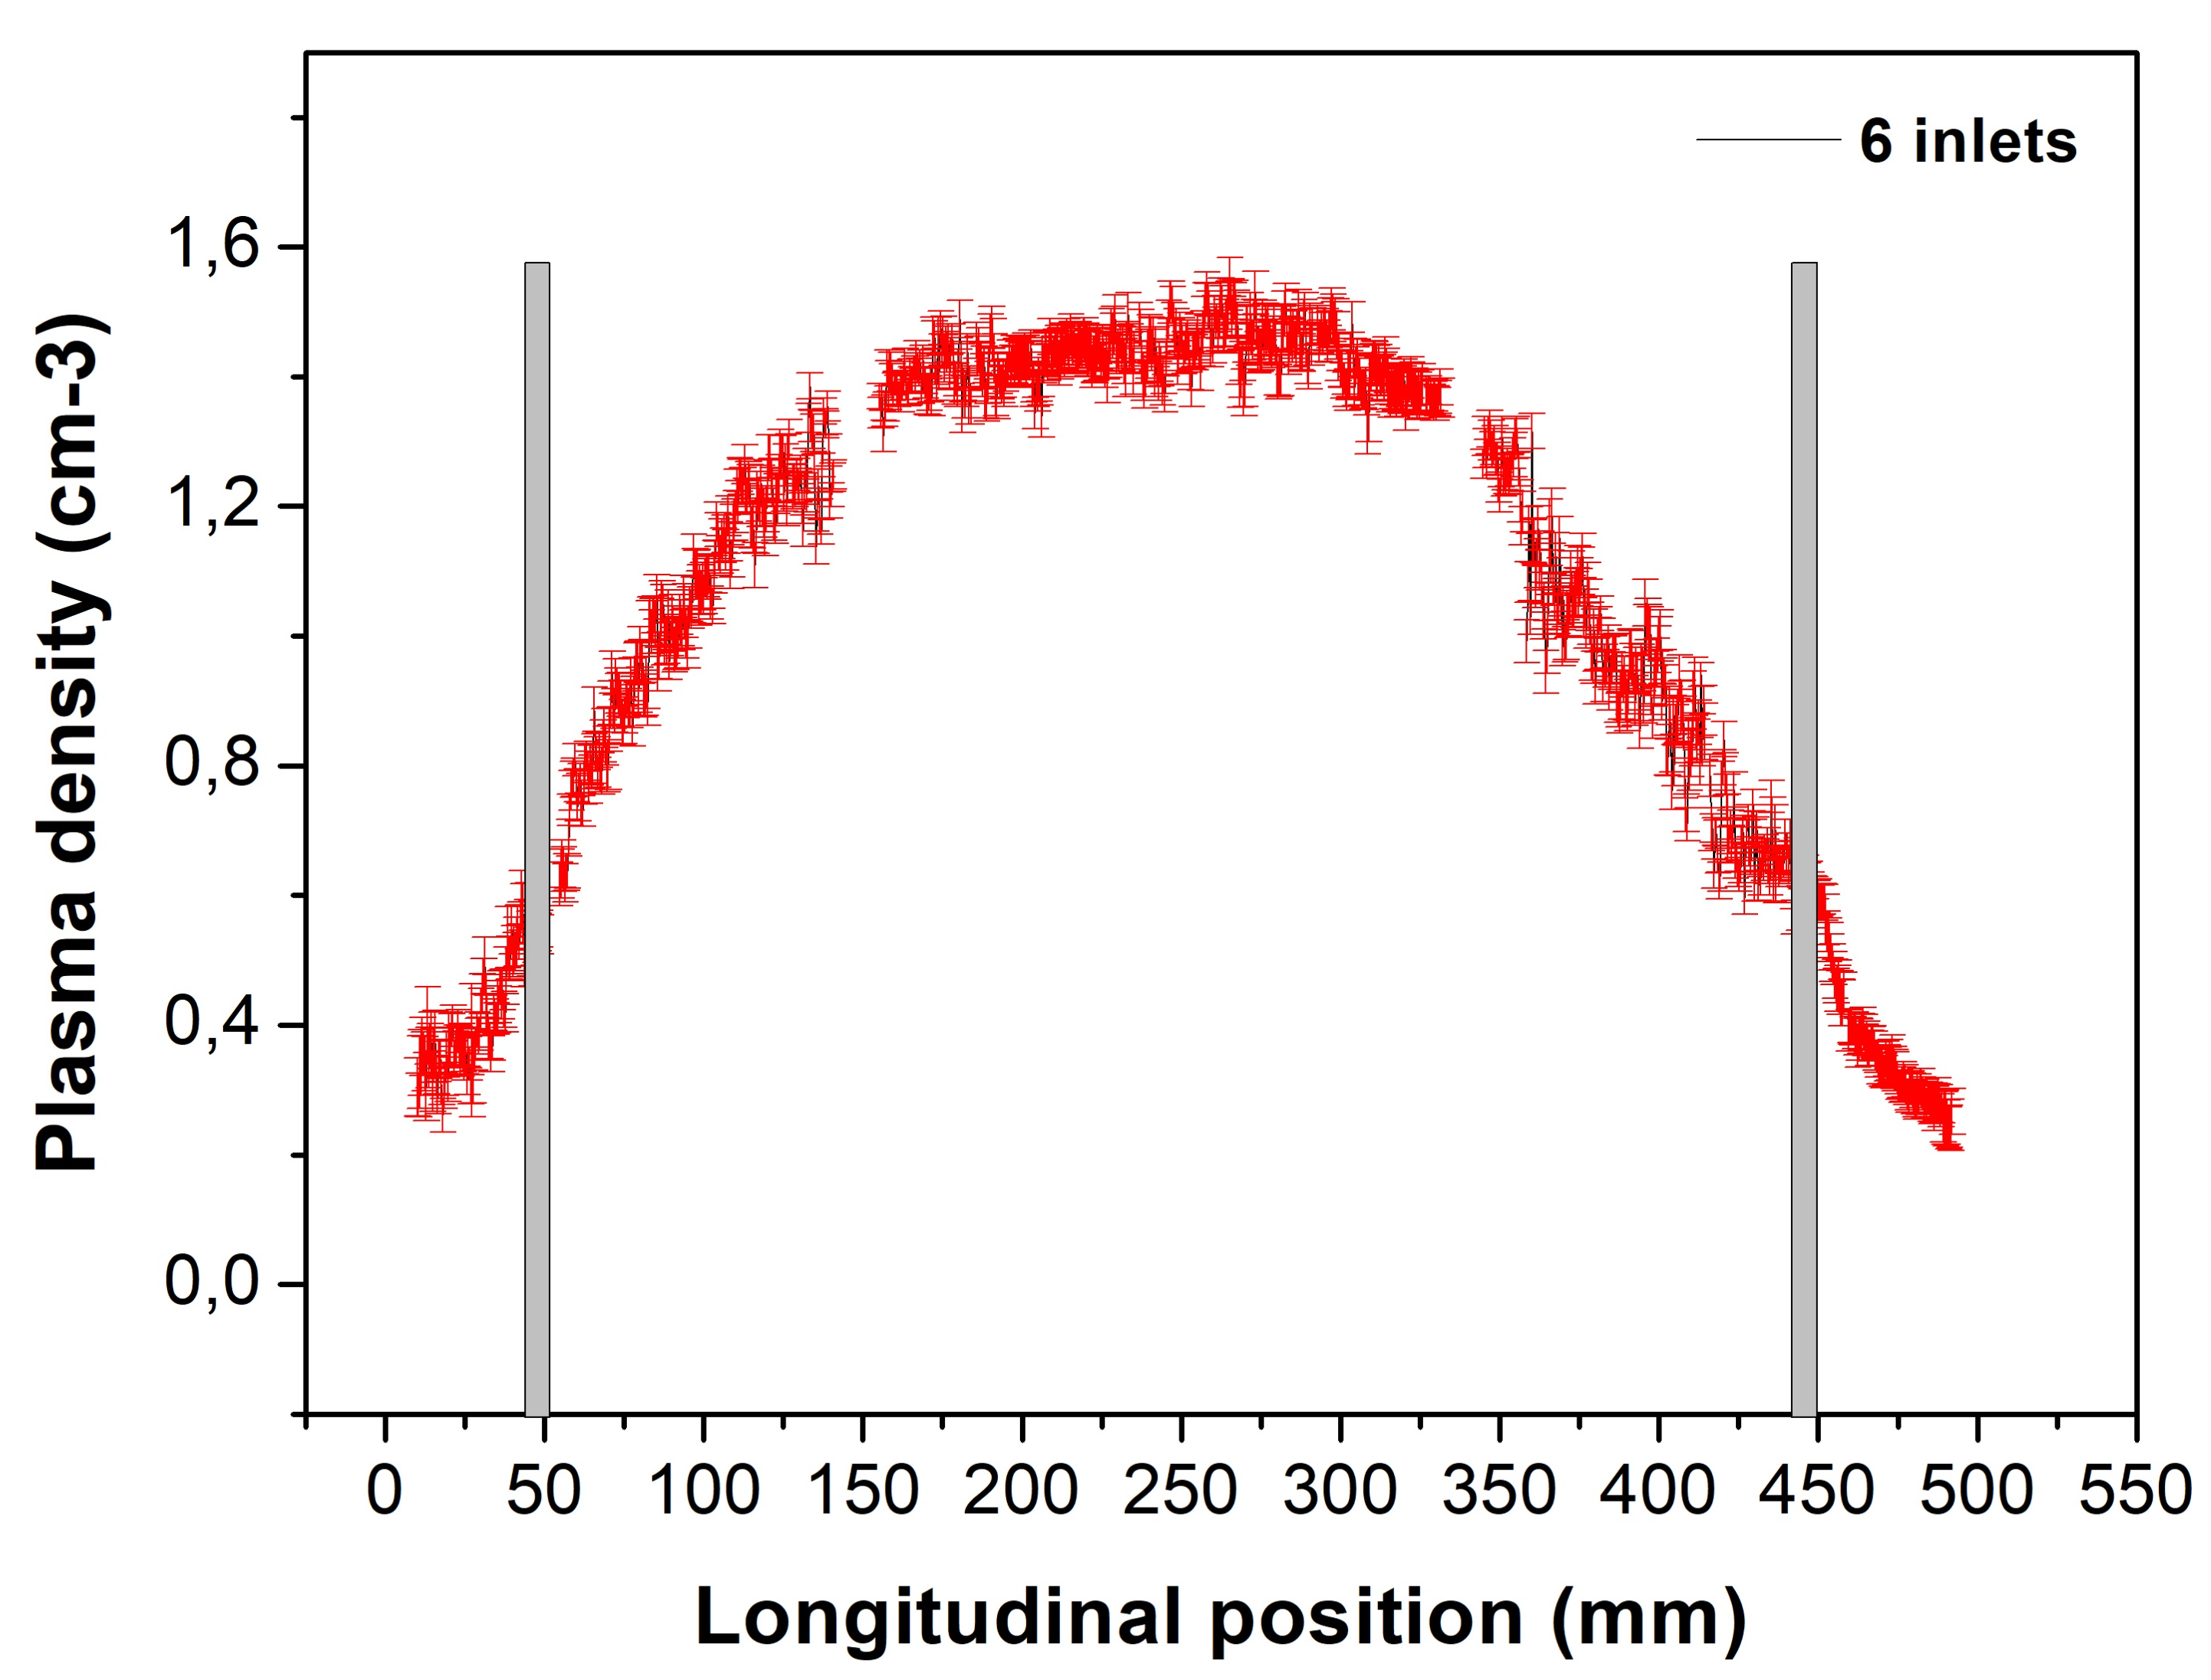
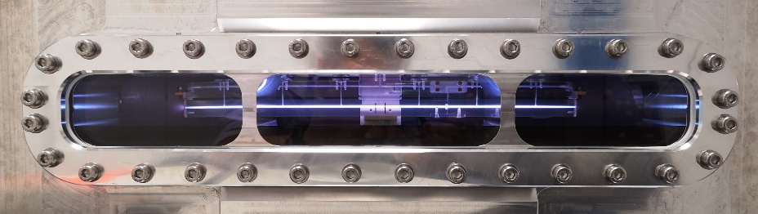
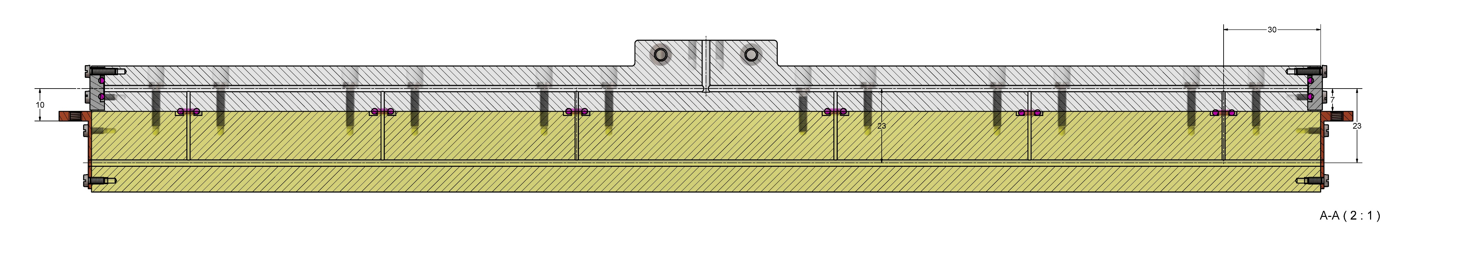
Plasma density manipulation for 40 cm long capillary
10 cm
20 cm
55%
40cm
inlet
80
60
60
40
6x1mm inlets to feed te plasma channel
10 cm long internal ramps to match the beam
20 cm long uniform electron distribution
55% density decreasing in 10 cm long rmps
Angelo Biagioni | LNF-INFN | EAAC 2025 | Page 11

Slide 12
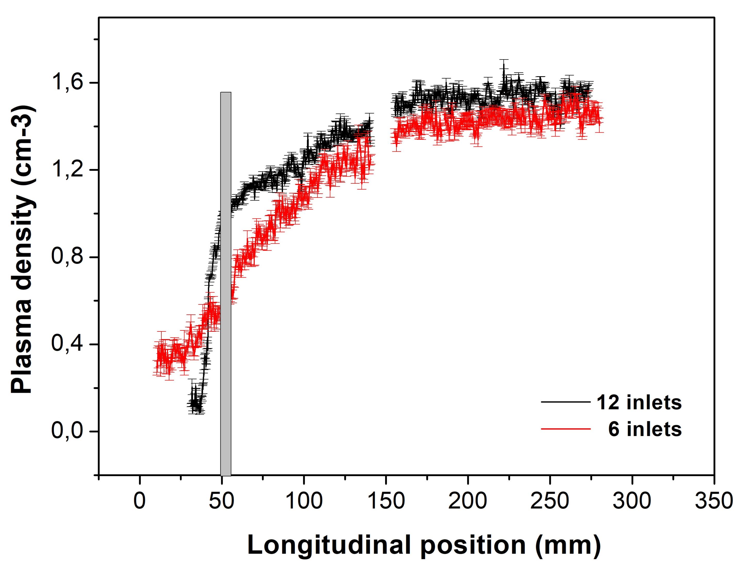
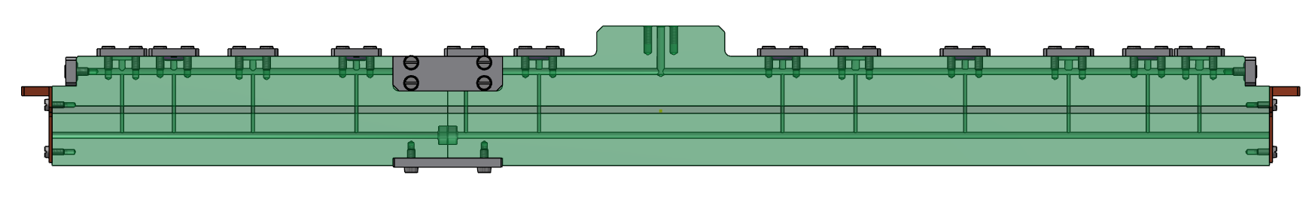
Plasma density manipulation for 40 cm long capillary
Half-capillary
New inlets
10 cm
32%
15
25
35
25
80
25
35
12x1mm inlets to feed te plasma channel injectors of constant diameter and progressively closer together
32% density decreasing in 10 cm long internal ramps (with respect to 55% of the previous geometry)
20 cm long uniform electron distribution
32% density decreasing in 10 cm long rmps
Internal ramps can be controlled to make the matching with the beam
Angelo Biagioni | LNF-INFN | EAAC 2025 | Page 12

Slide 13
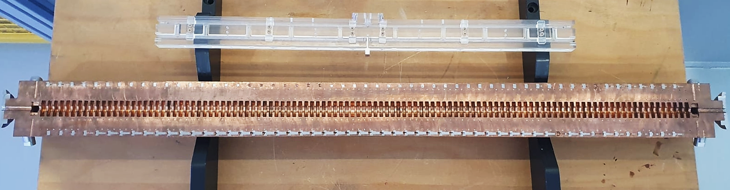
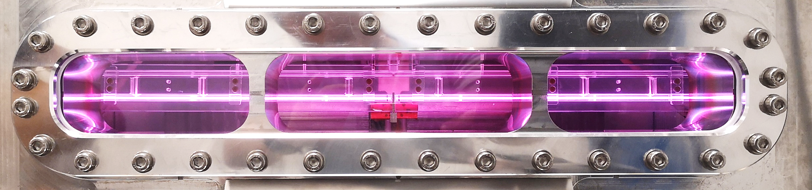
60 cm long discharge capillary for EuPRAXIA@SPARC_LAB
60 cm long Plasma accelerating module (1 GV/m)
100 cm long X-band structure (60 MV/m )
  Fabrication by machining
  10 increasing diameter
  Density range 10¹⁶ -10¹⁷ cm⁻³
  13 kV with 500 A
  100 Hz rep Rate (Ceramics)
Angelo Biagioni | LNF-INFN | EAAC 2025 | Page 13

Slide 14
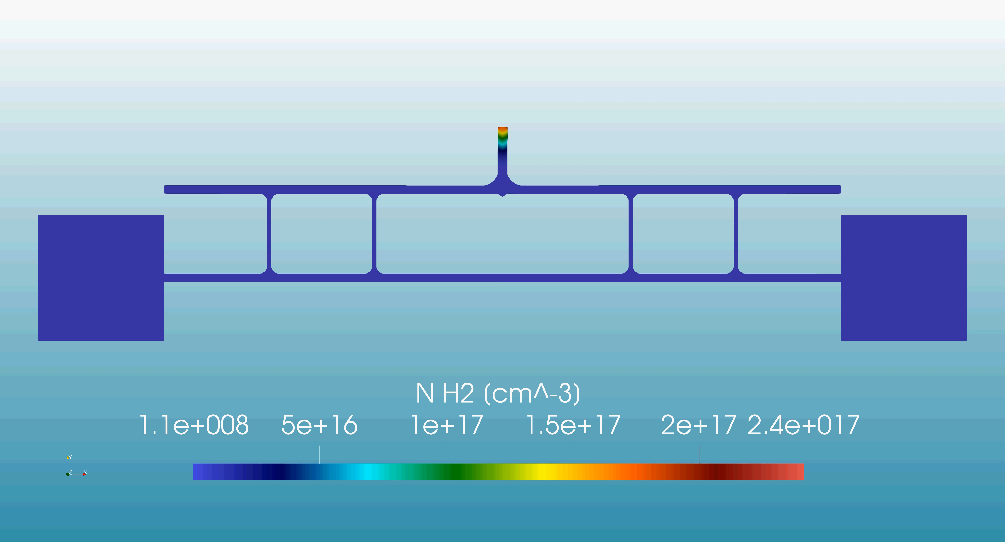
Conclusions
Density easily adjusted by controlling gas flow, geometry or voltage in the range: 10¹⁵ - 10¹⁹ cm⁻³
Longitudinal profiles, in particular plasma ramps, can be tailored to match the electron beams in order to optimize the interaction
Compact devices based on plasma formation through electrical discharges can be designed to integrate different components.
Active plasma lens removal system for Driver–Witness beam separation in Particle-Driven Plasma Acceleration
Very long plasma sources based on electrical discharge can be realized on the m-scale by appropriately designing the longitudinal profiles required to optimize the interaction with electron beams.
Angelo Biagioni | LNF-INFN | EAAC 2025 | Page 14

Slide 15
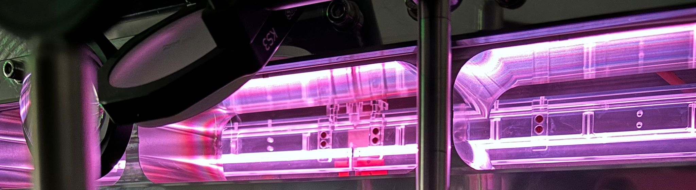
Thank you for your attention
Angelo Biagioni | INFN_LNF
Angelo.Biagioni@lnf.infn.it
Angelo.Biagioni@lnf.infn.it | EAAC 2025

