Slide 1

Visualizing plasma waves and long-living soliton-like structures in a laser-wakefield accelerator
Yu Zhao^{1,2}, Alexander Sävert¹, Xinhe Huang¹, Daniel Seipt¹, and Malte C. Kaluza^{1,2}
¹Helmholtz Institute Jena, Germany.
²Institute of Optics and Quantum Electronics, Jena, Germany.

Slide 2
Motivation
  Why (and when) is (few-cycle) probing of plasma accelerators useful?
  Which acceleration scenarios can be investigated with a pump-probe configuration?
  Which parameters of the interaction can be diagnosed?
    plasma parameters (density, temperature,…)
    acceleration fields (E- and B-fields),
    driver-laser field
    soliton-like structures
  Transition from single-frame imaging to multi-frame („burst“) imaging

Slide 3
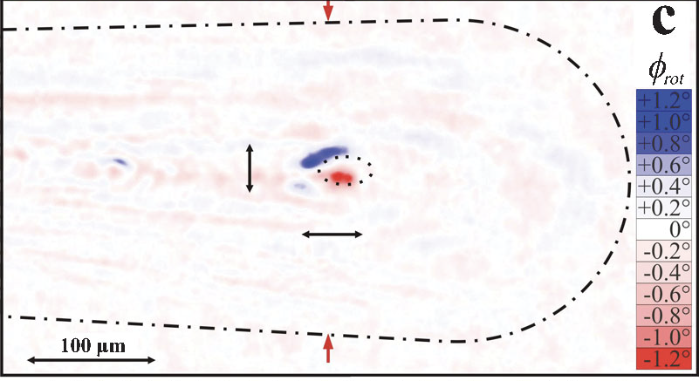
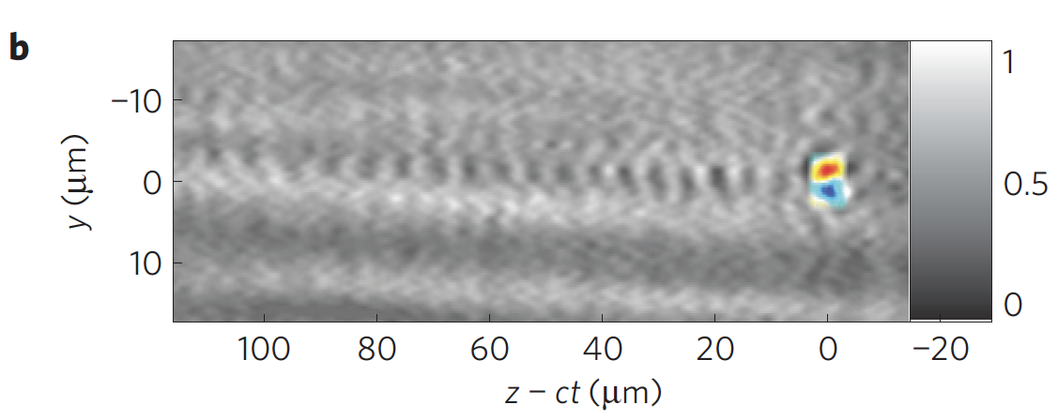
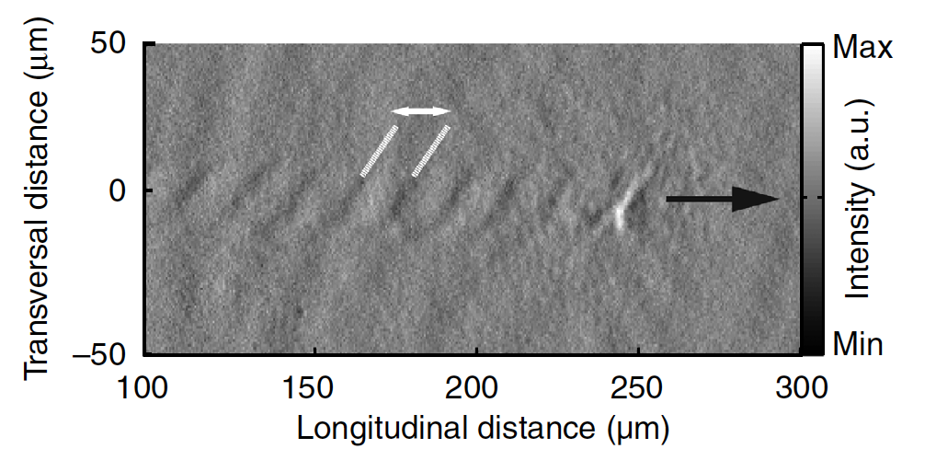
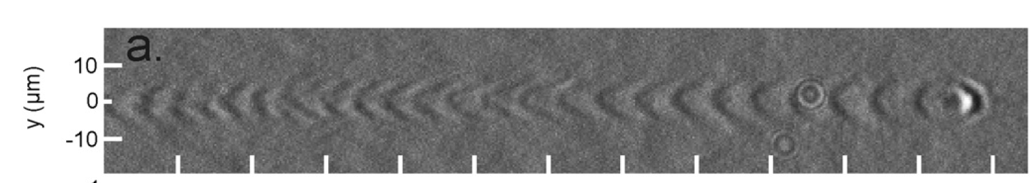
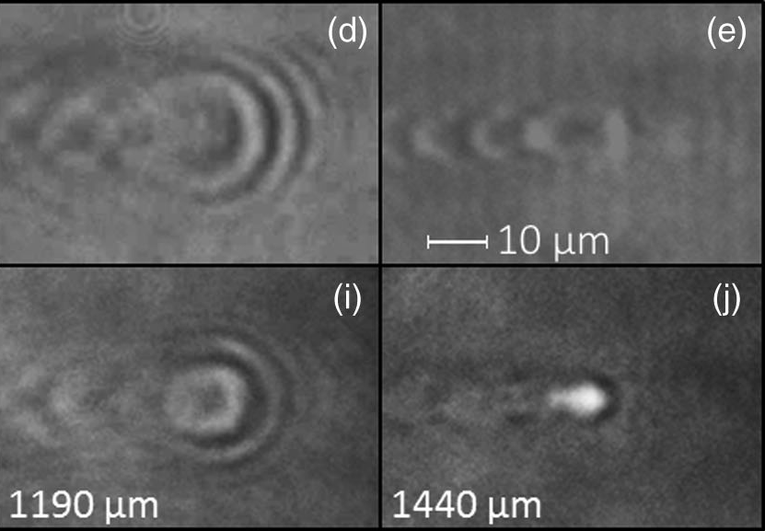
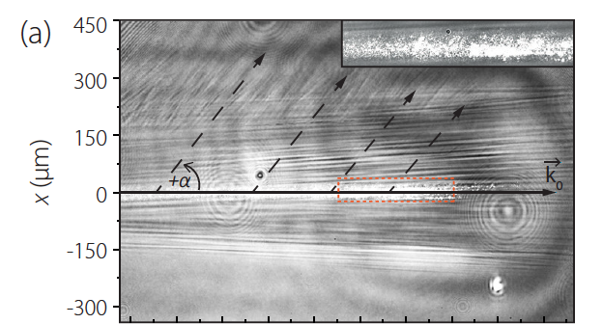
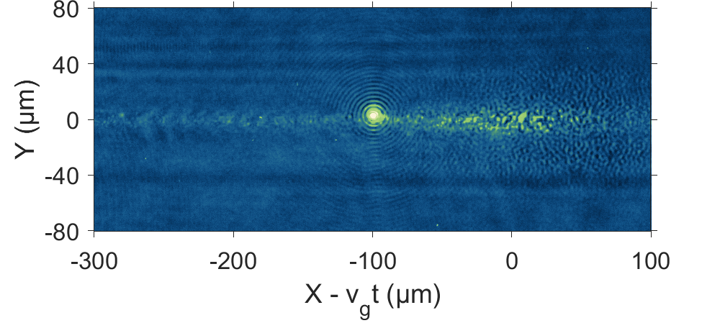
Optical Probing of Laser-Matter Interactions
M. Kaluza et al., PRL 3, 109 (2010)
A. Buck et al., Nat. Physics 7, 543 (2011)
M. Schnell et al., Nat. Comm. 4, 2421 (2013)
M. Schwab et al., APL 103, 191118 (2013)
A. Sävert et al., PRL 115, 055002 (2015)
M. Schwab et al., PRAB 23, 032801 (2020)
C. Zepter et al., PRR 5, L012023 (2023)
Y. Zhao et al., in preparation (2025)

Slide 4
Underdense Plasma: Wakefield Generation
Probing of underdense laser-matter interactions:
  Laser-driven electron acceleration
Methods
  Experiment: Space & time-resolved movies of plasma wave
  Numerical Simulations: Explanation for observed emission of radiation
Results
  Signatures of long-living soliton-like structures

Slide 5





Few-cycle probing of wakefields
$$80 mJ$$
$$< 1 mJ$$
$\sim 200 mbar$Ar
JETi 200, $2.6 J$
Limitation: only ONE snapshot from a single interaction
$∗$ A. Sävert et al., PRL 115, 055002 (2015)

Slide 6
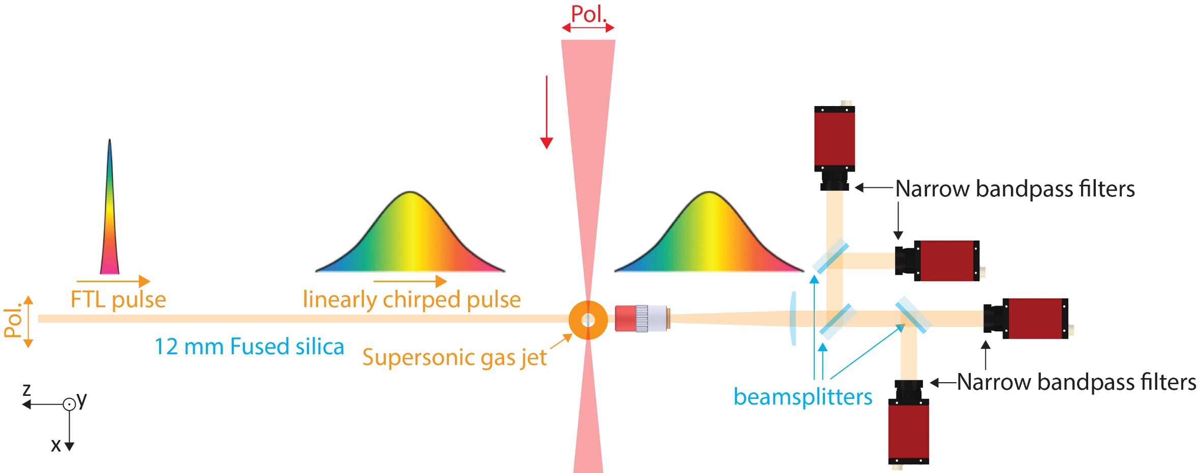
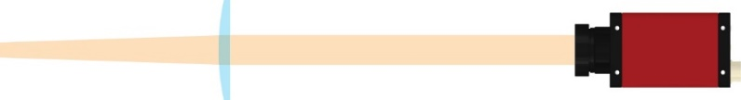



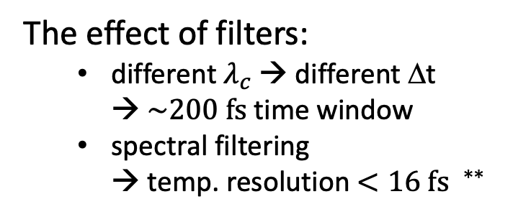
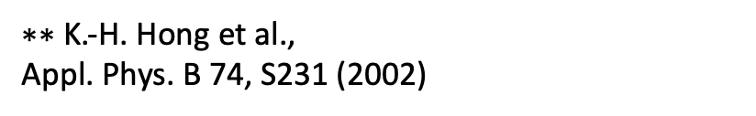
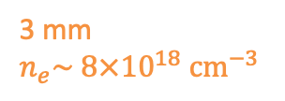
Few-cycle microscopic burst imaging
Few-cycle microscopy + modified STAMP$^{∗}$ (top-view)
The effect of filters:
  different ${\text{λ}}_{c}$ → different Δt
  → $\sim 200 fs$time window
  spectral filtering
  → temp. resolution $<16 fs$ $^{∗∗}$
JETi 200:
$$λ_{0}=800 nm, \\ E=2.6 J \\ τ_{L}=22 fs$$
f/20 focusing:
$$a_{0}≈2.7$$
$$τ_{probe}=9 fs$$
3 mm
$$n_{e}\sim 8×{10}^{18}{ cm}^{−3}$$
$∗∗$ K.-H. Hong et al.,
Appl. Phys. B 74, S231 (2002)
$∗$ K. Nakagawa et al., Nature Photonics 8, 695–700 (2014)

Slide 7
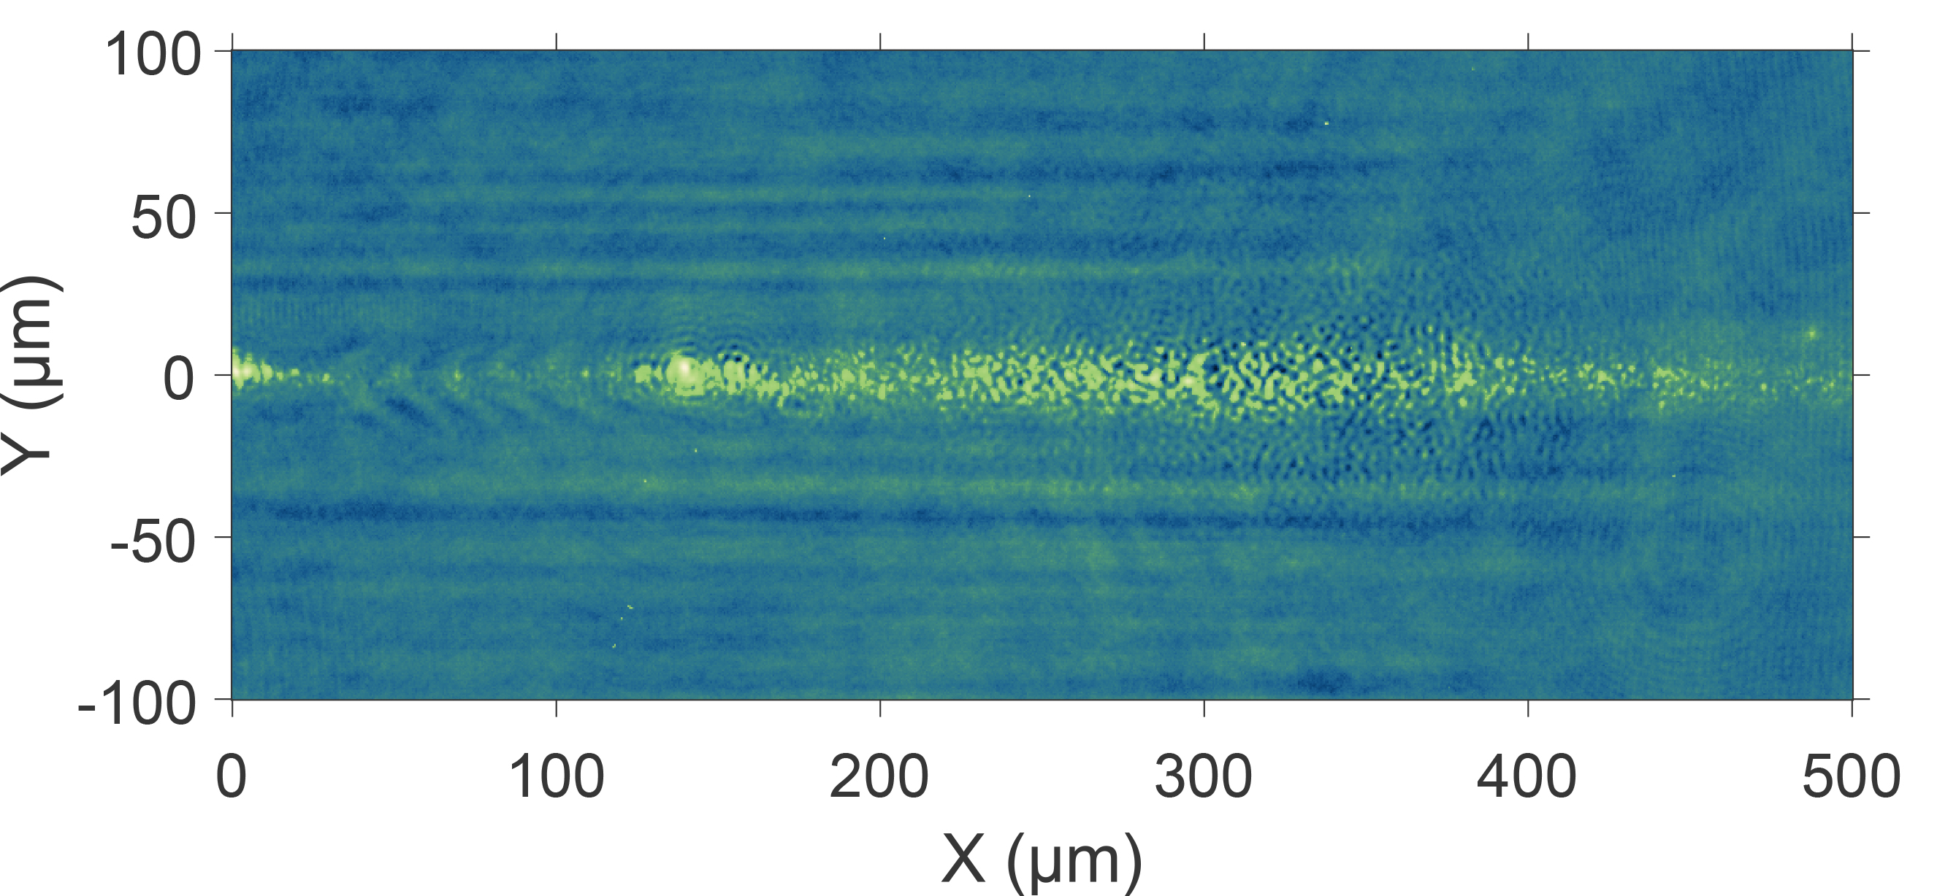

Localized sources of coherent emission
Only adjusted brightness to optimize visibility
$$800 ±5 nm$$
Coherent emissions
(with interference rings)
“Bubble”: main pulse pos.
Plasma wave
Thomson scattering of the main pulse
Dust

Slide 8
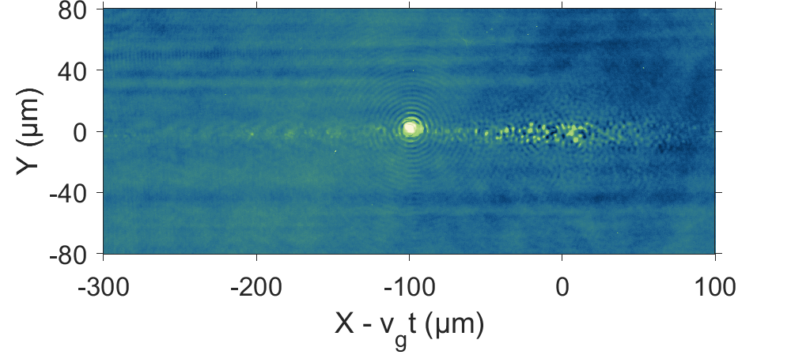
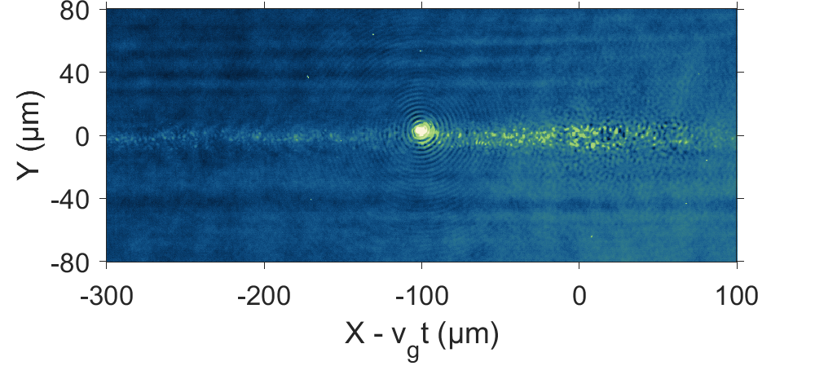
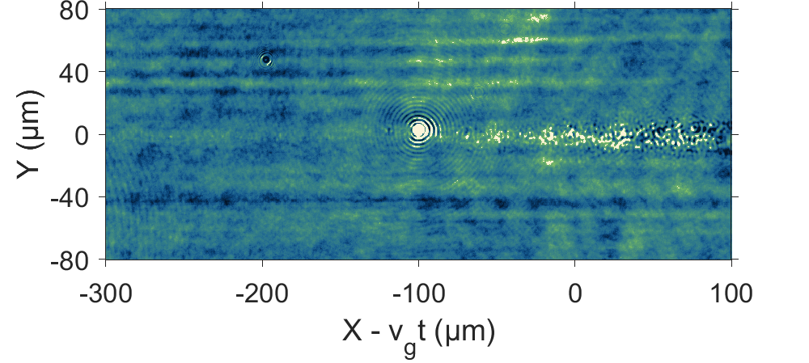





Interference rings around emitters
micrometer sized, coherent, broad spectrum, duration $>200 fs$, non-propagating
$t_{0}=0 fs$ ($850 ±5 nm$)
$t_{2}=130 fs$ ($750 ±5 nm$)
main pulse
main pulse
emission + interference
emission + interference
$t_{1}=60 fs$ ($800 ±5 nm$)
$t_{3}=200 fs$ ($700 ±5 nm$)
main pulse
main pulse
emission + interference
emission + interference
plasma density: $\sim 7×{10}^{18}{ cm}^{−3}$

Slide 9
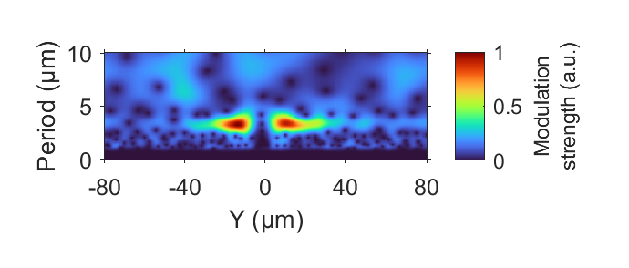
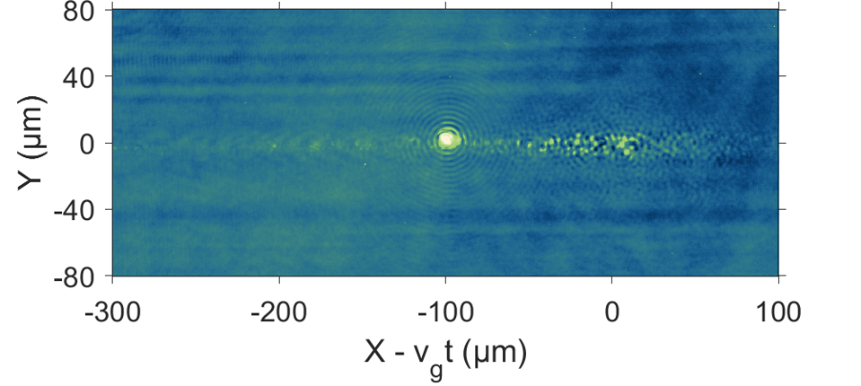
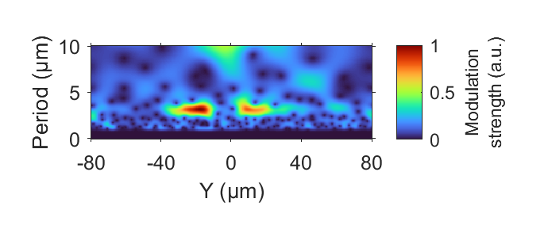


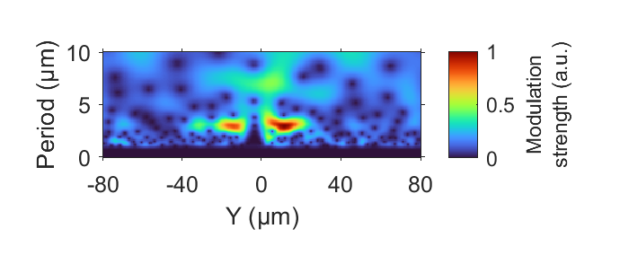

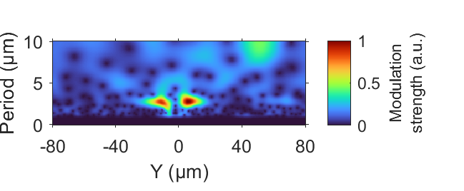



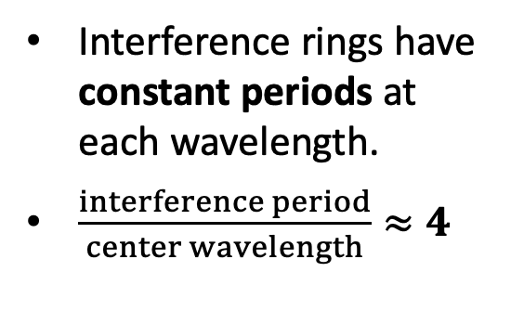





Emission source: spherical wave
Continuous wavelet analysis
$$850 ±5 nm$$
$$\frac{3.3 μm}{0.85 μm}≈4$$
$$800 ±5 nm$$
$$\frac{3.1 μm}{0.8 μm}≈4$$
Interference rings have constant periods at each wavelength.
$\frac{interference period}{center wavelength}≈4$
$$750 ±5 nm$$
$$\frac{3.0 μm}{0.75 μm}=4$$
$$700 ±5 nm$$
$$\frac{2.7 μm}{0.7 μm}≈4$$

Slide 10

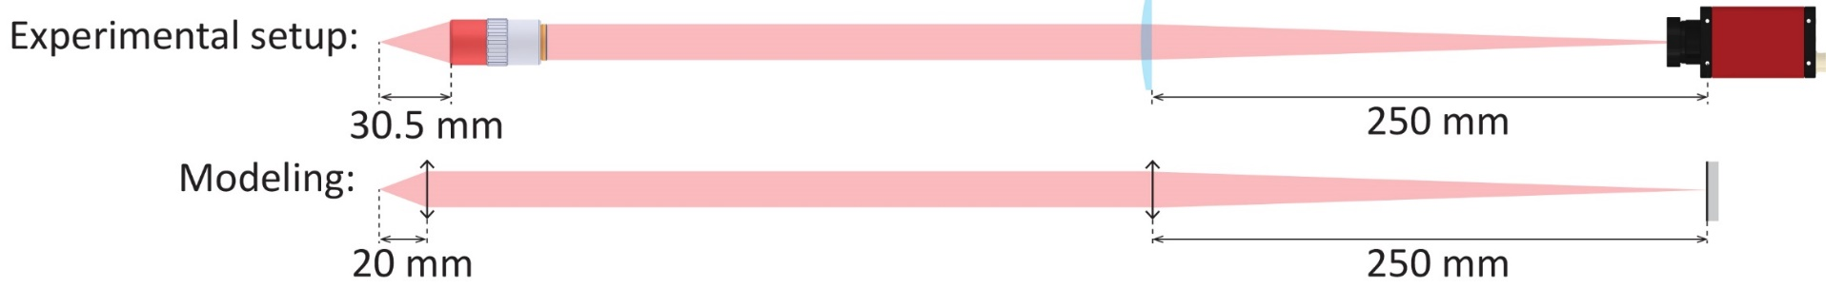
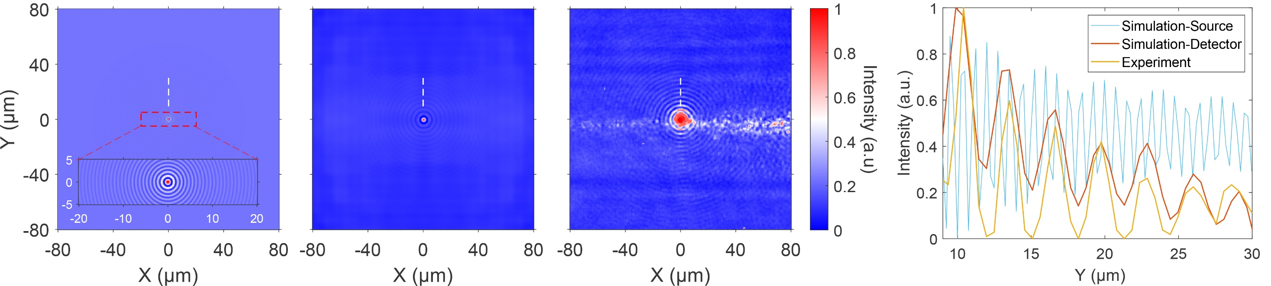

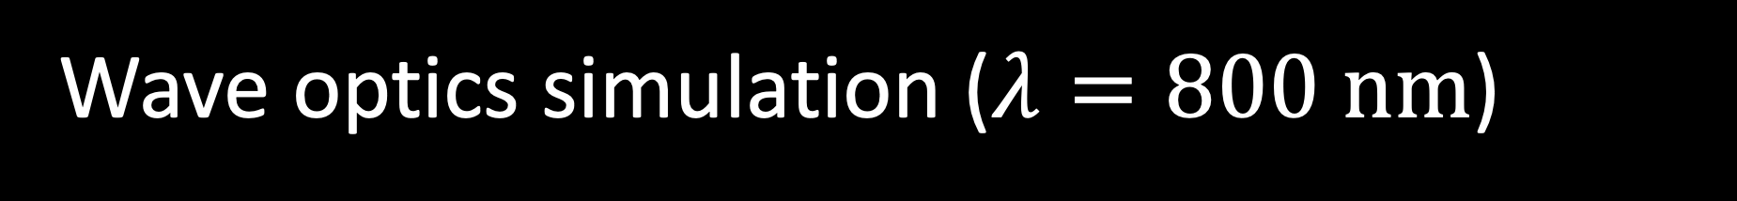

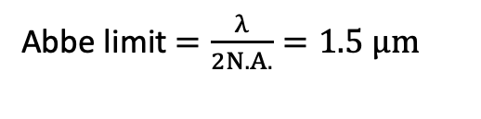
Wave optics simulation ($λ=800 nm$)
spatial res. : $\sim 2 μm$
Measured interference =
a plane wave (probe)
+ a spherical wave (emission)
+ imaging system artifact
Abbe limit $=\frac{λ}{2N.A.}=1.5 μm$
Simulation-Source
Simulation-Detector
Experiment ($λ=800 nm$)

Slide 11
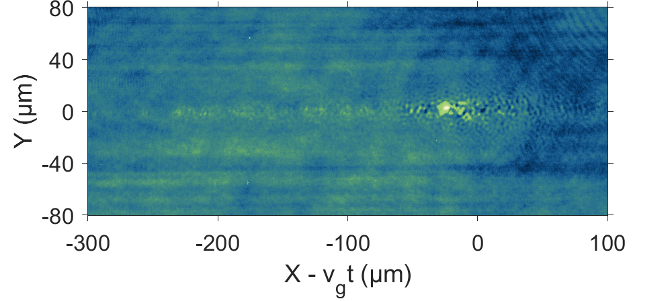
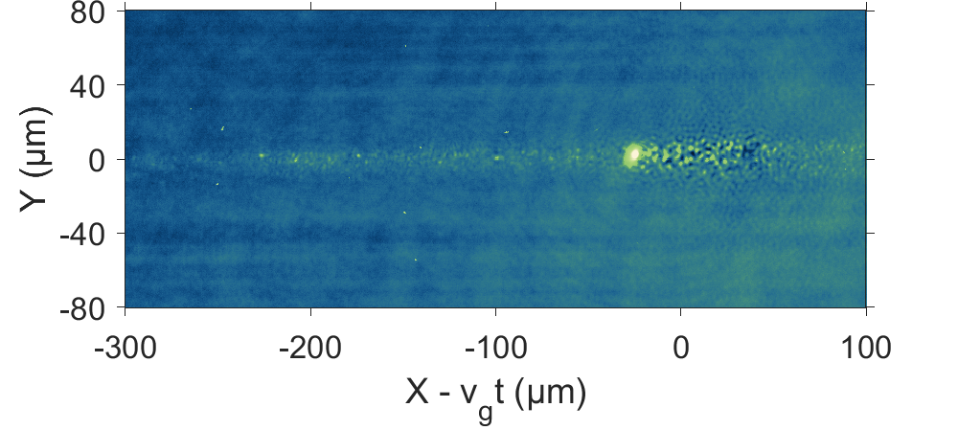
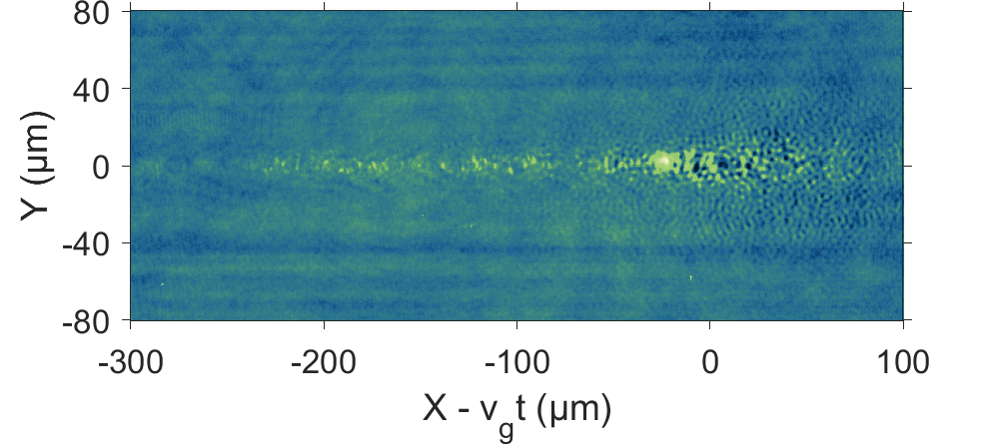
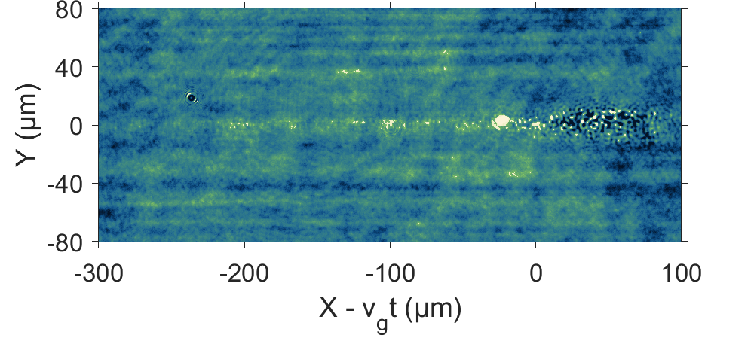





Temporal evolution: no interference
Probe pulse arrived before coherent emission started → no interference
$$t_{0}=0 fs$$
$$t_{2}=130 fs$$
Main pulse
Main pulse
Emission
Emission
$$t_{1}=60 fs$$
$$t_{3}=200 fs$$
Main pulse
Main pulse
Emission
Emission
plasma density: $\sim 6×{10}^{18}{ cm}^{−3}$

Slide 12
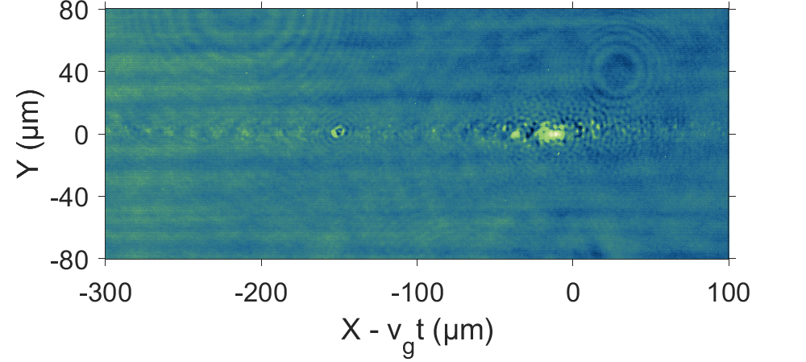
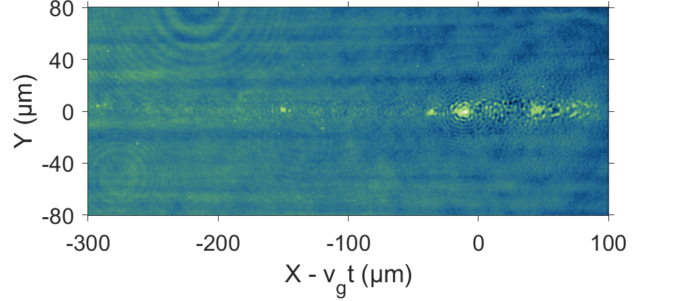
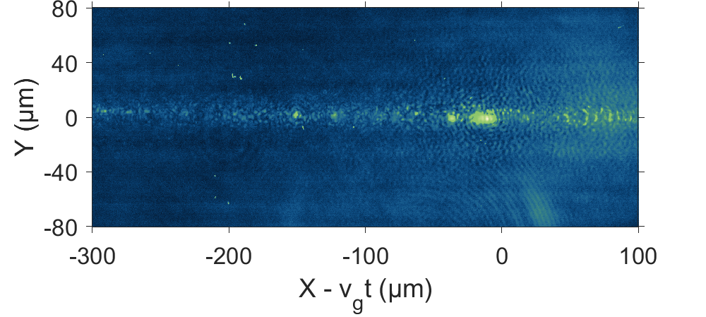
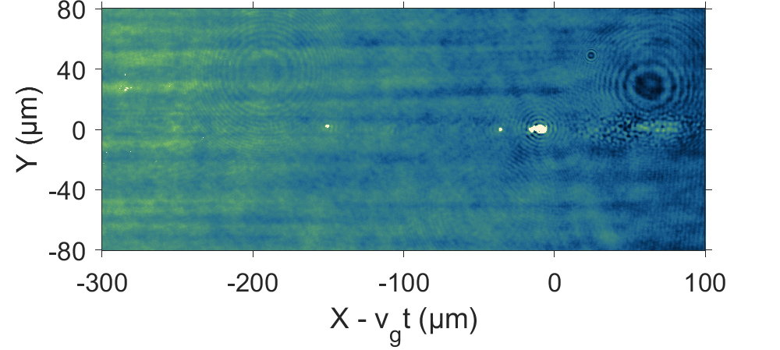




Temporal evolution: interference appears
Interference rings observed at $130 fs$ after the driver pulse
$$t_{0}=0 fs$$
$$t_{2}=130 fs$$
Main pulse
Main pulse
Emission
Emission + Interference
$$t_{1}=60 fs$$
$$t_{3}=200 fs$$
Main pulse
Main pulse
Emission
Emission + Interference
$$t_{3}=200 fs$$
plasma density: $\sim 8×{10}^{18}{ cm}^{−3}$

Slide 13
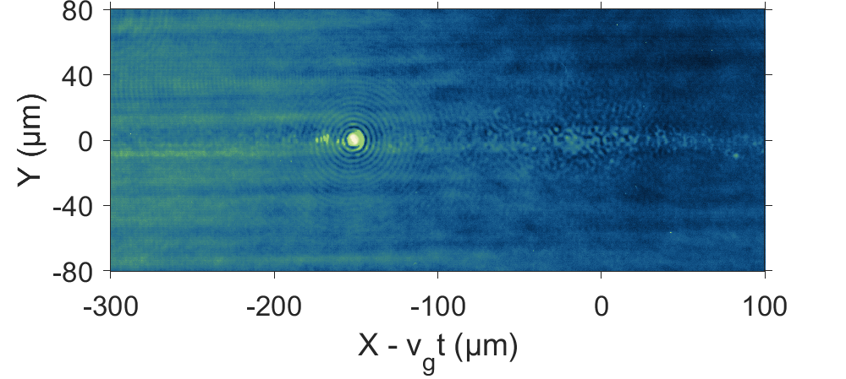
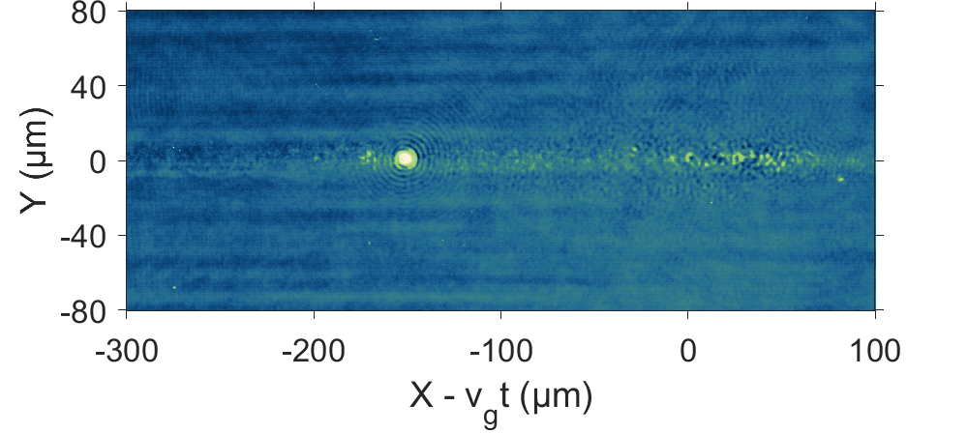
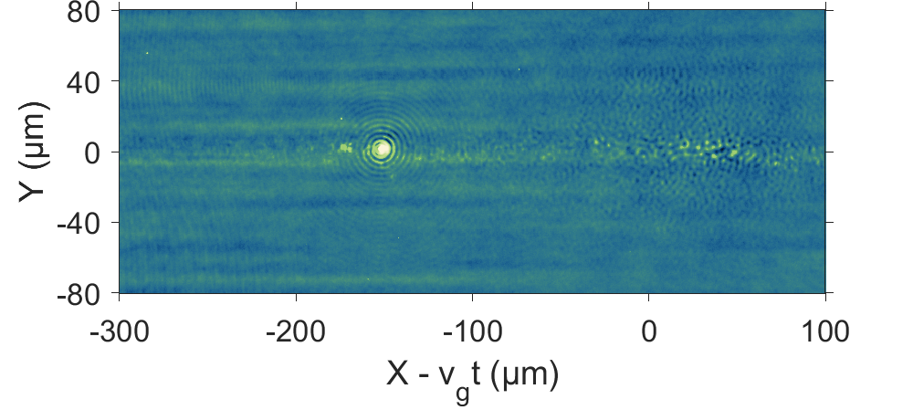
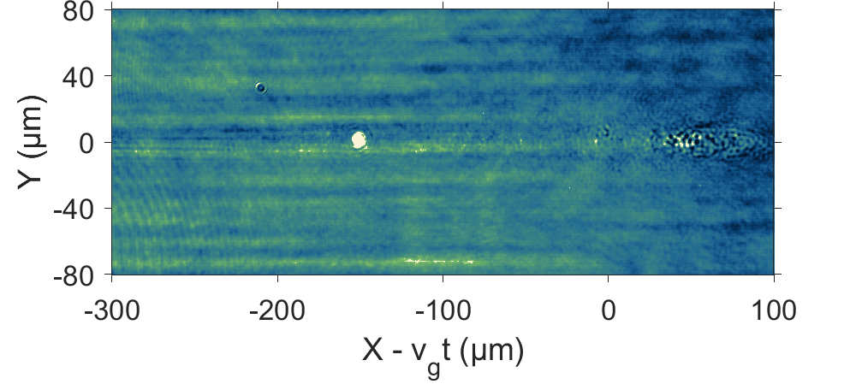



Temporal evolution: interference disappears
Interference rings vanished at $200 fs$ after the driver pulse
$$t_{0}=0 fs$$
$$t_{2}=130 fs$$
Main pulse
Main pulse
Emission + Interference
Emission + Interference
$$t_{1}=60 fs$$
$$t_{3}=200 fs$$
Main pulse
Main pulse
Emission + Interference
Emission
$$t_{3}=200 fs$$
Plasma density: $\sim 7×{10}^{18}{ cm}^{−3}$

Slide 14
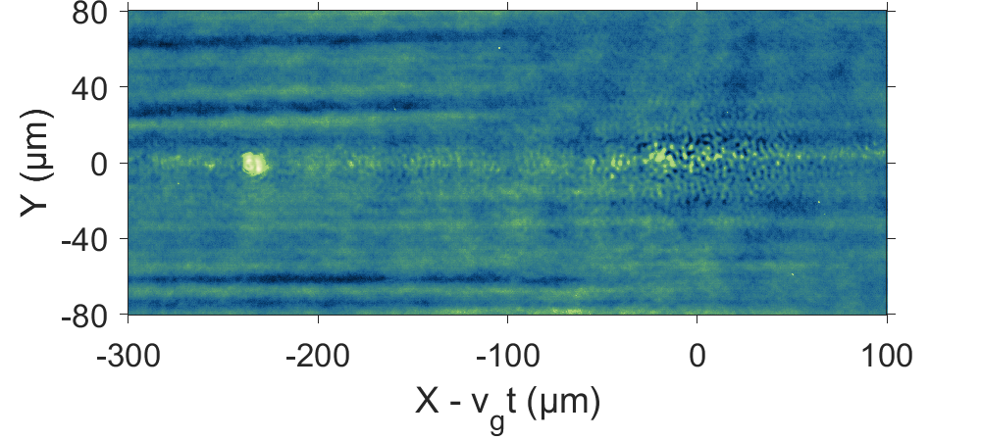
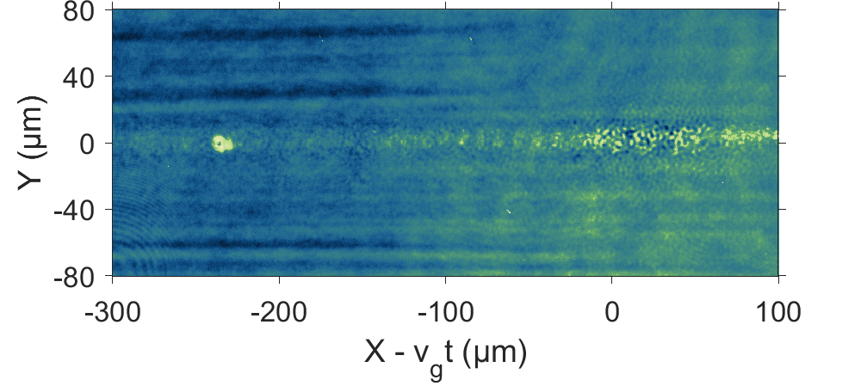
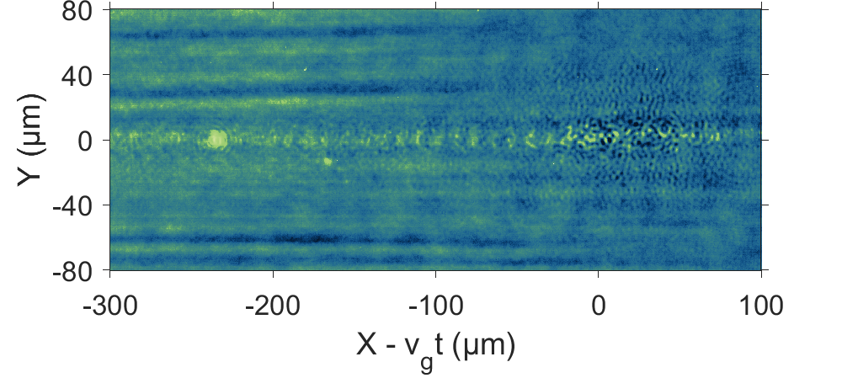
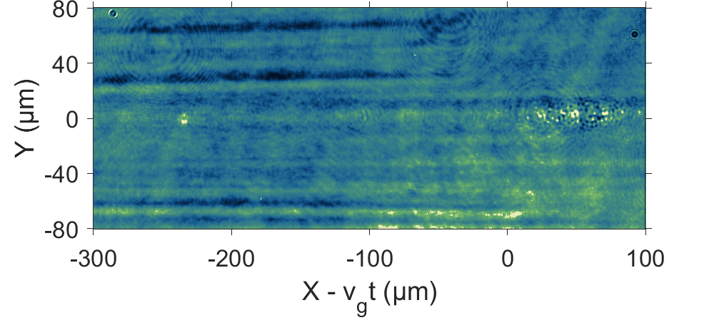



Temporal evolution: no interference
Probe pulsed arrived after coherent emission stopped→ No interference
$$t_{0}=0 fs$$
$$t_{2}=130 fs$$
Main pulse
Main pulse
Emission
Emission
$$t_{1}=60 fs$$
$$t_{3}=200 fs$$
Main pulse
Main pulse
Emission
Emission
$$t_{3}=200 fs$$
Plasma density: $\sim 8×{10}^{18}{ cm}^{−3}$

Slide 15
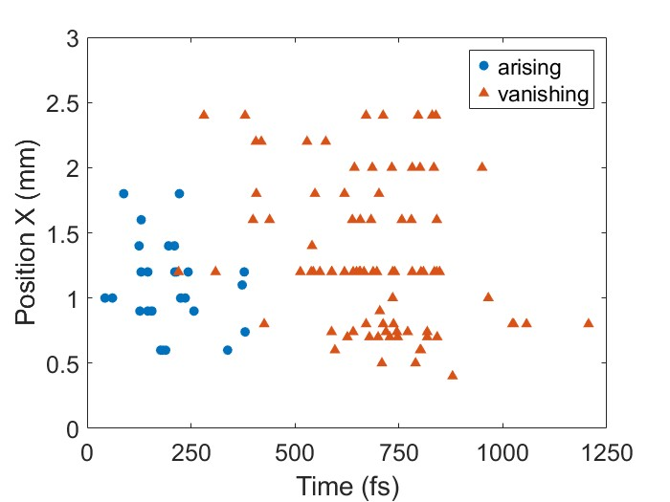
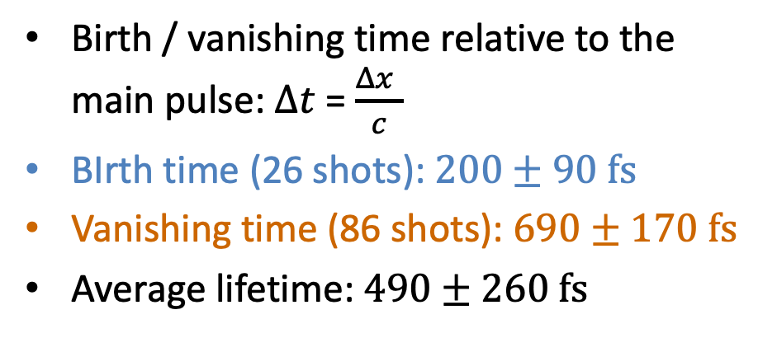


Lifetime evaluation
Arising / vanishing time:
$$t_{2}=130 fs$$
$$Δx$$
Birth / vanishing time relative to the main pulse: $Δt$= $\frac{Δx }{c}$
BIrth time (26 shots): $200±90 fs$
Vanishing time (86 shots): $690±170 fs$
Average lifetime: $490±260 fs$

Slide 16



Numerical simulations
PIC-simulation of interaction,
stationary frame behind main pulse showing n_{e} and B-field:
Stationary, soliton-like structures appearing in the wake of the main pulse
Associated with internal B-fields (and currents) and oscillating high-density electron shell -> emission of synchrotron-like radiation also at shorter wavelengths

Slide 17

Conclusions and Outlook
We observed the emission from soliton-like structures in the wake of high-power laser pulses:
  Micrometer sized
  Non-propagating at $200 fs$ timescale
  Emitting coherent spherical wave
  Emitting over broad bandwidth: $>700 nm−850 nm$
  Long lifetime: $> 200 fs, \sim 500 fs$
2D PIC-simulation:
emission from circulating electron currents on the surface of the soliton-like structures,
more detailed simulations are currently under way.
Thank you for your attention!

