Slide 1

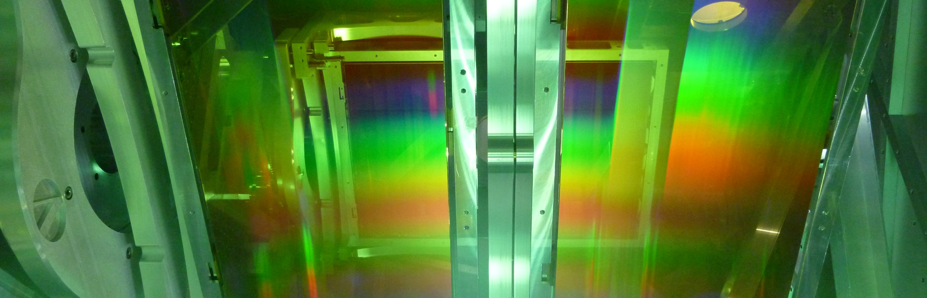
Statistical analysis of sources of instability on electron beam quality in a laser plasma accelerator
Preparing for Bayesian Optimization
Institute of Radiation Physics · Helmholtz-Zentrum Dresden-Rossendorf · Franziska Marie Herrmann· f.herrmann@hzdr.de · www.hzdr.de

Slide 2
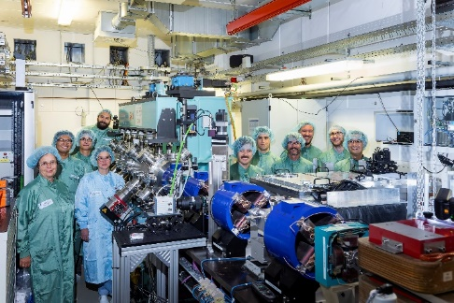



Motivation
Laser Plasma Accelerators as a compact alternative to conventional electron accelerators
Lighthouse experiment at HZDR in 2022:
Demonstration of Free Electron Lasing driven by LPA
    External seeding at 270 nm
    Labat, M. et al.: Seeded free-electron laser driven by a compact laser plasma accelerator. Nat. Photon. 17, pages 150–156 (2023).
    DOI: https://doi.org/10.1038/s41566-022-01104-w
  Demanding with respect to:
      Fast optimization of electron parameters for FEL on a daily basis
      High requirements regarding the stability of electron beam parameters

Slide 3
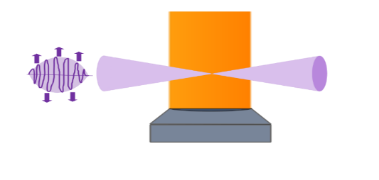

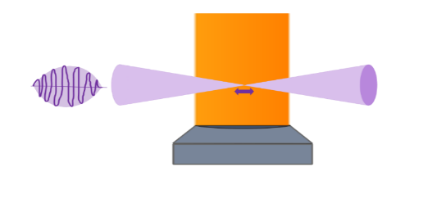
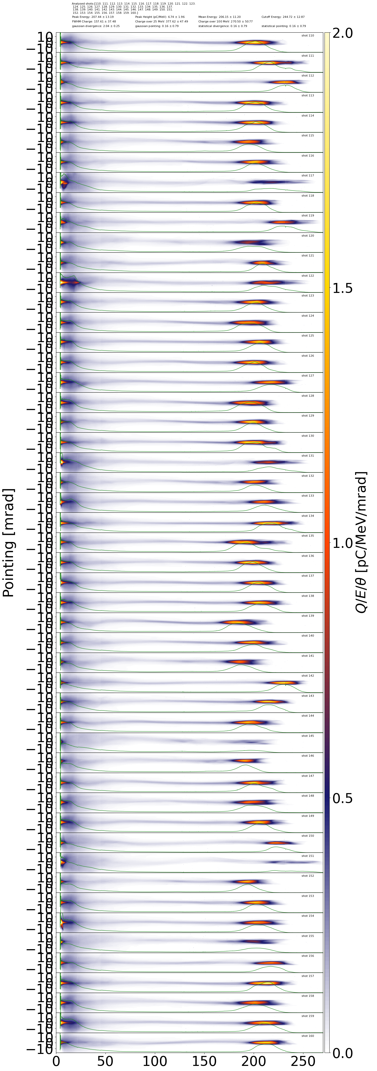
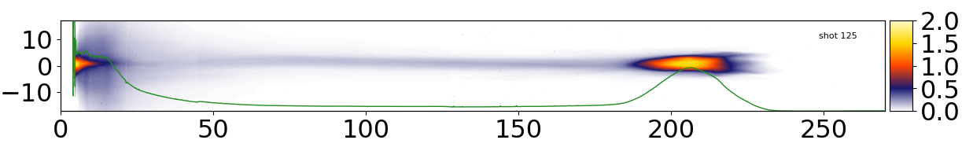
STII offers multiple pathways for control
Input parameters affecting electron acceleration performance
Injection scheme: Self-Truncated Ionization Injection (STII)
Input parameters:
Laser Group Velocity Dispersion (GVD)
Third order dispersion
(TOD)
Laser energy
Jet position relative to focus
Jet pressure
(plasma density)
Output parameters:
Typical ranges:
    Energy of electron bunch: 195 MeV
    Charge over 100 MeV: 400 pC
    Peak charge density: 12 pC/MeV

Slide 4
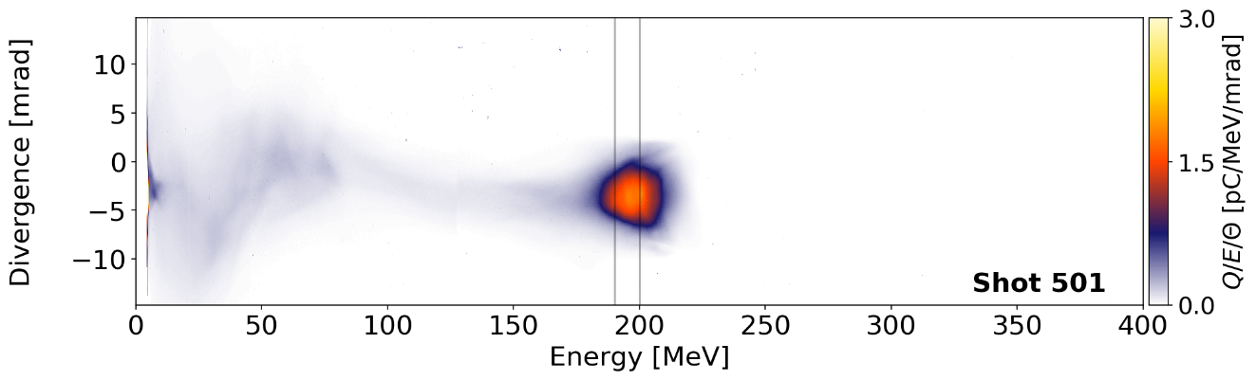
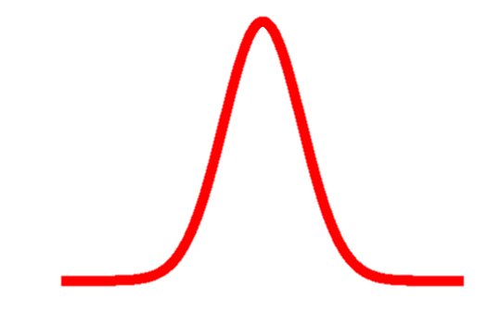
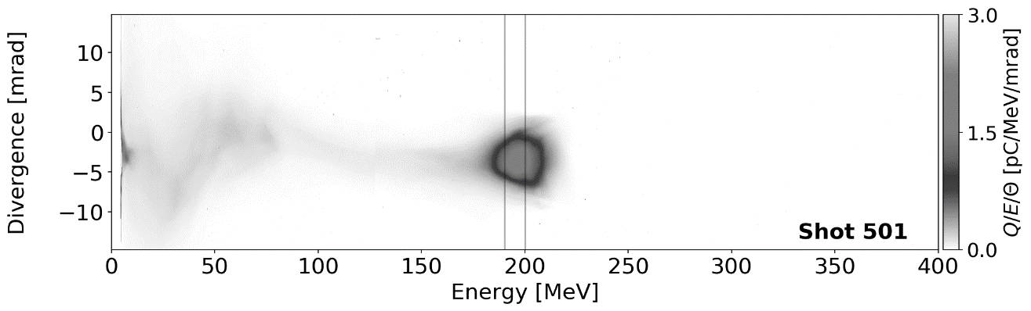

Tayloring the optimization function
Three ways to evaluate the quality of a shot
Charge in energy slice from 190 – 200 MeV
Charge in a gaussian window centered at 195 MeV
Absolute difference to custom spectrum

Slide 5
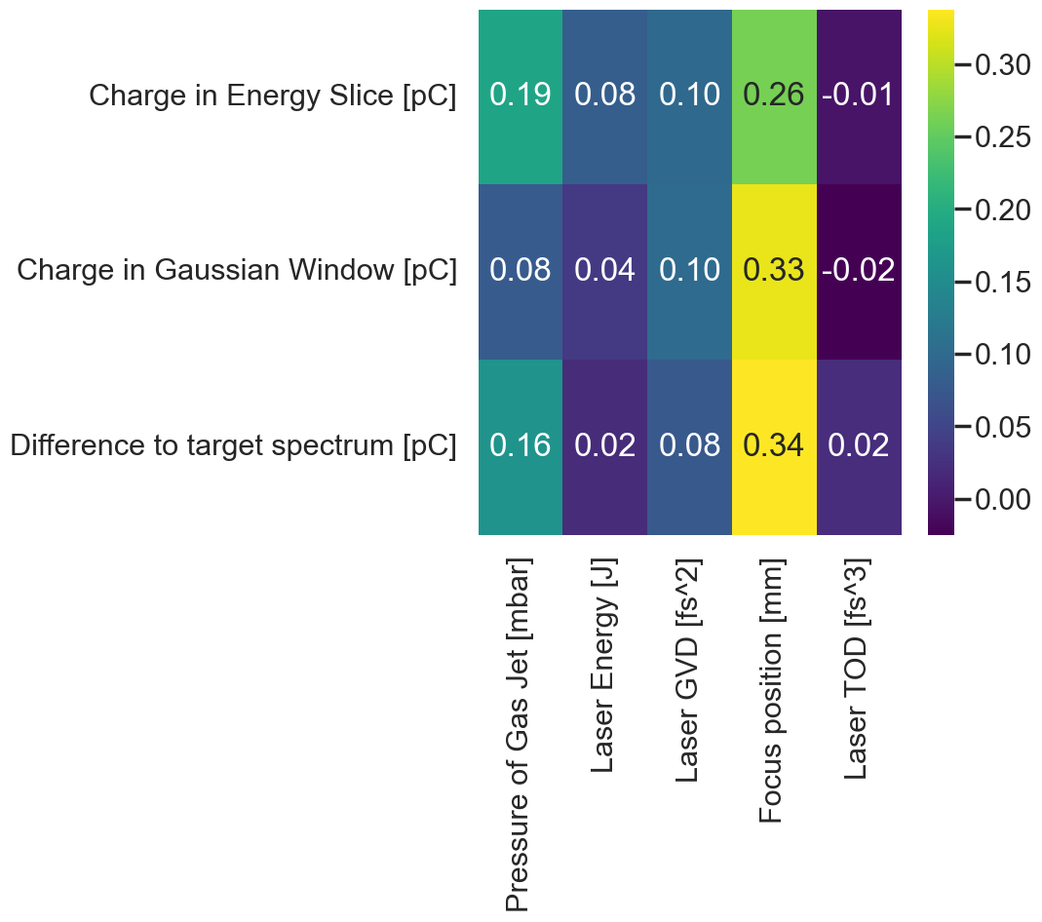
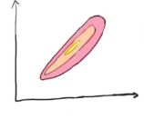
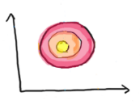
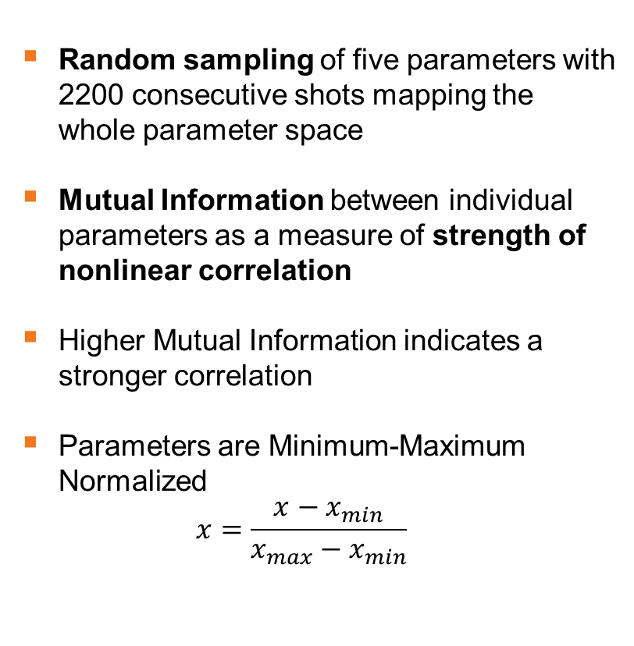
Understanding correlations between input and output parameters
Insights using Mutual Information (MI)
Random sampling of five parameters with 2200 consecutive shots mapping the whole parameter space
Mutual Information between individual parameters as a measure of strength of nonlinear correlation
Higher Mutual Information indicates a stronger correlation
Parameters are Minimum-Maximum Normalized
$x=\frac{x−x_{min}}{x_{max}−x_{min}}$

Slide 6
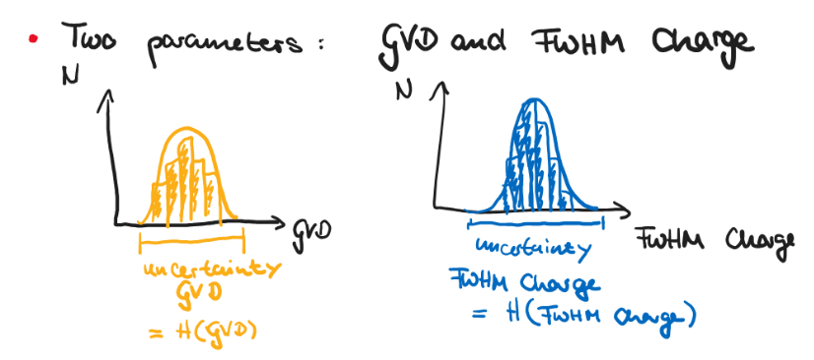
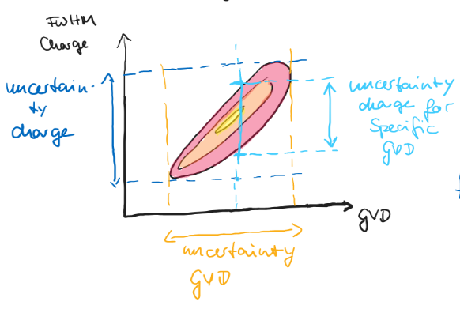
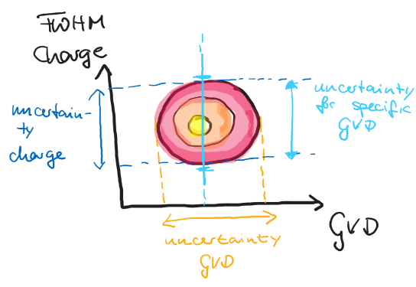

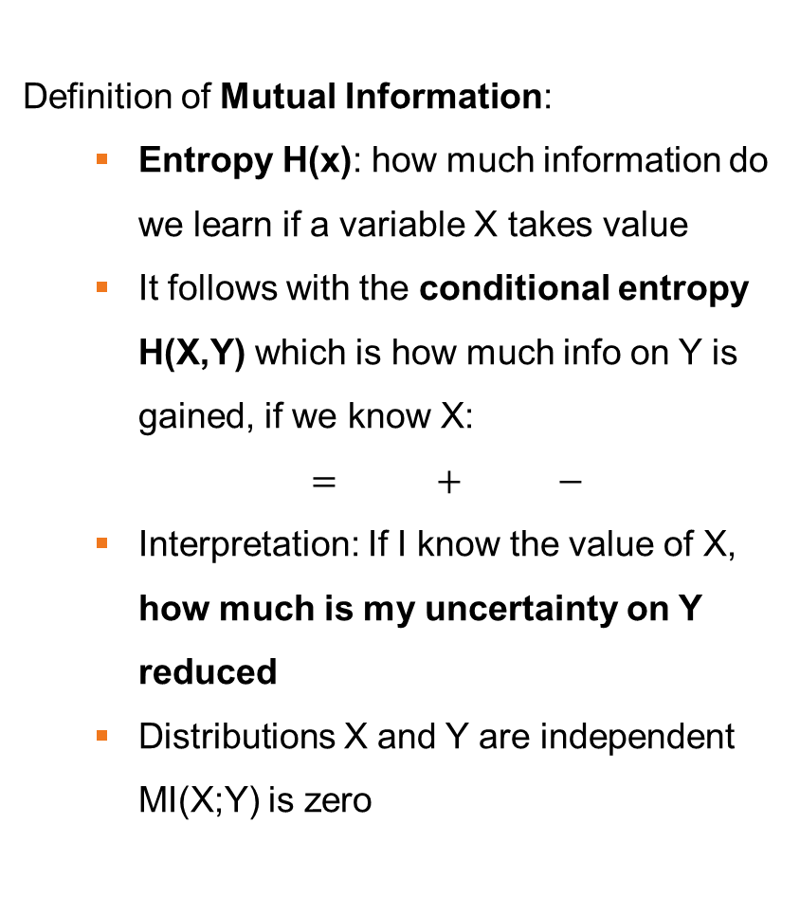
Statistics crashcourse: Mutual Information (MI)
Definition of Mutual Information:
  Entropy H(x): how much information do we learn if a variable X takes value
  It follows with the conditional entropy H(X,Y) which is how much info on Y is gained, if we know X:
  $MI(X;Y)=H(X)+H(Y)−H(X,Y)$
  Interpretation: If I know the value of X, how much is my uncertainty on Y reduced
  Distributions X and Y are independent
  MI(X;Y) is zero
Uncertainty GVD
Uncertainty charge
Uncorrelated
Correlated
Uncertainty charge for specific GVD
Uncer-tainty charge
Uncertainty charge for specific GVD
Uncer-tainty charge
Uncertainty GVD
Uncertainty GVD
Mutual Information
Uncertainty charge
Uncertainty charge for specific GVD
Uncertainty charge
Uncertainty charge for specific GVD

Slide 7
Understanding correlations between input and output parameters
Insights using Mutual Information (MI)
On all three parameters, the Focus position relative to the gas jet has the biggest impact
Scanned parameter ranges:
Laser energy on target [J] | 1.6 | 2.3
Laser GVD [fs²] | -600 | 600
Pressure of gas jet [bar] | 6 | 16
Focus position [mm] | -2 | 2
Laser TOD [fs³] | -20k | 20k

Slide 8
Understanding correlations between input and output parameters
Insights using Mutual Information (MI)
On all three parameters, the Laser Energy on target has the lowest impact
Influence of the parameters ranked:
  Focus position
  Pressure of Gas Jet
  Laser GVD
  Laser Energy
  (Laser TOD)

Slide 9
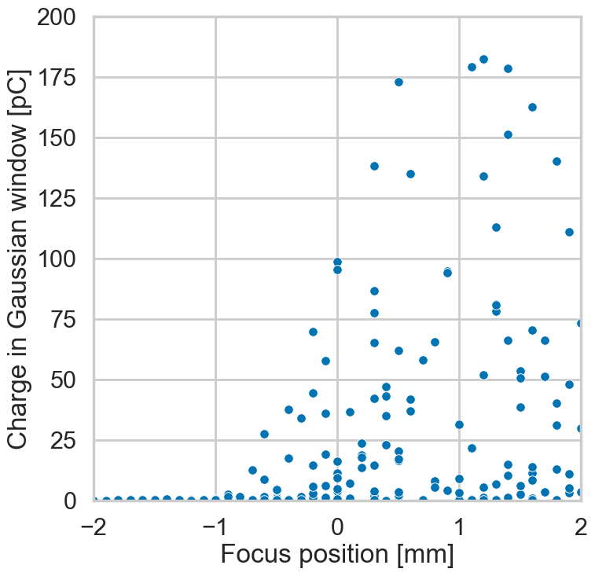
Understanding correlations between input and output parameters
Insights using Mutual Information (MI)
On all three parameters, the Focus position relative to the gas jet has the biggest impact

Slide 10
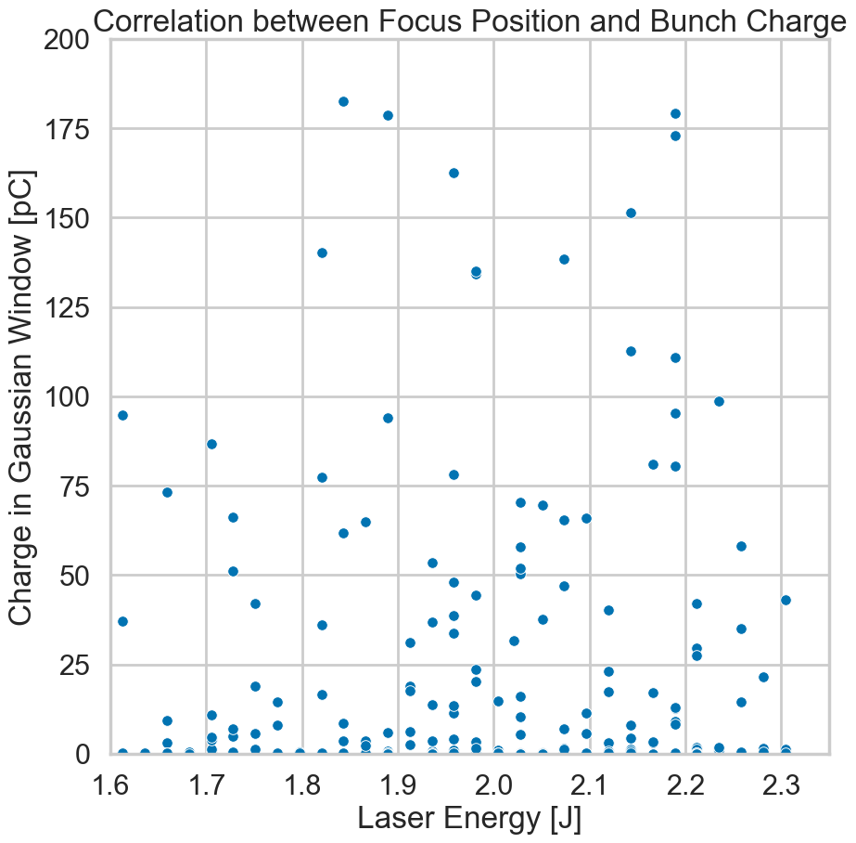
Understanding correlations between input and output parameters
Insights using Mutual Information (MI)
On all three parameters, the Laser Energy on target has the biggest impact

Slide 11
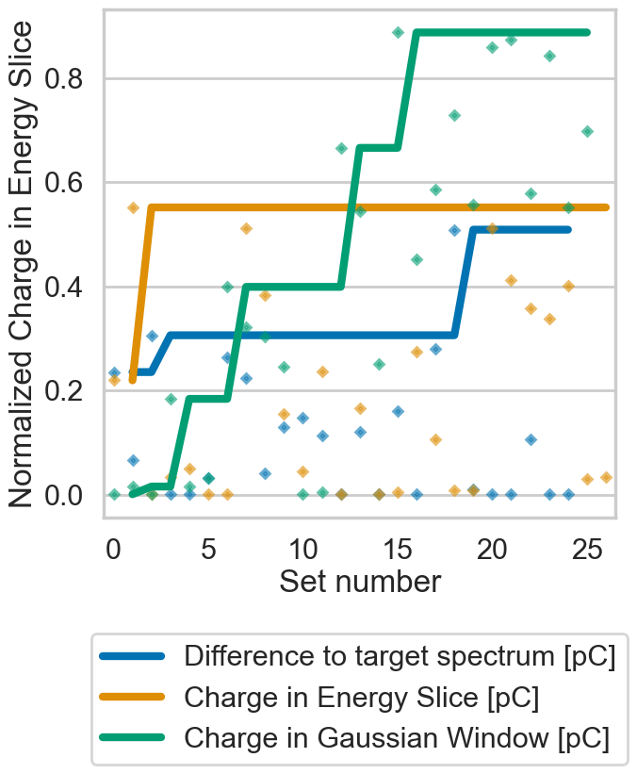
Apply all this knowledge creating a Bayesian optimization routine
Try to maximize the charge in the energy slice between 190 and 200 MeV
Created Bayesian optimization routine varying:
  Laser Energy
  Laser GVD
  Laser TOD
  Focus Position respective to gas jet
Hyperparameter tuning on live experiment
Evaluate performance of the Bayesian optimization respectively optimization speed (how fast do we reach 80% of days peak performance) and accuracy (how close are we to optimum)

Slide 12
Apply all this knowledge creating a Bayesian optimization routine
Try to maximize the charge in the energy slice between 190 and 200 MeV
Created Bayesian optimization routine varying:
  Laser Energy
  Laser GVD
  Laser TOD
  Focus Position respective to gas jet
Hyperparameter tuning on live experiment
Evaluate performance of the Bayesian optimization respectively optimization speed (how fast do we reach 80% of days peak performance) and accuracy (how close are we to optimum)
Come to my poster!
This evening (19h00)

Slide 13
What happens after optimising
In stable operation, we observe important fluctuations in electron parameters
After optimization:
Dataset of 1030 consecutive shots taken over 4,5 hours with same input settings
Evaluate the fluctuations of four input parameters and three output parameters
Total charge over 100 MeV [pC]
Electron Energy [MeV]
Peak charge density [pC/MeV]

Slide 14
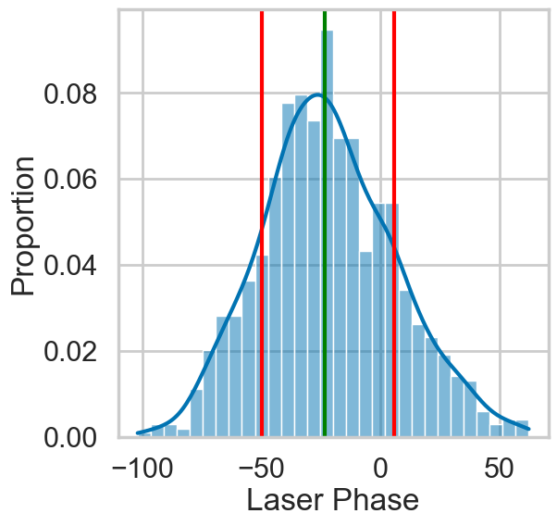
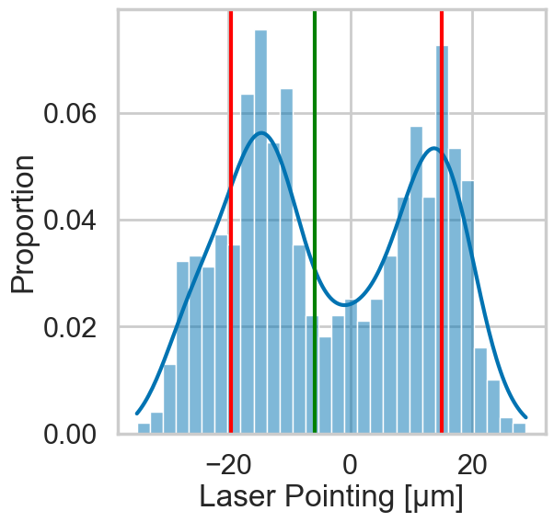
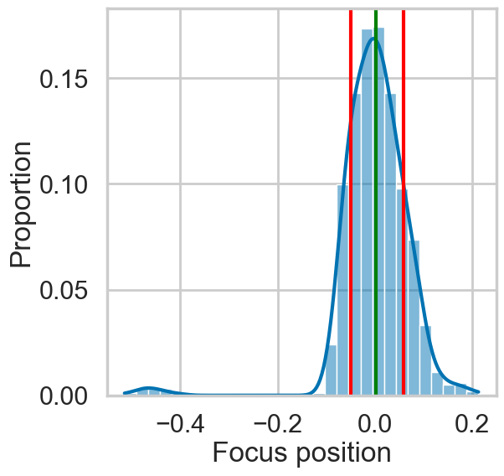
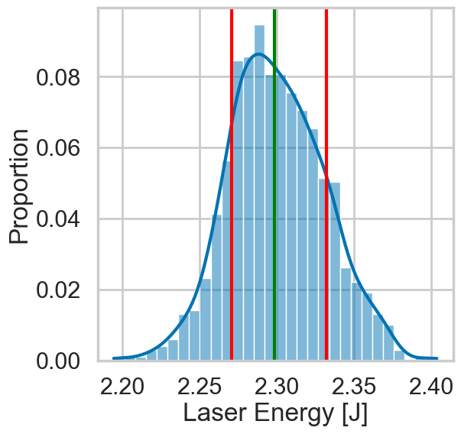
What happens after optimising
In stable operation, we observe important fluctuations in electron parameters
Observed fluctuations in four different input parameters
Laser Phase
Laser Pointing
Focus Position
Laser Energy
Z
[mm]
55.6
34 µm
0.10 mm
61 mJ

Slide 15
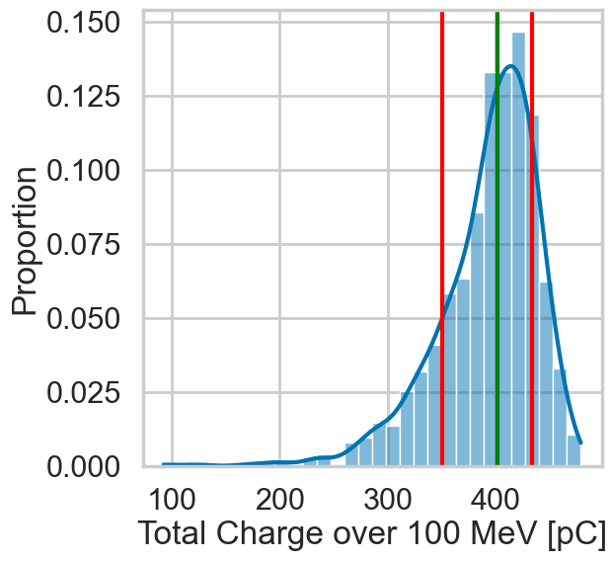
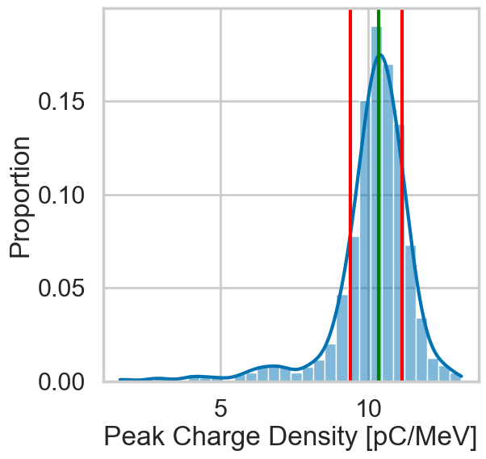
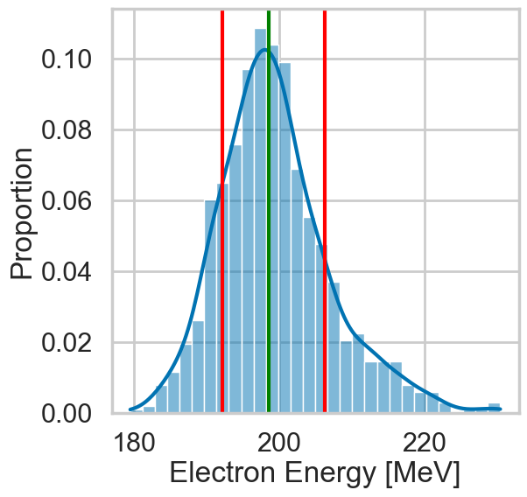
What happens after optimising
In stable operation, we observe important fluctuations in electron parameters
Observed fluctuations in four different input parameters
Translate into fluctuations in output parameters
Charge over 100 MeV
Peak Charge Density
Electron Energy
83.27 pC
1.74 pC/MeV
14 MeV

Slide 16
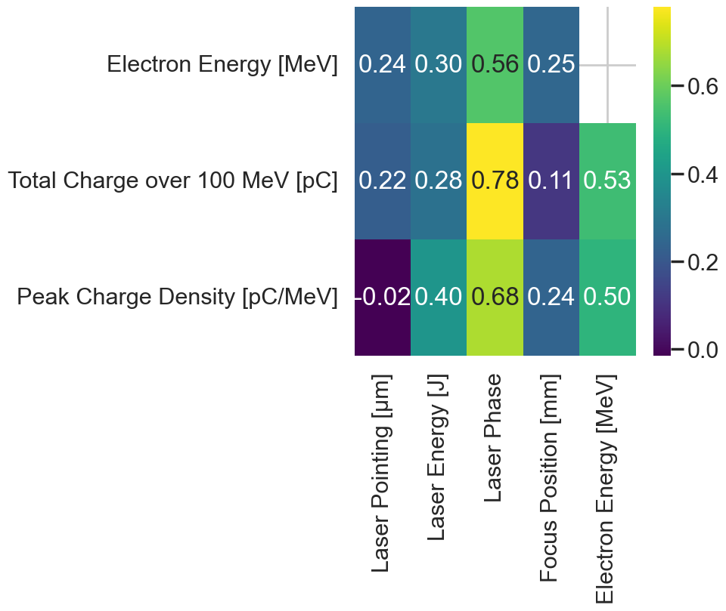
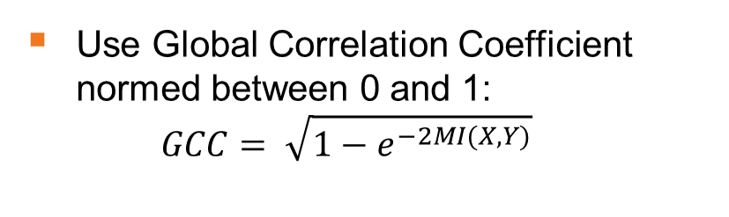
Which of these parameters is playing the biggest role?
In stable operation, we observe important fluctuations in electron parameters
Use Global Correlation Coefficient normed between 0 and 1:
$GCC= \sqrt{1−e^{−2MI(X,Y)}}$

Slide 17
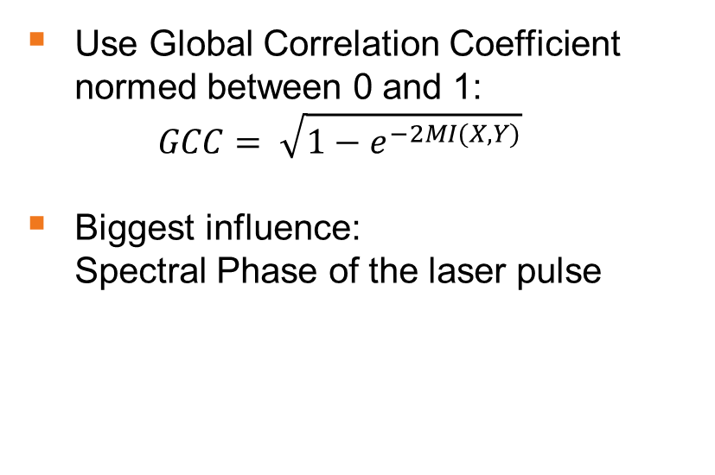
Which of these parameters is playing the biggest role?
In stable operation, we observe important fluctuations in electron parameters
Use Global Correlation Coefficient normed between 0 and 1:
$GCC= \sqrt{1−e^{−2MI(X,Y)}}$
Biggest influence:
Spectral Phase of the laser pulse

Slide 18
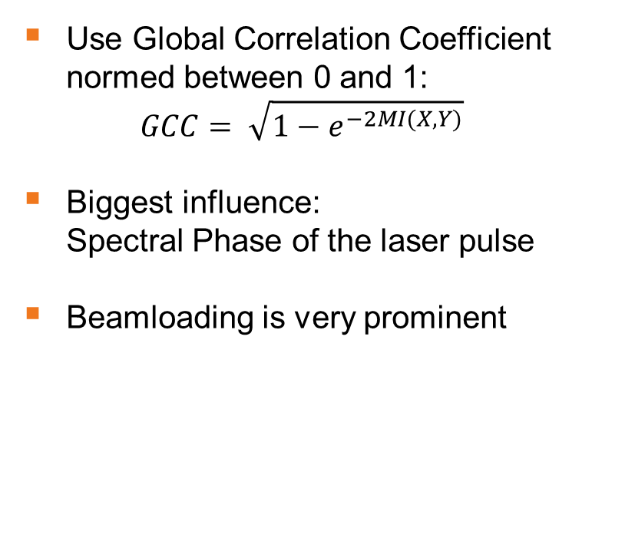
Which of these parameters is playing the biggest role?
In stable operation, we observe important fluctuations in electron parameters
Use Global Correlation Coefficient normed between 0 and 1:
$GCC= \sqrt{1−e^{−2MI(X,Y)}}$
Biggest influence:
Spectral Phase of the laser pulse
Beamloading is very prominent

Slide 19
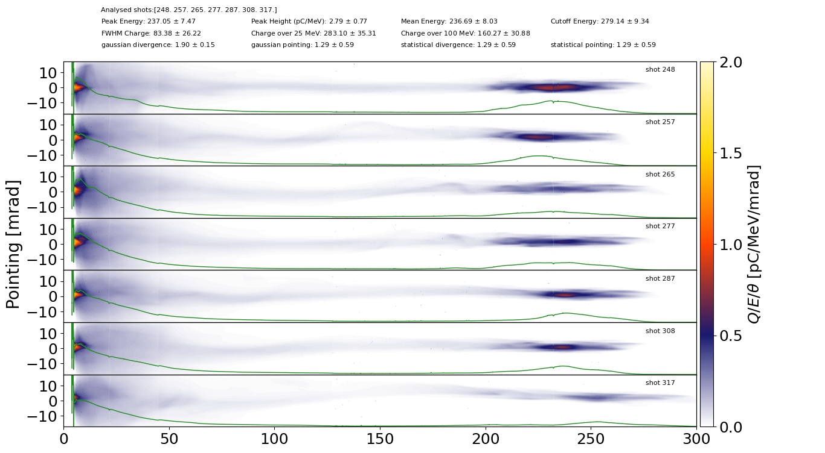
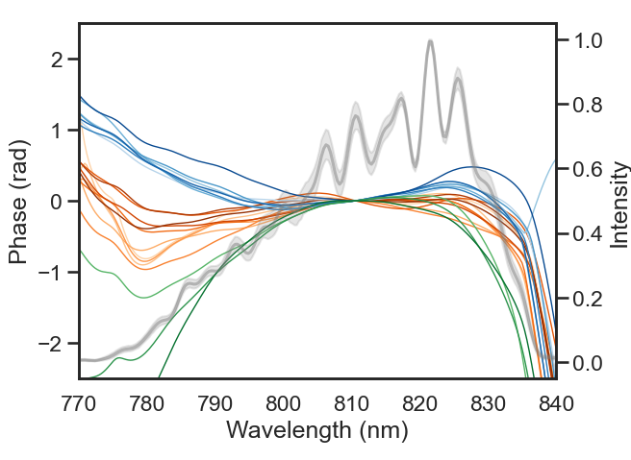
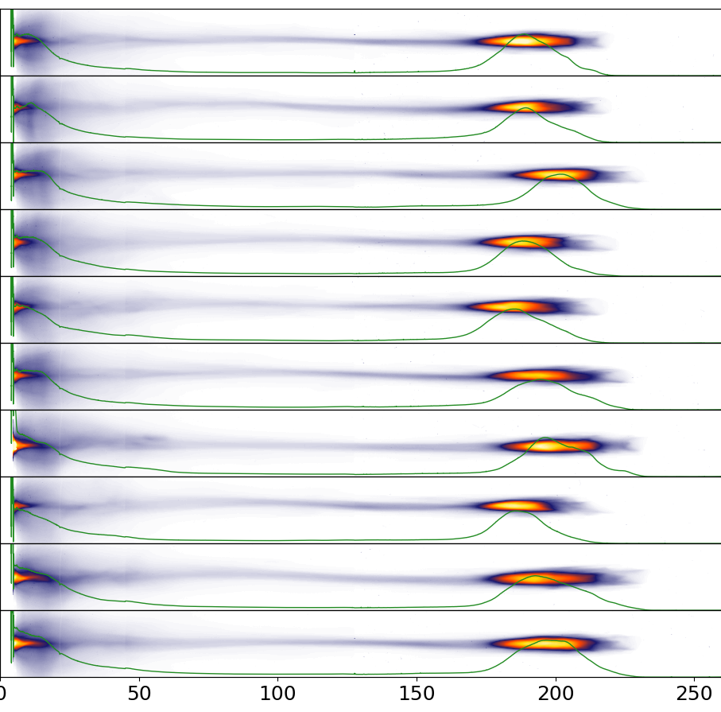
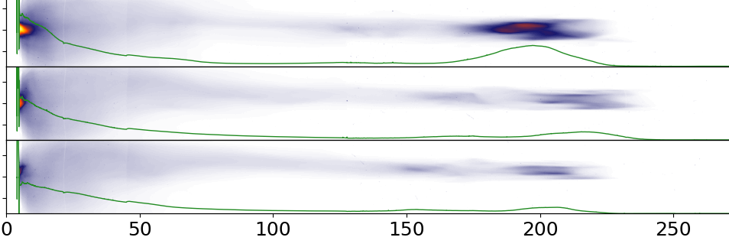
Zoom in on Spectral phase
Phenomenologically, the phase offers three different regimes
pulse length
τ=36.94 fs
0
100
200
300
Energy [MeV]
2.0
1.5
1.0
τ = 35.64 fs
Charge density [pC/MeV/mrad]
0.5
0
100
200
0.0
τ = 47.17 fs
0
100
200

Slide 20
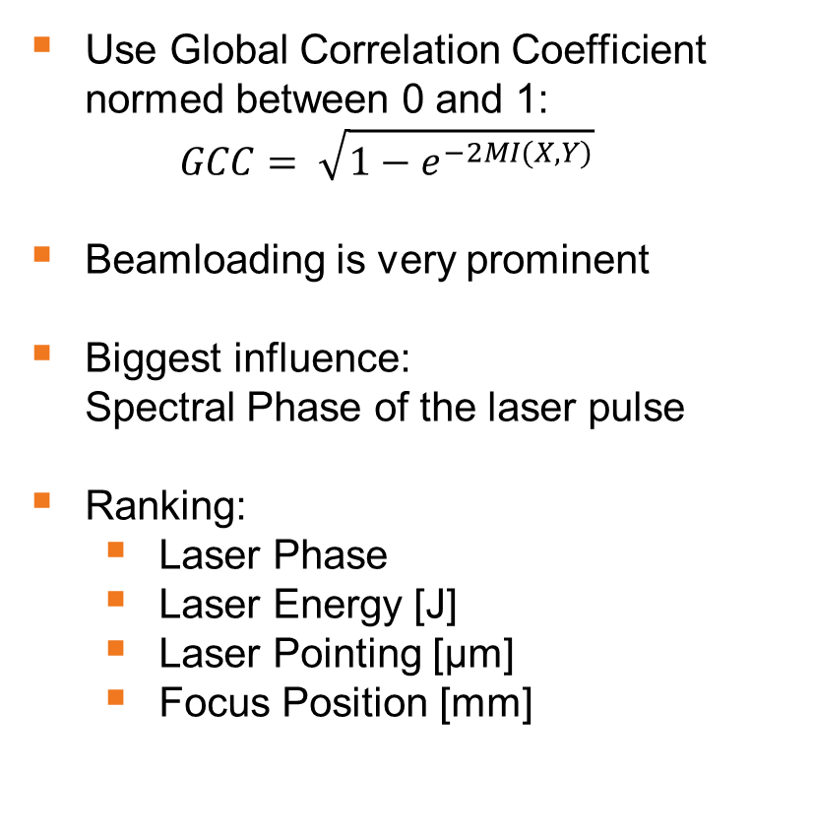
Which of these parameters is playing the biggest role?
In stable operation, we observe important fluctuations in electron parameters
Use Global Correlation Coefficient normed between 0 and 1:
$GCC= \sqrt{1−e^{−2MI(X,Y)}}$
Beamloading is very prominent
Biggest influence:
Spectral Phase of the laser pulse
Ranking:
  Laser Phase
  Laser Energy [J]
  Laser Pointing [µm]
  Focus Position [mm]

Slide 21
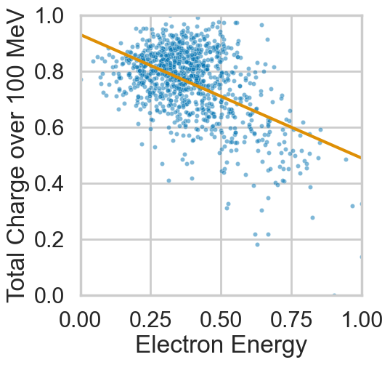
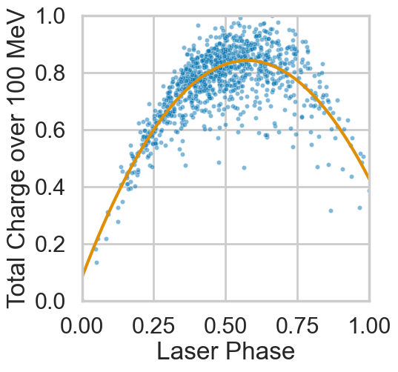
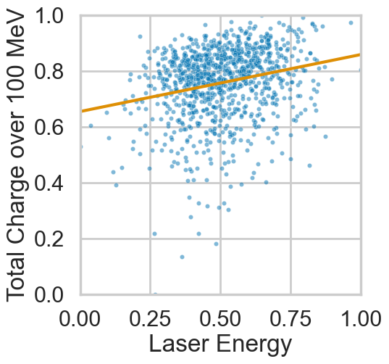
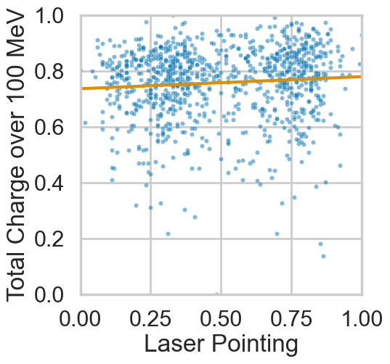
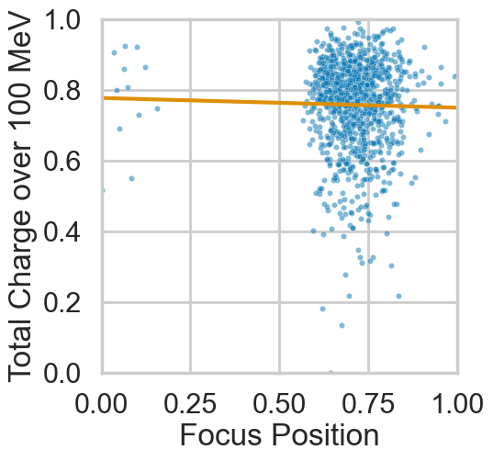
Investigation of the underlying correlations
Some strong correlations can overshadow weaker ones
Problem: We deal with many correlations at the same time in a high dimensional parameter space
Correlations can overshadow each other
Do a residual analysis
Uncleaned
Correlations

Slide 22
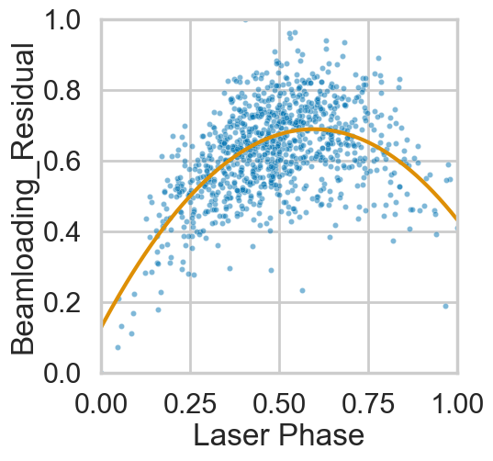
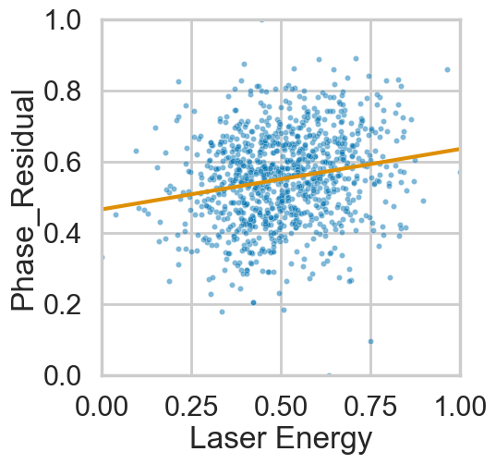
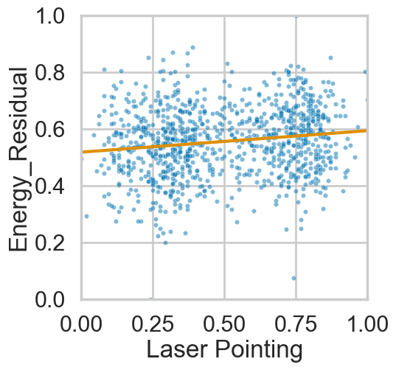
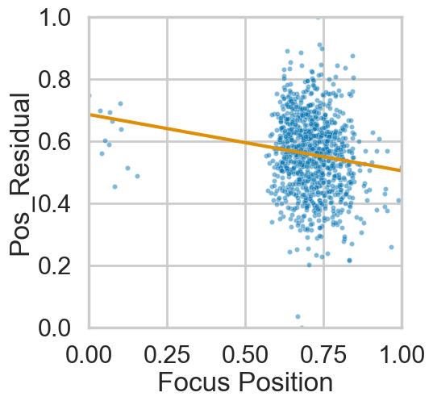




Investigation of the underlying correlations
Some strong correlations can overshadow weaker ones
Correlations such as
with Laser Energy and FF Com Position and Focus Position become more apparent
$$ρ=−0.44$$
$$ρ=0.16$$
Residual
Analysis
$$ρ=0.07$$
$$ρ=−0.18$$

Slide 23
Conclusion
Mutual Information is a powerful tool to estimate the strength of nonlinear correlations between input and output parameters.
Within the typical scanning range in STII experiments at HZDR, shifting the focus position has the biggest impact on electron beam quality
In multihour experiments, the input parameters underlie shot-to-shot fluctuations and long-term drifts.
Short-timescale phase fluctuations have the biggest impact on instabilities in electron beam quality

Slide 24

Thanks to the team
Anna Arie Patrick Susanne Franziska Vincent Max Amin + Mohamed

Slide 25

Crashcourse in Bayesian Optimization
Training data
5 random initialization sets
Gaussian Process
Evaluates outcome for different setpoints
Acquisition function
Decides new setpoint
Outcome
Experimental result
Candidate
New setpoint
Measurement
Human in the loop

Slide 26
Crashcourse in Bayesian Optimization
Training data
5 random initialization sets
Hyperparameter tuning
In total 19 models tested
Different configurations:
  Prior knowledge, random initialization, custom initialization
  Objective functions
  Choice of acquisition function
Gaussian Process
Evaluates outcome for different setpoints
Acquisition function
Decides new setpoint
Outcome
Experimental result
Candidate
New setpoint
Measurement

Slide 27
How to evaluate a model?
Rate the models with respect to their accuracy and convergence speed
Accuracy
Convergence speed
Some models reached optimum performance within the 20 configurations they were tested upon
some got stuck at false maxima, influenced by initialization shots
Calculate the difference of best set per model and best set of the day as a regret metric
Some models focus more heavily on exploration, some more on exploitation
Evaluate for each model, after what number of shots it reaches 80% of optimum
Tradeoff between reliability and speed

