Slide 1



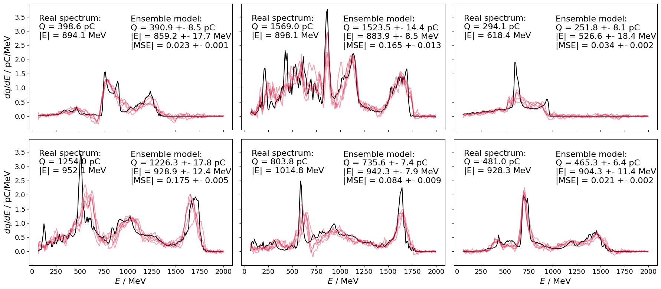


Non-destructive electron diagnosis by correlation with laser diagnostics
Paul S Gellersen, Dr Christopher D Murphy
Sep 22nd, EAAC 2025

Slide 2
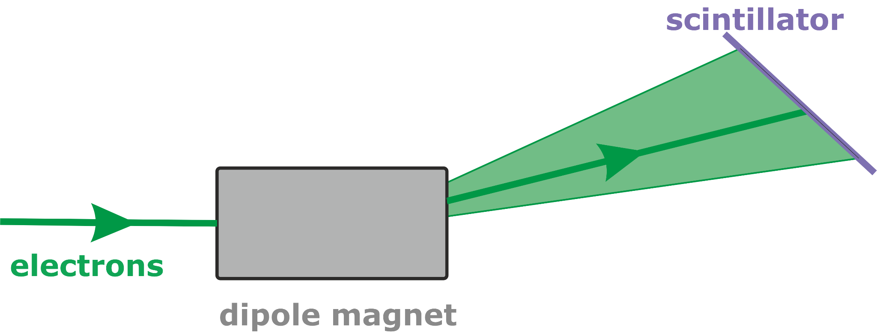
Motivation
Inconsistent LWFA performance
Destructive electron spectrometry
+
Limited applications
Can we avoid destructive spectrometry by measuring other quantities and finding correlations?

Slide 3
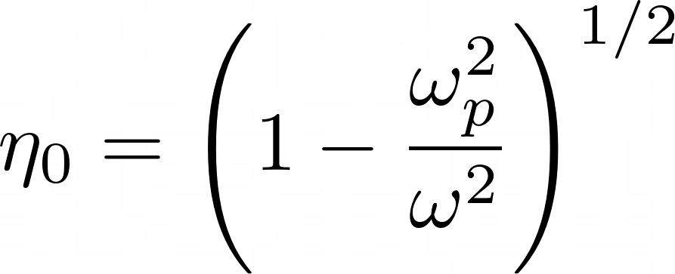
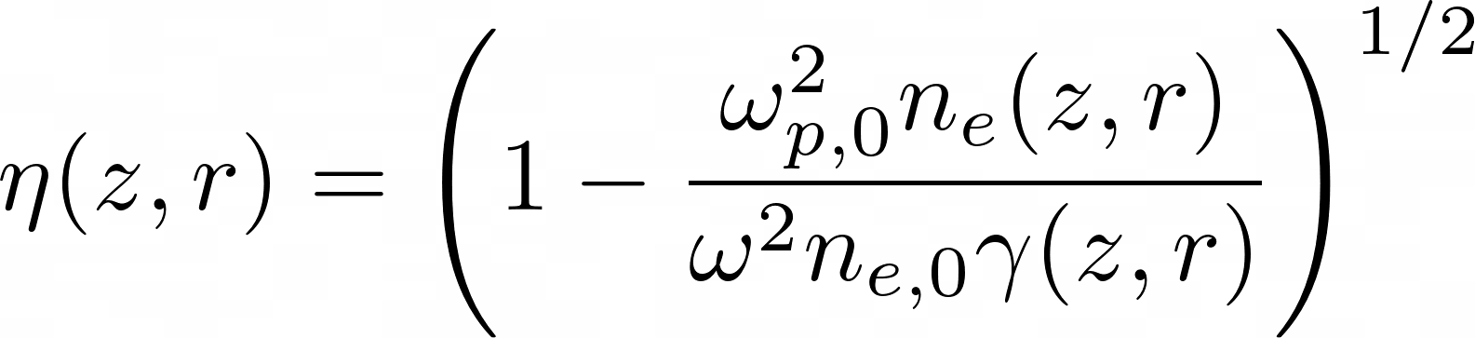
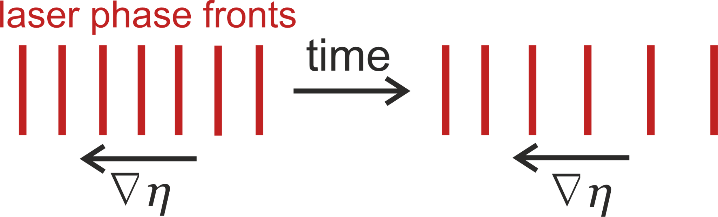
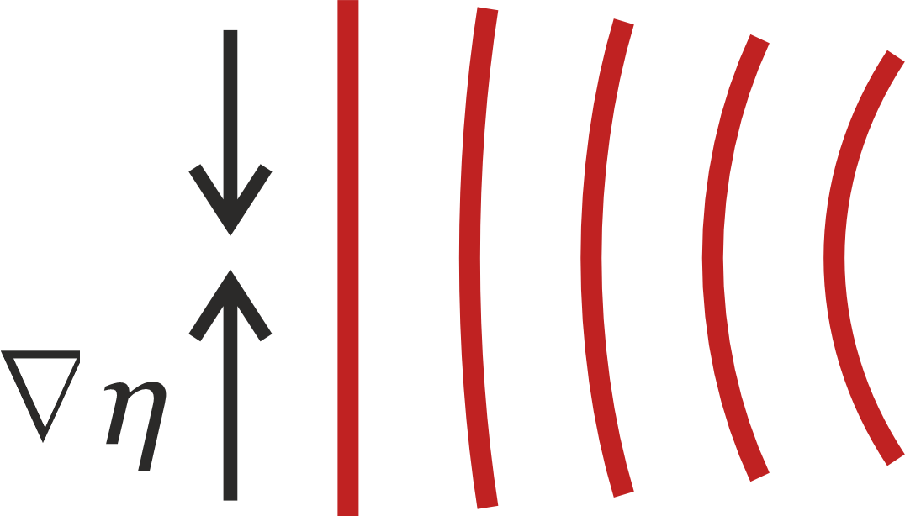
Origins of correlation
Axial variations
Radial variations
Spectral evolution
Self-focusing

Slide 4
Origins of correlation
Electron injection
‘absorption depends on almost every laser and target parameter imaginable in a non-trivial manner’ - J R Davies 2008
Laser self-focusing
Injected electron acceleration
Density gradients
Laser intensity profile
Laser spectral evolution
Highly non-linear behaviour ⇒ machine-learning analysis?
Increasing laser rep rates make generation of large datasets feasible

Slide 5
Diagnostic design - outline
For a given LWFA set-up:
Measure a large dataset of electron spectra and laser diagnostics: spectrum, energy, and spot shape.
Train model to predict electron spectrum.
Remove electron spectrometer and continue with model predictions.

Slide 6
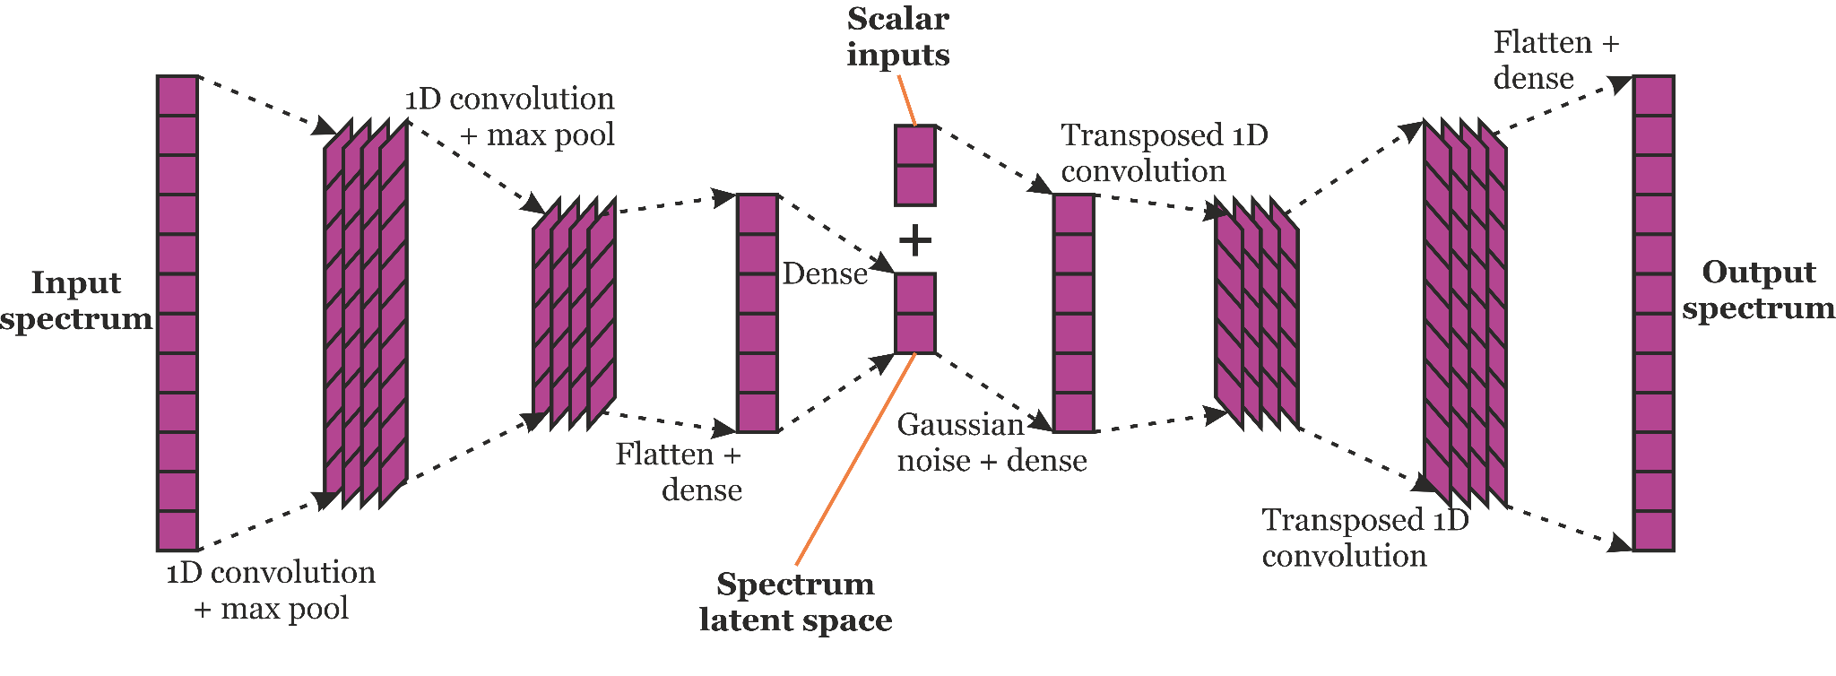
Diagnostic design - model architecture

Slide 7
Validation plan
Use idealised PIC simulation
  FBPIC, using cylindrical coordinates and boosted frame methods, run-time ~ 15 mins, so can generate many datapoints quickly
  Define a standard LWFA set-up and vary parameters to mimic random experimental variations
  Extract post-acceleration laser spectrum, energy and beam radius and electron spectrum in idealised experiment-like way for correlation

Slide 8
Nominal LWFA set-up
Typical LWFA:
  Plasma: 10mm plateau with 0.5mm ramps, ne = 1.5e18 cm-3, 98% He, 2% N
  Laser: I0 = 1e20 Wcm-2 with 15% energy on target, w0 = 27.2 μm, τ = 28 fs, focused 1 mm into plateau
Parameters to vary:
  Fraction of laser energy on target
  Laser focus position in z
  Plasma density
  Spot shape (modeled by adding higher order Laguerre-Gaussian modes)
  Pulse chirp

Slide 9
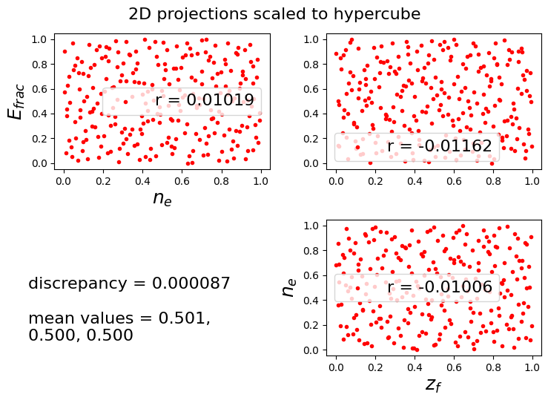
Validation - large datasets generation
3 randomly varied parameters:
  Energy fraction 0.1-0.2
  Density 1.4-1.6
  Focus z position -0.5 - 3.5 mm
Parameter sampling:
  50 using LHS
  200 more by discrepancy minimising method

Slide 10
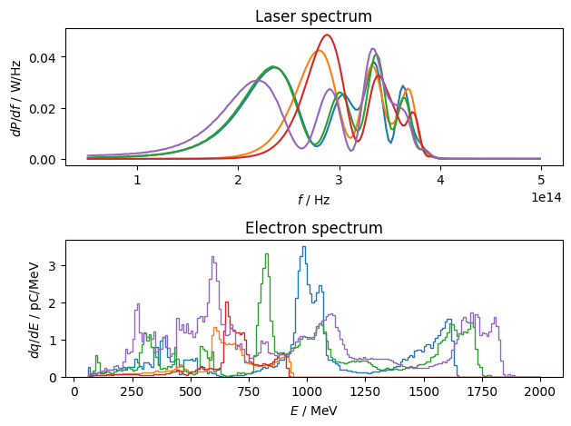
Validation - large datasets example data
10 samples reserved as test data
Remaining 240 samples split into 5 groups
5 models trained, each using 4 groups for training and 1 as validation data

Slide 11
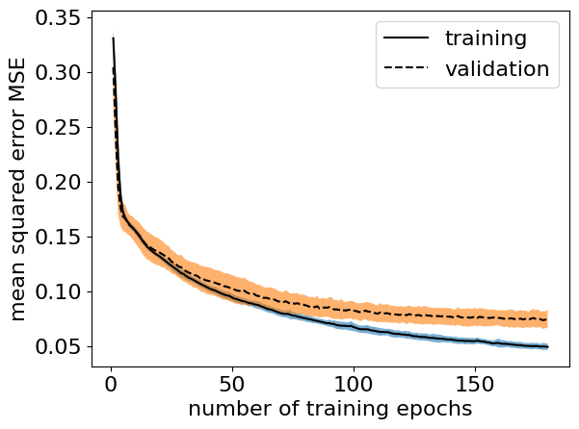
Validation - model training history
Minimum mean validation MSE = 0.075 +- 0.007

Slide 12
Example model predictions

Slide 13
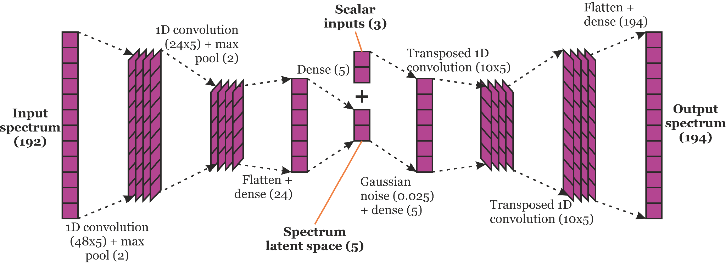
Optimised model architecture

Slide 14
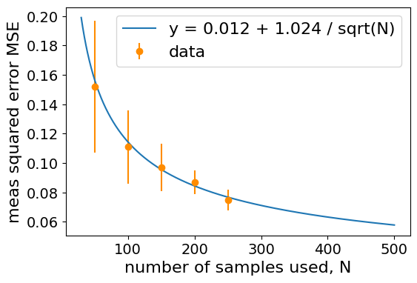
Number of samples scan
Significant gains still to be made by increasing sample size further
But diminishing returns of course

Slide 15
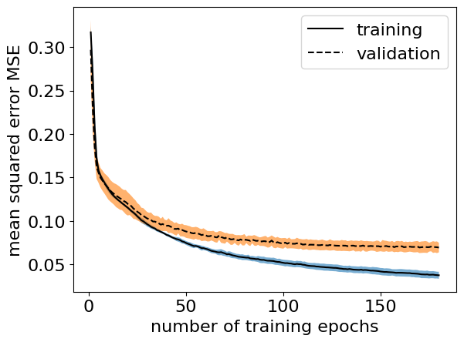
Downsampling output spectrum
Minimum mean validation MSE =0.070 +- 0006
Small improvement at the cost of some information.

Slide 16
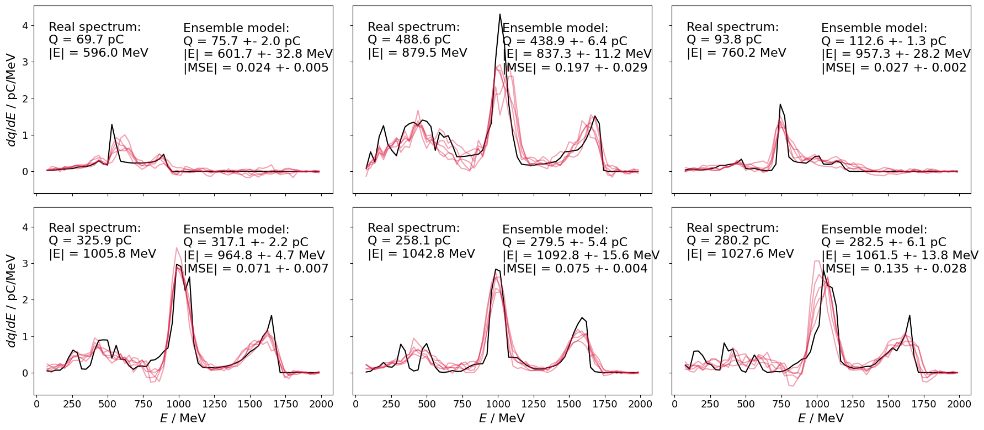
Downsampling output spectrum

Slide 17
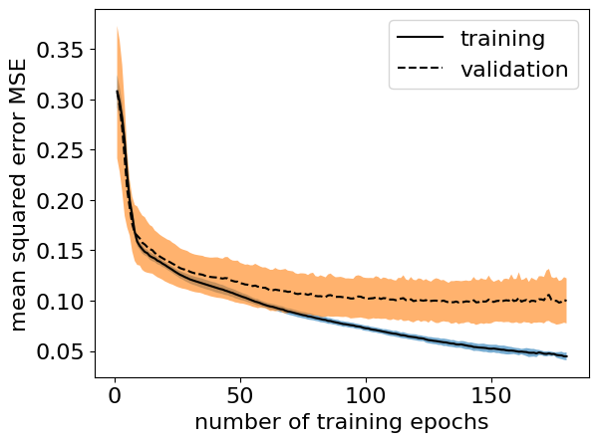
Normally distributed sampling
Only 100 samples ⇒ compare to minimum MSE = 0.111 for 100 evenly spread samples
Minimum MSE = 0.099 ⇒
Slight improvement!

Slide 18
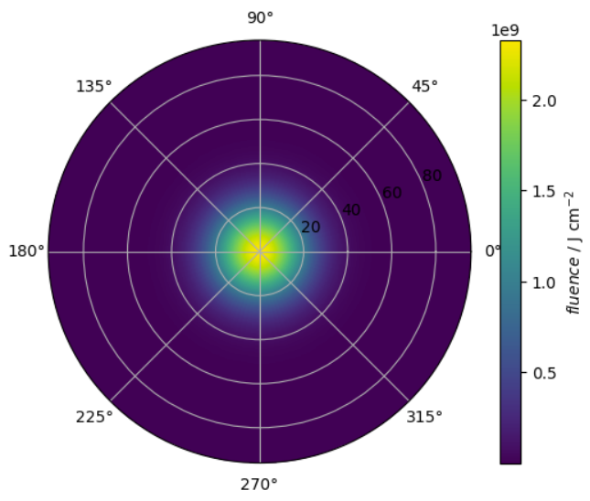
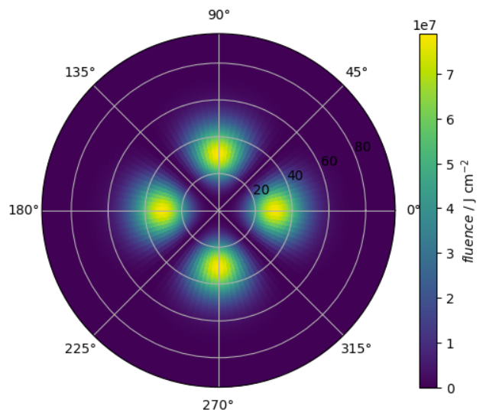
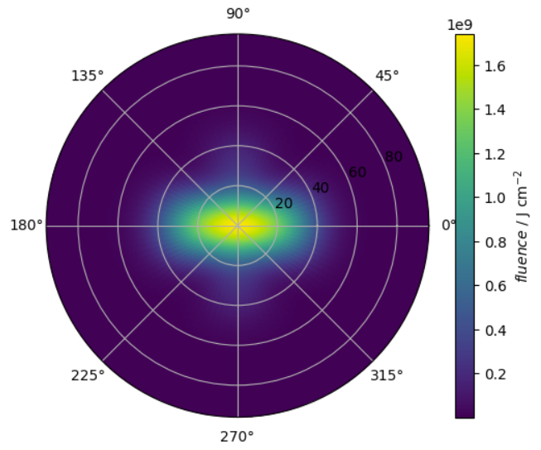
Including spot-shape variation
m=0:
m=2:
+
=

Slide 19
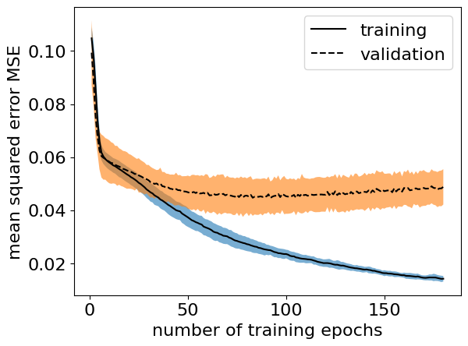
Including spot-shape variation
Only 150 samples ⇒ compare to minimum MSE = 0.097 for 150 samples with 3 varied parameters
Minimum MSE = 0.047 ⇒
Much lower! But fast overfitting…

Slide 20
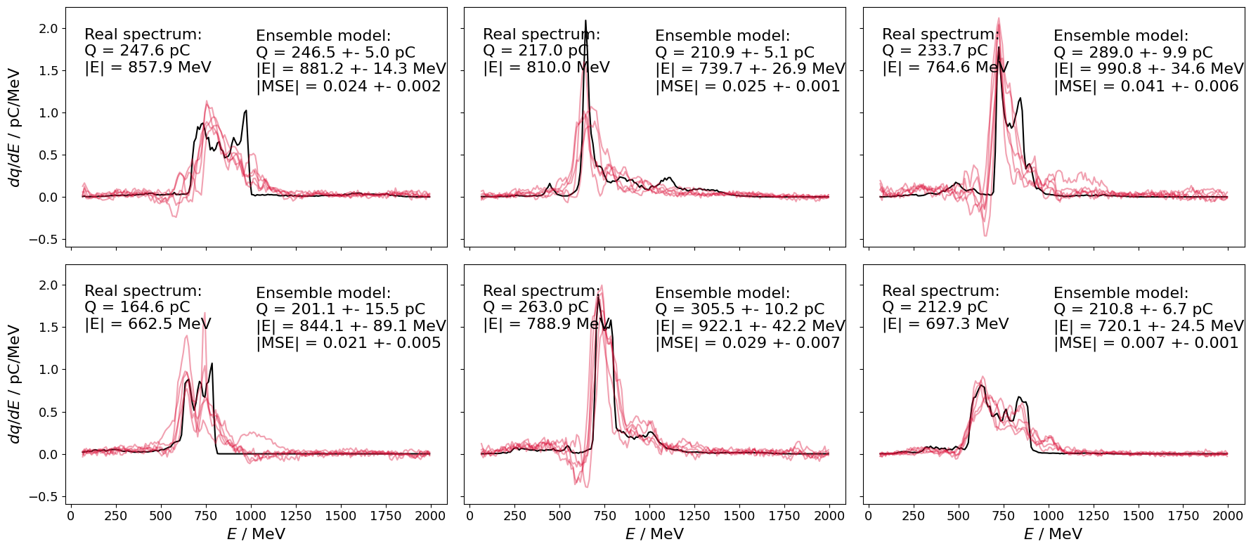
Including spot-shape variation

Slide 21
Future work
Implement algorithmic optimisation of model hyperparameters
Experiment with separated encoder-decoder training for each spectrum
Explore further the effect of reducing spectra resolutions
Test on datasets with more variable parameters
Test on simulations of other LWFA set-ups
Test on experimental data

Slide 22
Summary
Laser diagnostics are strongly correlated with electron spectrum because they both evolve due to density gradients in the plasma wave
Proposed training a CNN model on large datasets to deal with high non-linearity of relationship
Demonstrated low model error on simulated dataset, with just 3 variable parameters
Explored the effects of downsampling the output spectrum, parameters being normal distributed, and inclusion of spot shape variation

