Slide 1
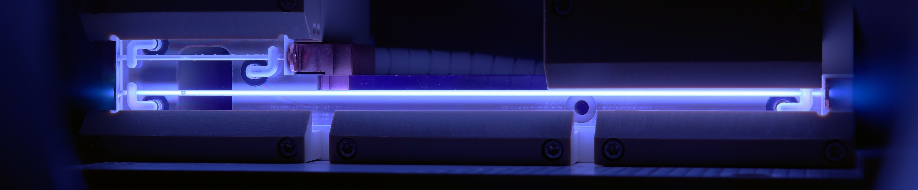
Advanced Controls and Machine Learning at FLASHForward
Lewis Boulton
Judita Beinortaite, Jonas Björklund Svensson, Philipp Burghart, Richard D'Arcy, Angel Ferran Pousa, Brian Foster, Pau Gonzalez Caminal, Maryam Huck, Harry Jones, Advait Kanekar, Carl A. Lindstrøm, Gregor Loisch,
Tianyun Long, Andreas Maier, Mathis Mewes, Jens Osterhoff, Felipe Peña, Sarah Schroeder, Maxence Thévenet, Stephan Wesch, Matthew Wing, Jonathan Wood
7th European Advanced Accelerator Concepts Workshop | September 21–27, 2025 | Elba, Italy

Slide 2
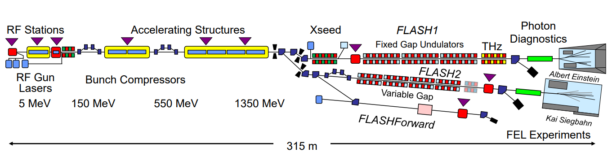
FLASHForward
Beam-driven plasma wakefield accelerator experiment at FLASH, DESY Hamburg
  Aim: brightness preserved, high energy efficiency , high rep. rate PWFA
Inherit the high-stability and diagnostic infrastructure from a FEL facility….
Typically short on beam time… efficient setup is crucial!
Notes:
FLASHForward: a beam

Slide 3
A typical linac setup…
Linac setup: can take a long time, particularly in commissioning
Any changes to the machine → need to repeat measurements, reoptimise etc…
E.g Matching after second bunch compressor
  Analytical matching can be done, but only if the section of accelerator is well understood / collective effects are small
  Measurements typically take ~5 mins each… many iterations make it a long procedure

Slide 4
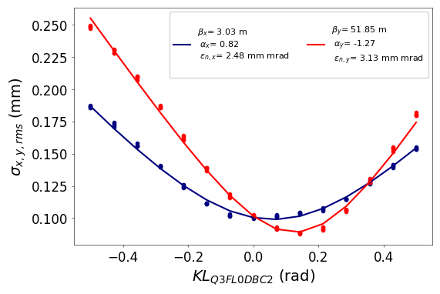
A typical linac setup…
Linac setup: can take a long time, particularly in commissioning
Any changes to the machine → need to repeat measurements, reoptimise etc…
E.g Matching after second bunch compressor
  Analytical matching can be done, but only if the section of accelerator is well understood / collective effects are small
  Measurements typically take ~5 mins each… many iterations make it a long procedure

Slide 5
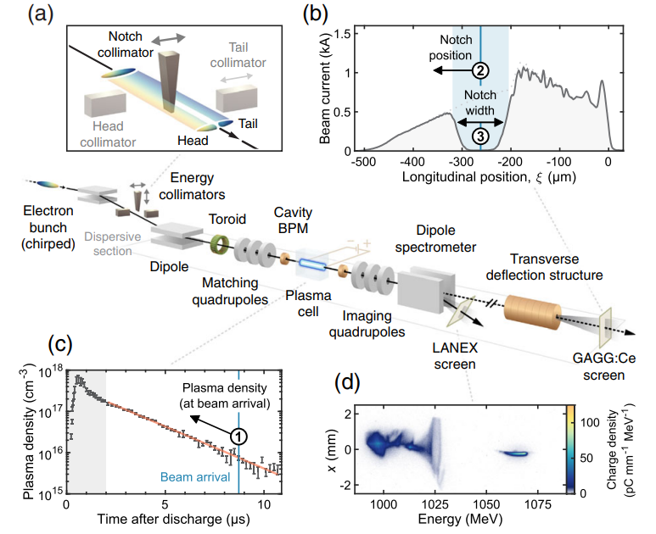
A typical PWFA setup…
C. A. Lindstrøm et al., Phys. Rev. Lett., vol. 126, p. 014801, Jan 2021

Slide 6
A typical PWFA setup…
C. A. Lindstrøm et al., Phys. Rev. Lett., vol. 126, p. 014801, Jan 2021

Slide 7
A typical PWFA setup…
C. A. Lindstrøm et al., Phys. Rev. Lett., vol. 126, p. 014801, Jan 2021

Slide 8
A typical PWFA setup…
C. A. Lindstrøm et al., Phys. Rev. Lett., vol. 126, p. 014801, Jan 2021

Slide 9
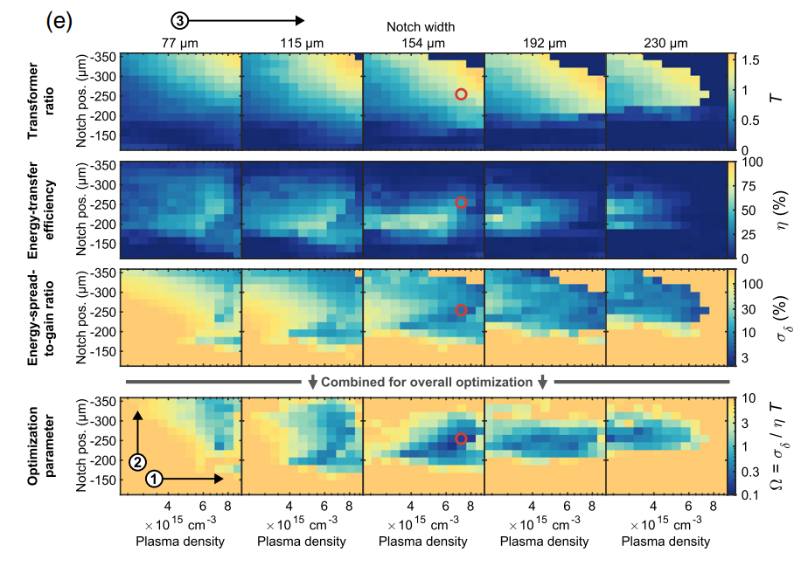
A typical PWFA setup…
C. A. Lindstrøm et al., Phys. Rev. Lett., vol. 126, p. 014801, Jan 2021
Optimise for high energy-transfer efficiency, low energy spread
Baseline for further studies e.g high-rep rate, beam-quality preservation
But is a very long and involved process…

Slide 10
Two Examples of Problems
Matching:
  Relatively stable environment…
  But very time-consuming and complicated, multi-point measurements
PWFA Setup:
  Measurements are ‘cheap’: evaluate accelerated bunch spectra on single-shot basis…
  But a very noisy environment, with a lot of tuning knobs available

Slide 11
Two Examples of Problems
Matching:
  Relatively stable environment…
  But very time-consuming and complicated, multi-point measurements
PWFA Setup:
  Measurements are ‘cheap’: evaluate accelerated bunch spectra on single-shot basis…
  But a very noisy environment, with a lot of tuning knobs available
How to do better…?

Slide 12
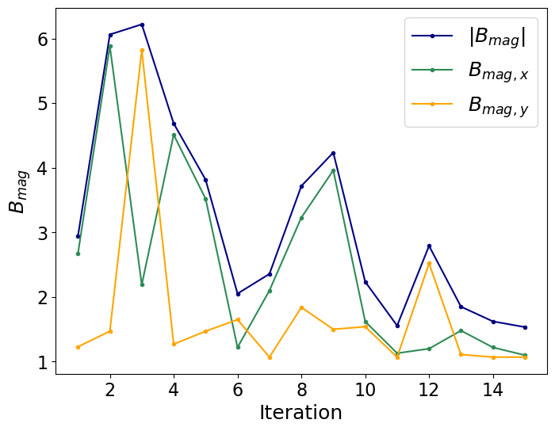
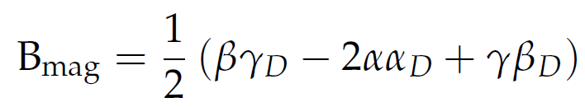

Bayesian optimisation for linac matching
Matching in accelerators- ‘match’ the beam twiss to some ‘design’ twiss
‘Brute force’: Minimise combined mismatch with ~5 matching quadrupoles
$$β=β_{D} , α=α_{D},γ=γ_{D} ⇒B_{mag}=1$$
$${otherwise B}_{mag}>1$$
Minty, M. G. & Zimmermann, F. (2003). Measurement and Control of Charged Particle Beams. Springer.
Problems: still v. time consuming and only as good as the diagnostic you use
Emittance also comes out of this analysis: minimise for that in the future?

Slide 13

Bayesian optimisation for linac matching
Ferran Pousa, A. et al. (2023). PRAB, 26(8), 084601.
Matching in accelerators- ‘match’ the beam twiss to some ‘design’ twiss
‘Brute force’: Using BO, Minimise combined mismatch with ~5 matching quadrupoles
$$β=β_{D} , α=α_{D},γ=γ_{D} ⇒B_{mag}=1$$
$${otherwise B}_{mag}>1$$
Minty, M. G. & Zimmermann, F. (2003). Measurement and Control of Charged Particle Beams. Springer.
Problems: still very time consuming and only as good as the diagnostic you use
Emittance also comes out of this analysis: minimise for that in the future?

Slide 14
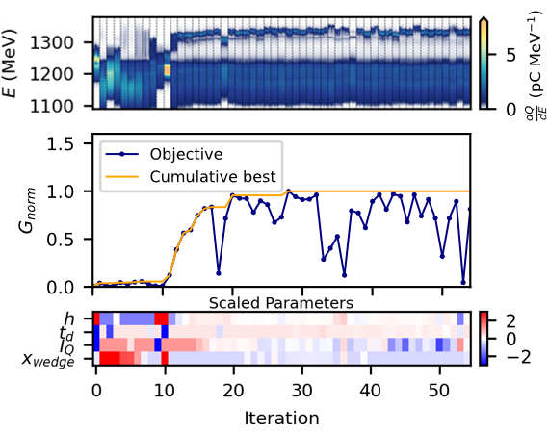
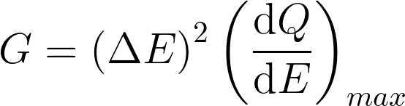
Bayesian optimisation of trailing bunch acceleration
Decelerated drive bunch spectra
Accelerated trailing bunch spectra
Goal function, maximise:
(High charge, high energy, low energy spread)
~
Energy gain
Peak spectral density
Exposed 4 parameters to the optimizer:
  Chirp h (compression)
  Discharge delay t_{d} (plasma density)
  Quad current I_{Q} (1st order horizontal dispersion)
  Position of wedge x_{wedge} (driver/ witness charge distribution)
Starting from ~ noise, converged on a solution in 28 iterations to:
  (34 ± 2) pC accelerated charge
  (103 ± 1) MeV energy gain in 50 mm (2.1 GV/m)
  Scan time: 37 minutes total, 19 to reach optimum
J. Wood et al., in Proc. IPAC'24, Nashville, TN, May 2024, pp. 541-544
Problems: combined goal function, poor scaling with more parameters, etc.

Slide 15
Bayesian optimisation of trailing bunch acceleration
Decelerated drive bunch spectra
Accelerated trailing bunch spectra
Goal function, maximise:
(High charge, high energy, low energy spread)
~
Energy gain
Peak spectral density
Exposed 4 parameters to the optimiser:
  Chirp h (compression)
  Discharge delay t_{d} (plasma density)
  Quad current I_{Q} (beam tilt)
  Position of wedge x_{wedge} (driver/ witness charge distribution)
Starting from ~ noise, converged on a solution in 28 iterations to:
  (34 ± 2) pC accelerated charge
  (103 ± 1) MeV energy gain in 50 mm (2.1 GV/m)
  Scan time: 37 minutes total, 19 to reach optimum
J. Wood et al., in Proc. IPAC'24, Nashville, TN, May 2024, pp. 541-544
Problems: combined goal function, poor scaling with more parameters, etc.

Slide 16
Bayesian optimisation of trailing bunch acceleration
Decelerated drive bunch spectra
Accelerated trailing bunch spectra
Goal function, maximise:
(High charge, high energy, low energy spread)
~
Energy gain
Peak spectral density
Exposed 4 parameters to the optimiser:
  Chirp h (compression)
  Discharge delay t_{d} (plasma density)
  Quad current I_{Q} (beam tilt)
  Position of wedge x_{wedge} (driver/ witness charge distribution)
Starting from ~ noise, converged on a solution in 28 iterations to:
  (34 ± 2) pC accelerated charge , (2.4 ± 0.2) pC/MeV peak spec. density, (0.8 ± 0.1)% FWHM energy spread
  (103 ± 1) MeV energy gain in 50 mm (2.1 GV/m)
  Scan time: 37 minutes total, 19 to reach optimum
J. Wood et al., in Proc. IPAC'24, Nashville, TN, May 2024, pp. 541-544
Problems: combined goal function, poor scaling with more parameters, etc.

Slide 17
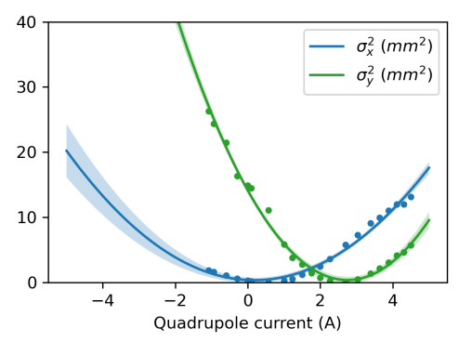

BO at FLASHForward: what next?
Only tried ‘basic’ algorithms so far: clear improvements to make
Faster, automated multi-point measurements for e.g optics:
  Use Bayesian Exploration to efficiently sample the measurement parameter space → quicker iterations
  Use constraints to avoid ‘bad’ measurements → more robust
‘Smarter’ PWFA optimisation:
  How to deal with ‘slow’ actuators e.g wedge collimator width?
  How much do drifts effect the optimiser? → time-dependent BO?
Roussel, R. et al. (2023). Instruments, 7(3), 29.

Slide 18
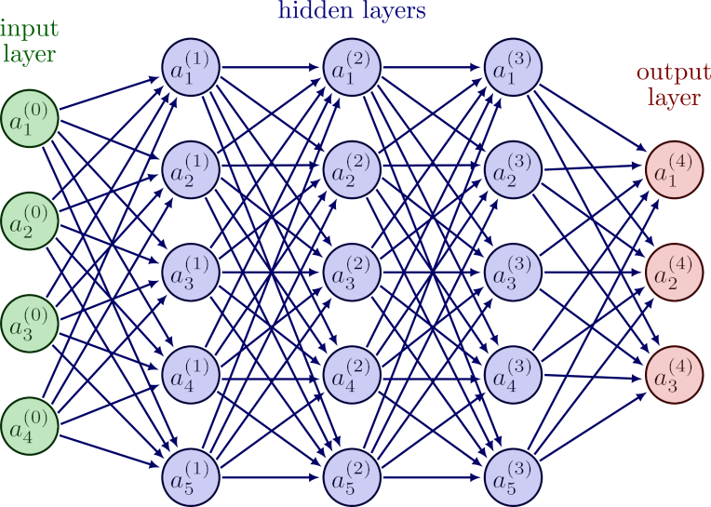
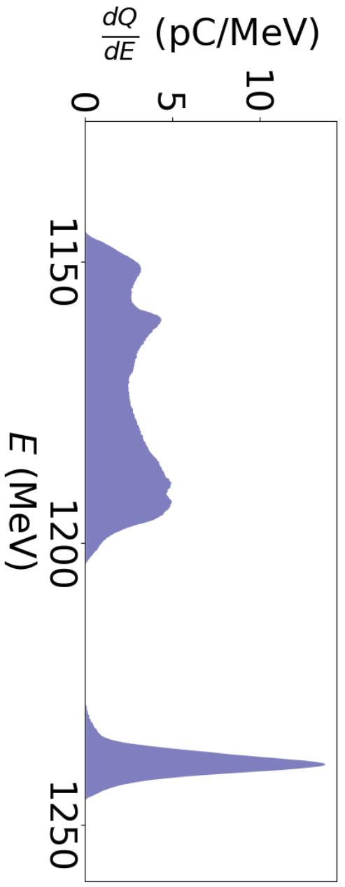
A Virtual Spectral Diagnostic for PWFA
Courtesy Phillip Burghart (FLASHForward Masters Student)
During optimisation- collect a lot of data from non-invasive diagnostics → train a NN to predict accelerated (or decelerated) bunch properties (e.g energy spectrum) → a ‘virtual diagnostic’
  Examples:
    Virtual LPS diagnostic: Emma, C. et al. (2018). Phys. Rev. Accel. Beams, 21(11), 112802.
    Virtual photon pulse diagnostic (FELs): El-Din, K. K. A., et al. (2024). Sci. Rep., 14, 7267.
Potential applications:
  A useful approach for assessing sources of variation in the acceleration process e.g in A. Maier et. Al., Phys. Rev. X 10, 031039, 2020
  Non-destructive: bunches could propagate to applications (or more acceleration stages)
  Beamline diagnostics measure across MHz bunch trains → Predict spectra across bunch trains?
{
}
BPMs (orbit, charge)
BCMs (bunch length)
RF parameters
…

Slide 19
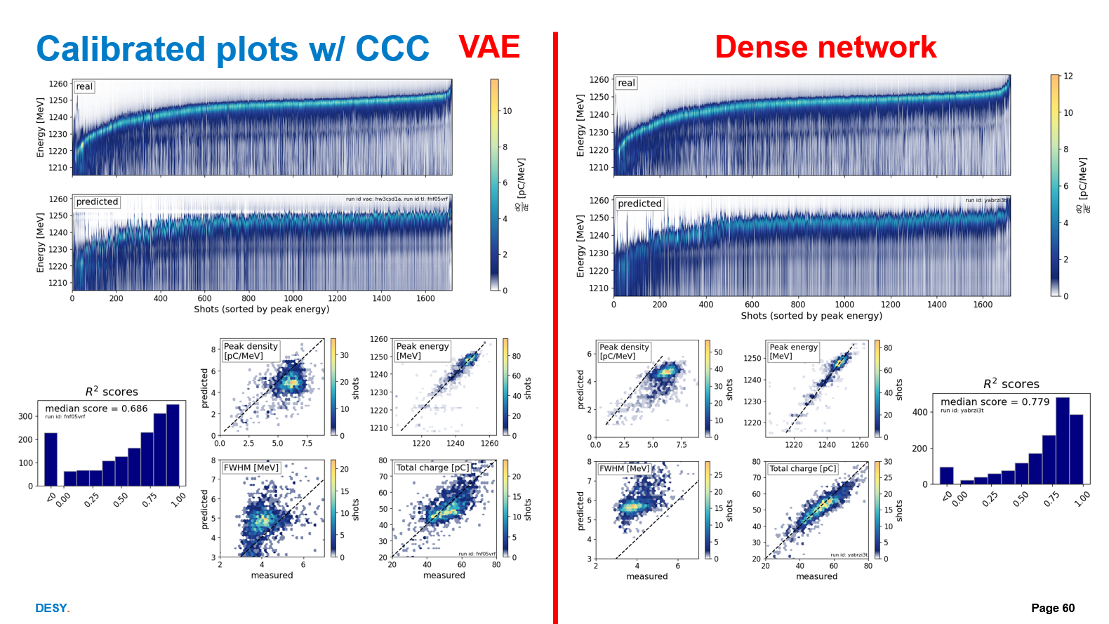
A Virtual Spectral Diagnostic for PWFA - Results
Courtesy Phillip Burghart (FLASHForward Masters Student)
Predict PWFA trailing bunch spectra from ~12000 shot stats dataset, 80:20 train test split
Simple Multi-layer perceptron network
Peak energy and charge of accelerated bunches are quite well-predicted
  Downstream BPMs have a lot of influence
Energy spread and peak spectral density less so: why?
  Beam loading is sensitive to the details of the wakefield and witness current profile: are we capturing that info shot-to-shot?

Slide 20

A Virtual Spectral Diagnostic for PWFA - Results
Courtesy Phillip Burghart (FLASHForward Masters Student)
Predict PWFA trailing bunch spectra from ~12000 shot stats dataset, 80:20 train test split
Simple Multi-layer perceptron network
Peak energy and charge of accelerated bunches are quite well-predicted
  Downstream BPMs have a lot of influence
Energy spread and peak spectral density less so: why?
  Beam loading is sensitive to the details of the wakefield and witness current profile: are we capturing that info shot-to-shot?
$${R^{2}}_{median}=0.779$$

Slide 21
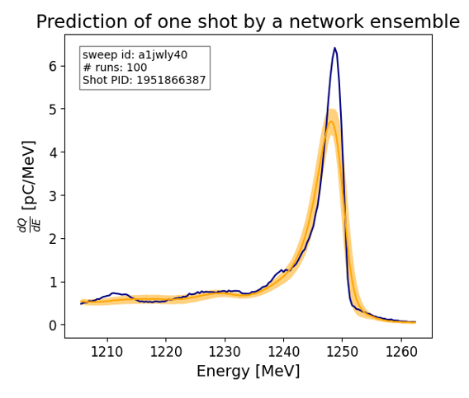
A Virtual Spectral Diagnostic for PWFA- What next?
Courtesy Phillip Burghart (FLASHForward Masters Student)
Different network architectures: VAEs
  E.g
Temporal stability:
  How often do we have to retrain our networks?
M. J. V. Streeter et al., High Power Laser Science and Engineering, 2023
Uncertainty estimation:
  Ensembling approach has been tested so far
  e.g Convery, O. et al. (2021). Phys. Rev. Accel. Beams, 24(7), 074602.
  How to include measurement errors from diagnostics?

Slide 22
Summary
Lots of examples of complicated setup tasks at FLASHForward:
  Matching in the linac: a stable environment but time consuming measurements
  PWFA optimisation: measurements are shot-to-shot but a lot of variables that are coupled
Some initial success with Bayesian Optimisers:
  Identifying the best goal functions and the best combinations of variables
  Future: simpler goal functions, more advanced algorithms (e.g to address speed of evaluation)
Development of Virtual spectral diagnostics for PWFA:
  Good prediction so far of coarse features like energy gain and charge: energy spread not so well captured
  Lots of things to try: new architectures, uncertainty estimation, temporal stability (more data??)
  Applications: a non-invasive, MHz diagnostic for PWFA bunches?

Slide 23
Backup

Slide 24
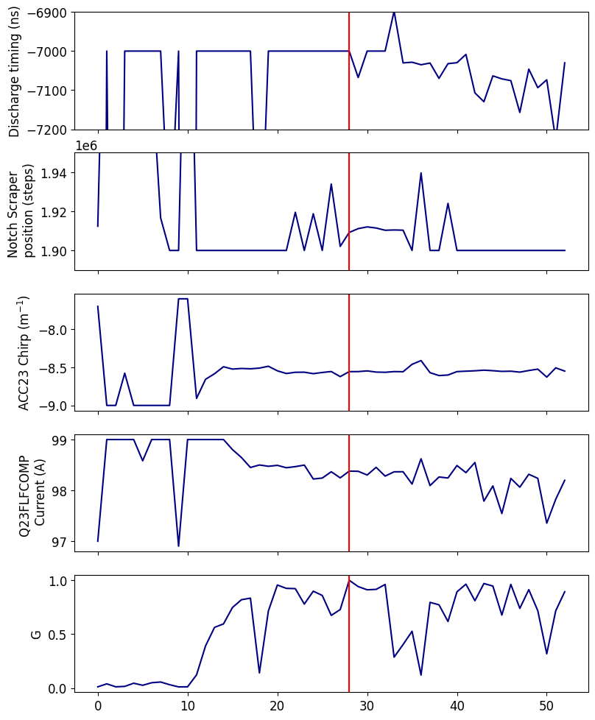
Bayesian optimisation of trailing bunch acceleration

Slide 25
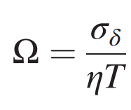
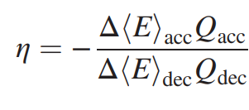
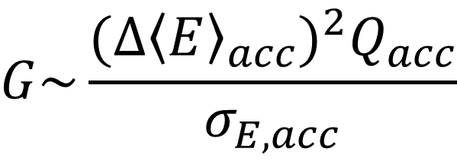
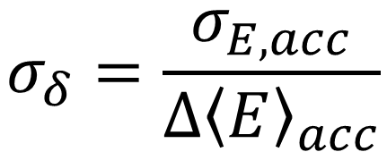
Goal function for witness acceleration
Wakefield parameter, minimise:
BO goal function, maximise:
$$G\sim \frac{{(∆{\left\langle E\right\rangle }_{acc})}^{2}Q_{acc}}{σ_{E,acc}}$$
$$σ_{δ}=\frac{σ_{E,acc}}{∆{\left\langle E\right\rangle }_{acc}}$$
Energy-transfer efficiency
Energy spread-to-gain ratio
C. A. Lindstrøm et al., Phys. Rev. Lett., vol. 126, p. 014801, Jan 2021

Slide 26
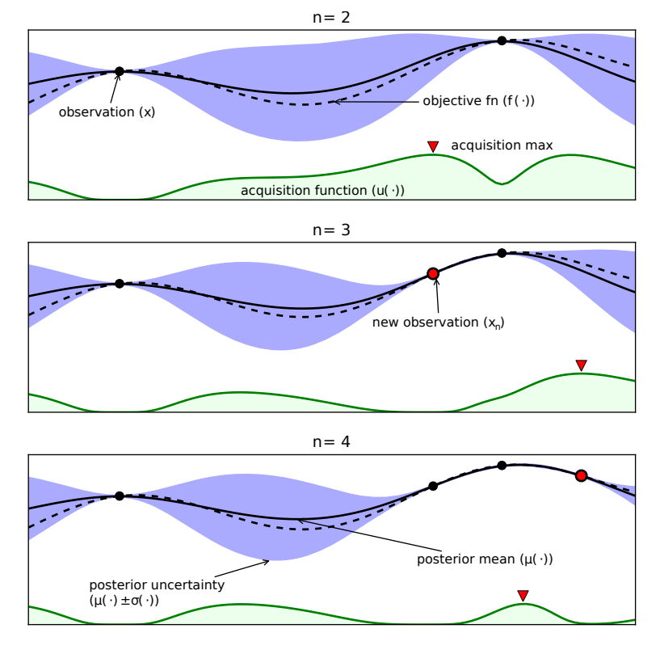
Bayesian Optimisation
Basic principle:
  Fit gaussian process (GP) model to data → objective function value and uncertainties
  Model → ‘Acquisition’ function- describes the ‘value’ sampling each point
  Sample where the acquisition function is highest, update model, repeat
Popular method for the sample-efficient optimisation of noisy, expensive-to evaluate objectives e.g in particle accelerators!
Shahriari, B. et al. (2016). Proc. IEEE, 104(1), 148–175.

Slide 27
A typical FLASHForward beamtime: Linac setup
FLASH linac: many examples of complicated, time-consuming setup tasks…
Injector setup:
Highly non-linear dynamics (e.g from space charge)
Many parameters to tune (injector laser, RF gun, optics etc.)
Proper diagnosis requires multi-point measurements
Twin bunch generation even more complicated, very little experience
Compressor setup:
PWFA requires high current bunches → coherent synchrotron radiation in compressors (complicated)
Matching after BCs requires iteration loop of (multi-point) measurements and tuning (time-consuming)
How to setup BCs optimally for plasma acceleration?

Slide 28
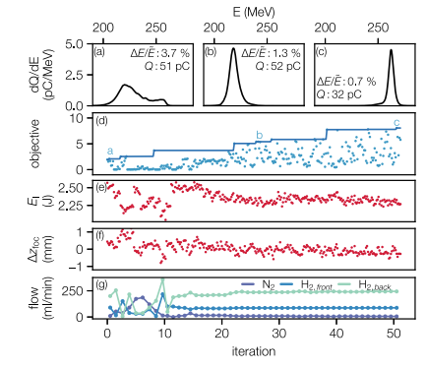
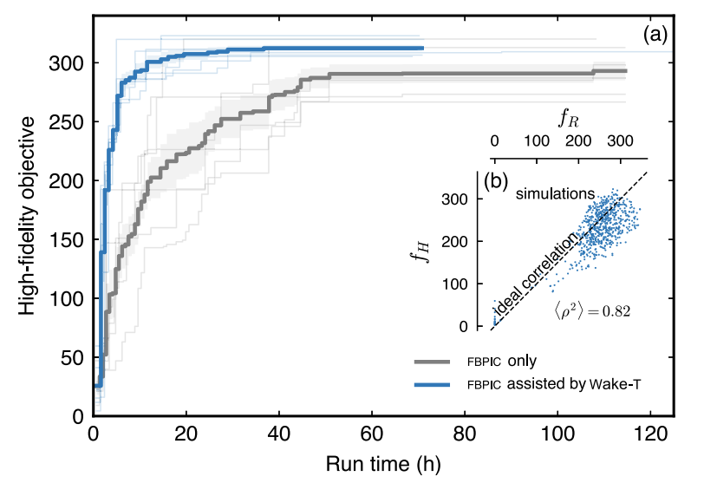
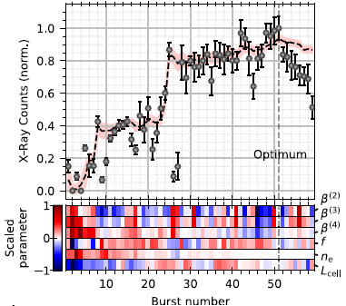
Examples already in (plasma) accelerator physics
S. Jalas et al., PRL, 126, 104801 (2021)
A. F. Pousa et al., PRAB, 26, 084601 (2023)
R. Shalloo et al., Nat. Comms, 11, 6355 (2020)
Ferran Pousa, A. et al. (2023). PRAB, 26(8), 084601.
Roussel, R., Mayes, C., Edelen, A., & Bartnik, A. (2023). IPAC2023, JACoW.

Slide 29
A Virtual Spectral Diagnostic for PWFA - Results
Courtesy Phillip Burghart (FLASHForward Masters Student)
Predict PWFA trailing bunch spectra from ~12000 shot stats dataset, 80:20 train test split
Simple Multi-layer perceptron network: 3 hidden layers, 100 neurons wide, ReLU activation, MSELoss
$$G\sim \frac{{(∆{\left\langle E\right\rangle }_{acc})}^{2}Q_{acc}}{σ_{E,acc}}$$
Peak energy and charge of accelerated bunches are quite well-predicted
  Downstream BPMs have a lot of influence
Energy spread and peak spectral density less so: why?
  Beam loading is sensitive to the details of the wakefield and witness current profile: are we capturing that info shot-to-shot?

