Slide 1

Advanced Beam Diagnostics with PolariX TDS: Experimental 5D Reconstruction at SwissFEL
Francesco Demurtasᵃ, E. Chiadroniᵃ ᵈ, P. Craievichᵇ, P. Dijkstalᵇ, E. Ericsonᵇ,
A. Giribonoᵈ, R. Ischebeckᵇ, S. Jaster-Merzᶜ, F. Marcelliniᵇ, E. Pratᵇ, S. Reicheᵇ
$\text{ᵃ}$Sapienza University of Rome, Roma, Italy
$\text{ᵇ}$Paul Scherrer Institut, CH-5232 Villigen PSI, Switzerland
$\text{ᶜ}$Deutsches Elektronen-Synchrotron DESY, Hamburg, Germany
ᵈIstituto Nazionale di Fisica Nucleare-Laboratori Nazionali di Frascati, Frascati, Italy

Slide 2
Talk outline
Motivations and goals of the presented experimental activities
Description of the Polarizable X-Band Transverse Deflection Structure system
Description of the 3D and 5D tomographic techniques
Preparations of the experimental setup:
      Athos SwissFEL diagnostics beamline
      Beam optics calculation
      PolariX TDS multiple streaking
      Deflector calibration
Experimental results of the 3D and 5D reconstruction
Summary and conclusions

Slide 3



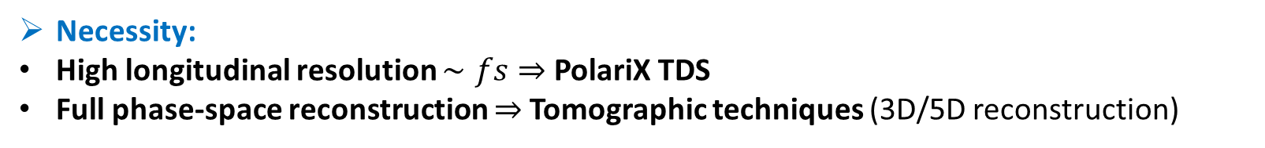
Motivations and goals
The presented experimental activity is a result from a collaboration between PSI center, DESY and INFN-LNF
Development of the PolariX TDS
Development and first demonstration of the tomographic reconstruction method
PolariX TDS implementation into the diagnostic system
Necessity:
High longitudinal resolution $∼fs⇒$ PolariX TDS
Full phase-space reconstruction $⇒$Tomographic techniques (3D/5D reconstruction)
Goal:
Demonstrate feasibility of 3D/5D reconstructions

Slide 4
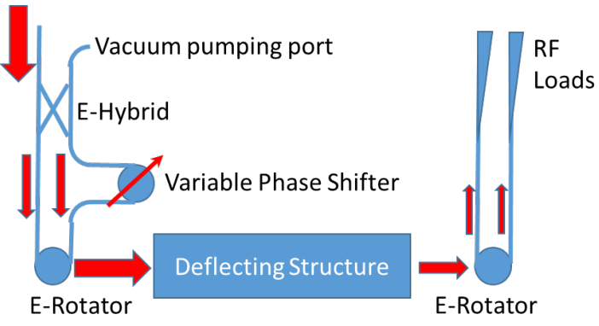
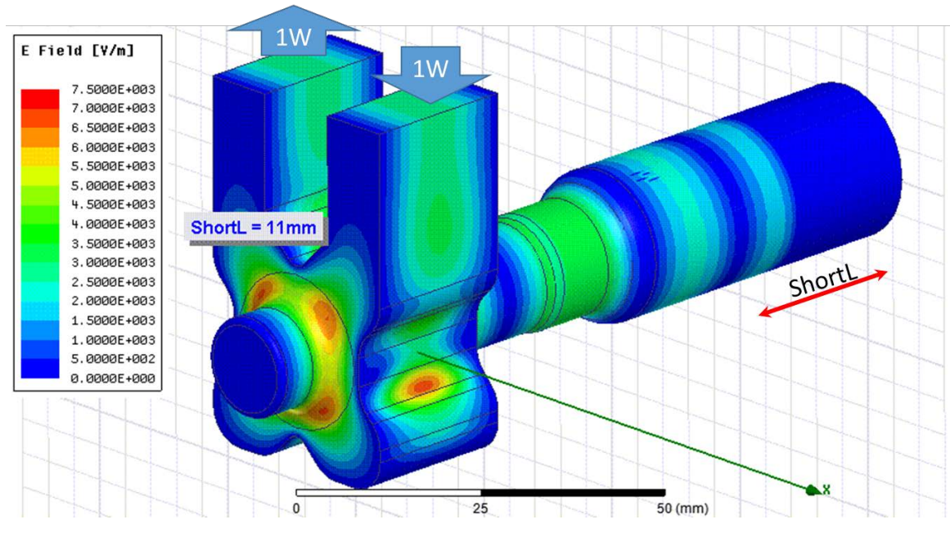
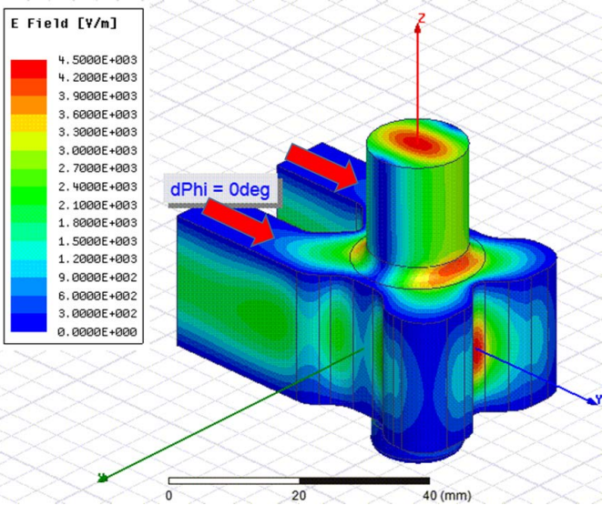
PolariX TDS: RF system
The PolariX is an X-band Transverse Deflection Structure with the feature of changing the beam streaking direction
The power is split into two branches
The phase shifter introduces a phase difference between ports 1 and 2:
  0 deg -> vertical polarization
  180 deg -> horizontal polarization
The two branches are then recombined into the E-rotator
Phase Shifter
E-Rotator
Ref. : Grudiev, Alexej. Design of compact high power RF components at X-band. No. CERN-ACC-NOTE-2016-0044. 2016.

Slide 5
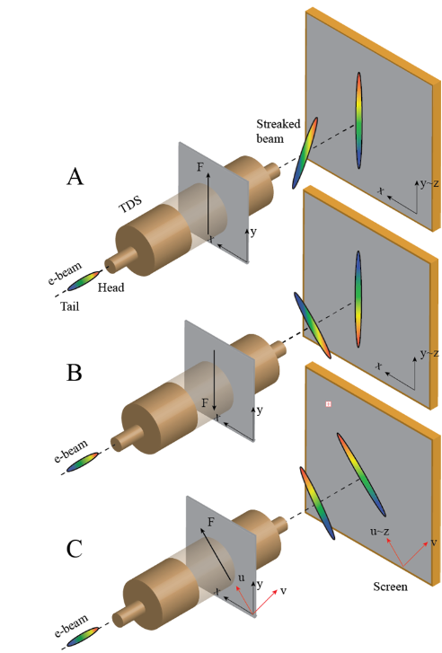
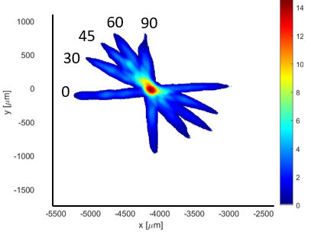
PolariX TDS: Working principle
It is capable of measuring the longitudinal properties of the beam in both transverse planes with fs-resolution
Allows for a tomography of the beam to reconstruct the 3D (x,y,t) and 5D (x,x’,y,y’,t) beam distribution, by streaking the beam for different field polarizations
Ref.: Marchetti, Barbara, et al. "Experimental demonstration of novel beam characterization using a polarizable X-band transverse deflection structure." Scientific reports 11.1 (2021): 3560.
Ref.: Jaster-Merz, S., et al. "5D tomographic phase-space reconstruction of particle bunches." Physical Review Accelerators and Beams 27.7 (2024): 072801.

Slide 6
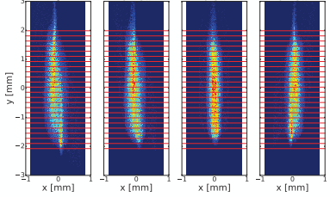
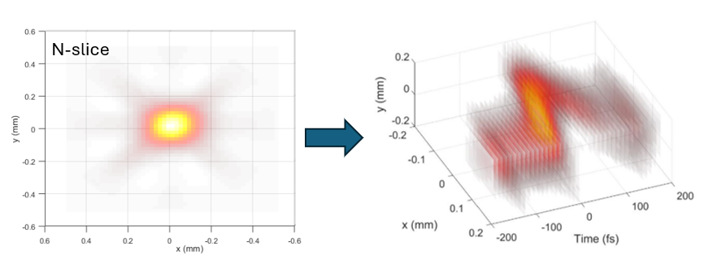
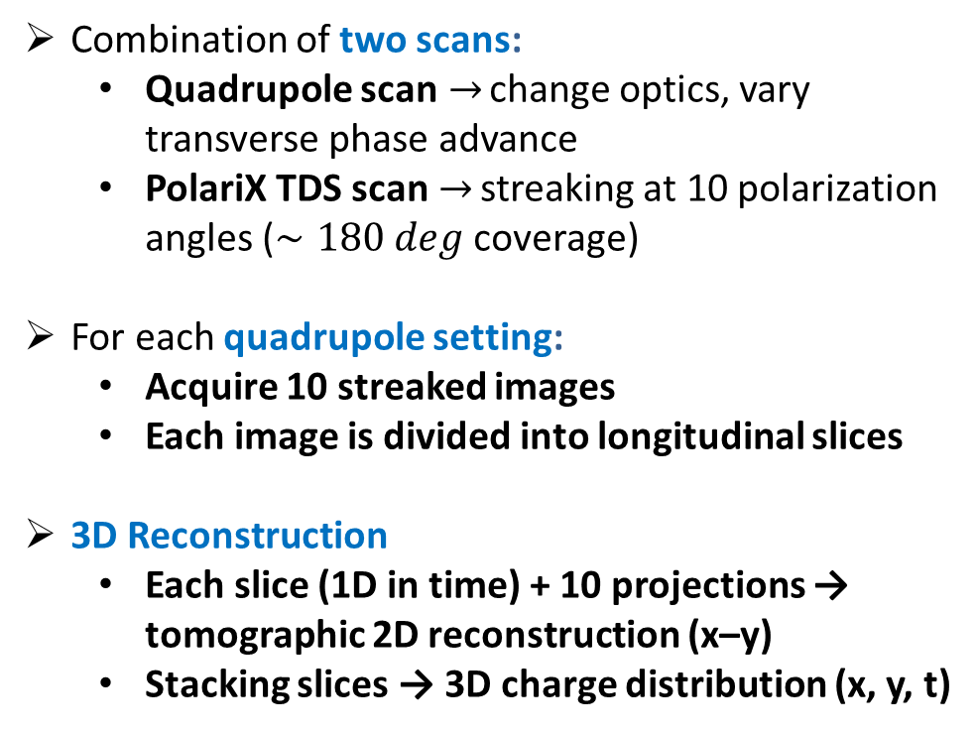


PolariX TDS: Tomographic reconstruction
Combination of two scans:
  Quadrupole scan$→$ change optics, vary transverse phase advance
  PolariX TDS scan$→$ streaking at 10 polarization angles ($∼180 deg$ coverage)
For each quadrupole setting:
  Acquire 10 streaked images
  Each image is divided into longitudinal slices
3D Reconstruction
  Each slice (1D in time) + 10 projections → tomographic 2D reconstruction (x–y)
  Stacking slices → 3D charge distribution (x, y, t)
$$D_{1}(θ)$$
$$D_{n}(θ)$$
Ref.: Marx, Daniel, et al. "Reconstruction of the 3D charge distribution of an electron bunch using a novel variable-polarization transverse deflecting structure (TDS)." Journal of Physics: Conference Series. Vol. 874. No. 1. IOP Publishing, 2017.
Ref.: Marx, Daniel, et al. "Simulations of 3D charge density measurements for commissioning of the PolariX-TDS." Journal of Physics: Conference Series. Vol. 1067. IOP Publishing, 2018.

Slide 7




PolariX TDS: 5D tomography
4D Reconstruction
  2D slice images interpreted as projections of full 4D phase space (x, x′, y, y′) rotated by an angle depending on the phase advance
$$I\left(x,y\right)=∫∫f_{b}\left(x,x^{′},y,y^{′}\right)dx^{′}dy′$$
$μ_{x}⇒\left(\begin{aligned}x_{1} \\ x_{1}^{′}\end{aligned}\right)=\left(\begin{aligned}cos⁡(θ_{x}) \\ sin⁡(θ_{x})\end{aligned}\begin{aligned} −sin⁡(θ_{x}) \\ cos⁡(θ_{x})\end{aligned}\right)$ $\left(\begin{aligned}x \\ x′\end{aligned}\right)⇒I_{y} (x_{1},θ_{x} )$
$I_{y} (x_{1},θ_{x} )$is the projection along the $θ_{x}$direction in the horizontal phase space
Filtered back-projection algorithm recovers transverse momenta $x’,y’$
1° iteration
2° iteration
$$I_{y,θ_{x}}\left(x\right)$$
$$f_{y }\left(x,x′\right)$$
$$f_{ }\left(x,x^{′},y,y′\right)$$
5D Reconstruction
  Combine transverse phase space slices (4D) with longitudinal coordinate (t)
  Result: full 5D beam distribution
  Developed and demonstrated for the first time at DESY.
Ref.: Hock, K. M., and A. Wolski. "Tomographic reconstruction of the full 4D transverse phase space." Nuclear Instruments and Methods in Physics Research Section A: Accelerators, Spectrometers, Detectors and Associated Equipment 726 (2013): 8-16.
Ref.: Jaster-Merz, S., et al. "5D tomographic phase-space reconstruction of particle bunches." Physical Review Accelerators and Beams 27.7 (2024): 072801
Ref.: Jaster-Merz, S., et al. "Experimental demonstration of a tomographic 5D phase-space reconstruction." arXiv preprint arXiv:2505.13724 (2025).

Slide 8
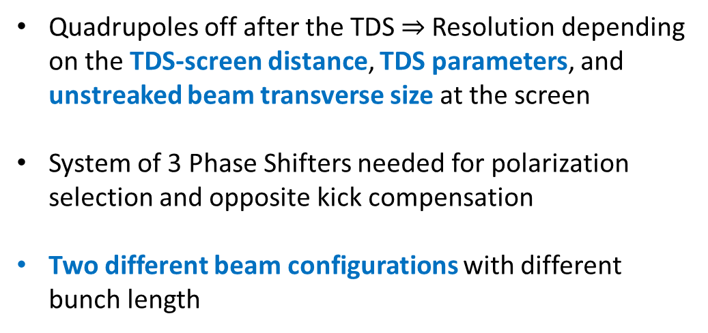
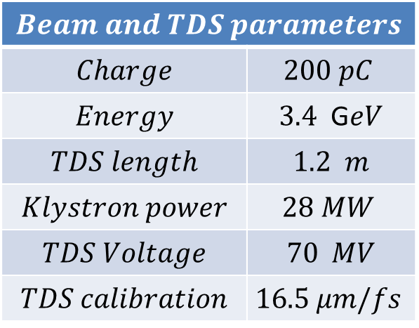
5D Reconstruction: Beamline layout
Athos 3-GeV Beamline at SwissFEL
Phase shifter system for polarization selection
PS3
Reconstruction Point
Measurement Screen
PS1
PS2
TDS 1
TDS 2
Quadrupoles upstream to the TDS used for matching to the screen
Quadrupoles off after the TDS$⇒$ Resolution depending on the TDS-screen distance, TDS parameters, and unstreaked beam transverse size at the screen
System of 3 Phase Shifters needed for polarization selection and opposite kick compensation
Two different beam configurations with different bunch length
$$Beam and TDS parameters$$
$$Charge$$ | $$200 pC$$
$$Energy$$ | $3.4$ G$eV$
$$TDS length$$ | $1.2$ $m$
$$Klystron power$$ | $$28 MW$$
$$TDS Voltage$$ | $70$ $MV$
$$TDS calibration$$ | $$16.5 μm/fs$$

Slide 9
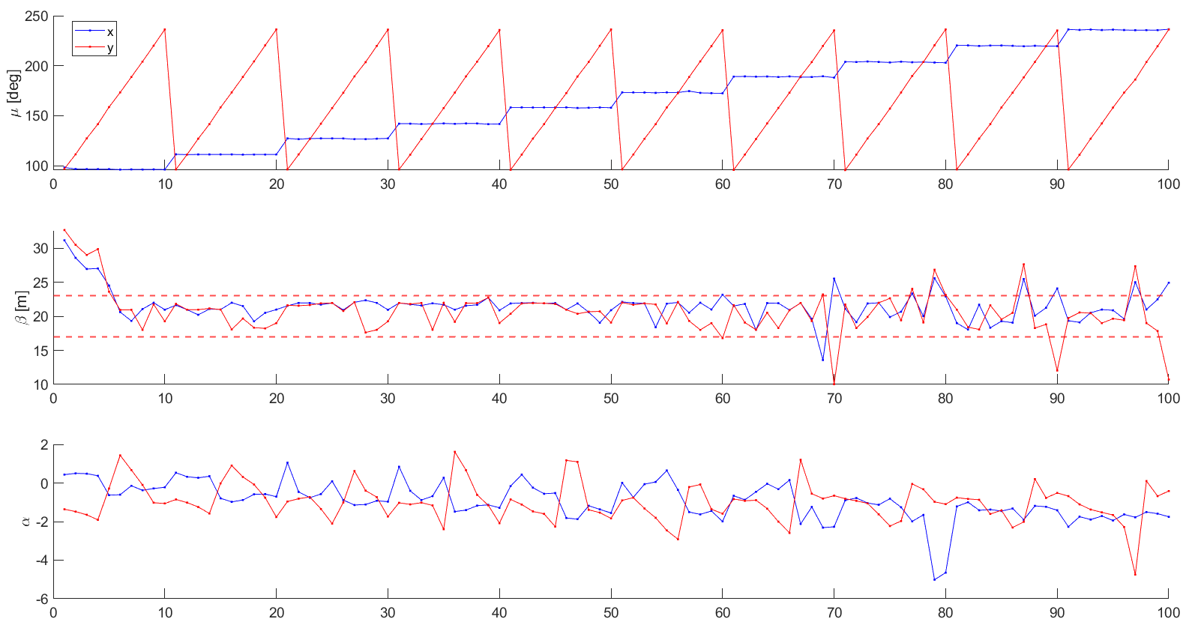
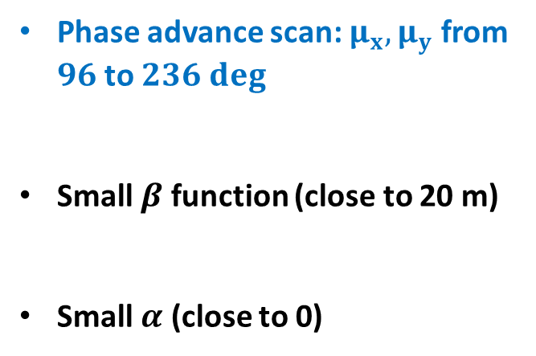
5D Reconstruction: Optics simulations
Single-particle simulations have been done to calculate the beam optics for the quadrupole scan
Reconstruction Point
Matching Quadrupoles
Measurement Screen
TDS 1
TDS 2
Phase advance scan: $μ_{x},μ_{y}$ from $96$ to $236 deg$
Small $β$ function (close to 20 m)
Small $α$ (close to 0)
Scan index

Slide 10
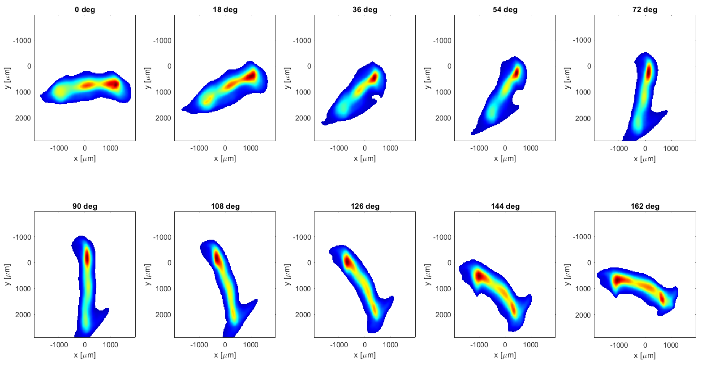

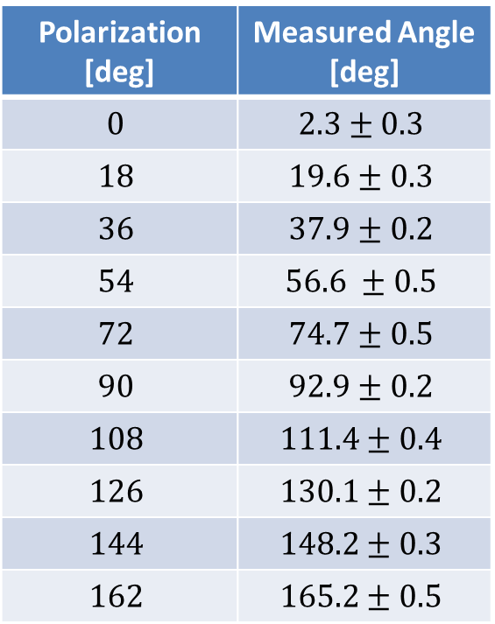
5D Reconstruction: TDS polarizations
The beam is streaked, covering a polarization range of 180 degrees, and from the centroids, the streaking angle can be evaluated
The polarization is set by three phase shifters that set the single cavity phase and the relative one
$$θ=\tan^{−1}⁡(\frac{C_{y} }{C_{x}})$$
Polarization [deg] | Measured Angle [deg]
$$0$$ | $$2.3±0.3$$
$$18$$ | $$19.6±0.3$$
$$36$$ | $$37.9±0.2$$
$$54$$ | $$56.6 ±0.5$$
$$72$$ | $$74.7±0.5$$
$$90$$ | $$92.9±0.2$$
$$108$$ | $$111.4±0.4$$
$$126$$ | $$130.1±0.2$$
$$144$$ | $$148.2±0.3$$
$$162$$ | $$165.2±0.5$$
Angle from: Centroid Shift vs RF Phase
Beam Images at different polarizations

Slide 11
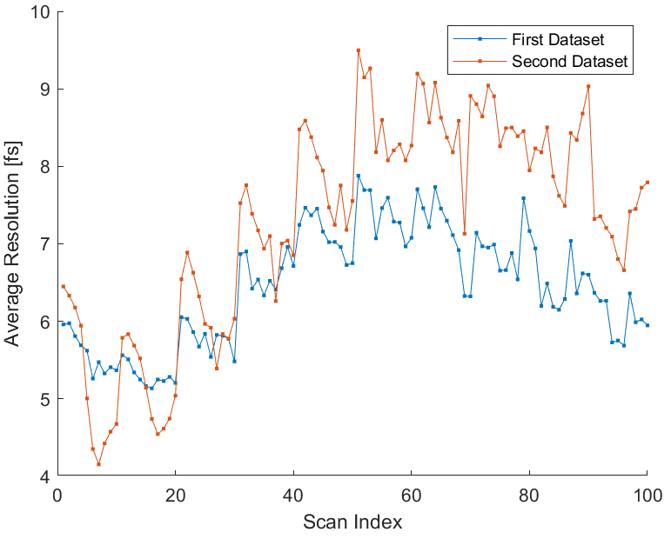
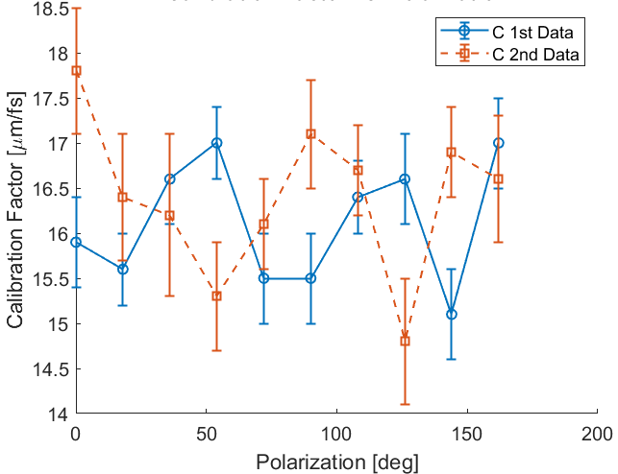
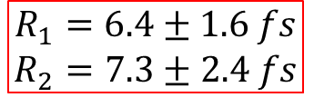


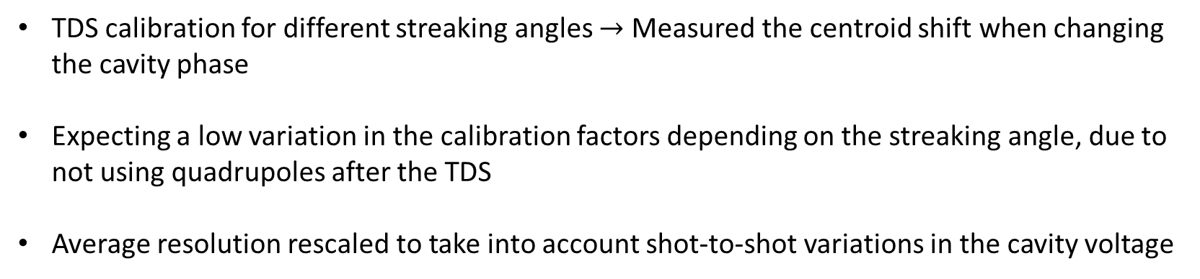
5D Reconstruction: Calibration results
TDS calibration for different streaking angles $→$ Measured the centroid shift when changing the cavity phase
Expecting a low variation in the calibration factors depending on the streaking angle, due to not using quadrupoles after the TDS
Average resolution rescaled to take into account shot-to-shot variations in the cavity voltage
$$C=\frac{eV_{0}L}{E}2πν [μm/fs]$$
$$R_{t}=\frac{σ_{off}}{C}$$
$$R_{1}=6.4±1.6 fs$$
$$R_{2}=7.3±2.4 fs$$

Slide 12
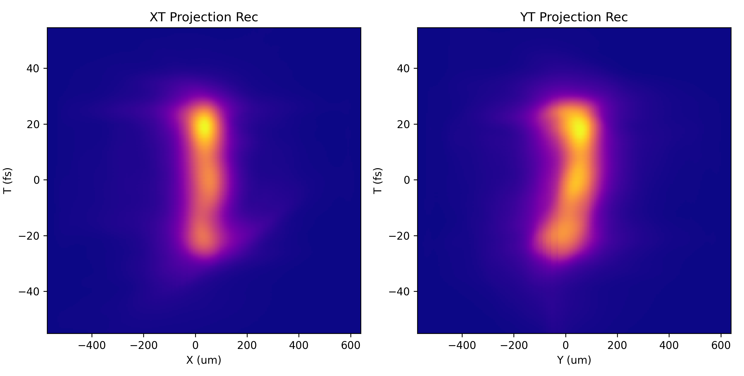
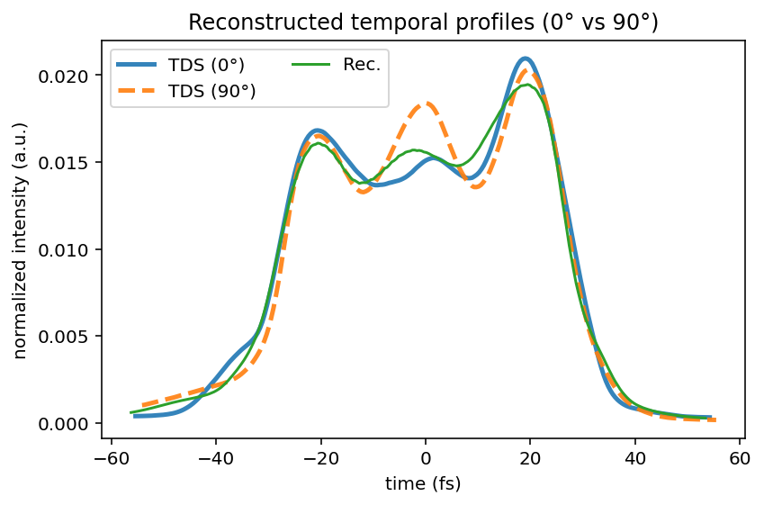
3D Reconstruction: 2D projections
For each dataset, we acquired 5 images for each combination of 100 quadrupole settings and 10 polarizations (Beam repetition rate: 1 Hz)
For each beam optics the 3D reconstruction can be performed
2D projections from the reconstructed 3D distribution ($μ_{x}=μ_{y}=96 deg$):

Slide 13
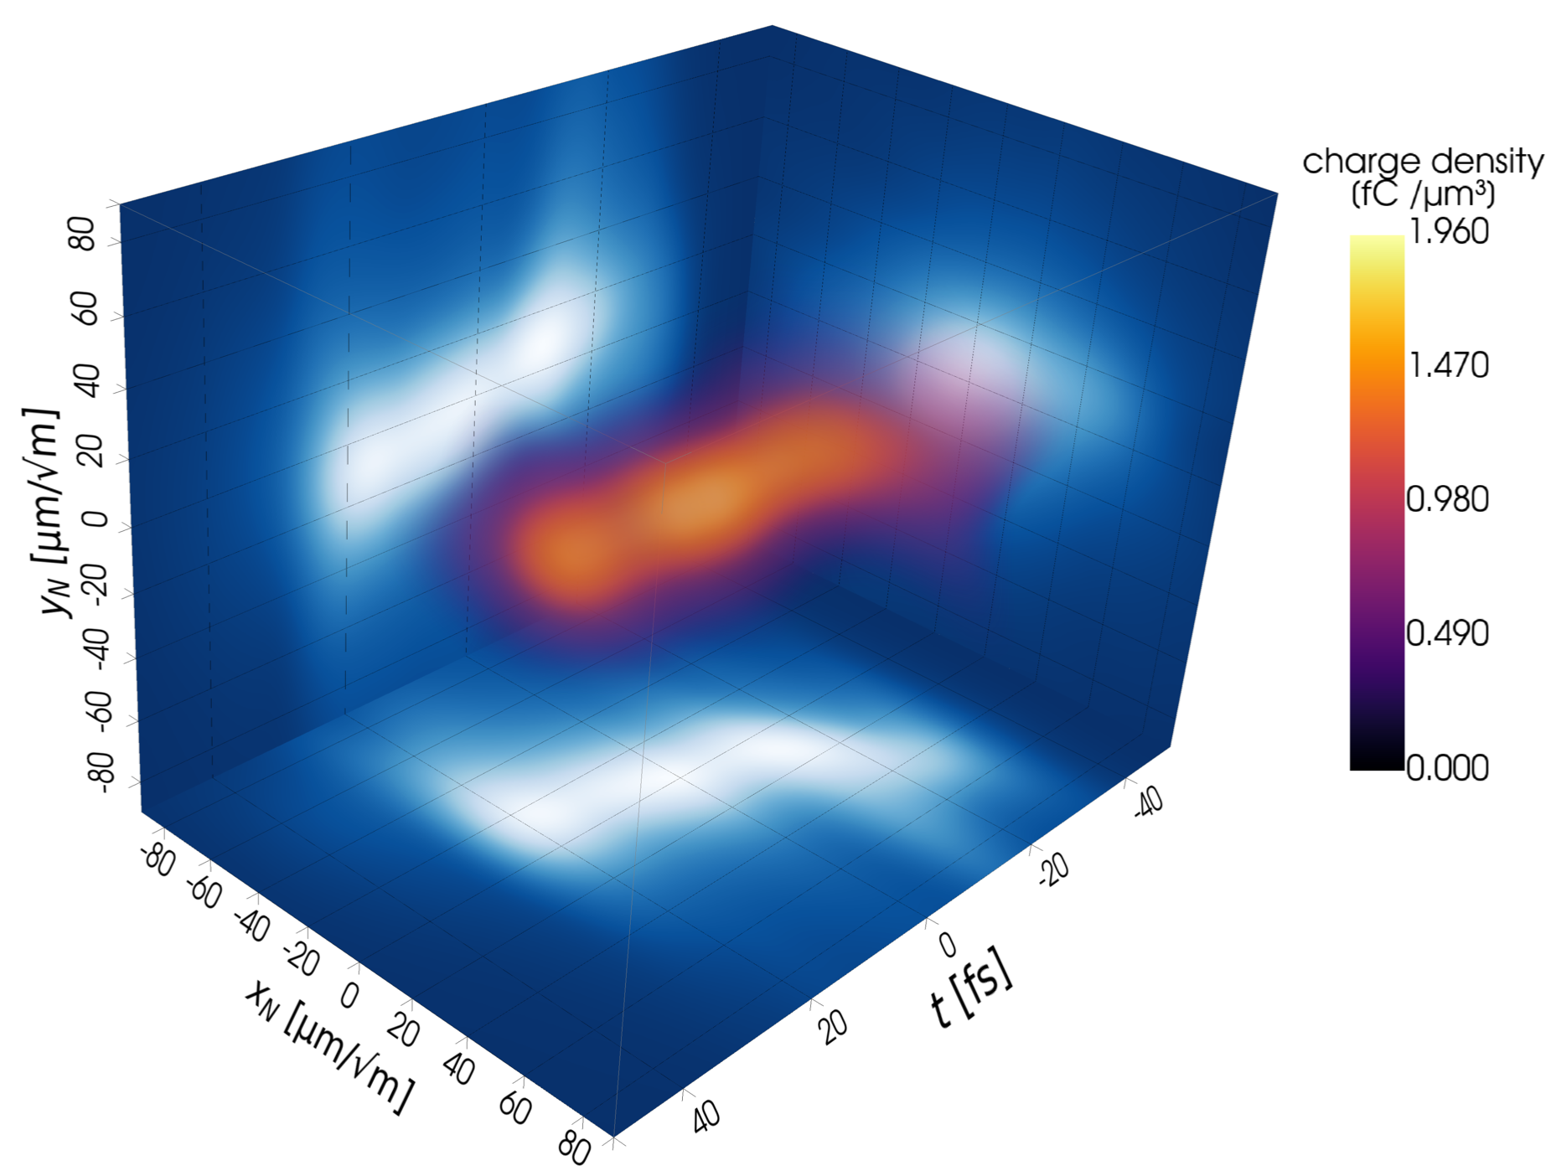
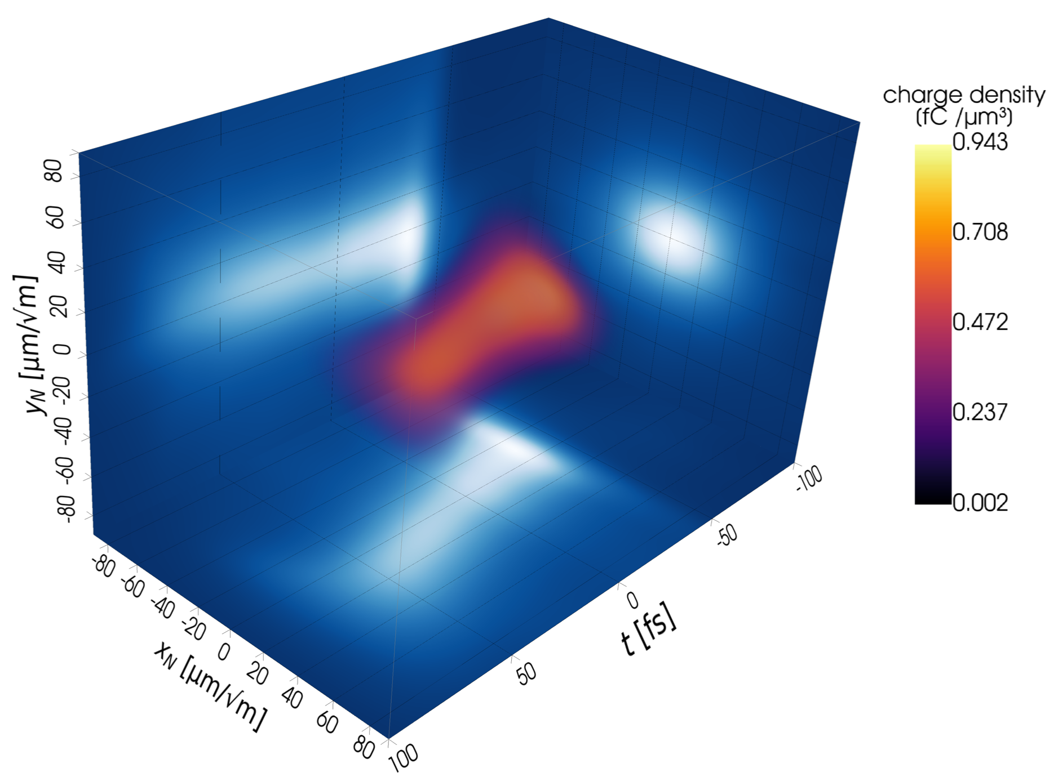



5D Reconstruction: Preliminary results
The measurement has been done in two settings: a short bunch ($σ_{t}∼19 fs$) and a less compressed ($σ_{t}∼40 fs$) to mitigate collective effects in the compressor and reduce the beam tilt
3D beam charge density obtained as a projection of the reconstructed 5D distribution:
Beam 1: High compression ${FWHM}_{t}∼56 fs$
Beam 2: Moderate compression$FWHM\sim 103 fs$
Preliminary results
Preliminary results
Courtesy: S. Jaster-Merz

Slide 14
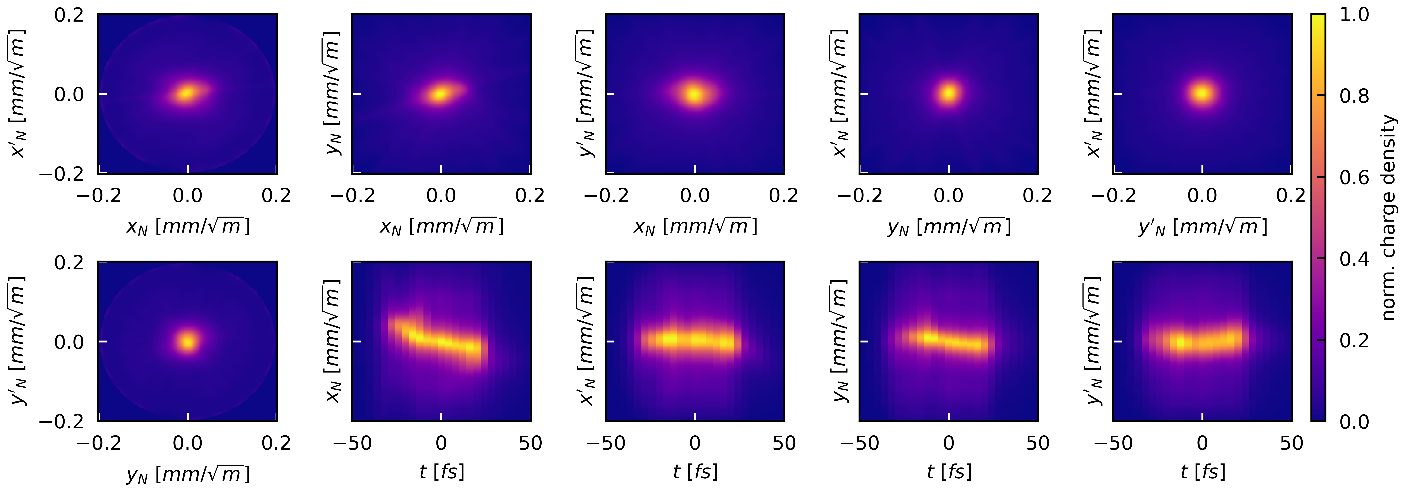
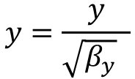
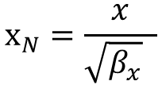
5D Reconstruction: Bunch 1
$$x_{N}=\frac{x}{\sqrt{β_{x}} }$$
$$y=\frac{y}{\sqrt{β_{y}} }$$
Bunch 1, reconstructed 2D projections:
Preliminary
Preliminary results
Courtesy: S. Jaster-Merz
In the first beam configuration, the high compression produces a very short bunch with an evident tilt in the (x,t) plane

Slide 15
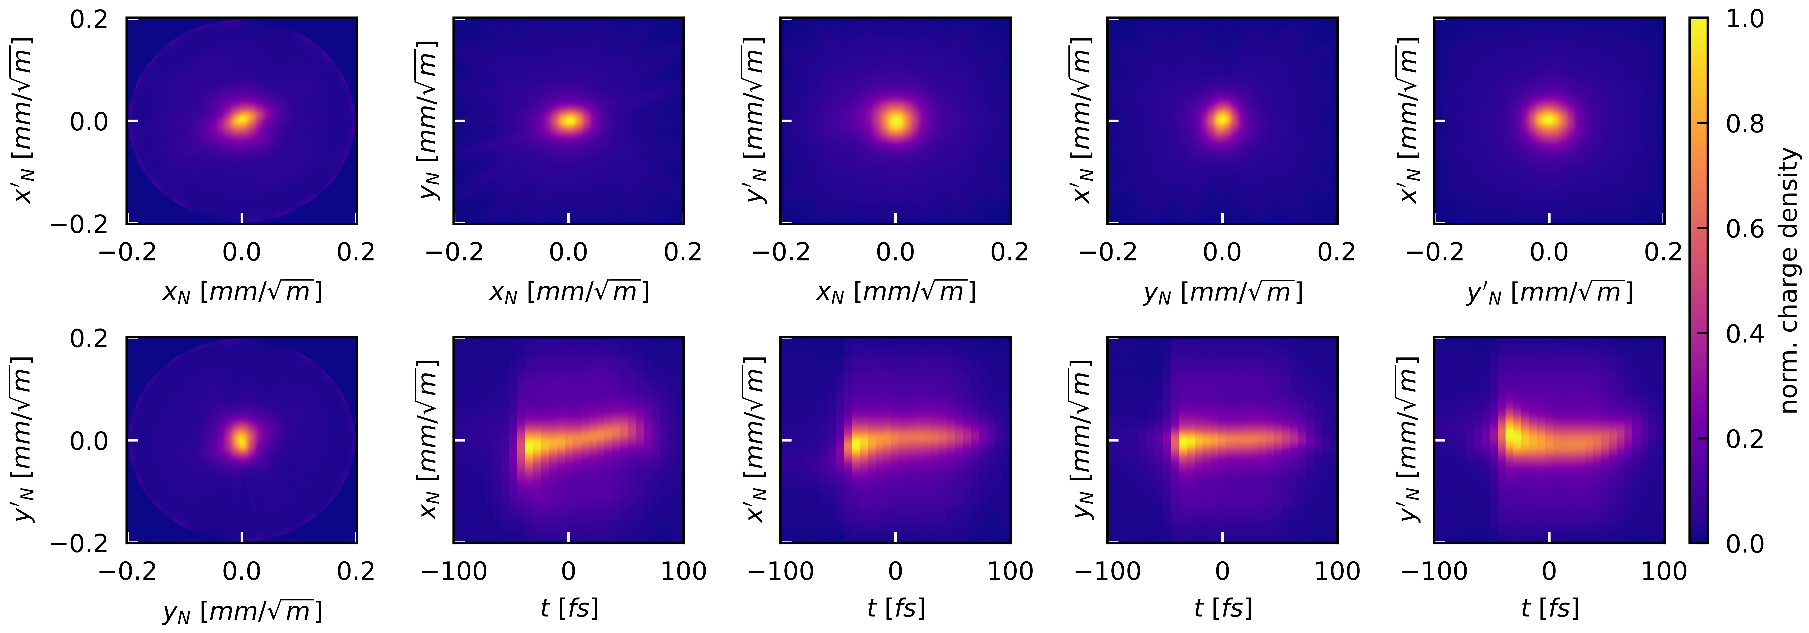
5D Reconstruction: Bunch 2
$$x_{N}=\frac{x}{\sqrt{β_{x}} }$$
$$y=\frac{y}{\sqrt{β_{y}} }$$
Bunch 2, reconstructed 2D projections:
Preliminary
Preliminary results
Courtesy: S. Jaster-Merz
In the second beam configuration, the relaxation of the bunch compression reduces the beam tilt

Slide 16
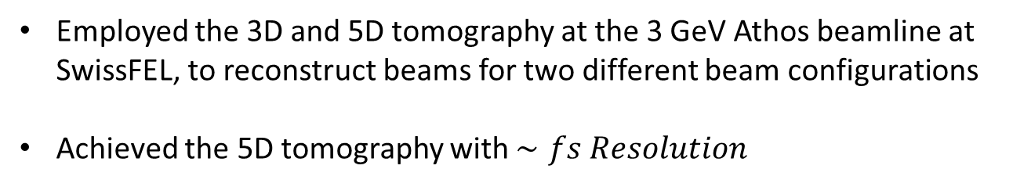
Summary and conclusions
Summary results
Employed the 3D and 5D tomography at the 3 GeV Athos beamline at SwissFEL, to reconstruct beams for two different beam configurations
Achieved the 5D tomography with $∼fs Resolution$
Next Studies:
Employ this technique as diagnostics to characterize the nominal bunch at Athos SwissFEL
Extend the 5D tomography method to perform the 6D Reconstruction, including the beam energy measurement at the spectrometer

Slide 17
Acknowledgements
INFN-LNF: E. Chiadroni, A. Giribono
PSI center: P. Craievich, P. Dijkstal, F. Marcellini, E. Prat, S. Reiche, E. Ericson, R. Ischebeck
DESY: S. Jaster-Merz, B. Beutner

Slide 18
Thank you for your attention

Slide 19
BACKUP SLIDES

Slide 20
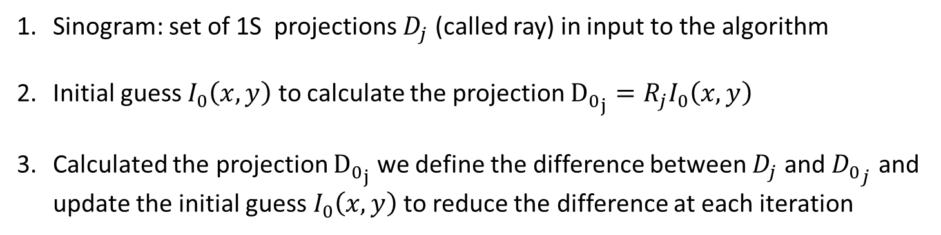
SART tomographic algorithm
SART (Simultaneous algebraic reconstruction technique) TOMOGRAPHIC ALGORITHM
Working principle:
Sinogram: set of 1S projections $D_{j}$ (called ray) in input to the algorithm
Initial guess $I_{0}\left(x,y\right)$ to calculate the projection ${D_{0}}_{j}=R_{j}I_{0}\left(x,y\right)$
Calculated the projection ${D_{0}}_{j}$ we define the difference between $D_{j}$ and ${D_{0}}_{j}$ and update the initial guess $I_{0}\left(x,y\right)$ to reduce the difference at each iteration
Advantages:
It is simultaneous because it updates all pixels at the same time
More accurate and robust than other similar algorithms
Good reconstruction with few projection angles

Slide 21
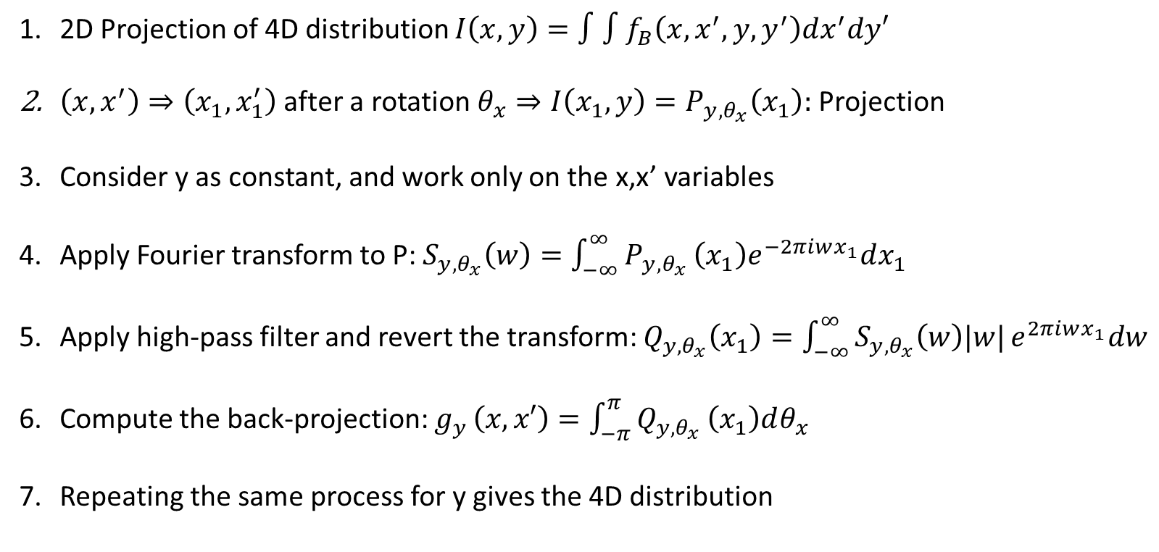
Filtered Back Projection algorithm
FILTERED BACK PROJECTION TOMOGRAPHIC ALGORITHM
Working principle:
2D Projection of 4D distribution $I\left(x,y\right)=∫∫f_{B}\left(x,x^{′},y,y^{′}\right)dx^{′}dy′$
$\left(x,x^{′}\right)⇒\left(x_{1},x_{1}^{′}\right)$ after a rotation $θ_{x}⇒I\left(x_{1},y\right)=P_{y, θ_{x}}\left(x_{1}\right):$ Projection
Consider y as constant, and work only on the x,x’ variables
Apply Fourier transform to P: $S_{y,θ_{x}}\left(w\right)=\int_{−∞}^{∞}{P_{y,θ_{x}}}\left(x_{1}\right)e^{−2πiwx_{1}}dx_{1}$
Apply high-pass filter and revert the transform: $Q_{y,θ_{x}}\left(x_{1}\right)=\int_{−∞}^{∞}{S_{y,θ_{x}}\left(w\right)|w|}e^{2πiwx_{1}}dw$
Compute the back-projection: $g_{y }\left(x,x′\right)=\int_{−π}^{π}{Q_{y,θ_{x}}}\left(x_{1}\right)dθ_{x}$
Repeating the same process for y gives the 4D distribution

Slide 22
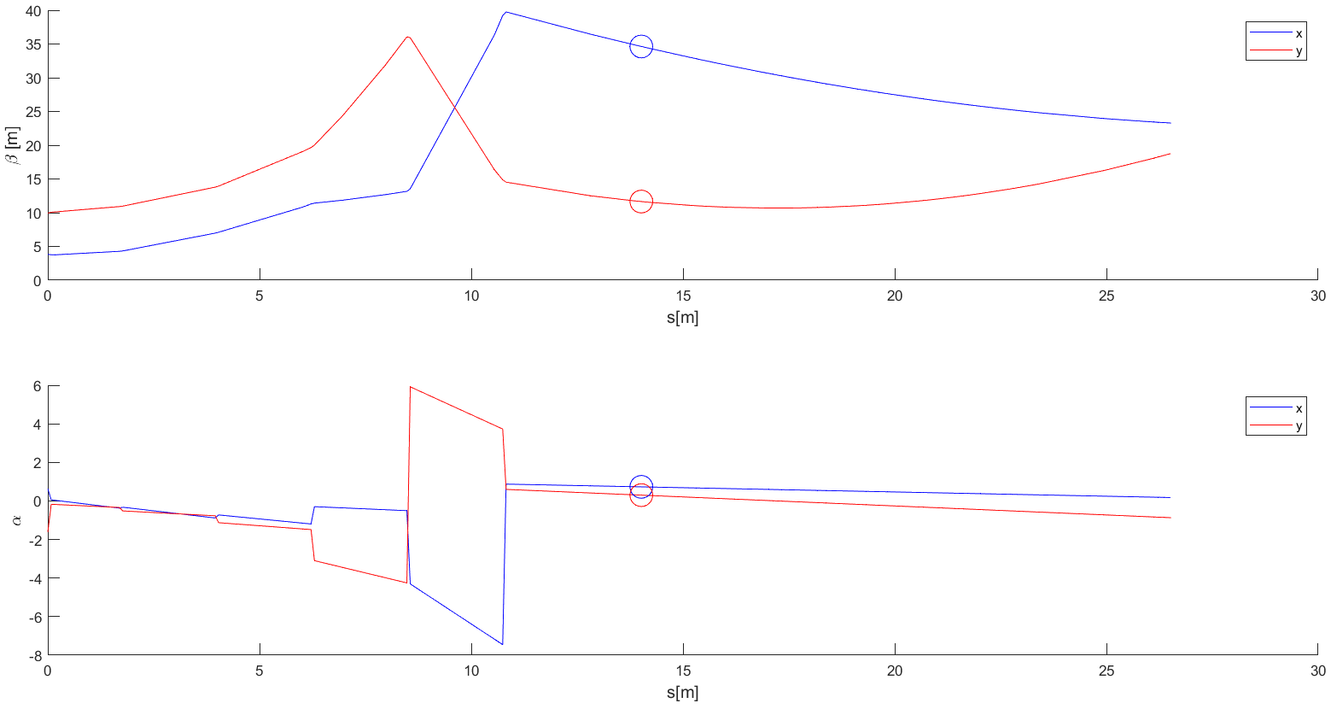

Beamline optics
The optics has been calculated to match the Twiss parameters to screen
Since there are no quadrupoles active, but only a drift after the TDS, the beta function at the TDS center and the beam size at the screen are dependent parameters
$$μ_{x}=μ_{y}=111 deg$$

Slide 23
Image treating methodology
The images have to be prepared to perform the tomographic reconstruction:
Remove background and apply gaussian filters to the images
Rescale images to have square pixels
Rotate the images by the streaking angle
Apply the calibration factor to the streaking axis and rescale the images to have the same temporal scale
Center the images
Set the ROI to select only the beam
This allows for the reconstruction, minimizing the artifacts that can arise from the disalignment in the images and from background contributions

Slide 24
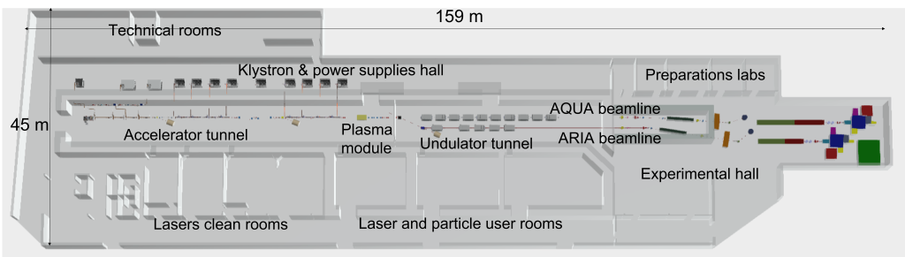
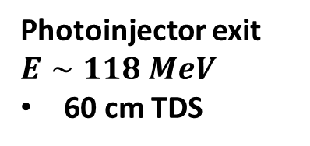
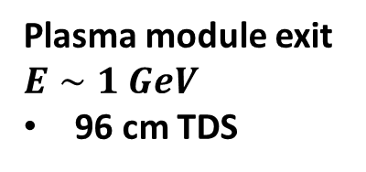
EuPRAXIA@SPARC_LAB
Two PolariX TDS will be implemented in the EuPRAXIA@SPARC_LAB diagnostics systems
Photoinjector exit $E∼118 MeV$
60 cm TDS
Plasma module exit $E∼1 GeV$
96 cm TDS

