Slide 1
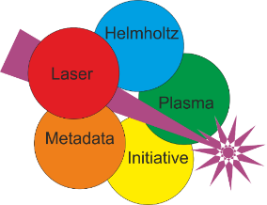


HELPMI: the Helmholtz Laser-Plasma Metadata Initiative
Start developing a data standard for the global LPA community
Project summary and outlook

Slide 2

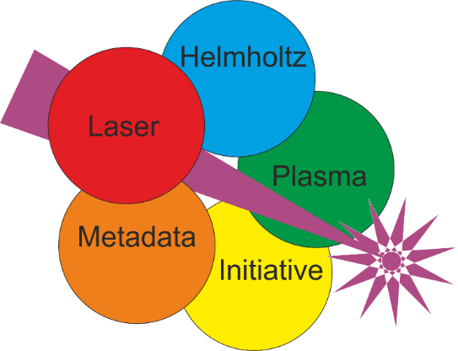
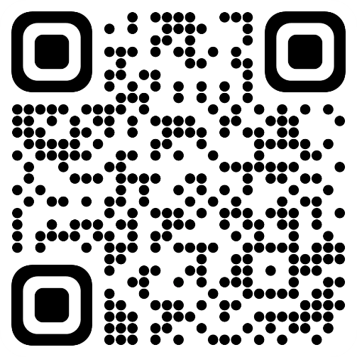
Acknowledgements
Visit laser-plasma-metadata.org
Who was HELPMI?
GSI: Johannes Hornung, Udo Eisenbarth, Vincent Bagnoud
HI Jena: Alexander Kessler, Matthew Schwab, Malte Kaluza
HZDR: Franz Pöschel, Michael Bussmann, Alexander Debus, Hans-Peter Schlenvoigt
Project Observers: Axel Huebl, Andreas Doepp, Rajeev Pattathil, Birgit Plötzeneder, Lajos Schrettner, Balázs Bagó
This project (ZT-I-PF-3-066) was funded by the Initiative and Networking Fund of the Helmholtz Association in the framework of the Helmholtz Metadata Collaboration project call.

Slide 3



HELPMI: Main Goals
Initiative: Start the development of a data standard for LPA experiments
  Consulting and assistance from HMC community
  Concepts, tools, trends, best practices, lessons learned…
Adopt NeXus standard from PaN experimental community
  Use existing base classes, possibly define new ones
  Propose application definition
Extend the openPMD standard and API for arbitrary hierarchies
  Currently established for simulations in LPA community
  Fileformat-agnostic
„an umbrella over a family of standards, currently for experiment data in the Photon and Neutron science community“
Generate a glossary: Domain-specific terms

Slide 4
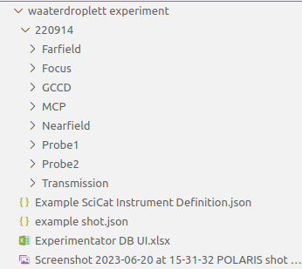

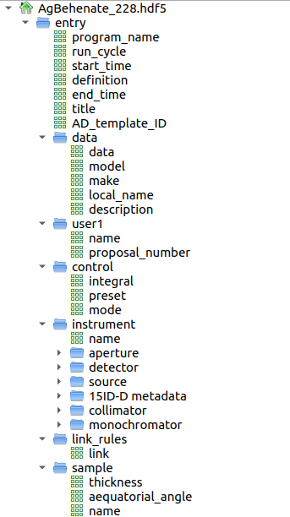
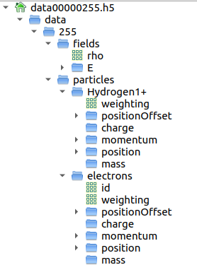
HELPMI: Working example
Example data chunk to perform our trials, and other examples
Data fields with attributes
Groups for logical gathering (hierarchy)
  Links for arbitrary layouts
Hierarchical structure
Meta/Data in folder names
Files containing instrument and experiment description
Setup models, calibration, scripts
NeXus base classes encoded in attributes NX_class
Named fields
  partly by definition

Slide 5
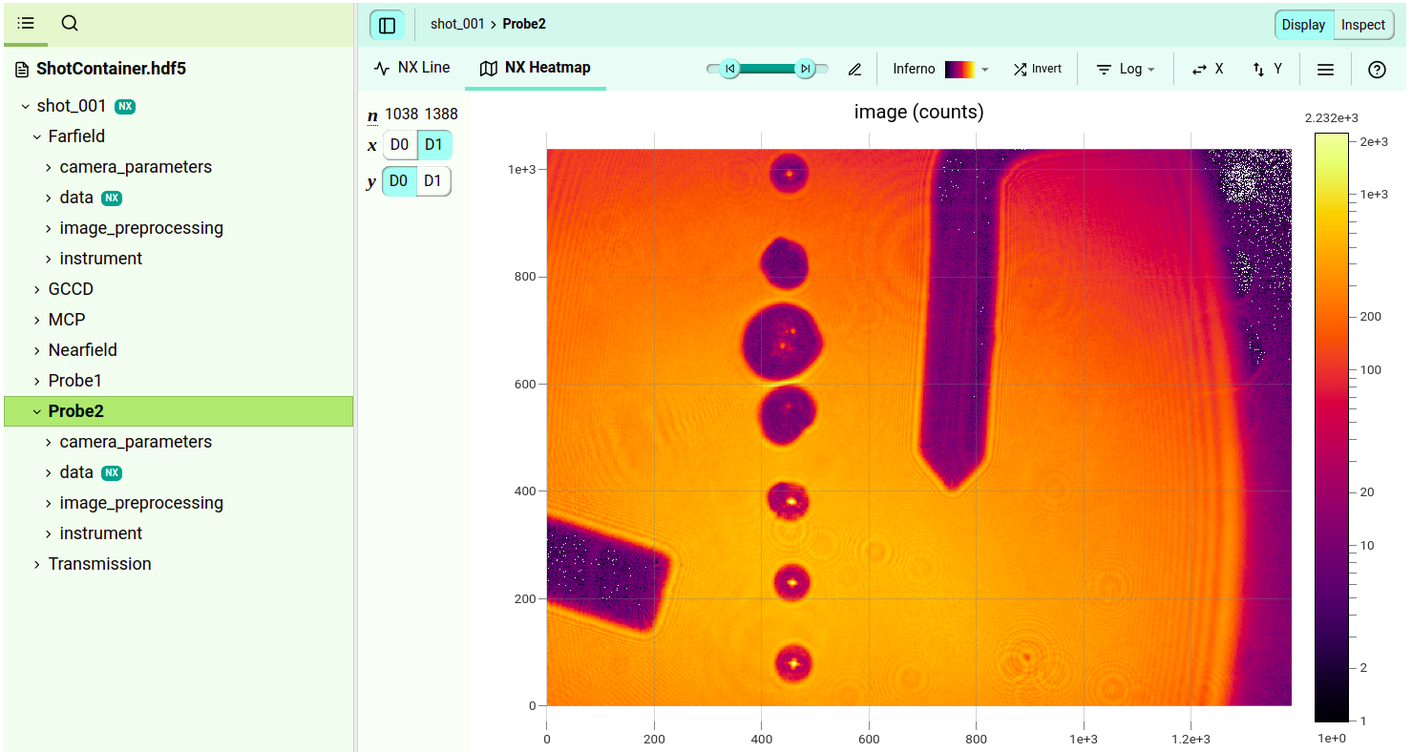

HELPMI: NeXus adoption
NXdata is awesome feature, scientific classes strongly bound to PaN
Hierarchical structure
Meta/Data in folder names
Files containing instrument and experiment description
Setup models, calibration, scripts

Slide 6
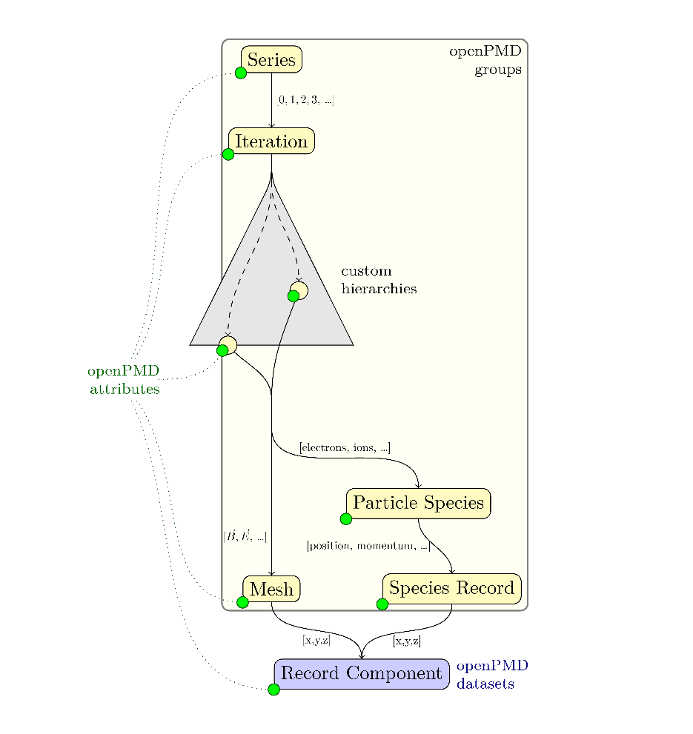
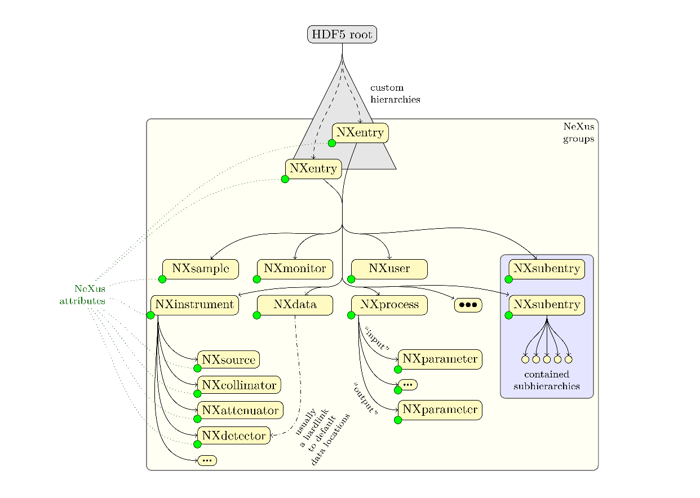
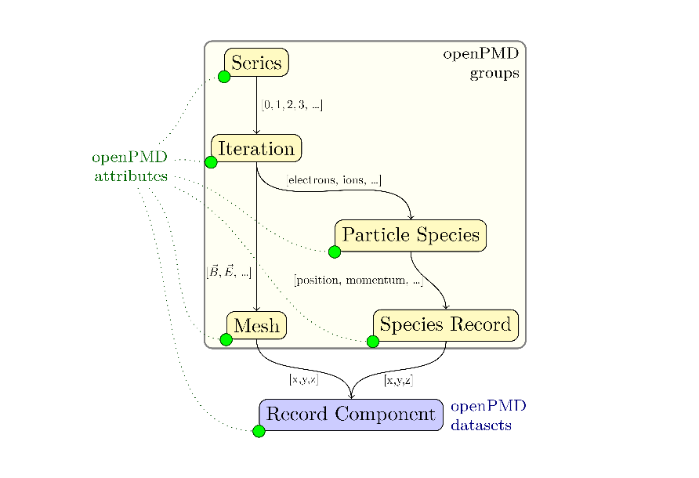
HELPMI: openPMD
Extend for any custom hierarchy

Slide 7
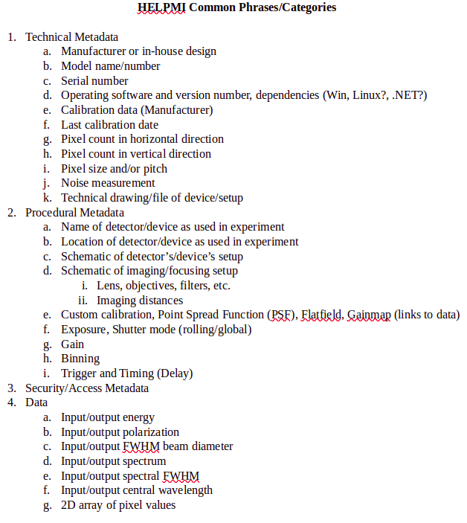
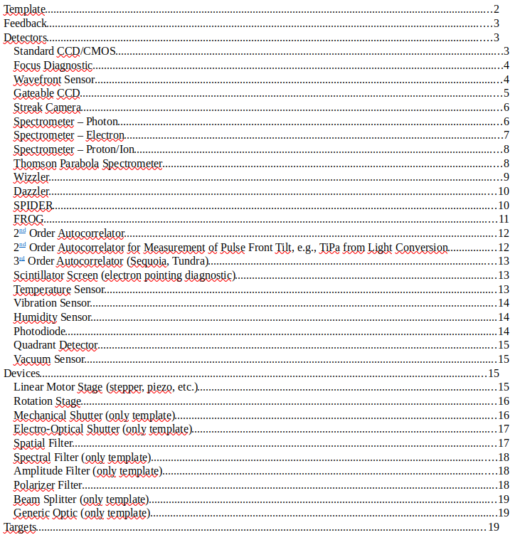
HELPMI: Glossary draft
Devices-Detectors-Components-Library: https://doi.org/10.5281/zenodo.11143947
We did not stick to example dataset and then got lost.
Needs involvement of (interested) community.
Unclear what kind of format and platform.

Slide 8
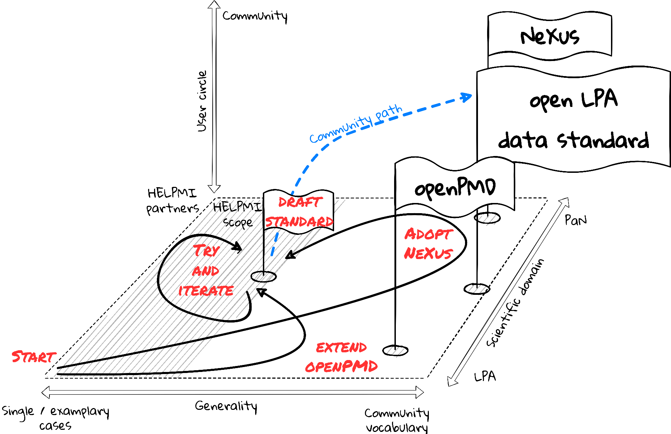
Summary
Initiative
Adopt Nexus
Extend openPMD
Glossary Draft
  General LPA ontology
https://github.com/ComputationalRadiationPhysics/laser_plasma_ontology

Slide 9

The sequel?
LAPIS – Laser Archives and Pipelines for Intelligent Systems
Submitted to DFG, could fund 2 FTE for 2 years w/o matching funds.
Laser data is data from well-defined, slowly-evolving structure
Raw data source is structured
High rates need automation in curation
Implement AI in pipelines for live processing
Share data with community for AI development

Slide 10
Acknowledgements
Visit laser-plasma-metadata.org
Who was HELPMI?
GSI: Johannes Hornung, Udo Eisenbarth, Vincent Bagnoud
HI Jena: Alexander Kessler, Matthew Schwab, Malte Kaluza
HZDR: Franz Pöschel, Michael Bussmann, Alexander Debus, Hans-Peter Schlenvoigt
Project Observers: Axel Huebl, Andreas Doepp, Rajeev Pattathil, Birgit Plötzeneder, Lajos Schrettner, Balázs Bagó
This project (ZT-I-PF-3-066) was funded by the Initiative and Networking Fund of the Helmholtz Association in the framework of the Helmholtz Metadata Collaboration project call.

