Slide 1

TNSA proton beam focussing in a low-density plasma behind the target
Peter Parsons
Centre for Light-Matter Interactions, Queen’s University Belfast
pparsons03@qub.ac.uk
EAAC European Advanced Accelerator Concepts Workshop
23/09/2025

Slide 2
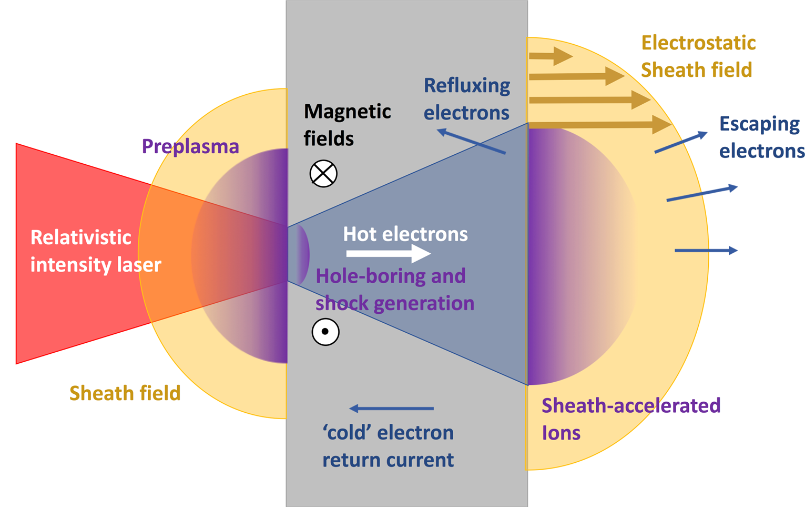
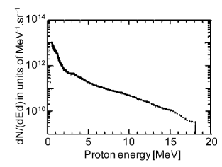
Target Normal Sheath Acceleration (TNSA)
Typical beams:
Predominantly protons
Broadband energy spectra, up to Mev/ 10s MeV. Flux decreases with energy, up to a cut-off
Diagram by C.A.J. Palmer
J. Fuchs, et.al, 2009. C.R.Physique 10

Slide 3
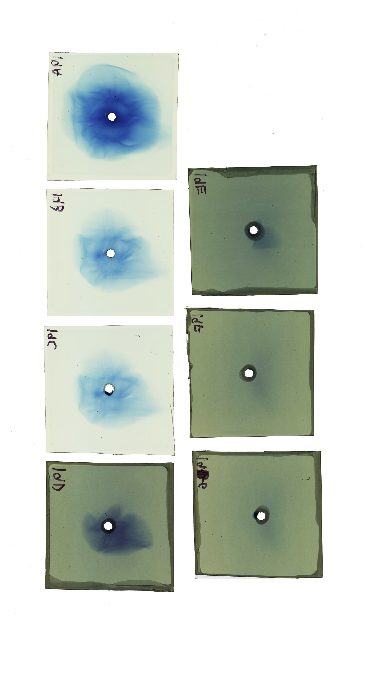
TNSA Divergence
High divergence: ≥10s degrees
Divergence decreases with energy
Low divergence is useful for applications:
  Capture and transport systems are more efficient
  Higher intensities possible
1.5 MeV
3.7 MeV
5.2 MeV
7.0 MeV
9.0 MeV
50°

Slide 4
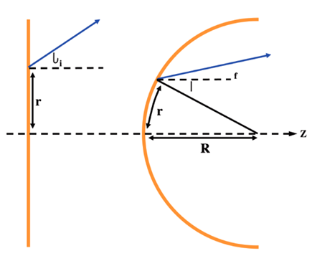
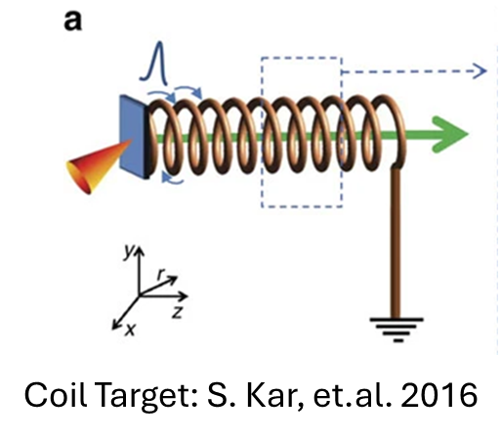
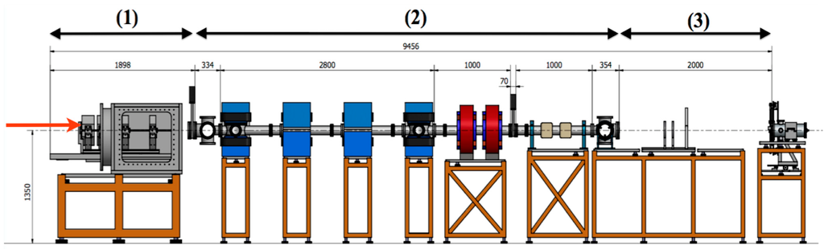
Reducing Divergence
Capture and Transport Systems:
  Quadrupoles
  Pulsed Solenoids
At source:
  Shaped foils / hemispherical targets
  Coils
Ballistic Focussing: K. Markey et.al. 2007
EliMed Beamline: G.A Cirrone et.al. 2015

Slide 5

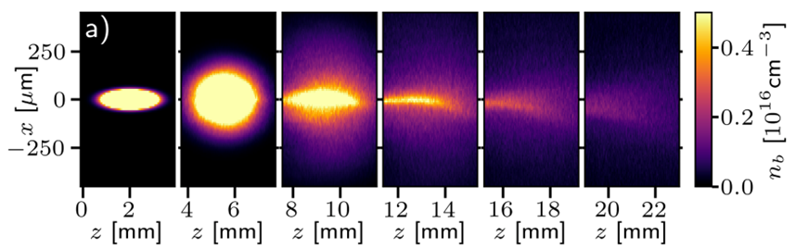
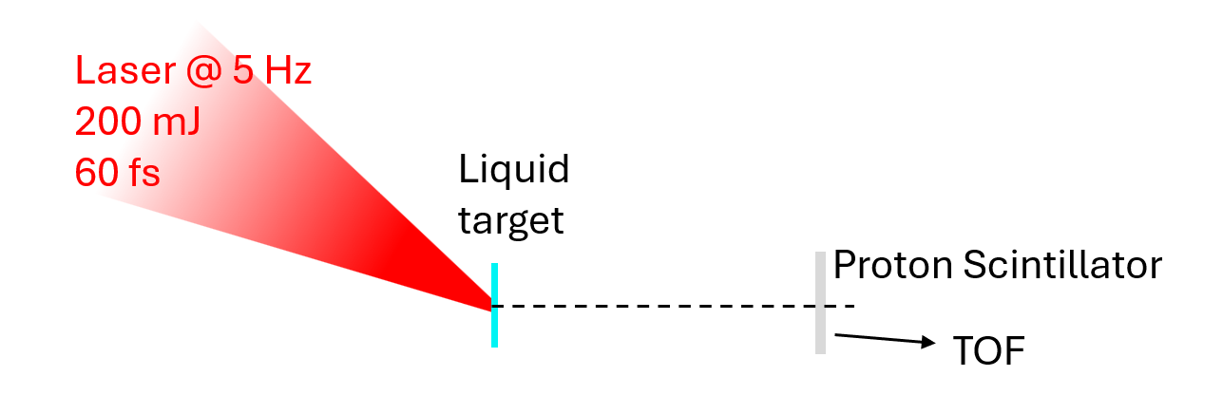
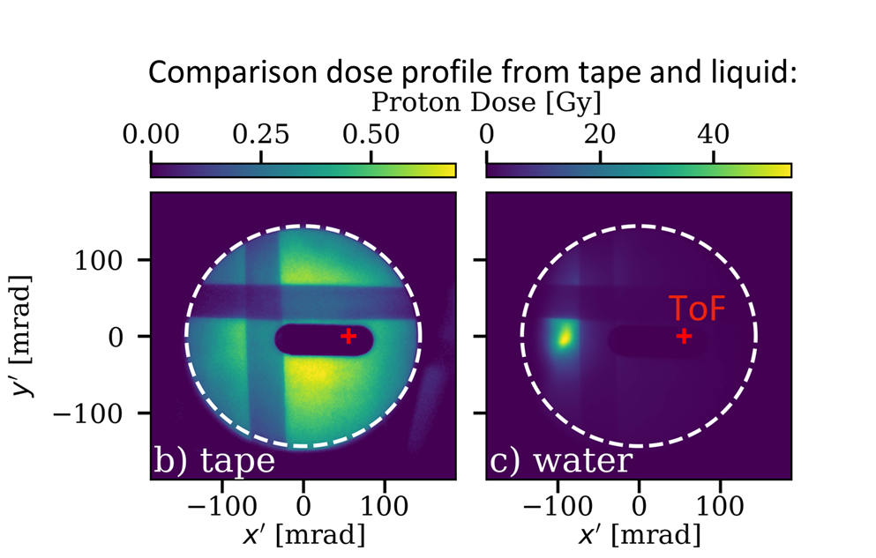

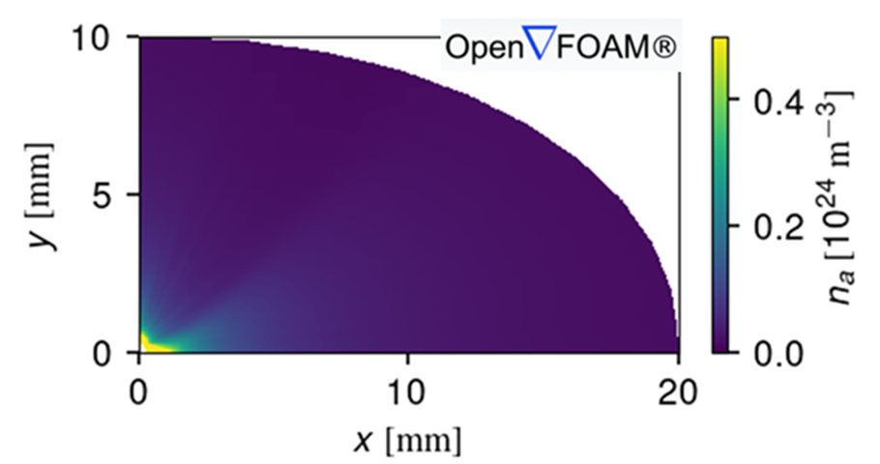
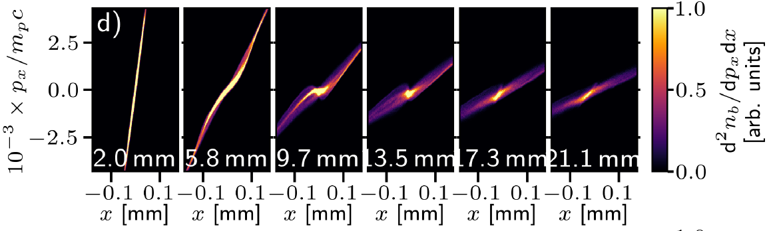

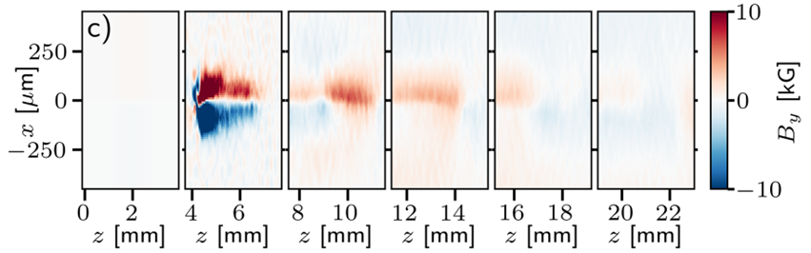


Water Sheet Experiment
Vapour around liquid sheet:
Streeter et.al. 2025. Nature Comms

Slide 6
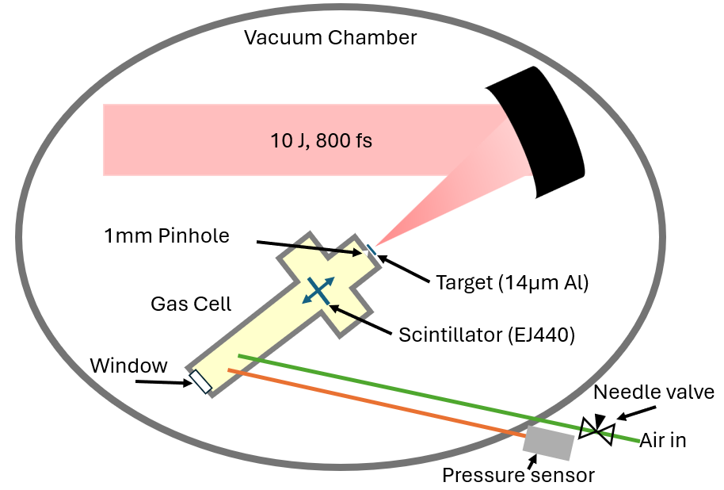
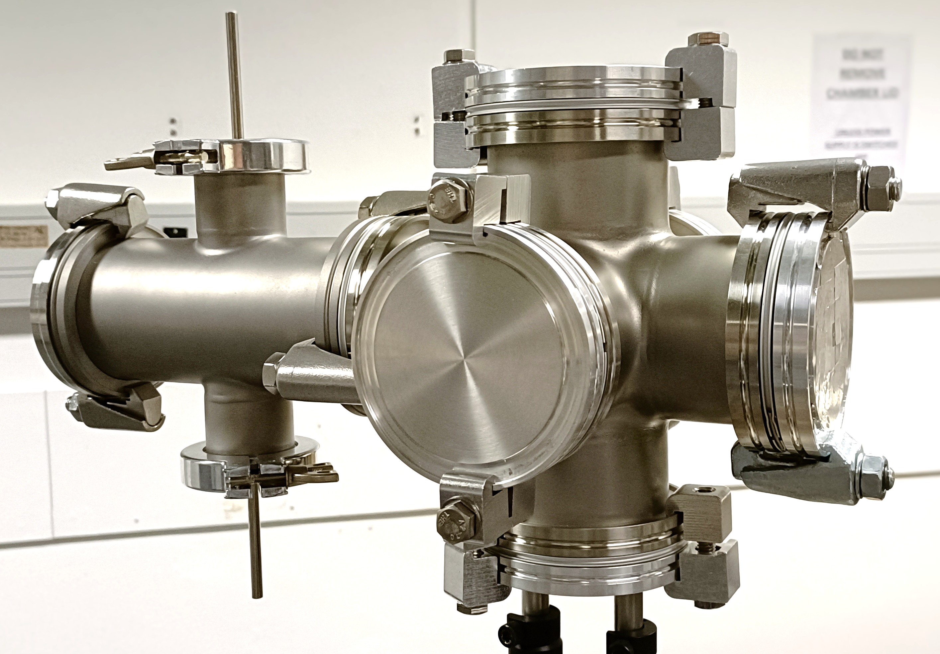
Taranis Gas Cell Experiment
Gas pressures 0.4 - 4 mbar
Densities 10¹⁶ – 10¹⁷ cm⁻³
Gas Cell

Slide 7
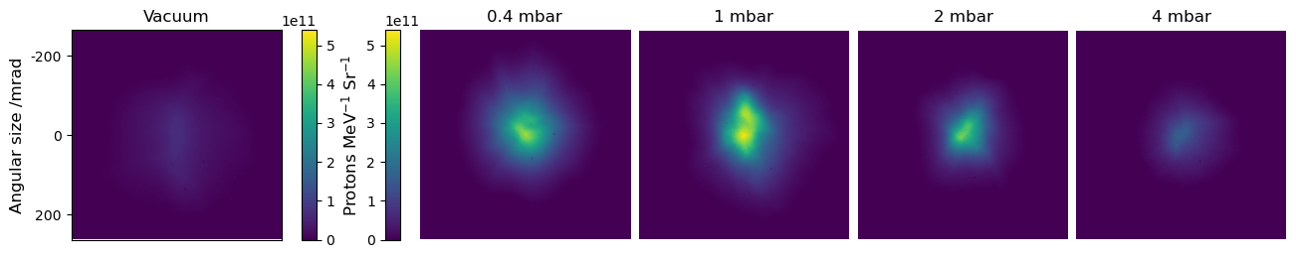
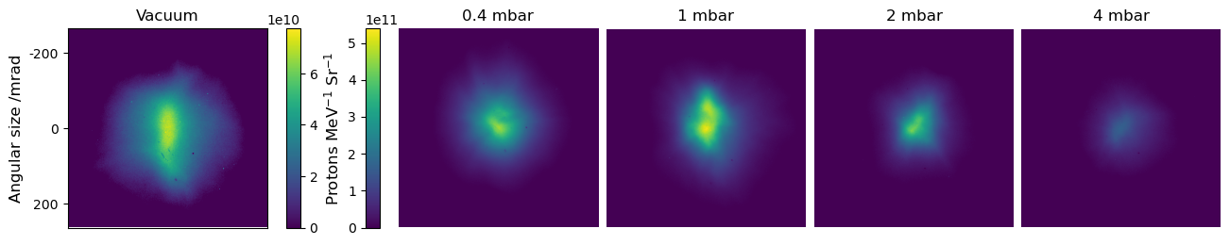
Taranis Experiment Initial Results
1.3 MeV protons
100 mm from interaction
20 um Al filtering – 1.3 MeV Protons:
Beam Angular Size
Beam Size
Intensity

Slide 8
Taranis Initial Results – Higher Energies
40 um Al filtering – 2.0 MeV Protons
Beam Angular size
Beam Size
Intensity
Maximum proton energy is 7-11 MeV.
Potential improvements:
  Shaping gas profile
  Pre-ionisation of gas

Slide 9

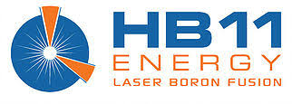

Preliminary Simulations
PIC simulations of proton beam propagating through pre-ionised plasma
By Daniel Molloy (QUB / HB11)

Slide 10
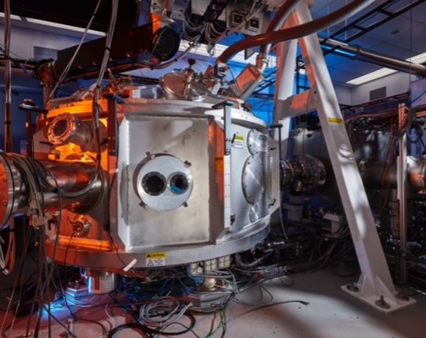
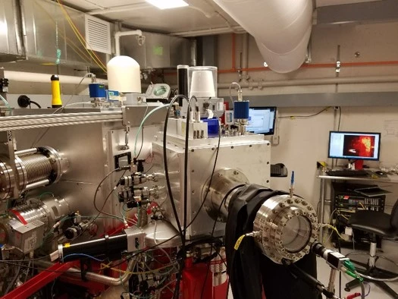
Future experiments
Probing magnetic fields with proton radiography (Titan, Jupiter Laser Facility)
  PI: Franziska Treffert, LLNL
Capturing low divergence beams from liquid sheets into a transport line (BELLA, LBNL)
  PI: Charlotte Palmer, QUB

Slide 11
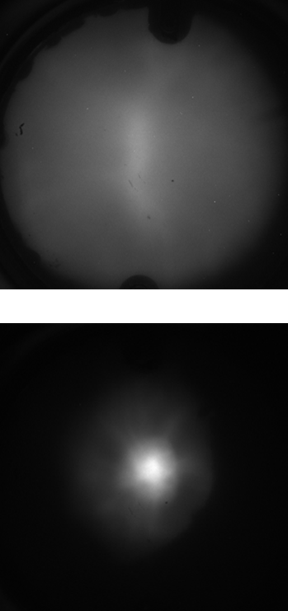
Summary
Smaller proton beams when gas was present
Supports explanation of observation of low divergence protons from liquid sheet targets
Stronger focussing effect for lower energy protons, likely dependent on proton beam density and density of plasma through which it propagates
Ongoing simulation campaign and future experiments planned
Thanks to all the collaborators on the Taranis experiment!
N. Kehoe, B. Loughran, C. McHugh, S. McLoughlin, D. Molloy, G. Nersisyan, C.I. Prestwood, M. J. V. Streeter, J. Weeks, J. Young , C.A.J. Palmer.

