Slide 1
Towards a Stable and Application-Oriented Laser-Driven Proton Source at CALA
Sonja Gerlach, Michael Bachhammer, Leonard Doyle,
Lianren He, Ina Hofrichter, Florian Schweiger, Jörg Schreiber
September 23, 2025
Chair of Experimental Physics – Medical Physics
Laser-Ion Acceleration Group, Prof. Dr. Jörg Schreiber

Slide 2
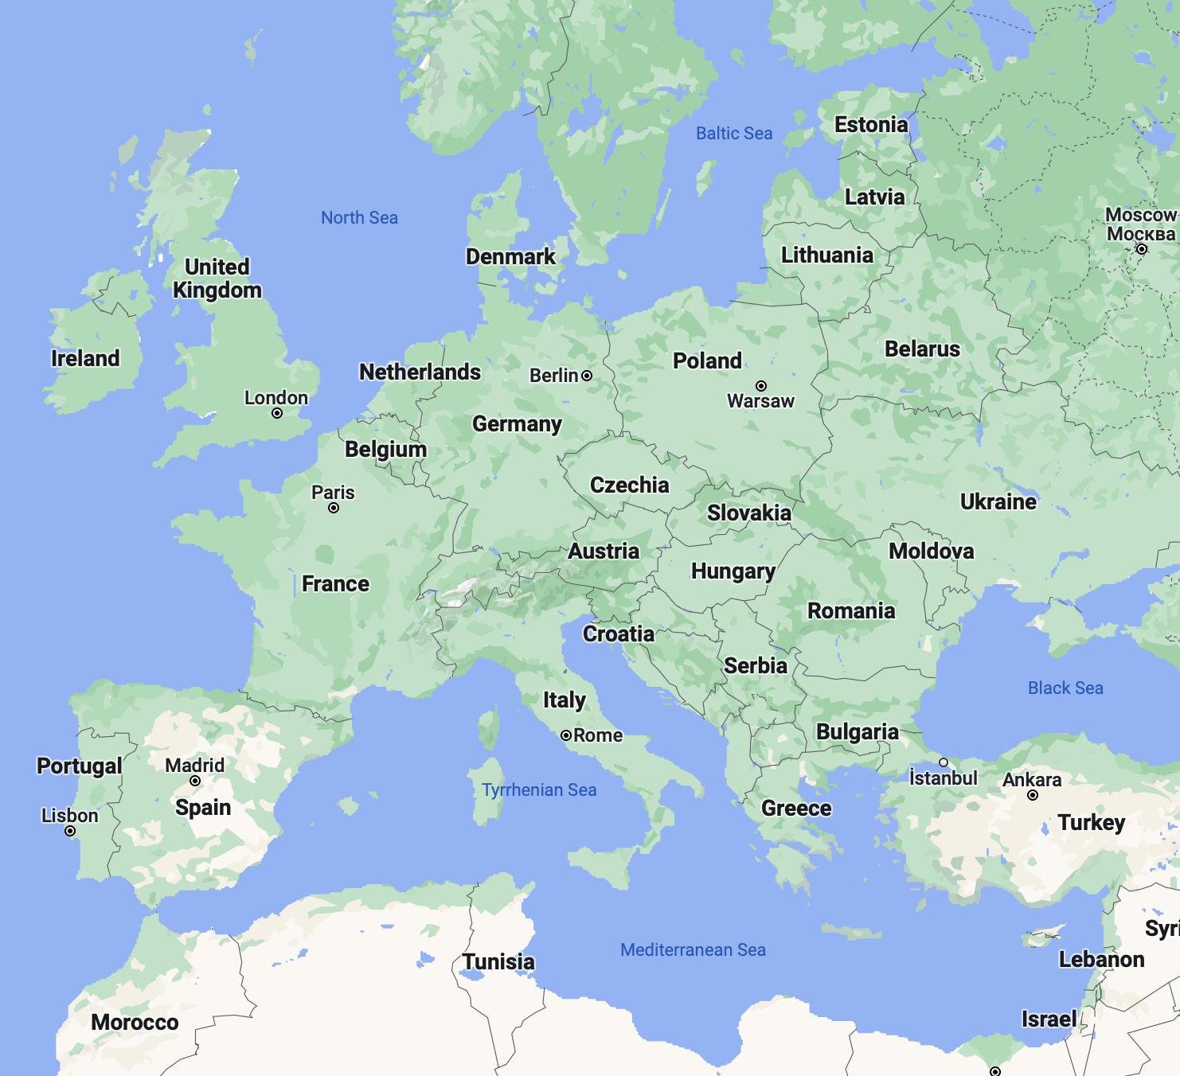
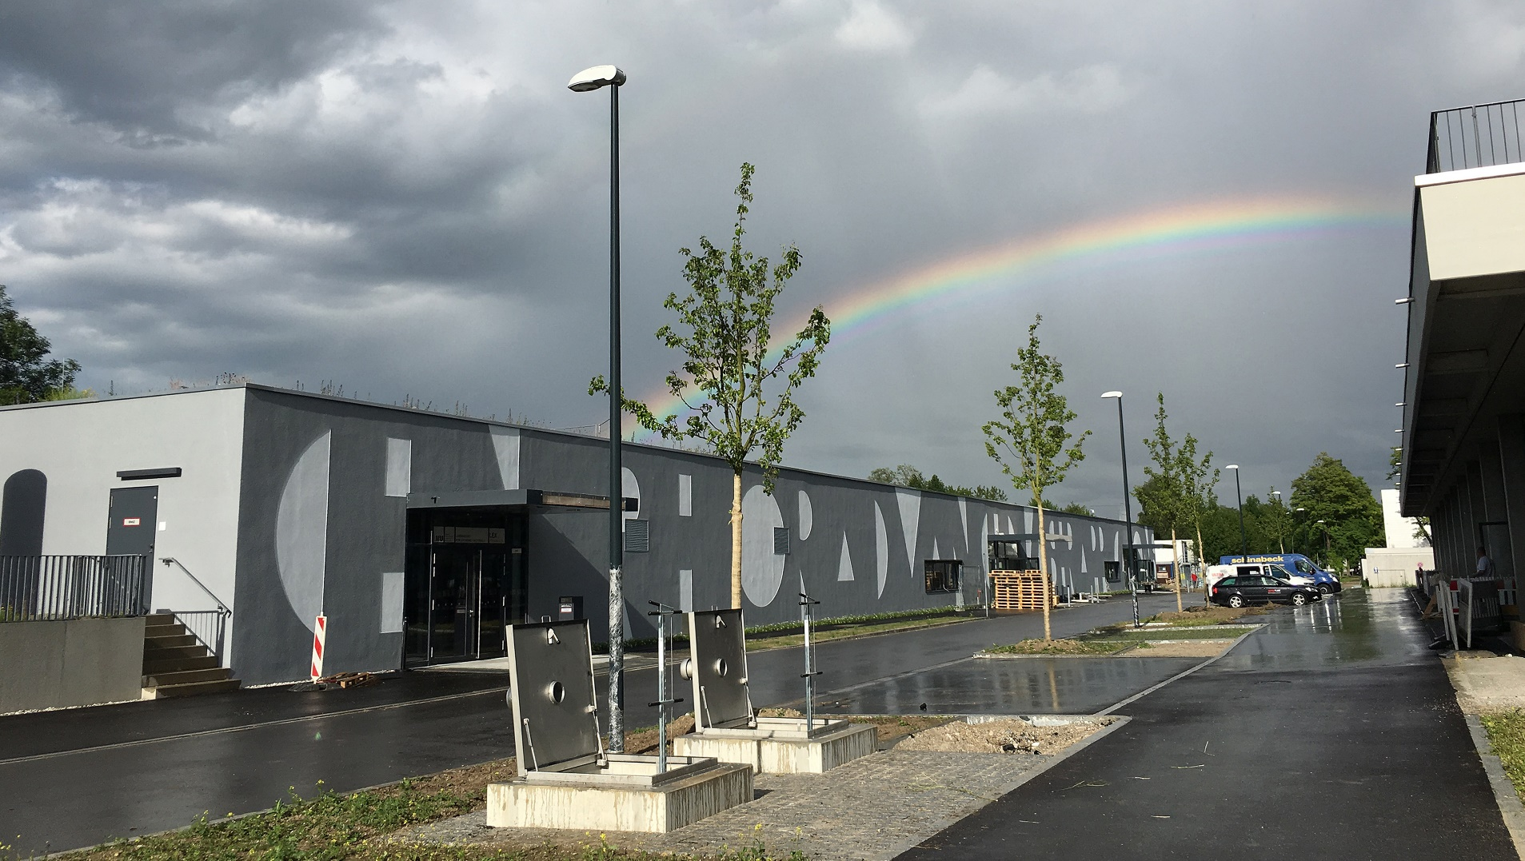
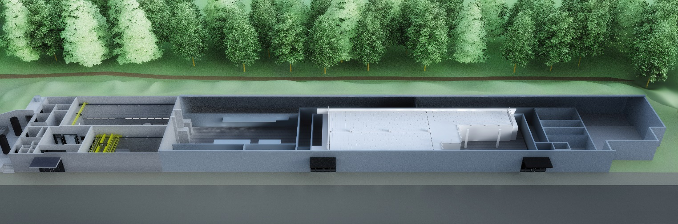
Centre for Advanced Laser Applications (CALA)
www.pulse.physik.uni-muenchen.de
Fig: Google maps
Broadband IR Diagnostics
Prot+carbons
Heavy ions
ATLAS3000
Laser diagnostic
Light-Light scatter
Electrons+xrays

Slide 3


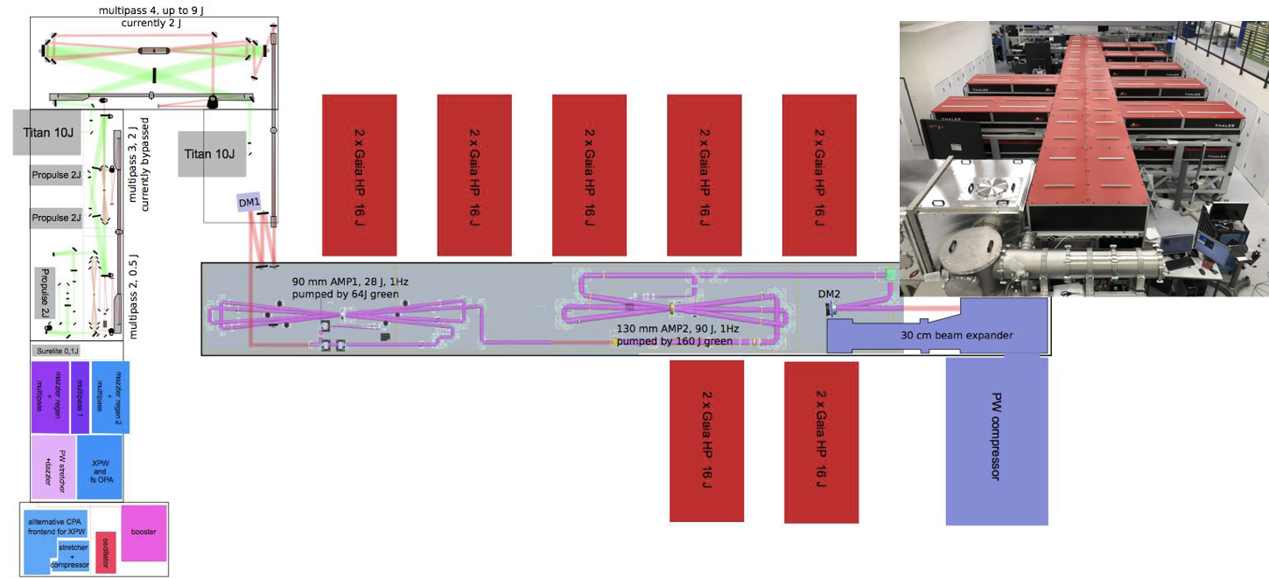
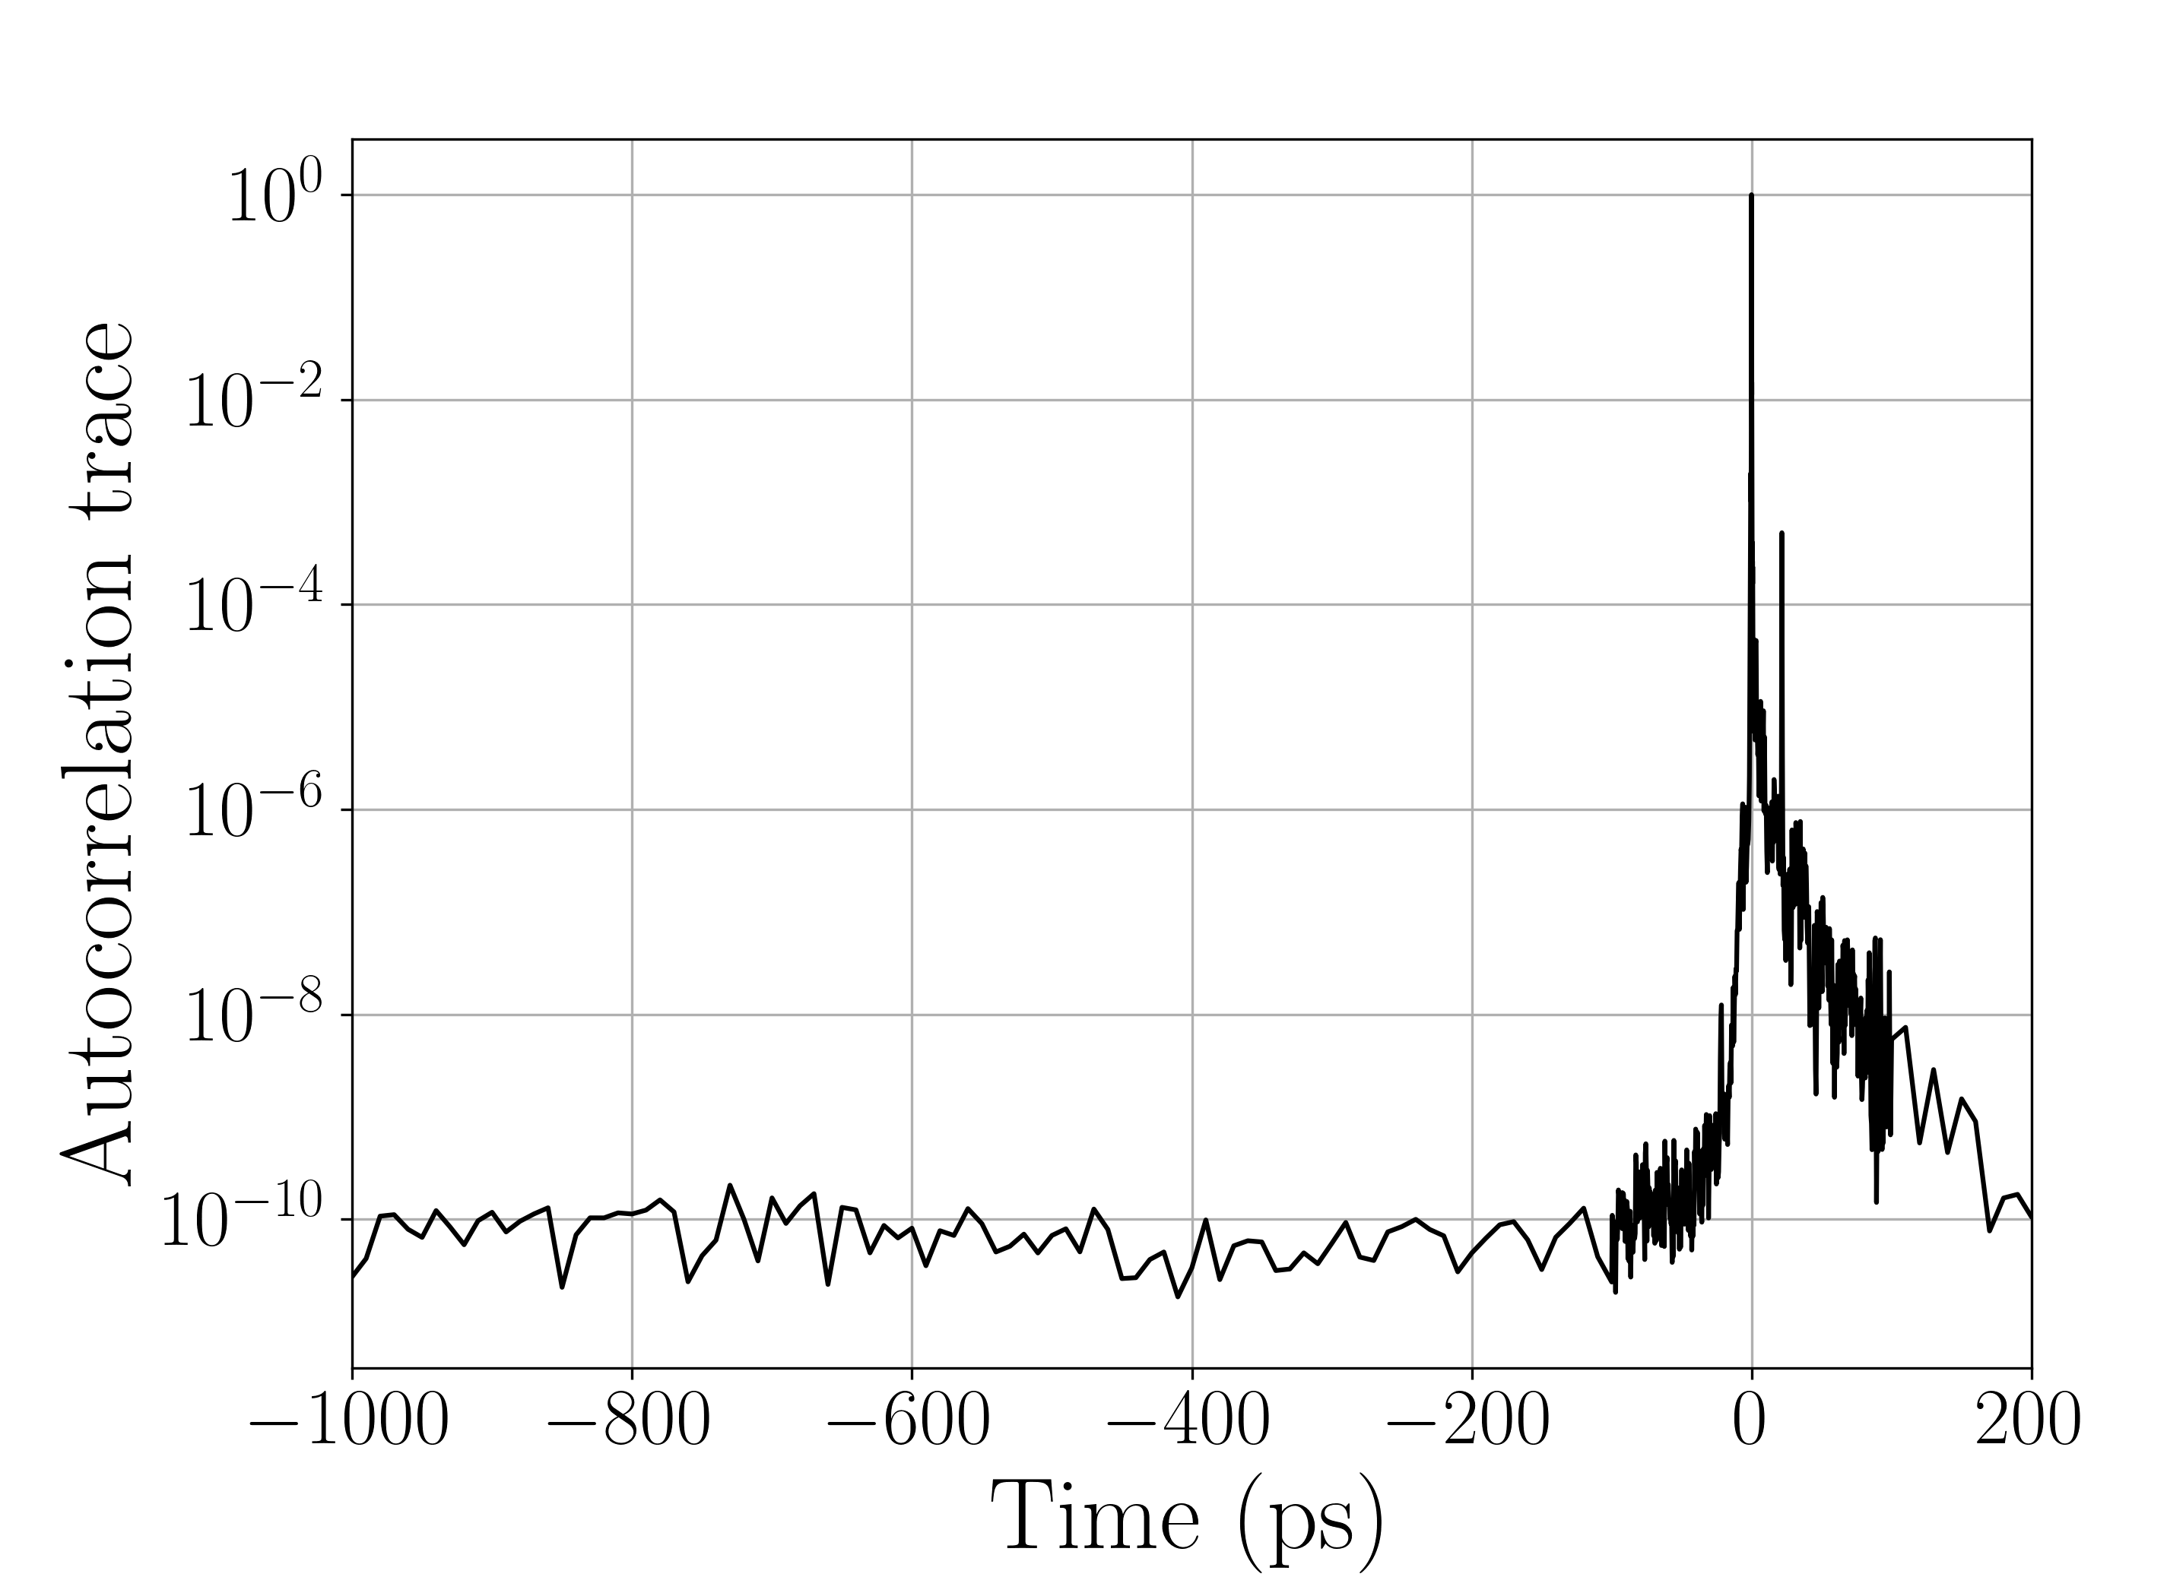


The ATLAS 3000 Laser
Ti:Sa
Pulse length: 25 fs
Repetition rate: 1 Hz
Energy: 60 J (13 J)
3 Deformable mirrors
Focus size: 4.5 μm
Bachreflex Suppression via PC
Temporal contrast:
Experimental areas
Frontend:
Homebuilt
Main amplifier:
Thales

Slide 4
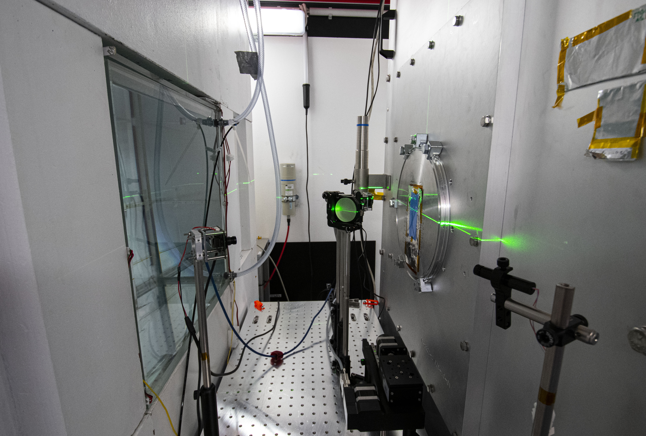
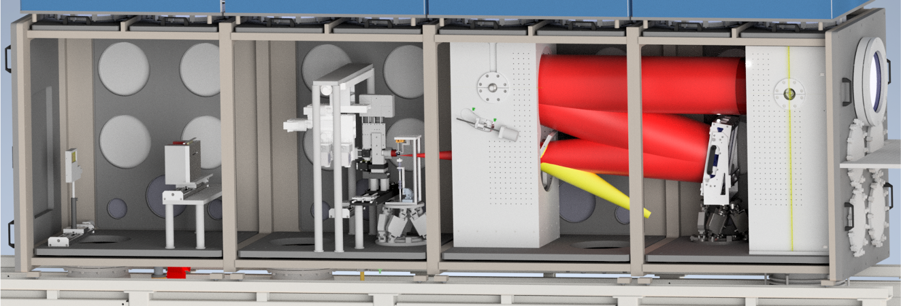
Laser-ION acceleration (LION)
Laser
Target positioning system
f/5 off-axis
parabola
Wide-angle spectrometer
Application plattform
Permanent magnet quadrupoles

Slide 5
Laser-ION acceleration (LION)
Goal:
Providing particle bunches with
reproducible & tunable parameters at 1 Hz
for various applications
Application plattform

Slide 6


Machine control via ‚Tango controls‘
Requirements:
Operation at 1 Hz
Correlation between laser- and ion-parameters
Intelligent feedback loops
Many device servers
available open source!
Scripted control
https://gitlab.lrz.de/cala-public
User control
ATLAS-3000
Diagnostics (energy, spectrum, profile)
Dispersion manipulation (Dazzler)
Attenuator + filters
Experiment
Motion (Phytron, PI, Owis, Thorlabs, …)
Cameras (Basler, IDS, Grasshopper, …)
Diagnostics (Picoscope, …)
Others (Arduino, power supplies, …)
Weiße et al, HPLSE 2023

Slide 7
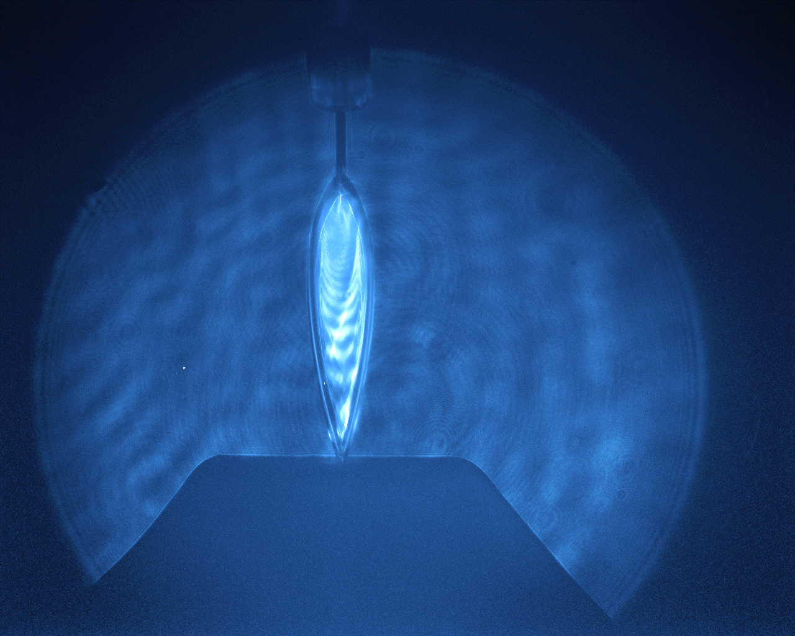
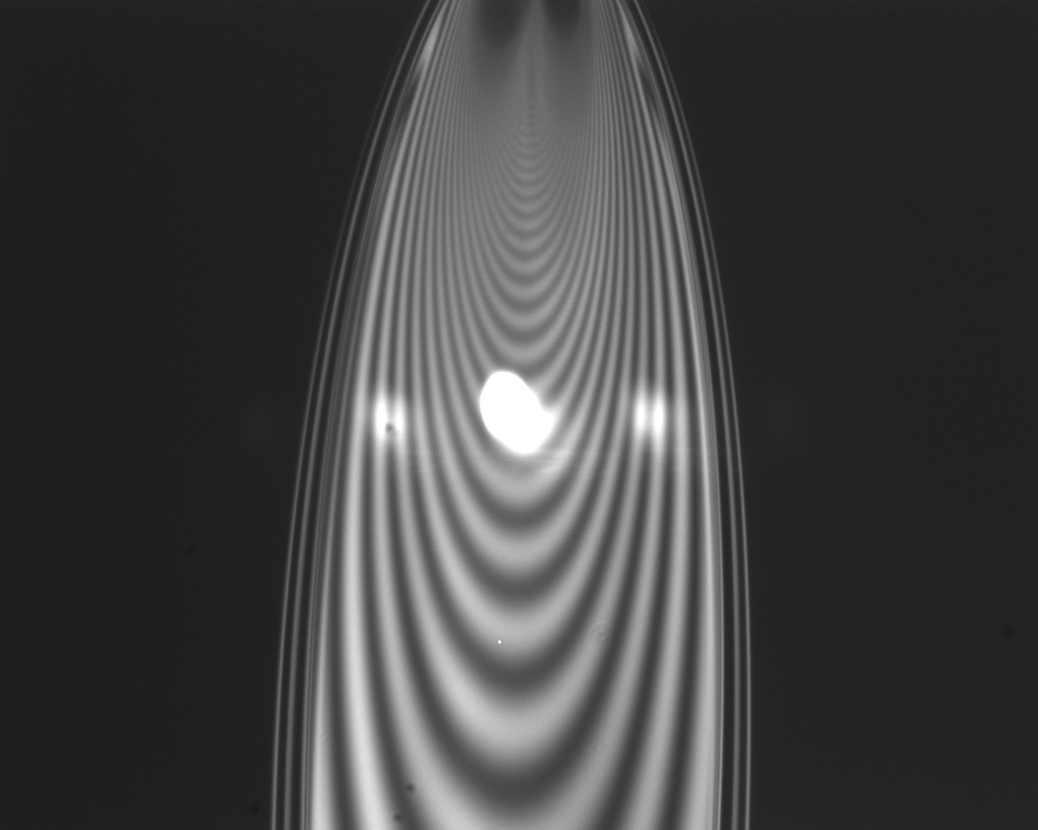
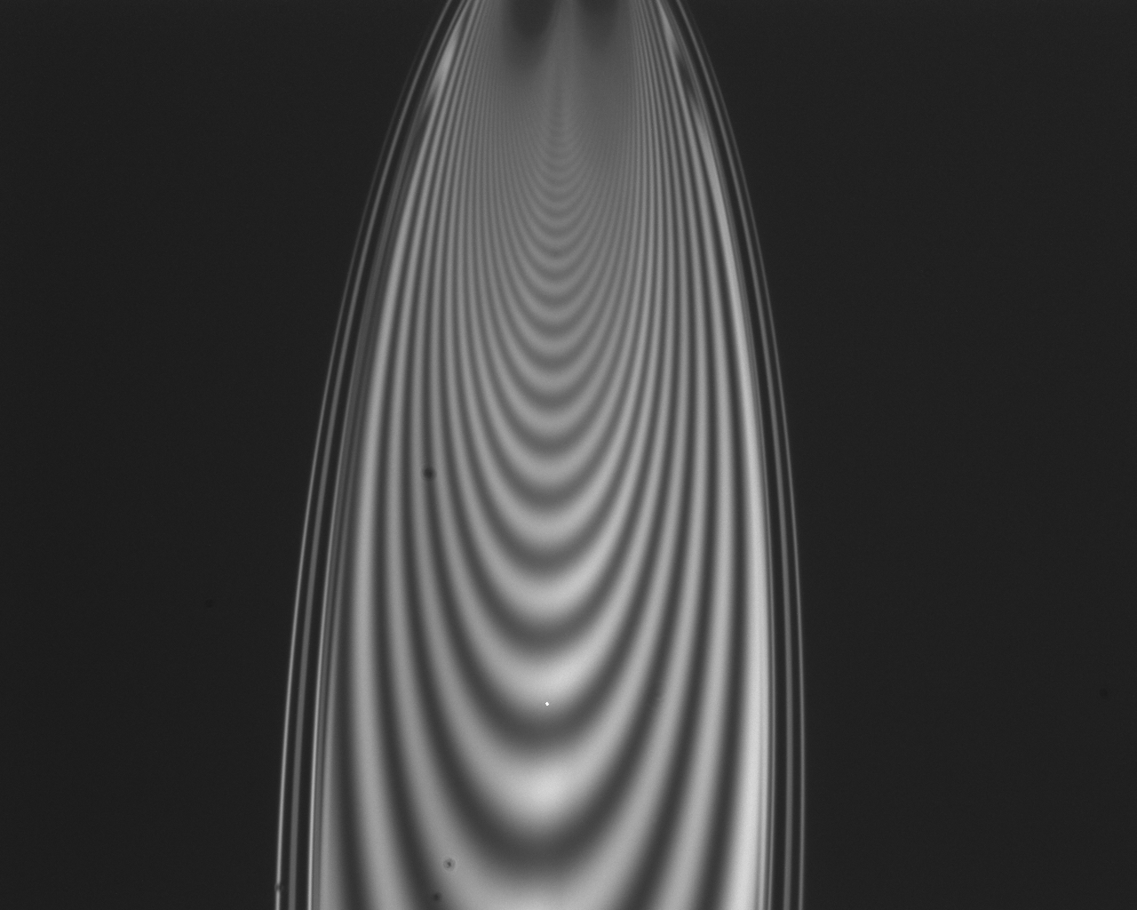
Liquid Leaf Target
Setup:
Maximum ion energy:
Daily:
20-25 MeV
Best performance:
42 MeV
FRONT VIEW
45° collision angle
fused silica nozzles:
50 and 25 µm
Ø1 mm catcher:
heated to approx. 110° C
1 mm

Slide 8
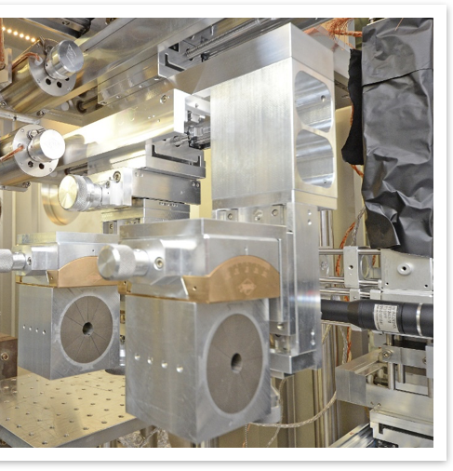
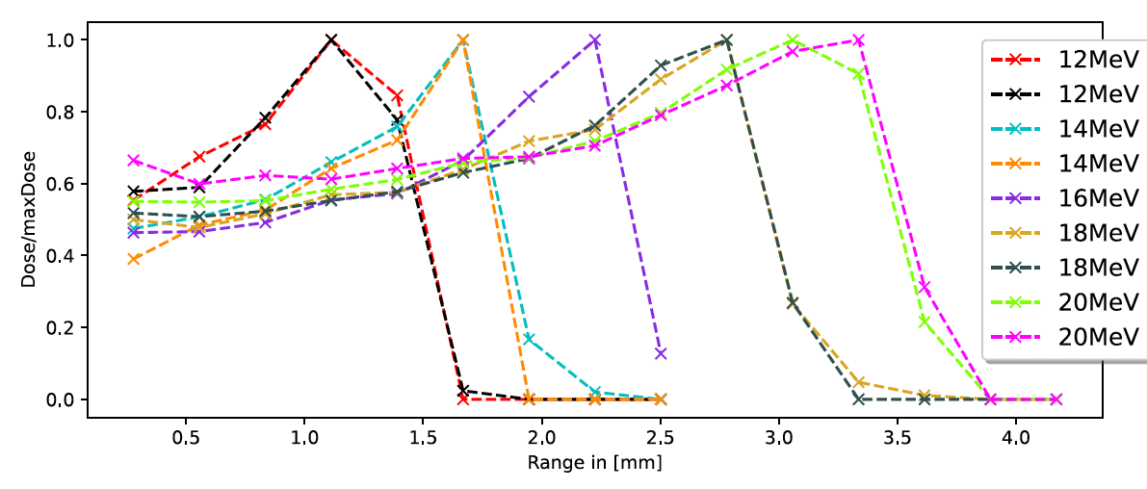
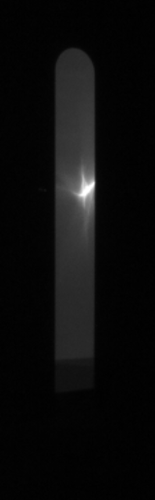
Chromatic Focusing Lens
Permanent magnet quadrupoles
Duplet / quadruplet available
Magnets motorized in x/y position & rotation
PMQ position defines transported proton energies
Lateral FWHM: ≈ 1 mm
Energy spread: ≈ 5 % (calculated & experimentally confirmed)
Target: liquid leaf
18 MeV
Normalized Dose (a.u.)
Target: formvar foils
1 cm
Range (mm)
Notes:
(1/(300/25.4))*15 = 1.27 mm entsprechen 15 pixel

Slide 9
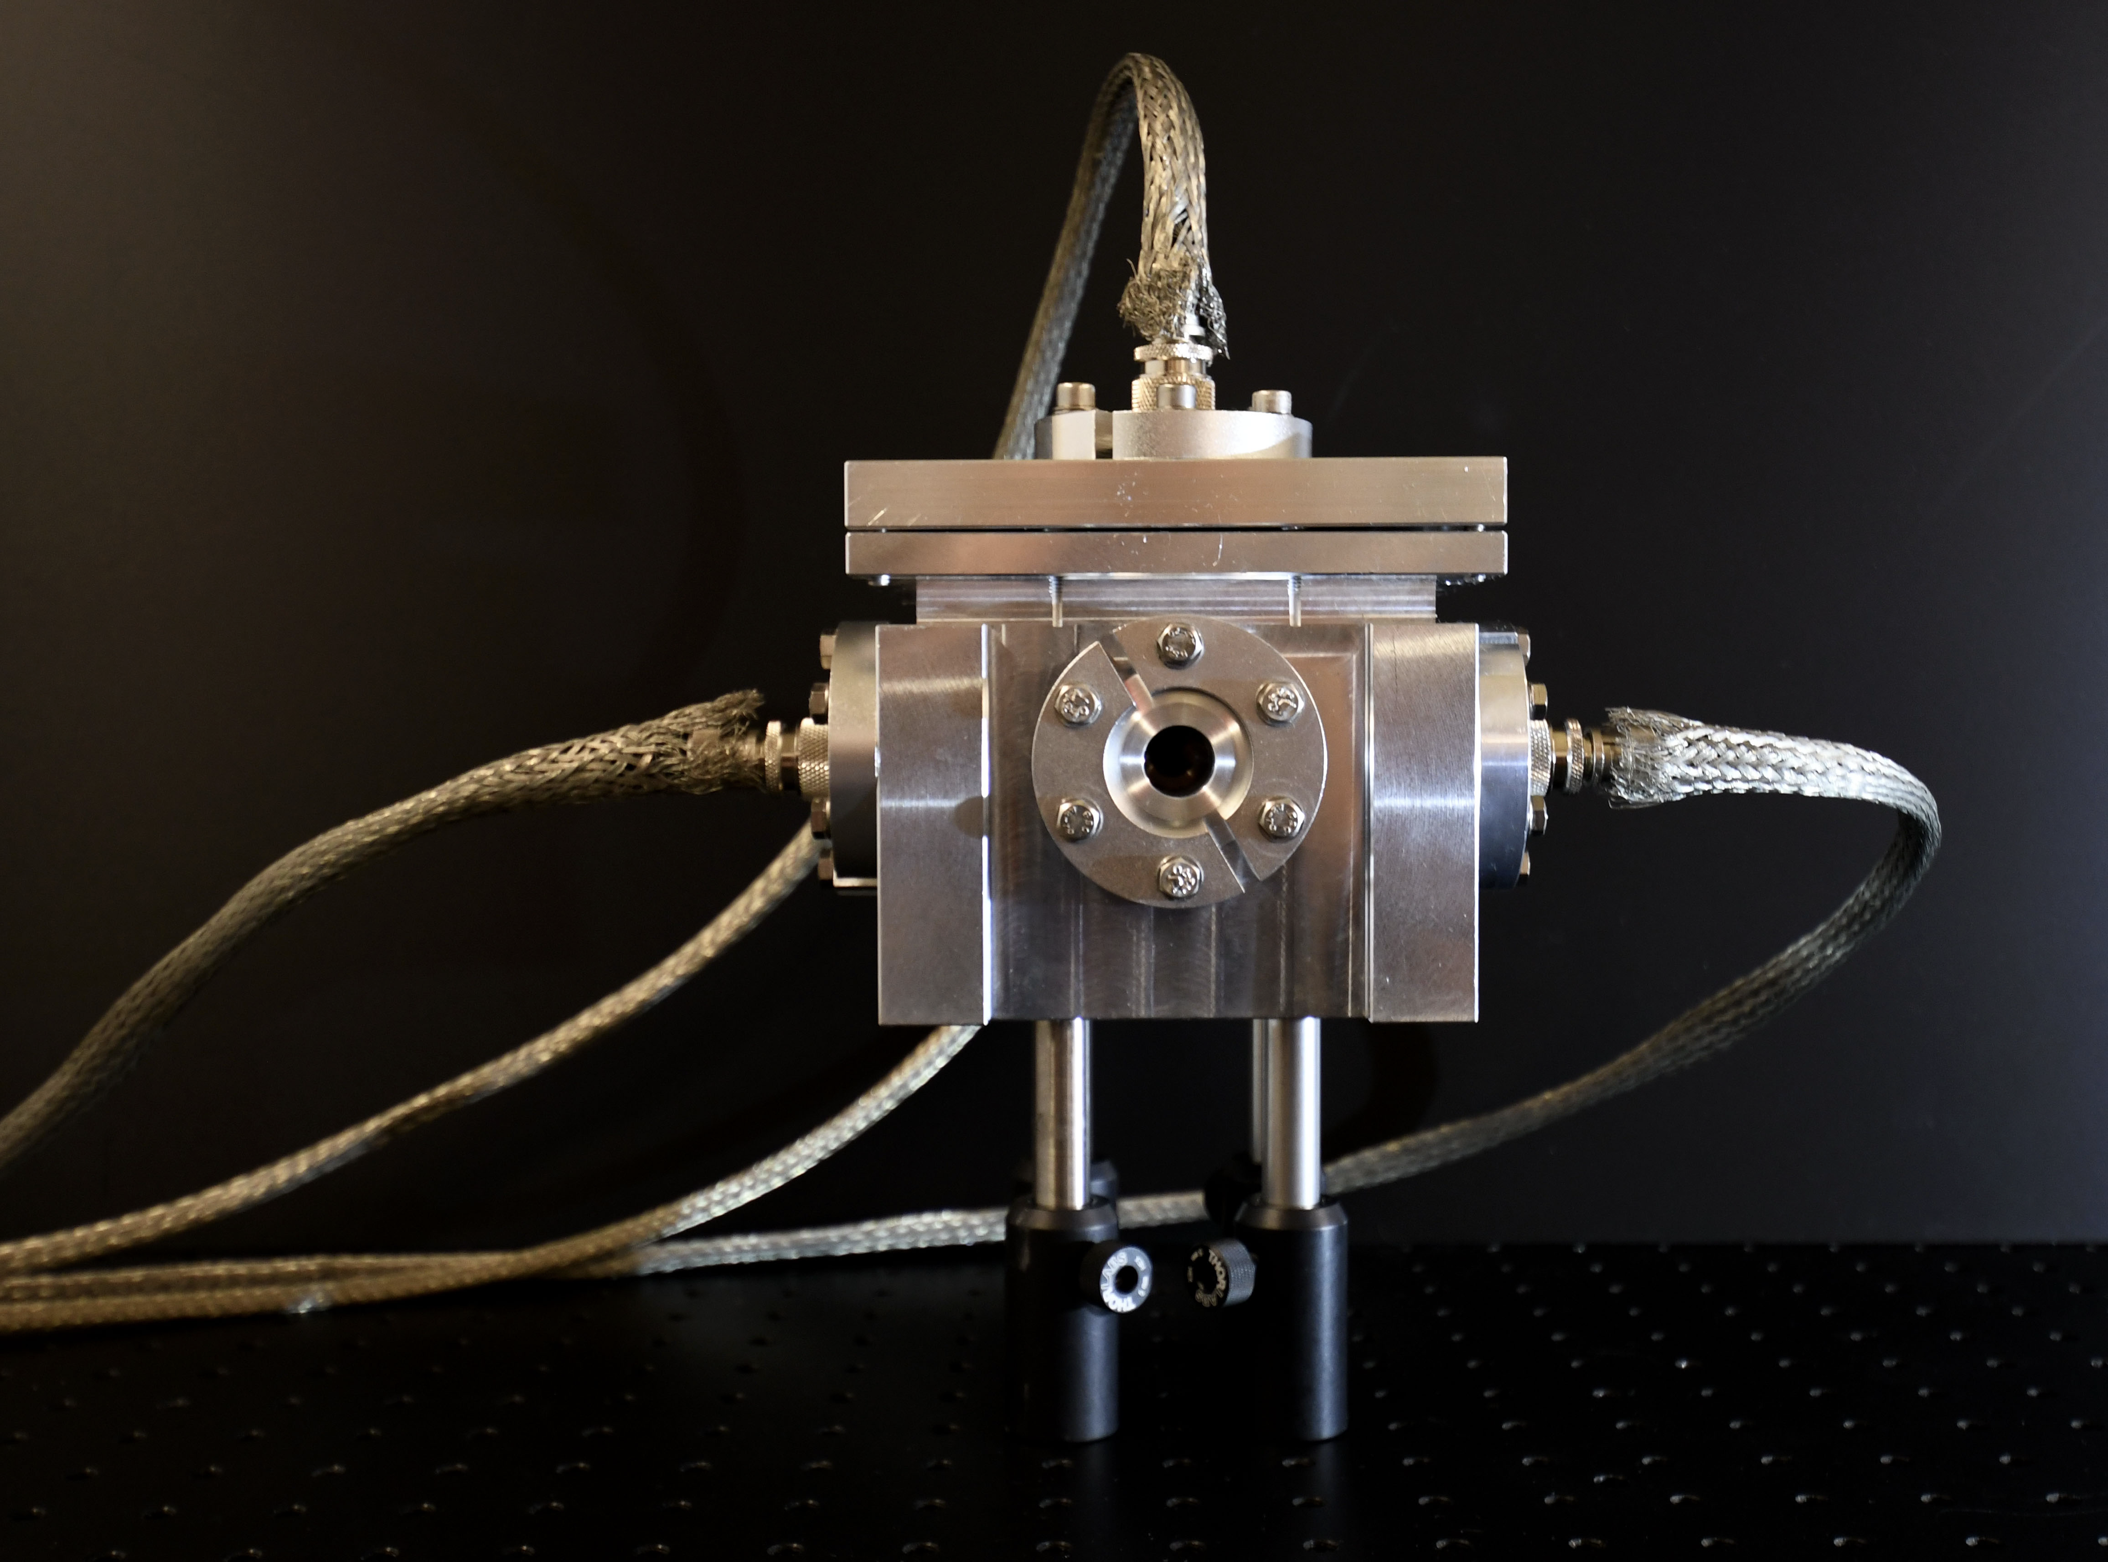
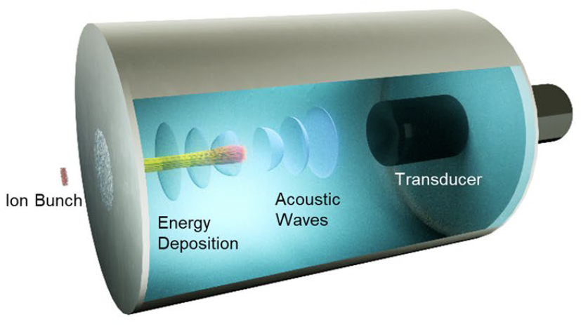
Particle Bunch Characterization
I-BEAT 3D
Measures particle bunch properties such as energy, position & particle number at the ion focus
Electromagnetic pulse resistant & cheap
1 Hz compatible
Working principle
Ions deposit their energy in a water reservoir
Energy deposition leads to localized heating
A pressure wave originates from gradients in thermal expansion
Ultrasonic signal is recorded by a transducer
Ion bunch
Gerlach et al, HPLSE 2023
Notes:
(1/(300/25.4))*15 = 1.27 mm entsprechen 15 pixel

Slide 10
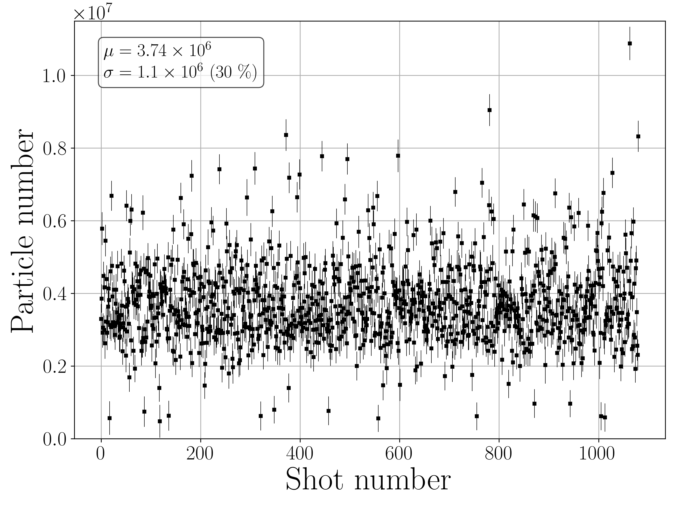
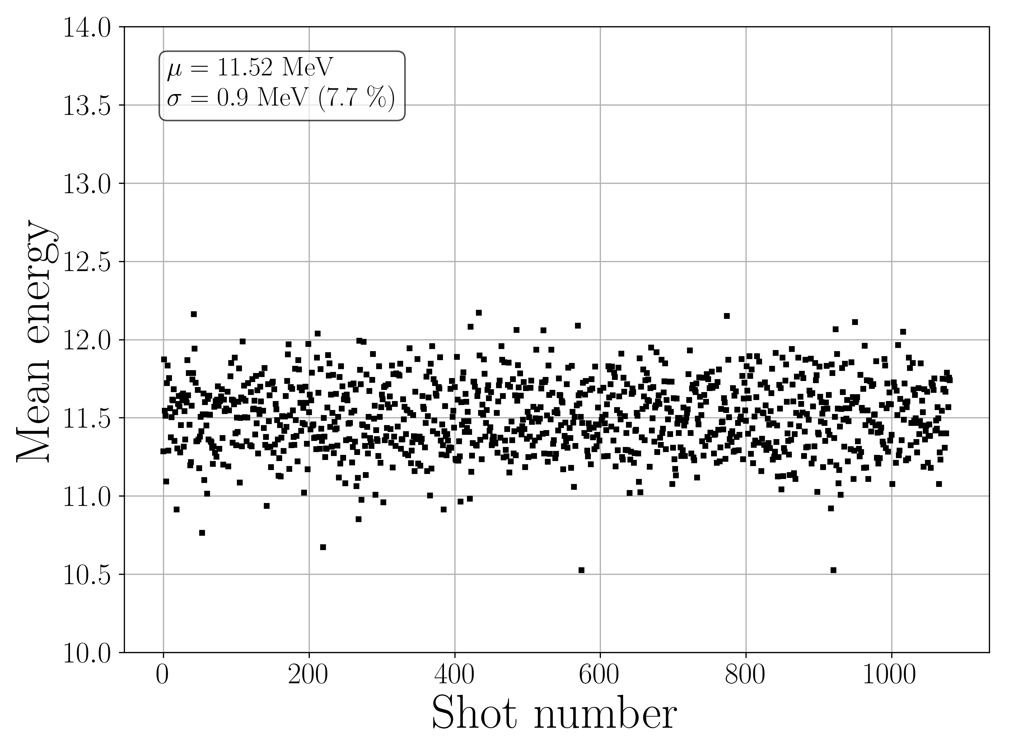
1 Hz studies @ LION
Particle number & mean energy characterized at 1 Hz @ LION
Notes:
(1/(300/25.4))*15 = 1.27 mm entsprechen 15 pixel

Slide 11
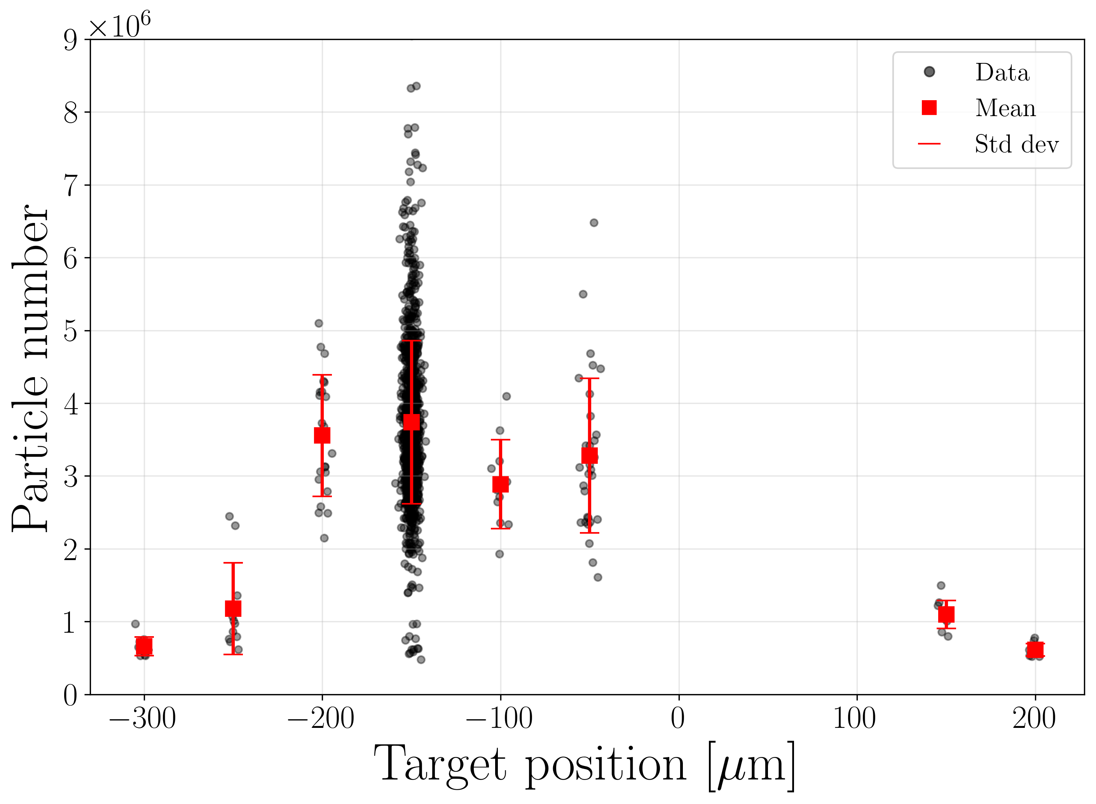
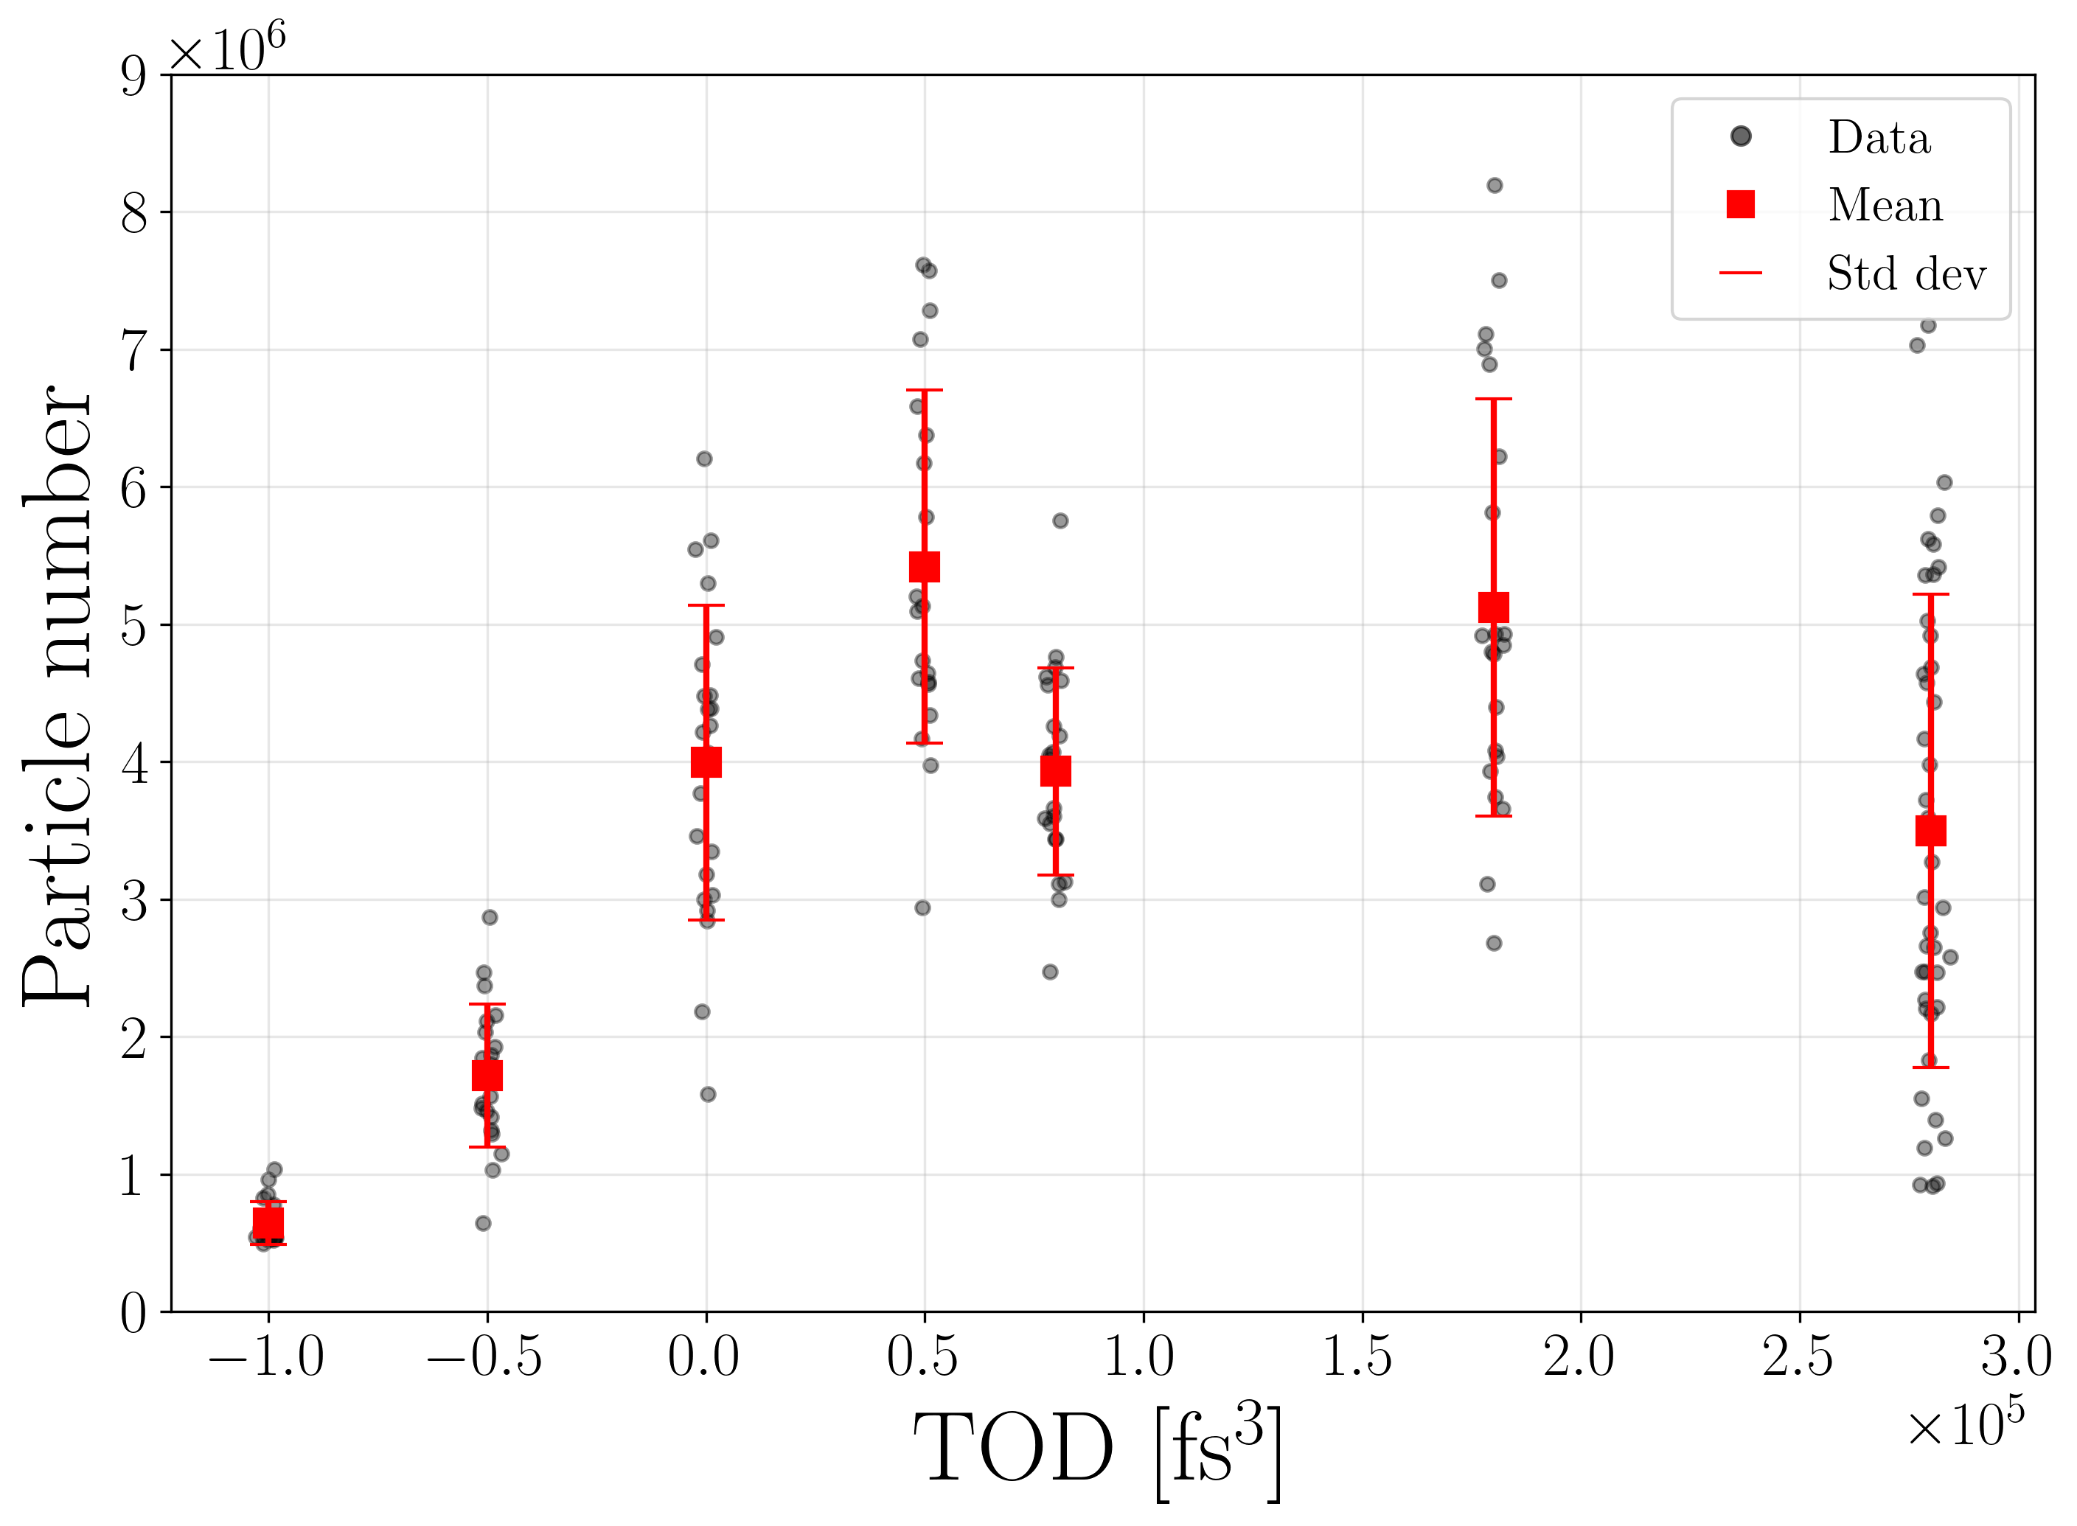
1 Hz studies @ LION
First systematic scans as proof of principle demonstrated
Notes:
(1/(300/25.4))*15 = 1.27 mm entsprechen 15 pixel

Slide 12
Summary
Conclusion
LION is evolving towards an accelerator-like experimental platform
Ionoacoustic detection provides a cost-effective and simple approach for three-dimensional monitoring of particle bunches
First successful 1 Hz studies at LION demonstrate feasibility and open the path towards application-oriented optimization
Ongoing work
Improve stability of target system & IT-Infrastructure
Identify correlations between laser and target parameters
Feedback loops allowing optimization of the ion performance
Notes:
(1/(300/25.4))*15 = 1.27 mm entsprechen 15 pixel

Slide 13
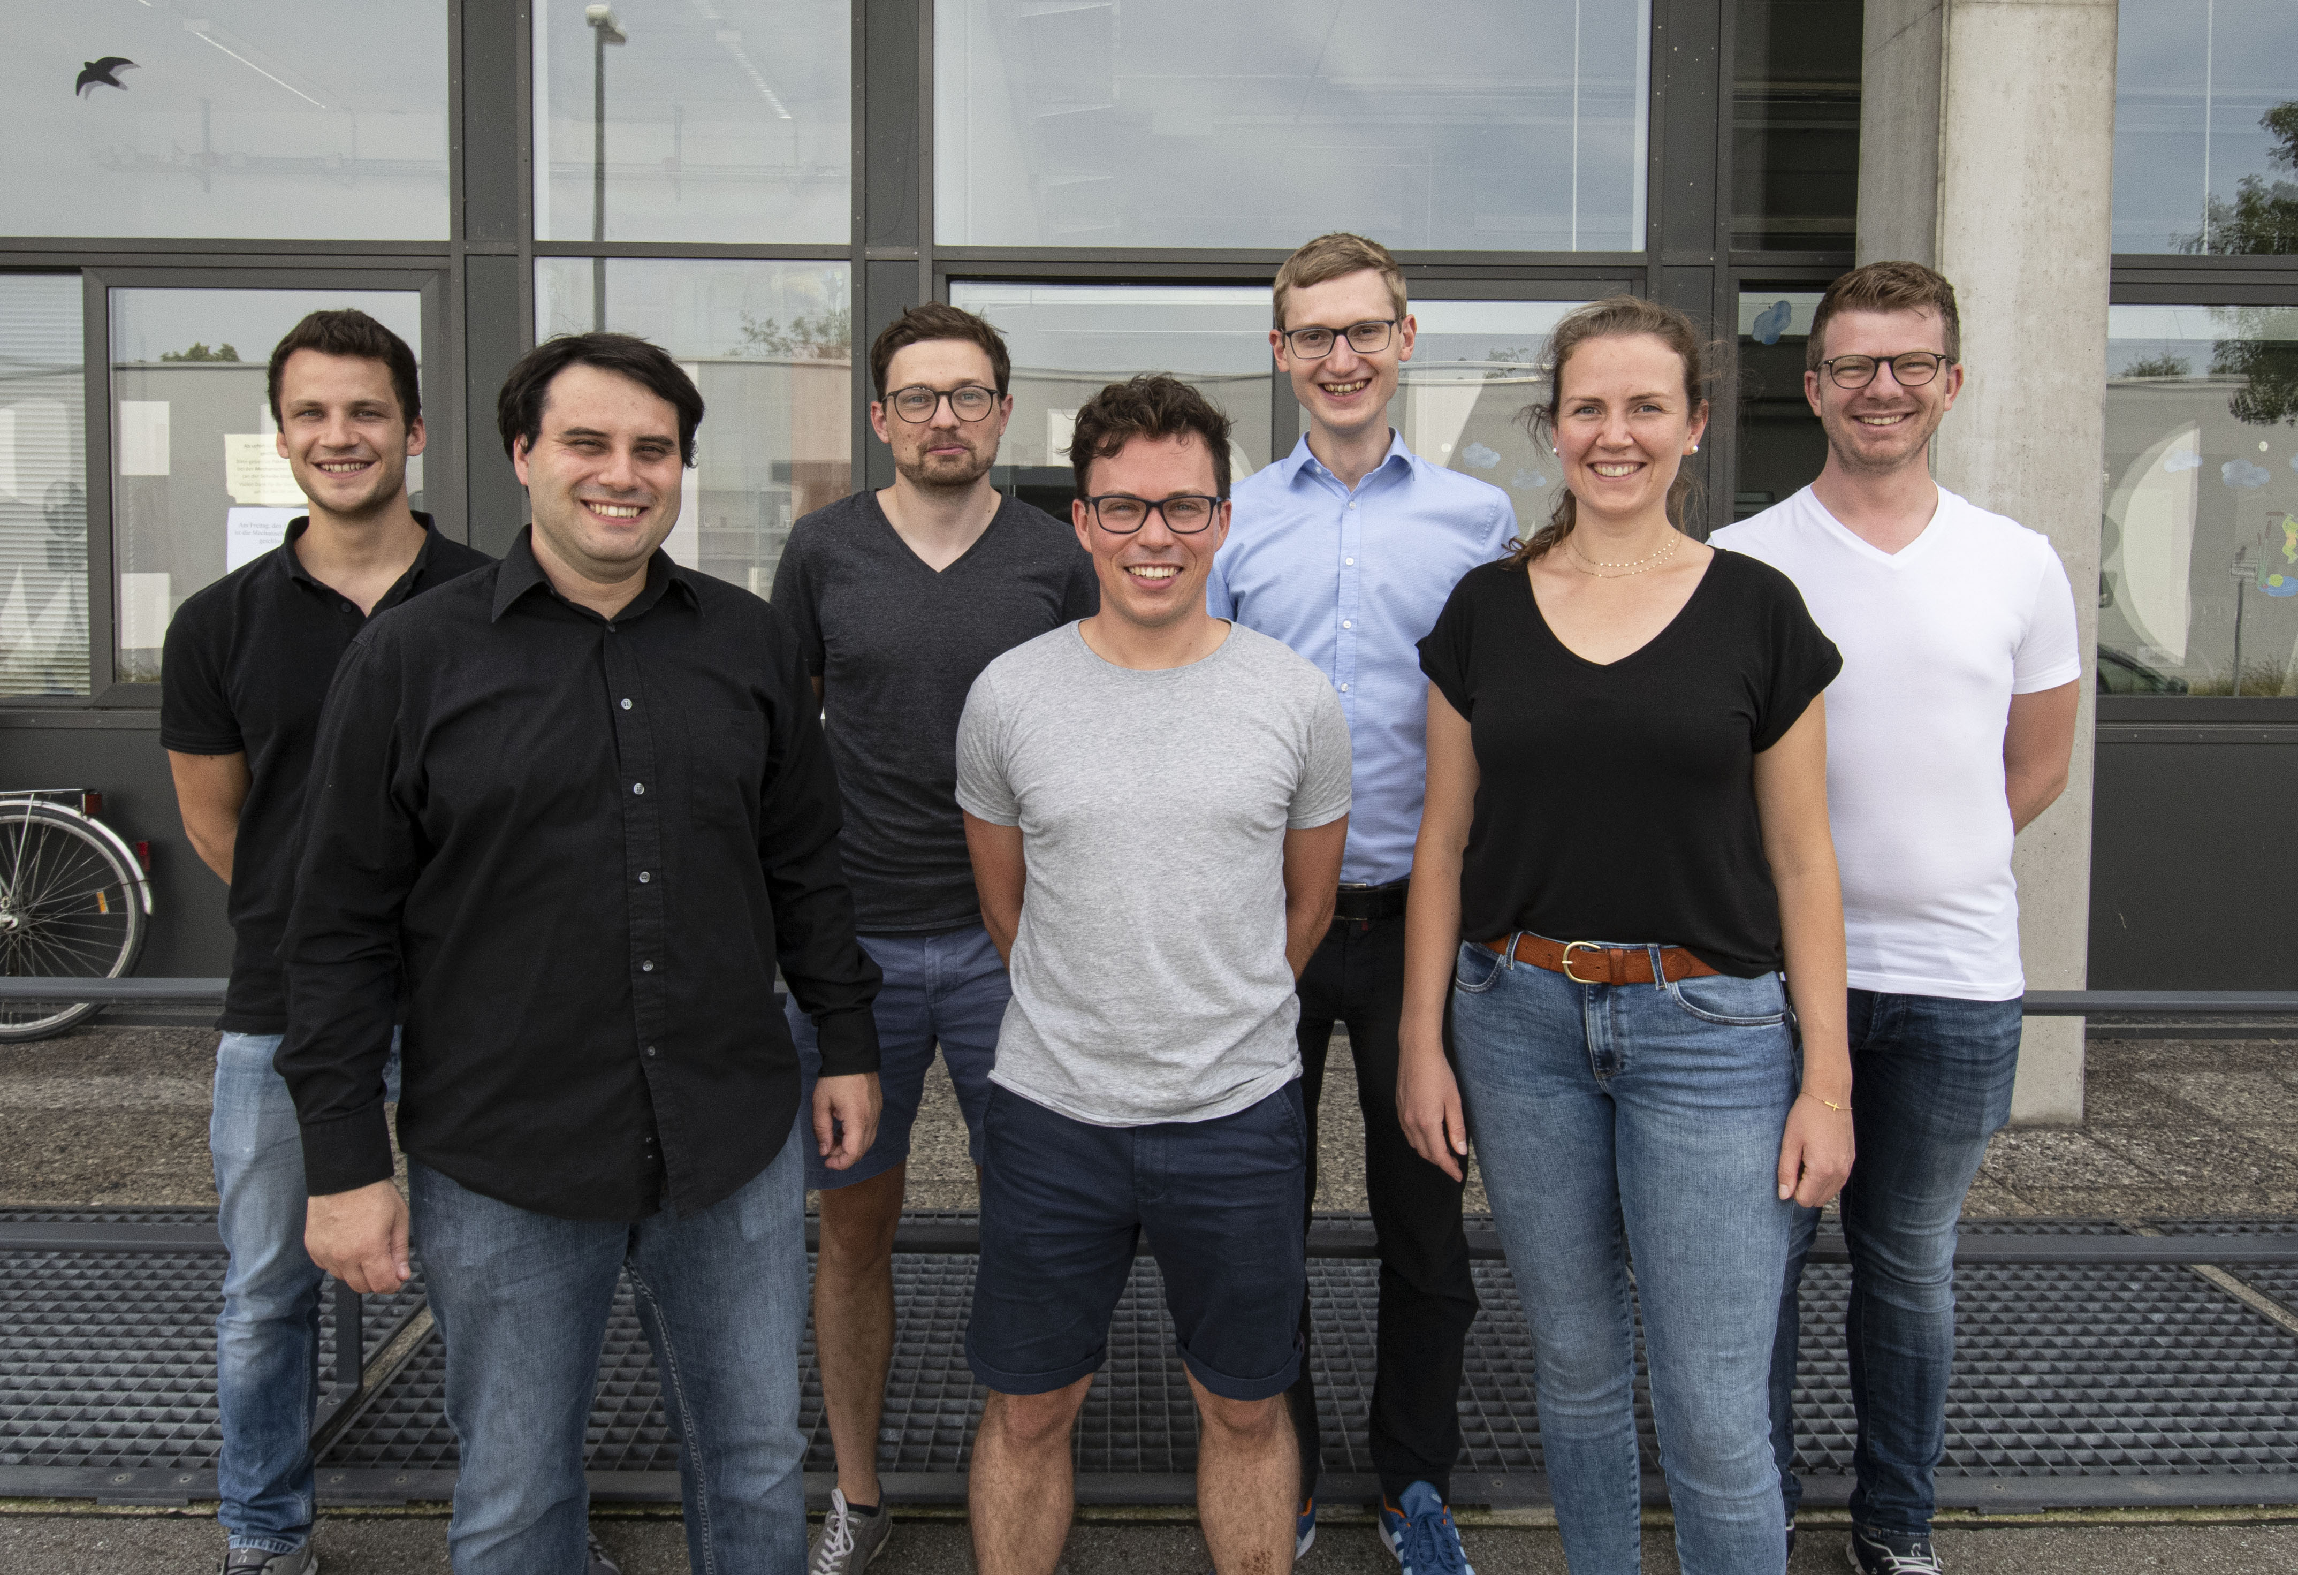
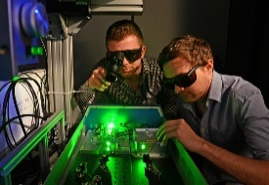
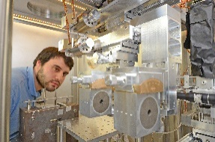
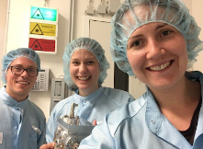
Acknowledgements
Ludwig Maximilians University Munich:
AG Schreiber, AG Karsch, AG Döpp, AG Thirolf
K. Parodi+, P.R. Bolton, J. Bortfeldt, G.Dedes, W. Assmann, F. Krausz+, H. Ruhl+, A. Friedl, M. Groß, J. Szerypo, H. Wirth, O. Gosau, N. Gjotev, F. Saran, G. Schilling
Funding:
DFG GE 3787/2-1, BMBF 01IS17048, CALA
Recent and ongoing collaborations:
Queens University Belfast (UK): B. Dromey+
GSI Darmstadt (Germany): B. Zielbauer, V. Bagnoud+
TU Darmstadt (Germany): M. Roth+, G. Schaumann,
HZDR Dresden (Germany): U. Schramm, M. Bussmann+
FSU Jena (Germany): M. Zepf, P. Hilz, +
Peking University (China): W. Ma+
SIOM (China): J. Bin
Notes:
(1/(300/25.4))*15 = 1.27 mm entsprechen 15 pixel

