Slide 1
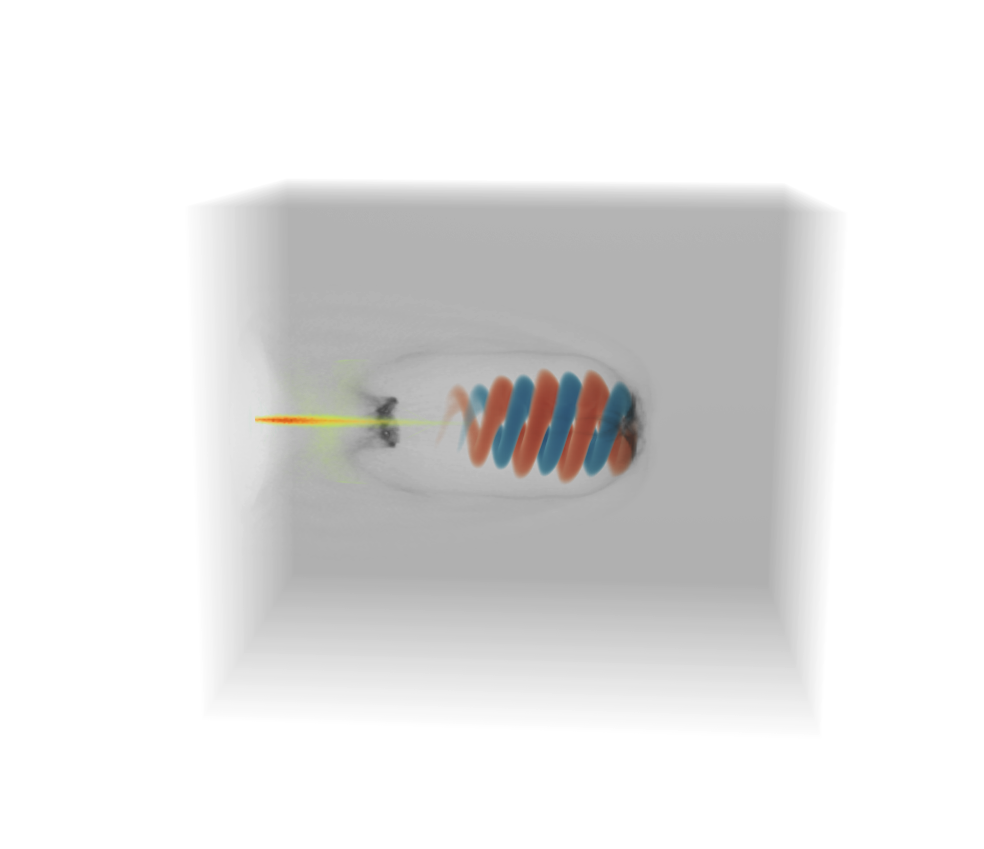



SPIN-POLARIZED BEAMS FROM PLASMA-BASED ACCELERATORS
(AND PROSPECTS FOR NUCLEAR FUSION)
A sort-of-extensive overview
23.09.2025 I Lars Reichwein, Z gong (弓正), C Zheng (郑川), LL JI (吉亮亮), A Pukhov & M Büscher

Slide 2
Table of Contents
An overview of developments in spin-polarized particle beams
Applications of polarized particle beams
Electrons (LWFA/PWFA)
Protons & ions (MVA/CSA)
Summary & outlook

Slide 3
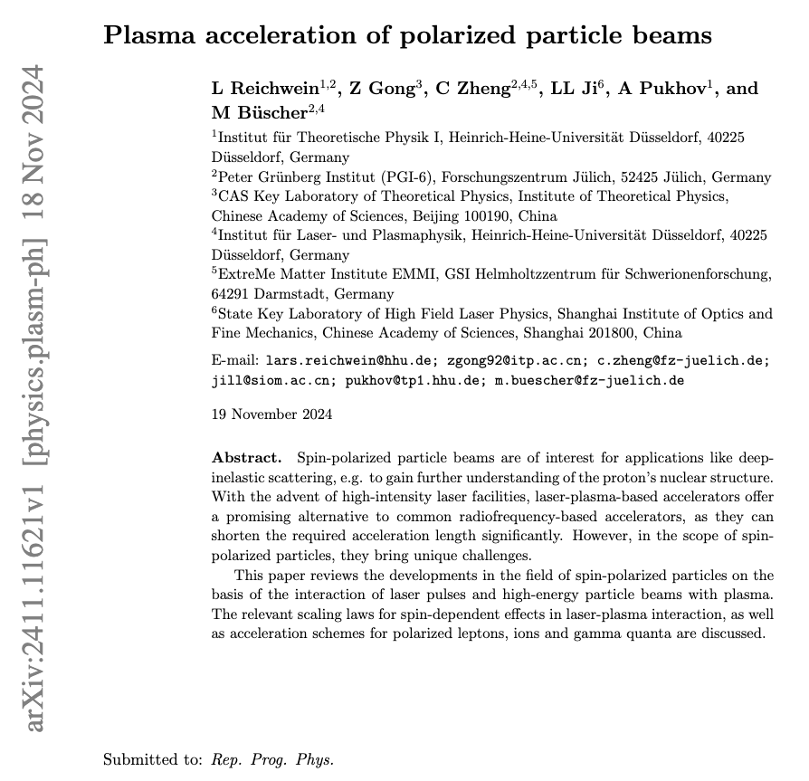

Review Paper on polarized particle beams
Submitted to Rep. Prog. Phys.
Covering the following topics:
  Experimental techniques (targets & polarimetry)
  Pol. electrons & positrons
  Pol. ions
  Pol. gamma quanta (incl. vortex states)
L Reichwein, arXiv:2411.1162 (2024)

Slide 4
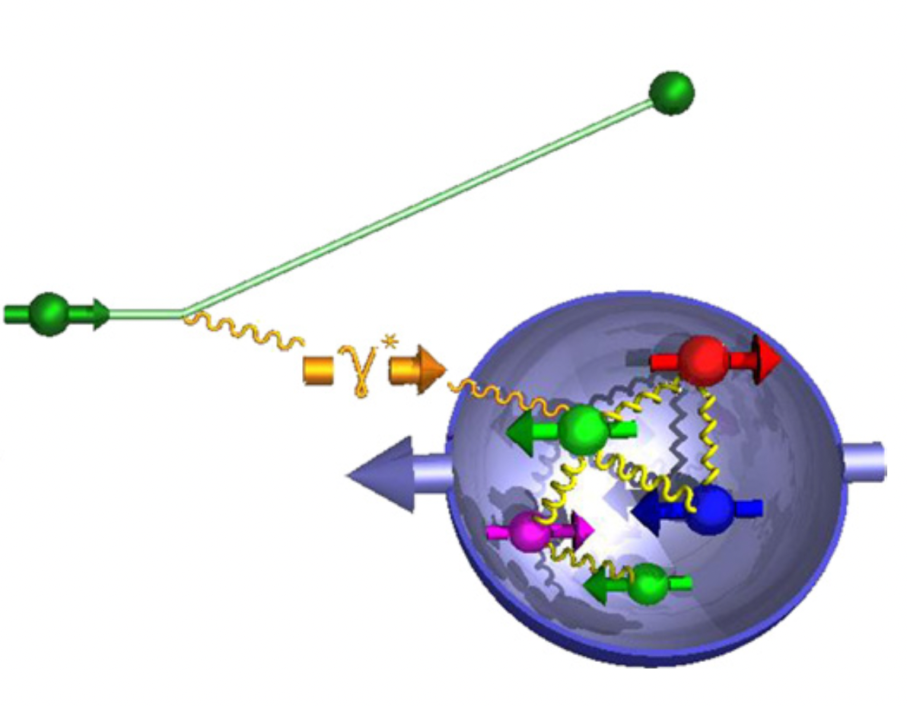
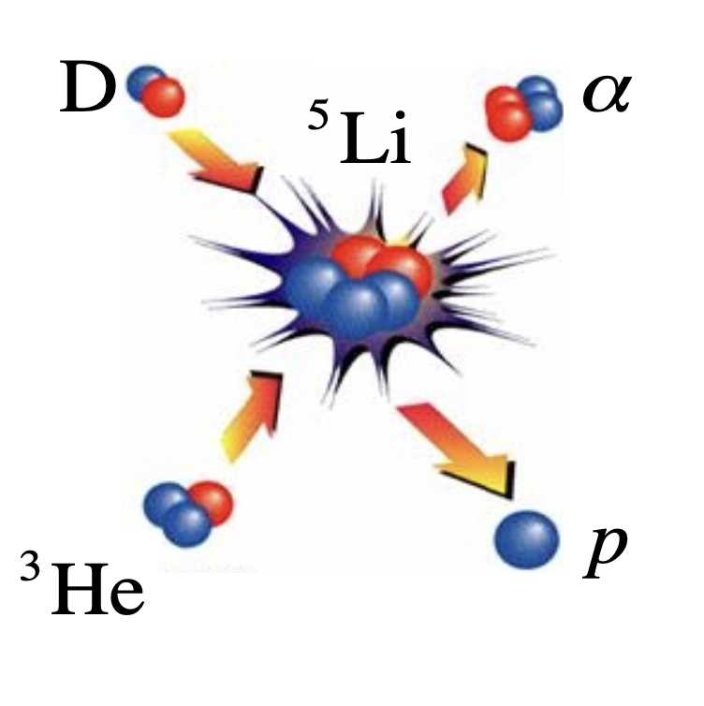
Motivation
Why consider spin-polarized particle beams?
Deep-inelastic scattering
Polarized nuclear fusion
M Burkardt, Rep. Prog. Phys. 73, 016201 (2010)
RM Kulsrud, PRL 49, 1248 (1982)

Slide 5
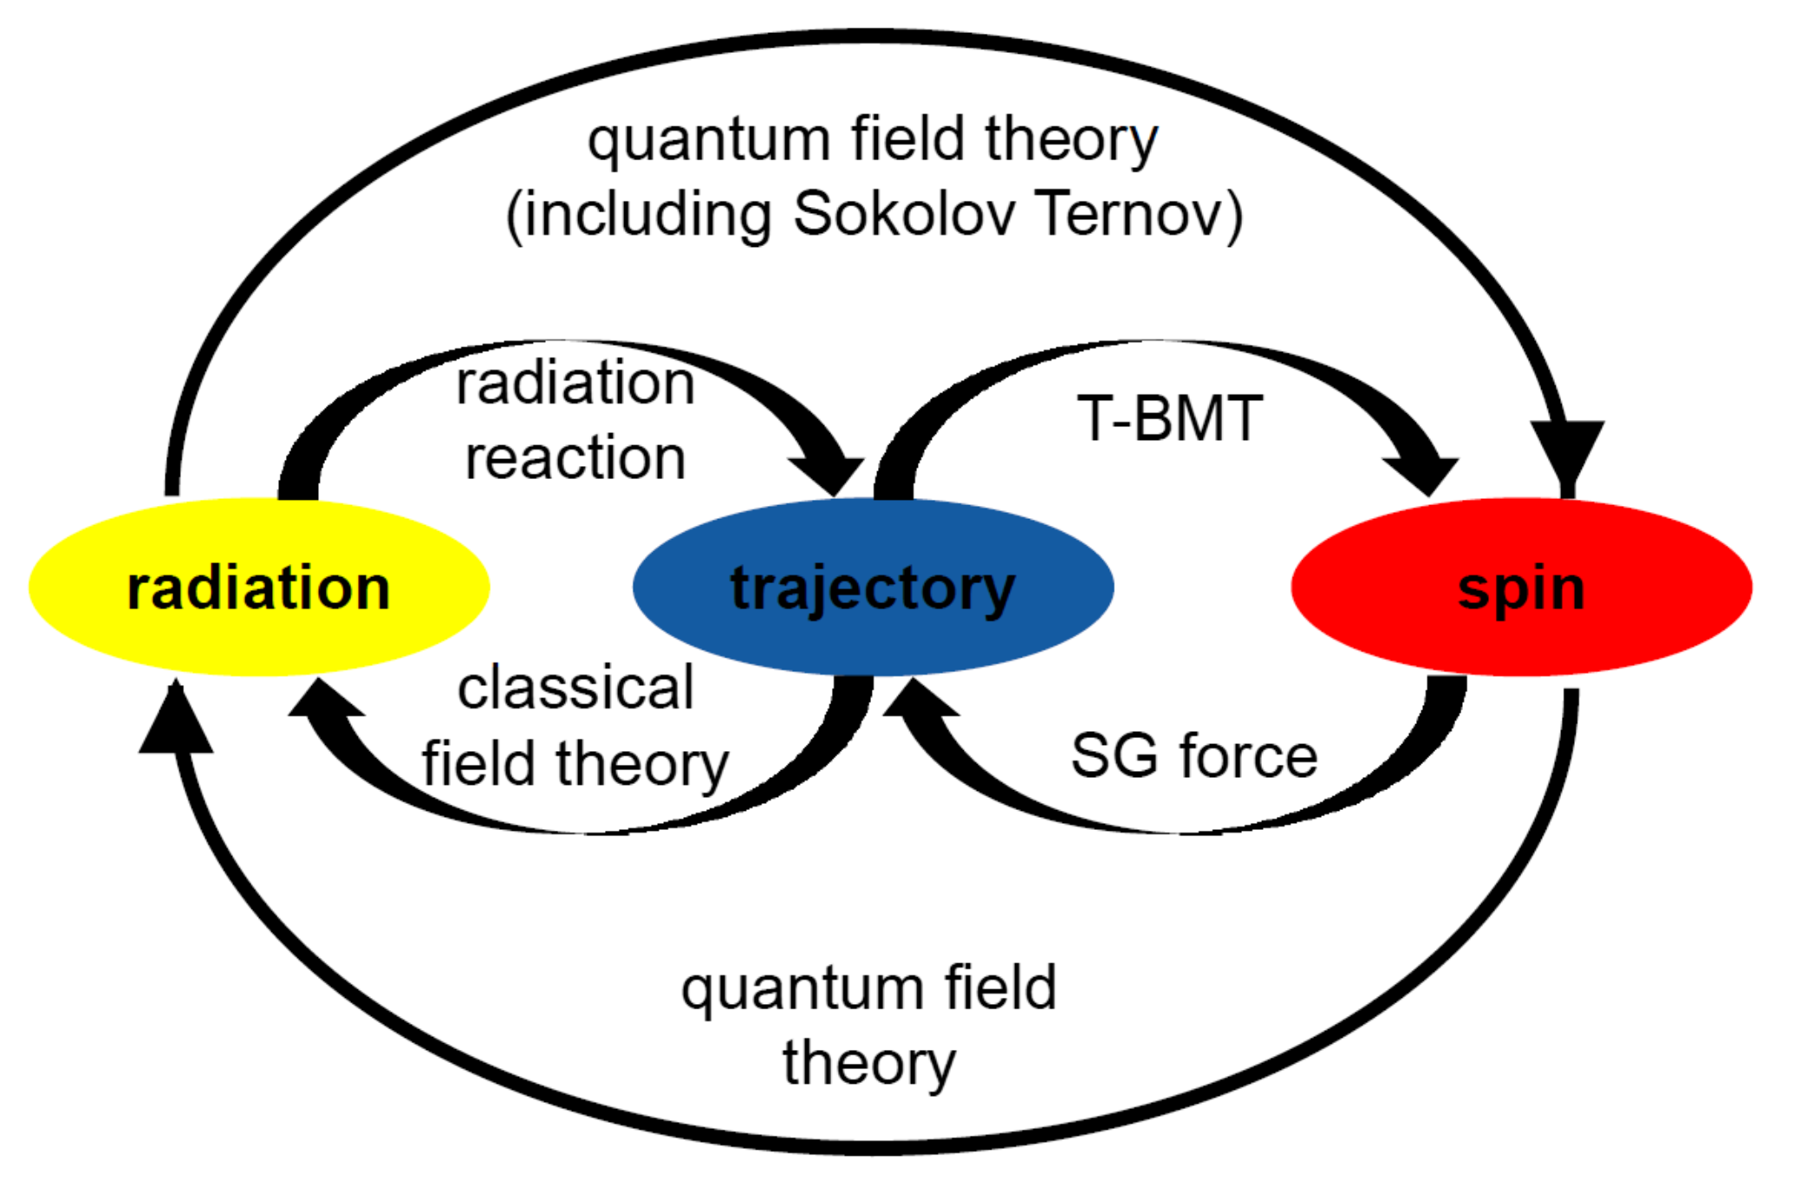
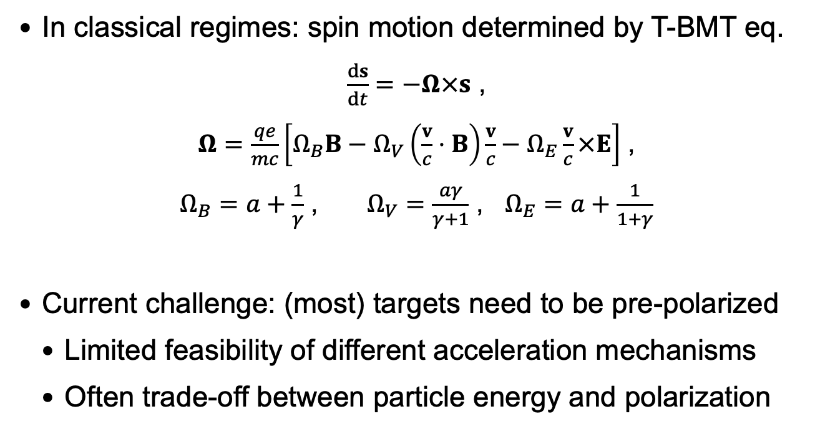
Spin-dependent Effects
In classical regimes: spin motion determined by T-BMT eq.
$\frac{ds}{dt}=−Ω×s$ ,
$Ω=\frac{qe}{mc}\left[Ω_{B}B−Ω_{V}\left(\frac{v}{c}⋅B\right)\frac{v}{c}−Ω_{E}\frac{v}{c}×E\right]$ ,
$Ω_{B}=a+\frac{1}{γ}$ , $Ω_{V}=\frac{aγ}{γ+1}$ , $Ω_{E}=a+\frac{1}{1+γ}$
Current challenge: (most) targets need to be pre-polarized
  Limited feasibility of different acceleration mechanisms
  Often trade-off between particle energy and polarization
L Thomas Nature 117, 514 (1926)
V Bargmann PRL 2, 435 (1959)
J Thomas, PRAB 23, 064401 (2020)

Slide 6
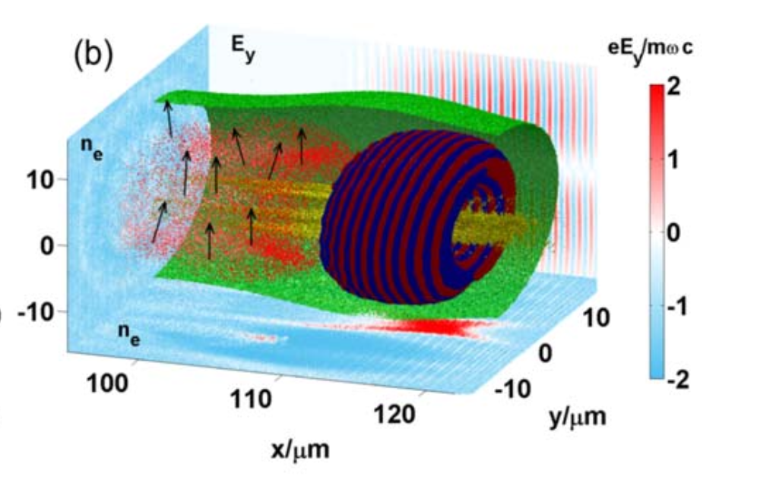
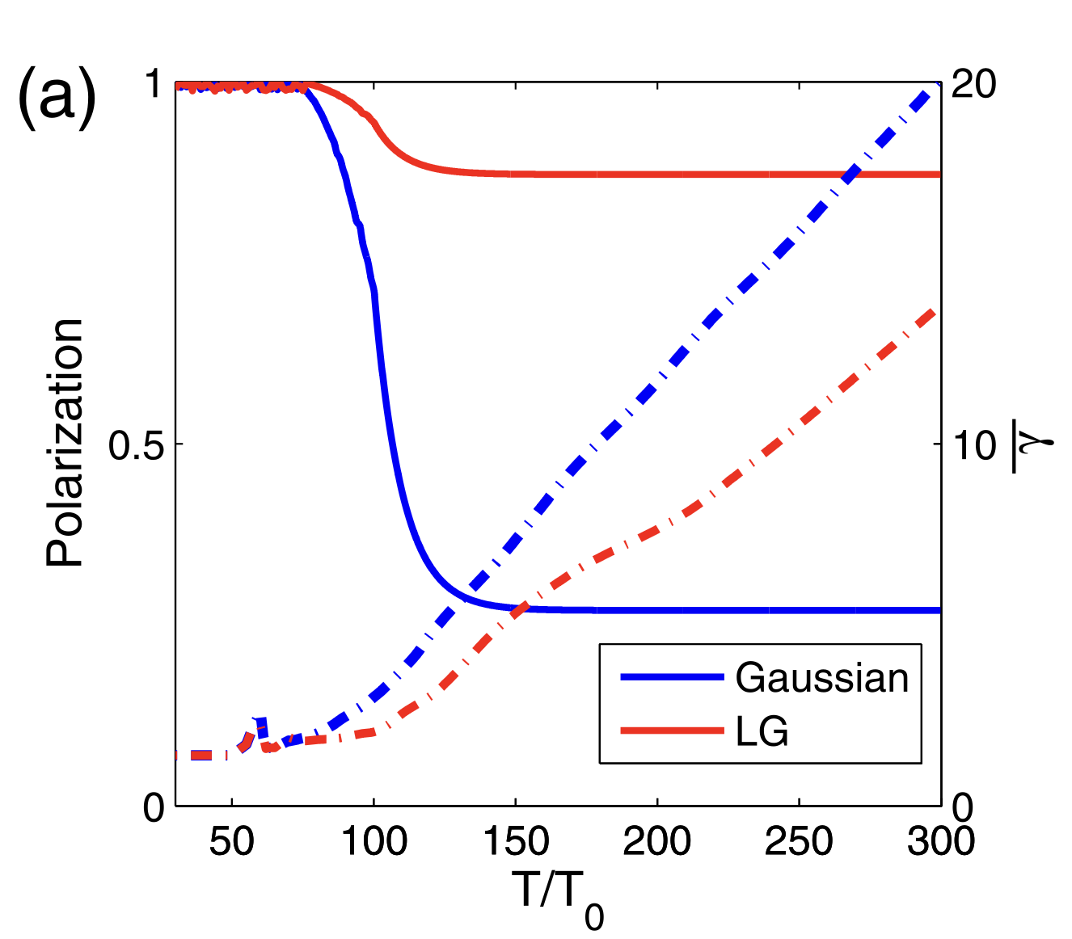
Polarized electrons: Wakefield acceleration
Both LWFA/PWFA usable for polarized electrons
  Injection crucial for final polarization
  First studies using density ramps
„Single-step method“ proposed by Nie et al (UCLA)
  no need for pre-polarization
Currently no experimental results on pol. electrons!
  restrictive target parameters
Y Wu, NJP 21, 073052 (2019)
Y Wu, PRE 100, 043202 (2019)
Z Nie, PRL 126, 054801 (2021)

Slide 7
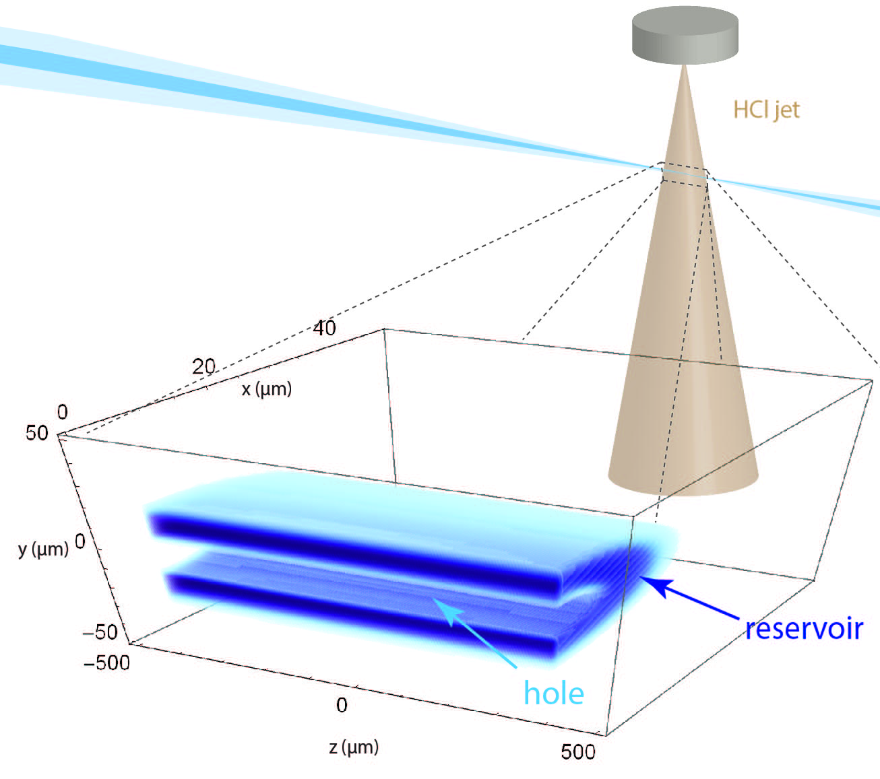
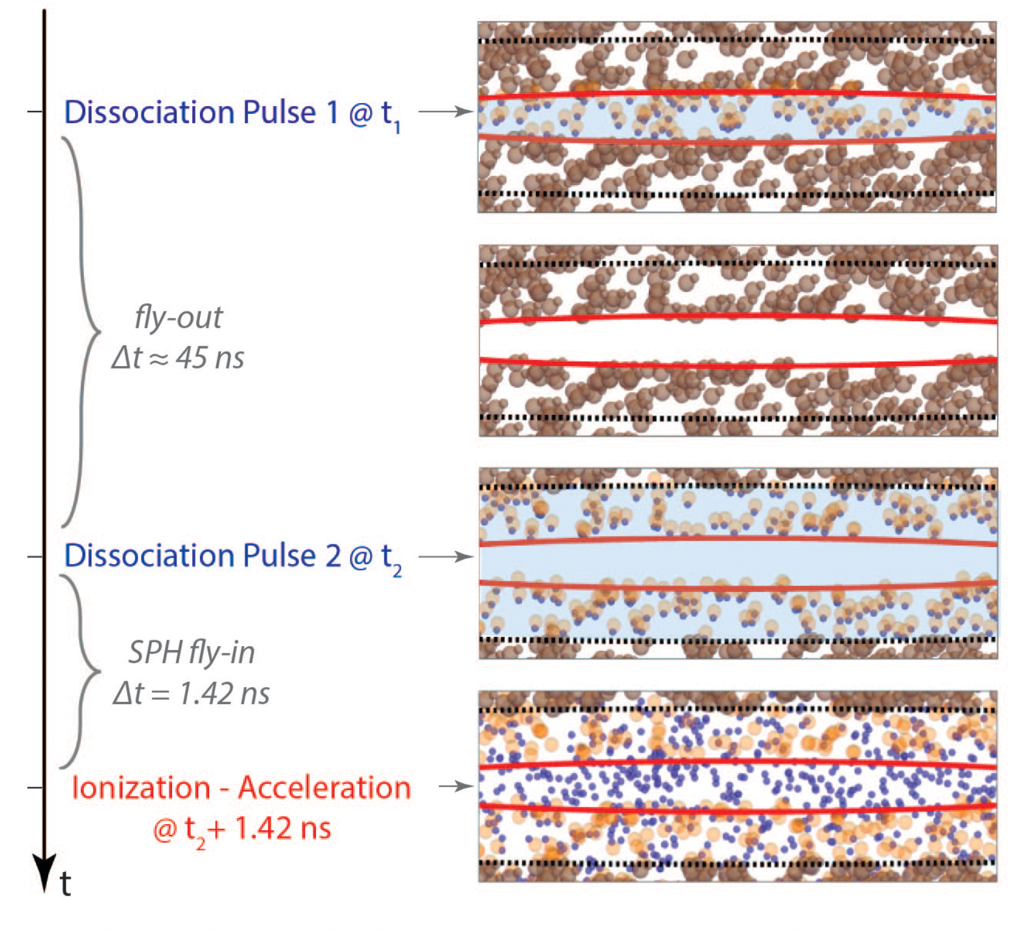

Towards realistic targets
Hydrogen halides as possible sources of pol. electrons (or ions)
D Sofikitis, PRA 111, 053119 (2025)

Slide 8
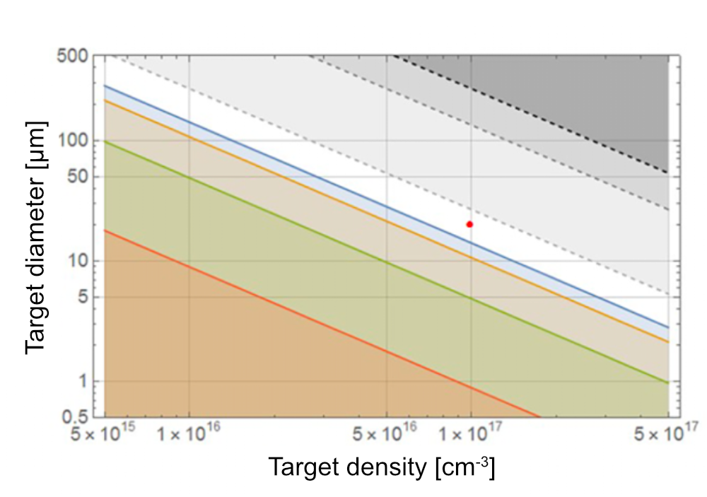
Towards realistic targets
Limited degree of pre-polarization depending on regime
Effective interaction volume limits choice of injection mechanisms for electrons
  Many studies consider densities ~ 10¹⁸ cm⁻³
Restrictions concerning density and interaction volume also exist for other targets like ³He …
P = 40%
P = 50%
P = 70%
P = 90%
D Sofikitis, PRA 111, 053119 (2025)

Slide 9
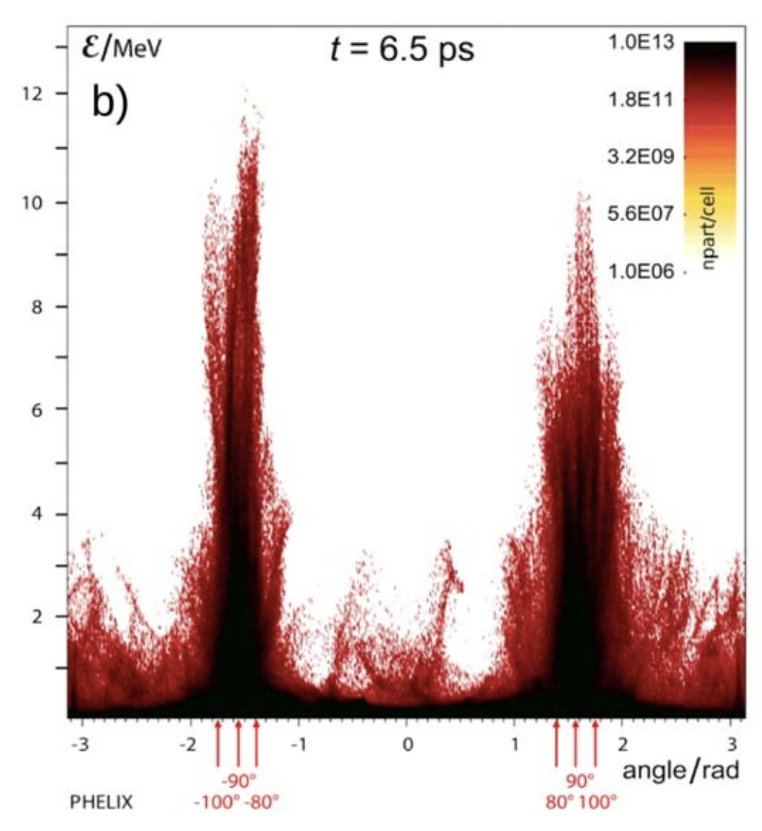
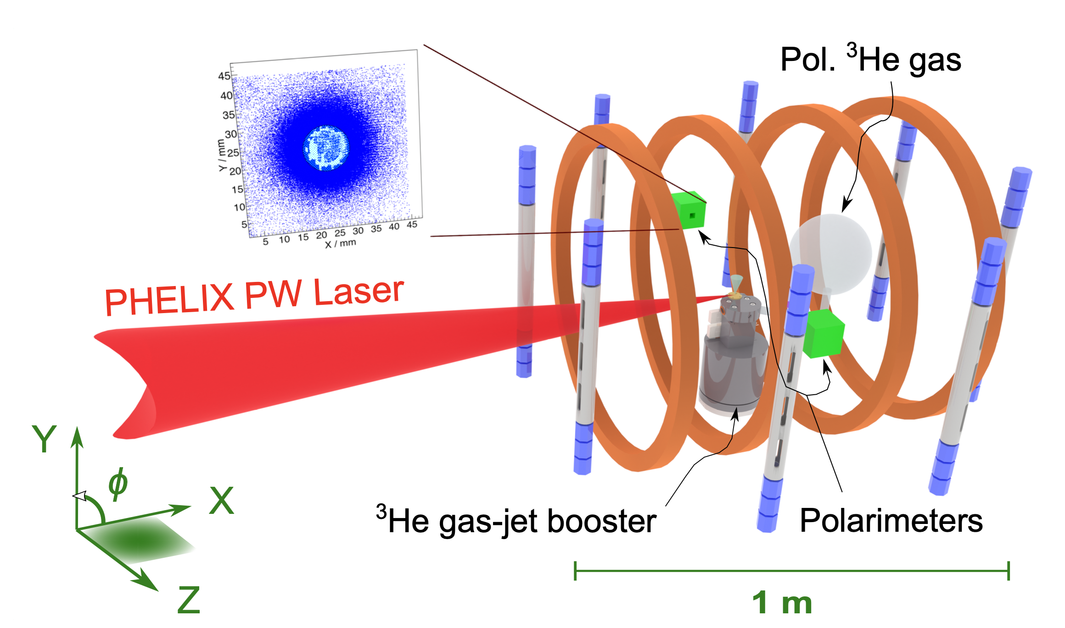
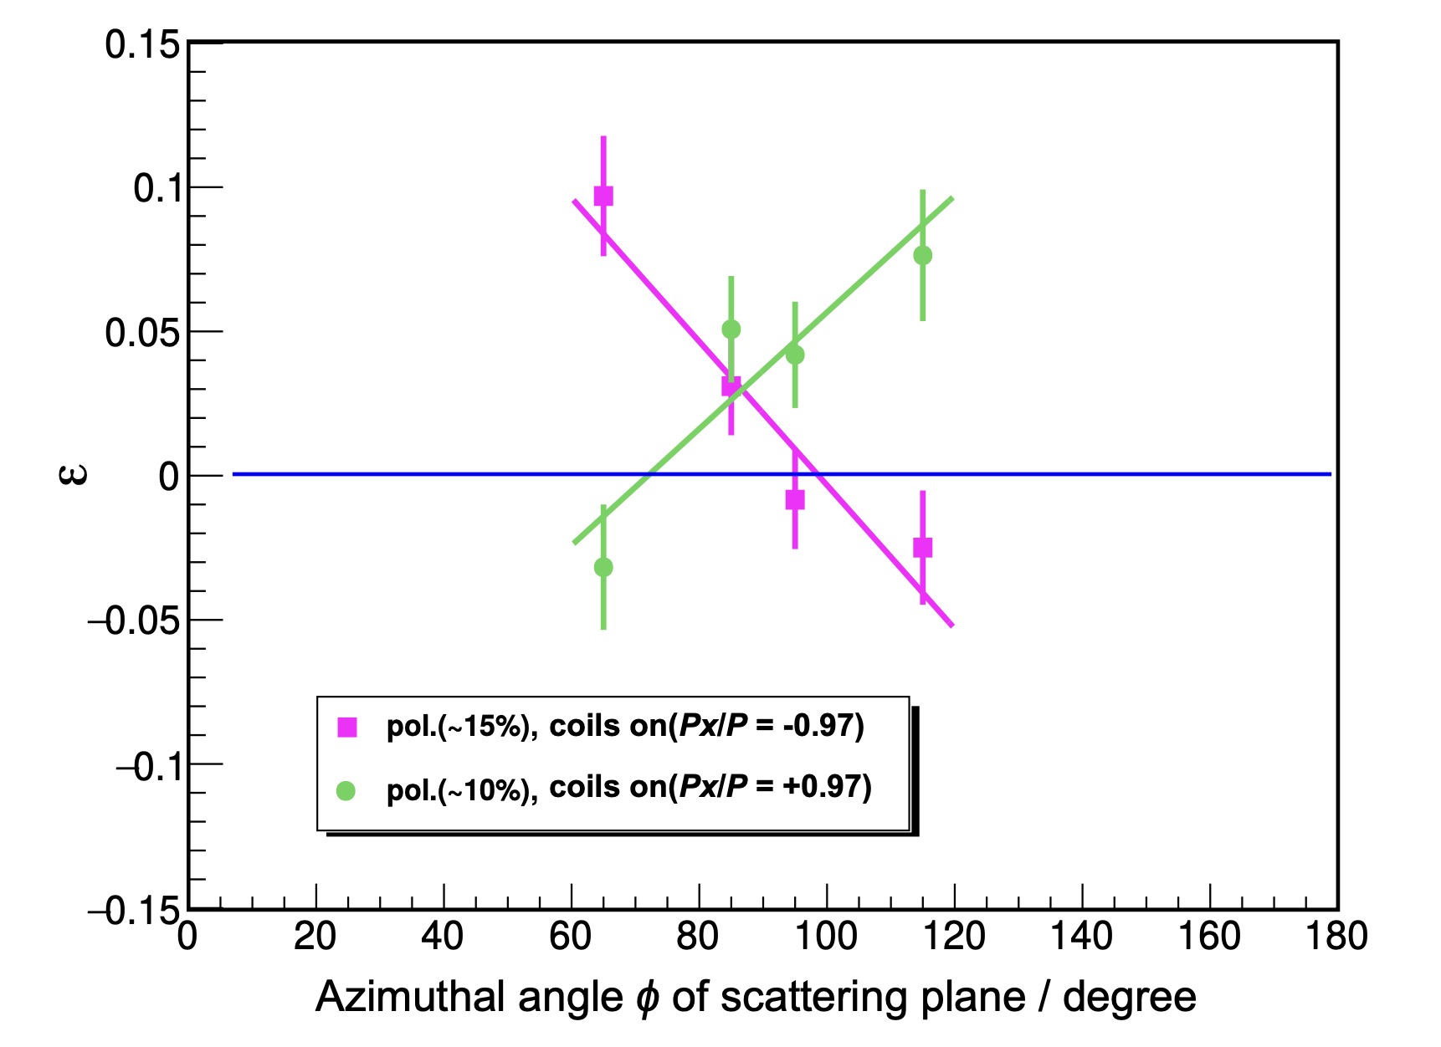
Experimental results at PHELIX
First successful acceleration of polarized ³He from laser-plasma
C Zheng, arXiv:2310.04184v2 (2024)
I Engin, PPCF 61, 115012 (2019)

Slide 10
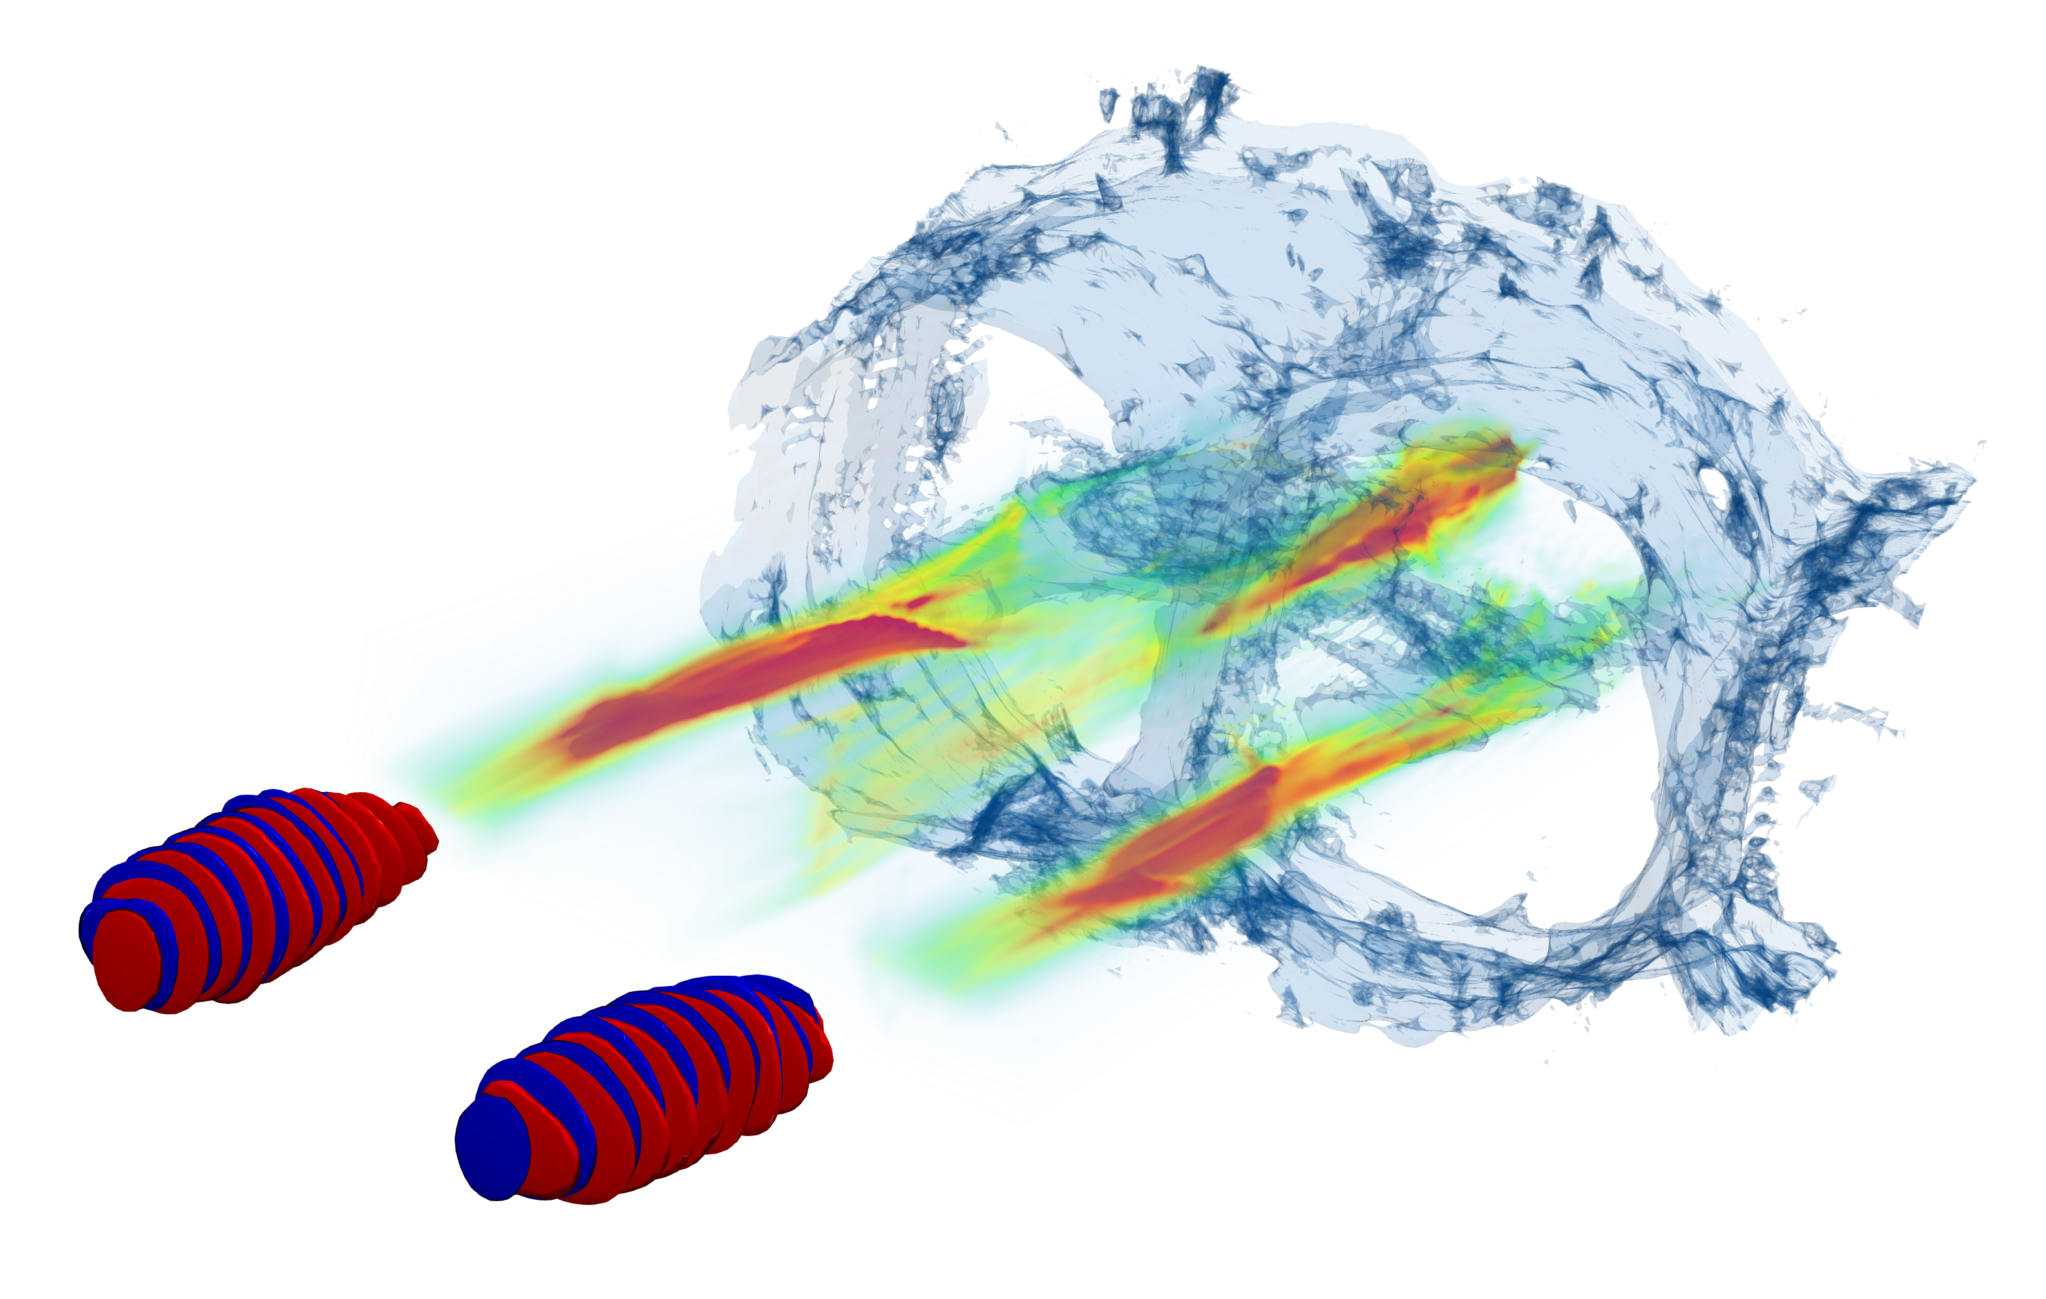
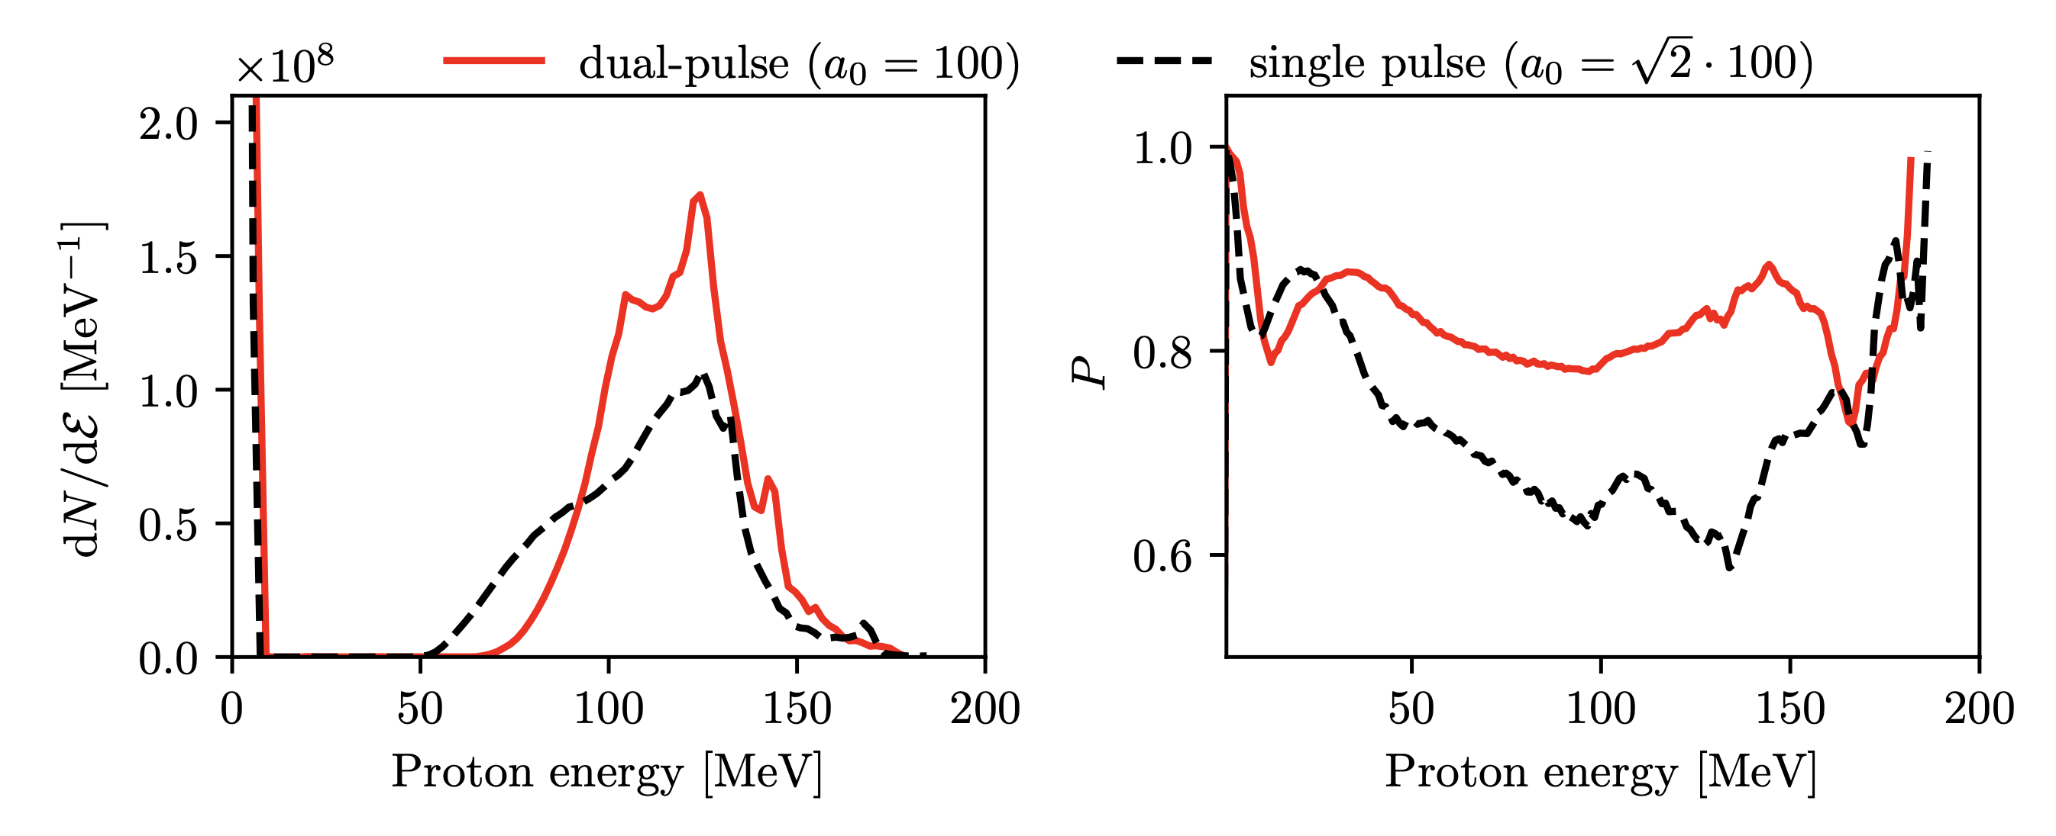


Back to Theory: Magnetic Vortex Acceleration
Feasible mechanism for shorter NCD targets
Increasing field strength leads to higher energy, but lower polarization
$Ω=\frac{qe}{mc}\left[Ω_{B}B−Ω_{V}\left(\frac{v}{c}⋅B\right)\frac{v}{c}−Ω_{E}\frac{v}{c}×E\right]$,
„Dual-pulse MVA“: CEP difference enables higher polarization
$$Δy$$
L Jin, PRE 102, 011201 (2020)
L Reichwein, PRAB 25, 081001 (2022)

Slide 11
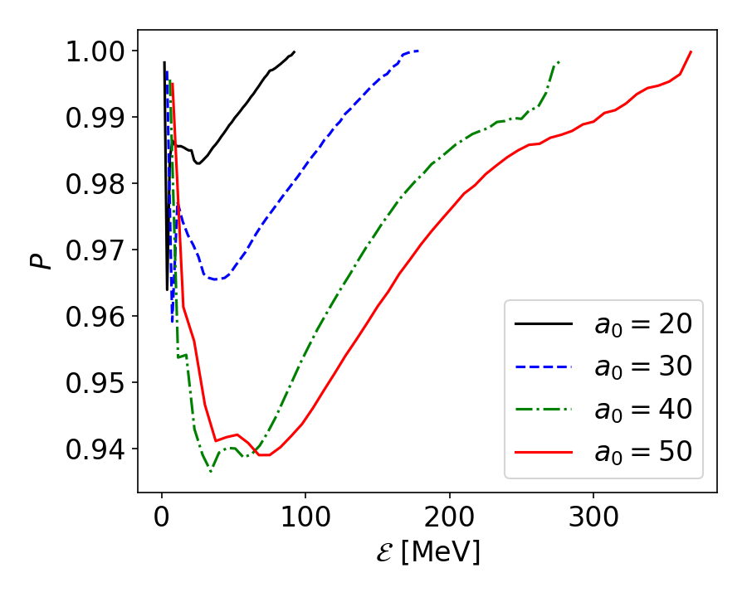

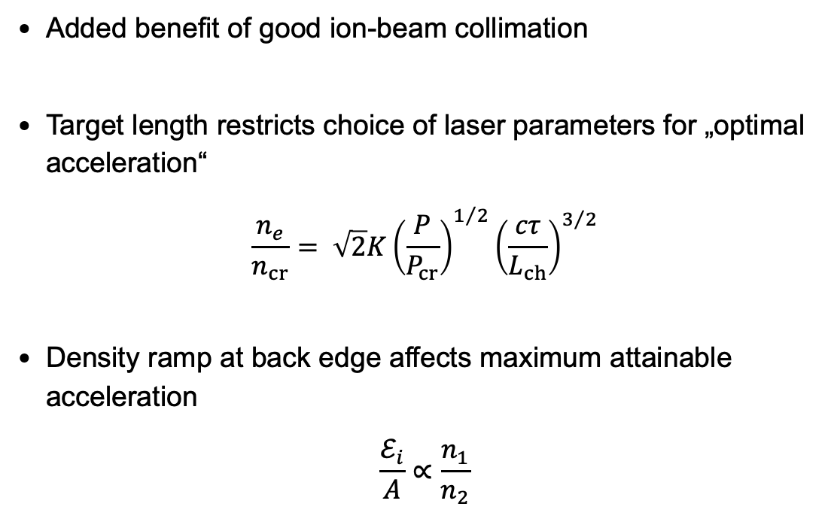
MVA with Laguerre-Gaussian pulses
Pulse structure improves polarization degree on 90%-level
Added benefit of good ion-beam collimation
Target length restricts choice of laser parameters for „optimal acceleration“
$$\frac{n_{e}}{n_{cr}}= \sqrt{2}K{\left(\frac{P}{P_{cr}}\right)}^{1/2}{\left(\frac{cτ}{L_{ch}}\right)}^{3/2}$$
Density ramp at back edge affects maximum attainable acceleration
$$\frac{ℰ_{i}}{A}∝\frac{n_{1}}{n_{2}}$$
J Park, PoP 26, 103108 (2019)
T Nakamura, PRL 105, 135002 (2010)
L Reichwein, arXiv:2505.05337 (2025)

Slide 12
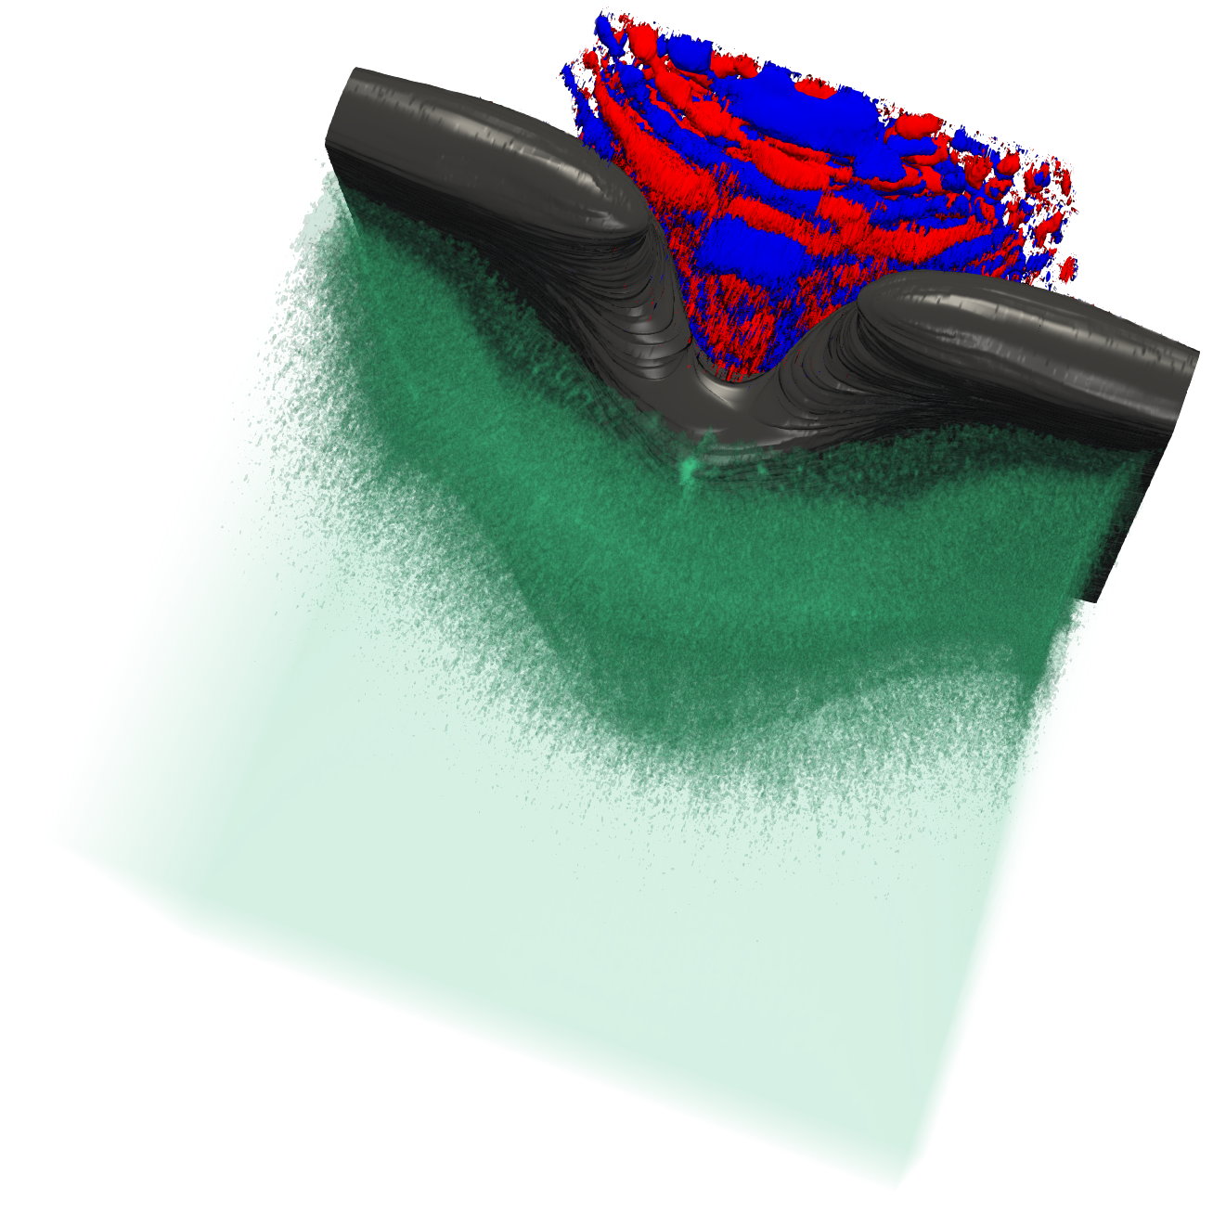
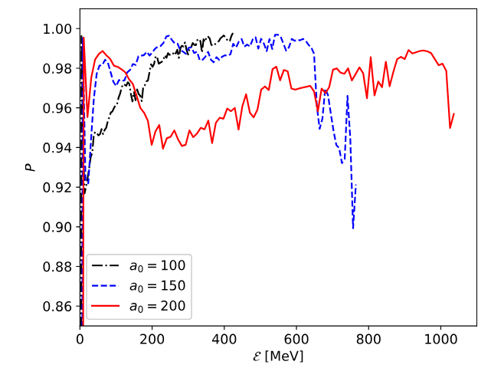
Collisionless shocks Acceleration (CSA)
Even for the optimized MVA schemes, the laser pulse interacts directly with pre-polarized plasma
  Highly oscillating fields → strong depolarization
Alternative: use shock acceleration, e.g., with additional foil for homogeneous accelerating field
  Investigated for different targets, by us for ³He
  Increased polarization degree even for a₀ = 200
  X Yan, PPCF 65, 053101 (2023)
  L Reichwein, PPCF 66, 055002 (2024)

Slide 13





Summary & Outlook
Towards higher energies
L Reichwein, PPCF 66, 055002 (2024)
Z Gong, PRL 135, 045101 (2025)
Polarized electrons
D Sofikitis, PRA 111, 053119 (2025)
Review Paper
L Reichwein, arXiv:2411.1162 (2024)
Polarized ions
C Zheng, arXiv:2310.04184v2 (2024)
Applications: DIS, Fusion, …
W Heidbrink, Front Phys 12,1355212 (2024)

Slide 14
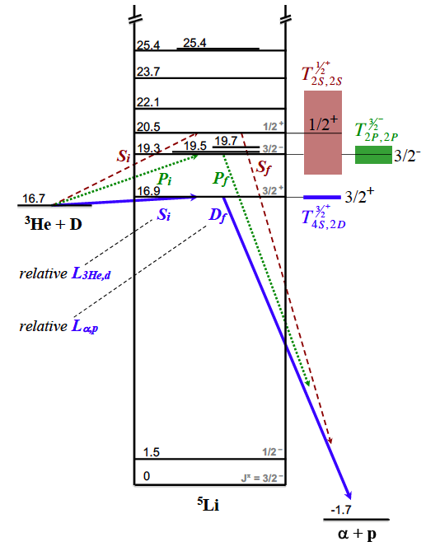
Application: Polarized nuclear Fusion
D-³He as a proxy for D-T
D + T → ⁵He (3/2⁺) → ⁴He + n
S =1/2
S = 1
S =1/2, 3/2
3/2
D and T unpolarized:
2/3 of the interaction contribute
S = 3/2
1/2
4 states
−1/2
−3/2
D and T polarized:
all interactions contribute
S = 1/2
1/2
2 states
−1/2
→ 50% increase (from 4 to 6 states) in the cross-section

