Slide 1

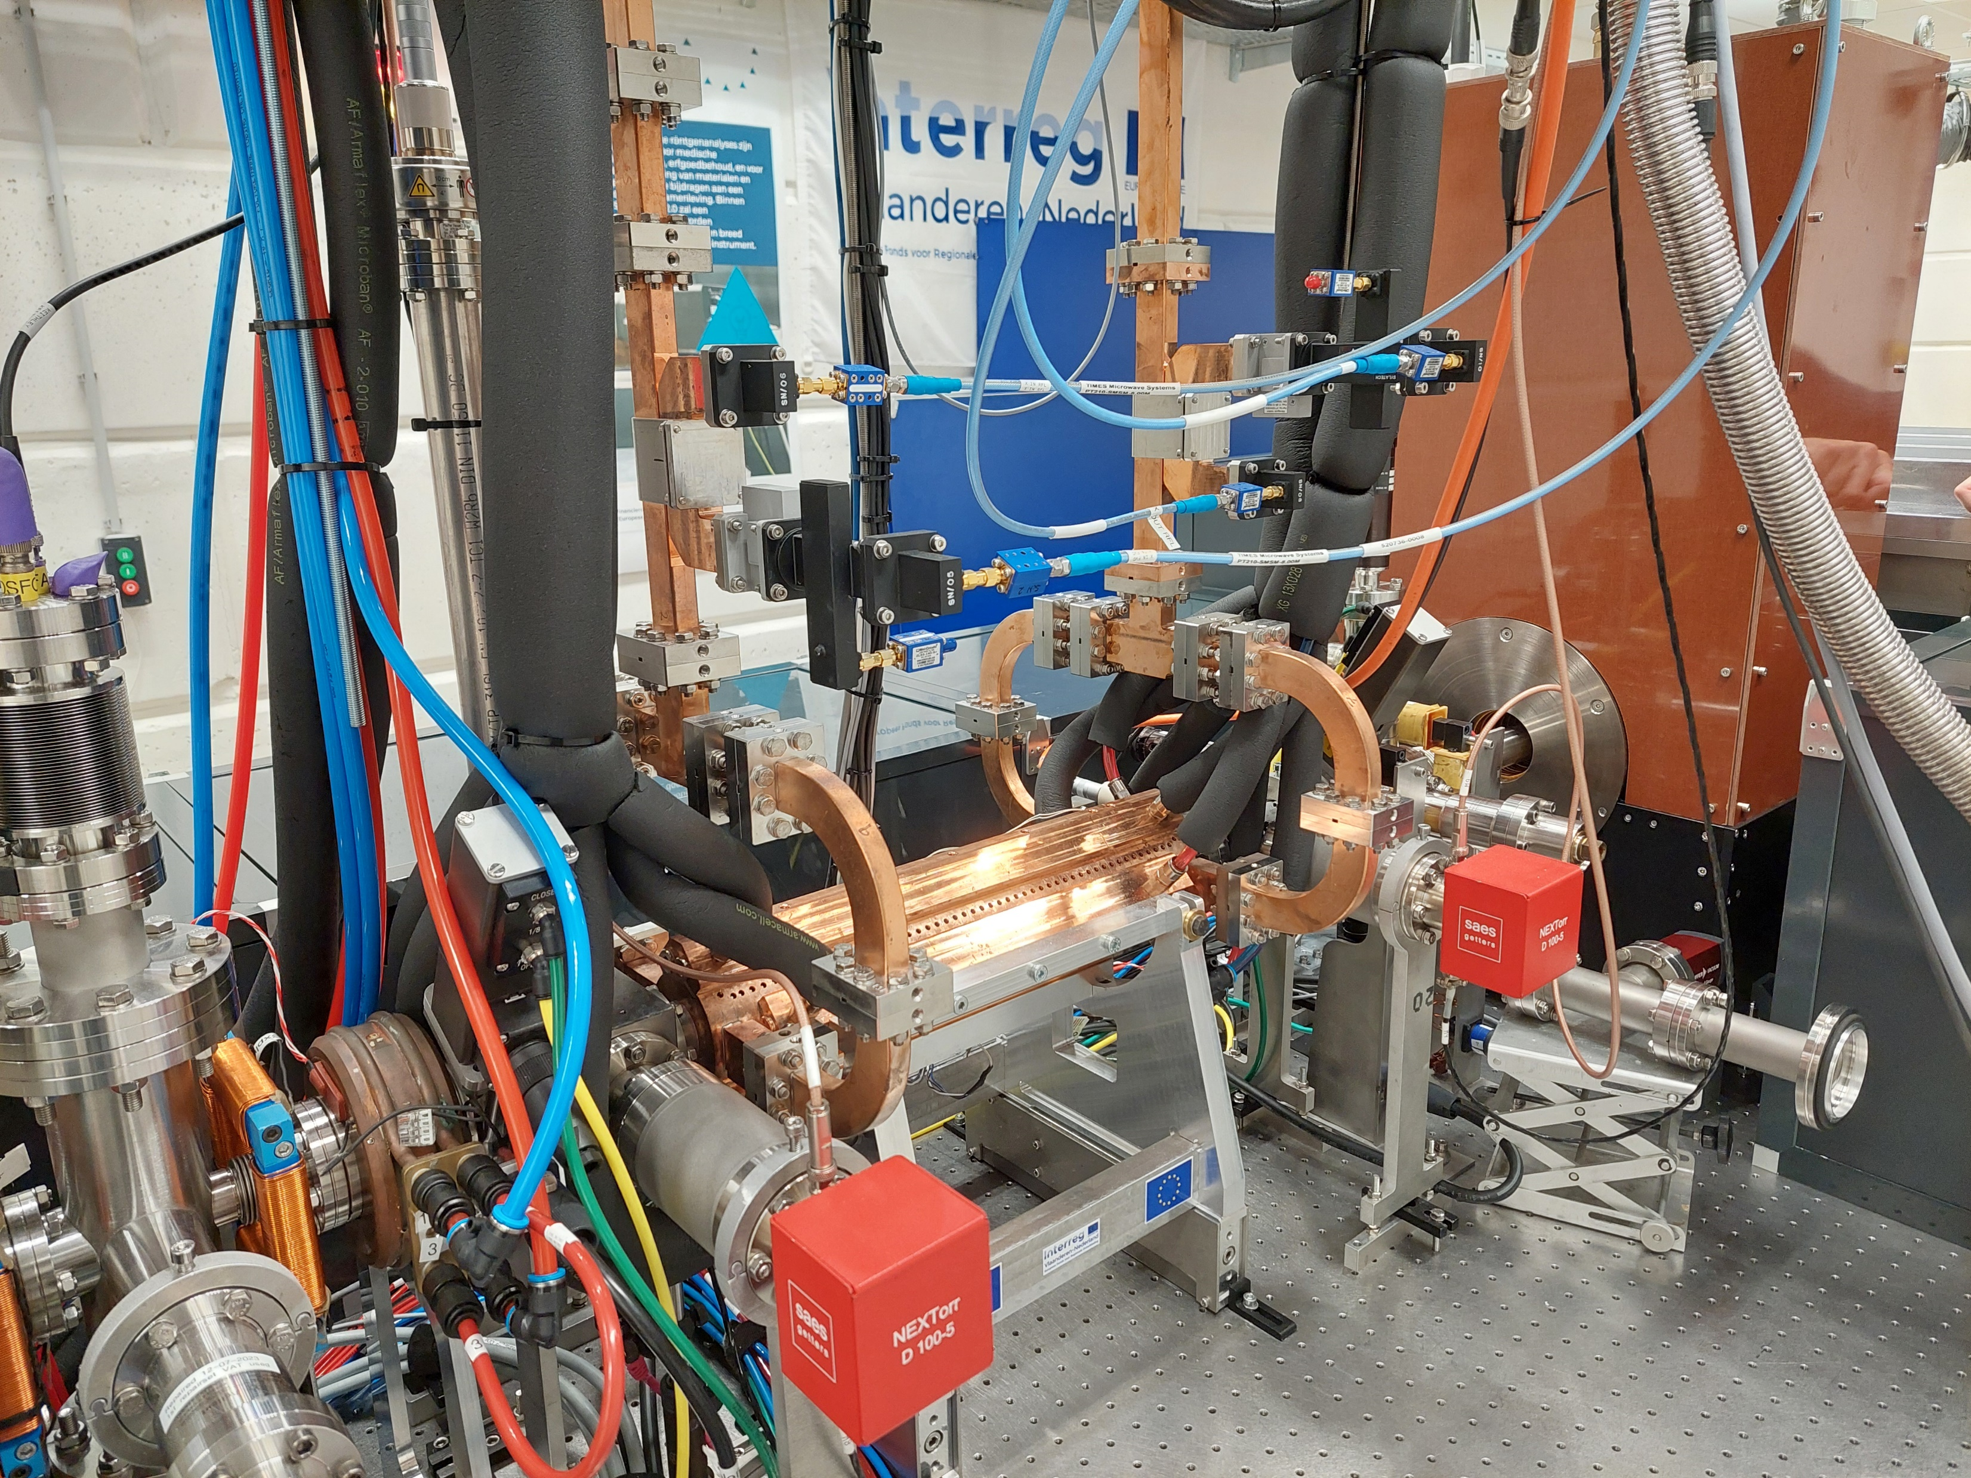


Smart*Light
Commissioning of the compact, tunable ICS based x-ray source
Coen Sweers, Ids van Elk, Peter Mutsaers and Jom Luiten
European Advanced Accelerator Conference 2025
September 25, 2025

Slide 2
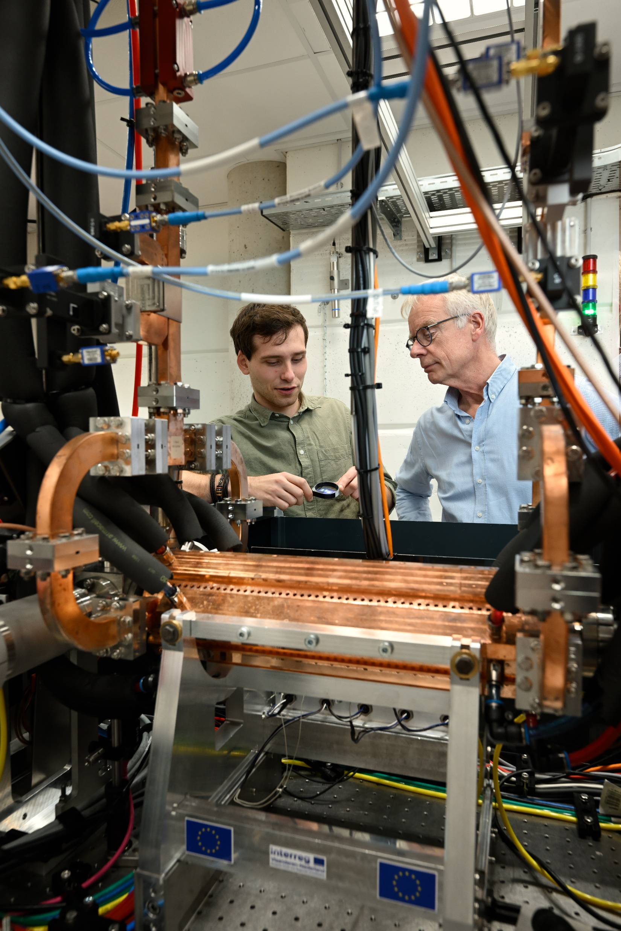
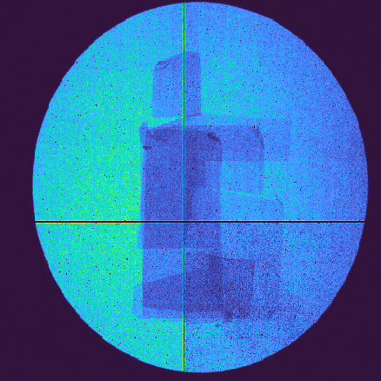
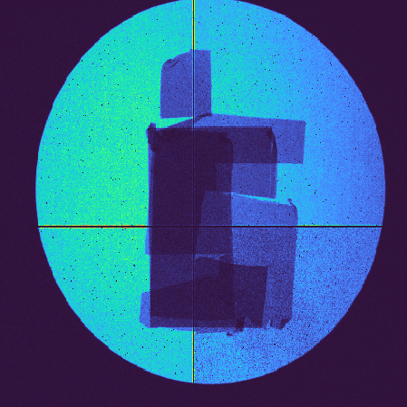
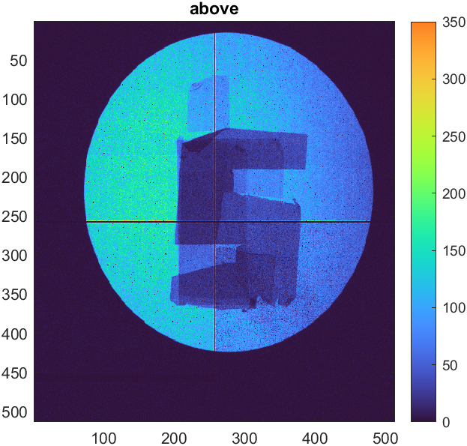
Structure
Inverse Compton scattering
Smart*Light beamline
1
2
2
x-ray results
3

Slide 3
Structure
Inverse Compton scattering
Smart*Light beamline
1
2
2
x-ray results
3

Slide 4

Inverse Compton Scattering
Inverse Compton Scattering
animation: Brian Schaap

Slide 5
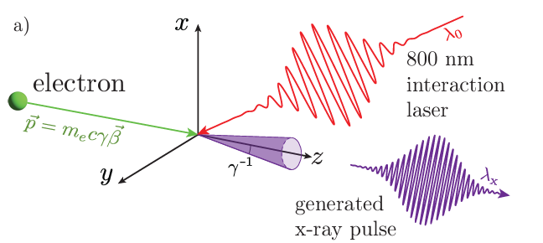
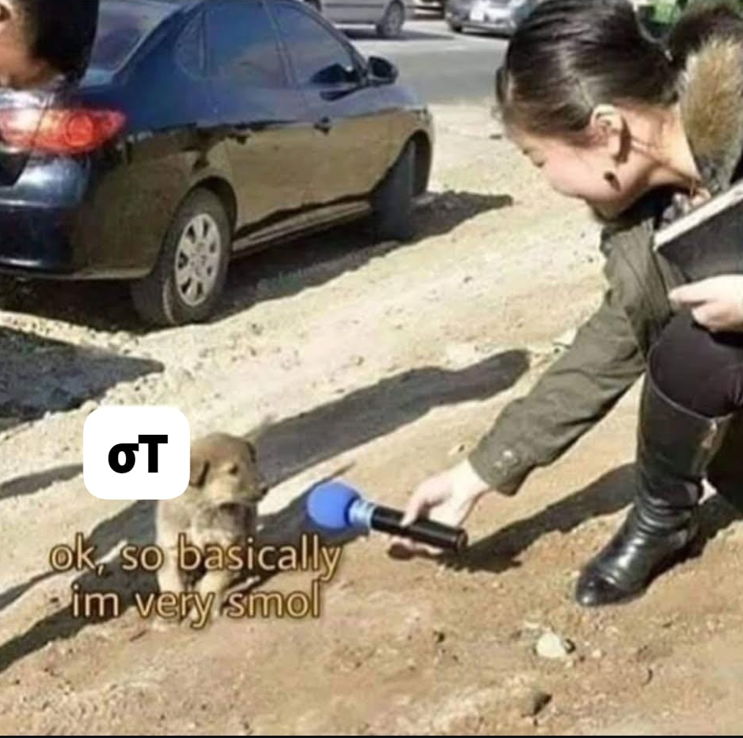

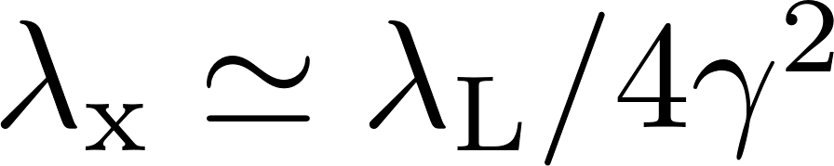
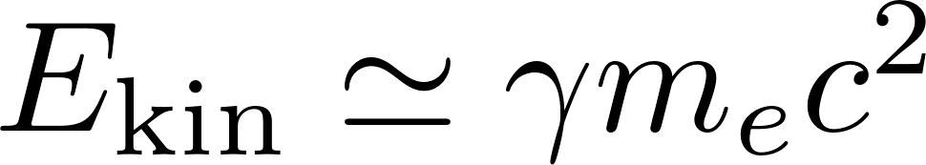

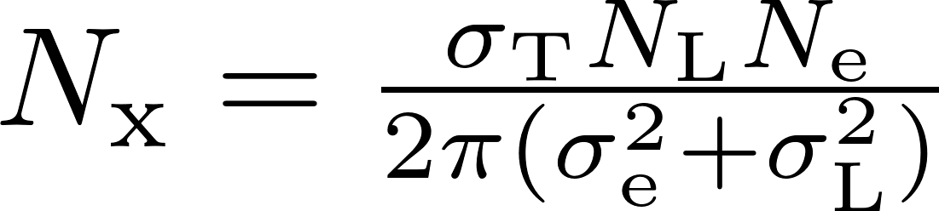
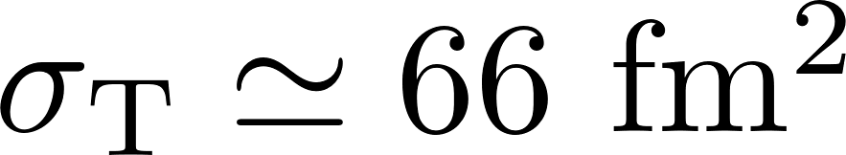
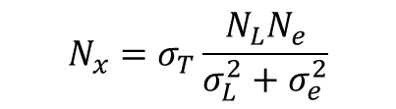
Inverse Compton Scattering
radiation wavelength
Micron source size
Highly directional emission
$$N_{x}=σ_{T}\frac{N_{L}N_{e}}{σ_{L}^{2}+σ_{e}^{2}}$$
λ₀ = 800 nm
E_{kin}= 20 MeV
λ_{X} = 0.1 nm
Figure: Daniel Nijhof

Slide 6
Structure
Inverse Compton scattering
Smart*Light beamline
1
2
2
x-ray results
3

Slide 7

















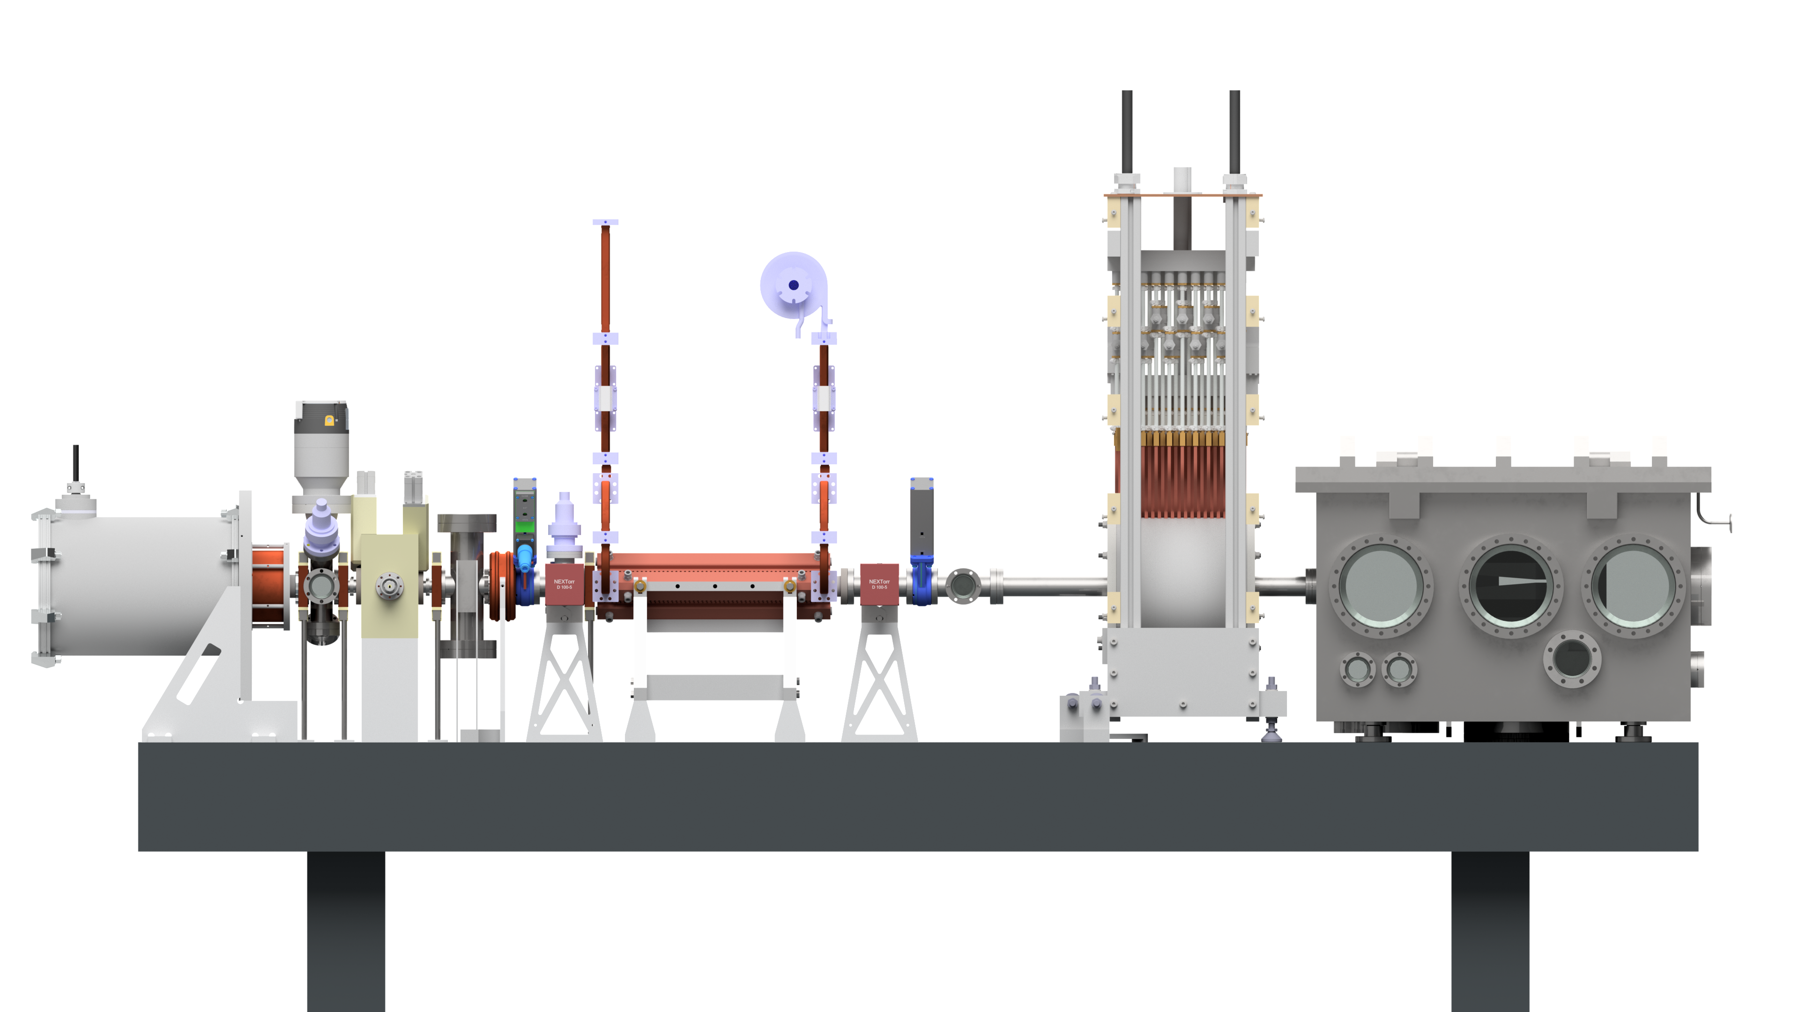
Smart*Light beamline
X-band LINAC
Electron injector
interaction chamber
300 cm
Figure: Daniel Nijhof

Slide 8
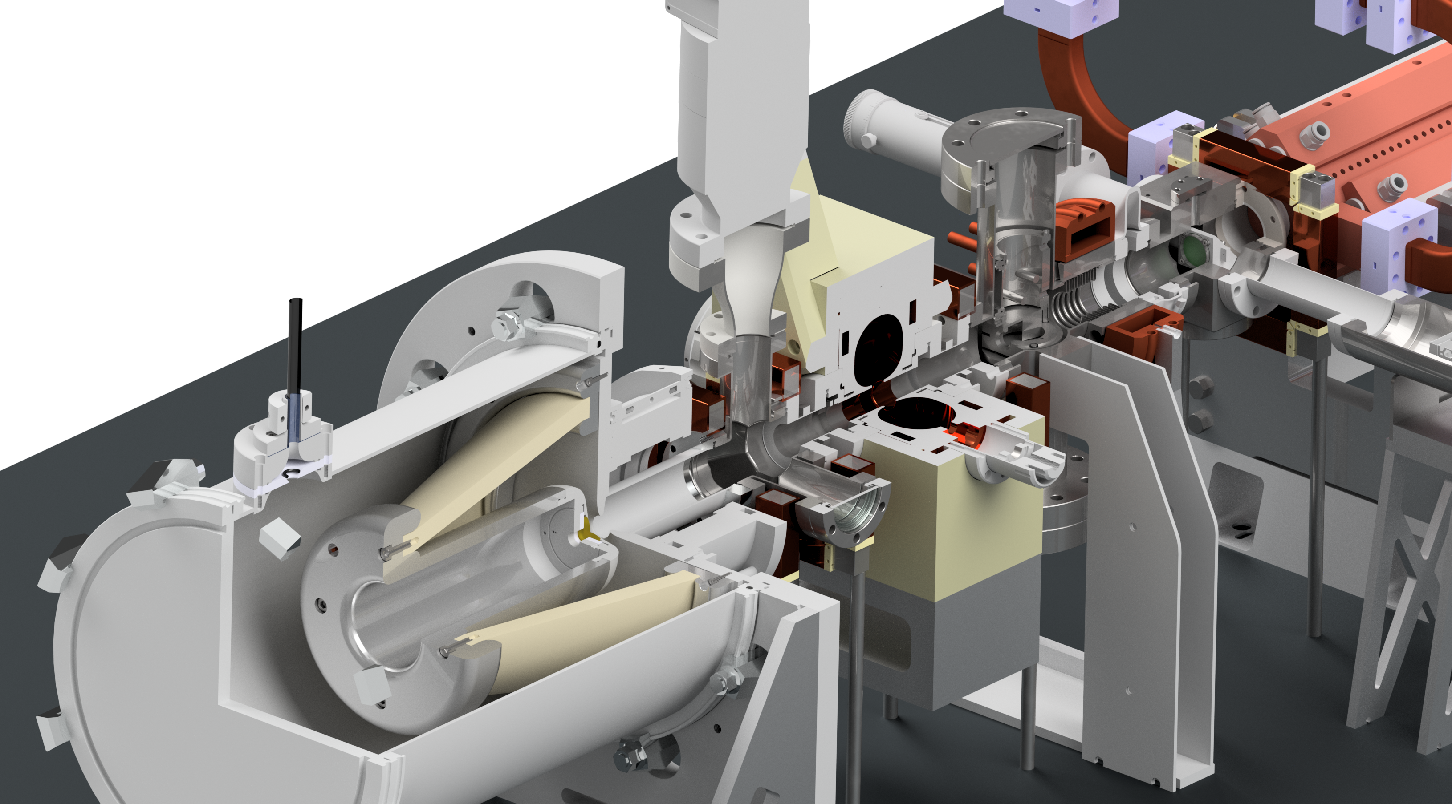

Electron injector
ps electron bunch
100 keV DC photogun
bunch charge 10 pC
emittance 400 nmrad
pulse length 1 ps
repetition rate 1 kHz
fs UV pulse
Courtesy of Daniel Nijhof
For ICS e-beam brightness is crucial!
$$B≃f Q/ε_{n}^{2}$$

Slide 9
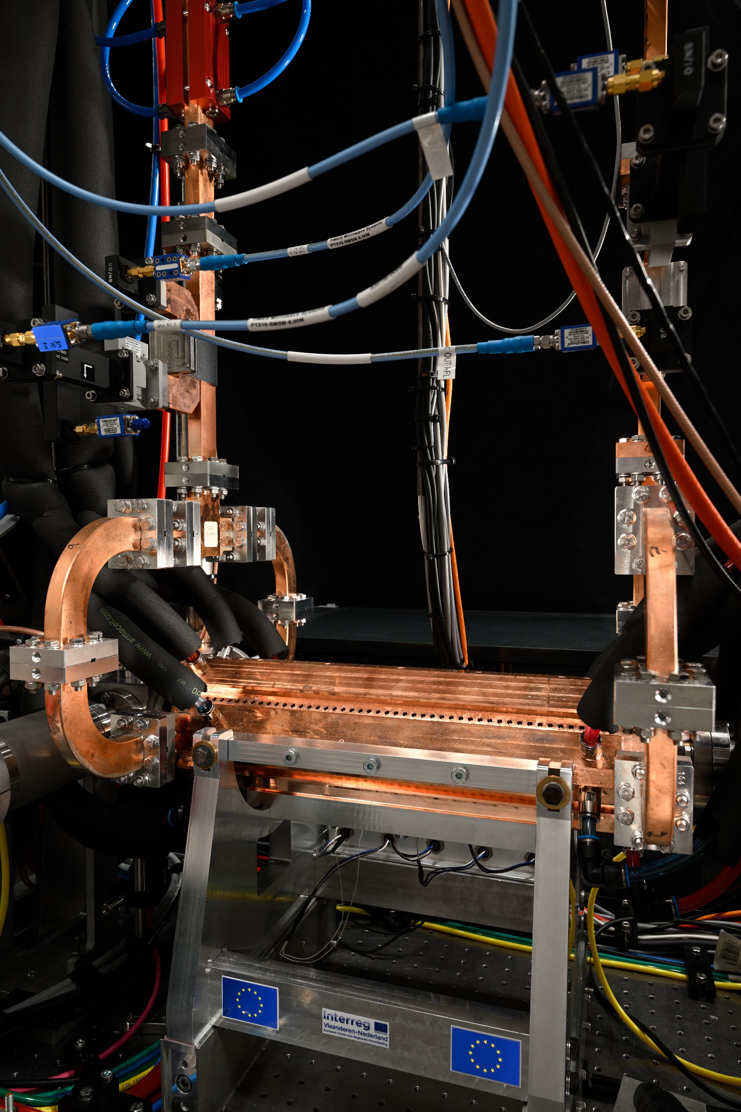
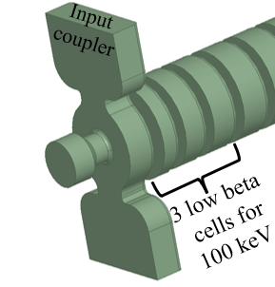
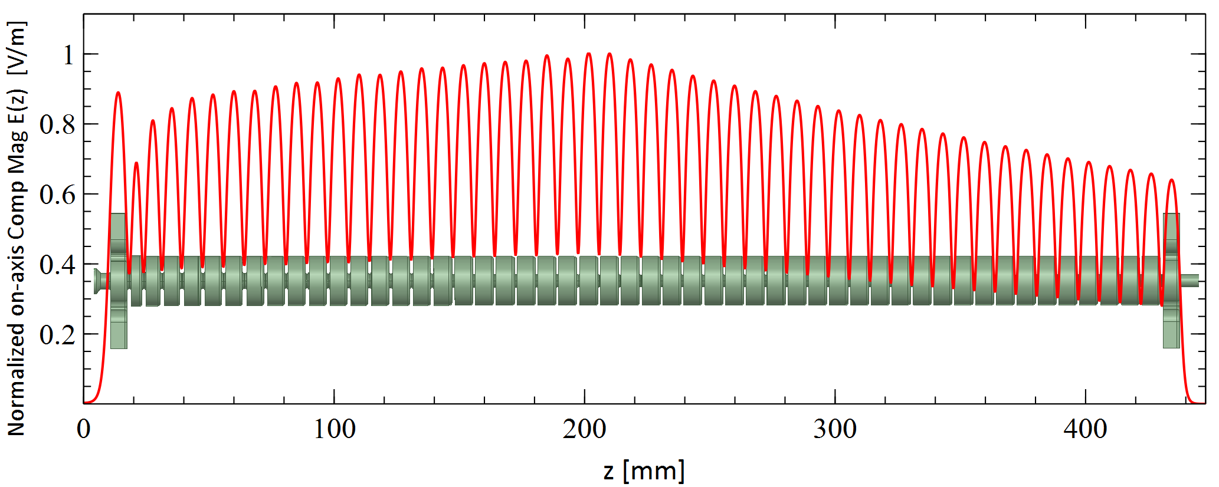
X-band accelerator
Adapted design based on CLIC TD26 structure
First 3 cells adapted for 100 keV injection
26 cells 50 cells
Design performance
30 MeV at 20 MW RF power
1 kHz repetition rate
Figure by Xavier Stragier
More info: Stragier, X.F.D., et al. A traveling wave X-band accelerating structure with low-beta front end for a compact inverse Compton scattering x-ray source. Eur. Phys. J. Spec. Top. (2025).
Photo by Bart van Overbeeke

Slide 10


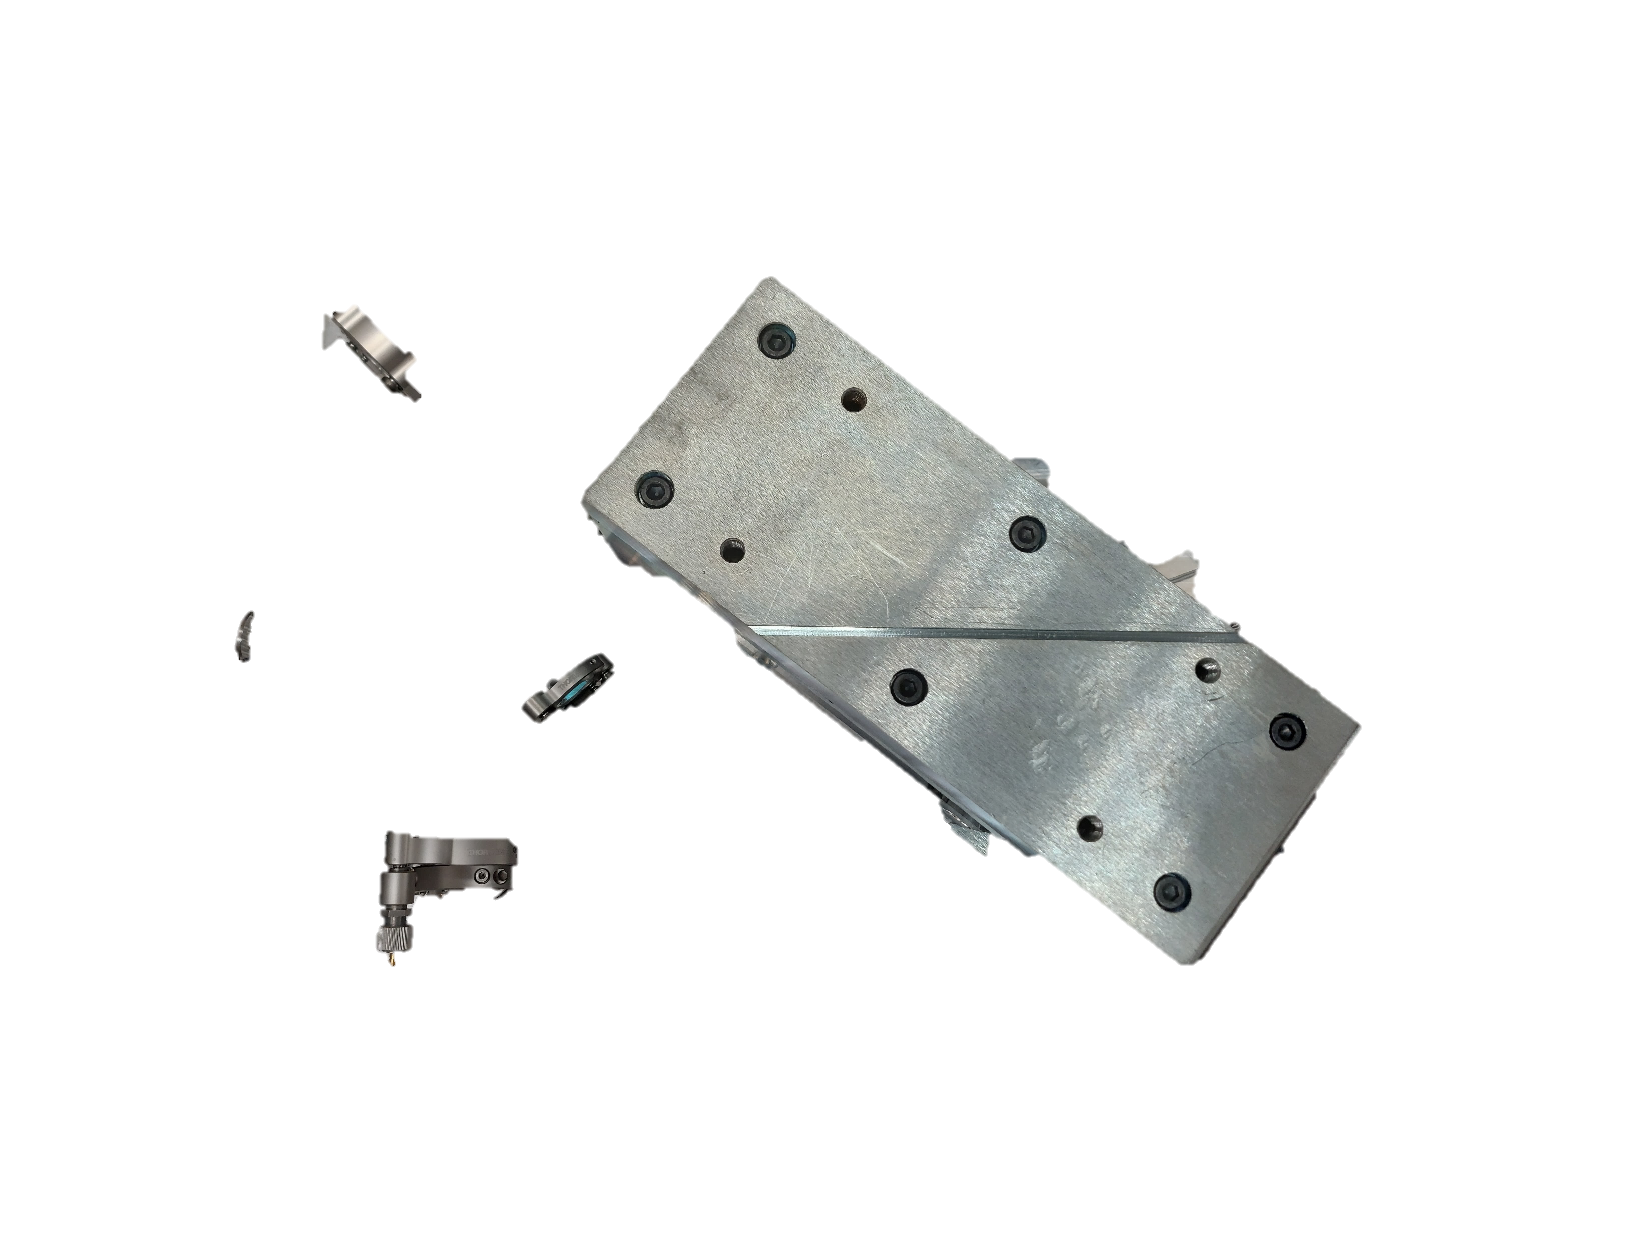
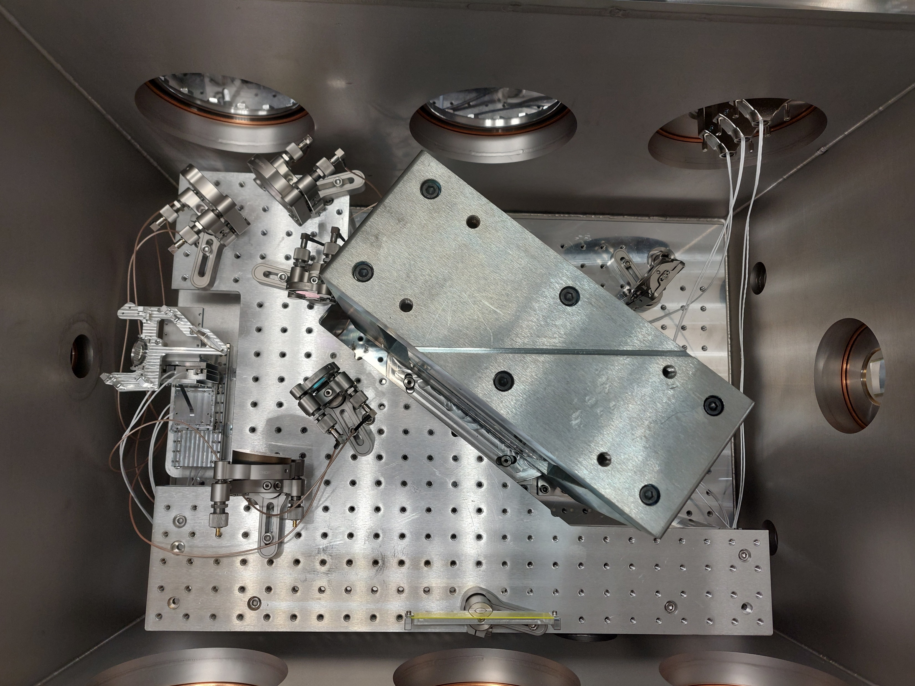



Interaction Chamber

Slide 11
Interaction Chamber
x-rays!
est. September 2024

Slide 12
Structure
Inverse Compton scattering
Smart*Light beamline
1
2
2
x-ray results
3

Slide 13



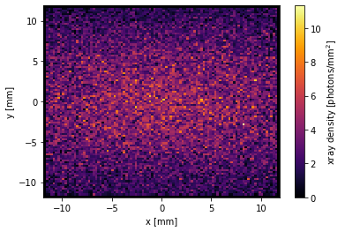
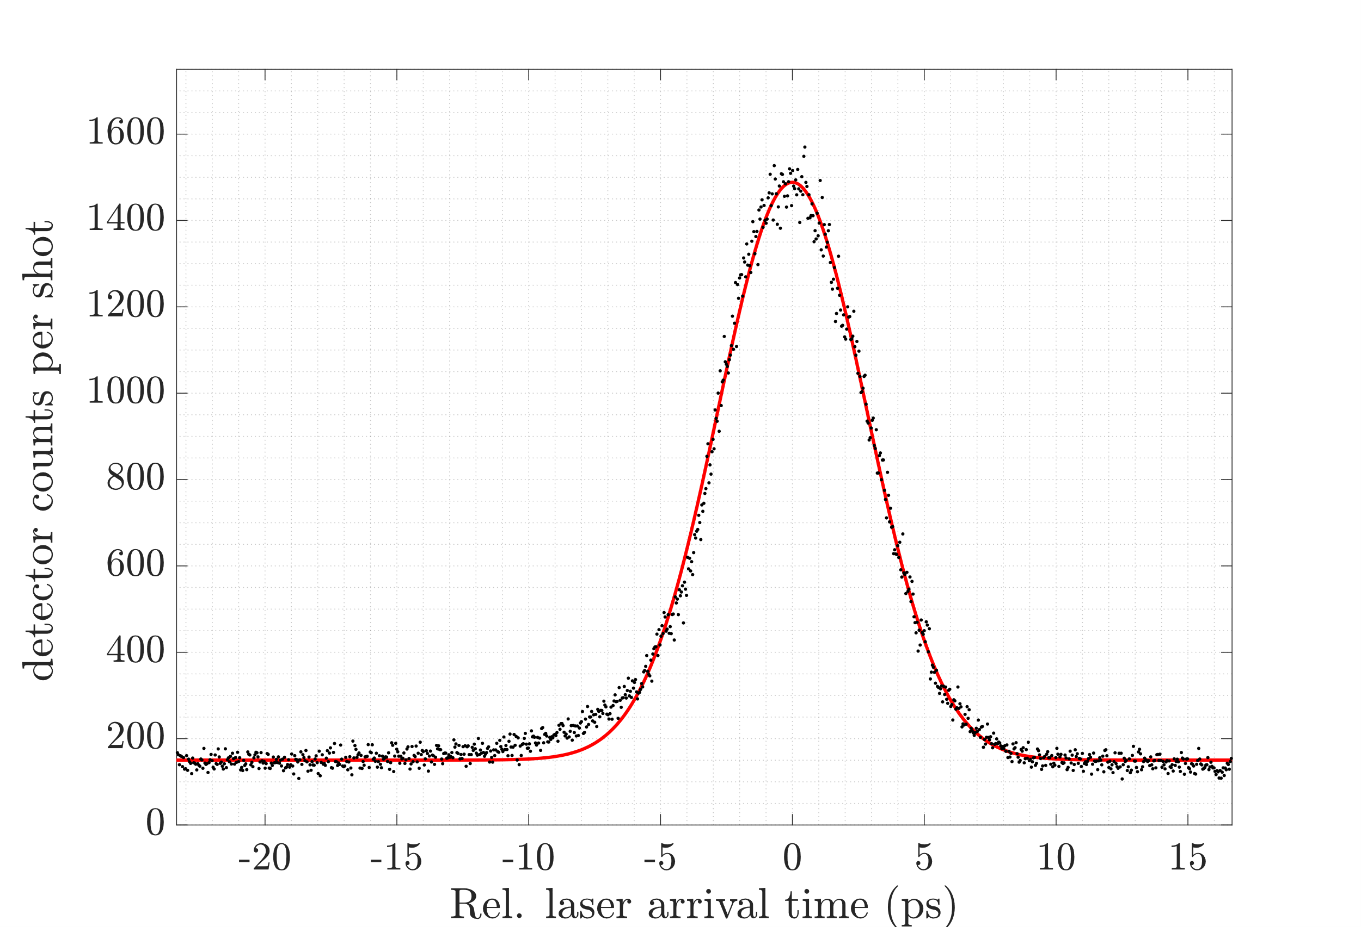
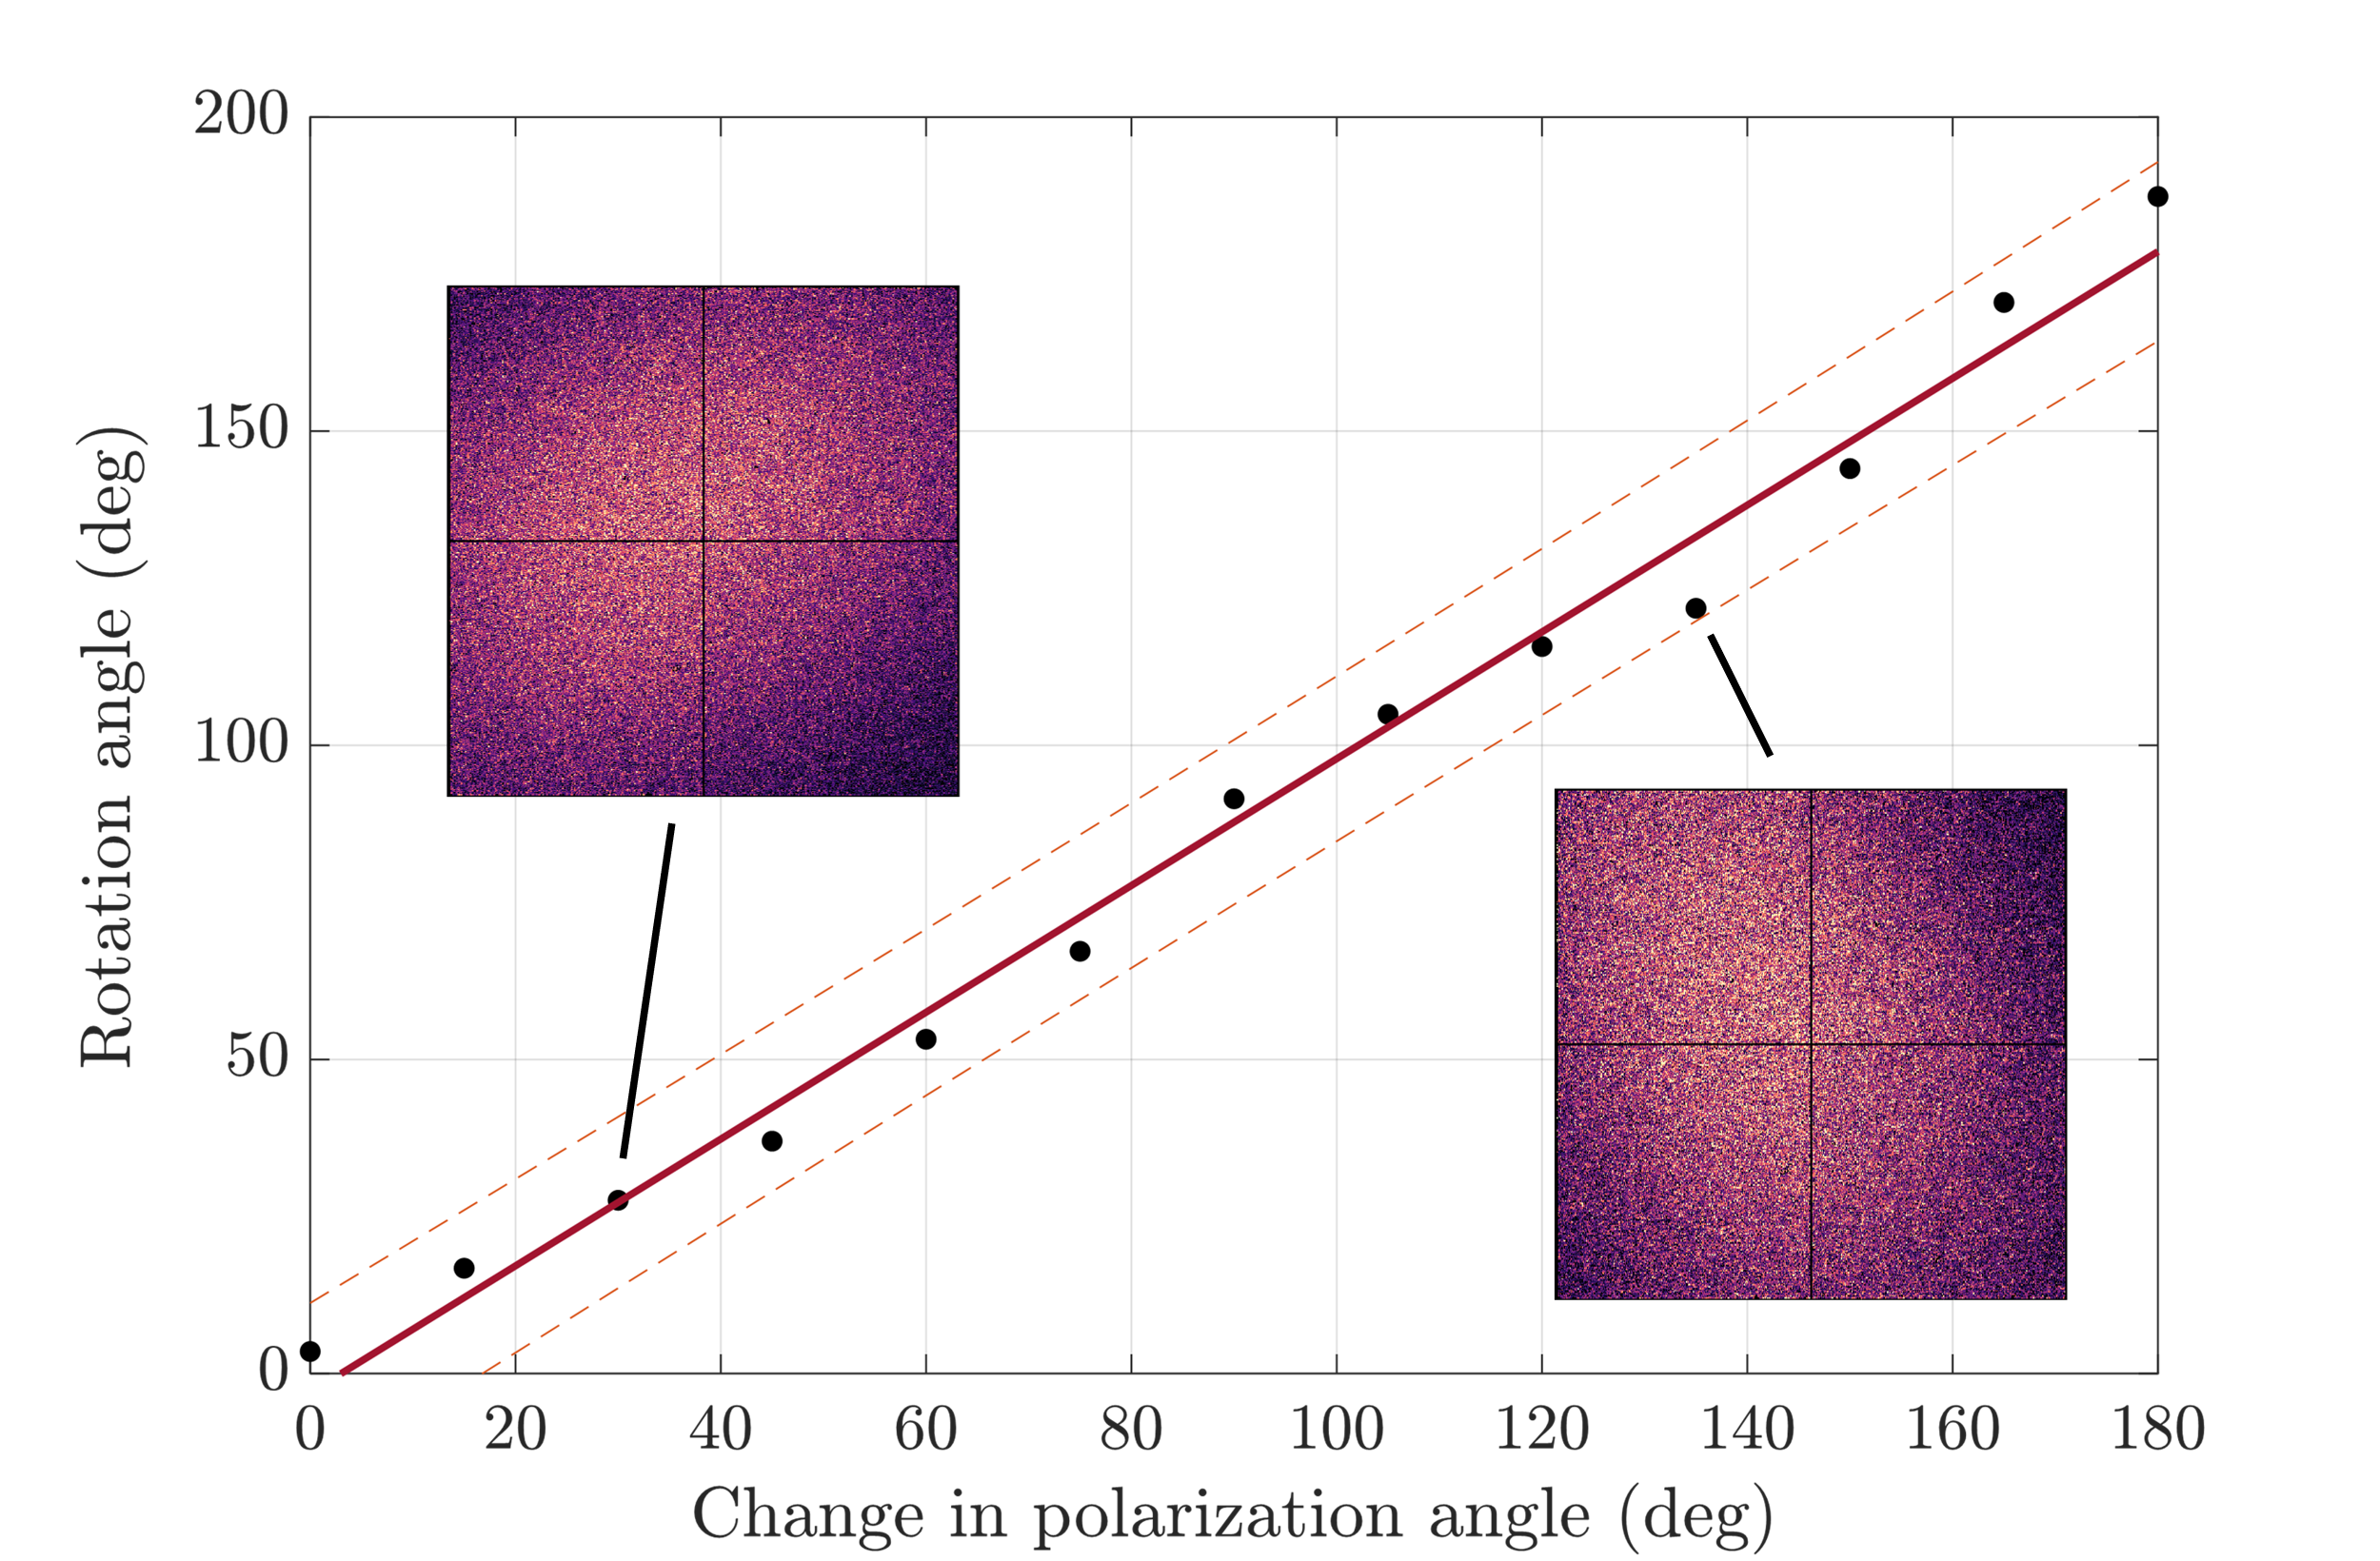
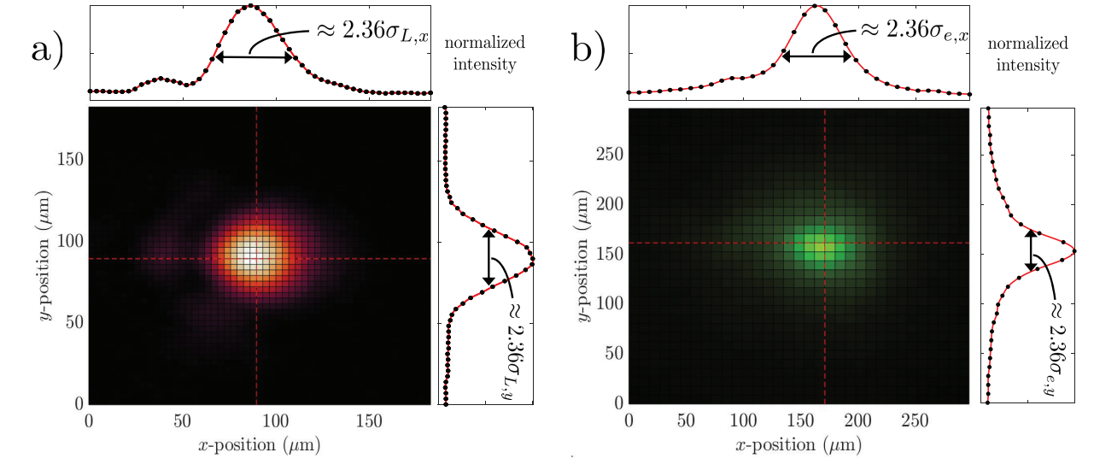
Photon distribution
x-ray results
Counts per shot: 1200
Counts per shot: 1700
70% of prediction! Very stable and repeatable!
short pulses
partial coherence
polarization switch
More info: van Elk, I. J. M., et al. "First x-rays from a compact and tunable LINAC-based Compton scattering source." arXiv preprint arXiv:2504.11897 (2025). accepted for publication

Slide 14
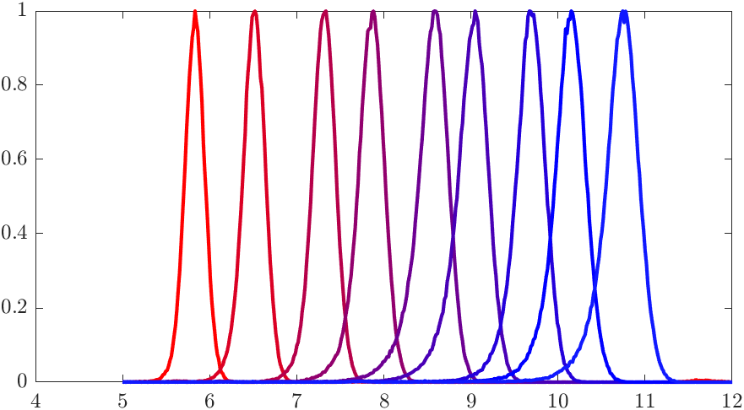
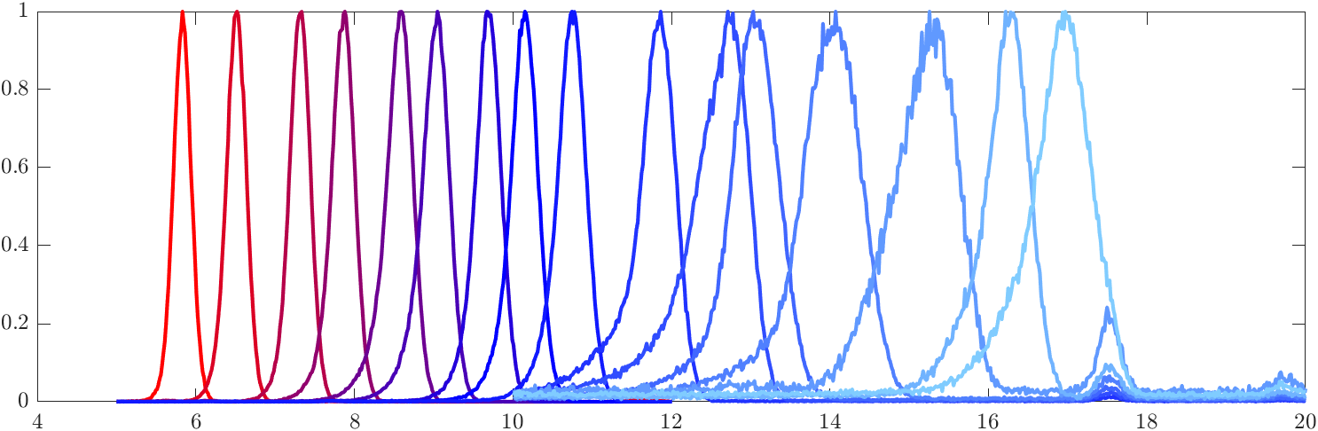

Continuous energy tunability
x-ray results
x-ray results
4% x-ray energy spread (FWHM)
1% electron energy spread (FWHM)
Special thanks to
Matthieu Boone and Pieter Tack! (UGent)
More info: van Elk, I. J. M., et al. "First x-rays from a compact and tunable LINAC-based Compton scattering source." arXiv preprint arXiv:2504.11897 (2025). accepted for publication

Slide 15


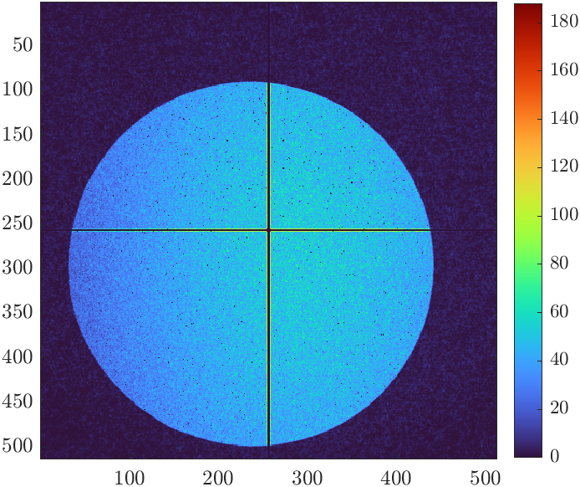
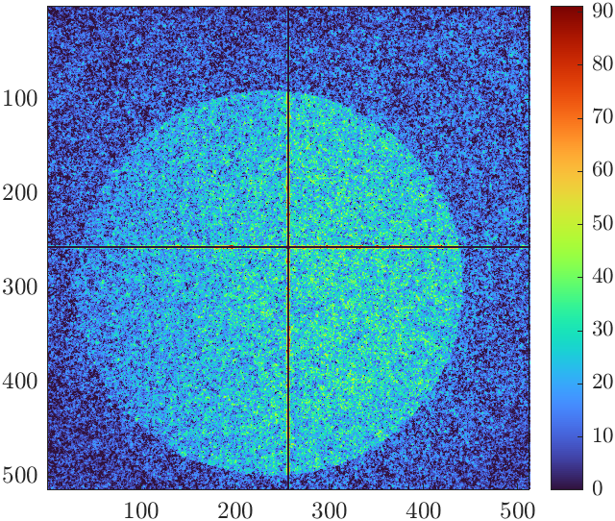
Background suppression
Background suppression
Causes
Reduced detector efficiency at high energy
Bremsstrahlung from e-beam
Dark current from accelerator
Solutions
Spatial filtering with optics
Fresnel zone plate
Temporal filtering with ultrafast detectors
Timepix3

Slide 16
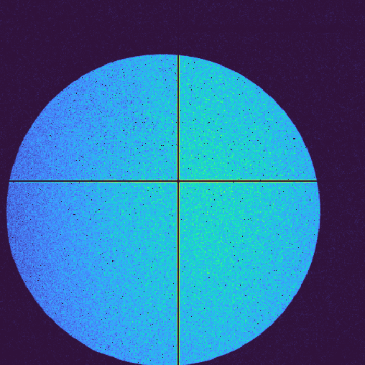
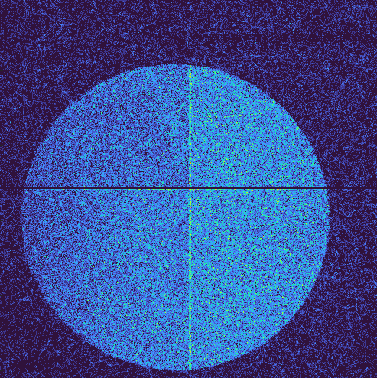
Background suppression
Background suppression
keV
17.5 keV
Unfiltered
SNR 20:1
Unfiltered
SNR 0.9:1
Filltered
SNR 80:1
Filtered
SNR 5:1

Slide 17
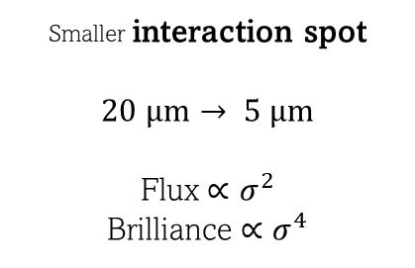
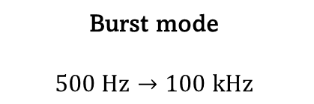
x-ray status and improvements
Coming Year
Following Years
 | Current status | improvements | Future developments
x-ray flux in 1%BW (ph/s/1%BW) | 1×10⁴ | 2 ×10⁶ | 10⁹
brilliance (ph/s/mm² /mrad² /0.1%BW) | 2×10⁵ | 3×10⁸ | 10¹³
energy range (keV) | 5 – 17 | 5 – 20 | 0.1 – 20
Coming Year:
Future developments:
Increase repetition rate
Burst mode
$$500 Hz→100 kHz$$
Smaller interaction spot
$$20 μm→ 5 μm$$
Flux $∝σ^{2}$
Brilliance $∝σ^{4}$

Slide 18
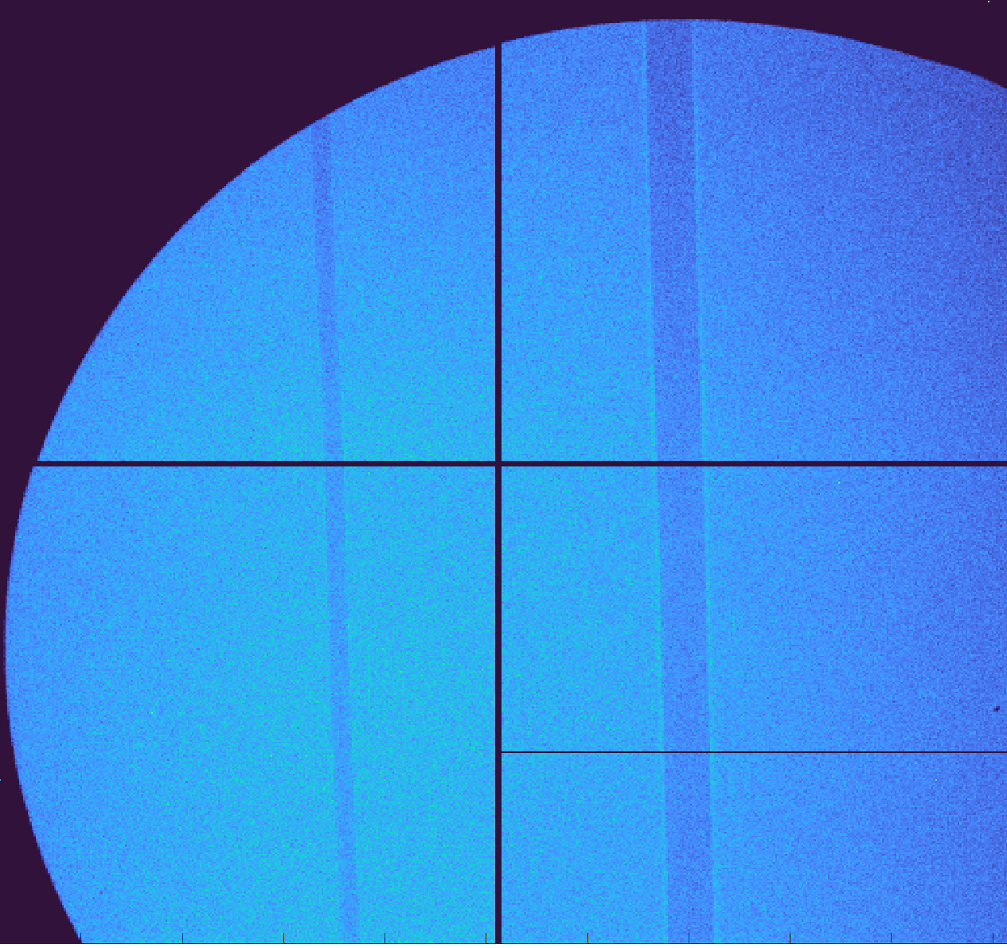
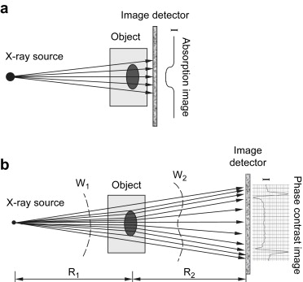


Phase contrast imaging
Phase shift
absorption
First testing
19-09-2025
Refractive index: $n=1−δ+i β$
Nylon wire 500 μm
Soft tissue with 10+ keV x-rays:
$δ/β$ $≃100 −1000$
10 keV x-rays
10 cm from detector
150 cm from detector
Image: Zhou, Shu-Ang, and Anders Brahme, Physica Medica 24.3 (2008): 129-148.

Slide 19
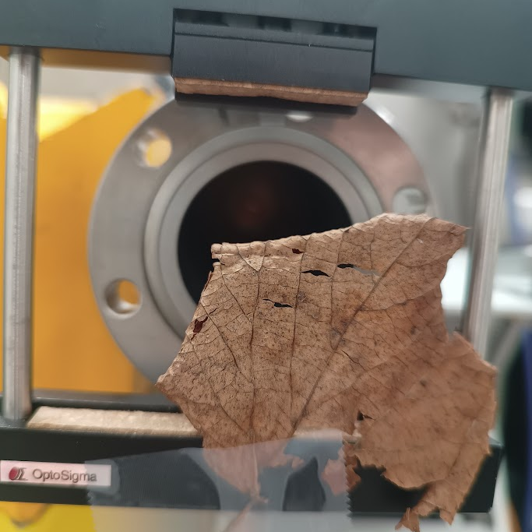
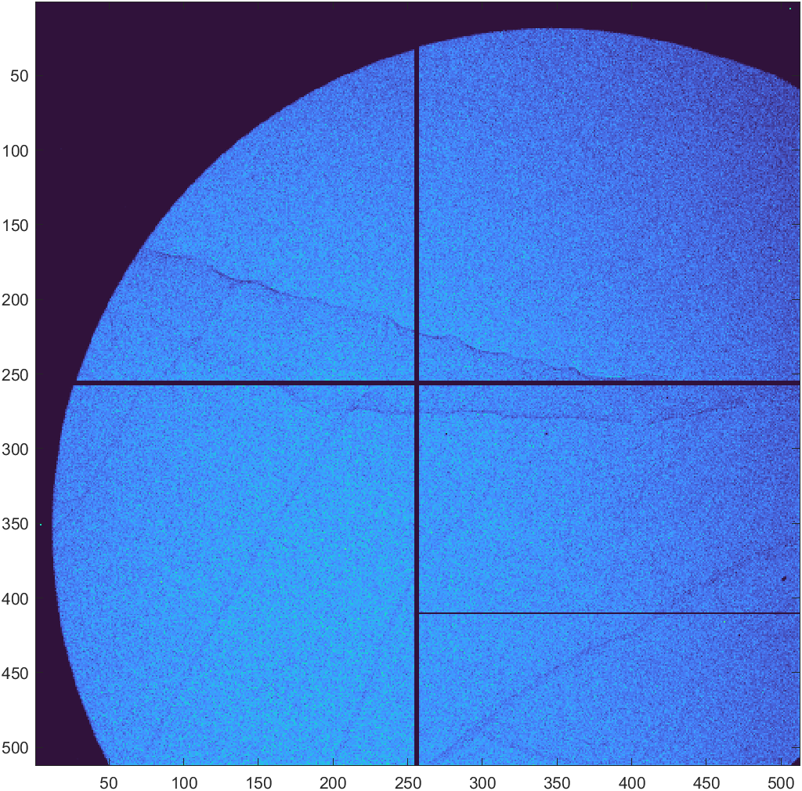
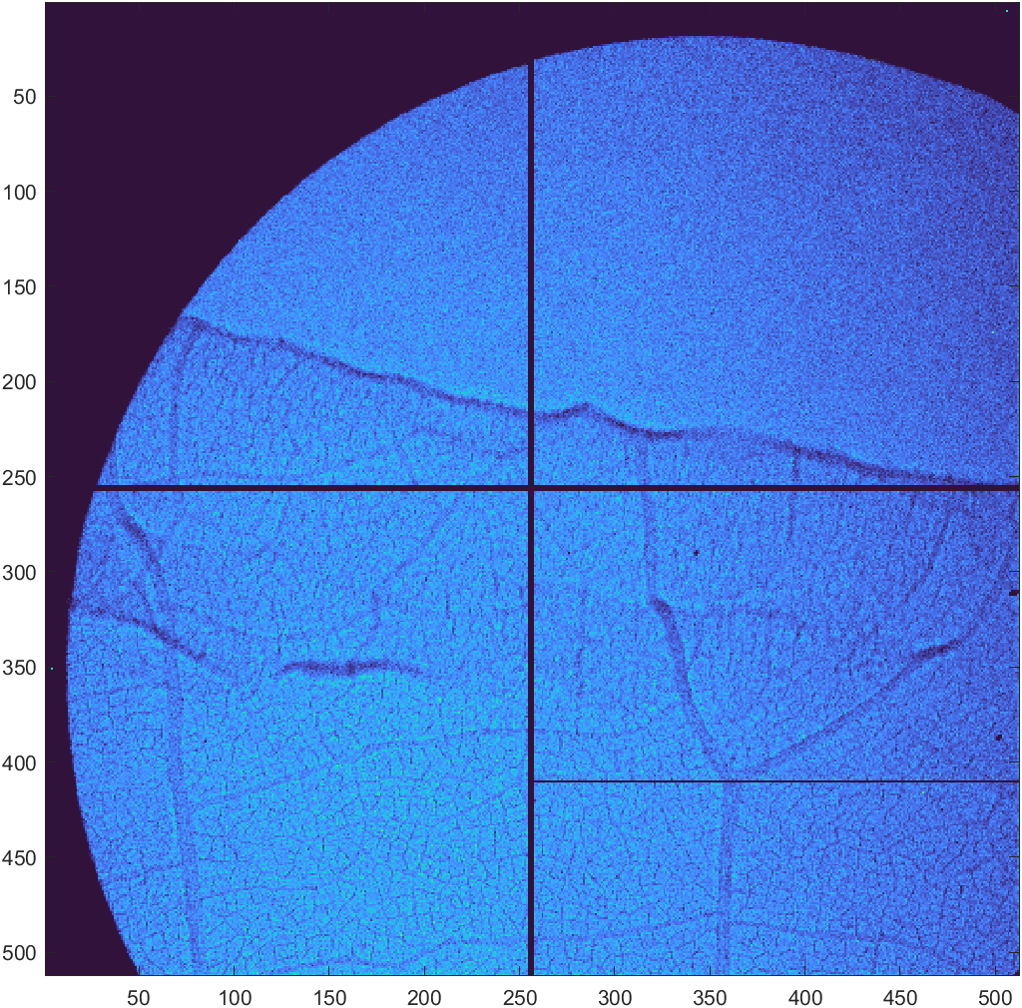
Phase contrast imaging
First testing
19-09-2025
10 cm from detector
150 cm from detector
Air
leaf
3 cm
1.5 cm

Slide 20





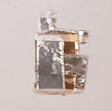



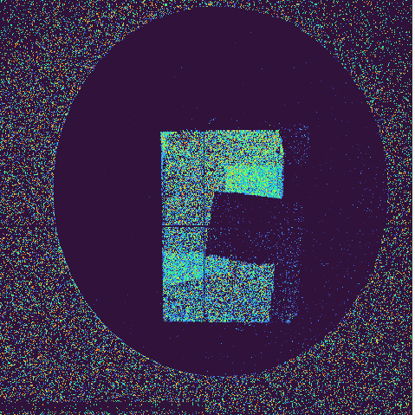
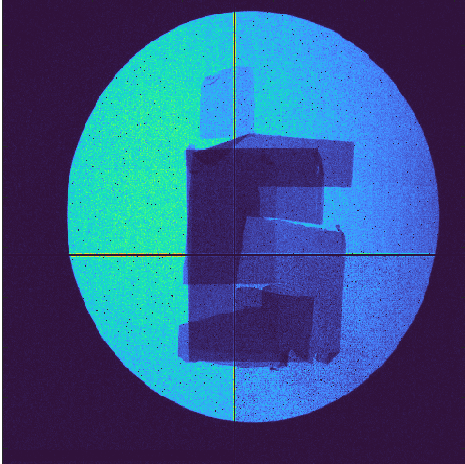
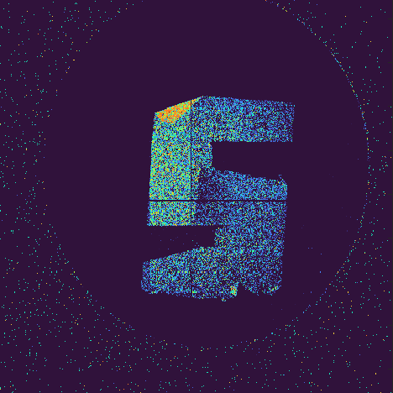
K-edge subtractive imaging
Zn
Ni
Cu
Zn
Cu
Ni
Ni
Cu
Zn
Images taken with TimePix3 detector

Slide 21



Concluding remarks
Conclusion
Future
Compact tunable x-ray source based on a X-band LINAC
Demonstration experiments for medical applications
(and many other)
Competitive with state-of-art
x-ray tubes
with continuous energy tunability
Works as advertised

Slide 22
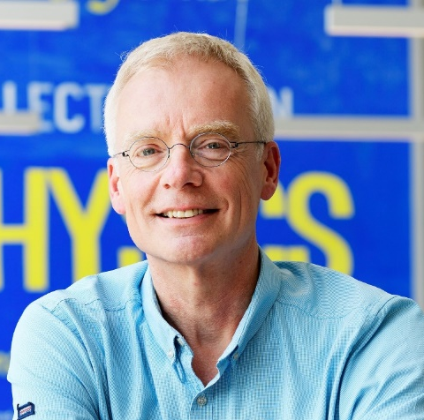
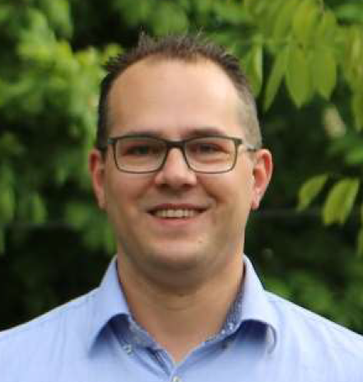
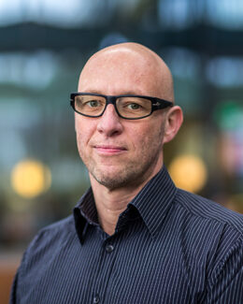
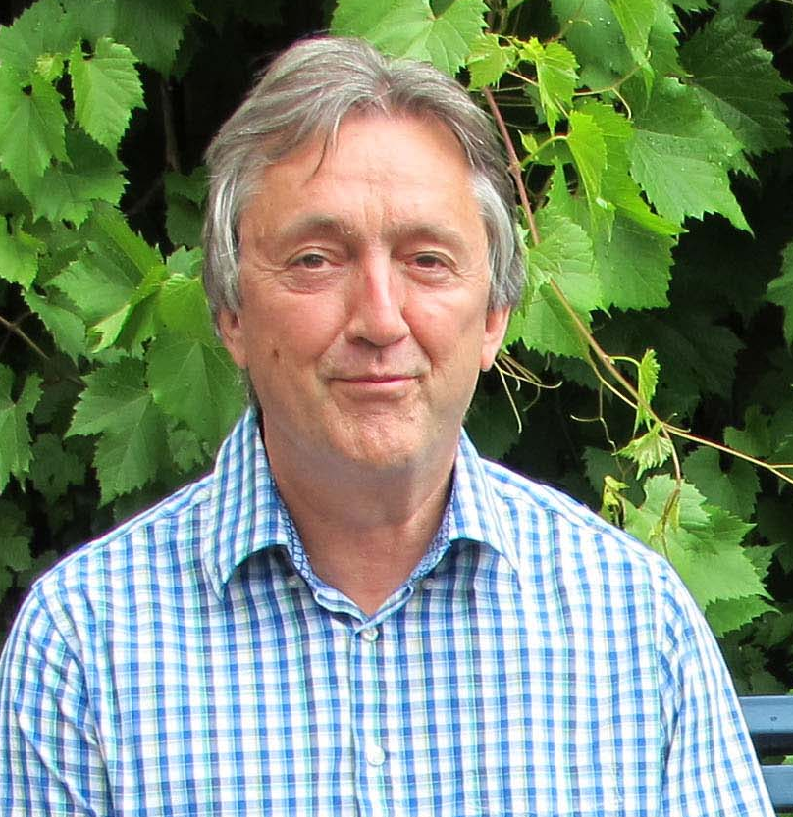
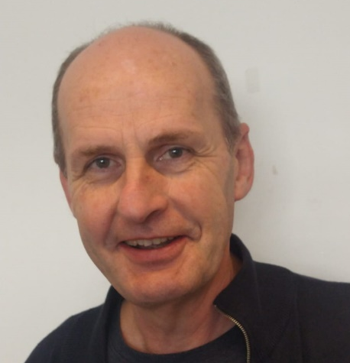
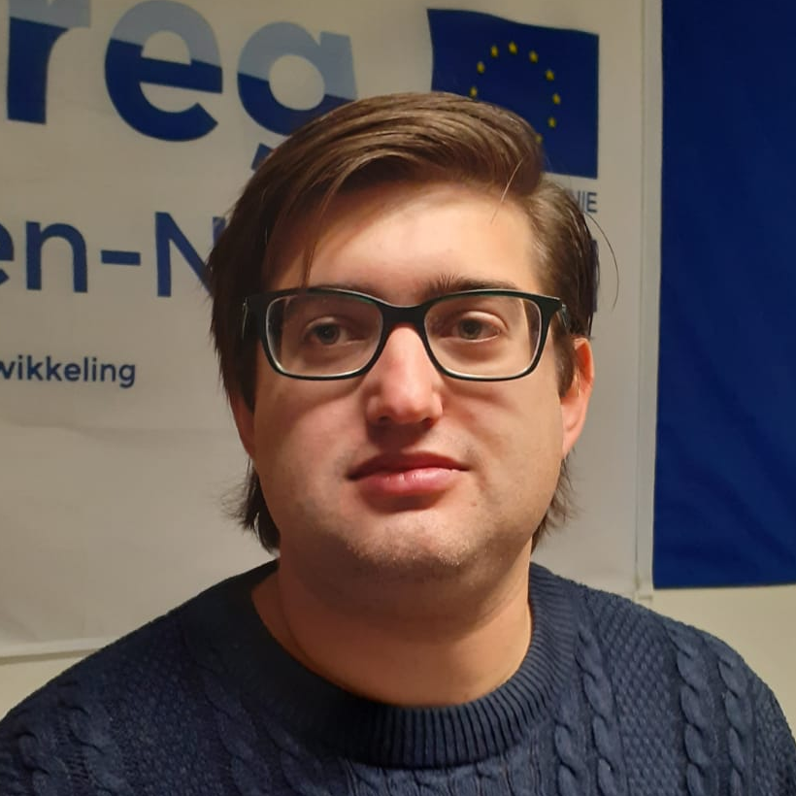
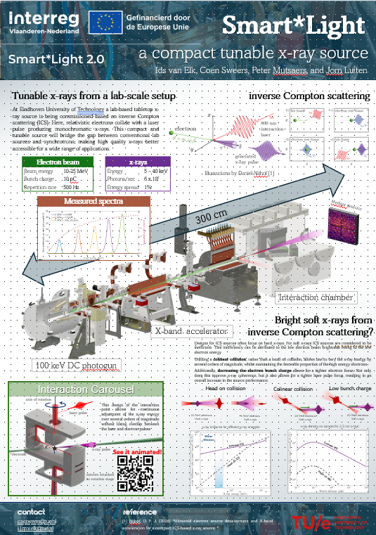
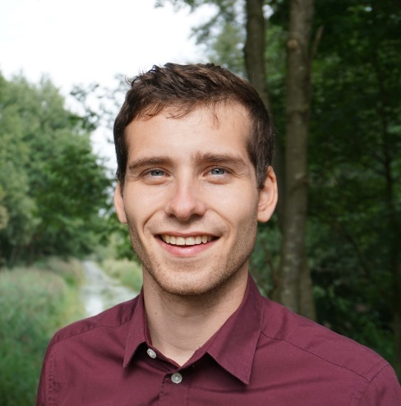
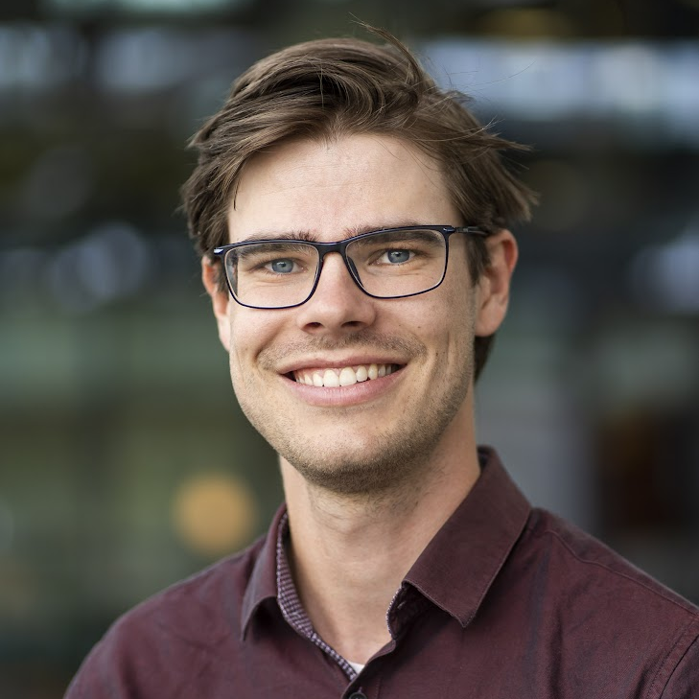
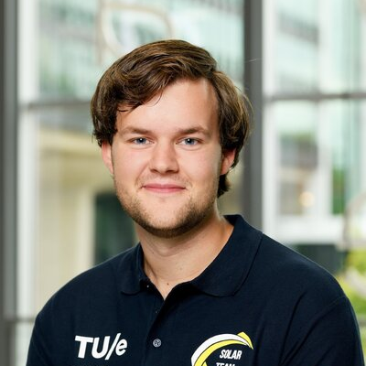


Thank you for your attention!
Poster session

Slide 23




Background suppression
Background suppression
Solutions
Spatial filtering with x-ray optics
ICS x-rays
Bremsstrahlung
Fresnel zone plate
pinhole
Under construction
winter 2025
Images: appliednt.com/zone-plates/#hard-x-ray

Slide 24






Background suppression
Background suppression
Solutions
Temporal filtering with ultrafast detectors
RF pulse length 200 ns
x-rays pulse length 1 ps
Laser off
Laser on
ICS x-rays
Time resolution TimePix3 1.5 ns
Bremsstrahlung
Conventional camera
TimePix camera
ICS x-rays
Figure: ASI scientific instruments

Slide 25







Soft x-rays
Head on collision
Grazing collision
20 MeV electrons
Hard x-rays
5 MeV electrons
Soft x-rays
20 MeV electrons
Soft x-rays
Change the interaction angle without loss of spatio-temporal overlap
Continuous energy tunability over several orders of magnitude
x-ray Brightness for different x-ray energies
Grazing ICS
Head on ICS
Patent Pending

Slide 26
x-ray results
partial coherence

Slide 27
Polarization
x-ray results
Change laser polarization
Change x-ray polarization
Change x-ray distribution

Slide 28




x-ray results

Slide 29

Future developments
Burst mode
Repetition rate limited by Klystron and laser (500-1000 Hz)
Solutions: new source that accelerates 300 e-bunches per Klystron pulse + couple laser pulse into cavity

