Slide 1



Laser Wakefield Acceleration Experimental Area at the CLF Extreme Photonics
Applications Centre
Daniel Symes
Central Laser Facility
Rutherford Appleton Laboratory
7th European Advanced Accelerator Conference, September 2025
Notes:
The abstract pattern can be removed or repositioned if required. Be careful to ‘Send to Back’ so that it does not obscure any important information.

Slide 2
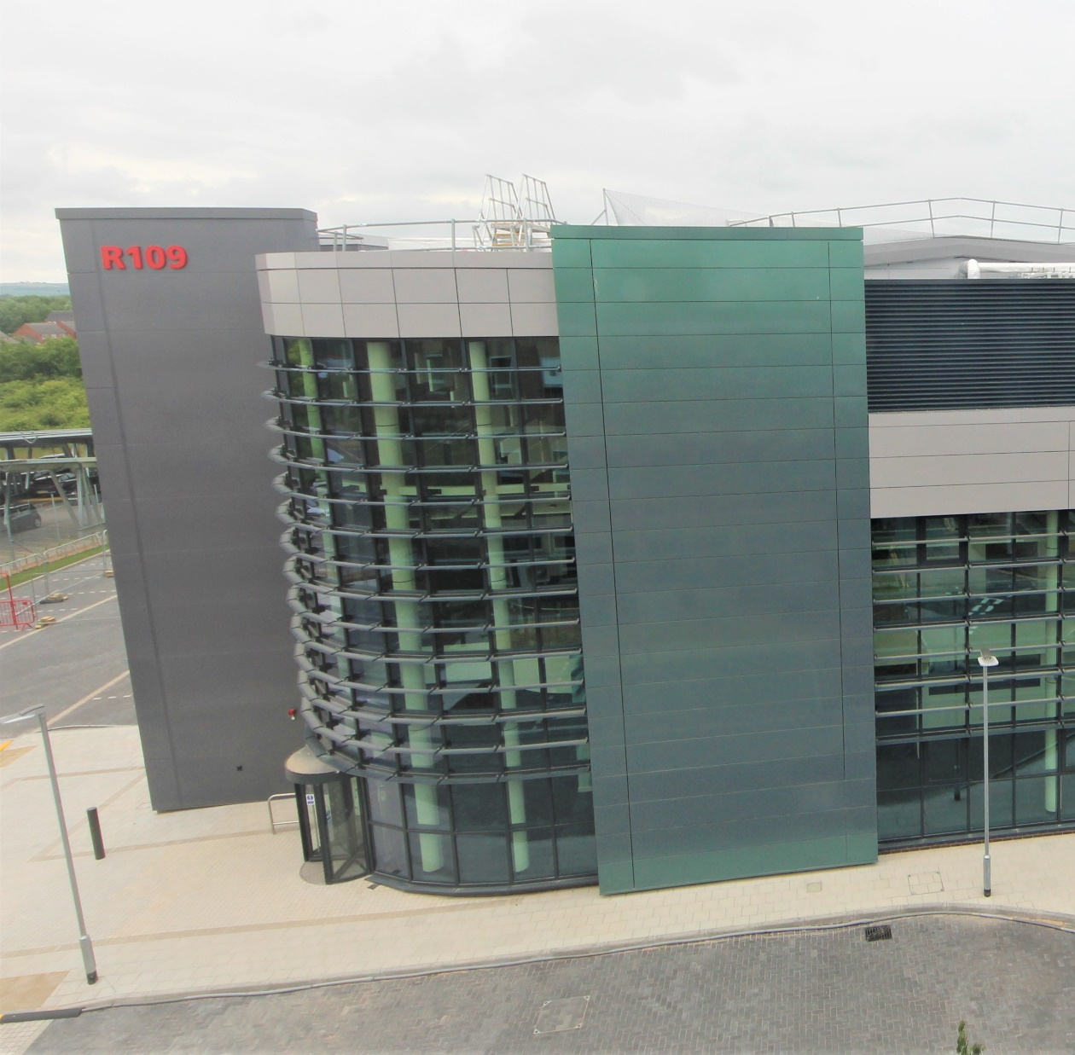
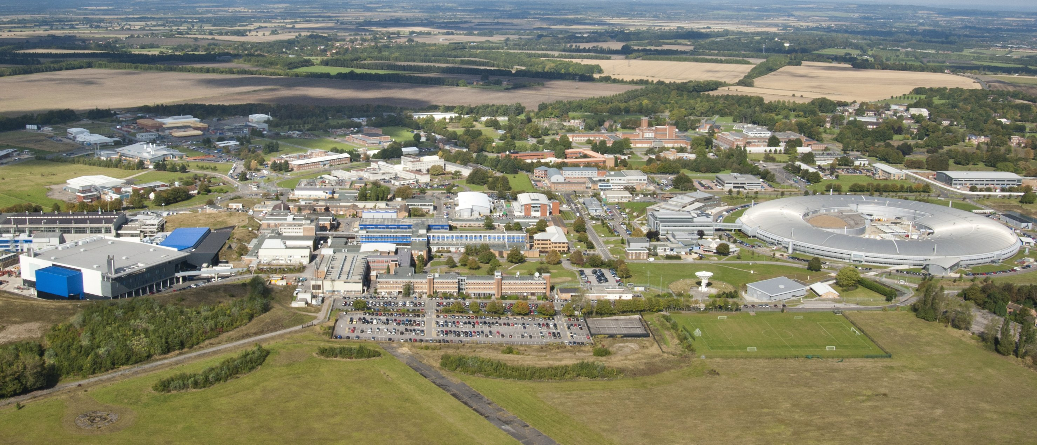
EPAC is a major facility development at the STFC Rutherford Appleton Laboratory
10 Hz PW laser based on DiPOLE DPSSL technology
High Power Laser User Facility
Development of plasma accelerators for applications
Notes:
Delete boxes as required

Slide 3
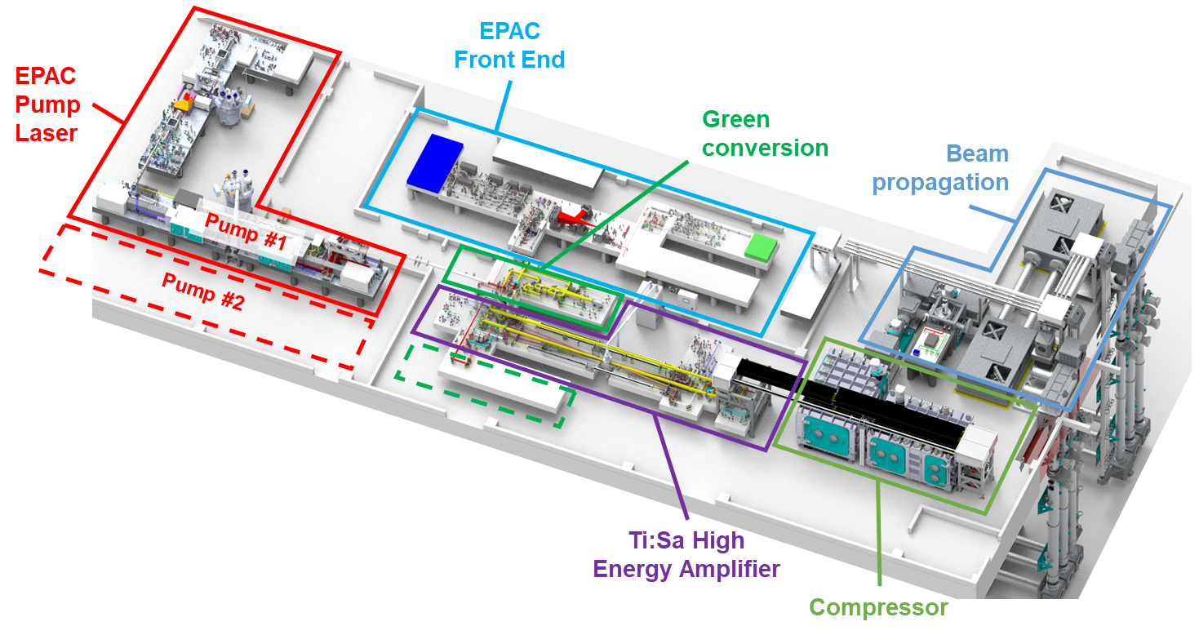
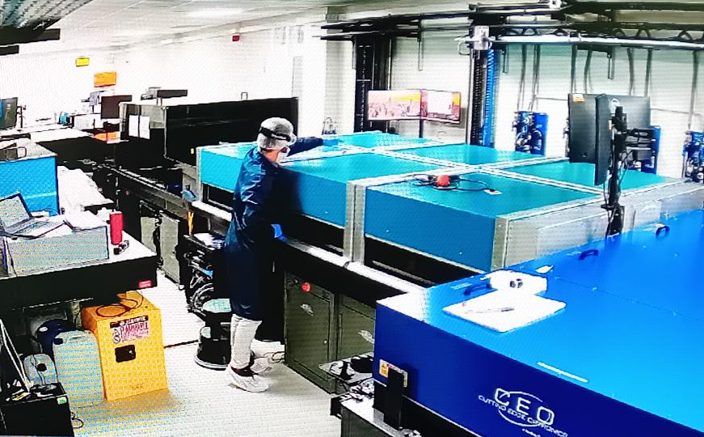
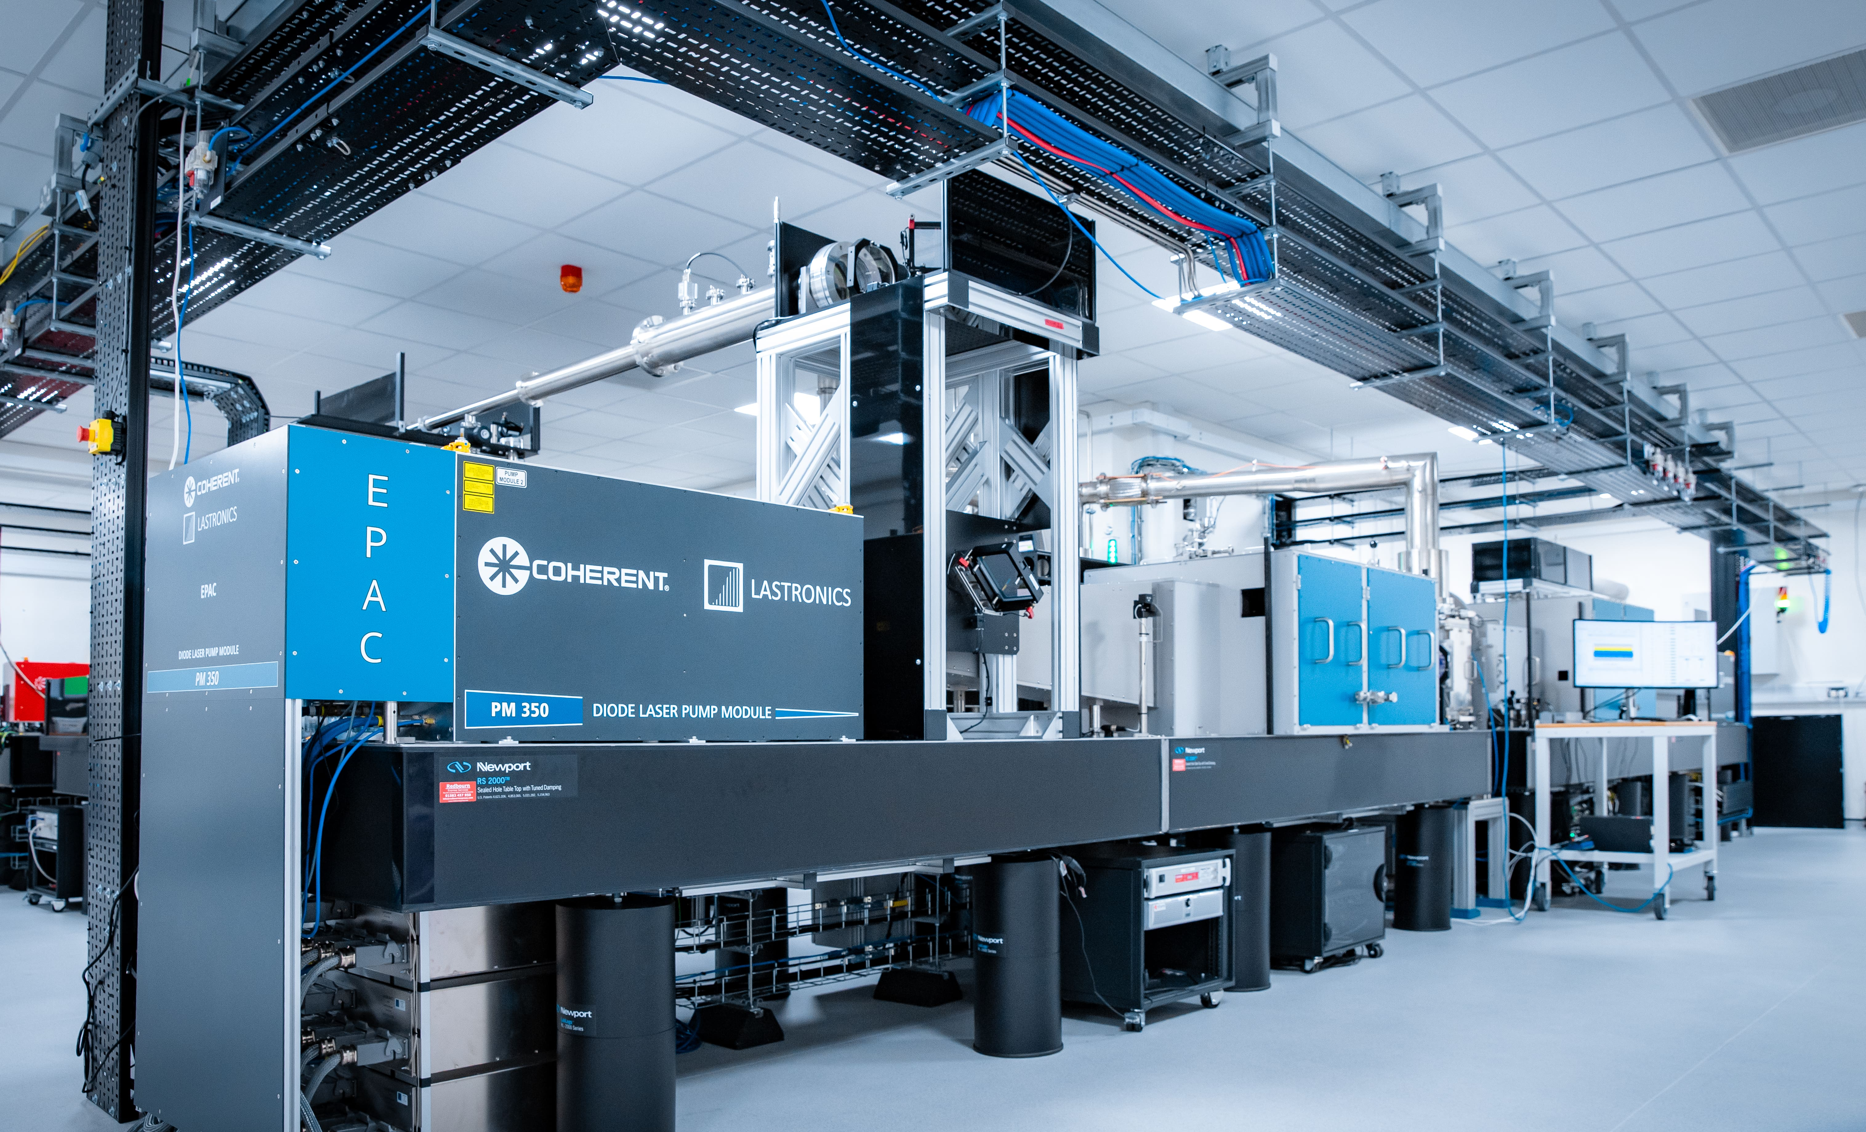
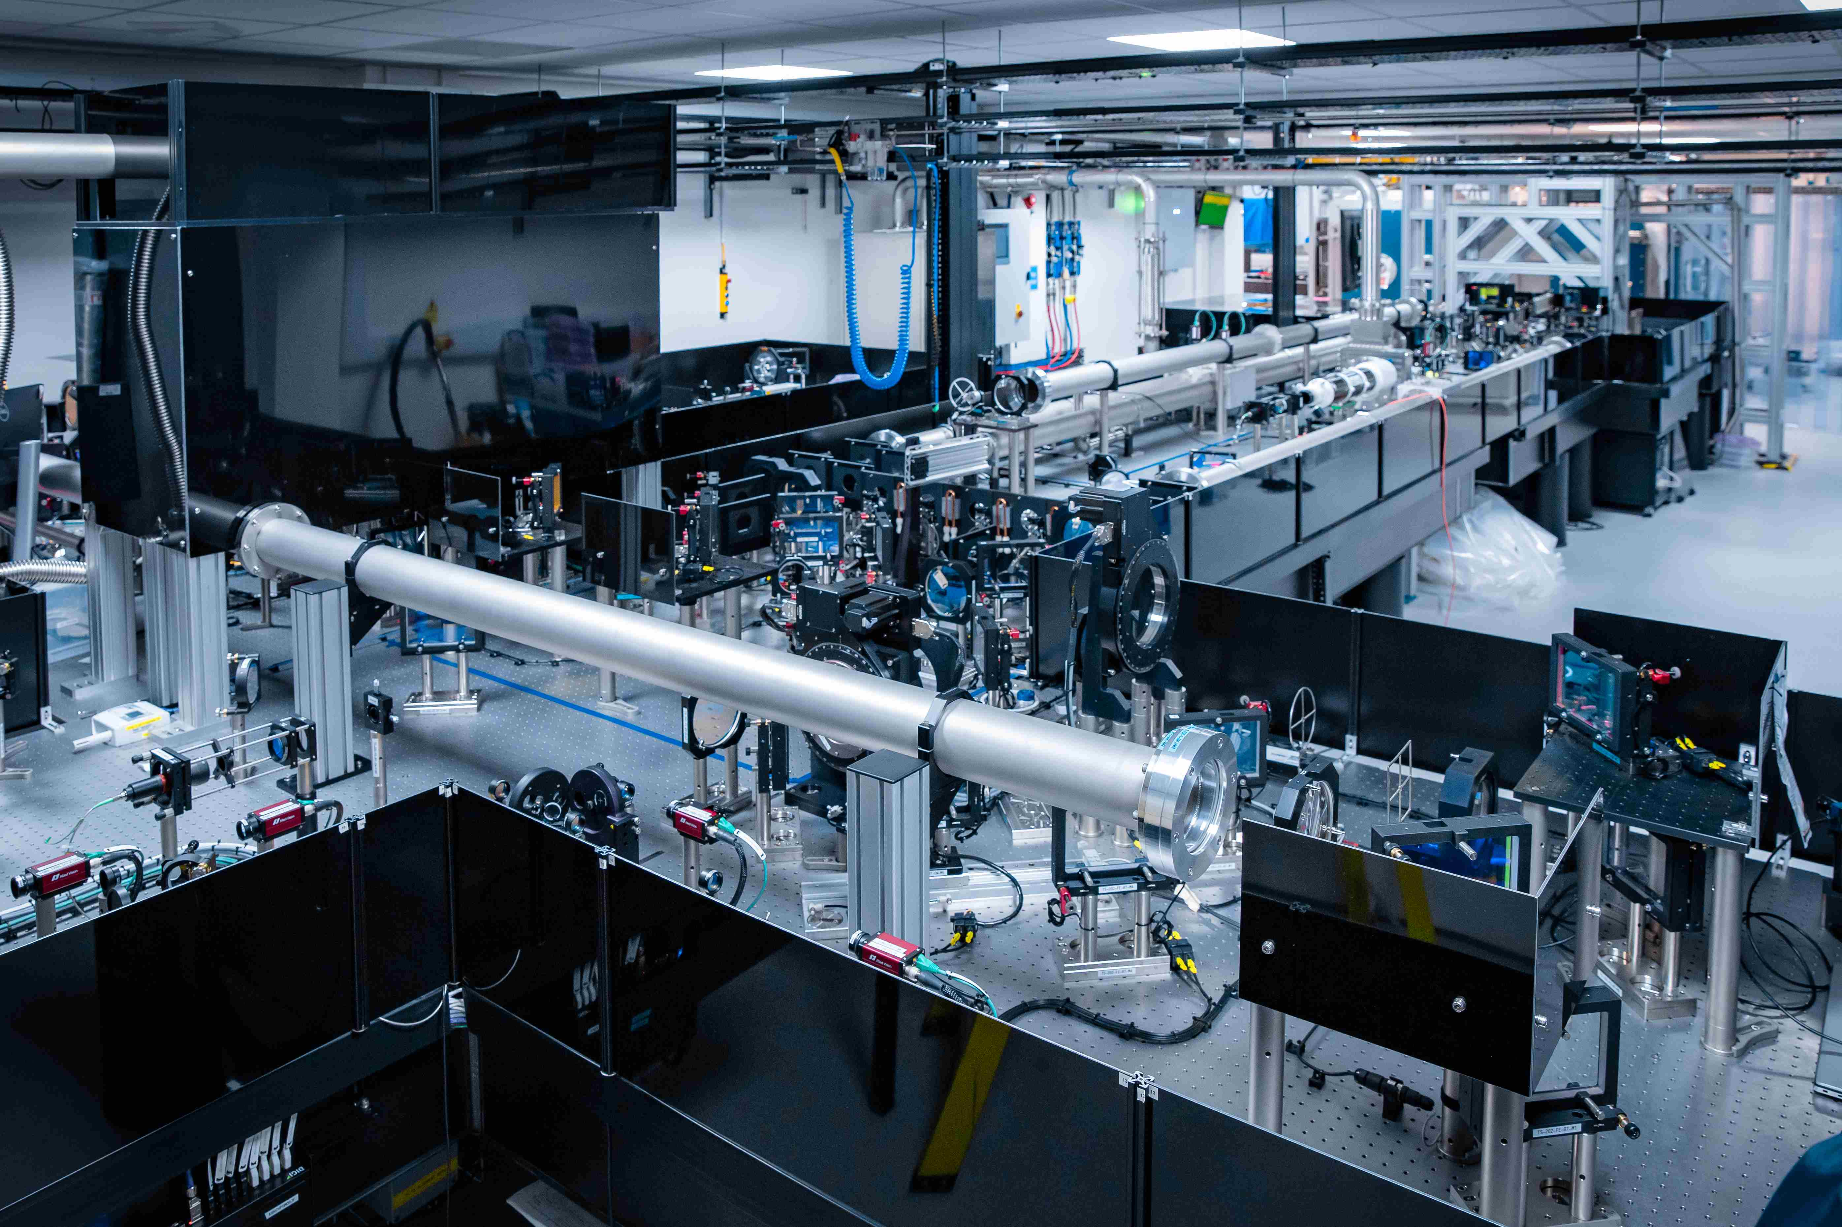
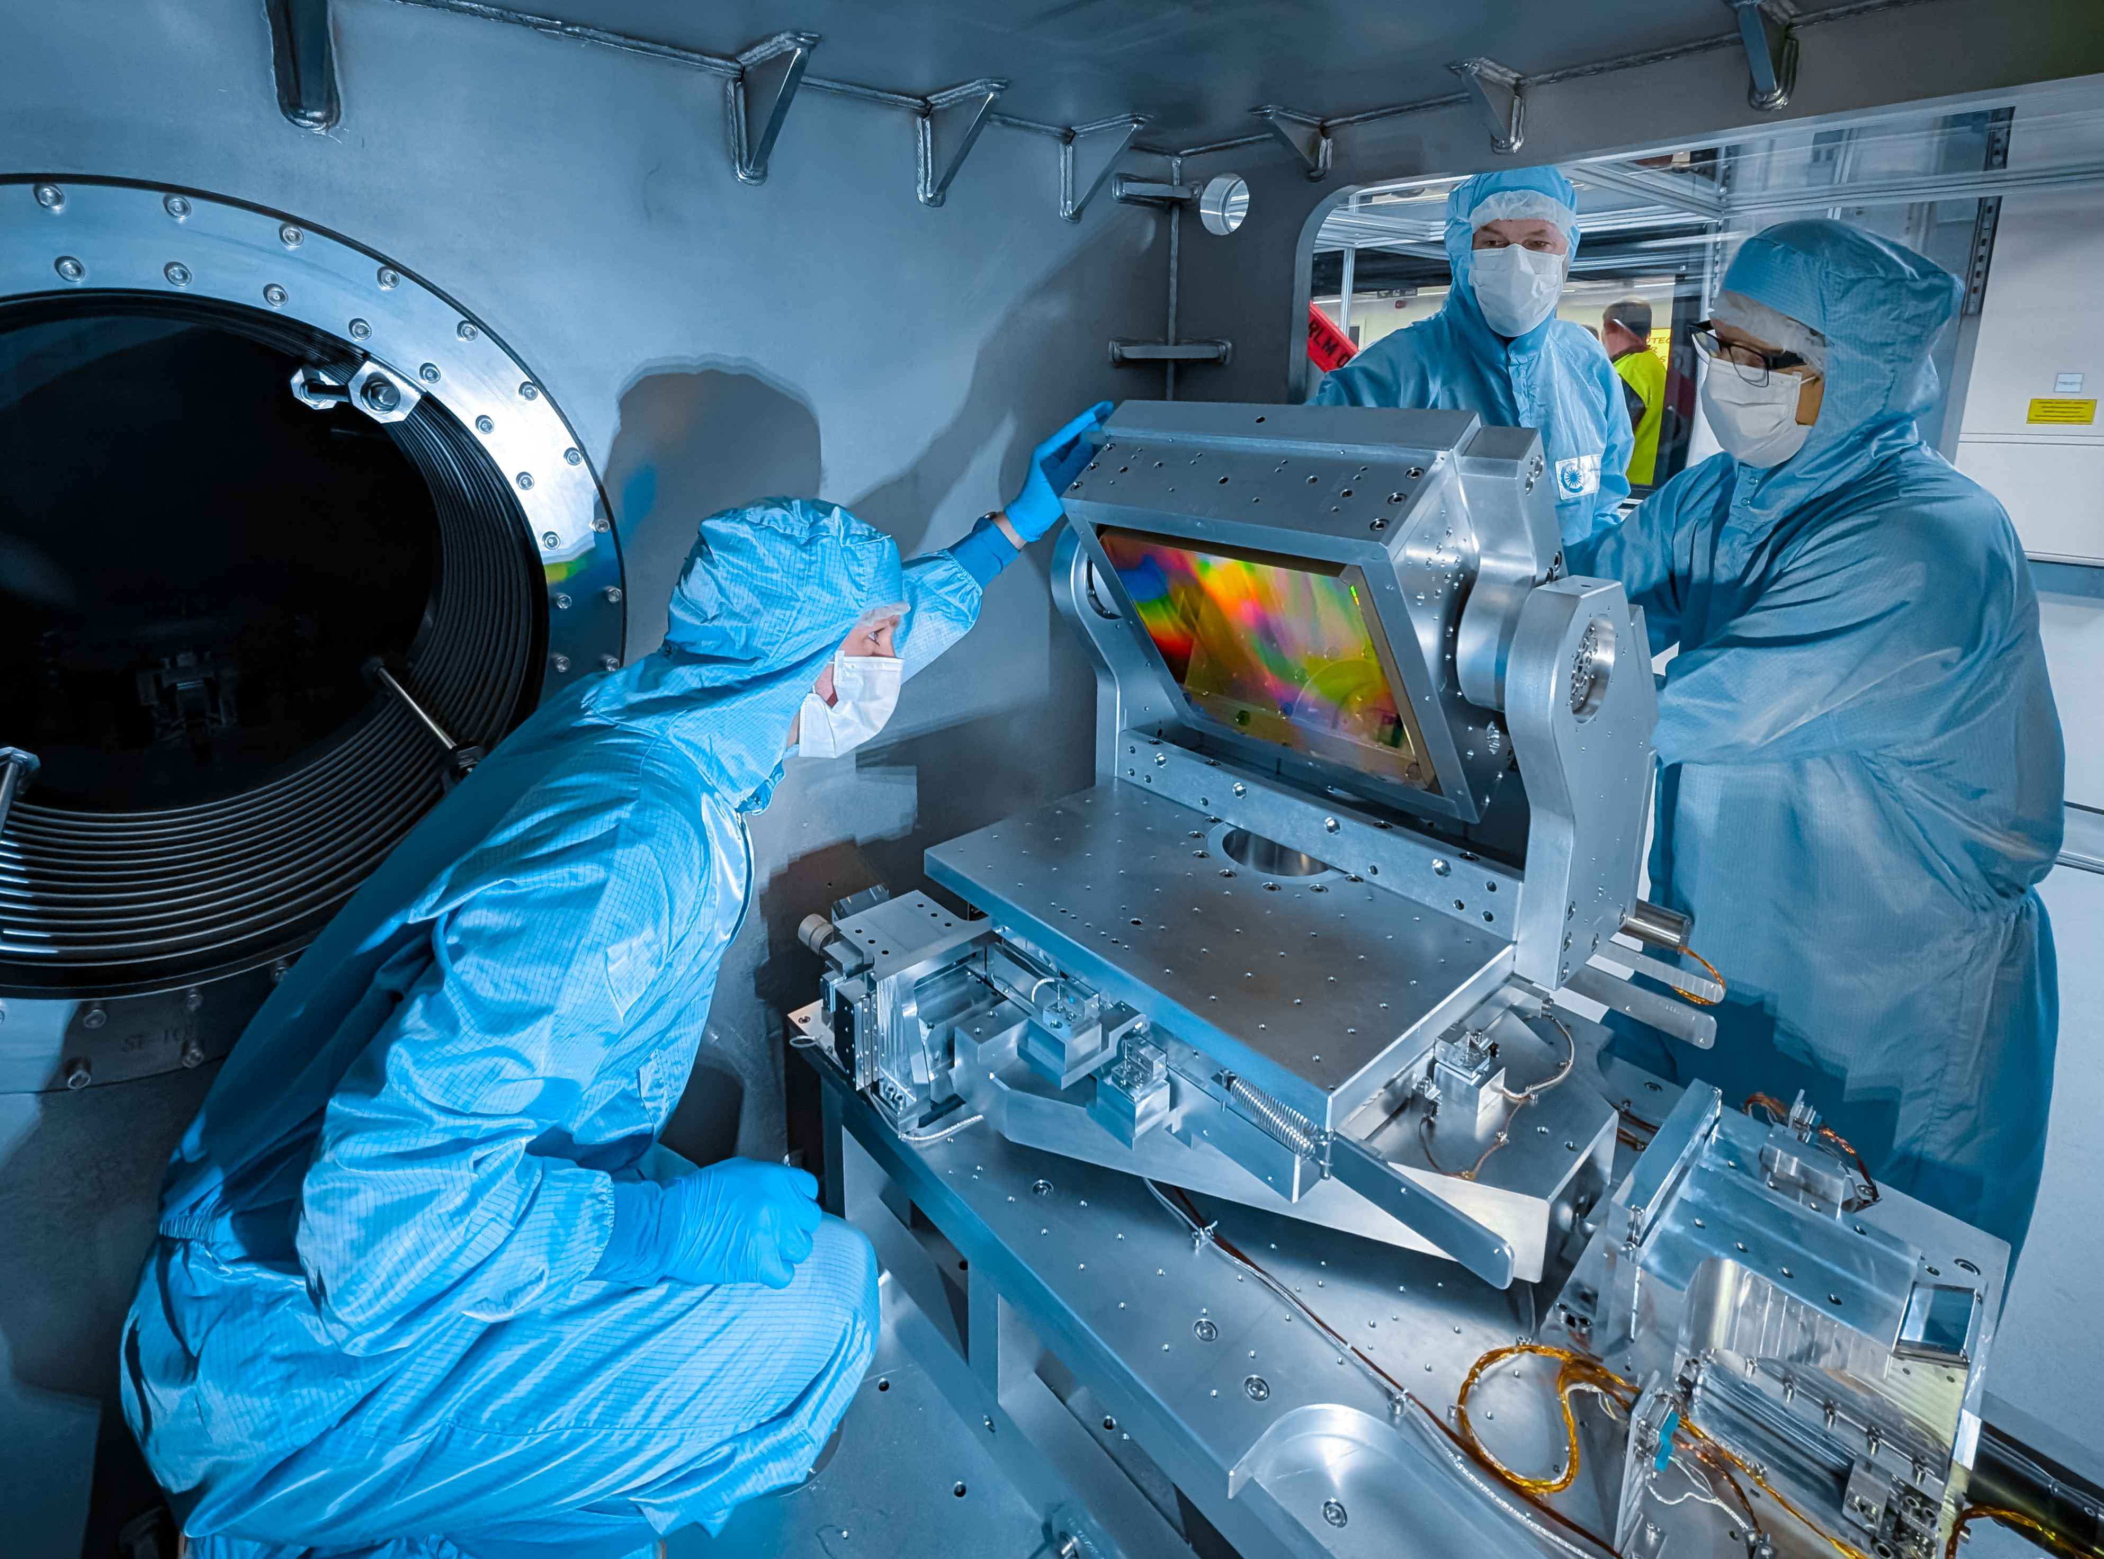
EPAC 10 Hz PW laser
Development of high peak and high pulse rate drivers for accelerators: opportunities and challenges
Mariastefania De Vido, Thursday am plenary
~ 1J OPCPA front end
DiPOLE DPSSL pump
Ti:Sa amplifier
Gold and MLD gratings
30 J, ≤ 30 fs @ 10 Hz
Notes:
Delete boxes as required

Slide 4
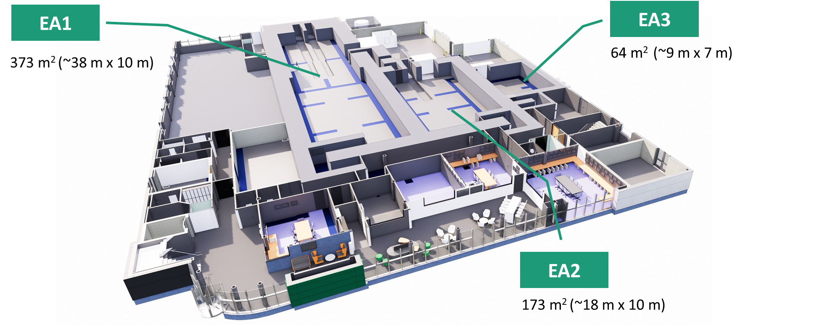
Ground Floor – experimental areas
Experimental Area 1
40 m x 10 m
Long-focus configuration
Primarily gas targets
Experimental Area 3
9 m x 7 m
Future development
Experimental Area 2
18 m x 10 m
Short-focus (f/3) configuration
Primarily solid density targets
Notes:
Delete boxes as required

Slide 5
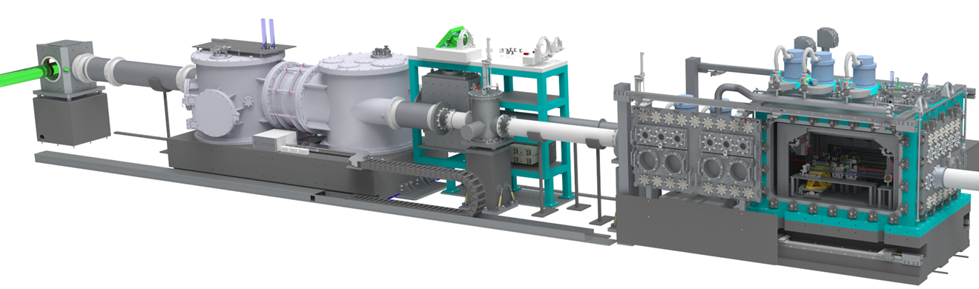
EPAC Experimental Area 1
Turning chamber
Beam focusing
Interaction chamber
Off-axis parabola: focal length 10 m (f / 45)
Intensity mid-10¹⁸ W cm⁻² (a₀ ~ 1 – 2)
1 Hz and 10 Hz operating modes
10 Hz energy limited by gold gratings
Notes:
Delete boxes as required

Slide 6
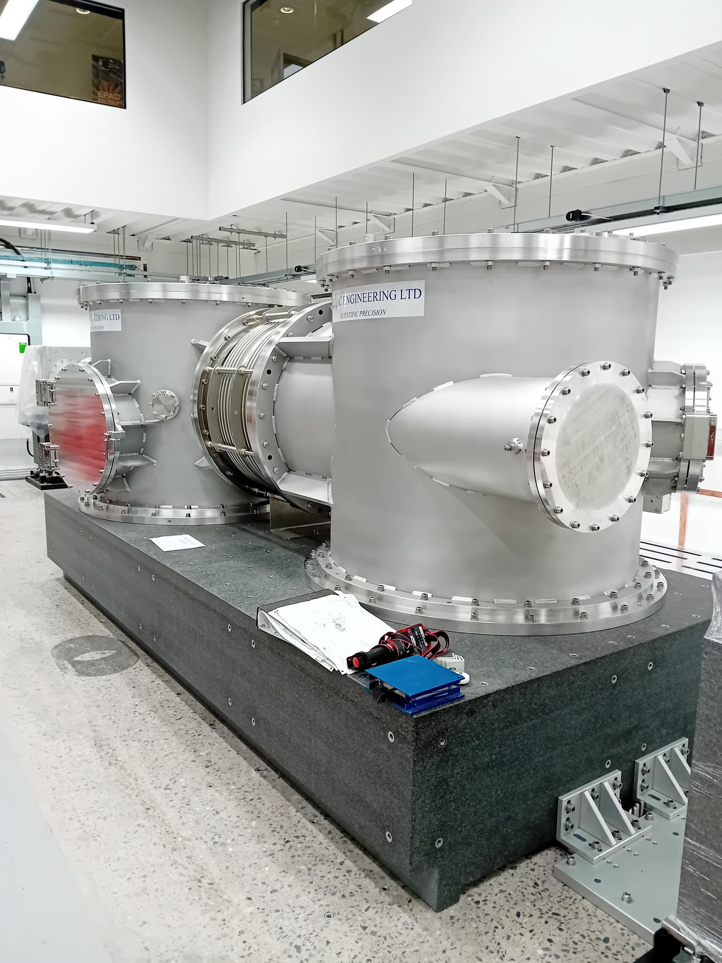
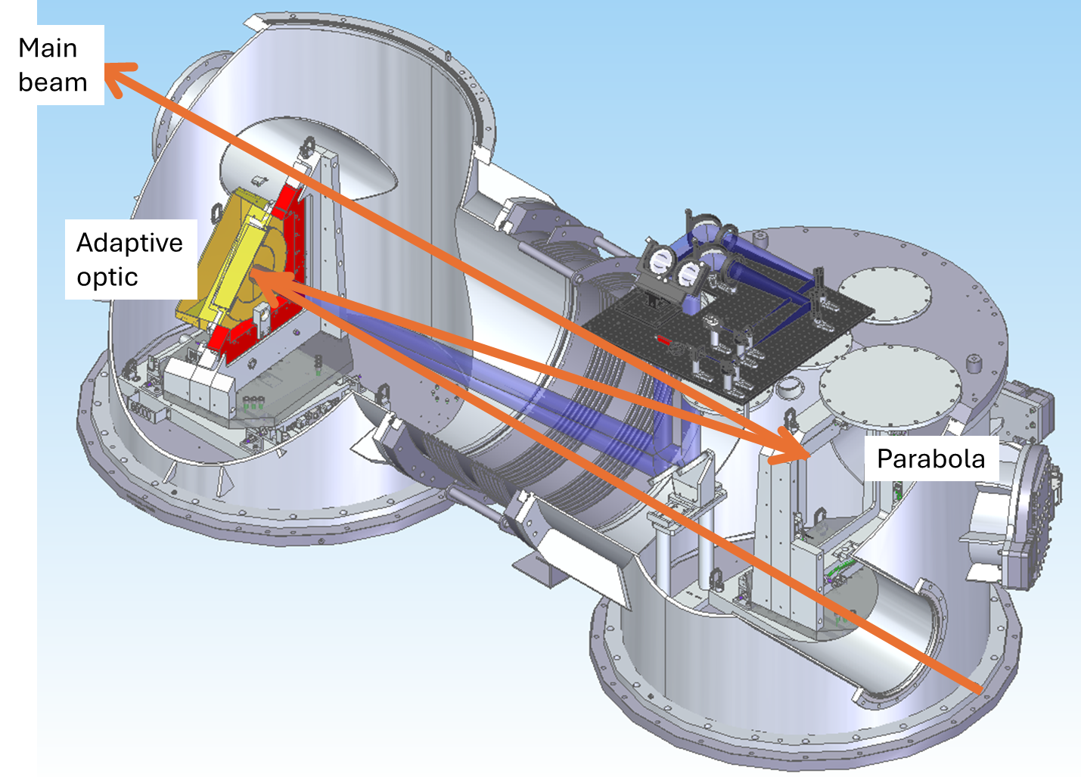
Focusing chamber
Installed on movable granite block
(up to 14.5 m focal length)
Day-one 10 m focal length parabola
Adaptive optic from ISP-system
Notes:
Replace this guidance text with your own bullet pointed content.
For further guidance please see https://www.bdadyslexia.org.uk/advice/employers/creating-a-dyslexia-friendly-workplace/dyslexia-friendly-style-guide

Slide 7
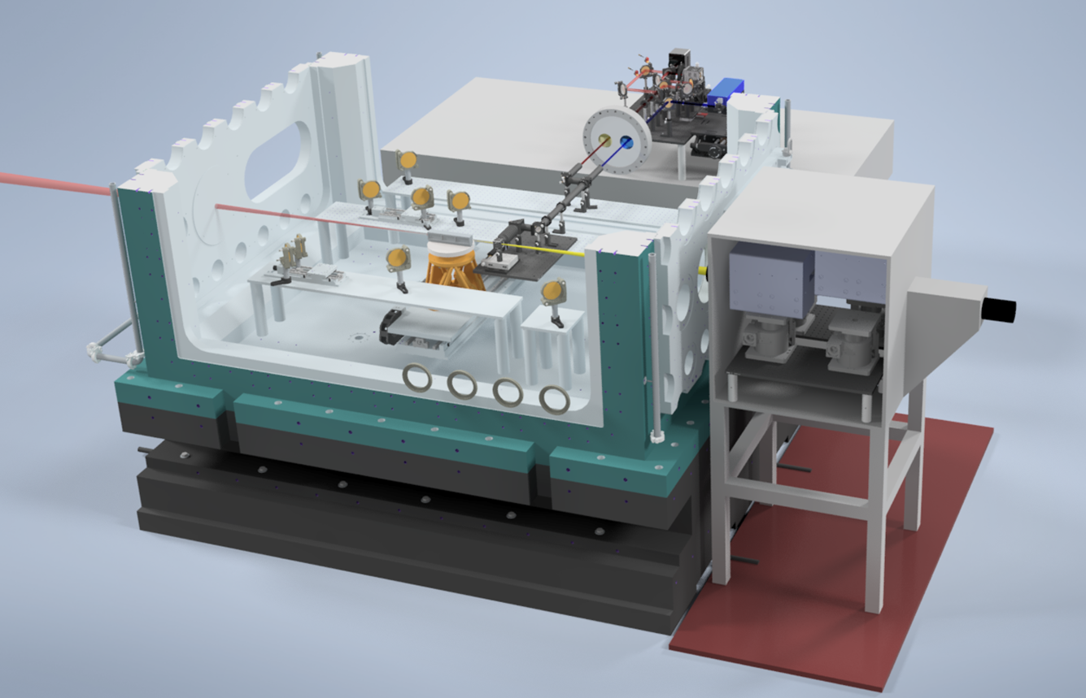
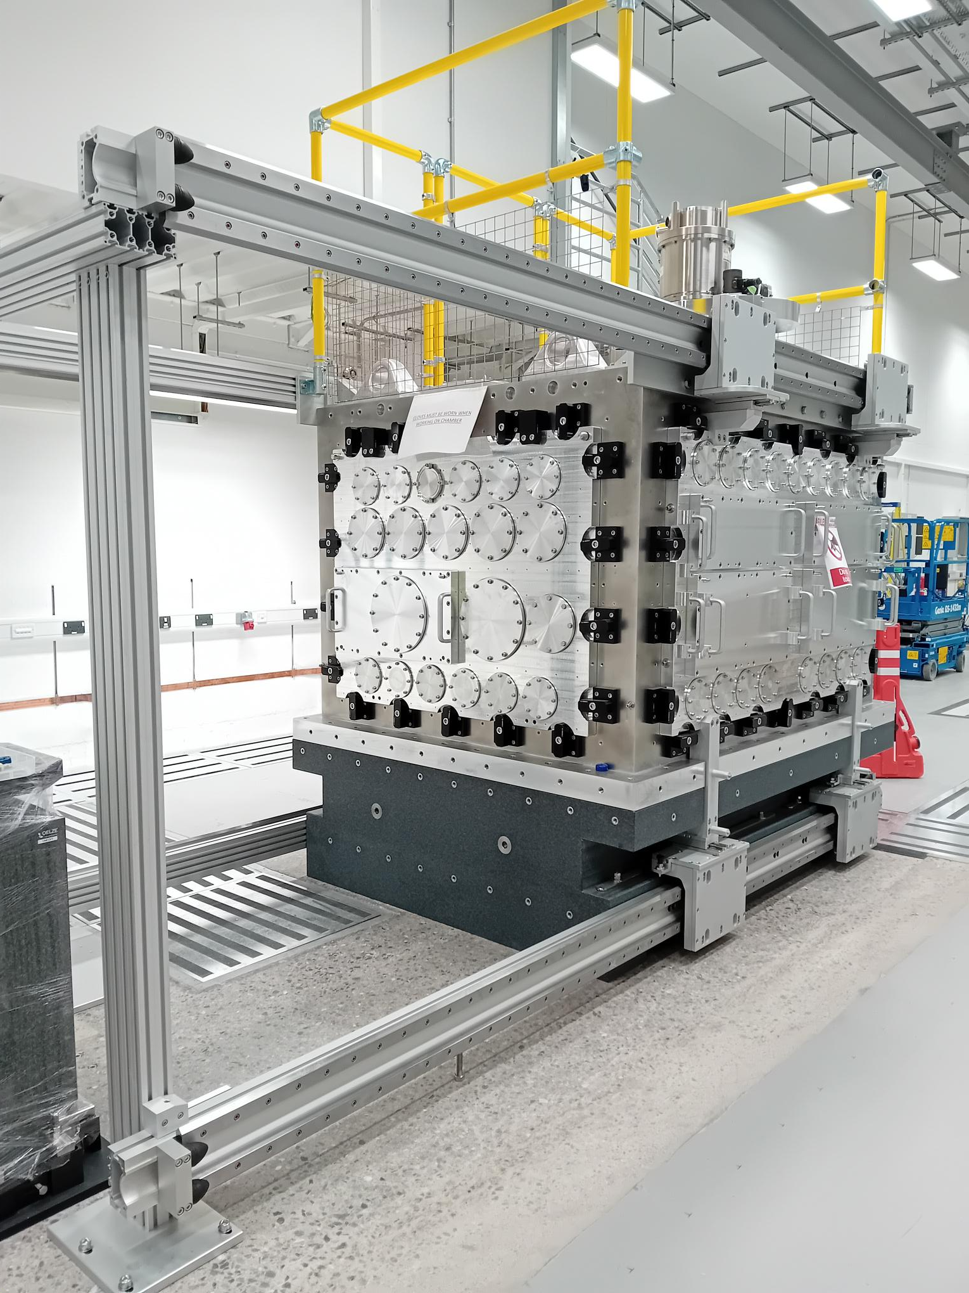
Interaction chamber
LWFA target (up to metre-scale)
Plasma optical diagnostics
Transition radiation diagnostics
Quadrupole magnets
Option for close-in spectrometer
Notes:
Replace this guidance text with your own bullet pointed content.
For further guidance please see https://www.bdadyslexia.org.uk/advice/employers/creating-a-dyslexia-friendly-workplace/dyslexia-friendly-style-guide

Slide 8
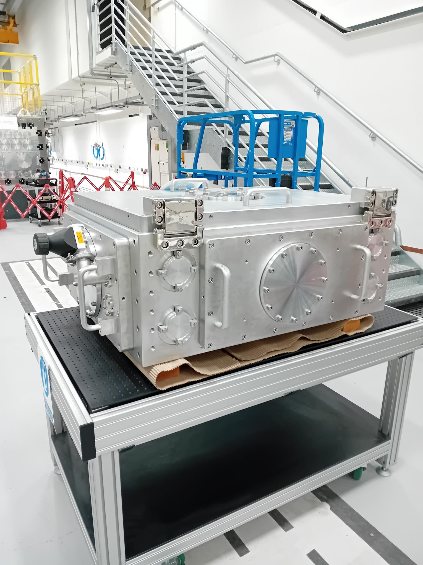
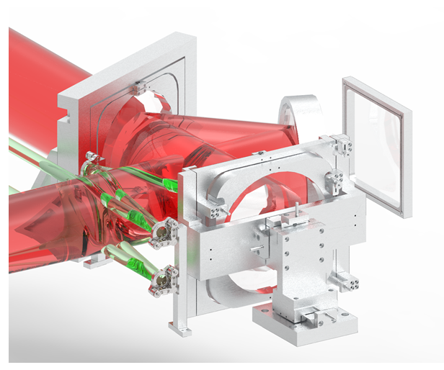
Exit mode chamber
Optics to attenuate and collimate
Diagnostics for beam profile, wavefront, pulse shape, spectrum
Notes:
Replace this guidance text with your own bullet pointed content.
For further guidance please see https://www.bdadyslexia.org.uk/advice/employers/creating-a-dyslexia-friendly-workplace/dyslexia-friendly-style-guide

Slide 9
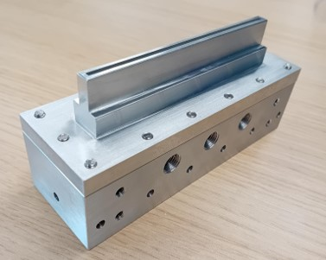
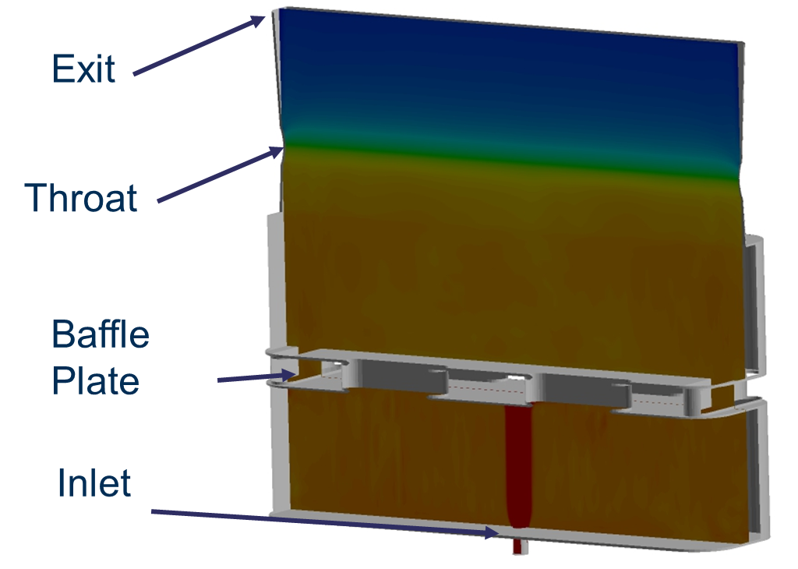
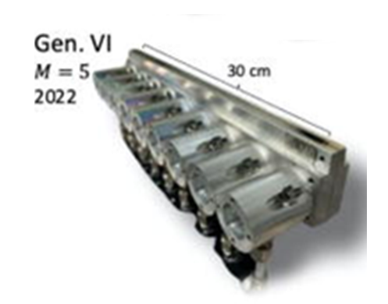
We are producing gas jet targets for EA1
Slot nozzles up to 100 mm in length
Designed and manufactured in-house
Aiming to develop metre-scale targets based on Maryland designs
Will need J-level auxiliary beam for HOFI channels
Metre-scale gas jet
Rockafellow Phys. Plasmas 32, 053102 (2025)
Notes:
Delete boxes as required

Slide 10
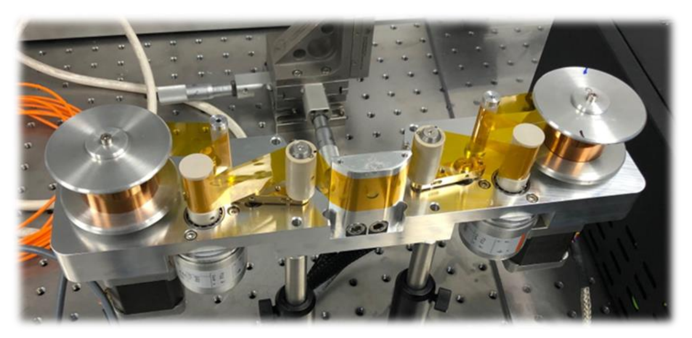
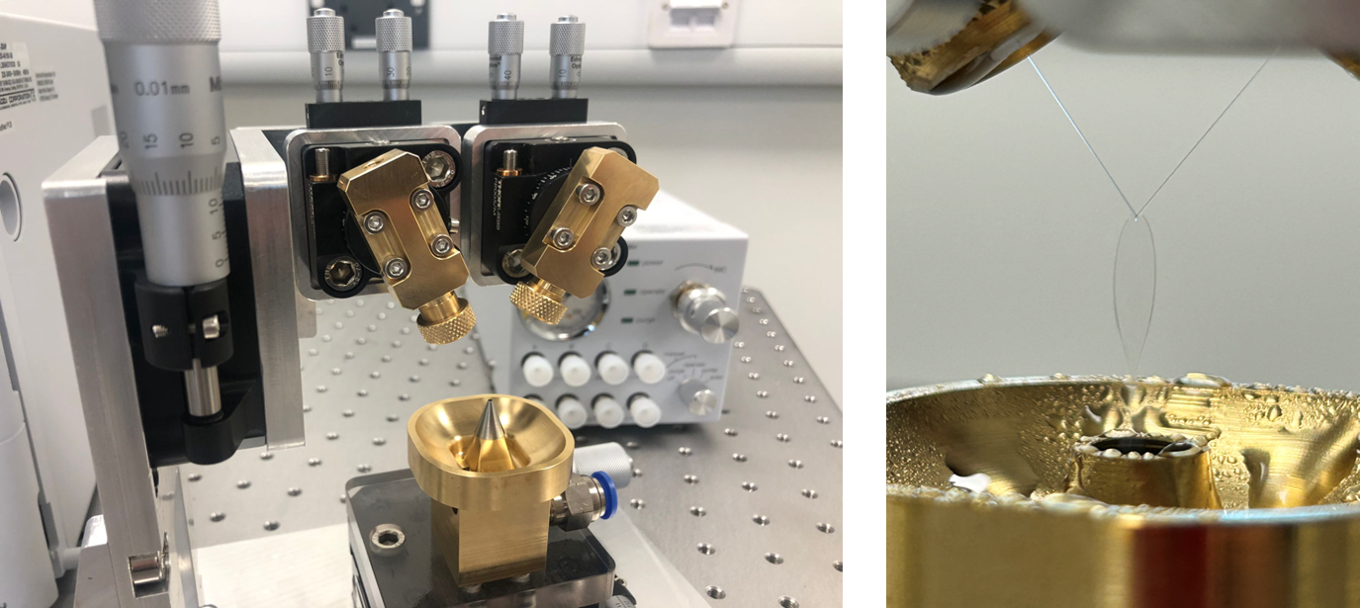




Plasma mirror for laser removal
Tape drives
Robust and high positional stability
EMP and debris protection
Liquid targets
Colliding streams (SLAC design)
Also considering Ohio liquid crystals
Notes:
Delete boxes as required

Slide 11
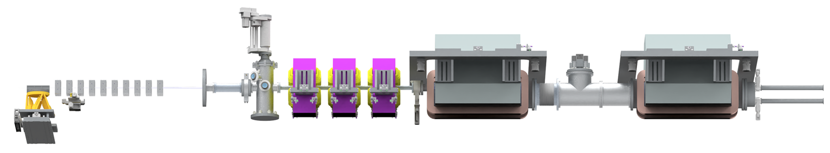
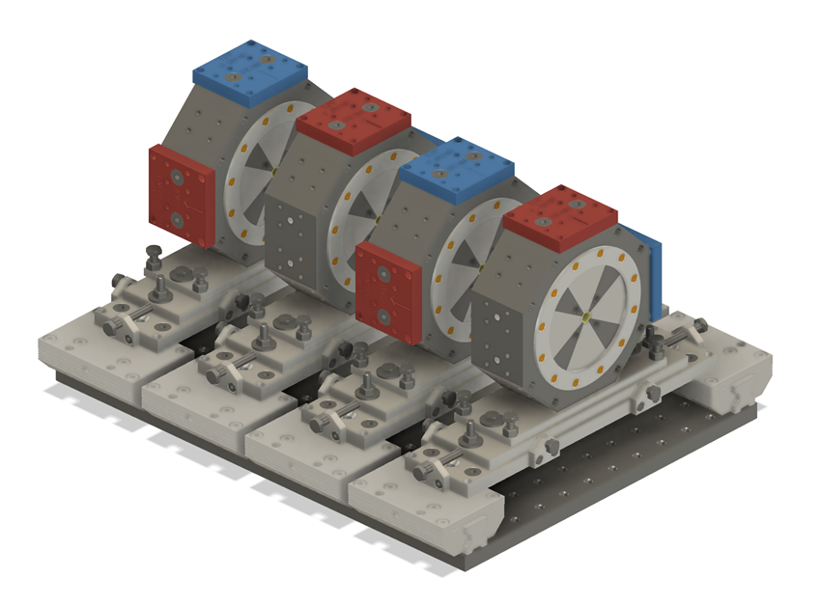
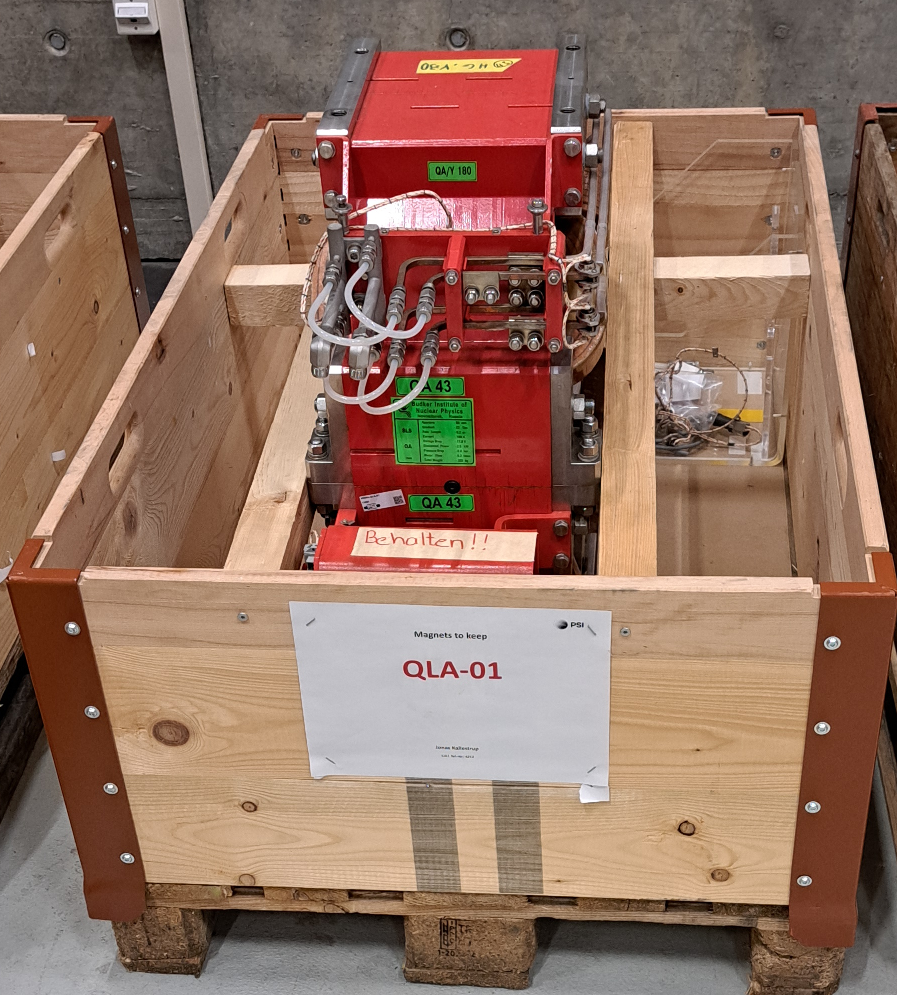
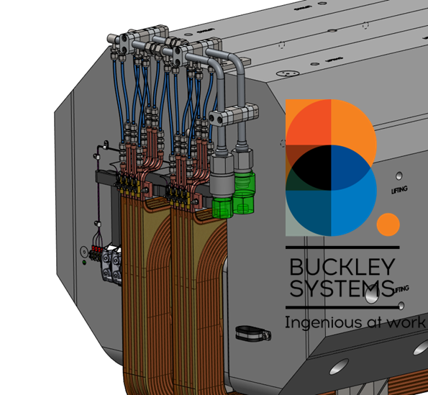

Electron beamline
B. D. Muratori et al., A Modular Quadrupole Array Capture Line for Plasma-Accelerated Electrons, submitted to PRAB
Permanent quadrupoles for capture array
Electro-magnet quadrupoles for focusing
Electro-magnet dipoles for measurement
Notes:
Delete boxes as required

Slide 12
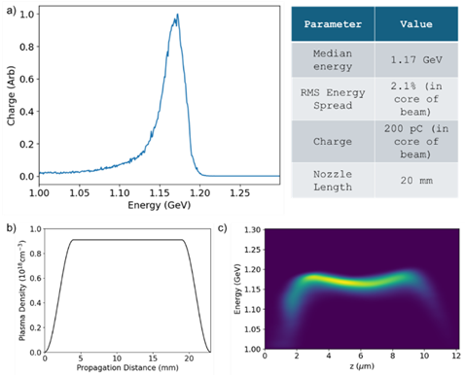
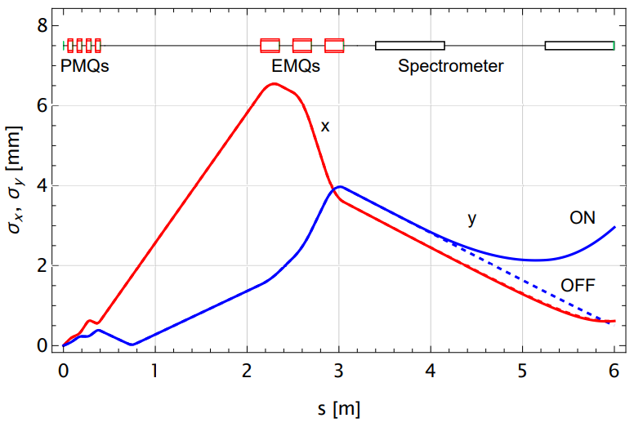
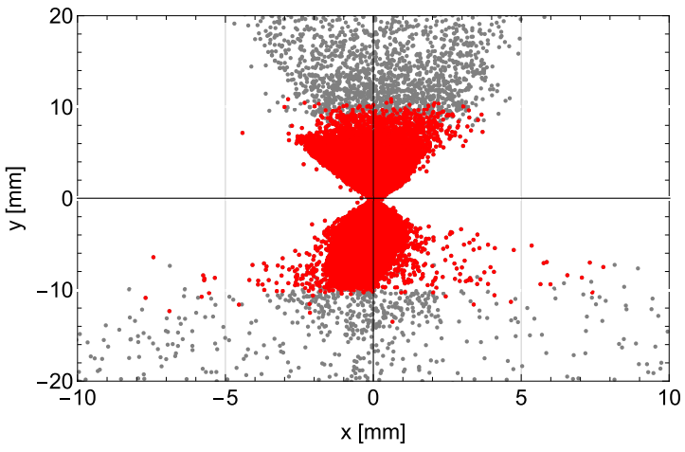
Electron beamline
B. D. Muratori et al., A Modular Quadrupole Array Capture Line for Plasma-Accelerated Electrons, submitted to PRAB
Start with flat-top gas jet ~ 1 GeV electrons
4 x PMQs (~400 Tm⁻¹), 3 x EMQs (~40 Tm⁻¹)
Focus on spectrometer screen
Single-shot emittance with bow-tie method
Notes:
Delete boxes as required

Slide 13
LWFA commissioning from Summer 2026
Stable electron and x-ray performance:
Test stabilisation feedback routines
Machine-learning for stability & LWFA optimisation
Electron beam characterisation and control:
Diagnostic installation & testing
E-beam focusing & steering
Proof-of-principle imaging:
10s keV phase contrast with betatron
> MeV high resolution radiography
Aim to open for user access in 2027
Notes:
Delete boxes as required

Slide 14
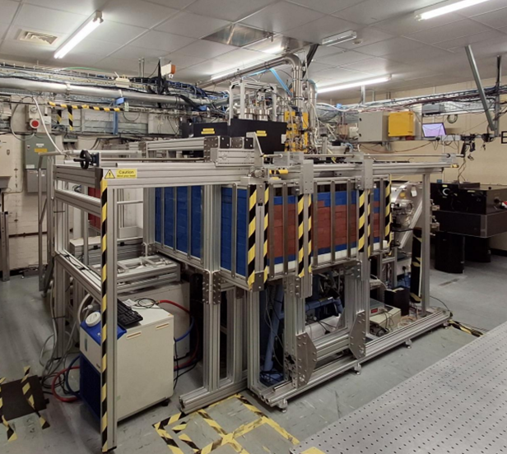
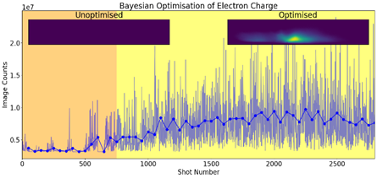
We are using Gemini TA2 as a
5 Hz, 50 MeV LWFA test beamline
Building on previous Bayesian optimisation work [Shalloo et al Nature Comm. 2020]
Adapting code for robust multi-objective optimisation for EPAC
Looking at the SLAC Xopt platform
~500 mJ, 40 fs
Notes:
Replace this guidance text with your own bullet pointed content.
For further guidance please see https://www.bdadyslexia.org.uk/advice/employers/creating-a-dyslexia-friendly-workplace/dyslexia-friendly-style-guide

Slide 15
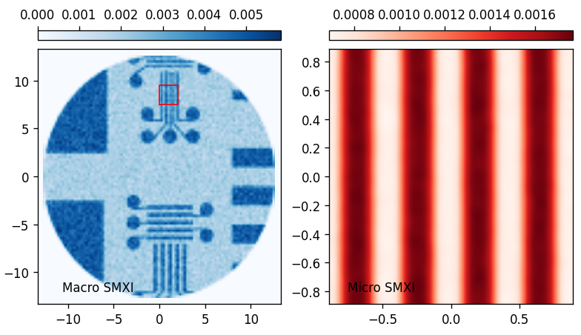
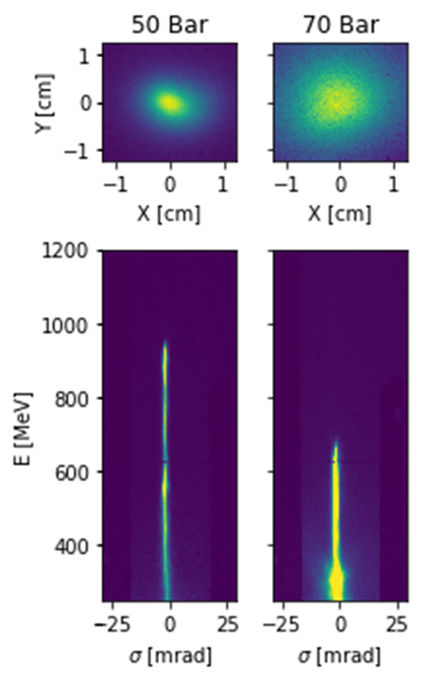
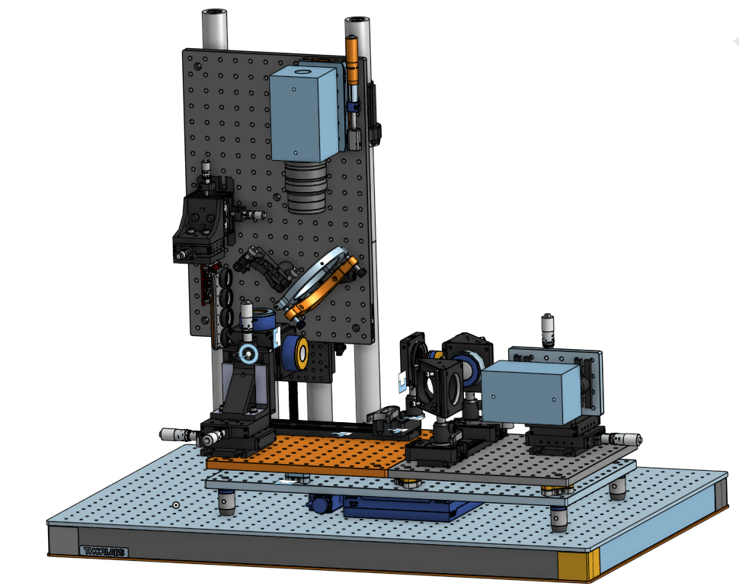
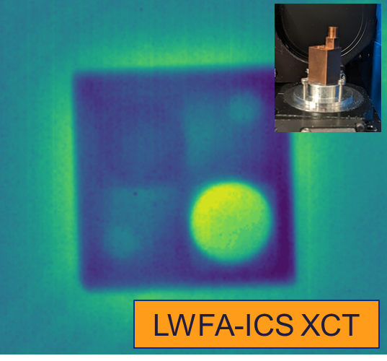
Optimizing image quality for XCT applications
Increased beamline length & detector development to achieve high resolution with betatron (10 – 100 keV)
Control over Brems and ICS properties to improve contrast and resolution (1 – 10 MeV)
FOV ~ 3 mm, 25 mm
Resolution 6 μm, 50μm
Notes:
Replace this guidance text with your own bullet pointed content.
For further guidance please see https://www.bdadyslexia.org.uk/advice/employers/creating-a-dyslexia-friendly-workplace/dyslexia-friendly-style-guide

Slide 16
User access to EPAC
We will run a certain number of operational weeks in a year
Access time is split between:
  Academic access (peer-reviewed through independent panel)
  Source development
  Industrial access (collaborative or proprietary)
Expecting 3 weeks for academic experiments
  Week 1: set up (no laser)
  Week 2: shot preparations (alignment modes)
  Week 3: data taking (~ 100k shots per day)
Notes:
Replace this guidance text with your own bullet pointed content.
For further guidance please see https://www.bdadyslexia.org.uk/advice/employers/creating-a-dyslexia-friendly-workplace/dyslexia-friendly-style-guide

Slide 17
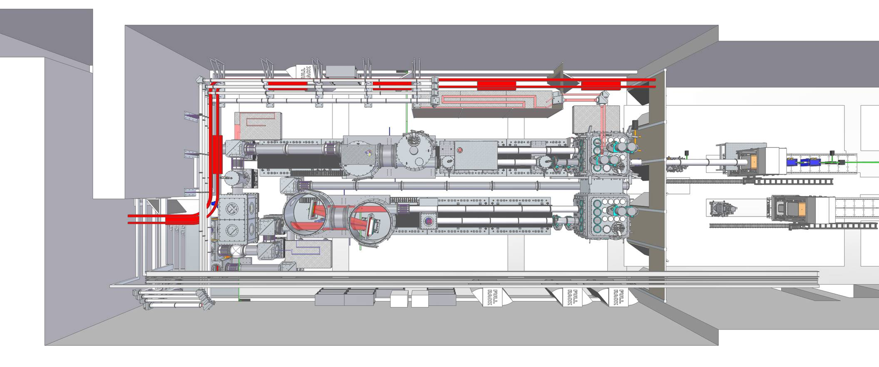
EA1 future development
Four auxiliary beams
Probes
HOFI / injection / collision
High energy, long pulse
Beam combinations
SF-QED
Compton scattering
Staged LWFA
Pump-probe / bimodal imaging
Application beamlines
X-ray tomography
Femtosecond XAS
FEL experiments
Electron beam irradiation
Second high-power beamline
Duplicate 10 Hz, PW
Multi-PW
100 Hz, 100 TW
Notes:
Delete boxes as required

Slide 18
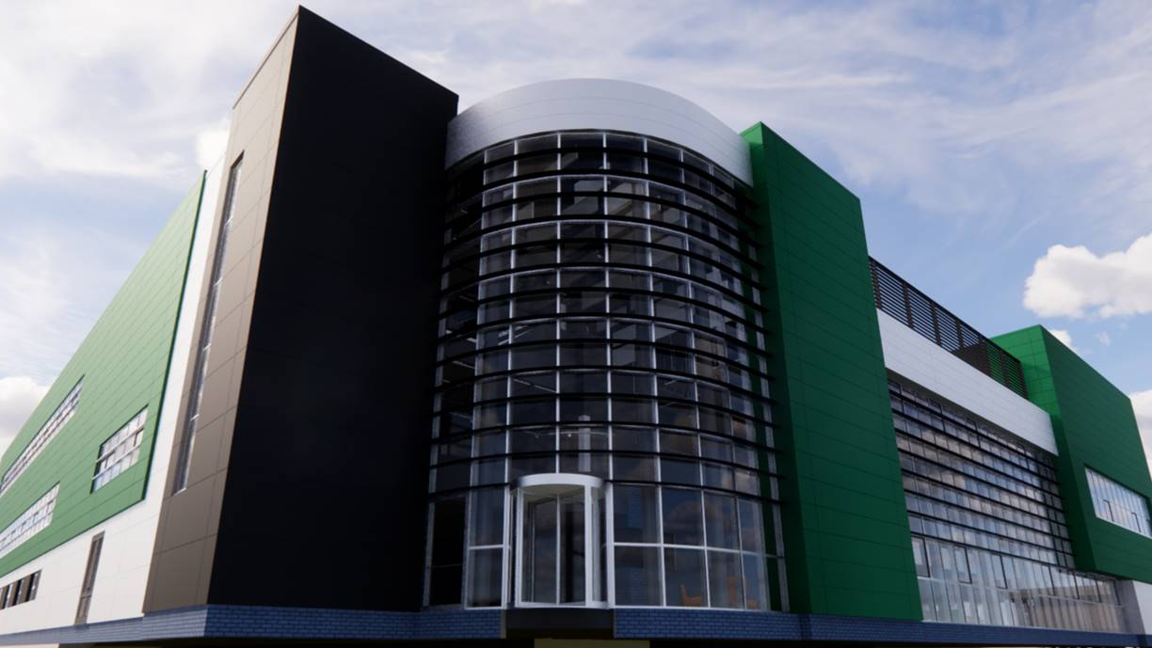
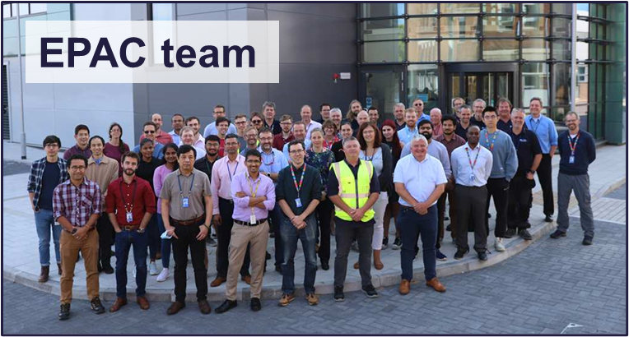

www.clf.stfc.ac.uk
CLFINDUSTRY@stfc.ac.uk
Notes:
Replace this guidance text with your own bullet pointed content.
For further guidance please see https://www.bdadyslexia.org.uk/advice/employers/creating-a-dyslexia-friendly-workplace/dyslexia-friendly-style-guide

