Slide 1




Design and challenges of the witness electron beam injection for AWAKE Run2c
E. Belli, M. Bergamaschi, P. Burrows, E. Gschwendtner, P. Muggli,
M. Turner, F. M.Velotti and the AWAKE collaboration
7th European Advanced Accelerator Conference
21-27 Sept 2025

Slide 2

Outline
The AWAKE experiment
AWAKE Run 2c program
A new 150 Mev electron line for external injection
  Optics design
  Operational challenges
  Injection system
Conclusion
E. Belli – Outline
1

Slide 3
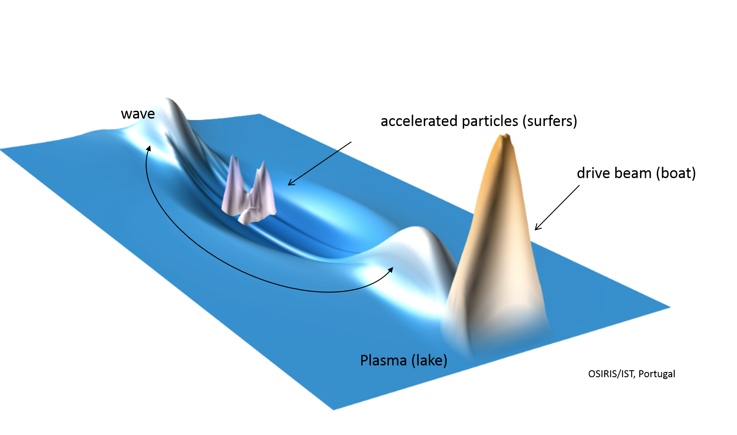
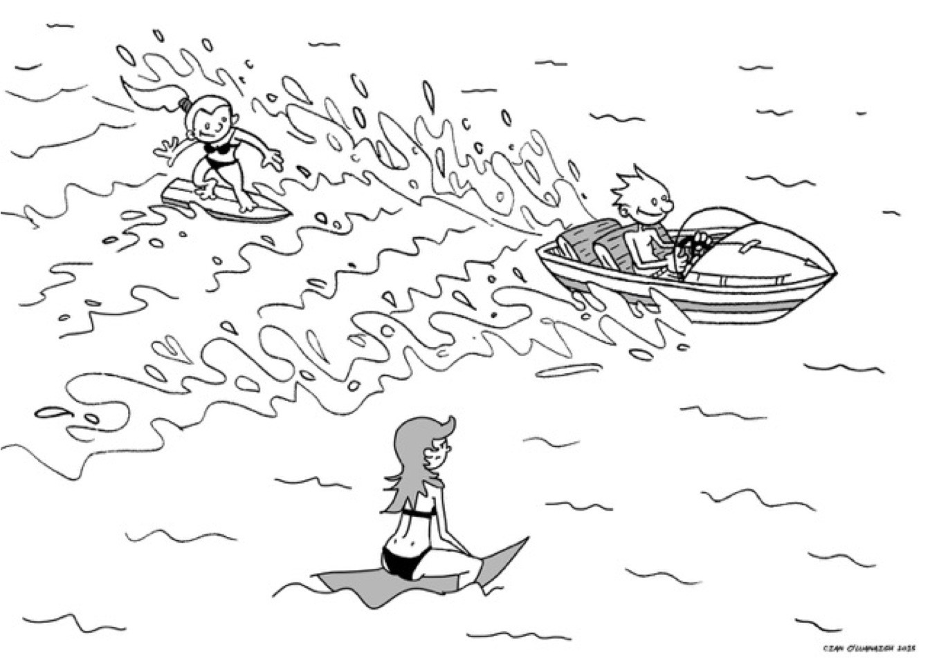
AWAKE: Advanced Wakefield Experiment
Accelerator R&D experiment at CERN based on plasma wakefield acceleration, a novel technology where electron acceleration can be compared with surfing
Accelerated witness beam (surfers)
Waves
Drive beam (boat)
E. Belli – The AWAKE experiment
Plasma (lake)
  Accelerating gradients limited to 100 MV/m in conventional accelerators
  Plasma can sustain very high accelerating fields → 1000x stronger acceleration in the same machine size!
In AWAKE, we accelerate electrons in a 10 m long Rubidium plasma cell using as wakefield driver the 400 GeV proton beam extracted from the CERN SPS
  It is the first plasma wakefield acceleration experiment worldwide to use a proton beam as a drive beam!
2

Slide 4
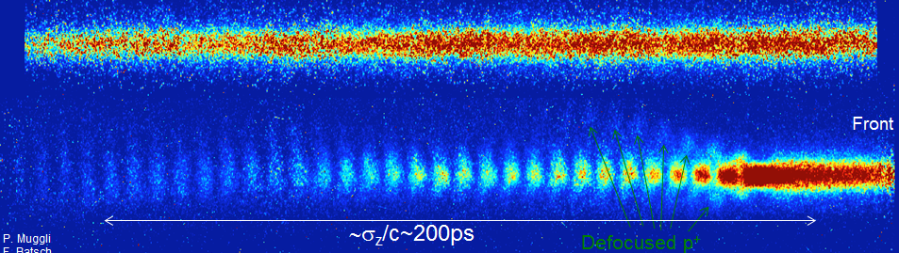
Self-modulation of the proton beam
CERN proton bunches are not ideal for driving wakefields
  To effectively excite wakefields:
    Transverse size σ_{r} ~ λ_{pe}
    Bunch length σ_{z} ~ λ_{pe} → CERN proton bunches very long (σ_{z}=12cm) compared to plasma wavelength (λ_{pe} = 1mm)
    Density n_{b} ~ n_{pe}
Self-modulation instability transforms a long bunch into a series of microbunches separated by λ_{pe}
Plasma OFF
E. Belli – The AWAKE experiment
Plasma ON
3

Slide 5
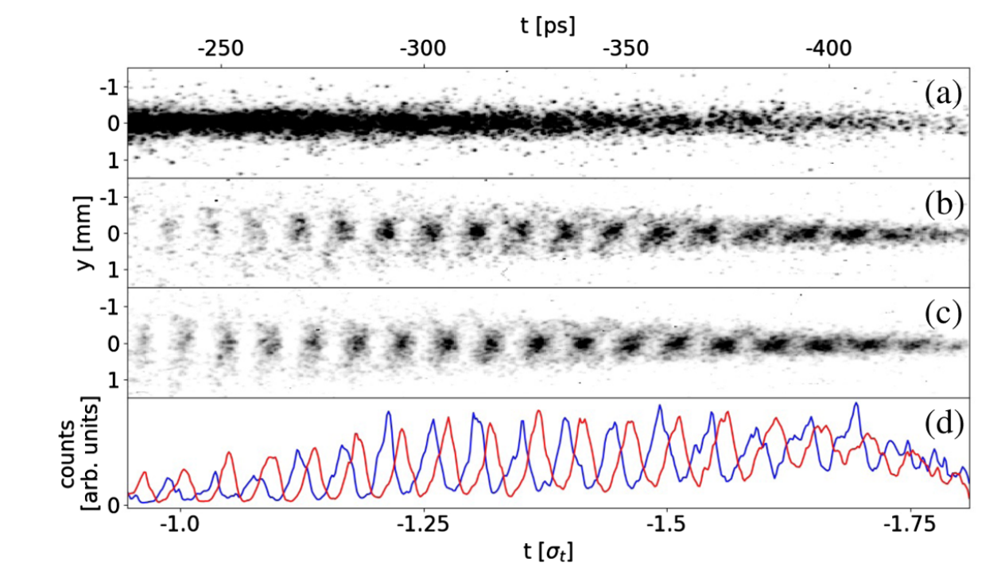

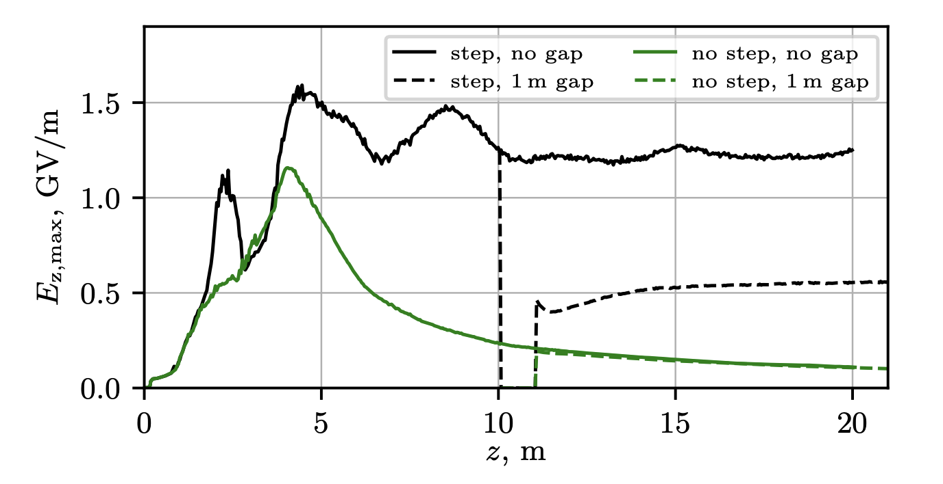
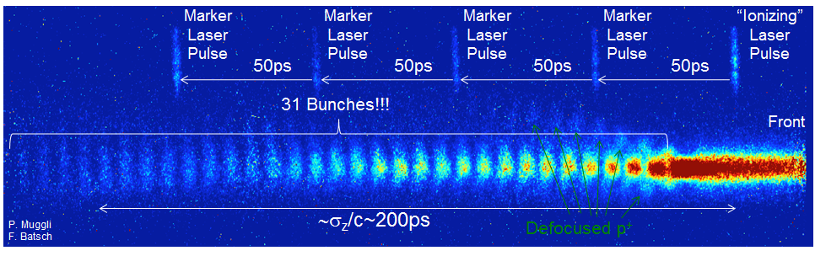
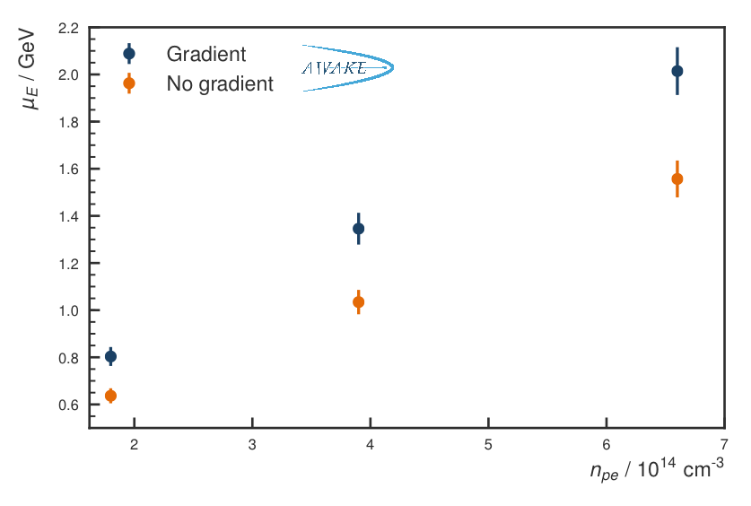
AWAKE program
Run 1
Run 2a
Run 2b
Seeded self-modulation of proton beam¹ and electron acceleration in plasma²
Electron-bunch seeding³
Stabilisation of the wakefields with a density step
E. Belli – The AWAKE experiment
¹ L. Verra et al. (AWAKE Collaboration), Phys. Rev. Lett. 129, 024802 (2022) G. Zevi Della Porta, for the AWAKE Collaboration
² Adli, E., Ahuja, A., Apsimon, O. et al. Acceleration of electrons in the plasma wakefield of a proton bunch. Nature 561, 363–367 (2018)
³ L. Verra et al. "Techniques to seed the self-modulation instability of a long proton bunch in plasma." arXiv preprint arXiv:2305.00431 (2023).
4

Slide 6
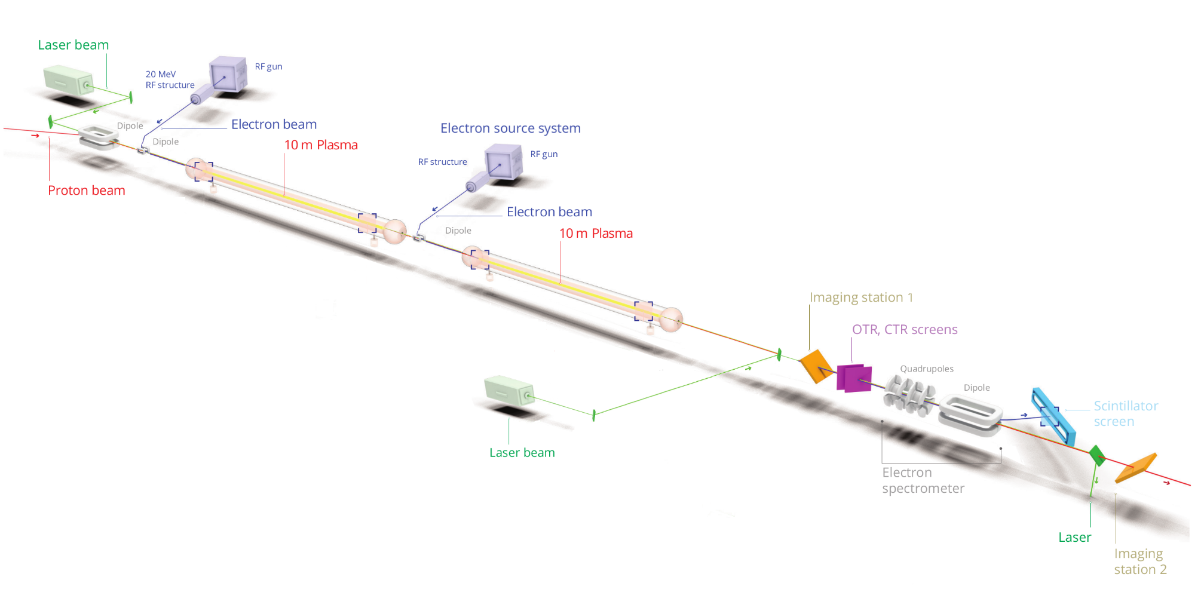
Run 2c overview
Goal: achieve electron energies up to 10 GeV while preserving the quality of the accelerated electron beam
New modular two-stage configuration: p⁺ self-modulation and e⁻ acceleration will occur in two separate plasma cells
18 MeV electron seeding beamline
Installation of a new 150 MeV witness electron beamline for external injection
E. Belli – `awake Run 2c program
Proton beamline from SPS to AWAKE
SELF-MODULATOR
ACCELERATOR
  Independent optimisation of each stage
  Very challenging in terms of beam transport, alignment and synchronisation
5

Slide 7
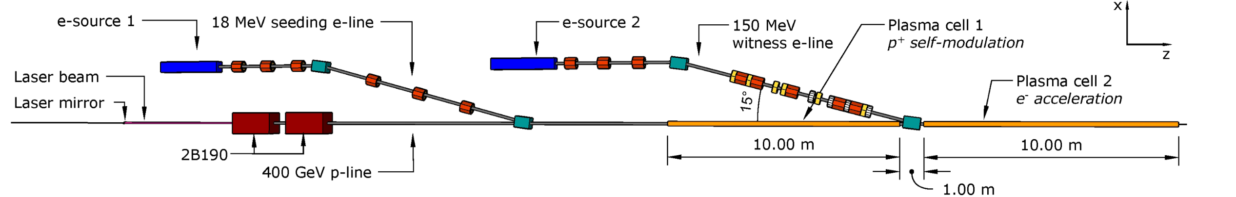
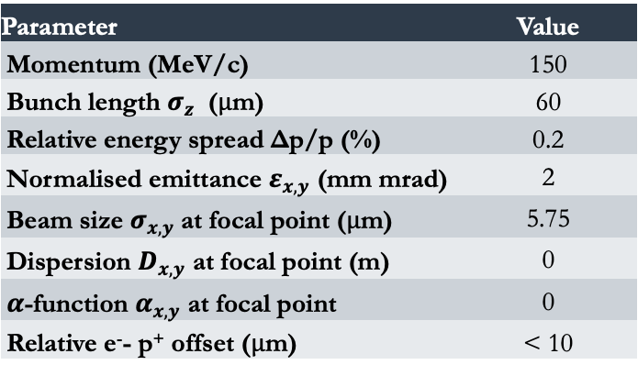
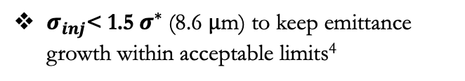

150 MeV electron line
New witness electron beamline to perform external on-axis injection into the 2nd plasma cell
Electrons must be injected into the second plasma stage with micron-level precision in both position and beam size to ensure proper matching with the accelerating and focusing regions of the wakefields
E. Belli – A new 150 MeV electron line for external injection
Parameter | Value
Momentum (MeV/c) | 150
Bunch length $σ_{z}$ ($μ$m) | 60
Relative energy spread Δp/p (%) | 0.2
Normalised emittance $ε_{x,y}$ (mm mrad) | 2
Beam size $σ_{x,y}$at focal point ($μ$m) | 5.75
Dispersion $D_{x,y}$ at focal point (m) | 0
$α$-function $α_{x,y}$ at focal point | 0
Relative e⁻- p⁺ offset ($μ$m) | < 10
Bunch matched to the plasma wakefield bubble:
$$σ^{∗}=\sqrt[4]{\frac{2ε_{0}m_{e}c^{2}γ}{n_{pe}e^{2}}ε^{2}}$$
with $n_{pe}$ = 7 x 10¹⁴ cm⁻³
$σ_{inj}$< 1.5${ σ}^{∗}$(8.6 $μ$m) to keep emittance growth within acceptable limits⁴
6
⁴ Farmer, John P., et al. "Injection tolerances and self-matching in a quasilinear wakefield accelerator." arXiv preprint arXiv:2203.11622 (2022).

Slide 8
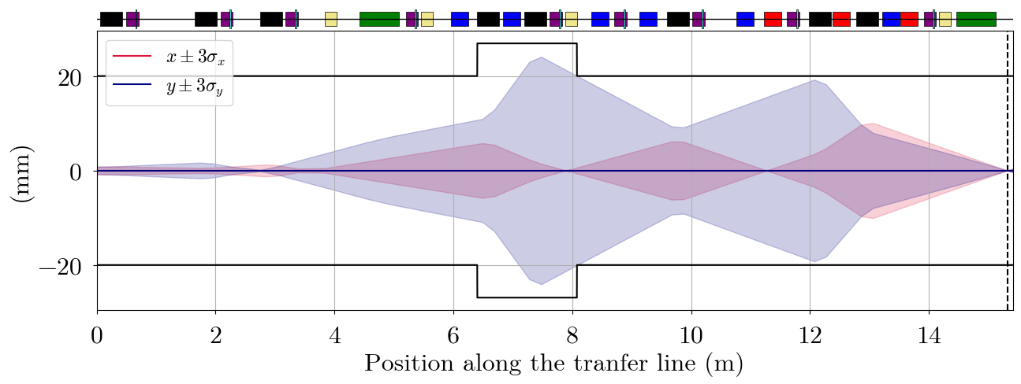
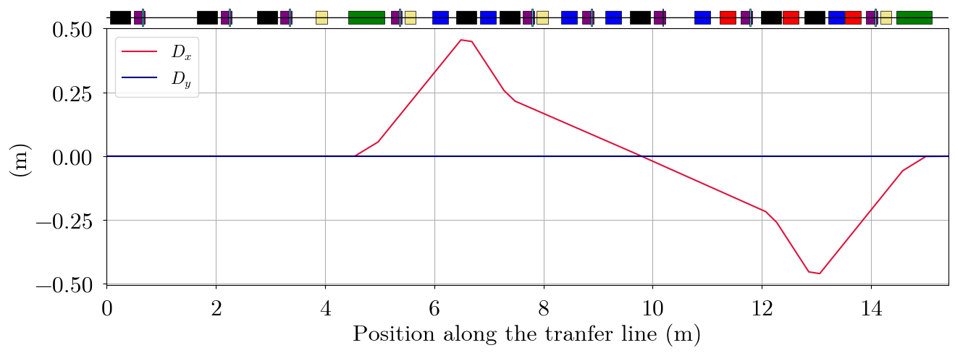
Beamline layout
Spatial constraints given by the tunnel (dog-leg with 15$°$ bending dipoles)
Injection point
E. Belli – 150 MeV electron line : design summary
Quadrupoles for matching, achromaticity and focusing
Sextupoles to combat chromatic effects due to strong focusing
Octupoles to mitigate remaining non-linear effects
Tracking simulations essential to model the line behaviour in presence of non-linear effects
7
⁵ Ramjiawan, Rebecca, et al. "Design of the AWAKE Run 2c transfer lines using numerical optimizers." arXiv preprint arXiv:2203.01605 (2022).

Slide 9
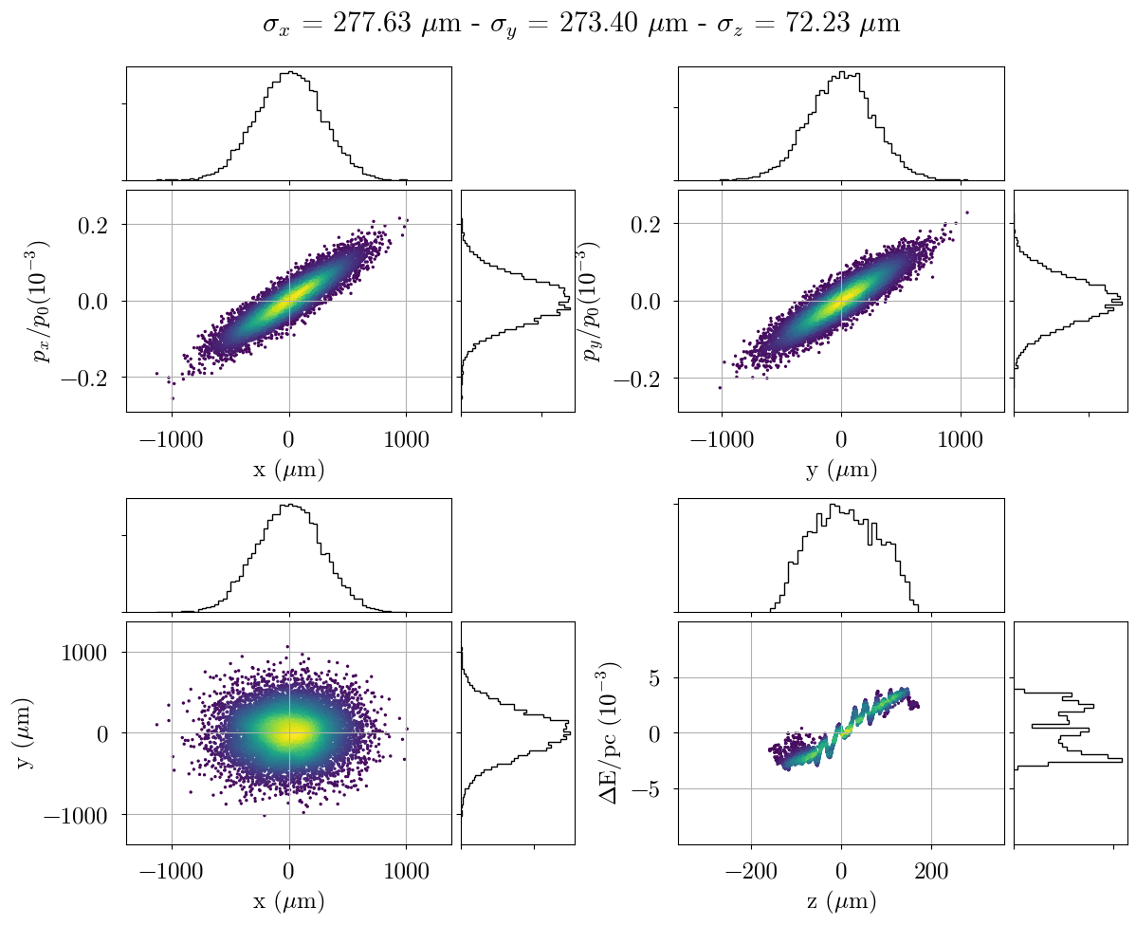
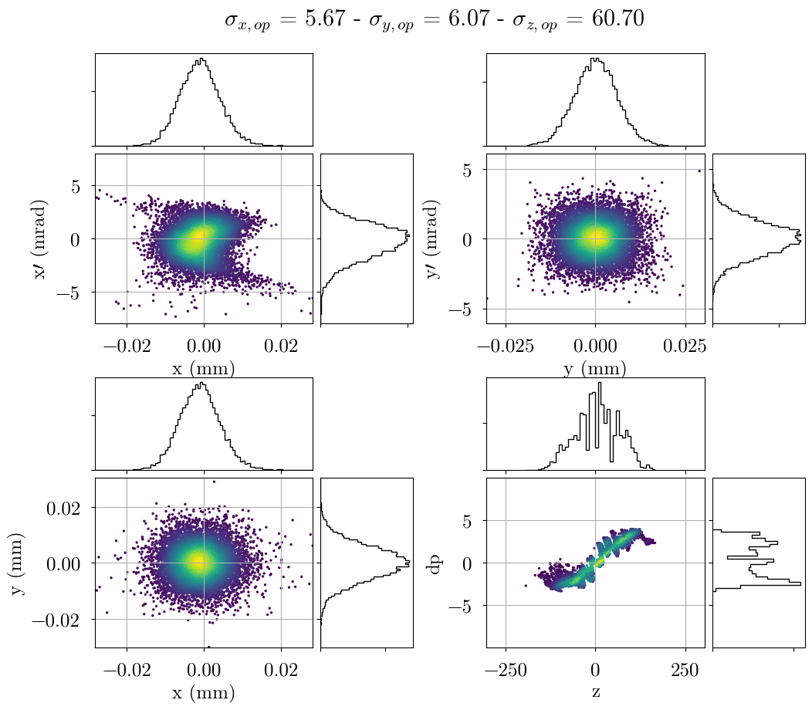
Beam at injection point
Input beam from simulations of electron injector
Beam size at injection meets experimental requirements
E. Belli – 150 MeV electron line : design summary
8

Slide 10
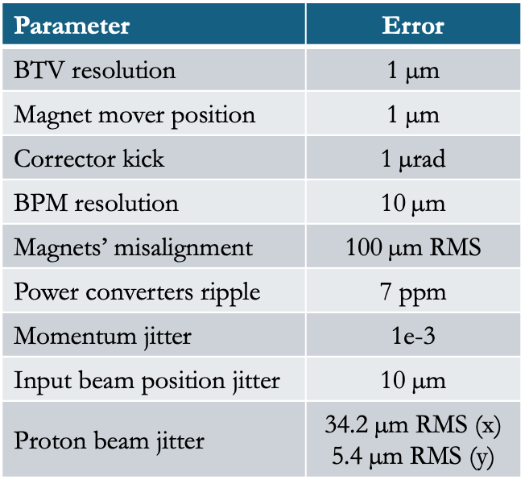
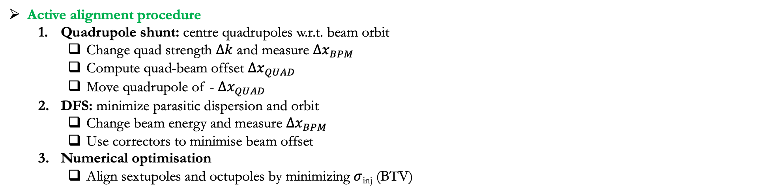
Errors and alignment procedure
To reach beam pointing specifications, magnets need to be installed on movers (vertical and radial adjustment at um-level)
Parameter | Error
BTV resolution | 1 $\text{µ}\text{m}$
Magnet mover position | 1 $\text{µ}\text{m}$
Corrector kick | 1$\text{µ}$rad
BPM resolution | 10$\text{µ}\text{m}$
Magnets’ misalignment | 100$\text{µ}\text{m}$ RMS
Power converters ripple | 7 ppm
Momentum jitter | 1e-3
Input beam position jitter | 10 µm
Proton beam jitter | 34.2 µm RMS (x) 5.4 µm RMS (y)
E. Belli – 150 MeV electron line : design summary
Active alignment procedure
  Quadrupole shunt: centre quadrupoles w.r.t. beam orbit
    Change quad strength $∆k$ and measure ${∆x}_{BPM}$
    Compute quad-beam offset ${∆x}_{QUAD}$
    Move quadrupole of - ${∆x}_{QUAD}$
  DFS: minimize parasitic dispersion and orbit
    Change beam energy and measure ${∆x}_{BPM}$
    Use correctors to minimise beam offset
  Numerical optimisation
    Align sextupoles and octupoles by minimizing $σ$_{inj} (BTV)
9

Slide 11
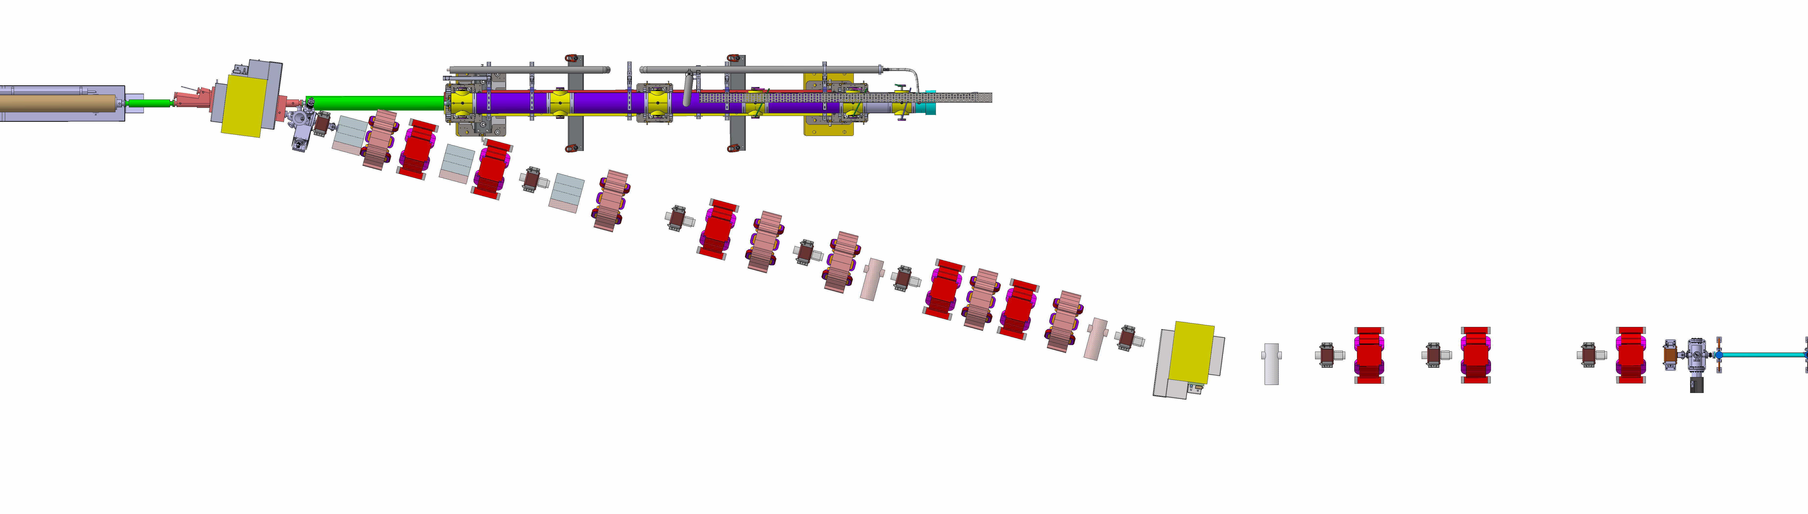
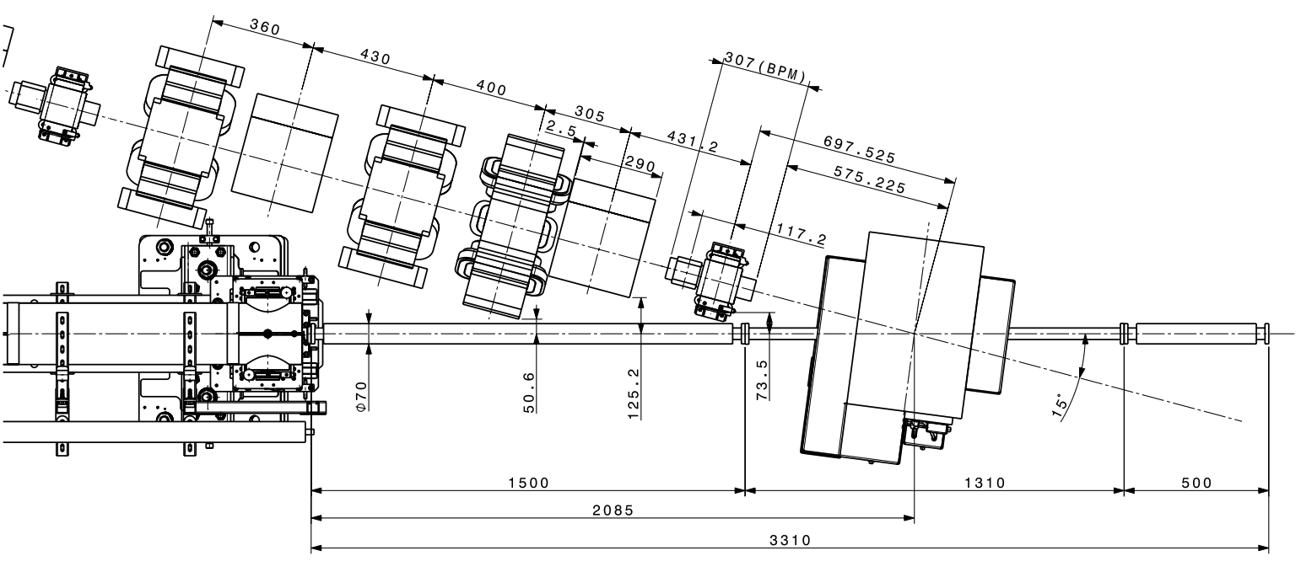
Injection region design
Integration challenge due to experimental needs and limited space
Expansion volume
E. Belli – 150 MeV electron line : injection region
injection point
Electron beam
Dipole
2nd plasma source
Proton beam
Diagnostics
installation
1st plasma source
7.5 cm clearance around the proton beam required
10

Slide 12
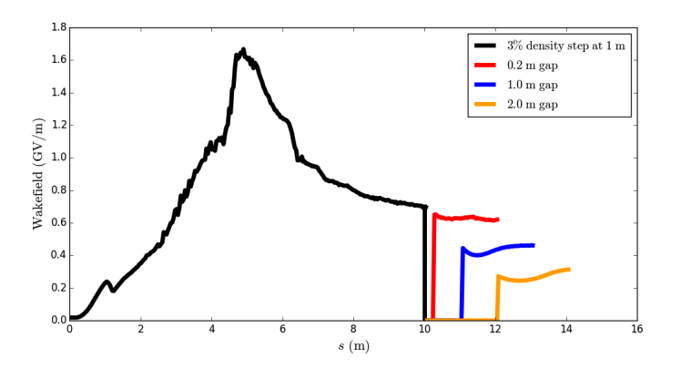
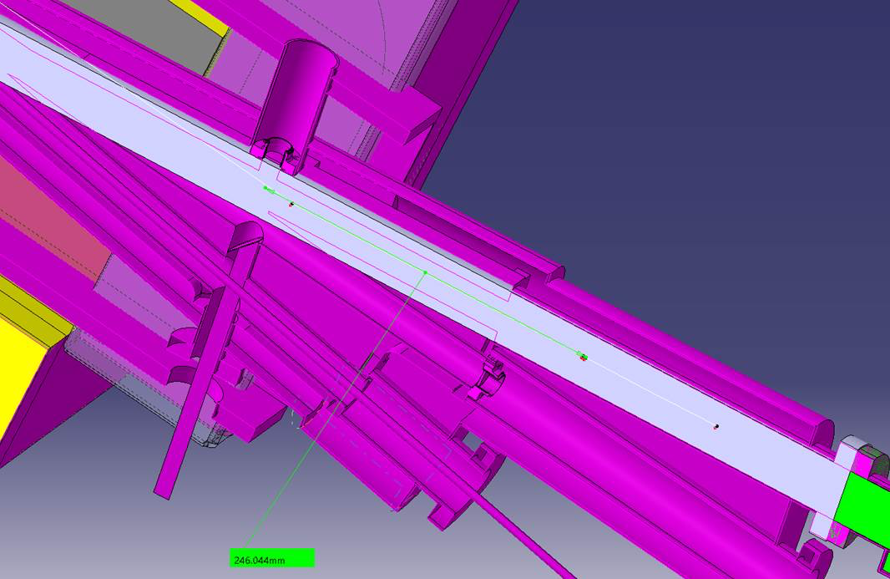
Injection region design
Rb vapor from the entrance of the 1st plasma cell to the exit of the 2nd one → entire structure at 200$°$C
  Cooling system design
IR dipole will bend e⁻ beam and p⁺ beam in two opposite directions
  Bending angle for a 400 GeV p+ beam $≈$ 0.1 mrad → the two vapor sources will be angled
30 cm gap between plasma sections defined as the distance between the laser beam dump and the focal point
New waist
E. Belli – 150 MeV electron line : injection region
Original waist
Gradient reduction of about 50% for 1 m gap⁶
Waist has been moved 25 cm upstream the original one → new optics → Full design validation needed
11
⁶ Adli, Erik. "Towards AWAKE applications: Electron beam acceleration in a proton driven plasma wake." Proceedings of IPAC2016, Busan, Korea WEPMY008.

Slide 13
Conclusions
Previous AWAKE experimental phases were successful and promising
Run 2c introduces a new modular two-stage configuration
  Independent optimisation of each stage
  Challenges in beam transport, alignment and synchronisation
New 150 MeV electron line designed
  Experimental requirements within specifications, even in presence of errors
  Complete 3D integration studies revealed several complex challenges
  Several open points still under review
  No showstopper for operational restart in 2029!
E. Belli – Conclusions
12

Slide 14
Thank you for listening

