Slide 1

Recent Progress on
QuickPIC and QPAD
Weiming An
Beijing Normal University
anweiming@bnu.edu.cn
Sep 23rd, 2025

Slide 2



QuickPIC/QPAD Collaboration
Weiming An, Weiyu Meng, Rong Tang, Hainan Wang, Yueran Tian, Zhihao Xu
Qianqian Su, Viktor Decyk, Lance Hildebrand, Yujian Zhao, Thamine Dalichaouch, Warren Mori
Fei Li
Work supported by Strategic Priority Research Program of the Chinese Academy of Sciences, Grant No. XDB0530000, NSFC Grant 12075030, and Beijing Normal University Scientific Research Initiation Fund for Introducing Talents 310432104

Slide 3
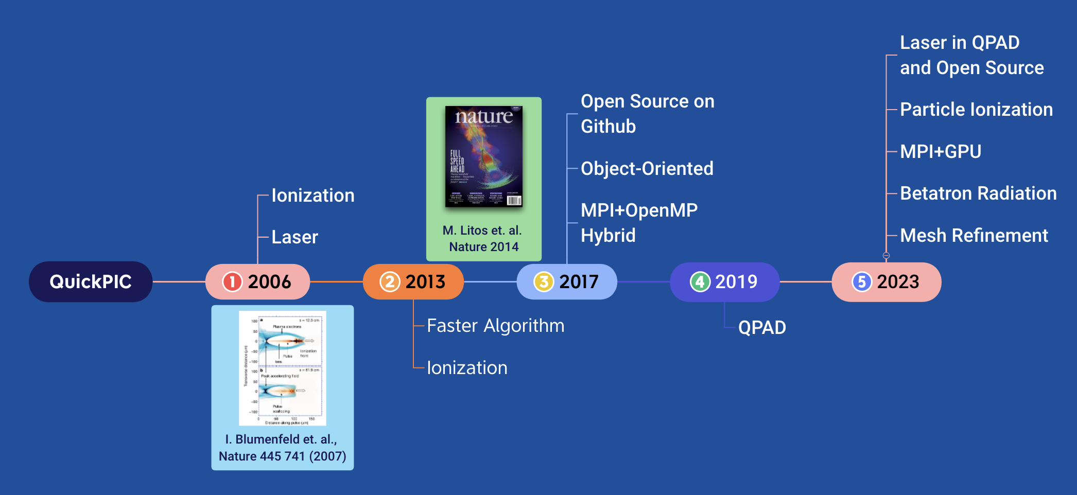

A Brief History of QuickPIC
FACET & FACET II
CEPC
FFTB
Plasma simulation has greatly impacted on PBA research.

Slide 4

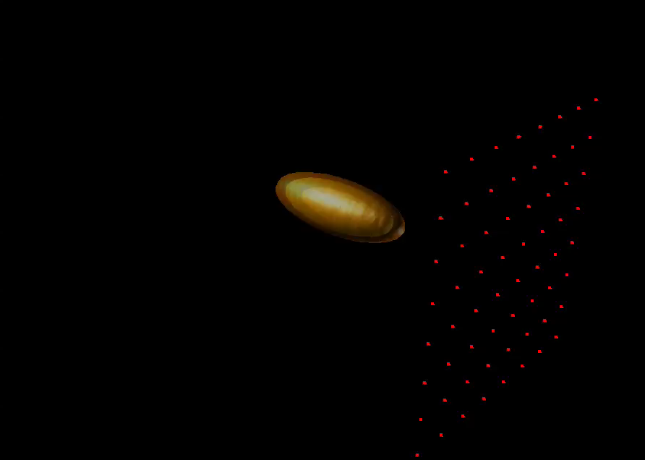

The Quasi-Static PIC code
Embeds a 2D PIC code inside a 3D PIC code
Quasi-Static Approximation*
(x, y, z; t)
(x, y, ξ=ct-z, s=z)
∂s << ∂ξ
Plasma: (x, y; ξ)
Beam: (x, y, ξ, s)
WAKE
LCODE
HIPACE
WAND-PIC
QuickPIC is a 3D parallel Quasi-Static PIC code, which is developed based on the framework UPIC.
Q
S
A
https://gitee.com/bnu-plasma-astrophysics-sg/quick-pic-open-source
W. An et. al., JCP 250, 165 (2013)

Slide 5
QPAD*: QuickPIC with Azimuthal Fourier Decomposition
Azimuthal decomposition is a technique to speed up the simulation without much loss of accuracy. Some explicit PIC codes (e.g. Calder, quasi-3D OSIRIS, FBPIC, PLARES-PIC) have employed this algorithm to achieve 100x ~ 1000x speed-up.
None of current quasi-static PIC codes has this feature.
QPAD is a newly developed code based on part of the frame work of open source QuickPIC.
Fei Li, Weiming An*, Viktor K. Decyk, Xinlu Xu, Mark J. Hogan, Warren B. Mori, et. al., "A quasi-static particle-in-cell algorithm based on an azimuthal Fourier decomposition for highly efficient simulations of plasma-based acceleration: QPAD”, Computer Physics Communications 261, 107784 (2021).

Slide 6
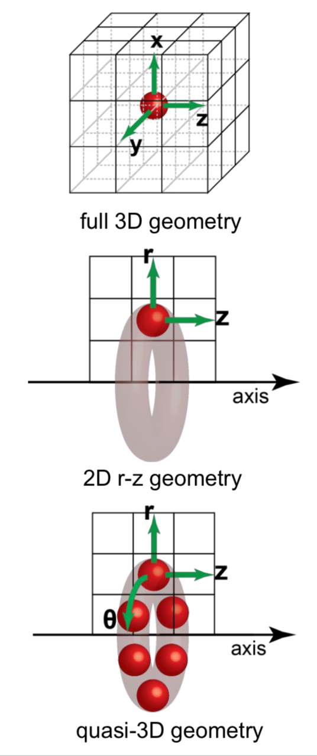
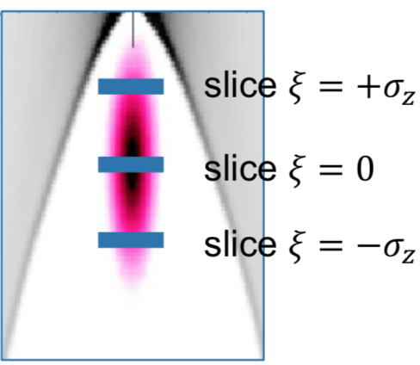

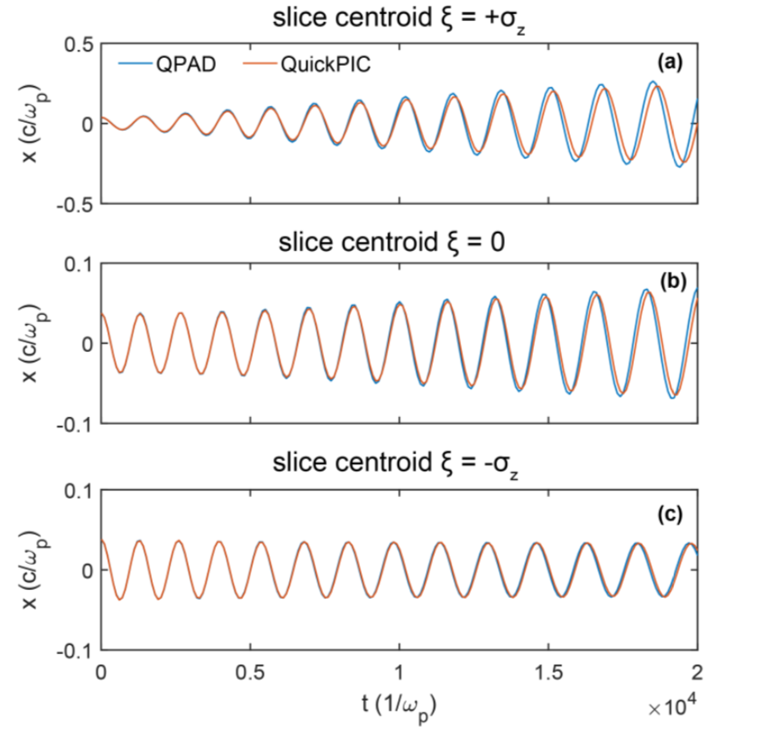
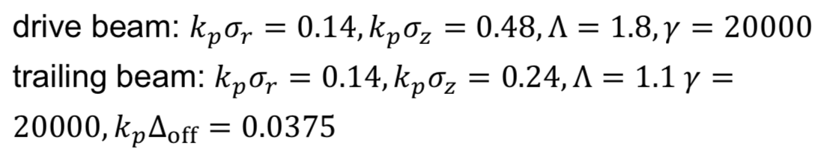
QPAD*: QuickPIC with Azimuthal Fourier Decomposition
QPAD(4 modes)
QuickPIC
[1] Fei Li, Weiming An*, et. al., Computer Physics Communications 261, 107784 (2021).

Slide 7
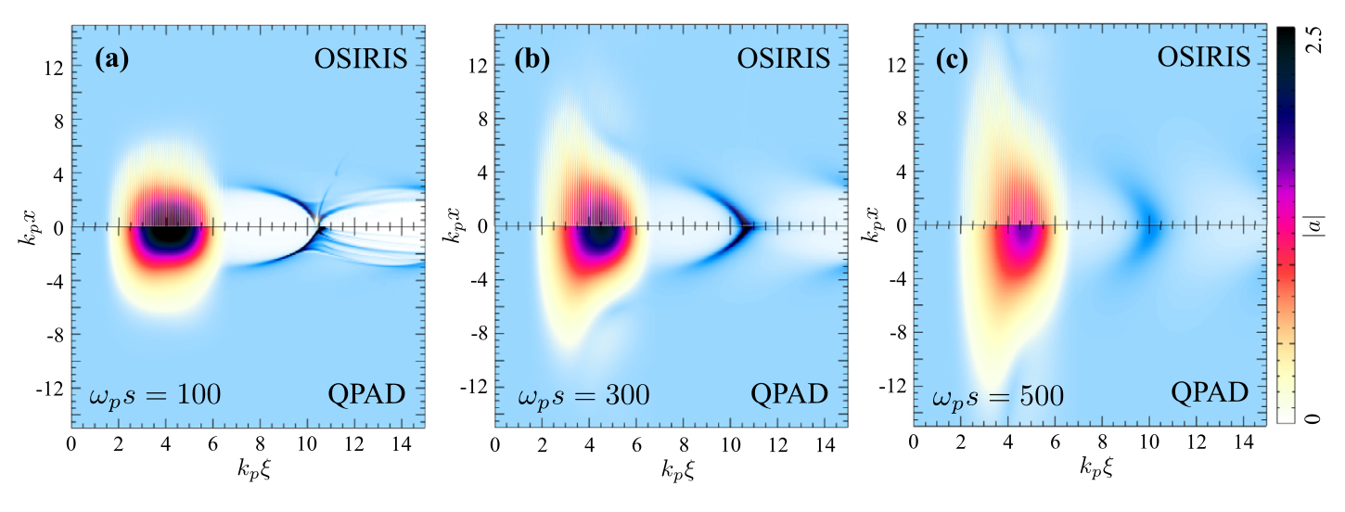
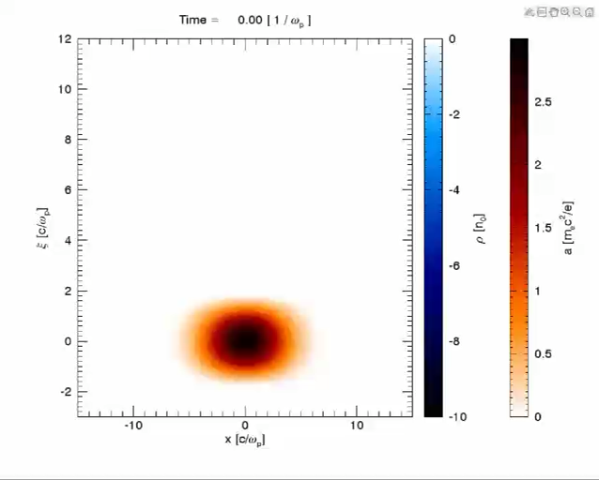
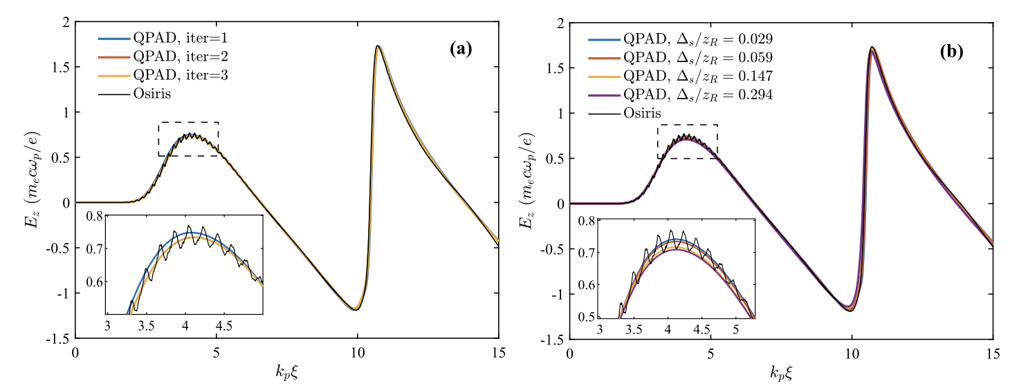
Laser Module in QPAD
*Fei Li, Weiming An, Frank S. Tsung, Viktor K. Decyk, Warren B. Mori, JCP 470 111599 (2022).

Slide 8
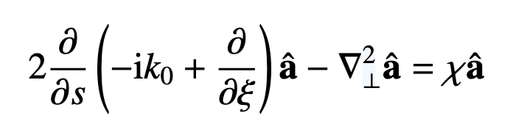
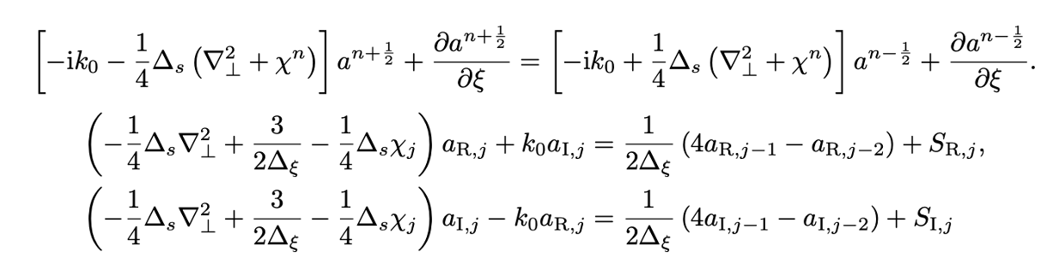
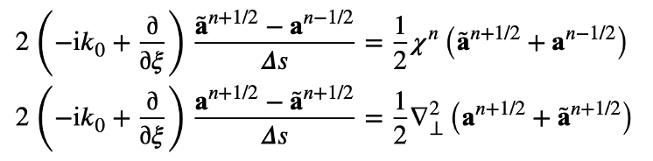
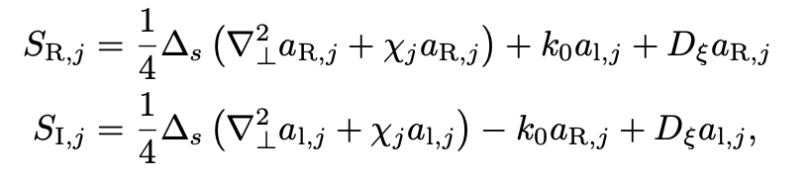
Laser Module in QuickPIC
*Weiyu Meng et. al., in preparation.
Laser envelope equation：
Finite difference：
FFT & Finite difference^{[2]}：
where：
can be solved with Hypre^{[1]}
[2] Huang C et al. JCP 2006
[1] Falgout R D, Jones J E, Yang U M. Springer Berlin Heidelberg, 2006: 267-294.

Slide 9
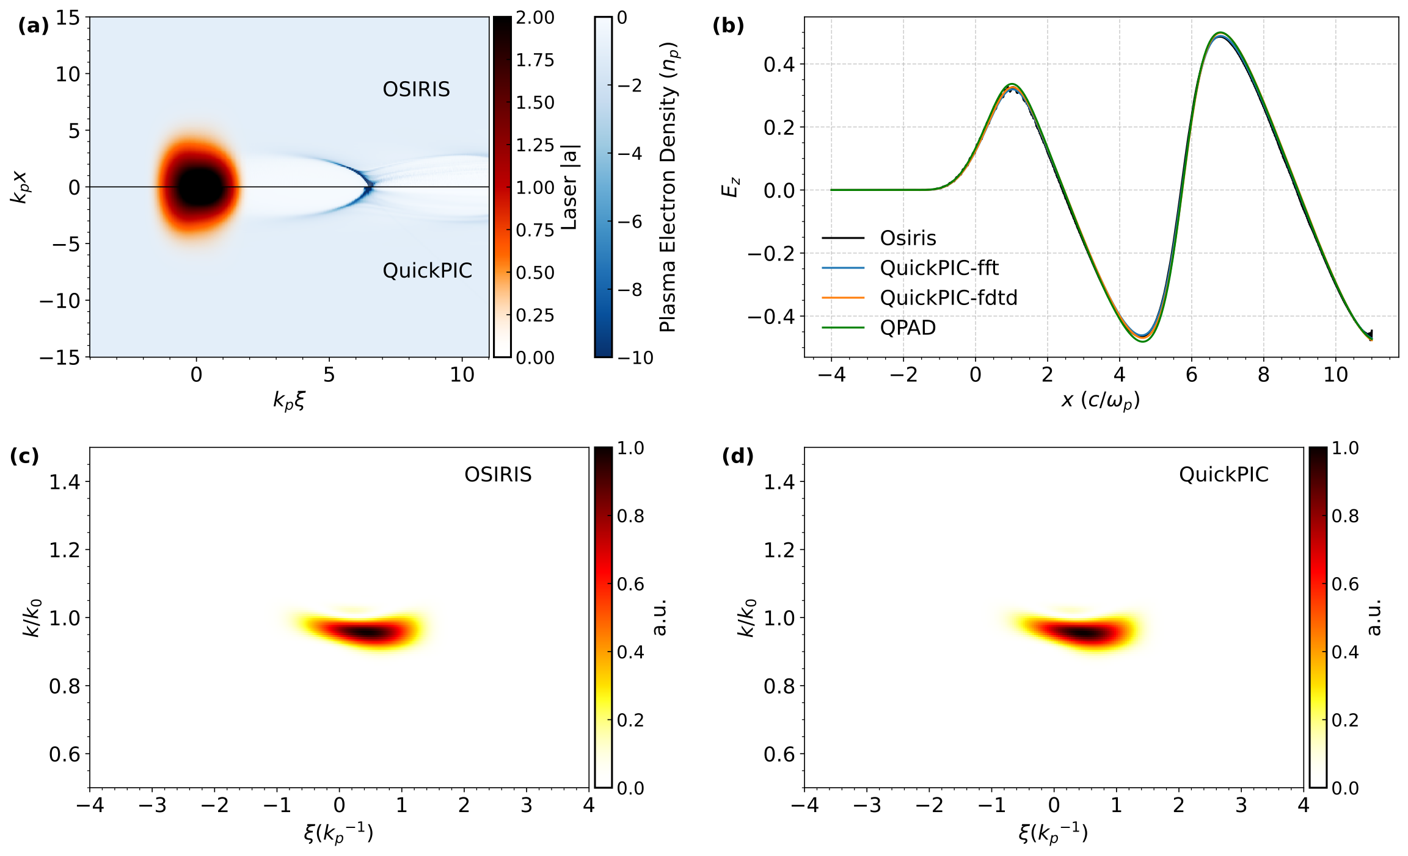
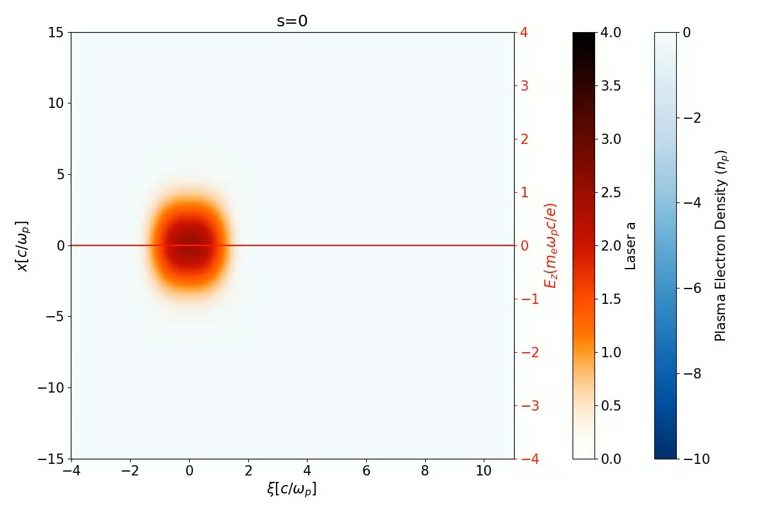
Laser Module in QuickPIC
*Weiyu Meng et. al., in preparation.
a0=2.5, k0/kp=34, kpw0=3.162, ωp τFWHM=2.26
QuickPIC with
FD Laser Sovler
QuickPIC vs Osiris vs Qpad

Slide 10
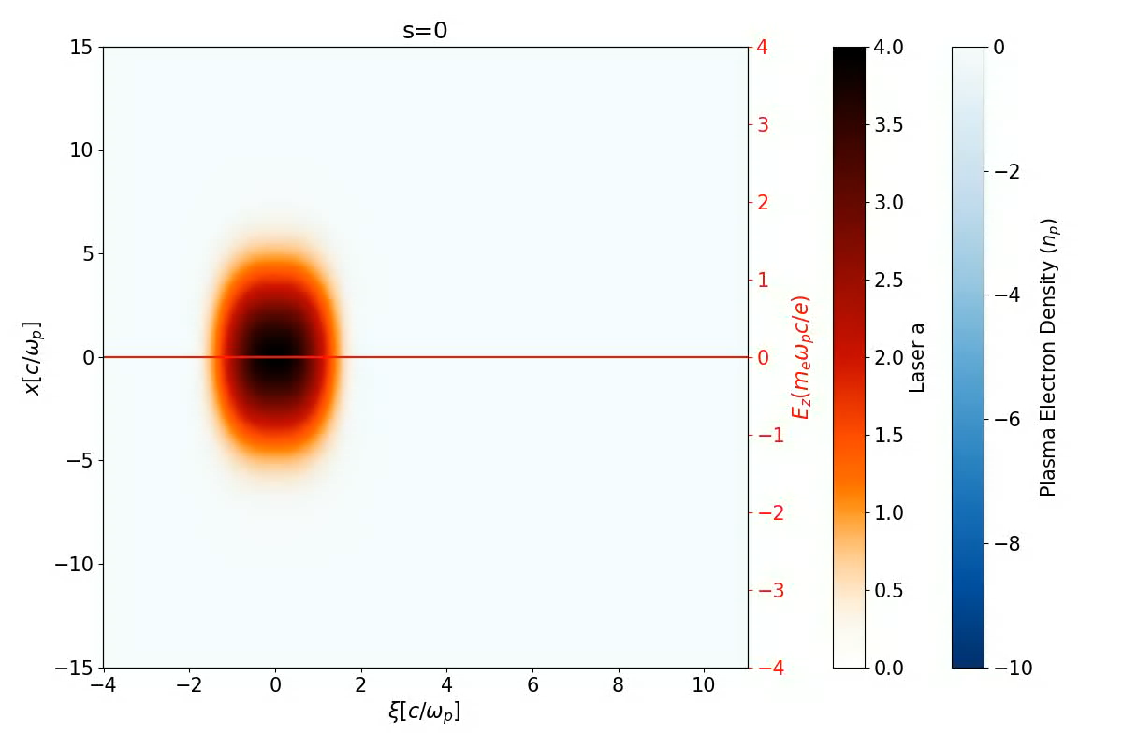
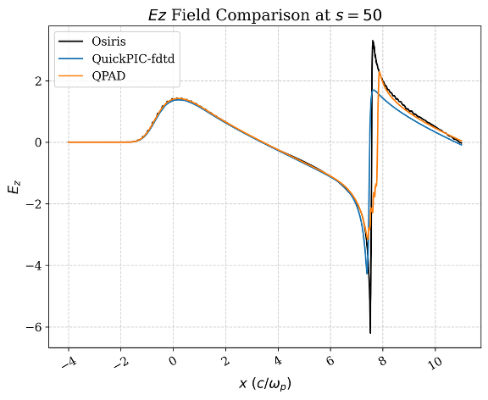
Laser Module in QuickPIC
*Weiyu Meng et. al., in preparation.
a0=4.0, k0/kp=34, kpw0=4.0, ωp τFWHM=2.26
QuickPIC with
FD Laser Sovler
QuickPIC vs Osiris vs Qpad

Slide 11
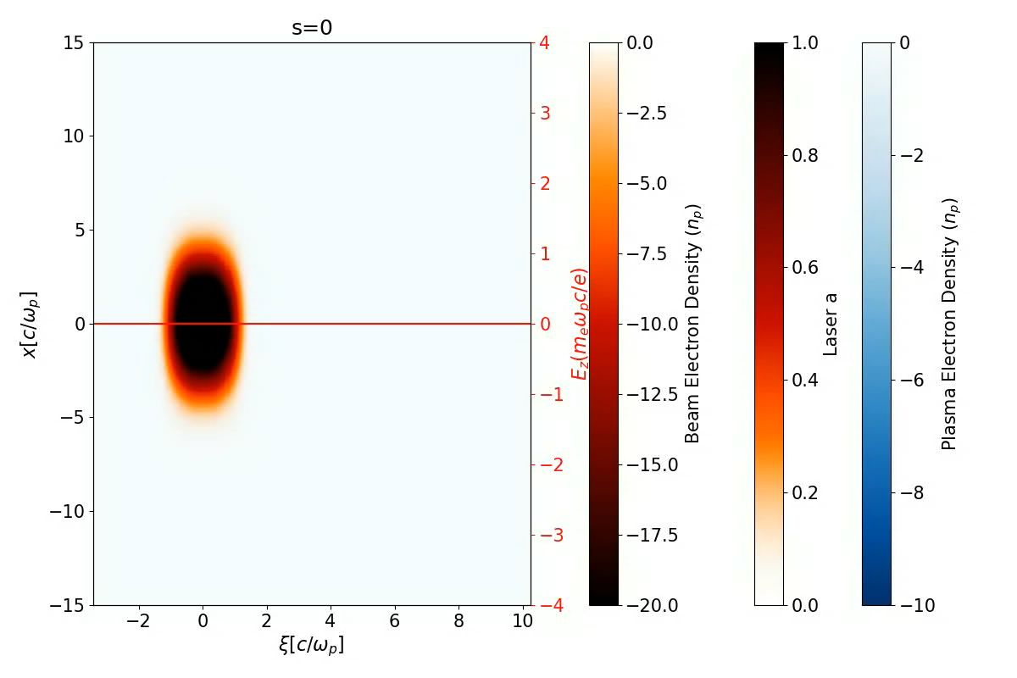
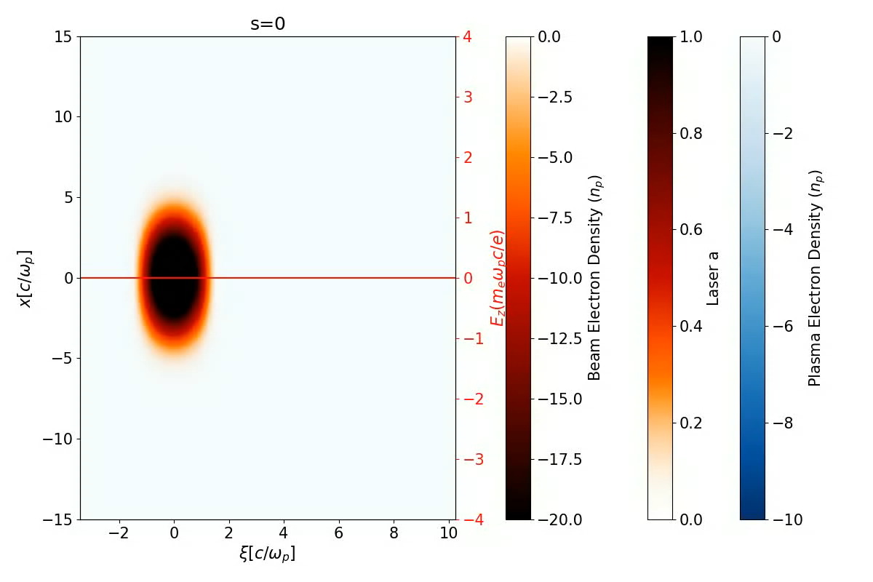
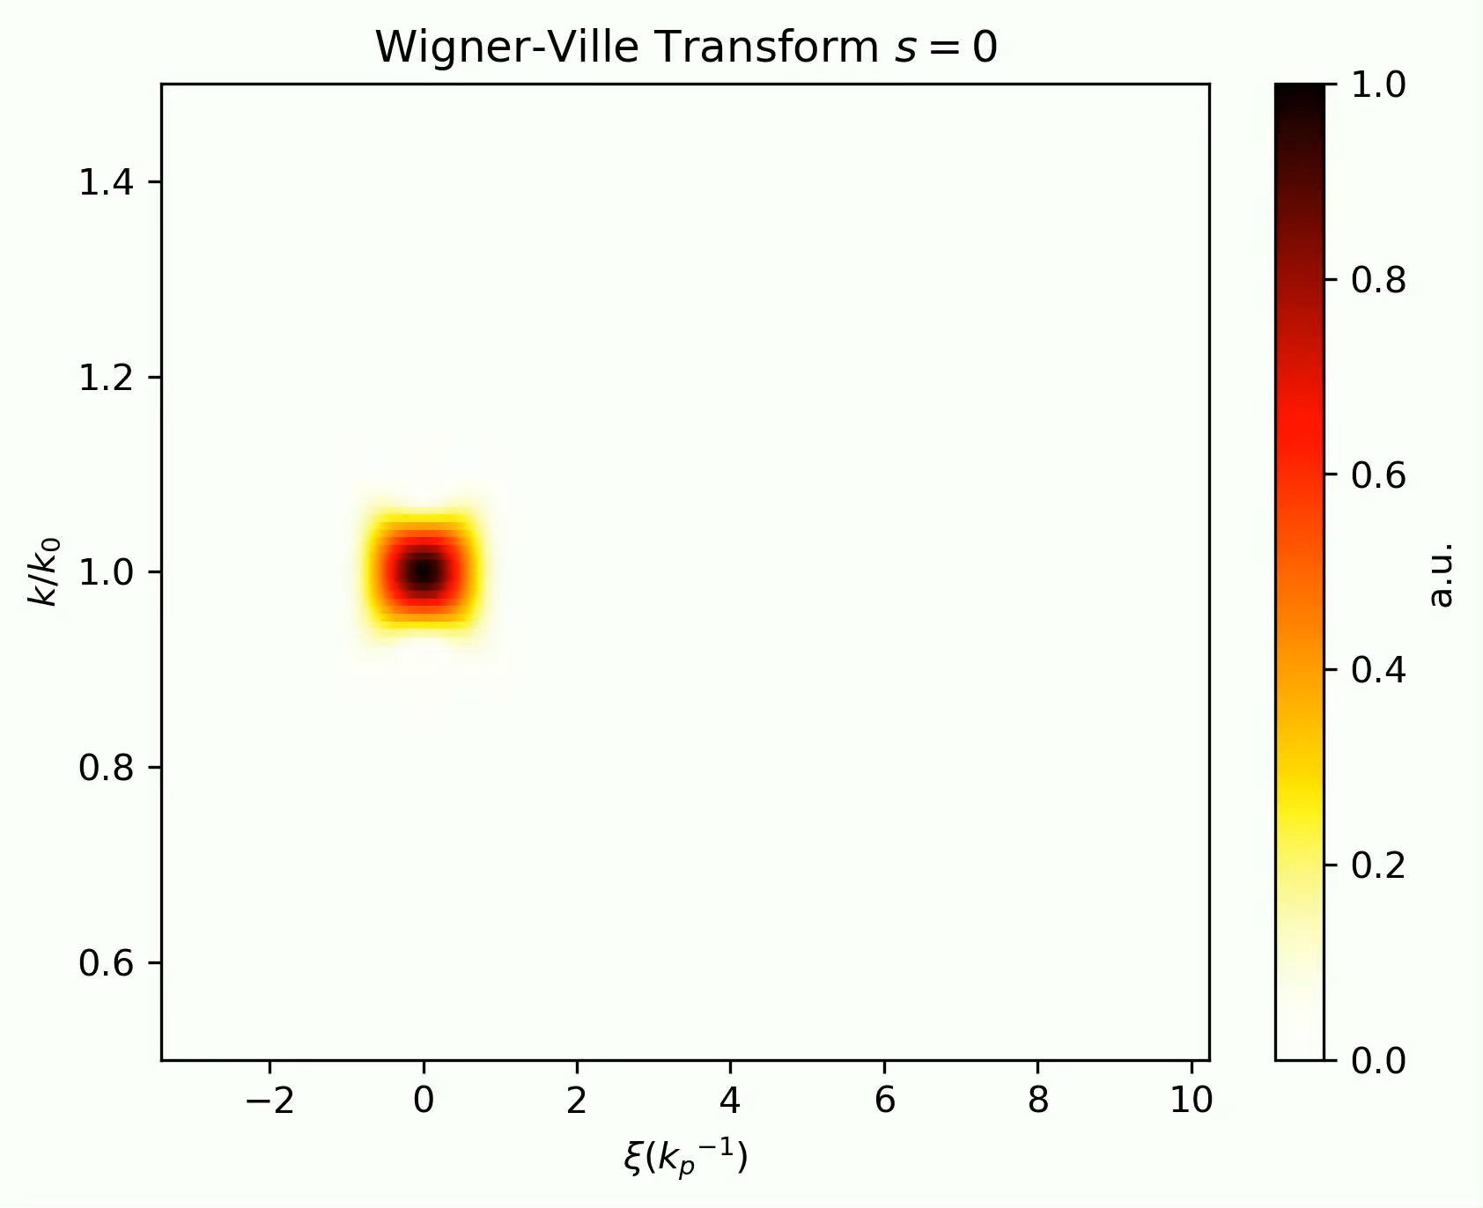
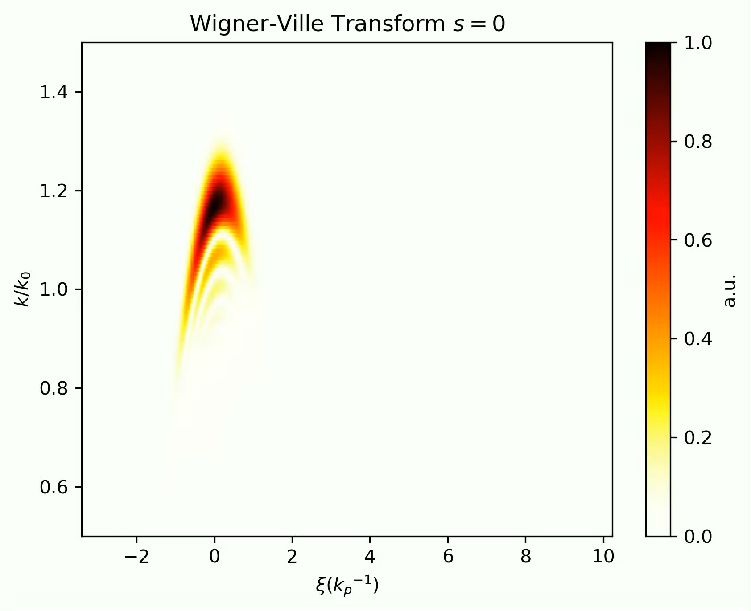
Laser Module in QuickPIC
*Weiyu Meng et. al., in preparation.
Laser Pulse without Initial Chirp
Laser Pulse with Initial Chirp

Slide 12
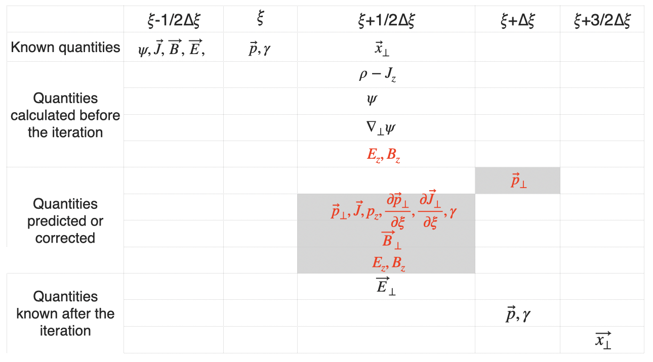
The explicit solver in QuickPIC/QPAD
POSTER on Monday and Tuesday
Iterative Solution
$$∇_{⊥}^{2}{\overset{→}{B}}_{⊥}^{\text{new}}-{\overset{→}{B}}_{⊥}^{\text{new}}=\overset{̂}{z}×\left(\frac{∂}{∂ξ}{\overset{→}{J}}_{⊥}+∇_{⊥}J_{z}\right)-{\overset{→}{B}}_{⊥}^{\text{old}}$$
Explicit Solution*
$$∇_{⊥}^{2}{\overset{⃗}{B}}_{plasma,⊥}-\frac{q_{e}(ρ-J_{z})_{e}}{m_{e}(1-\frac{q_{e}}{m_{e}}ψ_{e})}{\overset{⃗}{B}}_{e,⊥}S({\overset{⃗}{x}}_{⊥}-{\overset{⃗}{x}}_{i⊥})-\frac{q_{i}(ρ-J_{z})_{i}}{m_{i}(1-\frac{q_{i}}{m_{i}}ψ_{i})}{\overset{⃗}{B}}_{i,⊥}S({\overset{⃗}{x}}_{⊥}-{\overset{⃗}{x}}_{i⊥})$$
$$=\overset{̂}{z}×\left\{\frac{q}{\text{Volume}}\underset{s}{∑}\frac{q_{s}}{m(1-\frac{q_{s}}{m_{s}}ψ_{s})}(\frac{-γ_{s}∇_{⊥}ψ_{s}}{1-\frac{q_{s}}{m_{s}}ψ_{s}}-\overset{̂}{z}×{\overset{⃗}{B}}_{beam,⊥}+\frac{{\overset{⃗}{p}}_{s⊥}×B_{sz}\overset{̂}{z}}{1-\frac{q_{s}}{m_{s}}ψ_{s}}+\frac{{\overset{⃗}{p}}_{s⊥}(E_{sz}+∇_{⊥}ψ_{s}⋅\frac{{\overset{⃗}{p}}_{s⊥}}{1-\frac{q_{s}}{m_{s}}ψ_{s}})}{1-\frac{q_{s}}{m_{s}}ψ_{s}})S\left({\overset{⃗}{x}}_{⊥}-{\overset{⃗}{x}}_{s⊥}\right)\right\}$$
$-\overset{̂}{z}×\left[\frac{q}{\text{Volume}}∇_{⊥}⋅\underset{s}{∑}\frac{{\overset{⃗}{p}}_{s⊥}{\overset{⃗}{p}}_{s⊥}}{{\left(1-\frac{q_{s}}{m_{s}}ψ_{s}\right)}^{2}}S\left({\overset{⃗}{x}}_{⊥}-{\overset{⃗}{x}}_{s⊥}\right)\right]+\overset{̂}{z}×∇_{⊥}J_{z}$
solved with finite difference method
* Wang, Tianhong, et al. , Physical Review Accelerators and Beams 25.10 (2022): 104603.

Slide 13
The explicit solver in QuickPIC/QPAD
In QPAD, we need to perform a Fourier expansion of the field quantities.
The transverse magnetic field equation for each mode :
$$\frac{\frac{q}{m}(ρ-J_{z})}{1-\frac{q}{m}ψ}B_{⊥}=\frac{∑_{n1=-∞}^{+∞}a_{n1}e^{-in_{1}ϕ}}{1+∑_{n_{2}=-∞}^{+∞}b_{n_{2}}e^{-in_{2}ϕ}}B_{⊥}=\overset{+∞}{\underset{n_{3}=-∞}{∑}}u_{n_{3}}e^{-in_{3}ϕ}\overset{+∞}{\underset{n_{4}=-∞}{∑}}B_{⊥,n_{4}}e^{-in_{4}ϕ}=\overset{+∞}{\underset{n_{5}=-∞}{∑}}X_{⊥,n_{5}}e^{-in_{5}ϕ}$$
$$\left(\frac{∂^{2}}{∂r^{2}}+\frac{1}{r}\frac{∂}{∂r}-\frac{(k±1)^{2}}{r^{2}}\right)B_{±,k}+X_{k}=S_{±,k},k=[-m,m],X_{k}=\underset{n=k-m}{∑}B_{n}U_{k-n}$$
We use Hypre[1,2] to solve these linear equations.
[1] https://github.com/hypre-space/hypre/tags
[2] Falgout R D, Jones J E, Yang U M. Springer Berlin Heidelberg, 2006: 267-294.

Slide 14
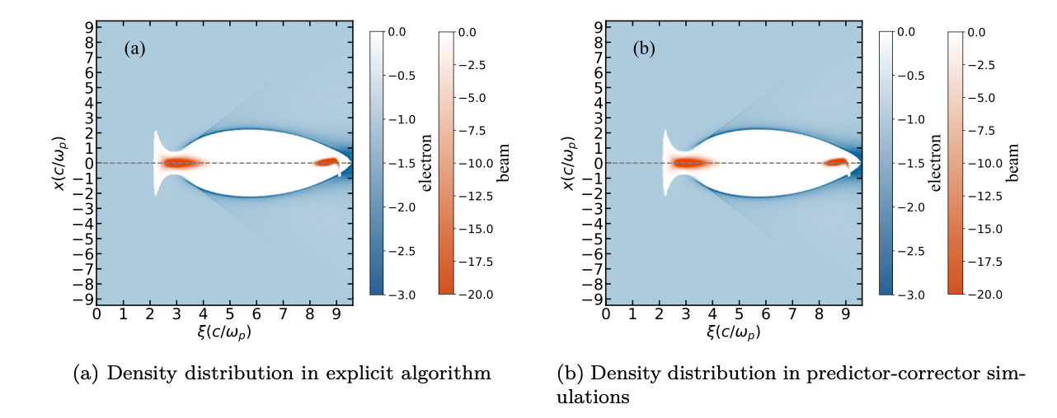
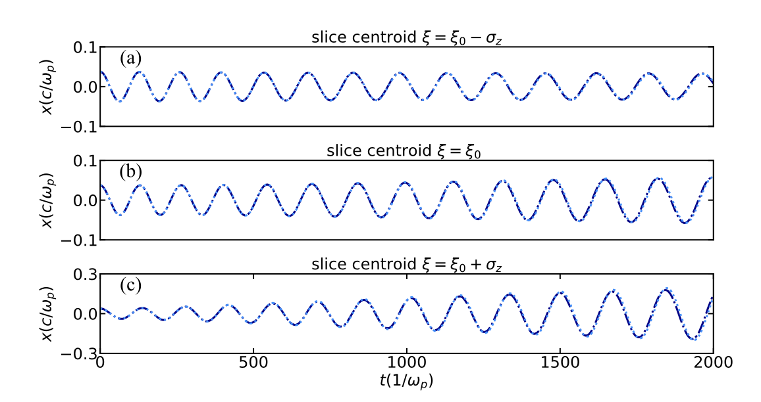
The explicit solver in QuickPIC/QPAD

Slide 15
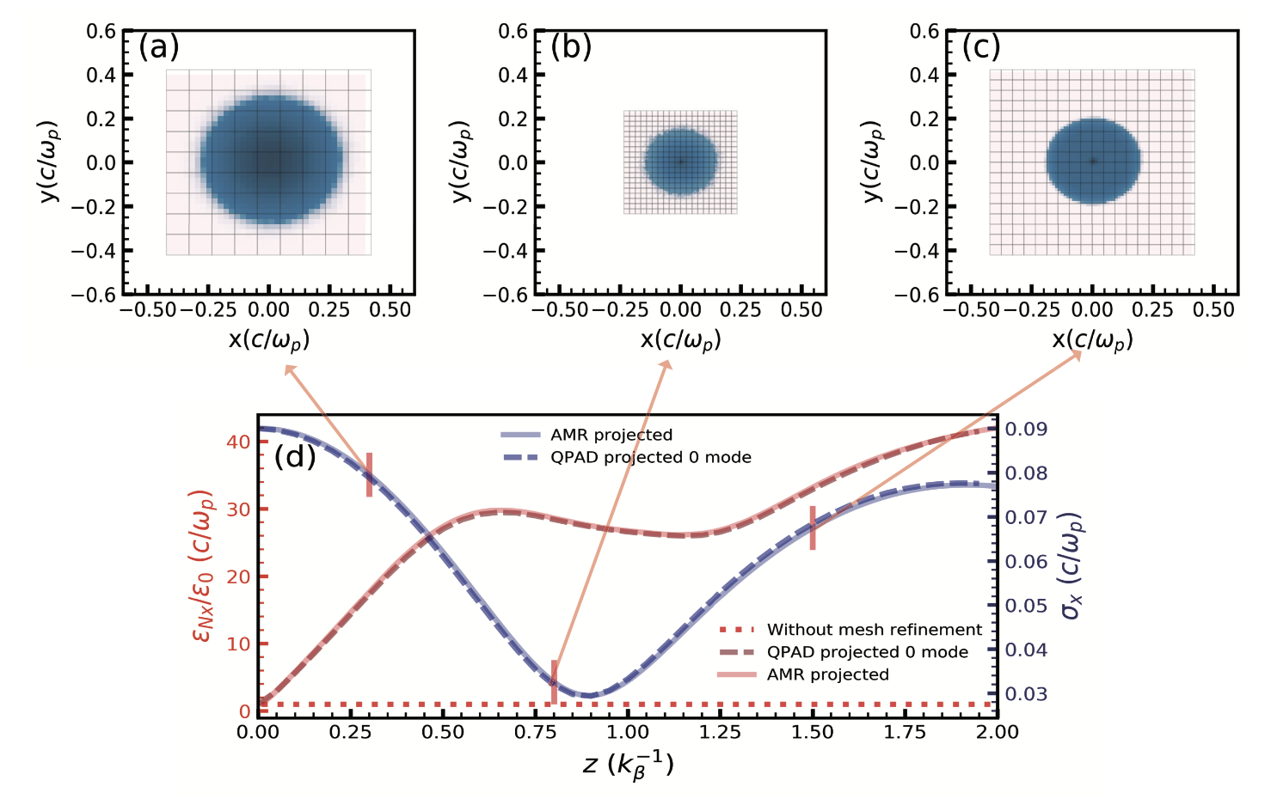
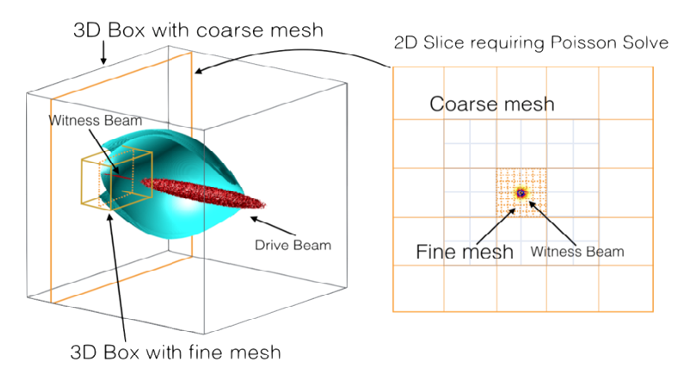
Mesh Refinement in QuickPIC
*Qianqian Su, et. al., JCP 539, 114225(2025)
Interpolate field on coarse grid 𝜙_𝑙 onto the boundary of 𝜙_(𝑙+1)
Use FFT solver to solve 𝜙_1, multigrid algorithm to solve 𝜙_(𝑙>1)
Fast fine mesh solver:
  Parallelized with MPI + OpenMP
  Scatter fine grid to other mpi ranks
Load balanced pipelining parallelization

Slide 16
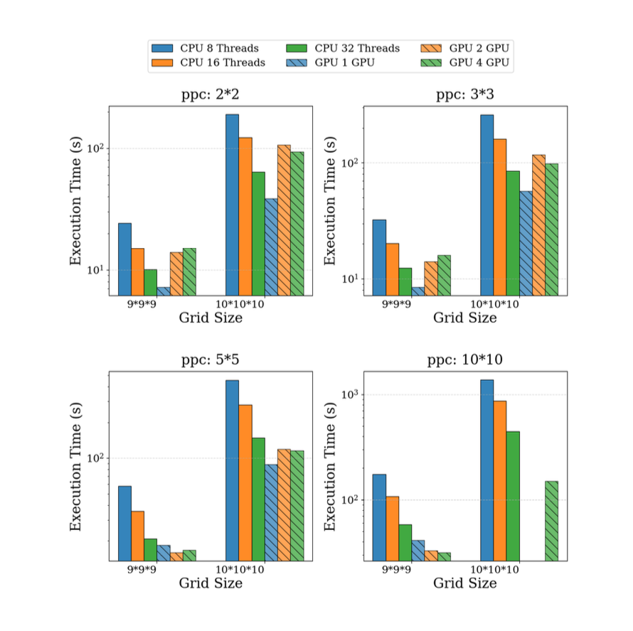
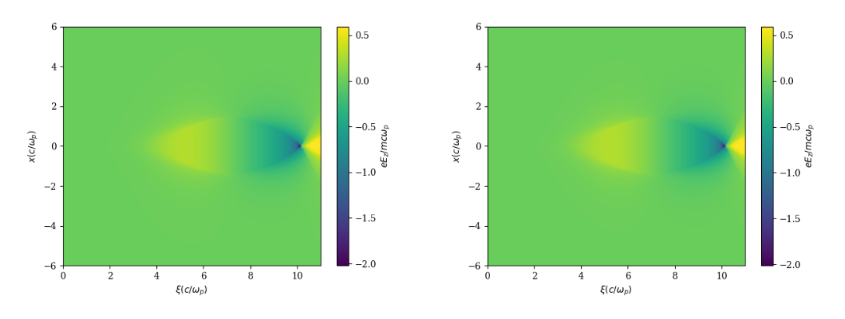
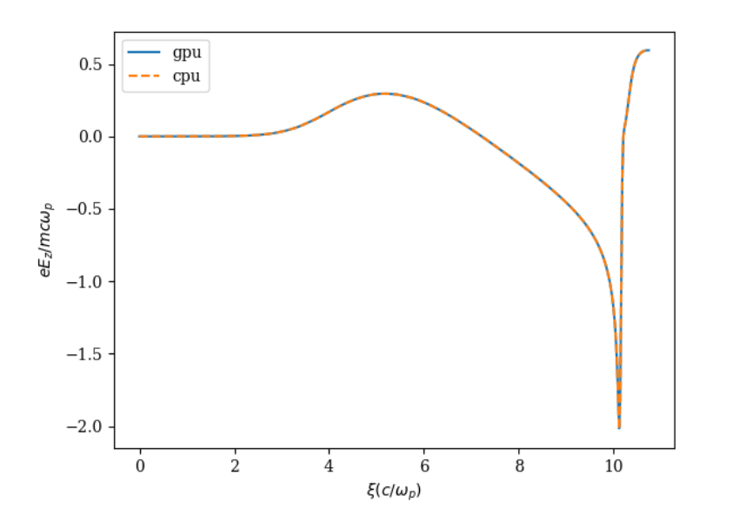
QuickPIC with GPU
*Yueran Tian, et. al., in preparation.
POSTER on Tuesday
CPU only
CPU with GPU
Lineouts Comparison

Slide 17
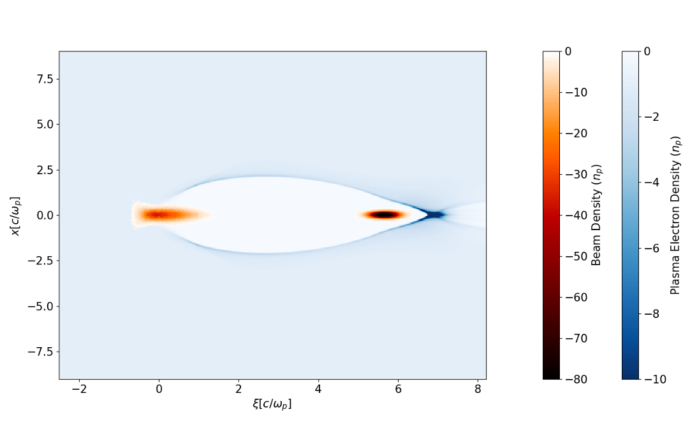
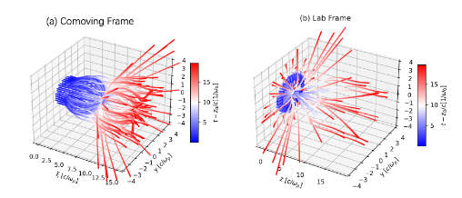
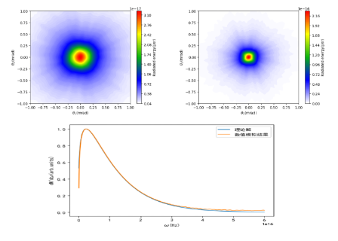
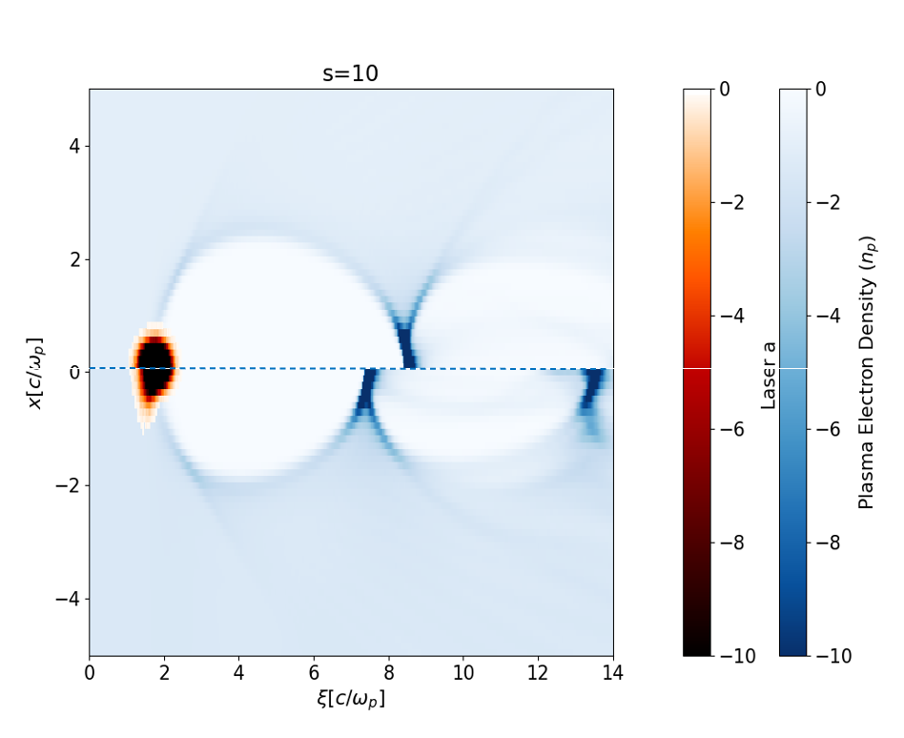
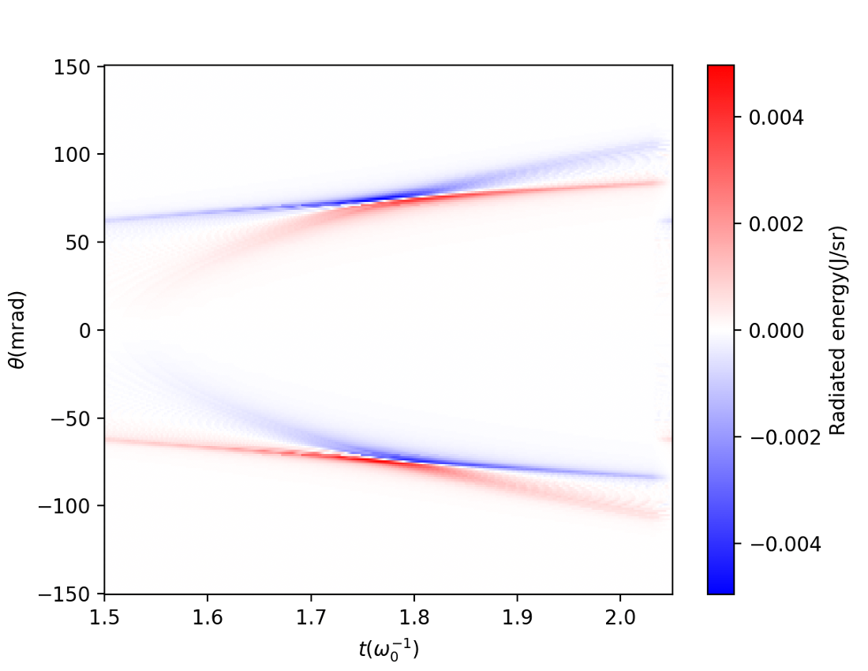
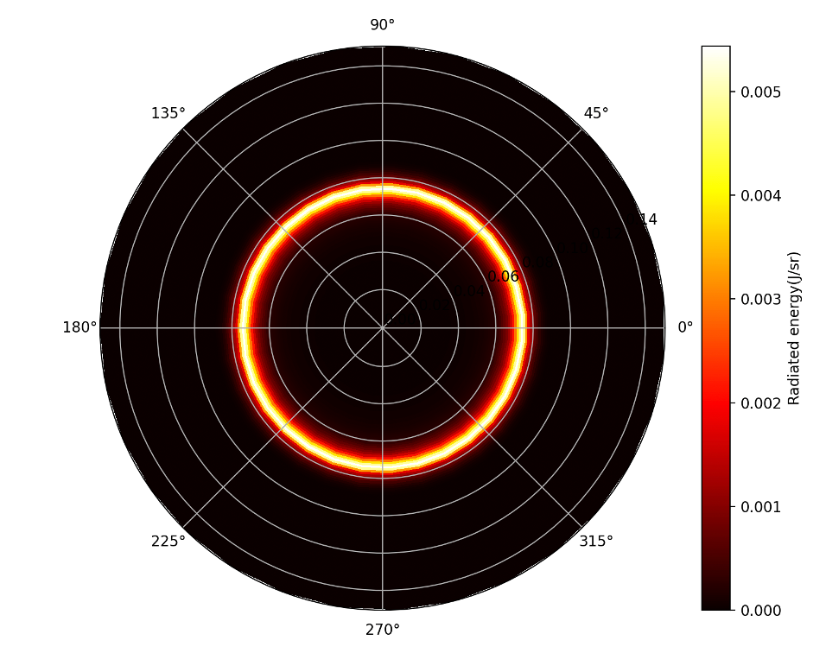
Radiation Module in QuickPIC
BETATRON RADIATION
PLASMA RADIATION
[1] H. Peng, T. W. Huang, et. al, Physical Review Letters, 131, 145003 (2023).
[2] B. Malaca, M. Pardal, et. al, Nat. Photon. 18, 39 (2024).

Slide 18
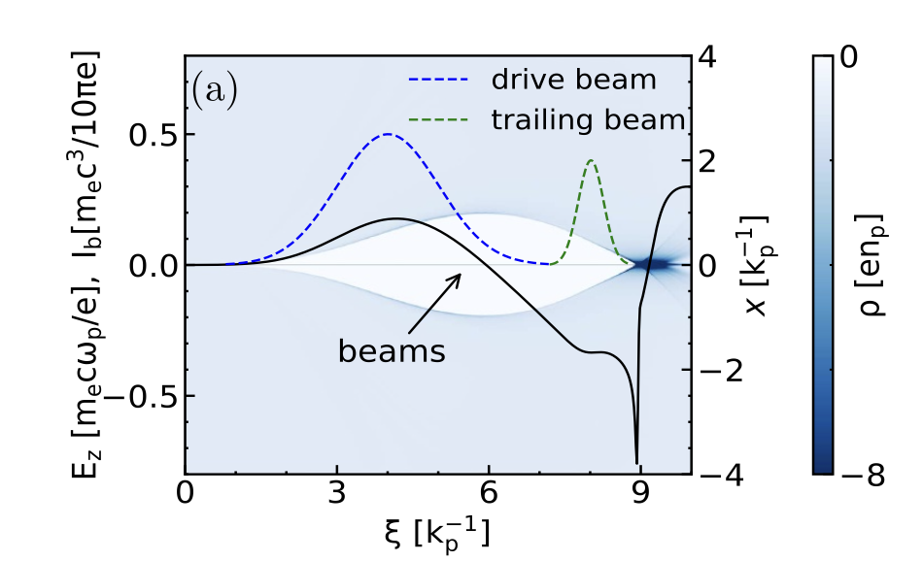
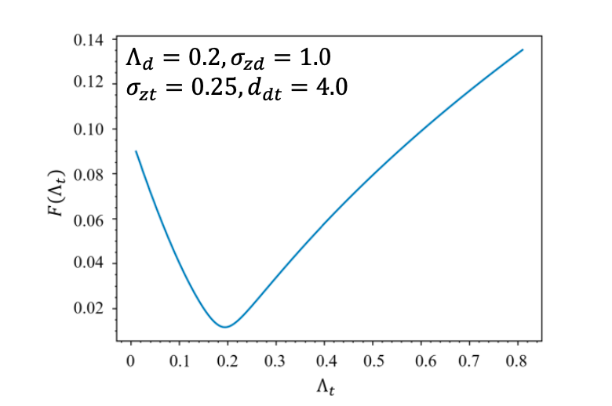
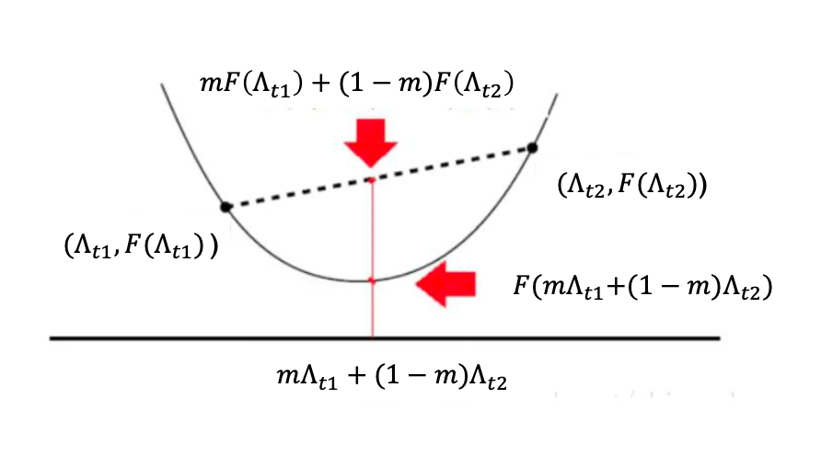
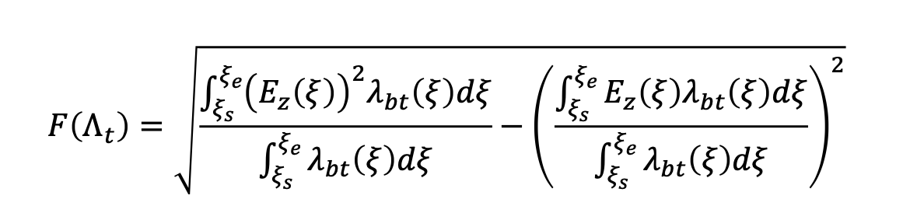
Find the Optimal Beam Loading
*Xiaoning Wang, et. al., Plasma Phys. Control. Fusion 64, 065007 (2022).
The Object Function
BFGS Method

Slide 19
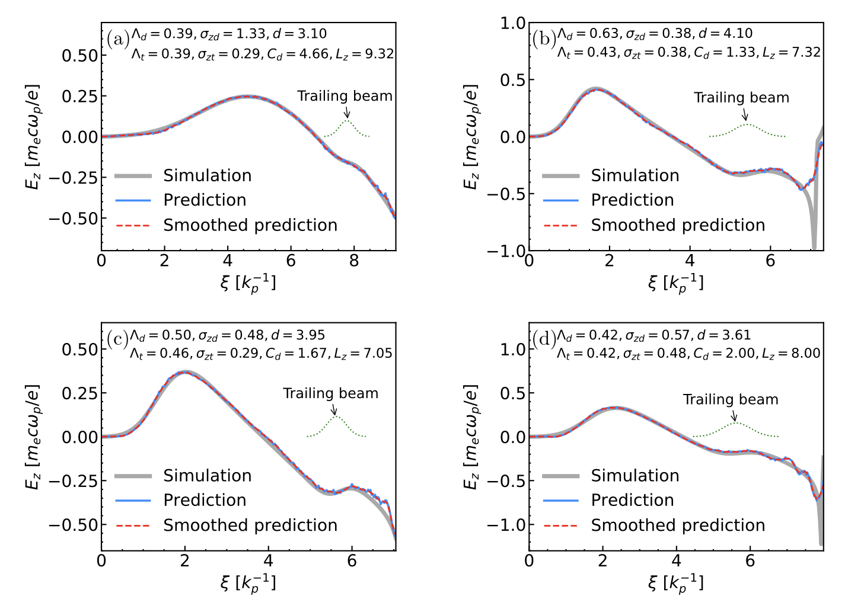
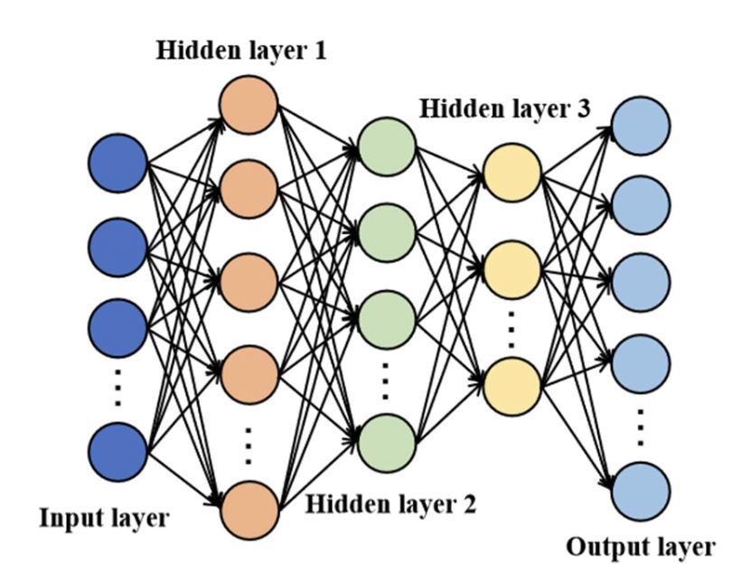
Neural-network-based longitudinal electric field prediction in nonlinear plasma wakefield accelerators
*Xiaoning Wang, et. al., Plasma Phys. Control. Fusion 67, 055038 (2025).

Slide 20
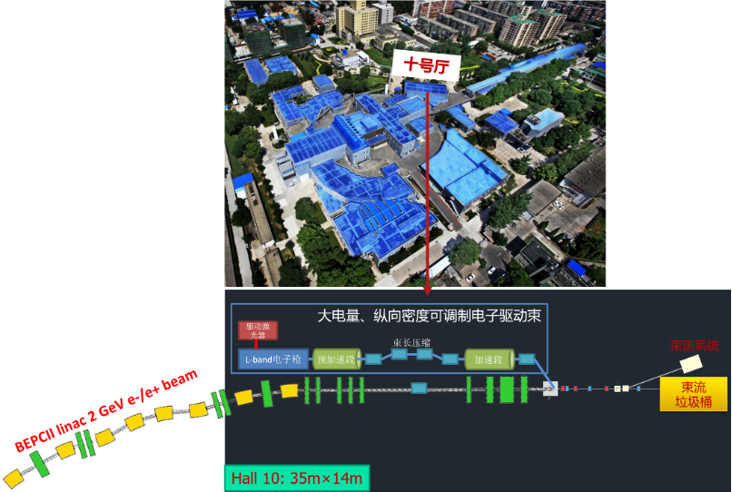
PWFA Optimization Framework: PAOF
Python
Lume-astra or
System Call
ctypes
Optimization
ASTRA
BEAM
DATA
ELEGANT.so
BEAM
DATA
QuickPIC.so
QPAD.so
BEAM
DATA
Input
Input
Input
Led by Wei Lu
(Talk on Friday)

Slide 21
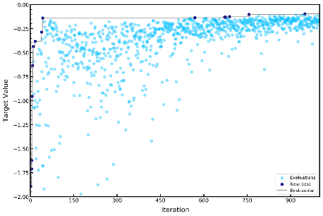
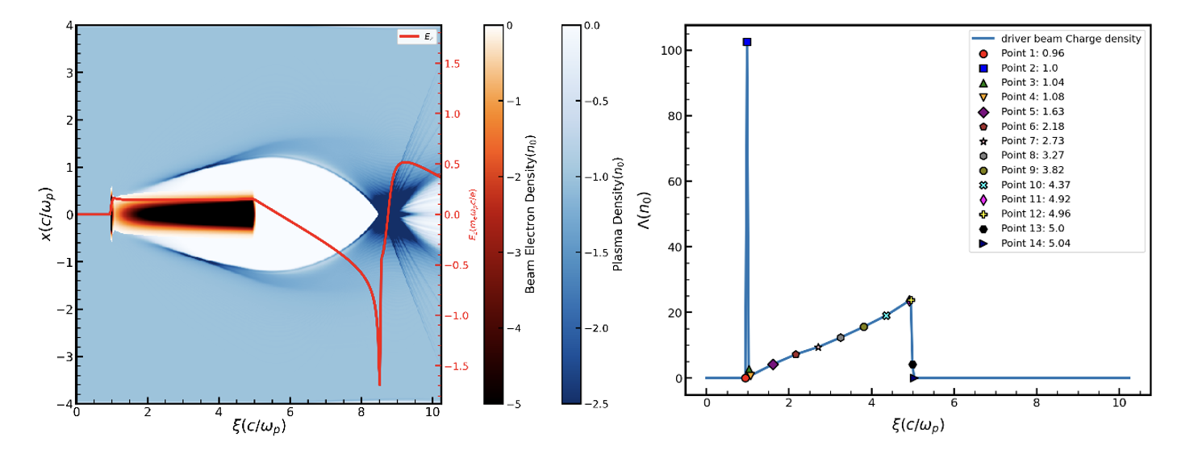
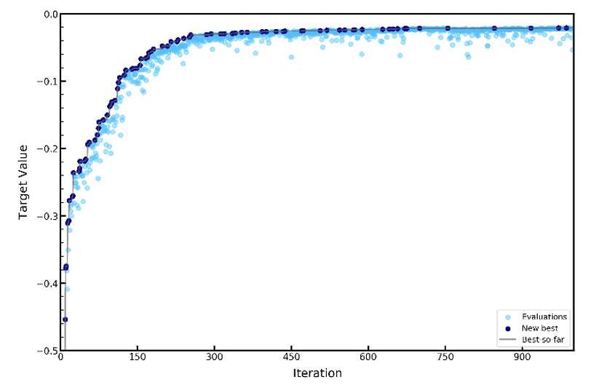
Bayesian Optimization for Beam Loading in PWFA
*Zhihao Xu, et. al., in preparation.
Improved Prediction Method

Slide 22
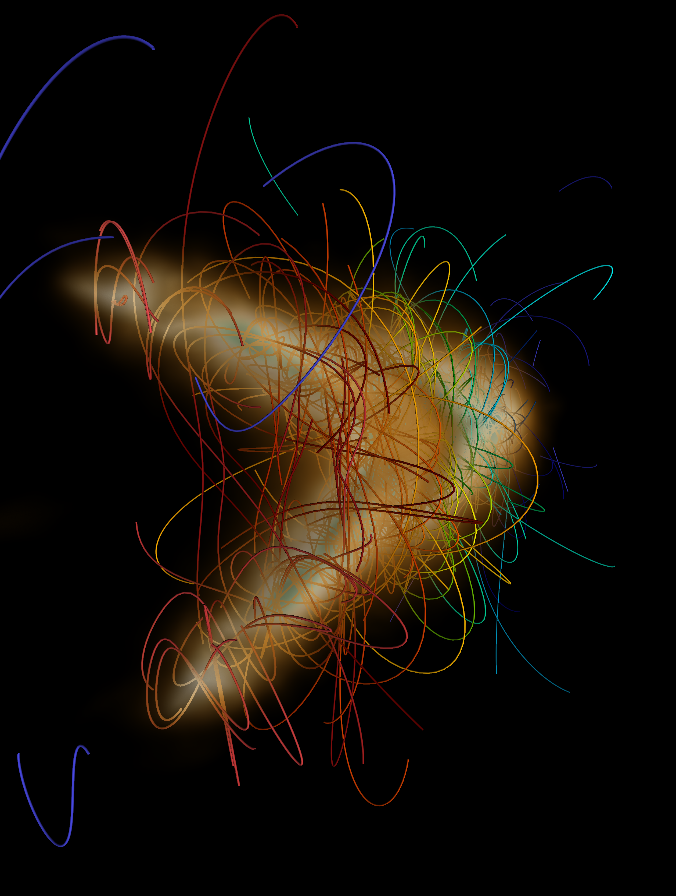
Thanks!
Weiming An
Beijing Normal University
anweiming@bnu.edu.cn
Sep 23rd, 2025

